Slide 1
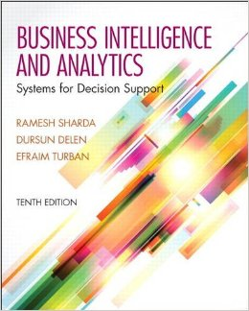
Business Intelligence and Analytics: Systems for Decision Support
(10th Edition)
Chapter 11:
Automated Decision Systems and Expert Systems

Slide 2
Learning Objectives
Understand the concept and applications of automated rule-based decision systems
Understand the importance of knowledge in decision support
Describe the concept and evolution of rule-based expert systems (ES)
Understand the architecture of rule-based ES
Learn the knowledge engineering process used to build ES
(Continued…)

Slide 3
Learning Objectives
Explain the benefits and limitations of rule-based systems for decision support
Identify proper applications of ES
Learn about tools and technologies for developing rule-based DSS

Slide 4

Opening Vignette…
InterContinental Hotel Group Uses
Decision Rules for Optimal Hotel Room Rates
Company background
Problem description
Proposed solution
Results
Answer & discuss the case questions...

Slide 5
Questions for the Opening Vignette
Describe the challenges faced by IHG during development of their retail price optimization system.
Besides the hotel business in the hospitality industry, explain at least three other areas where an optimization model could be used.
What other methods could be used to solve IHG’s price optimization problem?

Slide 6
Automated Decision Systems
A relatively new approach to supporting decision making
a.k.a. Decision Automation Systems (DAS)
Often a rule-based system that provides a solution in a functional area
“If only 70 percent of the seats on a flight from LA to NY are sold 3 days prior to departure, offer a discount of x to nonbusiness travelers”
Applies to repetitive/structured decisions

Slide 7

Application Case 11.1
Giant Food Stores Prices the Entire Store
Company background
Problem description
Proposed solution
Results

Slide 8
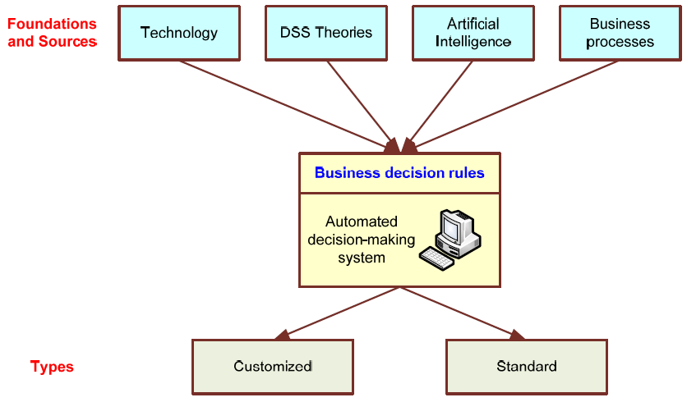
Automated Decision-Making Framework

Slide 9
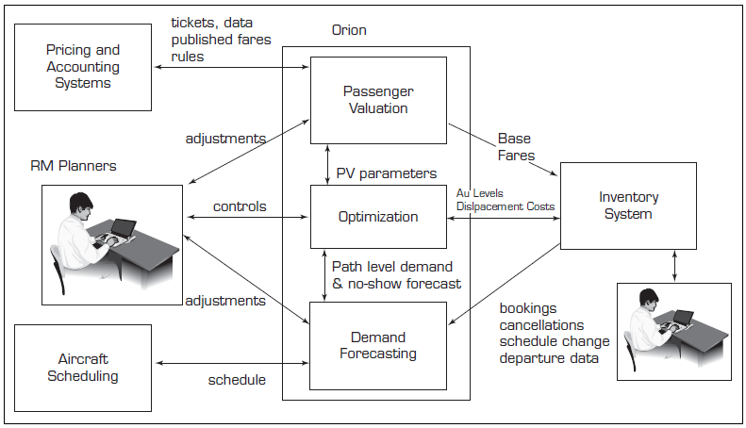
Architecture of the Airline Revenue Management Systems

Slide 10
Artificial Intelligence (AI)
Artificial intelligence (AI)
A subfield of computer science, concerned with symbolic reasoning and problem solving
AI has many definitions…
Behavior by a machine that, if performed by a human being, would be considered intelligent
“…study of how to make computers do things at which, at the moment, people are better
Theory of how the human mind works

Slide 11
AI Objectives
Make machines smarter (primary goal)
Understand what intelligence is
Make machines more intelligent & useful
Signs of intelligence…
Learn or understand from experience
Make sense out of ambiguous situations
Respond quickly to new situations
Use reasoning to solve problems
Apply knowledge to manipulate the environment

Slide 12
Test for Intelligence
Turing Test for Intelligence
A computer can be considered to be smart only when a human interviewer, “conversing” with both an unseen human being and an unseen computer, can not determine which is which.
- Alan Turing

Slide 13
The AI Field…
The Disciplines and Applications of AI.
AI provides the scientific foundation for many commercial technologies

Slide 14
AI Areas
Major…
Expert Systems
Natural Language Processing
Robotics and Sensory Systems
Computer Vision and Scene Recognition
Intelligent Computer-Aided Instruction
Automated Programming, Neural Computing
Additional…
Fuzzy Logic, Genetic Algorithms
Game Playing, Intelligent Software Agents …

Slide 15
AI is Often Transparent in Many Commercial Products
Anti-lock Braking Systems (ABS)
Automatic Transmissions
Video Camcorders
Appliances
Washers, Toasters, Stoves, …
Help Desk Software
Subway Control
…

Slide 16
Expert Systems (ES)
Is a computer program that attempts to imitate expert’s reasoning processes and knowledge in solving specific problems
Most Popular Applied AI Technology
Enhance Productivity
Augment Work Forces
Works best with narrow problem areas/tasks
Expert systems do not replace experts, but
Make their knowledge and experience more widely available, and thus
Permit non-experts to work better

Slide 17
Important Concepts in ES
Expert
A human being who has developed a high level of proficiency in making judgments in a specific domain
Expertise
The set of capabilities that underlines the performance of human experts, including
extensive domain knowledge,
heuristic rules that simplify and improve approaches to problem solving,
meta-knowledge and meta-cognition, and
compiled forms of behavior that afford great economy in a skilled performance

Slide 18
Features and Concepts in ES
Experts / Expertise
Degrees or levels of expertise
Ratio of non-experts to experts → 100 to 1
Transferring Expertise
From expert to computer to nonexperts via acquisition, representation, inferencing, transfer
Symbolic Reasoning / Inferencing
Deep Knowledge / Self Knowledge

Slide 19
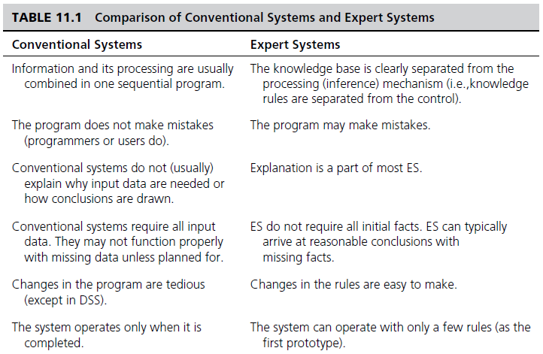
Conventional vs. Expert Systems
Continued…

Slide 20
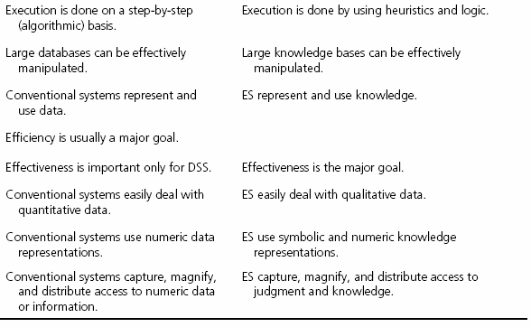
Conventional vs. Expert Systems
…

Slide 21
Application Case 11.2
Expert System Helps in Identifying Sport Talents
Background
Problem description
Proposed solution
Results

Slide 22
Applications of Expert Systems
Classical Applications
DENDRAL
Applied knowledge (i.e., rule-based reasoning)
Deduced likely molecular structure of compounds
MYCIN
A rule-based expert system
Used for diagnosing and treating bacterial infections
XCON
A rule-based expert system
Used to determine the optimal information systems configuration
New applications: Credit analysis, Marketing, Finance, Manufacturing, Human resources, Science and Engineering, Education, …

Slide 23
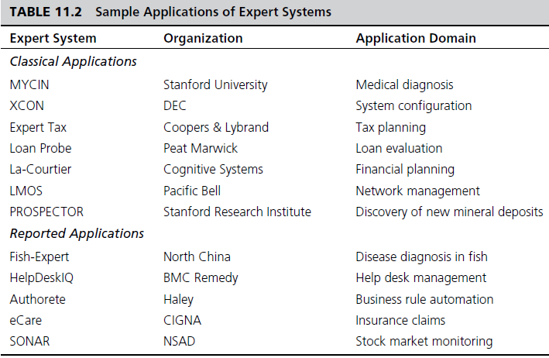
Applications of Expert Systems

Slide 24
Application Case 11.3
Expert System Aids in Identification of Chemical, Biological, and Radiological Agents
Questions for Discussion
How can CBR Advisor assist in making quick decisions?
What characteristics of CBR Advisor make it an expert system?
What could be other situations where such expert systems can be employed?

Slide 25
Structure of Expert Systems
Development Environment
Consultation Environment
Major Components
Knowledge acquisition subsystem
Knowledge Engineer
Knowledge Base
Inference Engine
User Interface
Blackboard (workplace)
Explanation subsystem (justifier)
Knowledge-refining system

Slide 26
Structures of Expert Systems

Slide 27
Application Case 11.4
Diagnosing Heart Diseases by Signal Processing
Questions for Discussion
List the major components involved in building SIPMES and briefly comment on them.
Do expert systems like SIPMES eliminate the need for human decision making?
How often do you think that the existing expert systems, once built, should be changed?

Slide 28
Knowledge Engineering (KE)
A set of intensive activities encompassing the acquisition of knowledge from human experts (and other information sources) and converting this knowledge into a repository (commonly called a knowledge base)
The primary goal of KE is to
help experts articulate how they do what they do, and
to document this knowledge in a reusable form
Narrow versus Broad definition of KE?

Slide 29
The Knowledge Engineering Process

Slide 30
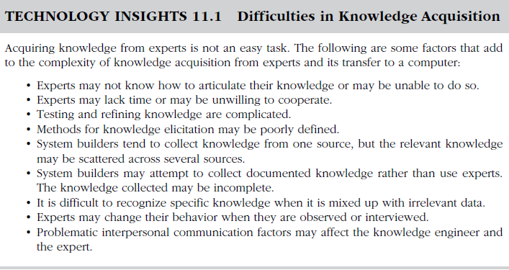
Difficulties in KE

Slide 31
Knowledge Engineering Knowledge Validation/Verification
Evaluation is a broad concept - its objective is to assess an ES’s overall value
Validation versus Verification
Validation is the part of evaluation that deals with the performance of the system
Verification is building the system right or substantiating that the system is correctly implemented to its specifications

Slide 32
Knowledge Representation in ES
Expert knowledge must be represented in a computer-understandable format and organized properly in the knowledge base
The most common/popular way to represent human knowledge:
Production rules
Condition-Action pairs
IF … THEN … ELSE …

Slide 33
Forms of Production Rules
IF premise, THEN conclusion
IF your income is high, THEN your chance of being audited by the IRS is high
Conclusion, IF premise
Your chance of being audited is high, IF your income is high
Inclusion of ELSE
IF your income is high, OR your deductions are unusual, THEN your chance of being audited by the IRS is high, ELSE your chance of being audited is low
More complex rules…

Slide 34
Knowledge and Inference Rules
Knowledge rules (declarative rules), state all the facts and relationships about a problem
Knowledge rules are stored in the knowledge base
Inference rules (procedural rules), advise on how to solve a problem, given that certain facts are known
Inference rules contain rules about rules (metarules)
Inference rules become part of the inference engine
Example:
IF needed data is not known THEN ask the user
IF more than one rule applies THEN fire the one with the highest priority value first

Slide 35
Inferencing in ES
Inference is the process of chaining multiple rules together based on available data
Forward chaining
A data-driven search in a rule-based system.
If the premise clauses match the situation, then the process attempts to assert the conclusion.
Backward chaining
A goal-driven search in a rule-based system.
It begins with the action clause of a rule and works backward through a chain of rules in an attempt to find a verifiable set of condition clauses.

Slide 36
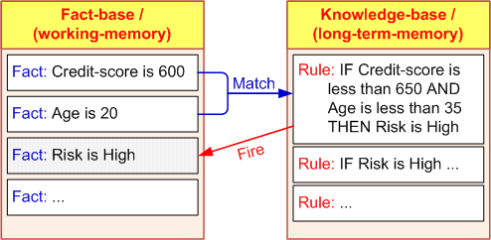
Inferencing with Rules: Forward and Backward Chaining
Firing a rule
When all of the rule's hypotheses (the “if parts”) are satisfied, a rule said to be FIRED
Inference engine checks every rule in the knowledge base in a forward or backward direction to find rules that can be FIRED
Continues until no more rules can fire, or until a goal is achieved

Slide 37
Inferencing – Backward Chaining
Goal-driven: Start from a potential conclusion (hypothesis), then seek evidence that supports (or contradicts with) it
Often involves formulating and testing intermediate hypotheses (or sub-hypotheses)
Investment Decision: Variable Definitions
A = Have $10,000
B = Younger than 30
C = Education at college level
D = Annual income > $40,000
E = Invest in securities
F = Invest in growth stocks
G = Invest in IBM stock
Knowledge Base
Rule 1: A & C -> E
Rule 2: D & C -> F
Rule 3: B & E -> F (invest in growth stocks)
Rule 4: B -> C
Rule 5: F -> G (invest in IBM)

Slide 38
Inferencing – Forward Chaining
Data-driven: Start from available information as it becomes available, then try to draw conclusions
Which One to Use?
If all facts available up front - forward chaining
Diagnostic problems - backward chaining
Knowledge Base
Rule 1: A & C -> E
Rule 2: D & C -> F
Rule 3: B & E -> F (invest in growth stocks)
Rule 4: B -> C
Rule 5: F -> G (invest in IBM)
FACTS:
A is TRUE
B is TRUE

Slide 39
Inferencing Issues
How do we choose between BC and FC
Follow how a domain expert solves the problem
If the expert first collect data then infer from it
=> Forward Chaining
If the expert starts with a hypothetical solution and then attempts to find facts to prove it => Backward Chaining
How to handle conflicting rules
IF A & B THEN C
IF X THEN C
Establish a goal and stop firing rules when goal is achieved
Fire the rule with the highest priority
Fire the most specific rule
Fire the rule that uses the data most recently entered

Slide 40
Inferencing with Uncertainty - Theory of Certainty
Certainty Factors and Beliefs
Uncertainty is represented as a Degree of Belief
Express the Measure of Belief
Manipulate degrees of belief while using knowledge-based systems
Certainty Factors (CF) express belief in an event based on evidence (or the expert's assessment)
1.0 or 100 = absolute truth (complete confidence)
0 = certain falsehood
CFs are NOT probabilities
CFs need not sum to 100

Slide 41
Inferencing with Uncertainty Combining Certainty Factors
Combining Several Certainty Factors in One Rule where parts are combined using AND and OR logical operators
AND
IF inflation is high, CF = 50 percent, (A), AND
unemployment rate is above 7, CF = 70 percent, (B), AND
bond prices decline, CF = 100 percent, (C)
THEN stock prices decline
CF(A, B, and C) = Minimum[CF(A), CF(B), CF(C)]
=> The CF for “stock prices to decline” = 50 percent
The chain is as strong as its weakest link

Slide 42
Inferencing with Uncertainty Combining Certainty Factors
OR
IF inflation is low, CF = 70 percent, (A), OR
bond prices are high, CF = 85 percent, (B)
THEN stock prices will be high
CF(A, B) = Maximum[CF(A), CF(B)]
=> The CF for “stock prices to be high” = 85 percent
Notice that in OR only one IF premise need to be true

Slide 43
Inferencing with Uncertainty Combining Certainty Factors
Combining two or more rules
Example:
R1: IF the inflation rate is less than 5 percent,
THEN stock market prices go up (CF = 0.7)
R2: IF unemployment level is less than 7 percent,
THEN stock market prices go up (CF = 0.6)
Inflation rate = 4 percent and the unemployment level = 6.5 percent
Combined Effect
CF(R1,R2) = CF(R1) + CF(R2)[1 - CF(R1)]; or
CF(R1,R2) = CF(R1) + CF(R2) - CF(R1) × CF(R2)

Slide 44
Explanation as a Metaknowledge
Explanation
Human experts justify and explain their actions
… so should ES
Explanation: an attempt by an ES to clarify reasoning, recommendations, other actions (asking a question)
Explanation facility = Justifier
Explanation Purposes…
Make the system more intelligible
Uncover shortcomings of the knowledge bases
Explain unanticipated situations
Satisfy users’ psychological and/or social needs, …

Slide 45
Two Basic Explanations
Why Explanations - Why is a fact requested?
How Explanations - To determine how a certain conclusion or recommendation was reached
Some simple systems - only at the final conclusion
Most complex systems provide the chain of rules used to reach the conclusion
Explanation is essential in ES
Used for training and evaluation

Slide 46
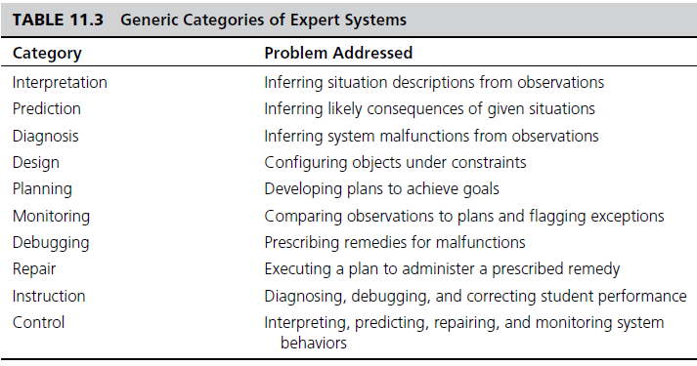
Problem Areas Suitable For Expert Systems

Slide 47
Development of ES
Defining the nature and scope of the problem
Identifying proper experts
Acquiring knowledge
Knowledge engineer
Selecting the Building Tools
Shells versus Complete Development
Coding the system
Evaluating and Launching the System

Slide 48
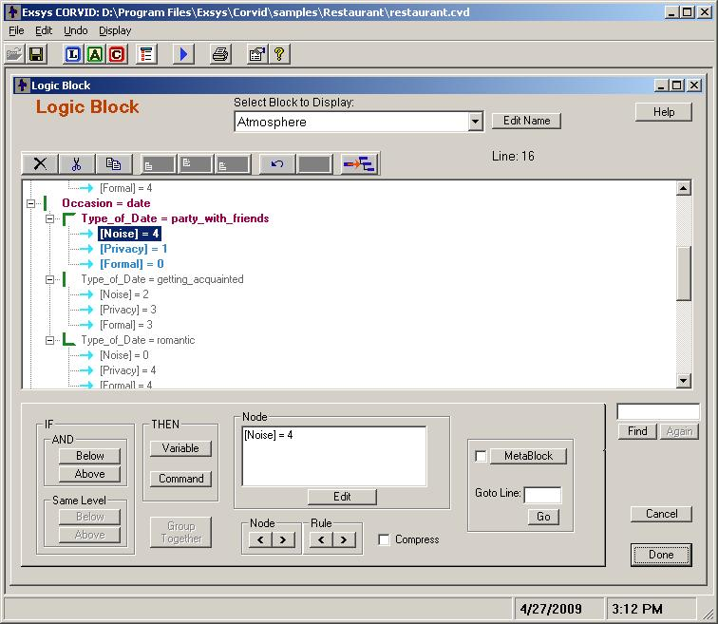
A Popular Expert System Shell

Slide 49

Application Case 11.5
Clinical Decision Support System for Tendon Injuries
Questions for Discussion
Research other expert systems in other domains and list a few of them.
Why is important to evaluate the expert systems before they are put into use?

Slide 50



Problem Areas Addressed by ES
Interpretation systems
Prediction systems
Diagnostic systems
Repair systems
Design systems
Planning systems
Monitoring systems
Debugging systems
Instruction systems
Control systems, …

Slide 51
End of the Chapter
Questions, comments

Slide 52
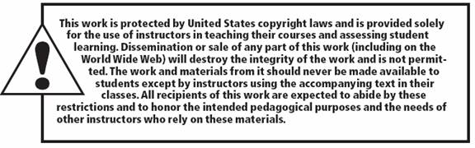
All rights reserved. No part of this publication may be reproduced, stored in a retrieval system, or transmitted, in any form or by any means, electronic, mechanical, photocopying, recording, or otherwise, without the prior written permission of the publisher. Printed in the United States of America.
Copyright © 2014 Pearson Education, Inc.

