Slide 1
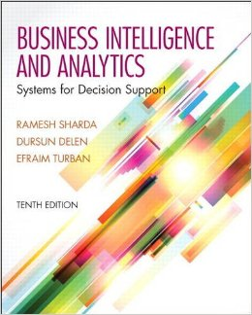
Business Intelligence and Analytics: Systems for Decision Support
(10th Edition)
Chapter 10:
Modeling and Analysis: Heuristic Search Methods and Simulation

Slide 2
Learning Objectives
Explain the basic concepts of simulation and heuristics, and when to use them
Understand how search methods are used to solve some decision support models
Know the concepts behind and applications of genetic algorithms
Explain the differences among algorithms, blind search, and heuristics
(Continued…)

Slide 3
Learning Objectives
Understand the concepts and applications of different types of simulation
Explain what is meant by system dynamics, agent-based modeling, Monte Carlo, and discrete event simulation
Describe the key issues of model management

Slide 4
Opening Vignette
System Dynamics Allows Fluor
Corporation to Better Plan for Project and Change Management
Background
Problem description
Proposed solution
Results
Answer & discuss the case questions...

Slide 5
Questions for the Opening Vignette
Explain the use of system dynamics as a simulation tool for solving complex problems.
In what ways was it applied in Fluor Corporation to solve complex problems?
How does a what-if analysis help a decision maker to save on cost?
In your own words, explain the factors that might have triggered the use of system dynamics to solve change management problems in Fluor Corporation…

Slide 6
Problem-Solving Search Methods
Search: choice phase of decision making
Search is the process of identifying the best possible solution / course of action [under limitations such as time, …]
Search techniques include
analytical techniques,
algorithms,
blind searching, and
heuristic searching

Slide 7
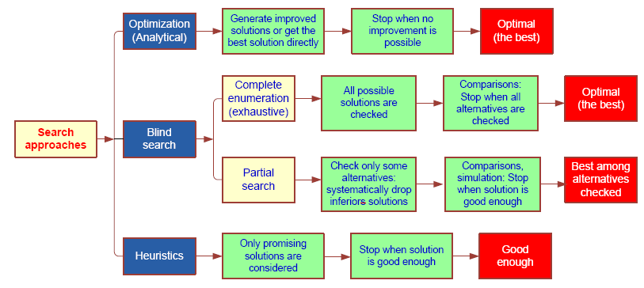
Problem-Solving Search Methods

Slide 8
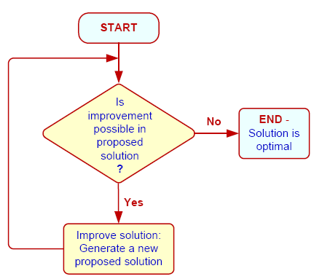
Problem-Solving Search Methods - Algorithmic/Heuristic
Cuts the search space
Gets satisfactory solutions more quickly and less expensively
Finds good enough feasible solutions to complex problems
Heuristics can be
Quantitative
Qualitative (in ES)
Traveling Salesman Problem see the example next >>>

Slide 9

Traveling Salesman Problem
What is it?
A traveling salesman must visit customers in several cities, visiting each city only once, across the country. Goal: Find the shortest possible route.
Total number of unique routes (TNUR):
TNUR = (1/2) (Number of Cities – 1)!
Number of Cities TNUR
5 12
6 60
9 20,160
20 1.22 10¹⁸

Slide 10
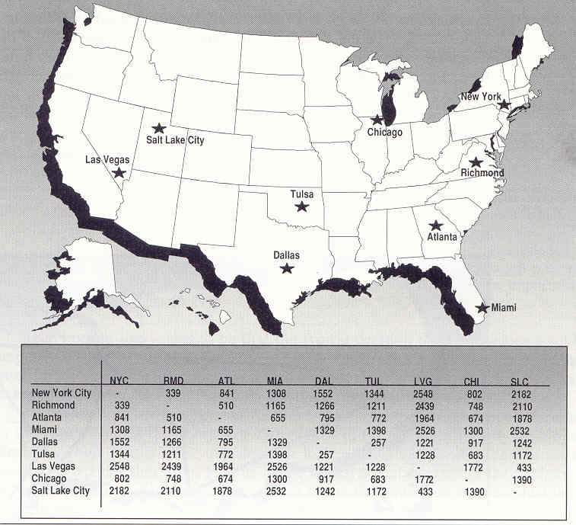
Traveling Salesman Problem

Slide 11
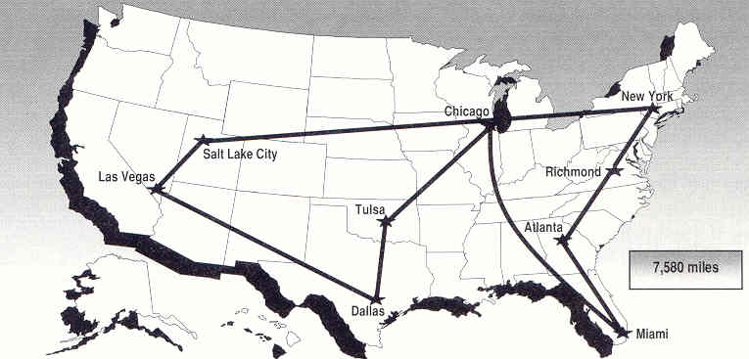
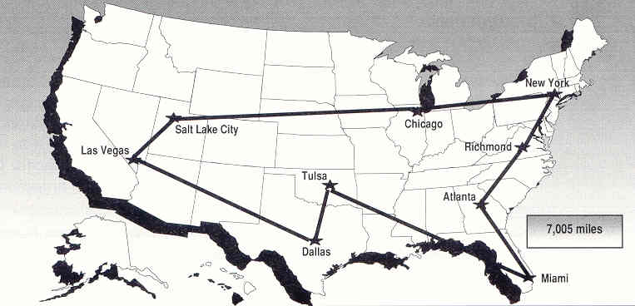
Traveling Salesman Problem
Rule 1: Starting from home base, go to the closest city
Rule 2: Always follow an exterior route

Slide 12
Application Case 10.1
Chilean Government Uses Heuristics to Make Decisions on School Lunch Providers
Questions for Discussion
What were the main challenges faced by JUNAEB?
What operation research methodologies were employed in achieving homogeneity across territorial units?
What other approaches could you use in this case study?

Slide 13
When to Use Heuristics
When to Use Heuristics?
Inexact or limited input data
Complex reality
Reliable, exact algorithm not available
Computation time excessive
For making quick decisions
Limitations of Heuristics!
Cannot guarantee an optimal solution

Slide 14
Modern Heuristic Methods
Tabu search
Intelligent search algorithm
Genetic algorithms
Survival of the fittest
Simulated annealing
Analogy to Thermodynamics
Ant colony and other Meta-heuristics

Slide 15
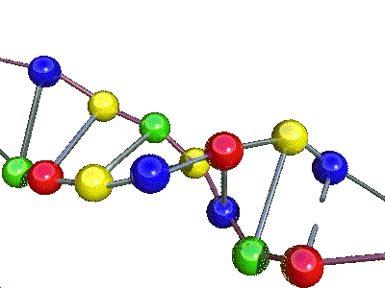
Genetic Algorithms
It is a popular heuristic search technique
Mimics the biological process of evolution
Genetic algorithms
Software programs that “learn/search” in evolutionary manner, similar to the way biological systems evolve
An efficient, domain-independent search heuristic for a broad spectrum of problem domains
Main theme: Survival of the fittest
Moving toward better and better solutions by letting only the fittest parents create the future generations

Slide 16
Evolutionary Algorithm
10010110
01100010
10100100
10011001
01111101
. . .
. . .
. . .
. . .
10010110
01100010
10100100
10011101
01111001
. . .
. . .
. . .
. . .
Elitism
Selection
Reproduction
. Crossover
. Mutation
Current
generation
Next
generation

Slide 17
GA Structure and GA Operators
Each candidate solution is called a chromosome
A chromosome is a string of genes
Chromosomes can copy themselves, mate, and mutate via evolution
In GA we use specific genetic operators
Reproduction
Crossover
Mutation

Slide 18
Genetic Algorithms - Example: The Vector Game
Description of the Vector Game
Identifying a string of 5 binary digits
Default Strategy: Random Trial and Error
Improved Strategy: Use of Genetic Algorithms
In an iterative fashion, using genetic algorithm process and genetic operators, find the opponent’s digit sequence
See your book for functional details

Slide 19
A Classic GA Example: The Knapsack Problem
Item: 1 2 3 4 5 6 7
Benefit: 5 8 3 2 7 9 4
Weight: 7 8 4 10 4 6 4
Knapsack holds a maximum of 22 pounds
Need to fill it for maximum benefit (one per item)
Solutions take the form of a string of 1’s
Example Solution: 1 1 0 0 1 0 0
Means choose items 1, 2, 5:
Weight = 21, Benefit = 20
Evolver solution works in Microsoft Excel… →

Slide 20
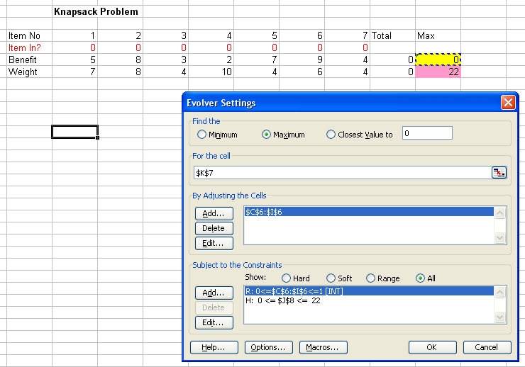
Define the objective function and constraint(s)

Slide 21
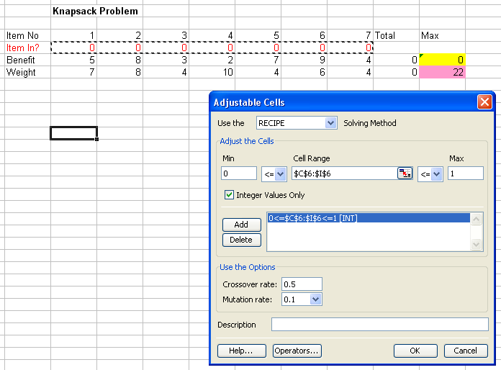
Identify the decision variables and their characteristics

Slide 22
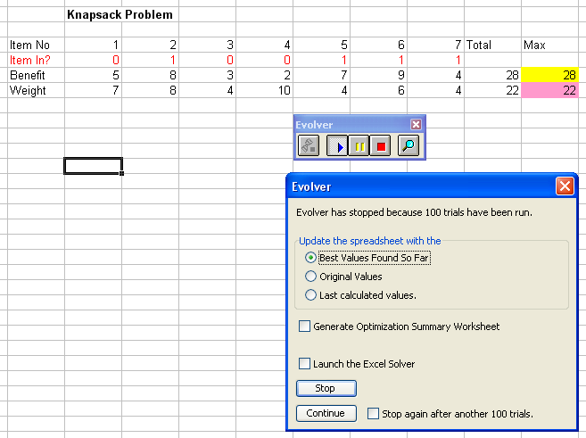
Observe and analyze the results

Slide 23
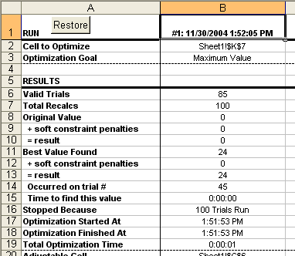
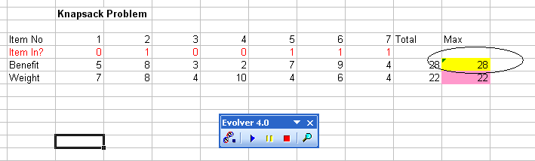
Observe and analyze the results

Slide 24
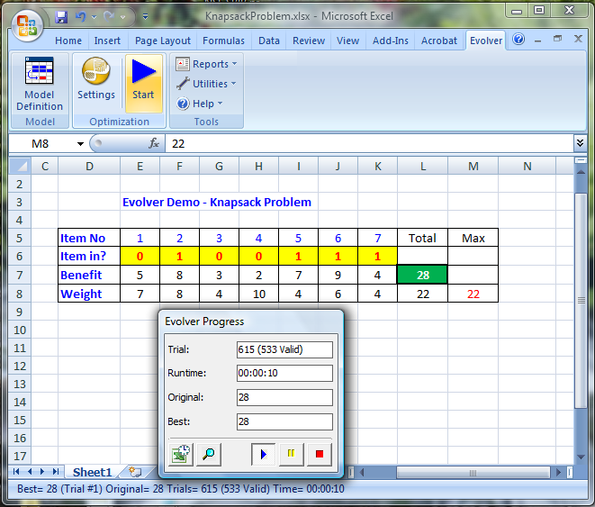
The Knapsack Problem at Evolver
Monitoring the solution generation process…

Slide 25
Genetic Algorithms
Limitations of Genetic Algorithms
Does not guarantee an optimal solution (often settles in a sub optimal solution / local minimum)
Not all problems can be put into GA formulation
Development and interpretation of GA solutions requires both programming and statistical skills
Relies heavily on the random number generators
Locating good variables for a particular problem and obtaining the data for the variables is difficult
Selecting methods by which to evolve the system requires experimentation and experience

Slide 26
Genetic Algorithm Applications
Dynamic process control
Optimization of induction rules
Discovery of new connectivity topologies (NNs)
Simulation of biological models of behavior
Complex design of engineering structures
Pattern recognition
Scheduling, transportation, and routing
Layout and circuit design
Telecommunication, graph-based problems, …

Slide 27
Simulation
Simulation is the “appearance” of reality
It is often used to conduct what-if analysis on the model of the actual system
It is a popular DSS technique for conducting experiments with a computer on a comprehensive model of the system to assess its dynamic behavior
Often used when the system is too complex for other DSS techniques

Slide 28
Application Case 10.3
Simulating Effects of Hepatitis B Interventions
Questions for Discussion
Explain the advantage of operations research methods such as simulation over clinical trial methods in determining the best control measure for Hepatitis B.
In what ways do the decision and Markov models provide cost-effective ways of combating the disease?
Discuss how multidisciplinary background is an asset in finding a solution for the problem described in the case.
Besides healthcare, in what other domain could such a modeling approach help reduce cost?

Slide 29
Major Characteristics of Simulation
Imitates reality and captures its richness both in shape and behavior
“Represent” versus “Imitate”
Technique for conducting experiments
Descriptive, not normative tool
Often to “solve” [i.e., analyze] very complex systems/problems
Simulation should be used only when a numerical optimization is not possible

Slide 30
Advantages of Simulation
The theory is fairly straightforward
Great deal of time compression
Experiment with different alternatives
The model reflects manager’s perspective
Can handle wide variety of problem types
Can include the real complexities of problems
Produces important performance measures
Often it is the only DSS modeling tool for non-structured problems

Slide 31
Disadvantages of Simulation
Cannot guarantee an optimal solution
Slow and costly construction process
Cannot transfer solutions and inferences to solve other problems (problem specific)
So easy to explain/sell to managers, may lead to overlooking analytical solutions
Software may require special skills

Slide 32
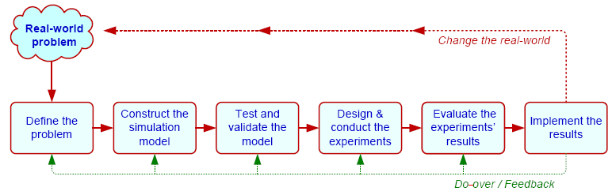
Simulation Methodology
Steps:
1. Define problem 5. Conduct experiments
2. Construct the model 6. Evaluate results
3. Test and validate model 7. Implement solution
4. Design experiments

Slide 33
Simulation Types
Probabilistic/Stochastic vs. Deterministic Simulation
Uses probability distributions
Time-dependent vs. Time-independent Simulation
Monte Carlo technique (X = A + B) [A, B, and X are all distributions]
Discrete Event vs. Continuous Simulation
Simulation Implementation
Visual Simulation and/or Object-Oriented Simulation

Slide 34
Visual Interactive Simulation (VIS)
Visual interactive modeling (VIM), also called Visual Interactive Simulation or Visual interactive problem solving
Uses computer graphics to present the impact of different management decisions
Often integrated with 3G and GIS
Users can perform sensitivity analysis
Static or dynamic (animation) systems
Virtual reality, immersive, …

Slide 35
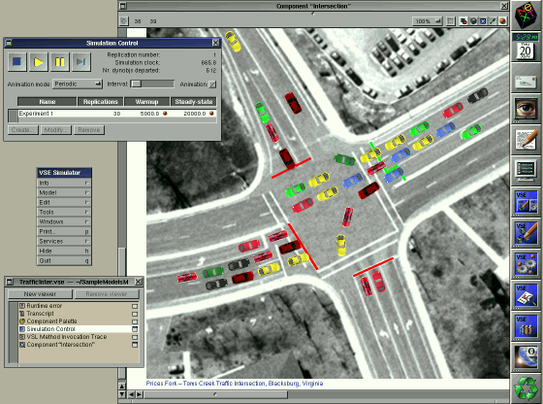
Traffic at an Intersection from the Orca Visual Simulation

Slide 36
Application Case 10.4
Improving Job-Shop Scheduling Decisions Through RFID: A Simulation-Based Assessment
Background
Problem description
Proposed solution
Results

Slide 37
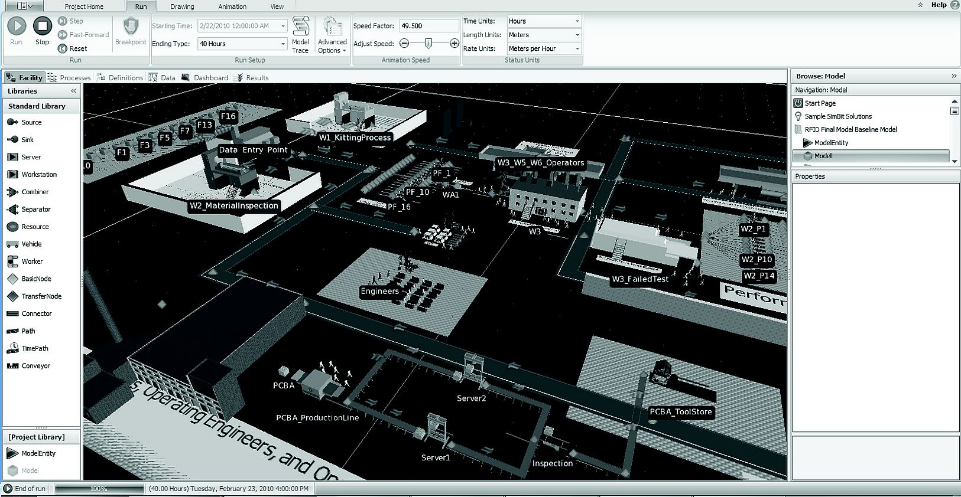
SIMIO Simulation Software

Slide 38
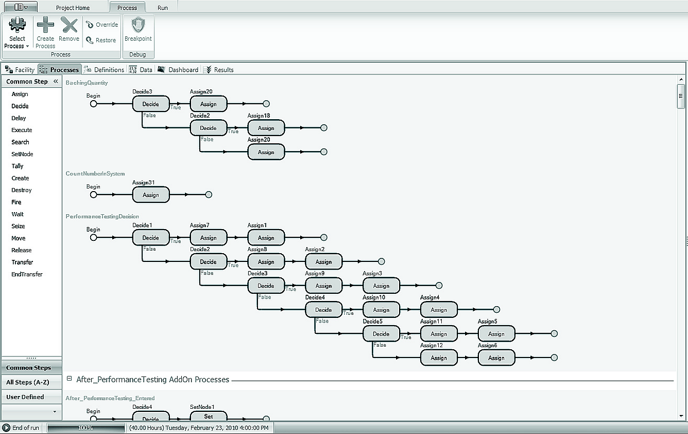
SIMIO Simulation Software

Slide 39
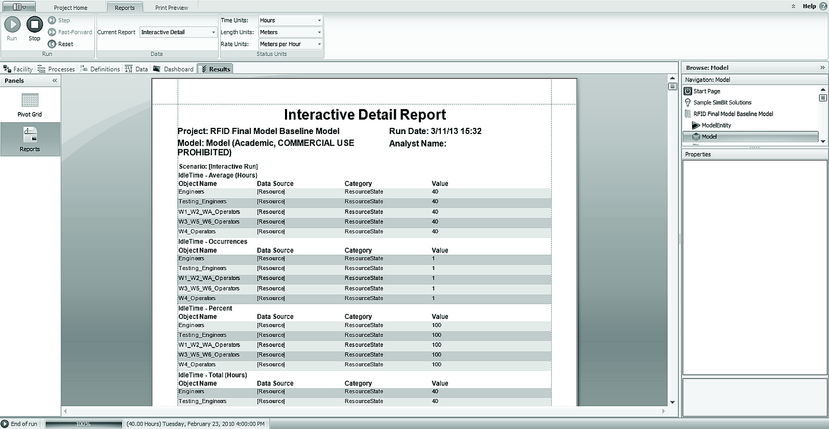
SIMIO Simulation Software

Slide 40
Simulation Software
A comprehensive list can be found at
orms-today.org/surveys/Simulation/Simulation.html
Simio LLC, simio.com
SAS Simulation, sas.com
Lumina Decision Systems, lumina.com
Oracle Crystal Ball, oracle.com
Palisade Corp., palisade.com
Rockwell Intl., arenasimulation.com …

Slide 41
System Dynamics Modeling
Macro-level simulation models in which aggregate values and trends are considered
Objective is to study the overall behavior of a system over time as a whole
Evolution of the various components of the system over time and as a result of interplay between the components over time
First introduced by Forrester (1958)
A widely used technique in operations research and management science

Slide 42
System Dynamics Modeling

Slide 43
Agent-Based Modeling
Agent - an autonomous computer program that observes and acts on an environment and directs its activity toward achieving specific goals
Relatively new technology
Other names include
Software agents
Wizards
Knowbots, Both
Intelligent software robots (Softbots) …

Slide 44
Agent-Based Modeling
Agent-based modeling (ABM) is a simulation modeling technique to support complex decision systems where a system is modeled as a set of autonomous decision-making units called agents
A bottom-up approach to simulation modeling
Agent-based modeling platforms
SWARM (www.swarms.org),
Netlogo (http://ccl.northwestern.edu/netlogo),
RePast/Sugarscape (www.repast.sourceforge.net),
…

Slide 45
Application Case 10.5
Agent-Based Simulation Helps Analyze Spread of a Pandemic Outbreak
Questions for Discussion
What are the characteristics of an agent-based simulation model?
List the various factors that were fed into the agent-based simulation model described in the case.
Elaborate on the benefits of using agent-based simulation models.
Besides disease prevention, in which other situations could agent-based simulation be employed?

Slide 46
End of the Chapter
Questions, comments

Slide 47
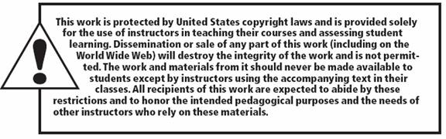
All rights reserved. No part of this publication may be reproduced, stored in a retrieval system, or transmitted, in any form or by any means, electronic, mechanical, photocopying, recording, or otherwise, without the prior written permission of the publisher. Printed in the United States of America.

