Slide 1
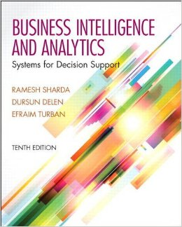
Business Intelligence and Analytics: Systems for Decision Support
(10th Edition)
Chapter 9:
Model-Based Decision Making: Optimization and Multi-Criteria Systems

Slide 2
Learning Objectives
Understand the basic concepts of analytical decision modeling
Describe how prescriptive models interact with data and the user
Understand some different, well-known model classes
Understand how to structure decision making with a few alternatives
Describe how spreadsheets can be used for analytical modeling and solution
(Continued…)

Slide 3
Learning Objectives
Explain the basic concepts of optimization and when to use them
Describe how to structure a linear programming model
Describe how to handle multiple goals
Explain what is meant by sensitivity analysis, what-if analysis, and goal seeking
Describe the key issues of multi-criteria decision making

Slide 4
Opening Vignette…
Midwest ISO Saves Billions by Better Planning of Power Plant Operations and Capacity Planning
Company background
Problem description
Proposed solution
Results
Answer & discuss the case questions...

Slide 5
Questions for the Opening Vignette
In what ways were the individual companies in Midwest ISO better off being part of MISO as opposed to operating independently?
The dispatch problem was solved with a linear programming method. Explain the need of such method in light of the problem discussed in the case.
What were the two main optimization algorithms used? Briefly explain the use of each algorithm.

Slide 6
Decision Support Systems Modeling
DSS modeling (optimization & simulation) contribute to organizational success. Examples include:
Pillowtex (see ProModel, 2013),
Fiat (see ProModel, 2006),
Procter & Gamble (see Camm et al., 1997),
and others.
INFORMS publications such as Interfaces, ORMS Today, and Analytics magazine have plenty of such example cases

Slide 7
Application Case 9.1
Optimal Transport for ExxonMobil Downstream Through a DSS
Questions for Discussion
List three ways in which manual scheduling of ships could result in more operational cost as compared to the tool developed.
In what other ways can ExxonMobil leverage the decision support tool developed to expand and optimize their other business operations?
What are some strategic decisions that could be made by decision makers using the tool developed?

Slide 8
Major Modeling Issues
Problem identification and environmental analysis (information collection)
Variable identification
Influence diagrams, cognitive maps
Forecasting/predicting
More information leads to better prediction
Multiple models: An MSS can include several models, each of which represents a different part of the decision-making problem
Categories of models >>>
Model management – DBMS vs. MBDM

Slide 9
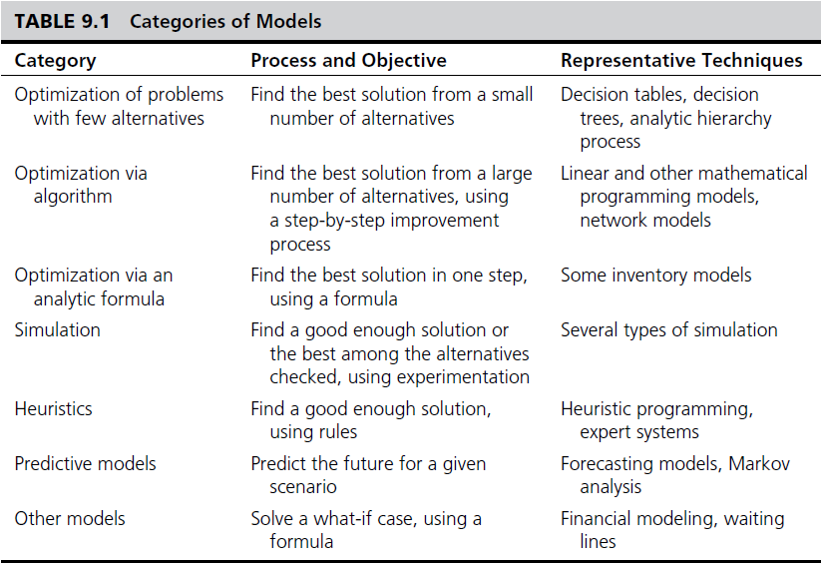
Categories of Models

Slide 10
Model Categories Static and Dynamic Models
Static Analysis
Single snapshot of the situation
Single interval
Steady state
Dynamic Analysis
Dynamic models
Evaluate scenarios that change over time
Time dependent
Represents trends and patterns over time
More realistic: Extends static models

Slide 11
Application Case 9.2
Optimal Transport for ExxonMobil Downstream Through a DSS
Company
Problem description
Proposed solution
Results

Slide 12
Model Categories Current Trends in Modeling
Development of Model/Solution Libraries
NEOS Server for Optimization
neos.mcs.anl.gov/neos/index.html
Resources link at informs.org
lionhrtpub.com/ORMS.shtml
Web-based modeling (optimization/simulation/…)
Multidimensional analysis (modeling)
Influence Diagrams

Slide 13
Structure of Mathematical Models for Decision Support
Non-Quantitative Models (Qualitative)
Quantitative Models: Mathematically links decision variables, uncontrollable variables, and result variables
Independent Variables
Uncontrollable
Variables
Dependent Variable
Decision
Variables
Mathematical
Relationships
Result
Variables
Intermediate
Variables

Slide 14
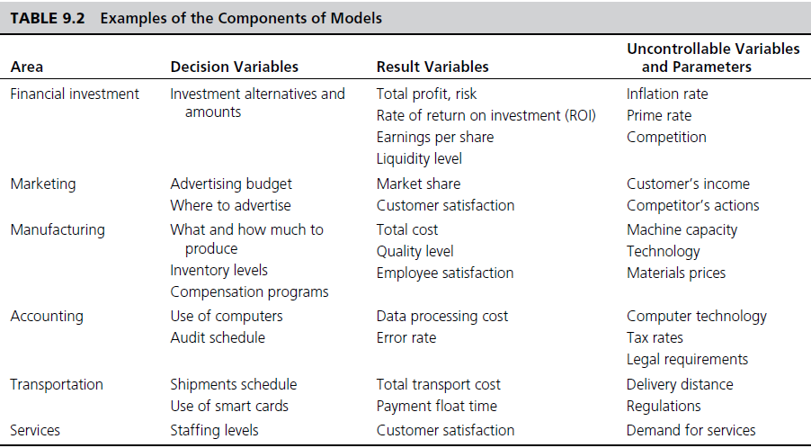
Examples - Components of Models

Slide 15
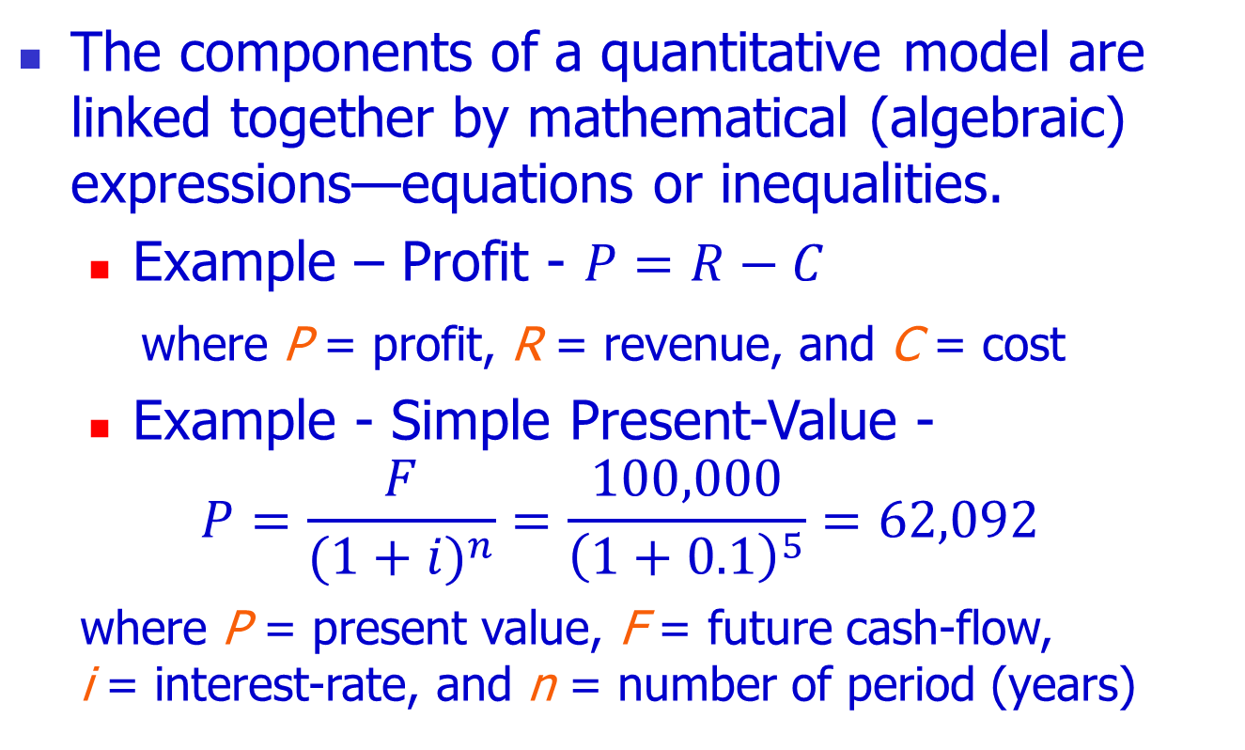
The Structure of a Mathematical Model
The components of a quantitative model are linked together by mathematical (algebraic) expressions—equations or inequalities.
Example – Profit - $P=R−C$
whereP= profit, R= revenue, and C= cost
Example - Simple Present-Value -
$$P=\frac{F}{{(1+i)}^{n}}=\frac{100,000}{{\left(1+0.1\right)}^{5}}=62,092$$
whereP= present value, F= future cash-flow, i= interest-rate, and n = number of period (years)

Slide 16
Modeling and Decision Making - Under Certainty, Uncertainty, and Risk
Certainty
Assume complete knowledge
All potential outcomes are known
May yield optimal solution
Uncertainty
Several outcomes for each decision
Probability of each outcome is unknown
Knowledge would lead to less uncertainty
Risk analysis (probabilistic decision making)
Probability of each of several outcomes occurring
Level of uncertainty => Risk (expected value)

Slide 17
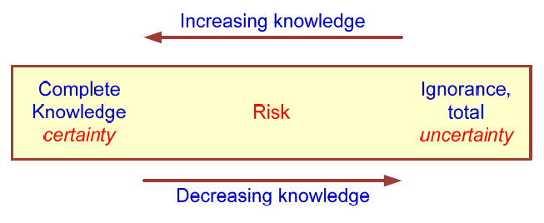
Modeling and Decision Making - Under Certainty, Uncertainty, and Risk
The Zones of Decision Making

Slide 18
Application Case 9.3
American Airlines Uses Should-Cost Modeling to Assess the Uncertainty of Bids for Shipment Routes
Questions for Discussion
Besides reducing the risk of overpaying or underpaying suppliers, what are some other benefits AA would derive from its “should be” model?
Can you think of other domains besides air transportation where such a model could be used?
Discuss other possible methods with which AA could have solved its bid overpayment and underpayment problem.

Slide 19
Decision Modeling with Spreadsheets
Spreadsheet
Most popular end-user modeling tool
Flexible and easy to use
Powerful functions (add-in functions)
Programmability (via macros)
What-if analysis and goal seeking
Simple database management
Seamless integration of model and data
Incorporates both static and dynamic models
Examples: Microsoft Excel, Lotus 1-2-3

Slide 20
Application Case 9.4
Showcase Scheduling at Fred Astaire East Side Dance Studio
Company
Problem description
Proposed solution
Results

Slide 21
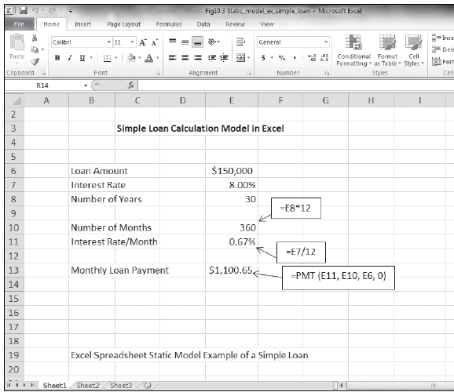
Excel spreadsheet - static model example: (Simple loan calculation of monthly payments)
Static model example:

Slide 22
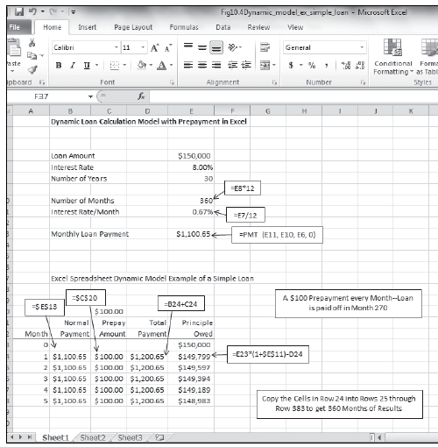
Excel spreadsheet - Dynamic model example: Simple loan calculation of monthly payments and effects of prepayment

Slide 23
Optimization via Mathematical Programming
Mathematical Programming
A family of tools designed to help solve managerial problems in which the decision maker must allocate scarce resources among competing activities to optimize a measurable goal
Optimal solution: The best possible solution to a modeled problem
Linear programming (LP): A mathematical model for the optimal solution of resource allocation problems. All the relationships are linear.

Slide 24
Application Case 9.5
Spreadsheet Model Helps Assign Medical Residents
Company
Problem description
Proposed solution
Results

Slide 25
LP Problem Characteristics
Limited quantity of economic resources
Resources are used in the production of products or services
Two or more ways (solutions, programs) to use the resources
Each activity (product or service) yields a return in terms of the goal
Allocation is usually restricted by constraints

Slide 26
Linear Programming Steps
Identify the …
Decision variables
Objective function
Objective function coefficients
Constraints
Capacities / Demands / …
Represent the model
LINDO: Write mathematical formulation
EXCEL: Input data into specific cells in Excel
Run the model and observe the results

Slide 27
Modeling in LP - An Example
The Product-Mix Linear Programming Model
MBI Corporation
Decision variable: How many computers to build next month?
Two types of mainframe computers: CC-7 and CC-8
Constraints: Labor limits, Materials limit, Marketing lower limits CC-7 CC-8 Rel Limit Labor (days) 300 500 <= 200,000 /mo Materials ($) 10,000 15,000 <= 8,000,000 /mo Units 1 >= 100 Units 1 >= 200 Profit ($) 8,000 12,000 Max Objective: Maximize Total Profit / Month

Slide 28
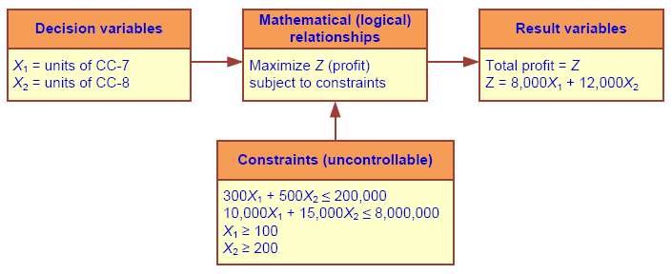
LP Solution – Algebraic Formulations

Slide 29
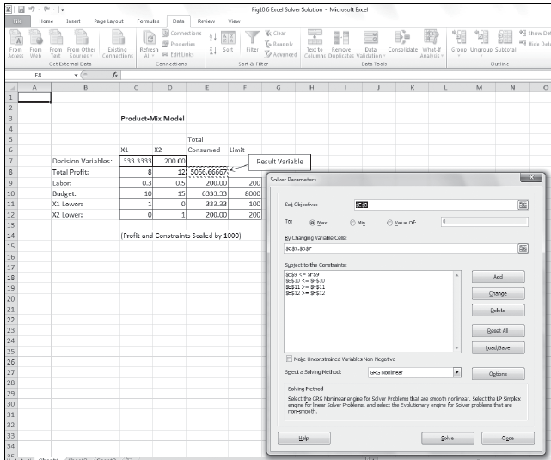
LP Solution with Excel
Decision Variables:
X₁: unit of CC-7
X₂: unit of CC-8
Objective Function:
Maximize Z (profit)
Z=8000X₁+12000X₂
Subject To
300X₁ + 500X₂ ≤ 200K
10000X₁ + 15000X₂ ≤ 8000K
X₁ ≥ 100
X₂ ≥ 200

Slide 30
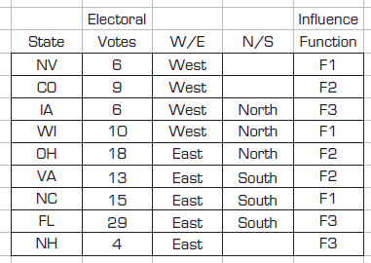
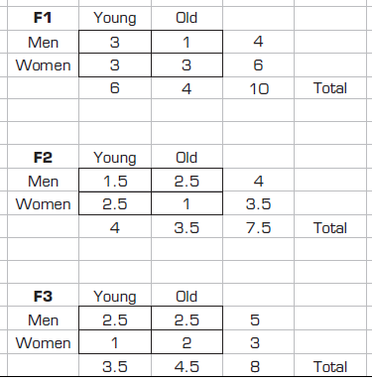
Illustrating the Power of Spreadsheet Modeling
Election Resource Allocation Problem
Analysis of “swing states” for the 2012 election…

Slide 31
Common Optimization Models
Product-mix problems (how many of each product to produce for max profit)
Transportation (minimize cost of shipments)
Assignment (best matching of objects)
Investment (maximizing rate of return)
Network optimization models for planning and scheduling
Replacement (capital budgeting), …

Slide 32
Multiple Goals, Sensitivity Analysis, What-If Analysis, and Goal Seeking
Multiple Goals
Simple-goal vs. multiple goals
Vast majority of managerial problems has multiple goals (objectives) to achieve
Attaining simultaneous goals
Methods of handling multiple goals
Utility theory
Goal programming
Expression of goals as constraints, using LP
A points system

Slide 33
Multiple Goals, Sensitivity Analysis, What-If Analysis, and Goal Seeking
Certain difficulties may arise when analyzing multiple goals
Difficult to obtain a single organizational goal
The importance of goals change over time
Goals and sub-goals are viewed differently
Goals change in response to other changes
Dynamics of groups of decision makers
Assessing the importance (priorities)
…

Slide 34
Multiple Goals, Sensitivity Analysis, What-If Analysis, and Goal Seeking
Sensitivity analysis
It is the process of assessing the impact of change in inputs on outputs
Helps to …
eliminate (or reduce) variables
revise models to eliminate too-large sensitivities
adding details about sensitive variables or scenarios
obtain better estimates of sensitive variables
alter a real-world system to reduce sensitivities
…
Can be automatic or trial and error

Slide 35
Multiple Goals, Sensitivity Analysis, What-If Analysis, and Goal Seeking
What-if analysis
Assesses solutions based on changes in variables or assumptions (scenario analysis)
What if we change our capacity at the milling station by 40% [what would be the impact]
Goal seeking
Backwards approach, starts with the goal and determines values of inputs needed
Example is break-even point determination
In-order to break even (profit = 0), how many products do we have to sell each month

Slide 36
Decision Analysis with Decision Tables and Decision Trees
Decision Tables – a tabular representation of the decision situation (alternatives)
Investment Example
Goal: maximize the yield after one year
Yield depends on the status of the economy (the state of nature)
Solid growth
Stagnation
Inflation

Slide 37
Decision Table - Investment Example: Possible Situations
1. If solid growth in the economy, bonds yield 12%; stocks 15%; time deposits 6.5%
2. If stagnation, bonds yield 6%; stocks 3%; time deposits 6.5%
3. If inflation, bonds yield 3%; stocks lose 2%; time deposits yield 6.5%

Slide 38
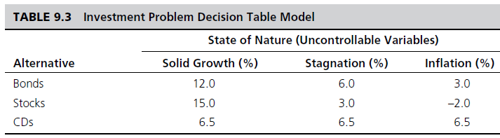
Decision Table Investment Example: Decision Table
Payoff decision variables (alternatives)
Uncontrollable variables (states of economy)
Result variables (projected yield)
Tabular representation:

Slide 39
Decision Table Investment Example: Treating Uncertainty
Optimistic approach
Pessimistic approach
Treating Risk/Uncertainty:
Use known probabilities
Expected values

Slide 40
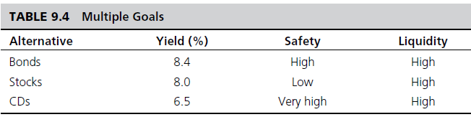
Decision Table Investment Example: Multiple Goals
Multiple goals
Yield, safety, and liquidity

Slide 41
Decision Trees
Graphical representation of relationships
Multiple criteria approach
Demonstrates complex relationships
Cumbersome, if many alternatives exists
Tools include
Mind Tools Ltd., mindtools.com
TreeAge Software Inc., treeage.com
Palisade Corp., palisade.com

Slide 42
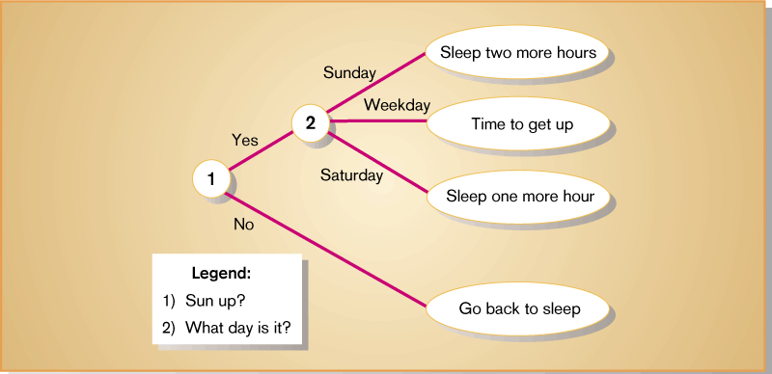
Decision Trees – An Example

Slide 43
Multi-Criteria Decision Making with Pairwise Comparisons
Having more than one criterion makes decision-making process complicated
Usually some type of weighing algorithm is used to analyze such problems
The Analytic Hierarchy Process
Developed by Thomas Saaty (1995, 1996)
A very popular technique for MCDM
Popular Tools - ExpertChoice.com
Web-based Tools - Web-HIPRE (hipre.aalto.fi)

Slide 44
Application Case 9.6
U.S. HUD Saves the House by Using AHP for Selecting IT Projects
Company
Problem description
Proposed solution
Results

Slide 45
Tutorial - Applying AHP Using Web-HIPRE
Goal: select the most appropriate movie
Identify some criteria for making this decision
The main and sub-criteria for movie selection are
a. Genre: Action, Comedy, Sci-Fi, Romance
b. Language: English, Hindi
c. Day of Release: weekday, weekend
d. User/Critics Rating: High, Average, Low
Alternatives are the following current movies:
SkyFall, The Dark Knight Rises, The Dictator, Dabaang, Alien, and DDL

Slide 46
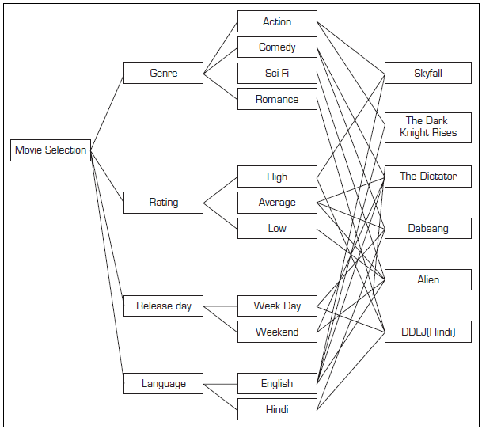
Tutorial - Applying AHP Using Web-HIPRE
Step 1: define the goal, criteria, and alternatives
Web-HIBRE allows defining all of these and relationships within an easy-to-use Web-based interface.

Slide 47
Tutorial - Applying AHP Using Web-HIPRE
Step 2: the main criteria are then ranked as they relate to the goal
A comparative ranking scale from 1 to 9 (with ascending order of importance) is used
The ranking is done using a Pairwise comparison procedure (i.e., divide-and-concur) between any two criteria for all combinations of twos
The tool readily normalizes the rankings of each of the main criteria over one another to a scale ranging from 0 to 1 and then calculates the row averages to arrive at an overall importance rating ranging from 0 to 1

Slide 48
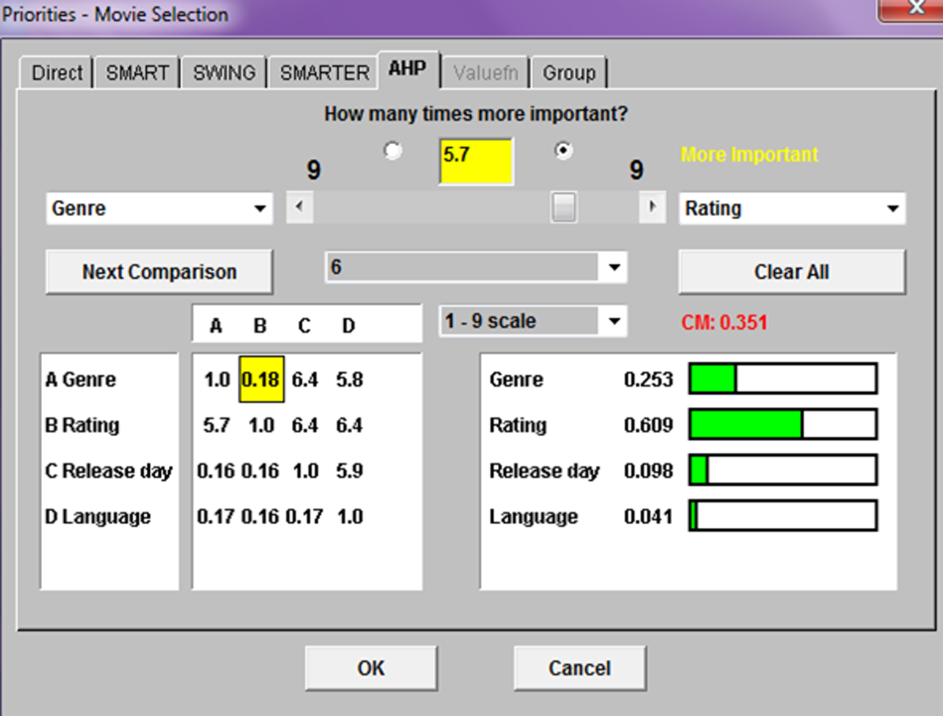
Tutorial - Applying AHP Using Web-HIPRE

Slide 49
Tutorial - Applying AHP Using Web-HIPRE
Step 3: All of the subcriteria related to each of the main criteria are then ranked with their relative importance over one another
Step 4: Each alternative is ranked with respect to all of the subcriteria that are linked with the alternatives in a similar fashion using the relative scale of 0–9; then the overall importance of each alternative is calculated
Step 5: The final result are obtained from the composite priority analysis involving all the subcriteria and main criteria

Slide 50
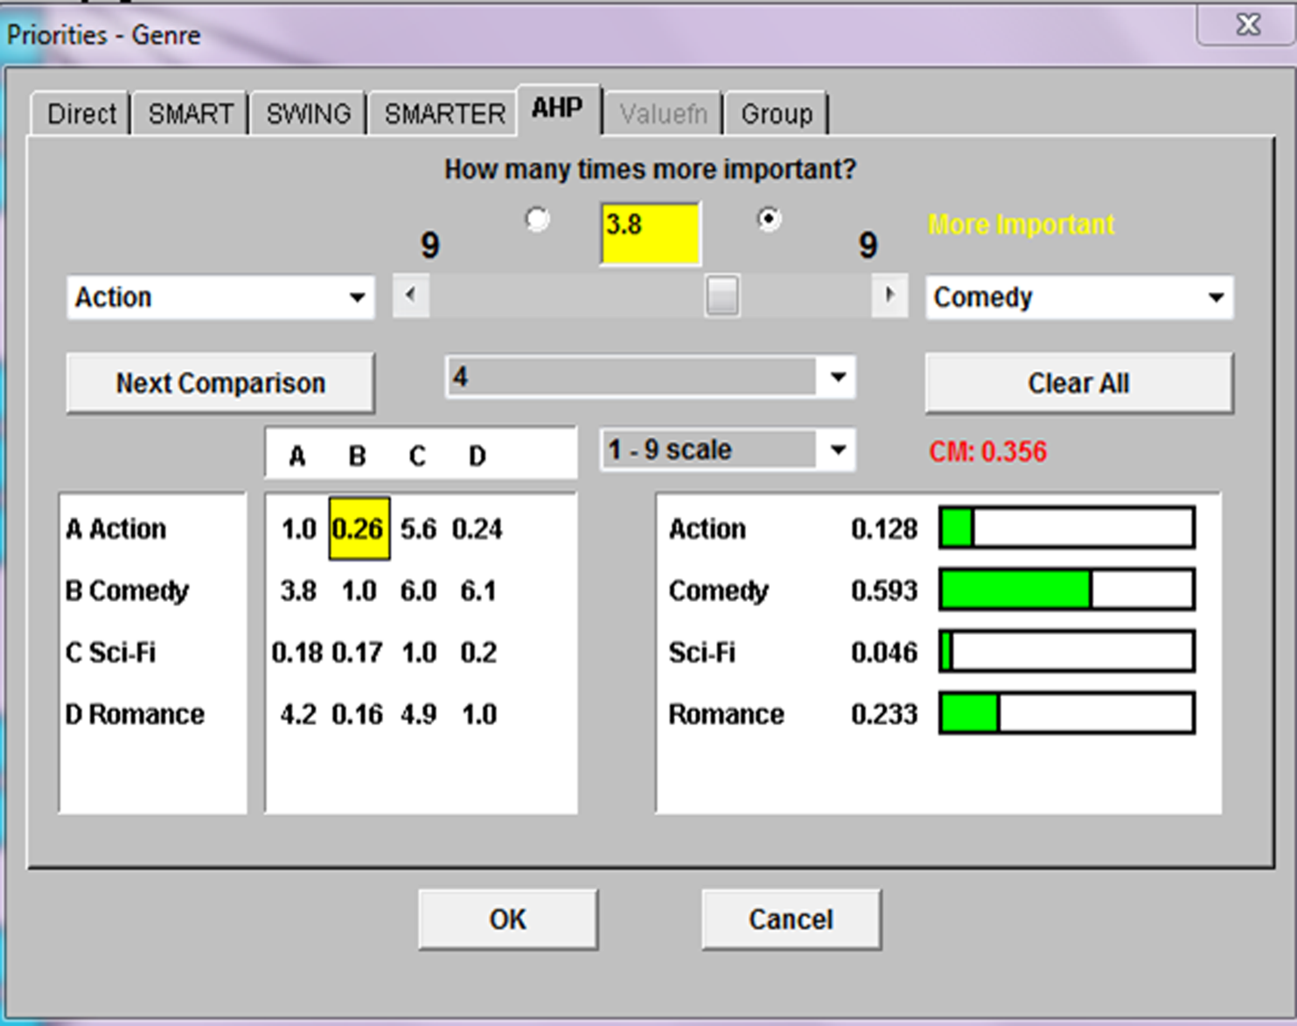
Tutorial - Applying AHP Using Web-HIPRE

Slide 51
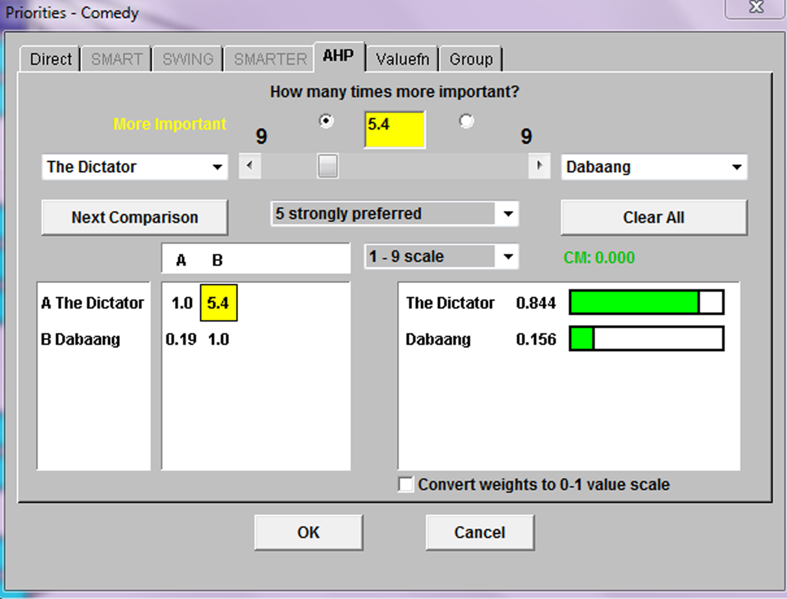
Tutorial - Applying AHP Using Web-HIPRE

Slide 52
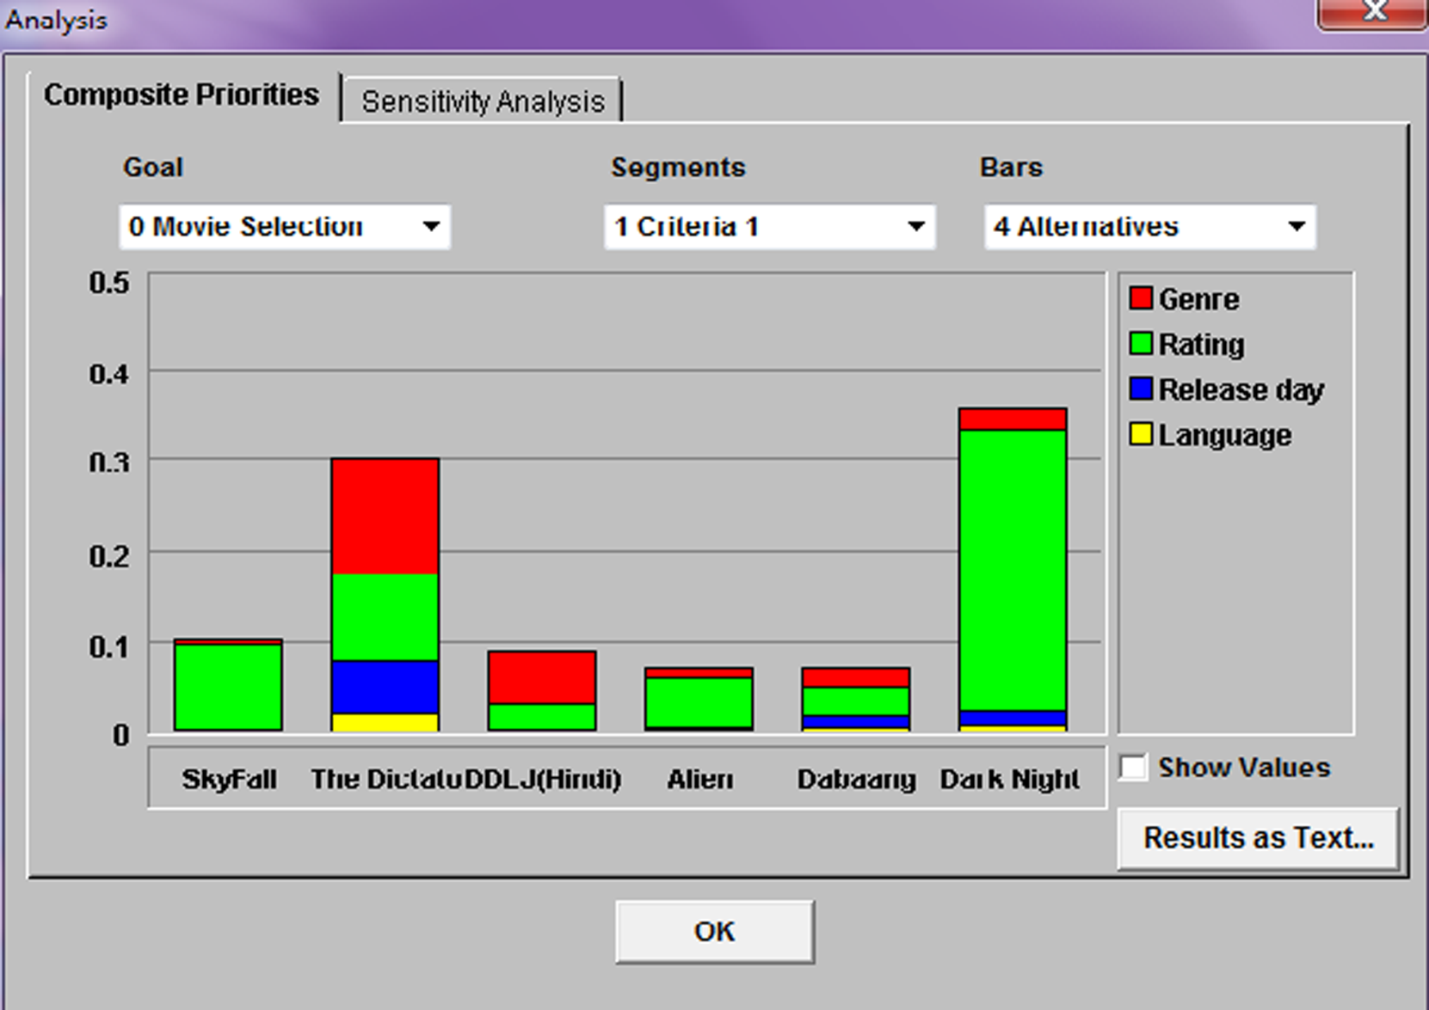
Tutorial - Applying AHP Using Web-HIPRE

Slide 53
End of the Chapter
Questions, comments

Slide 54

All rights reserved. No part of this publication may be reproduced, stored in a retrieval system, or transmitted, in any form or by any means, electronic, mechanical, photocopying, recording, or otherwise, without the prior written permission of the publisher. Printed in the United States of America.

