Slide 1
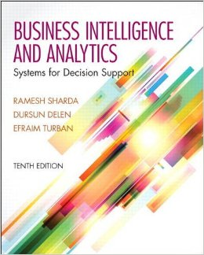
Business Intelligence and Analytics: Systems for Decision Support
(10th Edition)
Chapter 6:
Techniques for Predictive Modeling

Slide 2
Learning Objectives
Understand the concept and definitions of artificial neural networks (ANN)
Learn the different types of ANN architectures
Know how learning happens in ANN
Become familiar with ANN applications
Understand the sensitivity analysis in ANN
Understand the concept and structure of support vector machines (SVM)
(Continued…)

Slide 3
Learning Objectives
Learn the advantages and disadvantages of SVM compared to ANN
Understand the concept and formulation of k-nearest neighbor algorithm (kNN)
Learn the process of applying kNN
Learn the advantages and disadvantages of kNN compared to ANN and SVM

Slide 4
Opening Vignette…
Predictive Modeling Helps Better Understand and Manage Complex Medical Procedures
Situation
Problem
Solution
Results
Answer & discuss the case questions.

Slide 5
Questions for the Opening Vignette
Why is it important to study medical procedures? What is the value in predicting outcomes?
What factors do you think are the most important in better understanding and managing healthcare?
What would be the impact of predictive modeling on healthcare and medicine? Can predictive modeling replace medical or managerial personnel?
What were the outcomes of the study? Who can use these results? How can they be implemented?
Search the Internet to locate two additional cases in managing complex medical procedures.

Slide 6
Opening Vignette – A Process Map for Training and Testing Four Predictive Models

Slide 7
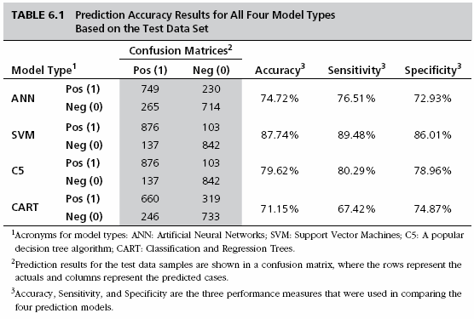
Opening Vignette The Comparison of Four Models

Slide 8
Neural Network Concepts
Neural networks (NN): a brain metaphor for information processing
Neural computing
Artificial neural network (ANN)
Many uses for ANN for
pattern recognition, forecasting, prediction, and classification
Many application areas
finance, marketing, manufacturing, operations, information systems, and so on

Slide 9
Biological Neural Networks
Two interconnected brain cells (neurons)

Slide 10
Processing Information in ANN
A single neuron (processing element – PE) with inputs and outputs

Slide 11
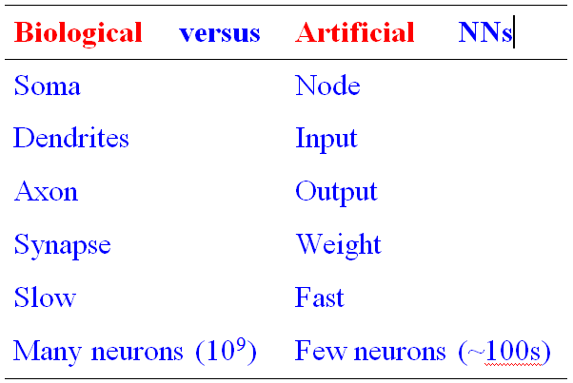
Biology Analogy

Slide 12
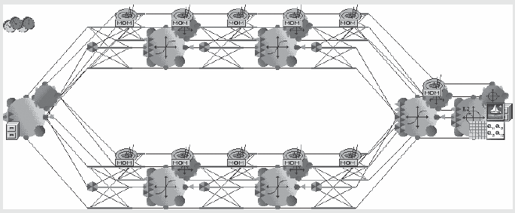
Application Case 6.1
Neural Networks Are Helping to Save Lives in the Mining Industry
Questions for
Discussion
How did neural networks help save lives in the mining industry?
What were the challenges, the proposed solution, and the obtained results?

Slide 13
Elements of ANN
Processing element (PE)
Network architecture
Hidden layers
Parallel processing
Network information processing
Inputs
Outputs
Connection weights
Summation function

Slide 14
Elements of ANN
Neural Network with One Hidden Layer

Slide 15
Elements of ANN
Summation Function for a Single Neuron (a), and
Several Neurons (b)

Slide 16
Elements of ANN
Transformation (Transfer) Function
Linear function
Sigmoid (logical activation) function [0 1]
Tangent Hyperbolic function [-1 1]
Threshold value?

Slide 17
Neural Network Architectures
Architecture of a neural network is driven by the task it is intended to address
Classification, regression, clustering, general optimization, association, ….
Most popular architecture: Feedforward, multi-layered perceptron with backpropagation learning algorithm
Used for both classification and regression type problems
Others – Recurrent, self-organizing feature maps, Hopfield networks, …

Slide 18
Neural Network Architectures Feed-Forward Neural Networks
Feed-forward MLP with 1 Hidden Layer

Slide 19
Neural Network Architectures Recurrent Neural Networks

Slide 20
Other Popular ANN Paradigms Self-Organizing Maps (SOM)
First introduced by the Finnish Professor Teuvo Kohonen
Applies to clustering type problems

Slide 21
Other Popular ANN Paradigms Hopfield Networks
First introduced by John Hopfield
Highly interconnected neurons
Applies to solving complex computational problems (e.g., optimization problems)

Slide 22
Application Case 6.2
Predictive Modeling is Powering the Power Generators
Questions for Discussion
What are the key environmental concerns in the electric power industry?
What are the main application areas for predictive modeling in the electric power industry?
How was predictive modeling used to address a variety of problems in the electric power industry?

Slide 23
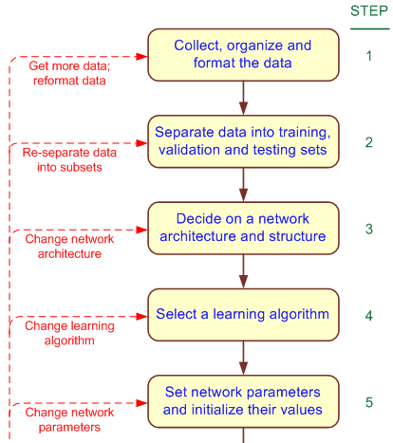
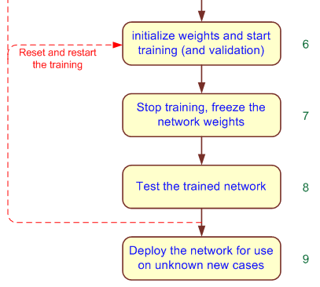
Development Process of an ANN

Slide 24
An MLP ANN Structure for the Box-Office Prediction Problem

Slide 25
Testing a Trained ANN Model
Data is split into three parts
Training (~60%)
Validation (~20%)
Testing (~20%)
k-fold cross validation
Less bias
Time consuming

Slide 26
AN Learning Process A Supervised Learning Process
Three-step process:
1. Compute temporary outputs.
2. Compare outputs with desired targets.
3. Adjust the weights and repeat the process.

Slide 27
Backpropagation Learning
Backpropagation of Error for a Single Neuron

Slide 28
Backpropagation Learning
The learning algorithm procedure
Initialize weights with random values and set other network parameters
Read in the inputs and the desired outputs
Compute the actual output (by working forward through the layers)
Compute the error (difference between the actual and desired output)
Change the weights by working backward through the hidden layers
Repeat steps 2-5 until weights stabilize

Slide 29
Illuminating The Black Box Sensitivity Analysis on ANN
A common criticism for ANN: The lack of transparency/explainability
The black-box syndrome!
Answer: sensitivity analysis
Conducted on a trained ANN
The inputs are perturbed while the relative change on the output is measured/recorded
Results illustrate the relative importance of input variables

Slide 30
Sensitivity Analysis on ANN Models
For a good example, see Application Case 6.3
Sensitivity analysis reveals the most important injury severity factors in traffic accidents

Slide 31
Application Case 6.3
Sensitivity Analysis Reveals Injury Severity Factors in Traffic Accidents
Questions for Discussion
How does sensitivity analysis shed light on the black box (i.e., neural networks)?
Why would someone choose to use a blackbox tool like neural networks over theoretically sound, mostly transparent statistical tools like logistic regression?
In this case, how did NNs and sensitivity analysis help identify injury-severity factors in traffic accidents?

Slide 32
Support Vector Machines (SVM)
SVM are among the most popular machine-learning techniques.
SVM belong to the family of generalized linear models… (capable of representing non-linear relationships in a linear fashion).
SVM achieve a classification or regression decision based on the value of the linear combination of input features.
Because of their architectural similarities, SVM are also closely associated with ANN.

Slide 33
Support Vector Machines (SVM)
Goal of SVM: to generate mathematical functions that map input variables to desired outputs for classification or regression type prediction problems.
First, SVM uses nonlinear kernel functions to transform non-linear relationships among the variables into linearly separable feature spaces.
Then, the maximum-margin hyperplanes are constructed to optimally separate different classes from each other based on the training dataset.
SVM has solid mathematical foundation!

Slide 34
Support Vector Machines (SVM)
A hyperplane is a geometric concept used to describe the separation surface between different classes of things.
In SVM, two parallel hyperplanes are constructed on each side of the separation space with the aim of maximizing the distance between them.
A kernel function in SVM uses the kernel trick (a method for using a linear classifier algorithm to solve a nonlinear problem)
The most commonly used kernel function is the radial basis function (RBF).

Slide 35
Support Vector Machines (SVM)
Many linear classifiers (hyperplanes) may separate the data

Slide 36
Application Case 6.4
Managing Student Retention with Predictive Modeling
Questions for Discussion
Why is attrition one of the most important issues in higher education?
How can predictive analytics (ANN, SVM, and so forth) be used to better manage student retention?
What are the main challenges and potential solutions to the use of analytics in retention management?

Slide 37
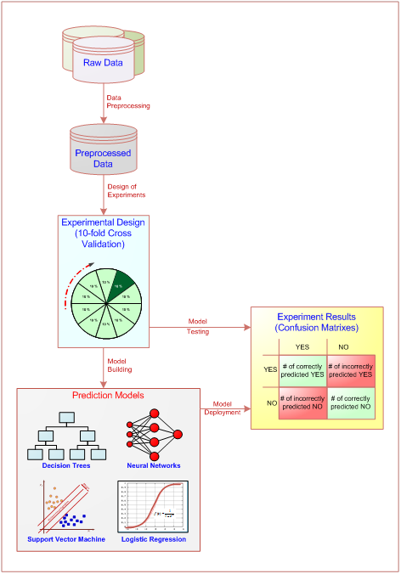
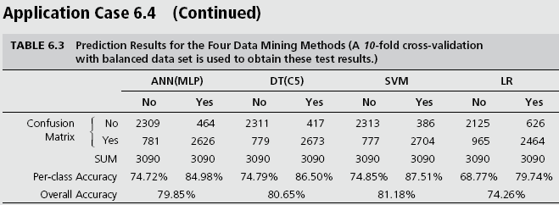
Application Case 6.4
Managing Student Retention with Predictive Modeling

Slide 38
How Does an SVM Work?
Following a machine-learning process, an SVM learns from the historic cases.
The Process of Building SVM
1. Preprocess the data
Scrub and transform the data.
2. Develop the model.
Select the kernel type (RBF is often a natural choice).
Determine the kernel parameters for the selected kernel type.
If the results are satisfactory, finalize the model; otherwise change the kernel type and/or kernel parameters to achieve the desired accuracy level.
3. Extract and deploy the model.

Slide 39
The Process of Building an SVM

Slide 40
SVM Applications
SVMs are the most widely used kernel-learning algorithms for wide range of classification and regression problems
SVMs represent the state-of-the-art by virtue of their excellent generalization performance, superior prediction power, ease of use, and rigorous theoretical foundation
Most comparative studies show its superiority in both regression and classification type prediction problems.
SVM versus ANN?

Slide 41
k-Nearest Neighbor Method (k-NN)
ANNs and SVMs → time-demanding, computationally intensive iterative derivations
k-NN is a simplistic and logical prediction method, that produces very competitive results
k-NN is a prediction method for classification as well as regression types (similar to ANN & SVM)
k-NN is a type of instance-based learning (or lazy learning) – most of the work takes place at the time of prediction (not at modeling)
k : the number of neighbors used

Slide 42
k-Nearest Neighbor Method (k-NN)
The answer depends on the value of k

Slide 43
The Process of k-NN Method

Slide 44
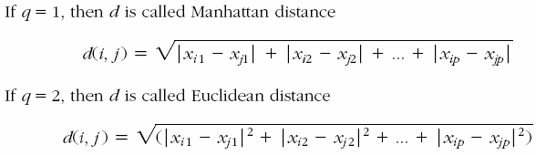
k-NN Model Parameter
Similarity Measure: The Distance Metric
Numeric versus nominal values?

Slide 45
k-NN Model Parameter
Number of Neighbors (the value of k)
The best value depends on the data
Larger values reduce the effect of noise but also make boundaries between classes less distinct
An “optimal” value can be found heuristically
Cross Validation is often used to determine the best value for k and the distance measure

Slide 46
Application Case 6.5
Efficient Image Recognition and Categorization with kNN
Questions for Discussion
Why is image recognition/classification a worthy but difficult problem?
How can k-NN be effectively used for image recognition/classification applications?

Slide 47
End of the Chapter
Questions, comments

Slide 48

All rights reserved. No part of this publication may be reproduced, stored in a retrieval system, or transmitted, in any form or by any means, electronic, mechanical, photocopying, recording, or otherwise, without the prior written permission of the publisher. Printed in the United States of America.

