Slide 1
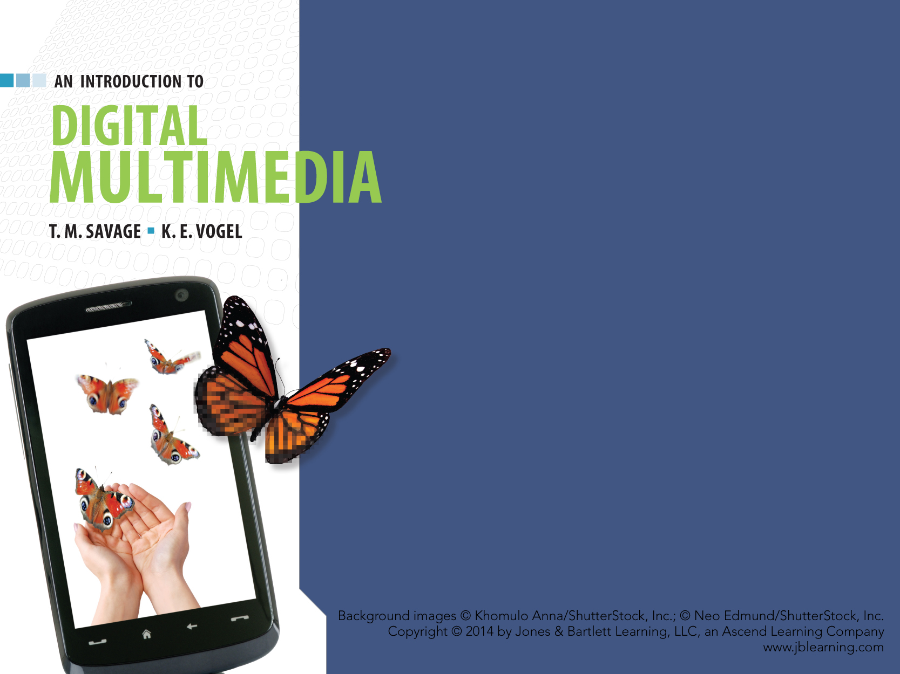
CHAPTER TEN
AUTHORING

Slide 2
CHAPTER HIGHLIGHTS
Two approaches to integrate media elements into a single application.
Authoring metaphors.
Authoring process.
Guidelines to select an authoring application.

Slide 3
METHODS TO INTEGRATE MEDIA
Programming
  Languages specify how the media is presented and user interactions carried out.
  Requires command of the language.
  Is time consuming.
Authoring
  Applications specially designed to integrate and present media elements.
  Developers can concentrate on design, interactivity, and functionality of the project.

Slide 4
AUTHORING APPLICATIONS
Software designed for creation of multimedia projects.
Applications are used to:
  Assemble media elements
  Synchronize content
  Design user interface
  Provide user interactivity.

Slide 5
AUTHORING METAPHORS
Authoring applications are grouped around three metaphors:
  Card
  Icon
  Timeline.
Metaphors help orient developer to how the software organizes the media, sequences events, and presents final project.
A metaphor is a comparison of one thing to another to enhance understanding.

Slide 6
CARD METAPHOR
Media is organized in sequential order on a stack of cards or slides.
  Appropriate for static media that is normally experienced in sequence.
Cards have two layers:
  Background layer contains shared elements. Foreground layer contains content specific to that card or slide.

Slide 7
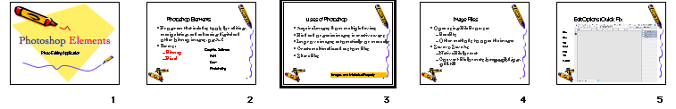
CARD METAPHOR
Benefits of card layers.
  Background content is created once which saves development time.
  Common background layer provides consistent design.
  File sizes are minimized by sharing background elements.
Notes:
View the background layer of this presentation to demonstrate the two layers and consistent content in the background layer.
Have students identify the elements on the slide that would be in the background layer and those in the foreground layer of the image from a PowerPoint presentation.

Slide 8
ICON METAPHOR
Icons define media and forms of interactivity.
Icons are placed on a flowline to create the application structure.
  Each icon has a dialog box with properties and parameters identified by the developer.
  Flowlines let developers visualize and adjust the structure of the application.
Branching routines add controls for user interaction.

Slide 9
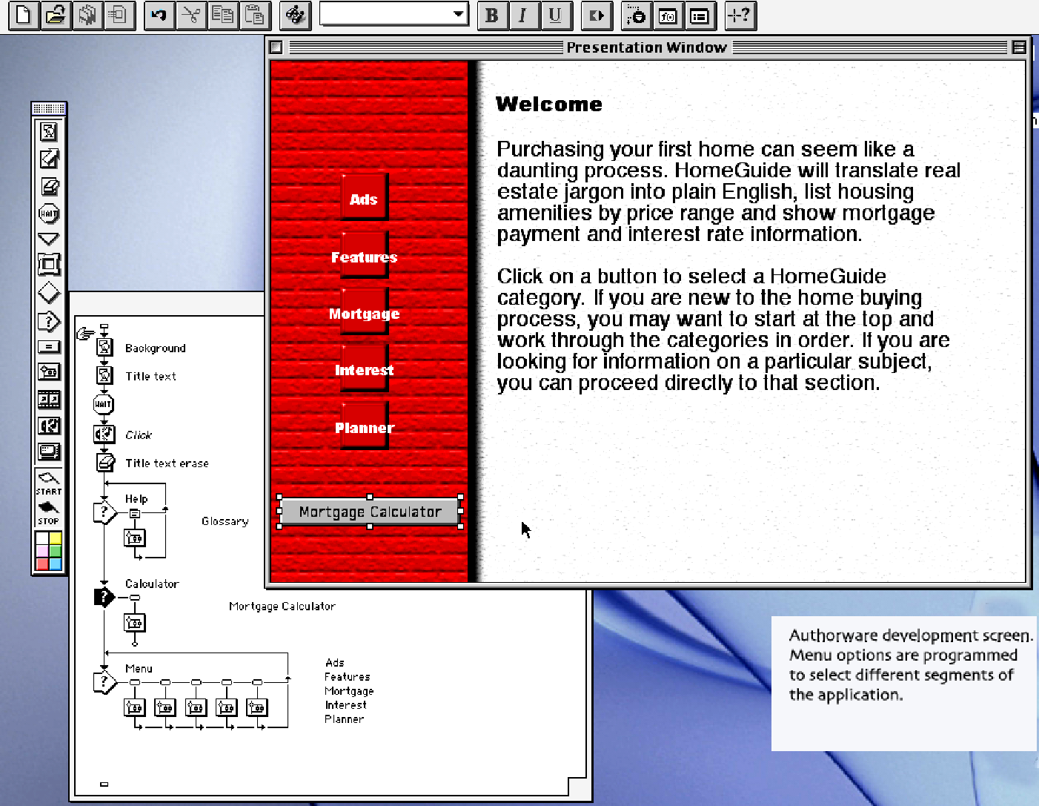
ICON METAPHOR
Flowline is a graphical representation of the relationships between components of the application.

Slide 10
TIMELINE METAPHOR
Organizes media and interactivity as sequence of frames.
  Each frame can have multiple layers.
  Layers define the stacking order of the content to be displayed.
Appropriate for dynamic media as the media can by synchronized precisely over time.

Slide 11
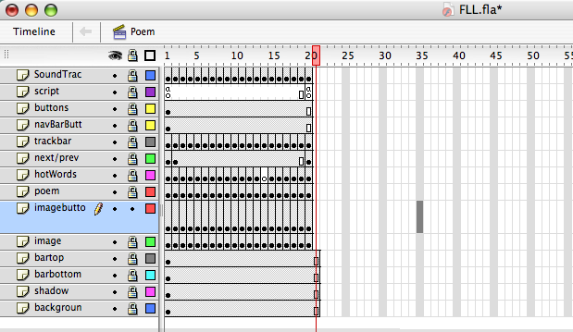
TIMELINE METAPHOR
Popular timeline-based applications include Director and Flash.
Best used when animation or video
is central to the application.

Slide 12
THE AUTHORING PROCESS
  A SERIES OF INTERRELATED TASKS FROM PROJECT DESIGN TO DELIVERY.

Slide 13
APPLICATION DESIGN
Authoring software supports the design process.
  Outline view in PowerPoint structures presentation.
  Storyboard development is common in complex applications.
    Storyboard is a series of screen sketches to guide development process.

Slide 14
IMPORTING CONTENT
Media is generally created in media-specific applications and imported into the authoring environment.
  File formats for imported media are important.
  Conversion utilities within the application are useful.

Slide 15
CREATE AND EDIT CONTENT
All authoring applications include some tools for creating and editing media content. For example:
  Text adjustments to font size and color.
  Paint tools to add shapes and edit image features.
  Sound adjustment on volume, duration.
  Animation changes to speed and direction.
Notes:
Have students comment on media editing features in PowerPoint.

Slide 16
INTEGRATION, SYNCHRONIZATION, and PLAYBACK
Techniques for integration are based on the metaphor (card, icon, timeline).
Sounds, animations and transitions must be synchronized to present a unified flow of information.
Playback of the content is often dependent on hardware factors. Timing controls can be established to ensure correct playback.
Notes:
Consider hardware factors that can impact playback consistency and could adversely affect the project. Processor speed and optical disc access times can have a major impact on smooth playback.

Slide 17
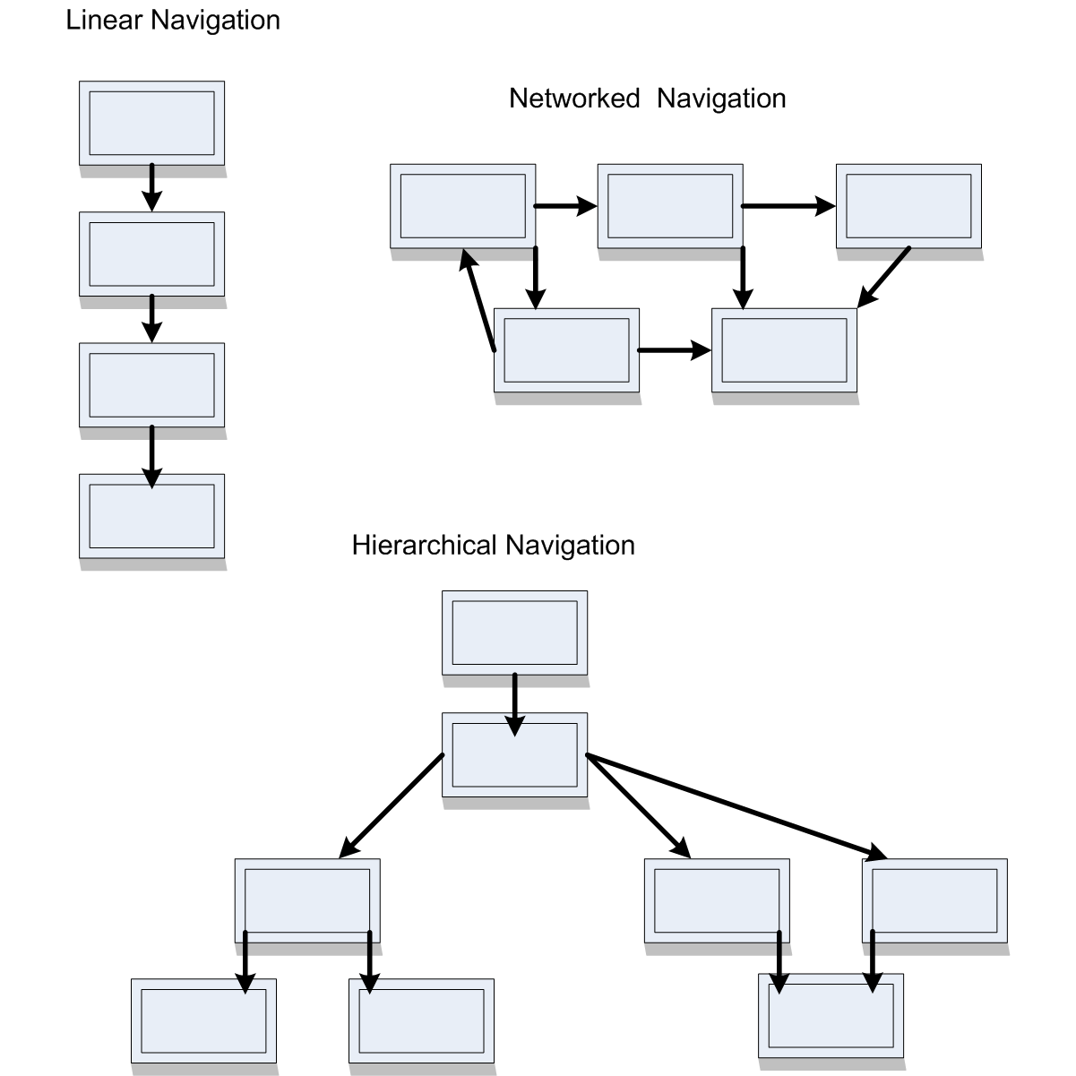
ESTABLISHING NAVIGATION
Authoring software can establish the order of the content on playback.
Basic navigation structures include:
  Linear or sequential
  Hierarchical
  Networked
  Conditional.
Notes:
Consider how each structure controls the playback and the type of project best suited to different methods. For example linear structure is best for a set of directions that must be followed in a set order.

Slide 18
PROGRAMMING
Provides more flexibility and control.
  For projects with extensive interactivity, custom features.
Two programming methods.
  Script: series of commands specifying properties or behavior of an element in the project.
    Commands are interpreted as the project is executed.
  Icon: dialog boxes allow the developer to specify parameters for icon's use.
    Does not require programming knowledge but does limit commands to icon parameters.
Notes:
Review popular scripting and icon programming techniques currently in use.

Slide 19
DATABASE SUPPORT
Some projects may require access to a collection of related files to store and retrieve user input.
  Tutorials have databases of related facts to test comprehension.
  User stores answers for future reference and scoring.
Authorware and Director applications offer an interface to a database.

Slide 20
PREVIEW, TEST, DEBUG
Projects are created in the development mode.
  Necessary to preview the project as it will appear in the final product and test the components of the screen displays.
  Authoring applications often have a preview mode to test the assembled project during development.
    Debugger tools can identify errors in program code.

Slide 21
PROJECT DELIVERY
Projects are published so they play outside the authoring environment.
Two approaches to publishing.
  Remote delivery
    Store the application and data on a server for access through a network, most often the WWW.
  Local installation
    Application is installed and maintained on user’s device.
Notes:
Discuss the advantages and disadvantages of publishing a project to require a separate player, or embed the player into the project. The latter is often used on CD or DVD distribution since there is adequate storage to contain the player file and the developer is assured the proper program is available for playback.
Web multimedia projects rely on a Player program on the client computer. This reduces file size for speedier download times. Client, however, may need to download the latest update of the player software on their computer.

Slide 22
PROJECT DELIVERY
Remote delivery through a network connection.
  Advantages:
    Content revisions are managed by server database.
    Wide market access
    Developer can track users and determine patterns of usage.
  Limitations:
    Bandwidth restrictions may apply depending on user’s location or network service.
    Browser applications are not uniformly compatible with all devices or applications.
Notes:
Discuss the advantages and disadvantages of publishing a project to require a separate player, or embed the player into the project. The latter is often used on CD or DVD distribution since there is adequate storage to contain the player file and the developer is assured the proper program is available for playback.
Web multimedia projects rely on a Player program on the client computer. This reduces file size for speedier download times. Client, however, may need to download the latest update of the player software on their computer.

Slide 23
PROJECT DELIVERY
Local installation on user device.
  Advantages:
    Project does not require constant connection to a network.
    Developer can incorporate larger data files within the application.
  Disadvantages:
    Platform dependency.
    Version control and critical updates are user dependent.
    Inability to track demographics and patterns of use.
Notes:
Discuss the advantages and disadvantages of publishing a project to require a separate player, or embed the player into the project. The latter is often used on CD or DVD distribution since there is adequate storage to contain the player file and the developer is assured the proper program is available for playback.
Web multimedia projects rely on a Player program on the client computer. This reduces file size for speedier download times. Client, however, may need to download the latest update of the player software on their computer.

Slide 24
Local Delivery approaches
Projects for local delivery have two approaches to provide the application:
  Project requires a separate player program to present the multimedia content.
    QuickTime, Flash, and MediaPlayer programs are free player downloads.
  Project embeds the player in the multimedia project.
    Larger files, but project is a stand-alone application.

Slide 25
CHOOSING AN AUTHORING
APPLICATION
No single authoring tool is suitable for all projects. To select the right application:
  Consider the subject (static or dynamic media).
  Consider the media (source file formats compatible).
  Consider delivery (where used, means of distribution).
  Consider maintenance (expertise needed to revise content, frequent update cycles).
Notes:
Use this screen to consider the advantages and disadvantages of a multimedia project done in PowerPoint and one done in Director or Flash.

Slide 26
WRAP UP
Authoring applications
  Integrate and synchronize media elements, add interface and interactivity, and deliver a project.
Authoring metaphors
  Card, Icon, Timeline.
Applications have tools built in to support basic authoring functions.
Choosing an application depends on project needs.

Slide 27
KEY TERM CHECK UP

