Slide 1
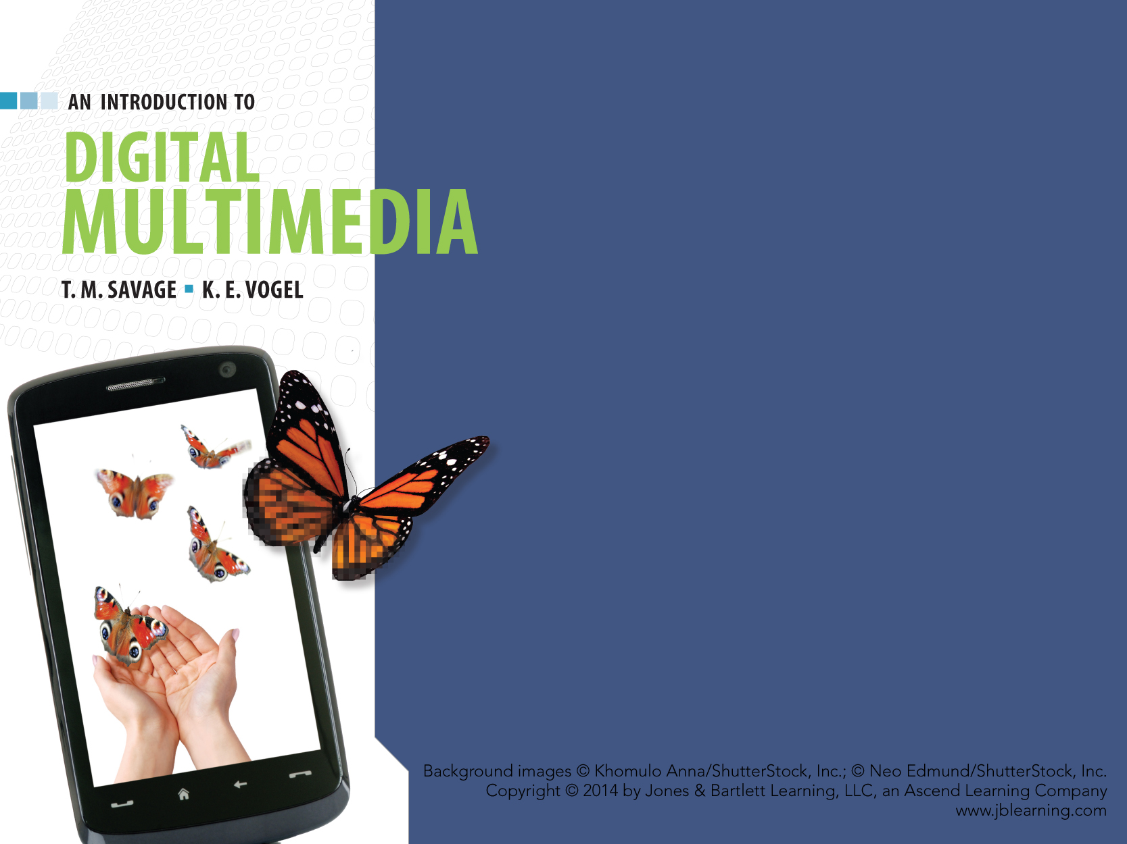
CHAPTER NINE
ANIMATION

Slide 2
CHAPTER HIGHLIGHTS
Animation basics
Traditional animation techniques
2-D animation techniques:
Keyframe
Tween
Programmed.
3-D animation:
Motion capture
Kinematics
Animating with physics.
Guidelines for animation in multimedia

Slide 3
PINNACLE OF MODERN MULTIMEDIA
Animation draws inspiration from each of the other media.
Computer is a partner in creative expression.
It lowered costs and increased ease of creating animation.
It supports creative expression through:
Interactivity
3-D sensory experience
Embodiment and implementation of rules of behavior.

Slide 4
ANIMATION BASICS
Animation: rapidly displayed sequence of individual, still images.
Made possible by "persistence of vision."
Images formed on the retina persist for a short period of time after stimulus has disappeared.
This physical memory of the retina produces the illusion of motion.
Early animating devices:
Thaumatrope
Zoetrope.
View sample Thaumatrope

Slide 5
ANIMATION BASICS
Flipbook technique
Still images showing a different stage of motion are created on each page.
Pages are "flipped" in rapid succession to view the motion. Animation basics used in flipbook:
Quality of motion is based on rate of display.
Speed is based on differences between images.
Onionskinning: a technique used to draw new image based on the previous image.
Registration: physically aligns images with one another.
View a sample FlipBook

Slide 6
TRADITIONAL ANIMATION
Film based process
Images are photographed and recorded as separate frames on long strip of transparent film.
Film passed in front of light source and animation appeared on a screen.
Film enhanced possibilities of animation.
Multiple reels allowed longer animations.
Projectors displayed images at reliable frame rates.
Animators could add sound to the motion.

Slide 7
CHALLENGES OF TRADITIONAL ANIMATION
Number of images to create.
24 frames per second requires 1,440 individual still images for each minute of animation.
Methods to generate images include:
Shooting on twos cuts number of images in half.
Cycle of images can be reused to extend repetitive motion.
Holds produce sequence of identical drawings to extend a particular state or action.

Slide 8
CHALLENGES OF TRADITIONAL ANIMATION
Artistic strategies to create realistic world require:
Awareness of how things move in the world.
Ease-in and ease-out address the physics of motion.
Overshooting a resting point addresses kinetic energy of motion.
Different components of objects move independently of one another (overlapping motion).
Exaggerate motion for dramatic effect using:
Variations in speed
Stretch and squash.
Animation principle explained.
Notes:
There are a number of videos of traditional Disney animations on YouTube to show in class and identify the traditional motion techniques that might be used. Goofy Gymnastics is particularly appropriate:
http://www.youtube.com/watch?v=6jKzr143K8U

Slide 9
Traditional Techniques
Strategies for achieving motion have been applied to:
Paper cut-outs
Clay figurines
Puppets
Natural objects photographed, reposed and re-photographed.

Slide 10
CEL ANIMATION
Perfected and made popular by Disney studios.
Cel: drawings of individual frames made on sheets of celluloid.
Drawings were then photographed to produce the animated film.
Technique that directly influenced development of digital animation.
Notes:
Disney celluloids are collector items in the art world. This site is marketing the drawings, but it is useful to show students what an individual cel might involve in artistic mastery.
http://www.animationsensations.com/disney_animation.html

Slide 11
CEL ANIMATION
Advantages:
Artists saved drawing time.
Fixed components of a scene were drawn once and layered on the bottom of a stack of celluloid sheets.
Moving components were drawn separately and placed on top of the fixed scene components.
Gave precise control over elements.
Individual cel layers could reproduce interdependent, complex motions.

Slide 12
CEL ANIMATION
Advantages, cont.
Encouraged division of labor and promoted high artistic standards.
Master artists drew key frames or extremes.
Assistants drew the tweens.
Inkers transferred drawings from paper to celluloid.
Opaquers applied colors to the celluloid.
Additional specialists included:
Producers
Directors
Script writers
Audio specialists
Camera operators
Checkers.
Notes:
View the video on Goofy Gymnastics (see http://www.youtube.com/watch?v=6jKzr143K8U) and identify the background cel layers, the key frames, the tween frames and work done by the animation team.

Slide 13
PRODUCING CEL ANIMATION
Cost and complexity of creating animation required a carefully defined process.
Storyboard: sequence of drawings that sketch out content of major scenes in the production.
Pencil test: series of simple sketches that are photographed and projected to test the design of the animated sequences.
Scratch track: draft of animation’s audio track.
Leica reel: working draft of the complete animation.
View IT
"Animation 101" from Dreamworks illustrates the production process for digital animation.

Slide 14
PRODUCING CEL ANIMATION
Uses specialized equipment in production process.
Specialized paints to convey proper hue.
Specialized camera and lighting to capture cels.
Devices to:
Track changes in paths of animated characters.
Align and hold the cels for camera shots.
Synchronize and edit the final film.
Cel animation is complex, demanding, and expensive animation.
Computers dramatically improved the process.

Slide 15
DIGITAL ANIMATION
TWO DIFFERENT FORMS:
2-D evolved from traditional animation techniques.
3-D exploited capabilities unique to the computer.

Slide 16
2-D ANIMATION
Produced by mimicking basic traditional techniques such as:
Flipbook technique
Cutout animation technique
Rotoscoping
Cel animation.
Paint/draw programs are used to create the components.
Animation software can sequence, set timing, transitions, and produce the final animation.
Notes:
Have students relate how the computer is used to efficiently enhance these traditional techniques.

Slide 17
DIGITAL CEL ANIMATION
Animations are a series of individual frames.
Synchronized to one or more sound tracks.
Graphics arranged on layers.
Major changes identified in keyframes.
Illusion of motion produced as series of tweens.

Slide 18
ANIMATION SOFTWARE
Elements of Flash organization.
Timeline: horizontal row of frames.
Frames: have multiple layers in columns.
Layers have stacking order (background elements on lower layers, changing elements on upper layers)
Keyframes: define major changes in a frame.
Tweens: frames created automatically by software.
Onionskinning: assists in drawing changes from one frame to the next.

Slide 19
ANIMATION SOFTWARE
Frame-by-frame animation: each frame is manually drawn to reflect motion sequence.
Gives detailed control of each motion.
Time consuming process.
Tween animation: computer generates in-between frames based on two designated key frames.
Motion tween Path-based tween Shape tween (morphing) | Size tween Color tween Transparency tween

Slide 20
ANIMATION SOFTWARE
Provide tools to support animation process.
Image-editing tools
Alignment tools and grids to control placement
Text tools
Basic sound control
Strategies to support interactivity.

Slide 21
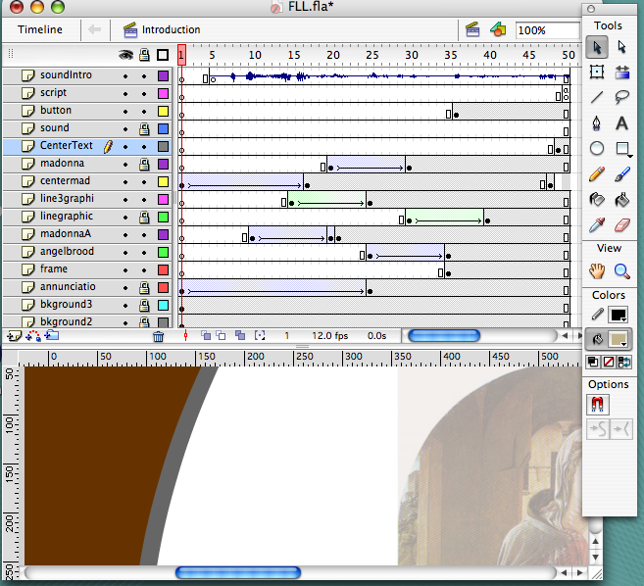
FLASH DEVELOPMENT SCREEN
Timeline
Keyframes and tweened sequence.
Frame one on the timeline
Development Tools
Layers contain individual elements arranged in a stacking order of background on the bottom to sound on the top layer.

Slide 22
PROGRAMMED ANIMATION
Animators write commands and the computer generates the animation.
Requires knowledge of programming and mathematical techniques to specify motion.
Advantages:
File sizes are smaller.
Animations load and play faster.
Reduces bandwidth and processor demands.
Efficient creation of different versions of animated sequence.

Slide 23
PROGRAMMED ANIMATION
Supports complex forms of interactivity.
Computer games take input from the user and animate the objects "on the fly."
Scripting languages frequently used to generate programmed animations:
Lingo
Actionscript
Javascript.

Slide 24
3-D ANIMATION
Elements of 3-D animation set in motion include:
Objects
Sounds
Cameras
Lights.
Techniques are similar to 2-D animation:
Key frame
Tween motion.
Complex motion may involve using models of humans and animals.

Slide 25
MOTION CAPTURE
Also called performance animation.
Technique of recording motion of actual objects and mapping these motions to a computer-generated animated character.
Performers have sensors to track the motion of various body parts as they create the action sequences.
Used to capture complex natural motions that are difficult to create.
View IT
Demonstration of a motion capture animation rig from YouTube.
Notes:
Numerous demonstrations of motion capture methods are available on YouTube. It is widely used in game development so many demos are referencing video game characters.

Slide 26
FORWARD KINEMATICS
Kinematics is study of motion of bodies or systems of bodies.
The motion of one part generates related motion in others.
Animator must adjust all motion in all related parts of the body.
Simple to implement.
Models easily defined.
Computer processing is minimal.
Quality of motion depends on animator's skill.
Animation is time consuming process.
View IT
Animation using forward kinematics as displayed on YouTube.

Slide 27
INVERSE KINEMATICS
Motion of one body part produces related motions in other body parts.
Simplifies animator's work and ensures consistent, realistic motion.
Software embodies the knowledge of anatomical motion.
Requires innovative programming.
Demands more processing power than forward kinematics.
Significantly reduces work of animator.
Notes:
The DVD of Shrek has several behind the scenes segments that nicely illustrate the power of IK animation.
YouTube features shorter clips done in Maya: http://www.youtube.com/watch?v=6JdLOLazJJ0

Slide 28
ANIMATING WITH PHYSICS
Software can automatically generate motions based on properties of object and laws of physics.
Will free animators from more tedious tasks of 3-D animation and produce more realistic content.
Animators can concentrate on developing stories and characters.

Slide 29
COMPLETING THE ANIMATION
Rendering creates the final animation frames by applying:
The modeling
Surface definition
Scene composition as specified by animator.

Slide 30
RENDERING OPTIONS
Shrek 1 in 2001 used about 5 million CPU render hours.
Shrek 2 in 2004 used 10 million CPU hours
Shrek3 in 2007 used 20 million CPU hours.
Pre-render
Requires enormous processing resources and time for animated movies.
Computer carries out complex calculations to implement the object properties, lighting, camera angles and motions.
Render in real time
Computer produces animation immediately.
Used in video games and highly interactive 3-D animations.
Notes:
Source for the CPU render time:
http://www.linuxjournal.com/article/9653
Students can research the size of render farms for popular animations from Pixar and Dreamworks to appreciate the number of computers required to compile the complex animation into a single digital film.

Slide 31
ANIMATION TIPS & GUIDELINES
Prepare for a learning curve.
Animation programs are more difficult to master.
Design for delivery.
Minimize file size if delivery is for Web.
Consider clip animation to reduce costs.
Consult the tradition in developing motion.
Cycles, holds, shooting on twos, tweening, stretch and squash, ease in & ease out, overshoot & overlap motion are traditional techniques.

Slide 32
WRAP UP
View IT
Finding Nemo production process illustrates the power of digital animation to create new worlds.
Digital animation based on:
Rich animation tradition
Powerful set of digital tools
Creativity of new digital artists.

Slide 33
WRAP UP
Potential of the "universal machine":
An assistant in the animation process.
A virtual partner in the creative process creating worlds only possible in digital environments.
Animation is the frontier of digital multimedia.

Slide 34
WRAP UP
Traditional animation set the procedures and techniques for computer animation.
Types of computer animation.
2-Dimensional
Based largely on traditional techniques.
Computer provides efficiencies in the animation development.
3-Dimensional
Techniques include motion capture, kinematics, animating with physics.
Computer becomes a virtual partner to create and animate objects.

Slide 35
KEY TERM CHECK UP

