Slide 1

CHAPTER EIGHT
VIDEO

Slide 2
CHAPTER HIGHLIGHTS
Digital video
Quality factors:
Screen resolution
Frame rate.
Compression strategies
File formats.
Create original video
Shooting
Editing
Rendering.
Digital video camera considerations.
Guidelines for video in multimedia.

Slide 3
MOVING PICTURES
Film and video are a series of rapidly displayed still pictures.
Each image captures an instance of motion.
Persistence of vision results in perception of flow of motion.
Analog film records images on transparent medium projected onto a screen.
Analog video records images as continuously varying electrical voltages that produce images on a CRT or projection screen.

Slide 4
DIGITAL VIDEO CHALLENGES
Large file sizes
Every second of uncompressed digital video requires 30MB of storage.
Hardware performance
Computer processors, memory and bus size must deliver digital video to the screen at full motion frame rates.
Distribution methods
DVD players.
High speed network bandwidth.
Digital video made possible by:
Compression algorithms
Fast computer hardware
DVD storage
Gigabit bandwidth.

Slide 5
DIGITAL VIDEO QUALITY
Three factors contribute to quality.
Screen resolution
Number of horizontal and vertical pixels used to present the video image.
Frame rate
Number of individual video frames displayed per second.
Compression method
Algorithm used to compress and decompress the video.
Developers can adjust these factors to optimize delivery of digital video.

Slide 6
SCREEN RESOLUTION
Screen resolution (or output resolution) impacts processing, storage, and transmission requirements.
High quality digital video (DV) format is 720 X 480 (or 350,000 pixels at rates of 30 Fps).
CD-Rom and Internet are too slow to deliver that much data.
Solution: reduce the display size, which reduces the number of pixels/second to output.
Notes:
Students should know that YouTube videos are best at a smaller size and when viewed at full screen the video will degrade as the computer tries to process more data.

Slide 7
FRAME RATE
Standard frame rate for broadcast video is 30 frames per second (Fps).
Reducing the frame rate reduces the data to be transferred.
Video on Internet is often delivered at 15Fps.
Cautions:
Lowering frame rate will slow delivery of individual images and drop out frames of video.
Result could be "jerky" motion.
15 Fps is a threshold for smooth motion video.

Slide 8
COMPRESS THE VIDEO
Compression is key to successful delivery of digital video.
Three strategies for compressing video:
Intra-frame: re-encodes within the frame.
Inter-frame: eliminates intervening frames saving only changes between the frames.
Variable bit rate (VBR)
CBR (constant bit rate) assigns same number of bits per second to all parts of the video.
VBR assigns more bits to complex scenes and fewer bits to simpler scenes.
Notes:
CBR+ constant bit rate
VBR = variable bit rate

Slide 9
COMPRESS THE VIDEO
Choosing compression depends on:
Output destination
DVD
Internet
Mobile device
Editing capability
Detailed editing tasks
Limited editing tasks
Type of images in video
Complex scenes
Similar scenes

Slide 10
INTRA-FRAME
Lossless strategy could be RLE.
Result: smaller more efficient file with all the original data.
Lossy strategy commonly used is M-JPEG.
Individual images are compressed and linked together as motion sequences.
Best for video editing as every frame is preserved despite data being lost from each separate frame.
M-JPEG 2000.
Successor to M-JPEG.
Preserves intra-frame advantages and scalability.

Slide 11
INTER-FRAME
MPEG compression identifies:
I-frames: "intra-frame" or complete compressed frames
P-frames: predictive frames record more significant changes.
B-frames: bidirectional frames record smaller changes between the I and P frame.
Good choice for distributing video.
Not appropriate for recording and editing video.
Decoding an MPEG video file:
Processor reassembles dropped frames using I-frames as references to recreate intervening frames with changes stored in P-frames and B frames.

Slide 12
Variable Bit Rate
Constant Bit Rate encoding uses same number of bits per second for simple and complex video.
Variable Bit Rate assigns more bits to complex scenes and fewer bits to simpler scenes.
Common option in video editing software.

Slide 13
COMMON VIDEO CODECS
MPEG
MPEG-1(short videos on Video CD—optical disc format).
MPEG-4 (video over the web).
M-JPEG (less-compressed higher quality files without inter-frame loss)
RealVideo (proprietary codec for streaming video on web)
Flash Video (popular Internet video standard)
QuickTime (cross-platform format supporting variety of codecs and screen resolutions)
Notes:
Emphasis here is the choices that developers must make to compress video.
At the source, DV is best for archiving the video. To distribute it, MPEG-4 or RealVideo would be best for web.

Slide 14
COMMON VIDEO CODECS
Windows Media Video (highly compressed streaming video format from Microsoft)
SDTV (digital format that uses roughly same resolution as analog TV)
HDTV ( uses 16:9 aspect ration and progressing scanning)
AVCHD ( a variant of MPEG-4 compression recording at 1080i, 1080p, or 720p)
Motion JPEG 2000 (produces smaller files at higher quality, uses intra-frame compression, visually lossless, lossy or mathematically lossless compression.
Notes:
Emphasis here is the choices that developers must make to compress video.
At the source, DV is best for archiving the video. To distribute it, MPEG-4 or RealVideo would be best for web.

Slide 15
DIGITAL VIDEO
SOURCES OF DIGITAL VIDEO
Convert existing analog video to digital.
Create or purchase digital footage.

Slide 16
ORIGINAL DIGITAL VIDEO
Three main steps in creating original digital video:
Shooting
Editing
Rendering.

Slide 17
STEP ONE: SHOOTING
Requires planning for:
Intended uses of video
List of shots required
Weather and lighting conditions
Availability of personnel
How the video will be integrated in the project.

Slide 18
STEP ONE: SHOOTING
Shooting to record.
Captures ultimate form of video as shooting is done.
Used to capture event and share immediately with others.
Shooting to edit.
Captures source video with editing in mind.
Acquire a variety of video clips that will later be trimmed, re-ordered, and blended into a single message.
Notes:
Have students locate an example on YouTube of a sequence that is an obvious shoot to record video. Locate another that demonstrates editing features.

Slide 19
DIGITAL VIDEO CAMERA CONSIDERATIONS
CCD
Lenses
Microphones
Light Sensitivity
Storage Media
File Format

Slide 20
DIGITAL VIDEO CAMERA CONSIDERATIONS
CCD (Charge-Coupled Device).
Generates levels of electrical voltage based on variations in light intensity striking the surface.
Converts voltages into digital values to store data about each pixel in the image.
Size varies from 1/16 to 1/2 inch.
Larger CCDs are more expensive.

Slide 21
DIGITAL VIDEO CAMERA CONSIDERATIONS
Number of CCDs
One CCD: Light is filtered and level of each filtered color is recorded.
Three CCDs: Light is split into three channels and each CCD records separate levels of RGB.
Produce clearer, more accurate color.
Resolution of CCD
Higher resolution delivers more accurate images.
For motion capture match the resolution to the format used to store the video.
Camera selection should always be based on resolution of CCD, not digital enlargement ratings.

Slide 22
DIGITAL VIDEO CAMERA CONSIDERATIONS
Lens
Look for high quality lens from better vendors.
Ignore software zoom capabilities.
Light sensitivity
Lower lux ratings indicate the camera can operate in lower light conditions.
DV camcorders vary from 2 to 8 lux.
Supplemental lighting may be needed for dimly lit conditions.

Slide 23
DIGITAL VIDEO CAMERA CONSIDERATIONS
Microphones: placement, type, and quality.
Omni-directional: optimized for broad range of background sound.
Unidirectional: record from narrowly defined location.
Placement on handle toward front of camera is preferred to avoid sound from camera itself.
Headphones give direct feedback of microphone effectiveness.

Slide 24
DIGITAL VIDEO CAMERA CONSIDERATIONS
Storage Media
Tape
Advantages:
Inexpensive archive format
DV and HDV formats are well-established.
Disadvantages:
Sequential access is demanding on tape
Transfer of video to another device is time consuming.
Optical media & Solid state media
Random access to video
Rapid transfer from camera
Light weight, low power consumption, ease of exchange and transport.
Declining costs and increased capacities
Notes:
Class activity could be to shop for two digital video cameras: one a high end and another a general hand held model. Identify and compare the camera features.

Slide 25
DIGITAL VIDEO CAMERA CONSIDERATIONS
File format
Source video footage should be captured at highest resolution possible and not be highly compressed.
DV format:
Limits compression to 5:1
Has relatively high resolution
Uses M-JPEG compression.
HD & 3D format:
New formats are emerging.
HD formats can increase processor demand during editing if using inter-frame compression.
Notes:
Class activity could be to shop for two digital video cameras: one a high end and another a general hand held model. Identify and compare the camera features.

Slide 26
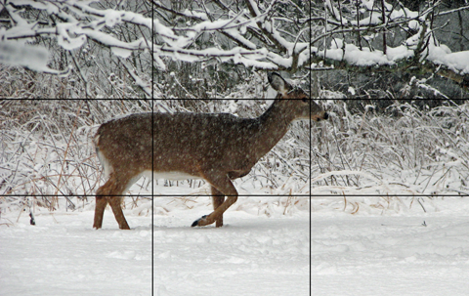
SHOOTING BASICS
Framing a Shot
Rule of thirds—widely embraced guideline for framing a video shot.
Preserves its interest.
Meaningfully relates it to action taking place.
Helps ensure adequate side and headroom.

Slide 27
SHOOTING BASICS
Minimize camera motion.
Use tripod or steady surface to support camera.
Keep the camera still at all times.
Camera controls for generating motion:
Pan—moving side to side.
Zoom—enlarge camera lens.

Slide 28
SHOOTING BASICS
Take care of time code.
Format of hours, minutes, seconds, frames.
Time code becomes the frame address.
Editing software uses time code for splits, trims, transitions.
Camera records the code but
Code can be lost if user shifts to VCR mode to view video and advances to new location to continue shooting.
Look for camera's "End Search" control to restart code.
Less significant using optical & solid state recording formats.

Slide 29
SHOOTING BASICS
Get the right shots.
Source video needs to cover all the important elements of the subject.
Videographer can use a variety of shots to tell the story.
Close up shot (CU) Medium shot (MS) Wide shot (WS) Establishing shot | Cutaway Point of view shot Reverse angle shot Over-the-shoulder shot
Notes:
Class activity: Have students locate a YouTube video that uses at least 2 or 3 of these shots. Evaluate how they help tell the story.

Slide 30
STEP TWO: EDITING
Editing software options:
Consumer packages.
Prosumer applications.
Specialized video and film production.
Features include:
Capture video from external source.
Arrange separate video clips.
Split and trim clips.
Add transitions and special effects.

Slide 31
CAPTURE/IMPORTING VIDEO
Transfer video from camera to computer through USB, FireWire, or Thunderbolt connection.
Transfer includes:
Video images & audio
Time Code
Date Stamp
Scene Detection
Geotagging
Editing software can use changes in data to identify different recording sessions.

Slide 32
BATCH CAPTURE
Transfer only selected portions of a source tape.
Portions are pre-selected by "in" and "out" points.
Editing software transfers only the marked video scenes to the computer's hard drive.
Clips are labeled with names and time code in a library window.

Slide 33
BASIC VIDEO EDITING
Captured clips are source video used to create the finished product.
Source video clips are arranged on a construction window.
The clip is now part of the master video, or the segments being developed in the editing environment.
Master video is a series of instructions and pointers for performing operations on the original source footage.

Slide 34
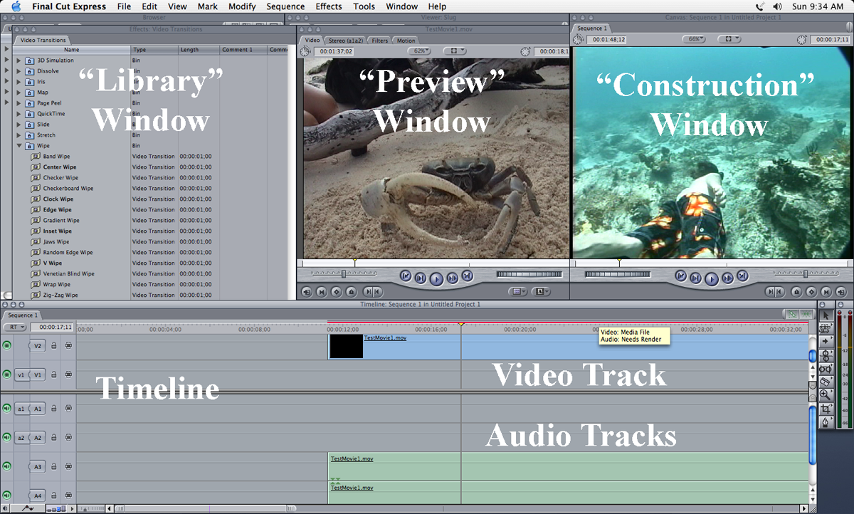
EDITING SOFTWARE
Preview window
Shows source video.
Library window
Lists clips transferred to the computer.
Construction window
Presents assembled clips.
Timeline
Shows duration of video's multiple tracks.

Slide 35
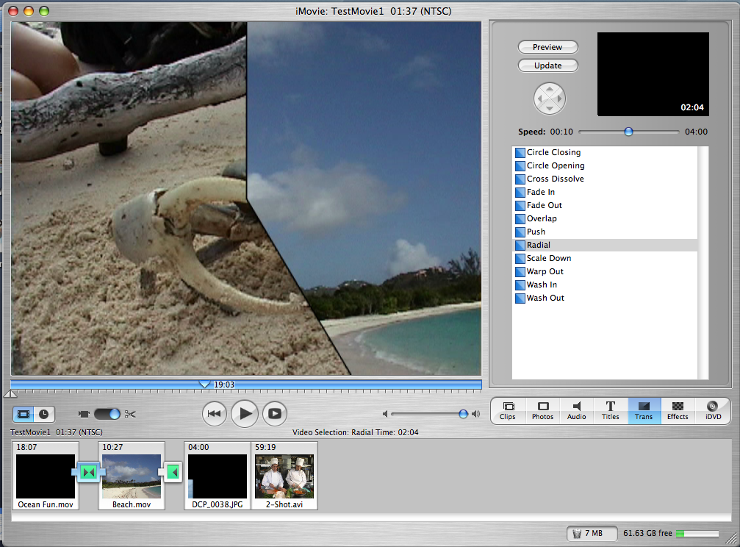
EDITING OPERATIONS
Splitting: dividing clip into multiple parts.
Trimming: removing unwanted frames from clips.
Transitions: effects to move into or out of a clip. These include:
Cut
Fades
Dissolve
Wipe.

Slide 36
STEP THREE: RENDERING
Process of applying the editing operations specified by the master video to produce a new, independent video file.
Can be processor intensive and time consuming process.
Output options are based on video's intended use. These include:
Video compression method
Resolution or screen size
Frame rate and video data rate
Audio data rate and audio format.

Slide 37
RENDERING DECISIONS
Choice of a codec.
All video must be compressed.
Choice will determine quality of resulting video.
Variable bit rate encoding better than constant bit rate.
Choice of screen resolution.
Vary depending on mode of delivery:
DVDs = 720 X 480
CD media = 320 X 240
Web = 240 X180
Cell phones = 176 X 144.

Slide 38
RENDERING DECISIONS
Choice of frame rate.
Impacts size of video file.
Web video must be significantly reduced for a wide viewing audience.
Choice of video data rate.
Low quality streaming web video = 20 – 30 Kb/s.
DVD high quality video = 9 Mb/s.
Blu-ray disc = 48 Mb/s
Typically set in the codec software preferences.

Slide 39
RENDERING DECISIONS
Choice of audio compression and data rate.
If file size is not critical, use PCM format.
Also widely used are MP3 and Dolby Digital AC-3 formats.
Choice of computer hardware.
Video complexity could make render time over 1 hour per minute of video.
CPU speed, amount of RAM, size of hard drive can save you time.
Multi-core processors and distributed processing can also reduce the time for rendering.

Slide 40
GUIDELINES FOR VIDEO
Shooting
Choose camera carefully. Steady the camera. White balance prior to shooting. Avoid shooting into light and backlit scenes. Limit pans and zooms. Frame the subject. Make inventory of required shots. | Use highest resolution available. Add external microphones. Use headphones to monitor sound quality. Record background sound for use in editing. Don’t break the time code.

Slide 41
GUIDELINES FOR VIDEO
Editing
Protect source video.
Save a copy of the master video prior to rendering.
Rendering
Match codec, resolution, frame rate, and data rate to intended use and delivery medium.
Use variable bit rate encoding when available.

Slide 42
Wrap Up
Methods to control digital video large file sizes by adjusting:
Screen resolution
Frame rate
Using compression.
Digital video file formats.

Slide 43
Wrap Up
Steps for creating original digital video.
Choosing the right digital video camera.
Guidelines for shooting footage.
Editing digital video.
Rendering options for digital video.
Guidelines for creating digital video.

Slide 44
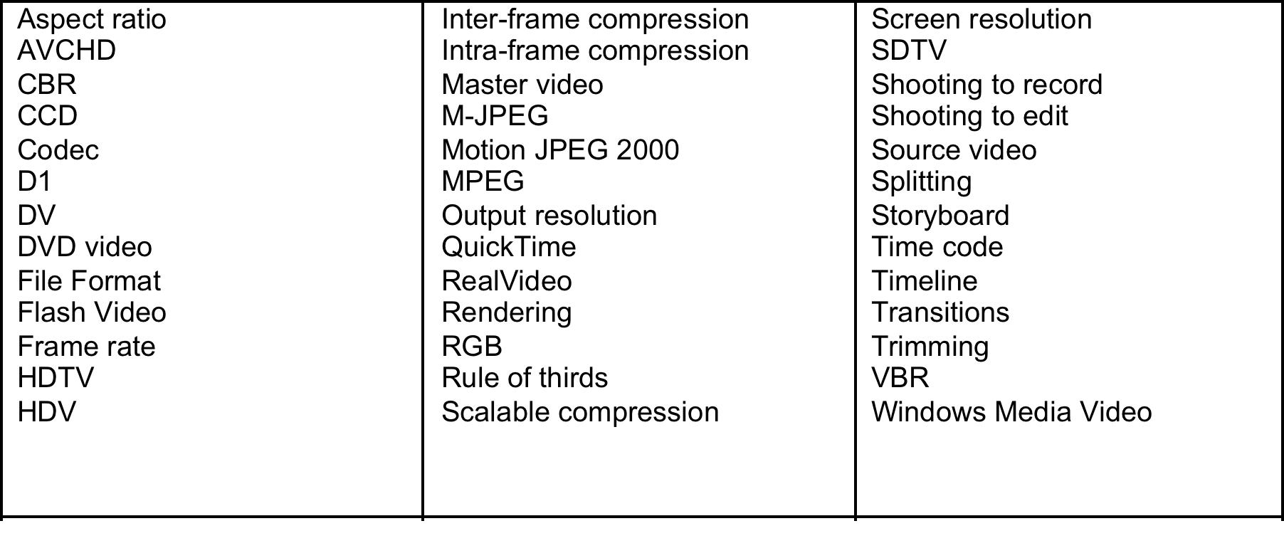
KEY TERM CHECK UP

