Slide 1
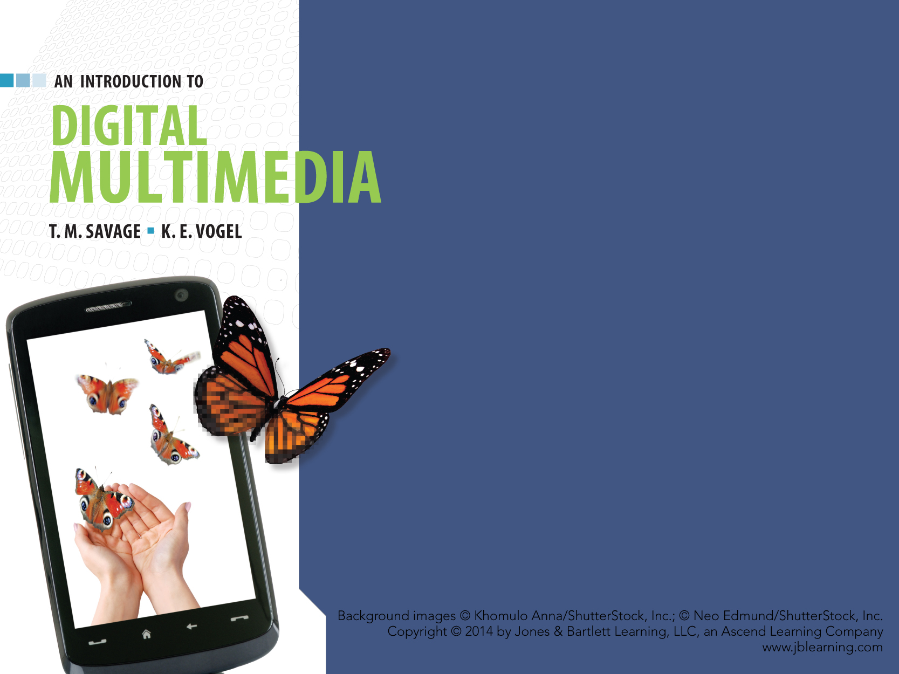
CHAPTER SEVEN
SOUND

Slide 2
CHAPTER HIGHLIGHTS
Nature of sound
  Sine waves, amplitude, frequency
Traditional sound reproduction
Digital sound
  Sampled
  Synthesized
Advantages of digital sound
Guidelines for digital sound in multimedia.

Slide 3
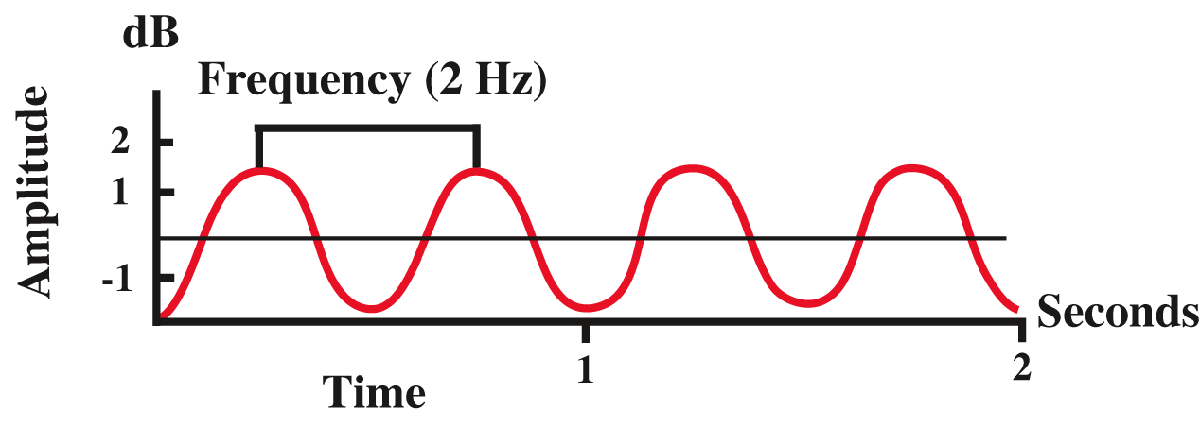
NATURE OF SOUND
Sound is a form of mechanical energy transmitted as vibrations in a medium.
Sine wave captures three features of sound:
  Amplitude
    Perceived as volume.
  Frequency
    Perceived as pitch.
  Duration
    Length of time sound lasts.

Slide 4
TRADITIONAL SOUND
REPRODUCTION
Analog sound capture.
    Sound waves vibrated diaphragms of early microphones.
    Vibration caused a stylus to inscribe a continuous pattern on tinfoil or on a wax cylinder.
Reproduce the analog sound.
    Rotate a drum while in contact with a stylus
    Movements of stylus are electrically amplified to vibrate the drum of a speaker
    Changes in air pressure produced the sound.
High-fidelity analog sound is still the final output stage for digital audio.

Slide 5
DIGITAL SOUND
  REPRESENTED AS DISCRETE ELEMENTS OF INFORMATION

Slide 6
DIGITAL SOUND
Two major types of digital sound:
  Sampled sound: digital recording of previously existing analog sound wave.
    File contains numeric values to describe the amplitude of the sound wave at a particular instant.
    Used to capture and edit naturally-occurring sounds.
  Synthesized sound: new sound generated by the computer.
    File contains instructions the computer uses to reproduce the sound.
    Used to:
      Create original compositions
      Produce novel sound effects.

Slide 7
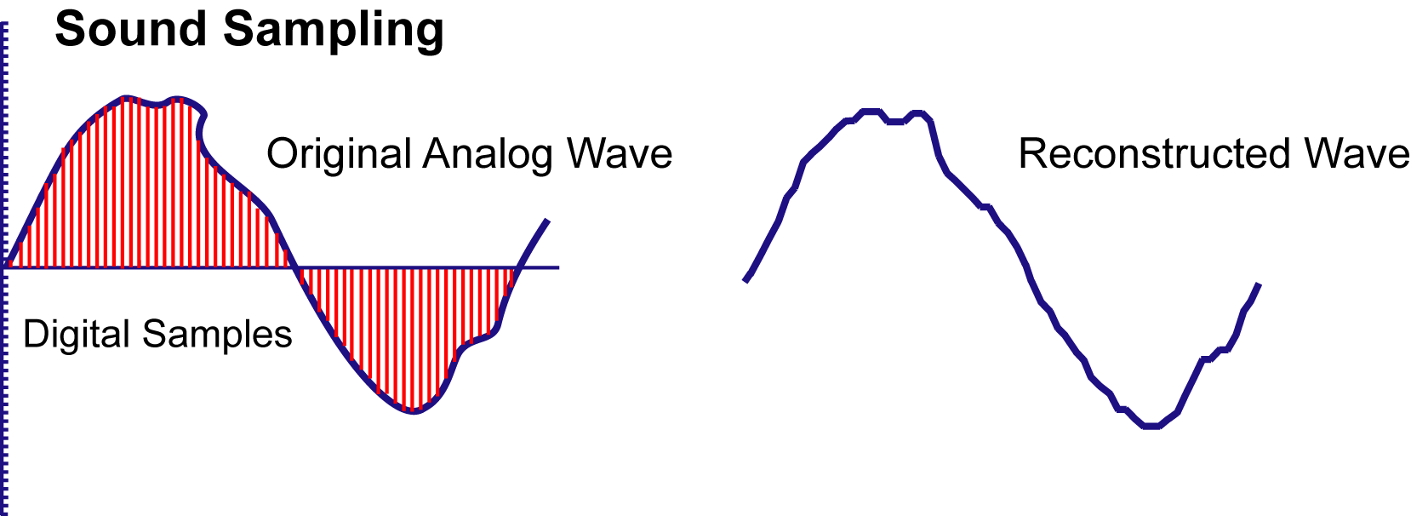
SAMPLED SOUND
Analog to Digital Converter captures separate measures of sound amplitude.
  Samples are recorded as digital numbers.
Digital values are used to recreate the analog form using a Digital to Analog Converter.
Quality of the sampling depends on:
  Sample resolution
  Sample rate.

Slide 8
SAMPLE RESOLUTION
Number of bits to encode amplitude.
  Sample resolutions range from 8-bit to 24-bit.
8-bit resolution captures 256 different amplitude levels.
  Adequate for limited decibel range.
16-bit CD quality sound has 65,000 different levels.
24-bit DVD audio can generate over 16 million different levels.

Slide 9
SAMPLED SOUND DISTORTIONS
Quantization: rounding a sample to the closest available value in the code being used.
  May produce background hissing or grainy sound.
  Caused by low sample resolution
  Solution: record at higher resolution
    Use 16-bit rather than 8-bit to increase the range of amplitudes.

Slide 10
SAMPLED SOUND DISTORTIONS
Clipping: wave amplitude exceeds available sample values.
  Causes:
    Recording equipment isn't designed for selected decibel range or
    Mixing tracks with amplitudes that exceed the available range.
  Result is harsh, distorted sound.
  Solutions:
    Lower amplitude of source sound within the limits of the ADC circuitry.
    Adjust volume of mixed tracks or use higher sample resolution.

Slide 11
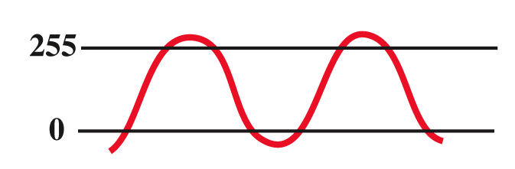
SAMPLE RATE
Number of samples taken in a fixed interval of time.
  Stated in thousands of Hertz, or kilohertz.
  Determines the range of frequencies that can be represented in a digital recording.
Two measurements capture each cycle of the sound wave:
    High value or peak
    Low value or trough.
  CD-quality sound captures 44.1kHz
  to record frequencies as high as 22.05kHz.
Highest frequency the human ear can detect is 20kHz.

Slide 12
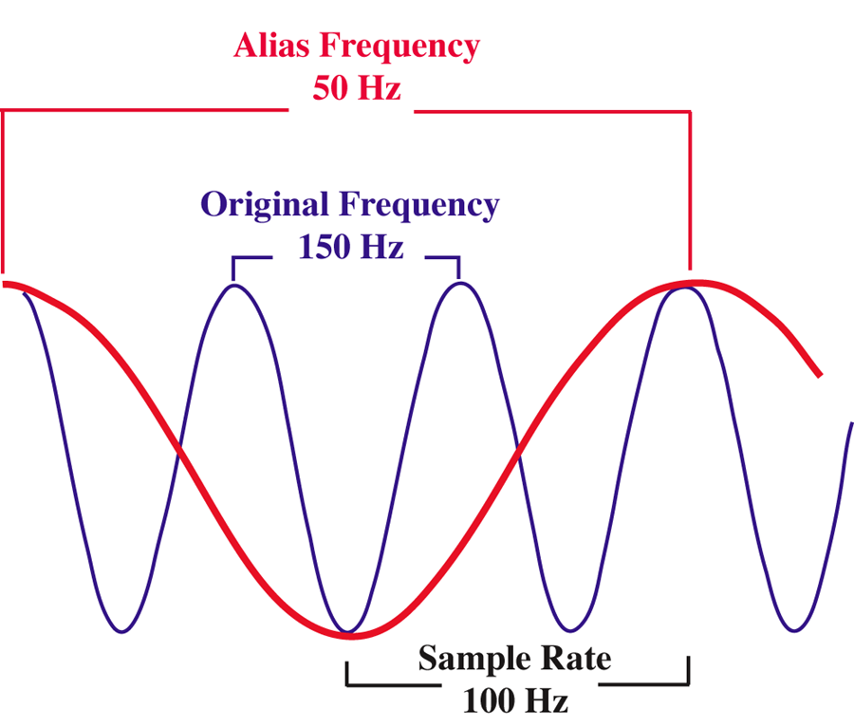
SAMPLE RATE DISTORTION
Aliasing: false representation of high frequencies as low frequencies.
  Occurs when source frequency is greater
  than one-half the sample rate being used.
  Solutions:
    Apply filters to source sound to eliminate frequencies above the sample rate.
    Oversample the source sound:
      Use digital filters to eliminate
      the high frequencies.
      Then downsample to reduce
      the sample rate in the audio file.

Slide 13
SOUND FILE SIZE
Sound files are large.
  60 seconds of stereo CD quality sound = 10 MB.
Reduce file size and maintain quality:
  Select sample rate and resolution to match the sound type.
    Human speech can accurately be captured at 11.025kHz with 8-bit resolution and have a smaller file.
  Lower sample rate and resolution to reduce file size.
Stereo file size = sample rate * sample size (in bytes) * sample time (in seconds) * 2 (stereo)

Slide 14
SOUND COMPRESSION
Compression is best strategy to lower file size for sounds with wide range of frequencies and amplitudes.
Lossy codecs use various techniques to reduce sound file sizes.
  Psychoacoustics: eliminates frequencies indistinguishable to the human ear.
  Variable bitrate encoding (VBR): alters the number of bits to encode the sample depending on the complexity of the sound.
Notes:
Compression strategies are both lossless and lossy. Have students comment on why lossless strategy is not used in sound, but is critical for text compression.

Slide 15
SAMPLED SOUND FILE FORMATS
AIFF: Apple Computer
  Uncompressed, high quality sound.
WAV: Microsoft and IBM standard
  Uncompressed, high quality sound.
AU: Sun Microsystems
  Internet transmission of lower quality sound files.
RealAudio: Real Media
  Streaming audio at low bandwidths.
MP3: (MPEG-1, audio layer 3)
  Significant compression of high quality sound.
WMA: Windows Media Audio
  Delivers lossy compression comparable to MP3 at lower bitrates.
AAC: Advanced Audio Coding
  Successor to MP3 specified in the MPEG-4 standard.
  Produces better quality sound than MP3 standard at comparable bitrates.

Slide 16
SYNTHESIZED SOUND
Computer sends commands to specialized electronic device called a synthesizer.
MIDI (Musical Instrument Digital Interface).
  Most common standard to code commands for synthesizers.
  Codes provided for:
    Specific instruments
    Notes
    Force and duration of note
    Routing commands to different instrument channels
    Specialized control functions.

Slide 17
MIDI
Messages (or commands) can be sent to any one of 16 channels.
  Voices or instruments are assigned to a channel.
  Multitimbral systems can play multiple instruments by simultaneously processing commands in different channels.
  Polyphonic systems play more than one note at once.

Slide 18
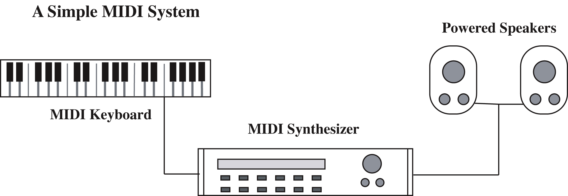
MIDI SOUND SYSTEM
Simplest system contains:
  Digital musical instrument to create messages
  Sound synthesizer to interpret the messages
  Amplifier/speaker output system.

Slide 19
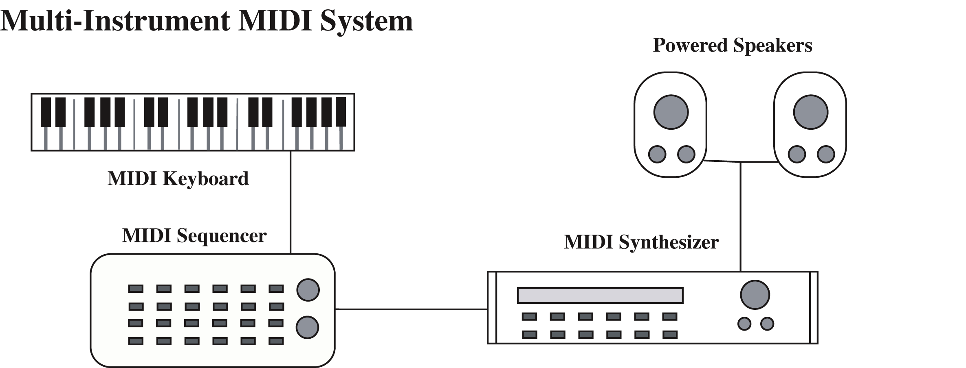
MIDI SOUND SYSTEM
Sequencer
  Device to control the flow or sequencing of the MIDI data to a multitimbral synthesizer.

Slide 20
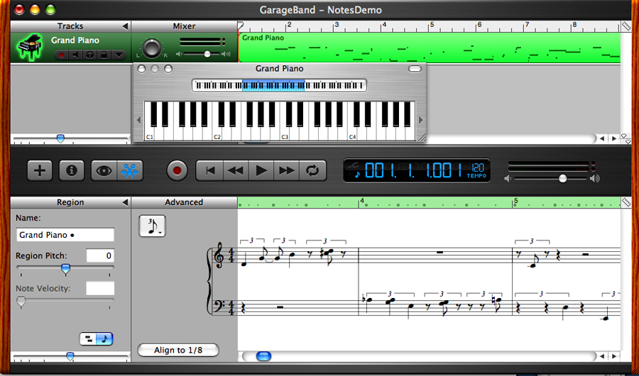
MIDI ON A COMPUTER
Software and hardware emulate the MIDI sound system.
Hardware
  Soundcards include synthesizers.
  Interface ports for MIDI-input devices.
Software
  Sequencer software
  can place notes on a musical scale.
  Editing includes changing pitch,
  tempo, duration and volume of notes,
  arrangement and timing of instruments.

Slide 21
SAMPLED vs. SYNTHESIZED
Advantages Sampled | Advantages Synthesized
1. High quality. | 1. Exceptional editing control.
2. Ease of creation. | 2. Small file size.
3. Ease of editing.
4. Consistent playback quality.
Challenges Sampled | Challenges Synthesized
1. Large file sizes. | 1. Musical expertise required.
2. Editing limitations. | 2. Playback quality is not consistent.
 | 3. Not effective for natural sounds and human voice.

Slide 22
ADVANTAGES OF DIGITAL SOUND
Noise reduction
Recording accuracy
No generation decay
Durability
Random access
Editing is easier and less expensive
Easily distributed by:
  CDs
  Networks.

Slide 23
SOUND and the INTERNET
  INCREASED BANDWIDTH + STANDARD FILE FORMATS + SIMPLIFIED USER ACCESS = SOUND ON THE WEB.

Slide 24
DELIVERING DIGITAL SOUNDS
Downloaded audio transfers the complete audio file from the server to the client.
  File remains on client computer for replay and editing.
Progressive downloads: file is saved to client computer, but begins to play from RAM as it is downloading.
Streaming audio: real-time sound that is played as it is being delivered. Not saved on client computer.
  Requires special protocols, special servers, special media formats and players.
Notes:
Discuss benefits and drawbacks of each technique. Note particularly the copyright issues with each. Have students identify methods used by iTunes, a live concern of a band, a song shared on peer to peer networking.

Slide 25
GUIDELINES FOR USE OF SOUND
Identify the purpose of the sound and use it for good reasons.
Use high-quality sound.
Conserve file space.
Consider playback environment.
Avoid excessive use of sound.
Organize sound files and preserve original sources.

Slide 26
WRAP UP
Two approaches to creating digital sound.
Sampled sound depends on:
  Sample resolution and Sample rate.
  Distortions degrade sampled sound.
Synthesized sound depends on:
  Synthesizer and Musical knowledge.
  Distortions come from poor sound output hardware.
Advantages and challenges of each.
Advantages and guidelines for digital sound.
Distributing sound on the Internet.

Slide 27
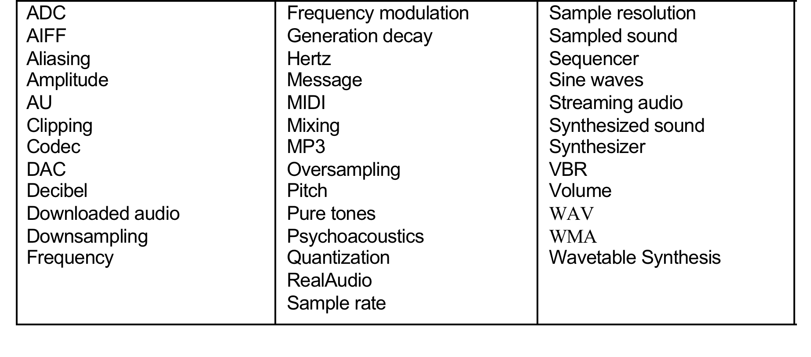
KEY TERM CHECK UP

