Slide 1
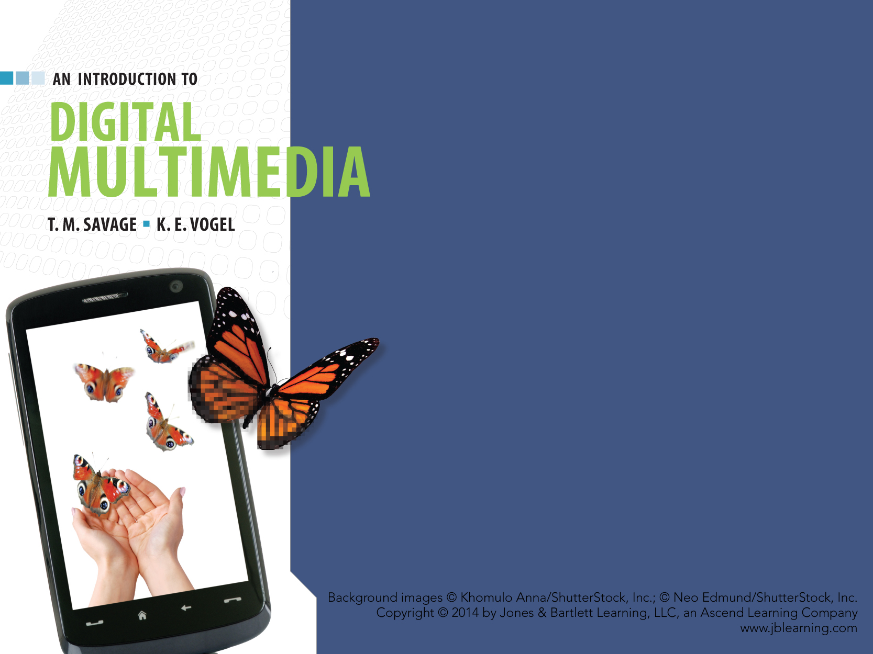
CHAPTER SIX
GRAPHICS

Slide 2
CHAPTER HIGHLIGHTS
Key elements of traditional graphics.
Features and uses of computer graphics.
  Bitmapped images.
  Vector-drawn images.
  3-D graphics.
Guidelines for using graphics in multimedia.

Slide 3
MULTIMEDIA & GRAPHICS
Graphics covers wide range of pictorial representations.
Computers are able to carry out many tasks of a traditional artist or designer.
New uses for computer graphics include:
  Buttons
  Charts
  Diagrams
  Animated images.

Slide 4
MULTIMEDIA GRAPHICS
Challenges of computer images include:
  Large file size
  Slow downloads and processing
  Possible inferior quality from original
  File format compatibility
  Images display differently on various monitors and printers.
Notes:
Have students comment on their experience with graphics files and the following challenges. Can students provide other challenges? Ability to violate copyright by cut and pasting images and create derivative works.

Slide 5
TRADITIONAL GRAPHICS
Contone image
  Composed of continuously varying shades of color.
Line art
  Combinations of lines to create images.
  Uses only two colors.

Slide 6
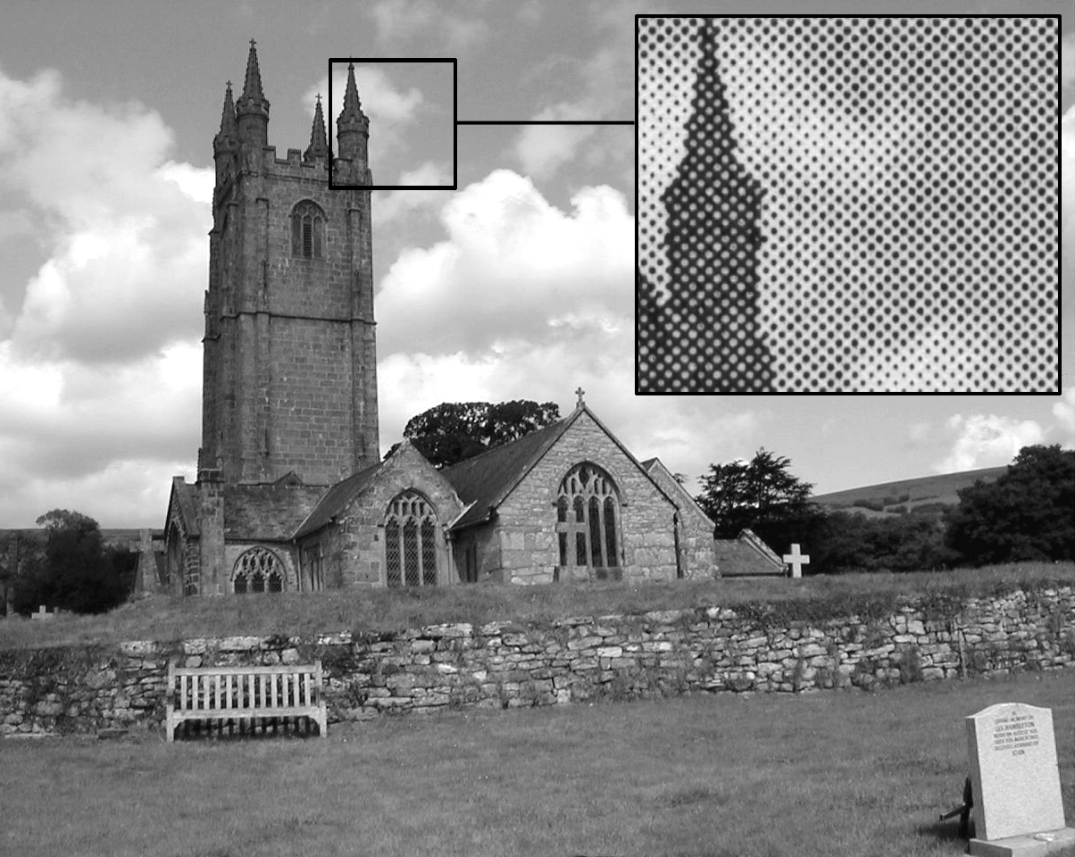
TRADITIONAL GRAPHICS
Black and white image reproduction.
  Images are made with a series of ink dots.
  Linescreen, or lines per inch, designates the size of the dots and quality of resulting image.
    150 lpi better quality than 85 lpi.
  Halftones form image by
  clustering the ink dots.
    Tight cluster of black and white
    dots create dark gray.
    Loose clusters create
    lighter tones of gray.
Notes:
Wall Street Journal uses halftone method of artwork for the portraits of it's writers. Students might locate several examples for class activity and study how the dots are clustered together.

Slide 7
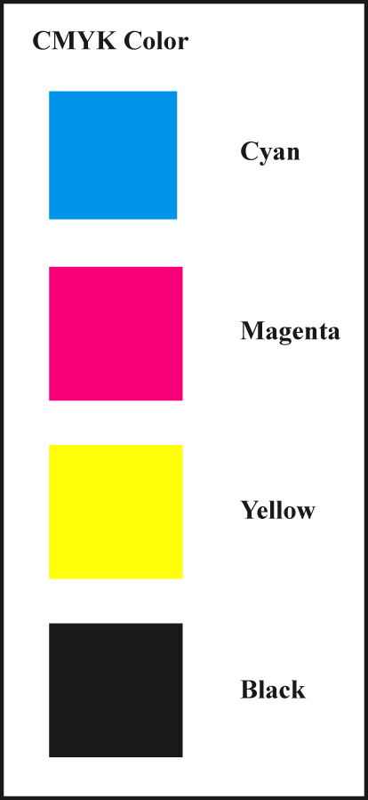
TRADITIONAL GRAPHICS
Color image reproduction.
  Use a series of four-color dots of transparent inks.
CYMK
  Cyan, magenta, yellow, and a key
  color usually black.
  Small dots of color combinations
  can reproduce many different colors.
Notes:
Review the distinction between additive and subtractive color and why this is important for computer graphics artists who create projects for printed output.

Slide 8
COLOR REPRODUCTION
Color images on printed surface are formed using subtractive process.
    Light is reflected from the printed surface.
    Pigments that form image absorb some of the colors.
    Remaining colors reach the eye to produce image.
Color images on computer monitor use additive process.
    Varying amounts of Red, Green, and Blue light are added together to create the color.
Graphic artists convert from RGB(additive) color models to CMYK model if image is printed.

Slide 9
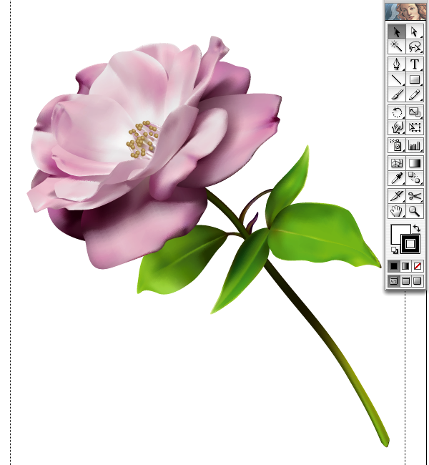
2-D COMPUTER GRAPHICS
  BITMAPPED IMAGES &
  VECTOR DRAWN GRAPHICS

Slide 10
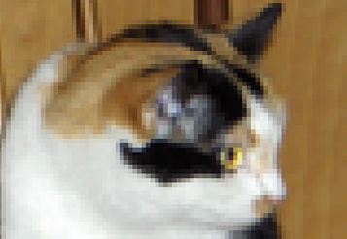
BITMAPPED GRAPHICS
Bitmapped graphics
  Created as a pattern of discrete elements.
  Each element is a pixel or "picture element."
Pixels
  Small squares.
  Assigned a binary code to define color.
    More bits = more color possibilities
Notes:
Students may identify the square elements that are part of the cat's image.
2 bit color code would yield 4 colors, 8 bit code yields 256 colors. Have students consider what 1, 16, 24 bit codes would generate for color ranges.

Slide 11
BITMAPPED IMAGES
Categories of bitmapped images are:
  Line art
    Produced using two colors.
  Grayscale
    Produced using shades of gray.
  Color
    Produced with patterns of colored pixels.

Slide 12
BITMAPPED IMAGES
Line art
  Two colors, usually black and white.
Advantages
  Clear, crisp image.
  Small file size.
Uses include:
  Charts
  Illustrations
  Diagrams.
Line art is
1-bit color
Line art flow chart diagram

Slide 13
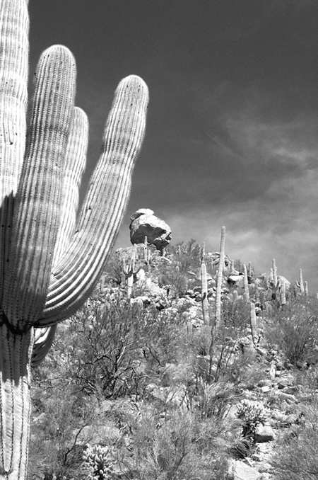
BITMAPPED IMAGES
Grayscale
  Generally 8-bit images of 256 shades of gray
  For images that require more detail than line art.
Advantages
  Excellent representation of black and white photos
  Smaller files size than full color
  Lower printing costs than color.

Slide 14
BITMAPPED IMAGES
Color
  Consists of a pattern of colored pixels
  Bit depth: the number of bits used to encode each pixel determines the amount of color possibilities.
  Photo-realistic color requires 24-bit color.
Two methods to create color on a computer:
  Identify a table of possible colors for the computer (Color Lookup Table)
  Specify varying amounts of Red, Green, Blue.

Slide 15
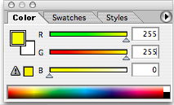
MAKING COMPUTER COLOR
8-bit color presents a specific range of colors in a table.
  PCs and Macs use different tables.
  Web-safe table provides colors that display the same on all platforms.
24-bit color combines 8-bit values of red, green, or blue to create the result.
  16.7 million color possibilities.
48-bit color has 16-bit values
  281 trillion color possibilities.
Notes:
Discuss uses of 8, 24, 48 bit color models and the advantages and disadvantages of each.
Web safe colors limit the range to 216 possibilities. Discuss the relevance of using web safe palettes for current computer displays.

Slide 16
BITMAPPED IMAGE QUALITY
Image quality depends on spatial and color resolution.
  Spatial resolution = density of pixels per inch.
  Color resolution = number of colors each pixel can display.
Spatial resolution measurements.
  Monitor output is measured in ppi (pixels per inch).
  Print output is measured as dpi (dots per inch).

Slide 17
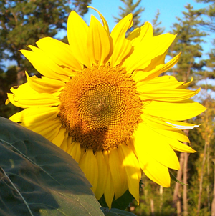

SPATIAL RESOLUTION
Higher spatial resolution
  Captures more detail.
    Pixels are smaller and closely packed.
  Produces sharper, more accurate images.
Lower spatial resolution
  Captures less detail.
    Pixels are larger.
  Images appear fuzzy.
High spatial resolutions yield large file sizes but better image quality.

Slide 18
DEVICE-DEPENDENCE
Dimensions of an image depend on the resolution of the output device.
  Monitors have low spatial resolution:
  72 ppi (Mac) or 96 ppi (PC).
  Printers have higher spatial resolutions:
  300 dpi to 2400 dpi.
Bitmapped images are device-dependent.
  300 ppi image prints the original size on 300 dpi printer.
  Same image is greatly enlarged on a 72 ppi monitor.
Notes:
Relate this concept to images from digital cameras. The photo may print on a 4 X 6 dimension, but on a monitor it will fill the screen to overflow the edges.
Consider the practice of producing bitmapped images in several spatial resolutions to match the intended output. Web images are typically 72 ppi, but color laser printer images would start at 300 ppi.

Slide 19

COLOR RESOLUTION
Bit-depth determines color resolution.
Making the bit-depth choice:
  Simple color images do not require many colors. Low bit-depth yields small file size.
  Complex color images require millions of colors. High bit-depth yields better quality but larger files.
Low color resolution may cause quantization and color banding.
  Quantization leads to breaks
  in shades of continuous tone images.
Notes:
Quantization will round off the missing color codes to the nearest available code. This may cause colors to band rather than transition smoothly to the next shade.

Slide 20
RESAMPLING BITMAPPED IMAGE
Process of increasing or decreasing the number of samples described in a file.
  Often need to control spatial resolution of bitmapped images.
    72 ppi for web display.
    300 ppi for laser output.
Upsampling: adding samples to the file.
Downsampling: reducing the samples in the image.
Notes:
Developers should be aware of the way resampling affects image quality so they can capture the image at the highest spatial resolution and adjust the resolution according to the use or device.

Slide 21
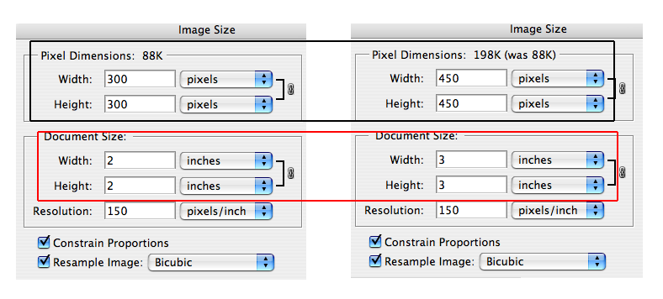
RESAMPLING BITMAPPED IMAGE
Upsampling used to enlarge the physical dimensions of an image on a given device.
  Software creates additional pixels for the image.
    Algorithms interpolate the pixel and color to add.
  Can significantly degrade the original image.
Notes:
What is the solution to avoid degrading an image through upsampling?
Capture the image at the highest possible spatial resolution using a scanner or camera. Scanners can also enlarge an image at the point of scanning which is also an alternative to upsampling to create a larger image.

Slide 22
RESAMPLING BITMAPPED IMAGE
Downsampling: reducing the pixels in the file can produce smaller images that maintain good quality.
Best Practice:
  Capture at highest possible spatial resolutions when possible and downsample as needed for various uses of the image.

Slide 23
RESIZE without RESAMPLING
A bitmapped image can be resized without resampling.
  Enlarging a printout may produce acceptable results.
    Caution: excessive enlargement will distort the image with blocky, mottled surface appearance.
  Reducing the image size without resampling can produce high quality printouts.
    Pixels are packed more closely together.
Notes:
A mistake many uses make is to take a digital camera image that is potentially 11 MB large with dimensions 32 X 24 inches and resize it to a small 3 X 4 inches on a PowerPoint screen. Without resampling the image, the file is still 11MB large. The overall PowerPoint application can become excessively large if many images are simple resized without resampling.

Slide 24
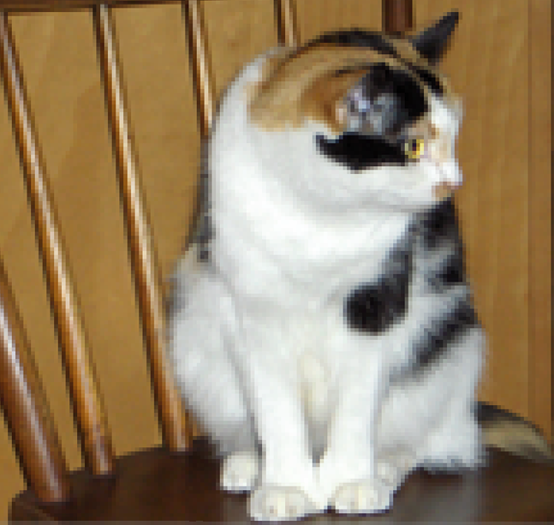
RESIZE without RESAMPLING
Excessive enlarging without resampling can lead to distorted images.

Slide 25
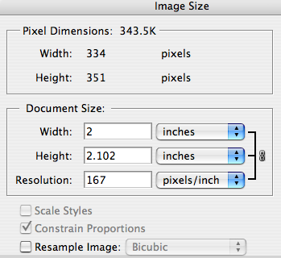
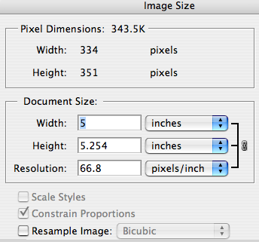
RESIZE without RESAMPLING
Resizing without resampling has no effect on monitor display of image.
Note: pixel dimensions of image remain the same in both dialog boxes.
Notes:
If you have Photoshop you can demo this to the students with any image. Changing the document size without resampling does not impact the overall display on the monitor, but would affect the printed output.

Slide 26
COLOR RESOLUTION
Indexing
  A specific palette of colors is identified to optimize the appearance of lower color resolution image.
  Two methods to create the index of colors:
    Adaptive
    Perceptual.
Dithering
  Combining pixels of different colors to produce another color not available in the indexed palette.
  Improves image quality without increasing bit depth.
Notes:
Discuss how developers can use indexing to reduce file size.

Slide 27
BITMAPPED IMAGE SOURCES
Paint programs
  Specialized software for creating bitmapped images.
    Photoshop
    Paint.
Digital cameras
  Number of pixels sampled by the camera is the camera's spatial resolution.
    Measured in megapixels.

Slide 28
BITMAPPED IMAGE SOURCES
Scanner
  Capture existing or original art image
  Capture 3-D objects.
Clip art
  Royality free
  Licensed usage.
Screen grab
  Save image on monitor to a bitmapped file
  Spatial resolution is generally low.

Slide 29
BITMAPPED FILE FORMATS
Compression of bitmapped graphics are:
  Lossy
  Lossless.
Common graphic file formats are:
  PICT
  BMP
  TIFF
  JPEG
  GIF
  PNG.
What form of compression do each of these formats use?
Notes:
Review special features of these file formats.
Have students suggest other file formats for images, some may be software specific such as .psd from Photoshop.
Identify which formats are lossy and which are lossless.

Slide 30
VECTOR-DRAWN GRAPHICS
Vector: a line with length, curvature, and direction.
Vector graphics: images created from mathematically defined shapes.
Draw programs: software used to create vector graphics.
Main advantages:
  Images can be enlarged without distortion
  Small file size.

Slide 31
VECTOR-DRAWN GRAPHICS
Draw programs use tools that resemble those of a draftsman:
  Fixed shapes
  Bezier curves
  Pen.
Objects are layered on each other and grouped to form complex images.
  Grouping joins individual shapes.
  Ungrouping restores image
  to separate shapes.
Notes:
Have students identify the shapes in the clip art. Then use the ungroup command in PPt. to view the many components of the clip.
Each of the shapes can be sized, moved, layered here to demo the way vector images are connected and edited.

Slide 32
DEVICE INDEPENDENCE
Vector graphics can be used with different devices without altering the image dimension.
  Printers and monitors preserve the original dimension of the image.

Slide 33
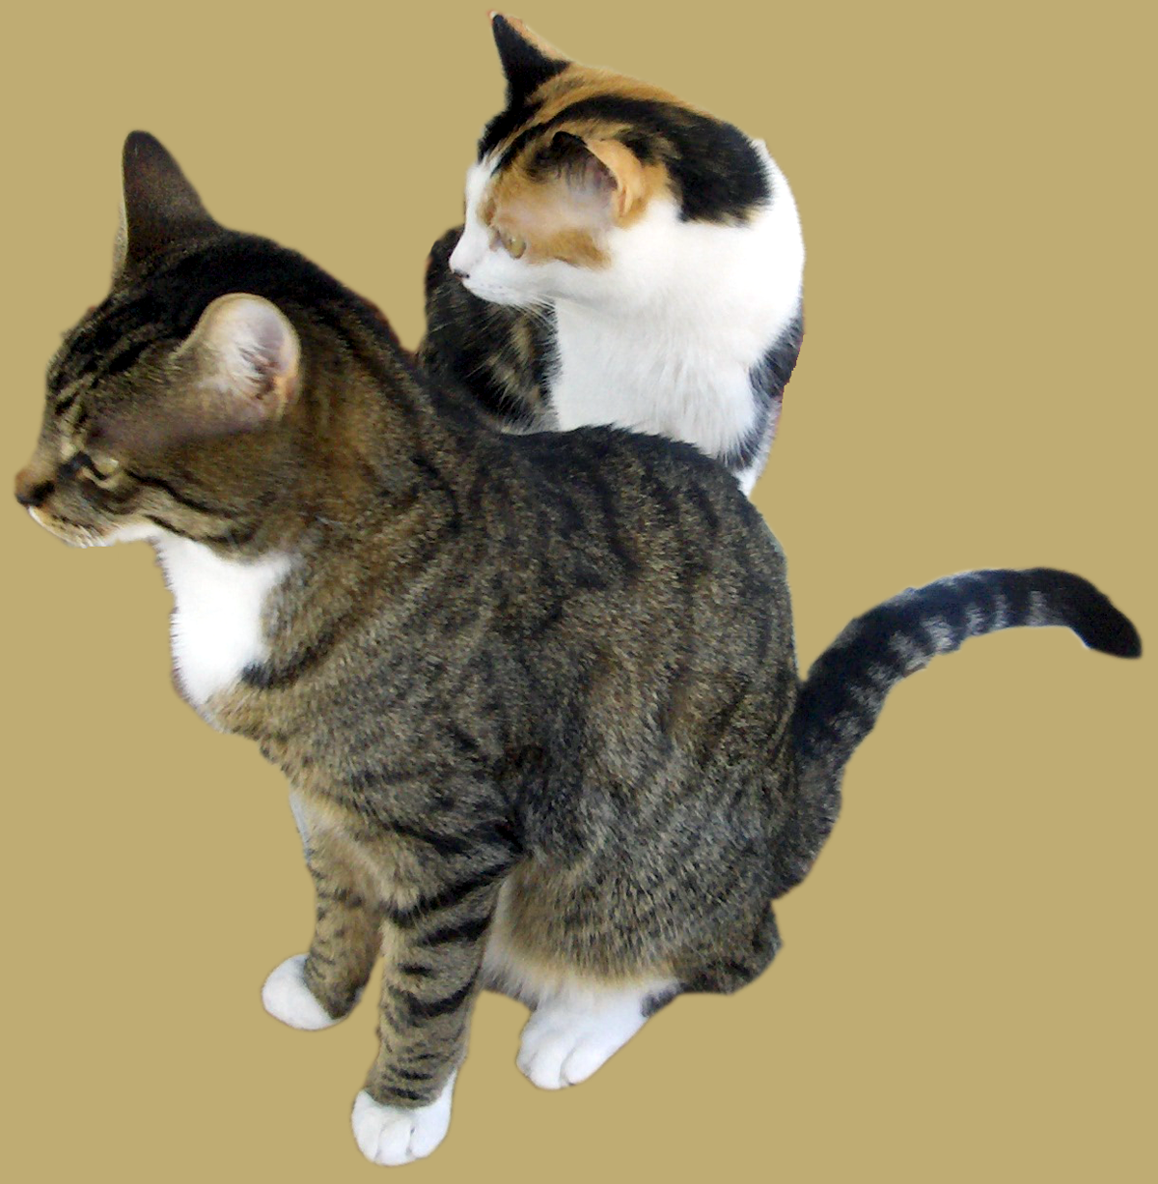
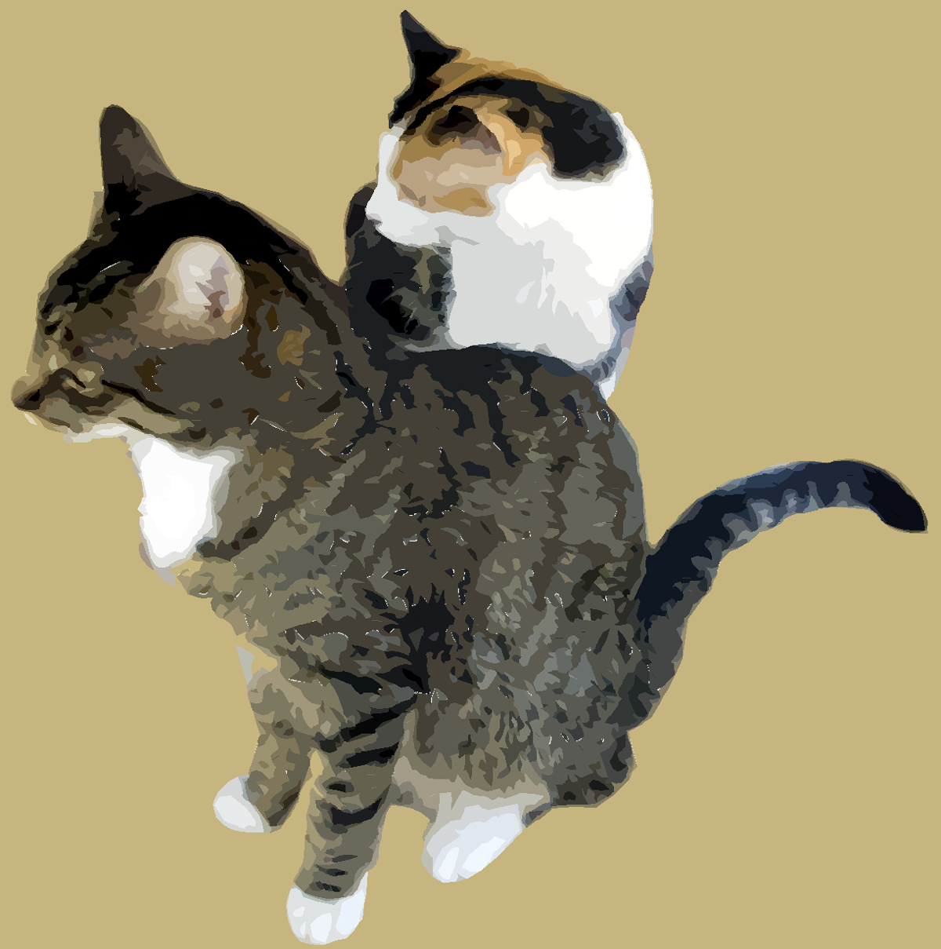
VECTOR to BITMAPPED
& Back Again
Autotracing: software analyzes a bitmapped image for shapes and converts the image to a vector graphic.
Rasterizing: samples the vector image and saves it in bitmapped form.
  Vector graphics displayed on a screen can be screen grabbed and saved as a bitmapped graphic.
Bitmapped
Autotraced
Notes:
Discuss why a designer would autotrace a bitmapped image, what advantages might result.
Conversely think about reasons to take a vector screen grab of a logo and save it into bitmapped format.

Slide 34
VECTOR GRAPHIC FILE FORMATS
Files are saved in native format or general purpose formats.
  Native format: dependent on the application.
  General purpose: can be used in many applications.
    Vector-only:
    EPS—Encapsulated Postscript
    PDF— Portable Document Format.
    Metafiles:
    SVG—Scalable Vector Format.
Notes:
Text identifies three categories. Two of these are relegated to the General Purpose category.
Review how each general purpose format might be used.

Slide 35
ADVANTAGES
BITMAPPED IMAGES
VECTOR IMAGES
Represent complex contones.
Full-featured photo editing.
Wide range of artistic effects.
Precise editing.
Smooth scaling and reshaping.
Ease of editing objects in layers.
Low file size.
Device-independent.

Slide 36
DISADVANTAGES
BITMAPPED IMAGES
VECTOR IMAGES
Large file sizes.
Loss of precise shapes when scaled or rotated.
Device-dependent.
Inaccurate, incomplete representation of complex contone images.
No photo-editing capability.
Limited artistic control.
Notes:
Developers use both paint and draw programs because of the unique features each has for graphic creation. Some applications such as Photoshop are blending the features of each program to provide a complete image creating toolbox in one package.

Slide 37
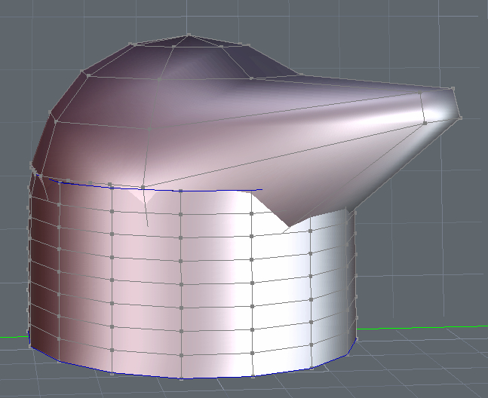
3-D COMPUTER GRAPHICS
  PRODUCE THE ILLUSION OF DEPTH ON A FLAT SURFACE.

Slide 38
3-D GRAPHICS
Computer becomes a virtual partner in the creative process.
Four interconnected steps in creating 3-D images:
  Modeling
  Surface definition
  Scene composition
  Rendering.

Slide 39
STEP 1: MODELING
Process of specifying the shape of the 3-D object.
Two major approaches to modeling:
  Combine cubes, cones, cylinders and other 3-D shapes supplied with the graphics program - modeling with primitives.
  Use a modeler to create shapes directly.

Slide 40
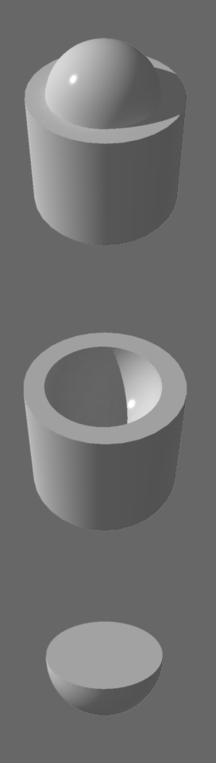
3-D MODELING
Modeling with primitives uses basic shapes to create complex 3-D images.
Parametric primitives
  Objects that can be changed by specifying parameters such as radius.
  Primitives can be scaled, rotated, moved, combined.
  Constructive Solid Geometry (CSG)
    Primitives are joined, subtracted from, or intersected with using Boolean operators.

Slide 41
3-D MODELING
Four modeling techniques:
  Polygon modeling
  Spline modeling
  Metaball modeling
  Formula modeling.
Modelers have ability to:
  Extrude: extend a 2-D shape through space to create a 3-D object.
  Lathe: rotate a 2-D line on an axis.
View IT
Tutorial on modeling a hand.

Slide 42
POLYGON MODELING
Object is defined as pattern of straight-edged polygons.
  Similar to bitmapped graphics in that the object is defined by fixed number of elements.
    Fixed number of polygons for 3-D.
    Fixed number of pixels for 2-D.
Advantages:
  High-quality, realistic surfaces,
  and precise editing control.
Disadvantages:
  Large file sizes and scaling distortions.
View IT
Polygon modeling demonstration on YouTube.
Design your own 3D model with Lego Digital Designer.

Slide 43
SPLINE MODELING
Uses curves to create objects. Similar to 2-D vector graphics.
NURB approach defines an image using mathematical formulas that can be adjusted to vary size and shape.
Advantages:
  Smaller file sizes,more flexible objects,
  NURBs are easily scaled.
Disadvantage:
  Less editing control.
View IT
Spline modeling of car on YouTube.
Notes:
Review meaning of spline and NURB from text.
A google search for "spline modeling images" will display a number of examples for class to view.

Slide 44
METABALL MODELING
Creates objects as combinations of elements called blobs.
Blobs have various shapes and are either positive or negative.
  Positive blobs add to the object.
  Negative blobs subtract from the object.
Metaball technique is good
for objects with soft edges.
The blobs are smoothed like
lumps of clay.
View IT
Demonstration of modeling a head in Blender on YouTube.
Notes:
Review meaning of metaball and search google to locate examples of metaball modeling. The link on the slide is a YouTube demo of blender that uses metaball method as part of the 3-D sculpting.
http://blender3dfr.free.fr/anglais/tut6/tut6.htm
http://youtube.com/watch?v=NHvayDzMRcI&feature=related

Slide 45
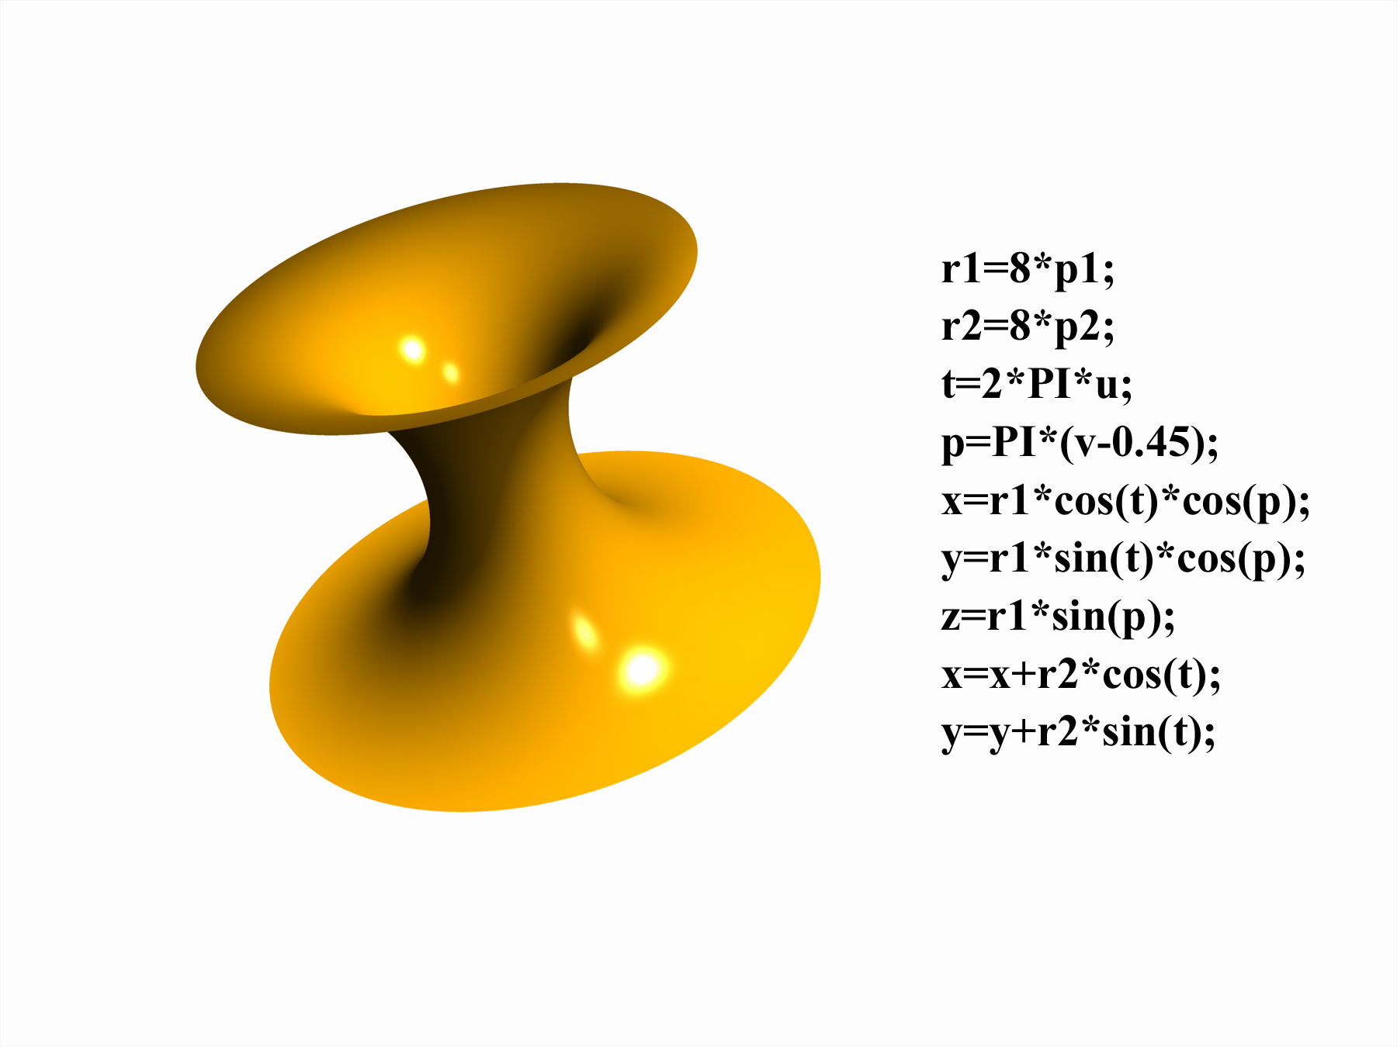
FORMULA MODELING
Creates objects by specifying mathematical formulas that are drawn by the computer.
Requires knowledge of programming and advanced mathematics.

Slide 46
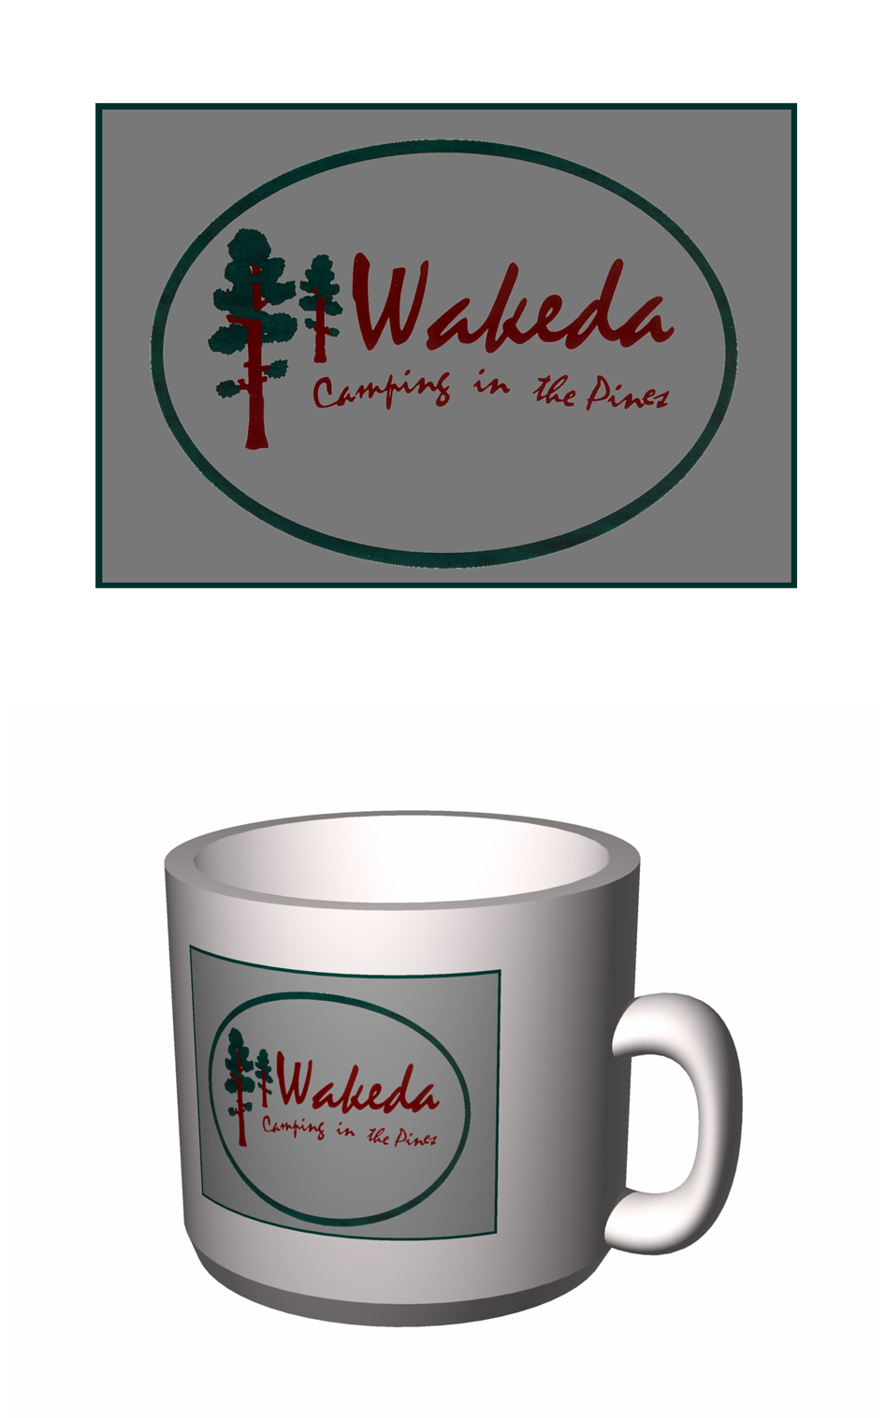
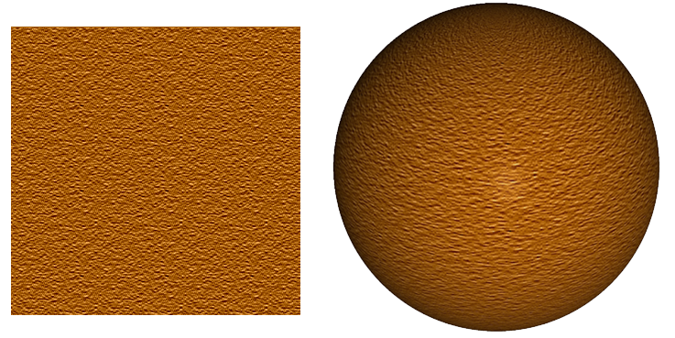
STEP 2: SURFACE DEFINITION
Surface definition: where textures are applied to the model's surface.
  Menu choices of surfaces include wood, glass, metal, skin.
  Can vary the appearance of surfaces with color, opacity, reflectivity.
Custom surfaces include:
  Image maps
  Bumb maps.

Slide 47
STEP 3: SCENE COMPOSITION
Objects are arranged, backgrounds introduced, environmental effects added, and lighting established.
Lighting choices in a scene include:
  Omni lights
  Directional lights
  Spot lights
  Volumetric light.
Adjust lighting with brightness, color, and attenuation.

Slide 48
STEP 4: RENDERING
Computer creates the scenes specified by the artist.
Two main approaches:
  Pre-rendering
    Used primarily for still graphics, animation, and video with limited interactivity.
  Real-time rendering
    Used for highly interactive 3-D applications such as video games.

Slide 49
RENDERING (cont.)
Forms of rendering to create test scenes in 3-D graphics:
  Wire frame rendering
    A series of lines used to define the shape of an object without defining its surface.
    Useful to test the basic geometry and placement of an object.

Slide 50
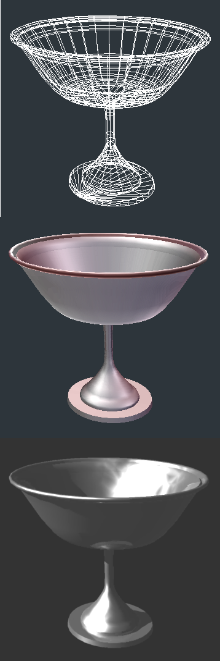
RENDERING (cont.)
Surface rendering applies lighting and shaders to the object.
  Flat shaders, has imperfections but a fast render process.
  Smooth shaders, better quality surface.
  Ray tracing, traces each ray of light as it interacts with objects on a scene.
  Radiosity, recreates the changes that result from interaction of different wavelengths of light.

Slide 51
FINAL RENDER
Final rendering translates 3-D information to a 2-D image.
Rendering engines apply effects to the finished product such as shadows, reflections, bumps, transparencies and lighting considerations.
Successful rendering requires processing power, time, and artistic talent.

Slide 52
CREATING WORLDS
3-D graphics are powerful tools to create reproductions of the world around us.
Fantasy worlds come alive with creative artists and software applications such as Maya, Blender, Zbrush, 3-D StudioMax.
  Check it out at Second Life.
  Education in a virtual world.
Notes:
There are many tutorials of 3D applications on YouTube. Have students view several to relate the concepts covered here to the specific software.
This overview from a training series on Maya mentions several terms just covered on the slides:
http://www.youtube.com/watch?v=oldRd36hpxg&feature=related

Slide 53
GUIDELINES FOR USING
GRAPHICS IN MULTIMEDIA
Identify purpose of the graphic.
Choose best format for each image.
Match graphic design to purpose.
Locate graphics.
Preserve image quality.
Economize.
Organize and store graphics files for later use.
Notes:
Use as method to review chapter details about types of graphics, resolution and quality issues, file types, file sizes.

Slide 54
WRAP UP
Traditional graphics characteristics.
  Contones and Line Art.
  Image Reproduction techniques.
2-D computer graphics.
  Bitmapped and Vector graphics.
  Features & sources of bitmapped graphics.
  Features of vector graphics.
3-D computer graphics.
  Steps to create 3-D images.

Slide 55
KEY TERM CHECK UP:
Notes:
Use this screen to focus on key term review from Ch.6. Students could work in groups to identify terms that relate directly to traditional graphics, bitmapped images, vector images, 3D graphics.

