Slide 1
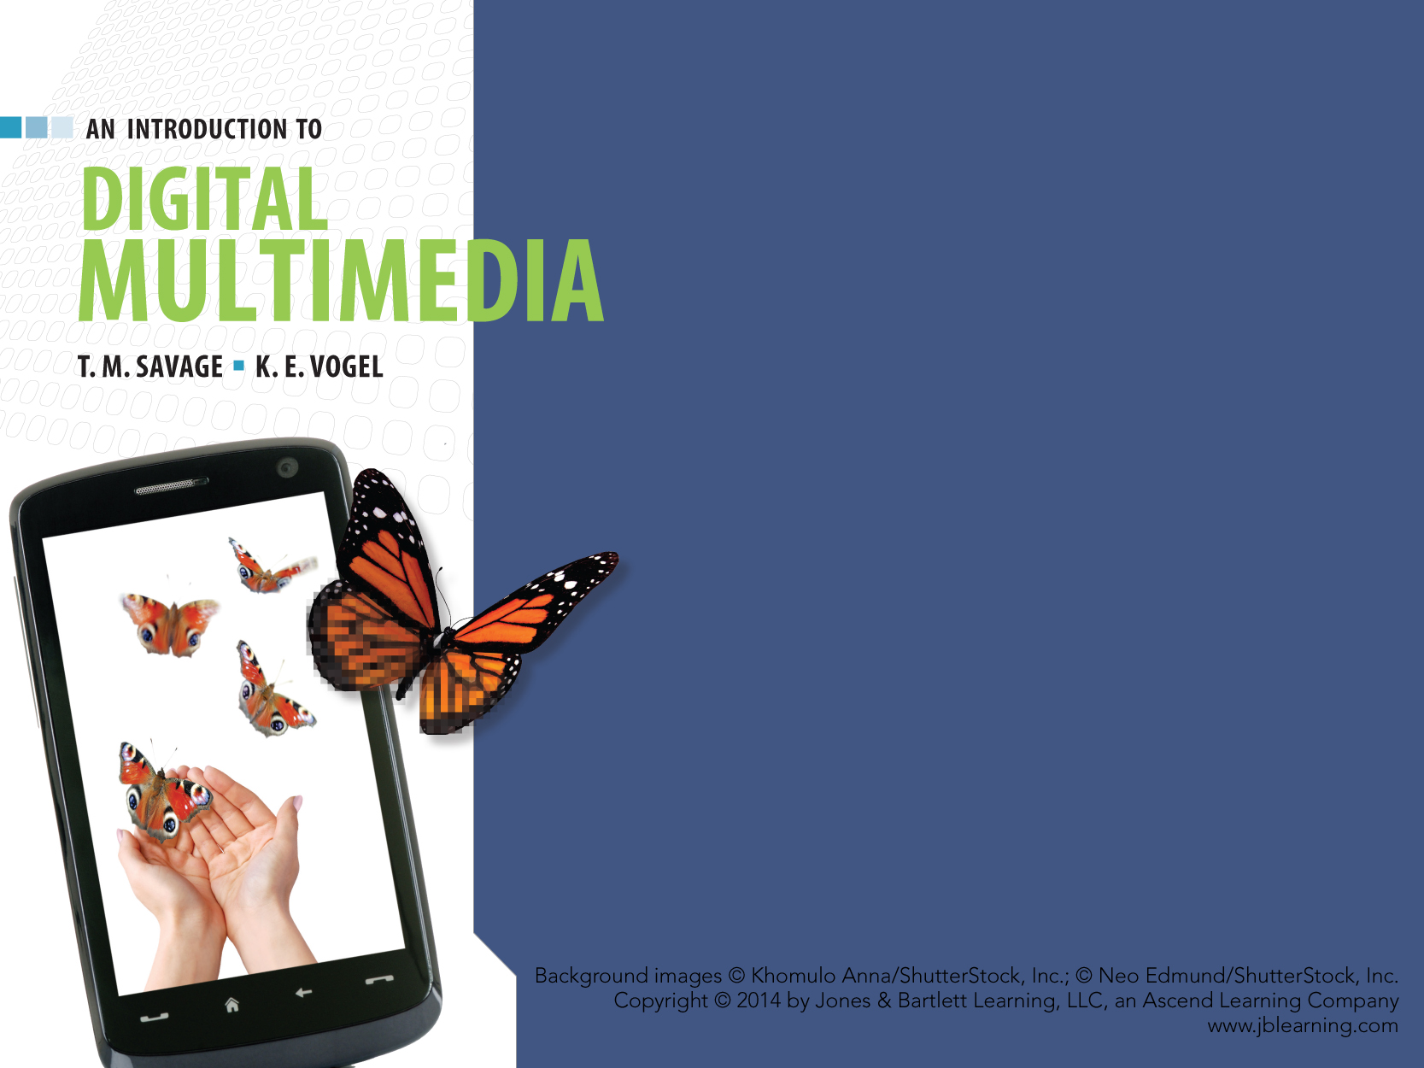
CHAPTER FIVE
TEXT

Slide 2
CHAPTER HIGHLIGHTS
Text tradition.
Codes for computer text.
Font technologies.
Multimedia text.
Guidelines for use of text in multimedia.

Slide 3
POWERS OF TEXT
Multimedia developers value text for:
Universality
Clarity
Efficiency
Powers of abstraction, engagement, and suggestion.
Developers can explore new uses for text in a media-rich environment.

Slide 4
TEXT TRADITION
Text properties are grounded in the print tradition.
Typeface is a family of characters sharing a common design.
Arial
Chicago
New York
Palatino
Notes:
Students will likely be familiar with these terms from word processing applications. This section can be a quick review of terminology but also a reminder of how traditional type setting was carried out in the print industry.
Some considerations also are appropriate for screen text vs. printed text. For example sans serif typefaces are better used on a screen for readability than on printed pages.

Slide 5
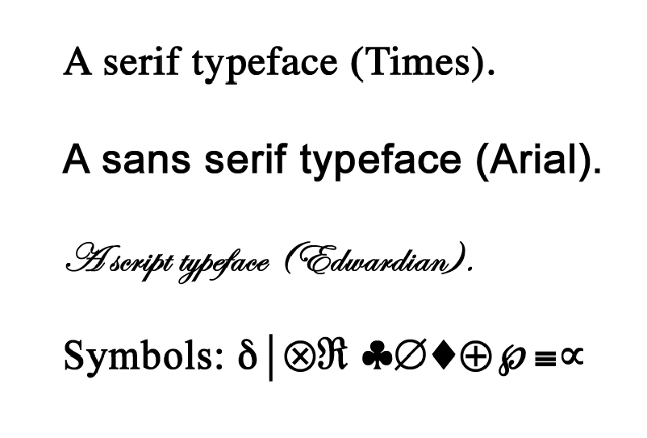
TEXT TRADITION
Typefaces are commonly categorized as:
Serif
Sans serif
Script
Symbols.
5
Notes:
5
Students will likely be familiar with these terms from word processing applications. This section can be a quick review of terminology but also a reminder of how traditional type setting was carried out in the print industry.
Some considerations also are appropriate for screen text vs. printed text. For example sans serif typefaces are better used on a screen for readability than on printed pages.

Slide 6
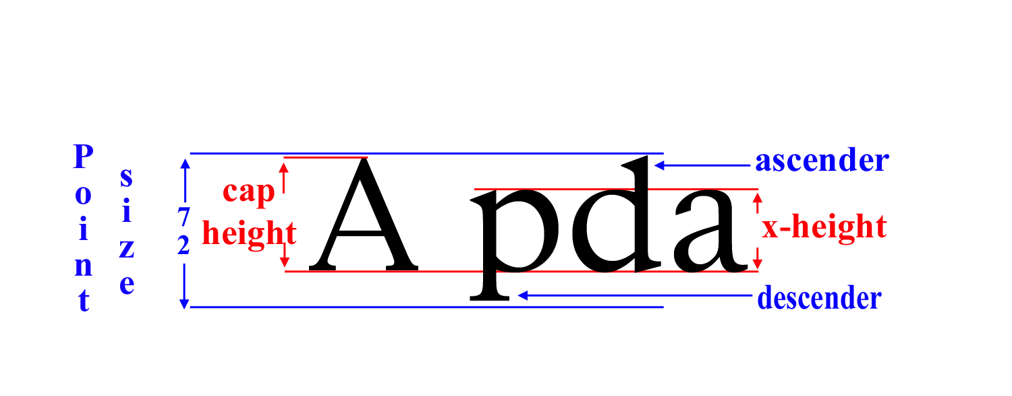
TEXT TRADITION
Style: appearance of characters such as:
Bold
Italic
Underline.
Point size: measure of type size.
Point is approximately 1/72 of an inch.
Pica is 12 points
6 picas = 1 inch.

Slide 7
TEXT TRADITION
Font
Complete set of characters of a particular typeface, style, and size.
Monospaced fonts: same width assigned to each character.
Proportional fonts: adjust width based on shape.
Case
Upper and lower case.
A a

Slide 8
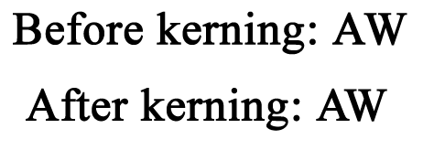
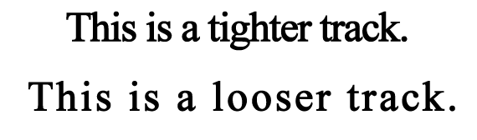
TEXT TRADITION
Weight
Line thickness of the typeface.
Arial Black has heavier weight.
Kerning
Adjusting spacing between specific letters.
Tracking
Adjusting spacing between all characters.

Slide 9
TEXT TRADITION
Condensed/extended text
Narrow width of text / widen width of text.
Leading
Spacing between lines.
Alignment & Justification
Alignment positions text relative to document's margins.
Justification adjusts line length to produce straight edges on left and right margins.

Slide 10
COMPUTER TEXT
FROM PRINTED CHARACTERS TO DIGITAL TEXT.

Slide 11
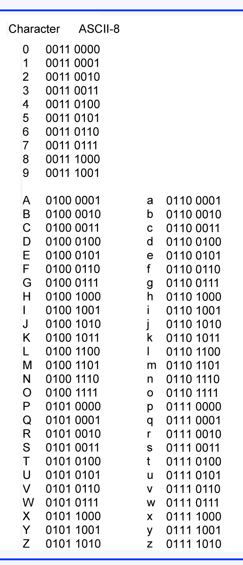
COMPUTER TEXT CODES
Coding schemes assign a group of binary numbers to represent a digital character.
ASCII
7-bit code = 128 characters.
Extended ASCII or ASCII-8 = 256 characters.
All computers understand ASCII.
American Standard Code for Information Interchange

Slide 12
COMPUTER TEXT CODES
RTF (Rich Text Format)
Developed by Microsoft for cross platform text files.
Reproduces the formatting of original file.
Unicode
New standard 16 bit code that provides for more than 65,000 characters.
Goal is to include multilingual text in a digital coding standard.
View IT
Unicode project.

Slide 13
FONT TECHNOLOGIES
Two techniques for displaying text on computer:
Bitmapped fonts
Outline fonts.

Slide 14
BITMAPPED FONTS
Pixels that make the letter are described by a binary code, or a "mapping" of the character.
Every character is stored as a bitmapped letter, number, or symbol.
Require large memory and storage capacity.
A
Notes:
Have students describe how a 12pt A would be constructed on 72dpi monitor. They should recognize the storage required to contain all the pixels for each point of the character. Then consider the storage is required to do all the upper case, lower case of a complete font collection at 12pts.

Slide 15
BITMAPPED FONTS
Advantages
Precise control over letter appearance.
Letters can be edited at pixel level.
Disadvantages
Letters can't be easily scaled.
Requires separate bitmaps for each typeface, style, and point size to be used.
Requires large storage capacities.
Limits flexibility in use of text fonts to those stored on the computer.

Slide 16
OUTLINE FONTS
Store a description of the character to be displayed.
Description is a series of commands to create the letter on the computer display.
Outline font technology:
Adobe Postscript
TrueType.
Notes:
Students might research the font wars that led to acceptance of TrueType on PC's and Mac computers.

Slide 17
OUTLINE FONTS
Advantages
Fonts are easily scaled.
Requires smaller storage capacity.
Disadvantages
Commands can't be edited to create unique characters.
Font families are controlled through license of Postscript and TrueType fonts.
Notes:
In chapter 2 students read about descriptive and command based digital media. Make a correlation between the bitmapped and outline fonts here and relate it to the reading in Ch.2.

Slide 18
JAGGIES and TEXT
Text is displayed on a monitor as a pattern of pixels.
Pixels are generally very small squares.
Squares can display straight lines with smooth edges.
Squares that display curved or diagonal lines produce a stair-stepped effect called JAGGIES.

Slide 19
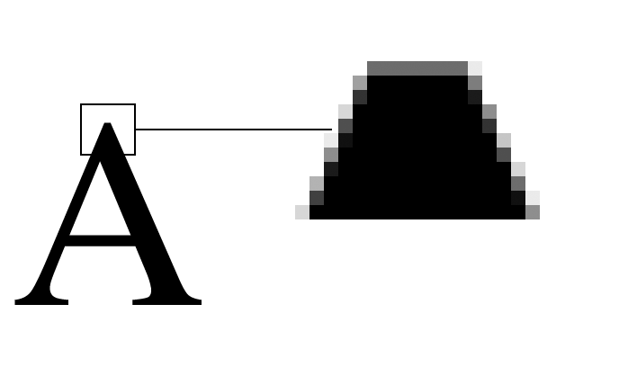
ANTI-ALIASING THE JAGGIES
Jaggies produce an alias of the true character.
Anti-aliasing creates a smooth edge by blending the color of the text with the color of the background.

Slide 20
INSTALLED FONTS — THE PROBLEM
ASCII and Unicode are standard.
Fonts are not standardized across computer platforms.
If the font is not available on the computer, it will substitute one that is.
The result may not be acceptable.
Solution
Use only widely available fonts.
Package the unique font with the application.
Notes:
Students may have experience with this using PowerPoint. They have created a presentation with fonts on their home computer and find it does not display well if played on a school or office computer.

Slide 21
MULTIMEDIA TEXT
Two main forms:
Editable: text produced by word processors or text editors.
Easy to alter content.
Can search and spell check.
Graphics: image of text that can be manipulated to produce a wide range of artistic effects.
Make original word picture.
Solves problem of installed fonts.
Graphics text
Graphics text

Slide 22
MULTIMEDIA TEXT and SOUND
Speech recognition: software analyzes human speech and converts words to editable text.
Requires specialized "intelligent" software.
Accuracy may depend on training and speaker's voice.
Speech synthesis: software analyzes text and reproduces it as spoken words.
Notes:
Discuss the uses and benefits of both forms of speech. Students might research how hospitals and doctors are using speech recognition for storing medial records. Speech synthesis is commonly experienced in computerized phone calls. Quality and accuracy of pronunciation is often a problem. Computers often have ability to program voice commands, GPS systems are also incorporating voice recognition applications.

Slide 23
TEXT & INTERACTIVITY
Hypertext is linked text.
User interacts with links to trace relationships of words and ideas created by the author.
Structure consists of:
Nodes
Link anchor
Link markers
Hypermedia is an information structure based on linked media.
Hyperlink text can take you places.
Notes:
Use insert on Hyperlink text to demo the Node, Link Anchor, and Link Marker.
The arrows on each screen might be considered hypermedia as they are graphic objects with a link to new location.

Slide 24
TEXT FOR THE WWW
HTML: hypertext markup language.
Contains "tags" used to specify the structure of the document and format the text and media.
Browser interprets the "tags" and displays the "page" on a client computer.
HTML limitations:
Limited set of tags to create a page.
Difficult to precisely define a page appearance.
Some browsers and client computers may present the html page differently from other browsers.
Notes:
Show students the code for your school's home page.
Open the page in a browser and select the menu option to View Source.

Slide 25
CSS & XHTML
Cascading Style Sheets (CSS).
An addition to HTML
Separates content of page from formatting commands
Easier to edit and maintain consistent appearance of a site.
eXtensible HTML (XHTML)
A blending of HTML and XML
XML supports more powerful data manipulation.
XHTML improves page display on mobile devices.

Slide 26
PORTABLE DOCUMENT FORMAT
PDF files maintain original formatting of documents across computer platforms.
Platform and application independent.
Support multiple media and user interaction.
Require a reader program to view the file and an application to convert a document to pdf format.
Adobe Acrobat Reader is a free download.
PDFCreator is a free open source converter.
Notes:
Adobe Acrobat is the most common pdf viewer and converter program. There are others on the market that will also deliver similar features such as ScanSoft's PDF Converter.
Browser applications require Acrobat plugin to view a .pdf file. They are free to download from Adobe.

Slide 27
ADDING TEXT TO MULTIMEDIA APPLICATION
Several methods to incorporate text in an authoring application.
Direct entry in a text box or text field.
Copy and paste from existing text source.
File import for large text files.
Scan text with OCR application for text that exists only in print media.
Optical Character Recognition accuracy will vary based on fonts and quality of source material.
Notes:
Review process of Optical Character Recognition. Software will convert an image of a letter to an ASCII code. Quality of conversion is dependent on OCR software, quality of source material, and type of paper being used. Any scanned text will require careful editing to remove stray markings and correct spelling.

Slide 28
GUIDELINES for TEXT in Multimedia Applications
Be selective.
Be brief.
Make text readable.
Be consistent.
Be careful
Be respectful.
Combine text with other media.
Make text interactive.
Notes:
Use a Powerpoint presentation or web page to review the importance of these guidelines. Students should elaborate on the meaning of each guideline in evaluating a presentation or web page.

Slide 29
WRAP UP
Traditional text features.
Computer text codes.
Font technologies.
Multimedia text.
Adding text to multimedia applications.
Guidelines for using text.
T
E
X
T

Slide 30
KEY TERM CHECK UP

