Slide 1
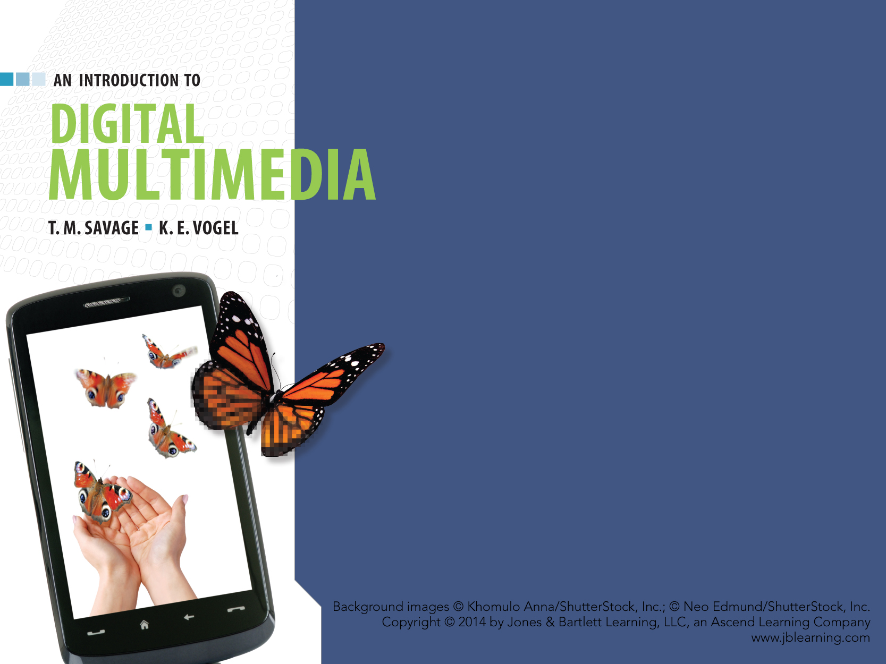
CHAPTER FOUR
COMPUTER
SOFTWARE

Slide 2
CHAPTER HIGHLIGHTS
Main categories of software
  Operating system
  Application
  Programming
Functions of the operating system
Types of programming languages
Software for multimedia development

Slide 3
SOFTWARE
A collection of computer programs that govern the operation of a computer.
  Program: list of instructions that can be carried out by the computer.
Three categories of software:
  Operating systems
  Programming languages
  Applications.

Slide 4
YOU DECIDE … Software
Label each as an operating system, programming language, application.
Word
Photoshop
Java
OS X
Visual Basic
Flash
Windows 8
C+
Linux
Open Office
HTML
Javascript
Browser
Director
Unix
Assembly
Notes:
Use this slide to survey student awareness of specific software packages to introduce the class, or use at the end of class as part of the wrap up.

Slide 5
OPERATING SYSTEM
Collection of programs that:
  Provides a user interface
  Manages computer resources
  Executes application programs.
User interface: a means to communicate with the programs and hardware.
  Command line interface
  Graphical user interface (GUI)
  Natural user interface (NUI).
Notes:
NUI is becoming a predominate method to interact with the programs and hardware. Have students report on the means they use to select items on an iPad, eReader, smartphone. Multi-touch technology is most prevalent in Mac and Windows devices. Voice input is also a form of NUI as is eye contact with areas of the screen. Soon there will be little need for a mouse or pointing device.

Slide 6
OPERATING SYSTEM
Manages computer resources such as:
  Processor
  Memory
  Peripheral devices
  Networks.

Slide 7
MANAGE COMPUTER RESOURCES
Manage the processor
  Controls how and when programs are executed.
  Control methods:
    Single user, single tasking
    Single user, multi-tasking
  If the processor is sufficiently powerful users are not aware of sharing the resources.
Notes:
Review these methods and the notion of time slice of the processor's activity. Have students explain the benefit of preemptive multitasking on today's microcomputers.

Slide 8
MANAGE COMPUTER RESOURCES
Manage memory
  Controls how much memory is accessed and used by application programs.
Virtual memory: operating system assigns a portion of the hard disk to simulate RAM.
  Problem: access to files in virtual memory is slowed.
  Solution: install more RAM.
Notes:
Review these methods and the notion of time slice of the processor's activity. Have students explain the benefit of preemptive multitasking on today's microcomputers.

Slide 9
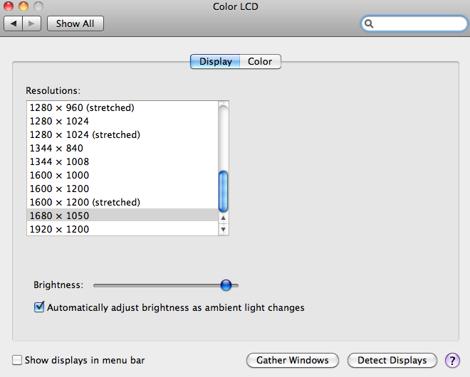
MANAGE COMPUTER RESOURCES
Control peripherals
  Built-in programs control devices such as monitors, printers, storage drives.
  Additional device drivers can be downloaded or come with the installation CD.
Plug and Play
  Operating system senses that a new device is plugged into the system board and immediately responds to "play" the device.
Notes:
USB and FireWire are popular plug and play interfaces that most operating systems recognize.

Slide 10
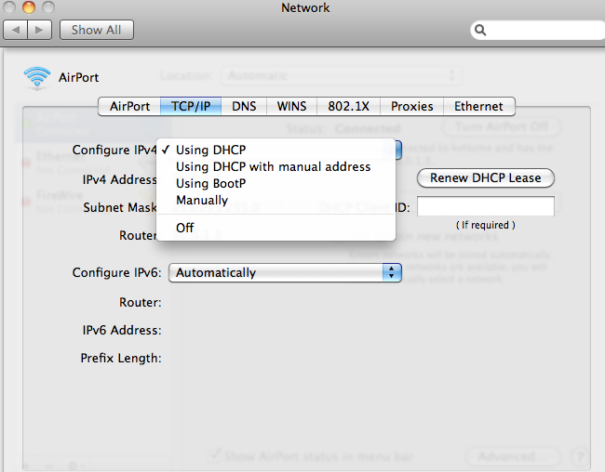
MANAGE COMPUTER RESOURCES
Manage access and security of network computers through:
  Built in protocols to connect to WANs (TCP/IP)
  Built in protocols to connect to LANs (Ethernet)
  Support for WiFi and Bluetooth connectivity
  Network firewall protection.
Notes:
Have students open the Network option in the Windows control panel or OS system preferences to study the options available through the operating system to connect and manage network protocols.

Slide 11
MANAGE COMPUTER RESOURCES
Utility programs
  Tools to optimize operating system functions such as:
    CD and DVD recording
    Screen savers
    Speech recognition for basic commands
    Text editors
    Multimedia utilities.
  Disk management utility
    Partition and format drives.
    Defragment and detect disk errors.

Slide 12
MANAGE COMPUTER RESOURCES
File management.
  Operating systems govern storage and retrieval of files.
  Basic file management includes:
    Copy
    Delete
    Rename
    Move.
  File extensions identify a file as data or program for the operating system.
Notes:
Have students explain why they can open a data file by "double clicking" it, and other files won't open.

Slide 13
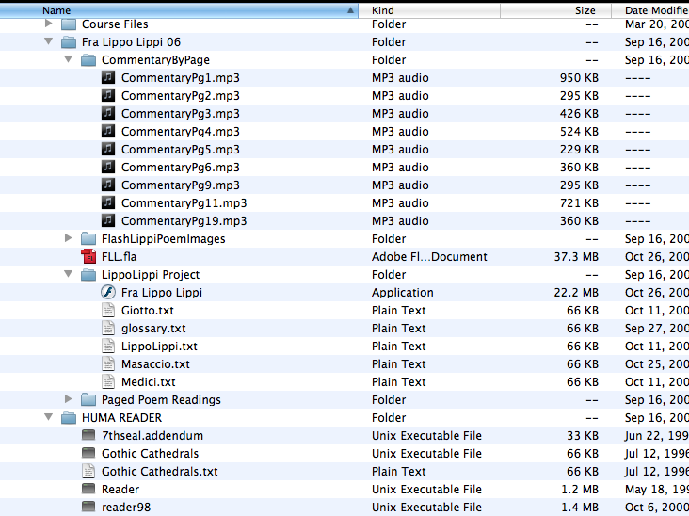
FILE MANAGEMENT
Directories are storage locations for groups of files.
  Directory path is identified by the operating system.
  Directories (or folders) are created, moved, copied, deleted using file management utility.
Notes:
Review best practices for naming files and directories.
Open the Vista or OS X file directory window to review basic tasks of managing files and folders.

Slide 14
PROGRAMMING LANGUAGES
  SYNTAX AND SEMANTICS TO WRITE COMPUTER PROGRAMS.

Slide 15
PROGRAMMING LANGUAGES
Low-Level Languages.
  Programs are written for a specific computer system.
  Machine code — binary code the processor directly executes.
  Assembly code — text abbreviations for binary commands.
    Requires a program (assembler) to convert the abbreviations to binary code.
Notes:
Remind students that all computers execute machine code. If a program is not directly written in binary code, it must be converted to binary using a program like an assembler or compiler.

Slide 16
PROGRAMMING LANGUAGES
High-Level Languages.
  Syntax and semantics are not dependent on a specific computer system.
  More English-like commands.
  Easier to debug errors.
Two methods to convert to machine code:
  Interpreter converts and executes one line of code at a time.
  Compiler converts entire program to an executable file.
Notes:
Review the benefits of using high level languages.
Consider the advantages and disadvantages of using an interpreter and compiler to convert the source code to machine code.

Slide 17
Approaches to Programming
Procedural approach:
  Follows a series of computational steps that focus on a specific result.
    Divides complex tasks into subroutines, functions that can be reused within a single program environment.
    Code modules cannot be ported to other applications without significant modification which leads to inefficiency in programming tasks.
Non-procedural:
  Maximizes programmer productivity by recycling modules from one program into other applications.

Slide 18
Two Non-procedural options
Object-Oriented languages.
  Modular approach reduces time to recode similar object routines.
Visual programming.
  Use graphical interface to expedite programming process.
  Enables Rapid Application Development.
Notes:
Have students research visual programming and report on how it is being used.
Textbox on Scripting languages identifies the distinction between procedural and non-procedural. Have students relate their experience with scripting macro code or ActionScript in Flash.

Slide 19
APPLICATION SOFTWARE
  SOFTWARE THAT PERFORMS A SPECIFIC TASK.

Slide 20
APPLICATION SOFTWARE
Two main categories for multimedia development.
  Media-specific applications.
    Create and edit specific media content.
  Authoring applications.
    Tools to integrate media components and provide a user interface.

Slide 21
MEDIA-SPECIFIC APPLICATIONS
Text media applications include:
  Word processors
  Text editors
  Portable document generators.
Graphics media applications include:
  Paint programs
  Draw programs
  3-D imaging applications.
Notes:
Have students identify specific software packages for each of these and discuss the benefits and features of each.

Slide 22
MEDIA-SPECIFIC APPLICATIONS
Sound media.
  Sound capture applications.
  Synthesized sound applications.
Video applications combine:
  Source material
  Synchronize clips to sound track
  Add special effects
  Save as a digital video.
Notes:
Sampled sound applications such as Audacity can record from microphone, CD, tape and user then edits the sound wave to create a new digital sound. Synthesized applications such as Garageband give user an interface to create original sounds through commands.
Video software such as Premiere and Final Cut are often used to edit source clips with transitions, sound tracks, still images to create an original digital video.

Slide 23
MEDIA-SPECIFIC APPLICATIONS
Animation applications.
  Software to create and edit animated sequences.
  Objects are drawn or imported into the software where they are manipulated in a series of frames.
Media utilities.
  Add functionality to media-specific applications such as file compression and file conversion.
Notes:
Common animation applications are Flash and Director.
Students could research media utilities that are currently used for clip art, font libraries, compression and streaming media formats.
Yahoo's directory of software has several selections to explore utility applications for multimedia.
http://dir.yahoo.com/Computers_and_Internet/Software/

Slide 24
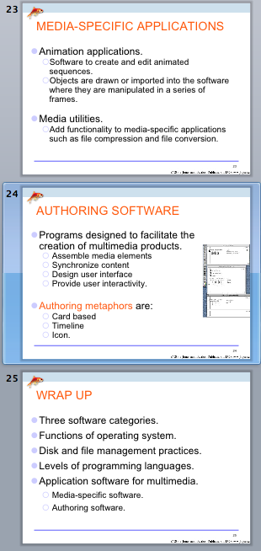
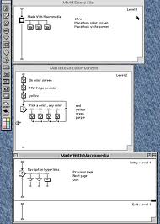
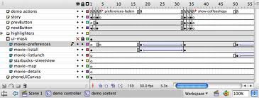
AUTHORING SOFTWARE
Programs designed to facilitate the creation of multimedia products.
  Assemble media elements
  Synchronize content
  Design user interface
  Provide user interactivity.
Authoring metaphors are:
  Card based
  Timeline
  Icon.
PowerPoint uses a card metaphor.
Flash uses a timeline metaphor.
Authorware uses a icon metaphor.
Notes:
Use functions of authoring software to determine if Word is considered an authoring application, PowerPoint, Photoshop.
Metaphors for authoring software are developed in more detail in Ch.10. Students will be familiar with PowerPoint as a type of card or page based application. Use that as an example to explain notion of metaphor.

Slide 25
WRAP UP
Three software categories.
Functions of operating system.
Disk and file management practices.
Levels of programming languages.
Application software for multimedia.
  Media-specific software.
  Authoring software.

Slide 26
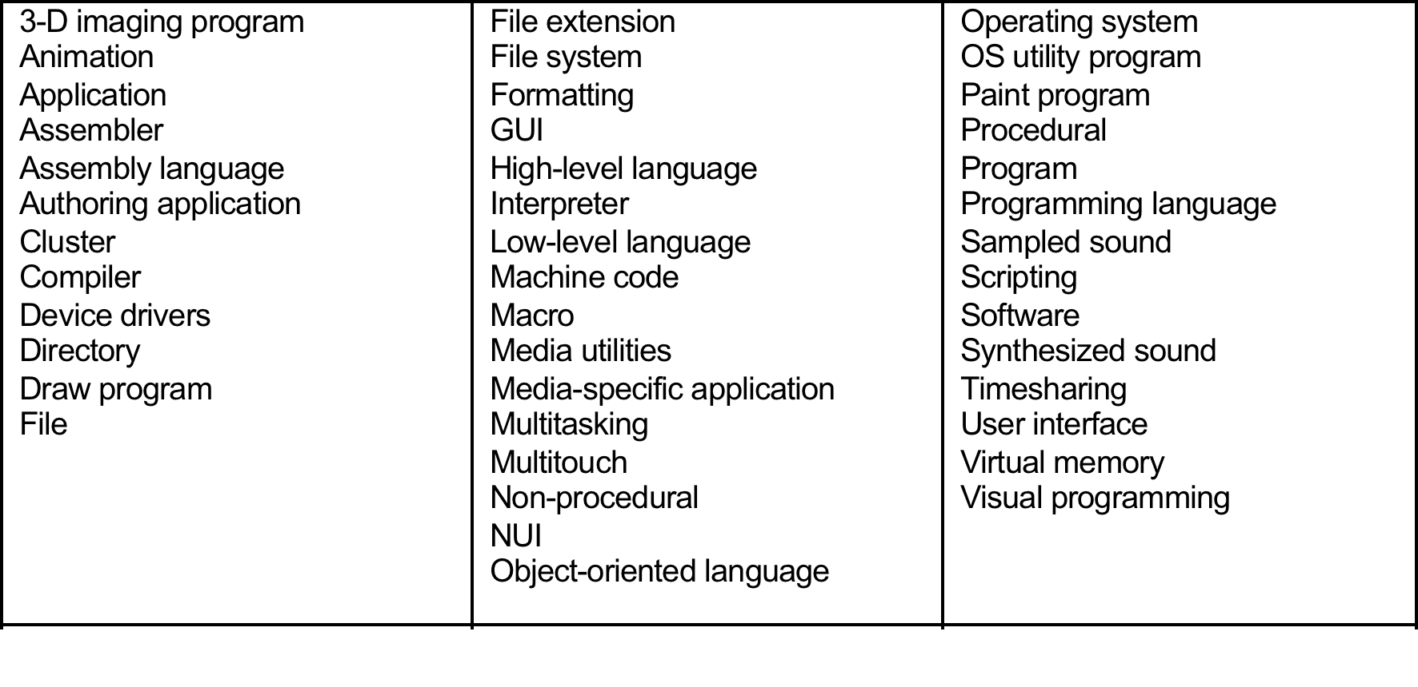
KEY TERM CHECK UP

