Slide 1
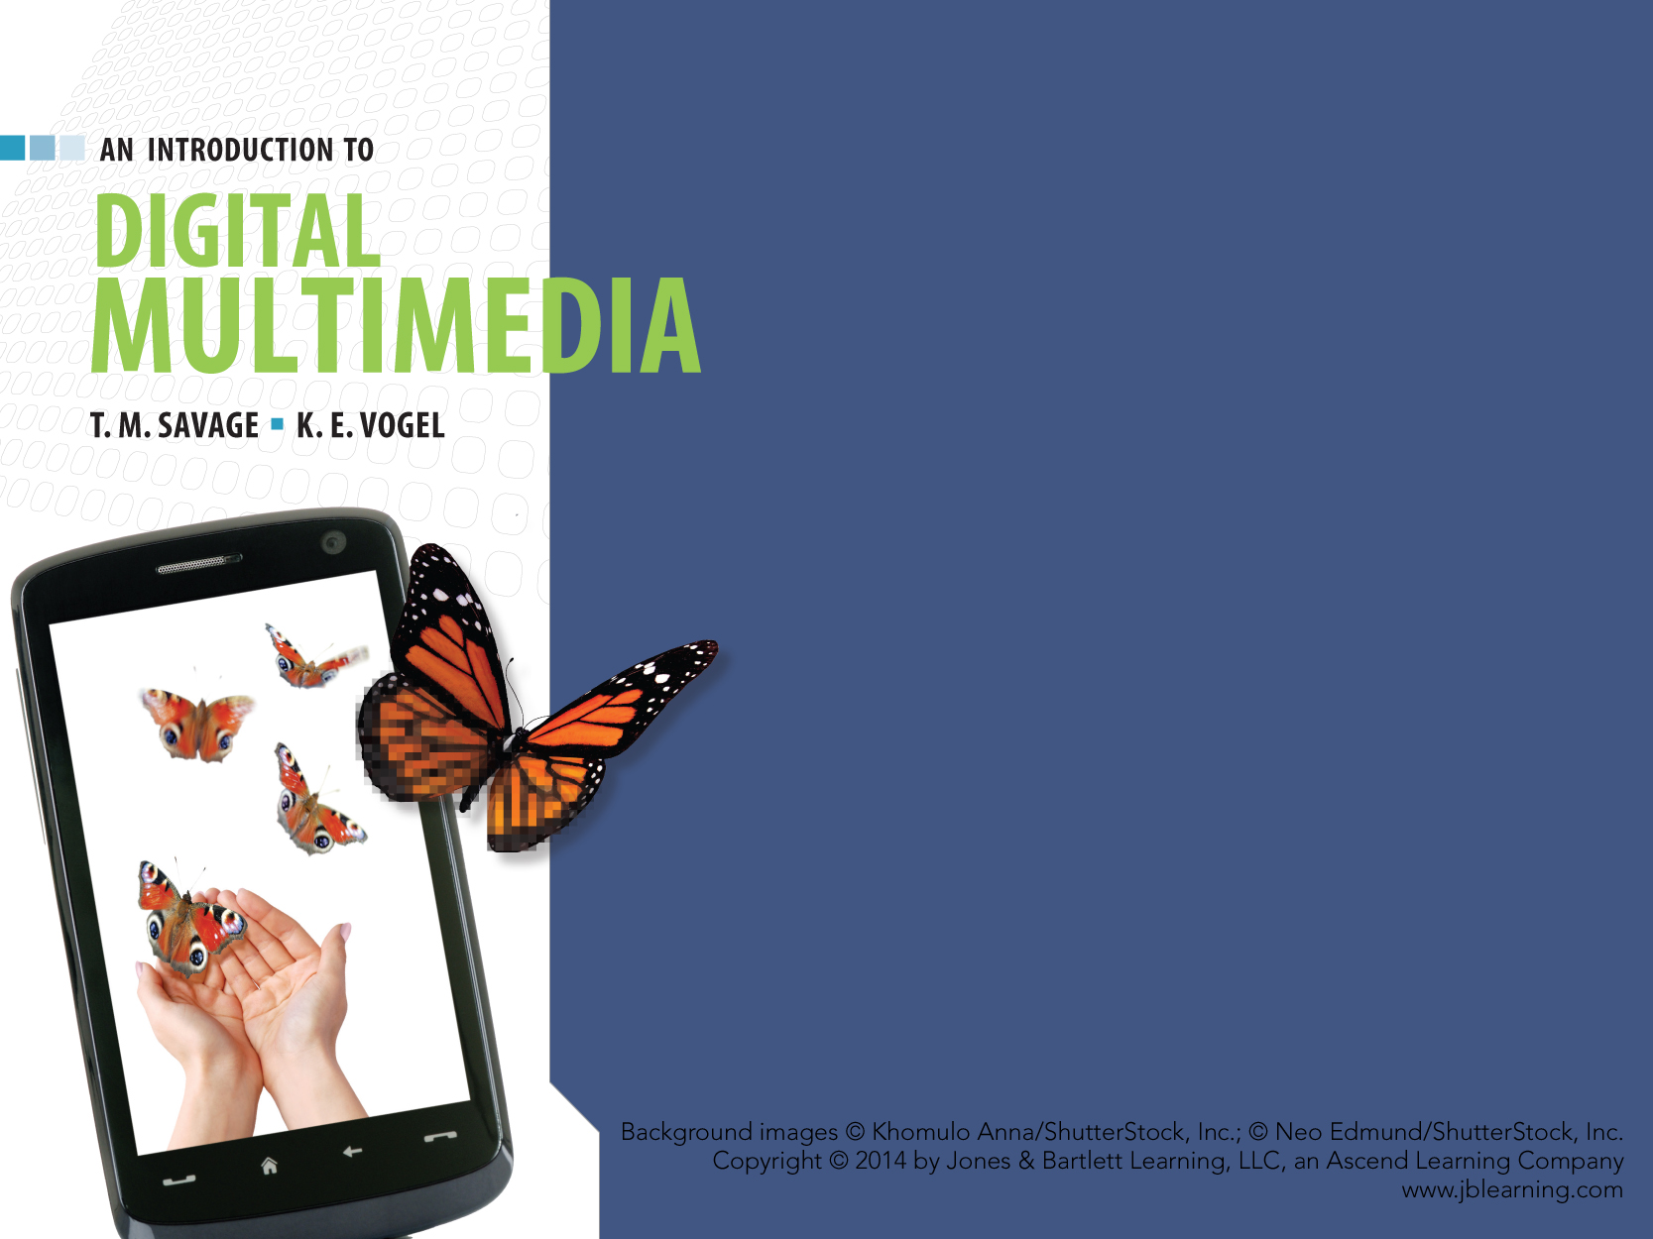
CHAPTER TWO
DIGITAL DATA

Slide 2
CHAPTER HIGHLIGHTS
Elements of digital media.
Digital codes.
Digital files.
Digitization process.
Compression for digital media.
Advantages of digital media.
Challenges of digital media.

Slide 3
CODING DIGITAL INFORMATION
Symbols represent something else.
  Organized and understood by a conventional standard.
Data are the givens of experience.
  Measurements, facts, observations.
Information is data made useful, interpreted, and applied to produce understanding.
Notes:
Students should provide examples for each of these concepts.

Slide 4
YOU DECIDE: data or information?
People who are 30 years old, pay $30 to run 30 miles in 30 degree weather for a charity benefit.
Age = 30 yrs.
Temperature = 30 degrees
Distance = 30 mi.
Cost = $30

Slide 5


ANALOG vs. DIGITAL DATA
Analog data varies continuously.
Digital data consists of separate, discrete units.
Hour glass to tell time.
Wind mill motion.
Numbers
1, 2, 3, 4
YOU DECIDE: Analog or Digital Data?

Slide 6
DIGITAL DATA
Digit = number.
Binary digit (bit) = 0 or 1.
Bits are the symbols to encode digital data.
Digital encoding assigns bits to data items.
Letter A | 0100 0001
Number 5 | 0011 0101
More bits in the code, means more distinct items to encode.

Slide 7
BUILDING DIGITAL CODES
Number of distinct bit combinations that can be produced is given by the formula 2^{n.}
  n = number of bits used in the code.
Adding 1 to the power doubles the number of distinct data items that can be encoded.
2 ¹ | 2 ² | 2 ³ | 2 ⁴ | 2 ⁵ | 2 ⁶ | 2 ⁷ | 2 ⁸
2 items | 4 items | 8 items | 16 items
Complete the table to identify the number of distinct items
represented by 2 ^{5,} 2 ^{6,} 2 ^{7,} and 2 ^{8.}

Slide 8
COMMON CODES
ASCII, a 7 bit code.
  128 letters, numbers, and symbols in English language.
ASCII-8, an 8 bit code.
  256 letters, numbers, and symbols in English language.
Unicode, a 16 bit code.
  Over 65,000 different characters.
24-bit color.
  Displays the full range a human eye can perceive.
16-bit sound.
  Plays the full decibel range the human ear can perceive.

Slide 9
DIGITAL FILES
A container for binary codes.
File formats define how instructions and data are encoded in the file.
  Sample formats that define data differently:
    Word file format
    Acrobat file format
    Media player file format.
Notes:
Have students identify additional common data formats and program formats.
What would happen if one tired to open a program file format such as Excel.exe as a data file in Word? Could students read the contents of a file that contains binary instructions in a Word program?

Slide 10
ALL ABOUT FILES
File size
  Measured in units of bytes.
    Kilo Bytes, Mega Bytes, Giga Bytes.
File extensions
  Series of letters to designate the file format.
    .fla, .exe, .rtf, .jpg
File compatibility
  Ability to use the file in a different platform of hardware and software.

Slide 11
FILE TYPES
Program files
  Contain executable instructions.
Data files
  Can hold text, images, sounds, video, animation.

Slide 12
DATA FILE COMPATIBILITY
Cross-platform compatible files.
  Open and use on any computer hardware and software configuration.
Files that are native or specialized to the application that created the data file.
  Require source application to open the file.
Notes:
Have students identify file formats that are cross platform (PDF, JPG, TIFF for example) and Native to an application such as Word, Photoshop, Flash files (.docx, .psd, .fla for example).

Slide 13
FILE MAINTENANCE
Data loss and destruction impacts multimedia project completion.
Effective file maintenance involves:
  Identification
  Categorization
  Preservation.
Notes:
Have students identify techniques to manage files effectively using meaningful file names, organized folders, backup data on routine basis.

Slide 14
DIGITIZATION
ANALOG TO DIGITAL CONVERSION.

Slide 15
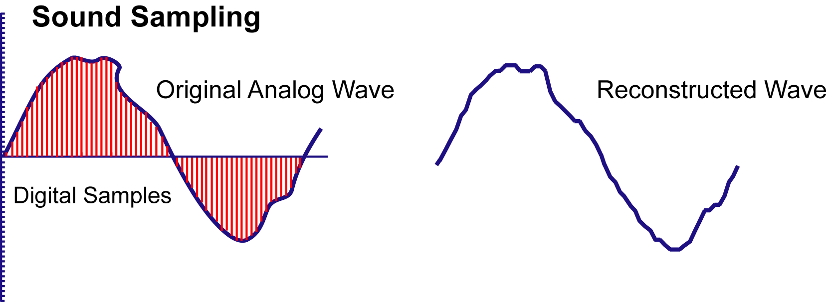
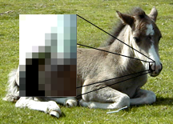
SAMPLING ANALOG DATA
Sampling analyzes a small portion of the analog source and converts it to digital code.

Slide 16
SAMPLE QUALITY
Factors that influence sample quality
  Sample Resolution.
    Number of bits used to represent digital sample.
    Quantization is process of rounding off the value of a sample to the nearest available digital code.
  Sample Rate.
    Number of samples taken in a given unit of time (sounds) or space (images).
    Spatial resolution describes sample rate in image files.

Slide 17
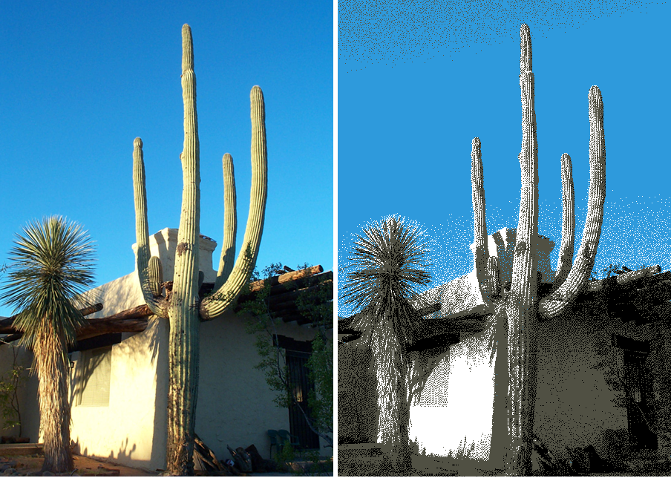
YOU DECIDE … sample resolution
Which image and sound sample will have better quality?
Image | Sound
8 bits / sample | 8 bits / sample
24 bits / sample | 16 bits / sample
Which image uses fewer bits to describe the color sample?
Notes:
Use this slide to discuss decisions developers must make to balance quality and file size. Higher sample resolutions lead to larger file sizes, but lower sample resolutions lead to lower quality representation of the analog data.
Ask students where they expect to find higher levels of quantization and why?

Slide 18

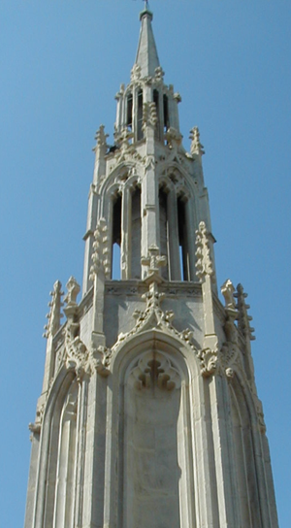
YOU DECIDE … sample rate
Which image and sound sample will have better quality? Why?
Image | Sound
72 pixels / inch | 11 kHz
300 pixels / inch | 44 kHz
Which image has higher spatial resolution?
50ppi
300ppi
Notes:
Use this slide to discuss decisions developers must make to balance quality and file size. Higher sample rates lead to larger file sizes, but lower sample rates lead to lower quality representation of the analog data.
Ask students to identify the spatial resolution setting for their digital camera. If they have a camera phone, have them locate the spatial resolution for the images they take on their camera phone.

Slide 19
DIGITAL ENCODING
Description-based encoding
  A detailed representation of the discrete elements that comprise the media.
Command-based encoding
  A set of instructions the computer follows to produce the digital media.
Notes:
Students should identify different forms of description and command based encoding.
Bitmapped images = description
Vector images = command
Sampled sound = description
Synthesized sound = command

Slide 20
MEDIA ENCODING COMPARED
Description | Command
Advantages
Represent natural scenes and sounds. | File sizes are small.
Supports detailed editing. | Scaled without distortion.
Limitations
Large file sizes. | Not appropriate for detailed photographs and natural sounds.
Lose quality if enlarged. | Requires knowledge of music and vector image creation.
Notes:
Use this table to compare digital data from a photograph or recording of bird songs to understand the benefits of using descriptive encoding.
Consider the benefits of creating MIDI sounds or PowerPoint clip media using command based encoding.
Discuss the decision process developers must make when they chose the format to capture, edit and save media in each mode.

Slide 21
FILE COMPRESSION
Process of re-encoding digital data to reduce file size.
Codec: a program to compress a file into a smaller size and decompress it into a usable form.
Notes:
Class should identify why compression is necessary with digital media and two reasons why developers should have an understanding of compression.

Slide 22
MAJOR TYPES OF COMPRESSION
Lossy
  Number of bits is reduced and some data is lost.
  Lossy strategies include MP3 and JPEG compression.
Lossless
  Efficient encoding reduces file size without loss of original data.
  Lossless strategies include RLE and GIF compression.

Slide 23
YOU DECIDE… Lossy or Lossless
  Photograph of sailboat on ocean.
  Journal article explaining nanotechnology.
  1812 Overture by New York Philharmonic Orchestra.
  Database of student names and addresses.
  Video of hot air balloon flying over a cornfield.
Choose a compression strategy best suited for:
Notes:
Discussion should center on what types of data are best suited for lossy or lossless strategies.
Photos and videos can lose data without compromising the content. A article would not be intelligible if some of the text were lost.

Slide 24
ERROR DETECTION & CORRECTION
Digital bits may be lost during transmission or damaged on storage media.
  CDs get scratched.
  Communication lines have interference.
Strategies to preserve data vary.
  Parity bits help detect an error during transmission.
  CDs include redundant data to replace data when an error occurs.
Notes:
Have students research the error correction overhead on a CD and DVD.

Slide 25
DIGITAL INFORMATION —
ADVANTAGES
Reproduction without generation decay.
Editing and re-editing much easier than with analog media.
Integration of media using cut, copy, paste more efficient.
Distribution over Internet - nearly everyone can be reached by anyone else.
Notes:
Consider additional advantages not mentioned here.

Slide 26
DIGITAL INFORMATION —
CHALLENGES
File sizes are large.
Digital media is processor intensive.
Absence of media standards renders data files incompatible.
Some media requires high bandwidth to distribute on networks.
Concern for longevity and future accessibility of digital data.
Notes:
Have students identify a specific example for one of the disadvantages. Examples might be to research the file size of a 40 minute uncompressed digital video, how many processors it takes to render a feature length animation, the bandwidth requirements for full motion video, the problem of preserving data on magnetic tape or disk cartridges.

Slide 27
WRAP UP
Analog vs. Digital data.
Symbols and binary code.
Data vs. Information.
Files as containers.
Digitization process.
Description- vs. Command-based media.
Compression strategies.
Error detection & correction.
Advantages & Challenges of digital data.

Slide 28
KEY TERM CHECK UP

