Slide 1
The Systems Development Life Cycle (SDLC)

Slide 2
The SDLC
  The development of a new software or application typically follows a methodology.
  This is called the Systems Development Life Cylce (SDLC).

Slide 3
The SDLC
  A methodology is a series of well-defined phases, performed in sequence, that serve as a framework for developing a system or project.

Slide 4
The SDLC
  A methodology is a series of well-defined phases, performed in sequence, that serve as a framework for developing a system or project.
  Each phase’s output (results) becomes the input for the next phase.

Slide 5
The SDLC
  The initial Planning and Strategy, and to a large extent, the Research you have been working on, are part of the SDLC methodology.
  Each phase’s output (results) becomes the input for the next phase.

Slide 6
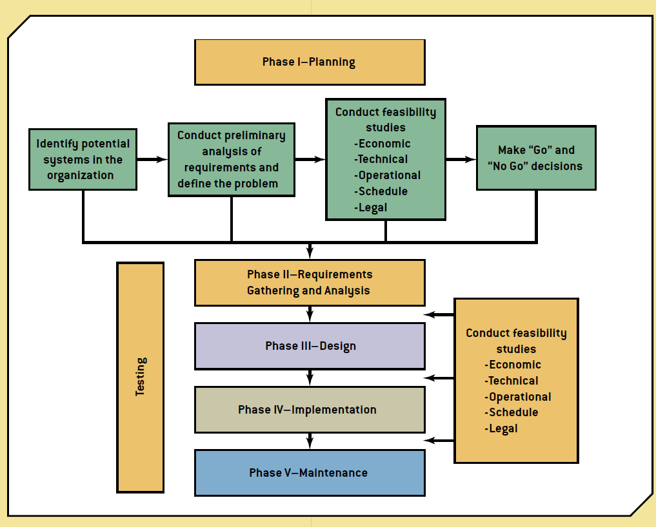
The SDLC
SDLC Methodology

