Slide 1

Mobile Application Development
Chapter 5
[Persistent Data in Android]

Slide 2
Contents
Data persistence
Preference, files and databases
Saving Key-Value sets
Saving Files
Saving Data in SQL databases

Slide 3
Data persistence
The three approaches to data persistence
          SharedPreferences,
          Standard flat file input/output, and
          SQLite database system.
  Preferences are implemented through use of the SharedPreferences class.
  There are two main modes for accessing SharedPreferences:
                getSharedPreferences ("String preference name", integer mode)
                getPreferences(integer mode).
  Files are written and read as a stream of bytes. This means that to the Android system, a file is one thing. It does not have parts.
Notes:
Figure:

Slide 4
  Files are written and read as a stream of bytes.
  Files can be written to either internal or external storage.
  Android supports the use of SQLite databases.
  The MyContactList app uses a simple, one table database to provide the data storage and manipulation functionality.
  The recommended approach to using SQLite in an Android app is to create a Database Helper class whose only function is to provide for the creation, modification, and deletion of tables in the database.
Notes:
Figure:

Slide 5
Explanation of code:
  The class ContactDBHelper is declared as a subclass of SQLiteOpenHelper
  A static variable is declared to name the database.
  A static variable to hold the database version number is declared and initialized to 1.
  A string variable is declared and assigned to a SQL command that creates the table.
Notes:
Figure:

Slide 6
Saving Data in Apps
https://developer.android.com/training/basics/data-storage/index.html

Slide 7
Explanation of code (contd.):
  The constructor method calls the super class’s constructor method.
  The onCreate method is called the first time the database is opened.
  The onUpgrade method is executed when the database is opened and the current version number in the code is higher than the version number of the current database.
Notes:
Figure:

Slide 8
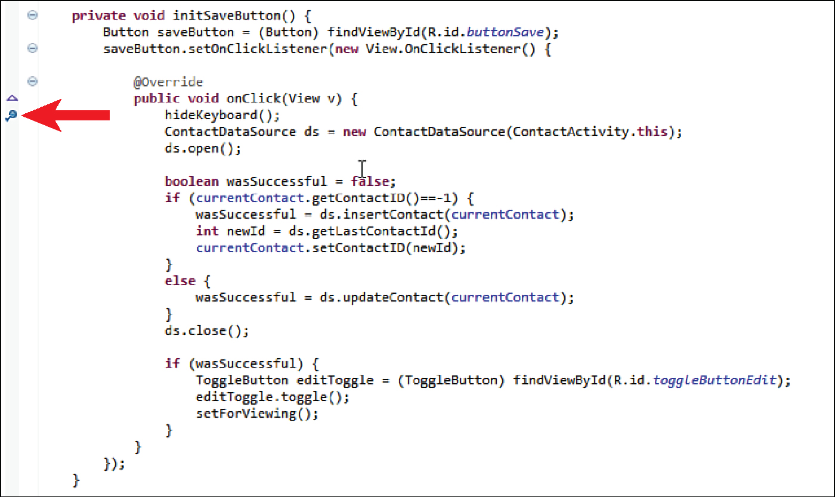
Figure 5.1 Code with breakpoint set.
Notes:
Figure:

Slide 9
Create the Data Source Class:
  Create a new class named ContactDataSource (Listing 5.2)
  Variables are declared to hold instances of the SQLite database and the helper class.
  The helper class is instantiated when the data source class is instantiated.
  Open and close methods are used to access and end access to the database.
  The rest of the code in this class is dependent on the needs of the app.
  The Contact class does not exist, so the first task is to create that class. Create another new class in the src folder named Contact (Listing 5.3).
Notes:
Figure:

Slide 10
Create the Data Source Class:
  The Contact class is a very simple class.
  After the Contact class has been created, you can now code the insert and update methods in the ContactDataSource class. (Listing 5.4).
  The two methods are very similar. The primary difference is that the updateContact method uses the Contact ID to overwrite values in the Contact table.
  The insertContact method just inserts contact data and the database inserts the ID because the _id field was declared as an autoincrement field.
Notes:
Figure:

Slide 11
Similarity of Two Methods:
  A Boolean variable is declared and assigned the value false.
  The ContentValues object is used to store a set of key/value pairs that are used to assign contact data to the correct field in the table.
  The values for the table are retrieved from the Contact object, associated with the correct field, and inserted into the ContentValues object.
Notes:
Figure:

Slide 12
Similarity of Two Methods:
  The database’s insert method is called and passed the name of the table and values to insert.
  If the method throws an exception, the return value is already set to false, so we don’t have to do anything.
  The update procedure needs the contact’s ID to correctly update the table.
  The database’s update method is called to place the changes in the database.
Notes:
Figure:

Slide 13
Using the Database:
  The three classes: Contact , ContactDBHelper , and ContactDataSource , are used in the ContactActivity class to implement the saving of contact data to the database.
  The first step is to provide an association between the ContactActivity class and a Contact object.
Notes:
Figure:

Slide 14
Using the Database:
  Next associate the currentContact variable with a new Contact object by entering the following code as the last line in the onCreate method: currentContact = new Contact() ;
  The final step in modifying existing code is to add a line of code in the didFinishDatePickerDialog method to store the selected birthday in the Contact object.
  Add the following line of code as the last line of code in that method: currentContact .setBirthday(selectedTime)
Notes:
Figure:

Slide 15
Capture User-Entered Data:
The first new method needed is used to capture the user data as it’s typed and store it in the currentContact object.
To start, enter the following line of code after all the other init methods in the onCreate method: initTextChangedEvents ( ) ;
Next, create a new method in the ContactActivity class called initTextChangedEvents ( ) .
Place this method after the other init methods currently in the class. Enter the code in Listing 5.5
Listing 5.5 is not the complete method. A listener has to be added for all the other EditTexts in the layout.
Notes:
Figure:

Slide 16
The code is essentially the same for each EditText.
  A reference to the Contact Name EditText is assigned to the variable contactName.
  A TextChangedListener is added to the EditText by creating a new TextWatcher object.
  The afterTextChanged method is a required method for the TextWatch object.
  This code is executed when the user ends editing of the EditText
  The beforeTextChanged method is a required TextWatcher method.
Notes:
Figure:

Slide 17
The code is essentially the same for each EditText.
  The onTextChanged method is also a required TextWatcher method.
  The pattern repeats for another EditText in the layout, except that value is assigned to a different attribute of the currentContact object.
  This code gets the value entered into the editAddress EditText , converts it to a string, and sets the streetAddress attribute of the currentContact object to that value.
  This code needs to be repeated for the remaining EditText s in the activity_contact.xml file.
  Next set the phone number EditText s to autoformat the number as it’s typed. Finally, add initTextChangedEvents(); to the onCreate method.
Notes:
Figure:

Slide 18
Save User-Entered Data:
The intTextChangedEvents method sets the stage for saving the contact’s data.
It sets the EditText s to update the ContactActivity ’s contact object with any changes users make as they make them.
All that is left is to pass that object to the insert or update method in the ContactDataSource class so that the changes can be stored in the database.
The initialization of the Save button is similar to the initialization of all the other buttons coded.
Notes:
Figure:

Slide 19
Enter the code in Listing 5.6 before the initTextChangedEvents method.
Call the method in the onCreate method where the rest of the button initialization methods are called.
The only new code in this method is the code associated with the save operation.
  A new ContactDataSource object is instantiated.
  The database is opened.
  A Boolean variable is declared and set to false.
  The currentContact’s id is compared to -1.
  The database is closed as soon as possible.
  The return value is checked.
Notes:
Figure:

Slide 20
Test the code on the emulator. Fix any discrepancies.
Repeat the last two lines of code in Listing 5.7 for each EditText in the layout.
Test the modification in the emulator. Fix any discrepancies.
Open the ContactDataSource and create a new method using the code in Listing 5.8.
Notes:
Figure:

Slide 21
The structure of this method is similar to the other insert and update methods.
  An SQL query is written to get the maximum value for the _id field in the contact table.
  A cursor is declared and assigned to hold the results of the execution of the query.
  The cursor is told to move to the first record in the returned data.
  The maximum ID is retrieved from the recordset.
  The cursor is closed.
Notes:
Figure:

Slide 22
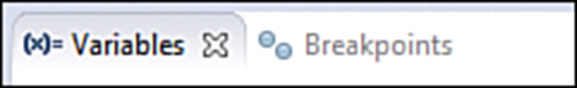

Use the Debugger:
To test if the functionality just added is working properly you have to watch it run. This is done using the debugger.
To check whether the currentContact is getting a new ID, set a breakpoint in the initSaveButton method on the hideKeyboard() line ( Figure 5.1 ).
To control execution during debugging, use the Debug toolbar buttons at the top of the perspective (See Figure 5.2 ).
Notes:
Figure:

Slide 23
Use the Debugger (contd):
Click the Step Over button and watch the code step line by line until you reach the currentContact.setContactID(newId) line.
On the upper right of the perspective is a pane with two tabs: Variables and Breakpoints (see Figure 5.3 ). Click the Variables tab.
In the Variables tab, find the newId variable and verify that its value is greater than -1.
The debugger can be stopped in several ways. The first would be to click the Terminate button in the toolbar.
An alternative to stepping through the code with the debugger is to use logging.
Notes:
Figure:

Slide 24
SharedPreferences are an easy way to store bits of information that need to persist over the life cycle of an app.
Settings Layout
  Open the activity_contact_settings.xml file.
  In Graphical Layout, drag two medium TextViews and two RadioGroup widgets from the Form Widgets folder in the Palette to the layout.
  Switch to activity_contact_settings .xml and modify the XML to match Listing 5.9 .
  After the modifications have been made, switch to Graphical Layout and verify that the layout
  looks like Figure 5.5 .
Notes:
Figure:

Slide 25
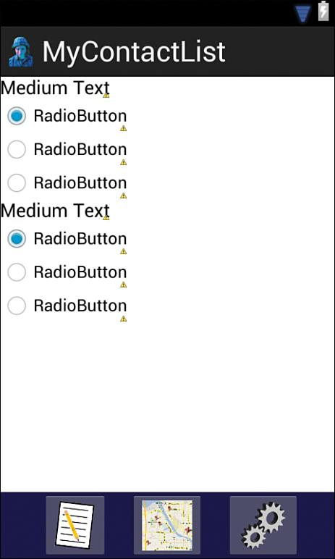
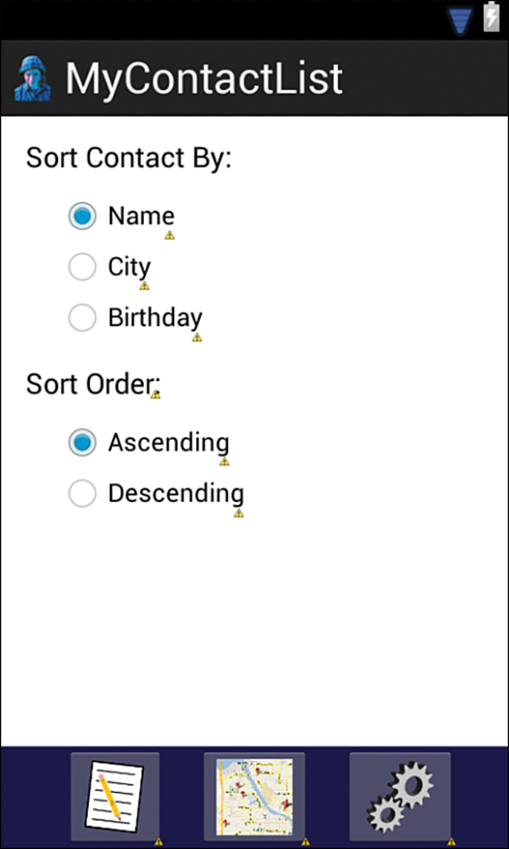
Figure 5.4 ContactSettings layout loading widgets.
Notes:
Figure:

Slide 26
Code the Page’s Behavior
  Open the ContactSettingsActivity .java file and complete the following steps:
    Copy the ImageButton initialization methods from the ContactActivity .java to the ContactSettingsActivity .java file so that the navigation bar will work.
    When the code is pasted into the ContactSettingActivity class, it will produce errors. Change this for each to be the ContactSettingActivity.
Notes:
Figure:

Slide 27
Change the code in the initSettingsButton() method so that the button is disabled.
    Call the three methods in the onCreate method.
    Create a method called initSettings and refer to the code in Listing 5.10 to get it to properly configure the activity at startup.
Notes:
Figure:

Slide 28
The initSettings method gets the values stored in SharedPreferences to set the RadioButtons to the value that the user checks.
  A string variable is declared, and the value for the field to sort contacts by is retrieved from SharedPreferences.
  A reference to each radio button in the sort field RadioGroup is assigned to a variable.
  The value retrieved for the preferred sort field is evaluated to determine which RadioButton should be set as checked.
  The same operations are performed to set the sort order to the order preferred by the user.
Notes:
Figure:

Slide 29
The next step is to create a method to store the selected user preference for each option. Refer to Listing 5.11 for the code for these methods.
The only new code is the code used to save the selected preference.
Add calls to these methods in the onCreate method and then run and test the Settings activity.
Remember, data that exists beyond the execution of the app is said to persist.
Notes:
Figure:

Slide 30
References
Saving Data in Apps
https://developer.android.com/training/basics/data-storage/index.html

