Slide 1

Mobile Application Development Chapter 4 [Android Navigation and Interface Design]

Slide 2
Contents
Activities, Layouts and Intents
Creating the Interface of the ContactList App
Activating the Interface

Slide 3
Activities, Layouts & Intents
Activities, Layouts and Intents are the three objects used as a basis for the structure of an Android app.
Activities & Layouts work together to present a display that the user can interact with.
Intents are objects that are used to switch between activities in an app.

Slide 4
Activities, Layouts & Intents The Activity Class
The Activity class is designed to handle a single task that the user can perform.
The Activity class is not directly instantiated in an Android app. Rather, it is sub-classed (inherited) for every activity that the developer needs to create in the app. This way developers can inherit all the functionality of the Activity class in addition to adding their own unique functionality through Java code.
One of the most important inherited functions of the Activity class is the capability to respond to life cycle events such as onCreate and onPause.
The Activity subclasses developed by the user are stored as .java files in the app project’s java folder.

Slide 5
Activities, Layouts & Intents The Activity Class
The Activity class has several subclasses, among which are:
FragmentActivity subclass : Fragments allow the developer to include multiple tasks or panes within a single activity. This class is also used to make an app backward compatible to OS versions earlier than 11.
ListActivity subclass: designed to specifically support the development of a list interface.

Slide 6
Activities, Layouts & Intents The Layout
A layout is the visual component of a user interface in Android.
The layout is not a class but rather an XML file that is used to tell the operating system what visual objects are to bedisplayed, how those objects are configured, and where those objects should be displayed on the screen.
The objects that make up an Android interface are referred to as widgets . Widgets are subclasses of the View class.
Android widgets include widgets to define where other widgets are displayed (for example, RelativeLayout ), to directly interact with the user (for example, RadioButton ), and to provide some type of navigation within the interfaces (for example, ScrollView ).
Layouts can also be defined at runtime by instantiating the widgets that make up an interface and configuring them as needed. However, designing the interface is more difficult because you cannot see the layout until you run the app.

Slide 7
Activities, Layouts & Intents The Intent class
An Intent is a class that is used to describe an operation to be performed.
An Intent is essentially a message that defines an action to be taken and the data that the action is to be performed on.
Intents are the primary way in which the developer starts new activities within the app.
Intents can also be used to communicate between activities.
Intents can be used to start activities or broadcast both within and outside the app to provide instructions and data to other activities.

Slide 8
Creating the Interface of the ContactList App
The MyContactList app requires four screens, i.e. ; four activities and four layouts to provide the desired functionality
Contact Screen
Contact List Screen
Map Screen
Settings Screen
The app will use Intents to switch between activities and pass data between these activities.
The app will also use four images, one for the app icon and three for the navigation bar. The images have to be copied (imported) into the drawable folder.

Slide 9
Creating the Interface Create the Navigation Bar
The navigation bar for the MyContactList app sits at the bottom of all screens and allows the user to quickly move between different functions in the app by tapping one of the images on the bar.
The navigation bar is made up of three ImageButtons contained within a RelativeLayout .
The RelativeLayout is set to be as big as the three buttons and is placed within the root RelativeLayout, which was placed in the layout files of the created activities. The navigation layout is anchored to the bottom of the root layout so that it always appears at the bottom of the screen.

Slide 10
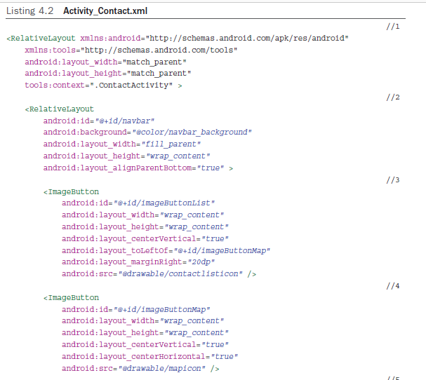
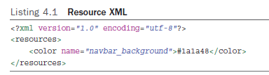
Creating the Interface Create the Navigation Bar

Slide 11
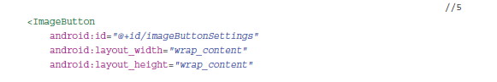
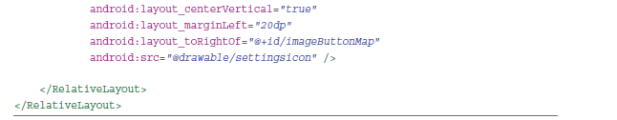
Creating the Interface Create the Navigation Bar
Once the navigation bar is coded, it can be copied into each of the other
three activities’ layouts. The copied xml code must include the start <RelativeLayout and end </RelativeLayout> tags.

Slide 12
Creating the Interface Create the Contact Layout
There are three major sections in this layout.
The navigation bar (completed in the previous section)
The toolbar, which is another RelativeLayout displayed at the top of the screen that allows the user to access overall functionality of the Contact screen.
The ScrollView (Data Entry form) that holds all the widgets that allow the user to enter information about a contact. A ScrollView is used to ensure that users can access all the data entry widgets regardless of the size of the used device.

Slide 13
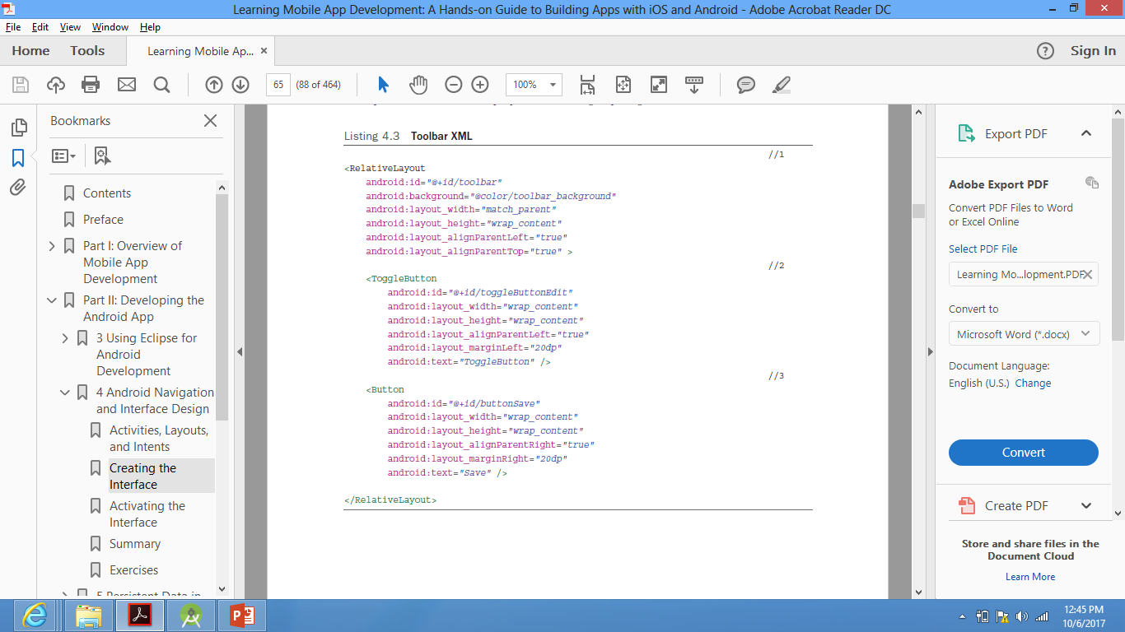
Creating the Interface Create the Contact Layout >> Toolbar
The toolbar consists of :
A RelativeLayout positioned at the top of the root layout
A ToggleButton to switch between editing and viewing modes
A Button to allow the user to save changes to the contact’s information.

Slide 14
Creating the Interface Create the Contact Layout >> ScrollView (Data Entry Form)
The ScrollView or the data form portion of the Contact Layout allows users to enter information on their contacts. It primarily relies on the EditText and TextView widgets.
The ScrollView is placed between the navigation bar and the toolbar.
By default the ScrollView has a LinearLayout as its only contents.
ScrollViews can have only one widget as their contents. However, if that widget is some type of layout, more widgets can be added as long as they are within that layout.
LinearLayouts allow a simple display of widgets one right after the other either vertically or horizontally. To get a more complex display, the LinearLayout is replaced with a RelativeLayout in the xml code.

Slide 15
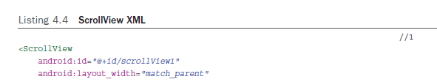
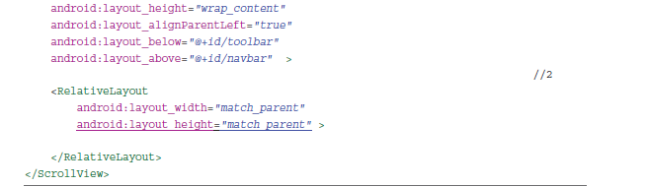
Creating the Interface Create the Contact Layout >> ScrollView (Data Entry Form)
Next step is to write the xml code for all widgets in the RelativeLayout of the ScrollView.
You cannot place the widgets in the ScrollView, as it has already one widget, namely
the RelativeLayout.

Slide 16
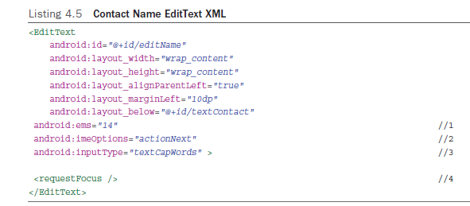
Creating the Interface Create the Contact Layout >> ScrollView (Data Entry Form)
Drag a TextView to the RelativeLayout in the ScrollView .Then switch to XML view and modify the TextView attributes so that its ID is textContact , is aligned to the top and left of its parent, and it has a left margin of 10dp , a top margin of 5dp , and displays Contact: as its text.
Then add an EditText for the user to enter the contact name. Code shown below.

Slide 17
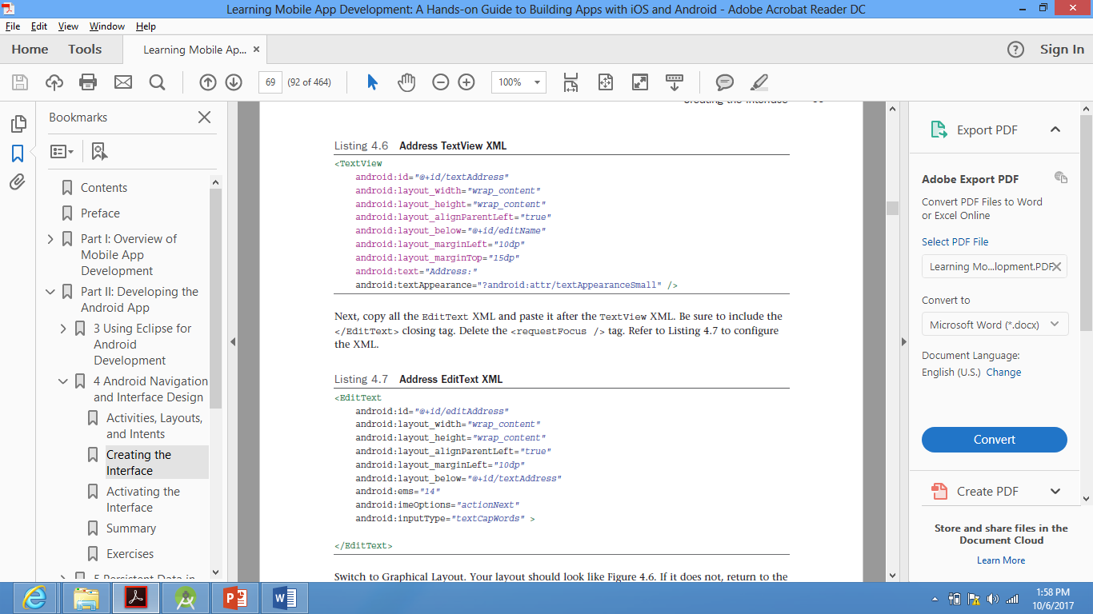
Creating the Interface Create the Contact Layout >> ScrollView (Data Entry Form)
Then add the Address TextView and EditText as shown below

Slide 18
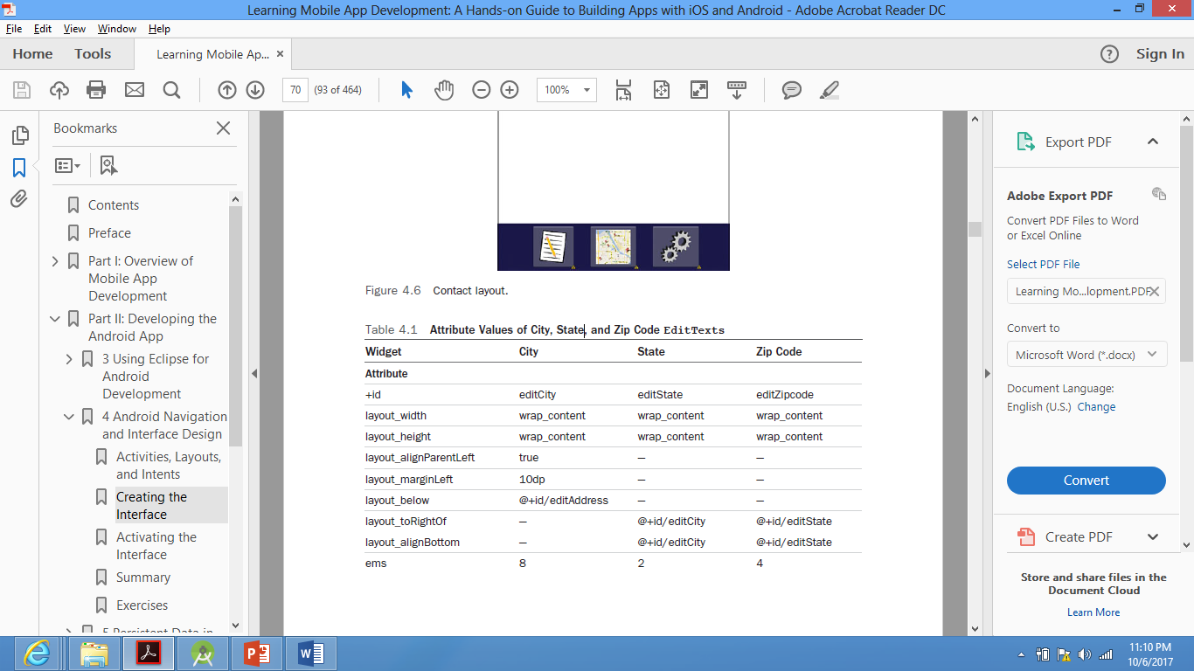
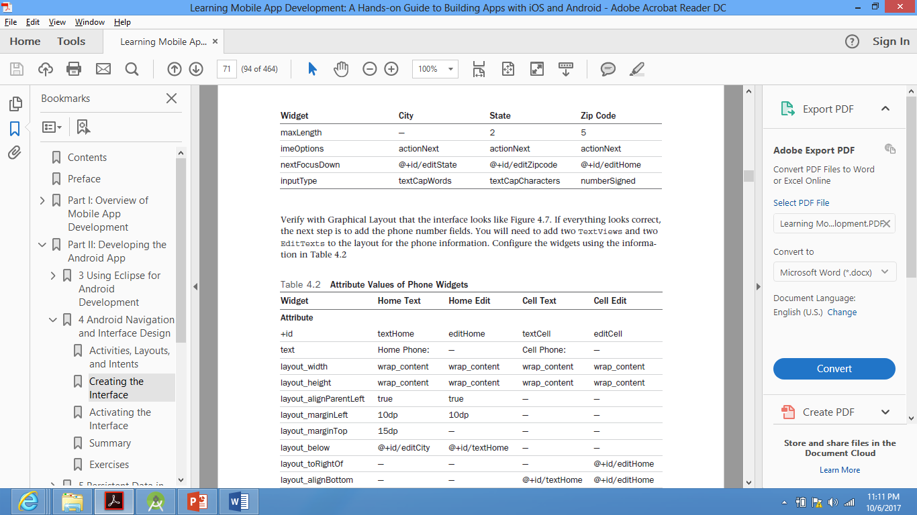
Creating the Interface Create the Contact Layout >> ScrollView (Data Entry Form)
The next step is to add the three TextViews and EditTexts required to enter the city, state and zip code of the contact. The xml attributes of these widgets are as follows:

Slide 19
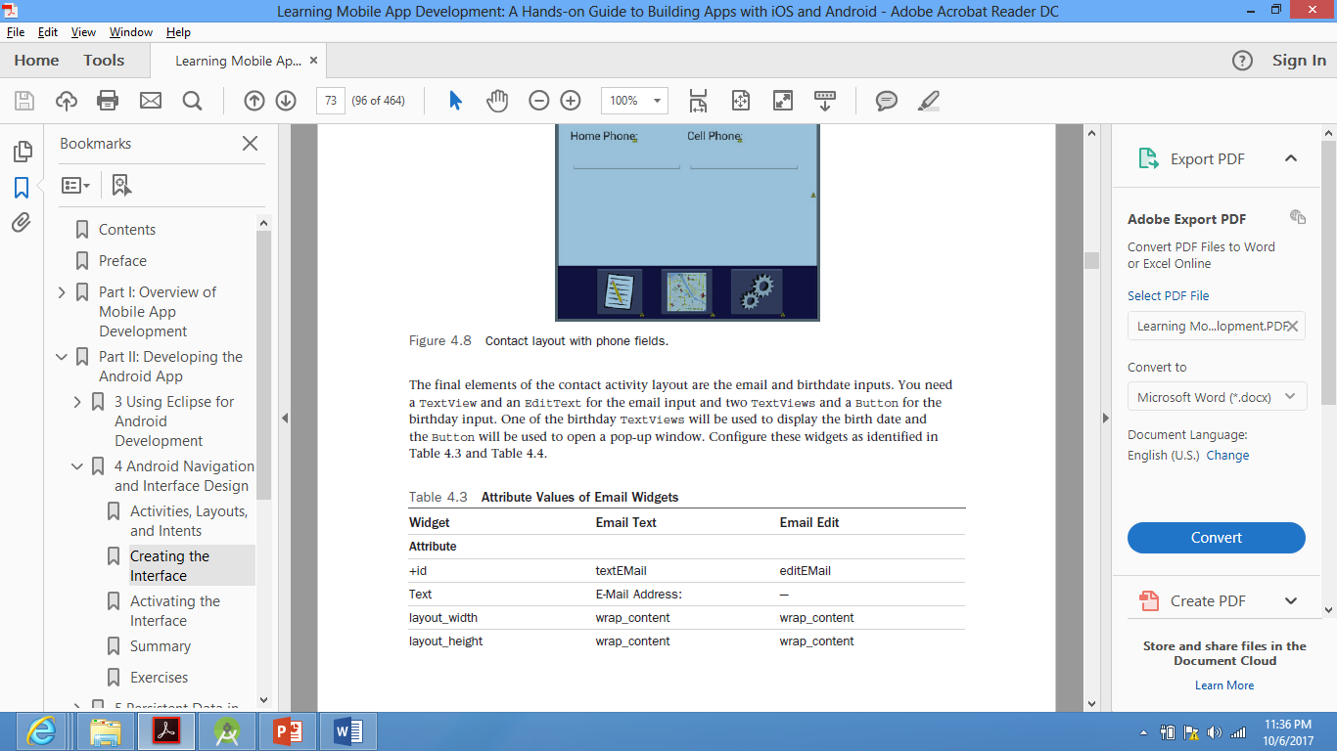
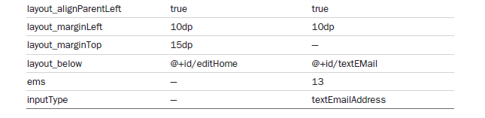
Creating the Interface Create the Contact Layout >> ScrollView (Data Entry Form)
Then the email and birthdate TextView and EditText. The xml attributes of these widgets are as follows:

Slide 20
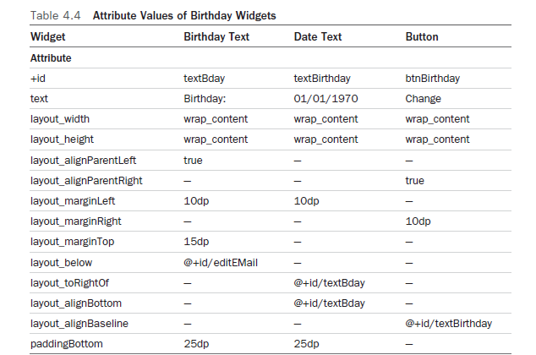
Creating the Interface Create the Contact Layout >> ScrollView (Data Entry Form)
This Button opens
a DatePicker Dialog,
where date is selected
and displayed in the DateText

Slide 21
Creating the Interface Create the Contact Layout >> DatePicker Dialog
Android provides a DatePickerDialog class that provides the functionality needed. However in this app, we will create a ‘date selection’ pop-up from scratch by creating a new empty layout file in the app layout folder.
The birthday selection date pop-up consists of the following:
DatePicker widget, which allows the user to select a specific date.
Cancel and OK buttons.
A LinearLayout for the DatePicker widget.
A TableLayout for the two buttons.
The DatePicker widget displays only at runtime

Slide 22
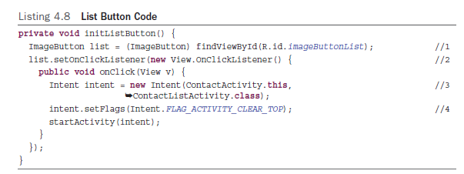
Activating the Interface Activating the Navigation Bar
Similar code is applied for the other two buttons in the navigation bar, but with minor modifications.
For the imageButtonMap the method initSettingsButton is declared, in which you change
initListButton() to initMapButton()
R.id.imageButtonList to R.id.imageButtonMap
ContactListActivity.class to ContactMapActivity.class
For the imageButtonSettings, the method initSettingsButton is declared, in which you change
initListButton() to initSettingsButton()
R.id.imageButtonList to R.id.imageButtonSettings
ContactListActivity.class to ContactSettingsActivity.class
Finally, the three methods must be called in the onCreate method to be ready
for use once the user clicks the buttons

Slide 23
Activating the Interface Activating the Toggle Button in the Toolbar
The Toggle button once pressed (On state), all widgets are enabled and can be edited. If the Toggle button is not pressed (Off state), all widgets are disabled.
The ToggleButton's functionality requires the creation of two methods.
A method to initialize the button to respond to the user.
A method to enable/disable all the data entry widgets

Slide 24
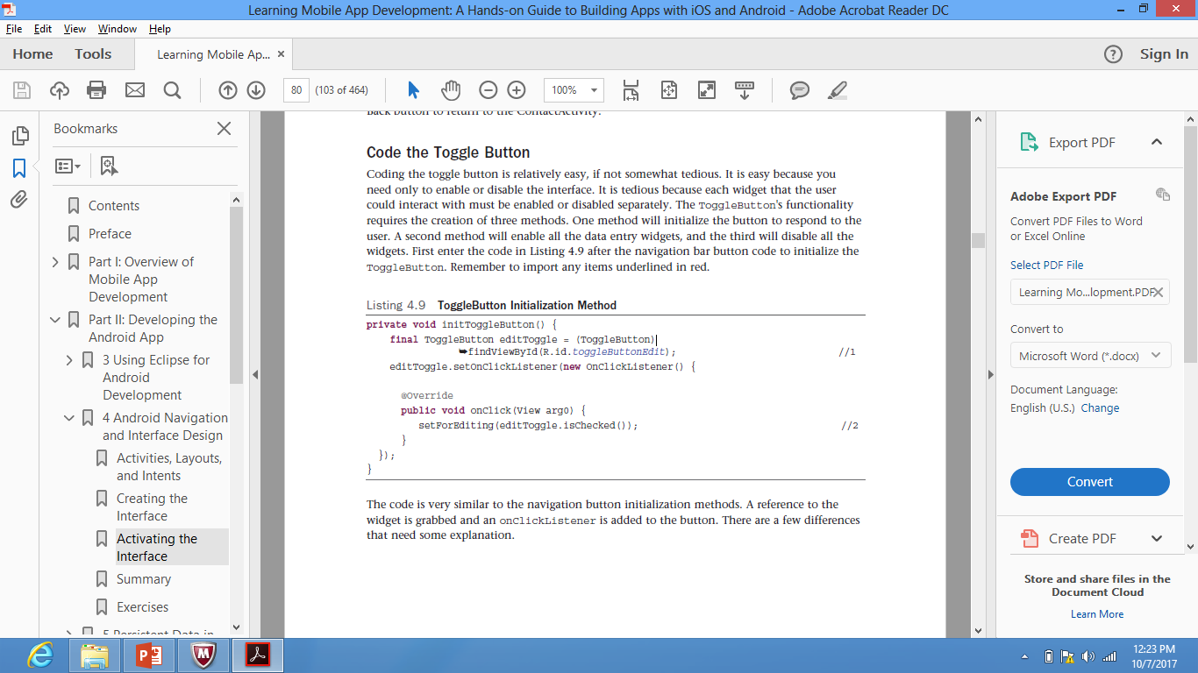
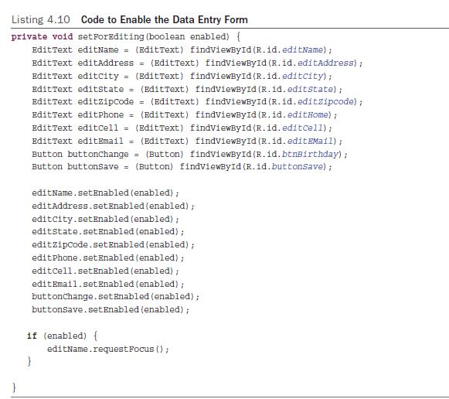
Activating the Interface Activating the Toggle Button in the Toolbar
After coding the methods,
call them in the onCreate() method

Slide 25
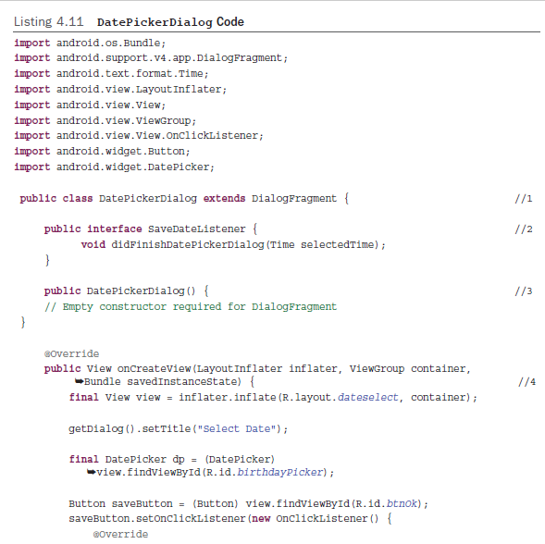
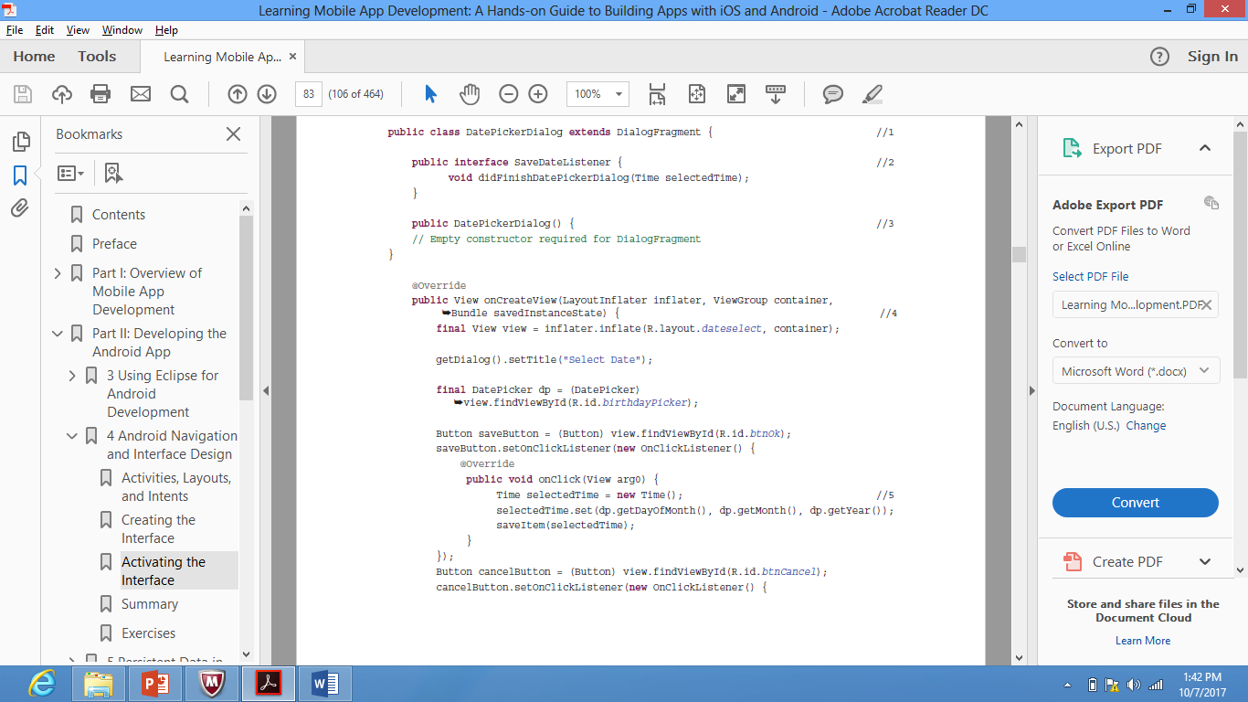
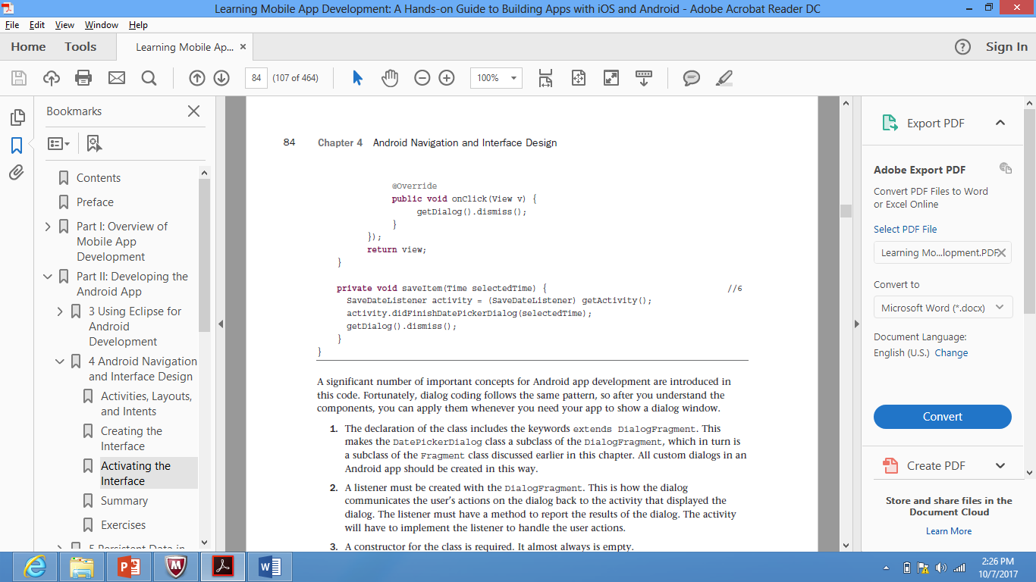
Activating the Interface Activating the DatePicker Dialog
The first task is to create a new java class (DatePickerDialog.java) to hold the following custom dialog code
To develop a custom dialog, it needs a listener interface and associated method, a constructor, an onCreateView method, and a call to the listener method. Finally, the dialog must be dismissed at the end of every code path in the DialogFragment .

Slide 26
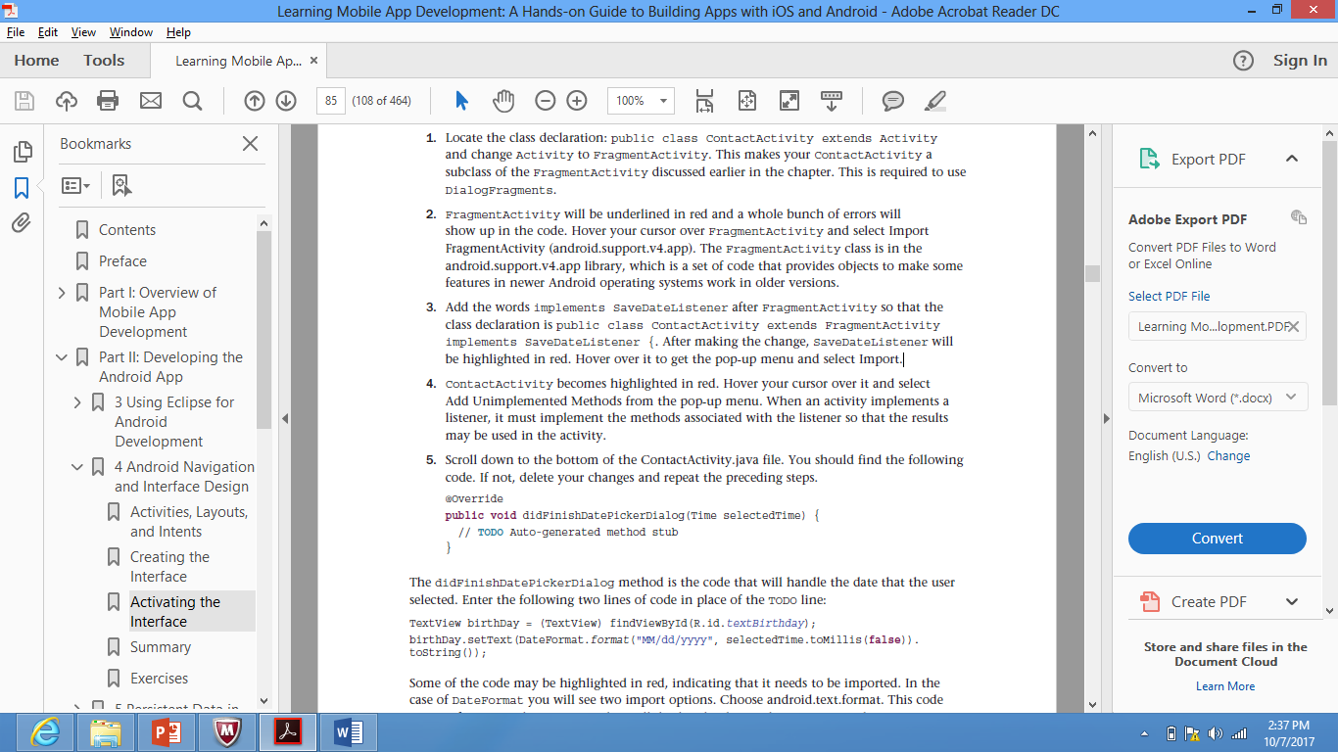
Activating the Interface Activating the DatePicker Dialog
Before the dialog can be tested, it must be implemented in the activity that uses it. In this case it is the ContactActivity. The following steps must be carefully implemented.

Slide 27
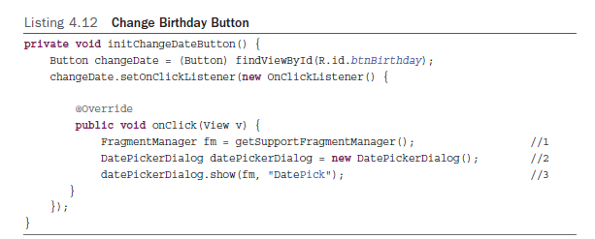
Activating the Interface Activating the DatePicker Dialog
The last step is to code the Change button to make it display the dialog.

Slide 28
Extra Resources
Running your app on a mobile device
https://developer.android.com/training/basics/firstapp/running-app.html
Android UI Layouts :
https://www.tutorialspoint.com/android/android_user_interface_layouts.htm
Android UI Controls :
https://www.tutorialspoint.com/android/android_user_interface_controls.htm
Android Event Handling
https://www.tutorialspoint.com/android/android_event_handling.htm

Slide 29
Thank You !

Slide 30
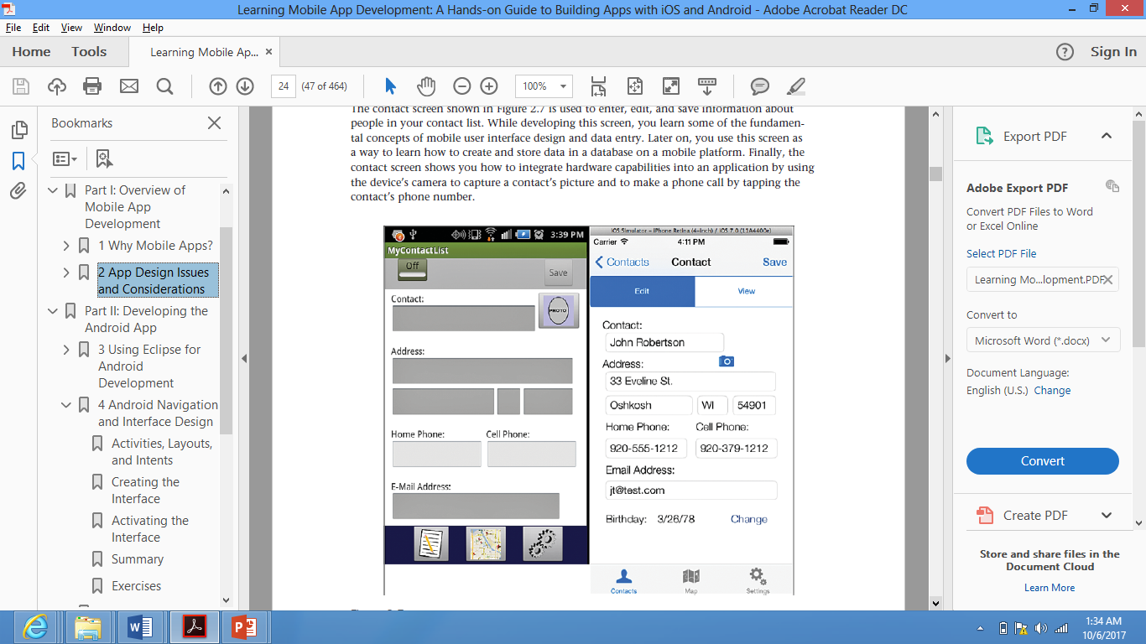
Contact Screen

Slide 31
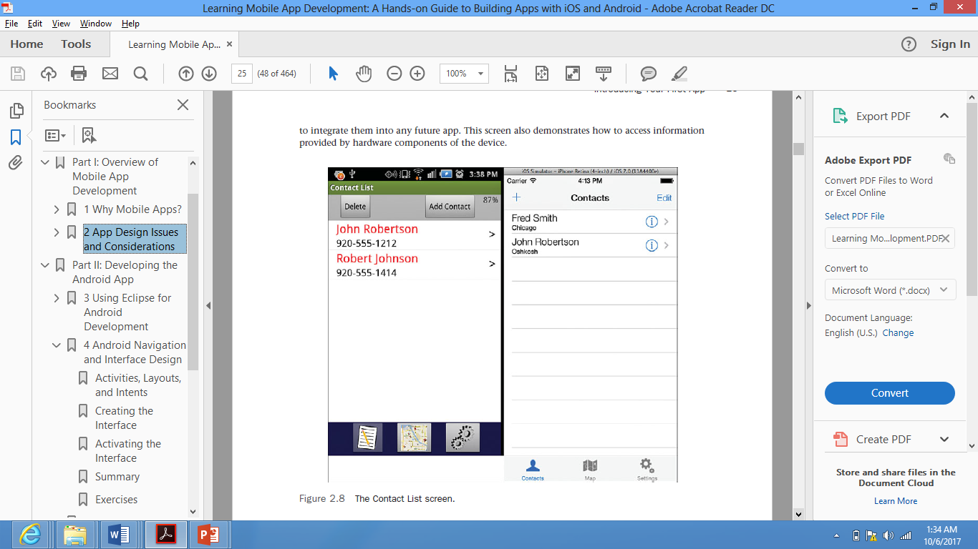
Contact List Screen

Slide 32
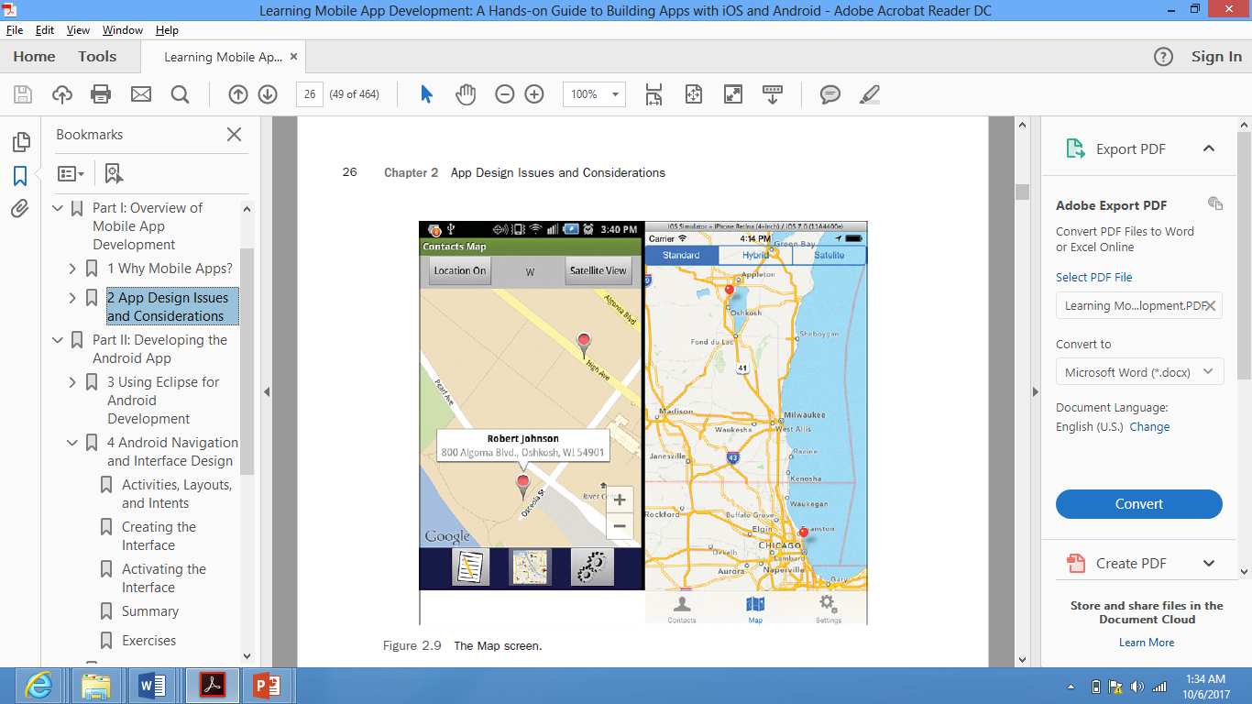
Map Screen

Slide 33
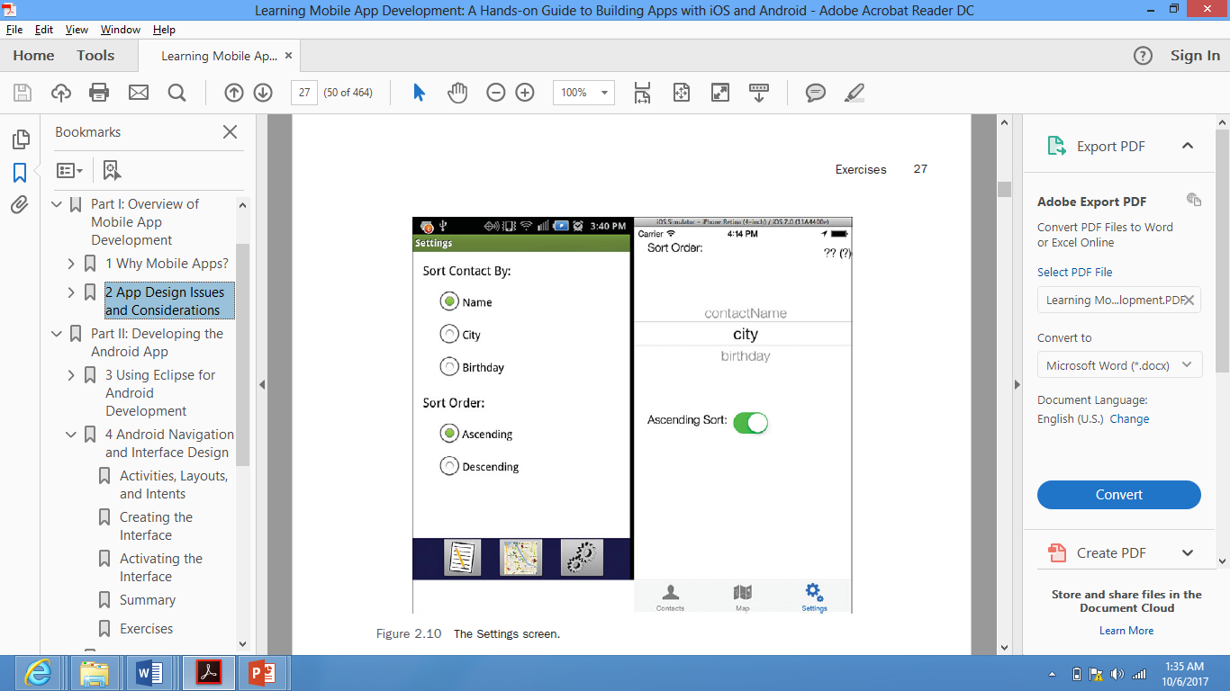
Settings Screen

