Slide 1

Mobile Application Development
Chapter 3
[Using Eclipse Android Studio for Android Development]

Slide 2
Contents
Android
Android Studio
Starting a new project
Components of the IDE
Configuring the Emulator
Coding The Interface
Coding App Behavior

Slide 3
Android
Android is a powerful mobile operating system by Google and designed for smartphones and tablets.
  It enables access to diverse hardware resources on a smartphone or tablet.
  It is continually updated, improved, and extended.

Slide 4
Android Studio
Android Studio is the official IDE for Android
It provides the fastest tools for building apps on every type of Android device.
It provides code editing, debugging and performance tools as well as a flexible build system and an instant build/deploy system
Notes:
Instant Run

Slide 5
Android Studio
Instant Run
see the effects of your code changes immediately without restarting the app or rebuilding the APK.
Intelligent code editor
advanced code completion, refactoring, and code analysis
Robust and flexible build system
offers build automation, dependency management, and customizable build configurations
Designed for Teams
Integrates with version control tools, such as GitHub and Subversion, so you can keep your team in sync with project and build changes
Optimized for all Android devices
provides a unified environment where you can build apps for Android phones, tablets, Android Wear, Android TV, and Android Auto

Slide 6
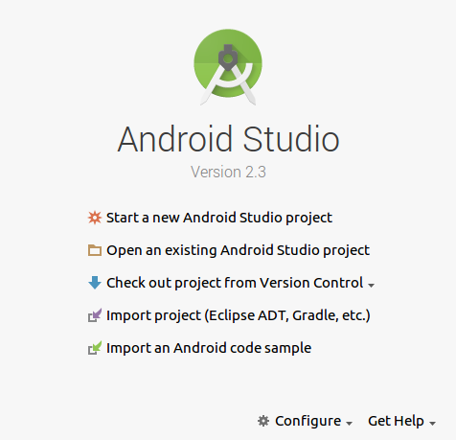
Starting a new Project

Slide 7
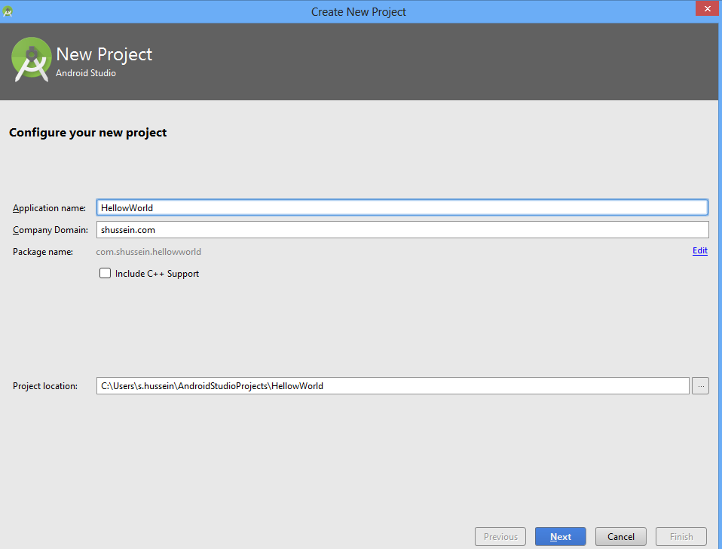
Starting a new Project

Slide 8
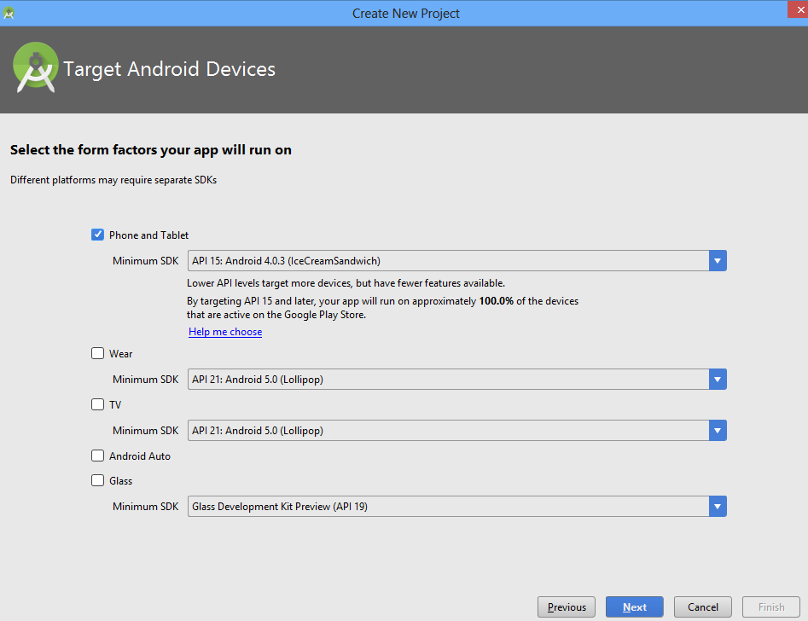
Starting a new Project

Slide 9
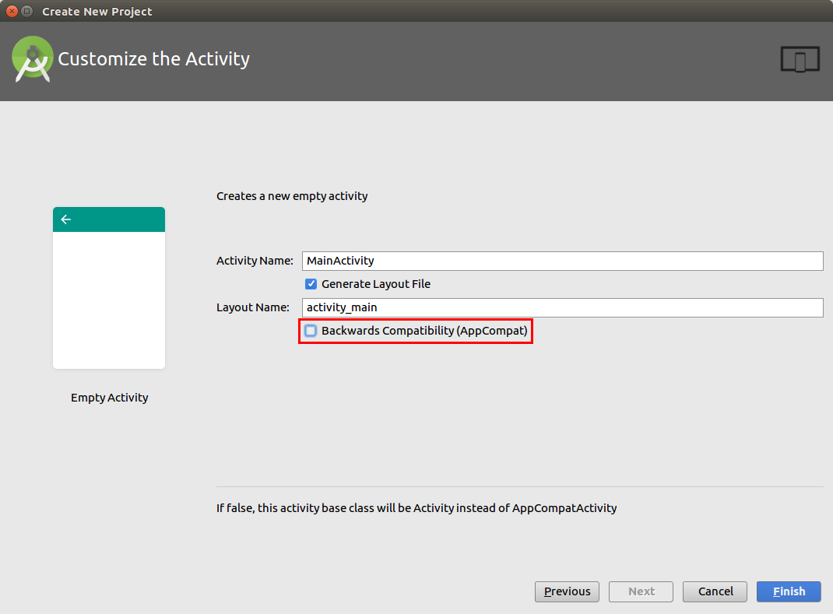
Starting a new Project

Slide 10
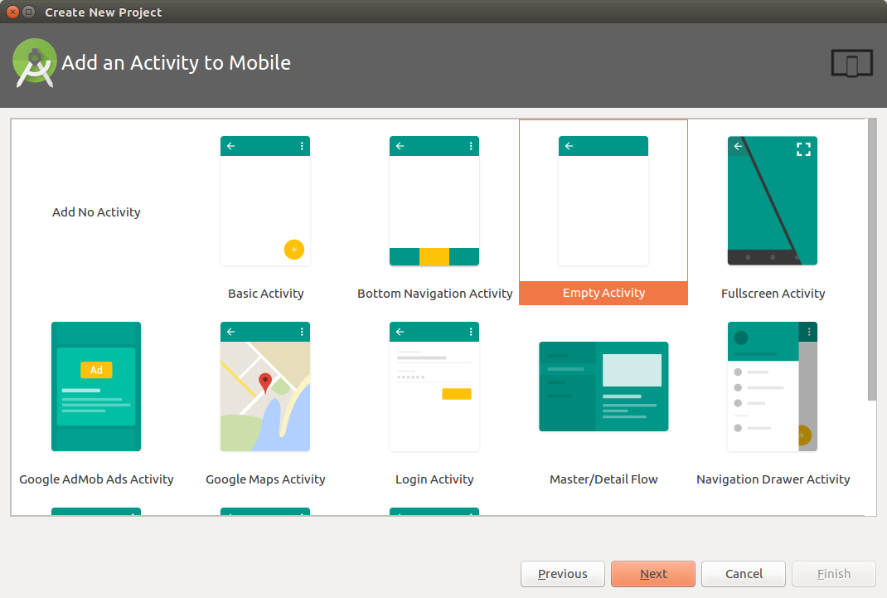
Starting a new Project

Slide 11
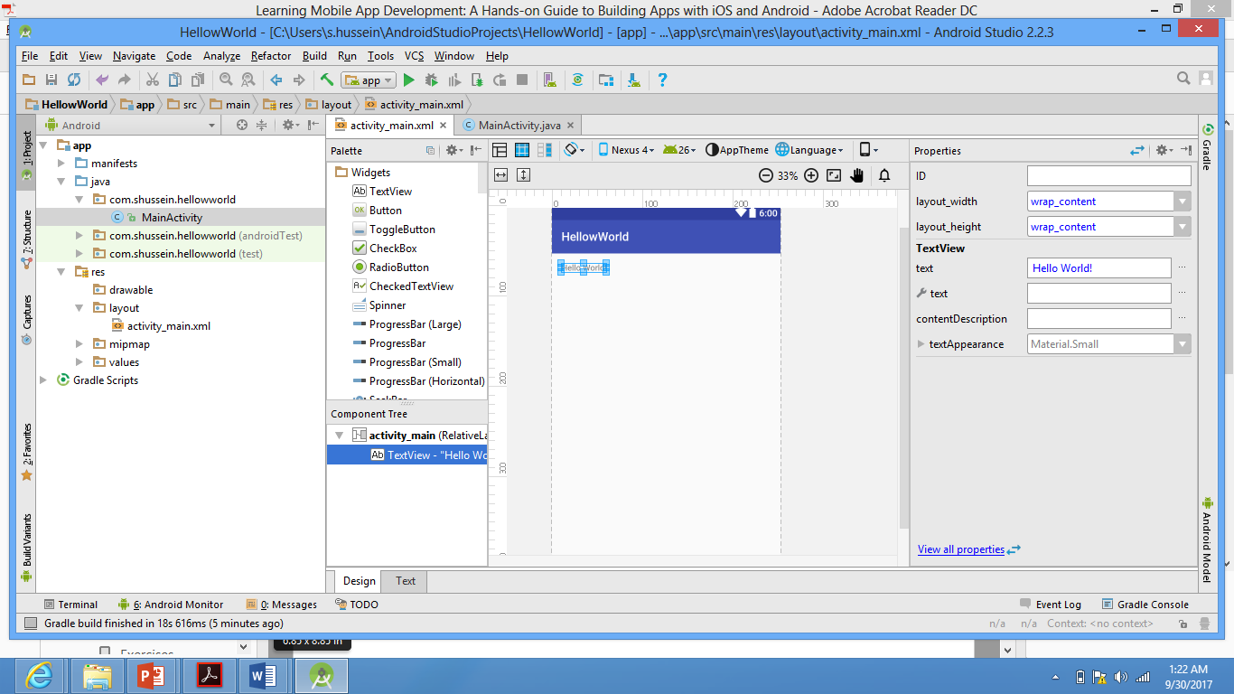
Components of the IDE
Java code
XML code
Design mode
of the HelloWorld Activity
Properties of selected
control
Package Explorer

Slide 12
Components of the IDE
Package Explorer
Manifest Folder
configures the app and informs when the device is installed.
Java Folder
Contains all the Java code files for the app. Each file typically represents one class (activity). This is where the code to create the activity’s functionality is written.
Res Folder
drawable folder:
layout folder
holds all the layouts for the user interface of your app. Each activity has a layout file. A layout file is an XML file that contains the XML used to create the objects and controls that the user can interact with.
mipmap folder
holds the app/launcher only. Any other images are placed in the drawable folder
values folder
contains three xml files that hold configuration data for an Android app. Android uses this information to limit the hard-coding of potentially changeable data.
dimens.xml—Values for the display size of items in a layout.
color.xml—Values for the displayed color of item in a layout.
strings.xml—Values for text.
array.xml—Defines string arrays and the values in those arrays.
ids.xml—IDs that cannot be reused by items in layouts.
holds all app images. Android uses Portable Network Graphics (PNG) files for its images

Slide 13
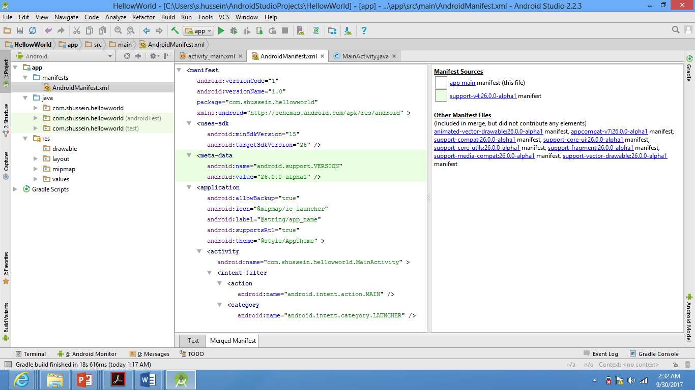
Components of the IDE
Package Explorer >> Manifest Folder
Every application must have an AndroidManifest.xml file in its root directory.
The manifest is used to configure the whole app and tell the device it is installed
on, what it can and should be able to do.

Slide 14
Components of the IDE
Package Explorer >> Manifest Folder
Among others, the manifest file has the following elements:
The <manifest> component is the root element. The attributes associated with this element define the application package, version code, and version name & others.
  The Version Code, which is an integer value, is used to indicate that there is a new version of the app available. Increasing value enables the Play Store to notify users of the app that a new version is available. It also controls the install of the upgrade so that no user data is lost during an upgrade.
  The Version Name is the displayed version of your app.
  The java package of the application. It serves as a unique identifier for the app.
The <uses-sdk> element and its attributes define the minimum and target SDKs for the app.
The <application> element has both attributes and child elements that configure how the app works. Application attributes in this manifest define the app icon, theme, and label(name). Each activity in an app must have an entry in the <application> element. In our app there is only one activity stated in the manifest

Slide 15
Components of the IDE
Package Explorer >> Manifest Folder
The <activity> element tells the operating system that an activity has permission to run in your application. All activities used in an app must be defined in the manifest. The Java source file for the activity and the activity’s title are identified.
The <intent-filter> element , a child element of the <activity> element, defines what the Android OS should do with this activity. Not all activities will have an intent filter. Specifically, activities that you want users to launch when they are using the app do not need intent-filters. However, for this app you want this activity to be displayed when the user runs it. Therefore, the <action> tag identifies the activity as the main or first activity to run.
The <category> tag tells the OS to use the app launcher to start this activity.

Slide 16
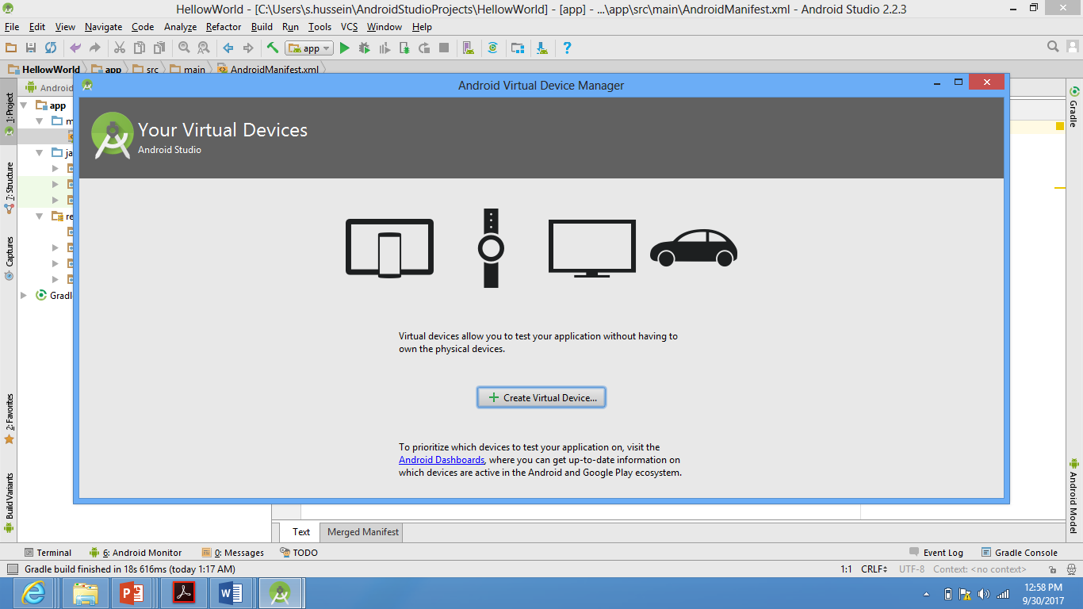
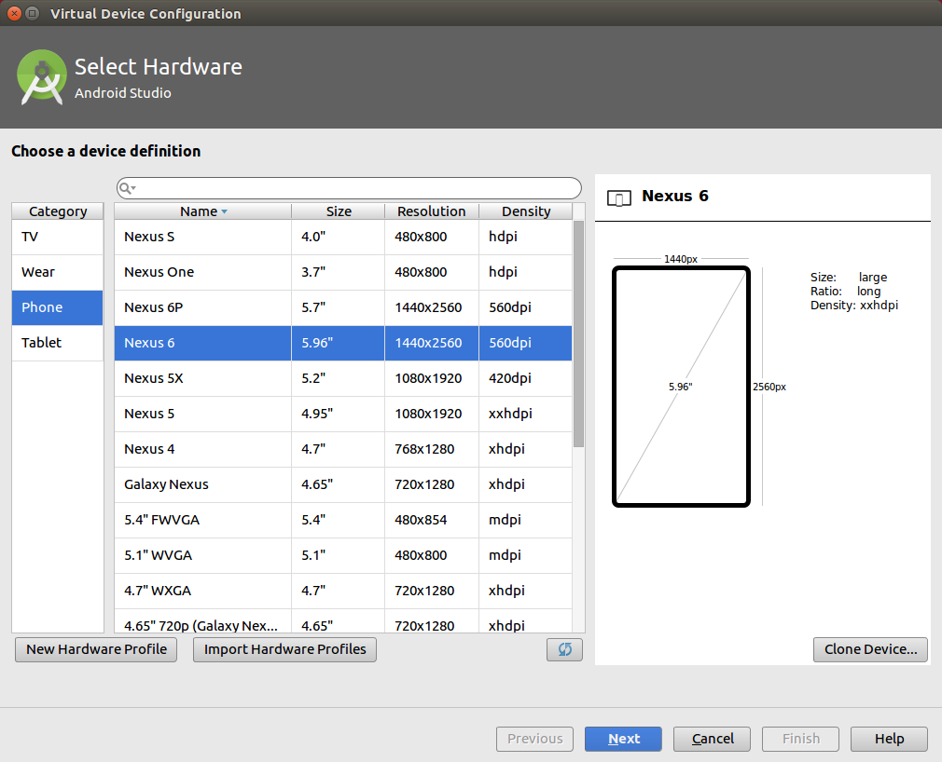
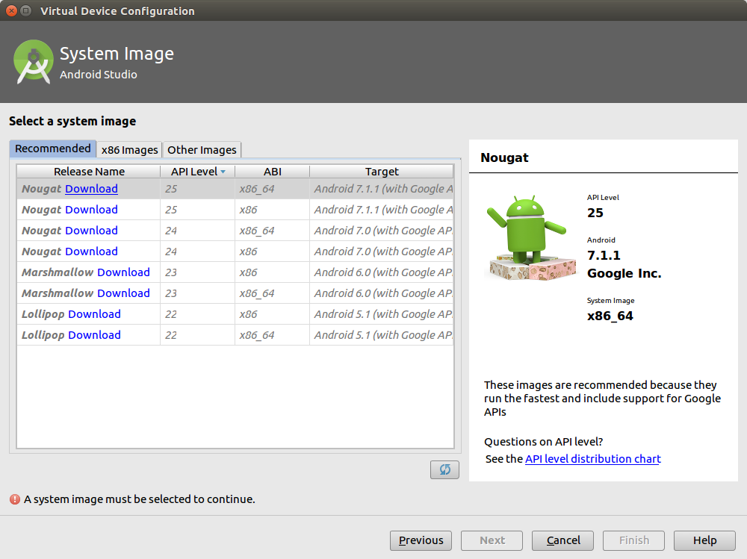
Configuring the Emulator (AVD)
To run your application create a new Android Virtual Device (AVD) by selecting Tools >> Android>>AVD Manager

Slide 17
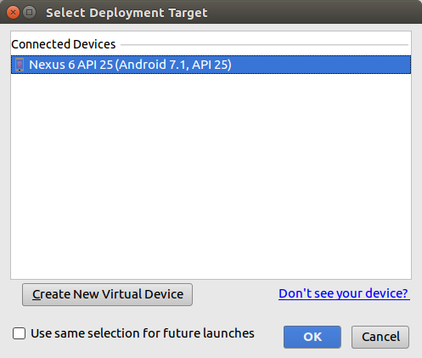
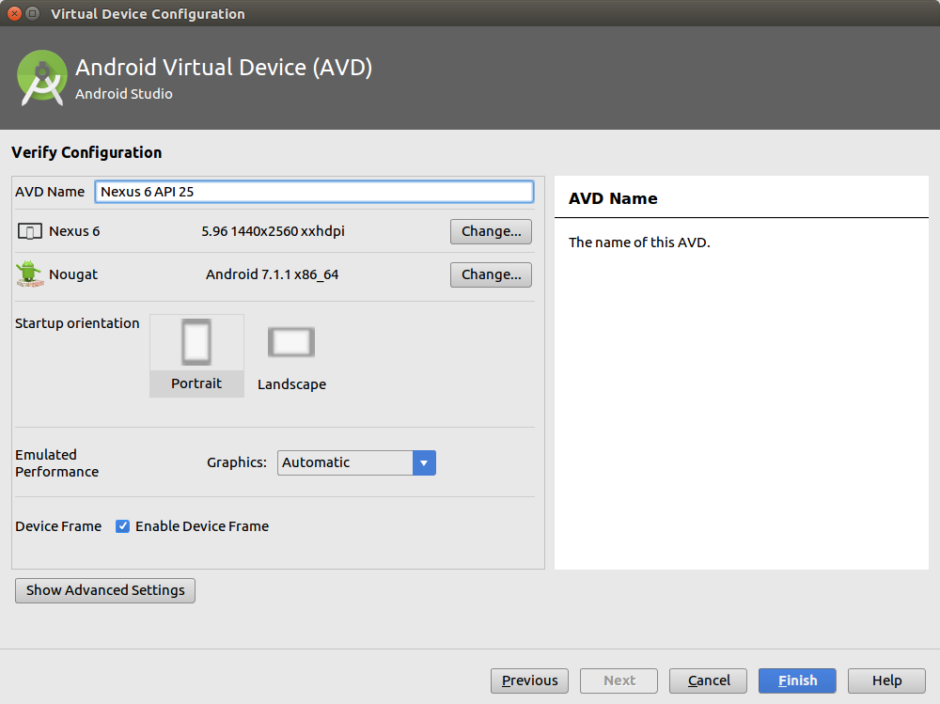
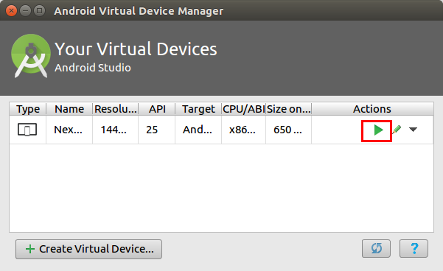
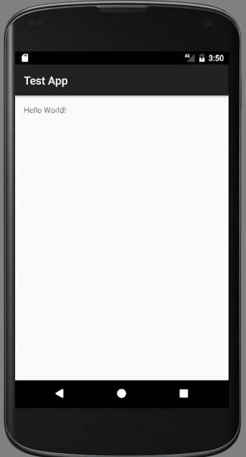
Configuring the Emulator (AVD)

Slide 18
Coding the Interface
The interface for any Android app is created through the use of a layout file.
A layout file is an XML file that contains the XML used to create the objects and controls that the user can interact with.
The default layout is the RelativeLayout, which designs the UI components as relative to one another rather than designing them as a fixed position.

Slide 19
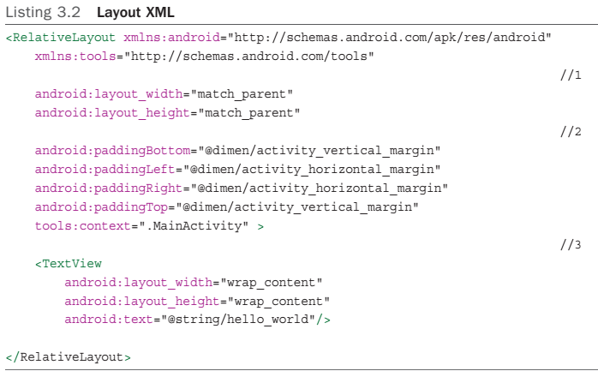
Coding the Interface

Slide 20
Coding the Interface
The value "match_parent" indicates that the layout should be the height and width of the device screen. If a child element of RelativeLayout has this value for either layout_height or layout_width, it will fill up as much of the RelativeLayout as it can.
The padding attributes tell Android that there should be blank space between the edge of the screen and the edge of the layout. The amount of space is dictated by referring to a value stored in the dimens.xml file in the values folder. Open the dimens.xml file to see all values.
android:paddingBottom = "@dimen/activity_vertical_margin" .
Valid dimensions for Android: px (pixels), in (inches), mm (millimeters), pt (points), dp / dip (density-independent pixels), and sp (scale-independent pixels). It is generally recommended to use dp for most dimensions and sp for specifying font sizes.

Slide 21
Coding the Interface
The only child element of the RelativeLayout, and thus the only item on the screen, is a TextView. TextView is Android’s version of a label (displayed text).
The two size attributes have the value "wrap_content" . This tells Android to size the TextView to the size of the text displayed in it. The android:text attribute tells Android what text to display. In this case it gets the text from the strings.xml file in the values folder. Open the dimens.xml file to see all values.

Slide 22
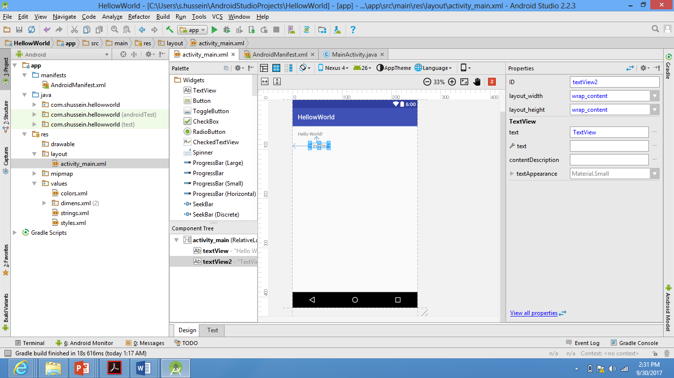
Coding the Interface
Adding a Widget : TextView
A TextView can be added by dragging it from the Palette panel on the left side of the editor.
Notice the blue arrows pointing to the left side of the layout and to the Hello World! TextView. Since RelativeLayout is used in this activity, these arrows show what object the widget is relative to for positioning purposes.

Slide 23
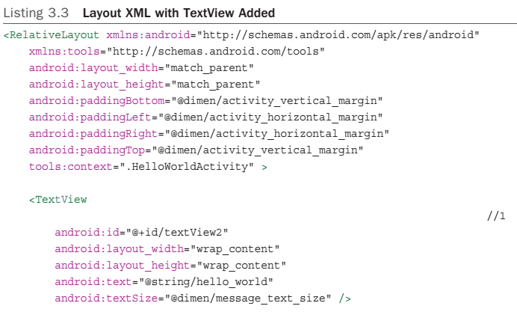
Coding the Interface

Slide 24
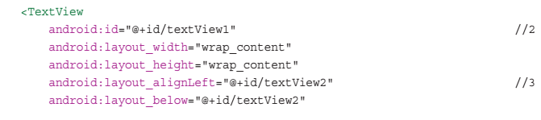
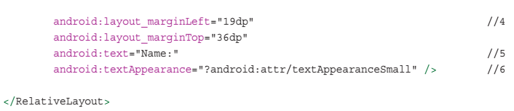
Coding the Interface

Slide 25
Coding the Interface
The Hello World! TextView now has an attribute android:id="@+id/textView2" .
The new TextView also has a +id . However, it is different from the first one.
The +id tells Android to create the ID for the widget. +ids may be reused in different layouts but cannot be reused within the same layout
TextView2 is not a very useful ID. It does not describe what the TextView is used for, so it needs to be changed the ID to textViewDisplay .
The layout attributes are the XML used to do the relative positioning.
alignLeft tells Android to align this widget’s left edge with the referenced
widget’s left edge. alignBelow tells Android to position the widget below the referenced widget.

Slide 26
Coding the Interface
The margin attributes layout_marginLeft and layout_marginTop tell Android how much space to put between the widget and the referenced widget.
The android:text attribute indicates what text should be displayed.
textAppearance attribute references the Android attr.xml file and is used in place of the textSize attribute. The attr.xml file is a file supplied by the Android SDK

Slide 27
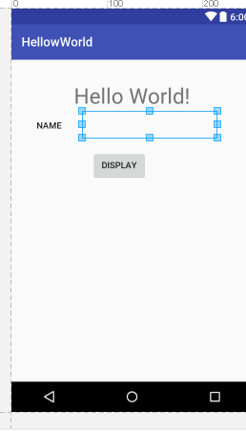
Coding the Interface
Add EditText and Button

Slide 28
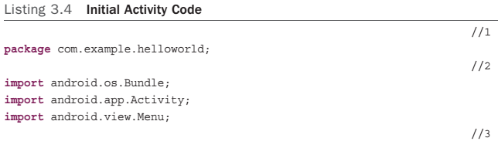
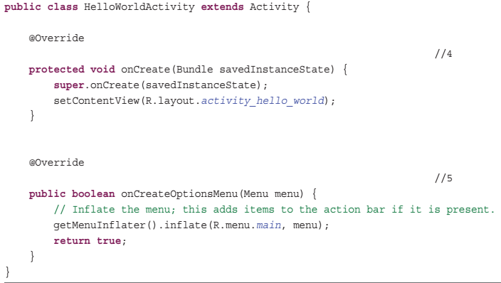
Coding App Behavior

Slide 29
Coding App Behavior
The keyword “package” identifies that this class belongs to the package com.example.helloworld. All source Java files in the same app will have this entry as the first code in the file.
The import lines of code are used to get the source code needed for your activity.
  The Activity class provides the functionality required for any class that uses or interacts with other Activities used in this class.
  The Menu class provides the functionality for the menu that is displayed when the user presses the device’s Menu button.
  A Bundle is an object for passing data between activities. In this way we can have an application that can perform some activity based on what another activity has done or the data it has used. The Bundle also passes data back to the activity itself. When the user rotates the device, the displayed activity is destroyed and re-created in the new orientation. So that the user doesn’t have to start over if this happens, the activity stores its current state just before it is destroyed in a bundle and passes that data to itself when it re-creates the activity in the new orientation.

Slide 30
Coding App Behavior
The public class line of code begins the Activity class and declares that this class is referred to as HelloWorldActivity and that it is a subclass of the SDK-provided.
The onCreate (..) method is the first method executed by the Activity when it is started. It takes ssavedInstanceState of type Bundle as a parameter.This is the object that contains information on the state of the Activity
The super.onCreate calls the super class’s onCreate method. Because this method is overriding the Activity class’s inherited onCreate method, it must call that method explicitly to use that functionality to create the Activity. It is passed the savedInstanceState bundle.
The setContentView(R.layout. activity_hello_world ) tells the activity to use the activity_hello_world.xml file as the layout to be displayed when the activity is running.

Slide 31
Coding App Behavior
The onCreateOptionsMenu(Menu menu) method is called when the user clicks the device’s Menu button. It returns a Boolean (true or false) value indicating whether the menu was successfully created. The first line of code ( getMenuInflator() ) gets an object that can create a menu from the running activity. It then tells it to inflate (create) a visual representation of the menu based on the main.xml file in the menu resource folder and refer to it with the name “menu”.

Slide 32
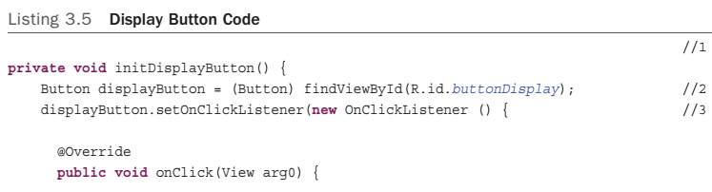
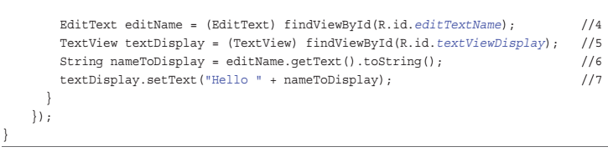
Adding Code

Slide 33
Coding App Behavior
The initDisplayButton () method is declared in the HelloWorldActivity class to code the functionality of the ‘Display’ button. The method is declared as private, hence useable by this class only. It does not return any value ( void ). The method name (signature) is up to the developer.
The method findViewById is used to get a reference to a widget on a layout so it can be used by the code. The method can return any View object. So it must be casted to (Button) before it can be used.
To set the button’s onClickListener , the code creates a new instance of the listener and then adds a method ( public void onClick(View arg0) ) to be executed when the button is clicked.

Slide 34
Coding App Behavior
This is the code for handling the click event of the Display button. Once the button is clicked it gets references to the EditText (where the name was entered) and the TextView (where the message will be displayed).
The name entered by the user is retrieved from the EditText and stored in a String
variable named nameToDisplay .
The text attribute of the TextView is then changed to the value of the String variable.

Slide 35
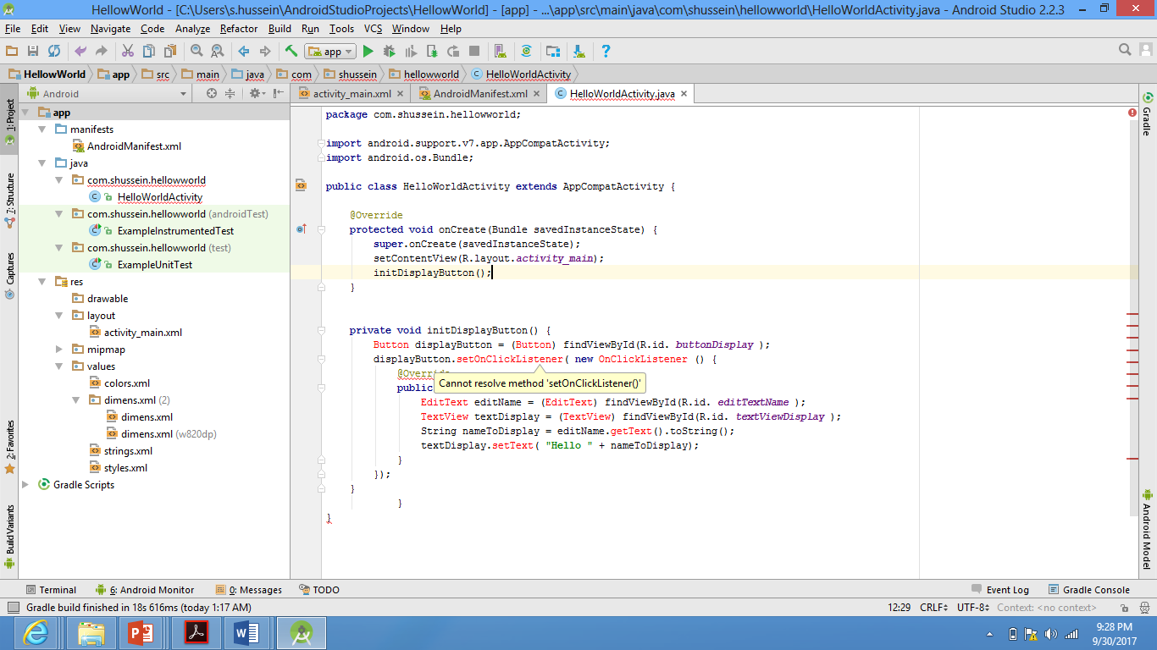
Coding App Behavior
Finally, to call the initDisplayButton method and get the behavior associated with the button to execute, you have to call the method in the onCreate method after the setContentView line.

Slide 36
Extra Resources
Build your first app in Android:
https://developer.android.com/training/basics/firstapp/index.html

Slide 37
Thank You !

