Slide 1

Mobile Application Development

Slide 2
Contents
1
Why Mobile Apps?
2
Business Process
3
App Design Issues
4
Introducing Your First App

Slide 3
Why Mobile Apps?
Transformative Devices
  There must be something that makes these devices important. There is! Mobile devices add a host of new possibilities for business and personal software because they are truly the first mobile computing platforms.
  One key feature of a mobile device is the capability to be made aware of its current environment through built-in sensors.
  The capability to communicate with other
  computing devices through a variety of mechanisms.

Slide 4
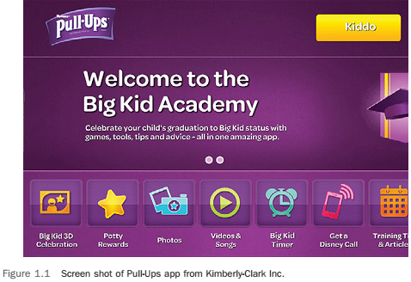
Why Mobile Apps?
Reaching Customers
  Having a mobile app can also support brand loyalty and awareness. Some organizations
  have developed apps that allow customers to interact with their brands in positive ways.

Slide 5
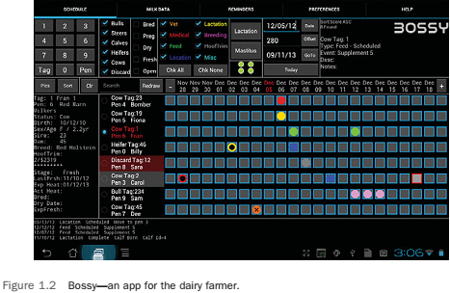
Why Mobile Apps?
Changing Business Process
  In smaller businesses that may have found that
  the cost, complexity, and nonmobile nature of traditional computing platforms made technological solutions to their business process infeasible.

Slide 6
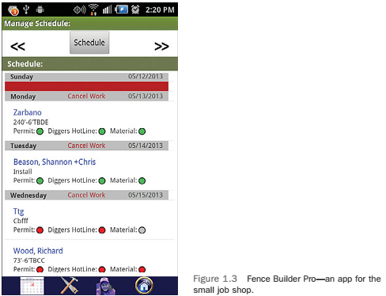
Why Mobile Apps?
Changing Business Process
  Although some big fence-building organizations exist, the majority of fence-building companies are much smaller, family owned businesses in which technology plays a very limited role.

Slide 7
Why Mobile Apps?
Making Money
  A final reason that mobile is all the rage is that many enterprising individuals see the potential to start businesses and make money. The Google Play Store and the Apple App Store provide
  the app developer access to the market of app purchasers. The developer does not have to worry about product distribution, returns, or payment collection. The store does all this and
  conveniently deposits the proceeds into the developer’s bank account.
  Apps can be sold for a onetime fee
  Ad supported apps make money by including an advertisement
  In-app purchases.

Slide 8
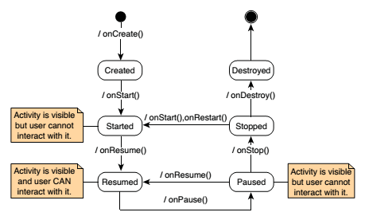
App Design Issues and Considerations
App Design
  Operating System Design Issues
    Android Activity Life Cycle

Slide 9
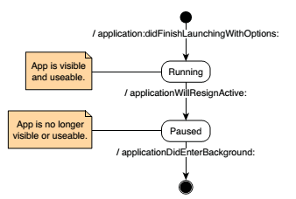
App Design Issues and Considerations
App Design
  Operating System Design Issues
    IOS Life Cycle

Slide 10
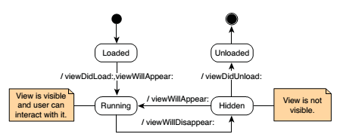
App Design Issues and Considerations
App Design
  Operating System Design Issues
    IOS Life Cycle

Slide 11
App Design Issues and Considerations
App Design
  Screen Size and Orientation Issues
    The mobile device has significantly less area to design the
    interaction that your users can experience with your app. Poor interface design is the easiest way to get bad reviews for your app.
    This significantly changes the amount of vertical and horizontal real estate for your interface. Interface elements that were obvious to the user in the vertical orientation may become inaccessible in the horizontal orientation.
    The solutions to these screen size and orientation issues are planning and design. What does the user want to do with your app? What can your user do with your app?

Slide 12
App Design Issues and Considerations
App Design
  Connectivity Issues
    The device’s capability to connect can be lost,
    or the connection speed may be very slow.
    The primary issue that the app developer has to be concerned with is blocking the user from working with your app. When the app gets or sends data, it can take a significant amount of time. Users are unlikely to be happy waiting for this action to complete before doing other tasks. This means you have to plan for uploading and downloading data asynchronously, which means you have to make it run outside the main thread of the app.

Slide 13
App Design Issues and Considerations
App Design
  Battery Issues
    Mobile devices rely on batteries for their power, and batteries can be drained. Your job as a developer is to not drain those batteries unnecessarily. This is not just a courtesy issue. If every time your app is used the user’s device quickly becomes a brick.

Slide 14
App Design Issues and Considerations
App Design
  Hardware Issues
    Many devices have the capability to locate the device within a few meters using the GPS, have sensors that can capture device orientation, have lights that can be turned on and off, have cameras, and have other hardware components that allow the device to interact with the environment.
    Availability of the component. Different manufacturers make
    Android devices, and some include devices that others do not. iOS devices are generally more homogeneous, but differences still exist.
    To access a hardware component you must use the
    component’s Application Program Interface (API). The component may take some time to turn on and respond with the information you need

Slide 15
App Design Issues and Considerations
Device Differences
  Android devices (phones and tablets) and iOS phones and tablets each have a unique set of hardware and software capabilities that make the way the user interacts with the device different for each. Again, to fully capture the device’s capabilities and not degrade the user experience, you must design for those unique characteristics. Remember, users can and will do things you are not expecting. Even if it makes no sense to you, they will do it! If the app crashes or
  loses important data because of something they did, it does not matter: IT IS YOUR FAULT! Plan accordingly.

Slide 16


App Design Issues and Considerations
Device Differences
  Android

Slide 17

App Design Issues and Considerations
Device Differences
  Android

Slide 18
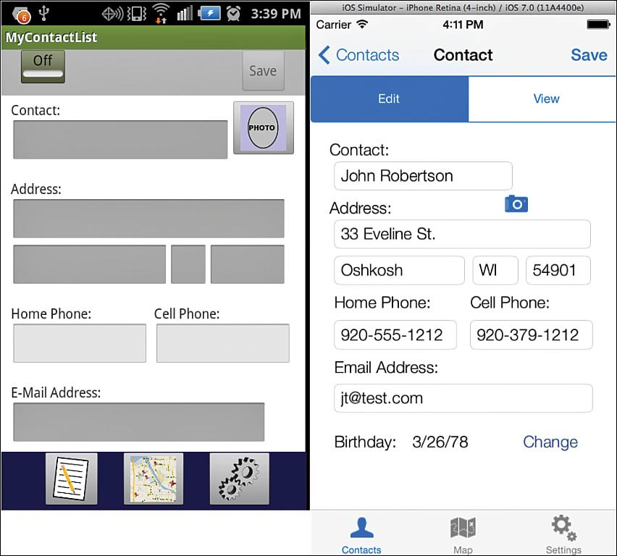
Introducing Your First App

Slide 19
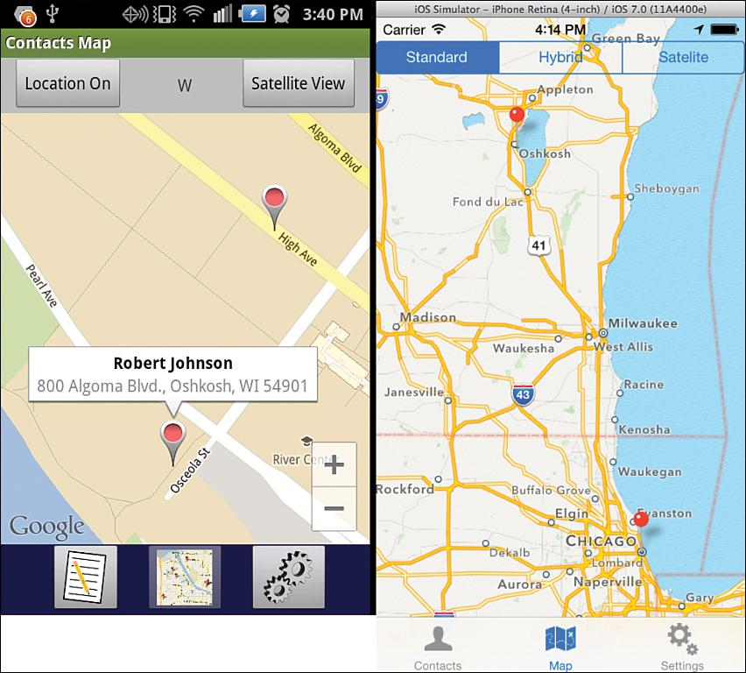
Introducing Your First App

Slide 20
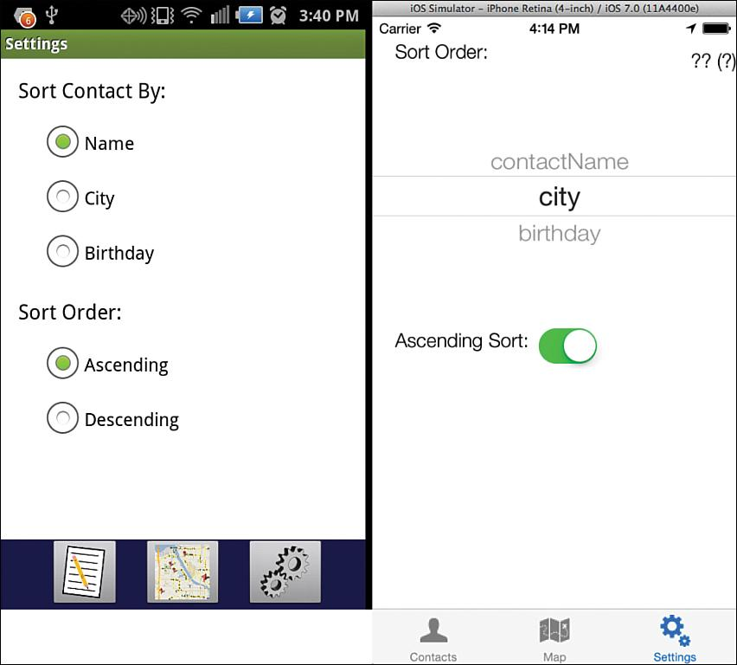
Introducing Your First App

Slide 21
Extra Resources
For Android Studio download:
https://developer.android.com/studio/index.html?gclid=EAIaIQobChMI1ubH4qa81gIVEoGyCh0eOgPhEAAYASAAEgIlxfD_BwE
For Android Studio installation :
http://www.vogella.com/tutorials/Android/article.html#android-studio-overview-and-installation
The steps of how to install Android studio and how to open a new project are covered from point 1-3. This link contains additional info that will be covered in the next week

Slide 22
Thank You !

