Slide 1

Mobile Application Development Chapter 10 [iOS Navigation and Interface Design]

Slide 2
Contents
Views and Controllers
Creating the Interface
Design the Contacts Screen
Activating the Interface

Slide 3
Views and Controllers
Designers create multiple screens for each app.
Each screen is managed by an instance of the UIViewController class.
This class is where other UIView objects for the various user interface elements are added.
User interface classes are contained in UIKit framework with the top class, UIView.

Slide 4
Views and Controllers
A subclass of UIView is UIWindow
Each iOS app has one UIWindow object that is created when the app launches.
All other screens are subviews of UIWindow.
Other subclasses are:
UILabel, UIScrollView, UINavigatorBar, UITableCell, UIControl.

Slide 5
Views and Controllers View Controller
View Controller is managed in three files:
a .storyboard file that specifies the layout of user interface elements;
a .h file that has information bout any outlets and actions needed to control the user interface; and,
a .m file that contains the implementation of the user interface actions.
After the View Controller has been set up, it can be added to the application in different ways (i.e. added as a root view).

Slide 6
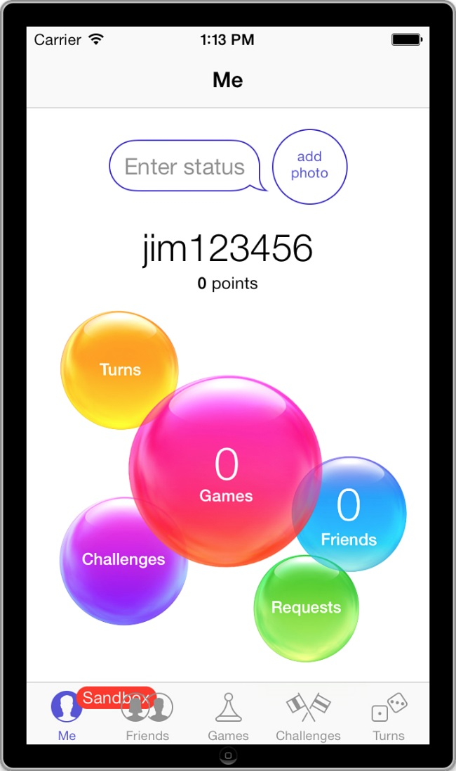
Views and Controllers Tab Bar Controller
The Tab Bar Controller shows up at the bottom of iPhone apps and allows the user to choose between different screens in the app.
This user interface is used in many common apps, including the built-in GameCenter app (see Figure 10.1 ).
Figure 10.1 Tab Bar Controller shown at the bottom of the built-in GameCenter app.

Slide 7
Views and Controllers Navigation Controller
Used to by users to drill down through multiple screens, but keeps track of the path so the user can go back the same way.
This pattern is used in iPhone apps, including the built-in Contacts app, (Figure 10.2).
When the user taps one of the contacts listed in the screen on the left, the app navigates to the screen on the right.
The button at the top left allows the user to navigate back to the list of all users.

Slide 8
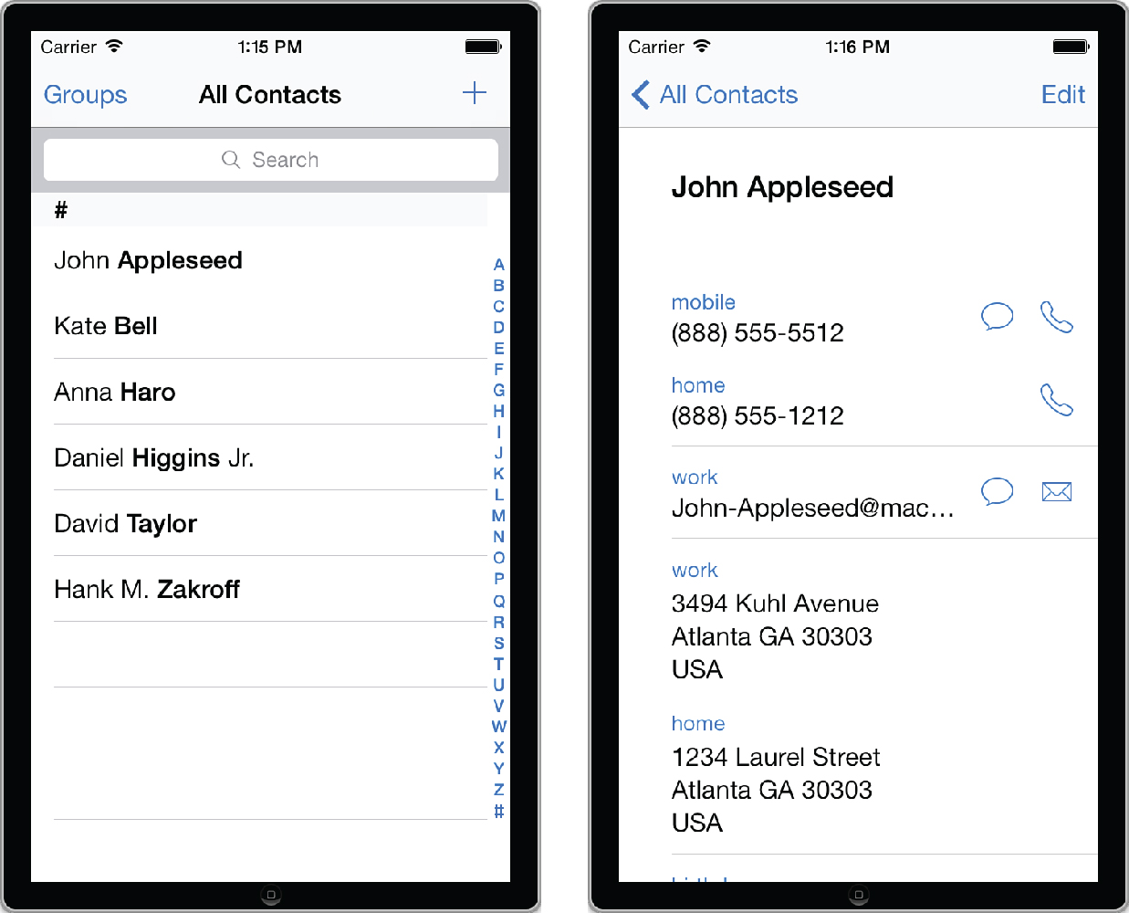
Views and Controllers Navigation Controller
Figure 10.2 Navigation Controller in the built-in Contacts app.

Slide 9
Creating the Interface Creating the Project
To create the user interface for the MyContactList app project in Xcode use the following settings in the first two steps in the wizard:
Template: Tabbed Application
Product Name: MyContactList
Organization Name: Learning Mobile Apps
Company Identifier: com.pearson
Class Prefix: LMA
Devices: iPhone

Slide 10
Creating the Interface
MyContactList app will have three basic screens:
Displaying and editing the contacts
A map view of one or more contacts, and
A settings screen
The contacts screen will also have an associated screen to edit the birthdate of the contact
First task is to create views for each of these four screens
As the Tabbed template is selected when creating the project
two of the view controllers and the tab bar have already been created in the storyboard
open the storyboard, to see the Tab Bar Controller and two View Controllers

Slide 11
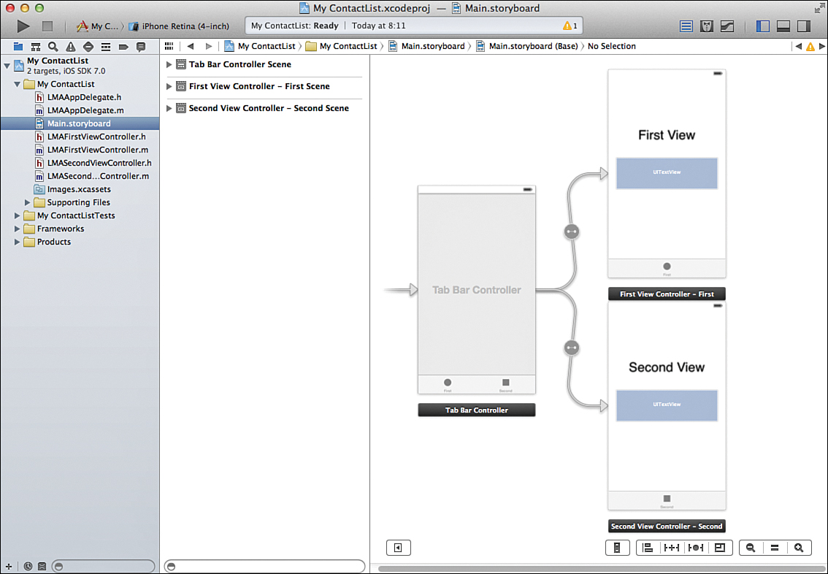
Creating the Interface Creating the Views
Figure 10.3 Tab Bar Controller and two View Controllers.

Slide 12
Creating the Interface Creating the Views
The tab bar needs three screens, start by adding a new View Controller for the third screen:
Drag a View Controller into the Storyboard.
Select the Tab Bar Controller.
Hold down the control key and then drag from the Tab Bar Controller to the new View Controller, then let go (this is called Control-dragging, and you will use this technique to accomplish a number of tasks when building user interfaces for iOS).
Choose View Controllers in the dialog that pops up (Figure 10.4). This will add an arrow from the Tab Bar Controller to the new View Controller and add a third element to the actual tab bar (Figure 10.5).

Slide 13
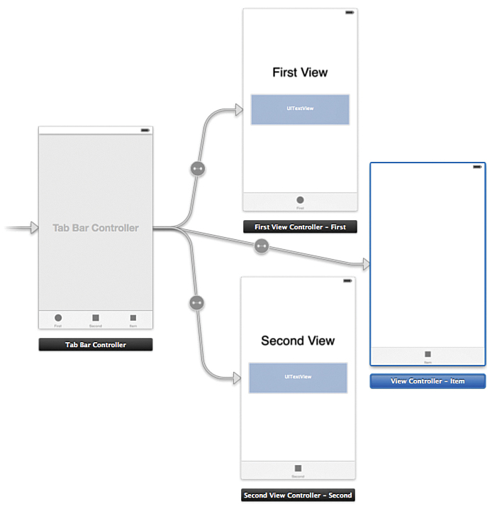
Creating the Interface Creating the Views
Figure 10.4 Adding a new View Controller.

Slide 14
Creating the Interface Creating the Views
To help distinguish among the three View Controllers, copy the label that says First View onto the new View Controller by selecting it and pressing Cmd-C; then select the new View Controller and press Cmd-V. You may have to zoom in a little to be able to select the label.
Double-click each of the three labels and change the text to Contacts , Map , and Settings , as shown in Figure 10.5 .

Slide 15
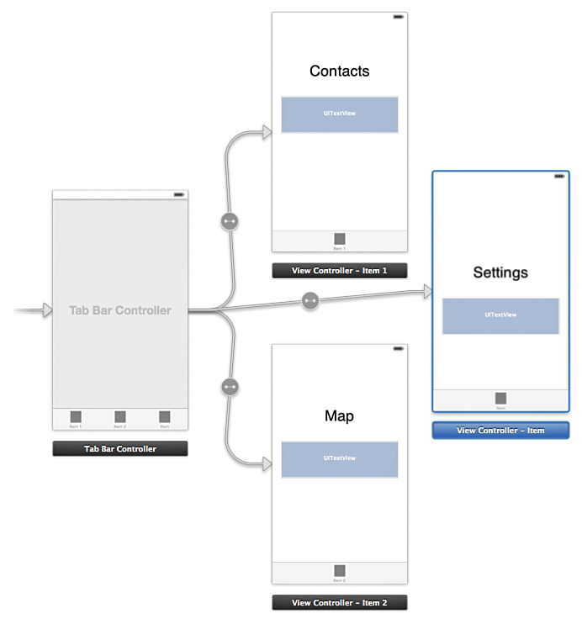
Creating the Interface Creating the Views
Figure 10.5 Completed interface of the Tab Bar Controller.

Slide 16
Creating the Interface Creating the Views
Run the app now, you will see the Contacts screen come up, and then the three tabs at the bottom, named First, Second, and Item.
To change the tabs to have the proper names:
Open the Storyboard and select the First View Controller in the Dock.
Make sure the Attributes Inspector is selected and then change the Title to Contacts (Figure 10.6).
Select the Tab Bar item at the bottom of the Contacts View Controller (see Figure 10.5) and change the Title in the Attributes Inspector to Contacts (Figure 10.7).
Repeat the same steps for the Map and Settings screen.

Slide 17
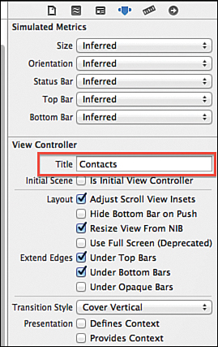
Creating the Interface Creating the Views
Figure 10.6 Changing the title of the Contacts View Controller.

Slide 18
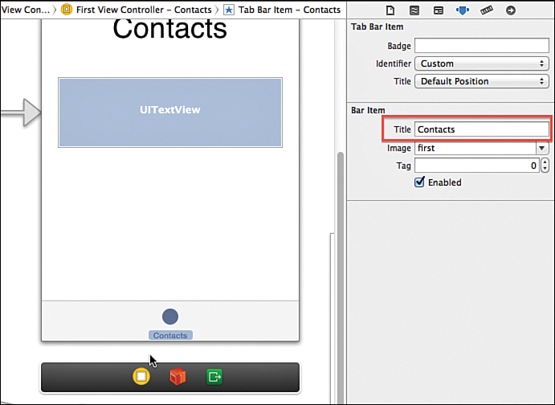
Creating the Interface Creating the Views
Figure 10.7 Changing the Title of the Tab Bar Item.

Slide 19
Creating the Interface Creating the Views
Rename the code files that manage each View Controller
These were autogenerated with the Tab Bar template and are currently named LMAFirstViewController and LMASecondViewController
The name of a View Controller appears in many places in the project
Xcode has good support for refactoring, which will find and rename everything:
With the Dock in List View, select the First View Controller and double check that this is the one that has the Contacts bar item. If it isn’t, go back to the previous instructions and redo the renaming of the tab bar items.

Slide 20
Creating the Interface Creating the Views
Open LMAFirstViewController.h and right-click LMAFirstViewController in the @interface line.
Select Refactor > Rename.
Change the name to LMAContactsController and ensure that Rename Related Files is checked. Click Save.
You will see the screen in Figure 10.8 .
This shows all the files on the left that will be affected, and for each file you can see the current and potential changes if you carry out the rename operation.
Click through each file and preview the changes. Note that in the Storyboard file, the code is shown as XML, as the Interface Builder generates XML code in the background.

Slide 21
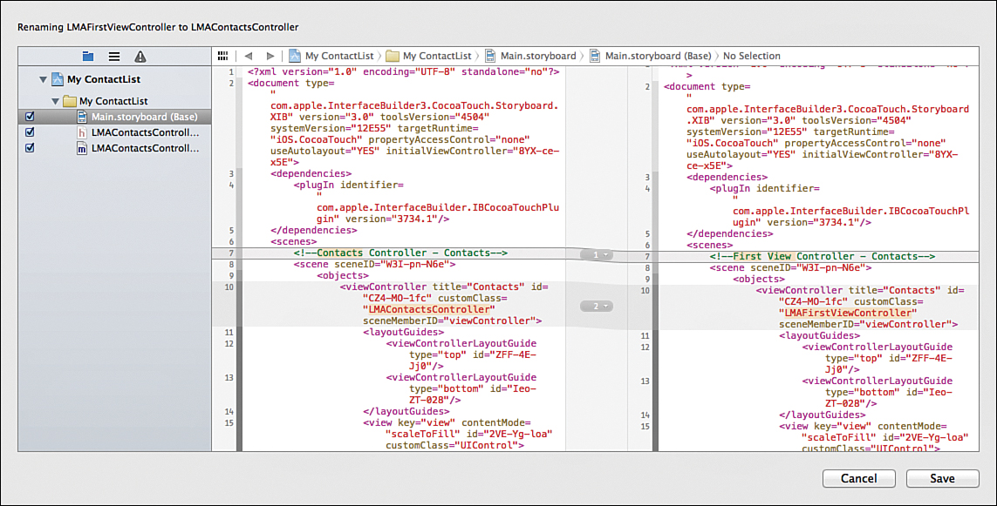
Creating the Interface Creating the Views
Figure 10.8 Renaming a file using the Refactor option in Xcode.

Slide 22
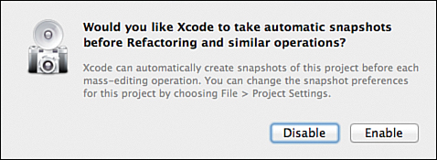
Creating the Interface Creating the Views
After reviewed the changes, click Save.
You will see a message about taking snapshots ( Figure 10.9 ).
If you enable this, you will be able to roll back changes like this renaming operation. Click Enable, and the rename is carried out.
Repeat for the Second View Controller, renaming it LMAMapController
Figure 10.9 Enabling automatic snapshots

Slide 23
Creating the Interface Creating the Views
The tab bar allows for having both a title and an image (icon).
These images have to be around 20x20 pixels for regular screens and about 40x40 pixels for retina screens.
iOS comes with a set of standard icon symbols you can use, but there are only 12 of them.
For the MyContactList app,
included the free set from Glyphish with the download files for the book (www.informit.com/title/9780321947864).
After you download it, open images.xcassets in Xcode and drag the following files to the right side of the asset catalog (where it says No Selection): 20-gear2.png, 103-map.png, and 111-user.png.

Slide 24
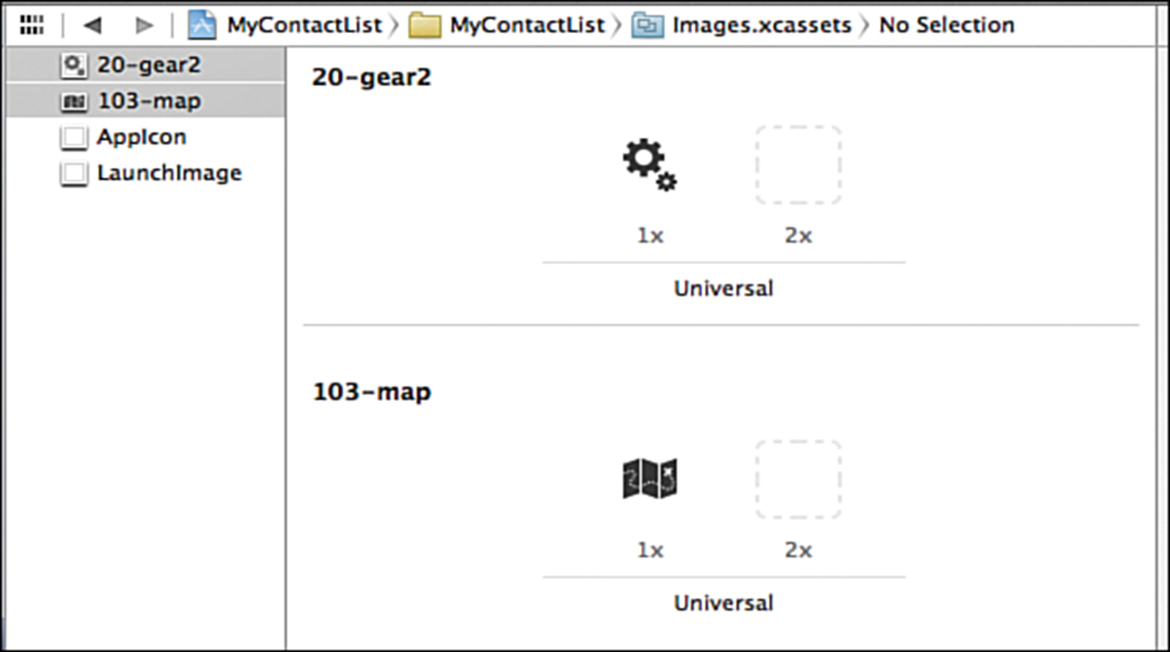
Creating the Interface Creating the Views
The images are inserted in the 1x spot. If you had a retina version, you would simply drag that into the 2x spot.
Because you won’t need them anymore, you can delete the images named first and second ( Figure 10.10 ).
Figure 10.10 Adding images to the Asset Catalog.

Slide 25
Creating the Interface Creating the Views
The images are now available for use anywhere in your code.
The icons are licensed under a Creative Commons attribution-only license, which means they can be used in any of your projects, as long as you put a note in your code with a reference to the Glyphish website
With the images imported
Open the Storyboard and select the Tab Bar Item for the Contacts View Controller.
Make sure the Attributes Inspector is open, and then change the Identifier to Contacts. As you do that, you’ll notice the other default options that you can use, such as Search, Bookmarks, History, and so on.

Slide 26
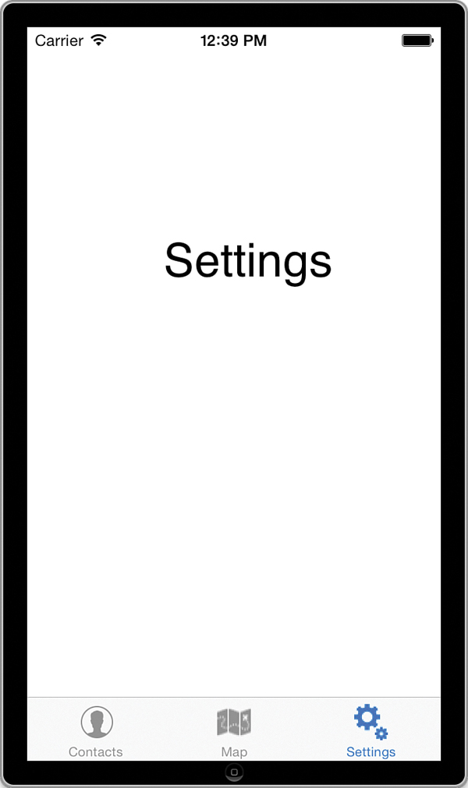
Creating the Interface Creating the Views
Select the Tab Bar Item for the Map View Controller.
In the Attributes Inspector, use the Image drop-down list to change the image to103-map.
Use the same technique to change the Settings image to 20-gear2
Run the app and you should see the three tabs with the text show up. Tap on each tab to make sure the proper View Controller shows up (see Figure 10.11 ).
Figure 10.11 The completed Tab Bar with three view controllers.

Slide 27
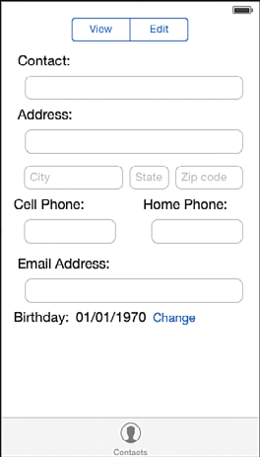
Design the Contacts Screen
To set up the user interface for the Contacts screen:
1. Open the Storyboard and remove the Contacts label and the UITextView control by clicking each and pressing Delete.
2. Drag a Segmented Control to the canvas and place in the center of the screen toward the top. A Segmented Control can have multiple segments, only one of which can be activated at a time. This is the iOS equivalent to a radio button. Double-click the text and change to Edit , then change Second to View you can also change these in the Attributes Inspector by choosing the Segment and then changing the Title.
3. Drag a Label to the left side of the screen below the Segmented Control and change its text to Contact:

Slide 28
Design the Contacts Screen
4. Drag a Text Field below the label, and resize to the right until the blue guideline appears. Then continue with the remaining labels and text fields.
5. The Birthday line has two Labels and a Button.
6. For the City, State, and Zip fields, select the Attributes Inspector and change the Place holder property for each of them as shown in the screenshot.
7. Use the Attributes Inspector to change the Capitalization to Words for the Contact, Address, and City fields. Change Capitalization for the State field to All Characters.
8. Use the Attributes Inspector to change the Keyboard for the Zip field to Number Pad, and for the two phone fields to Phone Pad, and for the Email field to Email Address.

Slide 29
Design the Contacts Screen
When running the app, you’ll notice that the keyboard cannot be dismissed, and some of the controls are hidden behind the keyboard. These two problems can be fixed by using a scroll view control.
1. With the Dock in List View, select all the controls on the page except the Segmented Control. (see Figure 10.13 ).
2. Select Editor > Embed In > Scroll View. This will embed all the controls in a Scroll View.
3. Add an outlet named scrollView for the Scroll View by using the Assistant Editor and control-drag from the Control View to LMAContactsController.h

Slide 30
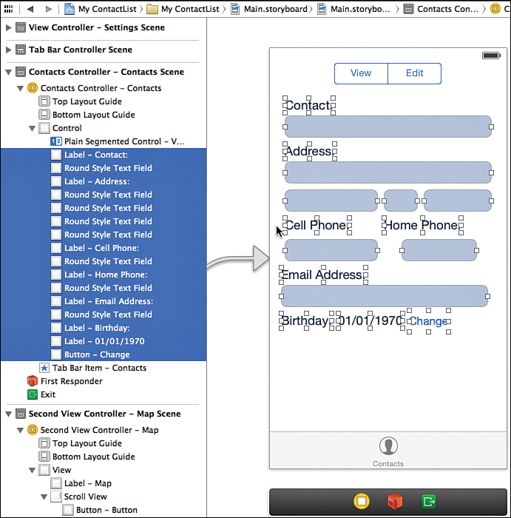
Design the Contacts Screen
Figure 10.13 Selecting the controls to embed in Scroll View.

Slide 31
Design the Contacts Screen
To set the size of the container that will be scrolled, enter the code of Listing 10.1 in LMAContactsController.m.
This code sets the content size to a rectangle that is 320 pixels wide and 500 pixels tall.
The second method, viewDidLayoutSubviews: , needs to be added to the file because of an apparent bug in iOS 7 that sets the size of the scroll view to (0, 0) sometime after viewDidLoad : This code was written on the iOS 7.0 SDK.

Slide 32
Design the Contacts Screen
Try running the app, and you should now be able to scroll the contents of the screen up and down, but the keyboard still can’t be dismissed
To fix the problem, select the Scroll View in the Storyboard and Keyboard setting in Attributes Inspector ( See Figure 10.14 ). There are two ways to dismiss the keyboard:
The first option, “Dismiss on Drag” will dismiss the keyboard as soon as the user starts dragging the scroll view.
The second option: “Dismiss Interactively” will dismiss the keyboard as the user scrolls down and starts to scroll into the space where the keyboard is.
The scroll view is used extensively throughout iOS. In addition to scrolling up and down, UIScrollView allows for scrolling horizontally as well as zooming.

Slide 33
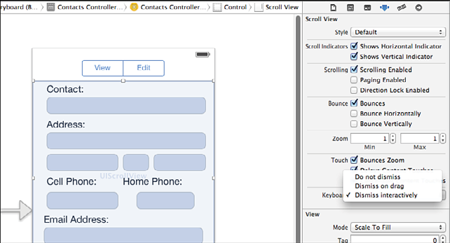
Design the Contacts Screen
Figure 10.14 Selecting the controls to embed in Scroll View.

Slide 34
Design the Contacts Screen Add Navigation Controller to the Date Screen
A Navigation Controller is a special control that allows users to drill down through several screens and then return the way they came by tapping a button in the top left of the screen to navigate back to the previous screen.
In MyContactList, you implement this by adding a Navigation Controller to the Contacts Controller, so the Tab Bar will actually be connected to the Navigation Controller, which in turn is connected to the View Controller.
1. Select the Contacts Controller and then choose Editor > Embed In > Navigation Controller. This adds a Navigation Controller between the Tab Bar Controller and the Contacts Controller (Figure 10.15). It also adds a gray bar to the top of the Contacts screen covering the Segmented Control and part of the scroll view. This is the navigation bar, which will contain the title of the screen, the button for navigating back, and possibly some other controls. You’ll need to move the Segmented Control and scroll view
down to be visible under the navigation bar.

Slide 35
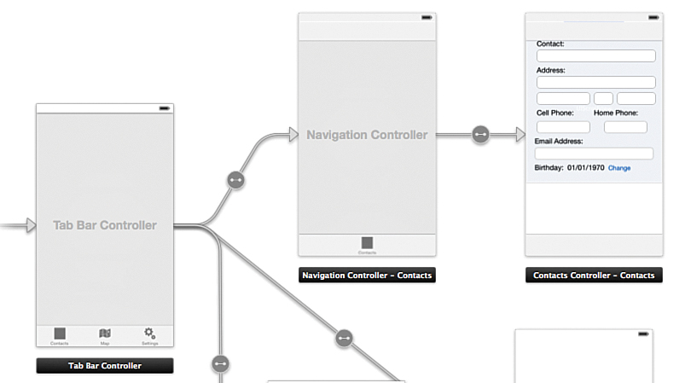
Design the Contacts Screen Add Navigation Controller to the Date Screen
Figure 10.15 Adding a Navigation Controller.

Slide 36
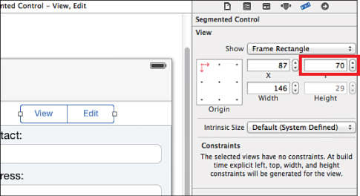
Design the Contacts Screen Add Navigation Controller to the Date Screen
2.Select the scroll view and drag down to free up some whitespace below the navigation bar.
3.The Segmented Control is hidden, so select it in the Dock, and then use the Size Inspector in the right sidebar to change the Y coordinate to 70 ( Figure 10.16 ).
4.Set the title of the navigation bar by selecting the Contacts Controller’s Navigation Item in the Dock and then use the Attributes Inspector to set the Title to Contact ( Figure 10.17)
Figure 10.16 Setting the Y placement for the Segmented Control.

Slide 37
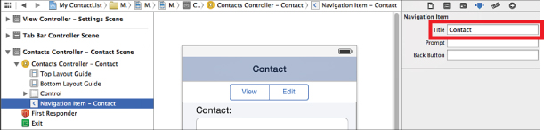
Design the Contacts Screen Add Navigation Controller to the Date Screen
Figure 10.17 Setting the navigation bar Title.
If you run the app, you should see the navigation bar show up on the Contact screen, but otherwise, everything else should function as before.

Slide 38
Design the Contacts Screen Add Navigation Controller to the Date Screen
The next step is to add a View Controller for the Date screen and add that to the Navigation Controller as well.
Drag a new View Controller onto the Storyboard
Use the Attributes Inspector to change the new View Controller’s Title to Birthdate .
3. Control-drag from the Change button to the Birthdate View Controller,
and pick Push in the action menu that comes up. This will push the new
View Controller on to the Navigation Stack that the Contacts screen is
already part of. You should see a navigation bar added to the new View
Controller, and in the Dock you will see a Navigation Item appear for the
Birthdate Controller.
4. Select the new Navigation Item and set its Title to Pick Birthdate ( Figure 10.18 ).

Slide 39
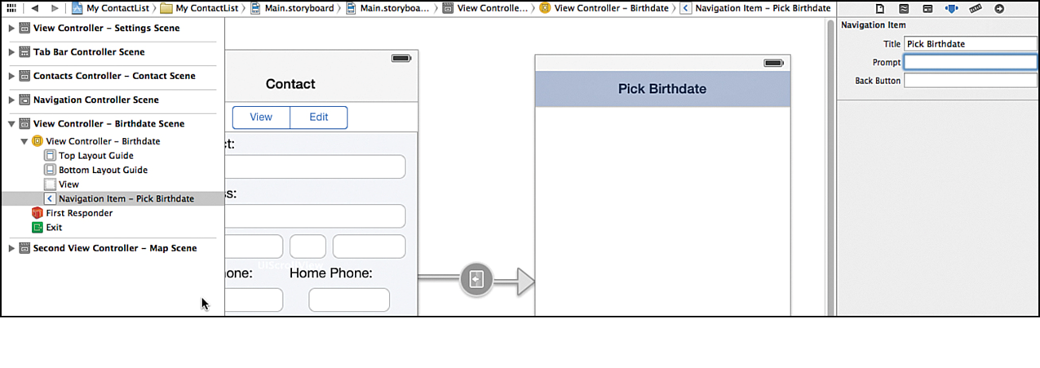
Design the Contacts Screen Add Navigation Controller to the Date Screen
Figure 10.18 Setting the Navigation Bar Title for the Birthdate View Controller.
The connections between the various view controllers are called segues, as they define how the various screens will transition back and forth.

Slide 40
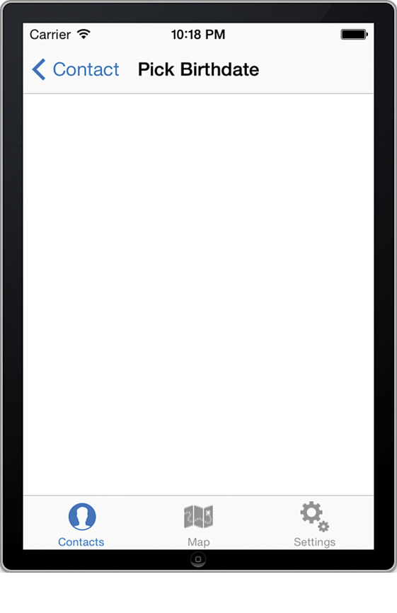
Design the Contacts Screen Add Navigation Controller to the Date Screen
Run the app and tap the Change button, and you should see the Date screen as shown in Figure 10.19 .
The Contacts button will take the user back to the Contacts screen. The text for the Contacts button is the Title setting in the Navigation Item for the Contacts View Controller.
You can set an alternative text for the button here by adding text to the Back Button setting for the Navigation Item.
Figure 10.19 The Date screen with the navigation controller and button to go back to Contacts.

Slide 41
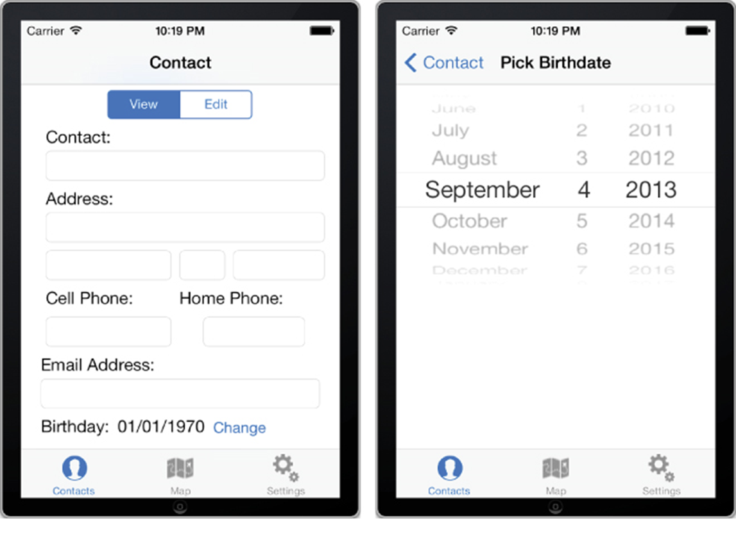
Design the Contacts Screen Add Navigation Controller to the Date Screen
The last step in setting up the user interface and navigation is to add the capability to choose a date on the Date screen.
Open the Storyboard and drag in a Date Picker from the toolbox and place it at the top of the Date View Controller.
The Date Picker can be configured to work with both time and date. However, you want to use only dates, so open the Attributes Inspector and change the Mode to Date.
You can also set the default date as well as constrain the picker between specific dates. You don’t have to change these settings for this app.
Run the app and make sure the Date Picker shows up as expected.
Figure 10.20 shows the completed navigation control hierarchy for the Contacts and Date View Controllers.
Figure 10.20 The completed navigation interface for the Contact and Date screens.

Slide 42
Activating the Interface
In this section will implement the capability to switch between view and edit modes
The edit mode is controlled by the Segmented Control.
When the user changes to View, all the controls will be disabled so they can’t be edited. And when the user changes back again, they will be reactivated. To achieve that, follow these steps:
Open the storyboard in Assistant Editor mode and control-drag from the Segmented Control in the Contact View Controller to the @interface section of the LMAContactsController.h file.
Add an action named changeEditMode: (see Figure 10.21 ). Click Connect. The changeEditMode: method is called anytime the value of the Segmented Control is changed, but the method call doesn’t indicate the current value of the control, so you need to add an outlet to be able to reference and read the value.

Slide 43
Activating the Interface
Figure 10.21 Adding an action to change the edit mode.
3. Control-drag again from the Segmented Control to the @interface section of
LMAContactsConroller.h.
4. Add an outlet named sgmtEditMode . Click Connect.

Slide 44
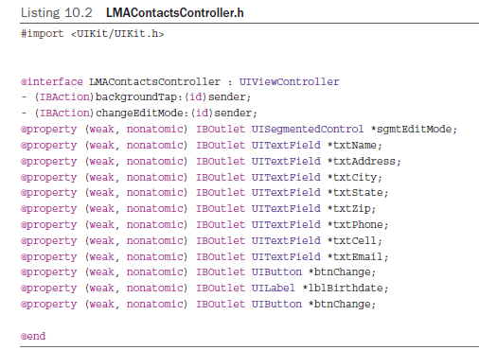
Activating the Interface
5. You will also need to reference all the text fields and buttons in the interface. See Listing 10.2 for the names to give the text fields, the Birthdate label, and the Change button. If you make a mistake in connecting the fields and the outlets, you may have some strange results when running the app. It’s always a good idea to check the connections.
If something doesn’t work as expected. You can see all the connections made on a View Controller by selecting the Connections Inspector.
6. Implement the changeEditMode: method as shown in Listing 10.3.
7. Run the app and switch between view and edit modes.

Slide 45
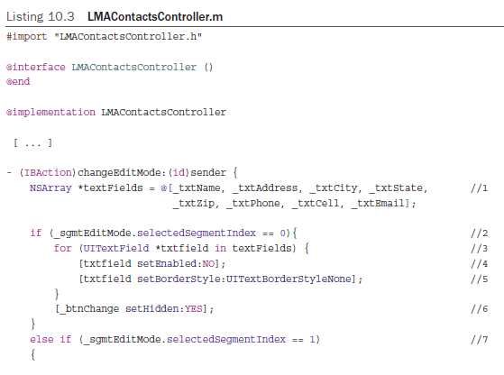
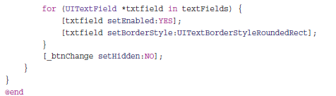
Activating the Interface
Implementing the changeEditMode: method
1. All the properties are changed in the same way for each of the text fields, so you set up a NSArray object containing all the text fields by separating the list of objects with commas and surrounding the entire list with square brackets.
2. Check the value of the Segmented Control. Viewing is 0 and Editing is 1.
3. Use a fast enumeration loop to go through all the text fields in the array.
4.–5. In view mode, the text fields are disabled, and the border is set to not be there( UITextBorderStyleNone ).
6. The Change button should not be shown in view mode.
7. When switching to edit mode, the code is similar, but the values are opposite. The text fields are enabled and the border is set to the Rounded Rect mode (the default). The
button is hidden.

Slide 46
Thank You !

