Slide 1
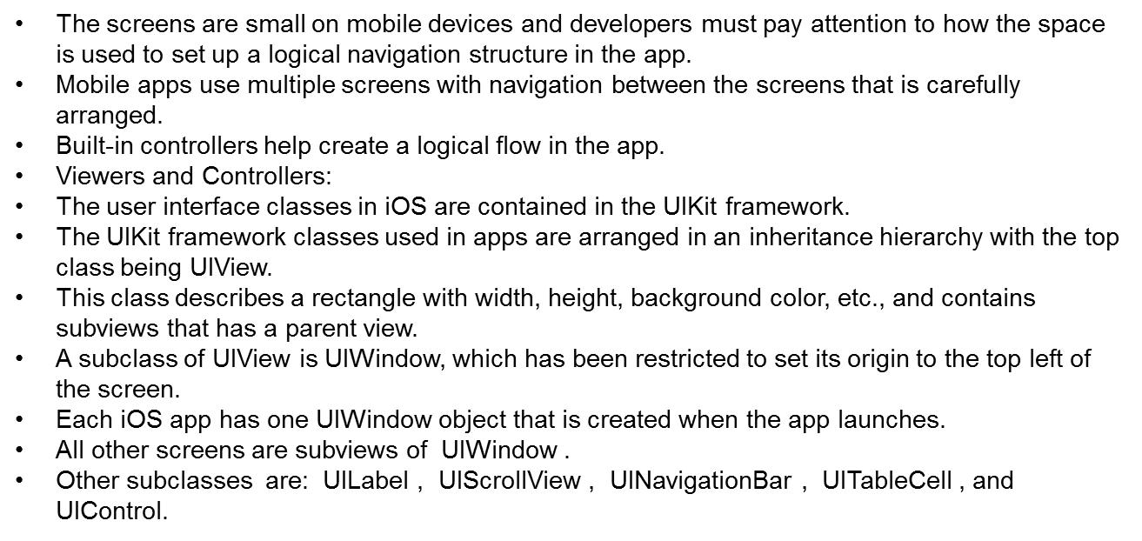

Slide 2
In creating iOS apps, designers create multiple screens for each app.
Each screen is managed by an instance of the UIViewController class.
This class is where other UIView objects for the various user interface elements are added.
Notes:
Figure:

Slide 3
View Controller is managed in three files:
  a .storyboard file that specifies the layout of user interface elements;
  a .h file that has information bout any outlets and actions needed to control the user interface; and,
  a .m file that contains the implementation of the user interface actions.
After the View Controller has been set up, it can be added to the application in different ways (i.e. added as a root view).
Notes:
Figure:

Slide 4
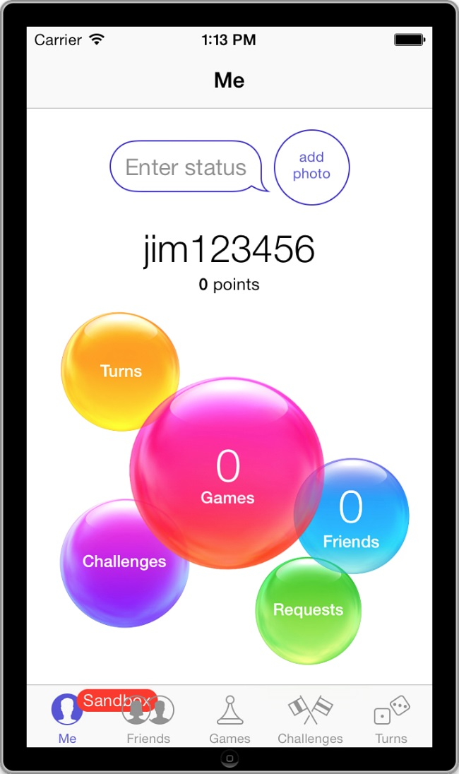
The Tab Bar Controller shows up at the bottom of iPhone apps and allows the user to choose between different screens in the app.
This user interface is used in many common apps, including the built-in GameCenter app (see Figure 10.1 ).
Figure 10.1 Tab Bar Controller shown at the bottom of the built-in GameCenter app.
Notes:
Figure:

Slide 5
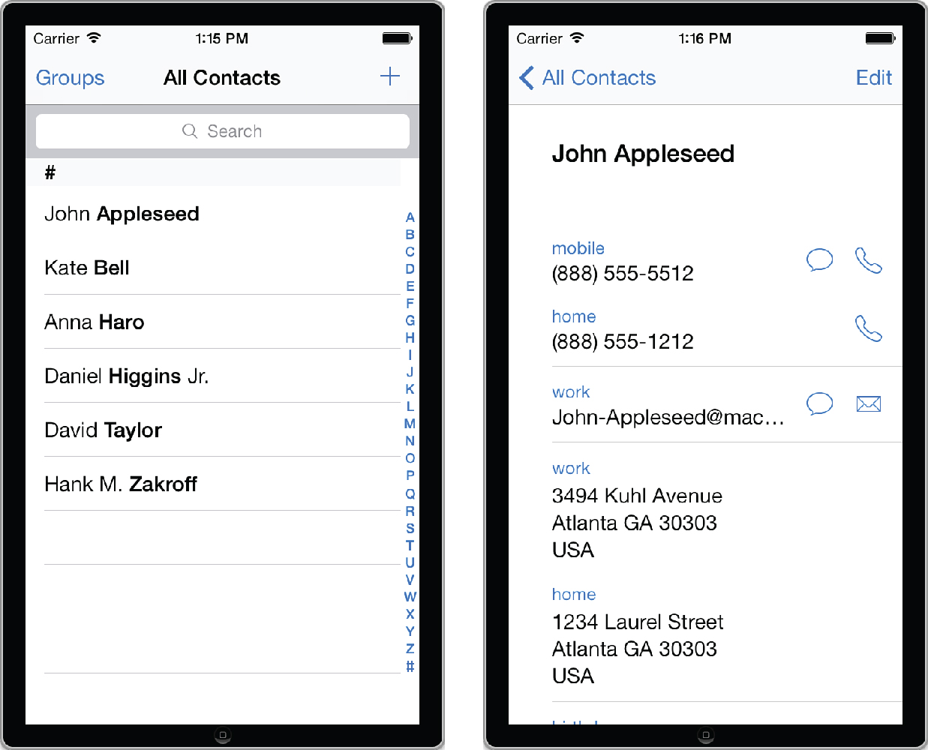
The Navigation Controller is used to by users to drill down through multiple screens, but keeps track of the path so the user can go back the same way.
This pattern is used in iPhone apps, including the built-in Contacts app, (Figure 10.2).
When the user taps one of the contacts listed in the screen on the left, the app navigates to the screen on the right.
The button at the top left allows the user to navigate back to the list of all users.
Figure 10.2 Navigation Controller in the built-in Contacts app.
Notes:
Figure:

Slide 6
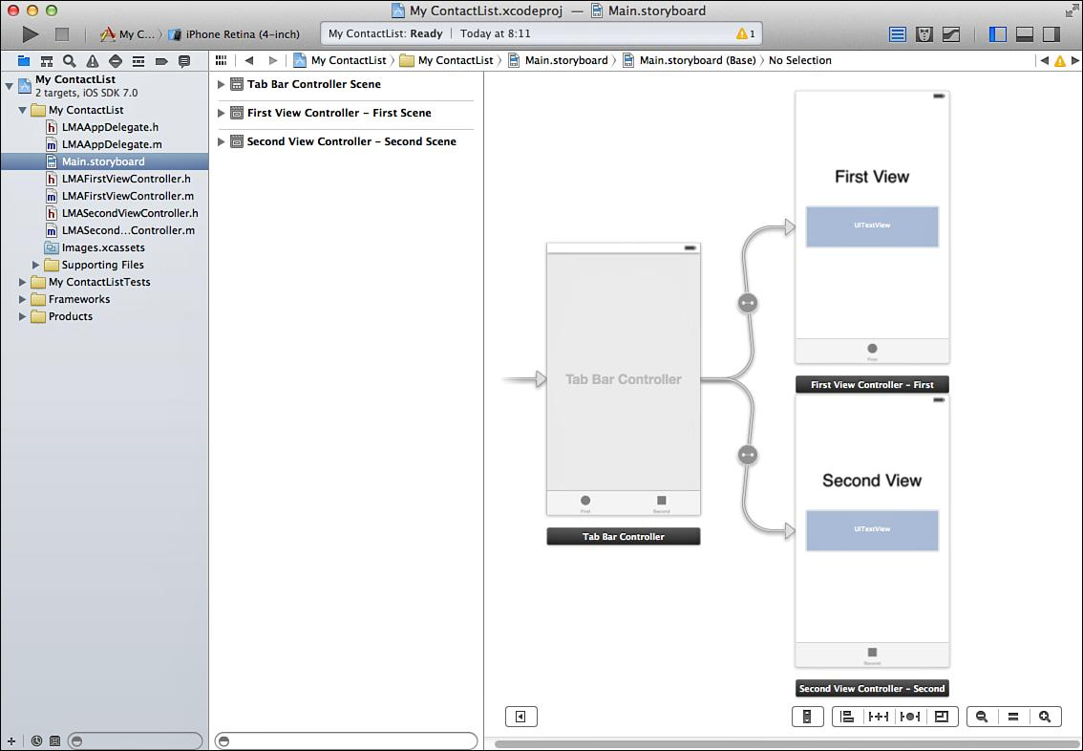
When creating views for each of the four screens using the Tabbed template when creating the project, two of the view controllers and the tab bar are already been created in the storyboard.
Open the storyboard and see the Tab Bar Controller and two View Controllers ( Figure 10.3 )
Figure 10.3 Tab Bar Controller and two View Controllers.
Notes:
Figure:

Slide 7
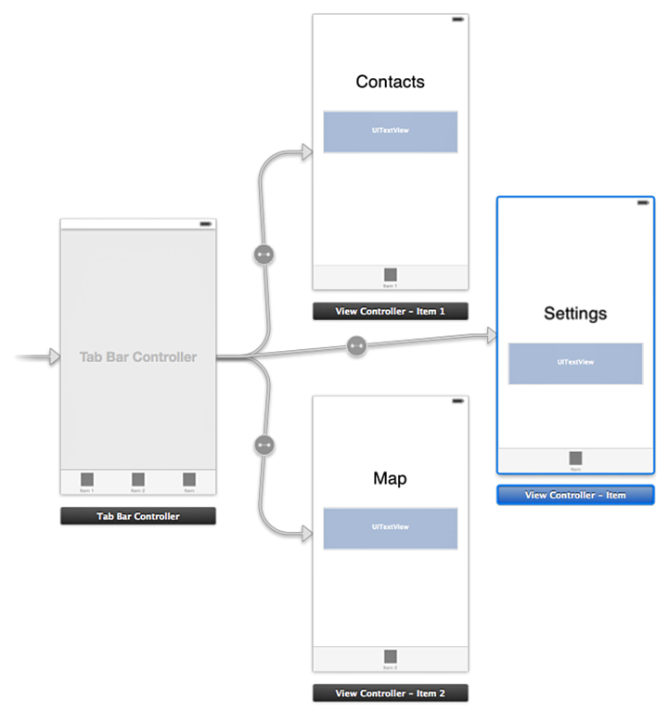
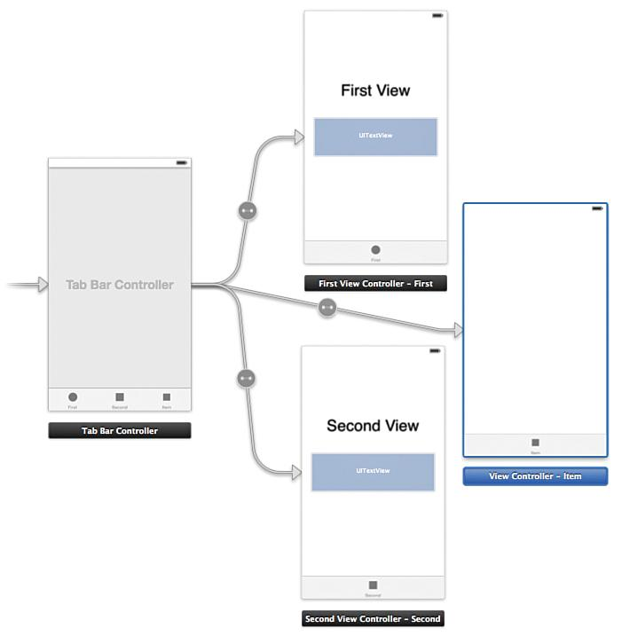
The tab bar needs three screens, start by adding a new View Controller for the third screen:
Drag a View Controller into the Storyboard.
Select the Tab Bar Controller.
Hold down the control key and then drag from the Tab Bar Controller to the new View Controller, then let go
Choose View Controllers in the dialog that pops up (Figure 10.4).
This will add an arrow from the Tab Bar Controller to the new View Controller and add a third element to the actual tab bar (Figure 10.5 ).
Copy the label that says First View onto the new View Controller by selecting it and pressing Cmd-C; then select the new View Controller and press Cmd-V.
Double-click each of the three labels and change the text to Contacts, Map, and Settings, as shown in Figure 10.5
Figure 10.4 Adding a new View Controller.
Notes:
Figure:

Slide 8
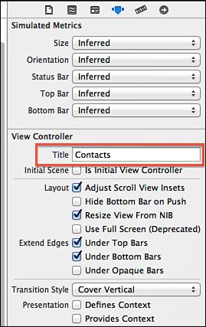
Running the app reveals the Contacts screen and the three tabs at the bottom, named First, Second, and Item.
To change the tabs to have the proper names:
  Open the Storyboard and select the First View Controller in the Dock.
  Make sure the Attributes Inspector is selected and then change the Title to Contacts (Figure 10.6).
Figure 10.6 Changing the title of the Contacts View Controller.
Notes:
Figure:

Slide 9
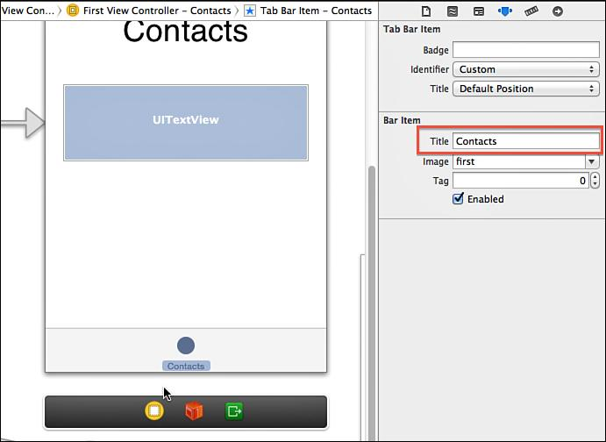
Select the Tab Bar item at the bottom of the Contacts View Controller (Figure 10.5 )
Change the Title in the Attributes Inspector to Contacts (Figure 10.7).
Repeat for the Map and Settings screen.
Figure 10.7 Changing the Title of the Tab Bar Item.
Notes:
Figure:

Slide 10
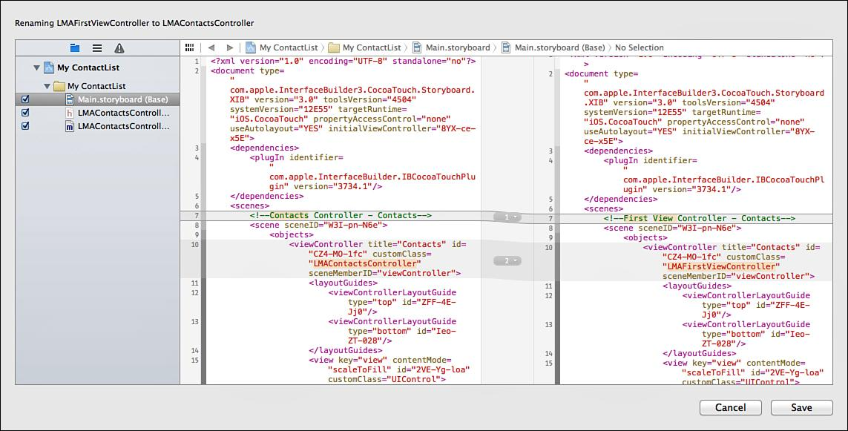
Rename the code files that manage each View Controller that are are currently named LMAFirstViewController and LMASecondViewController.
Xcode has good support for refactoring, which will find and rename everything.
The screen in Figure 10.8. shows all the files that will be affected and potential changes carrying out the rename operation.
Click save and repeat for the Second View Controller, renaming it LMAMapController
Figure 10.8 Renaming a file using the Refactor option in Xcode.
Notes:
Figure:

Slide 11
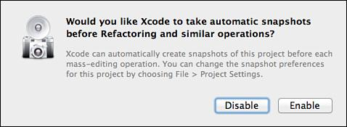
A message about taking snapshots (Figure 10.9) will appear.
Enabling this allows rolling roll back tom make changes such as the renaming operation.
Click Enable, and the rename is carried out.
Figure 10.9 Enabling automatic snapshots.
Notes:
Figure:

Slide 12
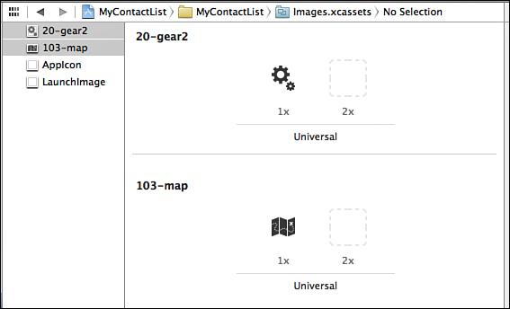
As they are no longer needed,delete the images named first and second ( Figure 10.10 ).
Figure 10.10 Adding images to the Asset Catalog.
Notes:
Figure:

Slide 13
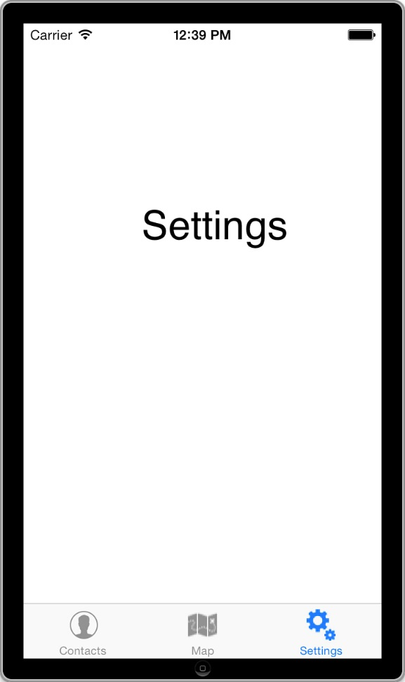
The images are now available for use anywhere in the code.
Code to have the images show up in the tab bar.
Run the app and see the three tabs with the text show up.
Tap on each tab to make sure the proper View Controller shows up (Figure10.11).
Figure 10.11 The completed Tab Bar with three view controllers.
Notes:
Figure:

Slide 14
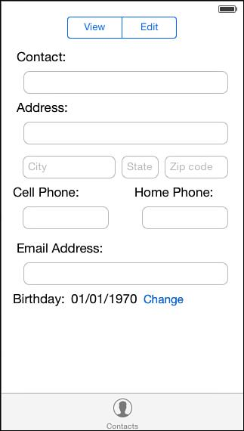
Set up the user interface for the Contacts screen (Figure 10.12)
Figure 10.12 Designing the Contacts screen.
Notes:
Figure:

Slide 15
Contacts screen set-up:
Open the Storyboard and remove the Contacts label and the UITextView control by clicking each and pressing Delete.
Drag a Segmented Control to the canvas and place in the center of the screen toward the top.
A Segmented Control can have multiple segments, only one of which can be activated at a time.
This is the iOS equivalent to a radio button. Double-click the text
First and change to Edit, then change Second to View.
Drag a Label to the left side of the screen below the Segmented Control and change its text to Contact:
Drag a Text Field below the label, and resize to the right until the blue guideline appears.
Notes:
Figure:

Slide 16
Continue with the remaining labels and text fields as shown in the screenshot.
Copy an existing control by holding down the Option key and dragging a control.
For multiple controls use the same technique to copy multiple controls.
Use the blue guidelines to place the controls. The Birthday line has two Labels and a Button.
For the City, State, and Zip fields, select the Attributes Inspector and change the Placeholder property for each of them as shown in the screenshot.
Use the Attributes Inspector to change the Capitalization to Words for the Contact, Address, and City fields. Change Capitalization for the State field to All Characters.
Use the Attributes Inspector to change the Keyboard for the Zip field to Number Pad, and for the two phone fields to Phone Pad, and for the Email field to Email Address.
Run the app and notice that controls are hidden behind the keyboard. Fix this by using a scroll view control.
Notes:
Figure:

Slide 17
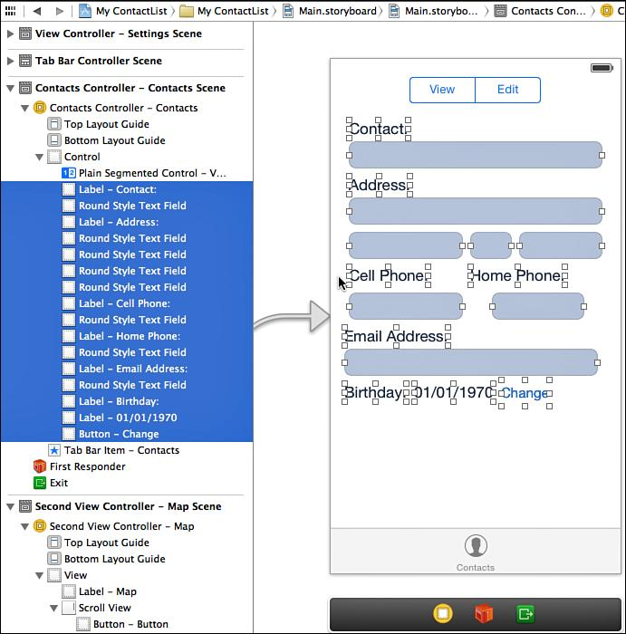
Using the Dock rather than on the screen
Figure 10.13 Selecting the controls to embed in Scroll View.
Notes:
Figure:

Slide 18
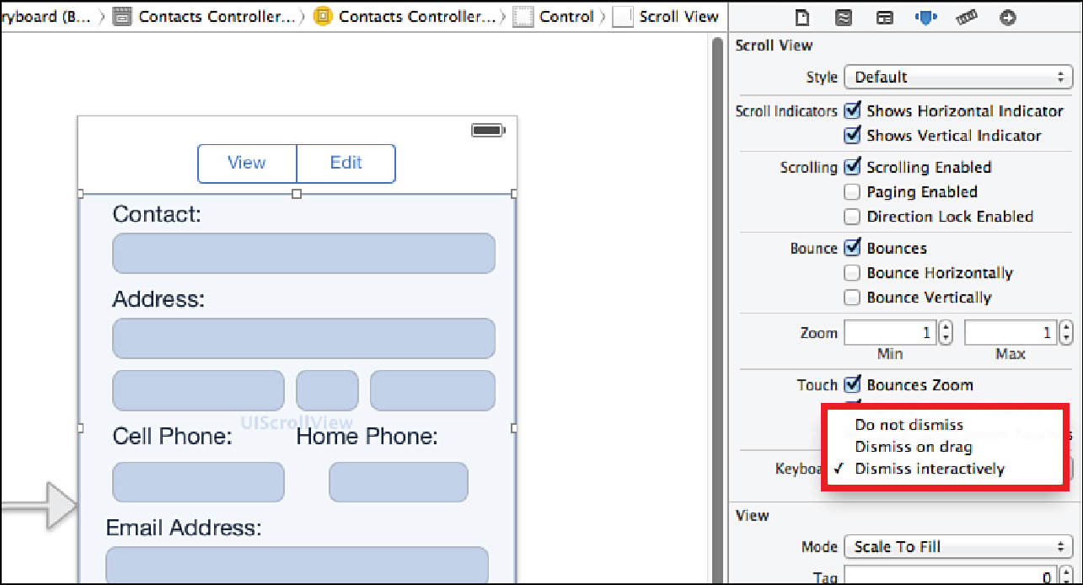
The scroll view is used extensively throughout iOS
Figure 10.14 Selecting the controls to embed in Scroll View.
Notes:
Figure:

Slide 19
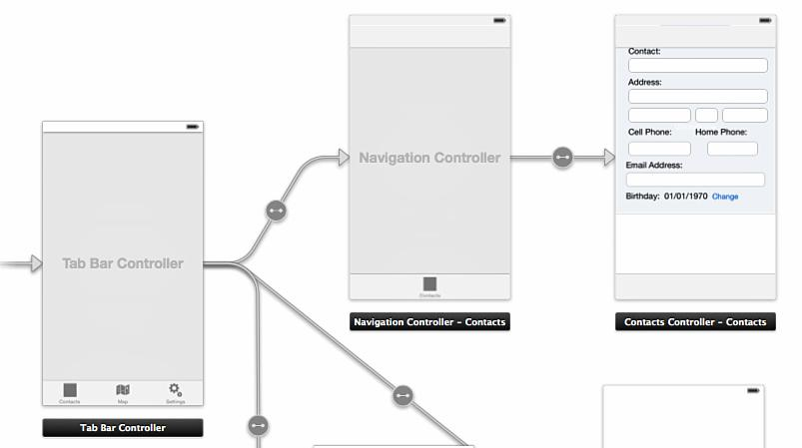
In MyContactList, add a Navigation Controller to the Contacts Controller.
This allows the Tab Bar to be connected to the Navigation Controller, which is connected to the View Controller.
Figure 10.15 Adding a Navigation Controller.
Notes:
Figure:

Slide 20
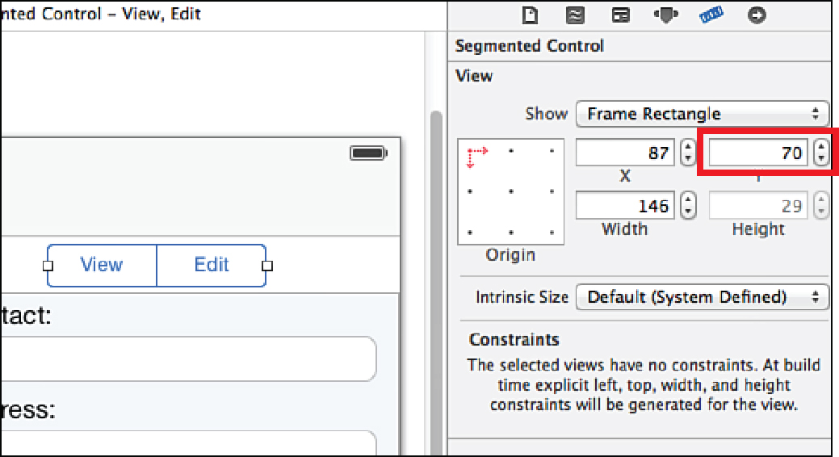
The Segmented Control is hidden, select it in the Dock, and then use the Size Inspector in the right sidebar to change the Y coordinate to 70 (Figure 10.16).
Figure 10.16 Setting the Y placement for the Segmented Control.
Notes:
Figure:

Slide 21
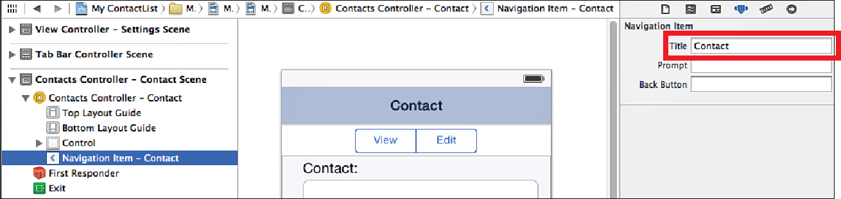
Set the title of the navigation bar by selecting the Contacts Controller’s Navigation.
Item in the Dock and then use the Attributes Inspector to set the Title to Contact (Figure 10.17).
Figure 10.17 Setting the navigation bar Title.
Notes:
Figure:

Slide 22
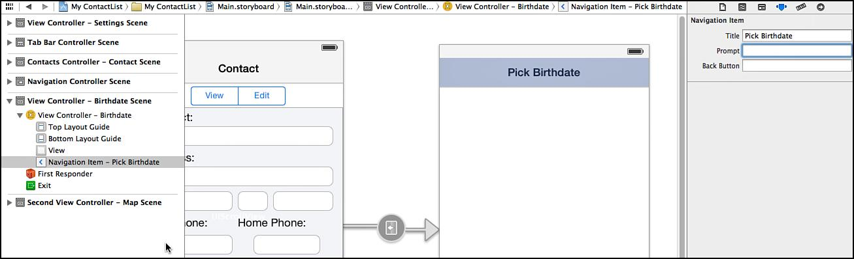
Select the new Navigation Item and set its Title to Pick Birthdate ( Figure 10.18 ).
The connections between view controllers are called segues.
Segues define how screens will transition back and forth.
Figure 10.18 Setting the Navigation Bar Title for the Birthdate View Controller.
Notes:
Figure:

Slide 23
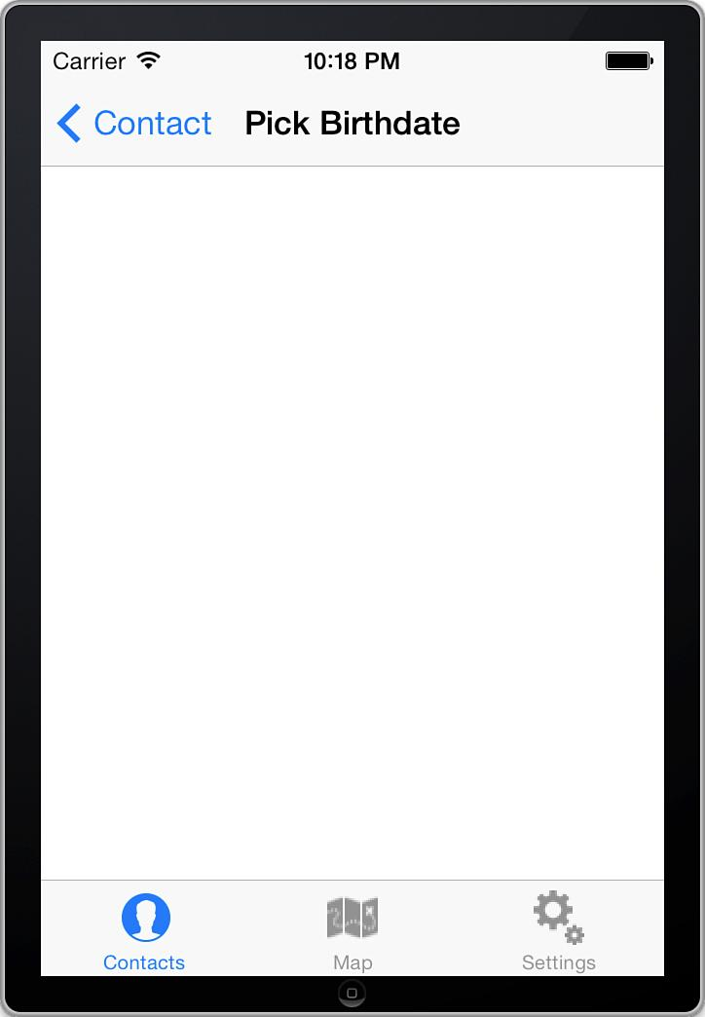
Run the app and tap the Change button, and you should see the Date screen as shown in Figure 10.19
Figure 10.19 The Date screen with the navigation controller and button to go back to Contacts.
Notes:
Figure:

Slide 24
Adding the capability to choose a date on the Date screen:
Open the Storyboard and drag in a Date Picker from the toolbox and place it at the top of the Date View Controller.
The Date Picker can be configured to work with
both time and date.
Use only dates, open the Attributes Inspector and
change the Mode to Date.
Designers can set the default date and constrain
the picker between specific dates.
Run the app to ensure thee Date Picker shows up as expected.
Notes:
Figure:

Slide 25
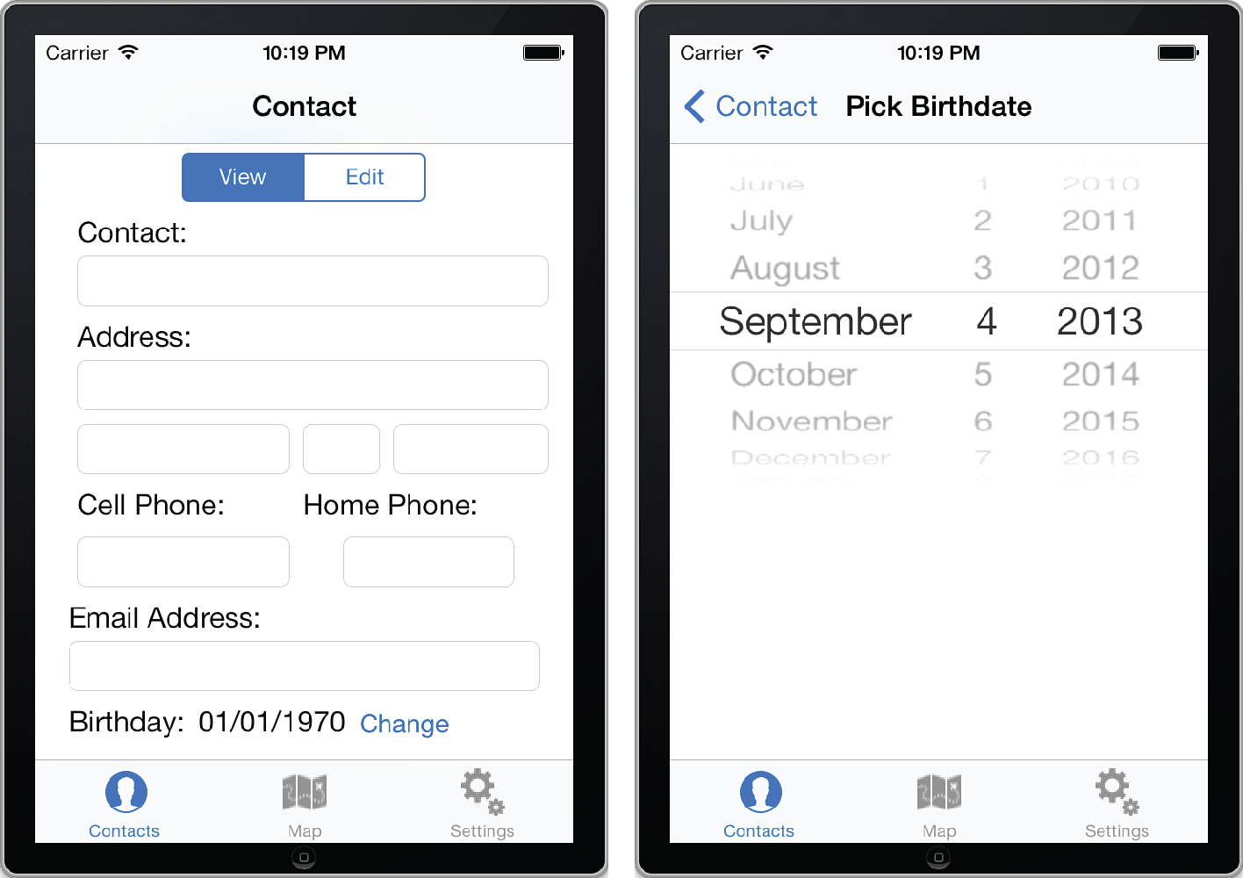
Figure 10.20 shows the completed navigation control hierarchy for the Contacts and Date View Controllers.
Figure 10.20 The completed navigation interface for the Contact and Date screens.
Notes:
Figure:

Slide 26
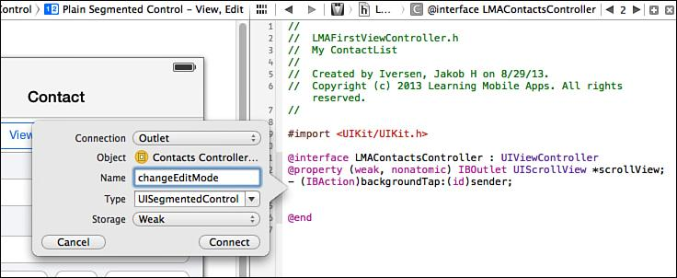
To implement the capability to switch between view and
edit modes designers must code adding an action to change the edit mode (Figure 10.21).
Figure 10.21 Adding an action to change the edit mode.
Notes:
Figure:

