Slide 1

After Xcode starts view see the screen shown in Figure 9.1 . Select the Create a New Xcode Project option.
Figure 9.1 Xcode’s Welcome screen.
Notes:
Figure:

Slide 2
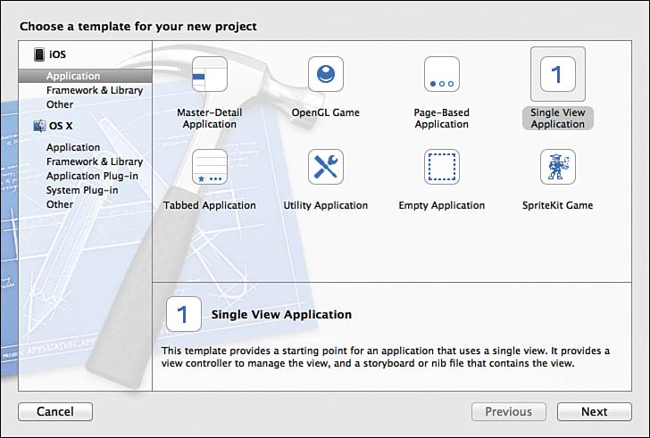
Both iOS and OS X projects can be created.
Choose the iOS application.
Choose Single View Application, and click Next.
Figure 9.2 Choose the Single View template for the first project.
Notes:
Figure:

Slide 3
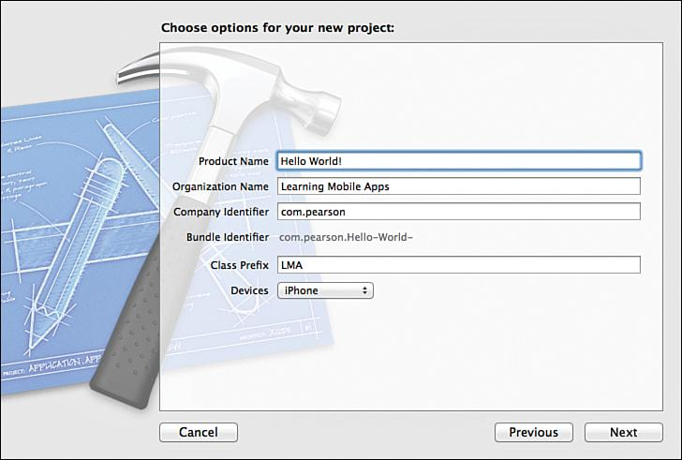
Choose a name for your app.
Type “Hello World!”
Use prefixes or stay with three-letter format.
Figure 9.3 Choosing options for the iOS project.
Notes:
Figure:

Slide 4
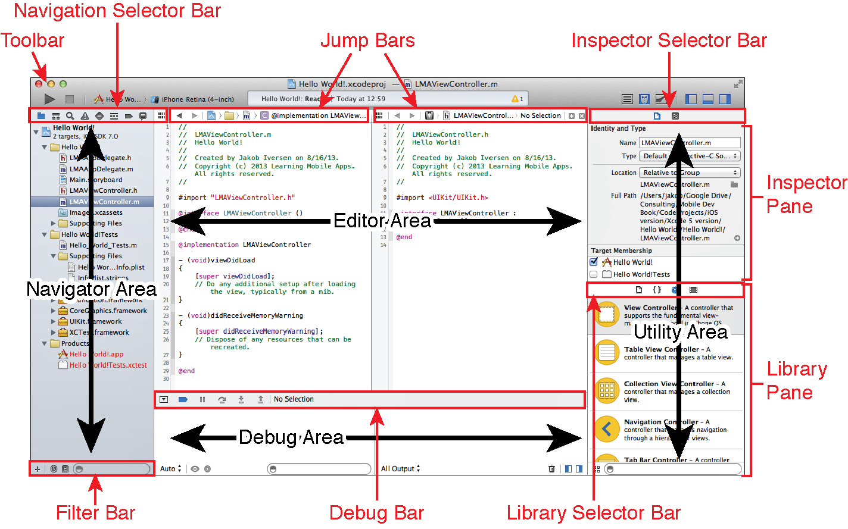
After creating the project, look at the main Xcode workspace window in Figure 9.4 which shows an overview of the Xcode workspace.
Xcode is a very powerful development environment with numerous functionality.
Figure 9.4 Overview of the Xcode workspace.
Notes:
Figure:

Slide 5
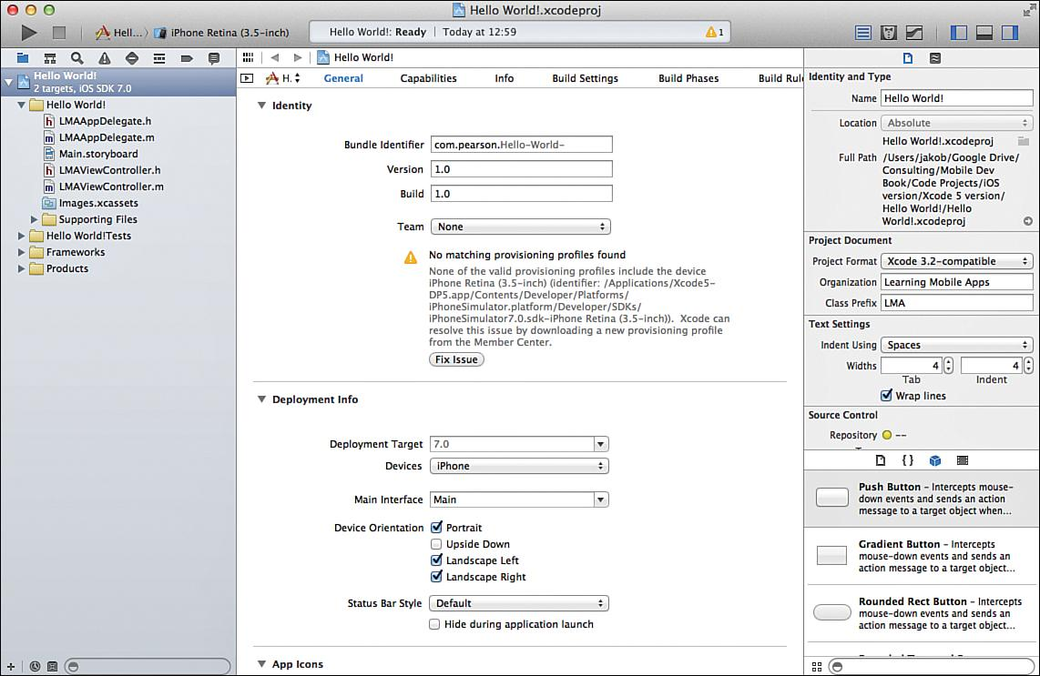
In Figure 9.5 the center of the workspace has a summary of the app and several appwide settings.
The first section enables you to specify the version and build for the app.
The version is used when the app is published to the App Store.
When an app has a higher version number is published users are prompted to download a new version.
You can specify which device orientations are supported.
Figure 9.5 Overview of the Xcode workspace with our newly created Hello World app.
Notes:
Figure:

Slide 6
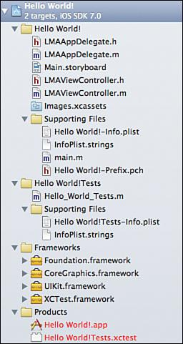
On the left, in the navigation area, view the files that Xcode created. Figure 9.6 displays what it looks like.
The number and types of files created depends on choices made when creating the project.
Figure 9.6 Contents of the Hello World project.
Notes:
Figure:

Slide 7
AppDelegate.h manages issues related to the entire app and used to manage the life cycle of the app.
“Persistent Data in iOS.” Objective-C programs follow the C-style and have both a header (.h) and method (.m) file.
Main.storyboard—The storyboard is used to design the interaction between multiple screens in the app and design the layout of the individual screens.
ViewController.h and ViewController.m contains the code that controls the user interactions with the app.
Figure 9.6 Contents of the Hello World project.
Notes:
Figure:

Slide 8
Images.xcassets contains all the images, including icons, needed for the app.
Supporting Files contains a number of files that the app may/may not use.
  Hello World!-Info.plist contains a few app-specific settings.
  main.m is responsible for launching the app.
Hello World! Tests—Xcode comes with a built-in Unit Test framework.
Frameworks are libraries that include in the project to add functionality to the app
Products—This is your compiled app file.
Figure 9.6 Contents of the Hello World project.
Notes:
Figure:

Slide 9
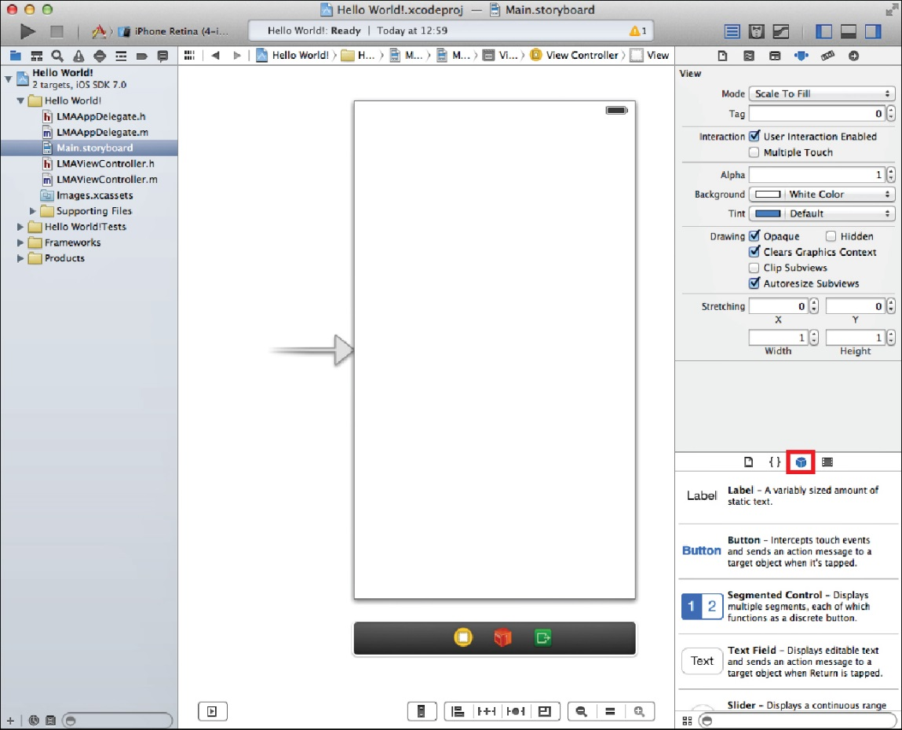
Click once on the Main.storyboard file.
This opens the file in Interface Builder (see Figure 9.7 )
This area allows easy creation of the user interface for the app.
Drag user interface elements from the utility pane on the bottom right and control a range of settings on the top of the utility pane.
The Object Library contains user interface elements used in the app.
If the Object Library is not visible, click the cube-shaped icon.
Figure 9.7 Interface Builder.
Notes:
Figure:

Slide 10
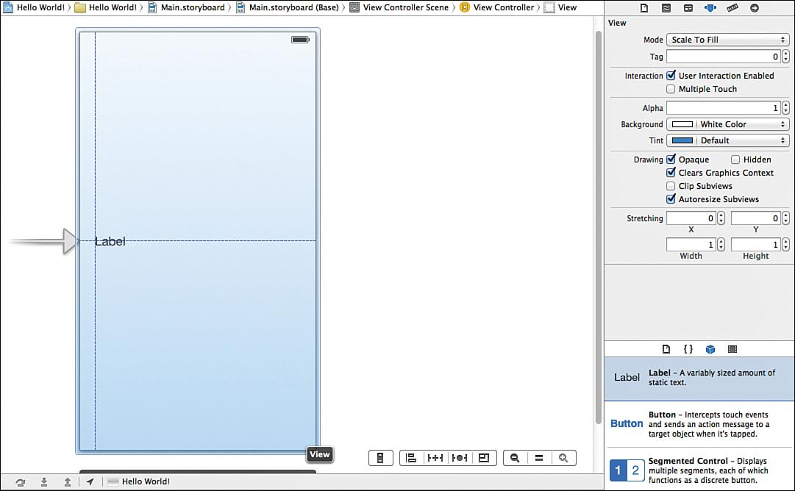
Start by dragging a label onto the user interface canvas (see Figure 9.8)
Blue dotted guidelines appear when the label is dragged around.
Drag it to the middle left of the screen and let go when both guidelines appear.
Double-click the label to change the text of it to “Hello World!” and press Enter.
Figure 9.8 Dragging a label onto the canvas and using guidelines for placement.
Notes:
Figure:

Slide 11
Expand the label by clicking the right side of it and dragging it to the right side until the blue dotted guidelines appear.
Above the utility area on the right, there’s little menu bar of five items. The fourth one from the right should be selected.
This is the Attributes Inspector, which enables you to set many properties for the currently selected user interface element.
Figure 9.8 Dragging a label onto the canvas and using guidelines for placement.
Notes:
Figure:

Slide 12
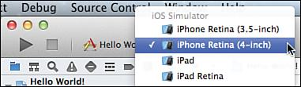
Launching the app in the built-in simulator that comes with Xcode is easy.
In the top-right corner of Xcode, there’s a big Run button, and next to that, a Scheme, which enables choosing which device is targeted (see Figure 9.9 ).
Click the right side of the scheme and choose the iPhone simulator.
Figure 9.9 Choosing the iPhone simulator to run the app.
Notes:
Figure:

Slide 13
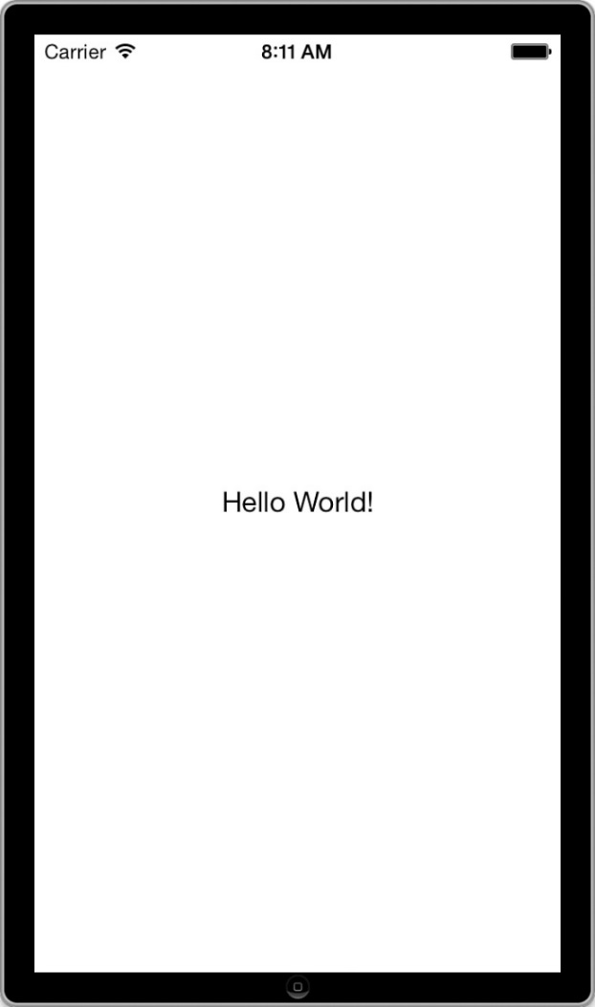
Click the Run button on the top left of the Xcode toolbar and wait a few seconds for the simulator to launch with the app (see Figure 9.10 ).
Control how the simulator looks and behaves under the Hardware menu.
Figure 9.10 iOS simulator with the Hello World! App.
Notes:
Figure:

Slide 14
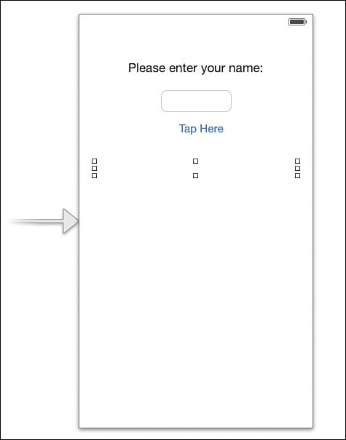
Set up the user interface when the storyboard is open.
Double-click the Hello World label and change it to Please enter your name.
Drag a Text Field onto the canvas and place it below the label.
Drag a button below the text field. Double-click the button and change its text to Tap Here!
Figure 9.11 Completed UI in Interface Designer and the iOS simulator.
Notes:
Figure:

Slide 15
Add a label below the button. Make the label as wide as the width of the screen, delete its text, and specify its content to be centered and blue.
Specify a keyboard that will show up on screen. Make sure the keyboard is set to Default.
Figure 9.11 shows the completed UI in the Interface Designer and the iOS
simulator with the default keyboard activated.
Figure 9.11 Completed UI in Interface Designer and the iOS simulator.
Notes:
Figure:

Slide 16
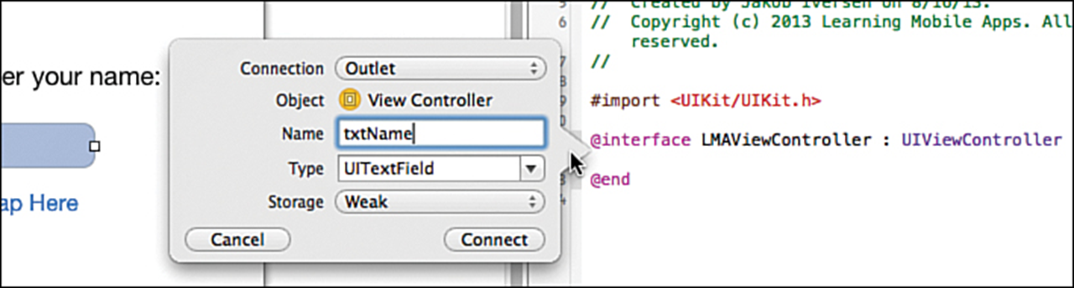

Add action to the app by having the app take the name entered and say Hello to the user by name.
To do this, return to Xcode and click Stop to quit the simulator. Then make sure the storyboard is open.
  Next, click the Show Assistant Editor button in the top-right corner of the Xcode window.
  This opens an extra editor that by default contains the file that best matches what is displayed in the main window.
  Create outlets for user interface elements we want to access from the code.
Figure 9.12 Creating an outlet for a user interface element.
Notes:
Figure:

Slide 17
  This includes the two text fields to read the text the user entered and the bottom label that will be updated to contain the text string based on the two text fields.
  To create the outlets, hold down the Control key, click the text field, and drag to the view controller between the @interface and @end entries. Then let go.
  See the situation as shown in Figure 9.13
  Enter txtName in the Name field and click Connect. You should now have this line of code in LMAViewController: @property (weak, nonatomic) IBOutlet UITextField *txtName;
Figure 9.12 Creating an outlet for a user interface element.
Notes:
Figure:

Slide 18
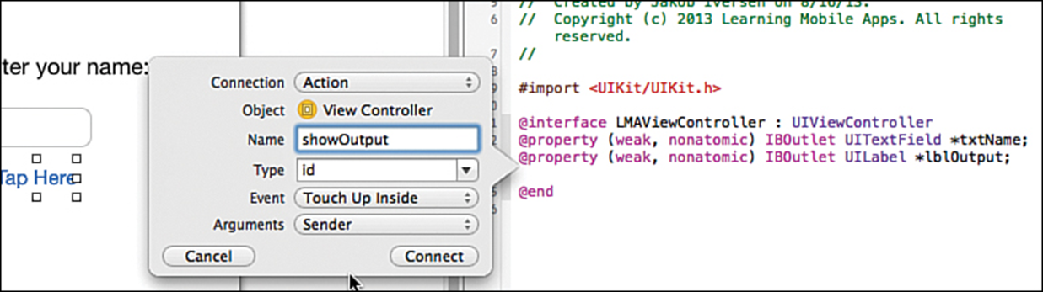
Add the code for the button. Switch back to the storyboard. Control-drag from the button to the view controller below the properties for the text fields and label.
In the top drop-down choose Action (See Figure 9.14 ). Give it the name showOutput .
For the Event, use the default Touch Up Inside.
To cancel a touch, drag your finger outside the target and then let go.
Leave the Arguments as Sender.
  In Android, whenever code needs a reference to a control, use a special command that will find it by its ID.
Switch the LMAViewController.m file, and notice the method at the bottom of the file called showOutput: . Between the curly braces of this method, enter the code shown in Listing 9.1 .
Notes:
Figure:

Slide 19
To get the keyboard to disappear, add code to the program.
Change the View, which is the background of the app, so that it is able to respond to a tap.
When the view intercepts a tap, it will then send a message to the text field to resign control. This makes the keyboard disappear.
First set up the code to handle the event and then tie the event to the code.
In LMAViewController.h, add this line between the @interface line and the @end line to define a new action method:
    ( IBAction )backgroundTap:( id )sender;
In LMAViewController.m, add the code in Listing 9.2 to implement the method.
Notes:
Figure:

Slide 20
This code tells the View to end editing, which will cause the keyboard to disappear.
Specify how this code gets called. Select the storyboard file. The Dock must be in list mode.
To expand it to list view, click the triangle in a rounded rectangle.
After the Dock is in list mode, select the top-level View (see Figure 9.15 ).
The View is the background canvas that all the other controls sit on. Change this to a Control, so it can fire events.
With the View selected, show the Identity Inspector in the far-right pane.
Change the Class field to UIControl by simply typing over UIView (Figure 9.16 ).
All controls that are capable of firing events are subclasses of UIControl by changing the underlying class from UIView to UIControl the View is capable of firing events.
Notes:
Figure:

Slide 21
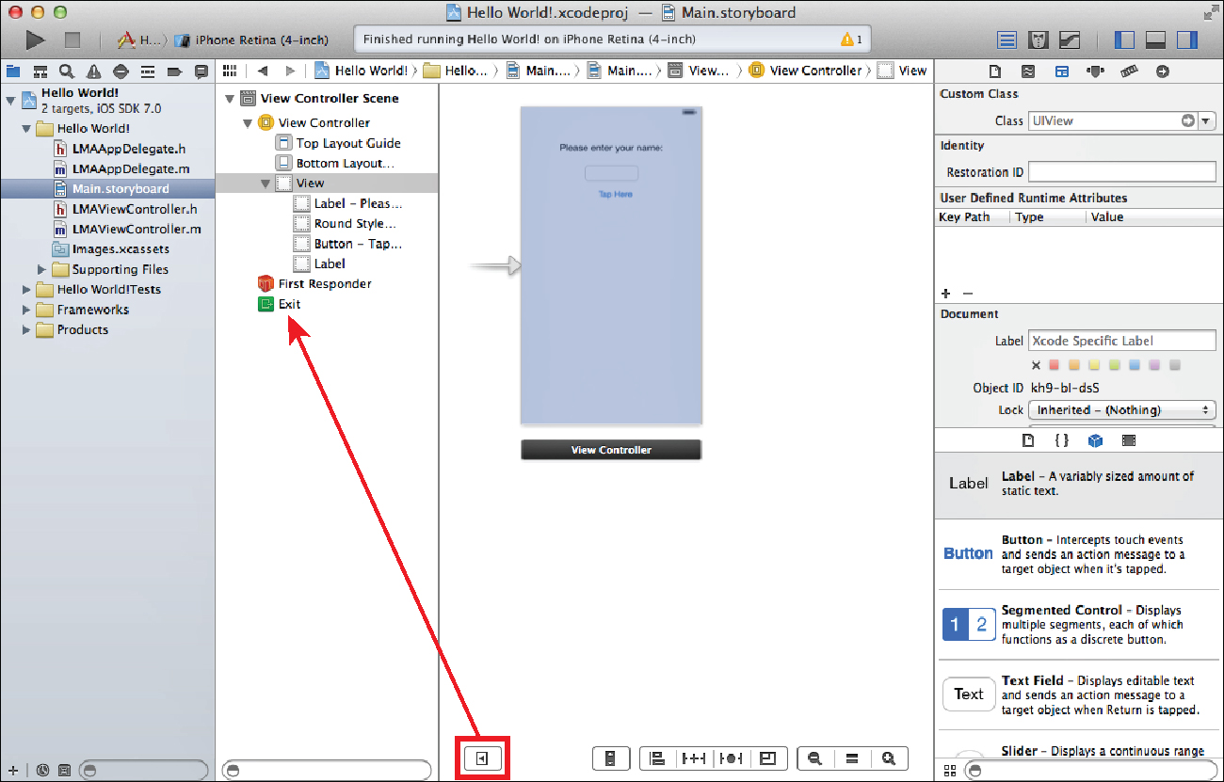
After the Dock is in list mode, select the top-level View.
Figure 9.15 Xcode with the Dock in List View.
Notes:
Figure:

Slide 22
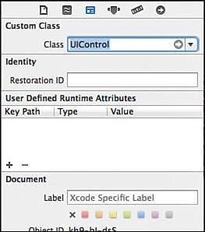
Change the Class field to UIControl by simply typing over UIView
Figure 9.16 Changing the View class to UIControl.
Notes:
Figure:

Slide 23
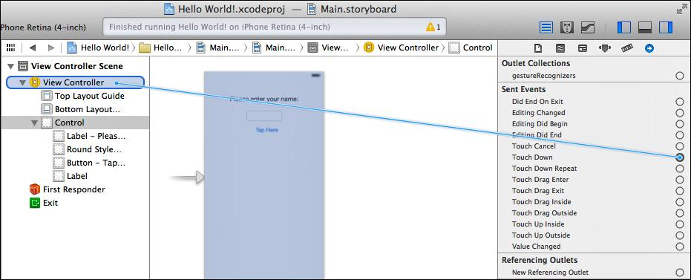
Select the Connections Inspector in the right pane. This shows all the possible actions that can be taken for the current control and can be used to connect those actions to methods in the code.
Drag the circle by Touch Down to the View Controller in the Dock (Figure 9.17 ).
When released, select backgroundTap: . This will then call the backgroundTap: method every time the Touch Down event fires on the View.
Figure 9.17 Connecting the Touch Down event for the View to File’s Owner.
Notes:
Figure:

Slide 24
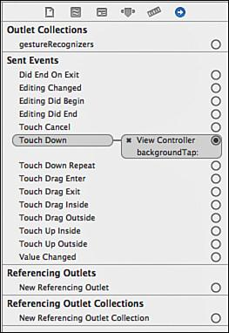
The View Controller object is the object that loads the current view typically the UIViewController class itself.
Click some of the other controls to view them in the Connections Inspector and see how events are linked to methods (Figure 9.18).
Run the app and see how the keyboard disappears when you tap outside the text field.
Figure 9.18 Connection Inspector after setting up the action to dismiss the keyboard.
Notes:
Figure:

Slide 25
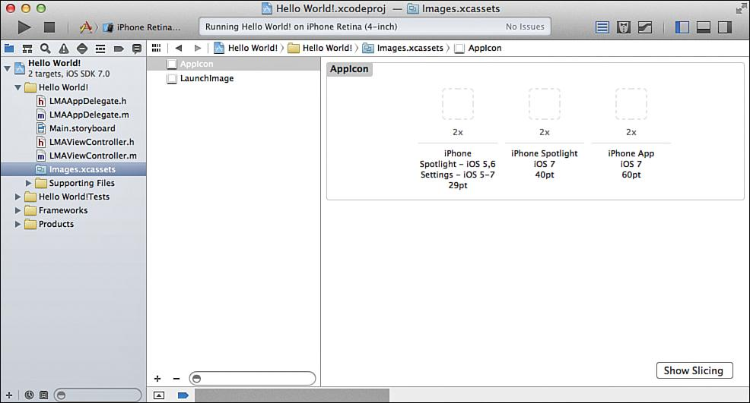
App Icons are graphical images that are used to indicate your app on the home screen of the iOS device your app is running on.
  The icon is used for three places:
  On the home screen, to give the user an easily recognizable image of your app.
  In Spotlight results when the user is searching on the device.
  In the Settings app where the user can change various settings for your app.
To determine the resolution look at the number in the last line under each spot (29pt, 40pt, and 60pt).
Figure 9.19 Asset catalog.
Notes:
Figure:

Slide 26
To supply icons for other situations, right-click anywhere with a white background in the asset catalog and select New App Icon.
To have the app listed in the app store, supply icons in sizes of 512x512 and 1024x1024 pixels.
Figure 9.20 Possible app icon resolutions.
Notes:
Figure:

Slide 27
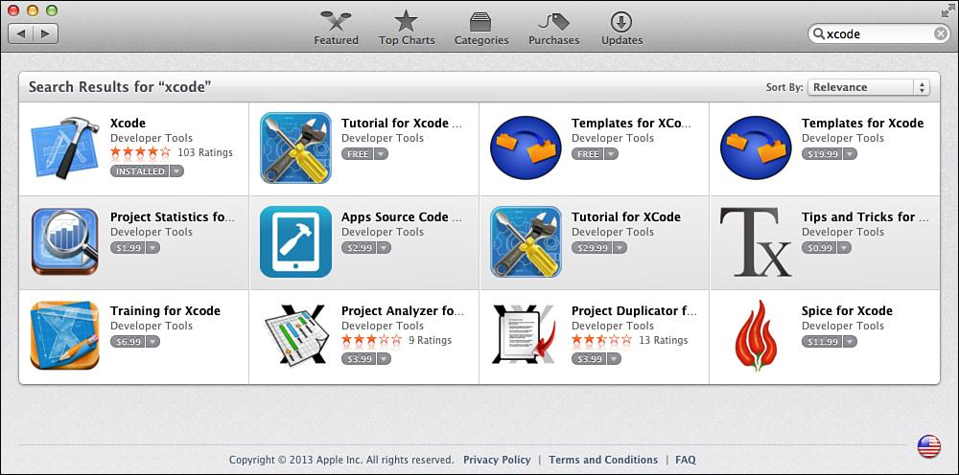
Getting Xcode installed by launching the Mac App Store on your Mac and searching for Xcode (Figure B.1 ).
Click Free, which turns the button green and changes to Install App.
Click again to install Xcode.
After it is downloaded, Xcode is automatically installed. Xcode is launched from the Applications folder.
Figure B.1 Finding Xcode in the Mac App Store.
Notes:
Figure:

Slide 28
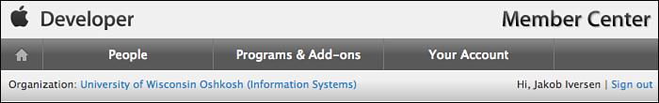
To register developers, the administrator for the program needs to log in to the Member Center on the Apple Developer Site (developer.apple.com).
At the top of the screen, choose the People tab (see Figure B.2 ).
Developers can be invited individually or in bulk.
Each person invited will receive an email with a link to register as a developer or sign in with an existing developer account.
The same developer account can be associated with multiple development programs.
Figure B.2 Click People to add developers to an iOS University Developer Program.
Notes:
Figure:

Slide 29
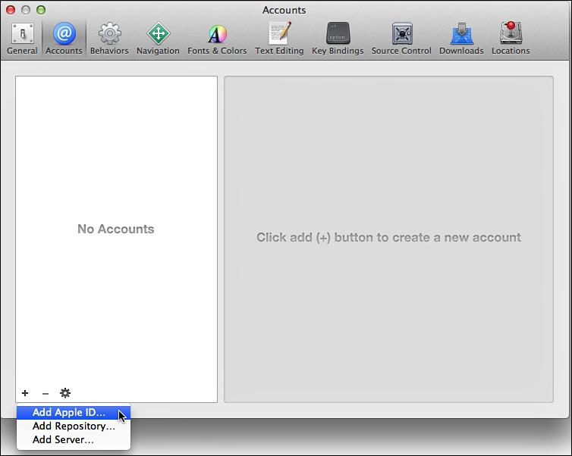
After the developer account has been created, it can be added to Xcode by selecting Xcode > Preferences > Accounts.
Then click the + sign at the bottom and choose Add Apple ID (see Figure B.3 ).
Figure B.3 Adding Apple ID to Xcode.
Notes:
Figure:

Slide 30
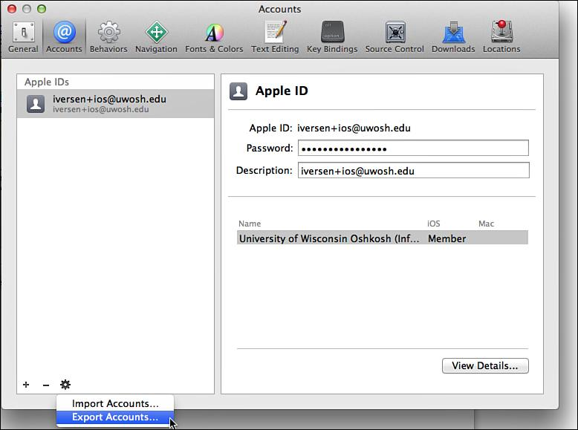
To back up the certificate, in Xcode, choose Xcode > Settings > Accounts
Click the gear icon in the lower left, and then select Export Accounts (see Figure B.4 ).
Figure B.4 Export Accounts from Xcode for backup.
Notes:
Figure:

Slide 31
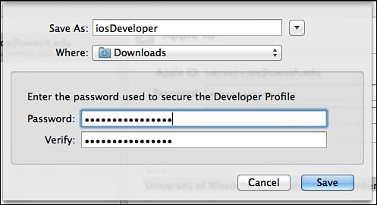
You will need to provide a name for the exported file and a password (see Figure B.5 )
Figure B.5 Saving the Developer Profile.
Notes:
Figure:

Slide 32
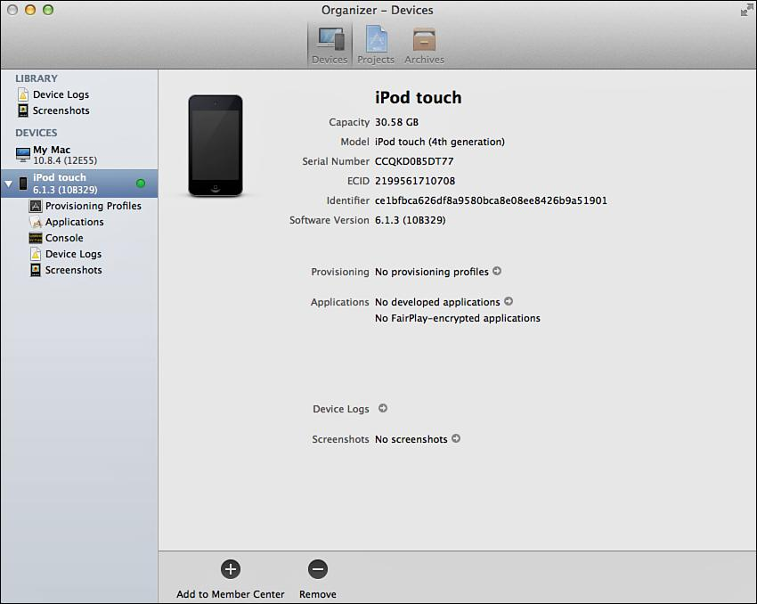
You can find the UDID in the Organizer in Xcode.
Another way to register devices is to connect them to Xcode one by one; then, using the Device Organizer, click Use for Development (see Figure B.6 ).
Figure B.6 Register a device for development using the Organizer.
Notes:
Figure:

Slide 33
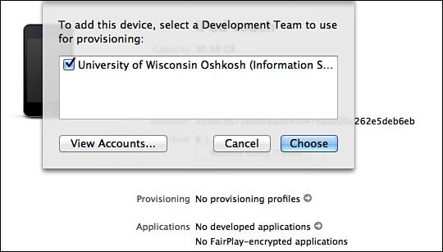
Choose the development team to register the device with (see Figure B.7 ).
This requires being signed in with an Admin account.
Figure B.7 Choose a Development Team to use for provisioning of a device.
Notes:
Figure:

Slide 34
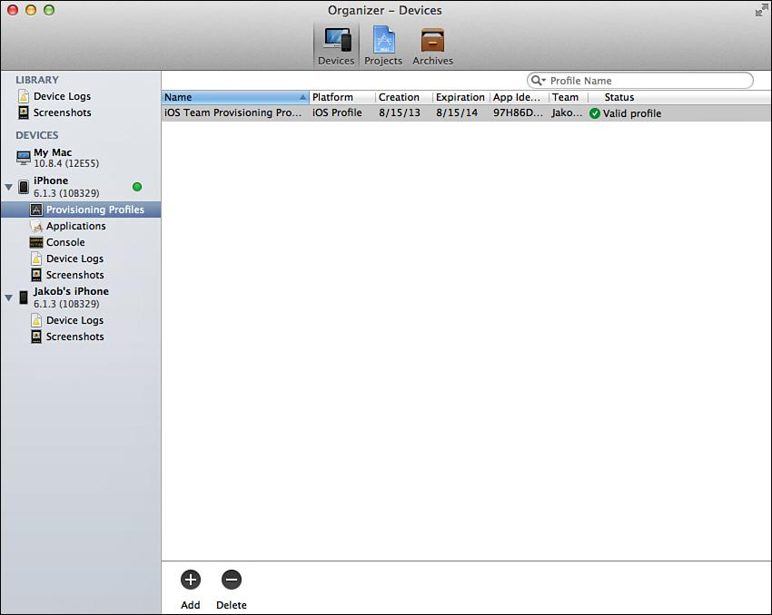
To ensure that the environment is set up properly, open the Organizer and check that the device has a valid provisioning profile (see Figure B.8 ).
Figure B.8 Checking that the device has a valid provisioning profile.
Notes:
Figure:

Slide 35
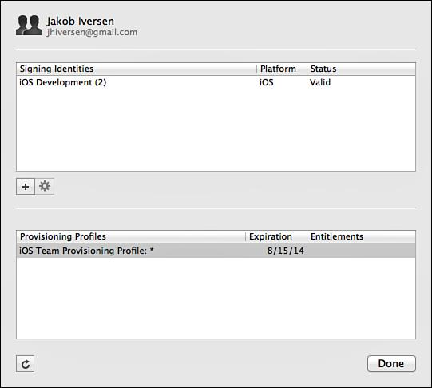
Ensure that the developer’s account is added to Xcode (Xcode > Preferences > Accounts > View Details) and has a valid certificate (see Figure B.9 ).
Figure B.9 Checking that the developer has a valid signing identity and provisioning profile.
Notes:
Figure:

Slide 36
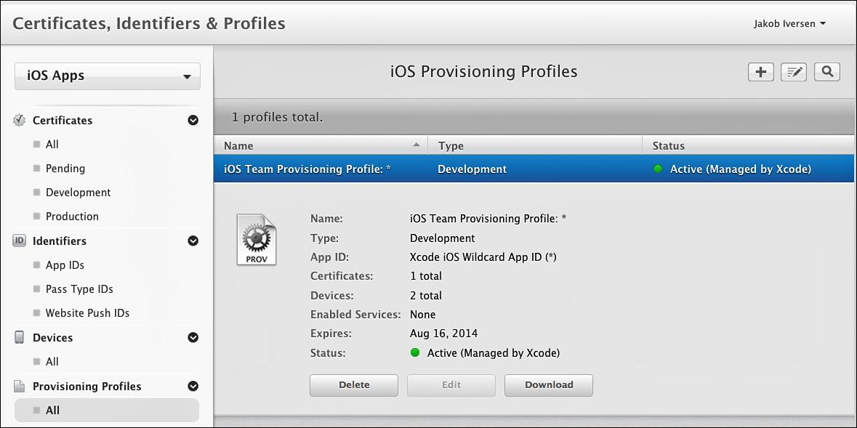
The most frequent problem that occurs in deploying to a device is that the device doesn’t have a valid provisioning profile.
If this happens, download the provisioning profile from the Developer Site under Certificates, Identifiers & Profiles/
Click the provisioning profile and then click Download (see Figure B.10 ).
The downloaded file can then be dragged into the Organizer.
Figure B.10 Downloading a provisioning profile from the Apple Developer Site.
Notes:
Figure:

Slide 37
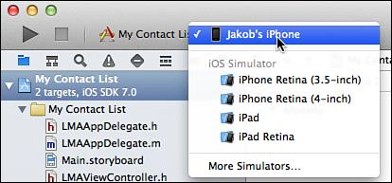
After a device is registered, the provisioning profile is properly installed, nd the device is connected to the Mac, run an app on the device by switching the scheme in Xcode to the device (Figure B.11 ).
Figure B.11 Changing the scheme to an actual device.
Notes:
Figure:

