Slide 1
Sensors, maps and fragments:
Sensors are hardware built in to the mobile device to allow an app to capture environmental data.
2 location sensors are in Android devices.
Network sensor based on cell towers/WiFi.
Sensor based on Global Positioning Services (GPS).
Notes:
Figure:

Slide 2
Location information is accessed within an app through the use of the LocationManager object.
Accessed through the method getSystemService .
The LocationManager object requests updates from either or both sensors.
To get the updates, an app has to instantiate a LocationListener.
A LocationListener implements the method onLocationChanged.
Change reported by sensors is captured by the LocationListener, which is passed a Location object.
A Location object has information on the new location, including GPS coordinates and altitude, which sensor provided the location, a measure of the accuracy of the coordinate estimate, etc.
The onLocationChanged performs operations based on developer code.
To receive information from the sensors, the LocationManager requests the updates from providers and indicates what LocationListener to use to handle the updates.
When the LocationManager requests updates from the GPS, the GPS is activated.
Notes:
Figure:

Slide 3
Sensors, maps and fragments (Cont):
Maps are used to display data that can be enhanced by a visual representation of its location.
Maps are implemented using the GoogleMap object in the source code file and a MapFragment in the layout file.
Google Play Services SDK is installed on your development machine to implement maps in your app.
Using Google Maps requires an API key, which is free.
Maps are implemented as a MapFragment widget in a layout.
The Activity that implements the code for the map’s behavior is a FragmentActivity.
Notes:
Figure:

Slide 4
Sensors, maps and fragments (Cont):
Fragments are used in coding Android Activities.
The FragmentActivity is a subclass of the Activity class.
Activities that implement a map must extend the FragmentActivity class not the Activity class.
This is because maps are enclosed in a MapFragment .
This allows a map to be a part of a layout not the only thing in a layout.
To set up for Maps:
Load the Google Play Services SDK into your workspace.
Select Window > Android SDK Manager.
Scroll through the list of available SDKs to the Extras folder.
Check the box next to Google Play Services.
Accept license and install.
Notes:
Figure:

Slide 5
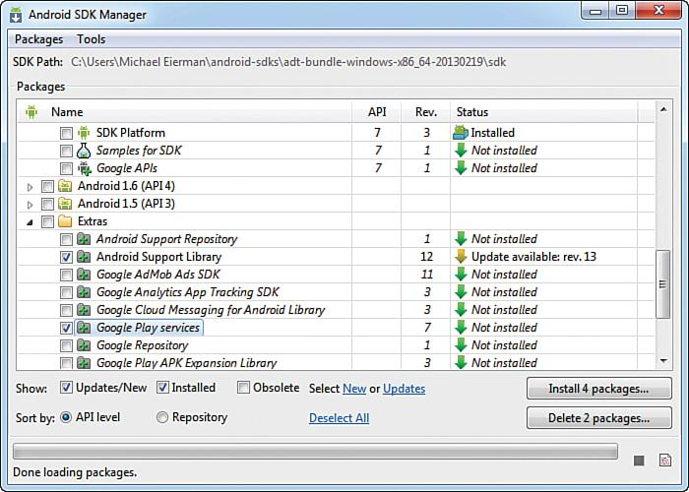
The process of updating or adding SDKs to Eclipse is known to be “buggy.”
Figure 7.1 Android SDK Manager window.
Notes:
Figure:

Slide 6
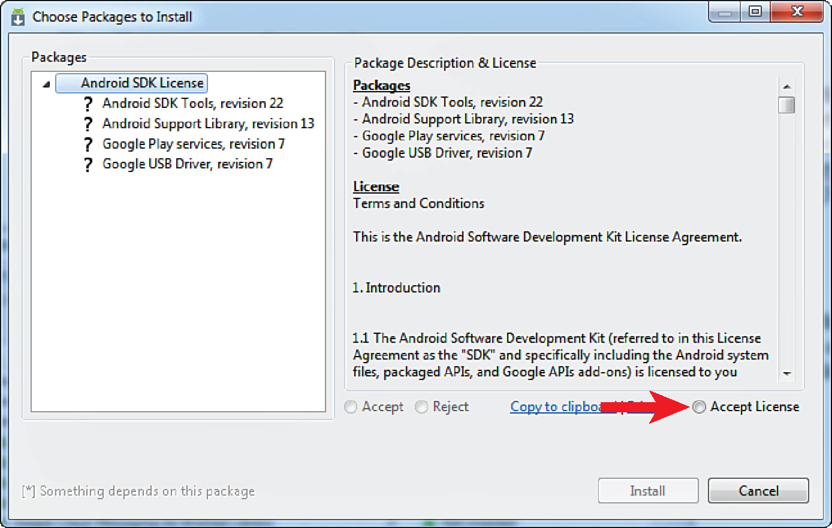
After you accept license and install follow the prompts to add the Google Play Services SDK to your project.
Figure 7.2 Choose Packages window.
Notes:
Figure:

Slide 7
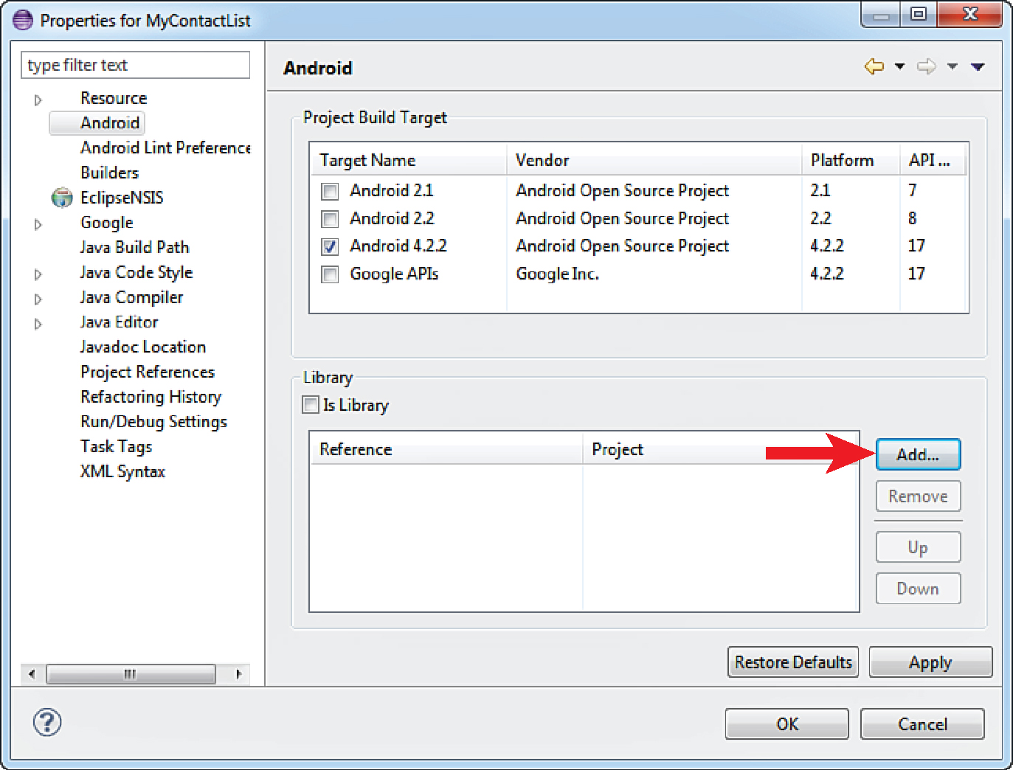
The Google Services Library is in the bottom window.
Click OK to close the Properties window, add the API key next.
Figure 7.3 Adding Google Play Services to project.
Notes:
Figure:

Slide 8
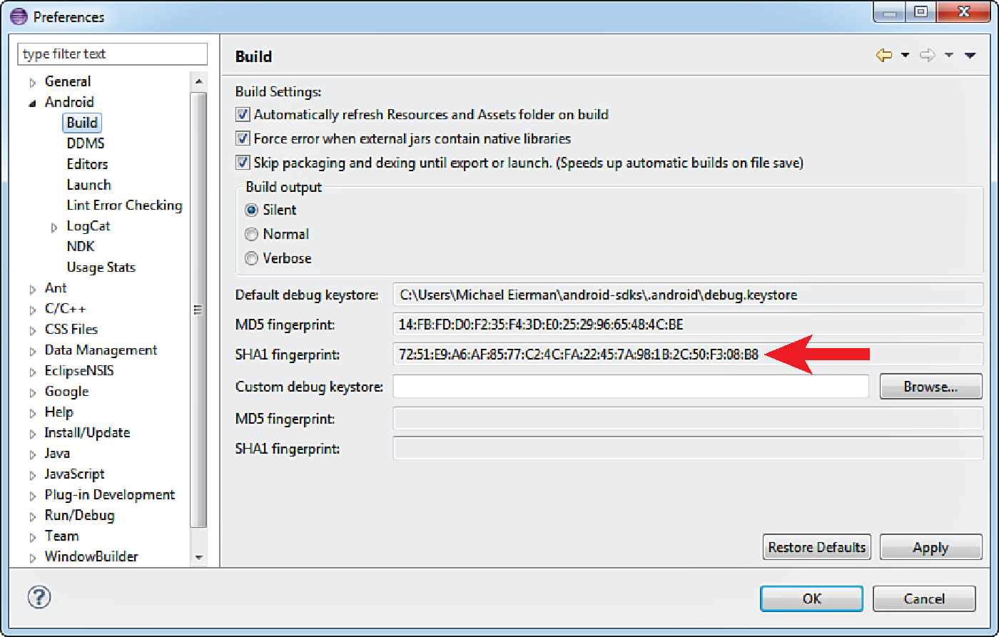
Go to the Google API Console and enter the fingerprint to get the API key.
Copy the API key into your app manifest file.
Figure 7.4 Get SHA1 fingerprint.
Notes:
Figure:

Slide 9
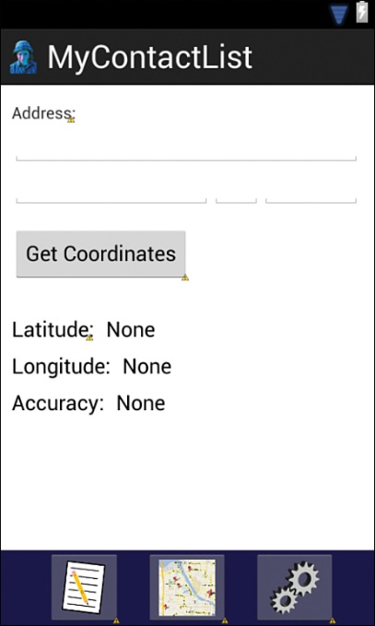
Open the AndroidManifest.xml file and enter the permissions in Listing 7.1
Find your location: use the map’s getMyLocation ( ) method to get the device’s current GPS coordinates.
Refer to Figure 7.5 to code this layout.
Figure 7.5 Initial Layout for getting location.
Notes:
Figure:

Slide 10
After layout creation open the ContactMapActivity.java file to write the code for the behavior for the Get Location button.
Refer to Listing 7.2 to write this code.
Code the call to the initialization method in the onCreate method.
The proper format for a call is required i.e. street address method.
A List object variable parameterized to hold an Address object is declared.
A Geocode variable is declared and assigned a new Geocoder object.
The getFromLocationName method is used as a parameter.
The latitude and longitude of the first address in the returned list are displayed.
Figure 7.5 Initial Layout for getting location.
Notes:
Figure:

Slide 11
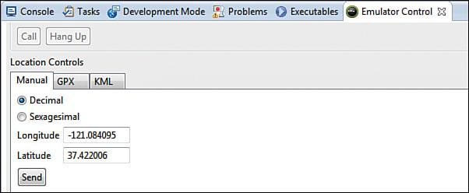
Get coordinates from the GPS sensor.
Replace the Geocoding code in the Get Location button with GPS listener code.
Refer to Listing 7.3
Users get a reference to the system’s location manager and instantiates a location listener to get the GPS coordinates.
Refer to Listing 7.4 for overriding onPauses method.
Be sure to change the location of the emulator.
Figure 7.6 Emulator location control.
Notes:
Figure:

Slide 12
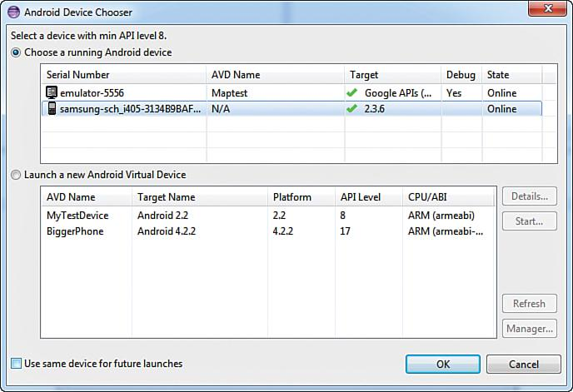
To test the code on a device that has a GPS, terminate the app running on the emulator (Run > Terminate) and plug an Android device into the computer.
1. Open Debug Configurations (Run > Debug Configurations). Select your debug
configuration and then click the Target tab.
2. Select Always Prompt to Pick Device. Press the Apply button and then the Debug button.
The Android Device Chooser Window is displayed ( Figure 7.7 ).
Figure 7.7 Device Chooser window.
Notes:
Figure:

Slide 13
Once the GPS sensor is working, changing or adding a network sensor is easy.
Use this declaration: LocationListener networkListener ;
Refer to Listing 7.5
Figure 7.7 Device Chooser window.
Notes:
Figure:

Slide 14
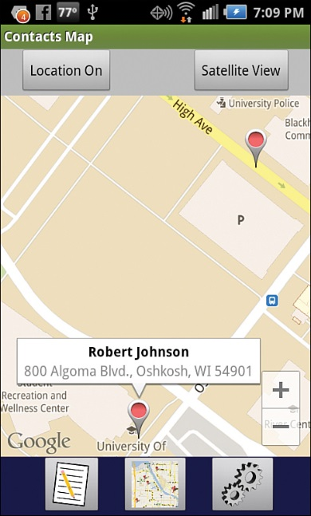
Refer to Listing 7.6 – 7.13 to code for Map of contacts with marker information displayed (see figure 7.8).
Figure 7.8 Map of Contacts with marker information displayed.
Notes:
Figure:

Slide 15
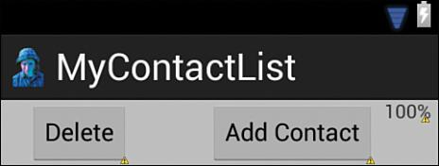
The Android platform supports 12 sensors.
Check for sensors before use.
The Sensor class represents all types of sensors.
Sensors are accessed through the SensorManager class.
SensorEvent and SensorEventListener are also required.
Figure 8.1 Toolbar with battery level TextView.
Notes:
Figure:

Slide 16
Android devices have managers for monitoring:
BatteryManager used to monitor the battery’s status.
StorageManager used to monitor long-term storage.
PowerManager used to monitor power consumption.
Android devices have other hardware features like a phone or a camera with apps to access their use.
Access via Application Program Interface (API).
See Listing 8.1 – 8.2 for monitoring the battery with the apps.
Figure 8.1 Toolbar with battery level TextView.
Notes:
Figure:

Slide 17
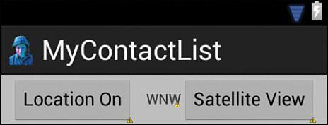
The Android OS supports sensors for motion, environmental, or position.
Motion sensors detect how the device is moving.
Environmental sensors capture measures of the ambient environment such as light level.
Position sensors capture information used to determine the physical position of the device.
Figure 8.2 Toolbar with heading TextView.
Notes:
Figure:

Slide 18
Not all devices have all sensors which has implications for how to code access to the sensors.
Understanding how the sensors are accessed is important for apps developed. See Listing 8.3
To monitor sensors aSensorManager object and Sensor objects for each sensor used is required. See Listing 8.4
Implement the SensorEventListener, a class that handles the events from the sensors and takes action on them. See Listing 8.5
Figure 8.2 Toolbar with heading TextView.
Notes:
Figure:

Slide 19
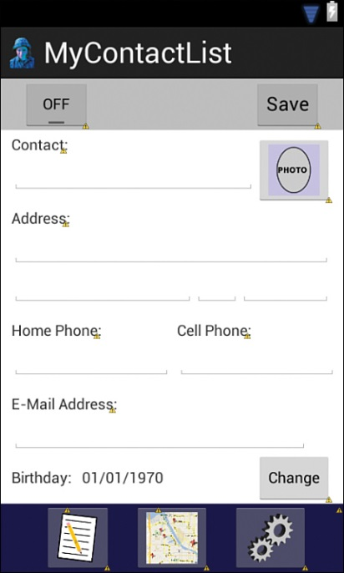
Using the Phone
In the MyContactList app code the ContactActivity so pressing and holding one of the contact’s automatically calls that number.
This requires accessing the phone’s API and asking it to call the number. See Listing 8.6 and 8.7
The app can call contacts by pressing and holding down a phone number.
Figure 8.3 Layout with ImageButton.
Notes:
Figure:

Slide 20
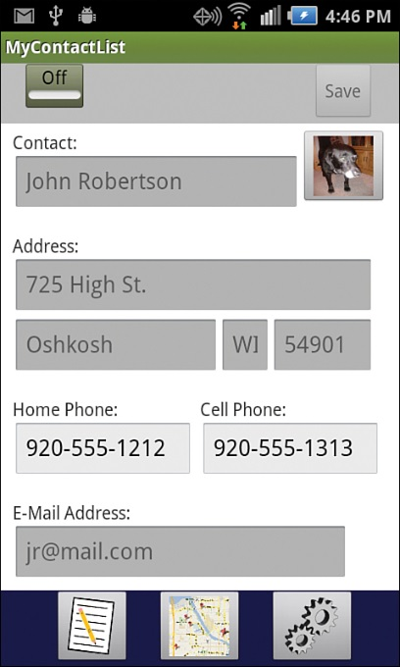
Android devices have a camera that is used independently or integrated into an app.
To add a photo to a contact in the phone see Listing 8.8 – 8.14
When done the contact should look like Figure 8.4 below.
Figure 8.4 Contact with a picture.
Notes:
Figure:

