Slide 1
Data Mining
Association Rules: Advanced Concepts and Algorithms
Lecture Notes for Chapter 7
Introduction to Data Mining
by
Tan, Steinbach, Kumar
© Tan,Steinbach, Kumar Introduction to Data Mining 4/18/2004 1

Slide 2
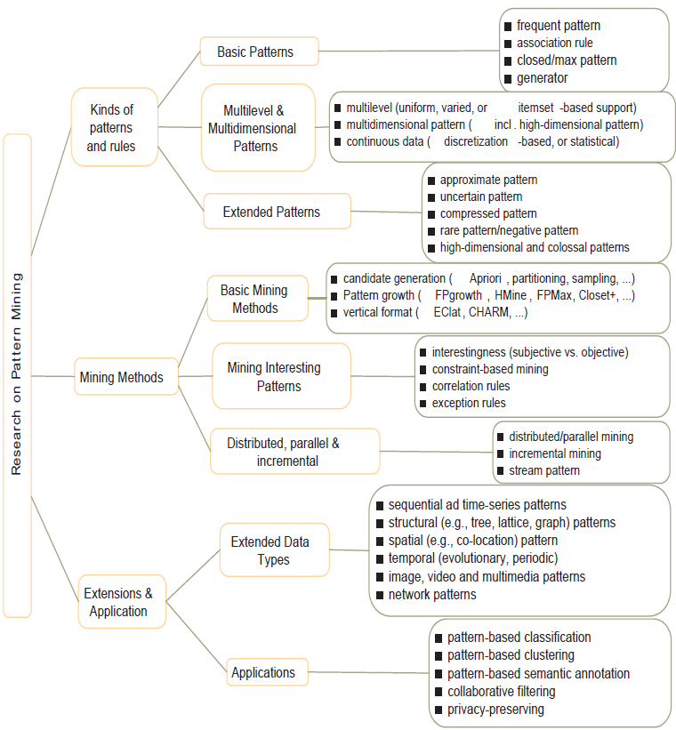

Slide 3
Negative and Rare Patterns
Rare patterns: Very low support but interesting
  E.g., buying Rolex watches
  Mining: Setting individual-based or special group-based support threshold for valuable items
Negative patterns
  Since it is unlikely that one buys Ford Expedition (an SUV car) and Toyota Prius (a hybrid car) together, Ford Expedition and Toyota Prius are likely negatively correlated patterns
Negatively correlated patterns that are infrequent tend to be more interesting than those that are frequent
3
Notes:
3

Slide 4
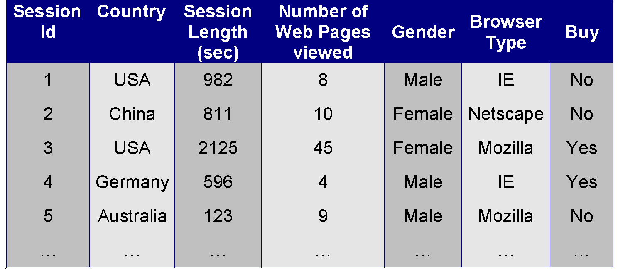
Continuous and Categorical Attributes
How to apply association analysis formulation to non-asymmetric binary variables?
Example of Association Rule:
{Number of Pages ∈[5,10) ∧ (Browser=Mozilla)} → {Buy = No}

Slide 5
Handling Categorical Attributes
Transform categorical attribute into asymmetric binary variables
Introduce a new “item” for each distinct attribute-value pair
  Example: replace Browser Type attribute with
    Browser Type = Internet Explorer
    Browser Type = Mozilla
    Browser Type = Mozilla

Slide 6
Handling Categorical Attributes
Potential Issues
  What if attribute has many possible values
    Example: attribute country has more than 200 possible values
    Many of the attribute values may have very low support
      Potential solution: Aggregate the low-support attribute values
  What if distribution of attribute values is highly skewed
    Example: 95% of the visitors have Buy = No
    Most of the items will be associated with (Buy=No) item
      Potential solution: drop the highly frequent items

Slide 7
Handling Continuous Attributes
Different kinds of rules:
  Age∈[21,35) ∧ Salary∈[70k,120k) → Buy
  Salary∈[70k,120k) ∧ Buy → Age: μ=28, σ=4
Different methods:
  Discretization-based
  Statistics-based
  Non-discretization based
    minApriori

Slide 8
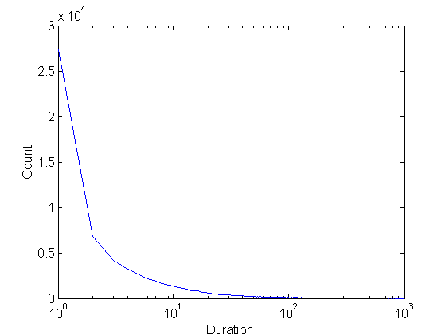
Handling Continuous Attributes
Use discretization
Unsupervised:
  Equal-width binning
  Equal-depth binning
  Clustering
Supervised:
Attribute values, v
Class | v₁ | v₂ | v₃ | v₄ | v₅ | v₆ | v₇ | v₈ | v₉
Anomalous | 0 | 0 | 20 | 10 | 20 | 0 | 0 | 0 | 0
Normal | 150 | 100 | 0 | 0 | 0 | 100 | 100 | 150 | 100
bin₁
bin₂
bin₃

Slide 9
Discretization Issues
Size of the discretized intervals affect support & confidence
  If intervals too small
    may not have enough support
  If intervals too large
    may not have enough confidence
Potential solution: use all possible intervals
{Refund = No, (Income = $51,250)} → {Cheat = No}
{Refund = No, (60K ≤ Income ≤ 80K)} → {Cheat = No}
{Refund = No, (0K ≤ Income ≤ 1B)} → {Cheat = No}

Slide 10
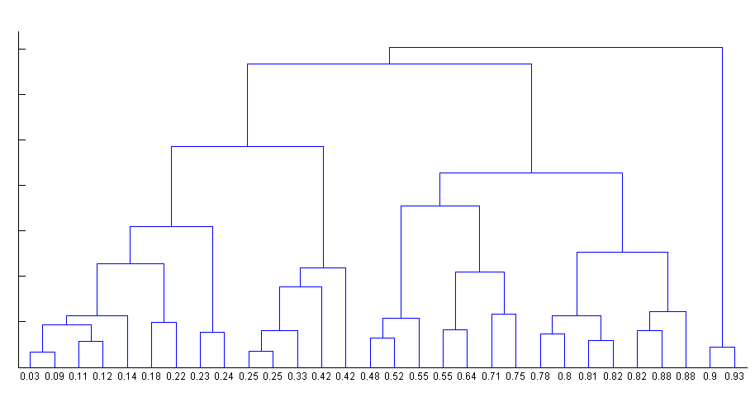
Discretization Issues
Execution time
  If intervals contain n values, there are on average O(n²) possible ranges
Too many rules
{Refund = No, (Income = $51,250)} → {Cheat = No}
{Refund = No, (51K ≤ Income ≤ 52K)} → {Cheat = No}
{Refund = No, (50K ≤ Income ≤ 60K)} → {Cheat = No}

Slide 11
Approach by Srikant & Agrawal
Preprocess the data
  Discretize attribute using equi-depth partitioning
    Use partial completeness measure to determine number of partitions
    Merge adjacent intervals as long as support is less than max-support
Apply existing association rule mining algorithms
Determine interesting rules in the output

Slide 12
Approach by Srikant & Agrawal
Discretization will lose information
  Use partial completeness measure to determine how much information is lost
C: frequent itemsets obtained by considering all ranges of attribute values
P: frequent itemsets obtained by considering all ranges over the partitions
P is K-complete w.r.t C if P ⊆ C,and ∀X ∈ C, ∃ X’ ∈ P such that:
1. X’ is a generalization of X and support (X’) ≤ K × support(X) (K ≥ 1)
2. ∀Y ⊆ X, ∃ Y’ ⊆ X’ such that support (Y’) ≤ K × support(Y)
Given K (partial completeness level), can determine number of intervals (N)
Approximated X
X

Slide 13
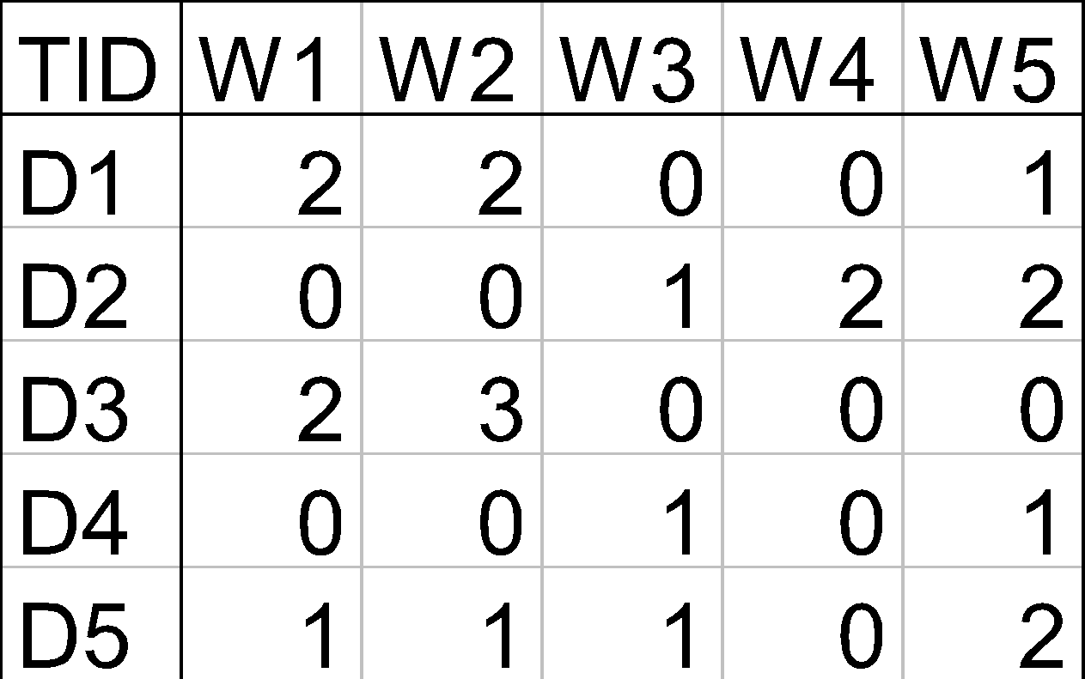
Min-Apriori (Han et al)
Document-term matrix:
Example:
W1 and W2 tends to appear together in the same document

Slide 14
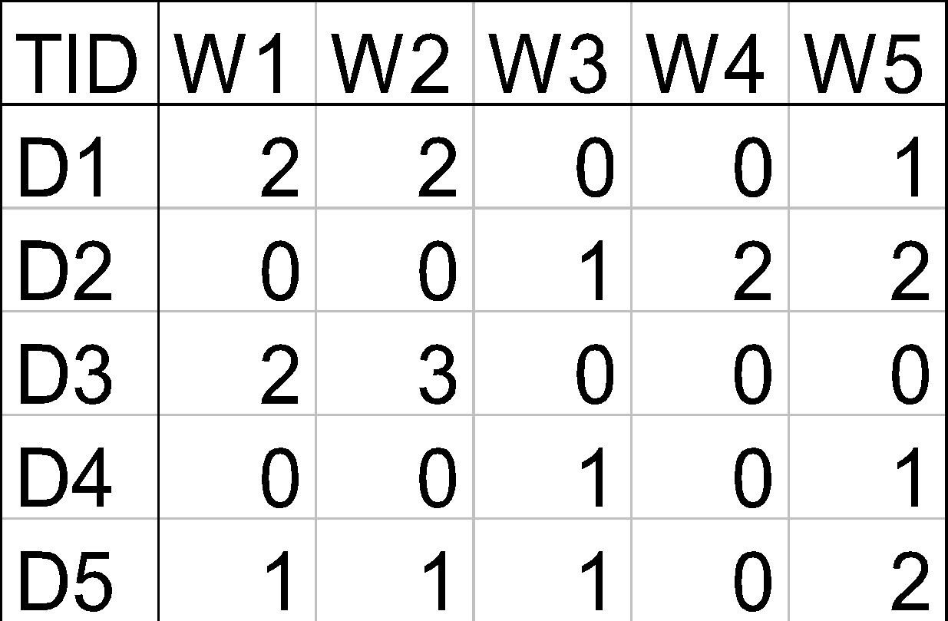
Min-Apriori
Data contains only continuous attributes of the same “type”
  e.g., frequency of words in a document
Potential solution:
  Convert into 0/1 matrix and then apply existing algorithms
    lose word frequency information
  Discretization does not apply as users want association among words not ranges of words

Slide 15
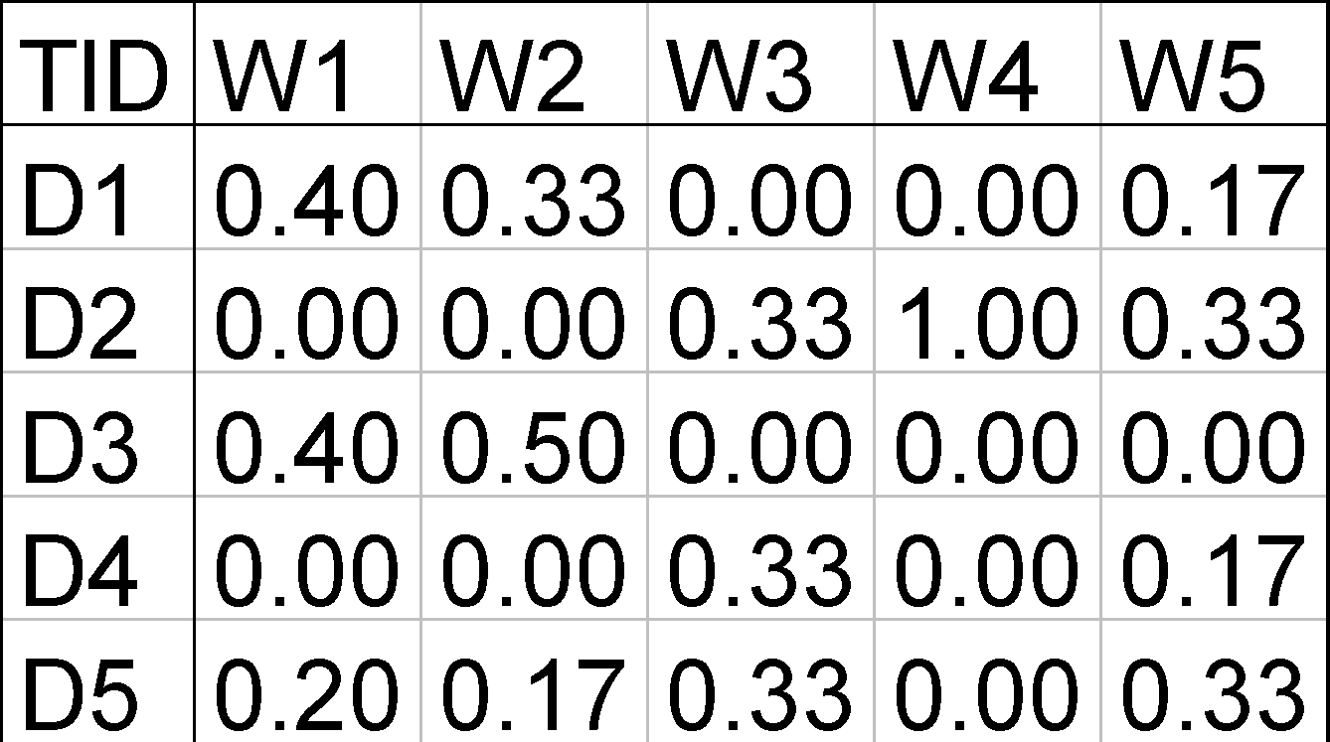
Min-Apriori
How to determine the support of a word?
  If we simply sum up its frequency, support count will be greater than total number of documents!
    Normalize the word vectors – e.g., using L₁ norm
    Each word has a support equals to 1.0
Normalize

Slide 16
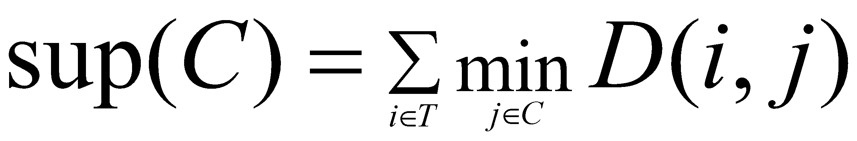
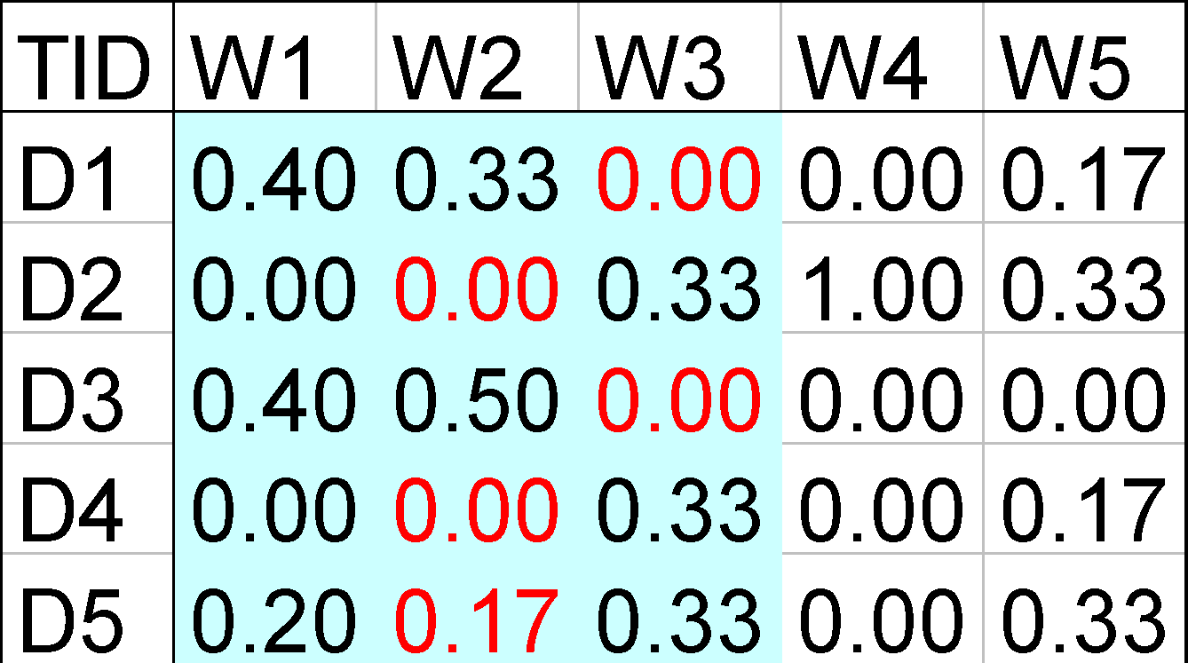
Min-Apriori
New definition of support:
Example:
Sup(W1,W2,W3)
= 0 + 0 + 0 + 0 + 0.17
= 0.17

Slide 17
Anti-monotone property of Support
Example:
Sup(W1) = 0.4 + 0 + 0.4 + 0 + 0.2 = 1
Sup(W1, W2) = 0.33 + 0 + 0.4 + 0 + 0.17 = 0.9
Sup(W1, W2, W3) = 0 + 0 + 0 + 0 + 0.17 = 0.17

Slide 18
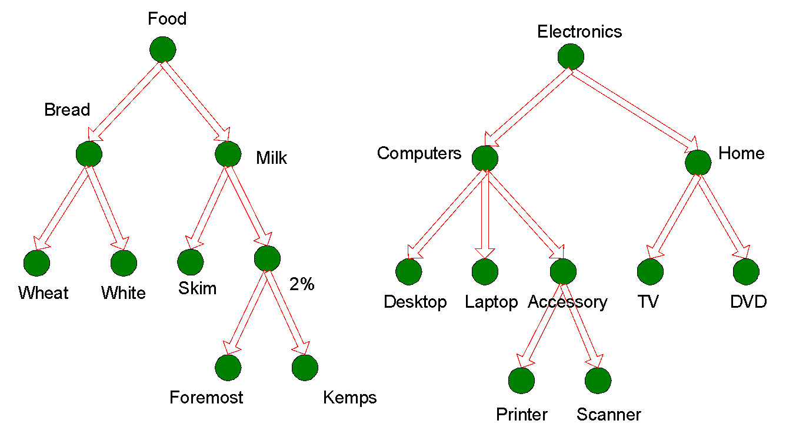
Multi-level Association Rules

Slide 19
Multi-level Association Rules
Why should we incorporate concept hierarchy?
  Rules at lower levels may not have enough support to appear in any frequent itemsets
  Rules at lower levels of the hierarchy are overly specific
    e.g., skim milk → white bread, 2% milk → wheat bread,
    skim milk → wheat bread, etc.
    are indicative of association between milk and bread

Slide 20
Multi-level Association Rules
How do support and confidence vary as we traverse the concept hierarchy?
  If X is the parent item for both X1 and X2, then
  σ(X) ≤ σ(X1) + σ(X2)
  If σ(X1 ∪ Y1) ≥ minsup,
  and X is parent of X1, Y is parent of Y1
  then σ(X ∪ Y1) ≥ minsup, σ(X1 ∪ Y) ≥ minsup
  σ(X ∪ Y) ≥ minsup
  If conf(X1 ⇒ Y1) ≥ minconf,
  then conf(X1 ⇒ Y) ≥ minconf

Slide 21
Multi-level Association Rules
Approach 1:
  Extend current association rule formulation by augmenting each transaction with higher level items
  Original Transaction: {skim milk, wheat bread}
  Augmented Transaction:
  {skim milk, wheat bread, milk, bread, food}
Issues:
  Items that reside at higher levels have much higher support counts
    if support threshold is low, too many frequent patterns involving items from the higher levels
  Increased dimensionality of the data

Slide 22
Multi-level Association Rules
Approach 2:
  Generate frequent patterns at highest level first
  Then, generate frequent patterns at the next highest level, and so on
Issues:
  I/O requirements will increase dramatically because we need to perform more passes over the data
  May miss some potentially interesting cross-level association patterns

Slide 23
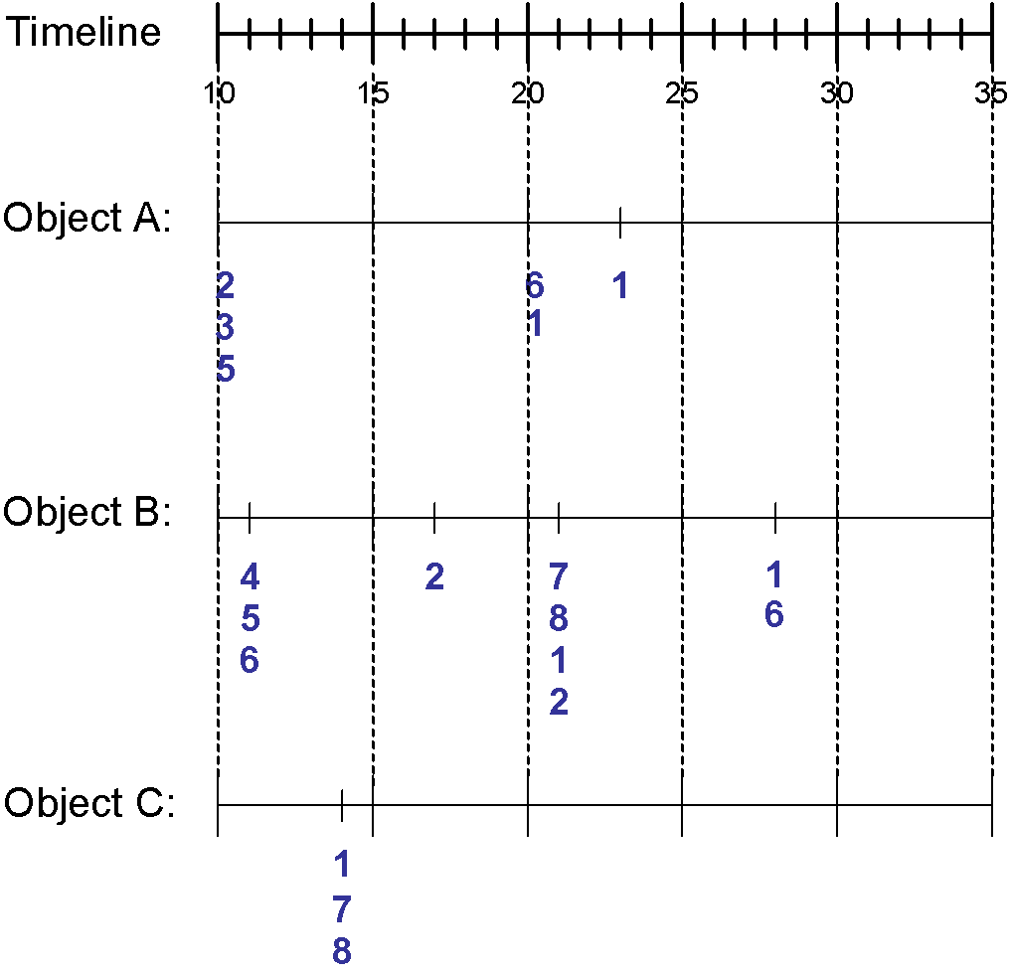
Sequence Data
Sequence Database:
Object
Timestamp
Events
A
10
2, 3, 5
A
20
6, 1
A
23
1
B
11
4, 5, 6
B
17
2
B
21
7, 8, 1, 2
B
28
1, 6
C
14
1, 8, 7

Slide 24
Examples of Sequence Data
Sequence Database
Sequence
Element (Transaction)
Event
(Item)
Customer
Purchase history of a given customer
A set of items bought by a customer at time t
Books, diary products, CDs, etc
Web Data
Browsing activity of a particular Web visitor
A collection of files viewed by a Web visitor after a single mouse click
Home page, index page, contact info, etc
Event data
History of events generated by a given sensor
Events triggered by a sensor at time t
Types of alarms generated by sensors
Genome sequences
DNA sequence of a particular species
An element of the DNA sequence
Bases A,T,G,C
Element (Transaction)
E1
E2
E1
E3
E2
E2
E3
E4
Event
(Item)
Sequence

Slide 25
Formal Definition of a Sequence
A sequence is an ordered list of elements (transactions)
  s = < e₁ e₂ e₃ … >
  Each element contains a collection of events (items)
  e_{i} = {i₁, i₂, …, i_{k}}
  Each element is attributed to a specific time or location
Length of a sequence, |s|, is given by the number of elements of the sequence
A k-sequence is a sequence that contains k events (items)

Slide 26
Examples of Sequence
Web sequence:
  < {Homepage} {Electronics} {Digital Cameras} {Canon Digital Camera} {Shopping Cart} {Order Confirmation} {Return to Shopping} >
Sequence of initiating events causing the nuclear accident at 3-mile Island:
(http://stellar-one.com/nuclear/staff_reports/summary_SOE_the_initiating_event.htm)
  < {clogged resin} {outlet valve closure} {loss of feedwater}
  {condenser polisher outlet valve shut} {booster pumps trip}
  {main waterpump trips} {main turbine trips} {reactor pressure increases}>
Sequence of books checked out at a library:
  <{Fellowship of the Ring} {The Two Towers} {Return of the King}>

Slide 27
Formal Definition of a Subsequence
A sequence <a₁ a₂ … a_{n}> is contained in another sequence <b₁ b₂ … b_{m}> (m ≥ n) if there exist integers
i₁ < i₂ < … < i_{n} such that a₁ ⊆ b_{i1} , a₂ ⊆ b_{i1}, …, a_{n} ⊆ b_{in}
The support of a subsequence w is defined as the fraction of data sequences that contain w
A sequential pattern is a frequent subsequence (i.e., a subsequence whose support is ≥ minsup)
Data sequence
Subsequence
Contain?
< {2,4} {3,5,6} {8} >
< {2} {3,5} >
Yes
< {1,2} {3,4} >
< {1} {2} >
No
< {2,4} {2,4} {2,5} >
< {2} {4} >
Yes

Slide 28
Sequential Pattern Mining: Definition
Given:
  a database of sequences
  a user-specified minimum support threshold, minsup
Task:
  Find all subsequences with support ≥ minsup

Slide 29
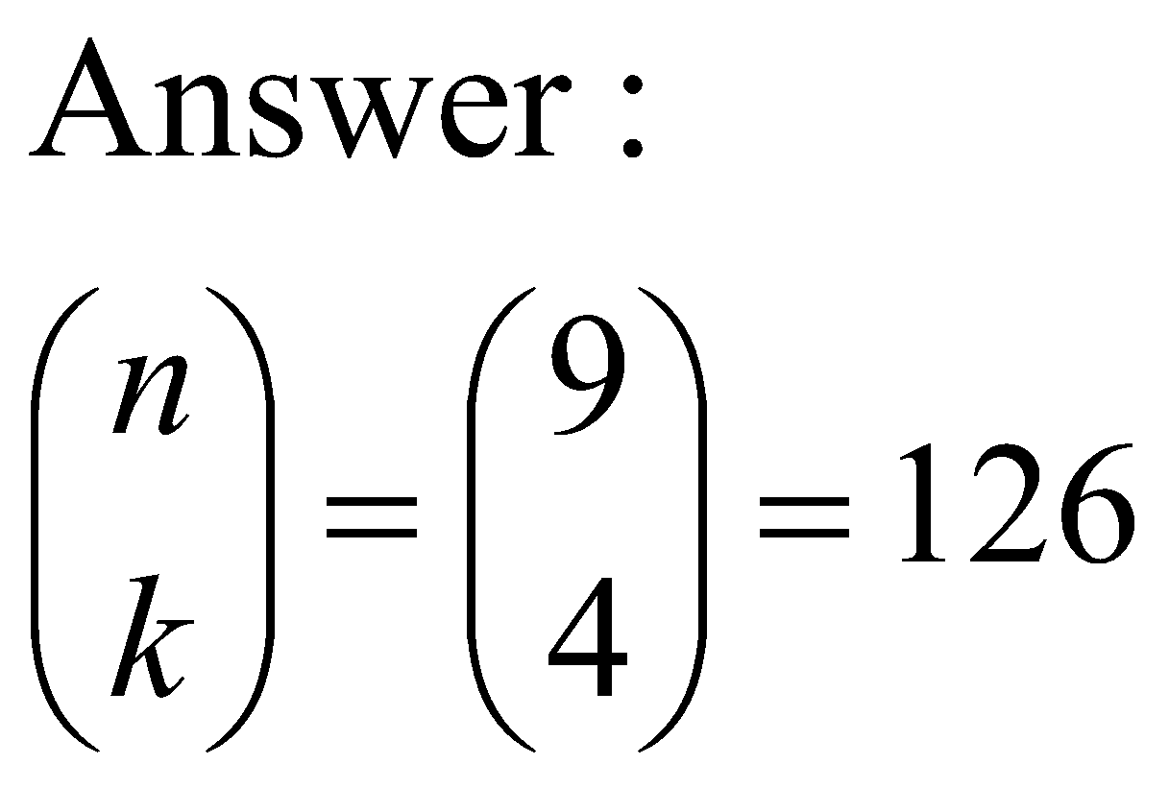
Sequential Pattern Mining: Challenge
Given a sequence: <{a b} {c d e} {f} {g h i}>
  Examples of subsequences:
    <{a} {c d} {f} {g} >, < {c d e} >, < {b} {g} >, etc.
How many k-subsequences can be extracted from a given n-sequence?
<{a b} {c d e} {f} {g h i}> n = 9
k=4: Y _ _ Y Y _ _ _ Y
<{a} {d e} {i}>

Slide 30
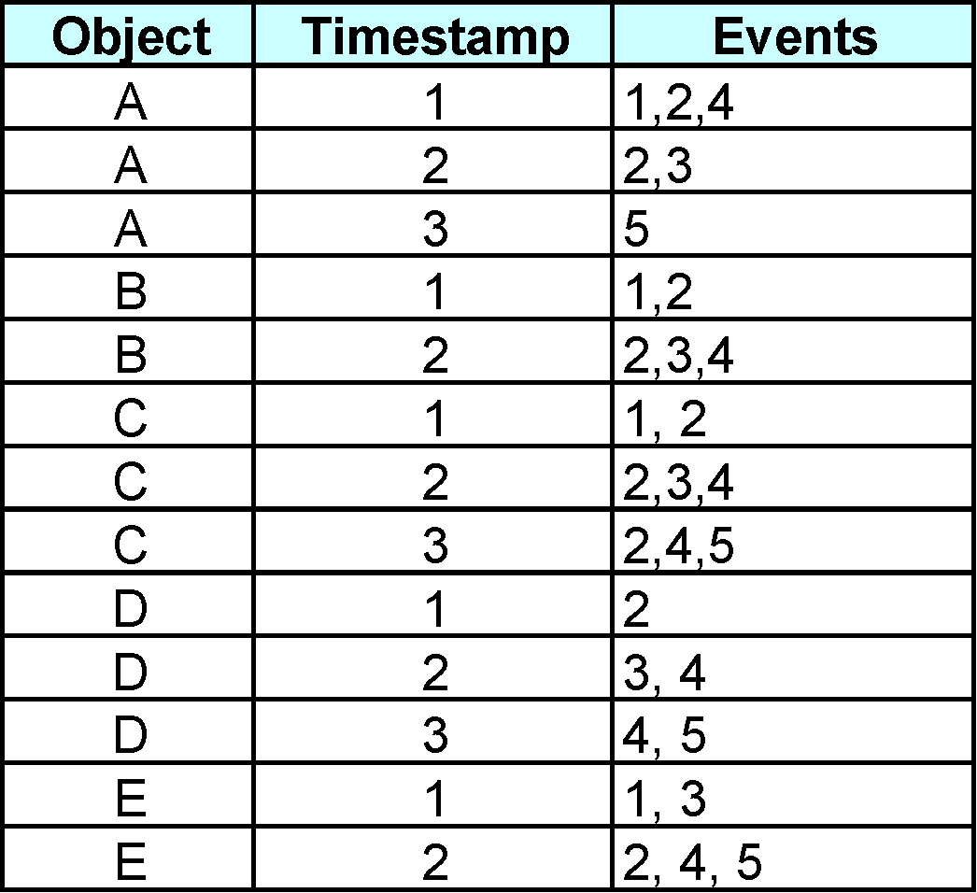
Sequential Pattern Mining: Example
Minsup = 50%
Examples of Frequent Subsequences:
< {1,2} > s=60%
< {2,3} > s=60%
< {2,4}> s=80%
< {3} {5}> s=80%
< {1} {2} > s=80%
< {2} {2} > s=60%
< {1} {2,3} > s=60%
< {2} {2,3} > s=60%
< {1,2} {2,3} > s=60%

Slide 31
Extracting Sequential Patterns
Given n events: i₁, i₂, i₃, …, i_{n}
Candidate 1-subsequences:
    <{i₁}>, <{i₂}>, <{i₃}>, …, <{i_{n}}>
Candidate 2-subsequences:
    <{i₁, i₂}>, <{i₁, i₃}>, …, <{i₁} {i₁}>, <{i₁} {i₂}>, …, <{i_{n-1}} {i_{n}}>
Candidate 3-subsequences:
    <{i₁, i₂ , i₃}>, <{i₁, i₂ , i₄}>, …, <{i₁, i₂} {i₁}>, <{i₁, i₂} {i₂}>, …,
    <{i₁} {i₁ , i₂}>, <{i₁} {i₁ , i₃}>, …, <{i₁} {i₁} {i₁}>, <{i₁} {i₁} {i₂}>, …

Slide 32
Generalized Sequential Pattern (GSP)
Step 1:
  Make the first pass over the sequence database D to yield all the 1-element frequent sequences
Step 2:
Repeat until no new frequent sequences are found
  Candidate Generation:
    Merge pairs of frequent subsequences found in the (k-1)th pass to generate candidate sequences that contain k items
  Candidate Pruning:
    Prune candidate k-sequences that contain infrequent (k-1)-subsequences
  Support Counting:
    Make a new pass over the sequence database D to find the support for these candidate sequences
  Candidate Elimination:
    Eliminate candidate k-sequences whose actual support is less than minsup

Slide 33
Candidate Generation
Base case (k=2):
  Merging two frequent 1-sequences <{i₁}> and <{i₂}> will produce two candidate 2-sequences: <{i₁} {i₂}> and <{i₁ i₂}>
General case (k>2):
  A frequent (k-1)-sequence w₁ is merged with another frequent
  (k-1)-sequence w₂ to produce a candidate k-sequence if the subsequence obtained by removing the first event in w₁ is the same as the subsequence obtained by removing the last event in w₂
    The resulting candidate after merging is given by the sequence w₁ extended with the last event of w₂.
      If the last two events in w₂ belong to the same element, then the last event in w₂ becomes part of the last element in w₁
      Otherwise, the last event in w₂ becomes a separate element appended to the end of w₁

Slide 34
Candidate Generation Examples
Merging the sequences
w₁=<{1} {2 3} {4}> and w₂ =<{2 3} {4 5}>
will produce the candidate sequence < {1} {2 3} {4 5}> because the last two events in w₂ (4 and 5) belong to the same element
Merging the sequences
w₁=<{1} {2 3} {4}> and w₂ =<{2 3} {4} {5}>
will produce the candidate sequence < {1} {2 3} {4} {5}> because the last two events in w₂ (4 and 5) do not belong to the same element
We do not have to merge the sequences
w₁ =<{1} {2 6} {4}> and w₂ =<{1} {2} {4 5}>
to produce the candidate < {1} {2 6} {4 5}> because if the latter is a viable candidate, then it can be obtained by merging w₁ with
< {1} {2 6} {5}>

Slide 35
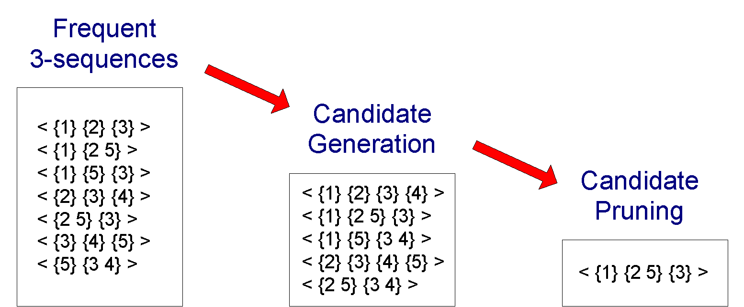
GSP Example

Slide 36
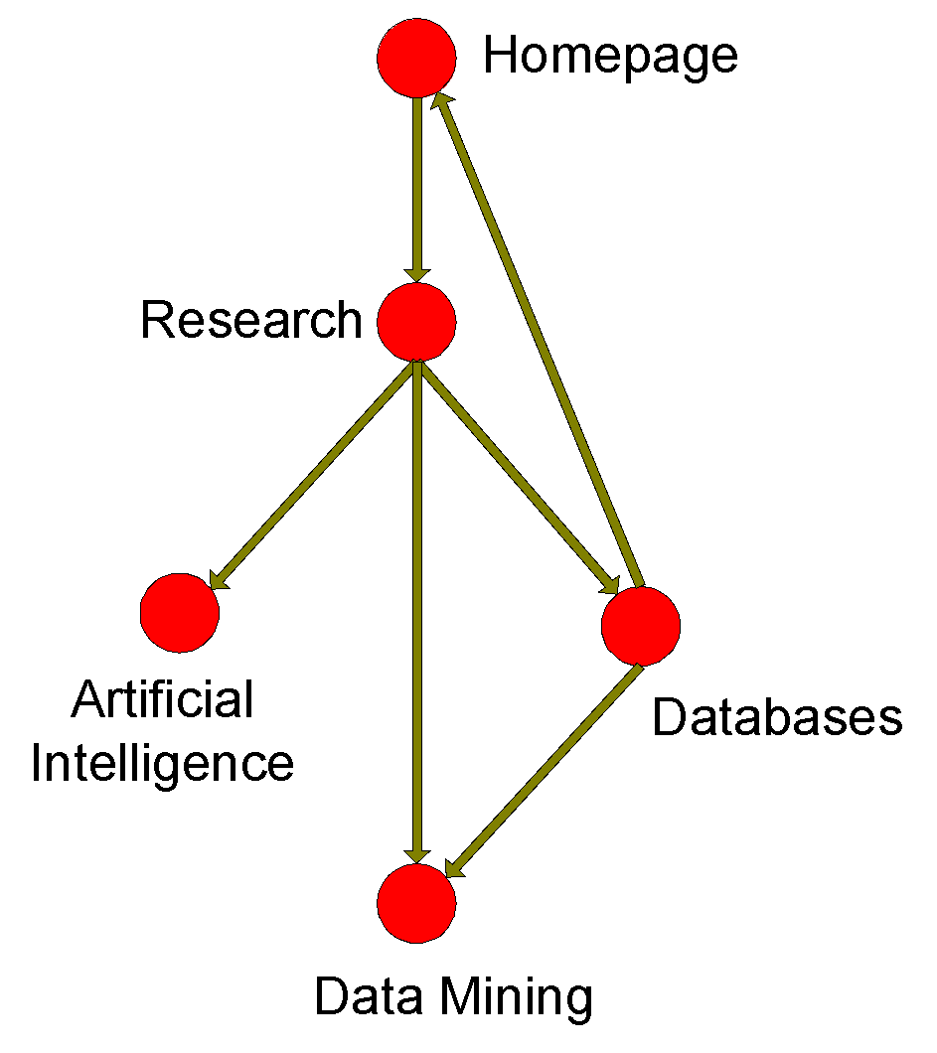
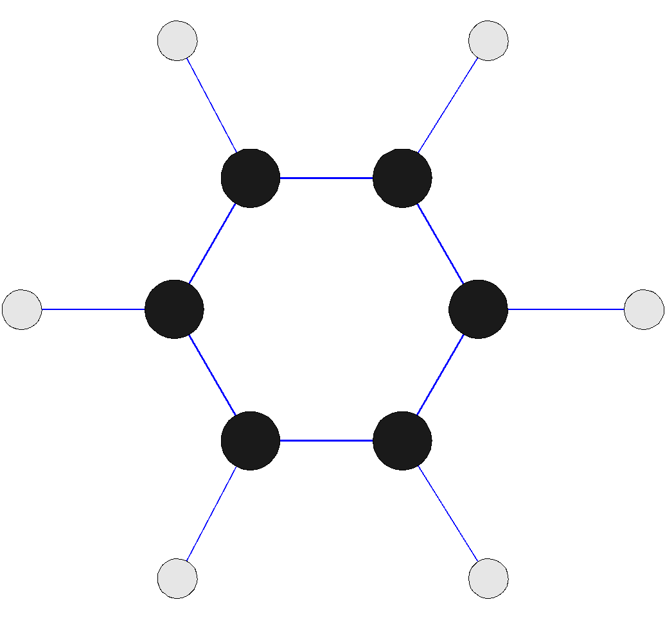
Frequent Subgraph Mining
Extend association rule mining to finding frequent subgraphs
Useful for Web Mining, computational chemistry, bioinformatics, spatial data sets, etc

Slide 37
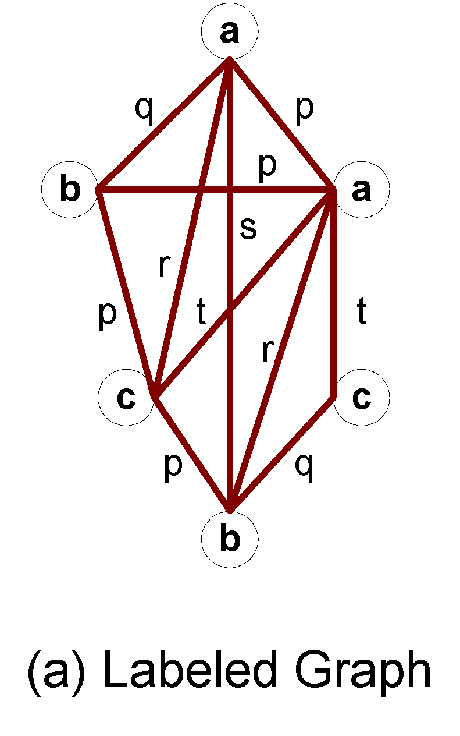
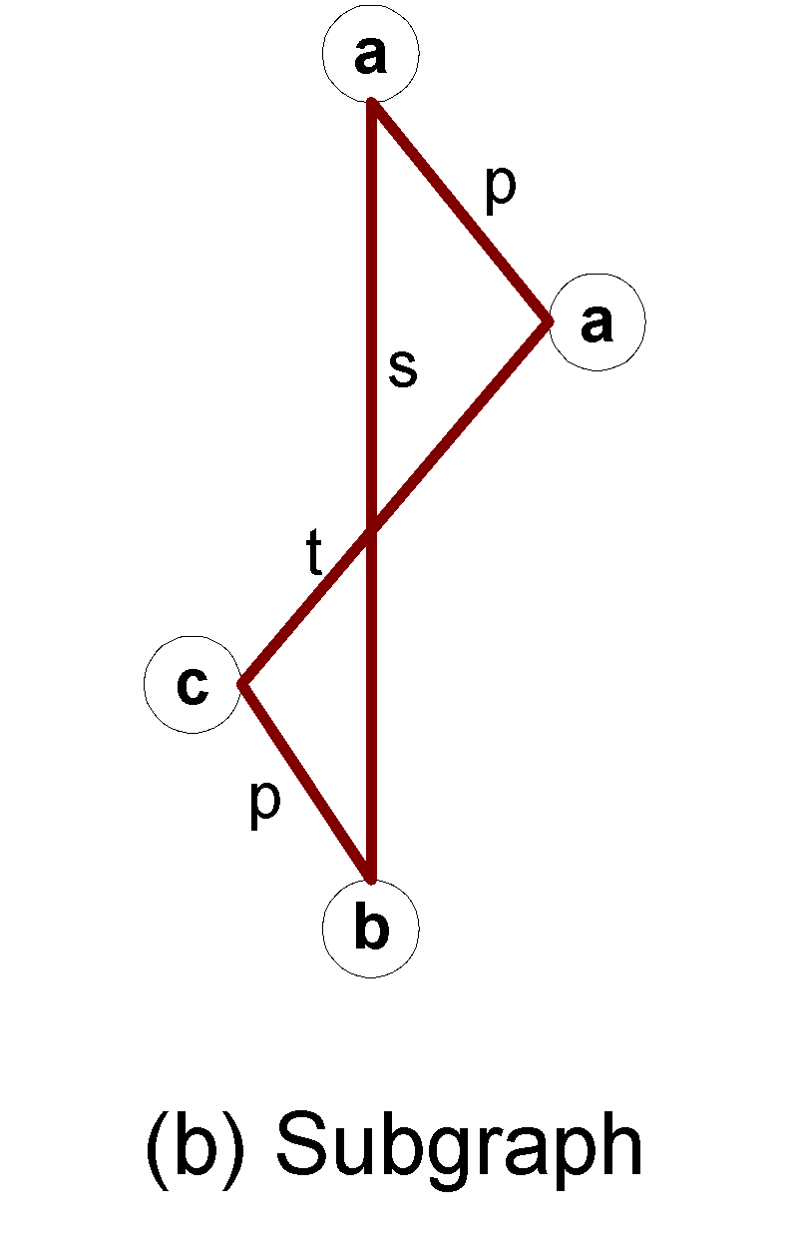
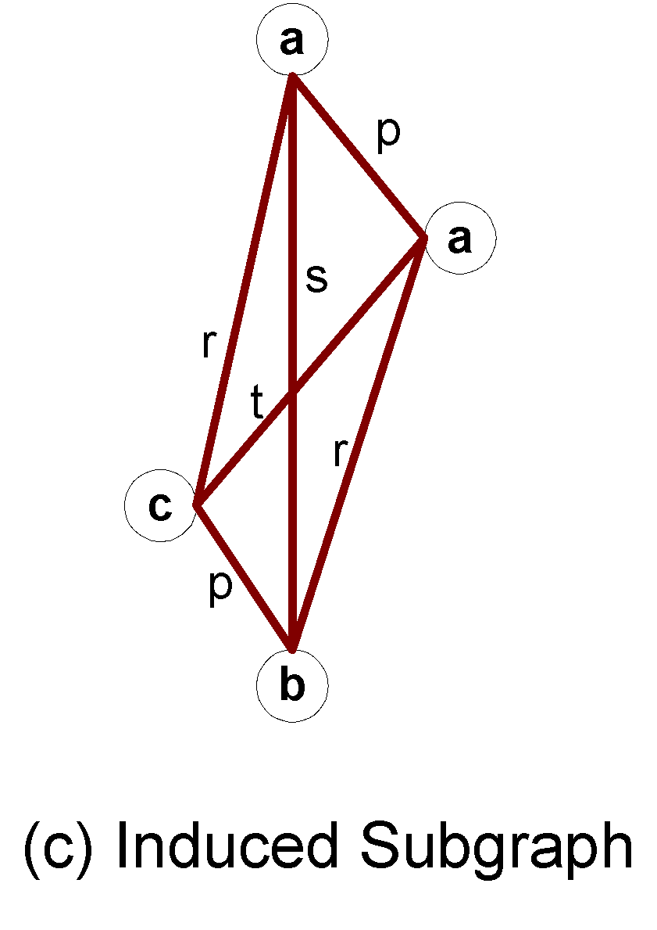
Graph Definitions

Slide 38
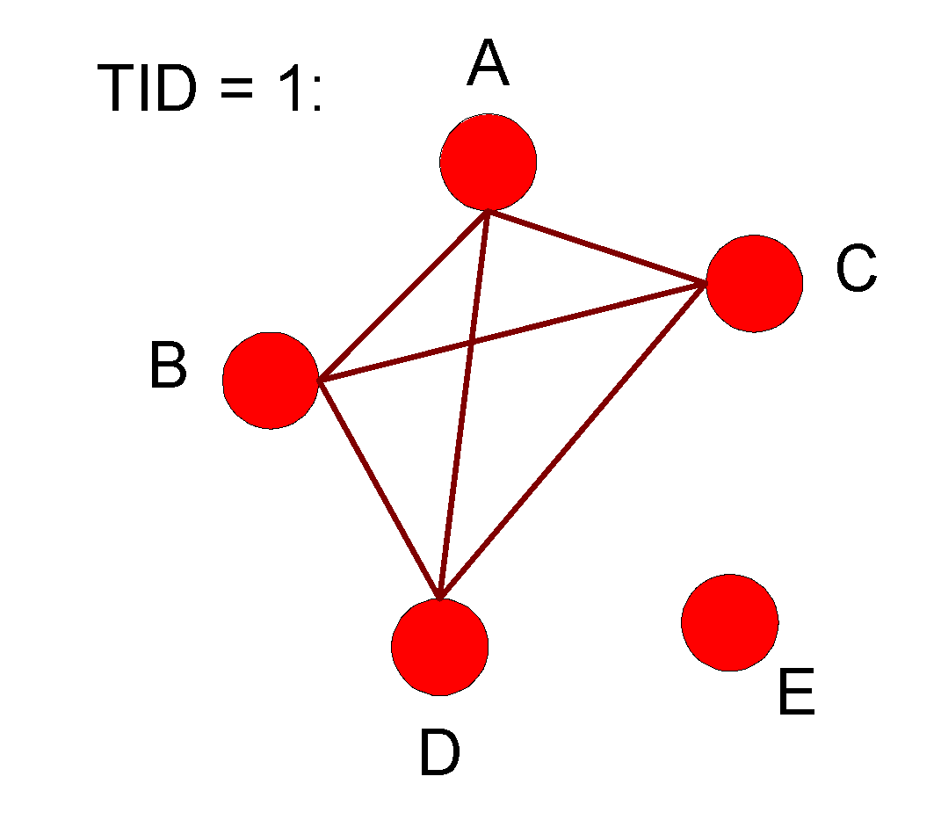
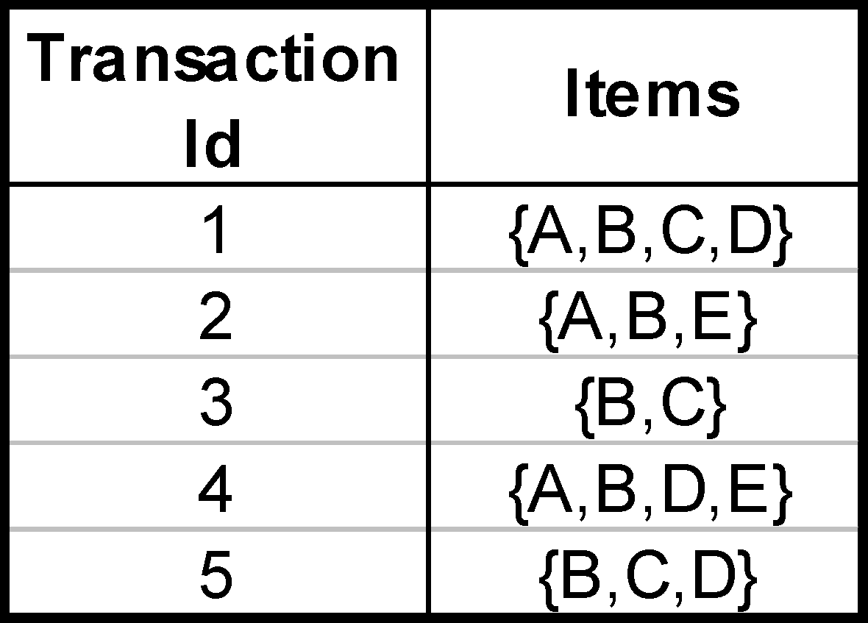
Representing Transactions as Graphs
Each transaction is a clique of items

Slide 39
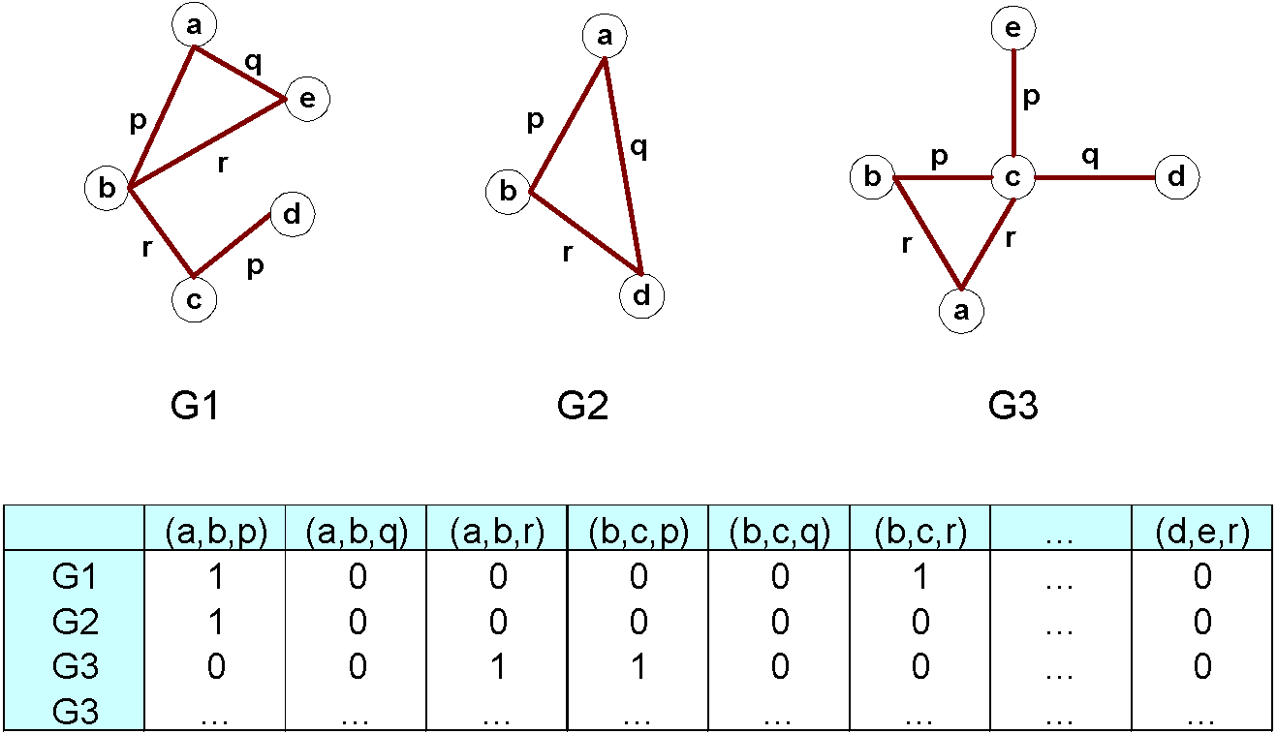
Representing Graphs as Transactions

Slide 40
Challenges
Node may contain duplicate labels
Support and confidence
  How to define them?
Additional constraints imposed by pattern structure
  Support and confidence are not the only constraints
  Assumption: frequent subgraphs must be connected
Apriori-like approach:
  Use frequent k-subgraphs to generate frequent (k+1) subgraphs
    What is k?

Slide 41
Challenges…
Support:
  number of graphs that contain a particular subgraph
Apriori principle still holds
Level-wise (Apriori-like) approach:
  Vertex growing:
    k is the number of vertices
  Edge growing:
    k is the number of edges

Slide 42
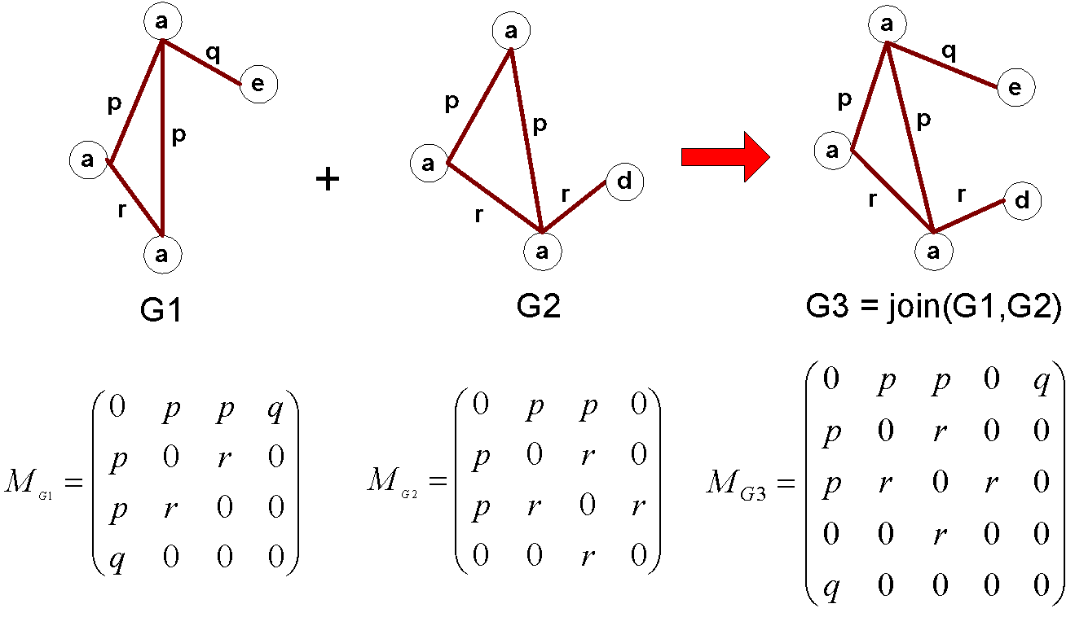
Vertex Growing

Slide 43
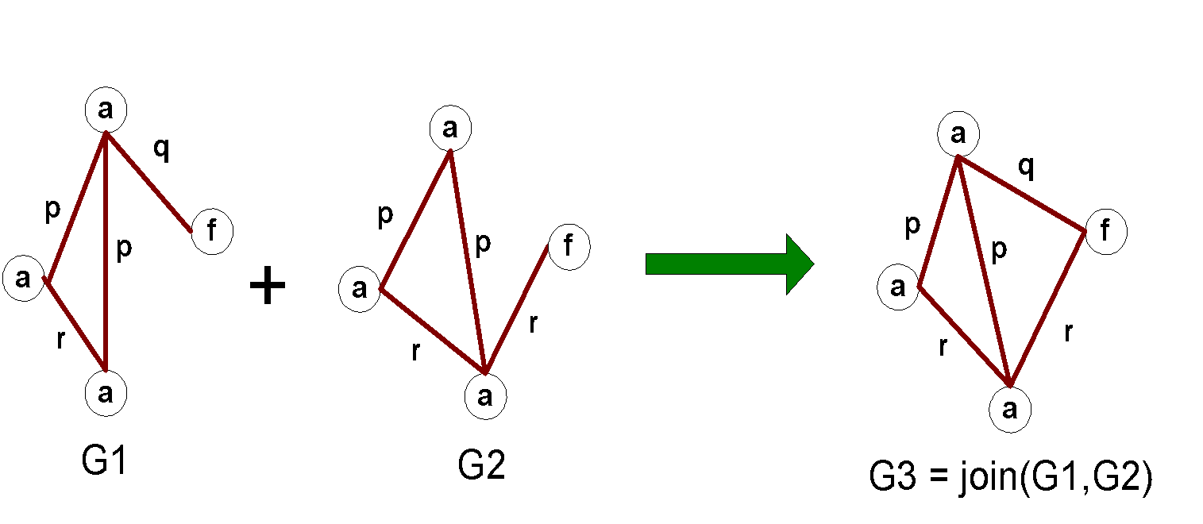
Edge Growing

Slide 44
Apriori-like Algorithm
Find frequent 1-subgraphs
Repeat
  Candidate generation
    Use frequent (k-1)-subgraphs to generate candidate k-subgraph
  Candidate pruning
    Prune candidate subgraphs that contain infrequent
    (k-1)-subgraphs
  Support counting
    Count the support of each remaining candidate
  Eliminate candidate k-subgraphs that are infrequent
In practice, it is not as easy. There are many other issues

Slide 45
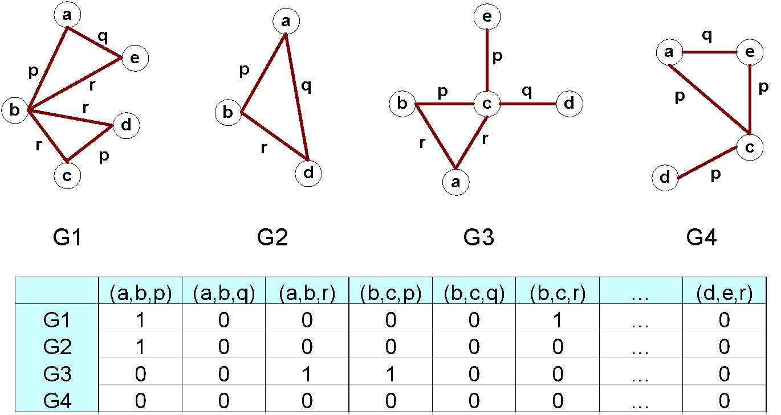
Example: Dataset

Slide 46
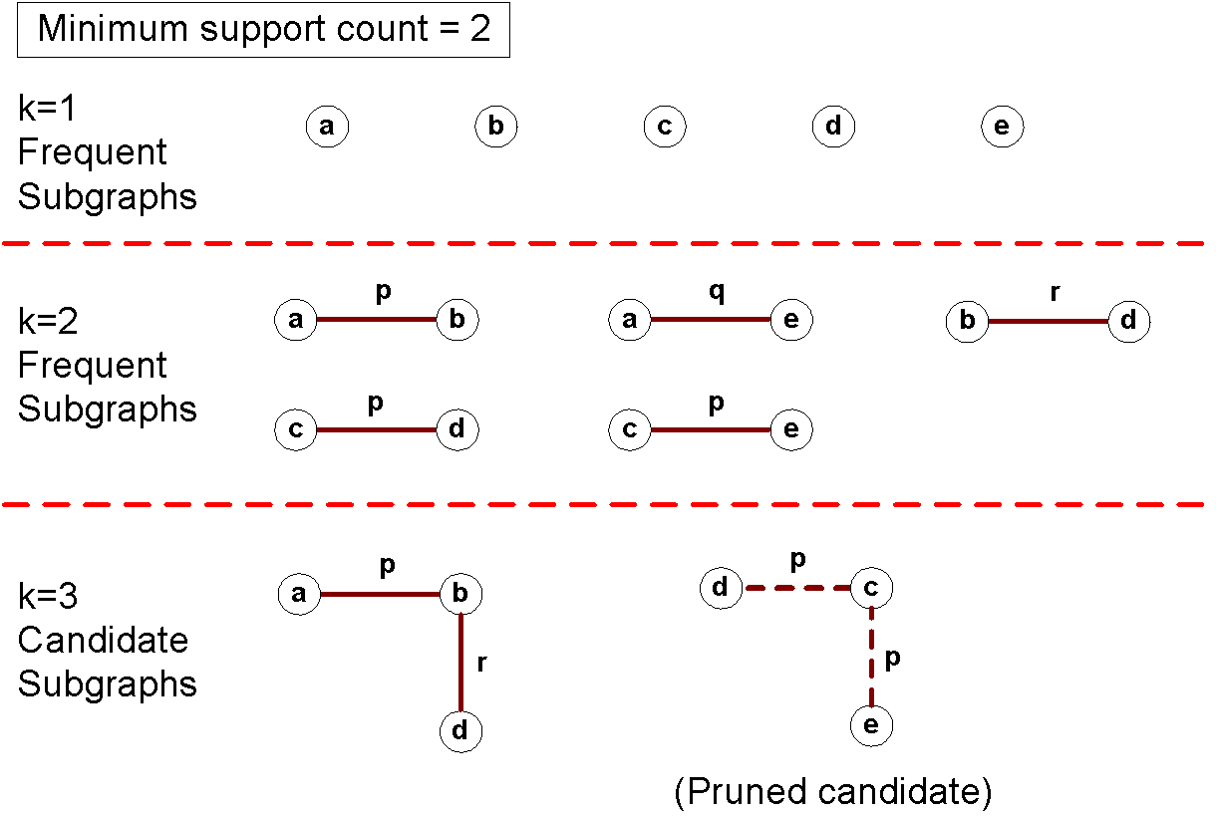
Example

Slide 47
Candidate Generation
In Apriori:
  Merging two frequent k-itemsets will produce a candidate (k+1)-itemset
In frequent subgraph mining (vertex/edge growing)
  Merging two frequent k-subgraphs may produce more than one candidate (k+1)-subgraph

Slide 48
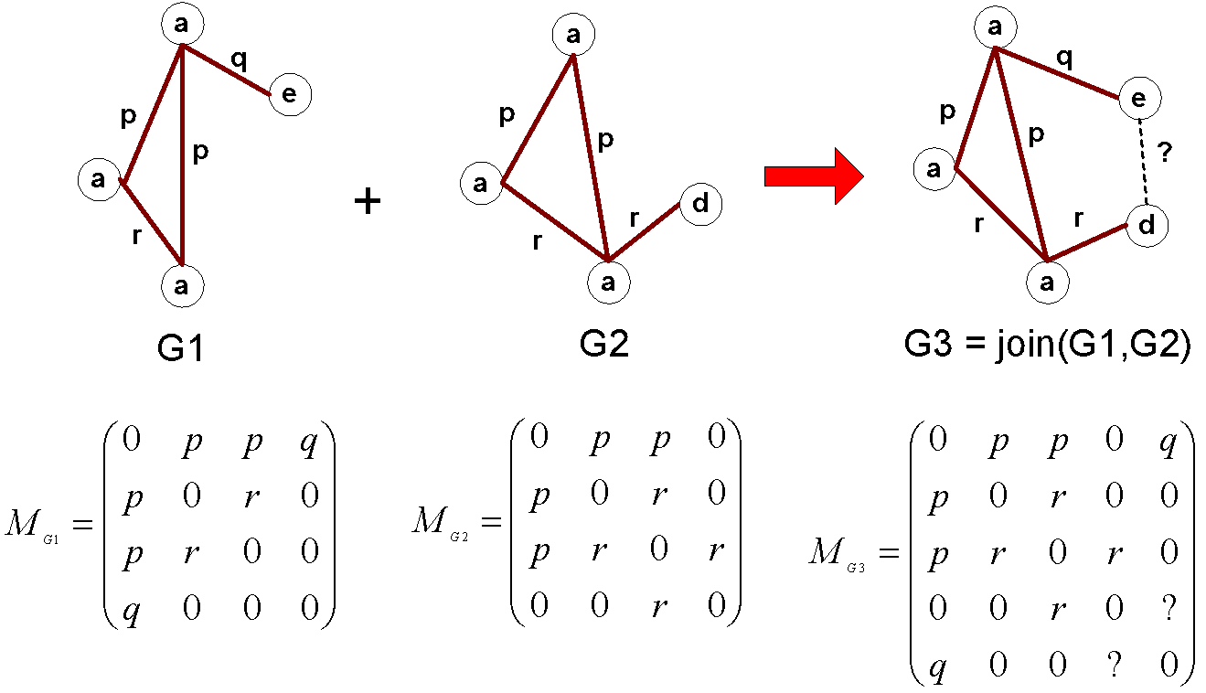
Multiplicity of Candidates (Vertex Growing)

Slide 49
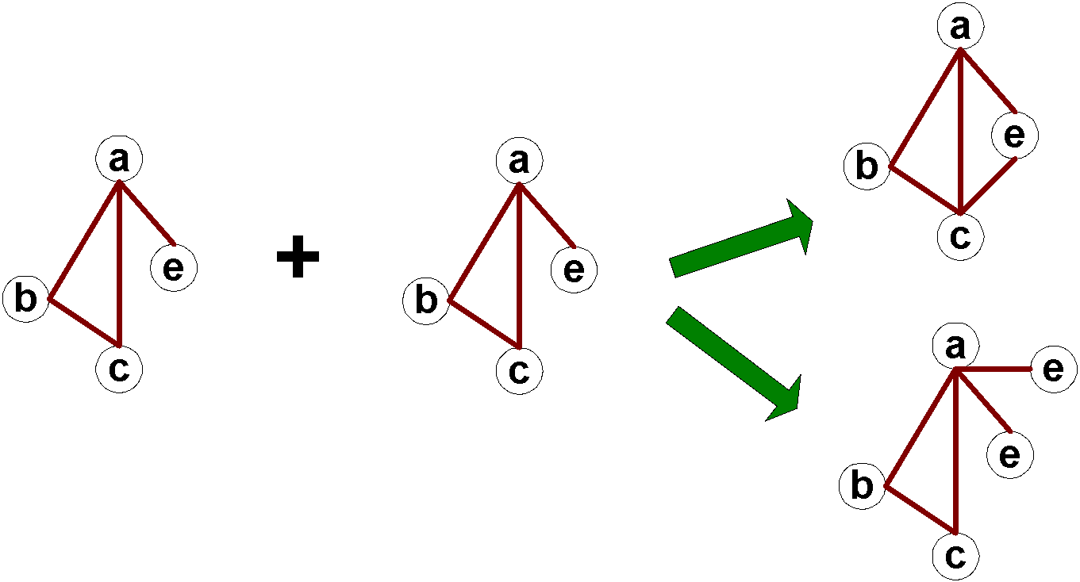
Multiplicity of Candidates (Edge growing)
Case 1: identical vertex labels

Slide 50
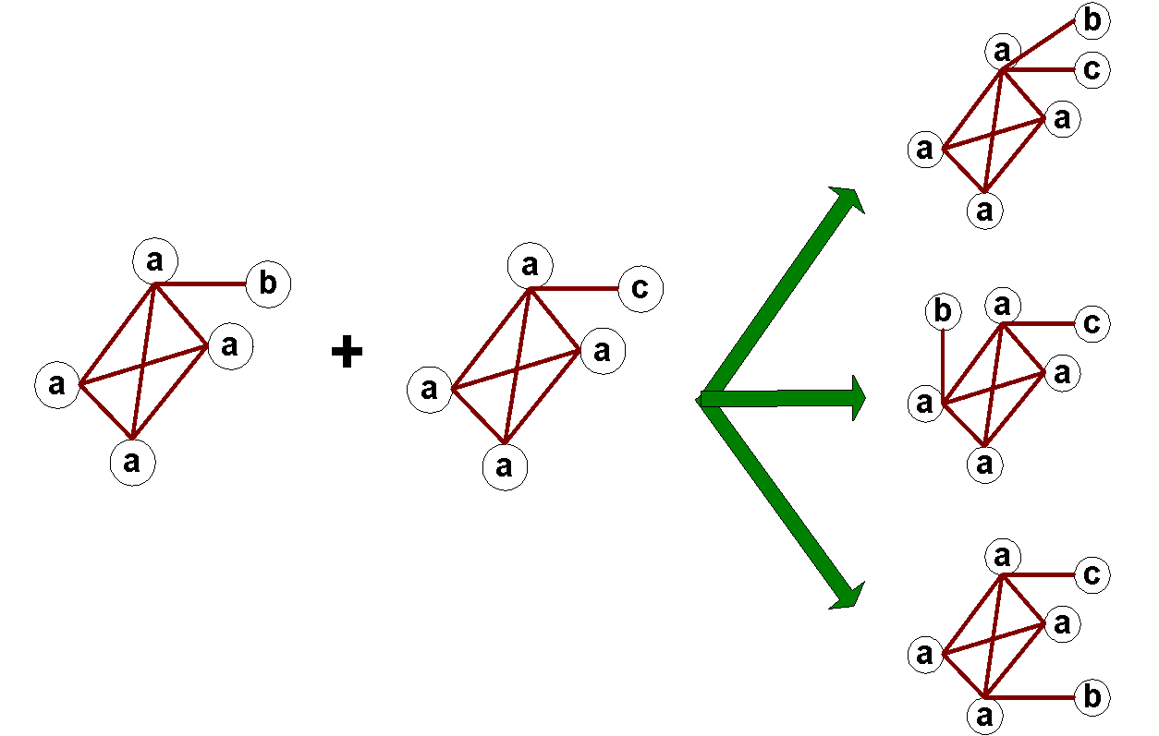
Multiplicity of Candidates (Edge growing)
Case 2: Core contains identical labels
Core: The (k-1) subgraph that is common
between the joint graphs

Slide 51
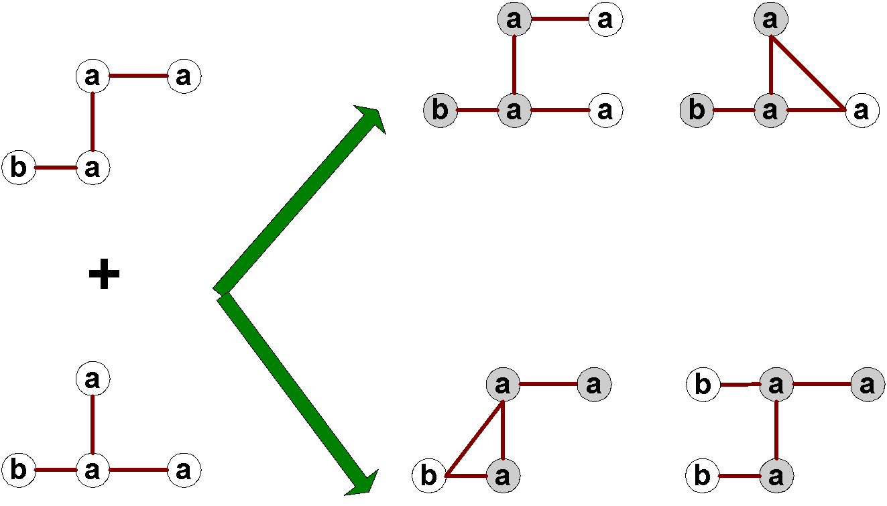
Multiplicity of Candidates (Edge growing)
Case 3: Core multiplicity

Slide 52
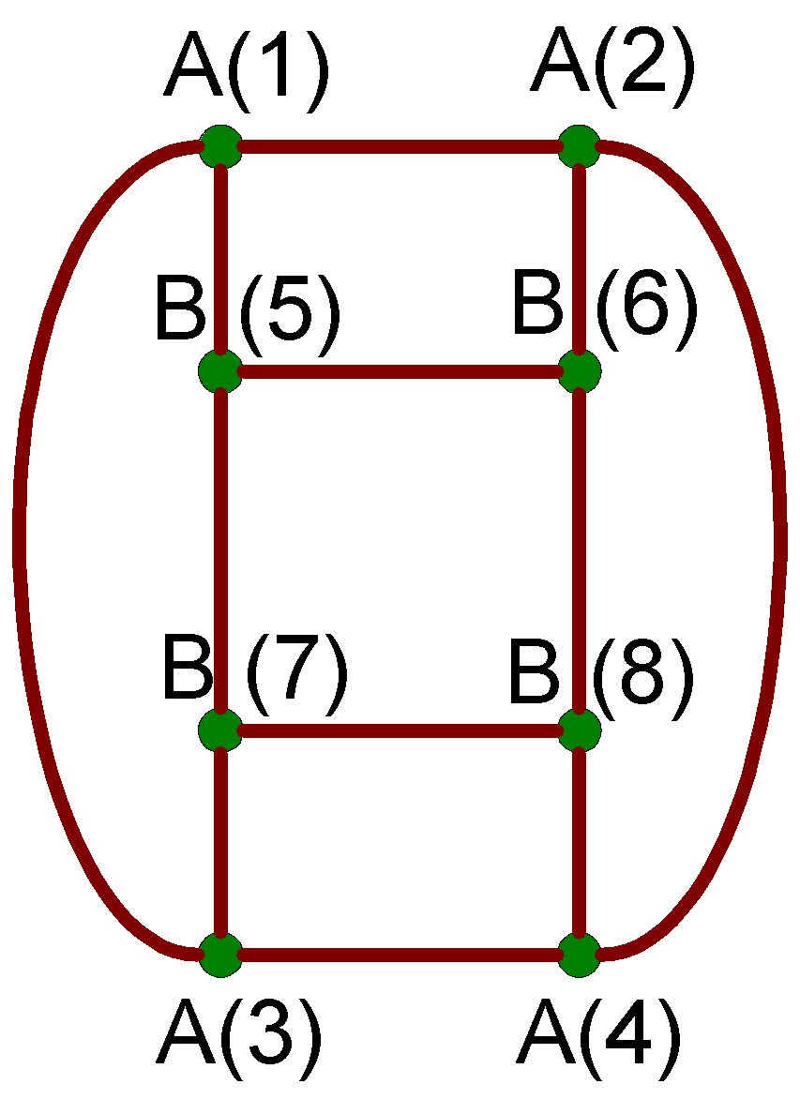
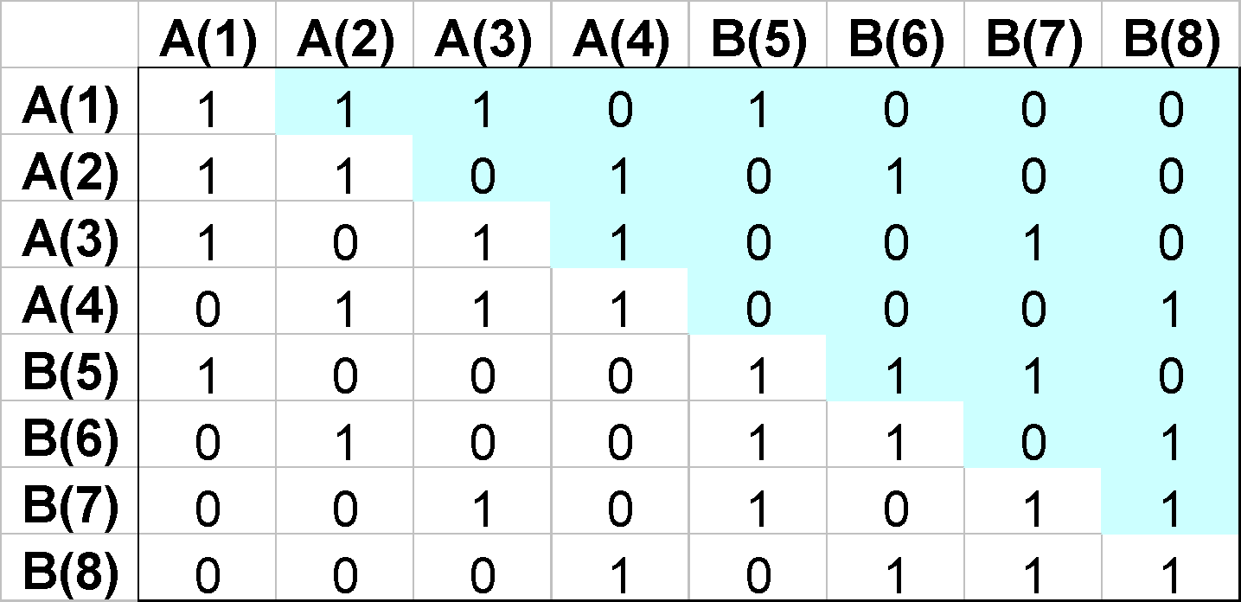
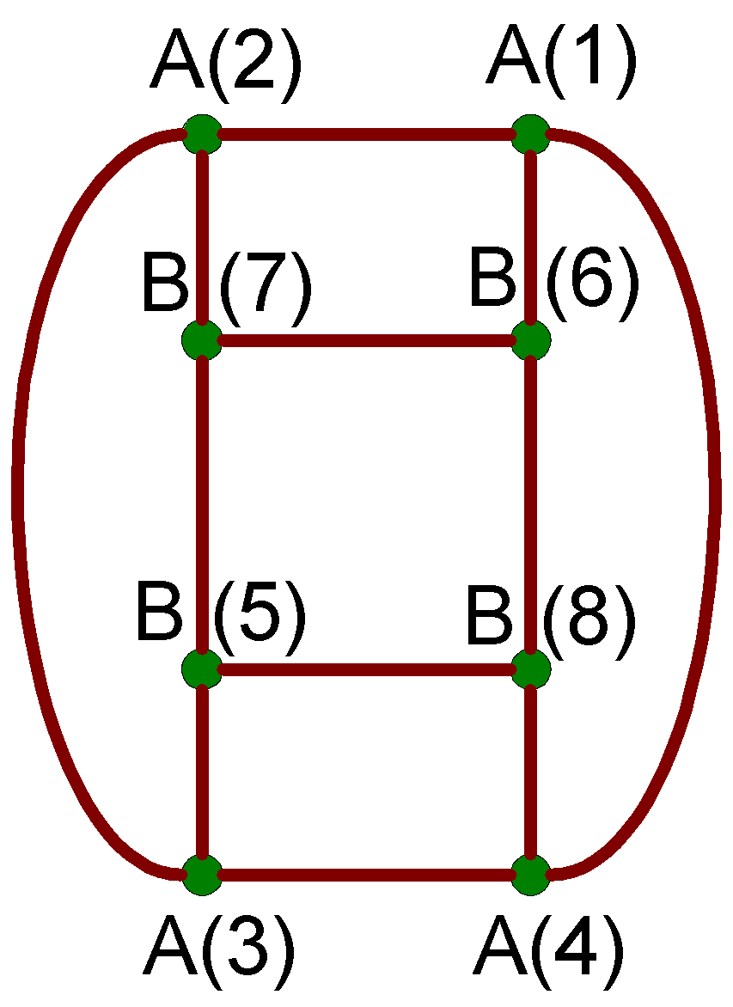
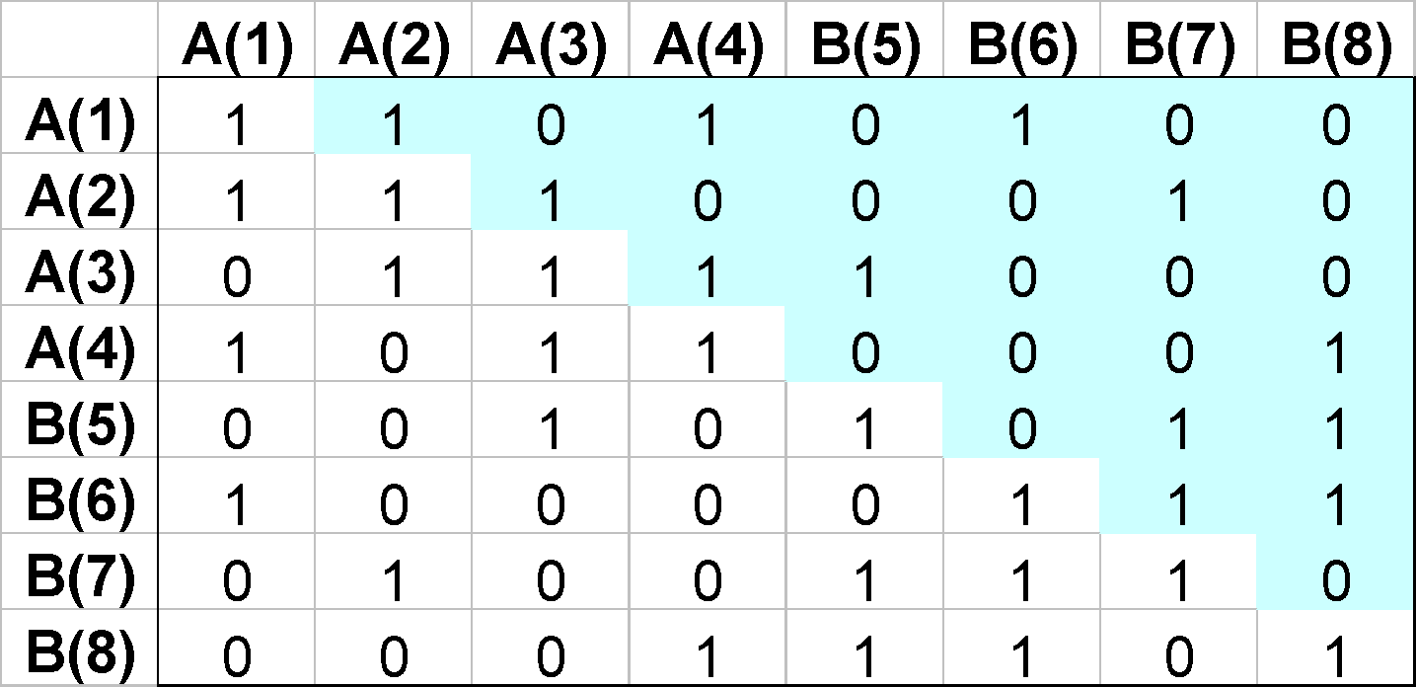
Adjacency Matrix Representation
The same graph can be represented in many ways

Slide 53
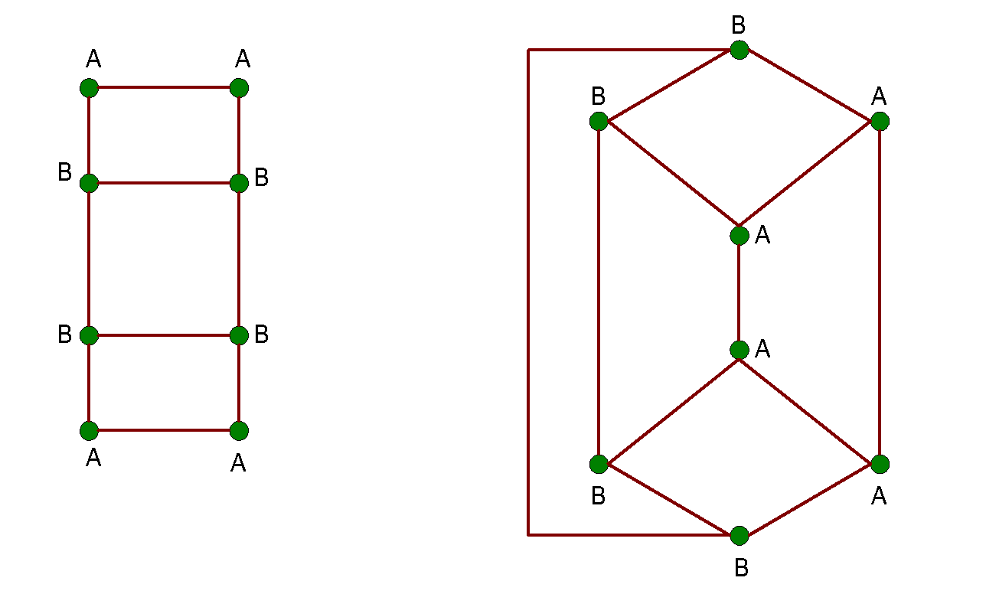
Graph Isomorphism
A graph is isomorphic if it is topologically equivalent to another graph

Slide 54
Graph Isomorphism
Test for graph isomorphism is needed:
  During candidate generation step, to determine whether a candidate has been generated
  During candidate pruning step, to check whether its
  (k-1)-subgraphs are frequent
  During candidate counting, to check whether a candidate is contained within another graph

Slide 55
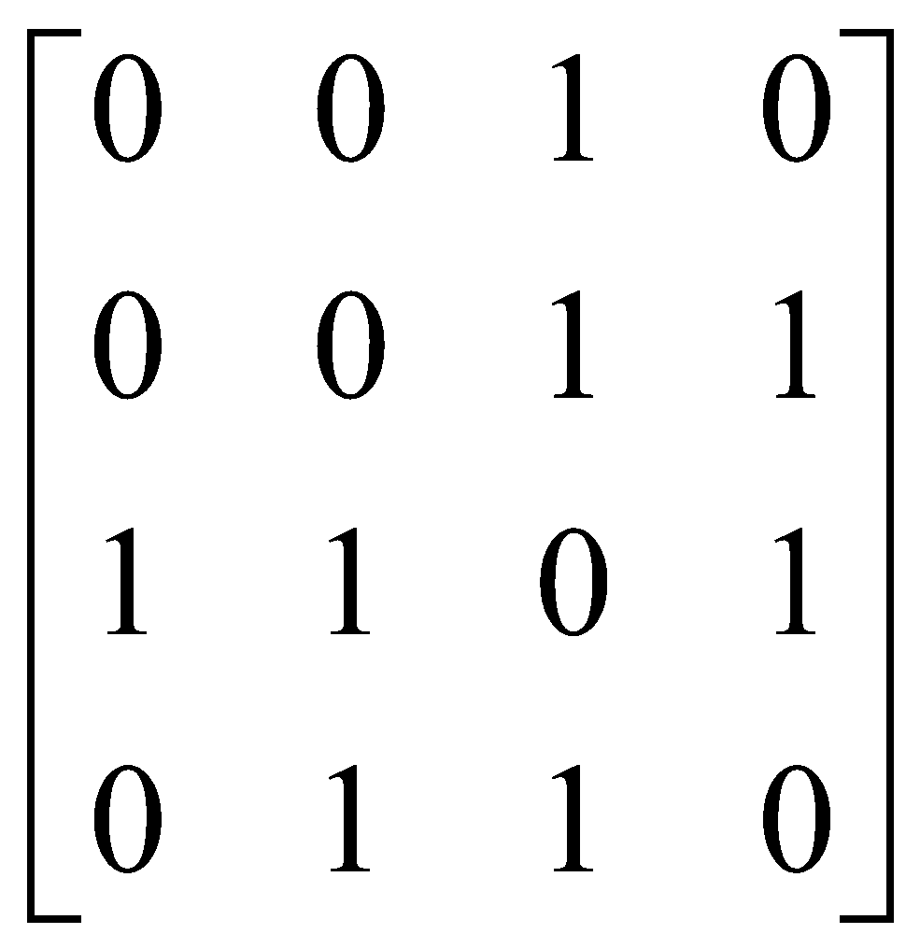
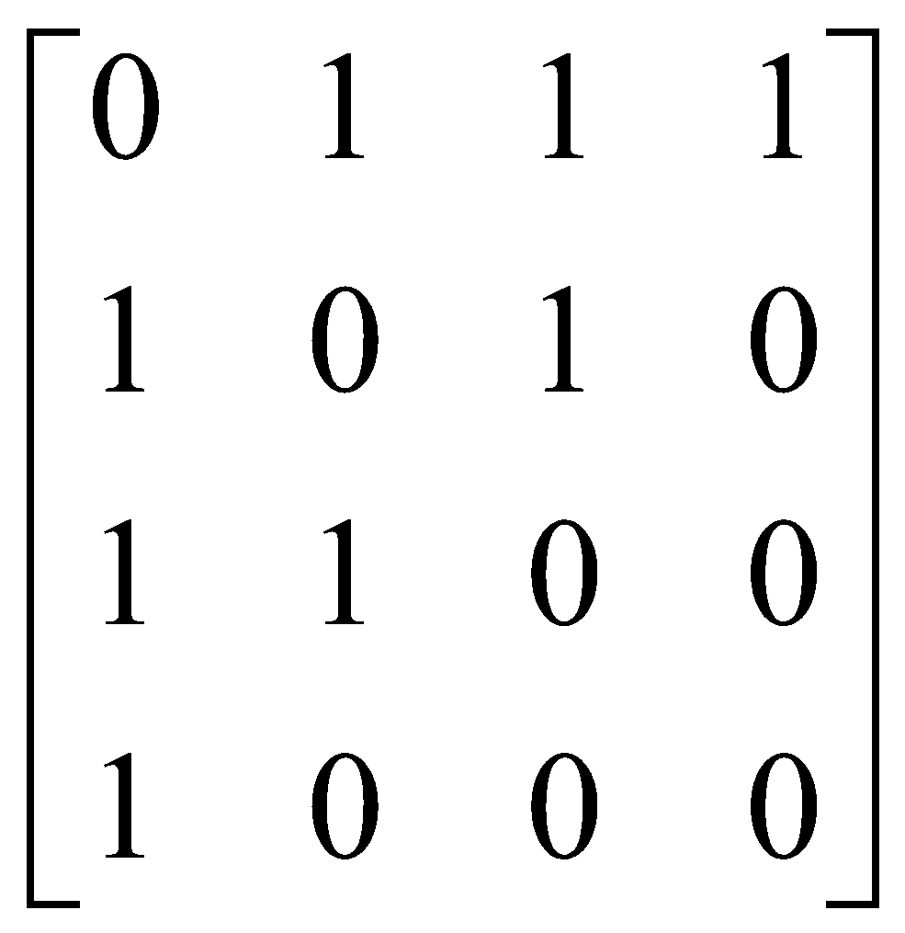
Graph Isomorphism
Use canonical labeling to handle isomorphism
  Map each graph into an ordered string representation (known as its code) such that two isomorphic graphs will be mapped to the same canonical encoding
  Example:
    Lexicographically largest adjacency matrix
String: 0010001111010110
Canonical: 0111101011001000

