Slide 1
Data Mining
Association Analysis: Basic Concepts and Algorithms
Lecture Notes for Chapter 6
Introduction to Data Mining
by
Tan, Steinbach, Kumar
© Tan,Steinbach, Kumar Introduction to Data Mining 4/18/2004 1

Slide 2
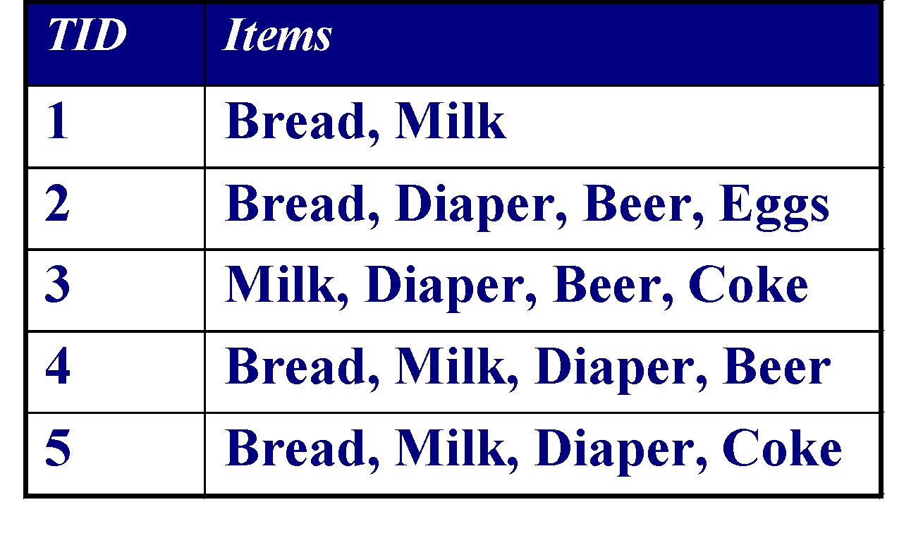
Association Rule Mining
Given a set of transactions, find rules that will predict the occurrence of an item based on the occurrences of other items in the transaction
Market-Basket transactions
Example of Association Rules
{Diaper} → {Beer},
{Milk, Bread} → {Eggs,Coke},
{Beer, Bread} → {Milk},
Implication means co-occurrence, not causality!

Slide 3
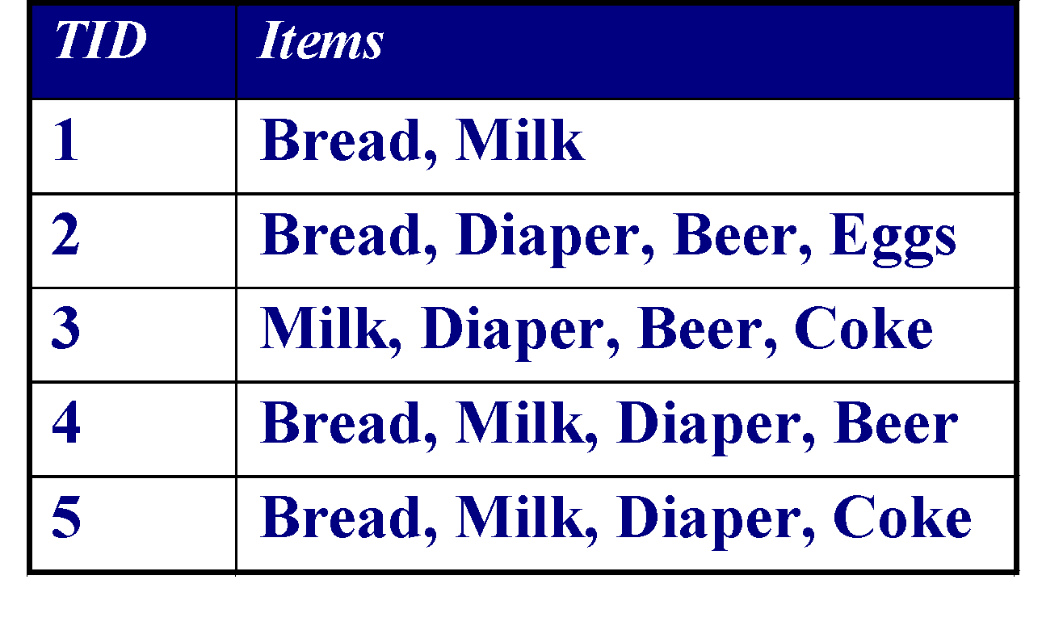
Definition: Frequent Itemset
Itemset
  A collection of one or more items
    Example: {Milk, Bread, Diaper}
  k-itemset
    An itemset that contains k items
Support count (σ)
  Frequency of occurrence of an itemset
  E.g. σ({Milk, Bread,Diaper}) = 2
Support
  Fraction of transactions that contain an itemset
  E.g. s({Milk, Bread, Diaper}) = 2/5
Frequent Itemset
  An itemset whose support is greater than or equal to a minsup threshold

Slide 4

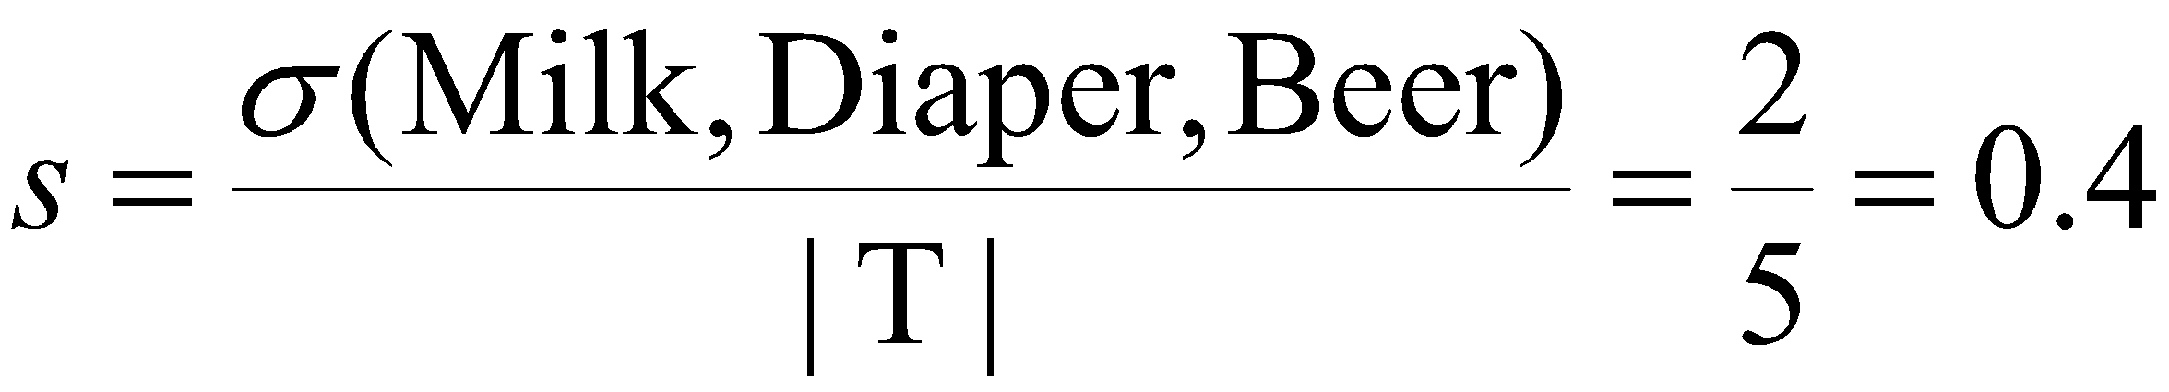
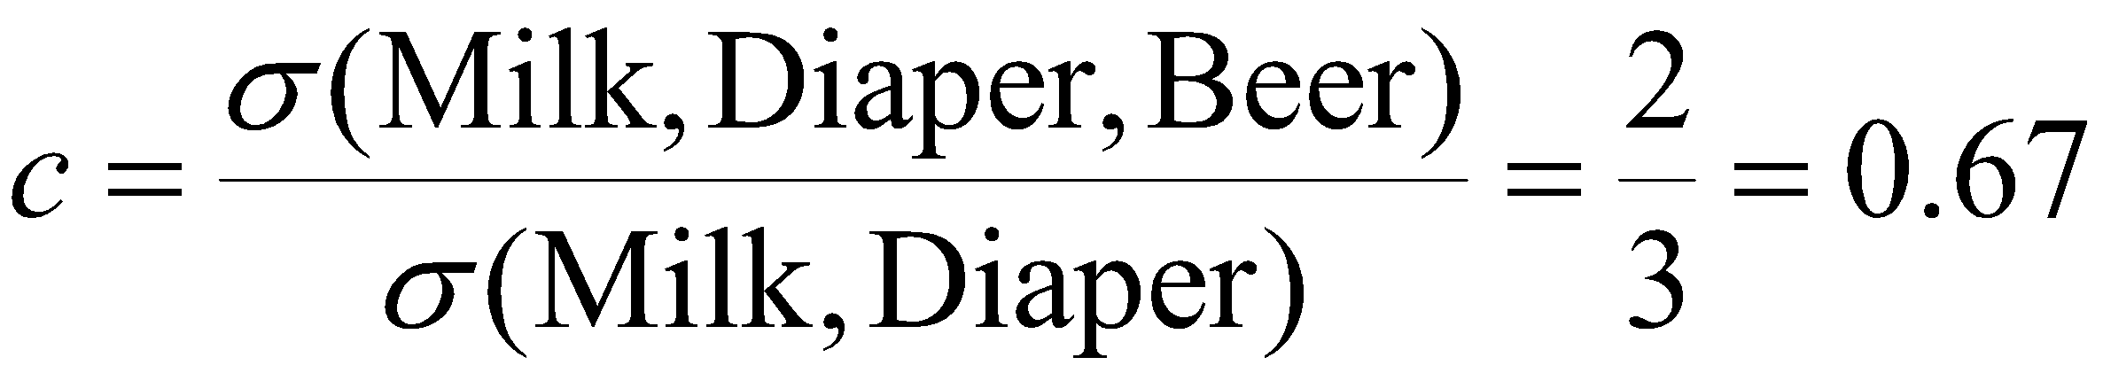
Definition: Association Rule
Association Rule
  An implication expression of the form X → Y, where X and Y are itemsets
  Example:
  {Milk, Diaper} → {Beer}
Rule Evaluation Metrics
  Support (s)
    Fraction of transactions that contain both X and Y
  Confidence (c)
    Measures how often items in Y
    appear in transactions that
    contain X
Example:

Slide 5
Association Rule Mining Task
Given a set of transactions T, the goal of association rule mining is to find all rules having
  support ≥ minsup threshold
  confidence ≥ minconf threshold
Brute-force approach:
  List all possible association rules
  Compute the support and confidence for each rule
  Prune rules that fail the minsup and minconf thresholds
  ⇒ Computationally prohibitive!

Slide 6
Mining Association Rules
Example of Rules:
{Milk,Diaper} → {Beer} (s=0.4, c=0.67)
{Milk,Beer} → {Diaper} (s=0.4, c=1.0)
{Diaper,Beer} → {Milk} (s=0.4, c=0.67)
{Beer} → {Milk,Diaper} (s=0.4, c=0.67)
{Diaper} → {Milk,Beer} (s=0.4, c=0.5)
{Milk} → {Diaper,Beer} (s=0.4, c=0.5)
Observations:
All the above rules are binary partitions of the same itemset:
{Milk, Diaper, Beer}
Rules originating from the same itemset have identical support but
can have different confidence
Thus, we may decouple the support and confidence requirements

Slide 7
Mining Association Rules
Two-step approach:
  Frequent Itemset Generation
    Generate all itemsets whose support ≥ minsup
  Rule Generation
    Generate high confidence rules from each frequent itemset, where each rule is a binary partitioning of a frequent itemset
Frequent itemset generation is still computationally expensive

Slide 8
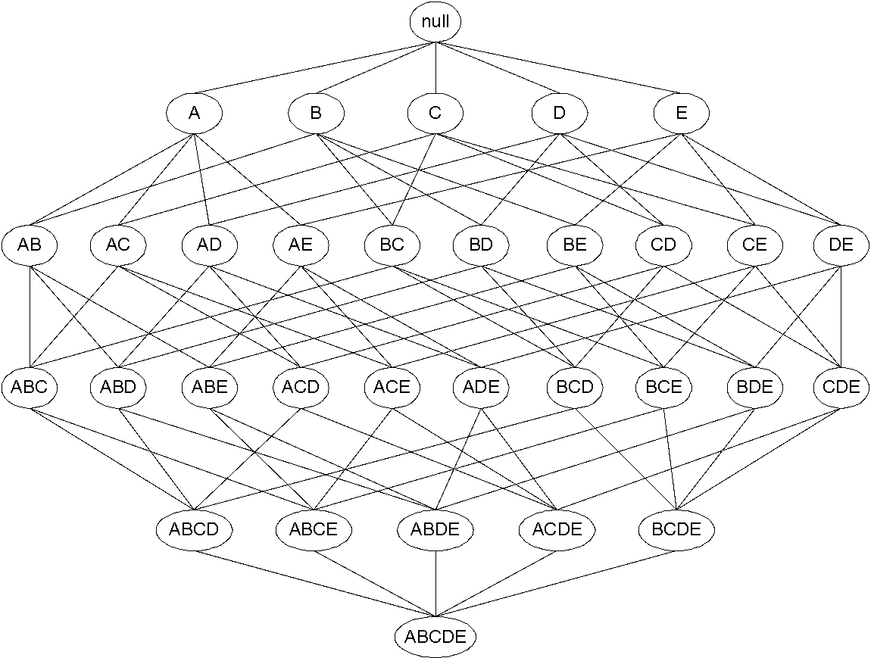
Frequent Itemset Generation
Given d items, there are 2^{d} possible candidate itemsets

Slide 9
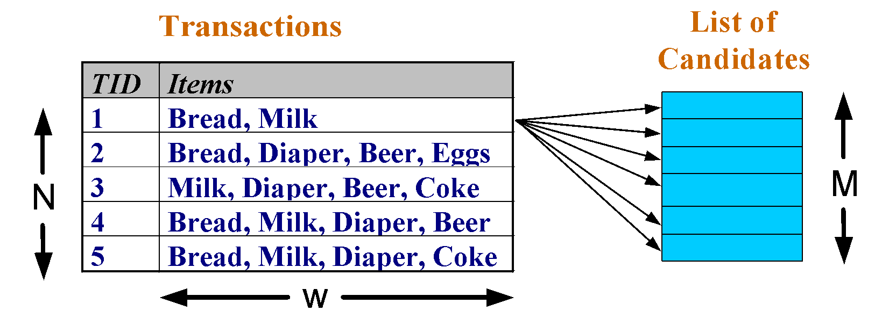
Frequent Itemset Generation
Brute-force approach:
  Each itemset in the lattice is a candidate frequent itemset
  Count the support of each candidate by scanning the database
  Match each transaction against every candidate
  Complexity ~ O(NMw) => Expensive since M = 2^{d} !!!

Slide 10
Frequent Itemset Generation Strategies
Reduce the number of candidates (M)
  Complete search: M=2^{d}
  Use pruning techniques to reduce M
Reduce the number of transactions (N)
  Reduce size of N as the size of itemset increases
  Used by DHP and vertical-based mining algorithms
Reduce the number of comparisons (NM)
  Use efficient data structures to store the candidates or transactions
  No need to match every candidate against every transaction

Slide 11
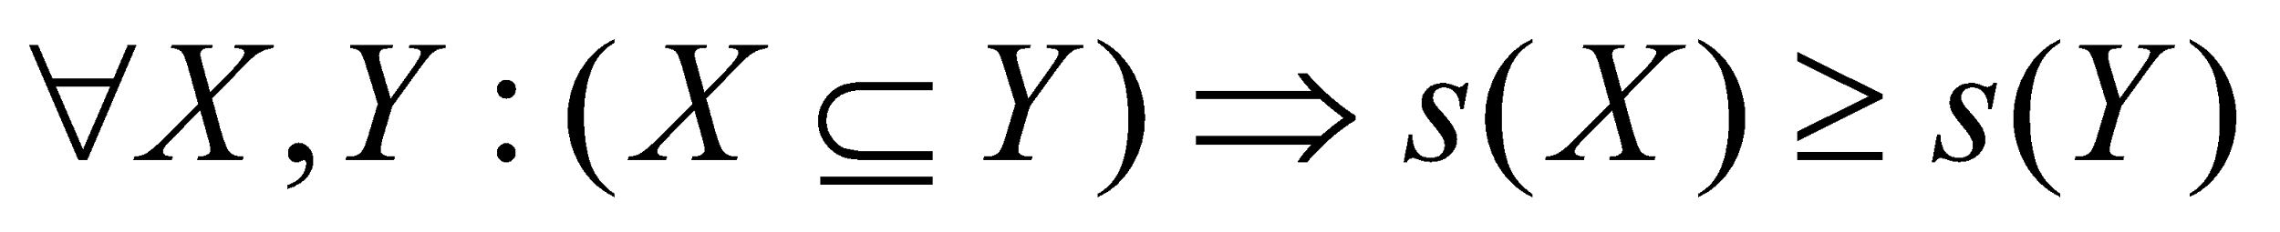
Reducing Number of Candidates
Apriori principle:
  If an itemset is frequent, then all of its subsets must also be frequent
Apriori principle holds due to the following property of the support measure:
  Support of an itemset never exceeds the support of its subsets
  This is known as the anti-monotone property of support

Slide 12
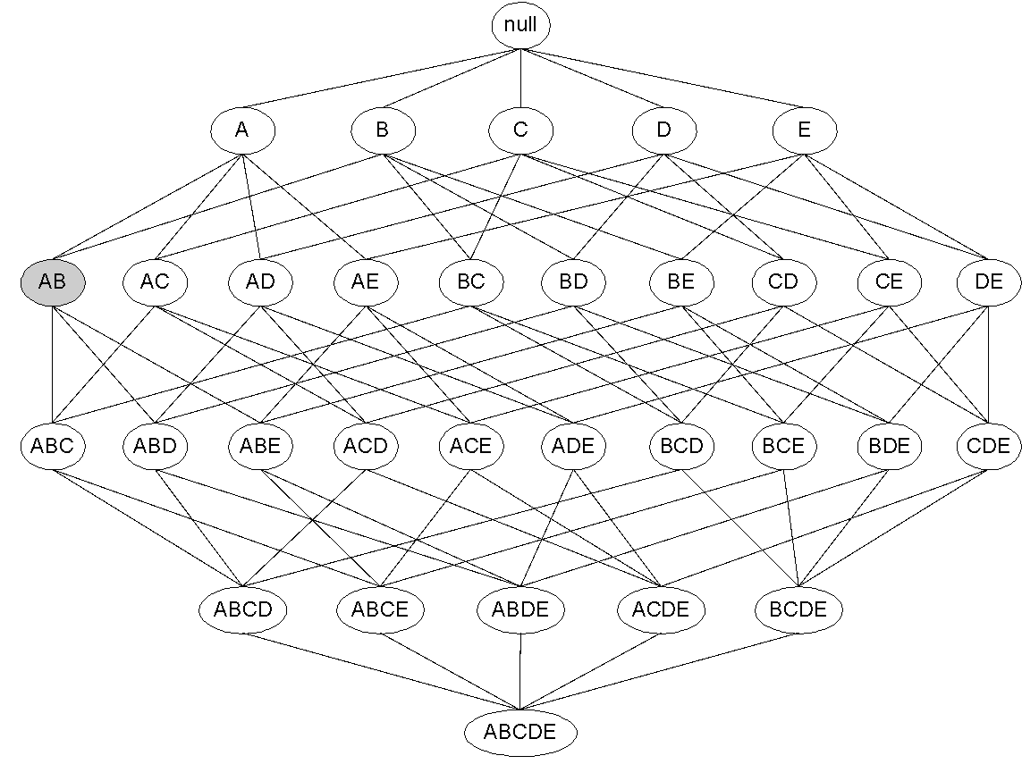
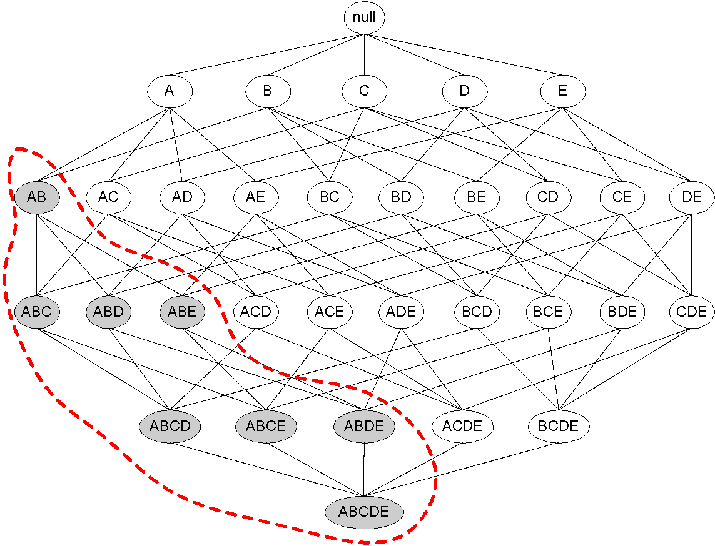
Illustrating Apriori Principle
Found to be Infrequent
Pruned supersets

Slide 13
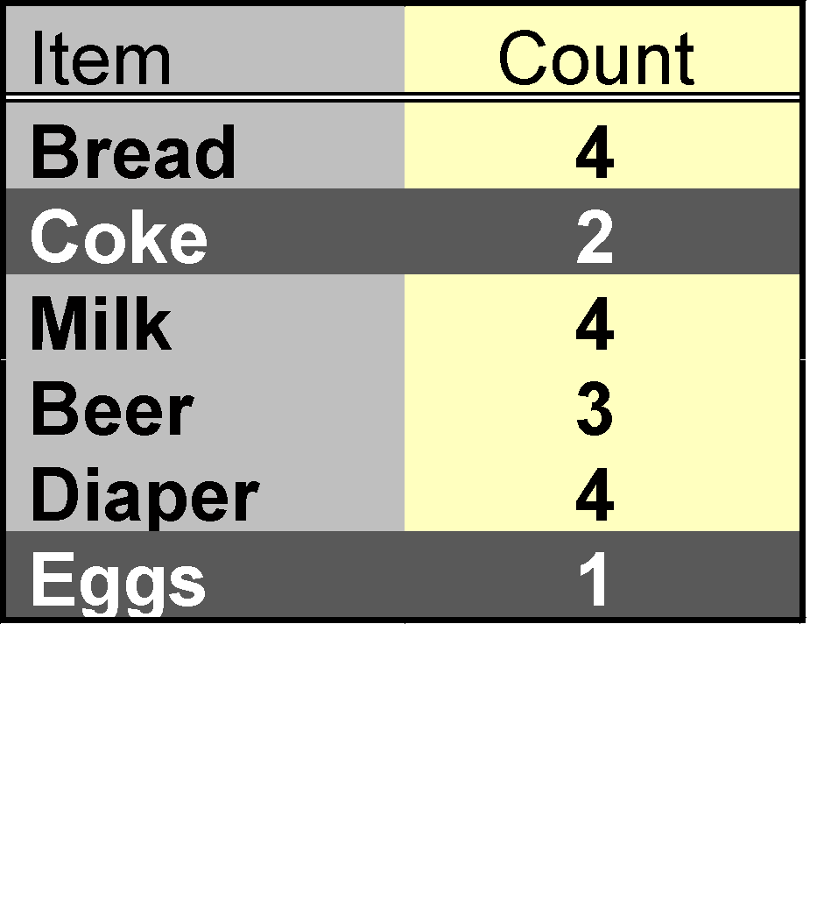
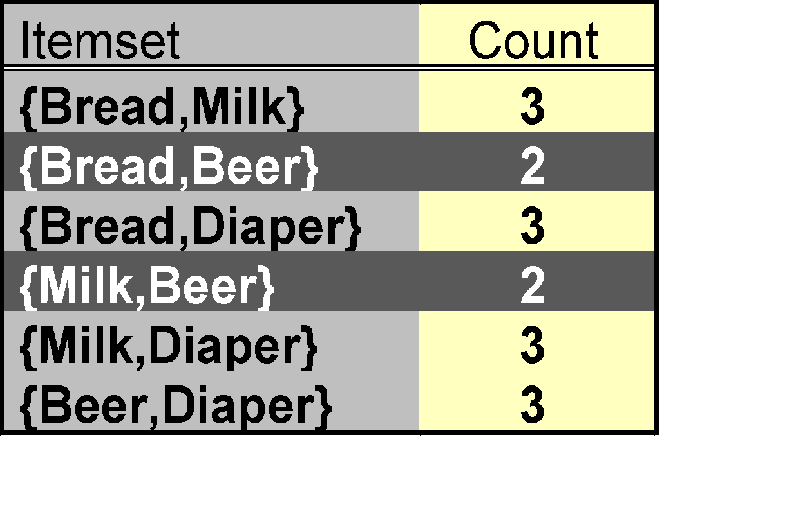
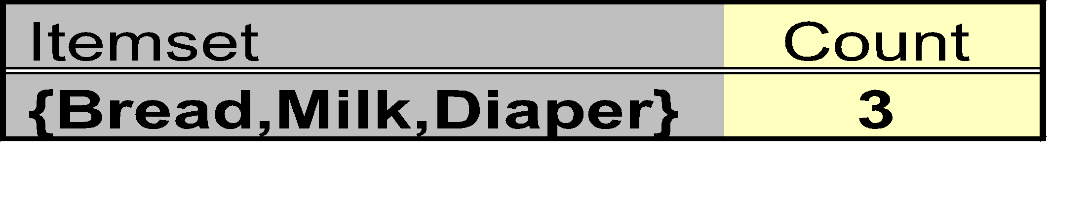
Illustrating Apriori Principle
Items (1-itemsets)
Pairs (2-itemsets)
(No need to generate
candidates involving Coke
or Eggs)
Minimum Support = 3
Triplets (3-itemsets)
If every subset is considered,
⁶C₁ + ⁶C₂ + ⁶C₃ = 41
With support-based pruning,
6 + 6 + 1 = 13

Slide 14
Apriori Algorithm
Method:
  Let k=1
  Generate frequent itemsets of length 1
  Repeat until no new frequent itemsets are identified
    Generate length (k+1) candidate itemsets from length k frequent itemsets
    Prune candidate itemsets containing subsets of length k that are infrequent
    Count the support of each candidate by scanning the DB
    Eliminate candidates that are infrequent, leaving only those that are frequent

Slide 15
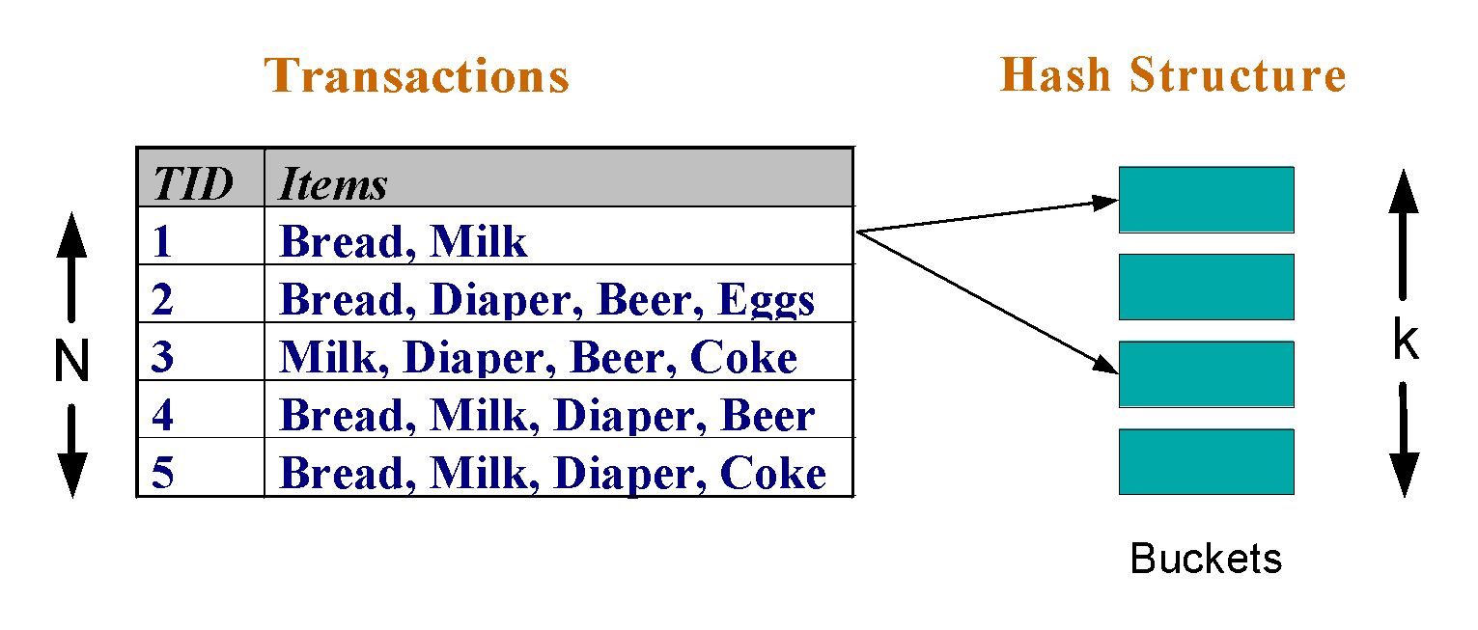
Reducing Number of Comparisons
Candidate counting:
  Scan the database of transactions to determine the support of each candidate itemset
  To reduce the number of comparisons, store the candidates in a hash structure
    Instead of matching each transaction against every candidate, match it against candidates contained in the hashed buckets

Slide 16
Generate Hash Tree
Suppose you have 15 candidate itemsets of length 3:
{1 4 5}, {1 2 4}, {4 5 7}, {1 2 5}, {4 5 8}, {1 5 9}, {1 3 6}, {2 3 4}, {5 6 7}, {3 4 5}, {3 5 6}, {3 5 7}, {6 8 9}, {3 6 7}, {3 6 8}
You need:
Hash function
Max leaf size: max number of itemsets stored in a leaf node (if number of candidate itemsets exceeds max leaf size, split the node)
Hash function
2 3 4
5 6 7
3,6,9
1,4,7
1 4 5
3 4 5
3 5 6
3 5 7
6 8 9
3 6 7
3 6 8
1 3 6
2,5,8
1 2 4
4 5 7
1 2 5
4 5 8
1 5 9

Slide 17
Association Rule Discovery: Hash tree
Hash Function
Candidate Hash Tree
1,4,7
3,6,9
2,5,8
2 3 4
5 6 7
1 4 5
1 3 6
3 4 5
3 5 6
3 6 7
Hash on 1, 4 or 7
3 5 7
3 6 8
1 2 4
1 5 9
6 8 9
1 2 5
4 5 7
4 5 8

Slide 18
Association Rule Discovery: Hash tree
Hash Function
Candidate Hash Tree
1,4,7
3,6,9
2,5,8
2 3 4
5 6 7
1 4 5
1 3 6
3 4 5
3 5 6
3 6 7
Hash on 2, 5 or 8
3 5 7
3 6 8
1 2 4
1 5 9
6 8 9
1 2 5
4 5 7
4 5 8

Slide 19
Association Rule Discovery: Hash tree
Hash Function
Candidate Hash Tree
1,4,7
3,6,9
2,5,8
2 3 4
5 6 7
1 4 5
1 3 6
3 4 5
3 5 6
3 6 7
Hash on 3, 6 or 9
3 5 7
3 6 8
1 2 4
1 5 9
6 8 9
1 2 5
4 5 7
4 5 8

Slide 20
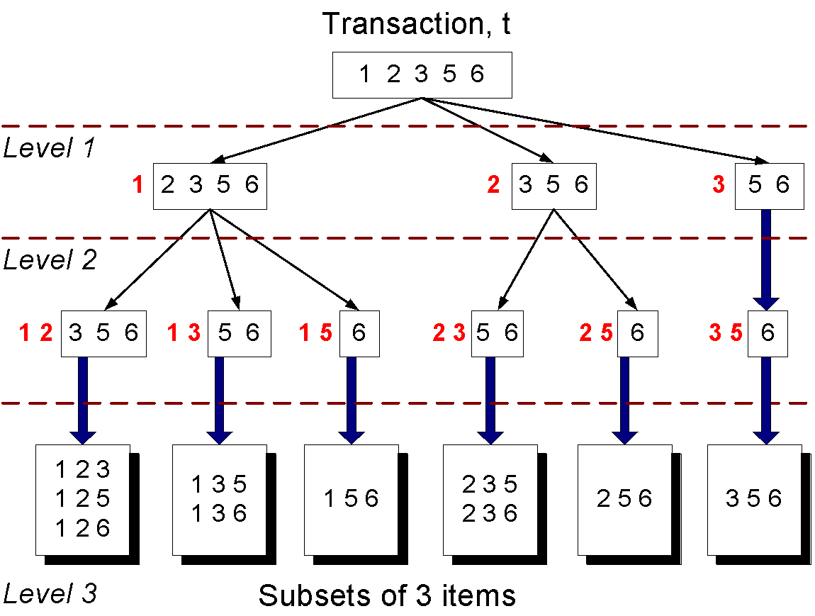
Subset Operation
Given a transaction t, what are the possible subsets of size 3?

Slide 21
Subset Operation Using Hash Tree
1 2 3 5 6
transaction
Hash Function
1 +
2 3 5 6
2 +
3 5 6
1,4,7
3,6,9
3 +
5 6
2,5,8
2 3 4
5 6 7
1 4 5
1 3 6
3 4 5
3 5 6
3 6 7
3 5 7
3 6 8
1 2 4
1 2 5
1 5 9
6 8 9
4 5 7
4 5 8

Slide 22
Subset Operation Using Hash Tree
1 2 3 5 6
transaction
Hash Function
1 +
2 3 5 6
2 +
3 5 6
1,4,7
3,6,9
1 2 +
3 5 6
3 +
5 6
2,5,8
1 3 +
5 6
2 3 4
1 5 +
6
5 6 7
1 4 5
1 3 6
3 4 5
3 5 6
3 6 7
3 5 7
3 6 8
1 2 4
1 2 5
1 5 9
6 8 9
4 5 7
4 5 8

Slide 23
Subset Operation Using Hash Tree
1 2 3 5 6
transaction
Hash Function
1 +
2 3 5 6
2 +
3 5 6
1,4,7
3,6,9
1 2 +
3 5 6
3 +
5 6
2,5,8
1 3 +
5 6
2 3 4
1 5 +
6
5 6 7
1 4 5
1 3 6
3 4 5
3 5 6
3 6 7
3 5 7
3 6 8
1 2 4
1 2 5
1 5 9
6 8 9
4 5 7
4 5 8
Match transaction against 11 out of 15 candidates

Slide 24
Factors Affecting Complexity
Choice of minimum support threshold
  lowering support threshold results in more frequent itemsets
  this may increase number of candidates and max length of frequent itemsets
Dimensionality (number of items) of the data set
  more space is needed to store support count of each item
  if number of frequent items also increases, both computation and I/O costs may also increase
Size of database
  since Apriori makes multiple passes, run time of algorithm may increase with number of transactions
Average transaction width
  transaction width increases with denser data sets
  This may increase max length of frequent itemsets and traversals of hash tree (number of subsets in a transaction increases with its width)

Slide 25
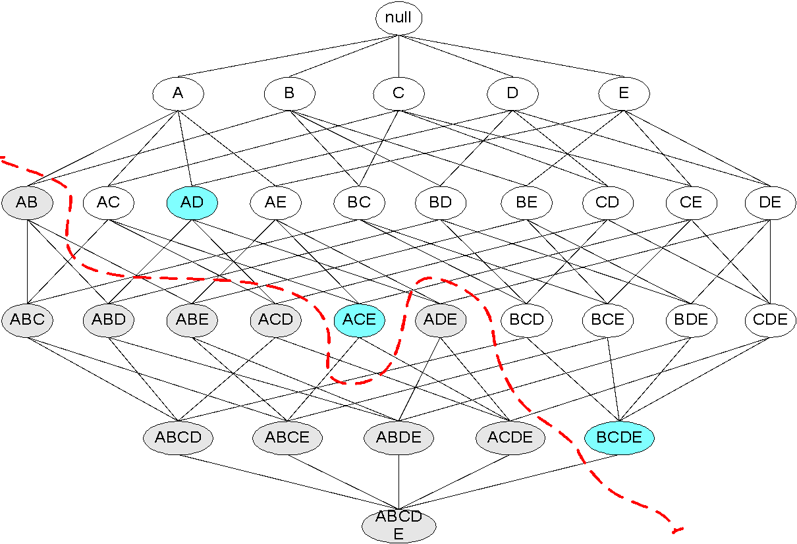
Maximal Frequent Itemset
An itemset is maximal frequent if none of its immediate supersets is frequent
Maximal Itemsets
Infrequent Itemsets
Border

Slide 26
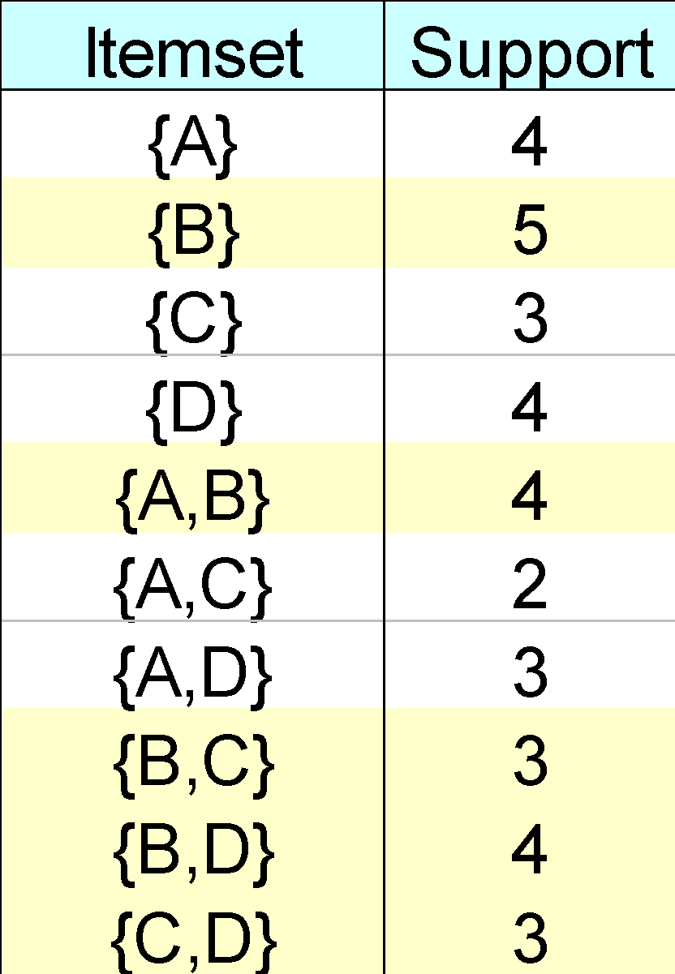
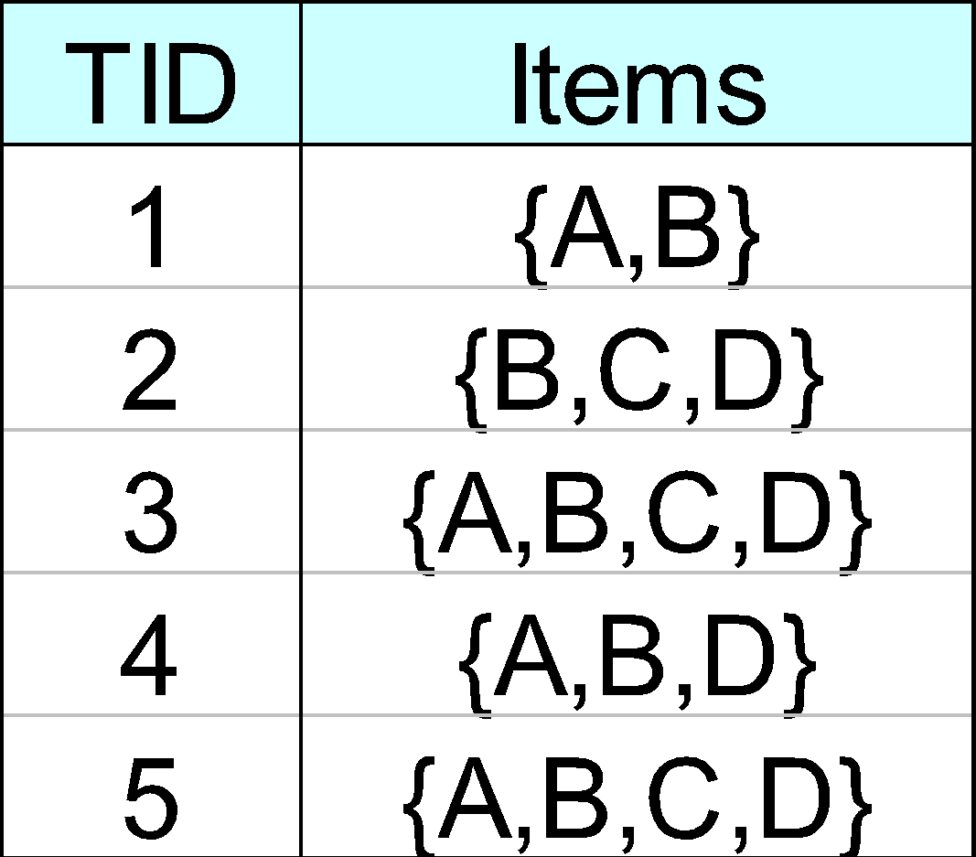
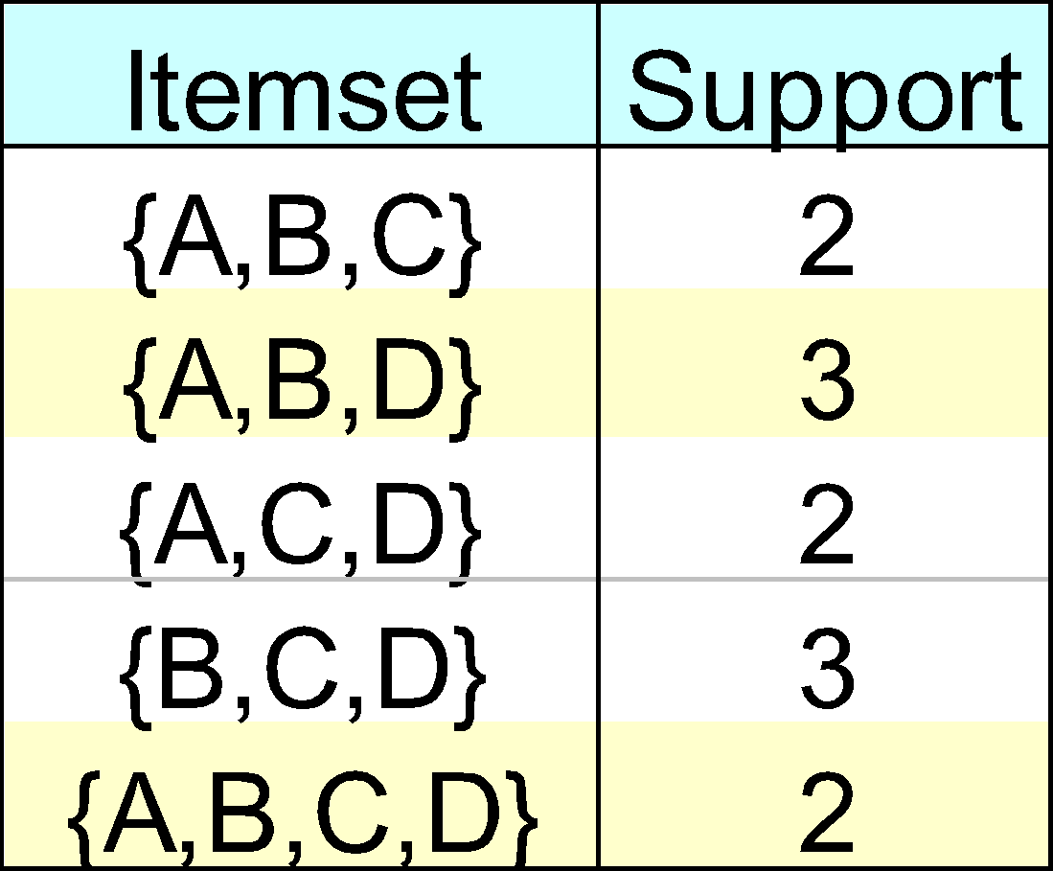
Closed Itemset
An itemset is closed if none of its immediate supersets has the same support as the itemset

Slide 27
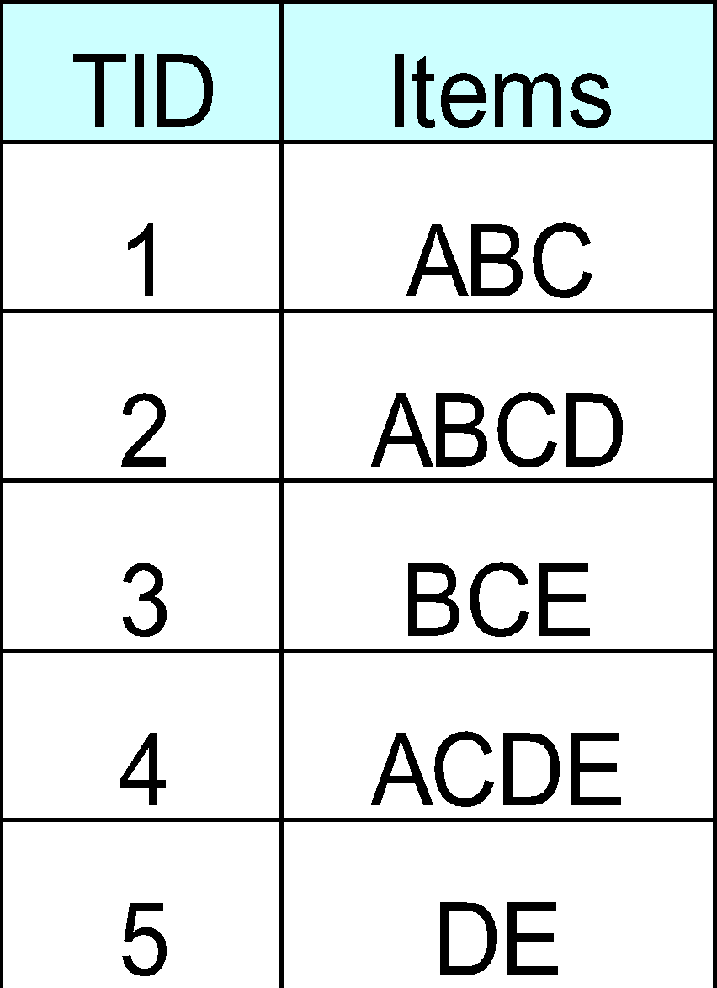
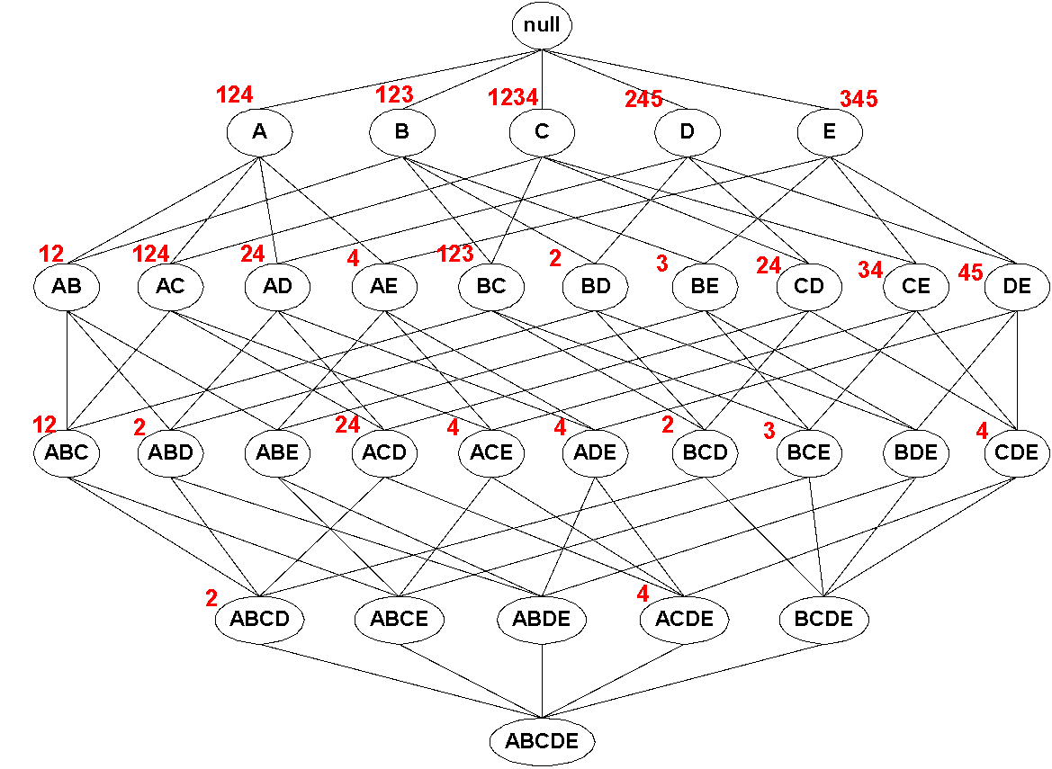
Maximal vs Closed Itemsets
Transaction Ids
Not supported by any transactions

Slide 28
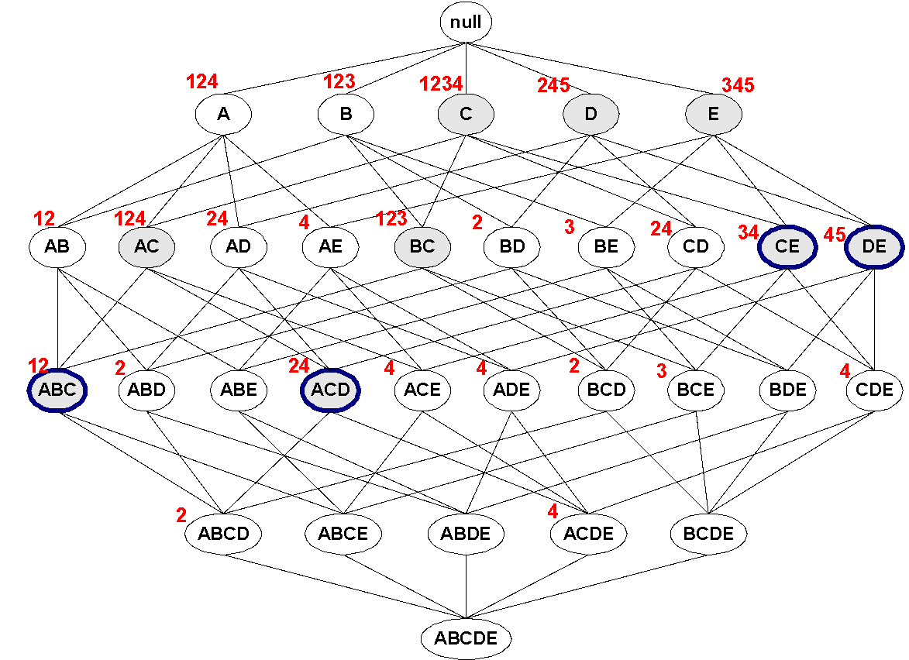
Maximal vs Closed Frequent Itemsets
Minimum support = 2
Closed but not maximal
Closed and maximal
# Closed = 9
# Maximal = 4

Slide 29
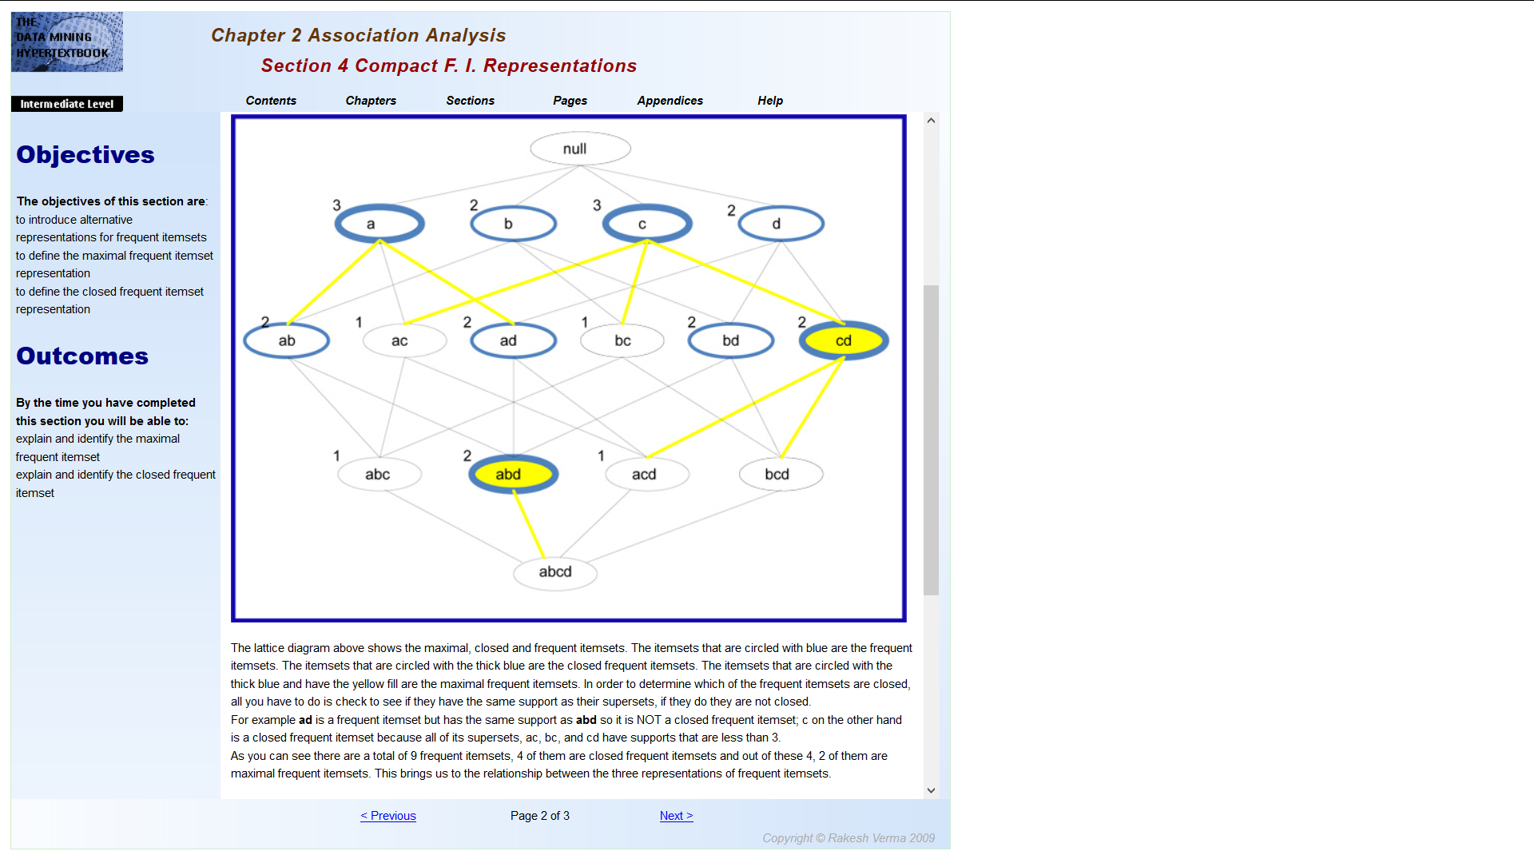

Slide 30
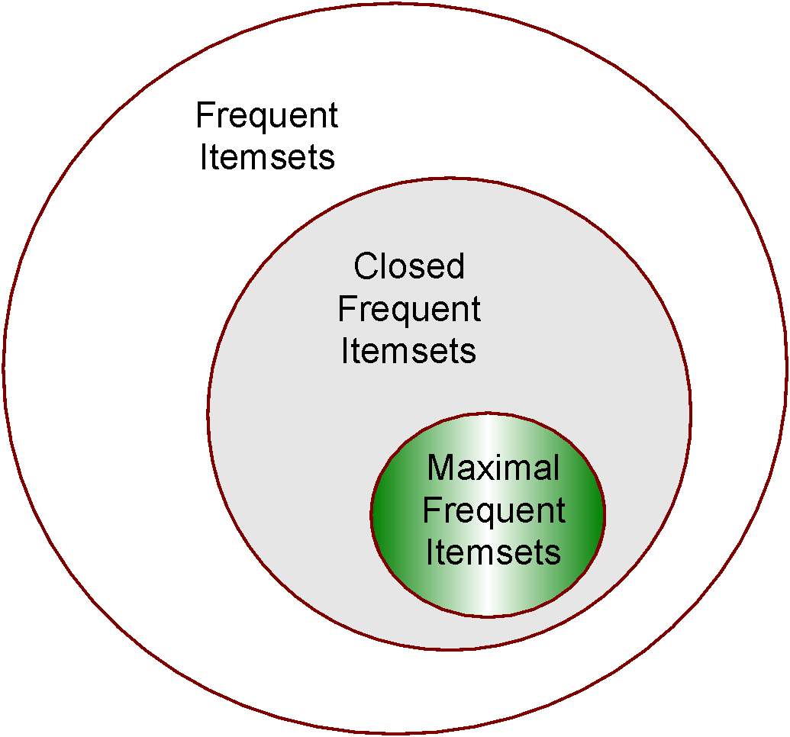
Maximal vs Closed Itemsets

Slide 31
FP-growth Algorithm
Use a compressed representation of the database using an FP-tree (Frequent Pattern-Tree)
Once an FP-tree has been constructed, it uses a recursive divide-and-conquer approach to mine the frequent itemsets

Slide 32
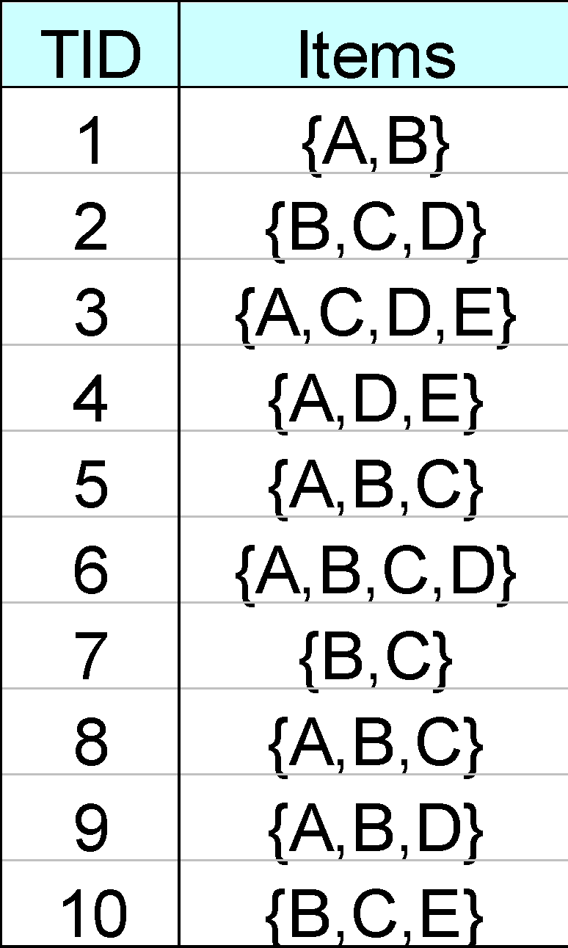
FP-tree construction
null
After reading TID=1:
A:1
B:1
After reading TID=2:
null
A:1
B:1
B:1
C:1
D:1

Slide 33
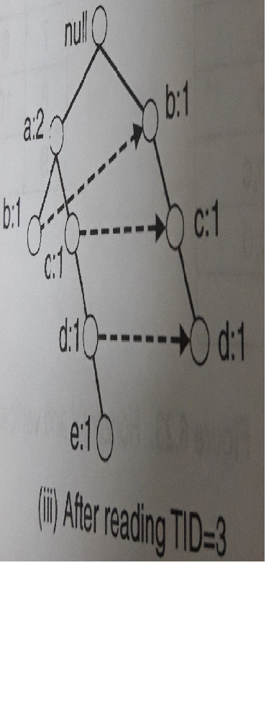

Slide 34
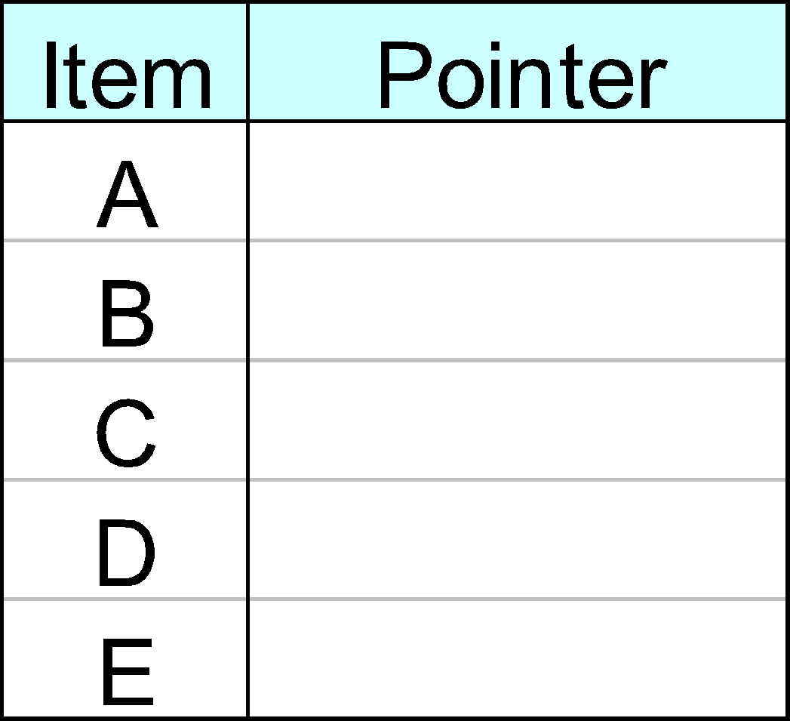
FP-Tree Construction
Transaction Database
null
A:7
B:3
B:5
C:3
C:1
D:1
Header table
D:1
C:3
E:1
D:1
E:1
D:1
E:1
D:1
Pointers are used to assist frequent itemset generation

Slide 35
FP-growth
null
Conditional Pattern base for D:
P = {(A:1,B:1,C:1),
(A:1,B:1),
(A:1,C:1),
(A:1),
(B:1,C:1)}
Recursively apply FP-growth on P
Frequent Itemsets found (with sup > 1):
AD, BD, CD, ACD, BCD
A:7
B:1
B:5
C:1
C:1
D:1
C:3
D:1
D:1
D:1
D:1

Slide 36
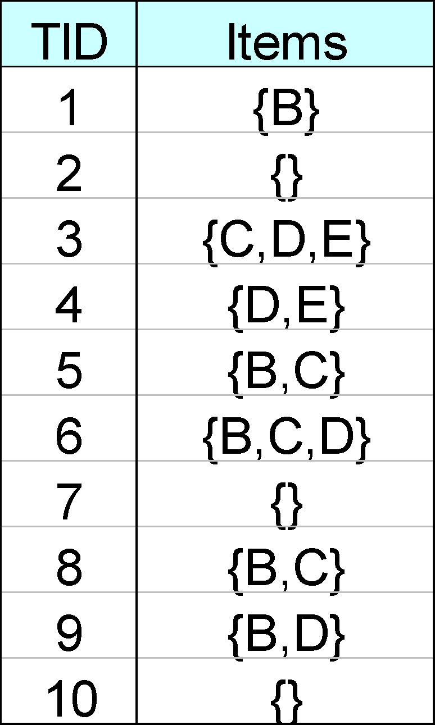
Projected Database
Projected Database for node A:
Original Database:
For each transaction T, projected transaction at node A is T ∩ E(A)

Slide 37
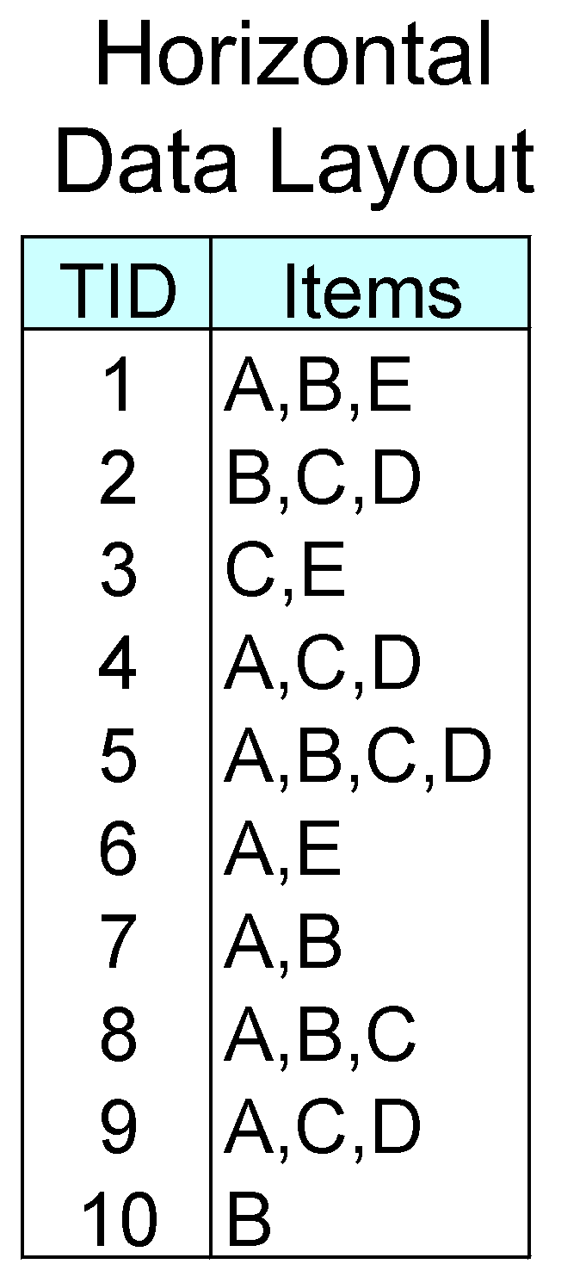
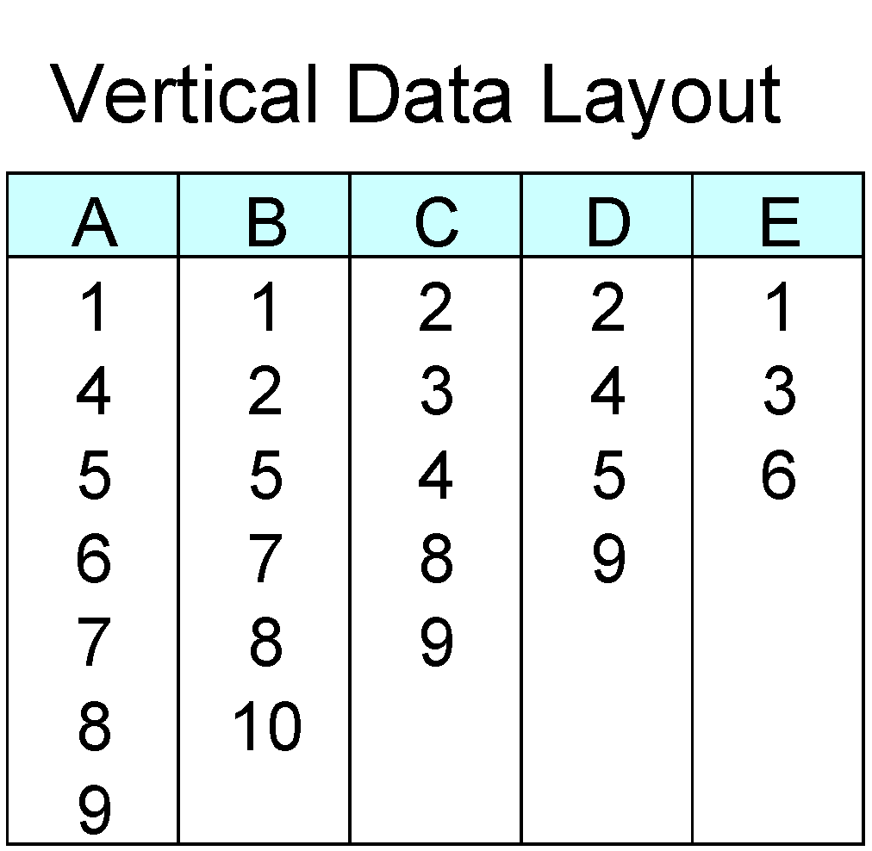
ECLAT
For each item, store a list of transaction ids (tids)
TID-list

Slide 38
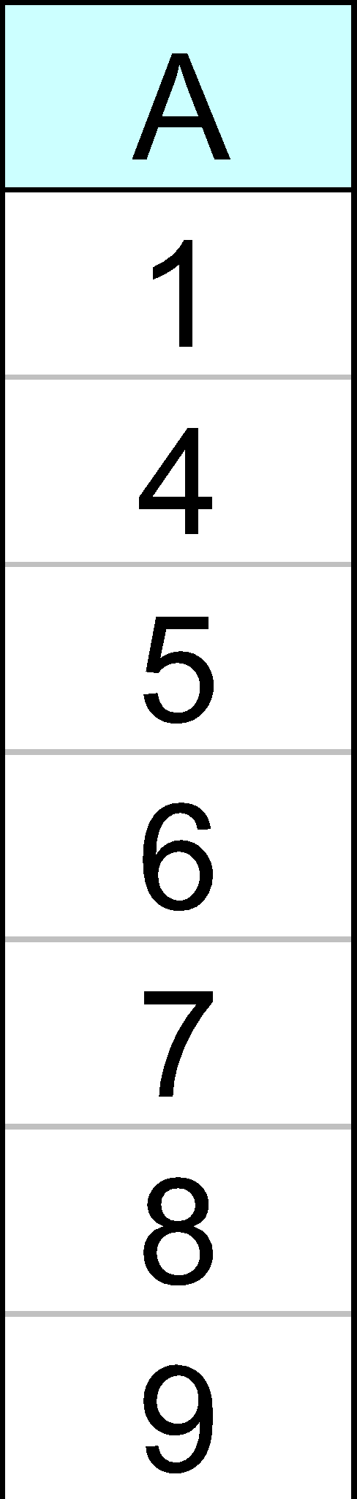
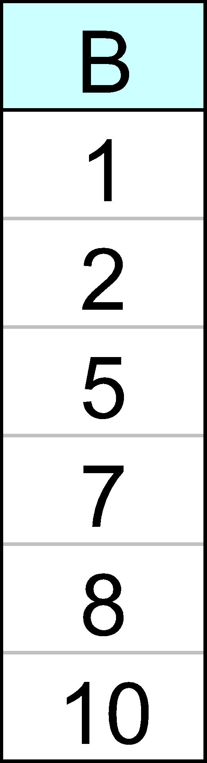
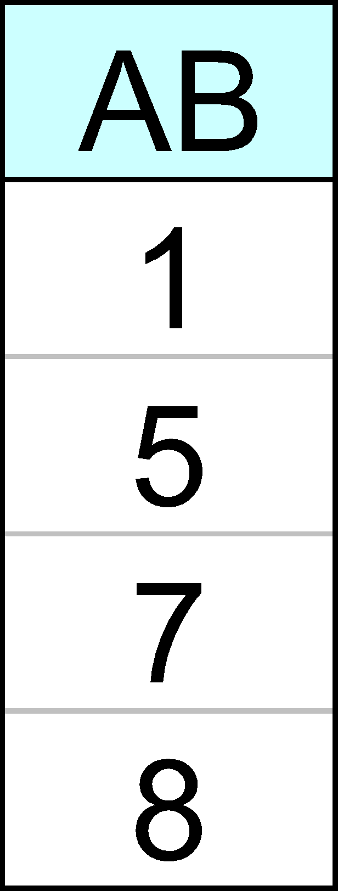
ECLAT
Determine support of any k-itemset by intersecting tid-lists of two of its (k-1) subsets.
3 traversal approaches:
  top-down, bottom-up and hybrid
Advantage: very fast support counting
Disadvantage: intermediate tid-lists may become too large for memory
∧
→

Slide 39
Effect of Support Distribution
How to set the appropriate minsup threshold?
  If minsup is set too high, we could miss itemsets involving interesting rare items (e.g., expensive products)
  If minsup is set too low, it is computationally expensive and the number of itemsets is very large
Using a single minimum support threshold may not be effective

Slide 40
Pattern Evaluation
Association rule algorithms tend to produce too many rules
  many of them are uninteresting or redundant
  Redundant if {A,B,C} → {D} and {A,B} → {D}
  have same support & confidence
Interestingness measures can be used to prune/rank the derived patterns
In the original formulation of association rules, support & confidence are the only measures used

Slide 41
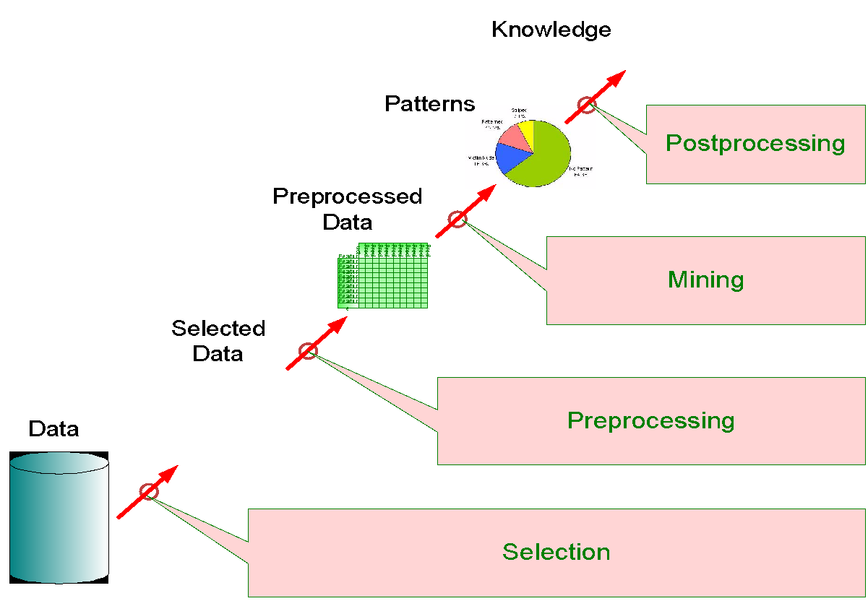
Application of Interestingness Measure
Interestingness Measures

Slide 42
Computing Interestingness Measure
Given a rule X → Y, information needed to compute rule interestingness can be obtained from a contingency table
Contingency table for X → Y
 | Y | Y
X | f₁₁ | f₁₀ | f₁₊
X | f₀₁ | f₀₀ | f_{o+}
 | f₊₁ | f₊₀ | |T|
f₁₁: support of X and Y
f₁₀: support of X and Y
f₀₁: support of X and Y
f₀₀: support of X and Y
Used to define various measures
support, confidence, lift, Gini,
J-measure, etc.

Slide 43
Drawback of Confidence
 | Coffee | Coffee
Tea | 15 | 5 | 20
Tea | 75 | 5 | 80
 | 90 | 10 | 100
Association Rule: Tea → Coffee
Confidence= P(Coffee|Tea) = 0.75
but P(Coffee) = 0.9
Although confidence is high, rule is misleading
P(Coffee|Tea) = 0.9375

Slide 44
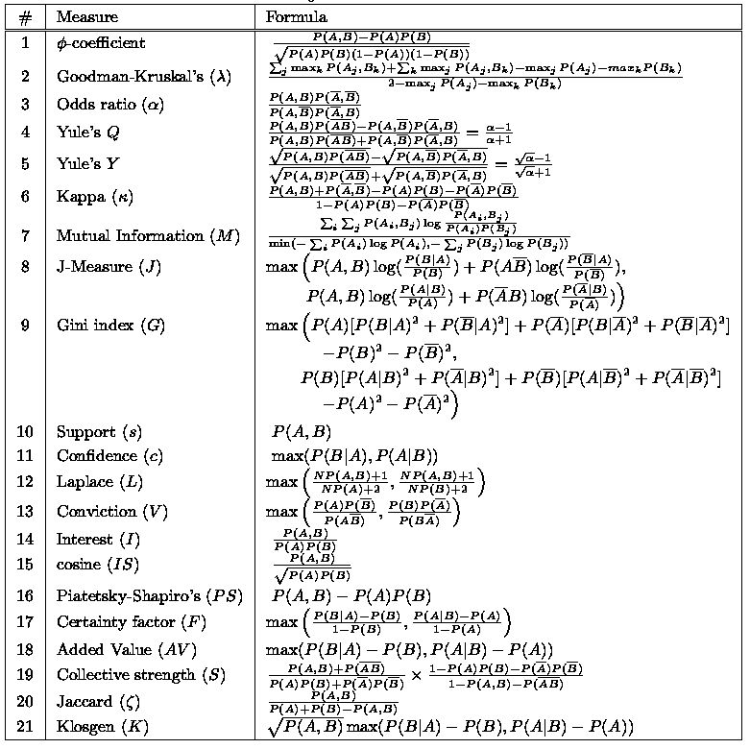
There are lots of measures proposed in the literature
Some measures are good for certain applications, but not for others
What criteria should we use to determine whether a measure is good or bad?
What about Apriori-style support based pruning? How does it affect these measures?

