Slide 1
Data Mining: Data
Lecture Notes for Chapter 2
Introduction to Data Mining
by
Tan, Steinbach, Kumar

Slide 2
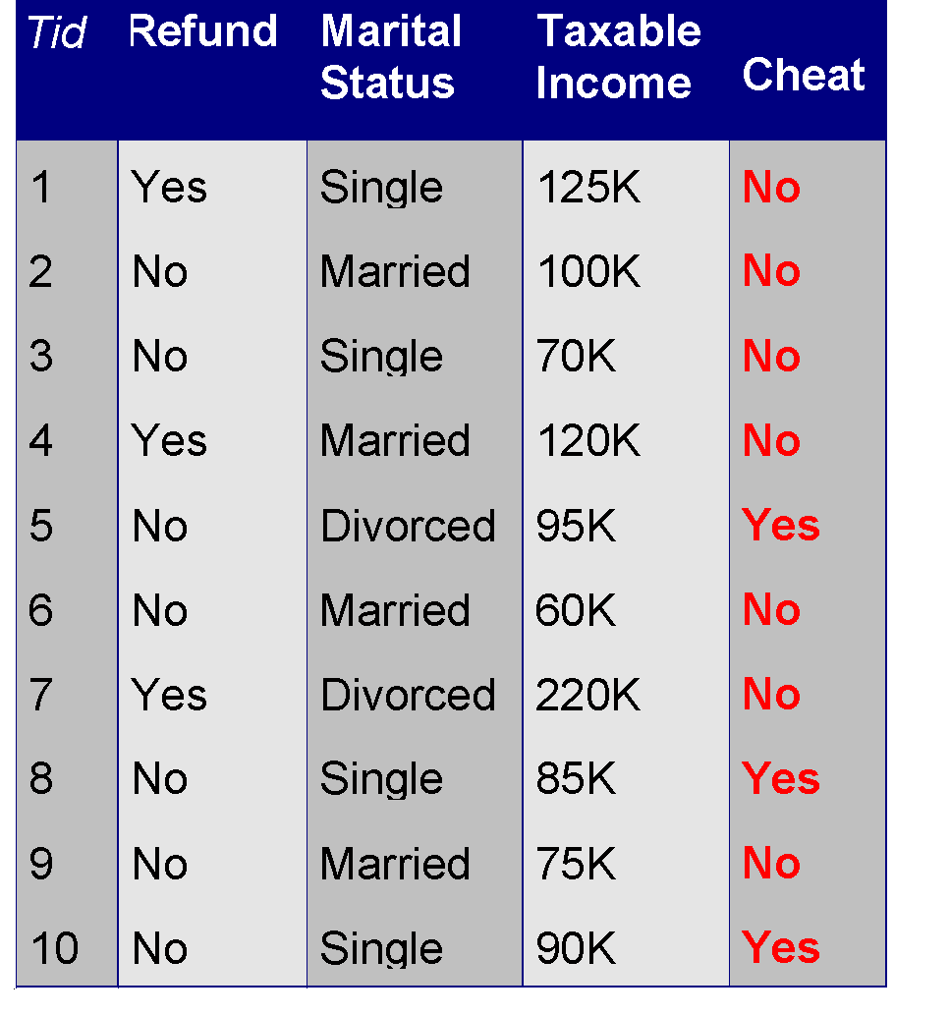
What is Data?
Collection of data objects and their attributes
An attribute is a property or characteristic of an object
  Examples: eye color of a person, temperature, etc.
  Attribute is also known as variable, field, characteristic, or feature
A collection of attributes describe an object
  Object is also known as record, point, case, sample, entity, or instance
Attributes
Objects

Slide 3
Attribute Values
Attribute values are numbers or symbols assigned to an attribute
Distinction between attributes and attribute values
  Same attribute can be mapped to different attribute values
    Example: height can be measured in feet or meters
  Different attributes can be mapped to the same set of values
    Example: Attribute values for ID and age are integers
    But properties of attribute values can be different
      ID has no limit but age has a maximum and minimum value

Slide 4
Types of Attributes
There are different types of attributes
  Nominal
    Examples: ID numbers, eye color, zip codes
  Ordinal
    Examples: rankings (e.g., taste of potato chips on a scale from 1-10), grades, height in {tall, medium, short}
  Interval
    Examples: calendar dates, temperatures in Celsius or Fahrenheit.
  Ratio
    Examples: temperature in Kelvin, length, time, counts

Slide 5
Properties of Attribute Values
The type of an attribute depends on which of the following properties it possesses:
  Distinctness: = ≠
  Order: < >
  Addition: + -
  Multiplication: * /
  Nominal attribute: distinctness
  Ordinal attribute: distinctness & order
  Interval attribute: distinctness, order & addition
  Ratio attribute: all 4 properties

Slide 6
Attribute Type
Description
Examples
Operations
Nominal
The values of a nominal attribute are just different names, i.e., nominal attributes provide only enough information to distinguish one object from another. (=, ≠)
zip codes, employee ID numbers, eye color, sex: {male, female}
mode, entropy, contingency correlation, χ² test
Ordinal
The values of an ordinal attribute provide enough information to order objects. (<, >)
hardness of minerals, {good, better, best},
grades, street numbers
median, percentiles, rank correlation, run tests, sign tests
Interval
For interval attributes, the differences between values are meaningful, i.e., a unit of measurement exists.
(+, - )
calendar dates, temperature in Celsius or Fahrenheit
mean, standard deviation, Pearson's correlation, t and F tests
Ratio
For ratio variables, both differences and ratios are meaningful. (*, /)
temperature in Kelvin, monetary quantities, counts, age, mass, length, electrical current
geometric mean, harmonic mean, percent variation

Slide 7
Attribute Level
Transformation
Comments
Nominal
Any permutation of values
If all employee ID numbers were reassigned, would it make any difference?
Ordinal
An order preserving change of values, i.e.,
new_value = f(old_value)
where f is a monotonic function.
An attribute encompassing the notion of good, better best can be represented equally well by the values {1, 2, 3} or by { 0.5, 1, 10}.
Interval
new_value =a * old_value + b where a and b are constants
Thus, the Fahrenheit and Celsius temperature scales differ in terms of where their zero value is and the size of a unit (degree).
Ratio
new_value = a * old_value
Length can be measured in meters or feet.

Slide 8
Discrete and Continuous Attributes
Discrete Attribute
  Has only a finite or countably infinite set of values
  Examples: zip codes, counts, or the set of words in a collection of documents
  Often represented as integer variables.
  Note: binary attributes are a special case of discrete attributes
Continuous Attribute
  Has real numbers as attribute values
  Examples: temperature, height, or weight.
  Practically, real values can only be measured and represented using a finite number of digits.
  Continuous attributes are typically represented as floating-point variables.

Slide 9
Types of data sets
Record
  Data Matrix
  Document Data
  Transaction Data
Graph
  World Wide Web
  Molecular Structures
Ordered
  Spatial Data
  Temporal Data
  Sequential Data
  Genetic Sequence Data

Slide 10
Important Characteristics of Structured Data
  Dimensionality
    Curse of Dimensionality
  Sparsity
    Only presence counts
  Resolution
    Patterns depend on the scale

Slide 11
Record Data
Data that consists of a collection of records, each of which consists of a fixed set of attributes

Slide 12
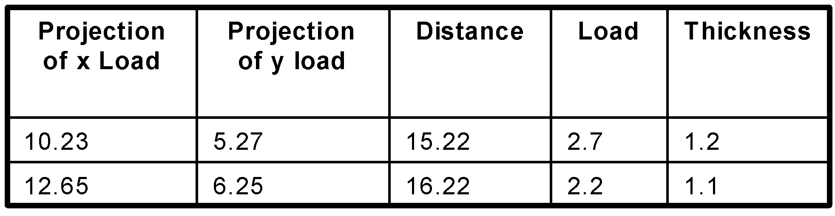
Data Matrix
If data objects have the same fixed set of numeric attributes, then the data objects can be thought of as points in a multi-dimensional space, where each dimension represents a distinct attribute
Such data set can be represented by an m by n matrix, where there are m rows, one for each object, and n columns, one for each attribute

Slide 13
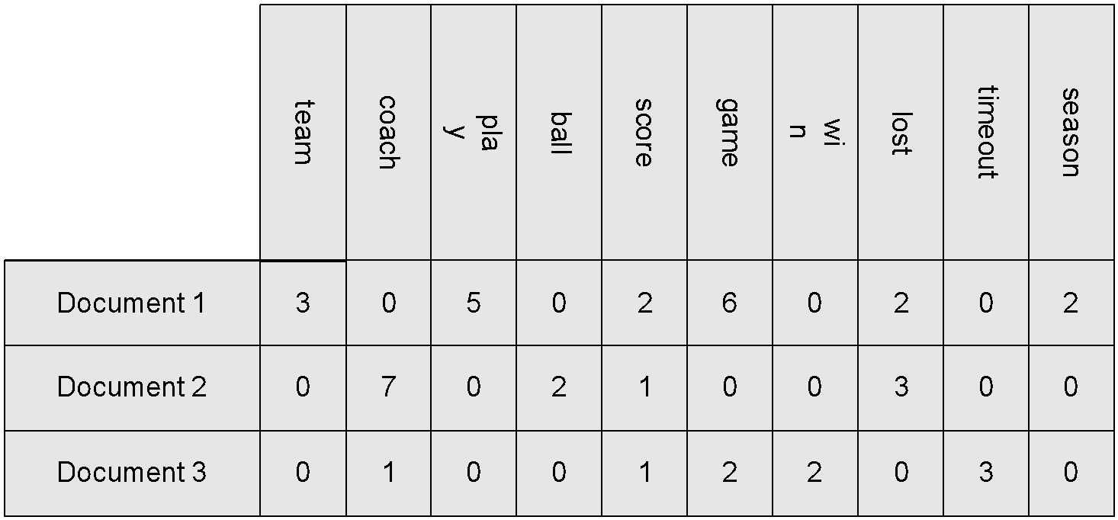
Document Data
Each document becomes a `term' vector,
  each term is a component (attribute) of the vector,
  the value of each component is the number of times the corresponding term occurs in the document.

Slide 14
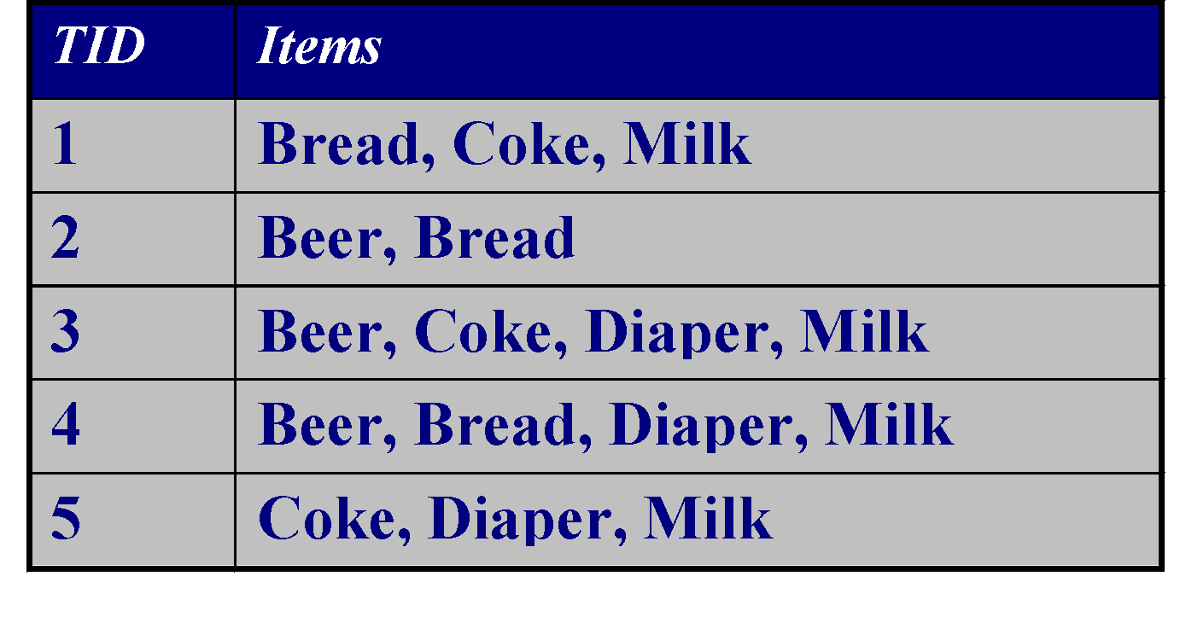
Transaction Data
A special type of record data, where
  each record (transaction) involves a set of items.
  For example, consider a grocery store. The set of products purchased by a customer during one shopping trip constitute a transaction, while the individual products that were purchased are the items.

Slide 15
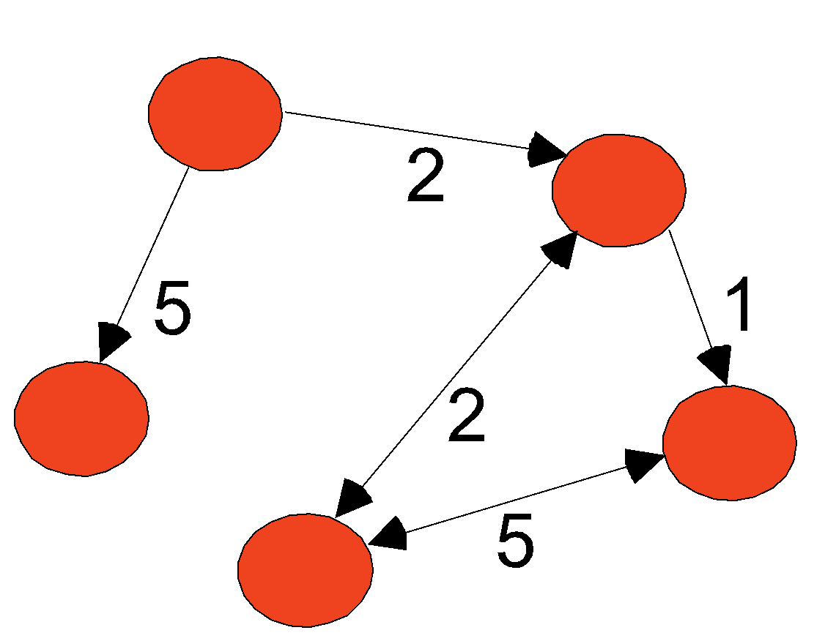
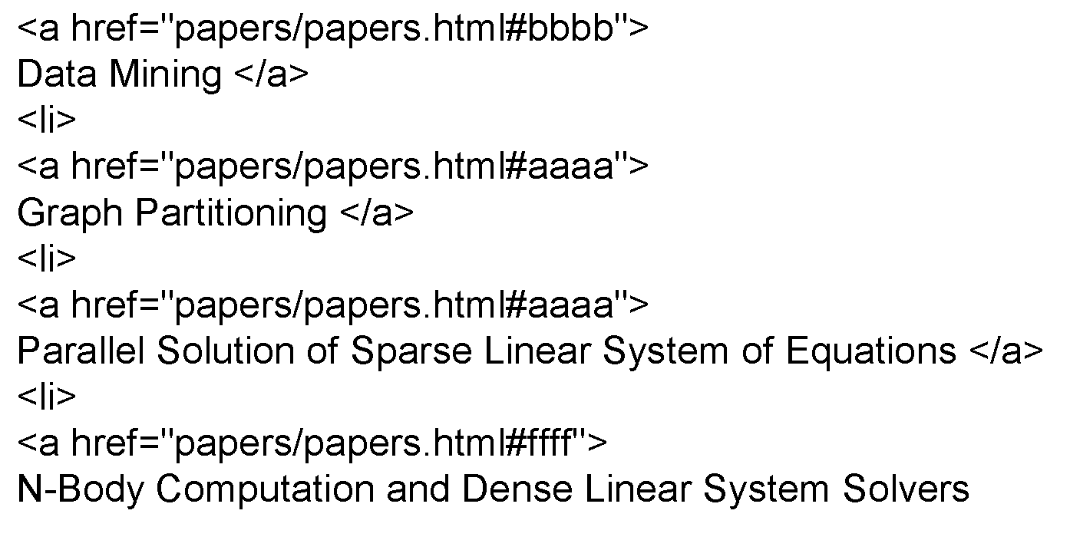
Graph Data
Examples: Generic graph and HTML Links

Slide 16
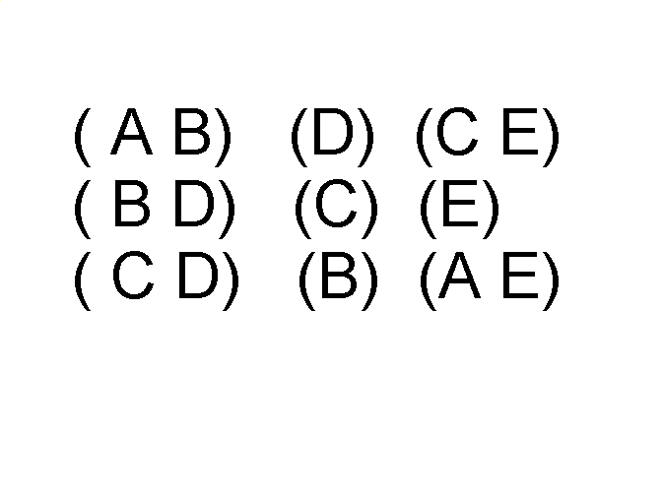
Ordered Data
Sequences of transactions
Items/Events
An element of the sequence

Slide 17
Data Quality
What kinds of data quality problems?
How can we detect problems with the data?
What can we do about these problems?
Examples of data quality problems:
  Noise and outliers
  missing values
  duplicate data

Slide 18
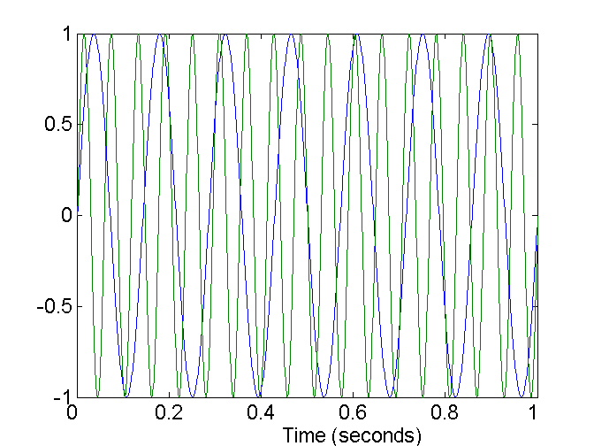
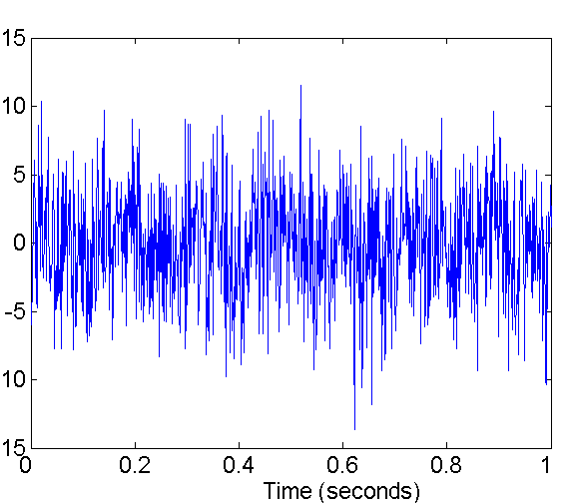
Noise
Noise refers to modification of original values
  Examples: distortion of a person’s voice when talking on a poor phone and “snow” on television screen
Two Sine Waves
Two Sine Waves + Noise

Slide 19
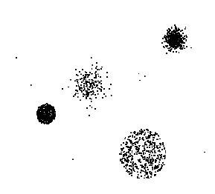
Outliers
Outliers are data objects with characteristics that are considerably different than most of the other data objects in the data set

Slide 20
Missing Values
Reasons for missing values
  Information is not collected
  (e.g., people decline to give their age and weight)
  Attributes may not be applicable to all cases
  (e.g., annual income is not applicable to children)
Handling missing values
  Eliminate Data Objects
  Estimate Missing Values
  Ignore the Missing Value During Analysis
  Replace with all possible values (weighted by their probabilities)

Slide 21
Duplicate Data
Data set may include data objects that are duplicates, or almost duplicates of one another
  Major issue when merging data from heterogeous sources
Examples:
  Same person with multiple email addresses
Data cleaning
  Process of dealing with duplicate data issues

