Slide 1
Chapter 16
Chapter 16 Advanced Management Topics
Advanced Management Topics
Network Management: Principles and Practice
© Mani Subramanian and N. Usha Rani 2010
*
Notes:
*
Chapter16

Slide 2
Objectives
Chapter 16 Advanced Management Topics
Next generation NM requirements
  ITU-T
  IETF
Status of current NM technology
  ISO Model: FCAPS
  Product requirements
Limitations of SNMP management
Early Web-based development
  Web interface and Web management
  WBEM
  WIMA
CORBA-based NM technology
XML-based NM technology
Comparison of NM technologies
Recent NM-related standards
Network Management: Principles and Practice
© Mani Subramanian and N. Usha Rani 2010
*

Slide 3
Need for New Management Technologies
Chapter 16 Advanced Management Topics
Since late ’80s
  Networks have evolved
  Management needs have changed
  Management technologies have evolved
Mismatch in speed of evolution of networks and management requirements vis a vis management technology
  Notes
Network Management: Principles and Practice
© Mani Subramanian and N. Usha Rani 2010
*

Slide 4
Evolution of Networks
Chapter 16 Advanced Management Topics
In the mid-late ’80s
  Devices simple, resources constrained
  Capabilities were limited
Today
  Increased functional complexity
  Increased complexity in configuration
  Increased intelligence and programmability
  of devices
  Networks that provide a wide range of
  services
  NGNs: Packet-based networks for all
  services
  Providing unfettered access for users to
  networks and to competing service
  providers for services of their choice
  Notes
Network Management: Principles and Practice
© Mani Subramanian and N. Usha Rani 2010
*

Slide 5
NGN Requirements
Chapter 16 Advanced Management Topics
Original Requirement | New Requirements
End-to-end transparency | Packet inspection, NAT
Peer-to-peer | NATs/firewalls/servers
Connectionless | MPLS
Best effort | Real-time demands, bandwidth demands
User back-off | QoS guarantees
Network empowerment | User empowerment
No flow state | Flow state
Trust | Hackers everywhere
Static addresses | DHCP, mobility
Fairness | QoS
Terminal-to-host | Mass public residential services, multiterminal, multi QoS
Flat network | Access and core domains
Simple protocol layering | Protocol maze
Research/Defence use | Commercialization, competition, consumer choice
NGN…Next Generation Networks
Network Management: Principles and Practice
© Mani Subramanian and N. Usha Rani 2010
*

Slide 6
Changes in Operator Needs
Chapter 16 Advanced Management Topics
Management of large backbone networks
requires powerful configuration management
Move from device management approach to
system management
Service-centric view of network
  VoIP (residential and business), multimedia
  streaming, IP TV, fast data connectivity,
  triple play
Increased speed of service delivery
  Automation of business processes
  Notes
Network Management: Principles and Practice
© Mani Subramanian and N. Usha Rani 2010
*

Slide 7
Configuration Management Needs
Chapter 16 Advanced Management Topics
Need for concurrent configuration changes to
several network devices
Download bulk configuration changes on many
devices
Schedule configuration operations on devices
at particular times
Roll back support
Coordinated activation of downloaded
configurations
  Notes
Network Management: Principles and Practice
© Mani Subramanian and N. Usha Rani 2010
*

Slide 8
Consequences for Management
Chapter 16 Advanced Management Topics
Rethinking management principles –
Integration of independent developments
Management support for delivering quality service
Changes resulting from “user” focus as opposed
to “network” focus
Importance of developing standardized
management software for easy maintenance
and extensibility
  Notes
Network Management: Principles and Practice
© Mani Subramanian and N. Usha Rani 2010
*

Slide 9
Traditional Approaches - Datacomm
Chapter 16 Advanced Management Topics
SNMP based
Aim was to have simple small footprint protocol
Kept self contained and independent of other
network services
Catered to fault, performance monitoring, and
simple configuration management
Soon after release, shortcomings were exposed
SNMPv2: Get-Bulk, Inform, SMIv2
SNMPv3: security
  Notes
Network Management: Principles and Practice
© Mani Subramanian and N. Usha Rani 2010
*

Slide 10
Drawbacks of SNMP
Chapter 16 Advanced Management Topics
Inadequate information modeling – simple data
structures and protocol operations
Object based rather than object oriented
No inheritance – so no information re-use
Inadequate primitive for bulk information retrieval
UDP transport restricts size of data sent
Limited configuration management support
Low level semantics
  Notes
Network Management: Principles and Practice
© Mani Subramanian and N. Usha Rani 2010
*

Slide 11
OSI NM
Chapter 16 Advanced Management Topics
Designed as successor to SNMPOSI-NM
Comprehensive management technology
addressing datacom and telecom arena
CMIP/CMISE support many primitives
Information access is powerful
Supports bulk and selective retrieval
Connection-oriented transport included
Found to be complex and technologically too
advanced for deployment in late ‘80s
  Notes
Network Management: Principles and Practice
© Mani Subramanian and N. Usha Rani 2010
*

Slide 12
Overcoming SNMP Shortcomings
Chapter 16 Advanced Management Topics
Evolutionary efforts were made to address
shortcomings
  Improving SMI
  Improving SNMP protocol
  Enhancing configuration management
  Notes
Network Management: Principles and Practice
© Mani Subramanian and N. Usha Rani 2010
*

Slide 13
Improving SMI
Chapter 16 Advanced Management Topics
Internet Research Task Force (IRTF) and
Network Management Research Group (NMRG)
developed SMIng
  Allows arbitrarily nested data structures
  Facilitates re-usability of complex data structures
  Extensible mechanisms
IETF was to develop a standards track for above in
2000
  Phase 1: requirements drawn up
  Phase 2: two strong proposals emerged
Efforts to merge these failed, in 2003 group was
wound up
  Notes
Network Management: Principles and Practice
© Mani Subramanian and N. Usha Rani 2010
*

Slide 14
SNMP Protocol Improvement
Chapter 16 Advanced Management Topics
Attempt to improve protocol shortcomings
Efforts to reduce overhead due to OID
redundancy
  Compression
  Suppression of redundant OID fragments
  Effect bulk transfer at MIB level instead of
  OID
Use of TCP as transport protocol
Did not meet with success because of industry
reluctance to accept new technology
  Notes
Network Management: Principles and Practice
© Mani Subramanian and N. Usha Rani 2010
*

Slide 15
Configuration Management
Chapter 16 Advanced Management Topics
COPS PR Common Open Policy Service–
Policy Provisioning) for improving Configuration
Management capability
Resource Allocation Protocol (RAP)–WG for
policy-based configuration and provisioning
Specification language: Structure of Policy
Provisioning Information (SPPI)
TCP is transport protocol
Intends to make configuration changes based
on PBMS
Did not meet with market acceptance
  Notes
Network Management: Principles and Practice
© Mani Subramanian and N. Usha Rani 2010
*

Slide 16
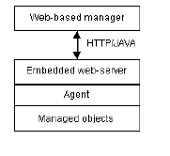
Web-based Management
Chapter 16 Advanced Management Topics
  Notes
Early approaches:
  Embedded Web server in device
  Browser can connect to the URL of the
  device and html pages with management
  information
  Provides graphical displays of
  management information
  Improved configuration facility, detailed
  device management
Drawbacks
  More an EMS-like approach – no end-to-
  end view
  High level management functions such as
  map-based view, root cause analysis, trend
  analysis not supported
Network Management: Principles and Practice
© Mani Subramanian and N. Usha Rani 2010
*

Slide 17
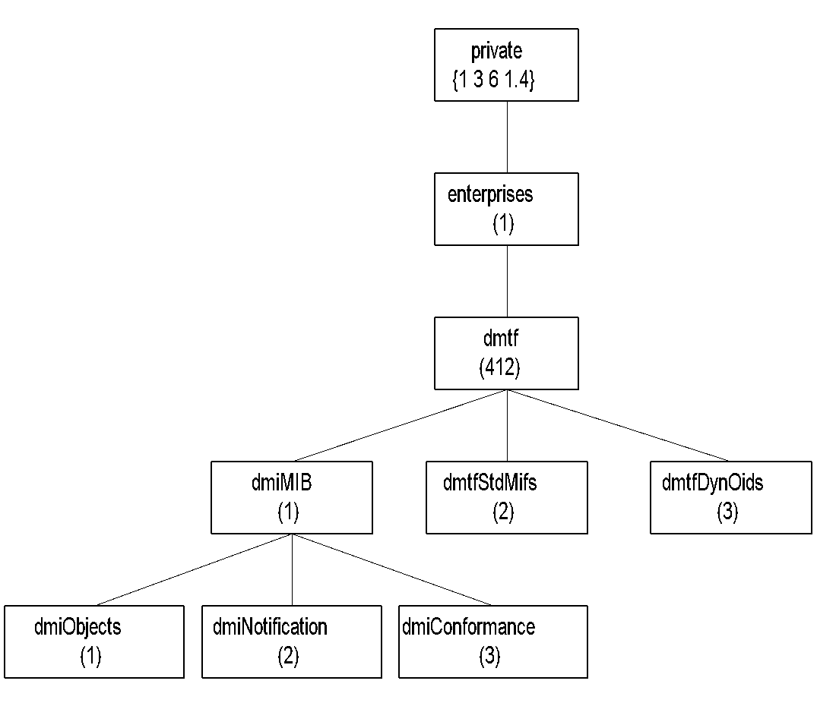
DMI MIB
Chapter 16 Advanced Management Topics
Figure 16.2 Desktop Interface MIB
  Notes
Desktop Interface Management (DMI ) standard
specified by Desktop Interface Management
(DMTF)
DMTF task expanded to specify Web-based
enterprise management (WBEM)
MIF specified using ASN.1 syntax
Can be managed by an SNMP manager
Network Management: Principles and Practice
© Mani Subramanian and N. Usha Rani 2010
*

Slide 18
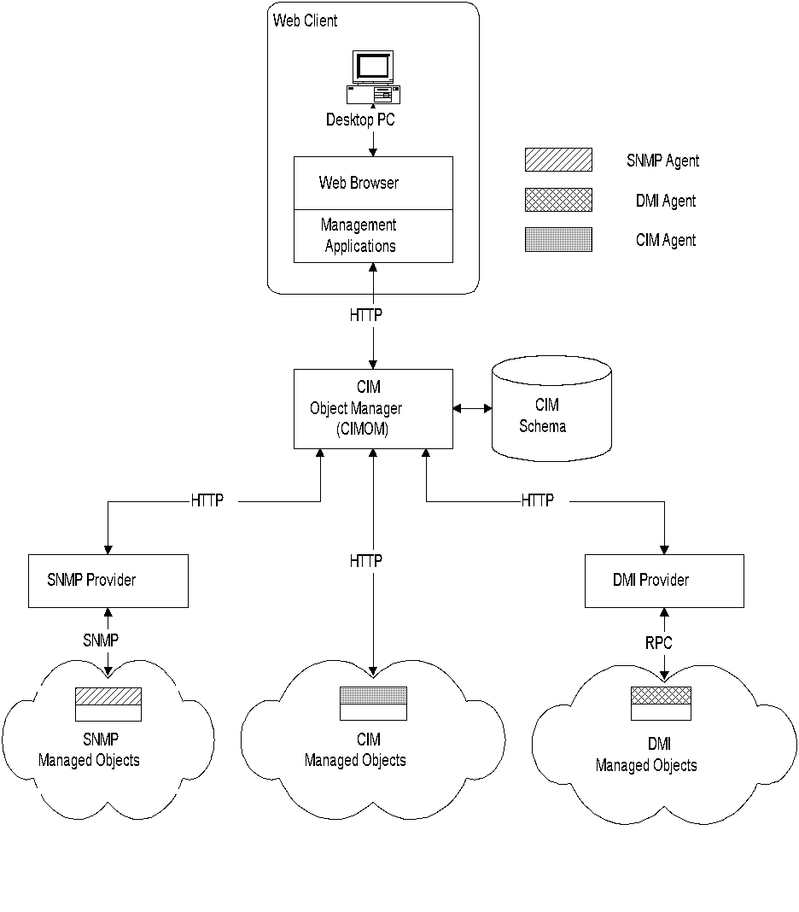
WBEM Architecture
Chapter 16 Advanced Management Topics
Figure 16.3 WBEM Architecture
  Notes
WBEM based on Common Information Module,
developed by Microsoft
CIM is information-modeling framework intended to
accommodate all protocols and frameworks
Object oriented
Five components:
  Web client
  CIM object manager (CIMOM)
  CIM schema
  Management protocol
  Managed objects with specific protocol
Network Management: Principles and Practice
© Mani Subramanian and N. Usha Rani 2010
*

Slide 19
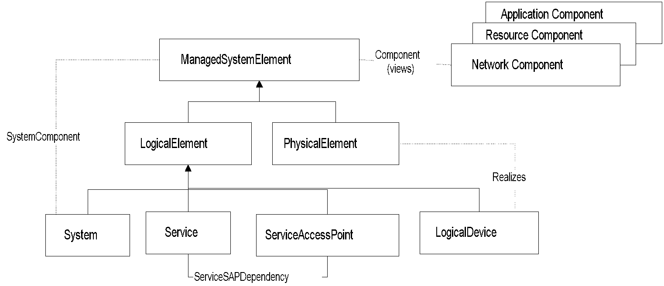
Simplified WBEM CIM
Core Model
Chapter 16 Advanced Management Topics
Figure 16.4 Simplified WBEM CIM Core Model
  Notes
Managed system element is a group of
components
System an aggregate of Managed System
Elements
Subclasses of system element are:
  PhysicalElement (e.g., interface card) and
  LogicalElement (IP address)
Service access point is management,
measurement, and configuration of a service
Network Management: Principles and Practice
© Mani Subramanian and N. Usha Rani 2010
*

Slide 20
WIMA
Chapter 16 Advanced Management Topics
Web-based interface management architecture
A push-based management for repetitive tasks
Pull-based for occasional on-demand tasks
Reduces management bandwidth
Uses SNMP MIB and organization model
Compression adds further benefit
Some functions moved from manager to agent
  Notes
Network Management: Principles and Practice
© Mani Subramanian and N. Usha Rani 2010
*

Slide 21
WIMA Communication Model
Chapter 16 Advanced Management Topics
Communication model
  HTTP based instead of SNMP based
  Transport protocol is TCP instead of UDP
  Compression to save bandwidth
  Unlimited number of MIB variables per push
  cycle
  BER encoding of data replaced by MIME
  (Multipurpose Internet Mail Extensions)
  parts + {strings, serialized Java objects,
  XML, etc.}
  Natural table retrievals
  Notes
Network Management: Principles and Practice
© Mani Subramanian and N. Usha Rani 2010
*

Slide 22
MIME-based Push
Chapter 16 Advanced Management Topics
HTTP offers no native support for bidirectional
persistent connections
Before HTTP sends a Response, it must have
received a Request – no unsolicited messages
Solution
  Initiate the data transfer from the HTTP
  client, and send an infinitely long response
  from the HTTP server, with separators
  embedded in the payload of the response
  Use the multipart type of MIME
  (Multipurpose Internet Mail Extensions)
  Notes
Network Management: Principles and Practice
© Mani Subramanian and N. Usha Rani 2010
*

Slide 23
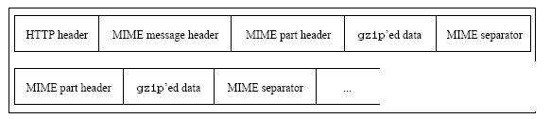
MIME-based Push (cont.)
Chapter 16 Advanced Management Topics
At every push cycle, the agent sends a new
MIME part including a number of {OID, value}
pairs
MIME separator delimits two consecutive
push cycles
Encode only one notification per MIME part
MIME parts transferring MIB data are
compressed with gzip
  Notes
Network Management: Principles and Practice
© Mani Subramanian and N. Usha Rani 2010
*

Slide 24
CORBA-based Network Management
Chapter 16 Advanced Management Topics
Client-server model
Fully object-oriented approach
Targets programmatic interface between manager
and agent
Distributed application with objects interacting
via services exposed by their interfaces
Meant for interworking of networked applications
developed on different platforms
  Notes
Network Management: Principles and Practice
© Mani Subramanian and N. Usha Rani 2010
*

Slide 25
CORBA-based Management
Chapter 16 Advanced Management Topics
CORBA (OMG’s proposal) is the real-world
approach
Object Request Broker (ORB) provides
underlying platform
ORB provides access, location, failure, resource
transparency
Specifies an RPC over TCP/IP – Internet
Inter-ORB Protocol (IIOP)
Interoperable References (IOR) of interfaces
through naming or trading service
Interface Definition Language (IDL) for
specifying interfaces
CORBA inherently supports some basic NM
needs
  Efficient data retrieval – bulk and selective
  Notifications with filtering
  Transaction support
  Notes
Network Management: Principles and Practice
© Mani Subramanian and N. Usha Rani 2010
*

Slide 26
CORBA-based Management (cont.)
Chapter 16 Advanced Management Topics
Information model – fully object oriented with
inheritance
  Interfaces to objects defined via Interface
  Definition Language (IDL)
Interfaces can be specialized through
inheritance
  Multiple inheritance, polymorphism
  supported
Internet Inter-ORB Protocol (IIOP)
provides reliable transport over TCP/IP
Grouping and retrieval of attributes
  Lists
  Iterator interface
  Notes
Network Management: Principles and Practice
© Mani Subramanian and N. Usha Rani 2010
*

Slide 27
Early Work
Chapter 16 Advanced Management Topics
TMF and OMG set up Joint Inter Domain
Management (JIDM) WG
  Aim was to provide static mapping of
  GDMO attributes to IDLs
  This approach has drawbacks
  One remote call per attribute is costly
  Scalability issue because of large number of
  connections
Solution to this
  Rather than syntactic translation from
  GDMO to IDLs, follow semantic approach
  Group commonly accessed attributes of
  object
  Notes
Network Management: Principles and Practice
© Mani Subramanian and N. Usha Rani 2010
*

Slide 28
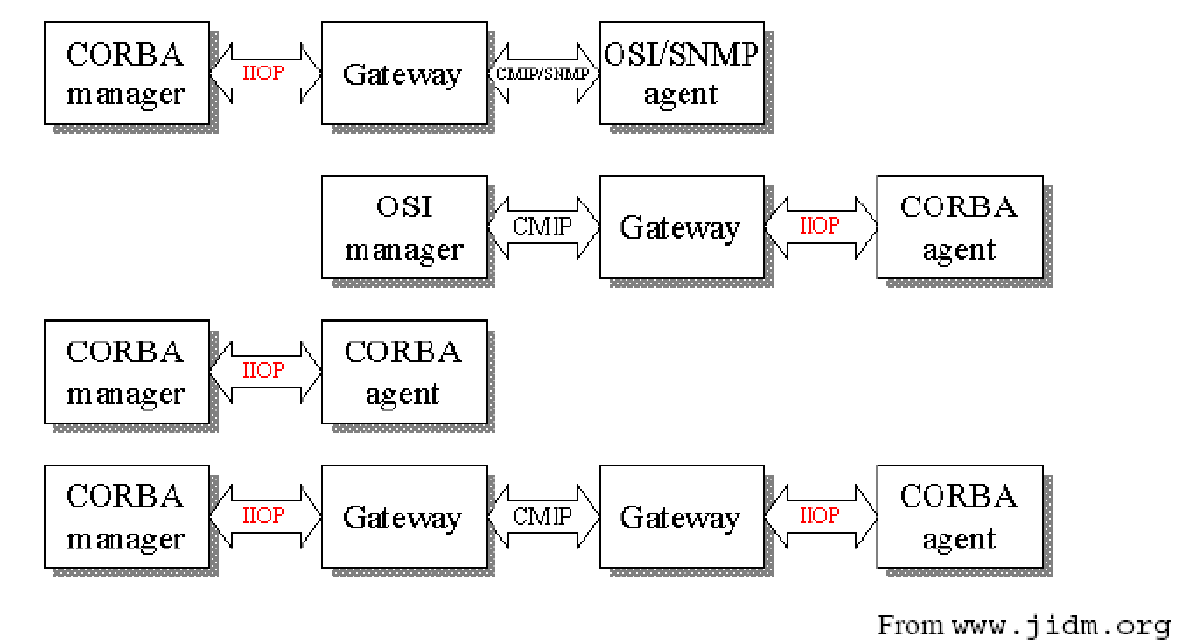
JIDM Scenarios
Chapter 16 Advanced Management Topics
  Notes
Network Management: Principles and Practice
© Mani Subramanian and N. Usha Rani 2010
*

Slide 29
Access and Distribution
Chapter 16 Advanced Management Topics
Access => access and communication between
MOs and management applications
  Both request response and notifications
  supported by CORBA
  A request looks like an API call, response is
  the return value
  IIOP over TCP/IP
CORBA objects are specified and accessed
separately
  Contrast to MO cluster administered by an
  agent in traditional manager/agent paradigm
  Notes
Network Management: Principles and Practice
© Mani Subramanian and N. Usha Rani 2010
*

Slide 30
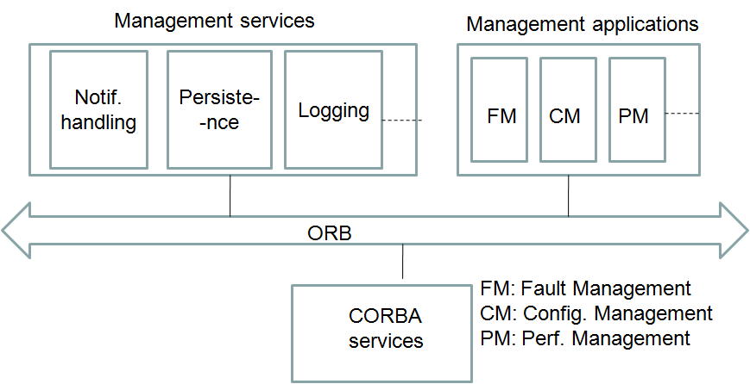
Architecture of
CORBA-based NMS
Chapter 16 Advanced Management Topics
Figure 16.7 CORBA-Based Manager Architecture
  Notes
Network Management: Principles and Practice
© Mani Subramanian and N. Usha Rani 2010
*

Slide 31
Scalability, Flexibility, Security
Chapter 16 Advanced Management Topics
Event-driven management supported
  Lower bandwidth utilization by management
  traffic
Lends itself naturally to hierarchical
management
Broad level of security services
APIs specified for authentication, protection
against replay, message confidentiality, access
control, auditing, authorization
  Notes
Network Management: Principles and Practice
© Mani Subramanian and N. Usha Rani 2010
*

Slide 32
CORBA Issues
Chapter 16 Advanced Management Topics
No support for bulk or selective transfer
  One remote invocation per attribute
Scalability
  Large number of dynamic objects may
  cause memory issues
Commonly accessed attributes grouped together
Dynamic entities such as connections are not
modeled as separate objects
Same problems exist with Web services…. And
more!!
  Notes
Network Management: Principles and Practice
© Mani Subramanian and N. Usha Rani 2010
*

Slide 33
MTNM
Chapter 16 Advanced Management Topics
Multi-Technology Network Management
Defines the information exchange between
NMS and EMS
Enables management of datacom and telecom
TeleManagement Forum (TMF) initiative: set of
documents specify the standard
Business agreement for the exchange of
management information: TMF 513
MTNM Information Model: TMF 608
Interface Model: TMF 814
  Uses CORBA as transport
  Set of CORBA IDLs published
  Uses Naming and Notification Service of
  CORBA
  Notes
Network Management: Principles and Practice
© Mani Subramanian and N. Usha Rani 2010
*

Slide 34
TMF 814 Basics
Chapter 16 Advanced Management Topics
The standard recommends that a number of
key objects in the network be exposed via this
interface.
Objects are modeled based on the layered
concepts and layer decomposition laid out in
ITU G.805.
An object model that is based on these
concepts is assumed to be used by the EMS.
A number of object managers that have
services to obtain data about the objects in the
network are defined.
  Notes
Network Management: Principles and Practice
© Mani Subramanian and N. Usha Rani 2010
*

Slide 35
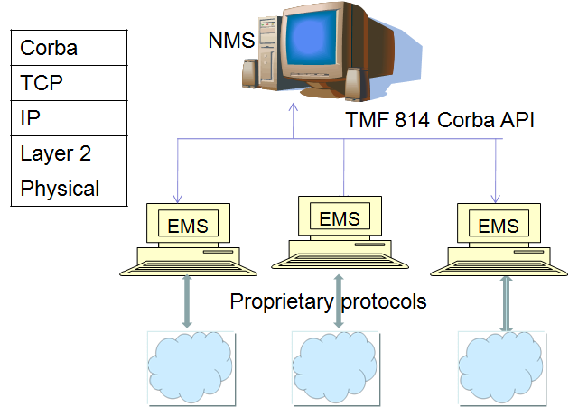
TMF 814-based Management
Chapter 16 Advanced Management Topics
Figure 16.9 TMF 814-Based NMS and EMSs
  Notes
Network Management: Principles and Practice
© Mani Subramanian and N. Usha Rani 2010
*

Slide 36
XML-based Management
Chapter 16 Advanced Management Topics
Distributed system approach
Complete, precise specifications of protocols imperative to a distributed system
Such standards exist
  Databases are queried using SQL
  Clients use ODBC/JDBC compliant APIs
  Remote object access is via standard RPC mechanisms or CORBA
However, these standards were developed independently of each other
  Do not build on each other or use common basic concepts
XML differs in this respect
  Notes
Network Management: Principles and Practice
© Mani Subramanian and N. Usha Rani 2010
*

Slide 37
Use of XML in Management
Chapter 16 Advanced Management Topics
The Desktop Management Task Force (DMTF) Web Based Enterprise Management (WBEM) have already used XML in Service and Application management.
A newer concept is the use of XML/Web Services for network management.
  Notes
Network Management: Principles and Practice
© Mani Subramanian and N. Usha Rani 2010
*

Slide 38
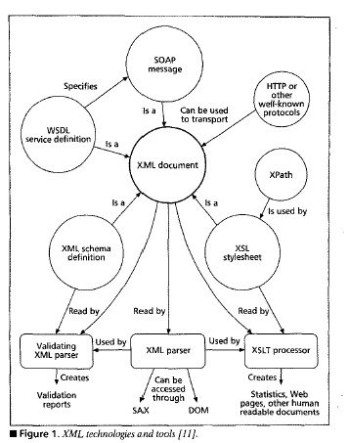
XML as Core Building Block
Chapter 16 Advanced Management Topics
  Notes
Figure 16.10 Interrelation between XML and Associated Technologies
  Notes
XML is core building block upon which related technologies are being developed
Network Management: Principles and Practice
© Mani Subramanian and N. Usha Rani 2010
*

Slide 39
Advantages of Use of XML
Chapter 16 Advanced Management Topics
Ease of use
Highly structured – arbitrary hierarchies can be
represented
Reduced cost of development and
maintenance
Powerful management transactions
Unifying system and service management
Extensible mechanism
  Notes
Network Management: Principles and Practice
© Mani Subramanian and N. Usha Rani 2010
*

Slide 40
XML in Network Management
Chapter 16 Advanced Management Topics
XML documents provide a structured way to
represent management data
Widely deployed protocols such as TCP and
HTTP can be used to ship data
There are standard APIs (DOM and SAX) to
access the data
Items within documents can be accessed
using Xpath expressions
XSLT can be used to process data
Data can be structured as XML schemas
  Notes
Network Management: Principles and Practice
© Mani Subramanian and N. Usha Rani 2010
*

Slide 41
XML-based Management
Chapter 16 Advanced Management Topics
Information model
  XML document, XML schemas, DTD
Communication model
  XML/HTTP/TCP
  Xpath to identify management information
  Notifications using HTTP post from agent
  Notes
Network Management: Principles and Practice
© Mani Subramanian and N. Usha Rani 2010
*

Slide 42
XML-based Device Management
Chapter 16 Advanced Management Topics
Use SNMP manager and SNMP agent, XML
only at the UI
XML-based manager (XBM) and SNMP-based
agent
SNMP-based manager and XML agent
XML-based manager and XML-based agent
  Notes
Network Management: Principles and Practice
© Mani Subramanian and N. Usha Rani 2010
*

Slide 43
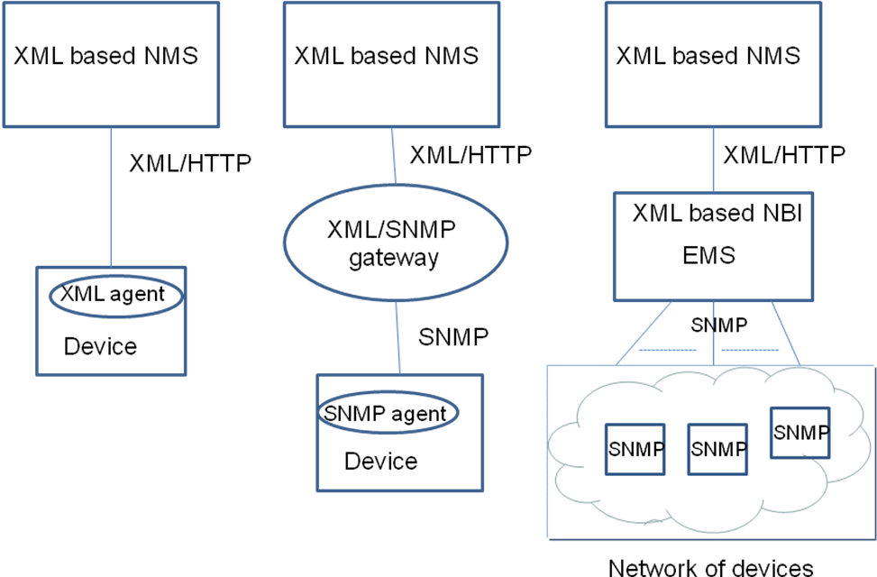
XML for IP Device Management
Chapter 16 Advanced Management Topics
Figure 16.12 Three Specific XML-Based Architectures
  Notes
Network Management: Principles and Practice
© Mani Subramanian and N. Usha Rani 2010
*

Slide 44
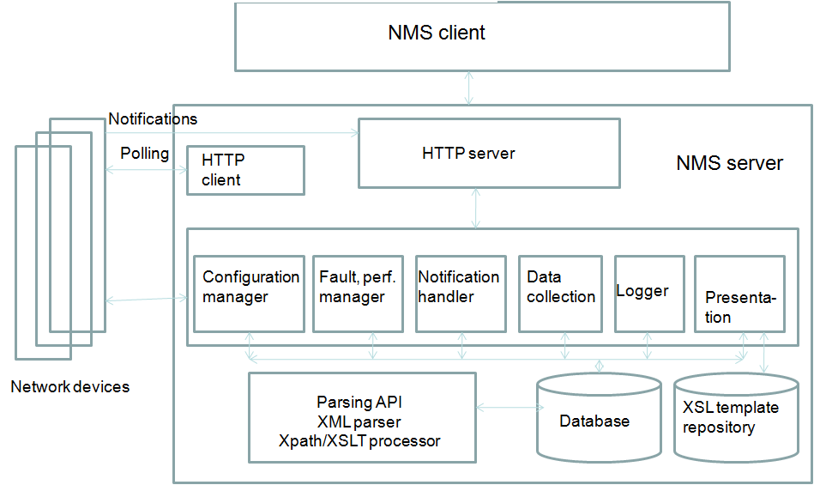
XML-based Manager
Chapter 16 Advanced Management Topics
Figure 16.13 Generalized XML-Based NM Architecture
  Notes
Network Management: Principles and Practice
© Mani Subramanian and N. Usha Rani 2010
*

Slide 45
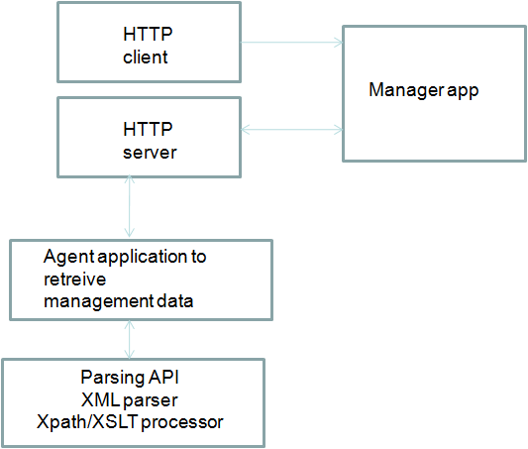
XML-based Agent
Chapter 16 Advanced Management Topics
  Notes
Figure 16.15 XML-Based Agent Architecture
  Notes
Network Management: Principles and Practice
© Mani Subramanian and N. Usha Rani 2010
*

Slide 46
Summing up Web-based Management
Chapter 16 Advanced Management Topics
Reduced cost of development and
maintenance of management solutions
More expressive and powerful transactions
Extensible approach
Better security and transaction support
Performance is an issue, bandwidth is an issue
  Notes
Network Management: Principles and Practice
© Mani Subramanian and N. Usha Rani 2010
*

Slide 47
Web Services
Chapter 16 Advanced Management Topics
XML-based framework for building distributed
applications
Basic Web services platform is XML + HTTP
Being considered for management
  More from perspective of a Service
  Oriented Architecture for integrating
  applications than from device management
  perspective
  Notes
Network Management: Principles and Practice
© Mani Subramanian and N. Usha Rani 2010
*

Slide 48
Comparison of Management Protocols
Chapter 16 Advanced Management Topics
Feature | OSI | SNMP | Corba | XML
Information model | ASN.1/GDMO fully object -oriented, powerful, comprehensive but very complicated. | SMI/MIBs are basic, simple, but not object oriented, less powerful. | CORBA IDLs specify a fully object-oriented model, less powerful than ASN1/GDMO | XML or WSDL documents - powerful, very expressive, flexible.
Organization model | Manager-agent paradigm using CMISE as the protocol | Manager-agent paradigm using SNMP as the protocol | Client-server model with programmatic interface between server and client | Message -based architecture with XML SOAP-based messages between server and client
Communication model | CMISE over OSI protocol stack | SNMP over UDP | CORBA RPC over TCP, IIOP | Usually HTTP over TCP
Service location | N/A | N/A | Inter-ORB-reference (IOR) | Universal Resource Identifier (URI)
Naming, directory | N/A | N/A | Naming service, interface repository | UDDI
Management operations | Comprehen-sive, powerful, support for notifications with filtering and scoping. | Basic, very few operations, notifications (traps) supported. | Powerful, notifications with filtering, somewhat less comprehensive than OSI. | Support exists
Network Management: Principles and Practice
© Mani Subramanian and N. Usha Rani 2010
*

Slide 49
Comparison of Management Protocols (cont.)
Chapter 16 Advanced Management Topics
Feature | OSI | SNMP | Corba | XML
Support for configuration management | Average | Not satisfactory | Good | Very powerful support
Scalability, flexibility | Scalable | Scalable. Useful for retrieval of small quantities of data from large number of elements rather than bulk data from fewer numbers. | Can pose scalability issues at the element management level | Can pose scalability issues at the element management level
Maturity | Mature and time tested | Mature and time tested | Mature. Has been in use since mid-1990s | Relatively new vendors support since around 2000.
Performance | Satisfac-tory and very efficient for fine grained operations. | Performs well especially for retrieval of atomic data. Very efficient for fine grained operations. | Satisfactory. Not very efficient for fine grained operations. More efficient when multiple objects retrieved with a single method call. | Poses problems for bandwidth usage, response times and CPU usage at the NE
Security | SNMP v3 |  | CORBA security service | HTTP/SSL, XML signature
Network Management: Principles and Practice
© Mani Subramanian and N. Usha Rani 2010
*

Slide 50
Recent Trends
Chapter 16 Advanced Management Topics
For efficient service delivery, end-to-end
automation of certain processes essential.
  eTOM map specifies these
Software architecture of individual applications
must cater to seamless integration.
Service Oriented Architecture holds the
promise of meeting this requirement.
MTOSI and OASIS are two standards getting
established in this regard.
  Notes
Network Management: Principles and Practice
© Mani Subramanian and N. Usha Rani 2010
*

Slide 51
MTOSI
Chapter 16 Advanced Management Topics
Multi Technology Operations Systems
Interface
Standard that provides an integration
framework for different applications in Service
Provider’s Operations Centre
Processes referred to as Operations Systems
or OS
  Management functional areas of an NMS
  (FCAPS)
  Root Cause Analysis, Service Impact
  Analysis, SLA monitoring, etc.
The objective of MTOSI is to extend MTNM
using XML/Web services interface
Results in integration of the different OS
components using SOA and NGOSS design
principles
Initial focus of MTOSI was to develop an OS-
to-OS interface that covers the NMS/EMS
interface as a special case
  Notes
Network Management: Principles and Practice
© Mani Subramanian and N. Usha Rani 2010
*

Slide 52
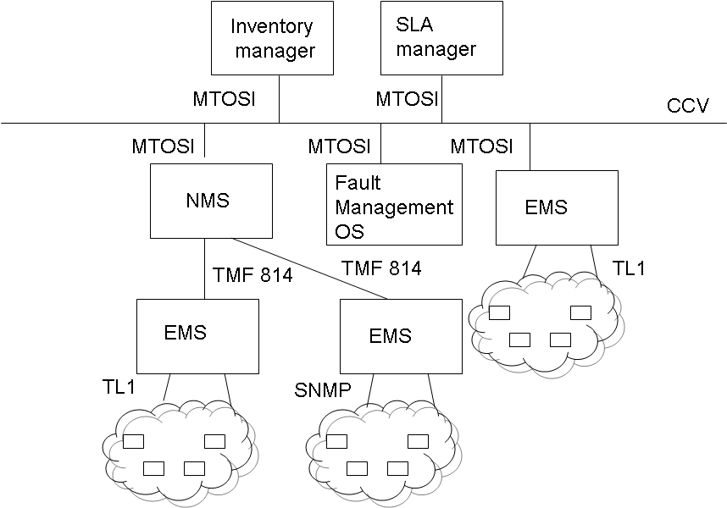
MTOSI-based Architecture
Chapter 16 Advanced Management Topics
  Notes
Figure 16.17 MTOSI Architecture
Network Management: Principles and Practice
© Mani Subramanian and N. Usha Rani 2010
*

Slide 53
OASIS
Chapter 16 Advanced Management Topics
“Organization for the Advancement of
Structured Information Standards (OASIS) is a
not-for-profit consortium that drives the
development, convergence, and adoption of
open standards for the global information
society.”
  Notes
Network Management: Principles and Practice
© Mani Subramanian and N. Usha Rani 2010
*

Slide 54
OASIS Standards
Chapter 16 Advanced Management Topics
Web Services Distributed Management
(WSDM) [WSD] committee defined the
architecture and technology to manage
distributed resources using Web services
Standard particularly applicable to systems
management
The two applicable standards are Management
Using Web Services (MUWS) and
Management Of Web Services (MOWS).
  Notes
Network Management: Principles and Practice
© Mani Subramanian and N. Usha Rani 2010
*

Slide 55
MUWS
Chapter 16 Advanced Management Topics
Addresses the use of Web services as the
foundation of a systems management
framework
Includes the use of Web services for
interaction between the managed resources
and management applications
Wire-level specification of how to describe the
manageability of a resource using WSDL
documents
Capability for discovery of manageable
resources and their manageability capabilities.
  Notes
Network Management: Principles and Practice
© Mani Subramanian and N. Usha Rani 2010
*

Slide 56
MOWS
Chapter 16 Advanced Management Topics
Includes management-specific attributes to
expose properties such as lifecycle state and
performance of Web services.
Management operations to monitor/control a
Web service itself are specified.
  Notes
Network Management: Principles and Practice
© Mani Subramanian and N. Usha Rani 2010
*

Slide 57
Summary
Chapter 16 Advanced Management Topics
Service Provider’s NOC has several loosely
coupled applications interacting with managed
resources and with each other.
Network facing interface is low-level, efficient,
and fast.
Application communication via event-driven
bus architecture required rather than a request-
response model.
Web services-based management approach
appropriate
  MTOSI, in the telecom IT environment ,
  and WSDM for systems management
  meet the needs.
  Notes
Network Management: Principles and Practice
© Mani Subramanian and N. Usha Rani 2010
*

