Slide 1
Chapter 15
Broadband Home Networks
Chapter 15 Broadband Home Networks
Network Management: Principles and Practice
© Mani Subramanian 2010
*
Notes:
Chapter 14

Slide 2
Objectives
Chapter 15 Broadband Home Networks
  Broadband home networks overview
  Applications and application protocols
  Middleware between applications and transports
  Transport technologies
  Wired home networks
    Comprehensive view
    Lower layer protocols
    Ethernet-like protocols and management
    Power Ethernet
  Wireless home network
    WiFi (802.11a/b/g) wireless LAN
    802.11 standards and amendments
    Hierarchical network using access point
    Basic service set (BSS)
    MAC protocols: DCF, PCF, and hybrid
  Special network management considerations
    Security management
    QoS management
    Centralized management
    WLAN MIBs
Network Management: Principles and Practice
© Mani Subramanian 2010
*

Slide 3
Home Networking Technologies
Chapter 15 Broadband Home Networks
Middleware and higher layer protocol networks
  HAVi (Home Audio-Video interoperability)
  Jini (Java-based middleware/network)
  UPnP (Universal Plug and Play)
  OSGi (Open Service Gateway initiative)
Lower Layer wired protocol based networks
  IEEE 802.3 Ethernet
  VHN (Versatile Home Network)
  IEEE 1394 (FireWire)
  Cable
  HomePNA (Home Phoneline Network Alliance)
  HomePlug (Power Line Communication, PLC)
Wireless LANs (Local Area Networks)
  IEEE 802.11 WLAN
  HomeRF
Wireless PANs (Personal Area Networks)
  IEEE 802.15.1 Bluetooth
  IEEE 802.15.3a UWB (Ultra Wideband)
  IEEE 802.15.4 Low data rate PAN
Network Management: Principles and Practice
© Mani Subramanian 2010
*

Slide 4
Networking Protocols
Chapter 15 Broadband Home Networks
Two Groups
  Physical interconnects
    X-10
    CEBus (Consumer Electronics Bus)
    IrDA (Infrared Data Association)
    HomePlug
    HomePNA
    WiFi 802.11
    Bluetooth
    Ethernet
    IEEE 1394
    USB (Universal Serial Bus)
  Service or application middleware
    HAVi (Home Audio/Video interoperability)
    UPnP (Universal Plug and Play)
    Jini
    OSGi (Open Services Gateway initiative)
  Notes
Network Management: Principles and Practice
© Mani Subramanian 2010
*

Slide 5
Application Layer Protocols
Chapter 15 Broadband Home Networks
Network Management: Principles and Practice
© Mani Subramanian 2010
*

Slide 6
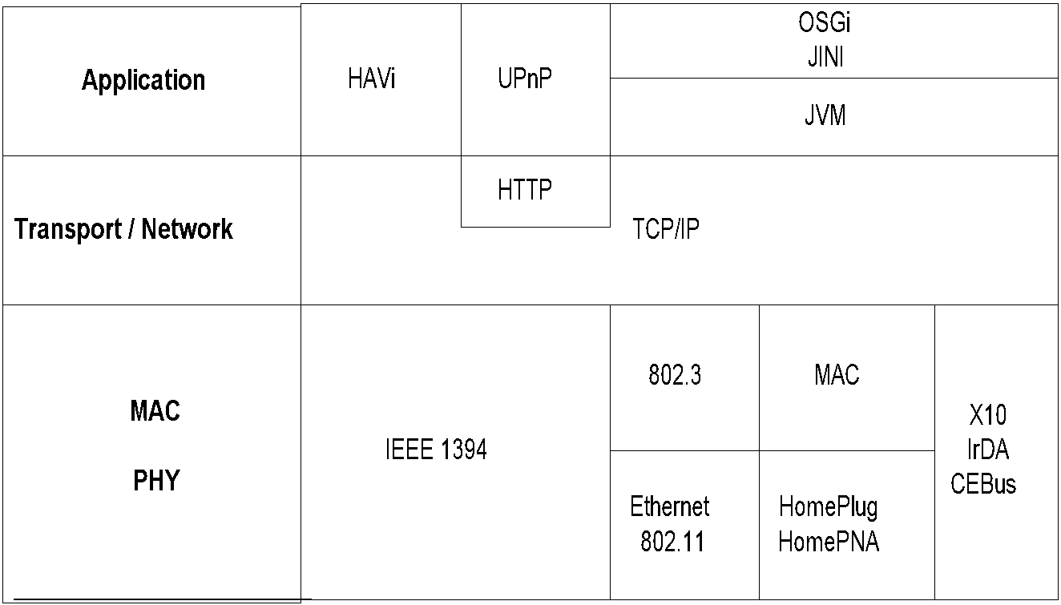
Home Network Protocol Architecture
Chapter 15 Broadband Home Networks
Figure 15.1 Home Network Protocol Architecture
  Notes
Network Management: Principles and Practice
© Mani Subramanian 2010
*

Slide 7
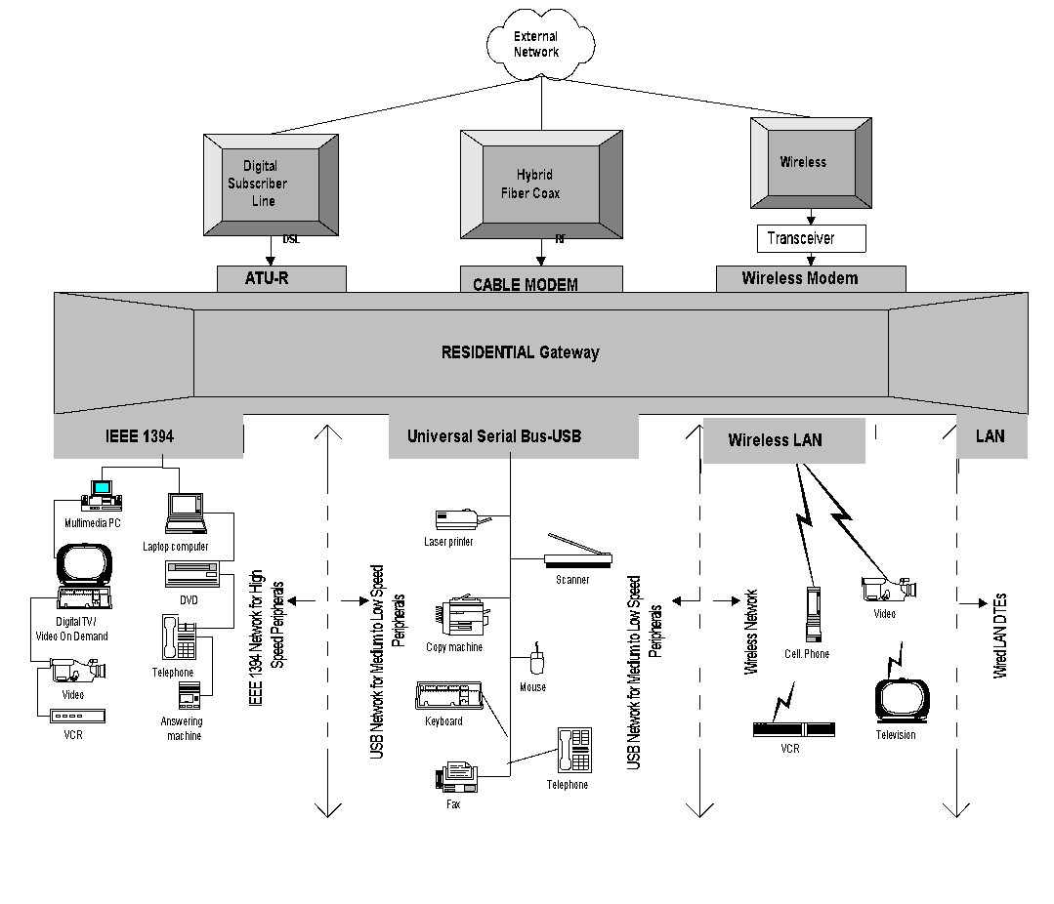
Home Networks
Chapter 15 Broadband Home Networks
  Notes
Three access networks and modems
Four types of distribution networks
Network Management: Principles and Practice
© Mani Subramanian 2010
*

Slide 8
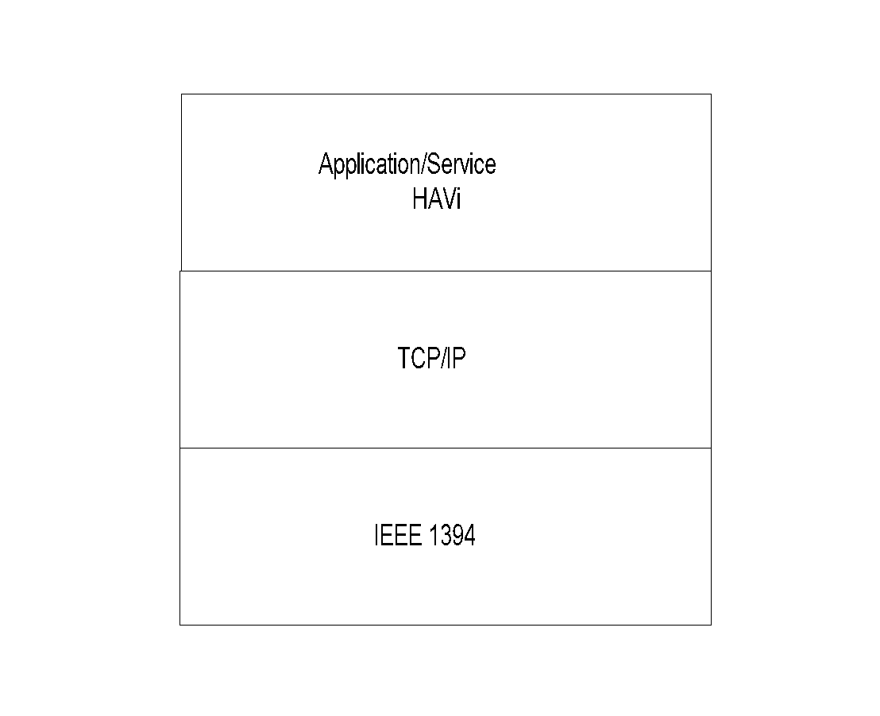
HAVi Protocol Architecture
Chapter 15 Broadband Home Networks
  Notes
Application for home entertainment and AV devices
HAVi Components
  Device
    FAV (Full Audio Visual)
    Intermediate AV
    Base AV
    Legacy AV
  Device control module (DCM): Aggregate of
  FCMs
  Functional control module (FCM): Controls
  application functions
Peer-to-peer environment
Network Management: Principles and Practice
© Mani Subramanian 2010
*

Slide 9
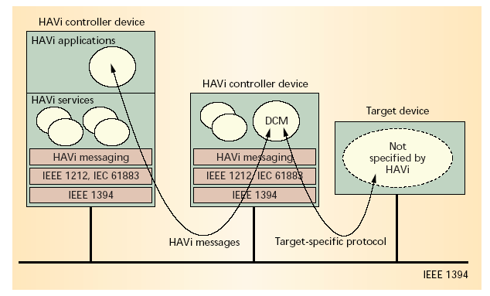
HAVi Communication
Chapter 15 Broadband Home Networks
  Notes
  Lower layer: IEEE 1394
    Function control protocol: IEC 61883.1
    Device control protocol: IEEE 1212
    HAVi messages
  Services
    Discovery Messaging
    Lookup Events
    Configuration Reservation
    Device control User interaction
Network Management: Principles and Practice
© Mani Subramanian 2010
*

Slide 10
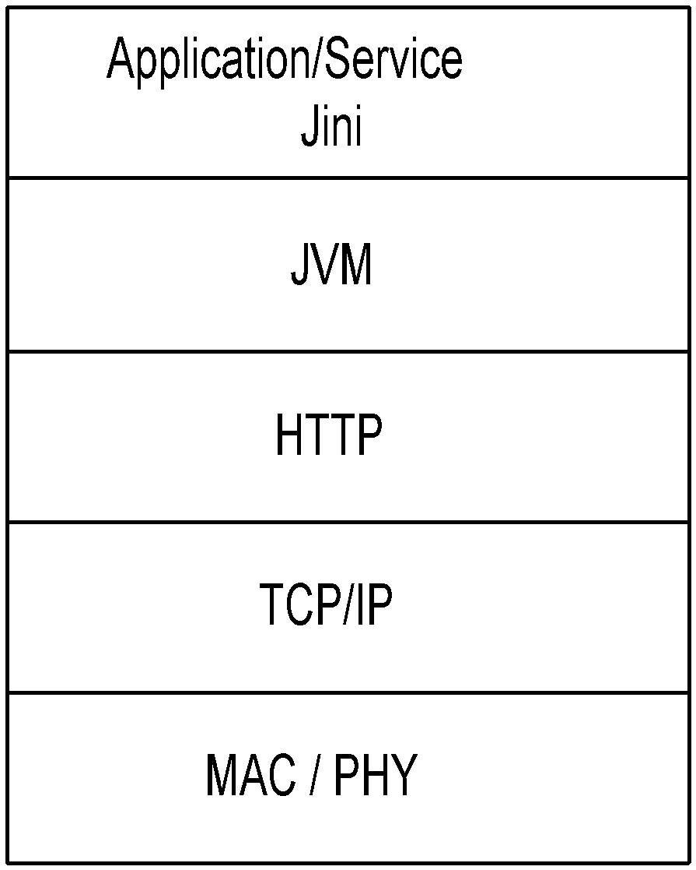
Jini Middleware
Chapter 15 Broadband Home Networks
  Notes
Components
  Device – Java object / Client
  Access: RMI (Remote Method Invocation)
  Services
    Lookup
    Discovery
Based on Java platform
Distributed environment for devices to communicate;
Not housed in a single computer
Forms impromptu communities – Group of shared
services
Federation: Jini communities linked together
Jini surrogate host to handle non-Jini host
JiniME (Mobile Edition) for mobile devices
Network Management: Principles and Practice
© Mani Subramanian 2010
*

Slide 11
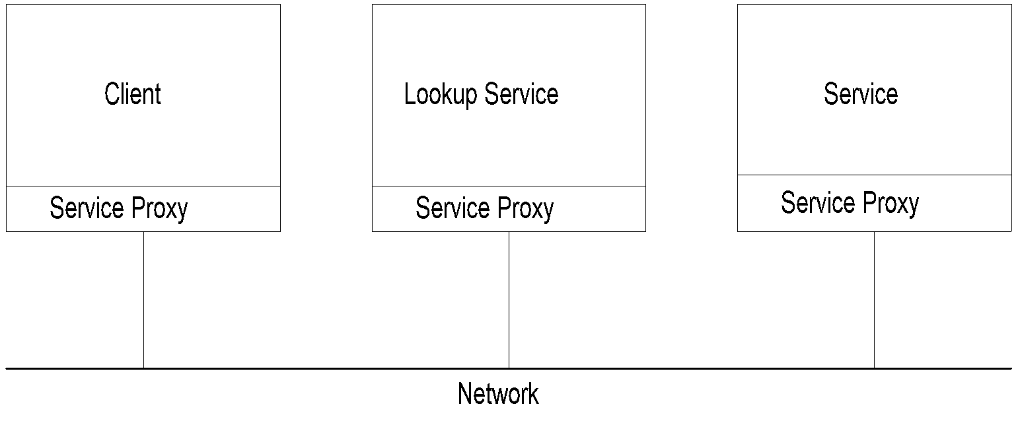
Jini Network: Service
Chapter 15 Broadband Home Networks
  Notes
Lookup Service:
  Client requests service (e.g., clock)
  Lookup service: locator
  Service provides the service (e.g., TV)
Network: Any network supporting Jini service
Network Management: Principles and Practice
© Mani Subramanian 2010
*

Slide 12
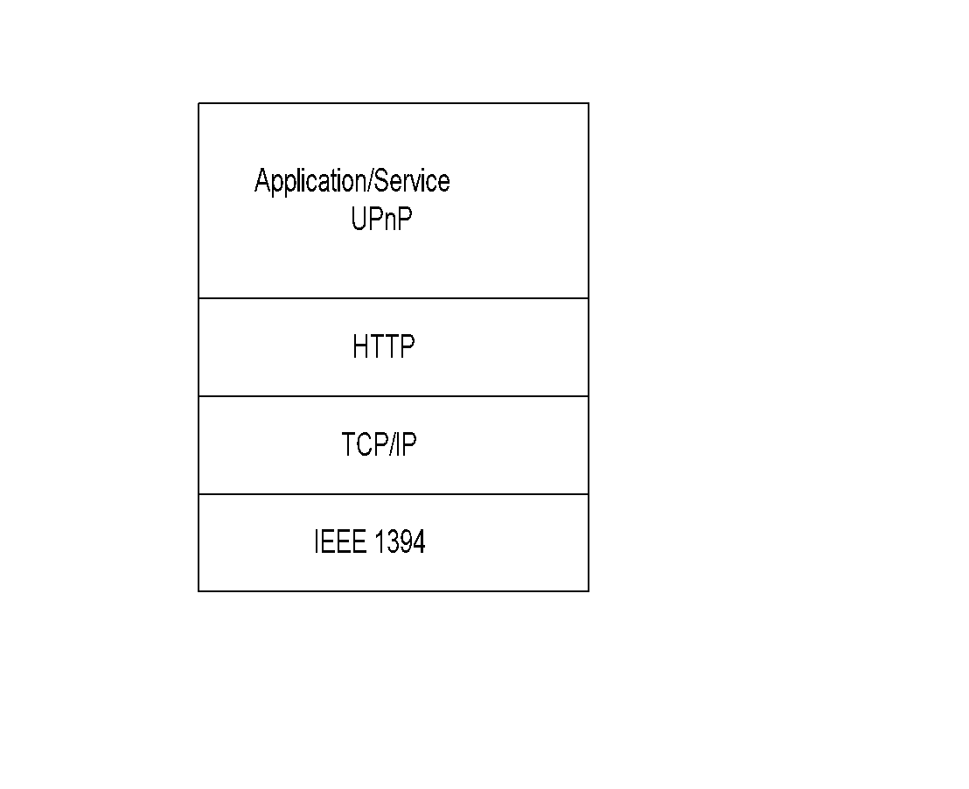
UPnP Protocol Architecture
Chapter 15 Broadband Home Networks
  Notes
Universal plug and play
Active addition and deletion of devices
Components
  Devices
  Services
  Control points
Peer-to-peer network
Network Management: Principles and Practice
© Mani Subramanian 2010
*

Slide 13
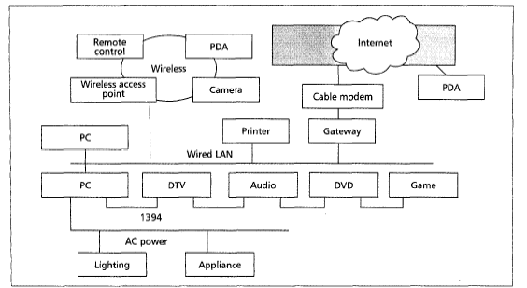
UPnP Network
Chapter 15 Broadband Home Networks
  Notes
Underlying networks with standard protocols:
  HomePlug
  IEEE 1394
  LAN
  WLAN
Gateway and cable modem link to Internet
Dynamic configuration of devices offering
services requested by control points
Needs zero-configuration
Automatic discovery of devices
Network Management: Principles and Practice
© Mani Subramanian 2010
*

Slide 14
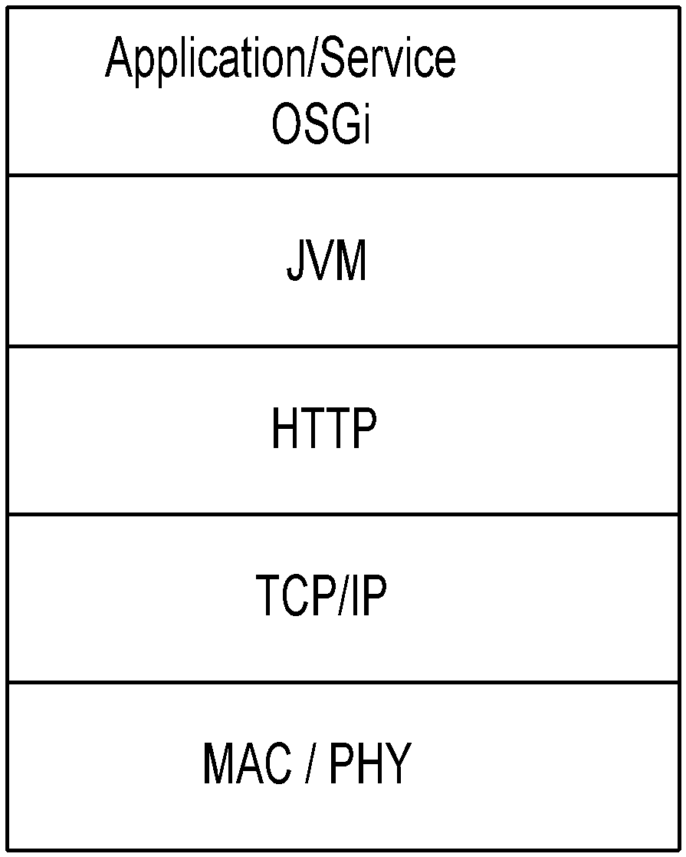
OSGi Gateway
Chapter 15 Broadband Home Networks
  Notes
OSGi: Open Service Gateway initiative
Platform for residential gateway
Specifies API only, not underlying implementation;
Platform and application independent
Service and device discovery functions
Imports multiple discovery protocols and registers
them as OSGi services
Network Management: Principles and Practice
© Mani Subramanian 2010
*

Slide 15
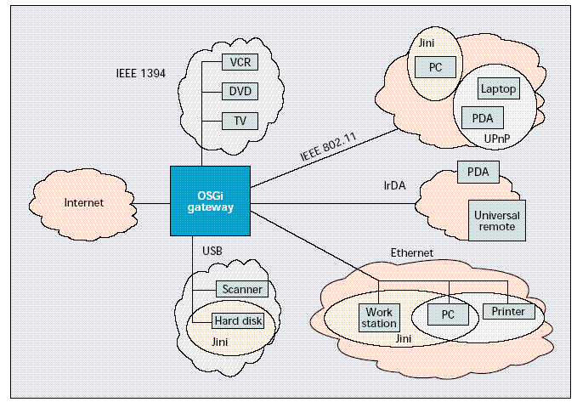
OSGi Home Network Architecture
Chapter 15 Broadband Home Networks
Source: Dobrev, et.al., IEEE Communications Magazine, Aug. 2002
  Notes
Residential OSGi Gateway
External link to Internet via embedded modem with
interface to cable, DSL, or wireless access network
Intra-home networks with multiple protocols integrated
with OSGi
Jini creates impromptu communities automatically
IEEE 1394 network for AV devices
IEEE 802.11 and Ethernet networks for mobile fixed
data devices
Imports discovery services from other protocol
networks
Network Management: Principles and Practice
© Mani Subramanian 2010
*

Slide 16
Lower Layer Networking Protocols
Chapter 15 Broadband Home Networks
Network Management: Principles and Practice
© Mani Subramanian 2010
*

Slide 17
Lower Layer Protocols for Networked Appliances
Chapter 15 Broadband Home Networks
Category | Appliance | Protocol
Home Automation and Control | Lighting, Appliances, Climate Control | EIB, LonWorks, X10, CEBus
Entertainment | A/V Equipment, TV, PC | IEEE 1394
Communications | Telephone, Cell Phone, Intercom | IEEE 1394, HomePNA
Computers and Information | PC, Peripherals, PDA | Ethernet, WiFi
  Notes
Issues:
  rt, near-rt, and non-rt, requirements
  Multiplicity of component networks
  Backbone QoS
  Interoperability
Network Management: Principles and Practice
© Mani Subramanian 2010
*

Slide 18
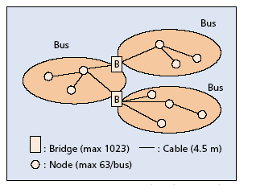
IEEE 1394
Chapter 15 Broadband Home Networks
Source: Nakagawa, et. al.
  Notes
Wired IEEE 1394
  Applicable to audio, video, and high-speed data
  Transport speed 100, 200, and 400 Mbps
  1394b: 800 and 1600 Mbps
  Extension to 3.2 Gbps in the future
  specifications
  Supports asynchronous and isochronous
  Flexible topology; supports daisy chaining and
  node branching
  Active connect and disconnect
Wireless /1394 bridge
Network Management: Principles and Practice
© Mani Subramanian 2010
*

Slide 19
USB
Chapter 15 Broadband Home Networks
USB 1.0 1.5 Mbps Low speed Cable length = 3m
USB 1.1 12 Mbps Full Speed Cable length = 3m
USB 2.0 400 Mbps High speed Cable length = 5m
Source: Nakagawa, et. al.
  Notes
Universal Serial Bus (USB)
  Alternative to Ethernet as a computer
  peripheral interface
  Data-centric, not multimedia-oriented
Network Management: Principles and Practice
© Mani Subramanian 2010
*

Slide 20
Residential Ethernet
Chapter 15 Broadband Home Networks
Medium
  UTP-CAT5 (Unshielded twisted Pair Category 5);
  Maximum 100 meters
  Optical Fiber in new homes
Requirements different from enterprise Ethernet
  Multiplicity of multimedia and networked
  appliances
  Single physical port, multiple logical / channel
  interface handled by ifStackTable (RFC 2863)
  ifOctets redefined to handle 10 Gbps
  IP phones wired with powered Ethernet cable
  New MIB for powered Ethernet
  Notes
Network Management: Principles and Practice
© Mani Subramanian 2010
*

Slide 21
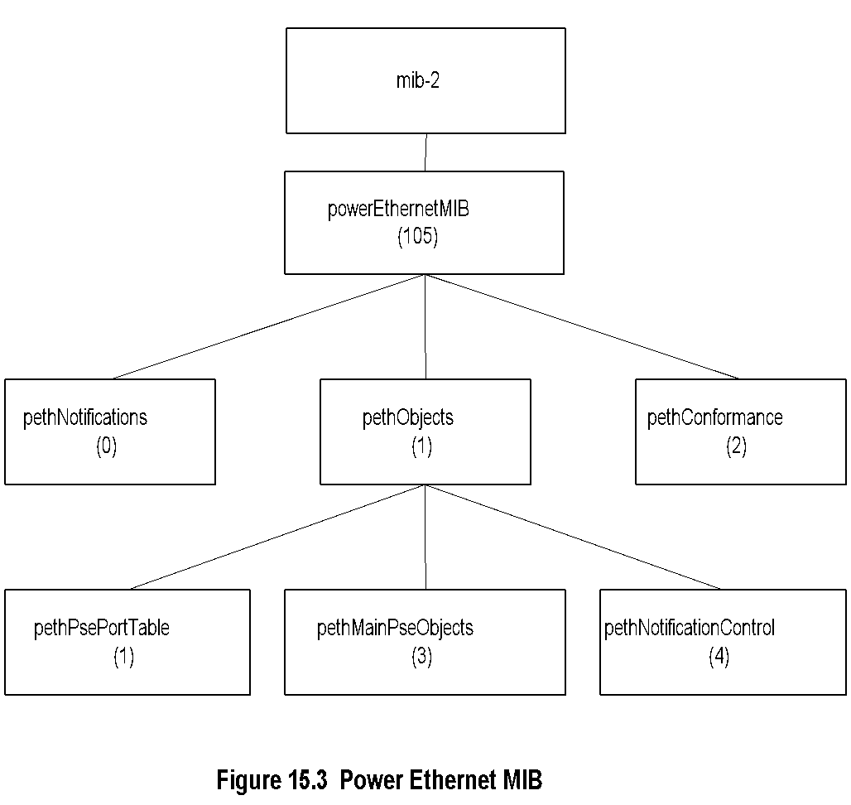
Power Ethernet MIB
Chapter 15 Broadband Home Networks
  Notes
pse: Power sourcing equipment
pethObjects has three groups:
  pethPsePortTable: MOs for status of PSE
  device ports
  pethMainPseObjects: MOs for PSE device
  pethNotificationControlTable: Notifications
Network Management: Principles and Practice
© Mani Subramanian 2010
*

Slide 22
IEEE 802.11
Wireless LAN
Chapter 15 Broadband Home Networks
Network Management: Principles and Practice
© Mani Subramanian 2010
*

Slide 23
802.11 PHY & MAC
Chapter 15 Broadband Home Networks
MAC Layer
  CSMA/CA (CSMA/ Collision Avoidance) is
  used: (CSMA/CD in 802.3)
  BSS Basic service set comprise AP (Access
  Point) and STAs (Stations); a.k.a. Wi-Fi
  Choice of coordination function by AP
    DCF Distributed coordination function
      Asynchronous
      Contention-based
    PCF Point coordination function
    (optional)
      Synchronous
      Contention-free
PHY Layer
  802.11b @ 2.4 GHz & data rate 11 Mbps
  802.11a @ 5 GHz & data rate 54 Mbps
  802.11g extends 802.11b to 54 Mbps with
  OFDM
  Notes
IBSS: Independent BSS
  Ad-hoc configuration of 802.11
Network Management: Principles and Practice
© Mani Subramanian 2010
*

Slide 24
802.11 Standards & Amendments
Chapter 15 Broadband Home Networks
Table 15.1 IEEE 802.11 Standards and Amendments
802.11a | 54 Mbps data rate 5.15 MHz to 5.35 and 5.4 MHz to 5.825 MHz
802.11b | 11 Mbps data rate at 2.4 GHz
802.11e | Addresses QoS issues
802.11f | Addresses multivendor AP interoperability
802.11g | Higher data rate extension to 54 Mbps in the 2.4 GHz
802.11h | Dynamic frequency selection and transmit power control for operation of 5 GHz products
802.11i | Addresses enhanced security issues
802.11j | Addresses channelization in Japan’s 4.9 GHz band
802.11k | Enables medium and network resources more efficiently
802.11v | Wireless network management (in preparation)
  Notes
Network Management: Principles and Practice
© Mani Subramanian 2010
*

Slide 25


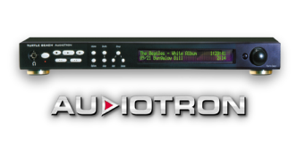

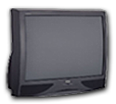


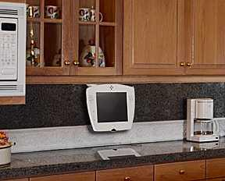

Residential WLAN
Chapter 15 Broadband Home Networks
Den
Dining Room
Bedroom
MP3 Player
PC
WebPad
Kitchen
Touch Pad
AP
Family room
Kitchen
Internet
Figure 15.4 Residential WLAN
Network Management: Principles and Practice
© Mani Subramanian 2010
*

Slide 26

WiFI Network Infrastructure
Chapter 15 Broadband Home Networks
AP
Internet
Layer 2/3
Switch
802.11
IP
User
802.3
Figure 15.5 WiFI Network Infrastructure
  Notes
Layer 2/3 bridge is traditional Ethernet hub
AP performs security functions
Network Management: Principles and Practice
© Mani Subramanian 2010
*

Slide 27
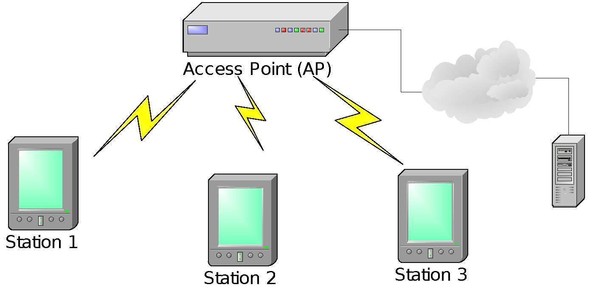
Enterprise WLAN
Chapter 15 Broadband Home Networks
Figure 15.6 Enterprise WLAN
  Notes
An access point (AP) and multiple stations (STAs)
AP works as a bridge
Every transmission is between AP and STA(s)
Network Management: Principles and Practice
© Mani Subramanian 2010
*

Slide 28
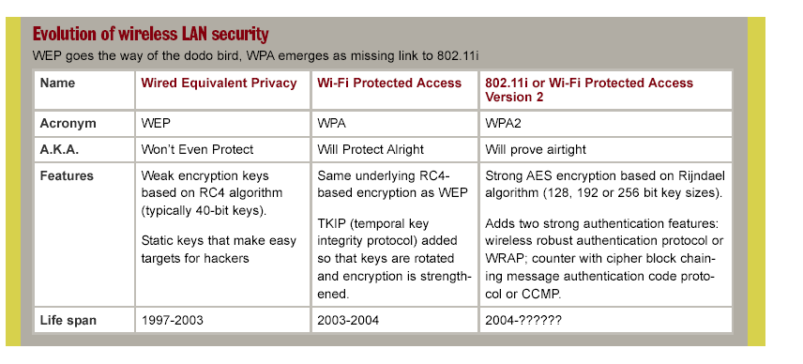
Evolution of WLAN Security
Chapter 15 Broadband Home Networks
WEP Wired Equivalent Privacy
WPA WiFi Protected Access – IEEE 802.11i based
WPA2 802.11i (?)
Source: Network World 2003
  Notes
Network Management: Principles and Practice
© Mani Subramanian 2010
*

Slide 29
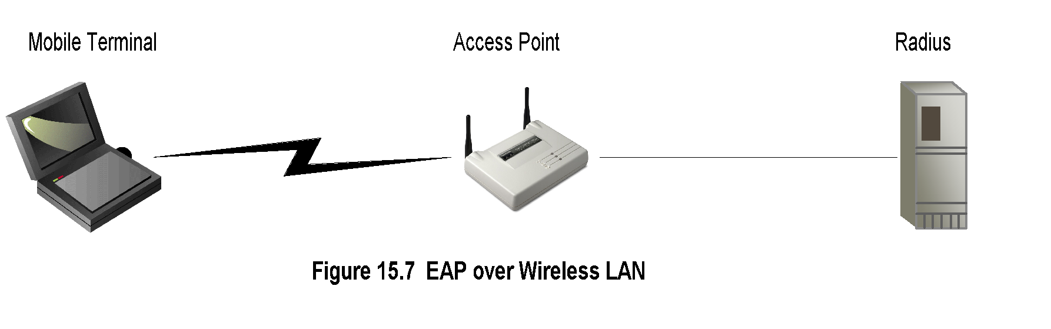
Security Management
Chapter 15 Broadband Home Networks
  Notes
Evolution:
WAP (Wireless Application Protocol) Security
  WAP Wireless transport layer security (WTLS)
    Based on transport layer security (TLS)
    or secured sockets shell (SSL)
    “Walled garden” “vertical” integrated
    approach
WEP Wired Equivalent Privacy
WPA WiFi Protected Access
WPA2 WPA with IEEE 802.11i
3G network security
  3GPP (Third Generation Partnership Project)
  and 3GPP2 plan for IP to wireless device
  Open standard SNMP-based
Network Management: Principles and Practice
© Mani Subramanian 2010
*

Slide 30
WLAN Broadband QoS Issues
Chapter 15 Broadband Home Networks
Broadband comprises:
  Voice: Real-time data
  Video: Streaming data with/without delay
  Data: Non-real time data
Broadband QoS determined by MAC and PHY layers
QoS Parameters:
  Datarate
  Delay bound
  Jitter
Two types of media access (MAC)
  DCF (Distributed Control Function): CSMA/CA
  PCF (Point Control Function): Polled Xmission
Both DCF and PCF fail to satisfy broadband service
Range dependencies
  Power level
  Antenna choice
    Diversity antenna focuses beam
    Diversity reception improves S/N ratio
    MIMO (Multiple Input Multiple Output)
    technology enhances reception
  Notes
Network Management: Principles and Practice
© Mani Subramanian 2010
*

Slide 31
IEEE 802.11e QoS Table
Chapter 15 Broadband Home Networks
Table 15.2 IEEE 802.11e QoS Table
UP (user priority) | AC (access category) | Service type
2 | 0 | Best Effort
1 | 0 | Best Effort
0 | 0 | Best Effort
3 | 1 | Video Probe
4 | 2 | Video
5 | 2 | Video
6 | 3 | Voice
7 | 3 | Voice
  Notes
Network Management: Principles and Practice
© Mani Subramanian 2010
*

Slide 32
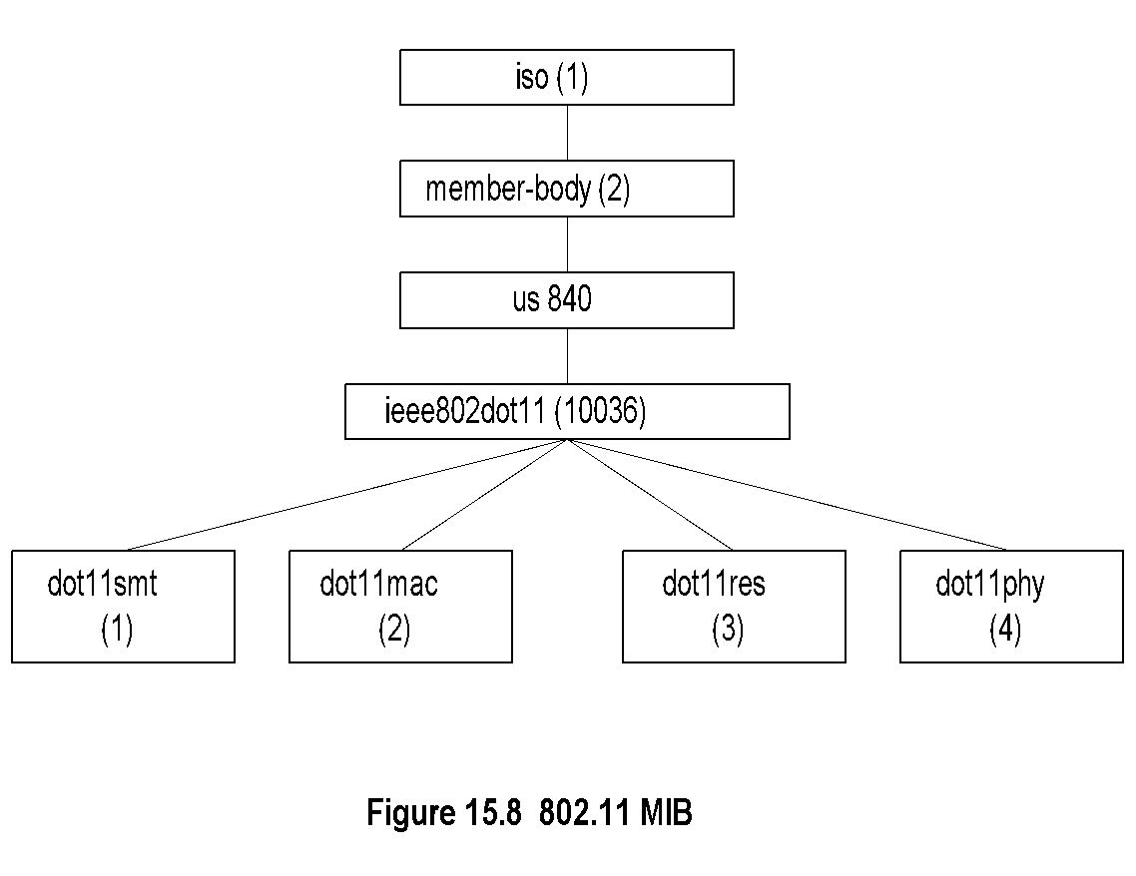
802.11 MIB
Chapter 15 Broadband Home Networks
  Notes
Entity | OID | Description
dot11smt | ieee802dot11 1 | Station management attributes: WEP security, power, transmission
dot11mac | ieee802dot11 2 | Mac attributes
dot11res | ieee802dot11 3 | Resource type attributes
dot11phy | ieee802dot11 4 | Physical attributes
Network Management: Principles and Practice
© Mani Subramanian 2010
*

Slide 33
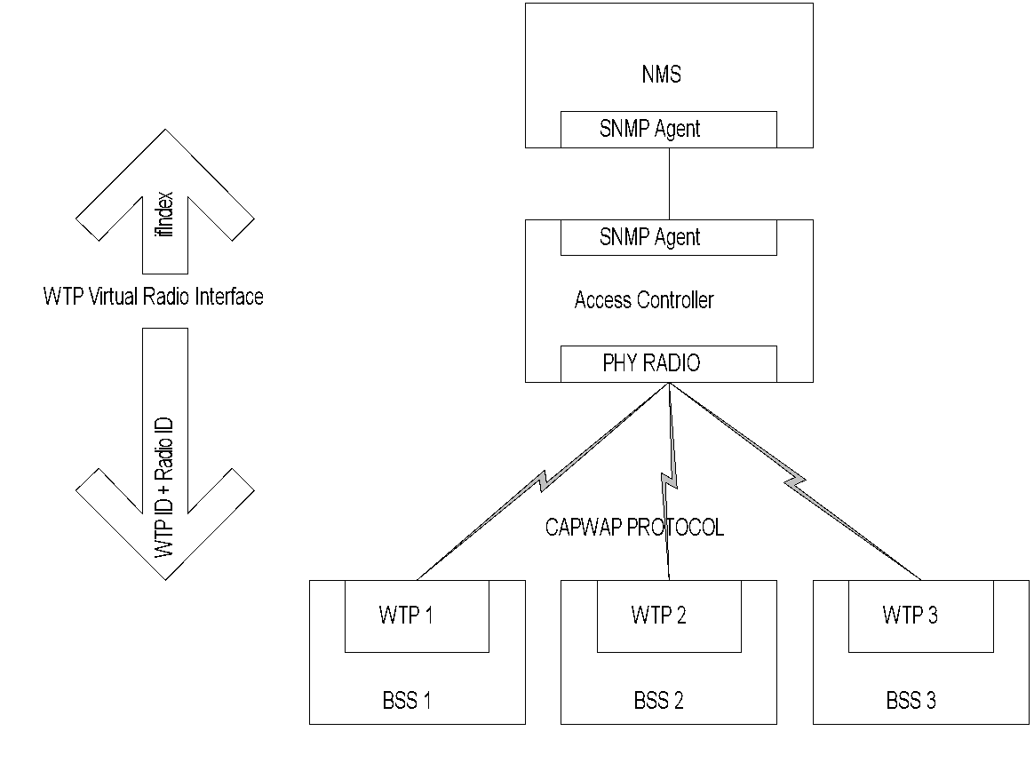
Centralized Management of WLANs
Chapter 15 Broadband Home Networks
Figure 15.9 Centralized Management of WLANs
  Notes
CAPWAP interoperable protocol standard
Centralized Access Controller manages multiple
BSSs via Wireless Termination Points (WTPs)
CAPWAP – IETF compatibility achieved by one-
to-one relationship between ifIndex and WTP ID +
Radio ID
Network Management: Principles and Practice
© Mani Subramanian 2010
*

Slide 34
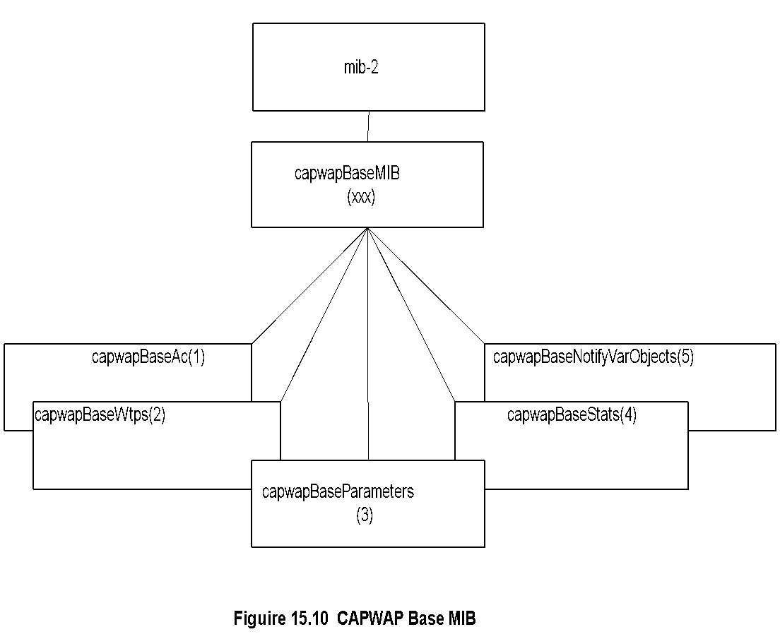
CAPWAP Base MIB
Chapter 15 Broadband Home Networks
  Notes
CAPWAP MIB in proposal stage
Network Management: Principles and Practice
© Mani Subramanian 2010
*

Slide 35
CAPWAP Base MIB
Chapter 15 Broadband Home Networks
Entity | OID | Description
capwapBaseObjects | capwapBaseMIB 1 | CAPWAP MIB objects
capwapBaseAc | capwapBaseObjects 1 | Access Controller Objects group
capwapBaseAc NameListTable | capwapBaseAc 9 | Objects that display AC name list
capwapBaseMac AclTable | capwapBaseAc 10 | Set of objects that configure station ACL
capwapBaseWtps | capwapBaseObjects 2 | Wireless Termination Point Objects group
capwapBaseWtp StateTable | capwapBaseWtps 1 | Objects that display WTP CAPWAP FSM state
capwapBaseWtp Table | capwapBaseWtps 2 | Objects that display and control WTPs in running state
capwapBaseRadio BindTable | capwapBaseWtps 3 | Objects that display mapping relationship between specific interface of 'WTP Virtual Radio Interface' ifType and PHY radio
capwapBaseStation Table | capwapBaseWtps 4 | Objects that display stations which are accessing the wireless service provided by the AC
capwapBaseWtpRebootStatsTable | capwapBaseWtps 5 | Objects that display WTPs' reboot statistics
capwapBaseRadioStatsTable | capwapBaseWtps 6 | Objects that display statistics on radio’s behavior, and reasons why the WTP radio has been reset.
capwapBaseParameters | capwapBaseObjects 3 | CAPWAP Base Parameters group
capwapBaseStats | capwapBaseObjects 4 | CAPWAP Statistics group
capwapBaseNotifyVar Objects | capwapBaseObjects 5 | Objects used only in notifications
Network Management: Principles and Practice
© Mani Subramanian 2010
*

Slide 36
IEEE 802.15
WPANs
(Wireless Personal Area Networks)
Chapter 15 Broadband Home Networks
Network Management: Principles and Practice
© Mani Subramanian 2010
*

Slide 37
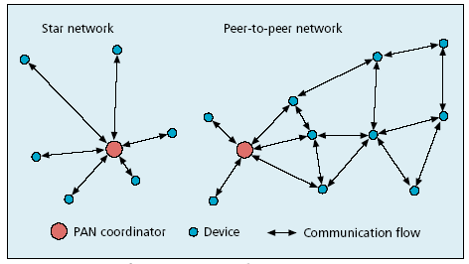
WPANs
Chapter 15 Broadband Home Networks
Source: Callaway, et. al., IEEE Communications Magazine, Aug. 2002
  Notes
802.15.1 Bluetooth base line standard
802.15.2 Coexistence of 802 wireless technologies
802.15.3 High-rate radio (>20 Mbps)
802.15.4 Low-rate radio (<200 kbps)
Network Management: Principles and Practice
© Mani Subramanian 2010
*

Slide 38
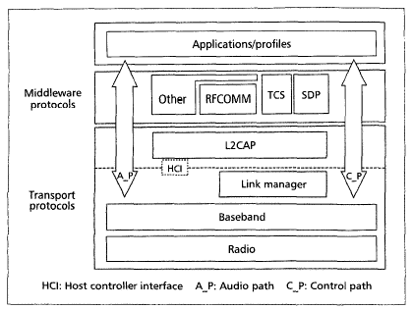
Bluetooth Protocol Stack
Chapter 15 Broadband Home Networks
Source: Bisdikian, IEEE Communications Magazine, Dec. 2001
  Notes
Short range up to 10m
2.042 GHz to 2.483 GHz band
79 channels of 1 MHz width
Data rate 1 Mbps
Time division multiplexing
Master-slave architecture
Voice support synchronous connection-oriented link
Data support using asynchronous connectionless link
Network Management: Principles and Practice
© Mani Subramanian 2010
*

