Slide 1
Chapter 14 Broadband Wireless Access Networks
Chapter 14 Broadband Wireless Access Networks
Network Management: Principles and Practice
© Mani Subramanian 2010
*
Notes:
Chapter 14

Slide 2
Objectives
Chapter 14 Broadband Wireless Access Networks
Broadband wireless access networks
Multichannel multipoint distribution service, MMDS
Local multipoint distribution service, LMDS
IEEE 802.16/WiMax networks
Components of wireless access network
Base station (BS)
Subscriber station (SS)
Wireless medium
Wireless spectrum
Basic principles of wireless communication
Free space propagation
Terrestrial propagation
Cellular mobile environment
Fading phenomena
MMDS and LMDS
Deployment in rural areas
Line-of-sight (LOS) limitation
Operational spectrum and modes
Similarity with cable access network
DOCSIS standards or proprietary protocol
DOCSIS management standards for DOCSIS-based systems
Network Management: Principles and Practice
© Mani Subramanian 2010
*
Notes:
Chapter 14

Slide 3
Objectives (cont.)
Chapter 14 Broadband Wireless Access Networks
IEEE 802.16/WiMax networks
IEEE 802.16 spectrum 10 to 66 GHz
WiMax spectrum windows in the 2 to 11 GHz
WiMax mesh network eliminates LOS limitation
Management of BS and SS
Spectrum management
Service flow management
Management using wmanIfMib
Mobile wireless network
2.5, 3, and 4G technologies
TDM, TDMA, and CDMA protocol systems
Management issues
Use of mobile IP
Mobility management
Power and resource management
QoS management
Security management
VSAT network and management
Network Management: Principles and Practice
© Mani Subramanian 2010
*
Notes:
Chapter 14

Slide 4
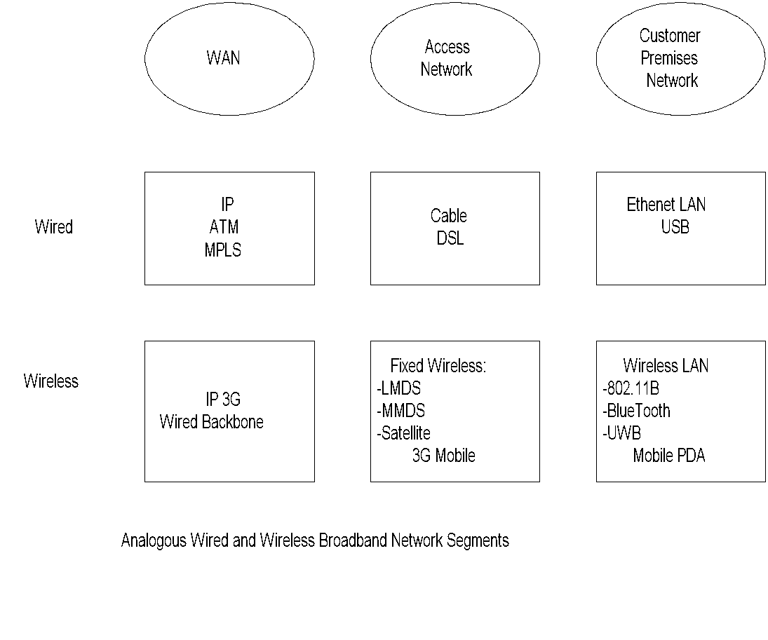
Wired & Wireless Broadband Networks
Chapter 14 Broadband Wireless Access Networks
Notes
Wireless Mobile ATM (WmATM) is not shown in Wireless WAN as it does not appear to be in the current road map of technology.
Network Management: Principles and Practice
© Mani Subramanian 2010
*
Notes:
Chapter 14

Slide 5
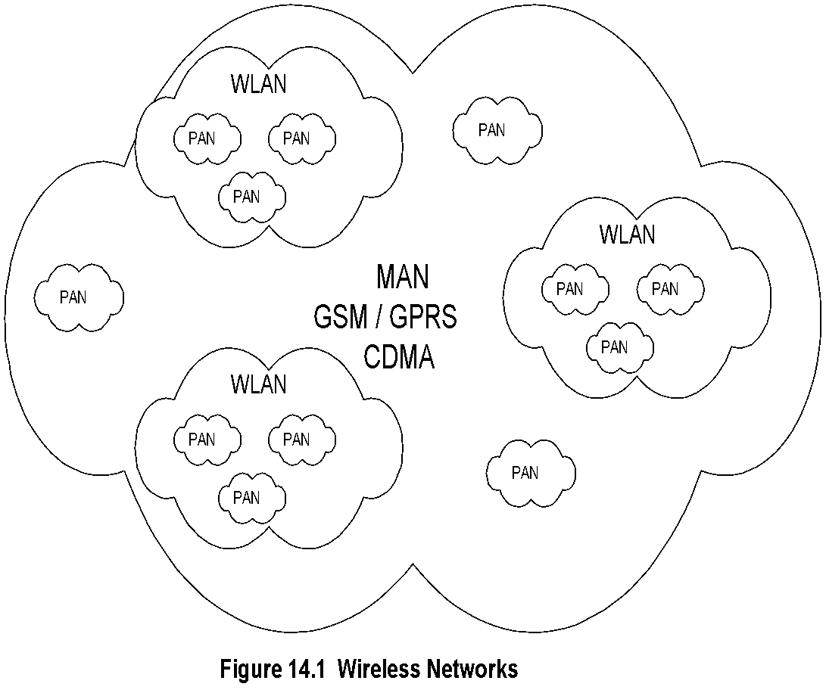
Wireless Broadband Networks
Chapter 14 Broadband Wireless Access Networks
Notes
Access Networks
MAN a.k.a. WiMax
Wireless LAN (WLAN)
Personal Area Network (PAN)
Network Management: Principles and Practice
© Mani Subramanian 2010
*
Notes:
Chapter 14

Slide 6
Basic Principles
Chapter 14 Broadband Wireless Access Networks
Network Management: Principles and Practice
© Mani Subramanian 2010
*
Notes:
Chapter 14

Slide 7
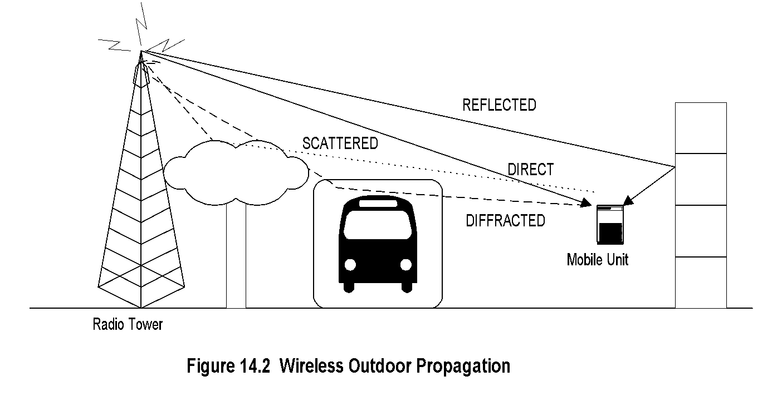
Outdoor Propagation
Chapter 14 Broadband Wireless Access Networks
Notes
Adverse Characteristics:
Attenuation
Dispersion: Frequency and Phase (independent of refractive index)
Dispersion due to refractive index
Decreasing signal strength due to beam pattern
Water absorption
Fading: short and long
Doppler effect
Network Management: Principles and Practice
© Mani Subramanian 2010
*
Notes:
Chapter 14

Slide 8
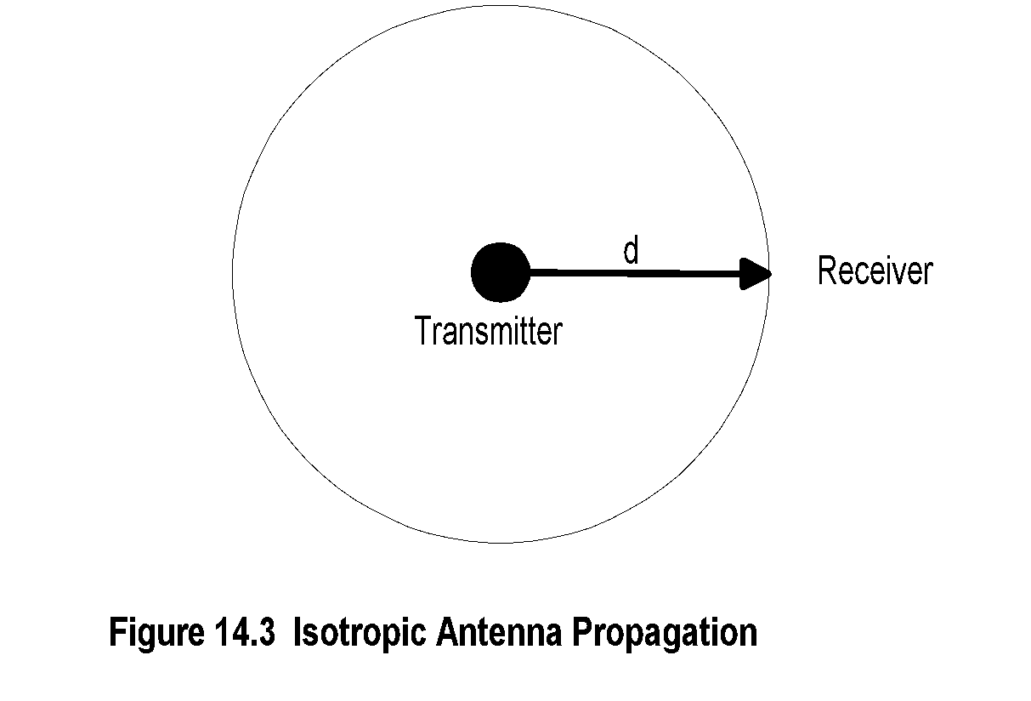
Isotropic Propagation
Chapter 14 Broadband Wireless Access Networks
Notes
Pr = (PT / 4πd²) watts /m² (14-1)
Pr = Received power per unit area and
PT = Total transmitted power.
Network Management: Principles and Practice
© Mani Subramanian 2010
*
Notes:
Chapter 14

Slide 9

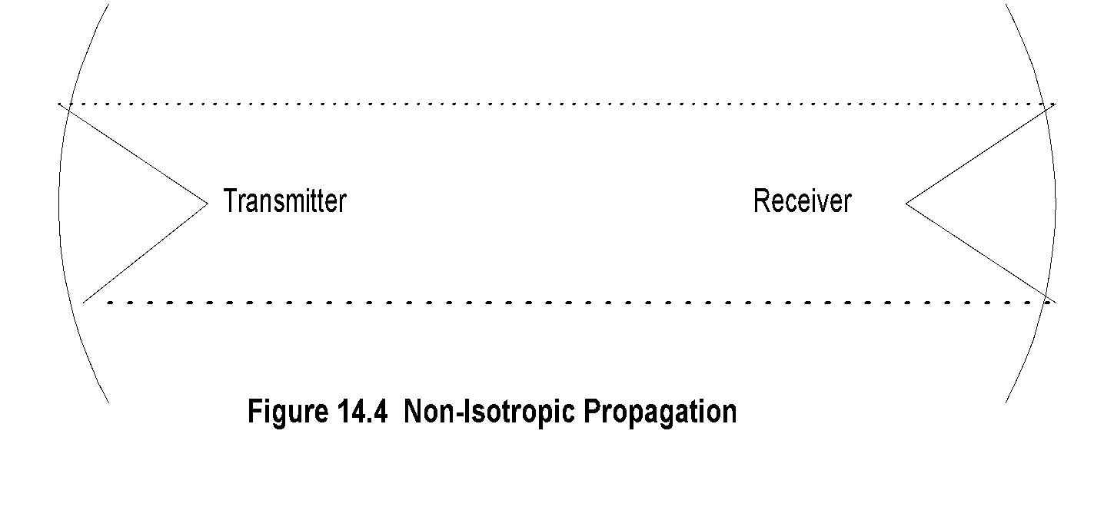
Non-Isotropic Propagation
Chapter 14 Broadband Wireless Access Networks
Notes
P_{R} = P_{T}G_{T}G_{R} (λ / 4d)2 (14-5)
P_{R} = Received power
P_{T} = Transmitted power
G_{T} = Transmitter antenna gain
G_{R} = Receiver antenna gain
λ = Wavelength
Network Management: Principles and Practice
© Mani Subramanian 2010
*
Notes:
Chapter 14

Slide 10
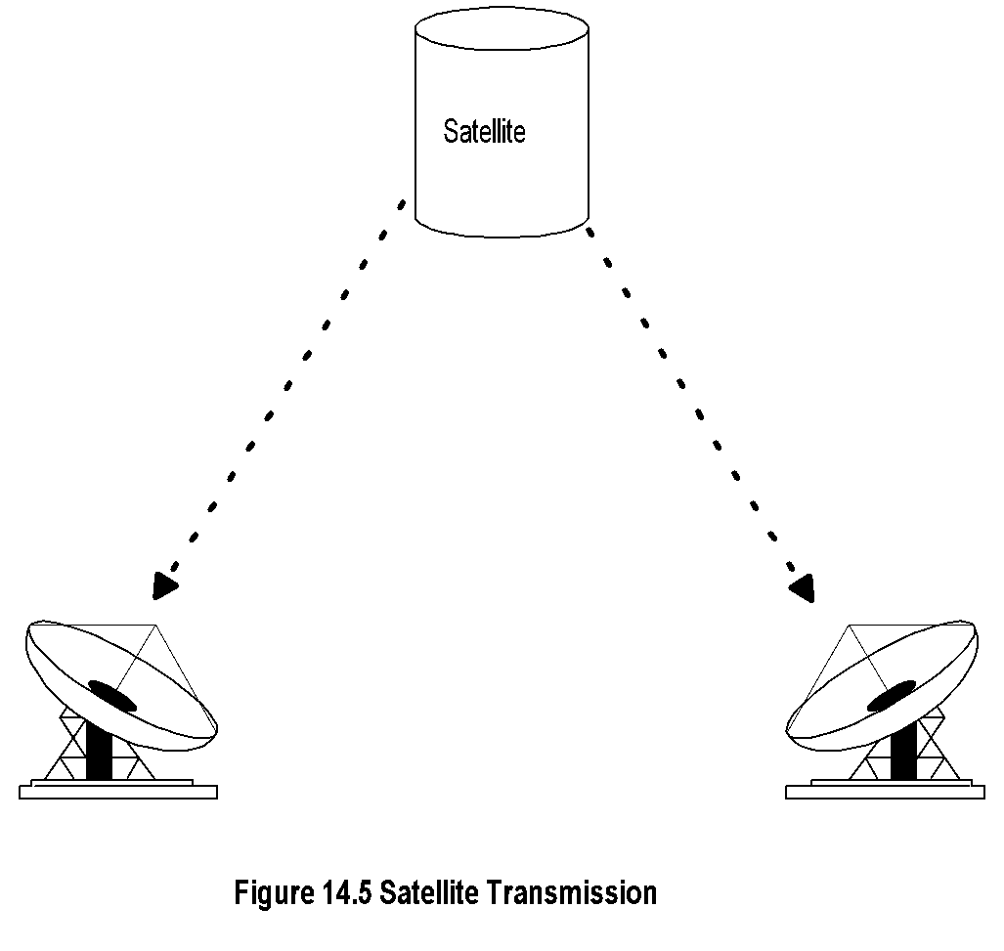
Satellite Free Space Propagation
Chapter 14 Broadband Wireless Access Networks
Notes
P_{R} ά 1/d²
Network Management: Principles and Practice
© Mani Subramanian 2010
*
Notes:
Chapter 14

Slide 11
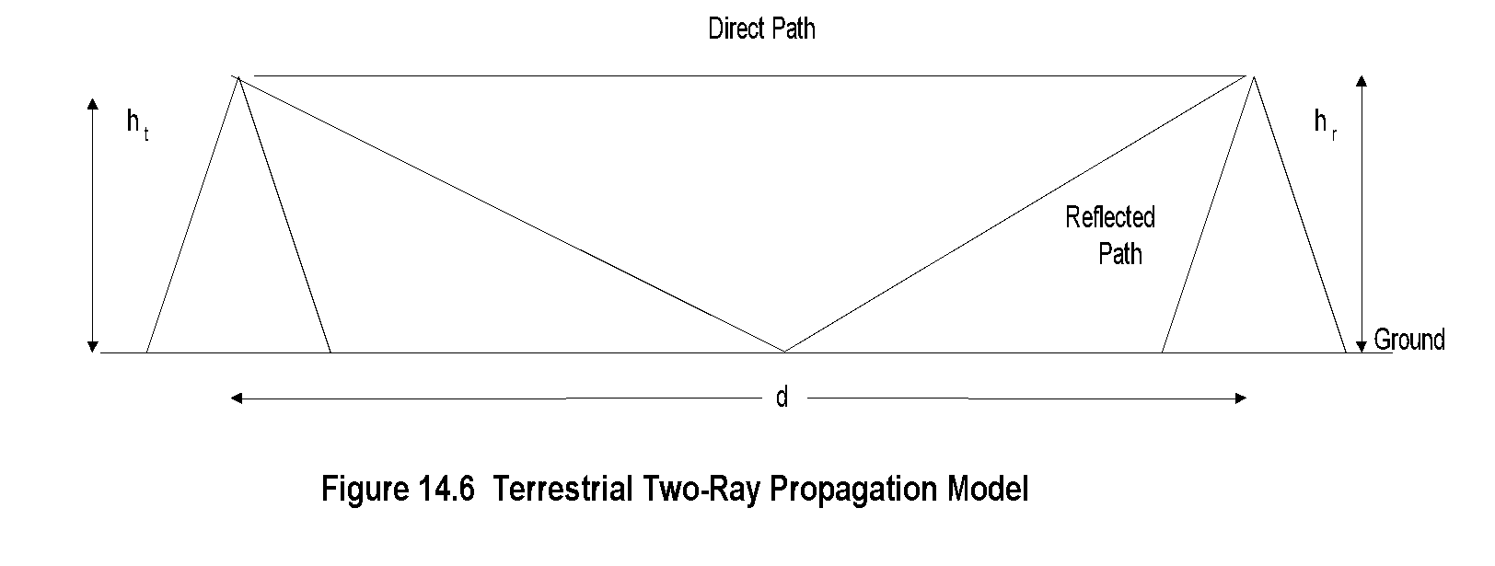
Terrestrial Propagation
Chapter 14 Broadband Wireless Access Networks
Notes
P_{R} ά 1/d²
Network Management: Principles and Practice
© Mani Subramanian 2010
*
Notes:
Chapter 14

Slide 12
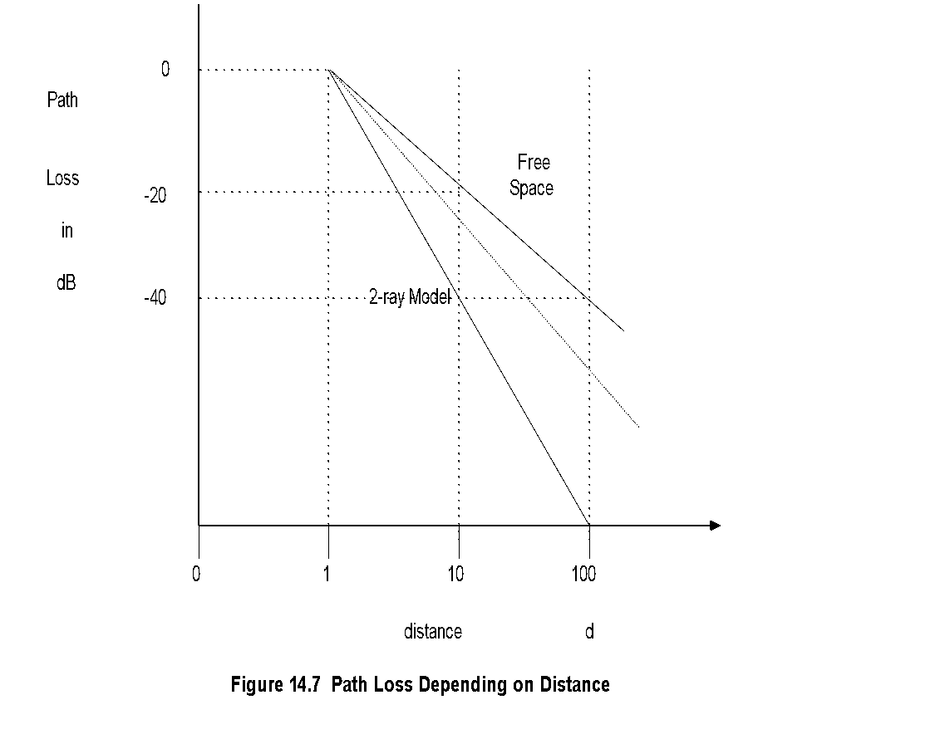
Path Loss Dependency
Chapter 14 Broadband Wireless Access Networks
Notes
Network Management: Principles and Practice
© Mani Subramanian 2010
*
Notes:
Chapter 14

Slide 13
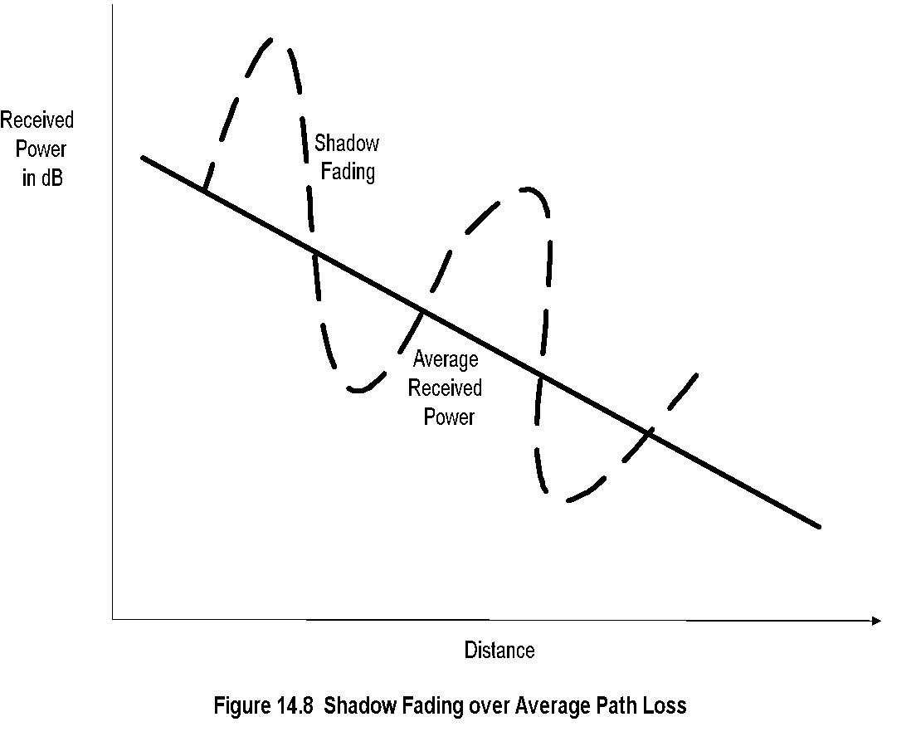
Shadow Fading
Chapter 14 Broadband Wireless Access Networks
Notes
Large-scale fading
Slow spatial rate compared to wavelength
Slow rate of change
Small-scale fading or Shadow fading
Spatial dimension comparable to wavelength
Rapid rate of change
Network Management: Principles and Practice
© Mani Subramanian 2010
*
Notes:
Chapter 14

Slide 14
Fixed Wireless Networks
Chapter 14 Broadband Wireless Access Networks
Network Management: Principles and Practice
© Mani Subramanian 2010
*
Notes:
Chapter 14

Slide 15
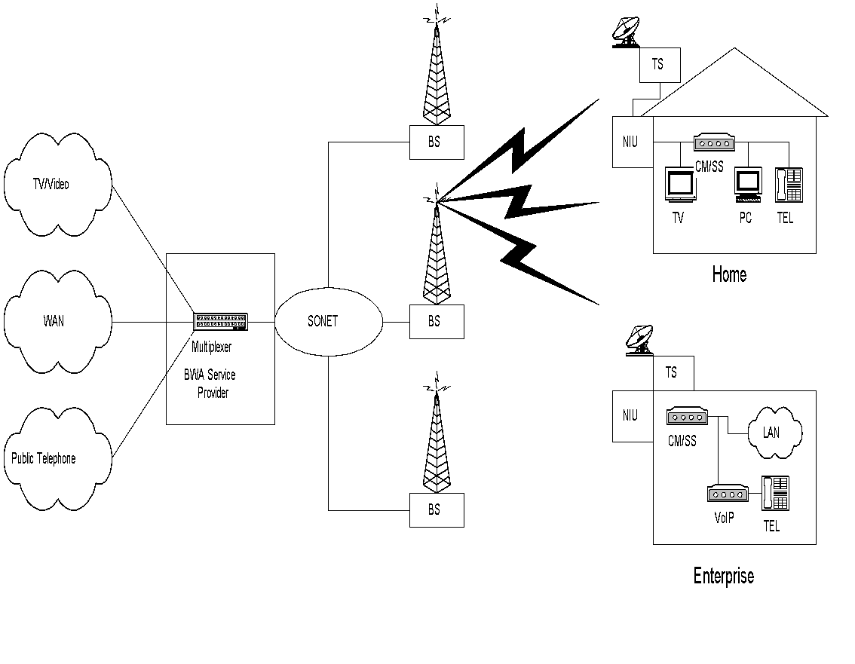
Fixed Wireless Network
Chapter 14 Broadband Wireless Access Networks
Figure 14.9 Fixed Wireless Access Network
Notes
Fixed wireless access
a.k.a wireless local loop
Point-to-multipoint network architecture
Benefits:
Less capital investment
Quick and cheap to install and operate
Network Management: Principles and Practice
© Mani Subramanian 2010
*

Slide 16
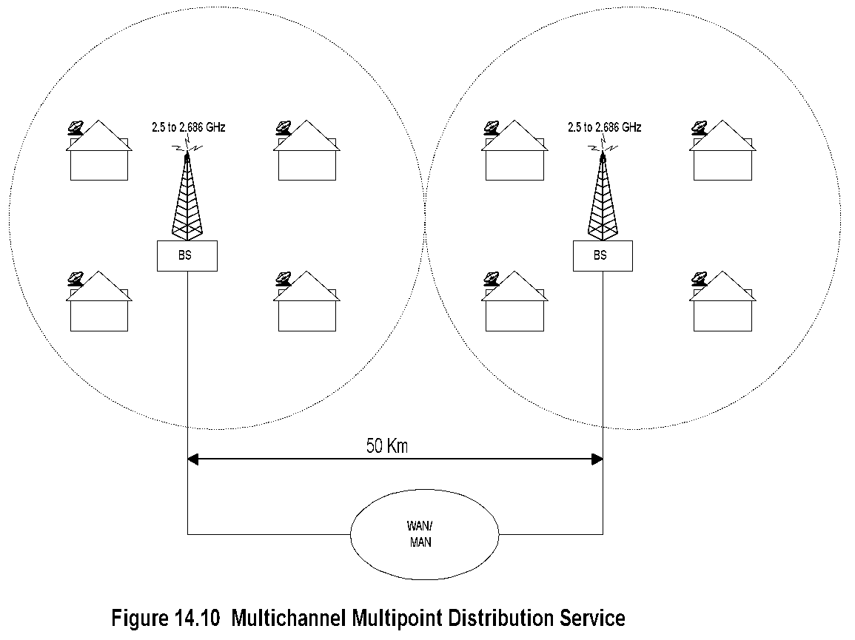
MMDS
Chapter 14 Broadband Wireless Access Networks
Notes
Point-to-multipoint architecture
Range between BSs is 50 km
Operates over 2.5 to 2.686 GHz band
Could operate on multichannels and hence capable of providing 2-way high-speed communication
An implementation using cable modem equipment at both ends
Network Management: Principles and Practice
© Mani Subramanian 2010
*

Slide 17
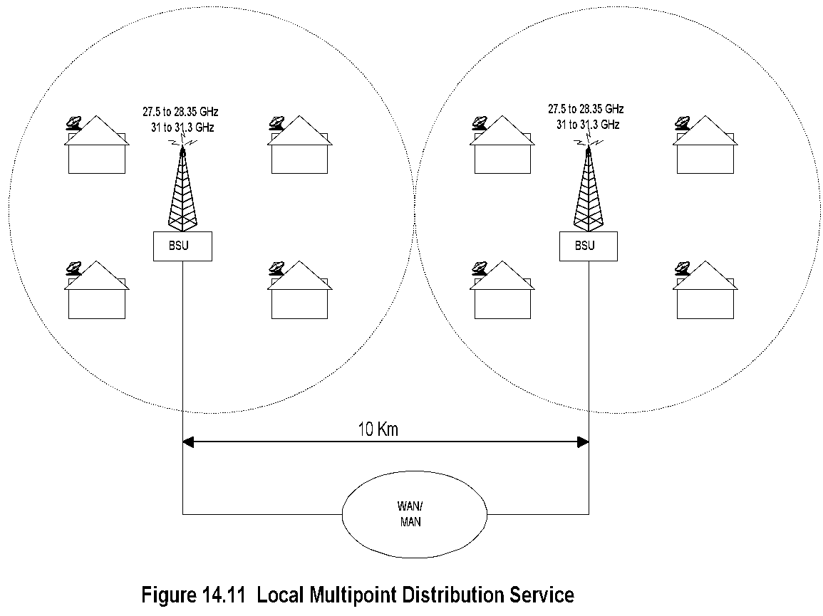
LMDS
Chapter 14 Broadband Wireless Access Networks
Notes
Point-to-multipoint architecture
Covers 5 km radius; BSUs spaced 10 km apart
Operates over 27-28.35 and 31-31.3 GHz bands
Sensitive to rain attenuation
Deploys cable modem equipment at both ends
Network Management: Principles and Practice
© Mani Subramanian 2010
*

Slide 18
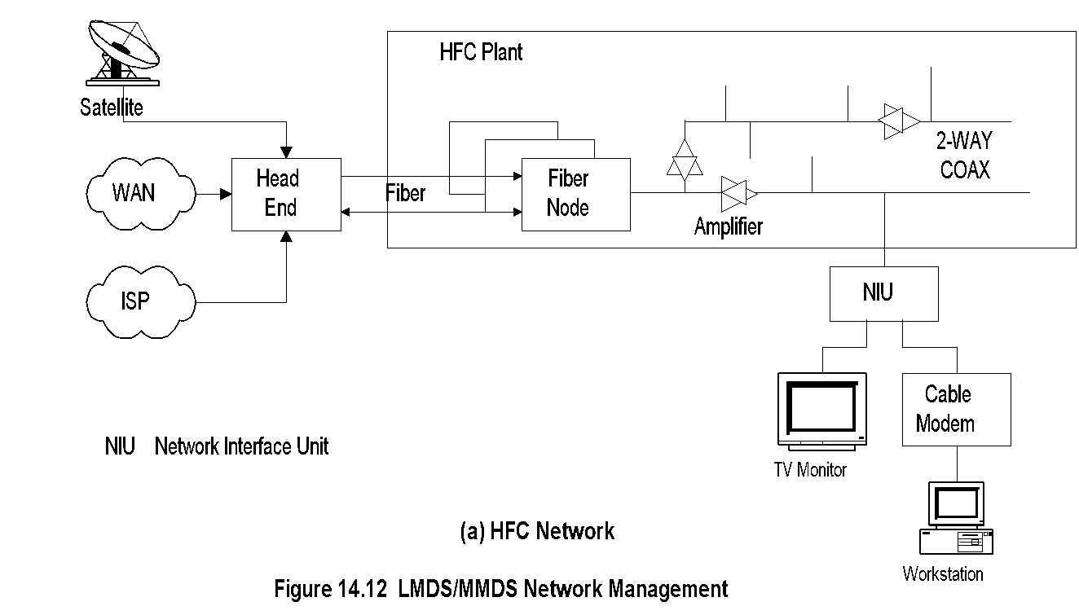
MMDS and Cable Network Management
Chapter 14 Broadband Wireless Access Networks
Notes
MMDS managed using DOCSIS (Data-Over- Cable Standard Interface Specifications)
Head end:
Signals from multiple sources multiplexed
Frequency conversion for local signal
NIU demarcation point between customer and service provider networks
Cable modem: RF-to-Ethernet conversion
Network Management: Principles and Practice
© Mani Subramanian 2010
*

Slide 19
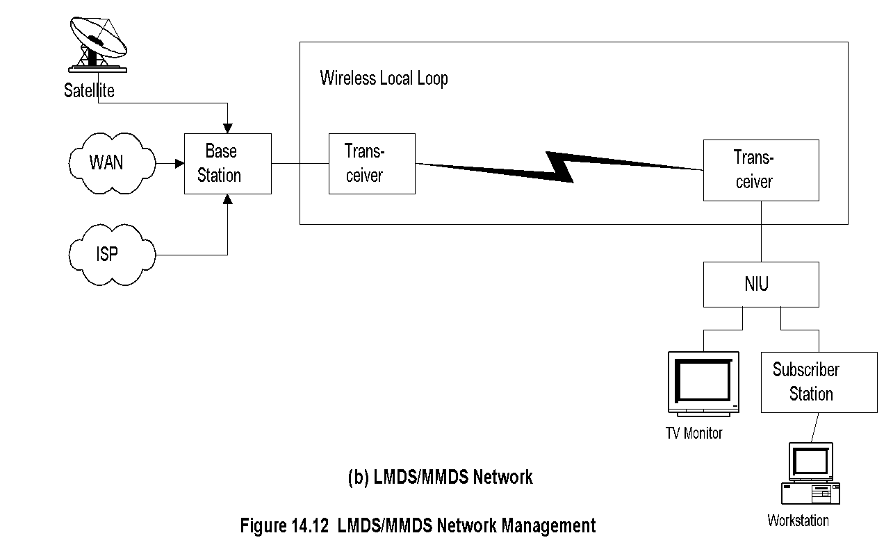
MMDS / LMDS Network Management
Chapter 14 Broadband Wireless Access Networks
Notes
Head end is replaced by base station
Cable modem replaced by transceiver and subscriber station
HFC plant replaced by wireless
DOCSIS standards used for the system
DOCSIS management standards adapted for management
Network Management: Principles and Practice
© Mani Subramanian 2010
*

Slide 20
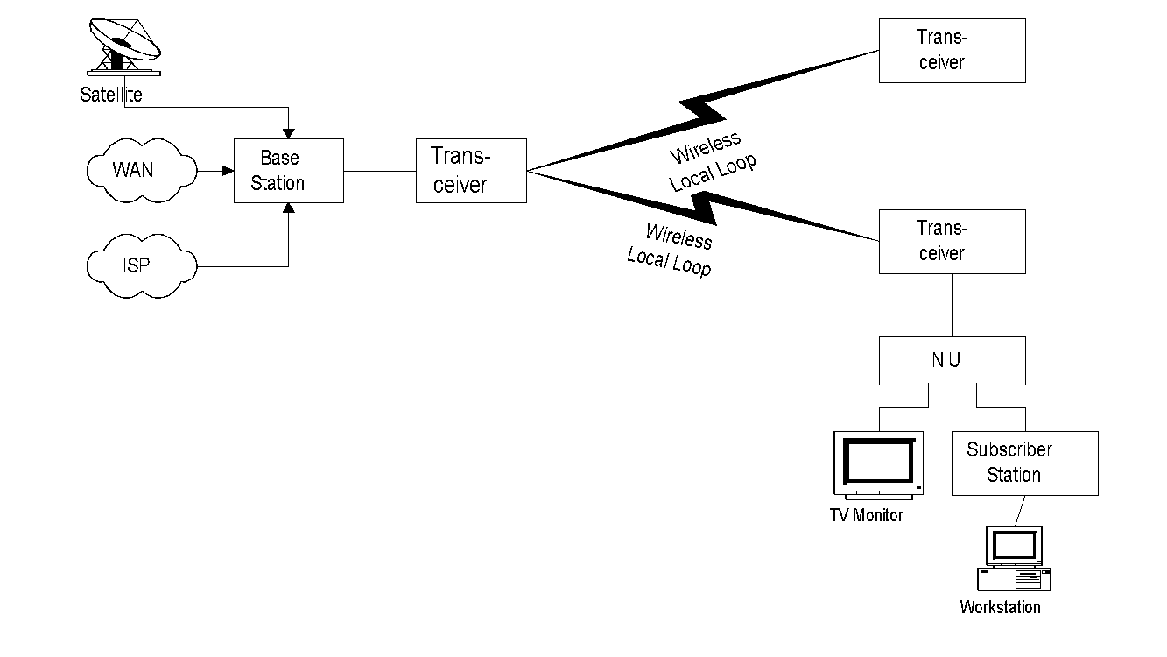
802.16 Fixed Wireless System
Chapter 14 Broadband Wireless Access Networks
Figure 14.13 IEEE 802.16 Fixed Wireless System
Notes
IEEE 802.16.1 specifications for 11 GHz to 66 GHz @ 2 to 155 Mbps with flexible asymmetry
Encompasses multiple end configurations and transmission modes
Point-to-multipoint architecture
Early implementation based on cable network
HFC medium replaced with wireless carrier
Transceivers perform up-conversion and down-conversion
Subscriber station a more complex modem than CM
Base station functions as enhanced CMTS
TDMA (Time Division Multiple Access) downstream transmission
DAMA (Demand Assigned Multiple Access) – TDMA upstream transmission
Network Management: Principles and Practice
© Mani Subramanian 2010
*

Slide 21
802.16 Base Station
Chapter 14 Broadband Wireless Access Networks
802.16 uses sector technology for base station antenna (HFC uses tree topology)
Point-to-multipoint transmission
All SSs in a cell terminated at the head end
Downstream in broadcast mode
Upstream transmission by DAMA-TDMA
Allocates bandwidth requested by SS to meet QoS
Gateway to the external (core) network
Multiplexes and demultiplexes signals
Frequency converts upstream to downstream signals in FDD (Frequency Division Duplex)
Can be designed either as a bridge or router
Notes
Network Management: Principles and Practice
© Mani Subramanian 2010
*

Slide 22
802.16 Subscriber Station
Chapter 14 Broadband Wireless Access Networks
Highly directional antenna
DOCSIS 1.1 (and beyond) compliant CM used with primary upstream service flow
Downstream in broadcast mode
Upstream transmission by CM/SS coordinated by head end
Notes
Network Management: Principles and Practice
© Mani Subramanian 2010
*

Slide 23
IEEE 802.16 Extensions
Chapter 14 Broadband Wireless Access Networks
IEEE 802.16a
2 to 11 GHz; Supports mesh deployment
IEEE 802.16b
5 TO 6 GHz; Real-time DiffServ service
IEEE 802.16c
10 to 66 GHz
IEEE 802.16d
Improvement over 802.16a
IEEE 802.16e (future)
Std networking between carrier base stations
High-speed handoff with moving vehicles
Notes
Network Management: Principles and Practice
© Mani Subramanian 2010
*

Slide 24
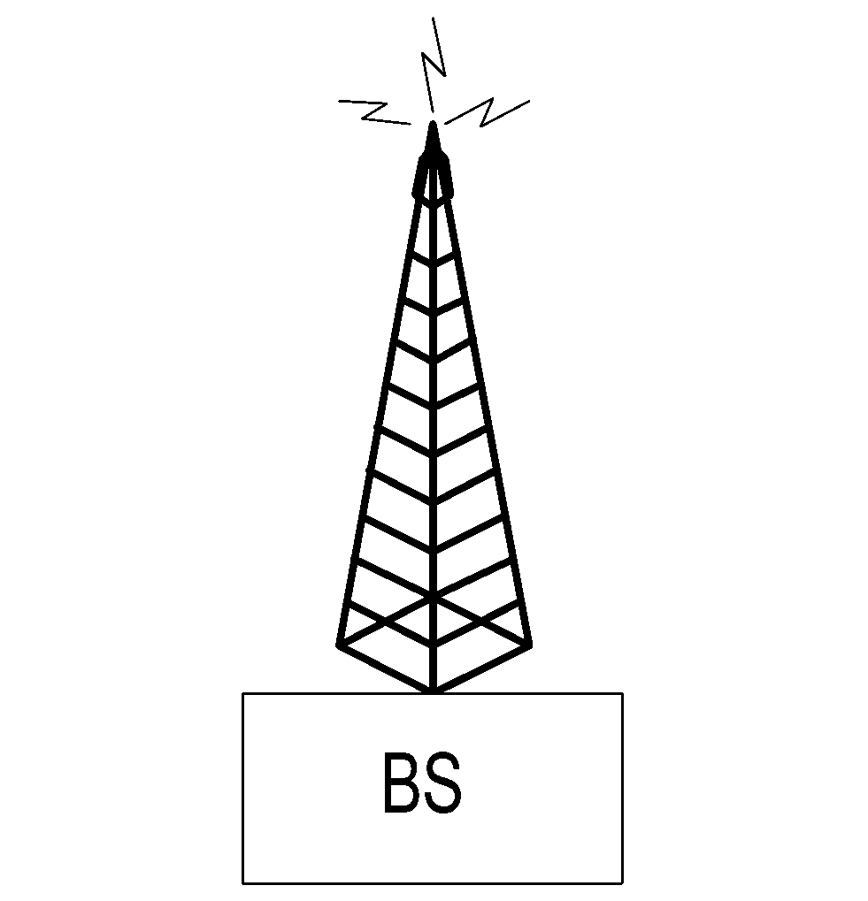
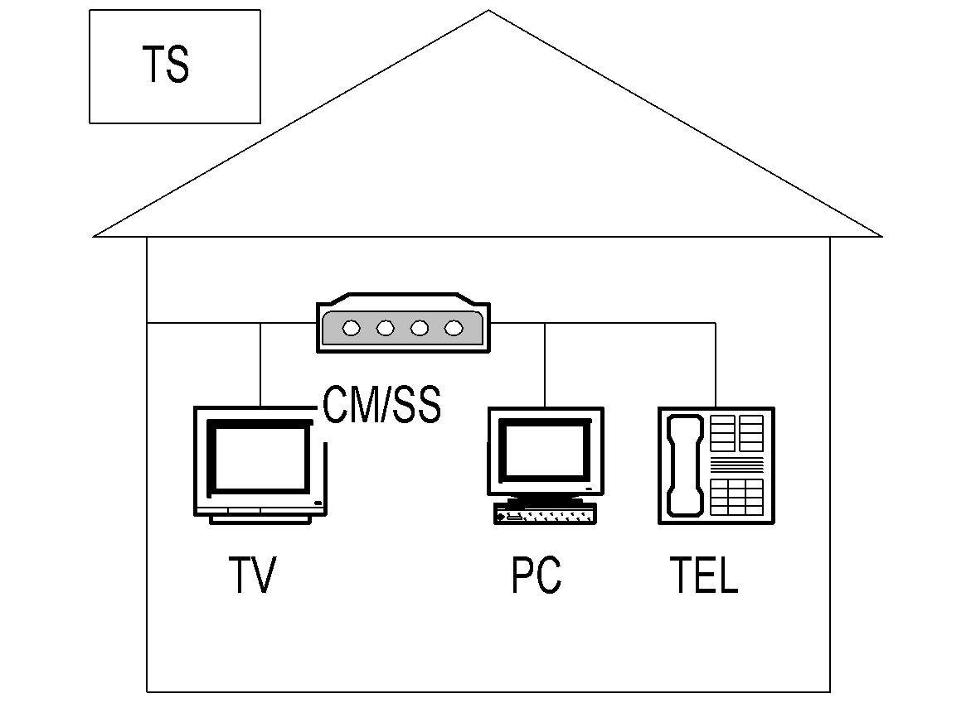

802.16d WiMax
Chapter 14 Broadband Wireless Access Networks
Figure 14.14 WiMax Mesh Network
Notes
WMAN … Wireless Metropolitan Network
802.16a can support no-line-of-sight access
(unlike 802.16)
802.16a operated in the frequency range of 2 – 11 GHz and thus supports both licensed and unlicensed spectrum
Modulation scheme is OFDM as in 802.11a and 802.11g
Support for mesh architecture.
Network Management: Principles and Practice
© Mani Subramanian 2010
*

Slide 25
802.16d: PHY Layer
Chapter 14 Broadband Wireless Access Networks
Air interfaceWirelessMAN-
SCa Single carrier
OFDM (commonly adopted) 256-carrier OFDM TDMA upstream
OFDMA 2048-carrier OFDM Upstream OFDMA – multiple carriers assigned to a receiver
Modulation and decoding
QPSK
16-QAM
64-QAM
Adaptive antenna system
Directed beams in PMP (Point-to-Multipoint)
Channel quality feedback from SS to BS
Notes
Network Management: Principles and Practice
© Mani Subramanian 2010
*

Slide 26
802.16d: MAC Layer
Chapter 14 Broadband Wireless Access Networks
Supports mesh network
Two sublayers
Convergence-specific: transport-specific
Common: independent of transport mechanism
Notes
Network Management: Principles and Practice
© Mani Subramanian 2010
*

Slide 27
Fixed BWA (Broadband Wireless Access) Management
Chapter 14 Broadband Wireless Access Networks
Components to be managed:
CM/SS management
BS management
Wireless link management
RF spectrum management
802.16 Recommendation OSI standards
FCAPS functions managed
Notes
Network Management: Principles and Practice
© Mani Subramanian 2010
*

Slide 28
Class of Service and QoS
Chapter 14 Broadband Wireless Access Networks
802.16.1 supports classes of service with various QoS for bearer services
Bandwidth negotiation for connectionless service
State information maintainable for connection- oriented service
ATM Traffic categories:
CBR, VBR-rt, VBR-nrt, ABR, ABR
IETF Traffic categories: (Integrated services RFC 1633 and differentiated services RFC 2475)
Elastic:
Interactive bursts (Telnet)
Interactive bulk (FTP)
Asynchronous bulk (email)
Real-time
Guaranteed service (audio and video conferencing)
Predictive service (video playback)
Notes
Network Management: Principles and Practice
© Mani Subramanian 2010
*

Slide 29
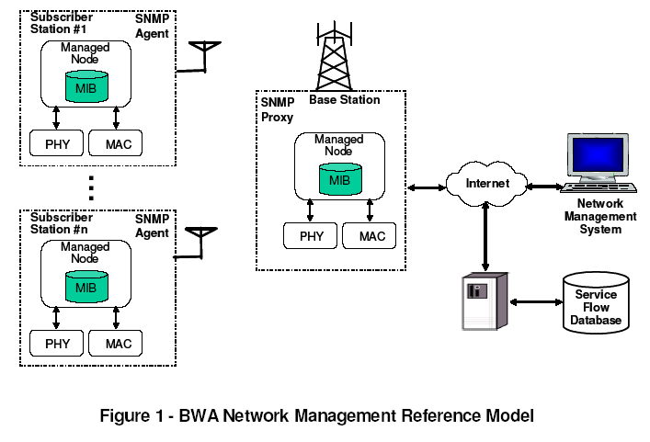
BWA NM Reference Model
Chapter 14 Broadband Wireless Access Networks
Figure 14.15 BWA Network Management Reference Model
Notes
Reference: “MAC and PHY MIB for WirelessMAN and WirelessHUMAN BS and SS,” IEEE C802.16mgt-04/04r1, http://ieee802.org/16
Network Management: Principles and Practice
© Mani Subramanian 2010
*

Slide 30
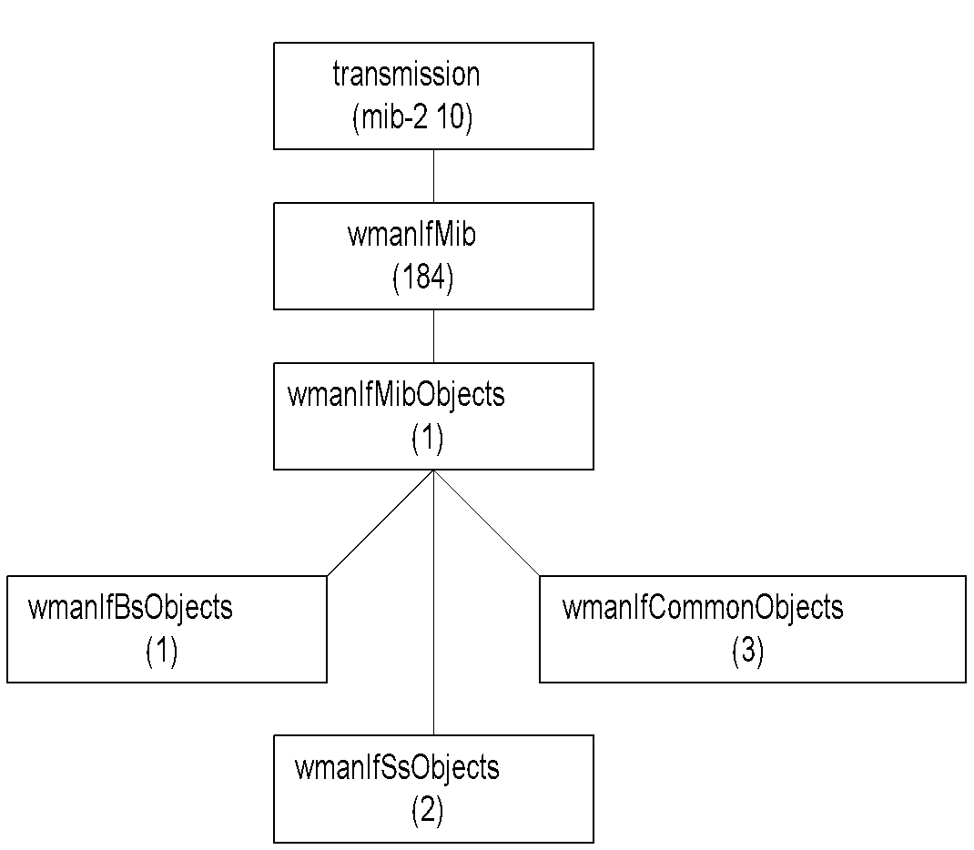
WMAN IF MIB
Chapter 14 Broadband Wireless Access Networks
Figure 14.16 WMAN IF MIB
Notes
Network Management: Principles and Practice
© Mani Subramanian 2010
*

Slide 31
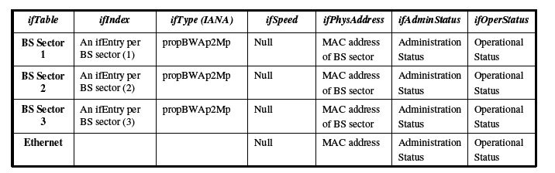
Usage of ifTable Objects for Base Station
Chapter 14 Broadband Wireless Access Networks
Table 14.1 Usage of ifTable Objects for the Base Station
Notes
SNMP agent in a common base station controller: Each BS sector will have an entry in the ifTable
SNMP agent in the sector controller: One entry for the BS sector in the ifTable
Network Management: Principles and Practice
© Mani Subramanian 2010
*

Slide 32
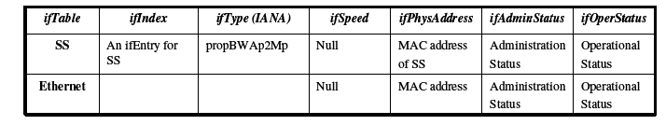
Usage of ifTable Objects for Subscriber Station
Chapter 14 Broadband Wireless Access Networks
Table 14.2 Usage of ifTable Objects for the Subscriber Station
Notes
Network Management: Principles and Practice
© Mani Subramanian 2010
*

Slide 33
Commercial Examples
Chapter 14 Broadband Wireless Access Networks
CorDect / CorVan
Ricochet
Broadband Solutions
MeshNetworks
PacketHop
Navini
Notes
Network Management: Principles and Practice
© Mani Subramanian 2010
*

Slide 34
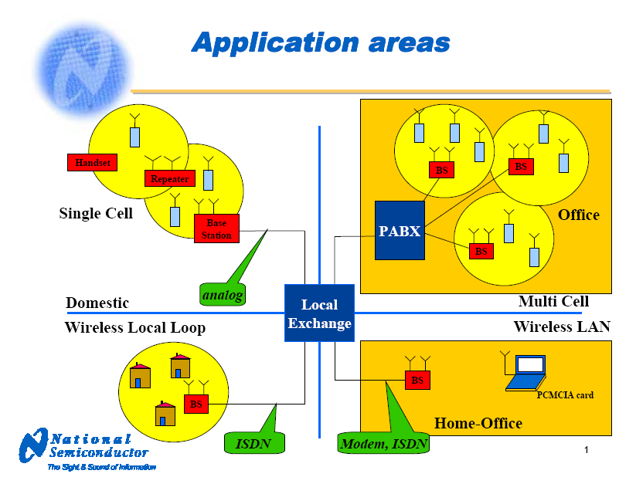
DECT WLL
Chapter 14 Broadband Wireless Access Networks
Notes
Digital European Cordless Telecommunications
Digital Enhanced Cordless Telecommunications
Frequency spectrum
ISM 2.4 GHz
DECT 1.9 GHz
Low-cost DCT design platforms for base stations and handsets
Network Management: Principles and Practice
© Mani Subramanian 2010
*

Slide 35
corDect
Chapter 14 Broadband Wireless Access Networks
Midas Communications / IITM TeNet Group
Components
Central station: DIU
Base Stations: 5 BSDs per DIU
Air Interface: 4 CVSs per BSD
Simultaneous voice and dedicated Internet access (up to 70 Kbps)
Coverage up to 10 km, can be extended to 35 km using relay base station
EMS / NMS with proprietary MIB
.
Notes
Network Management: Principles and Practice
© Mani Subramanian 2010
*

Slide 36
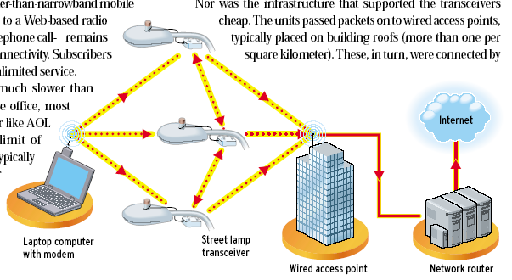
Ricochet Internet Access
Chapter 14 Broadband Wireless Access Networks
Source: IEEE Spectrum, March 2002
Notes
128 kbps Internet connection
Unlicensed 900 MHz spectrum
Access Points mounted on light poles
Established in 22 cities
Filed bankruptcy in 2001
Bought out by Aerie Networks
Network Management: Principles and Practice
© Mani Subramanian 2010
*

Slide 37
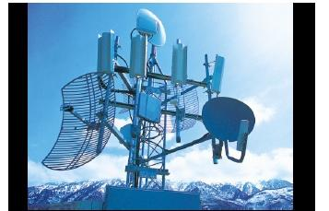
BBSC Broadband Solution
Chapter 14 Broadband Wireless Access Networks
Broadband Solutions Co. (BBSC) Hub
Notes
Broadband Solutions Co. (BBSC) broadband net- work in Utah uses fixed wireless access network
Has 6 wireless hubs over 1500 square kilometers
Supports 1400 customers
Supports hot spots of 2 – mbps connectivity
Operation at 2.4 and 5.7 GHz
Network Management: Principles and Practice
© Mani Subramanian 2010
*

Slide 38
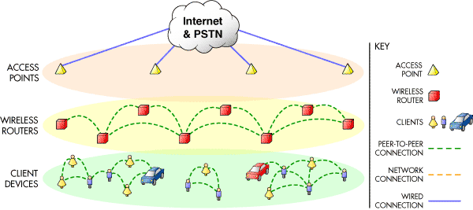
MeshNetworks Enabled Architecture
Chapter 14 Broadband Wireless Access Networks
Source: www.MeshNetworks.com
Notes
Supports
Backhaul access point infrastructure
Client meshing of wireless peer-to-peer networks
Supports handoff between access points from mobile auto
Test set-up in Florida supports 500 kbps in moving vehicle at highway speed
Network Management: Principles and Practice
© Mani Subramanian 2010
*

Slide 39
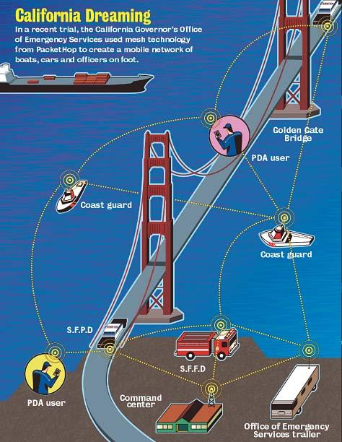
PacketHop
Chapter 14 Broadband Wireless Access Networks
Source: www.packethop.com
Notes
Network Management: Principles and Practice
© Mani Subramanian 2010
*

Slide 40
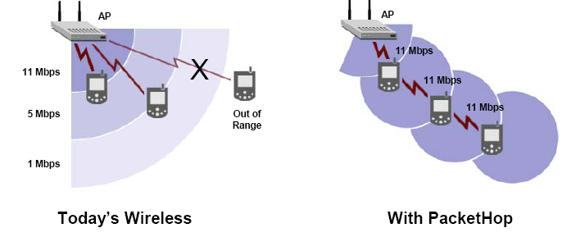
PacketHop Technology
Chapter 14 Broadband Wireless Access Networks
Source: www.packethop.com
Notes
Mobile units act as routers in a mesh configuration
Network Management: Principles and Practice
© Mani Subramanian 2010
*

Slide 41
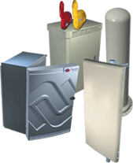
Navini Ripwave
Chapter 14 Broadband Wireless Access Networks
Source:www.navini.com
Notes
Fixed wireless
Components
Base Station
Element Management System
Modem
Operates in the unlicensed 2.4 GHz ISM band, or the licensed 2.3 GHz WCS, 2.5/2.6 GHz ITFS/MMDS bands
Network Management: Principles and Practice
© Mani Subramanian 2010
*

Slide 42
Mobile Wireless Networks
Chapter 14 Broadband Wireless Access Networks
Network Management: Principles and Practice
© Mani Subramanian 2010
*
Notes:
Chapter 14

Slide 43
Mobile and Wireless
Chapter 14 Broadband Wireless Access Networks
Mobile Network
A network with ability to perform computing anytime/anywhere
May or may not use wireless transmission medium
Types of mobility
Cellular: Always-on
Nomadic: Session not active while in motion
Wireless Network
A network with wireless interface to computing devices and/or wired network
Deployed for networking both fixed and mobile users
Mobile and Wireless Broadband Network Management
Management of integrated wired/wireless and fixed/mobile broadband – voice, video, and data networks
Notes
Network Management: Principles and Practice
© Mani Subramanian 2010
*
Notes:
Chapter 14

Slide 44
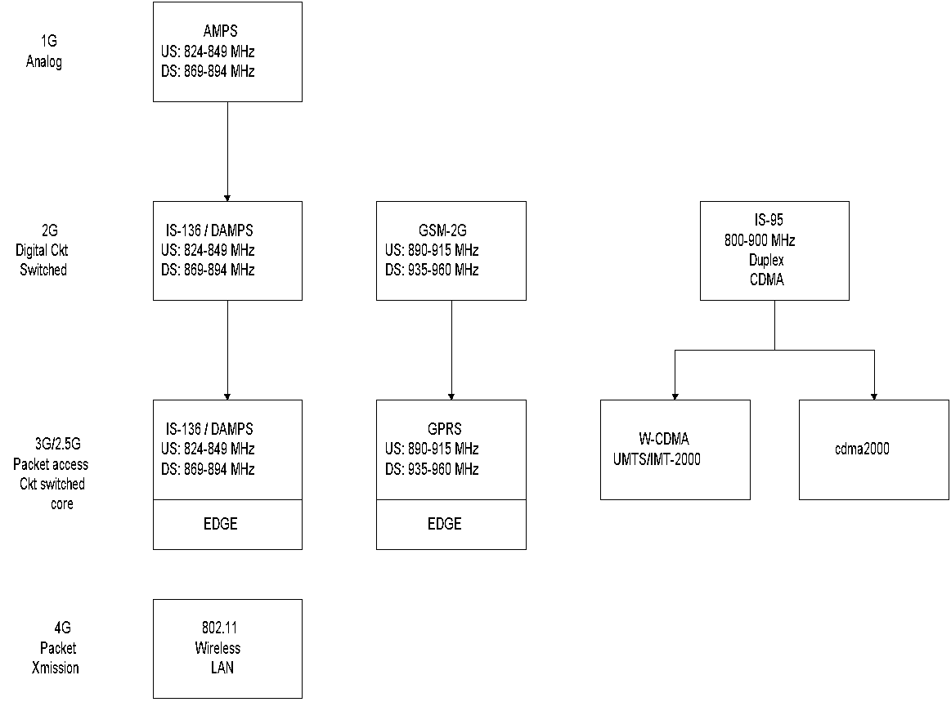
Mobile Wireless Evolution
Chapter 14 Broadband Wireless Access Networks
Notes
IS-136/DAMPS TDMA-based
GSM TDMA-based
IS-95 CDMA based
FDD (Frequency Division Duplex)
IS-136, GSM/GPRS, and IS-95
Network Management: Principles and Practice
© Mani Subramanian 2010
*
Notes:
Chapter 14

Slide 45
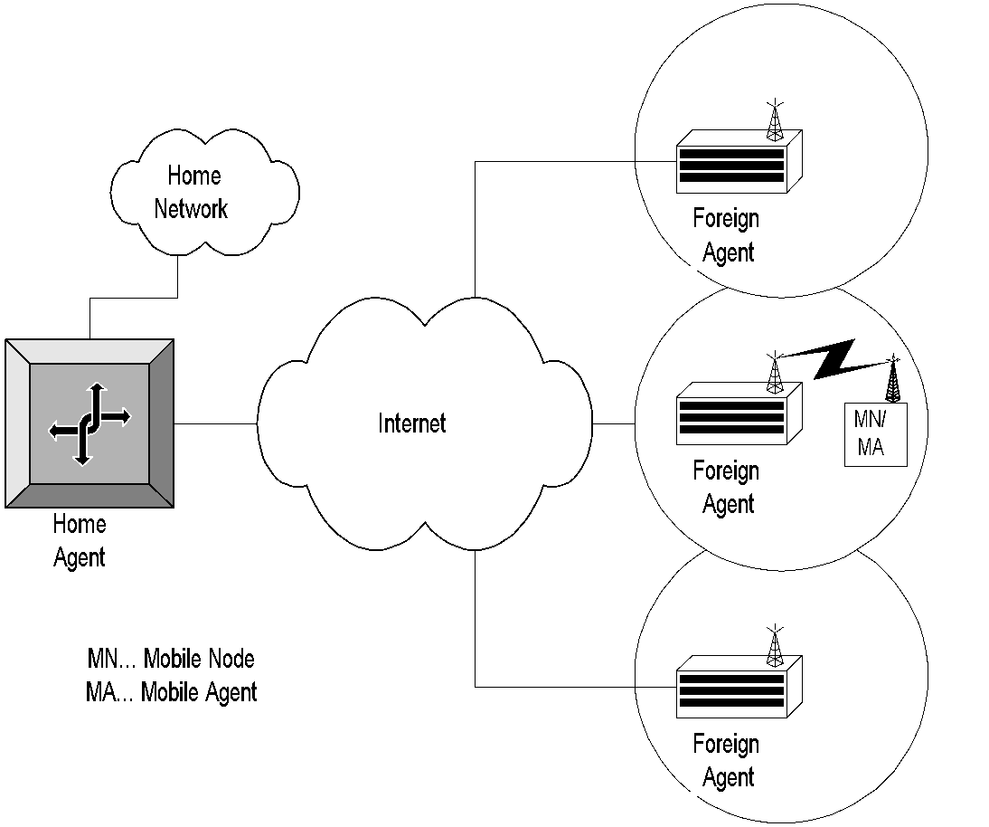
Cellular Network
Chapter 14 Broadband Wireless Access Networks
Table 14.17 Cellular Network
Notes
Network Management: Principles and Practice
© Mani Subramanian 2010
*
Notes:
Chapter 14

Slide 46
3G Management Issues
Chapter 14 Broadband Wireless Access Networks
Hierarchical LAN
Joint management with wired network
Mobile computing unit
Hardware limitations
Software limitations
Mobility management
Location tracking
Resource management
Wireless QoS management
Power management
Security management
Notes
Network Management: Principles and Practice
© Mani Subramanian 2010
*
Notes:
Chapter 14

Slide 47
Mobility Management
Chapter 14 Broadband Wireless Access Networks
Mobile IP
Location tracking
Discovery of Foreign Agents by Mobile Units
Broadcasting/advertising to locate an MU
Solicitation by MU
Handoff management
Packet control function (PCF) / Radio Network
Handoff of PCF to PCF within PDSN
Handoff of PCF between PDSNs
Notes
Network Management: Principles and Practice
© Mani Subramanian 2010
*
Notes:
Chapter 14

Slide 48
Mobile IP
Chapter 14 Broadband Wireless Access Networks
Mobile vs. nomadic
Mobile: activities not disrupted when point of attachment is changed
Nomadic: not active in motion; a.k.a. Portable computing
Analogy with telephone: Subscriber assigned an ID in both – phone number vs. IP address
Mobile IP is analogous to call forwarding, except the forwarding address is mobile
Notes
Network Management: Principles and Practice
© Mani Subramanian 2010
*
Notes:
Chapter 14

Slide 49
Mobile IP Functions - Roaming
Chapter 14 Broadband Wireless Access Networks
Mobile IP uses two addresses: a fixed home address and a care-of-address that changes the point of attachment
Mobile IP functions:
Mobile Agent ( Mobile Node) Discovery of foreign agent (FA)
Registration of current location with FA and home agent (HA)
Tunneling of packets to and from the HA to FA care-of-address as mobile node roams
Notes
Network Management: Principles and Practice
© Mani Subramanian 2010
*
Notes:
Chapter 14

Slide 50
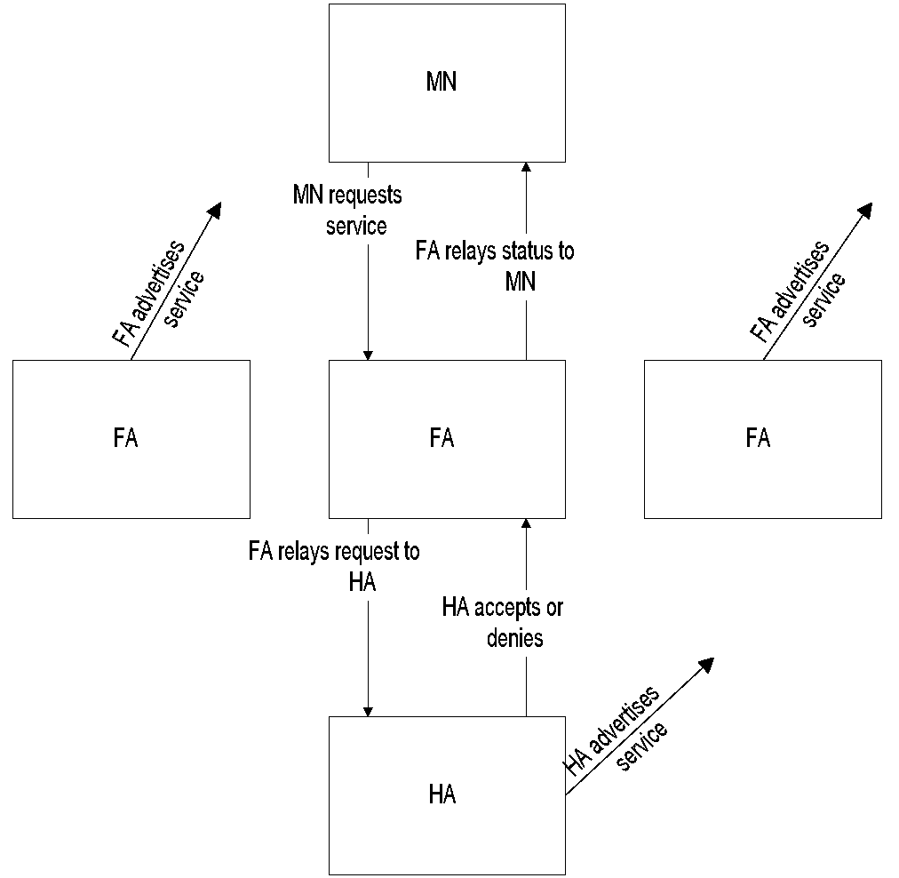
Discovery and Registration
Chapter 14 Broadband Wireless Access Networks
Table 14.18 Discovery and Registration in a Mobile System
Notes
Mobile node discovers foreign agent (FA) and its care-of-address by advertisements of FA
Mobile node can also discover by its solicitation
Mobile node registers FA with HA
Network Management: Principles and Practice
© Mani Subramanian 2010
*
Notes:
Chapter 14

Slide 51
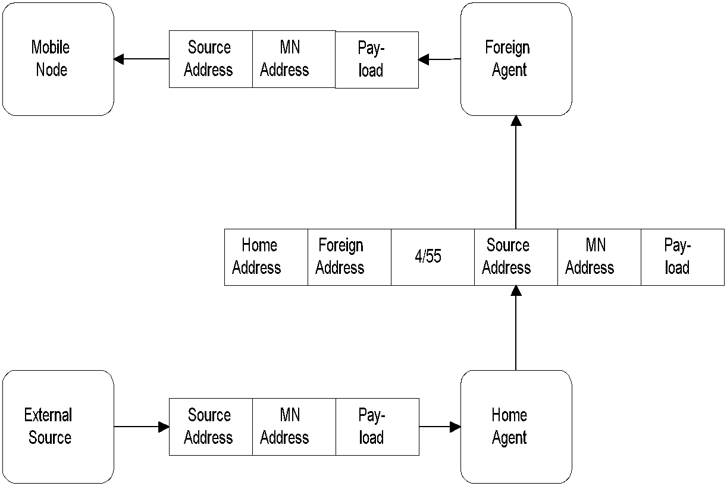
Tunneling
Chapter 14 Broadband Wireless Access Networks
Table 14.19 Tunneling in a Mobile System
Notes
Protocol number in the header:
4 indicates to higher level that the next header is an IP header with full encapsulation
55 indicates minimal encapsulation
Network Management: Principles and Practice
© Mani Subramanian 2010
*
Notes:
Chapter 14

Slide 52
SNMP Management of Mobile IP
Chapter 14 Broadband Wireless Access Networks
IETF Specifications using SMIv2 (RFC 1902) and MIB-II (RFC 1213)
Functional entities:
Mobile Node: A host or router that changes point of attachment from one network or subnet to another
Home Agent: A router on a mobile node’s home network, which tunnels packets to and from the mobile node via foreign agent
Foreign Agent: A router on a mobile node’s visited network, which provides services to the mobile node
Notes
Network Management: Principles and Practice
© Mani Subramanian 2010
*
Notes:
Chapter 14

Slide 53
Mobile IP MIB Groups
Chapter 14 Broadband Wireless Access Networks
Groups | Mobile Node | Foreign Agent | Home Agent
mipSystemGroup | X | X | X
mipSecAssociationGroup | X | X | X
mipSecViolationGroup | X | X | X
mnSystemGroup | X
mnDiscoveryGroup | X
mnRegistrationGroup | X
maAdvertisementGroup |  | X | X
faSystemGroup |  | X
faAdvertisementGroup |  | X
faRegistrationGroup |  | X
haRegistrationGroup |  |  | X
haRegNodeCountersGroup |  |  | x
Network Management: Principles and Practice
© Mani Subramanian 2010
*
Notes:
Chapter 14

Slide 54
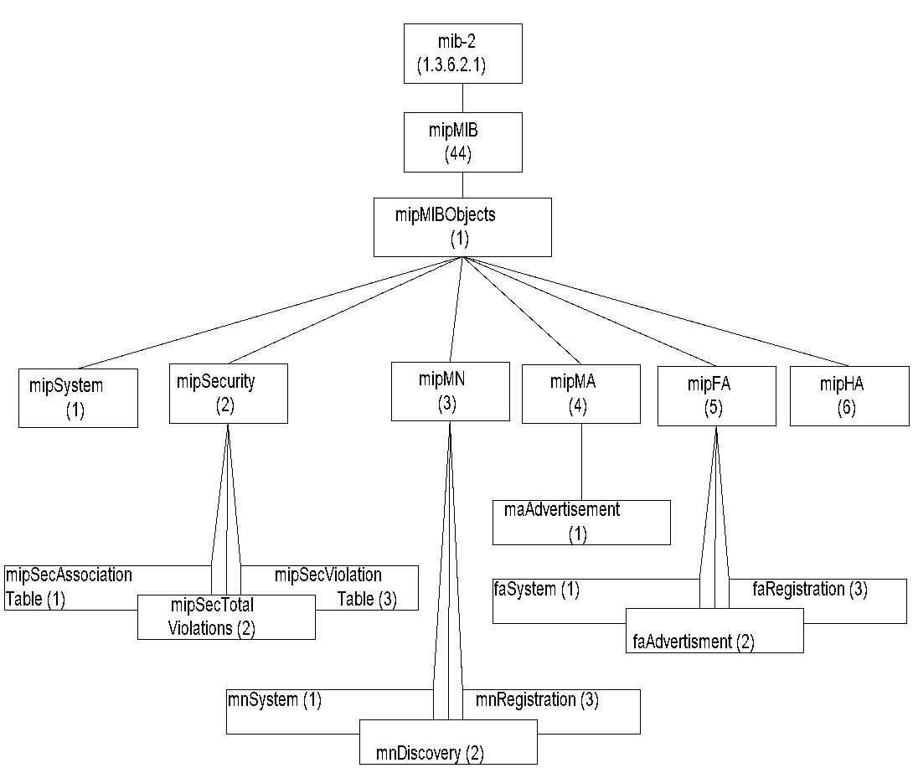
Mobile IP MIB
Chapter 14 Broadband Wireless Access Networks
Figure 14.20 Mobile IP MIB
Notes
Network Management: Principles and Practice
© Mani Subramanian 2010
*
Notes:
Chapter 14

Slide 55
mipMIBObjects
Chapter 14 Broadband Wireless Access Networks
Table 14.4 mipMIBObjects
Entity | OID | Description
mipMIBObjects | mipMIB 1 | Objects under mipMIB
mipSystem | mipMIBObjects 1 | Mobile IP system related parameters
mipSecurity | mipMIBObjects 2 | Mobile IP security parameters
mipSecurity AssociationTable | mipSecurity 1 | Security associations table
mipSecTotal Violations | mipSecurity 2 | Total number of security violations in the entity
mipSecViolation Table | mipSecurity 3 | Security violation information
mipMN | mipMIBObjects 3 | Mobile node group
mnSystem | mipMN 1 | Mobile node system information
Notes
Network Management: Principles and Practice
© Mani Subramanian 2010
*
Notes:
Chapter 14

Slide 56
mipMIBObjects
Chapter 14 Broadband Wireless Access Networks
Table 14.4 mipMIBObjects (cont.)
Entity | OID | Description
mnDiscovery | mipMN 2 | Mobile node discovery counter on solicitations, advertisements, and moves
mnRegistration | mipMN 3 | Mobile node registration table
mipMA | mipMIBObjects 4 | Mobile agent group
maAdvertisement | mipMA 1 | Mobility agent advertisement configuration table present in both MN and FA
mipFA | mipMIBObjects 5 | Foreign agent group
faSystem | mipFA 1 | Foreign agent system information
faAdvertisement | mipFA 2 | Foreign agent advertisement information plus MA advertisement group
faRegistration | mipFA 3 | Foreign agent visitors list
mipHA | mipMIBObjects 6 | Home agent registration group and mobility binding list
Network Management: Principles and Practice
© Mani Subramanian 2010
*
Notes:
Chapter 14

Slide 57
Resource Management
Chapter 14 Broadband Wireless Access Networks
Scheduling and call admission control
Reservation of guard channels for handoff - static
Dynamic control of call admission – complex to control multimedia service
Proposals for QoS-based handoffs
Load balancing between access networks
Power management
Notes
Network Management: Principles and Practice
© Mani Subramanian 2010
*
Notes:
Chapter 14

Slide 58
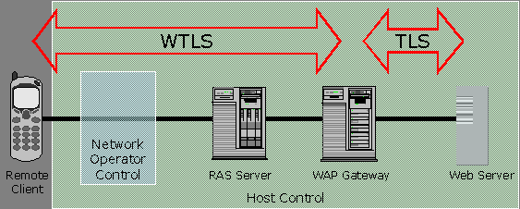
Security Management
Chapter 14 Broadband Wireless Access Networks
Notes
WAP (Wireless Application Protocol) Security
WAP Wireless transport layer security (WTLS)
Based on transport layer security (TLS) or secured sockets shell (SSL)
“Walled garden” “vertical” integrated approach
3G network security
3GPP (Third Generation Partnership Project) and 3GPP2 plan for IP to wireless device
Open standard SNMP based
Network Management: Principles and Practice
© Mani Subramanian 2010
*
Notes:
Chapter 14

Slide 59
QoS Management
Chapter 14 Broadband Wireless Access Networks
Table 14.5 UMTS QoS Specifications
QoS Class | TransferDelay | Transfer Delay Variation | Low BER | Guaran-teed Bit Rate | Example
Conver-sation | Strin- gent | Strin- gent | No | Yes | VoIP, Video- and Audio-conferencing
Stream-ing | Con- strained | Con- strained | No | Yes | Broadcast service, news, sport
Inter- active | Looser | No | Yes | No | Web browsing, interactive chat, games
Back-ground | No | No | Yes | No | email, SMS, TFP transactions
Notes
QoS support for last leg between access point and mobile node
Depends on mobility and resource management
3GPP/3GPP2 (3G Partnership Project) standards ensure interoperability
3GPP has defined four QoS classes (TS 23.107) shown above
Telephony handled using SIP (session initiation protocol)
Backbone based on DiffServ
Network Management: Principles and Practice
© Mani Subramanian 2010
*
Notes:
Chapter 14

Slide 60
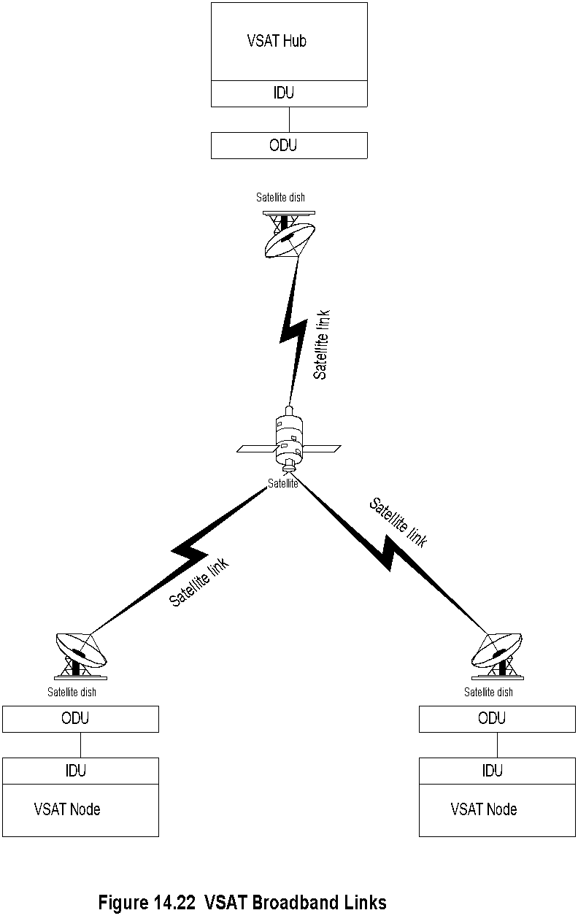
VSAT
Chapter 14 Broadband Wireless Access Networks
Notes
KU Band and KA band
40 – 60 kbps uplink and 500 kbps downlink
Network Management: Principles and Practice
© Mani Subramanian 2010
*
Notes:
Chapter 14

Slide 61
VSAT Components
Chapter 14 Broadband Wireless Access Networks
ODU Outdoor unit
Power amplifier
Up-converter
Down-converter
IDU Indoor unit
Modems
Frequency synthesizer
Encoder / decoder
Proxy agent for management; Later models with SNMP agent
Notes
Network Management: Principles and Practice
© Mani Subramanian 2010
*
Notes:
Chapter 14

