Slide 1
Chapter 12
Chapter 12 Broadband Network Management: WAN
Broadband Network Management: WAN
Network Management: Principles and Practice
© Mani Subramanian 2010
*

Slide 2
Objectives
Chapter 12 Broadband Network Management: WAN
Broadband WAN segment
IP (has been dealt with earlier)
ATM
MPLS
Optical and MAN feeder network
ATM
Virtual path–virtual circuit (VP-VC) operation
Real-time and non-real-time function for broadband service
ATM as public and private switched networks
Emulated LAN configuration
ATM management: M1, M2, M3, and M4 interfaces
ATM digital exchange interface management
MPLS
Possesses rich features of IP and good performance of ATM
Basic principles of label switching
Label switched path, LSP
Traffic engineering
MPLS OAM
Service level management
MPLS MIBs
MPLS TE MIBs
MPLS example
Optical and MAN feeder network
SONET-based MAN
SONET transport hierarchy
SDH and (D)WDM network
SDH management
WDM management
Network Management: Principles and Practice
© Mani Subramanian 2010
*

Slide 3
Broadband Services
Chapter 12 Broadband Network Management: WAN
Broadband Integrated Services Digital Network (BISDN)
Voice, video, and data services
Transport protocol and medium
(Basic) Integrated Services Digital Network (ISDN)
2B + D
WAN
ATM Cell-based Technology
SONET / OC-n (n x 51.84 Mbps)
SDH / STS
LAN
ATM LAN Emulation
Access Technology
Cable modem / HFC
DSL
Wireless
Notes
Network Management: Principles and Practice
© Mani Subramanian 2010
*

Slide 4
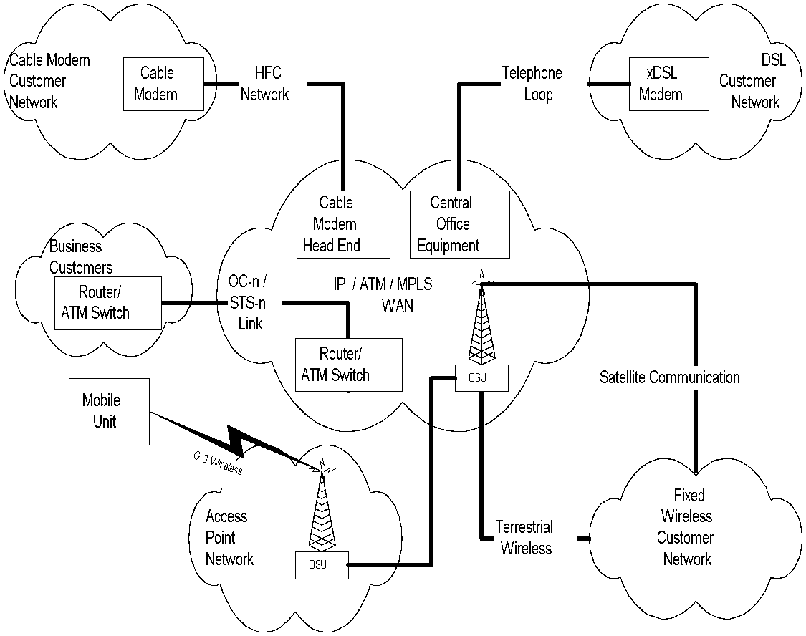
Broadband Services Network
Chapter 12 Broadband Network Management: WAN
Figure 12.1 Broadband Service Networks
Notes
IP / ATM over MPLS WAN
MAC / PHY layer SDH / SONET
Access Networks
OC-n used to access institutions
HFC, DSL and Fixed Wireless to residence
Limited mobile wireless technology
Network Management: Principles and Practice
© Mani Subramanian 2010
*

Slide 5
ATM Technology
Chapter 12 Broadband Network Management: WAN
ATM technology based on:
VP / VC
Fixed packet size or cell
Small packet size (53 bytes)
Statistical multiplexing
Integrated services
After initial set up, latency is reduced
Variable bit rate
Simultaneous real- and non-real time traffic
Notes
Network Management: Principles and Practice
© Mani Subramanian 2010
*

Slide 6
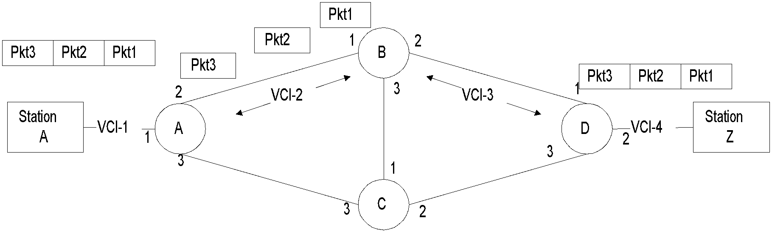
VP - VC
Chapter 12 Broadband Network Management: WAN
Figure 12.2 Virtual Circuit Configuration
Notes
Table 12.2 A-Z Virtual Circuit –Routing Tables
Switch | Input VCI / Port | Output VCI / Port
A | VCI-1 / Port-1 VCI-2 / Port-2 | VCI-2 / Port-2 VCI-1 / Port-1
B | VCI-2 / Port-1 VCI-3 / Port-2 | VCI-3 / Port-2 VCI-2 / Port-1
D | VCI-3 / Port-1 VCI-4 / Port-2 | VCI-4 / Port-2 VCI-3 / Port-1
All packets take the same path and arrive in the same sequence in virtual circuit
Packets in a session take the same path in VP/VC
After initial set up, latency is reduced
Network Management: Principles and Practice
© Mani Subramanian 2010
*

Slide 7
ATM LAN Emulation (LANE)
Chapter 12 Broadband Network Management: WAN
Difference between ATM and Ethernet
ATM is connection-oriented
ATM makes one-to-one connection
ATM 20-byte addressing scheme different from 6-byte Ethernet MAC address
LANE emulates services of a traditional LAN
Notes
Network Management: Principles and Practice
© Mani Subramanian 2010
*

Slide 8
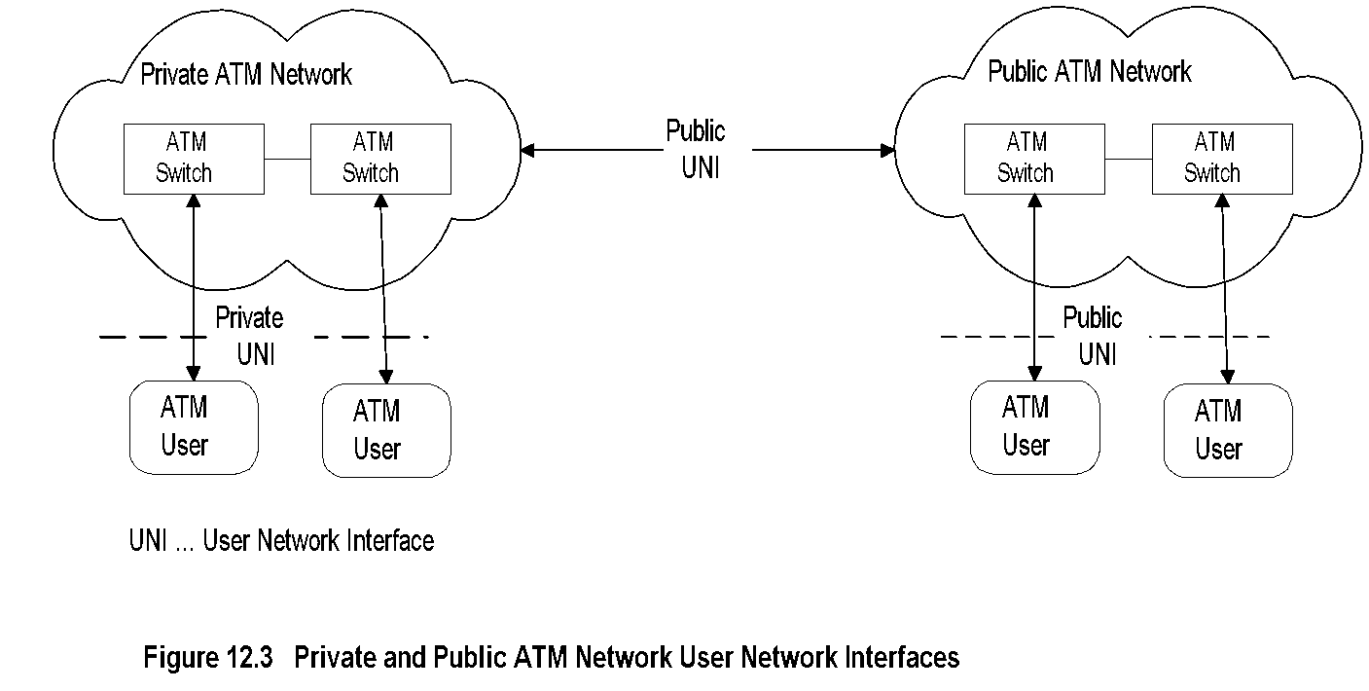
ATM WAN Reference Model
Chapter 12 Broadband Network Management: WAN
Notes
WAN service provided by public service providers
Private networks use public WAN facilities
Management functions (OAMP)
Operations
Administration
Maintenance
Provisioning
Public and private User Network Interface (UNI) define user interfaces
Network Management: Principles and Practice
© Mani Subramanian 2010
*

Slide 9
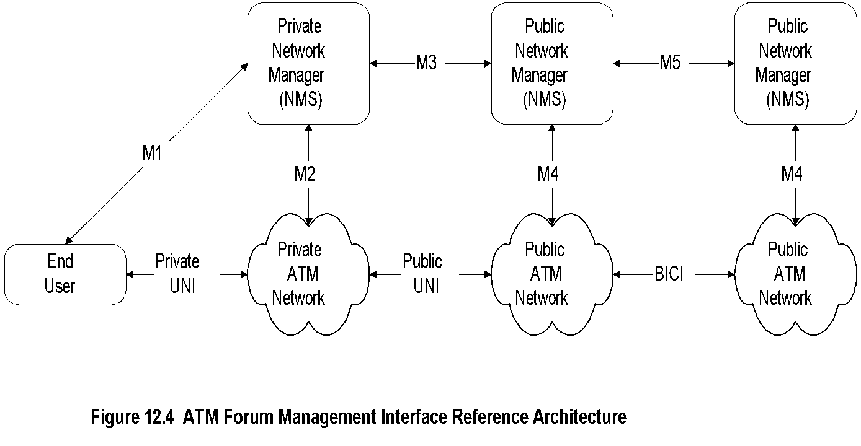
ATM WAN Management
Chapter 12 Broadband Network Management: WAN
BICI Broadband inter-carrier interface
Notes
Management interface architecture defined by ATM Forum
Public and private NMS responsible to manage respective domains
OSI has defined five management interfaces:
M1 Interface between private NMS and end user
M2 Interface between private NMS and network
M3 Interface between private NMS and public NMS
M4 Interface between public NMS and network
M5 Interface between public NMSs
Network Management: Principles and Practice
© Mani Subramanian 2010
*

Slide 10
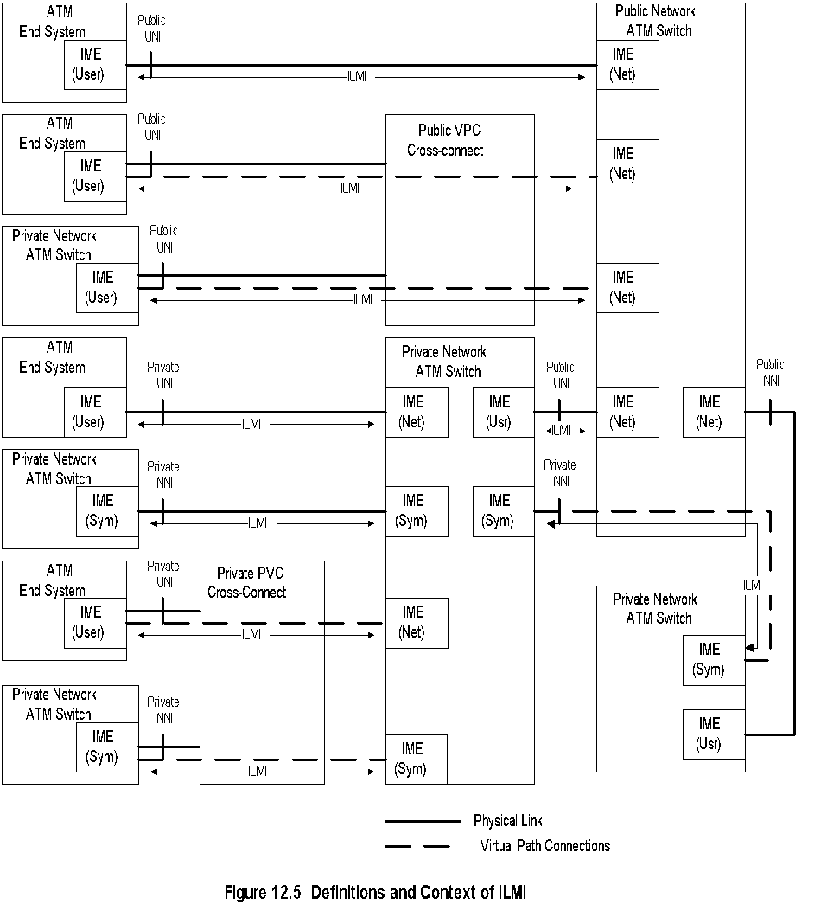
Integrated Local Management Interface (ILMI)
Chapter 12 Broadband Network Management: WAN
Notes
ATM Forum defines additional interface (ILMI)
UNI User network interface
NNI Network-Network interface
Network Management: Principles and Practice
© Mani Subramanian 2010
*

Slide 11
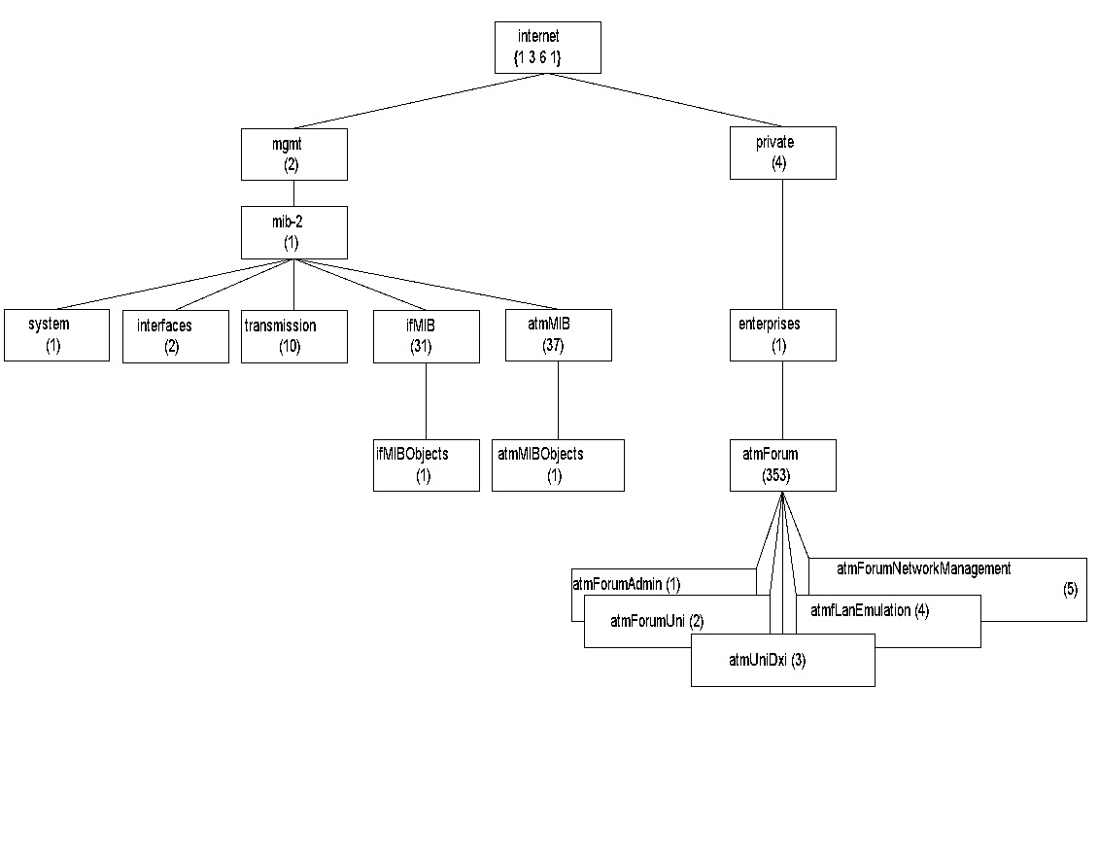
ATM MIB
Chapter 12 Broadband Network Management: WAN
Figure 12.6 Internet ATM MIB
Notes
MIBs defined in two sets of documents - IETF (5 nodes) & ATM Forum (1 node)
ATM MIBs address ATM sublayer parameters only
ifMIB contains additional objects not covered in interfaces MIB
atmMIB contains ATM objects
atmForum specifies interfaces, LANE, Mx, and ILMI
atmRMON (experimental) address ATM remote monitoring (covered in Chapter 8)
Network Management: Principles and Practice
© Mani Subramanian 2010
*

Slide 12
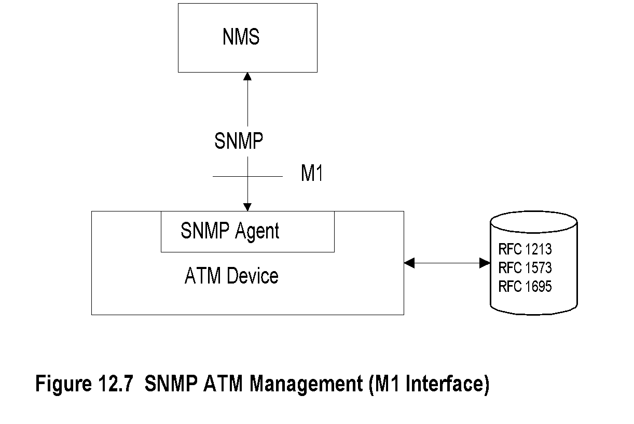
SNMP ATM Management
Chapter 12 Broadband Network Management: WAN
Notes
ATM Management specifications available for both SNMP and OSI management implementations
SNMP agent built in ATM device
System, Interfaces, Interface types, transmission carrier groups (T1, T3, SONET), and ATM object groups are monitored
Network Management: Principles and Practice
© Mani Subramanian 2010
*

Slide 13
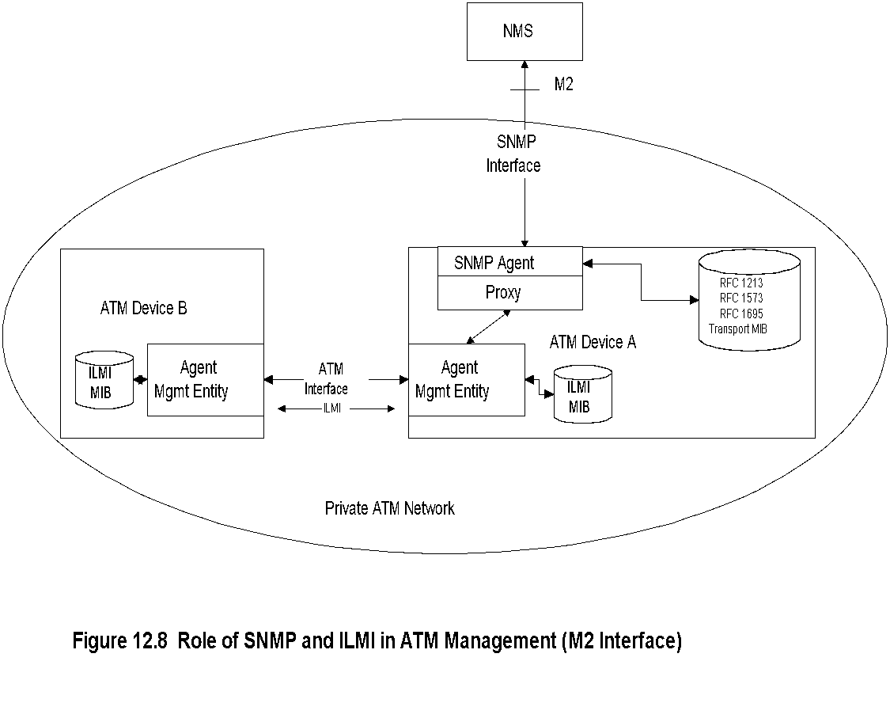
SNMP and ILMI
Chapter 12 Broadband Network Management: WAN
Notes
ILMI MIB used to gather data between ATM devices
Proxy agents convert ILMI objects to SNMP objects
Network Management: Principles and Practice
© Mani Subramanian 2010
*

Slide 14
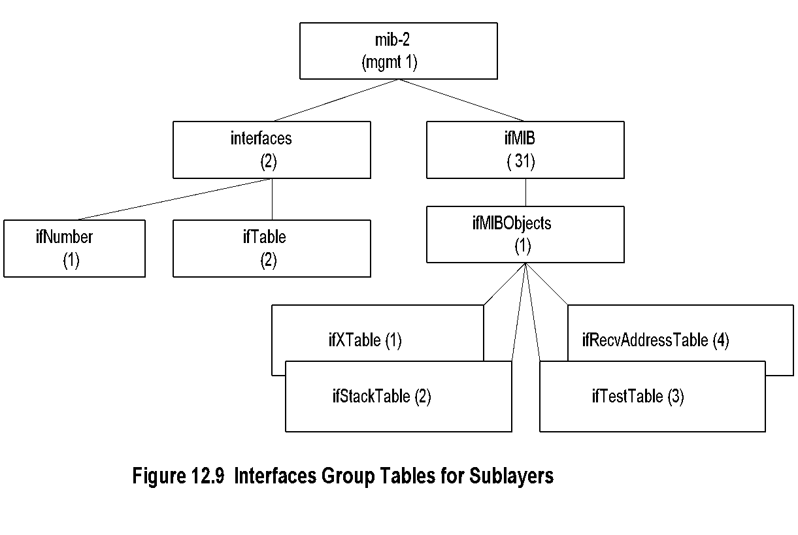
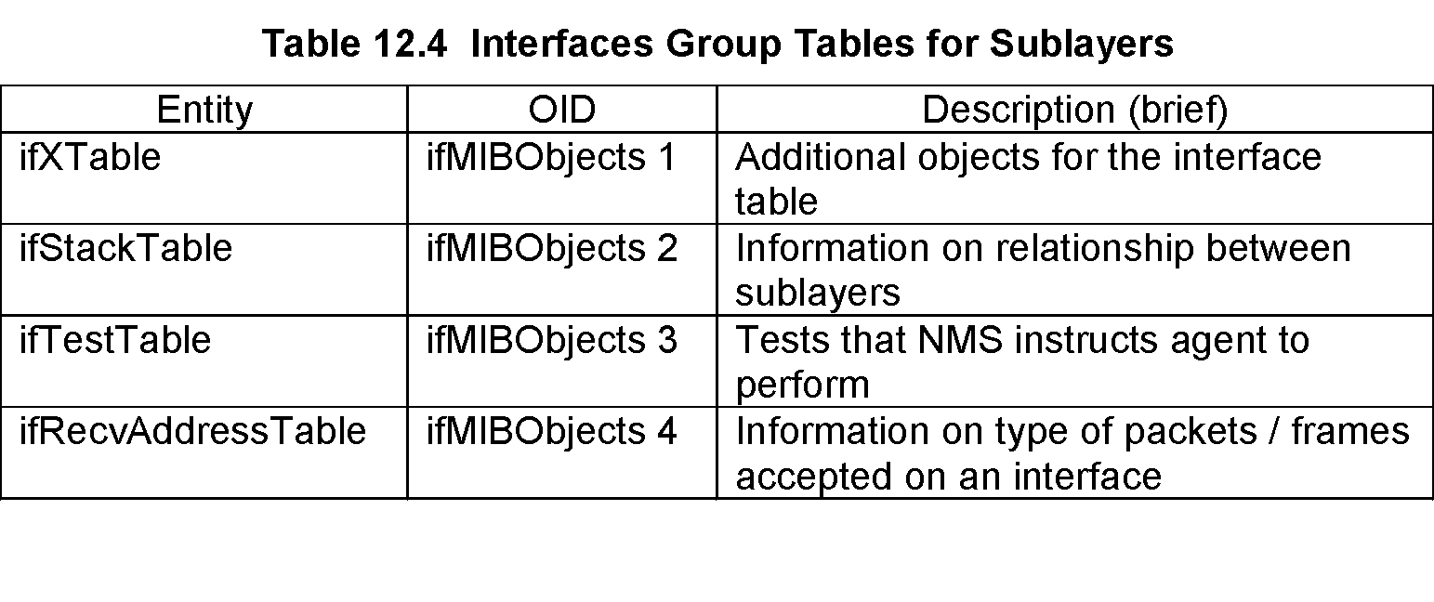
M1 Interface Management
Chapter 12 Broadband Network Management: WAN
Notes
M1 management interface is across an ATM device
Additional MIBs created using ifMIB group to handle sublayers
Network Management: Principles and Practice
© Mani Subramanian 2010
*

Slide 15
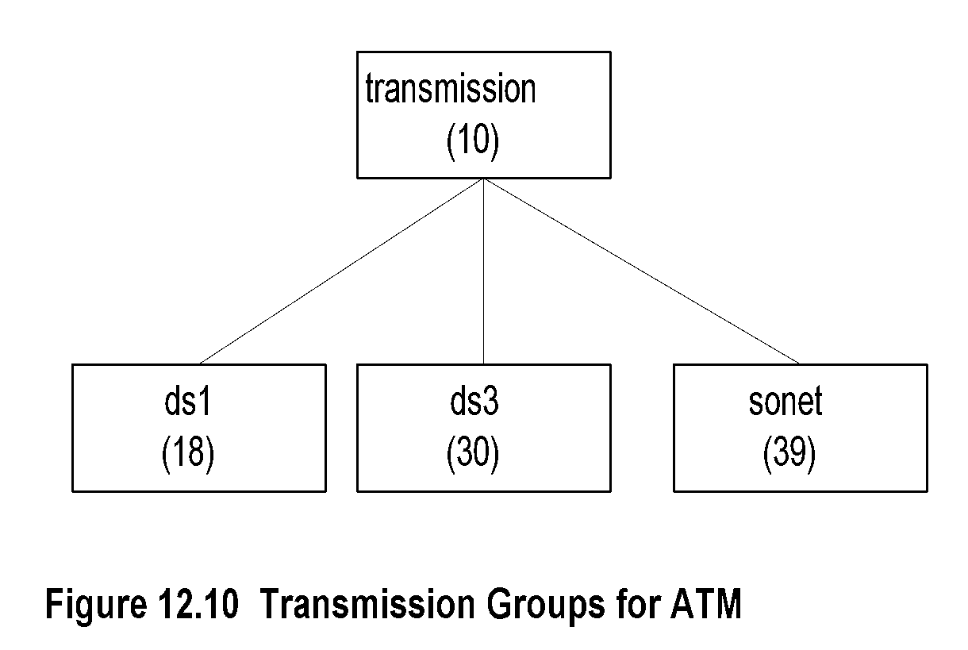
ATM Transmission Groups
Chapter 12 Broadband Network Management: WAN
Notes
Three transmission modes used for ATM in US
DS1 1.544 Mbps T1 carrier
DS3 44.736 Mbps T3 carrier
SONET n X 155.52 Optical fiber
Network Management: Principles and Practice
© Mani Subramanian 2010
*

Slide 16
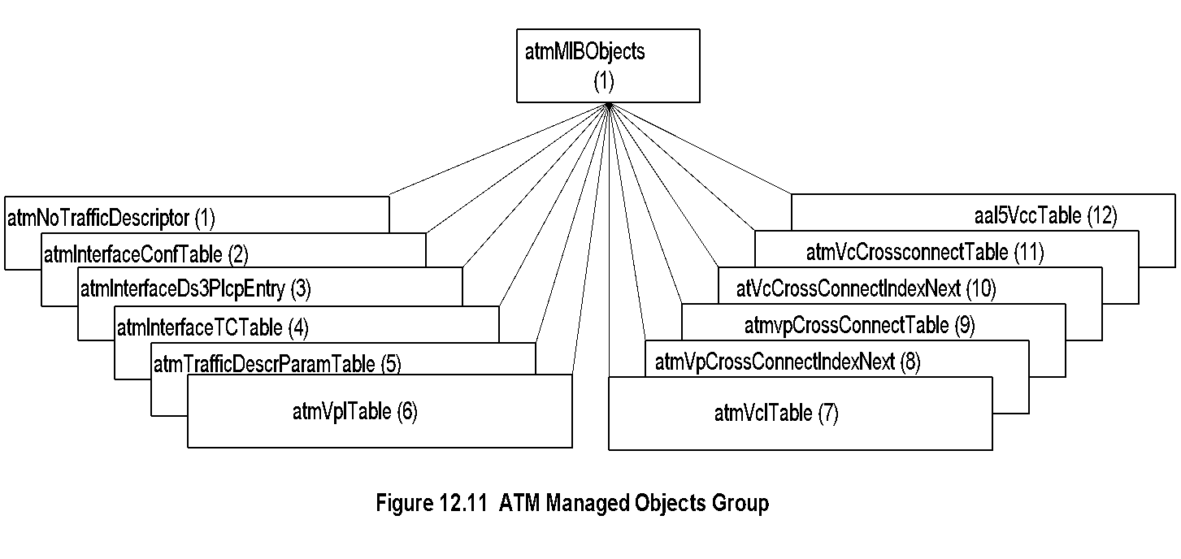
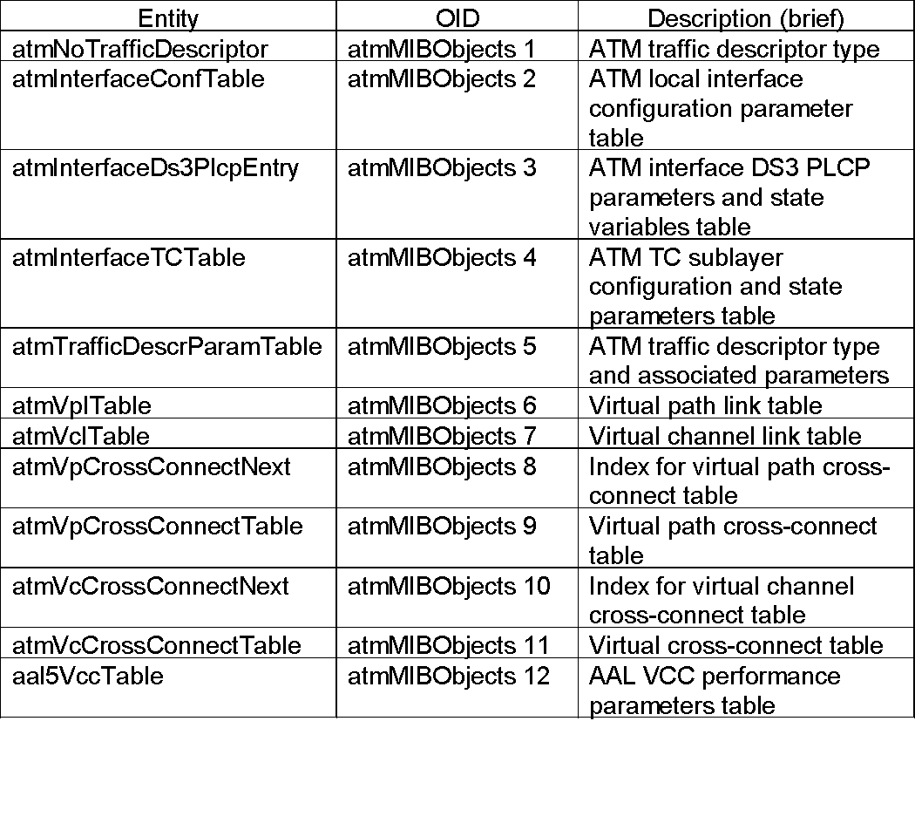
ATM Managed Objects Group
Chapter 12 Broadband Network Management: WAN
Network Management: Principles and Practice
© Mani Subramanian 2010
*

Slide 17
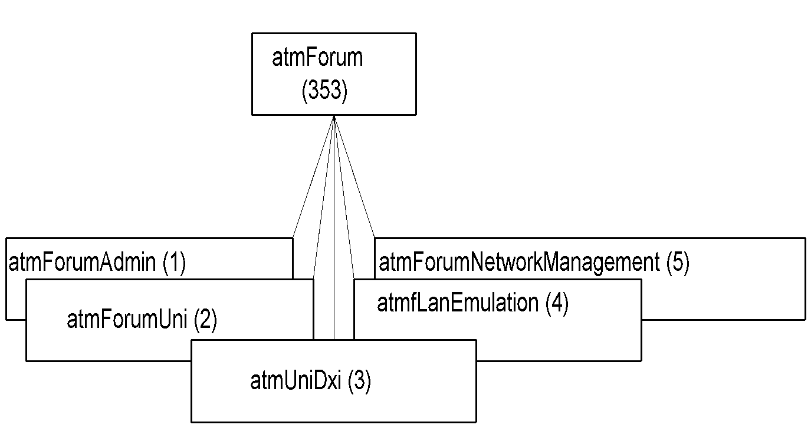
M2 Interface Management
Chapter 12 Broadband Network Management: WAN
Notes
M2 interface used to manage private networks
ATM link management data gathered using ILMI MIB
ILMI addresses:
Administrative information (atmForumAdmin) - registry to locate ATM network services such as LECS and ANS
UNI
DXI (Data Exchange Interface)
LAN Emulation
NNI
Network Management: Principles and Practice
© Mani Subramanian 2010
*

Slide 18
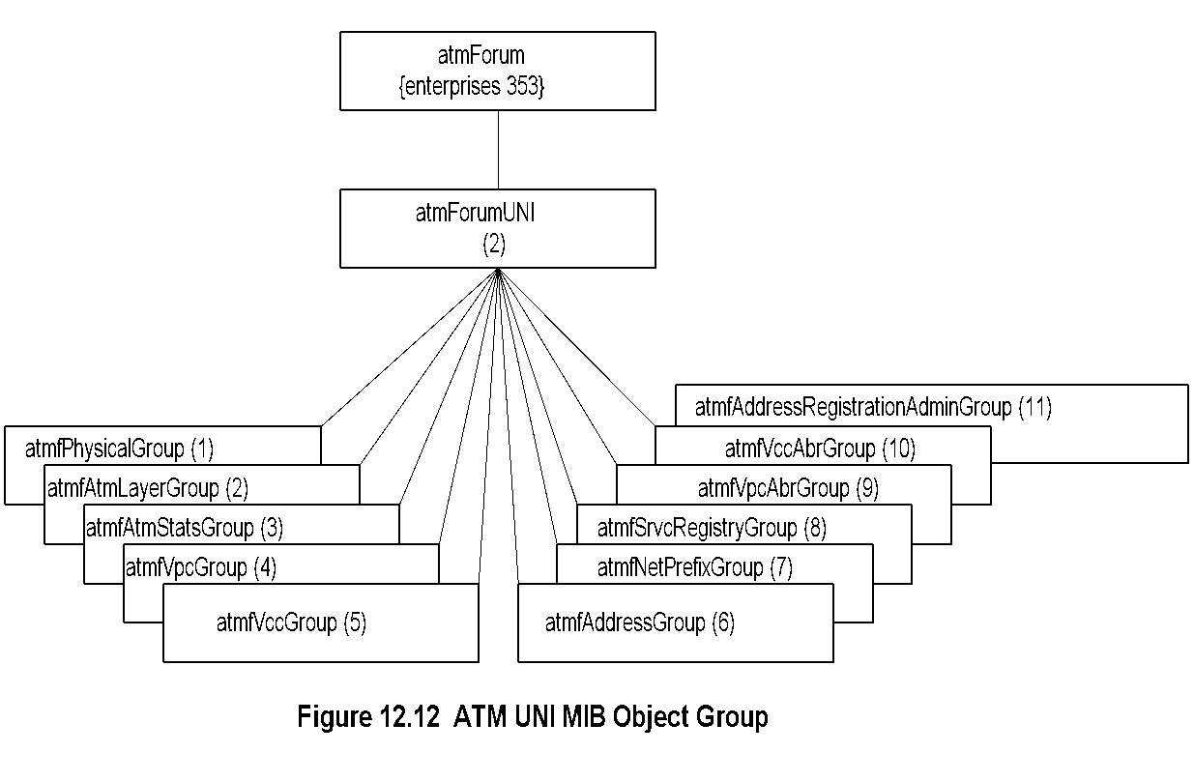
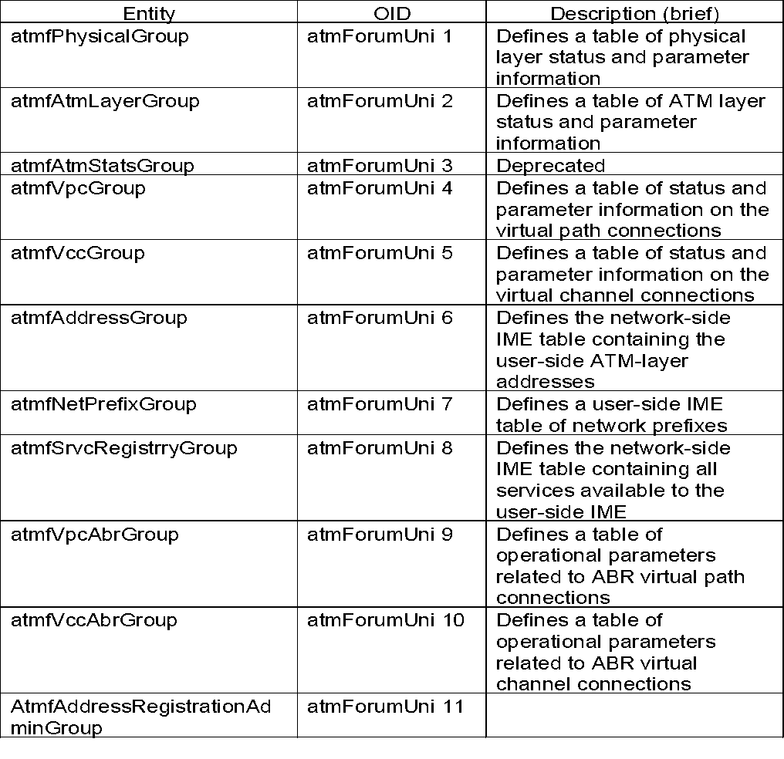
ATM UNI Group
Chapter 12 Broadband Network Management: WAN
Network Management: Principles and Practice
© Mani Subramanian 2010
*

Slide 19
M3 Interface
Chapter 12 Broadband Network Management: WAN
Services offered by public NMS to customer on PVCs
Two classes
Class I: Status and configuration management
Class II: Virtual configuration control
Class I:
Functions offered by public NMS to customer - monitoring and management of configuration, fault, and performance
Class II:
User ability to add, delete, and change VC between customer UNIs
Class I mandatory and Class II optional
Notes
Class I examples
Retrieving performance and configuration for UNI link
Public NMS reporting of a UNI link failure
Class II examples
Establishing a new VP
Increase the number of VCs in a VP
Network Management: Principles and Practice
© Mani Subramanian 2010
*

Slide 20
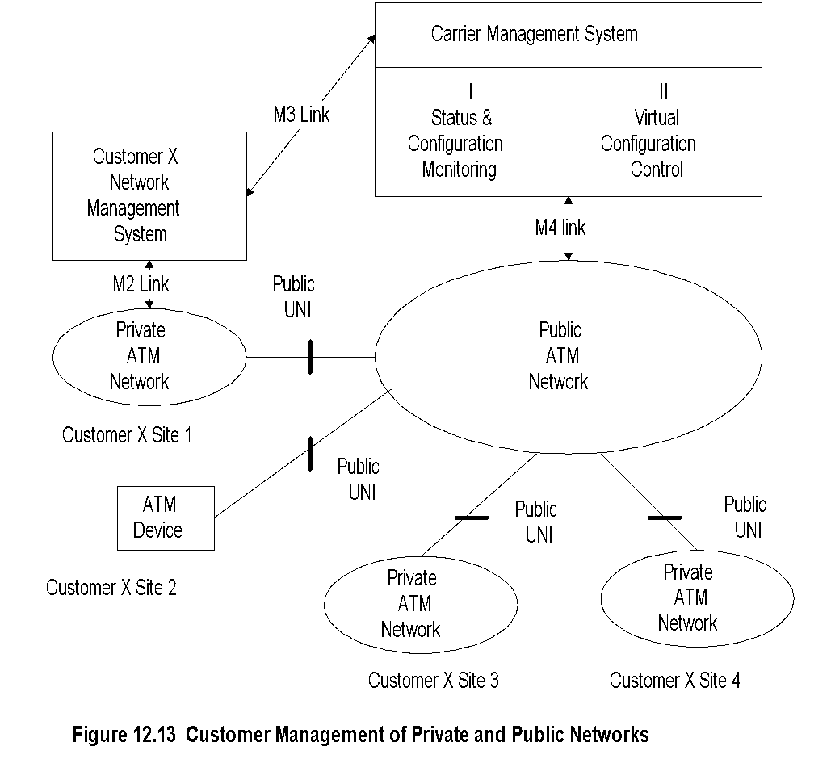
Customer Network Management (CNM)
Chapter 12 Broadband Network Management: WAN
Notes
CNM manages both private and public networks
CNM agent in public network provides M3 service
CNM manages its own ATM networks at sites 1, 3, and 4.
Network Management: Principles and Practice
© Mani Subramanian 2010
*

Slide 21
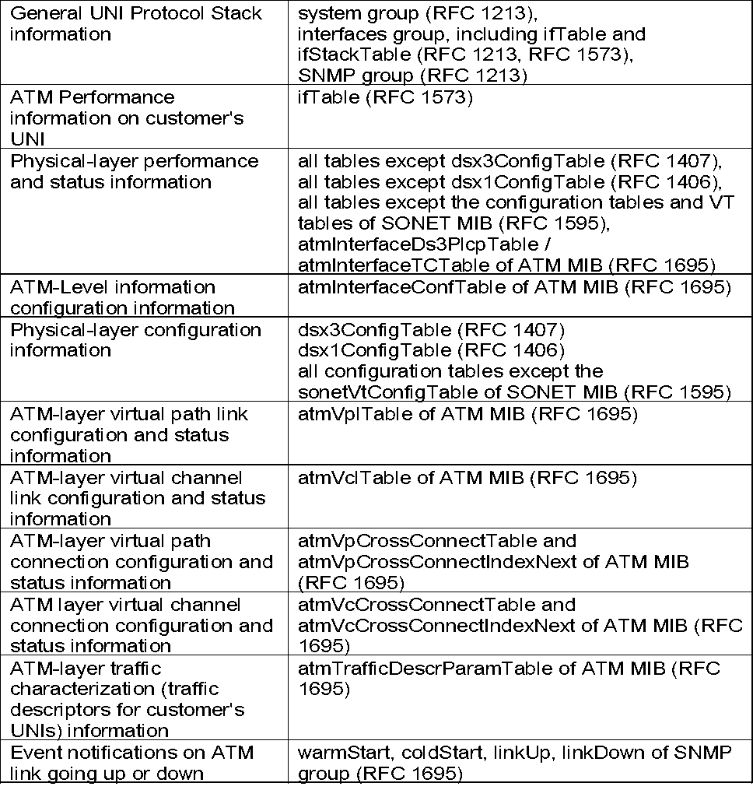
M3 Class I Management
Chapter 12 Broadband Network Management: WAN
Notes
Class I requirements used by customer NMS from carrier NMS
The MIB access is “read-only”
Network Management: Principles and Practice
© Mani Subramanian 2010
*

Slide 22
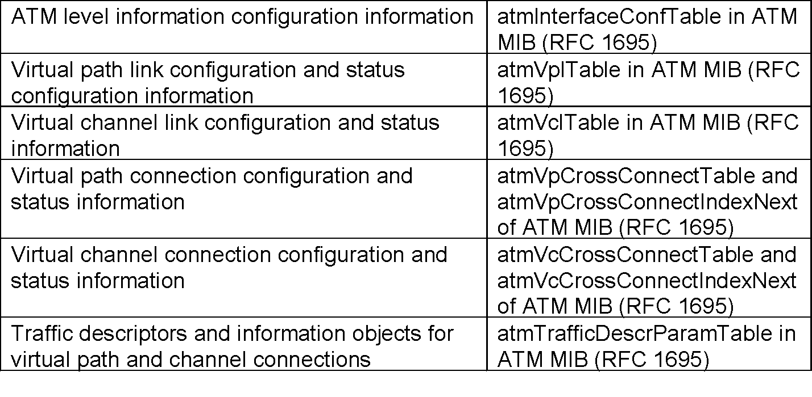
M3 Class II Management
Chapter 12 Broadband Network Management: WAN
Notes
Management information falls into three subgroups
ATM-level subgroup: configuration modification
VPC/VCC-level subgroup: configuration modification and status information of VP/VC link and connection
Traffic subgroup: modification of traffic descriptors and information for VP/VC connections
Network Management: Principles and Practice
© Mani Subramanian 2010
*

Slide 23
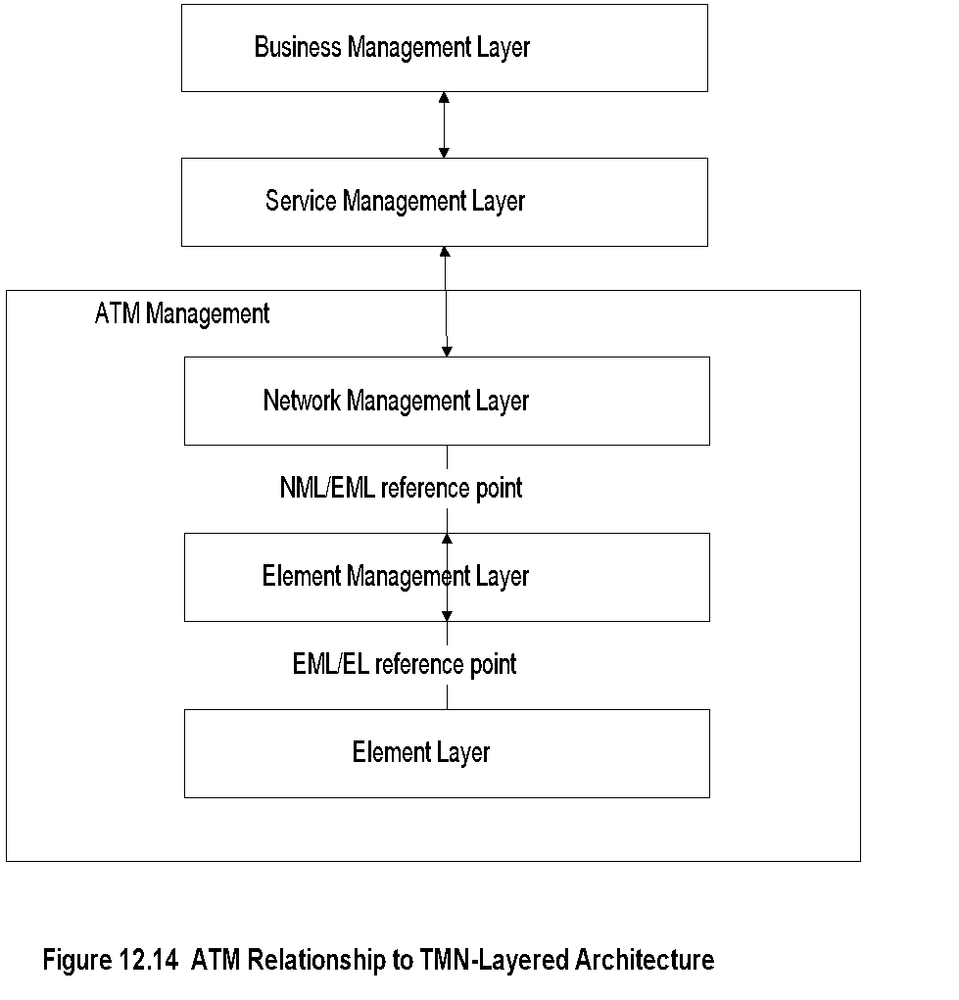
ATM Relationship to TMN
Chapter 12 Broadband Network Management: WAN
Notes
ITU-T definition of five-layer model to manage telecommunications network
ATM heavily used in WAN, responsibility of public service providers
The bottom three layers apply to ATM management
Reference points are abstract interfaces between layers
Network Management: Principles and Practice
© Mani Subramanian 2010
*

Slide 24
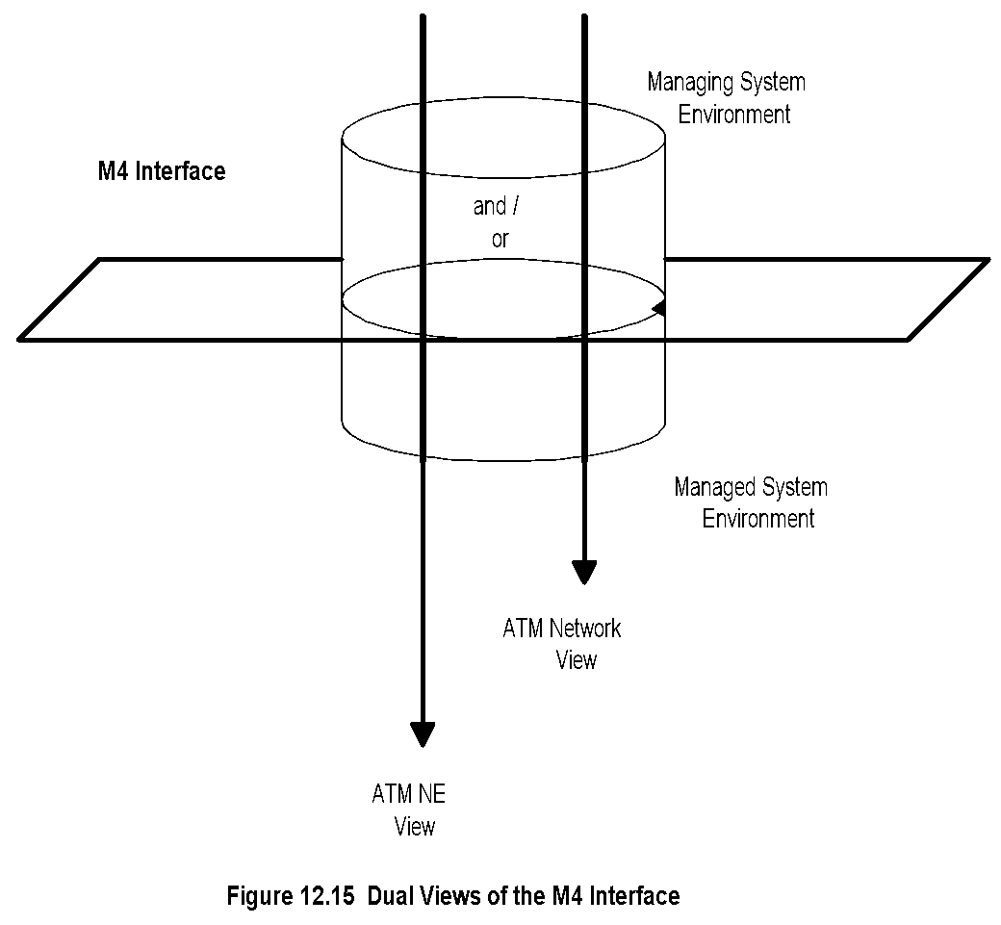
M4 Interface
Chapter 12 Broadband Network Management: WAN
Notes
M4 interface defines dual views
Network element view
Network view
Two NMSs interface at network view level
Each NMS interfaces with network elements using network element view
Network Management: Principles and Practice
© Mani Subramanian 2010
*

Slide 25
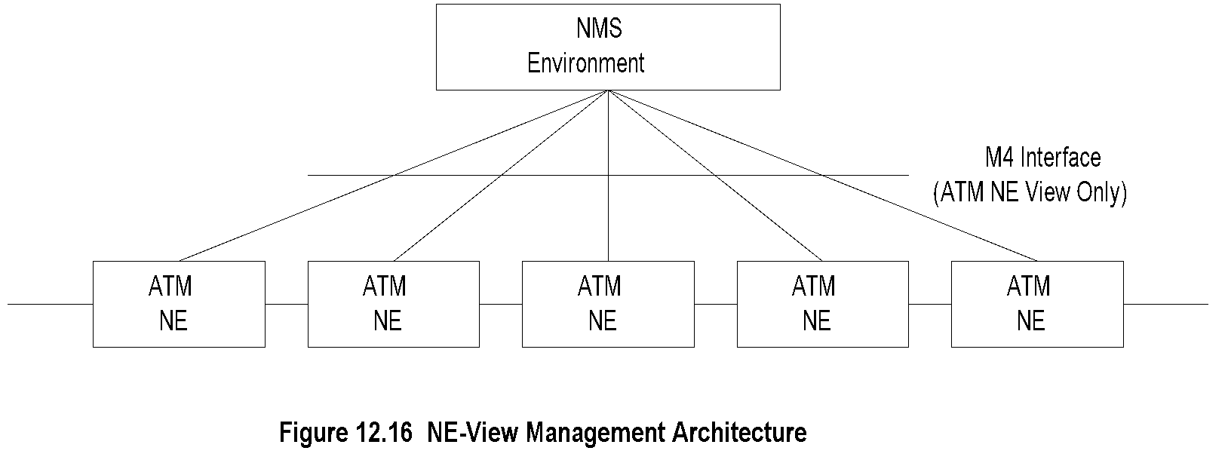
Network Element View
Chapter 12 Broadband Network Management: WAN
Notes
Network element view architecture proposed by ATM Forum
Multiple agent layers - SNMP and ILMI agents implied in the representation
Network Management: Principles and Practice
© Mani Subramanian 2010
*

Slide 26
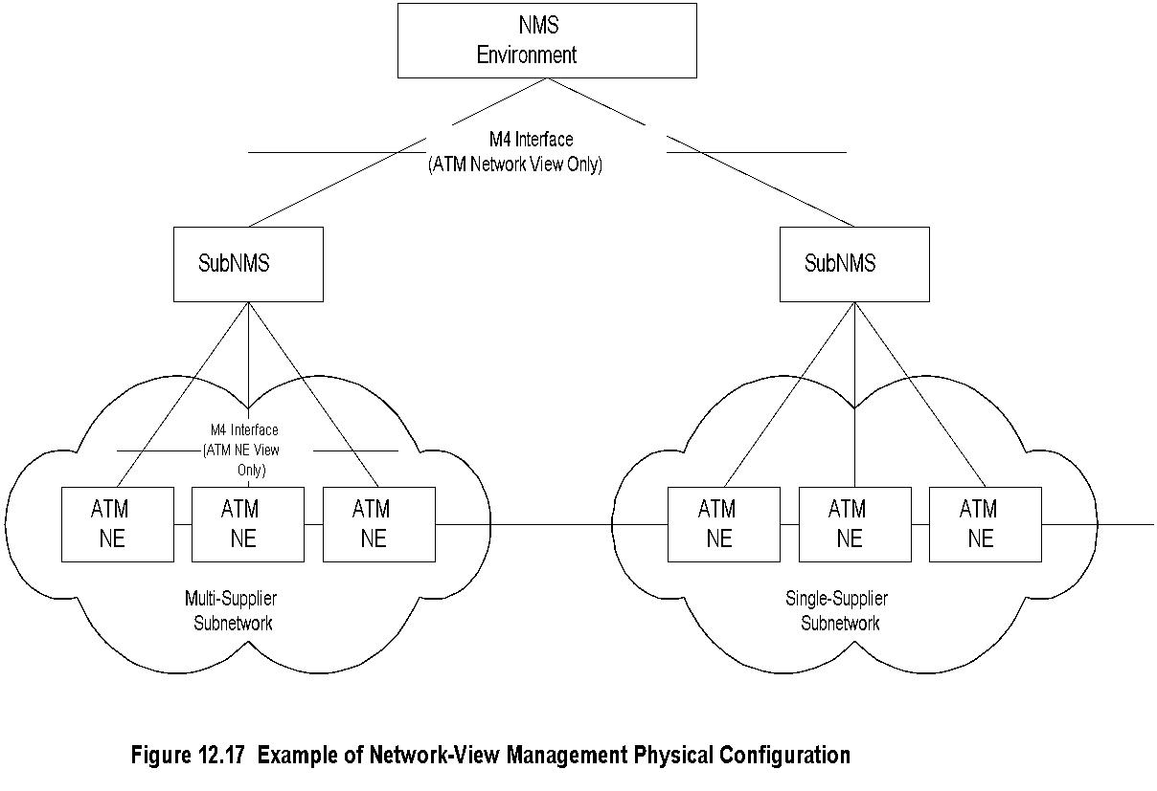
Network View
Chapter 12 Broadband Network Management: WAN
Notes
Three-tier architecture
Each subNMS manages its respective domains
SubNMS communicates with MoM at network view level
Network Management: Principles and Practice
© Mani Subramanian 2010
*

Slide 27
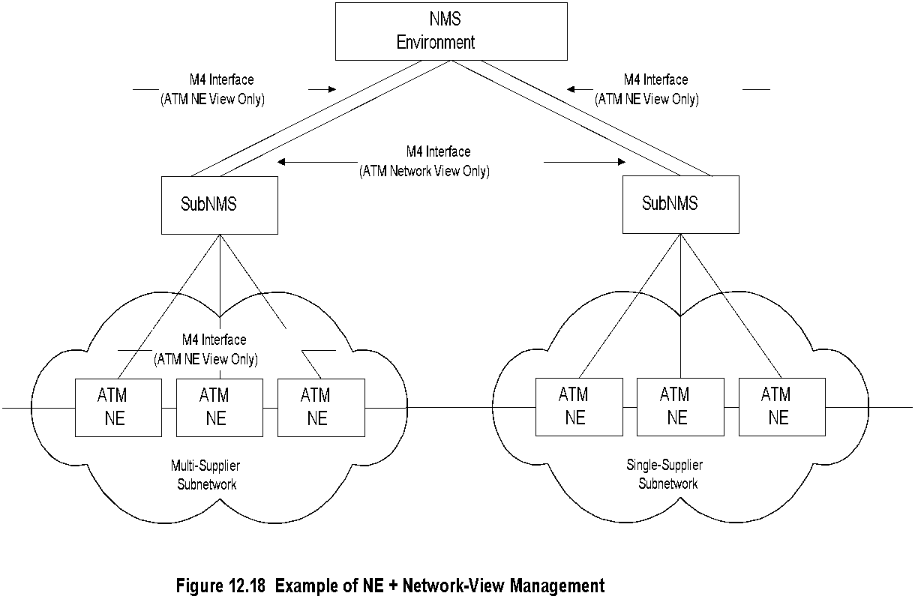
Combined NE and Network Views
Chapter 12 Broadband Network Management: WAN
Notes
An NMS could function at both levels simultaneously
Local elements can be managed using NE view and remote elements using network view with subNMS
Network Management: Principles and Practice
© Mani Subramanian 2010
*

Slide 28
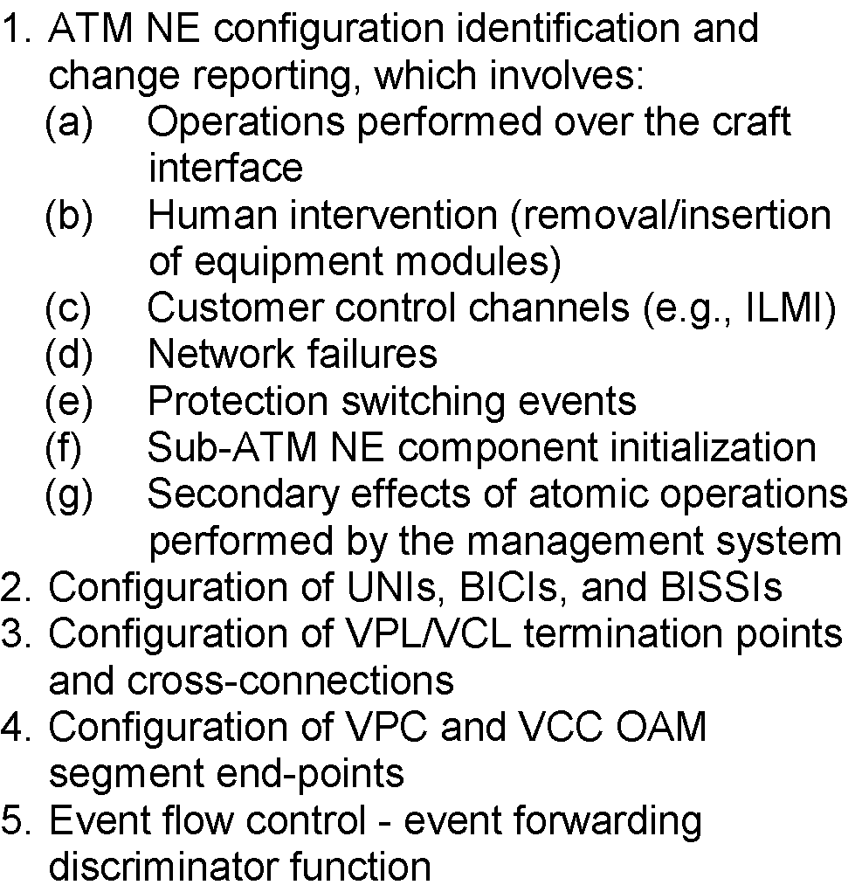
M4 NE View Requirements: Configuration Management
Chapter 12 Broadband Network Management: WAN
Notes
Network Management: Principles and Practice
© Mani Subramanian 2010
*

Slide 29
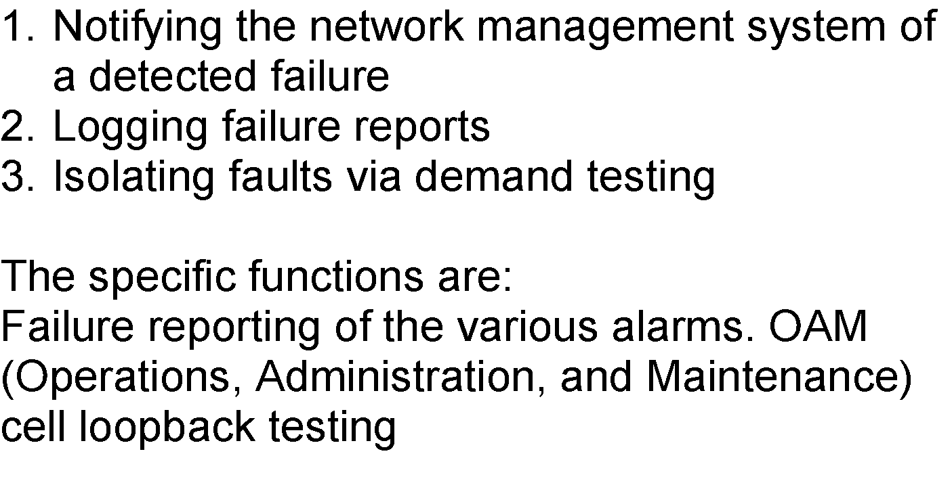
M4 NE View Requirements: Fault Management
Chapter 12 Broadband Network Management: WAN
Notes
Network Management: Principles and Practice
© Mani Subramanian 2010
*

Slide 30
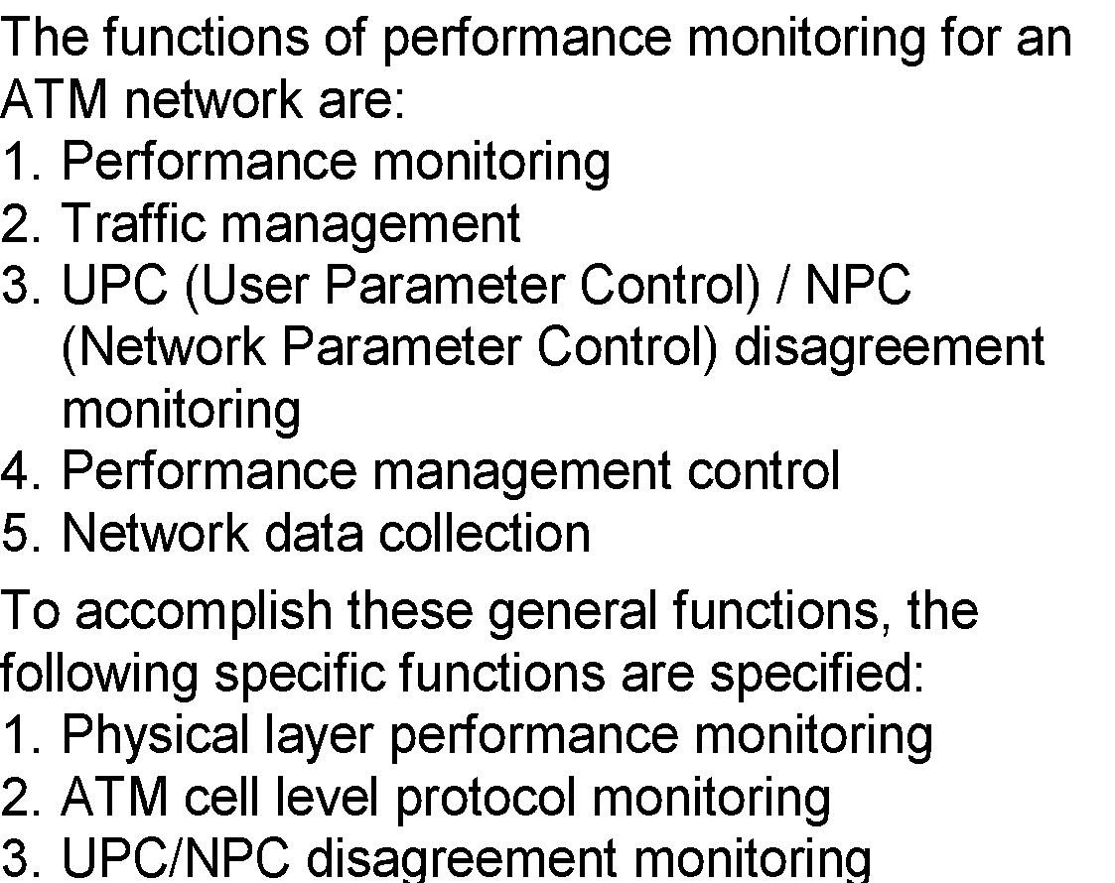
M4 NE View Requirements: Performance Management
Chapter 12 Broadband Network Management: WAN
Notes
Network Management: Principles and Practice
© Mani Subramanian 2010
*

Slide 31
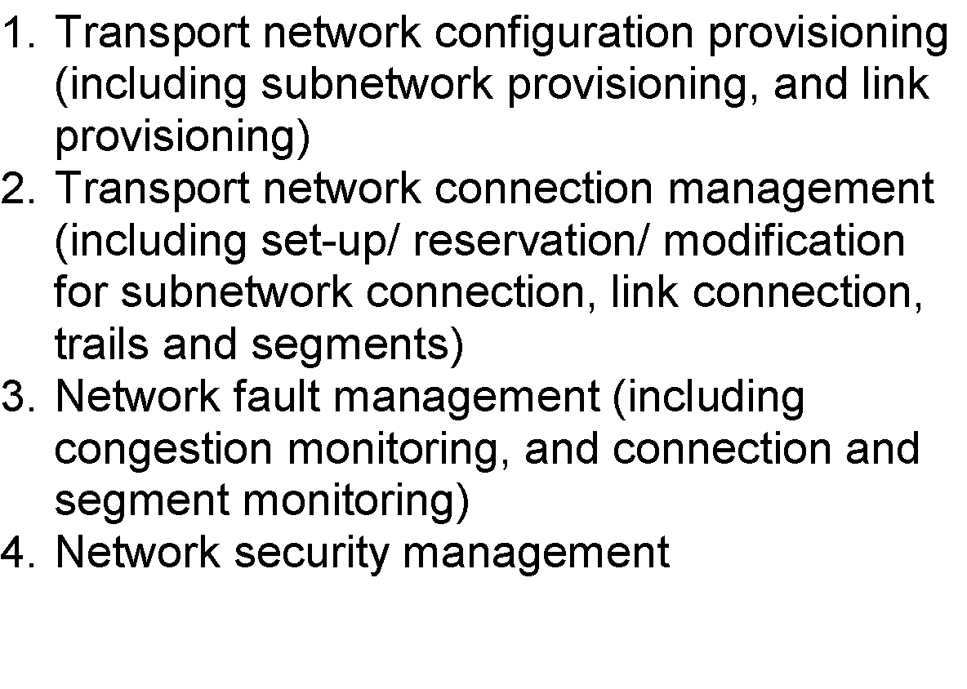
M4 Network View Requirements
Chapter 12 Broadband Network Management: WAN
Notes
Network Management: Principles and Practice
© Mani Subramanian 2010
*

Slide 32
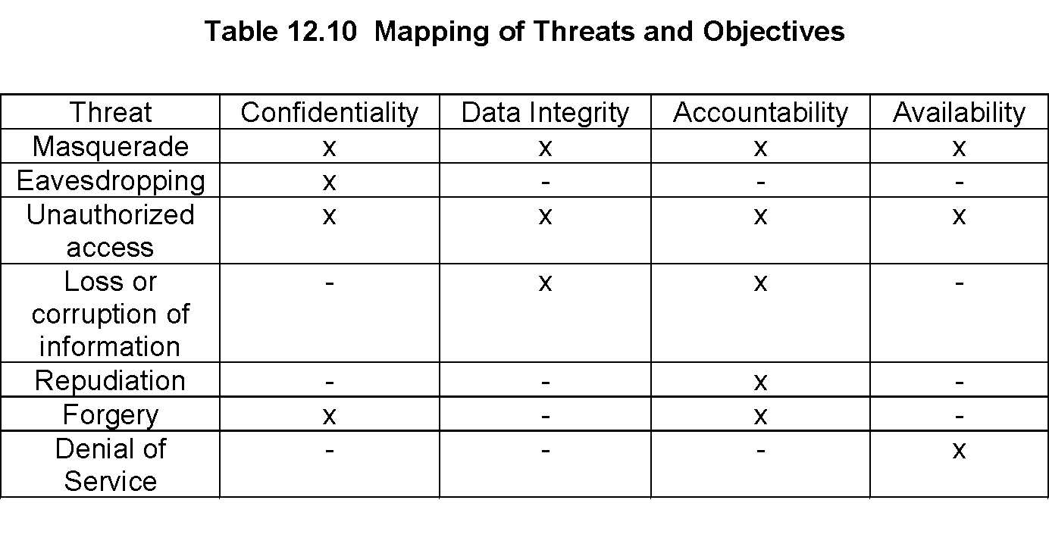
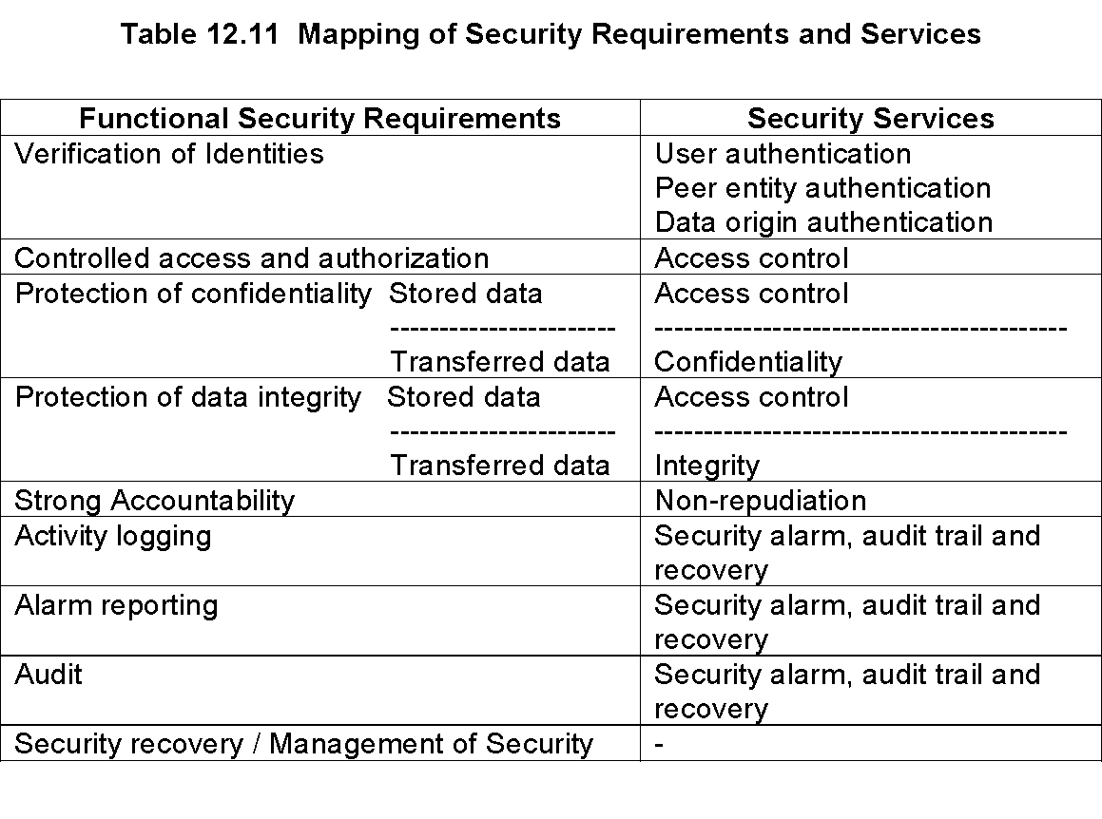
M4 Network View Requirements: Security Management
Chapter 12 Broadband Network Management: WAN
Network Management: Principles and Practice
© Mani Subramanian 2010
*

Slide 33
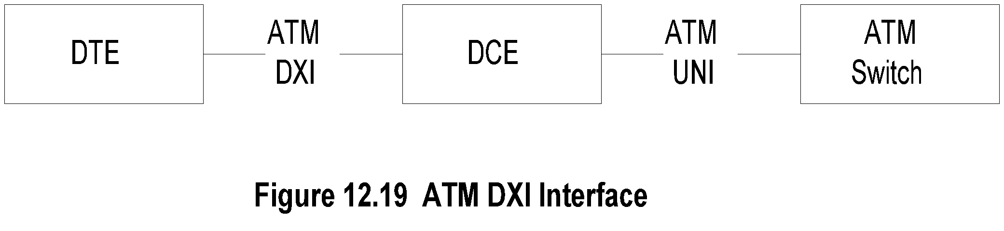
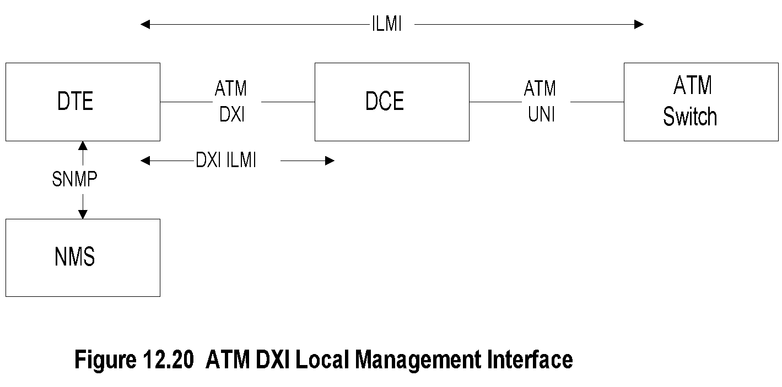
ATM DXI Management
Chapter 12 Broadband Network Management: WAN
Notes
Digital Exchange Interface defined between DTE (digital terminating equipment) and DCE (digital circuit equipment)
Example of DTE is hub and DCE is DSU (digital service unit); ATM switch is part of public network
Management of DXI and ATM UNI done using ILMI specifications
NMS manager uses SNMP with proxy agent for ILMI management objects
Network Management: Principles and Practice
© Mani Subramanian 2010
*

Slide 34
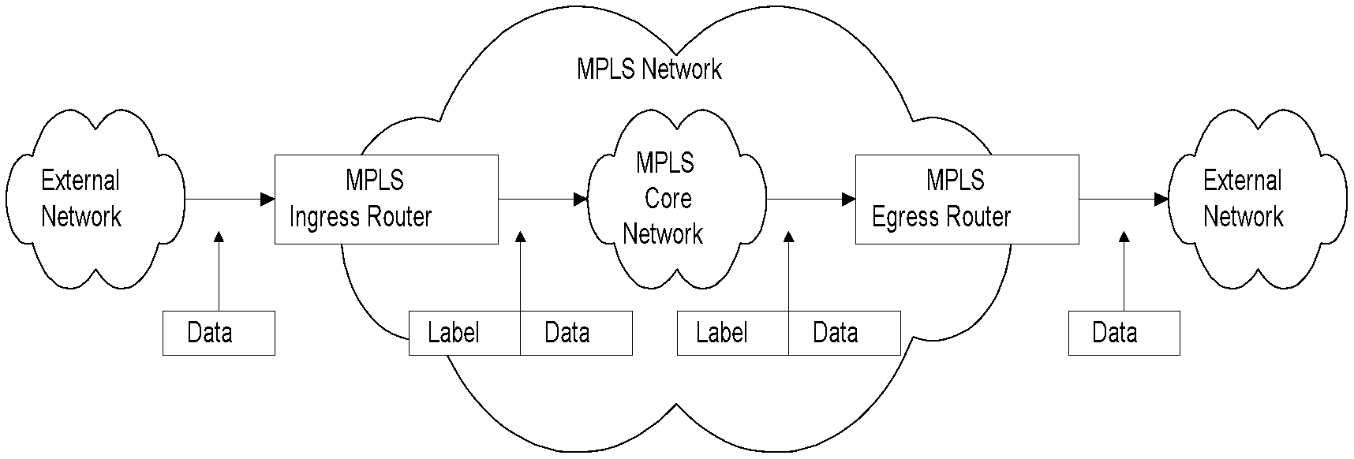
Simplified MPLS Network
Chapter 12 Broadband Network Management: WAN
Figure 12.21 Simplified MPLS Network
Notes
MPLS … Multiprotocol Label Switching combines
Richness of IP
Performance of ATM
FEC assigned at the ingress router and encoded in the label
Label is removed at the egress router and original protocol packet is sent out
Network Management: Principles and Practice
© Mani Subramanian 2010
*

Slide 35
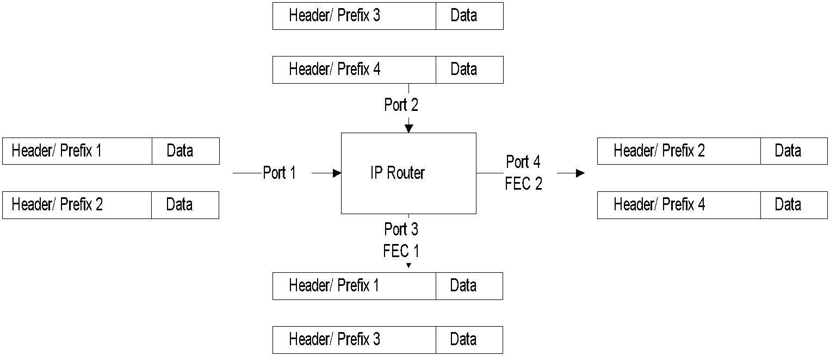
IP Network
Chapter 12 Broadband Network Management: WAN
Figure 12.22(a) IP Packet Forwarding Based on the FEC Index Table
Notes
FEC (Forward Equivalent Class) decides the port for the next hop
Packets with the same FEC indistinguishable and sent to the same port
FEC determination is complex and done at each node
This leads to low performance (compare with ATM VP-VC achieving high performance)
Network Management: Principles and Practice
© Mani Subramanian 2010
*

Slide 36
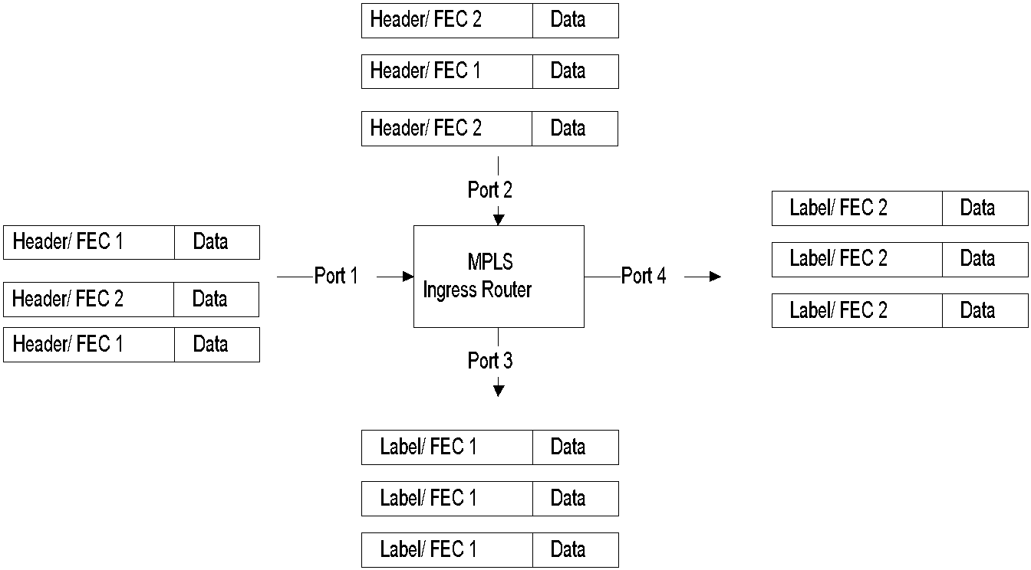
MPLS / IP Network
Chapter 12 Broadband Network Management: WAN
Figure 12.22(b) MPLS Packet Forwarding Based on the FEC Index Table
Notes
FEC assigned at the ingress router and encoded in the label
Label is removed at the egress router and original protocol packet is sent out
Label is sent along with the packet
Label is used as index to look up a table and forward the packet and a new label to the next hop
Packet not analyzed for FEC by downward routers
Header in layer-3 ignored
Network Management: Principles and Practice
© Mani Subramanian 2010
*

Slide 37
MPLS / ATM مهم
Chapter 12 Broadband Network Management: WAN
Figure 12.2 Virtual Circuit Configuration
Notes
Table 12.2 A-Z Virtual Circuit –Routing Tables
Switch | Input VCI / Port | Output VCI / Port
A | VCI-1 / Port-1 VCI-2 / Port-2 | VCI-2 / Port-2 VCI-1 / Port-1
B | VCI-2 / Port-1 VCI-3 / Port-2 | VCI-3 / Port-2 VCI-2 / Port-1
D | VCI-3 / Port-1 VCI-4 / Port-2 | VCI-4 / Port-2 VCI-3 / Port-1
All packets take the same path and arrive in the same sequence in virtual circuit
Packets in a session take the same path in VP/VC
After initial set up, latency is reduced
Both real- and non-real time traffic handled simultaneously
Network Management: Principles and Practice
© Mani Subramanian 2010
*

Slide 38
MPLS Traffic Configuration
Chapter 12 Broadband Network Management: WAN
Packets in MPLS with input labels are mapped to next hop with output labels; header in layer 3 ignored
Packet routing configured for MPLS / IP with IGP
with and without TE (traffic engineering) and tunneling
Notes
Network Management: Principles and Practice
© Mani Subramanian 2010
*

Slide 39
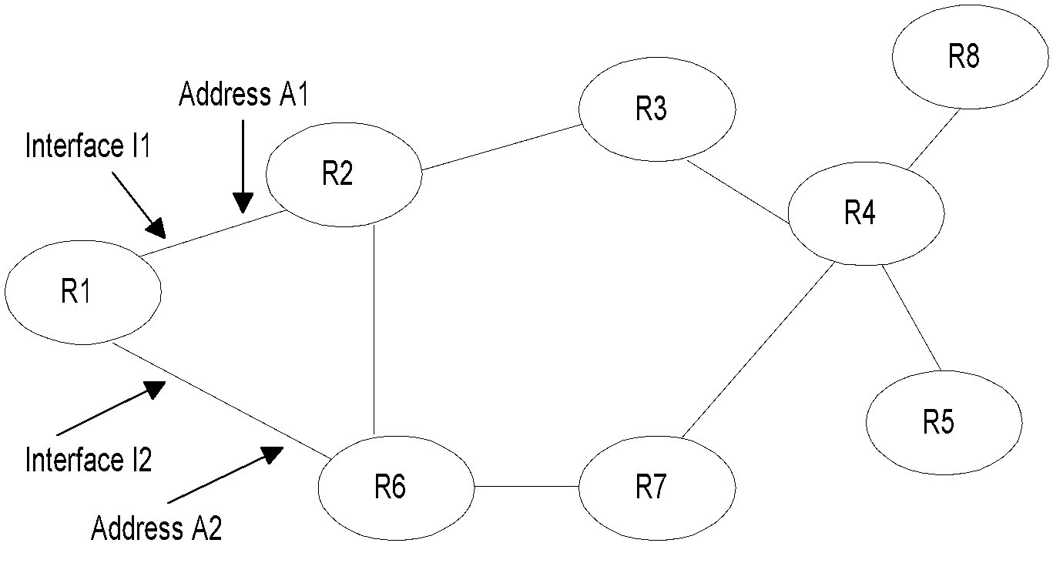
MPLS / IP without Tunnel
Chapter 12 Broadband Network Management: WAN
Figure 12.23 Topology without MPLS Tunnels
Notes
Table 12.12 R1 Routing Table without Tunnel
Dest | 0utput Interface | Next Hop | Metric
2.2.2.2 | I1 | 2.2.2.2 | 1
3.3.3.3 | I1 | 2.2.2.2 | 2
4.4.4.4 | I1 I2 | 2.2.2.2 6.6.6.6 | 3 3
5.5.5.5 | I1 I2 | 2.2.2.2 6.6.6.6 | 4 4
6.6.6.6 | I2 | 6.6.6.6 | 1
7.7.7.7 | I2 | 6.6.6.6 | 2
8.8.8.8 | I1 I2 | 2.2.2.2 6.6.6.6 | 4 4
Network Management: Principles and Practice
© Mani Subramanian 2010
*

Slide 40

MPLS / IP with Tunnels
Chapter 12 Broadband Network Management: WAN
Figure 12.24 MPLS Topology with Tunnels
Notes
Table 12.13 R1 Routing Table with Tunnel
Dest | 0 Intf | Next Hop | Metric
2.2.2.2 | 1I1 | 2.2.2.2 | 1
3.3.3.3 | 1I1 | 2.2.2.2 | 2
4.4.4.4 | T1 | 4.4.4.4 | 3 /1
5.5.5.5 | T2 | 5.5.5.5 | 4/1
6.6.6.6 | 1I2 | 6.6.6.6 | 1
7.7.7.7 | 1I2 | 6.6.6.6 | 2
8.8.8.8 | T1 | 4.4.4.4 | 4/2
Network Management: Principles and Practice
© Mani Subramanian 2010
*

Slide 41
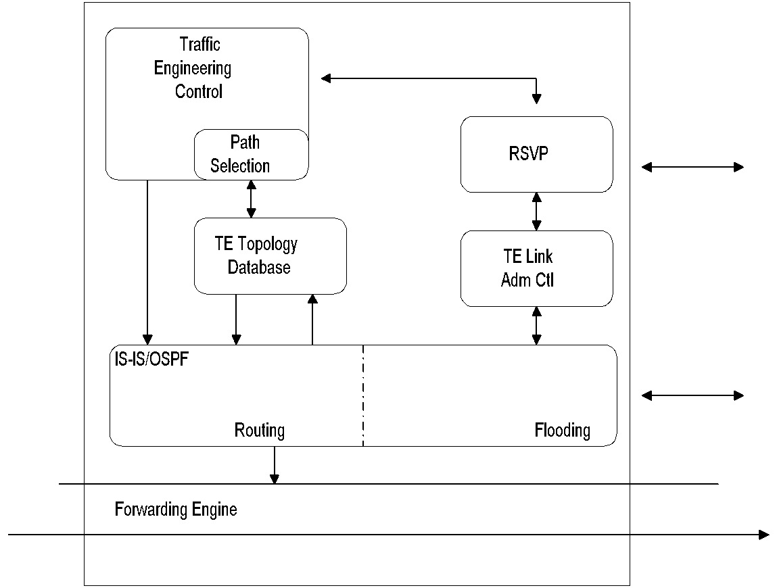
MPLS-TE
Chapter 12 Broadband Network Management: WAN
Figure 12.25 MPLS-TE System Block Diagram (Head-End Router)
Notes
Traffic Engineering (TE): Optimization of performance
Overlay over inadequate IGP
Constrained-base routing at VC level
VC paths
Path compression
Call admission control
Traffic shaping and policing
VC survivability
Network Management: Principles and Practice
© Mani Subramanian 2010
*

Slide 42
Label Switching Router (LSR)
Chapter 12 Broadband Network Management: WAN
MPLS router called Label Switching Rouer (LSR)
End-to-end MPLS path called Label Switching Path (LSP)
IGP extended to include MPLS-TE
Route set up by RSVP-TE
Control and data planes separated in MPLS
VoIP handled using SIP (Session Initiation Protocol)
Notes
Network Management: Principles and Practice
© Mani Subramanian 2010
*

Slide 43
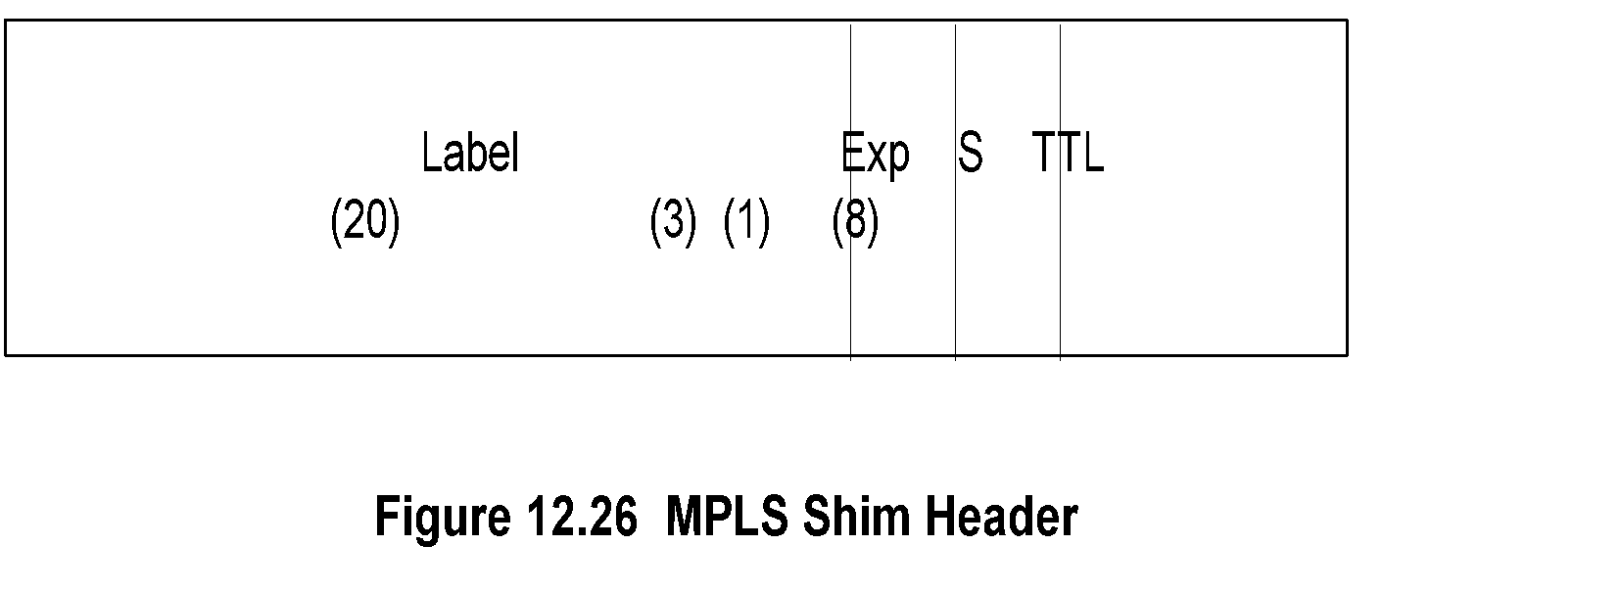
MPLS Label
Chapter 12 Broadband Network Management: WAN
Exp…experimental
S…….stack indicator
TTL….time-to-live
Notes
MPLS Label is
Short and fixed length – 32 bits
FEC locally significant identifier
Label assigned by the downstream router
Label is “shimmed” between layers 2 and 3 headers
Network Management: Principles and Practice
© Mani Subramanian 2010
*

Slide 44
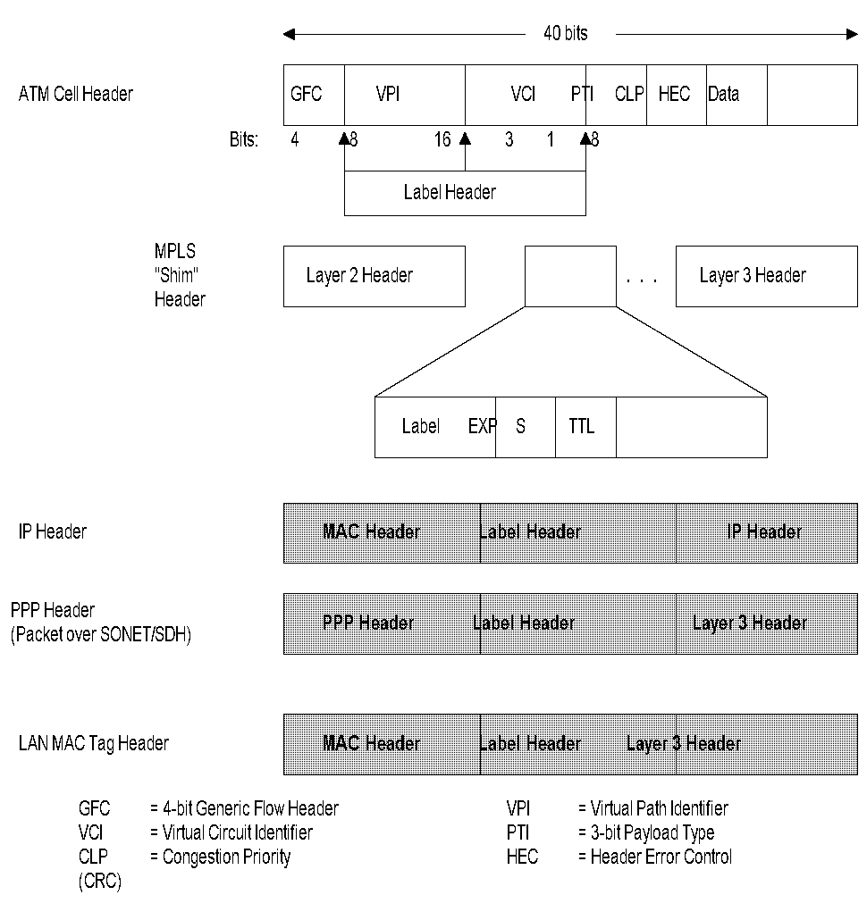
MPLS Labeled Packets
Chapter 12 Broadband Network Management: WAN
Figure 12.27 Encapsulation of an MPLS-Labeled Packet
Network Management: Principles and Practice
© Mani Subramanian 2010
*

Slide 45
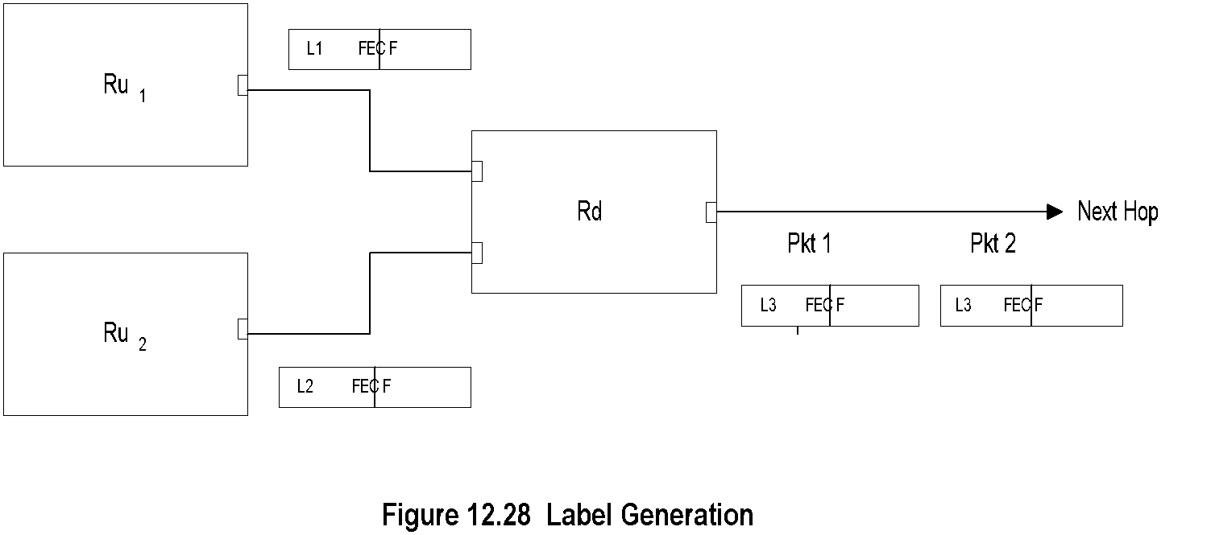
Label Generation
Chapter 12 Broadband Network Management: WAN
Notes
Label generated by downstream LSR R_{d}
Upstream LSR R_{u} and R_{d} together generate “label” between label Lx and FEC F
R_{d} has incoming labels L1 and L2, and outgoing label L3 with FEC F
Label L associated with FEC F is local to R_{u} and R_{d}
R_{u} and R_{d} called “label binding pair”
Network Management: Principles and Practice
© Mani Subramanian 2010
*

Slide 46
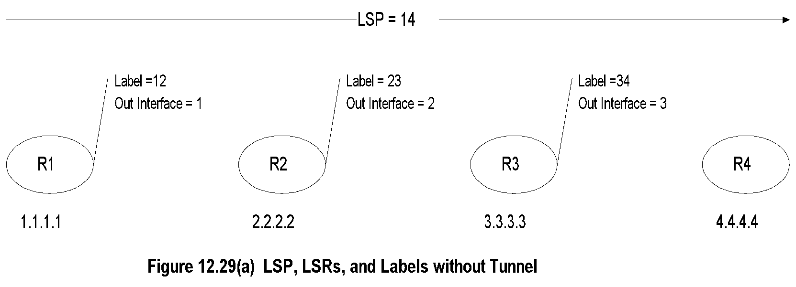
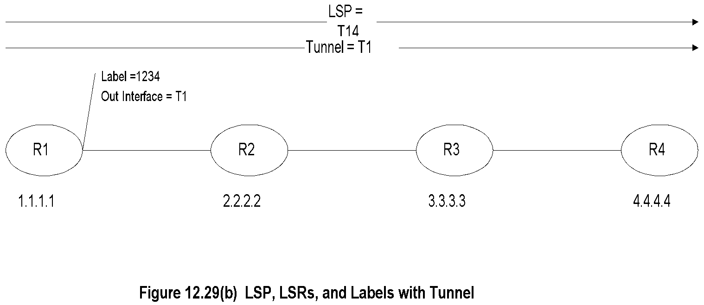
LSP, LSR, Label مهم
Chapter 12 Broadband Network Management: WAN
Network Management: Principles and Practice
© Mani Subramanian 2010
*

Slide 47
MPLS OAM Management
Chapter 12 Broadband Network Management: WAN
Data and control planes are separate in MPLS
OAM packets travel the data path
Basic Tools
LSP connectivity verification
LSP ping
LSP traceroute
Fault management
Configuration management
Performance management
Notes
LSP Fault scenarios:
(a) Simple loss of connection
(b) Misconnection
(c) Swapped connection
(d) Mismerging
(e) Loop/unintended replication
Detection of LSP fault using
connectivity verification (CV) – ITU-T
Bidirectional forwarding detection (BFD) - IETF
Network Management: Principles and Practice
© Mani Subramanian 2010
*

Slide 48
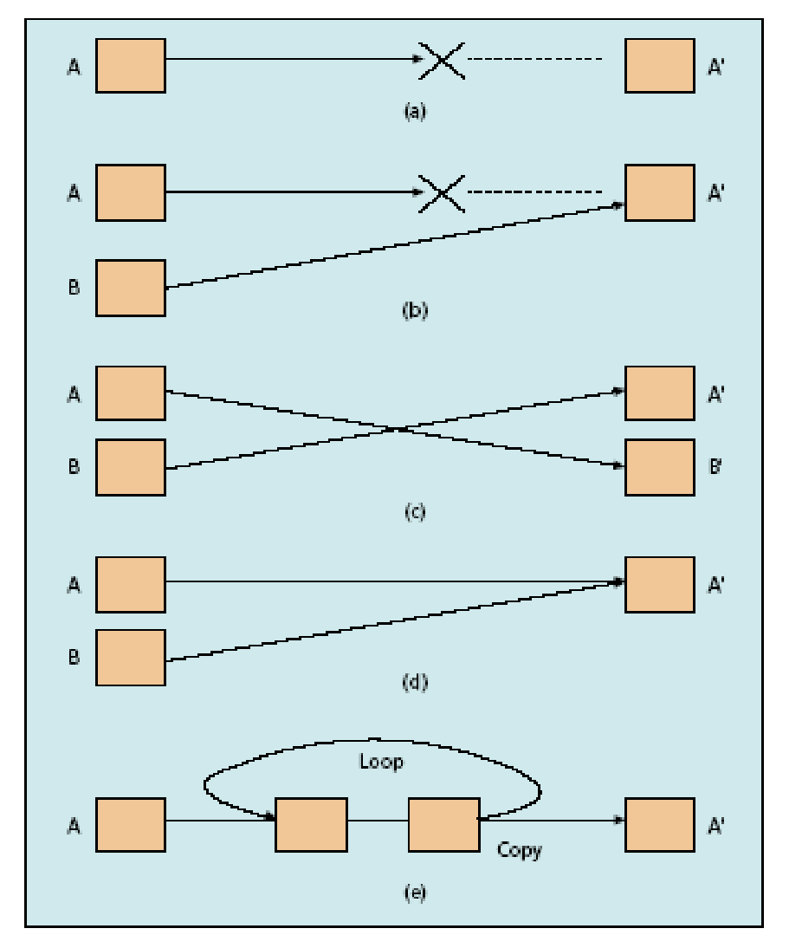
Fault Management of LSP
Chapter 12 Broadband Network Management: WAN
Figure 12.30 MPLS Fault Scenarios
Network Management: Principles and Practice
© Mani Subramanian 2010
*

Slide 49
LSP Ping
Chapter 12 Broadband Network Management: WAN
Table 12.15 MPLS Echo Request Packet
Byte 1 | Byte 2 | Byte 3 | Byte 4
Version Number |  | Global Flags
Message Type | Reply Mode | Return Code | Return Subcode
Sender’s Handle
Sequence Number
TimeStamp Sent (seconds)
TimeStamp Sent (microseconds)
TimeStamp Received (seconds)
TimeStamp Received (microseconds)
TLV
Notes
Modified Internet ping
MPLS echo request from Ingress to egress LSR; response from egress LSR on connectivity and validation
Verify packets of specific FEC end their LSP on an LSR that is an egress for that FEC.
Packet travels data path to egress LSR and transferred to control plan
Control plane validates FEC belongs to the egress LSR and sends response
Network Management: Principles and Practice
© Mani Subramanian 2010
*

Slide 50
LSP Traceroute
Chapter 12 Broadband Network Management: WAN
Similar to IP traceroute
Hop-by-hop fault localization as well as path tracing
Packet sent to control plane of each transit LSR
Transit LSR validates LSP
Validates control plane against data plane of the LSR
Notes
Network Management: Principles and Practice
© Mani Subramanian 2010
*

Slide 51
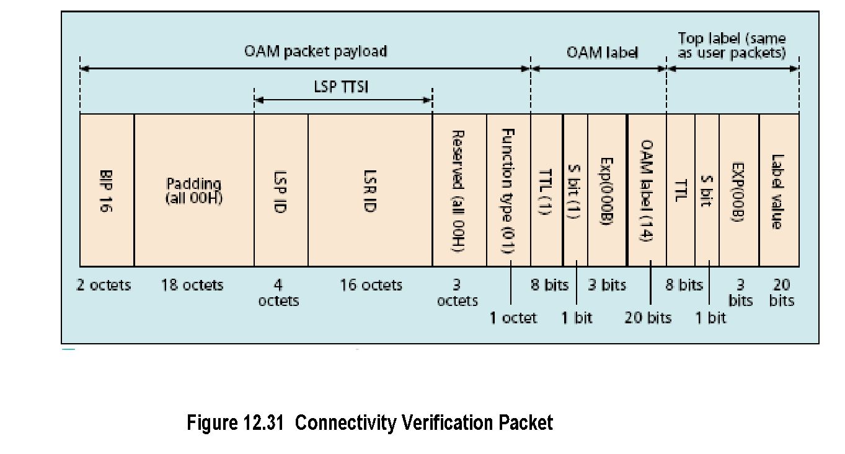
Connectivity Verification
Chapter 12 Broadband Network Management: WAN
Notes
Top label user packet label
2nd label OAM label with reserved value of 14
Stack bit value 1 indicates bottom label
Ingress LSR sends CV packet with TTSI (trail termination source identifier) – LSP and LSR IDs
CV packets sent asynchronously at regular intervals
On consecutive loss of set number of packets (3) egress LSR declares loss of connectivity (dlOCV)
Other scenarios analyzed by egress LSR and notifications sent
Network Management: Principles and Practice
© Mani Subramanian 2010
*

Slide 52
BFD
Chapter 12 Broadband Network Management: WAN
Bidirectional forwarding failure detection
An IETF specification (CV is ITU-T spec); more versatile
Uses LSP-ping MPLS echo - response to detect data plane failure in LSP
Helpful to detect failures in the data plane when the control plane is functional and data plane is not
Establishes session between ingress and egress LSRs
Verification packet can be used at any protocol layer
Fast and low overhead detection between adjacent NEs
BFD fault detection interval should be longer than switching time in the fast-reroute LSP
Separate session for multiple FECs in an LSP
LSP traceroute used for data path check in alternate paths
Notes
Network Management: Principles and Practice
© Mani Subramanian 2010
*

Slide 53
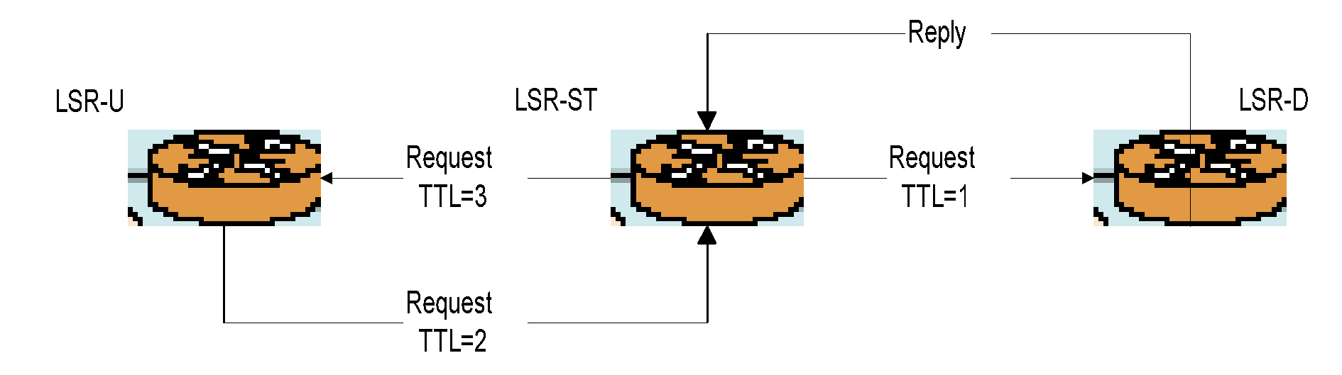
LSP Self-Test
Chapter 12 Broadband Network Management: WAN
Figure 12.32 LSP Self-Test
Notes
Used for fault localization of an LSP
Uses 3 LSRs, ST (self test), LSR-U upstream, and LSR-D downstream
LSR-ST sends special LSP-ping to LSR-U with TTL=3
LSR-U forwards it via LSR-ST to LSR-D with TTL=2
LSR-D sends reply to LSR-ST completing the test
Fault localized for link and node failures and notification sent out
Network Management: Principles and Practice
© Mani Subramanian 2010
*

Slide 54
MPLS Service Level Management
Chapter 12 Broadband Network Management: WAN
Customer
Customer
Net A
Net B
R1
R2
R3
R4
R5
R6
LSP 2
LSP 1
LSP 1 PROTECTION
Figure 12.33 LSP Nesting and Fault Localization
Notes
SLA between Service Provider and customer
Multiple protection paths
LSP1 PROTECTION global protection
Nested path LSP 2 local protection path
Network Management: Principles and Practice
© Mani Subramanian 2010
*

Slide 55
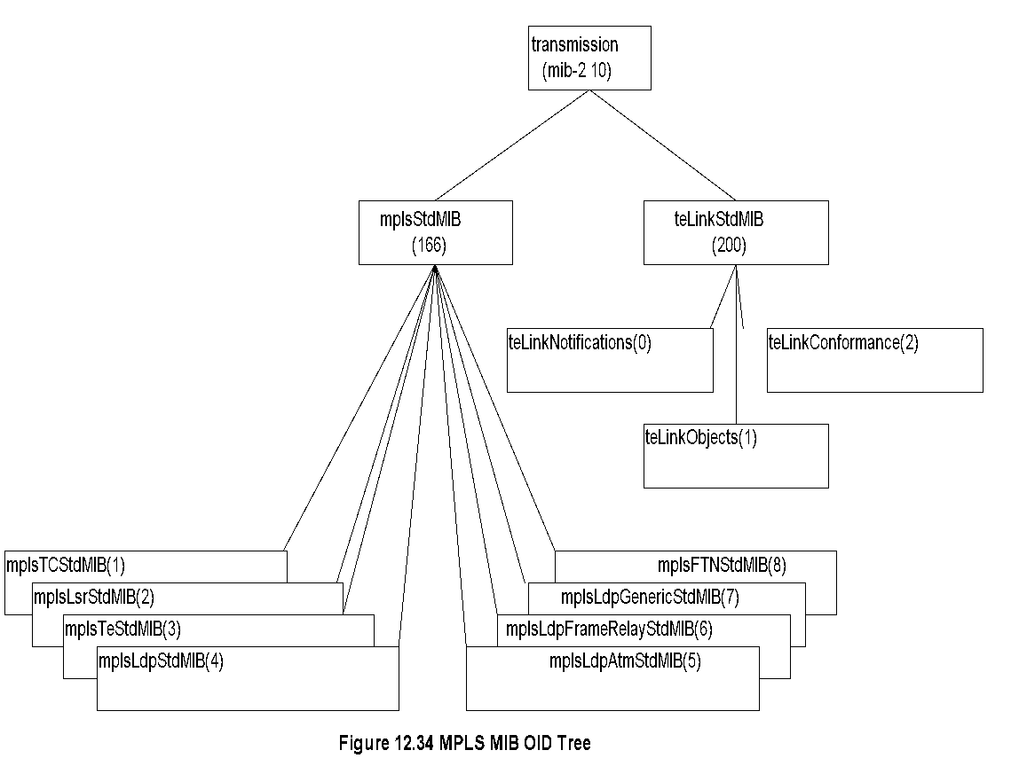
MPLS MIB OID Tree
Chapter 12 Broadband Network Management: WAN
Notes
MPLS network has a range of MIB modules
Complex and interdependent modules
Two nodes under transmission (mib-2 10)
mplsstd MIB…MPLS OID group
teLinkstdMIB…MPLS Traffic engineered links
Network Management: Principles and Practice
© Mani Subramanian 2010
*

Slide 56
MPLS MIBs
Chapter 12 Broadband Network Management: WAN
Table 12.16 MPLS Object Identifier (OID) MIB Group
Entity | OID | Description (brief)
mplsStdMIB | transmission (166) | MPLS OID Group
mplsTCStdMIB | mplsStdMIB (1) | Defines textual conventions
mplsLsrStdMIB | mplsStdMIB (2) | LSR Managed Objects (MO)
mplsTeStdMIB | mplsStdMIB (3) | Traffic Engineered Tunnel MO
mplsLdpStdMIB | mplsStdMIB (4) | Label Distribution Protocol (LDP) MO
mplsLdpAtmStdMIB | mplsStdMIB (5) | MO used with MPLS-LDP-STD-MIB for MPLS/ATM as layer 2
mplsLdpFrameRelayStdMIB | mplsStdMIB (6) | MO used with MPLS-LDP-STD-MIB for MPLS/Frame Relay as layer 2
mplsLdpGenericStdMIB | mplsStdMIB (7) | LDP Per Platform Label Space reserved for other platforms
mplsFTNStdMIB | mplsStdMIB (8) | FTN MO (FEC-to-NHLFE (Next Hop Label Forwarding Entry)
Notes
MPLS-LSR-STD-MIB heart of the MPLS manage- ment architecture
MPLS-LSR-STD-MIB describes managed objects for modeling MPLS LSR and comprises:
Label-forwarding info base (LFIB) -> View of LSP being switched by the LSR
Cross-connects and their properties referred in other MPLS MIBs
Network Management: Principles and Practice
© Mani Subramanian 2010
*

Slide 57
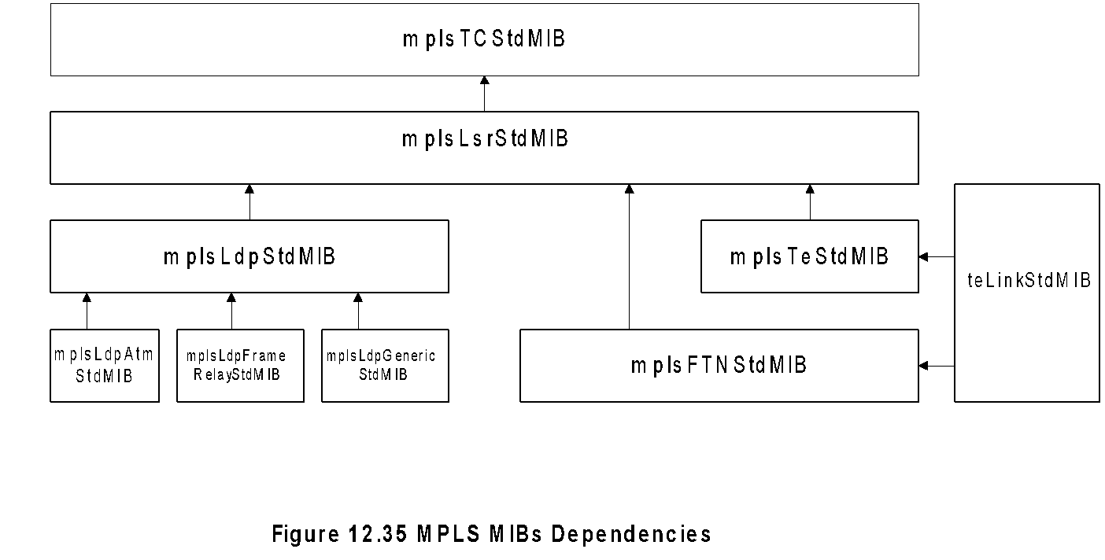
MPLS MIB Dependencies
Chapter 12 Broadband Network Management: WAN
Notes
Arrow indicates “depends on” relationship
All MIBs depend on MPLS-TC-STD-MIB that defines textual convention
External dependencies on IF-MIB
Network Management: Principles and Practice
© Mani Subramanian 2010
*

Slide 58
MPLS MIB Group Composition
Chapter 12 Broadband Network Management: WAN
Table 12.17 MPLS LSR Tables
Table | OID | Functions
Interface configuration | mplsInterfaceTable | Enables MPLS interface
In-segment | mplsInSegmentTable | Enables and monitors LSP segments into LSR
Out-segment | mplsoutSegmentTable | Enables and monitors LSP segments out of LSR
In-segment Mapping | mplsInSegmentMapTable | Lookup table for discovery of an in-segment in In-segment table
Cross-connect | mplsXCTable | Associate in and out segment for an LSP
Label stack | mplsLabelStackTable | Specifies multi-label stacks on LSP
In-segment performance | mplsInSegmentPerfTable | Measures performance of LSP
Out-segment performance | mplsOutSegmentPerfTable | Measures performance of LSP
Interface performance | mplsInterfacePerftable | Measures performance on a per-interface basis.
Notes
MPLS Group comprise:
Tables
Scalars provide the next available index to generate a row
Indices are arbitrary
Network Management: Principles and Practice
© Mani Subramanian 2010
*

Slide 59
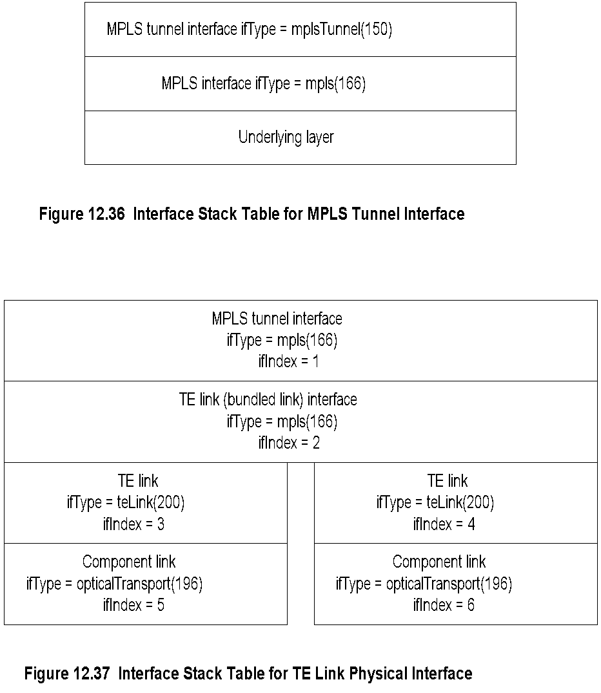
MPLS Stack Table
Chapter 12 Broadband Network Management: WAN
Network Management: Principles and Practice
© Mani Subramanian 2010
*

Slide 60
Traffic Engineering Link MIB
Chapter 12 Broadband Network Management: WAN
Table 12.18 Traffic Engineering Link MIB Group
Entity | OID | Description (Brief)
teLinkStdMIB | transmission (200) | MPLS Traffic Engineered Links MO
teLinkNotifications | teLinkStdMIB(0) | Event notifications MO
teLinkObjects | teLinkStdMIB(1) | Traffic Engineered Link MO
teLinkConformance | teLinkStdMIB(2) | MPLS compliance MIB
Notes
TE-LINK-STD-MIB used for modeling and managing TE links
Aggregates similar data channels or TE links between pairs of LSRs
A TE link is a sub-interface capable of carrying TE MPLS traffic
Bundled link bonds traffic of a group of TE links
Network Management: Principles and Practice
© Mani Subramanian 2010
*

Slide 61
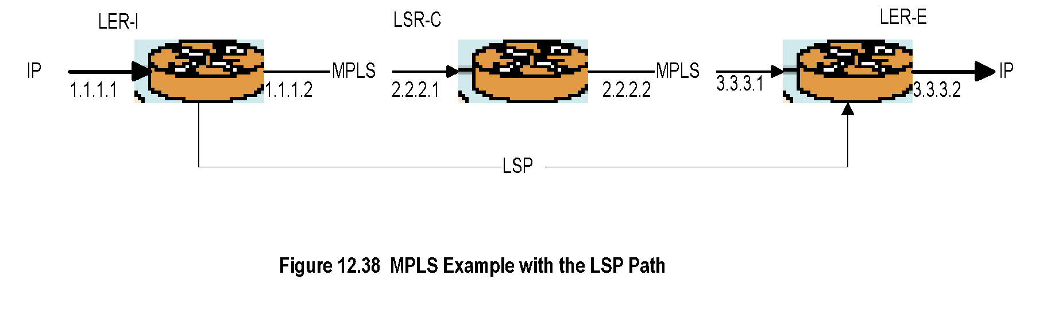
MPLS Example with LSP Path
Chapter 12 Broadband Network Management: WAN
Notes
Table 12.19 LER-1 MPLS Out-Segment Table for LSP
mplsoutSegmentIndex | 1
mplsoutSegmentInterface | 2
mplsoutSegmentPushTopLabel
mplsoutSegmentTopLabel | 13
mplsoutSegmenttopLabelPointer | 0.0 (no external table pointer)
mplsoutSegmentNextHopAddrType | 1 (IPv4)
mplsoutSegmentNextHopaddr | 2.2.2.1
mplsoutSegmentXCIndex | mplsXCTable.1
mplsoutSegmentOwner | LER-2
mplsoutSegmentTrafficParam | 0.0 (for best effort)
Network Management: Principles and Practice
© Mani Subramanian 2010
*

Slide 62
MPLS Example (cont.)
Chapter 12 Broadband Network Management: WAN
Table 12.20 LER-1 MPLS Cross-Connect Table
mplsXCIndex | 1
mplsXCInSegmentIndex | 0
mplsXCOutSegmentIndex | 1
mplsXCLspId | 4 (LSP Id forward path from LER-1 to LER-R3)
mplsXCLabelStackIndex | 0 (only one outgoing label)
mplsXCOwner | LER-1
Table 12.21 MPLS LSR-C Core In-Segment Table
mplsoutSegmentIndex | 1
mplsoutSegmentInterface | 2
mplsoutSegmentPushTopLabel | True (1) for tunnel
mplsoutSegmentTopLabel | 14
mplsoutSegmenttopLabelPointer | 0.0 (no external table pointer)
mplsoutSegmentNextHopAddrType | 1 (IPv4)
mplsoutSegmentNextHopaddr | 4.4.4.4 (Tunnel/LSP destination)
mplsoutSegmentXCIndex | mplsXCTable.1
mplsoutSegmentOwner | LSR-C
mplsoutSegmentTrafficParam | 0.0 (for best effort)
Network Management: Principles and Practice
© Mani Subramanian 2010
*

Slide 63
MPLS Example (cont.)
Chapter 12 Broadband Network Management: WAN
Table 12.22 MPLS LSR-C Core Out-Segment Table
mplsoutSegmentIndex | 1
mplsoutSegmentInterface | 2
mplsoutSegmentPushTopLabel
mplsoutSegmentTopLabel | 13
mplsoutSegmenttopLabelPointer | 0.0 (no external table pointer)
mplsoutSegmentNextHopAddrType | 1 (IPv4)
mplsoutSegmentNextHopaddr | 3.3.3.1
mplsoutSegmentXCIndex | mplsXCTable.1
mplsoutSegmentOwner | LER-C
mplsoutSegmentTrafficParam | 0.0 (for best effort)
Table 12.23 MPLS LSR-C Core Cross-Connect Table
mplsXCIndex | 1
mplsXCInSegmentIndex | 0
mplsXCOutSegmentIndex | 1
mplsXCLspId | 13 (LSP Id forward path from R1 to R4)
mplsXCLabelStackIndex | 0 (only one outgoing label)
mplsXCOwner | LSR-C
Network Management: Principles and Practice
© Mani Subramanian 2010
*

Slide 64
MPLS Example (cont.)
Chapter 12 Broadband Network Management: WAN
Table 12.24 MPLS LER-2 In-Segment Table
mplsInSegmentIndex | 1
mplsInSegmentInterface | 1
mplsInSegmentLabel | 0 (if no external LabelPointer)
mplsInSegmentLabelPointer | 0.0
mplsInSegmentNPop | 1
mplsInSegmentAddrFamily | 1 (IPv4)
mplsInSegmentXCIndex | 1 (given)
mplsInSegmentTrafficParam | 0.0
Table 12.25 MPLS LER-2 Cross-Connect Table
mplsXCIndex | 1
mplsXCInSegmentIndex | 1
mplsXCOutSegmentIndex | 0
mplsXCLspId | 4 (LSP Id forward path from R1 to R4)
mplsXCLabelStackIndex | 0 (only one outgoing label)
mplsXCOwner | R1
Network Management: Principles and Practice
© Mani Subramanian 2010
*

Slide 65
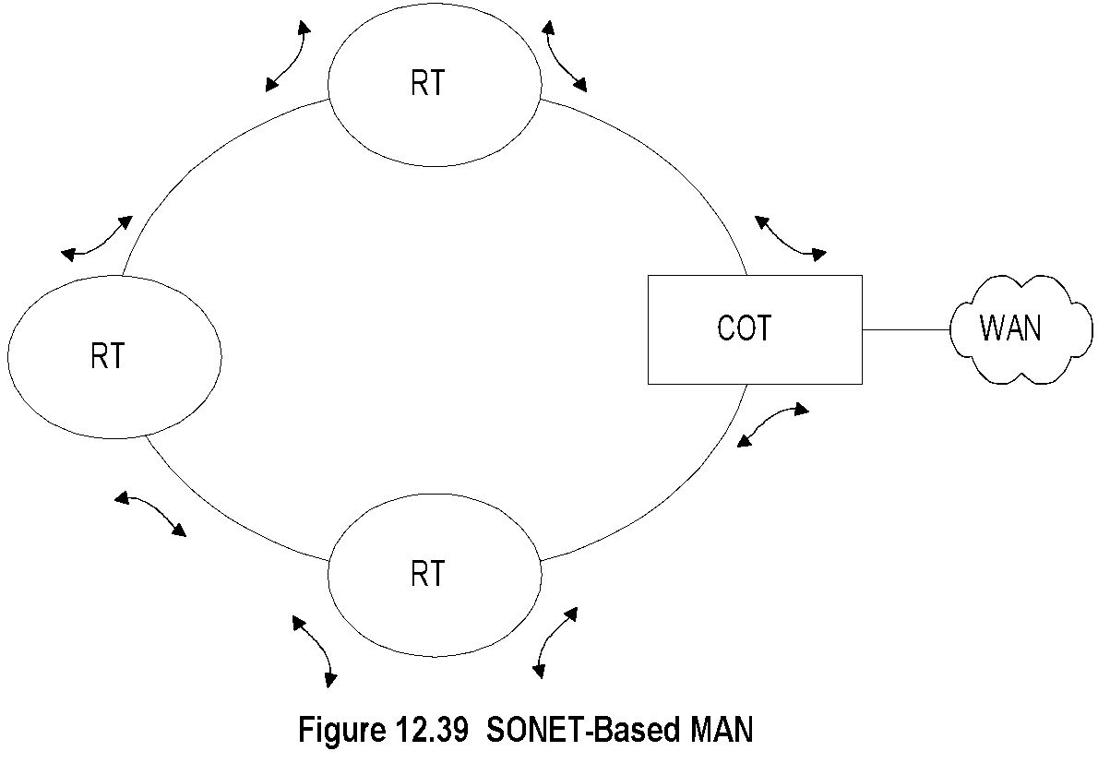
Optical Metropolitan Area Network (MAN)
Chapter 12 Broadband Network Management: WAN
Notes
MAN…segment that connects WAN to Access Network
Wired (incl fiber) and wireless (WiMax) MAN
Wired MAN evolved from digital loop carrier (DLC)
Link SONET (synchronous optical network) ring using SDH (synchronous digital hierarchy)
STM-1 (synchronous transport module level 1) @155.52 Mbps. STM-4 @ 622.08 Mbps (OC-3), etc.
RT is add-drop multiplexer (ADM)
Protocol is RPR (resilient packet ring)
RTs connected to access networks
Network Management: Principles and Practice
© Mani Subramanian 2010
*

Slide 66

Dual Ring Configuration
Chapter 12 Broadband Network Management: WAN
Notes
Failure recovery mode in dual ring configuration
SONET/SDH OC-1 or STS (51.84 Mbps) signal multiplexed to higher level (e.g.,OC-3) and transmitted over optical carrier
WDM (wavelength division multiplexer) strictly a physical layer (optical) system
WDM directly interfaces with the switch
DWDM (Dense WDM) higher density over fiber
Network Management: Principles and Practice
© Mani Subramanian 2010
*

Slide 67

Broadband MAN
Chapter 12 Broadband Network Management: WAN
Notes
Network Management: Principles and Practice
© Mani Subramanian 2010
*

Slide 68
SDH Management
Chapter 12 Broadband Network Management: WAN
ITU-T G Series documentation
Transmission Systems and Media
Digital Systems and Networks
Digital Terminal Equipments
G.774 SDH
Management Information Model
OAM
Data Communication Channels (DCCs)
G.784 Element Management Functions (EMFs)
G.831 Management capabilities of transport networks
Notes
Network Management: Principles and Practice
© Mani Subramanian 2010
*

Slide 69
SDH Data Communication Channels
Chapter 12 Broadband Network Management: WAN
G.774 specifies 3 modes of management for DCCs
IP-only stack use PPP as data link
OSI-only use LAP-D as data link
Dual (IP + OSI) stack PPP or LAP-D with tunneling to communicate between stacks
Notes
Network Management: Principles and Practice
© Mani Subramanian 2010
*

Slide 70
SDH Element Management Functions
Chapter 12 Broadband Network Management: WAN
G.784 specs equipment management functions (EMF)
Fault management
Performance management
Configuration management
Two DCC channels
DCCM forwards over the multiplex sections: behaves as backbone network
DCCR (and LAN) forwards data to regenerators: interconnects backbone to equipment
DCCM and DCCR carry independent management applications
Notes
Network Management: Principles and Practice
© Mani Subramanian 2010
*

Slide 71
SDH Fault Management
Chapter 12 Broadband Network Management: WAN
Alarm messages called ”defects”
Error messages called “anomalies”
Loss of signal (LOS) alarm triggers subsequent messages, alarm indication signals (AIS)
Transmitter notified by return of an RDI (remote defect indicator) alarm
Notes
Network Management: Principles and Practice
© Mani Subramanian 2010
*

Slide 72
SDH Performance Management
Chapter 12 Broadband Network Management: WAN
Performance parameters quantified in G.826
Four commonly used parameters:
Errored seconds (ES)
# 1-second intervals containing at least 1 ES
Severely errored seconds (SES)
# 1-second intervals with > 30% block errors (or) one severely disturbed period
Background block error (BBE)
Errored block that is not SES
Unavailable seconds (UAS)
Circuit unavailable from the first of at least 10 consecutive SESs
Notes
Network Management: Principles and Practice
© Mani Subramanian 2010
*

Slide 73

SONET Hierarchy and IF Stack Layers
Chapter 12 Broadband Network Management: WAN
VC-n …Virtual container (Europe)
VT-n … Virtual tributary (America & Japan)
Network Management: Principles and Practice
© Mani Subramanian 2010
*

