Slide 1
Chapter 11
Chapter 11 Network Management Applications
18-29 محذوف
Network Management Applications
Network Management: Principles and Practice
© Mani Subramanian 2010
*

Slide 2
Objectives
Chapter 11 Network Management Applications
Network management and system management
Network management
Configuration
Fault
Performance
Security
Accounting
Configuration management
Configuration management
Service/Network provisioning
Inventory management
Fault management
Fault detection and isolation
Correlation techniques for root cause analysis
Performance management
Performance metrics
Data monitoring
Problem isolation
Performance statistics
(continued)
Network Management: Principles and Practice
© Mani Subramanian 2010
*

Slide 3
Objectives (cont.)
Chapter 11 Network Management Applications
Security management
Security policies and procedures
Security threats
Firewall
Cryptography: keys, algorithms, authentication, and authorization schemes
Secure message transfer methods
Accounting management
Report management
Policy-based management
Service level management
Quality of service, QoS
Service level agreement, SLA
Network Management: Principles and Practice
© Mani Subramanian 2010
*

Slide 4
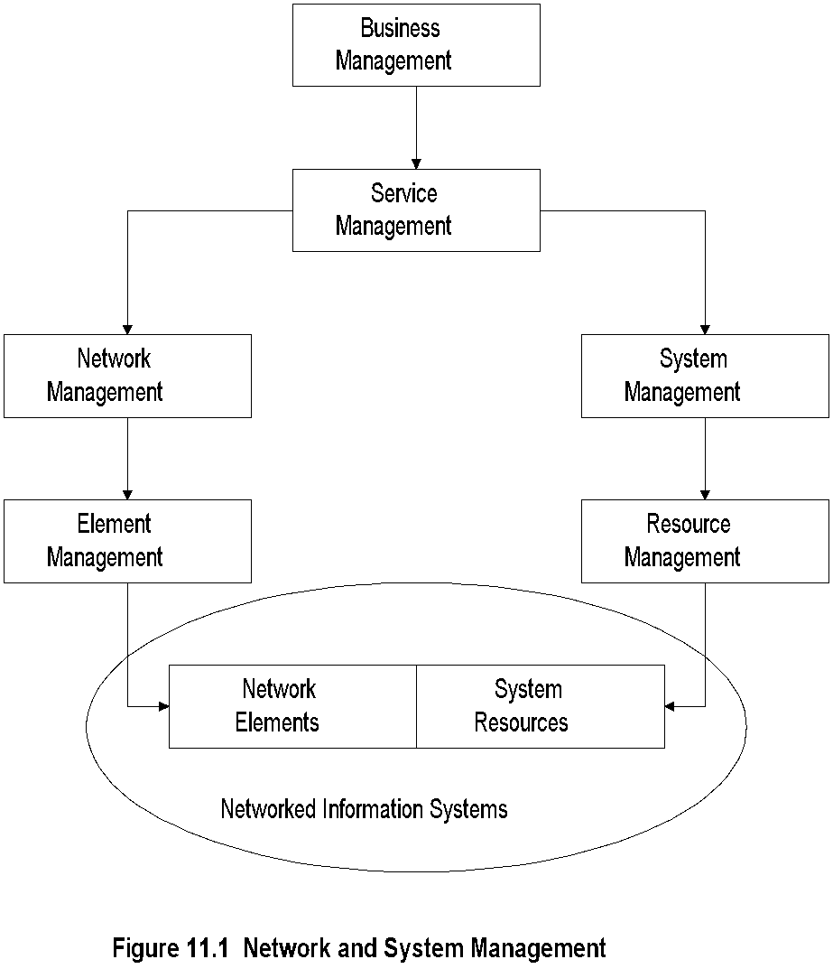
Chapter 11 Network Management Applications
Network and Systems Mgmt
Notes
TMN architecture expanded to include systems management
Network Management: Principles and Practice
© Mani Subramanian 2010
*

Slide 5
Chapter 11 Network Management Applications
Management Applications
OSI Model
Configuration
Performance
Fault
Security
Accounting
Reports
Service Level Management
Policy-based management
Notes
Network Management: Principles and Practice
© Mani Subramanian 2010
*

Slide 6
Chapter 11 Network Management Applications
Configuration Management
Network Provisioning
Inventory Management
Equipment
Facilities
Network Topology
Database Considerations
Notes
Network Management: Principles and Practice
© Mani Subramanian 2010
*

Slide 7
Chapter 11 Network Management Applications
Circuit Provisioning
Network Provisioning
Provisioning of network resources
Design
Installation and maintenance
Circuit-switched network
Packet-switched network, configuration for
Protocol
Performance
QoS
ATM networks
Notes
Examples:
TIRKS (Trunk Integrated Record Keeping System) for circuit-switched networks
E1 in TIRKS for equipment management
F1 in TIRKS for facilities management
Network Management: Principles and Practice
© Mani Subramanian 2010
*

Slide 8
Chapter 11 Network Management Applications
Network Topology
Manual
Autodiscovery by NMS using
Broadcast ping
ARP table in devices
Mapping of network
Layout
Layering
Views
Physical
Logical
Notes
Network Management: Principles and Practice
© Mani Subramanian 2010
*

Slide 9
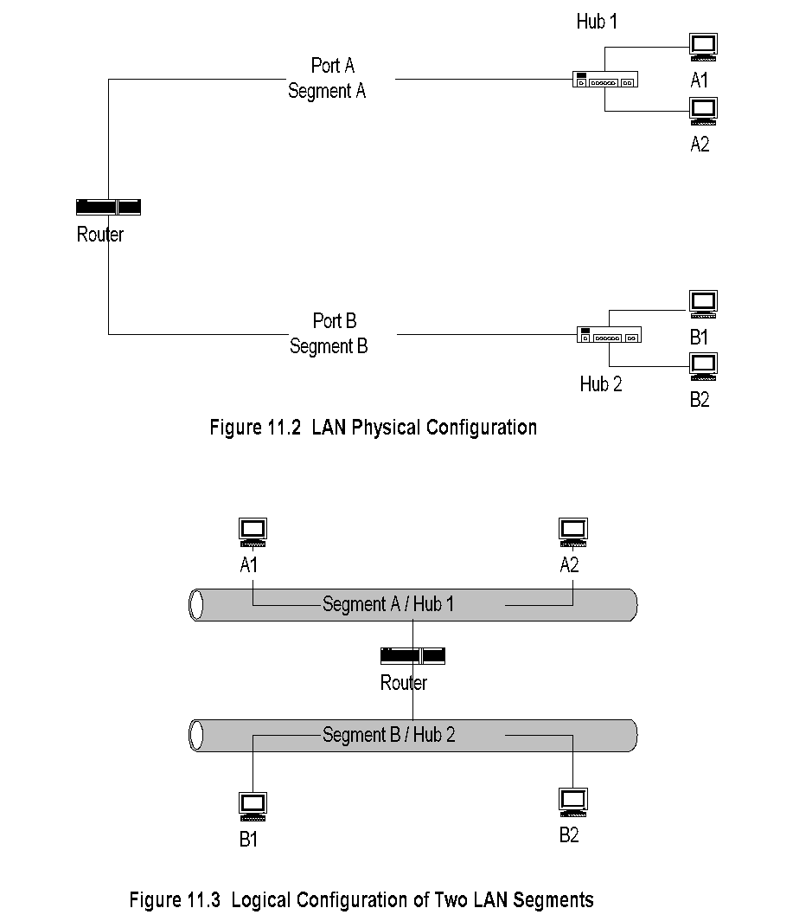
Chapter 11 Network Management Applications
Traditional LAN Configuration
Notes
One-to-one mapping between physical and logical configuration
Network Management: Principles and Practice
© Mani Subramanian 2010
*

Slide 10
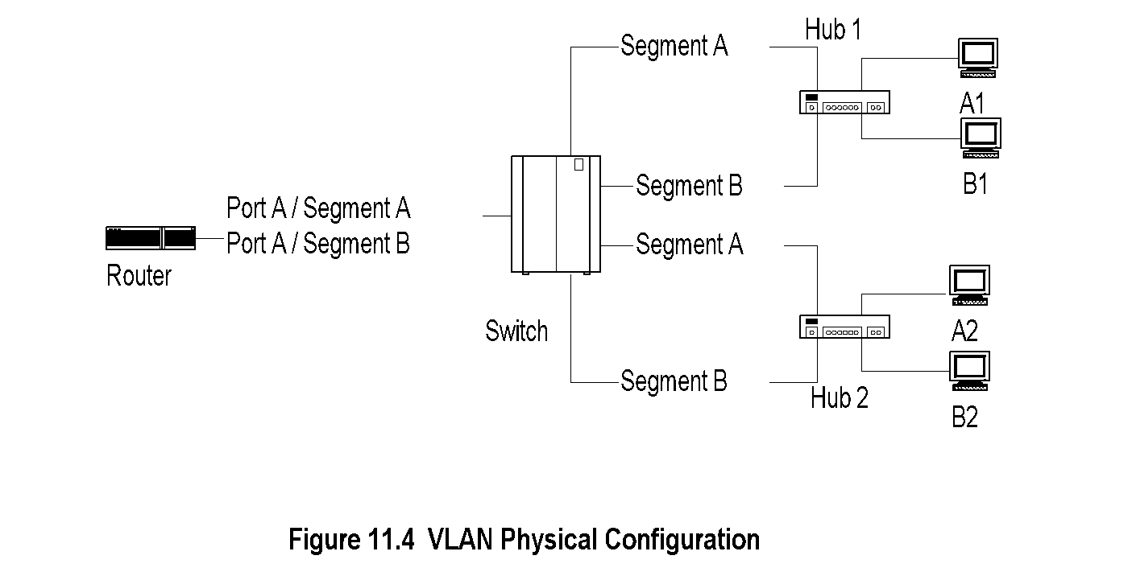
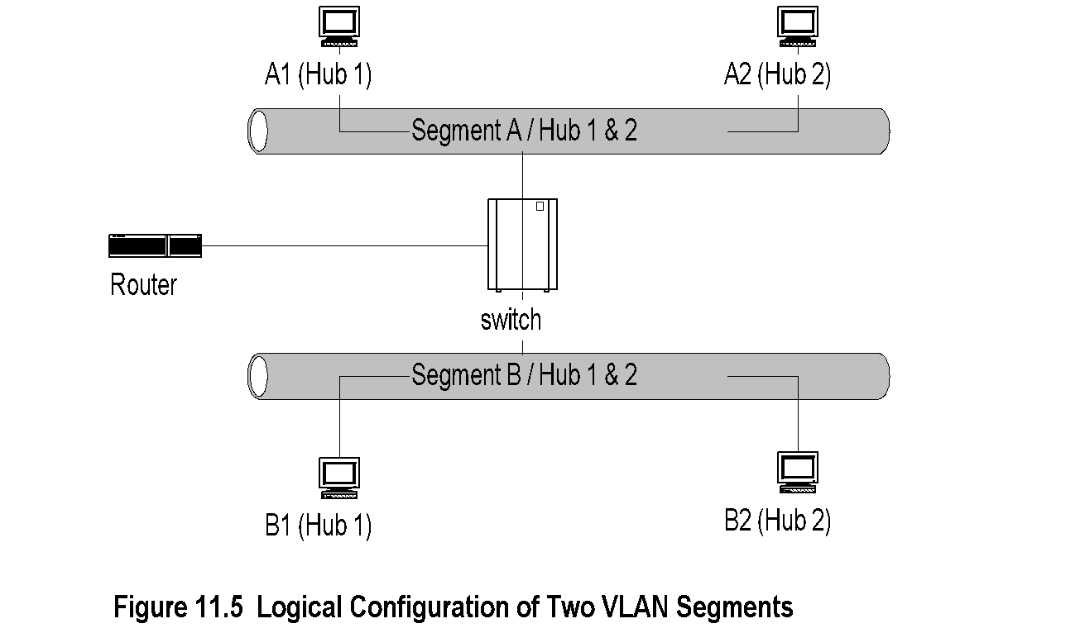
Chapter 11 Network Management Applications
Virtual LAN Configuration
Notes
Physical and logical configurations different
Physical location obtained from System group
Network Management: Principles and Practice
© Mani Subramanian 2010
*

Slide 11
Chapter 11 Network Management Applications
Fault Management
Fault is a failure of a network component
Results in loss of connectivity
Fault management involves:
Fault detection
Polling
Traps: linkDown, egpNeighborLoss
Fault location
Detect all components failed and trace down the tree topology to the source
Fault isolation by network and SNMP tools
Use artificial intelligence / correlation techniques
Restoration of service
Identification of root cause of the problem
Problem resolution
Notes
Network Management: Principles and Practice
© Mani Subramanian 2010
*

Slide 12
Chapter 11 Network Management Applications
Performance Management
Tools
Performance Metrics
Data Monitoring
Problem Isolation
Performance Statistics
Notes
Tools:
Protocol analyzers
RMON
MRTG
Network Management: Principles and Practice
© Mani Subramanian 2010
*

Slide 13
Chapter 11 Network Management Applications
Performance Metrics
Macro-level
Throughput
Response time
Availability
Reliability
Micro-level
Bandwidth
Utilization
Error rate
Peak load
Average load
Notes
Network Management: Principles and Practice
© Mani Subramanian 2010
*

Slide 14
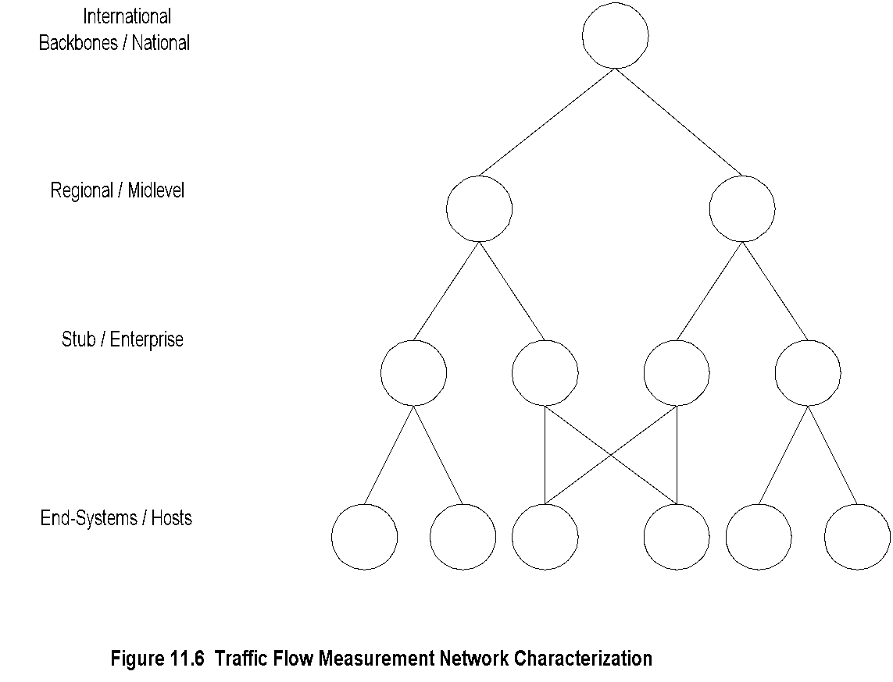
Chapter 11 Network Management Applications
Traffic Flow Measurement
Network Characterization
Notes
Four levels defined by IETF (RFC 2063)
Three measurement entities:
Meters gather data and build tables
Meter readers collect data from meters
Managers oversee the operation
Meter MIB (RFC 2064)
NetrMet - an implementation (RFC 2123)
Network Management: Principles and Practice
© Mani Subramanian 2010
*

Slide 15
Chapter 11 Network Management Applications
Data Monitoring and
Problem Isolation
Data monitoring
Normal behavior
Abnormal behavior (e.g., excessive collisions, high packet loss, etc.)
Set up traps (e.g., parameters in alarm group in RMON on object identifier of interest)
Set up alarms for criticality
Manual and automatic clearing of alarms
Problem isolation
Manual mode using network and SNMP tools
Problems in multiple components need tracking down the topology
Automated mode using correlation technology
Notes
Network Management: Principles and Practice
© Mani Subramanian 2010
*

Slide 16
Chapter 11 Network Management Applications
Performance Statistics
Traffic statistics
Error statistics
Used in
QoS tracking
Performance tuning
Validation of SLA
Trend analysis
Facility planning
Functional accounting
Notes
Network Management: Principles and Practice
© Mani Subramanian 2010
*

Slide 17
Chapter 11 Network Management Applications
Event Correlation Techniques
Basic elements
Detection and filtering of events
Correlation of observed events using AI
Localize the source of the problem
Identify the cause of the problem
Techniques
Rule-based reasoning
Model-based reasoning
Case-based reasoning
Codebook correlation model
State transition graph model
Finite state machine model
Notes
Network Management: Principles and Practice
© Mani Subramanian 2010
*

Slide 18
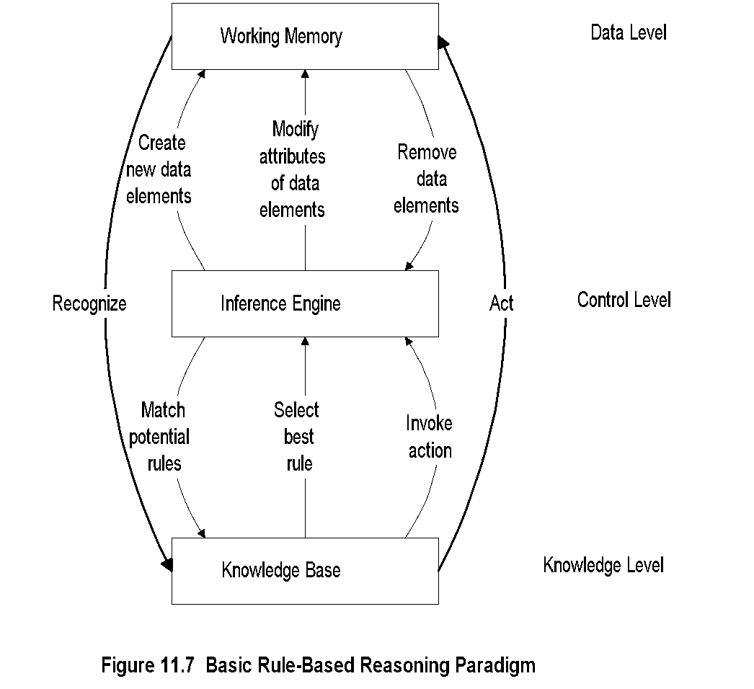
Chapter 11 Network Management Applications
Rule-Based Reasoning
Notes
Knowledge base contains expert knowledge on problem symptoms and actions to be taken if -> then condition -> action
Working memory contains topological and state information of the network; recognizes system going into faulty state
Inference engine in cooperation with knowledge base decides on the action to be taken
Knowledge Base executes the action
Process is interactive
Network Management: Principles and Practice
© Mani Subramanian 2010
*

Slide 19
Chapter 11 Network Management Applications
Rule-Based Reasoning
Rule-based paradigm is an iterative process
RBR is “brittle” if no precedence exists
An exponential growth in knowledge base poses problem in scalability
Problem with instability if packet loss < 10% alarm green if packet loss => 10% < 15% alarm yellow if packet loss => 15% alarm red Solution using fuzzy logic
Notes
Network Management: Principles and Practice
© Mani Subramanian 2010
*

Slide 20
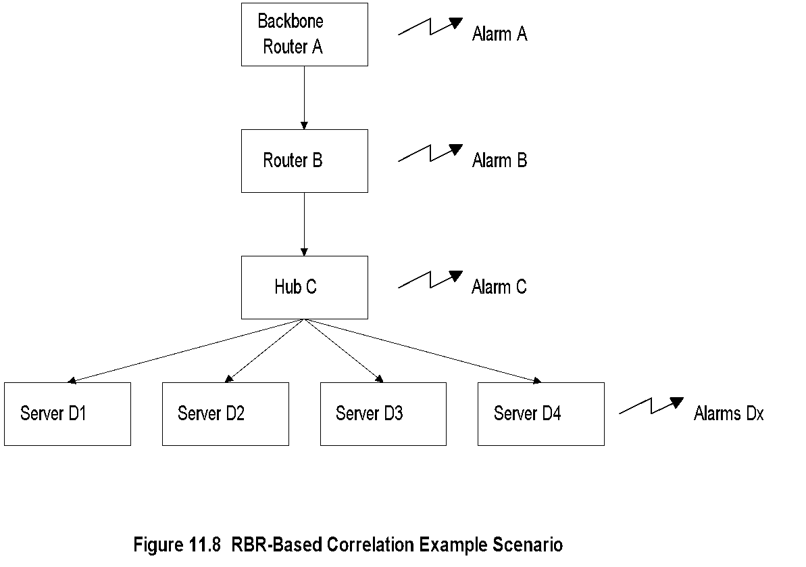
Chapter 11 Network Management Applications
Configuration for RBR Example
Notes
Network Management: Principles and Practice
© Mani Subramanian 2010
*

Slide 21
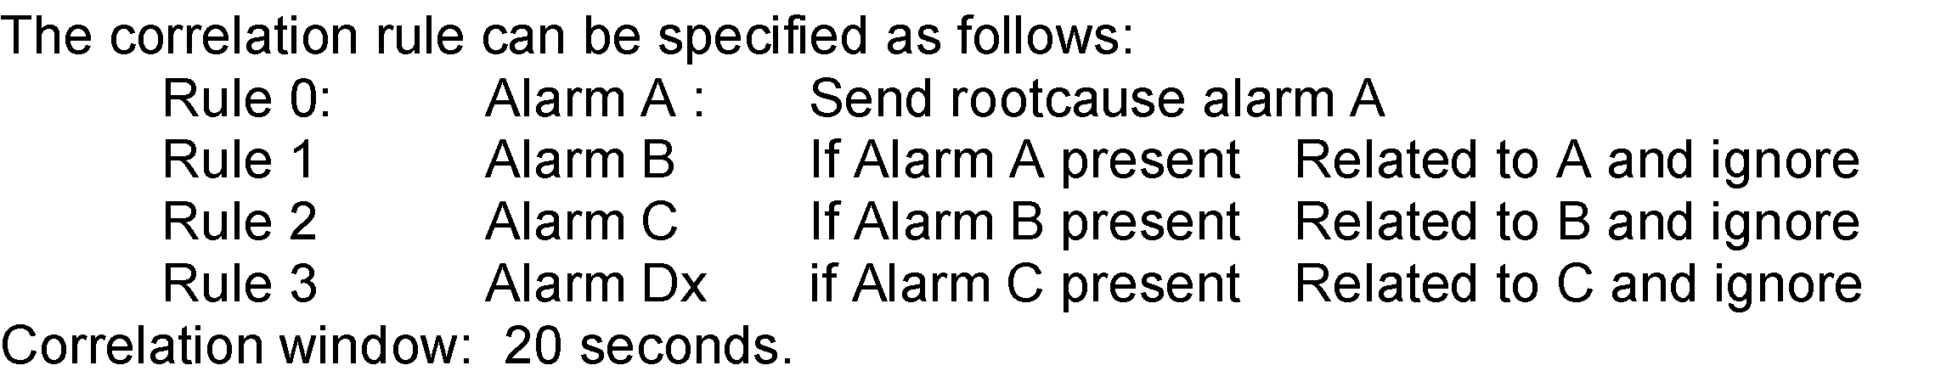
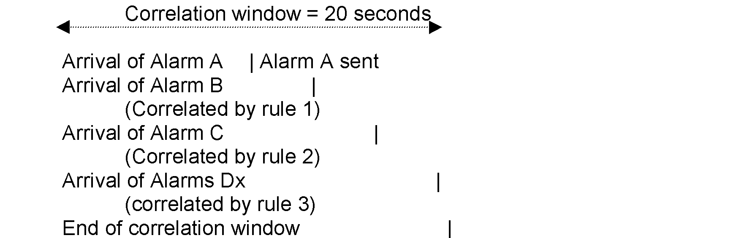
Chapter 11 Network Management Applications
RBR Example
Notes
Network Management: Principles and Practice
© Mani Subramanian 2010
*

Slide 22
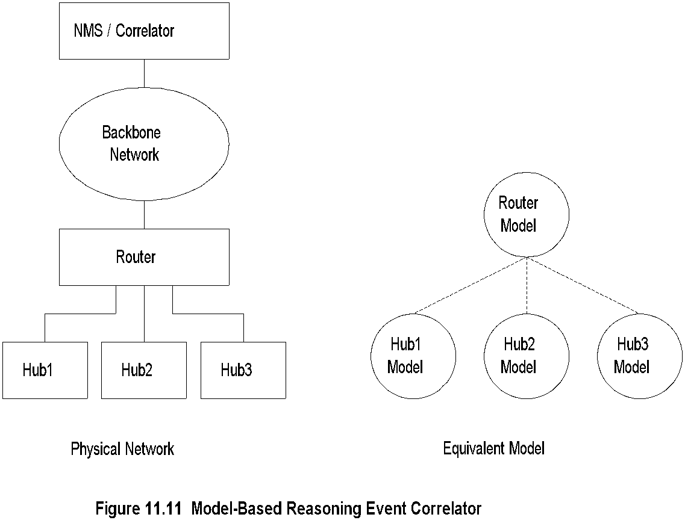
Chapter 11 Network Management Applications
Model-Based Reasoning
Notes
Object-oriented model
Model is a representation of the component it models
Model has attributes and relations to other models
Relationship between objects reflected in a similar relationship between models
Network Management: Principles and Practice
© Mani Subramanian 2010
*

Slide 23
Chapter 11 Network Management Applications
MBR Event Correlator
Example:
Hub 1 fails
Recognized by Hub 1 model
Hub 1 model queries router model
Router model
declares failure
Router model
declares no
failure
Hub 1 model
declares NO failure
Hub 1 model
declares Failure
Notes
Network Management: Principles and Practice
© Mani Subramanian 2010
*

Slide 24
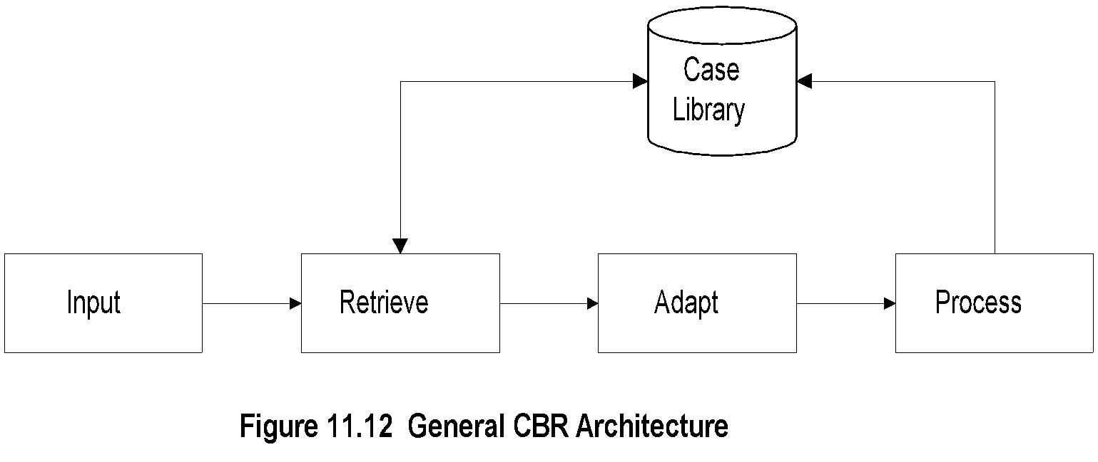
Chapter 11 Network Management Applications
Case-Based Reasoning
Notes
Unit of knowledge
RBR rule
CBR case
CBR based on the case experienced before; extend to the current situation by adaptation
Three adaptation schemes
Parameterized adaptation
Abstraction / respecialization adaptation
Critic-based adaptation
Network Management: Principles and Practice
© Mani Subramanian 2010
*

Slide 25
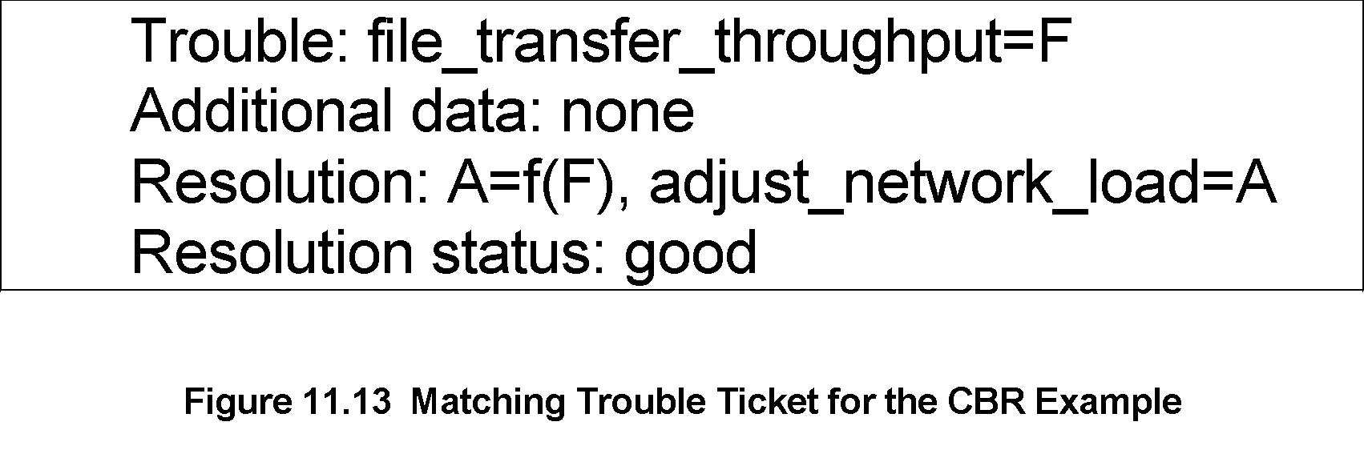
Chapter 11 Network Management Applications
CBR: Matching Trouble Ticket
Example: File transfer throughput problem
Notes
Trouble ticket in case library: A = f(F)
Parameter A is a function of Parameter F
Network Management: Principles and Practice
© Mani Subramanian 2010
*

Slide 26
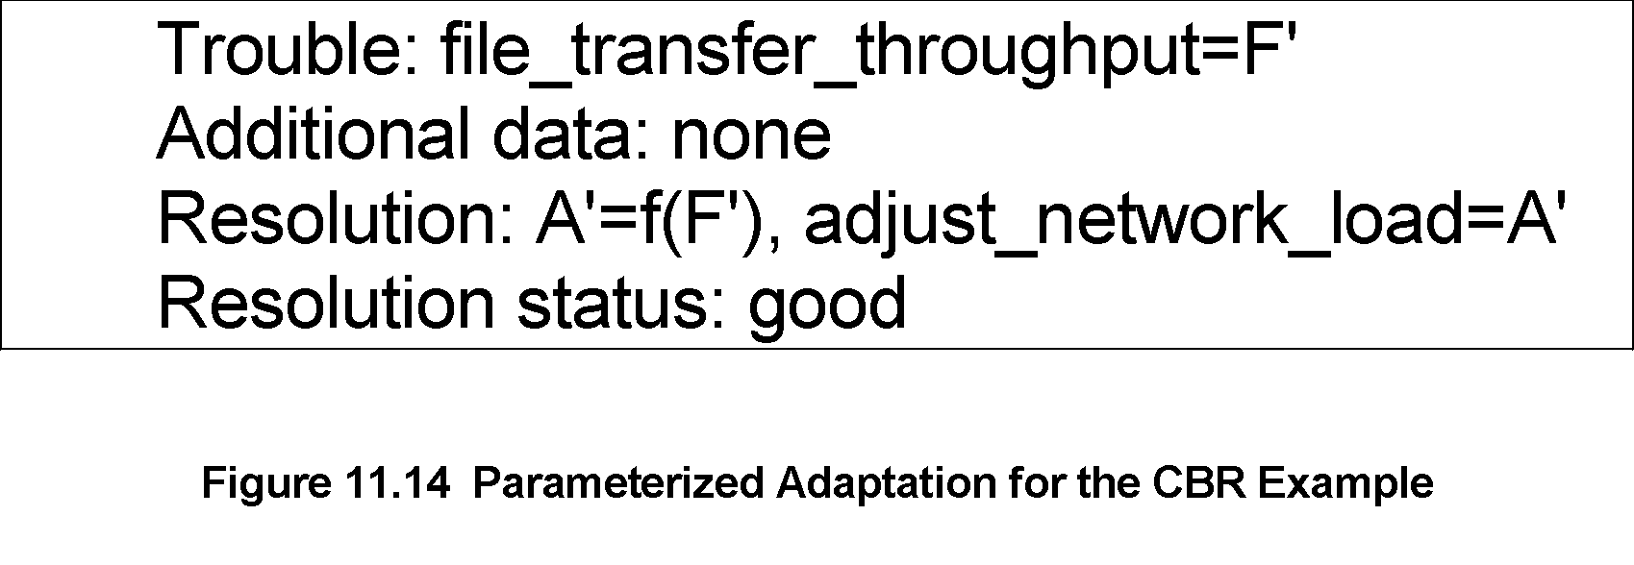
Chapter 11 Network Management Applications
CBR: Parameterized Adaptation
Notes
A = f(F)
A’ = f(F’)
Functional relationship f(x) remains the same
Network Management: Principles and Practice
© Mani Subramanian 2010
*

Slide 27
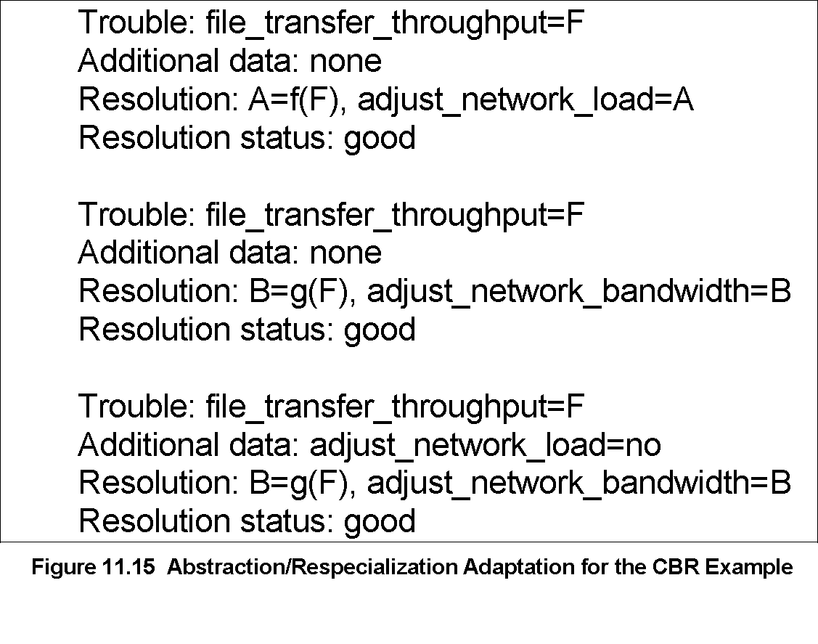
Chapter 11 Network Management Applications
CBR: Abstraction / Respecialization
Notes
Two possible resolutions
A = f(F) Adjust network load level
B = g(F) Adjust bandwidth
Resolution based on constraint imposed
Network Management: Principles and Practice
© Mani Subramanian 2010
*

Slide 28
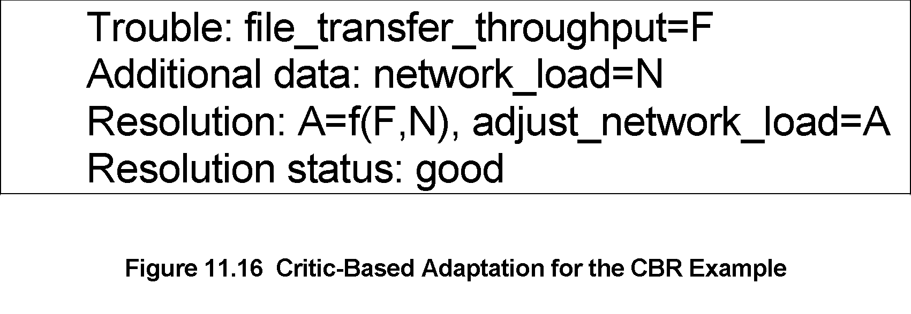
Chapter 11 Network Management Applications
CBR: Critic-Based Adaptation
Notes
Human expertise introduces a new case
N (network load) is an additional parameter added to the functional relationship
Network Management: Principles and Practice
© Mani Subramanian 2010
*

Slide 29
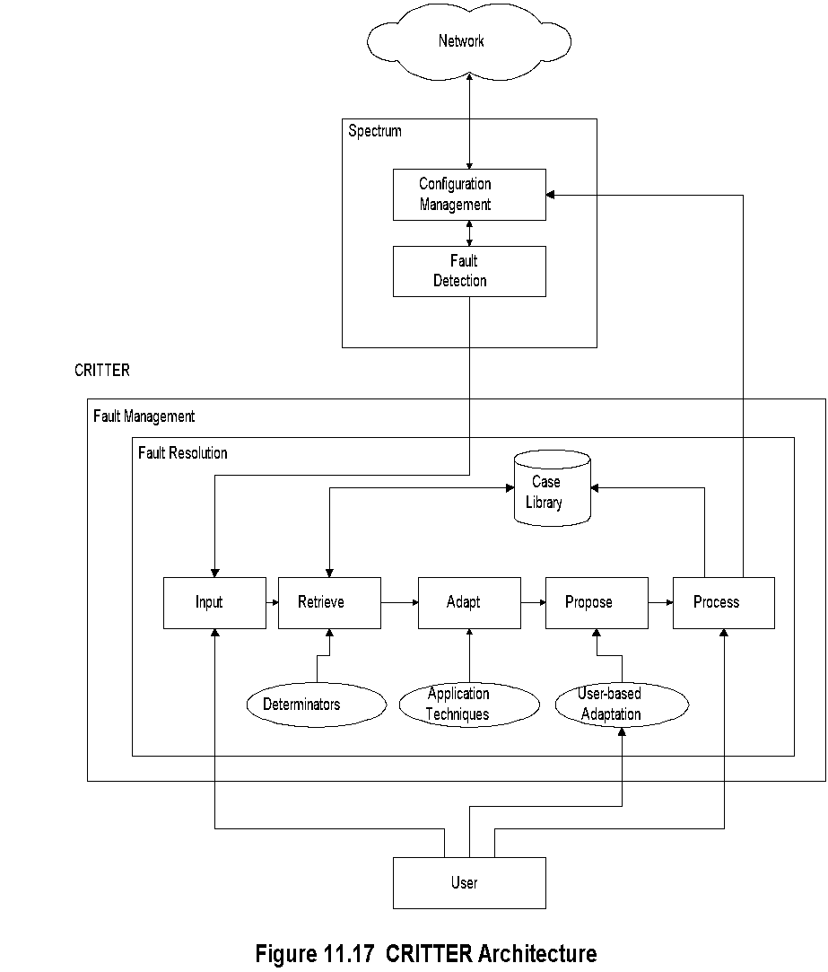
Chapter 11 Network Management Applications
CBR-Based Critter
Notes
CRITTER is CBR-based trouble resolution system
Integrated with Cabletron Spectrum NMS
“Propose” is additional (5th) module to CBR architecture; permits manual intervention
Network Management: Principles and Practice
© Mani Subramanian 2010
*

Slide 30
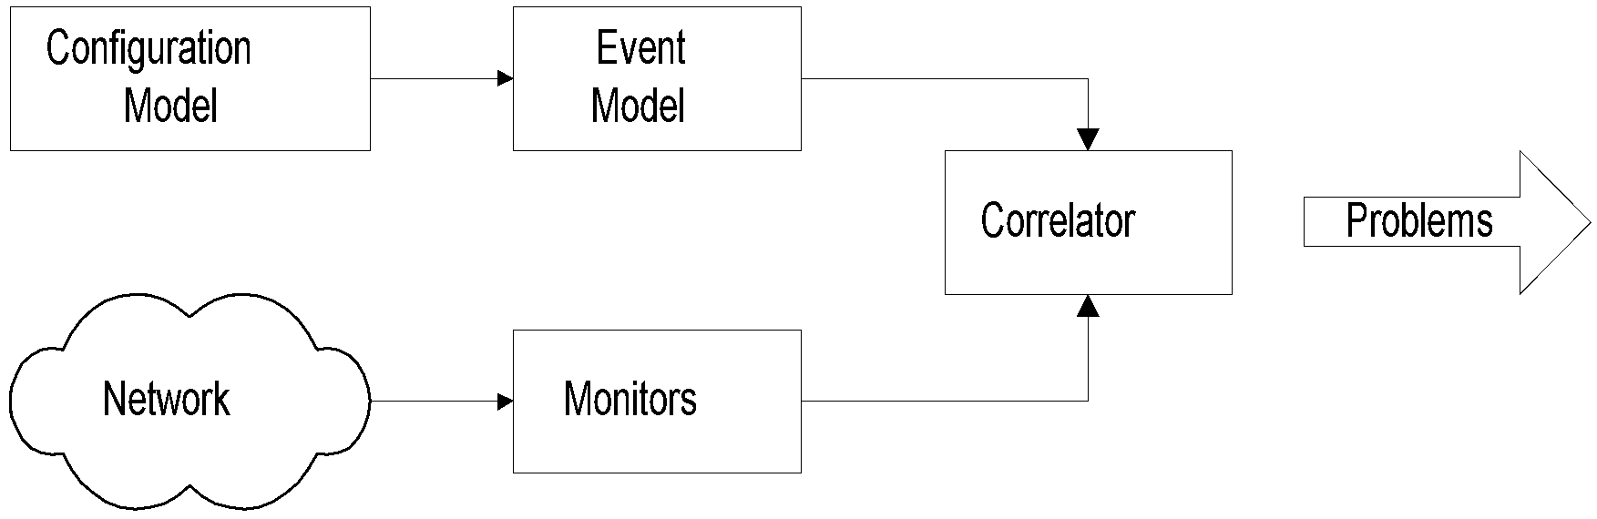
Chapter 11 Network Management Applications
Codebook Correlation Model:
Generic Architecture مهم
Figure 11.18 Generic Architecture of an Event Correlation System
Notes
Yemini, et. al. proposed this model
Monitors capture alarm events
Configuration model contains the configuration of the network
Event model represents events and their causal relationships
Correlator correlates alarm events with event model and determines the problem that caused the events
Network Management: Principles and Practice
© Mani Subramanian 2010
*

Slide 31
Chapter 11 Network Management Applications
Codebook Approachمهم
Approach:
Correlation algorithms based upon coding approach to even correlation
Problem events viewed as messages generated by a system and encoded in sets of alarms
Correlator decodes the problem messages to identify the problems
Two phases:
1. Codebook selection phase: Problems to be monitored identified and the symptoms they generate are associated with the problem. This generates codebook (problem-symptom matrix)
2. Correlator compares alarm events with codebook and identifies the problem.
Notes
Network Management: Principles and Practice
© Mani Subramanian 2010
*

Slide 32
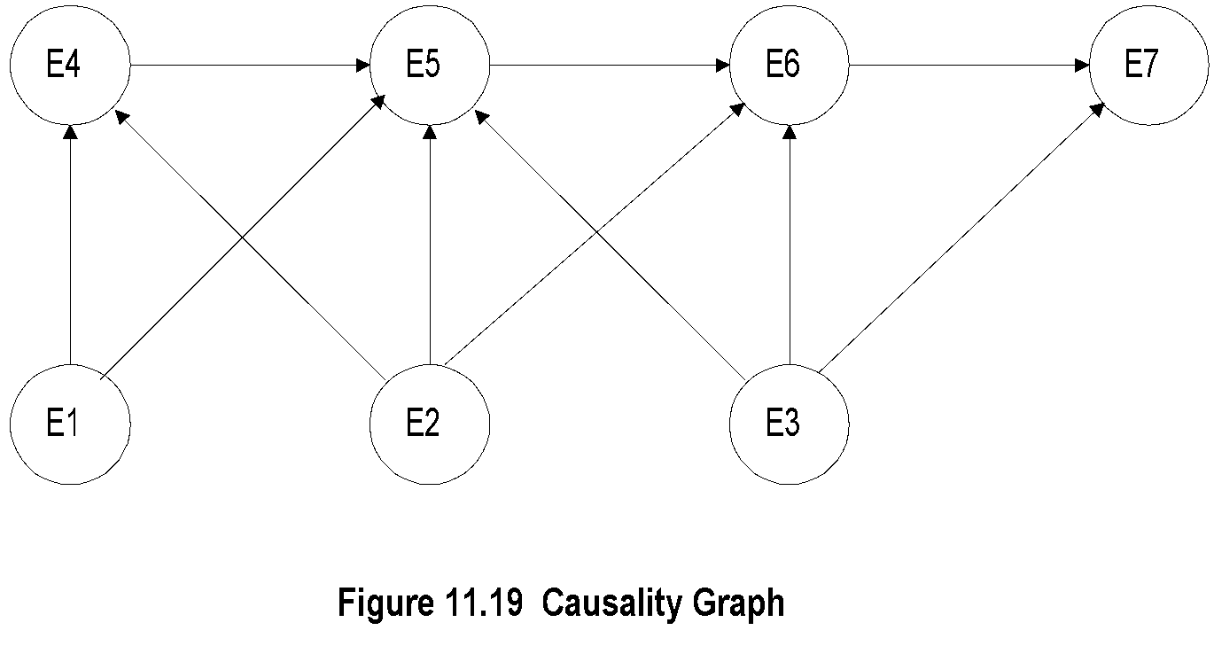
Chapter 11 Network Management Applications
Causality Graph
Notes
Each node is an event
An event may cause other events
Directed edges start at a causing event and terminate at a resulting event
Picture causing events as problems and resulting events as symptoms
Network Management: Principles and Practice
© Mani Subramanian 2010
*

Slide 33
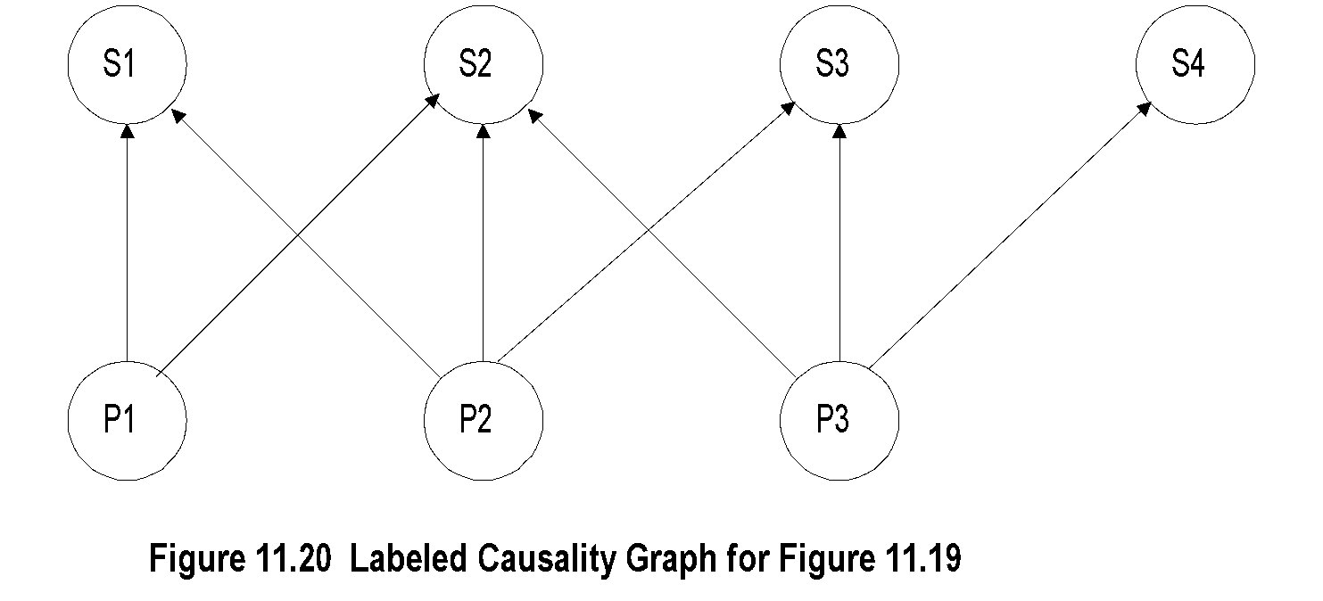
Chapter 11 Network Management Applications
Labeled Causality Graph
Notes
Ps are problems and Ss are symptoms
P1 causes S1 and S2
Note directed edge from S1 to S2 removed; S2 is caused directly or indirectly (via S1) by P1
S2 could also be caused by either P2 or P3
Network Management: Principles and Practice
© Mani Subramanian 2010
*

Slide 34

Chapter 11 Network Management Applications
Codebook
Figure 11.21 Codebook for Figure 11.20
Notes
Codebook is problem-symptom matrix
It is derived from causality graph after removing directed edges of propagation of symptoms
Number of symptoms => number of problems
2 rows are adequate to uniquely identify 3 problems
Network Management: Principles and Practice
© Mani Subramanian 2010
*

Slide 35

Chapter 11 Network Management Applications
Correlation Matrix
Figure 11.22 Correlation Matrix for Figure 11.20
Notes
Correlation matrix is reduced codebook
Network Management: Principles and Practice
© Mani Subramanian 2010
*

Slide 36
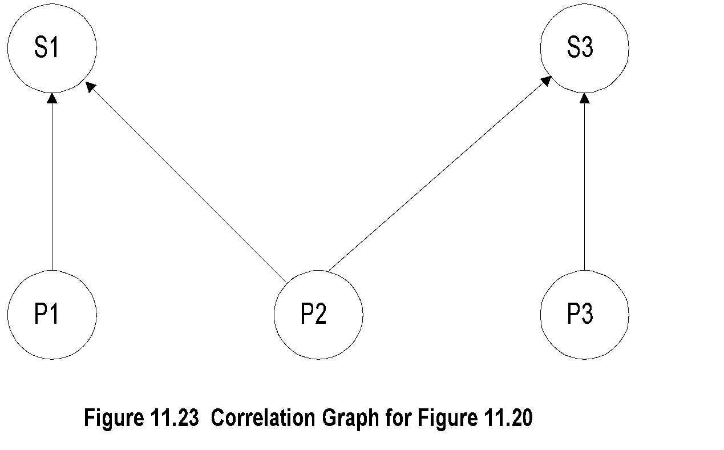
Chapter 11 Network Management Applications
Correlation Graph
Notes
Correlation graph is derived from correlation matrix
Network Management: Principles and Practice
© Mani Subramanian 2010
*

Slide 37
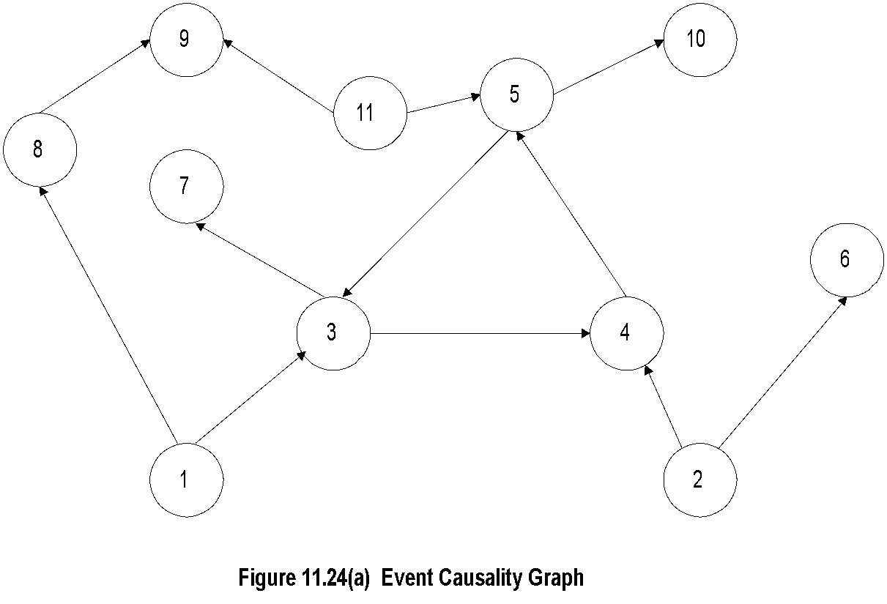
Chapter 11 Network Management Applications
Generalized Causality Graph
Notes
Causality graph has 11 events - problems and symptoms
Mark all nodes that have only emerging directed edges as problems - Nodes 1, 2, and 11
Other nodes are symptoms
Network Management: Principles and Practice
© Mani Subramanian 2010
*

Slide 38
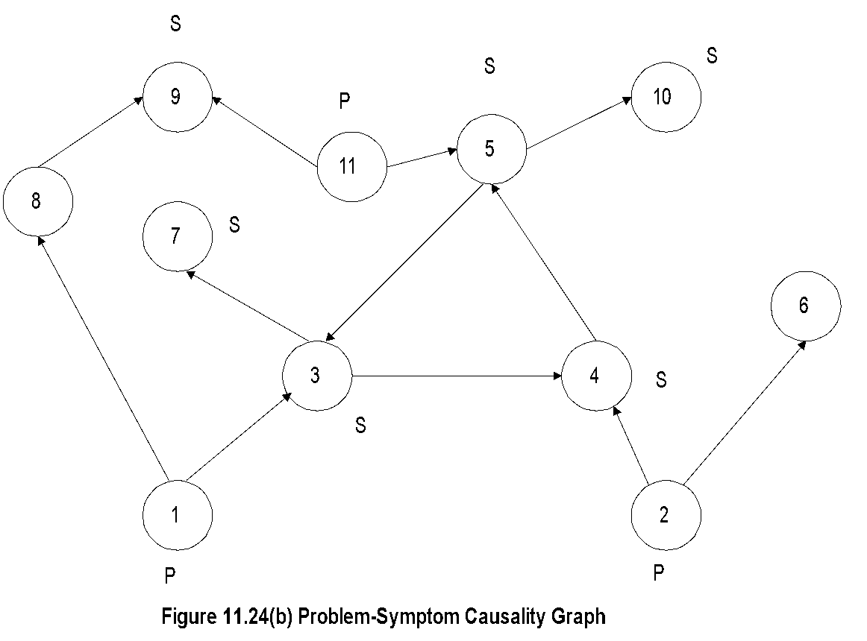
Chapter 11 Network Management Applications
P-S Causality Graph
Figure 11.24 Generalized Causality Graph
Notes
To reduce causality graph to correlation graph:
Symptoms 3, 4, and 5 are cyclical: replace with one symptom, say 3
S7 and S10 are caused by S3 and S5 and hence ignored
S8 causes S9. Keep S9 and eliminate S8; reason for this would be more obvious if we go through reduction of codebook to correlation matrix
Network Management: Principles and Practice
© Mani Subramanian 2010
*

Slide 39
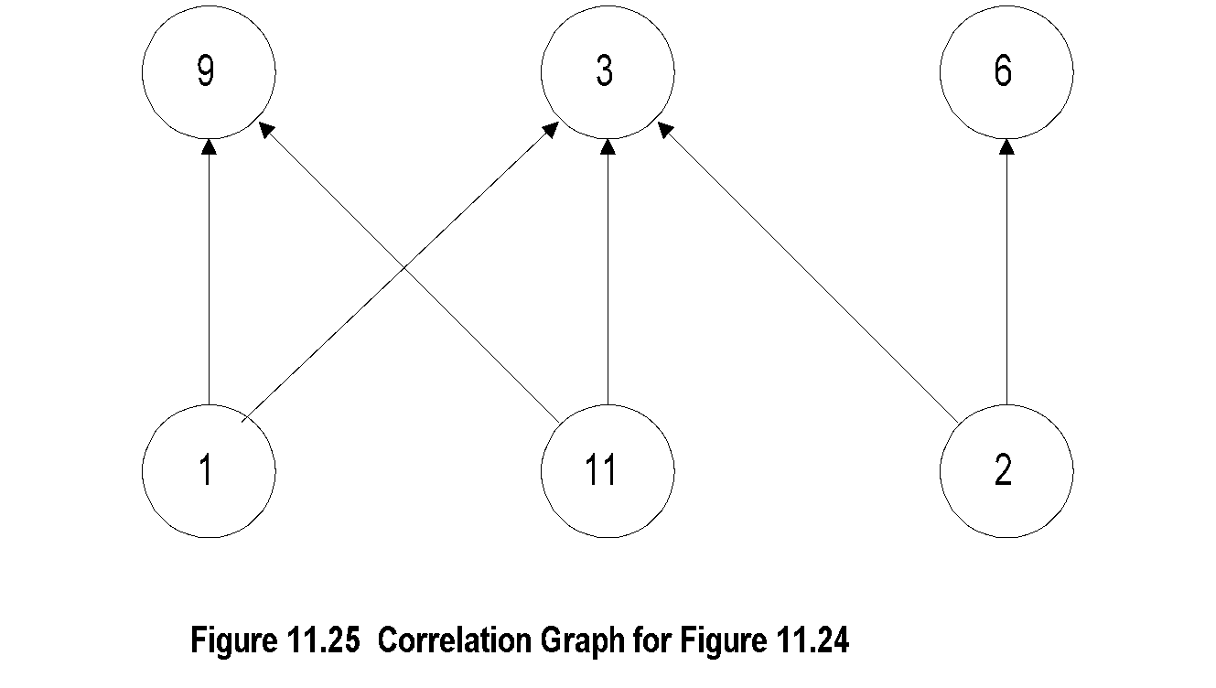

Chapter 11 Network Management Applications
Correlation Graph and Matrix
Notes
Figure 11.26 Correlation Matrix for Figure 11.24
Note that problems 1 and 11 produce identical symptoms
Network Management: Principles and Practice
© Mani Subramanian 2010
*

Slide 40
Chapter 11 Network Management Applications
Codebook Enhancements
Codebook described so far assumes Hamming distance of 1 for uniqueness
Noise affects accuracy
Increase Hamming distance to >1
Probability of a problem causing a symptom assumed as 1. It can be made Si = Pr(Pj) to be more realistic
Notes
Network Management: Principles and Practice
© Mani Subramanian 2010
*

Slide 41
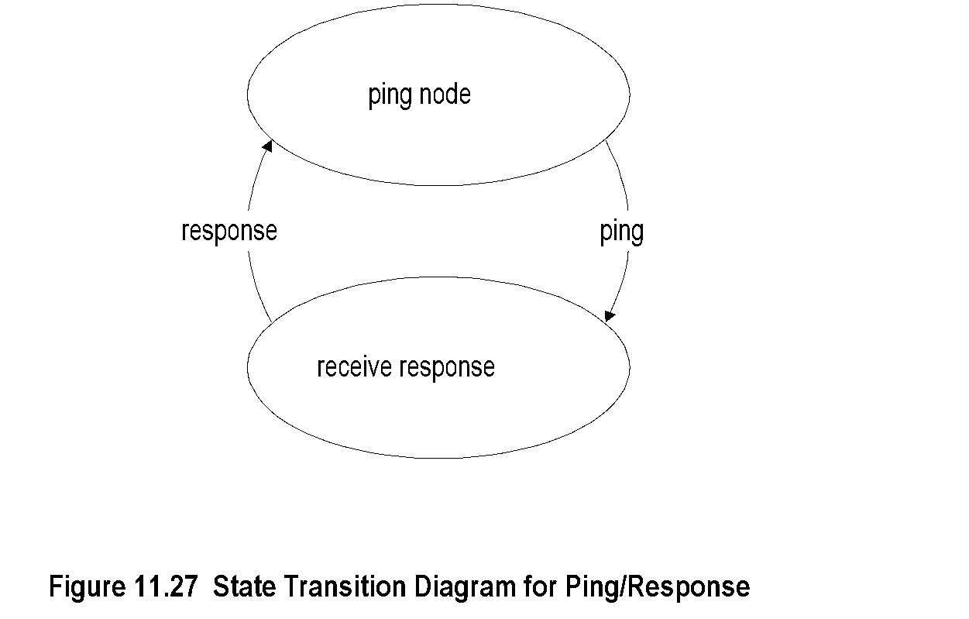
Chapter 11 Network Management Applications
State Transition Model
Notes
Used in Seagate’s NerveCenter correlation system
Integrated in NMS, such as OpenView
Used to determine the status of a node
Network Management: Principles and Practice
© Mani Subramanian 2010
*

Slide 42
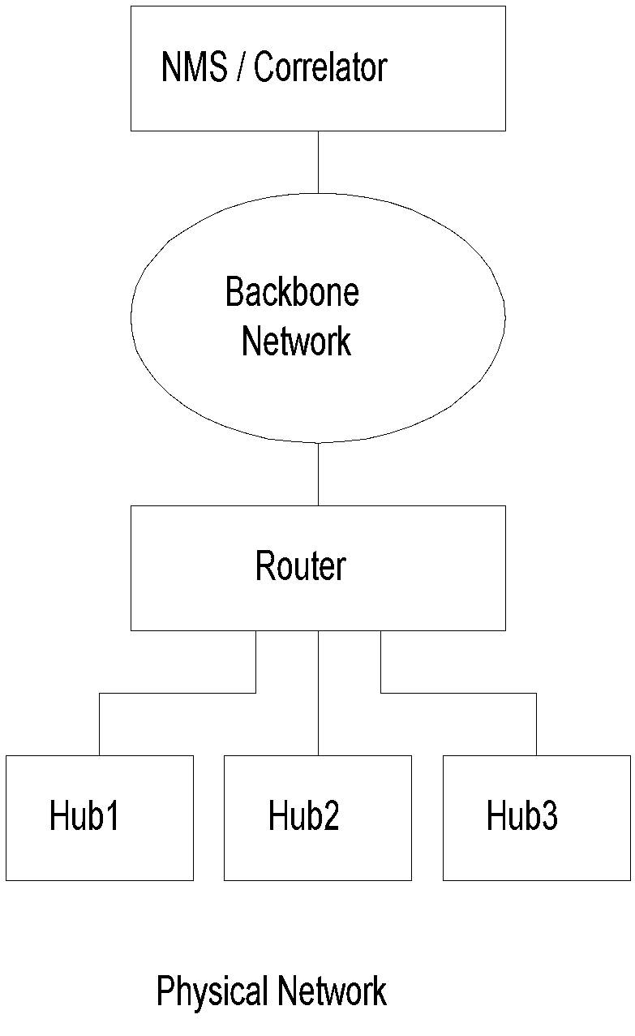
Chapter 11 Network Management Applications
State Transition Model Example
Notes
NMS pings hubs every minute
Failure indicated by the absence of a response
Network Management: Principles and Practice
© Mani Subramanian 2010
*

Slide 43
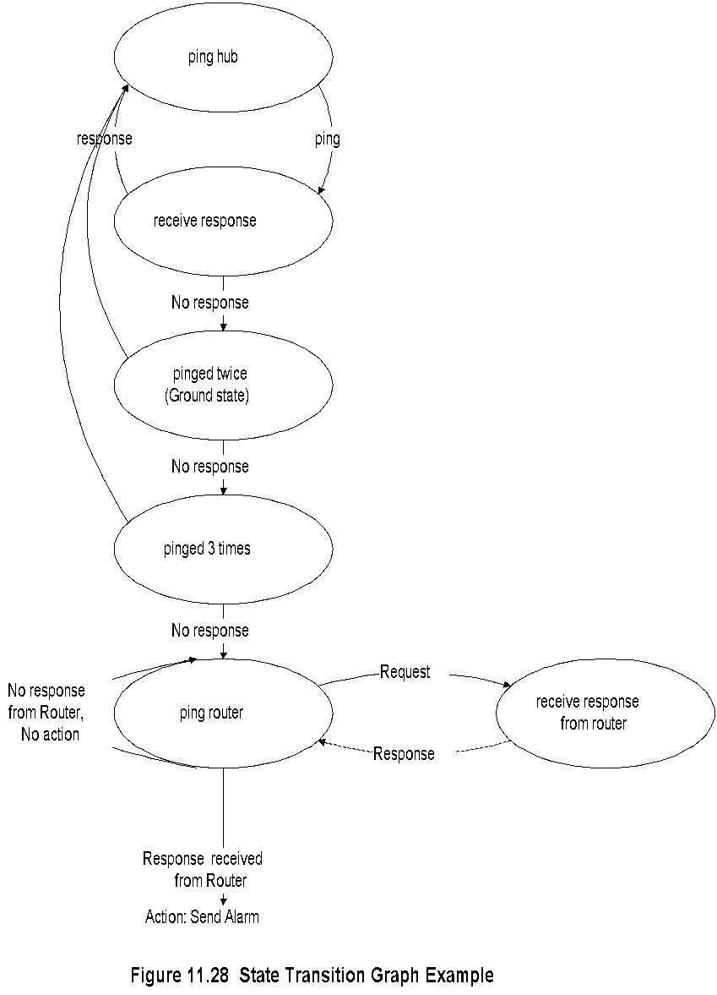
Chapter 11 Network Management Applications
State Transition Graph
Network Management: Principles and Practice
© Mani Subramanian 2010
*

Slide 44
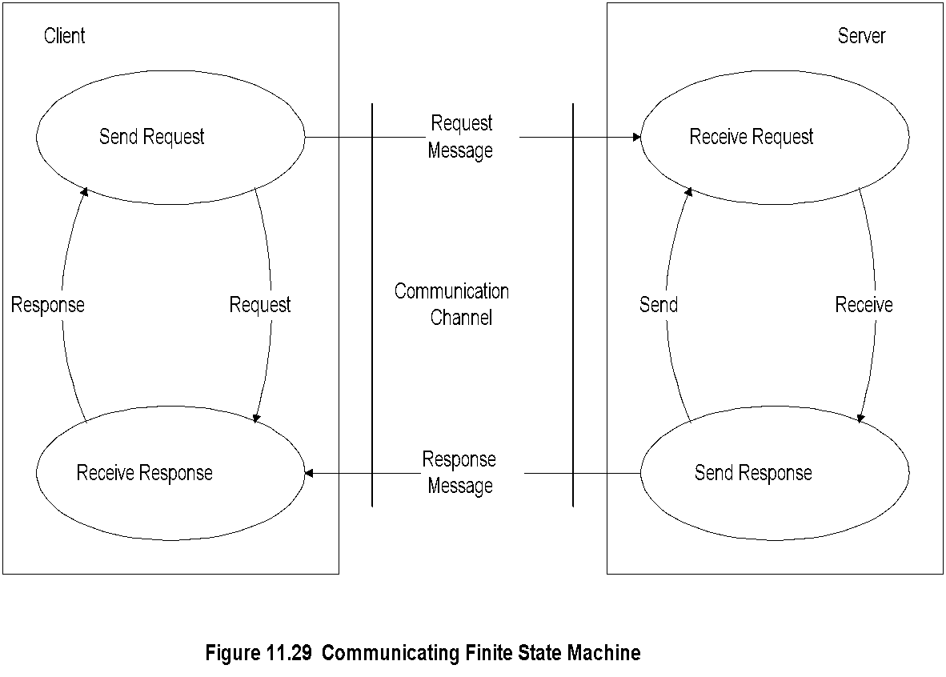
Chapter 11 Network Management Applications
Finite State Machine Model
Notes
Finite state machine model is a passive system; state transition graph model is an active system
An observer agent is present in each node and reports abnormalities, such as a Web agent
A central system correlates events reported by the agents
Failure is detected by a node entering an illegal state
Network Management: Principles and Practice
© Mani Subramanian 2010
*

Slide 45
Chapter 11 Network Management Applications
Security Management
Security threats
Policies and Procedures
Resources to prevent security breaches
Firewalls
Cryptography
Authentication and Authorization
Client/Server authentication system
Message transfer security
Network protection security
Notes
Network Management: Principles and Practice
© Mani Subramanian 2010
*

Slide 46
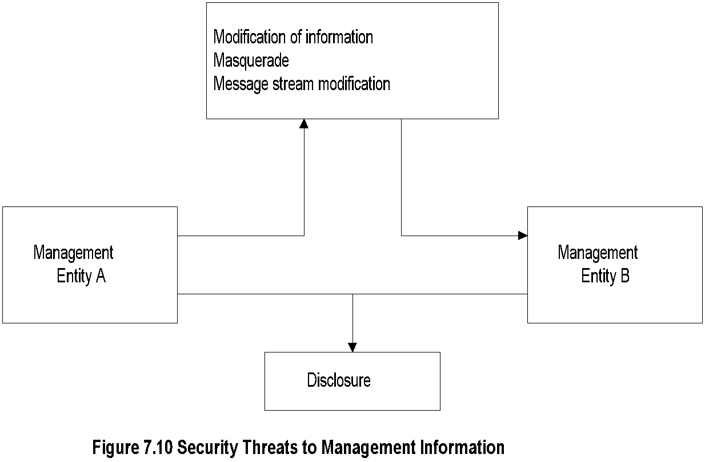
Chapter 11 Network Management Applications
Security Threats
Notes
SNMPv3 addressed security threats using USM (user-based security model)
USM has two modules:
Authentication module
Data integrity
Data origin
Privacy module
Data confidentiality
Message timeliness
Message protection
Network Management: Principles and Practice
© Mani Subramanian 2010
*

Slide 47
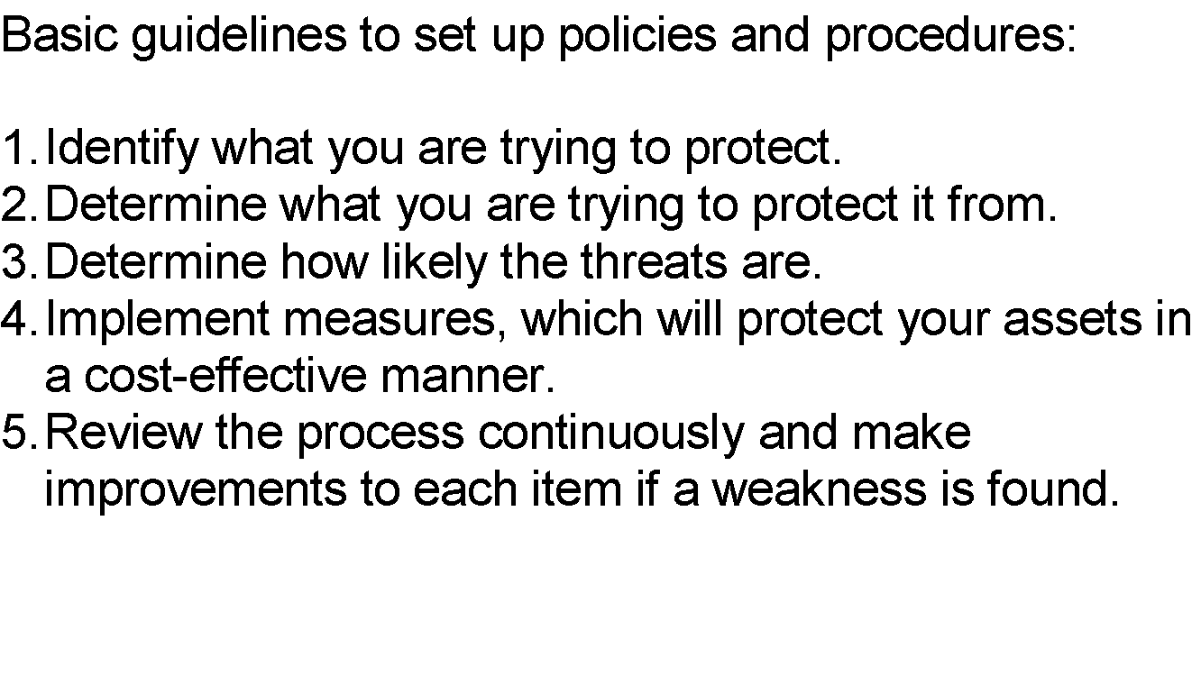
Chapter 11 Network Management Applications
Policies and Procedures
Notes
References:
Formal statement of rules for protecting organization’s technology and assets (RFC 2196)
Introduction to Firewalls (NIST)
Orange Book by National Computer Security Center (NCSC) rates computers based on security design features
Network Management: Principles and Practice
© Mani Subramanian 2010
*

Slide 48
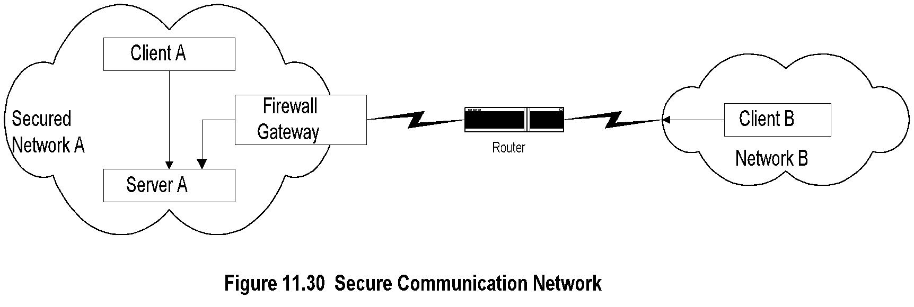
Chapter 11 Network Management Applications
Secure Communication Network
Notes
Firewall secures traffic in and out of Network A
Security breach could occur by intercepting the message going from B to A, even if B has permission to access Network A
Most systems implement authentication with user id and password
Authorization is by establishment of accounts
Network Management: Principles and Practice
© Mani Subramanian 2010
*

Slide 49
Chapter 11 Network Management Applications
Firewalls
Protects a network from external attacks
Controls traffic in and out of a secured network
Could be implemented in a router, gateway, or a special host
Benefits
Reduces risks of access to hosts
Controlled access
Eliminates annoyance to the users
Protects privacy (e.g., finger)
Hierarchical implementation of policy and and technology (e.g., finger)
Notes
Network Management: Principles and Practice
© Mani Subramanian 2010
*

Slide 50
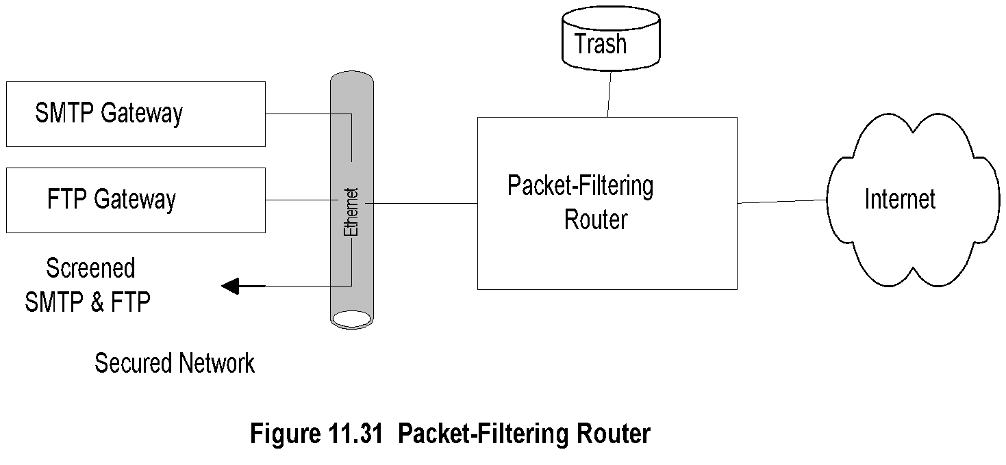
Chapter 11 Network Management Applications
Packet Filtering Firewall
Notes
Uses protocol specific criteria at DLC, network, and transport layers
Implemented in routers - called screening router or packet-filtering routers
Filtering parameters:
Source and/or destination IP address
Source and/or destination TCP/UDP port address, such as ftp port 21
Multistage screening - address and protocol
Works best when rules are simple
Network Management: Principles and Practice
© Mani Subramanian 2010
*

Slide 51
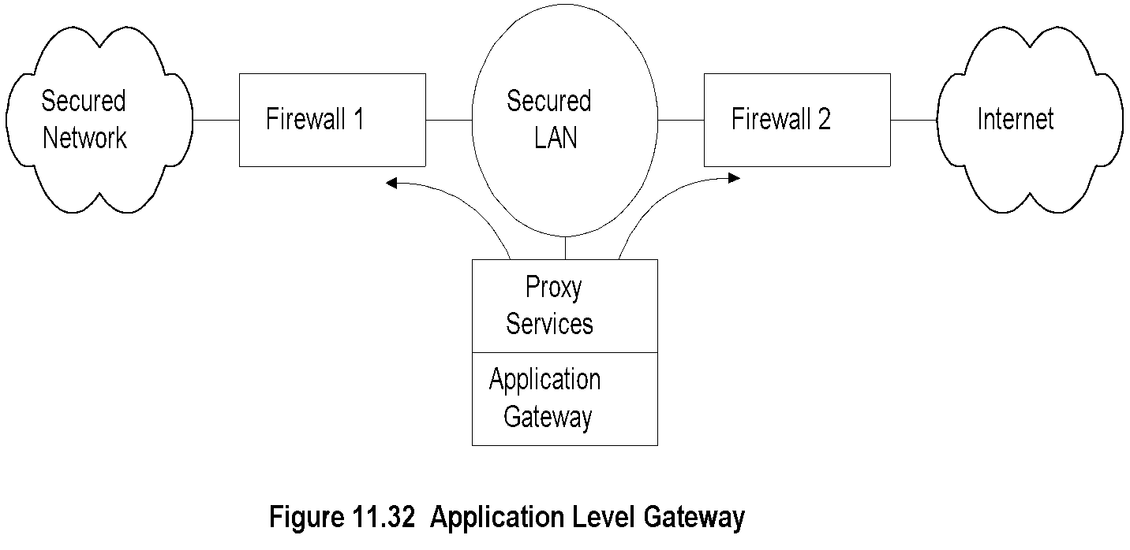
Chapter 11 Network Management Applications
Application Level Gateway
Notes
Firewalls 1 and 2 route traffic only from and to the secured LAN
Secured LAN is gateway LAN
Behavior of application gateway dependent on the application
FTP traffic stored and forwarded after validation
TELNET hosts validated for the session and then direct communication established
Network Management: Principles and Practice
© Mani Subramanian 2010
*

Slide 52
Chapter 11 Network Management Applications
Cryptography
Secure communication requires
Integrity protection: ensuring that the message is not tampered with
Authentication validation: ensures the originator identification
Security threats
Modification of information
Masquerade
Message stream modification
Disclosure
Hardware and software solutions
Most secure communication is software based
Notes
Network Management: Principles and Practice
© Mani Subramanian 2010
*

Slide 53
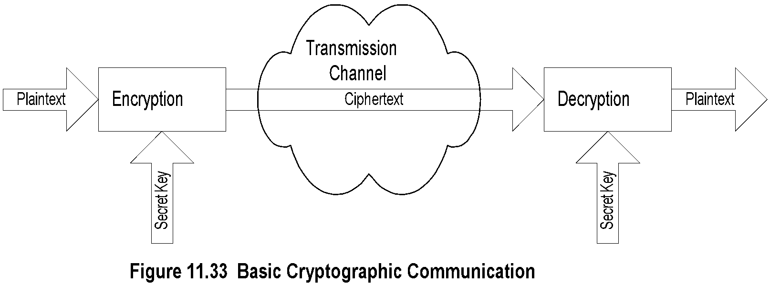
Chapter 11 Network Management Applications
Secret Key Cryptography
Notes
Caesar cipher: each letter replaced by another letter, which is three letters behind in the alphabet
Maximum of 26 attempts to decode Caesar cipher
Monoalphabetic cipher: Replace a letter with another randomly chosen; Maximum attempts to decode 26!
One secret key is needed between each pair
Two standard algorithms for secret key:
DES (Data Encryption Standard): 64-bit message blocks and 56-bit key
IDEA (International Data Encryption Algorithm): 64-bit message blocks and 128-bit key
Message block derived using CBC (Cipher Block Chaining)
Principle based on rearranging the blocks several times based on predetermined algorithm and secret key
Network Management: Principles and Practice
© Mani Subramanian 2010
*

Slide 54
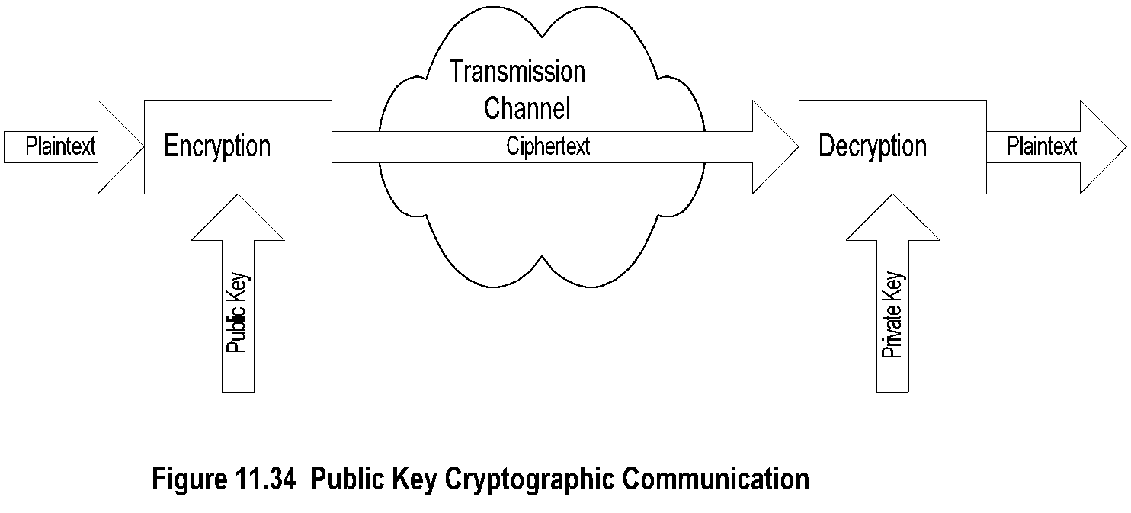
Chapter 11 Network Management Applications
Public Key Cryptography
Notes
Asymmetric cryptography - public and private key
Public key is distributed by the receiver to the senders to encrypt the message.
Private key is used by receiver to decode ciphertext
Mailbox analogy
Commonly used public key is RSA (Rivest, Shamir, and Adleman); 512-bit key, variable block size
RSA less efficient than DES and IDEA; used to encrypt secret key
Network Management: Principles and Practice
© Mani Subramanian 2010
*

Slide 55

Chapter 11 Network Management Applications
Message Digest
Message digest is a cryptographic hash algorithm added to a message
One-way function
Analogy with CRC
If the message is tampered with the message digest at the receiving end fails to validate
MD5 (used in SNMPv3) commonly used MD
MD5 takes a message of arbitrary length (32-byte) blocks and generates 128-bit message digest
SHS (Secure Hash Standard) message digest proposed by NIST handles 2⁶⁴ bits and generates 160-bit output
Notes
Example:
Network Management: Principles and Practice
© Mani Subramanian 2010
*

Slide 56
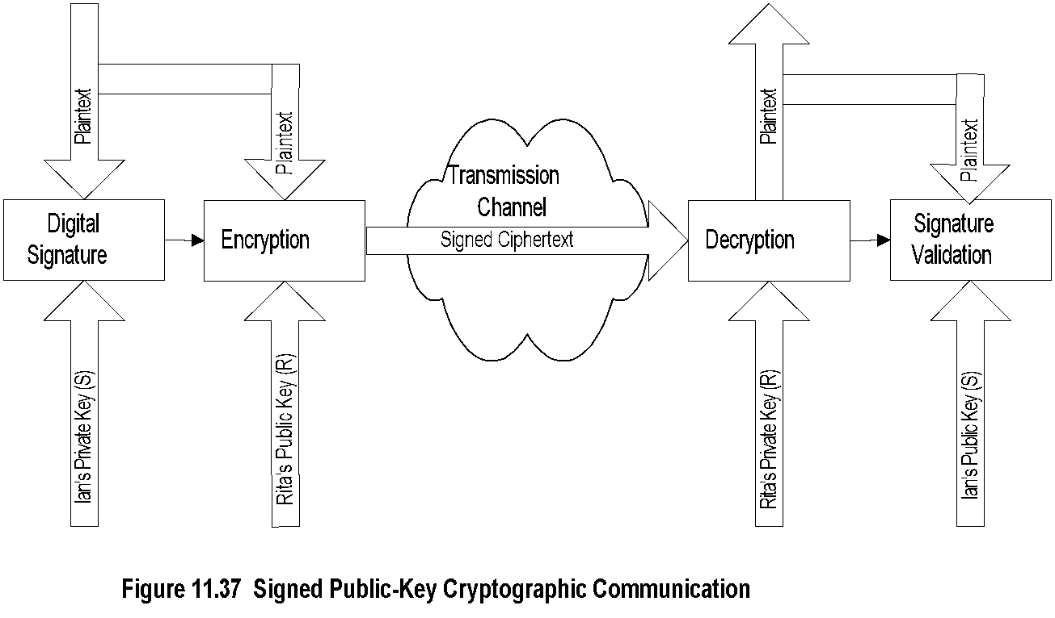
Chapter 11 Network Management Applications
Digital Signature
Notes
Why do we need digital signature?
Principle reverse of public key
Signature created using private key and validated using public key
Digital signature is a message digest generated from plaintext and private key by a hashing algorithm
Digital signature is concatenated with the plaintext and encrypted using public key
Network Management: Principles and Practice
© Mani Subramanian 2010
*

Slide 57
Chapter 11 Network Management Applications
Authentication and Authorization
Authentication verifies user identification
Client/server environment
Ticket-granting system
Authentication server system
Cryptographic authentication
Messaging environment
e-mail
e-commerce
Authorization grants access to information
Read, read-write, no-access
Indefinite period, finite period, one-time use
Notes
Network Management: Principles and Practice
© Mani Subramanian 2010
*

Slide 58
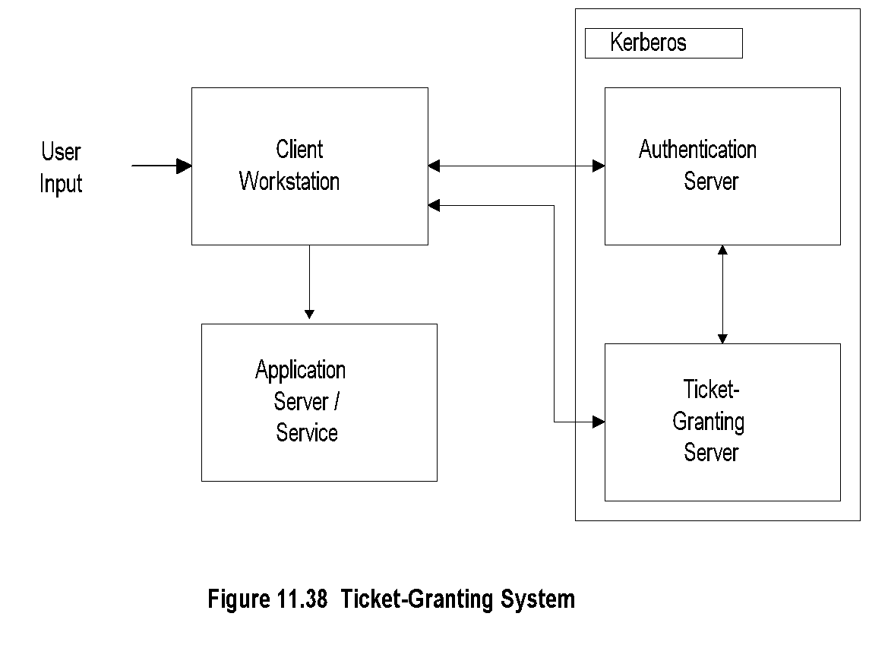
Chapter 11 Network Management Applications
Ticket-Granting System
Notes
Used in client/server authentication system
Kerberos developed by MIT
Steps:
User logs on to client workstation
Login request sent to authentication server
AS checks ACL, grants encrypted ticket to client
Client obtains from TGS service-granting ticket and session key
Application Server validates ticket and session key, and then provides service
Network Management: Principles and Practice
© Mani Subramanian 2010
*

Slide 59
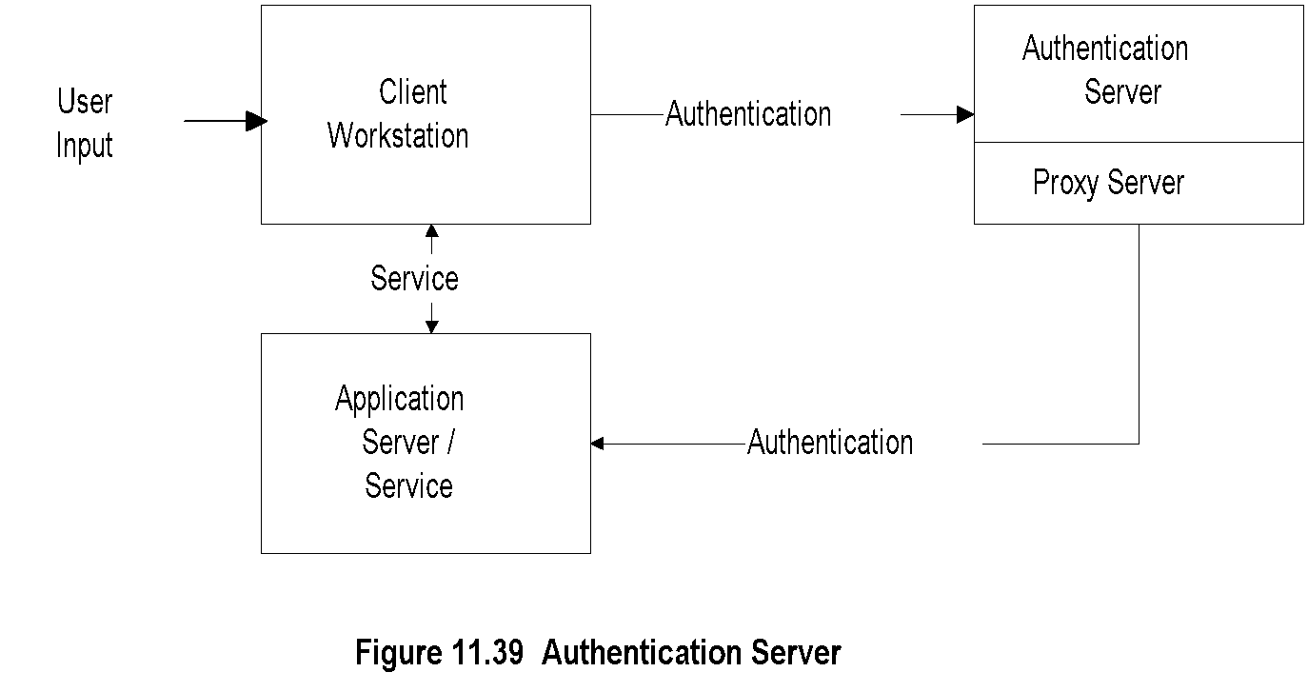
Chapter 11 Network Management Applications
Authentication Server
Notes
Architecture of Novell LAN
Authentication server does not issue ticket
Login and password not sent from client workstation
User sends id to central authentication server
Authentication server acts as proxy agent to the client and authenticates the user with the application server
Process transparent to the user
Network Management: Principles and Practice
© Mani Subramanian 2010
*

Slide 60
Chapter 11 Network Management Applications
Message Transfer Security
Messaging one-way communication
Secure message needs to be authenticated and secured
Three secure mail systems
Privacy Enhanced Mail (PEM)
Pretty Good Privacy (PGP)
X-400: OSI specifications that define framework; not implementation specific
Notes
Network Management: Principles and Practice
© Mani Subramanian 2010
*

Slide 61
Chapter 11 Network Management Applications
Privacy Enhanced Mail
Developed by IETF (RFC 1421 - 1424)
End-to-end cryptography
Provides
Confidentiality
Authentication
Message integrity assurance
Nonrepudiation of origin
Data encryption key (DEK) could be secret or public key-based originator and receiver agreed upon method
PEM processes based on cryptography and message encoding
MIC-CLEAR (Message Integrity Code- CLEAR)
MIC-ONLY
ENCRYPTED
Notes
Network Management: Principles and Practice
© Mani Subramanian 2010
*

Slide 62
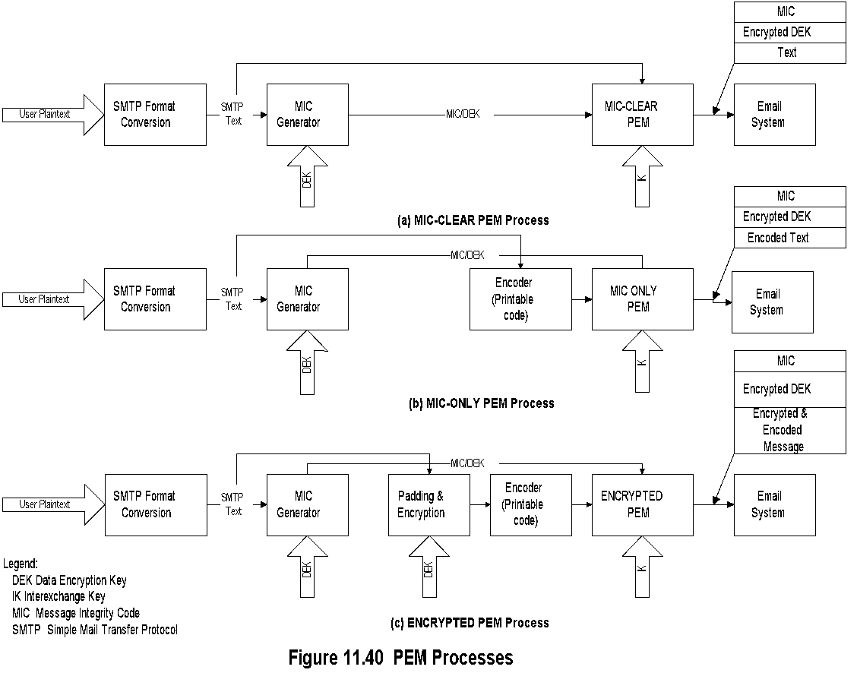
Chapter 11 Network Management Applications
PEM Processes
(Originating end)
Notes
DEK a random number generated per message basis: used to encrypt the message text and generate MIC
IK a long-range key agreed upon between the sender receiver used to encrypt DEK: IK is either public or secret
Public key avoids repudiation
Network Management: Principles and Practice
© Mani Subramanian 2010
*

Slide 63
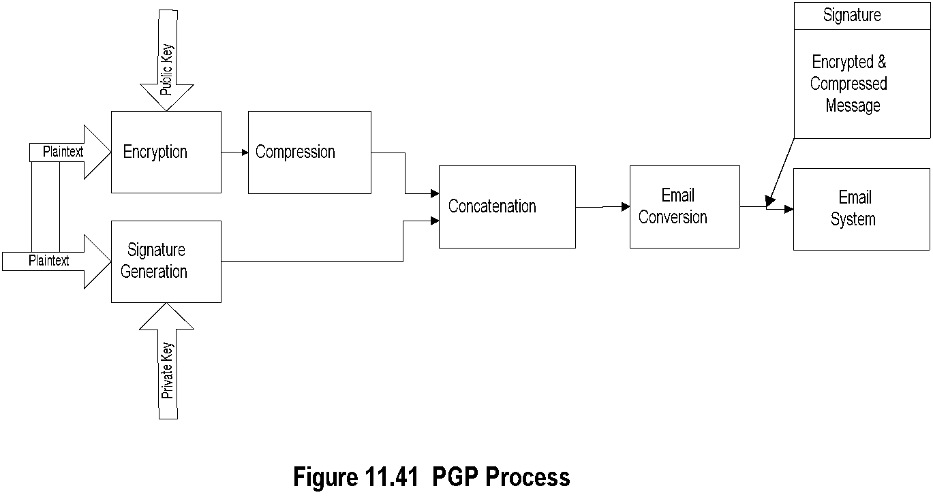
Chapter 11 Network Management Applications
Pretty Good Privacy
(Originating end)
Notes
PGP secure mail package developed by Zimmerman
Available in public domain
Signature generation
Uses MD5 to generate hash code
Encrypts hash code with sender’s private key using RSA algorithm
Encryption of the message done using IDEA or RSA
Compression done with ZIP
email conversion done using Radix-64
PGP similar to encrypted PEM with added compression
Network Management: Principles and Practice
© Mani Subramanian 2010
*

Slide 64
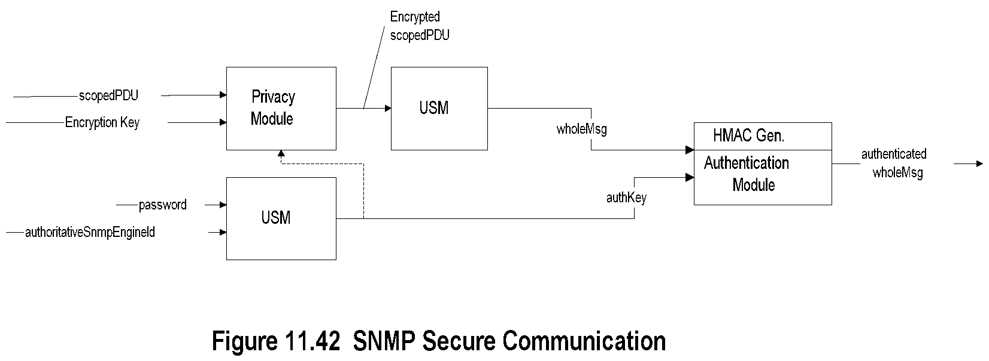
Chapter 11 Network Management Applications
SNMPv3 Security
(Outgoing message)
Notes
Authentication key equivalent to DEK in PEM or private key in PGP
Authentication key generated using user password and SNMP engine id
Authentication key may be used to encrypt message
USM prepares the whole message including scoped PDU
HMAC, equivalent of signature in PEM and PGP, generated using authentication key and the whole message
Authentication module provided with authentication key and HMAC to process incoming message
Network Management: Principles and Practice
© Mani Subramanian 2010
*

Slide 65
Chapter 11 Network Management Applications
Virus Attacks
Executable programs that make copies and insert them into other programs
Attack hosts and routers
Attack infects boot track, compromises cpu, floods network traffic, etc.
Prevention is by identifying the pattern of the virus and implementing protection in virus checkers
Notes
Network Management: Principles and Practice
© Mani Subramanian 2010
*

Slide 66
Chapter 11 Network Management Applications
Accounting Management
Least developed
Usage of resources
Hidden cost of IT usage (libraries)
Functional accounting
Business application
Notes
Network Management: Principles and Practice
© Mani Subramanian 2010
*

Slide 67
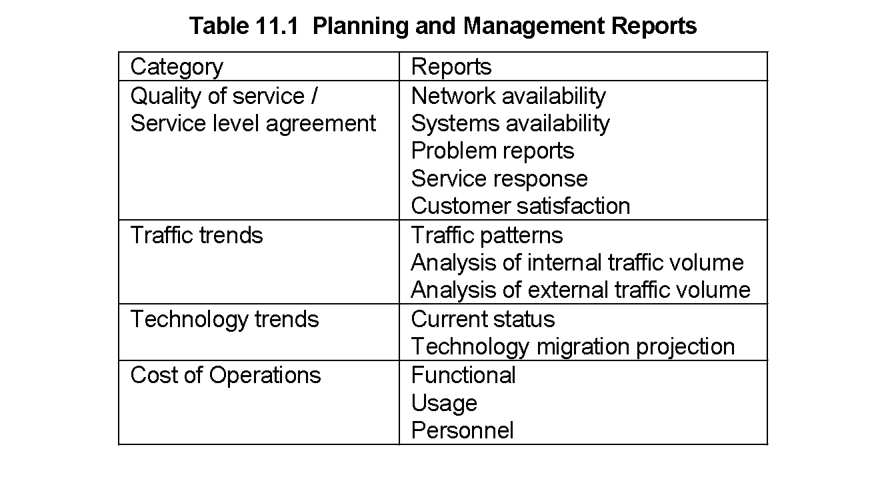
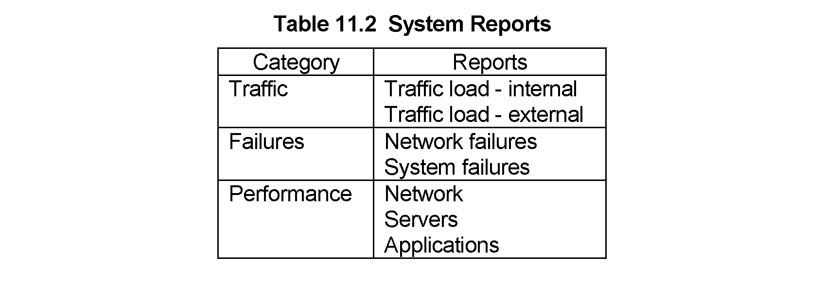
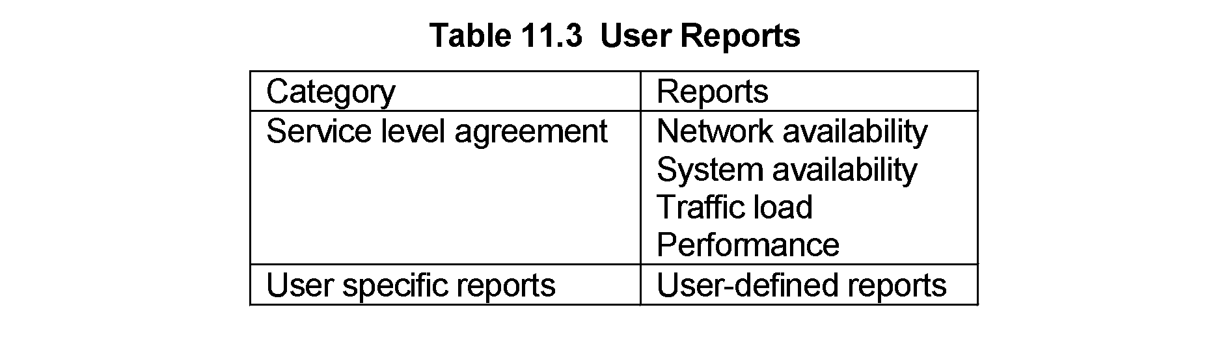
Chapter 11 Network Management Applications
Report Management
Network Management: Principles and Practice
© Mani Subramanian 2010
*

Slide 68
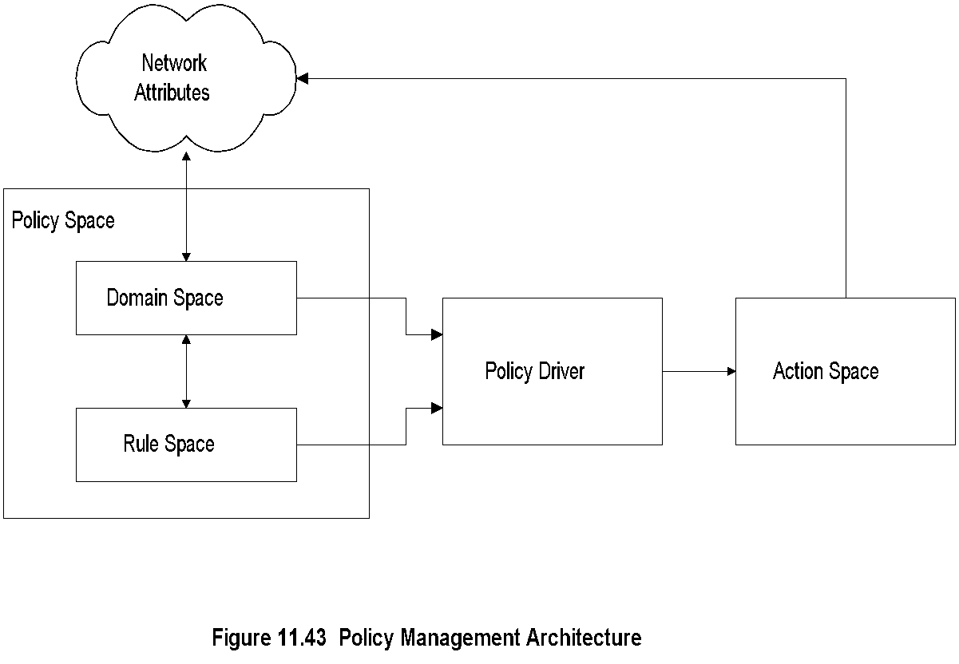
Chapter 11 Network Management Applications
Policy-Based Management
Notes
Domain space consists of objects (alarms with attributes)
Rule space consists of rules (if-then)
Policy Driver controls action to be taken
Distinction between policy and rule; policy assigns responsibility and accountability
Action Space implements actions
Network Management: Principles and Practice
© Mani Subramanian 2010
*

Slide 69
Chapter 11 Network Management Applications
Service Level Management
SLA management of service equivalent to QoS of network
SLA defines
Identification of services and characteristics
Negotiation of SLA
Deployment of agents to monitor and control
Generation of reports
SLA characteristics
Service parameters
Service levels
Component parameters
Component-to-service mappings
Notes
Network Management: Principles and Practice
© Mani Subramanian 2010
*

