Slide 1
Chapter 9
Chapter 9 Network Management Tools, Systems, and Engineering
Network Management Tools, Systems, and Engineering
Network Management: Principles and Practice
© Mani Subramanian and T. A. Gonsalves 2010
*
Notes:
*

Slide 2
Basic Network Software Tools
Chapter 9 Network Management Tools, Systems, and Engineering
Status monitoring tools
Traffic monitoring tools
Route monitoring tools
Notes
Basic tools are available as
Part of the Operating System
Add-on applications
Network Management: Principles and Practice
© Mani Subramanian and T. A. Gonsalves 2010
*
Notes:
*

Slide 3
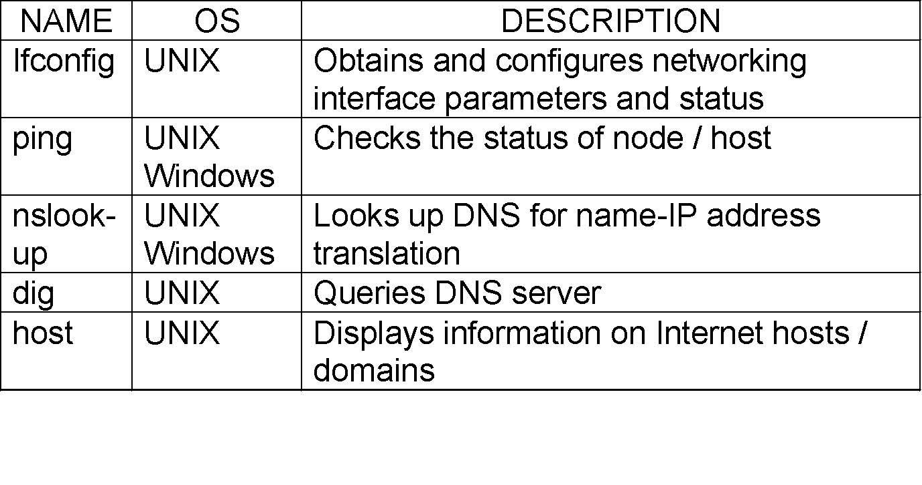
Status Monitoring Tools
Chapter 9 Network Management Tools, Systems, and Engineering
Table 9.1 Status-Monitoring Tools
Notes
Network Management: Principles and Practice
© Mani Subramanian and T. A. Gonsalves 2010
*
Notes:
*

Slide 4
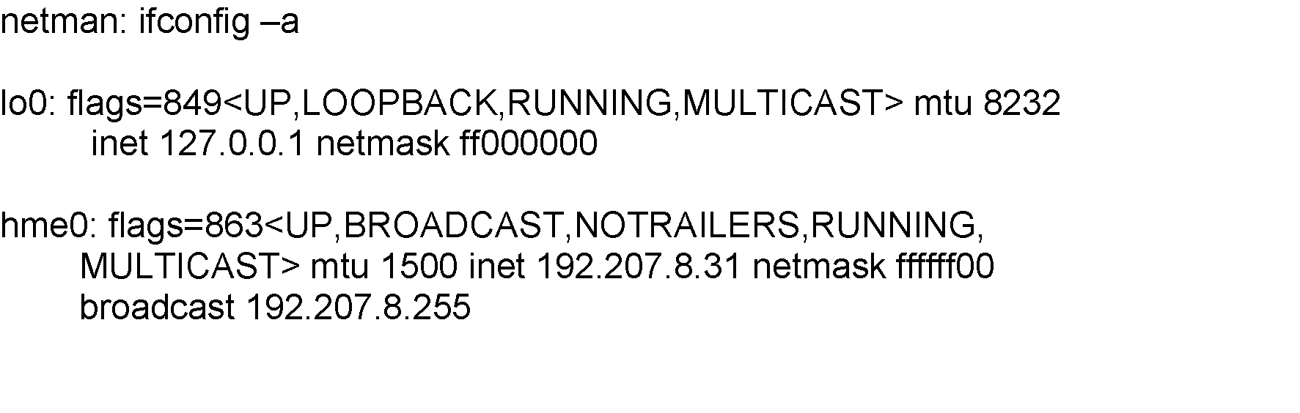
ifConfig
Chapter 9 Network Management Tools, Systems, and Engineering
Used to assign/read an address to/of an interface
Option -a is to display all interfaces
Notice two interface loop-back (lo0) and Ethernet (hme0)
Notes
Example:
Network Management: Principles and Practice
© Mani Subramanian and T. A. Gonsalves 2010
*
Notes:
*

Slide 5
Ping
Chapter 9 Network Management Tools, Systems, and Engineering
Most basic tool for internet management
Based on ICMP ECHO_REQUEST message
Available on all TCP/IP stacks
Useful for measuring connectivity
Useful for measuring packet loss
Can do autodiscovery of TCP/IP equipped stations on single segment
Notes
Example:
% ping 205.152.8.138
PING 205.152.8.138 (205.152.8.138): 56 data bytes
64 bytes from 205.152.8.138: icmp_seq=0 ttl=17 time=14.8 ms
64 bytes from 205.152.8.138: icmp_seq=1 ttl=17 time=20.2 ms
64 bytes from 205.152.8.138: icmp_seq=2 ttl=17 time=15.7 ms
64 bytes from 205.152.8.138: icmp_seq=3 ttl=17 time=21.6 ms
64 bytes from 205.152.8.138: icmp_seq=4 ttl=17 time=20.0 ms
--- 205.152.8.138 ping statistics ---
5 packets transmitted, 5 packets received, 0% packet loss
round-trip min/avg/max = 14.8/18.4/21.6 ms
Network Management: Principles and Practice
© Mani Subramanian and T. A. Gonsalves 2010
*
Notes:
*

Slide 6
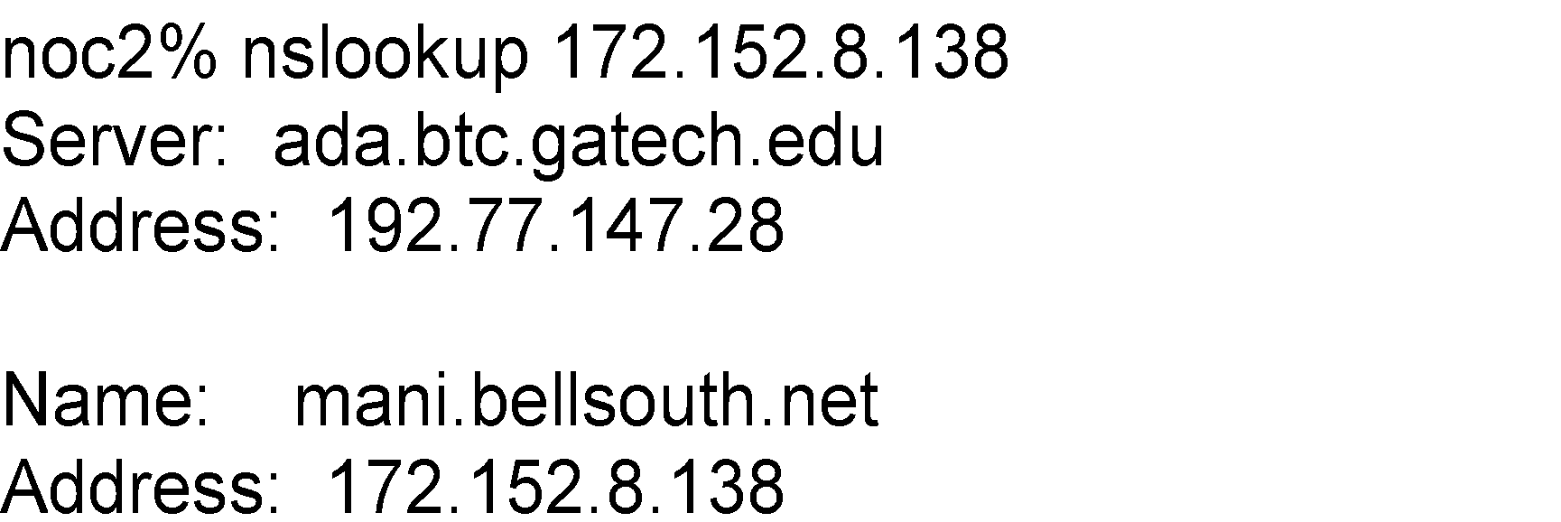
nslookup
Chapter 9 Network Management Tools, Systems, and Engineering
An interactive program for querying Internet Domain Name System servers
Converts a hostname into an IP address and vice versa querying DNS
Useful to identify the subnet a host or node belongs to
Lists contents of a domain, displaying DNS record
Available with BSD UNIX; FTP from uunet.uu.net
Available in Windows NT
Notes
Example:
Network Management: Principles and Practice
© Mani Subramanian and T. A. Gonsalves 2010
*
Notes:
*

Slide 7
Domain Name Groper: dig
Chapter 9 Network Management Tools, Systems, and Engineering
Used to gather lots of information on hosts from DNS
Notes
Example:
[beluga]~> dig +nocomments nimbus.tenet.res.in nimbus.tenet.res.in. 604800 IN A 203.199.255.4 tenet.res.in. 604800 IN NS volcano.tenet.res.in. tenet.res.in. 604800 IN NS lantana.tenet.res.in. volcano.tenet.res.in. 604800 IN A 203.199.255.3 ;; Query time: 2 msec ;; SERVER: 203.199.255.3#53(203.199.255.3) ;; WHEN: Fri Mar 6 14:12:43 2009 ;; MSG SIZE rcvd: 149 [beluga]~>
Network Management: Principles and Practice
© Mani Subramanian and T. A. Gonsalves 2010
*
Notes:
*

Slide 8
Host
Chapter 9 Network Management Tools, Systems, and Engineering
Command: host
Displays host names using DNS
Available from ftp.nikhef.nl:/pub/network/host.tar.Z
Notes
Example:
% host -a sun4-gw.cc.gatech.edu
Trying null domain
rcode = 0 (Success), ancount=1
The following answer is not authoritative:
sun4-gw.cc.gatech.edu 85851 IN A 130.207.111.100
Network Management: Principles and Practice
© Mani Subramanian and T. A. Gonsalves 2010
*
Notes:
*

Slide 9
Traffic Monitoring Tools
Chapter 9 Network Management Tools, Systems, and Engineering
Table 9.2 Traffic-Monitoring Tools
Name | Operating System | Description
ping | UNIX / Windows | Used for measuring roundtrip packet loss
bing | UNIX | Measures point-to-point bandwidth of a link
tcpdump | UNIX | Dumps traffic on a network
getethers | UNIX | Acquires all host addresses of an Ethernet LAN segment
iptrace | UNIX | Measures performance of gateways
ethereal, wireshark | Linux / Windows | Graphical tool to capture, inspect , and to save Ethernet packets
Notes
ping and bing used to measure the propagation characteristics of the transmission path
ethereal (a.k.a. wireshark), and tcpdump (also snoop) puts the network interface in promiscuous
mode and logs the data
iptrace uses NETMON program in UNIX and produces 3 types of outputs:
IP traffic
Host traffic matrix
Abbreviated sampling of pre-defined number of packets
Network Management: Principles and Practice
© Mani Subramanian and T. A. Gonsalves 2010
*
Notes:
*

Slide 10
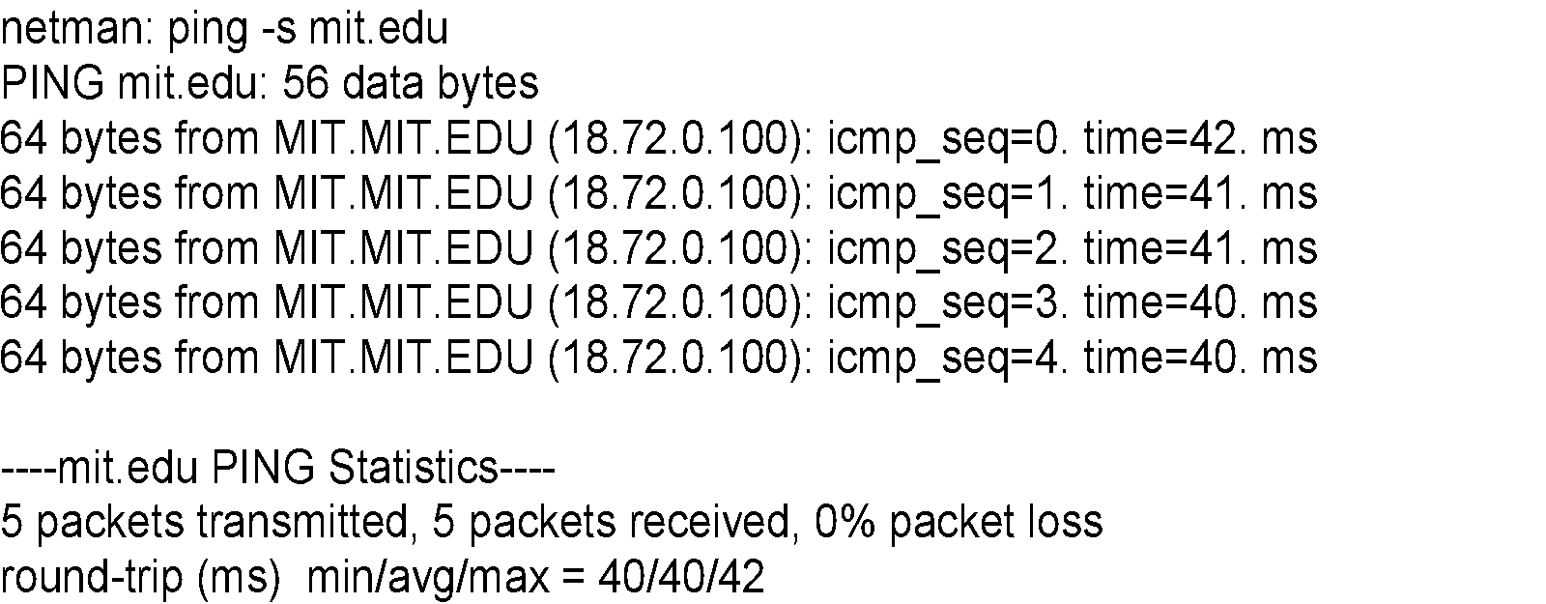
Packet Loss Measurement
Chapter 9 Network Management Tools, Systems, and Engineering
Command: ping
Many options available
Implementation varies from system to system
Notes
Example:
Network Management: Principles and Practice
© Mani Subramanian and T. A. Gonsalves 2010
*
Notes:
*

Slide 11
bing
Chapter 9 Network Management Tools, Systems, and Engineering
Used to determine throughput of a link
Uses icmp_echo utility
Knowing packet size and delay, calculates bandwidth
bing L1 and L2 and the difference yields the bandwidth of link L1-L2
Bandwidth of link L1-L2 could be higher than the intermediate links.
Notes
Network Management: Principles and Practice
© Mani Subramanian and T. A. Gonsalves 2010
*
Notes:
*

Slide 12
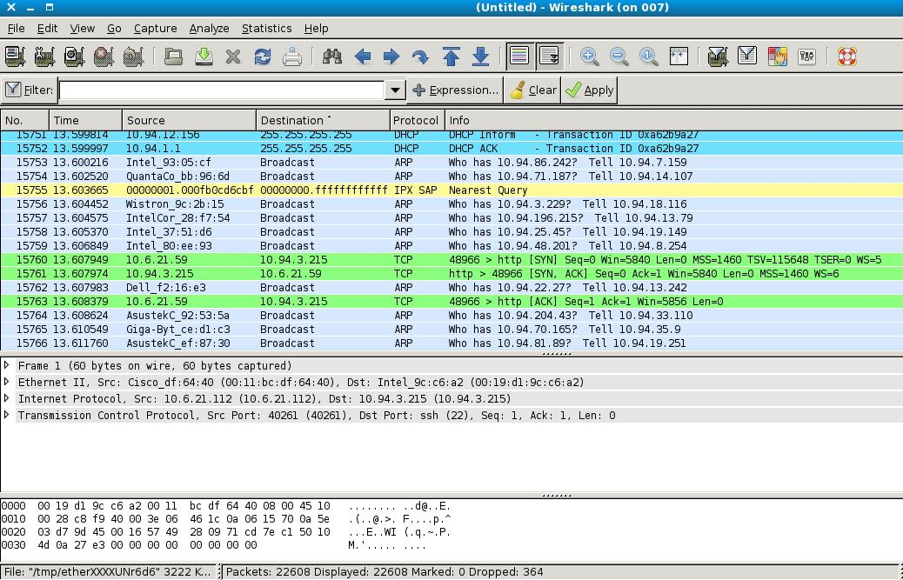
Ethereal (Wireshark)
Chapter 9 Network Management Tools, Systems, and Engineering
Notes
Network Management: Principles and Practice
© Mani Subramanian and T. A. Gonsalves 2010
*
Notes:
*

Slide 13
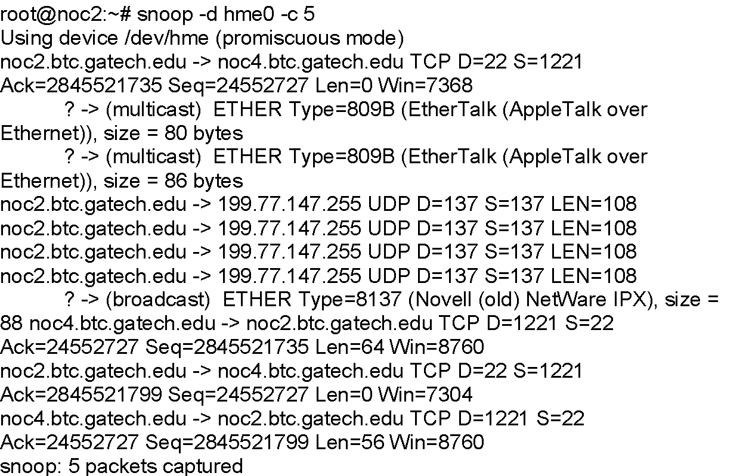
snoop
Chapter 9 Network Management Tools, Systems, and Engineering
Puts a network interface in promiscuous mode
Logs data on
Protocol type
Length
Source address
Destination address
Reading of user data limited to superuser
Notes
Example: Options: -d for device interface and -c for counts
Network Management: Principles and Practice
© Mani Subramanian and T. A. Gonsalves 2010
*
Notes:
*

Slide 14
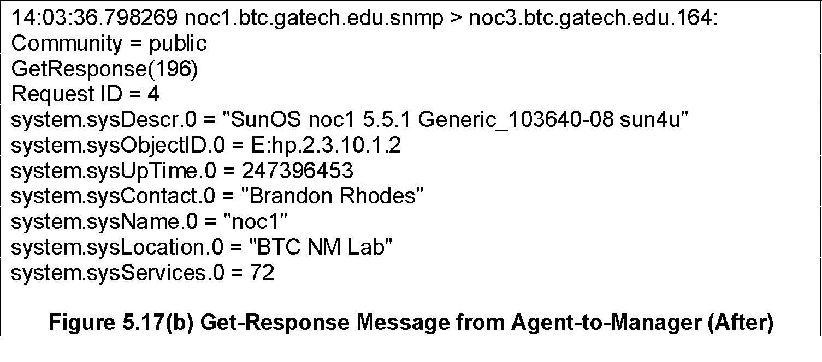
tcpdump
Chapter 9 Network Management Tools, Systems, and Engineering
Command: tcpdump
Interprets and prints headers for:
Ethernet IP ICMP
TCP UDP NFS
ND ARP Appletalk
Useful for examining and evaluating the TCP based traffic
Available in UNIX system; FTP from ftp.ee.lbl.gov
Notes
Example: SNMP message
Network Management: Principles and Practice
© Mani Subramanian and T. A. Gonsalves 2010
*
Notes:
*

Slide 15
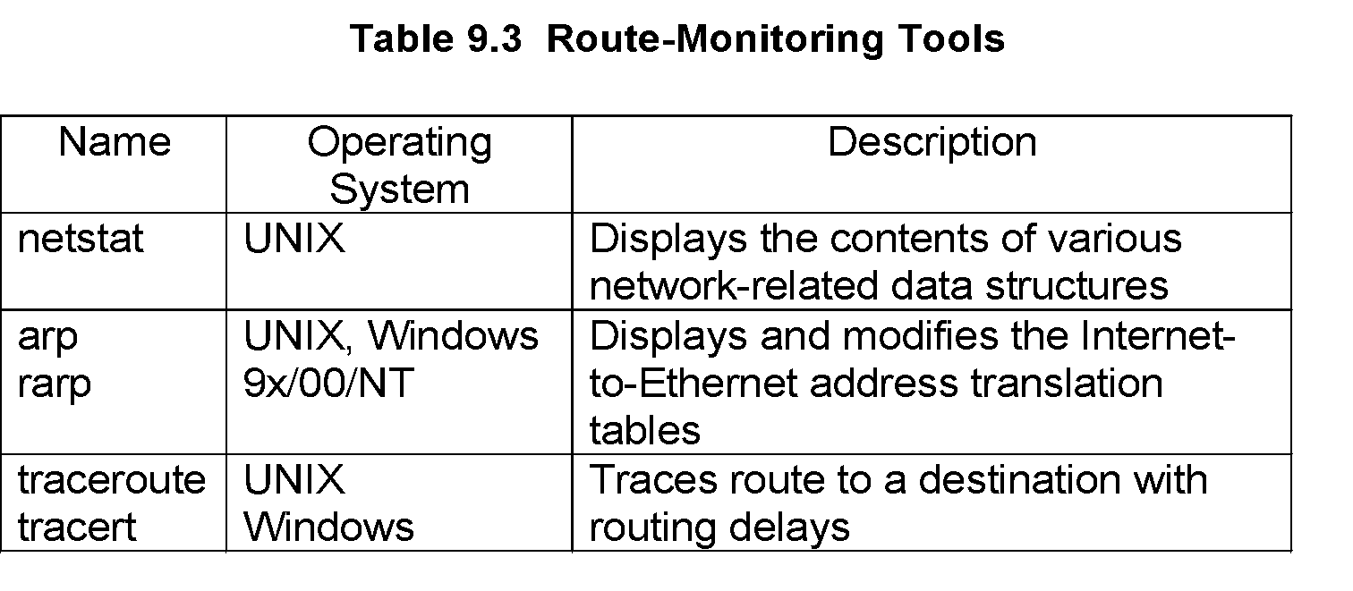
Network Routing Tools
Chapter 9 Network Management Tools, Systems, and Engineering
Notes
Network Management: Principles and Practice
© Mani Subramanian and T. A. Gonsalves 2010
*
Notes:
*

Slide 16
Network Status
Chapter 9 Network Management Tools, Systems, and Engineering
netstat -r
Routing tables
Internet:
Destination Gateway Flags Refs Use Netif Expire
Default gw.litech.net UGC 44 541550 de0
172.16.15.1 gw.litech.net UGH 0 0 de0
ah.litech.net 0:80:48:ee:74:b4 UHLW 9 2653683 de0 202
uucp.litech.net uucp.litech.net UH 0 0 lo0
sip-17.litech.net big UH 0 5551 ppp3
dip-244.litech.net gw.litech.net UGH 0 2472 de0
univers-litech-gw gw.litech.net UGH 0 47 de0
194.44.232 gw.isr.lviv.ua Ugc 0 171831 ppp9
OSPF-ALL.MCAST.NET localhost UH 1 86491 lo0
OSPF-DSIG.MCAST.NE localhost UH 1 25127 lo0
Figure 9.5 Routing Table using netstat -r
Notes
Network Management: Principles and Practice
© Mani Subramanian and T. A. Gonsalves 2010
*
Notes:
*

Slide 17
Route Tracing
Chapter 9 Network Management Tools, Systems, and Engineering
Command: traceroute (UNIX) / tracert (MS TIME-EXCEED error report
Available in most UNIX OS
Windows)
ICMP Also available from uc.msc.unm.edu
Discovers route taken by packets from source to destination
Useful for diagnosing route failures
Useful for detecting bottleneck nodes
Notes
Network Management: Principles and Practice
© Mani Subramanian and T. A. Gonsalves 2010
*
Notes:
*

Slide 18
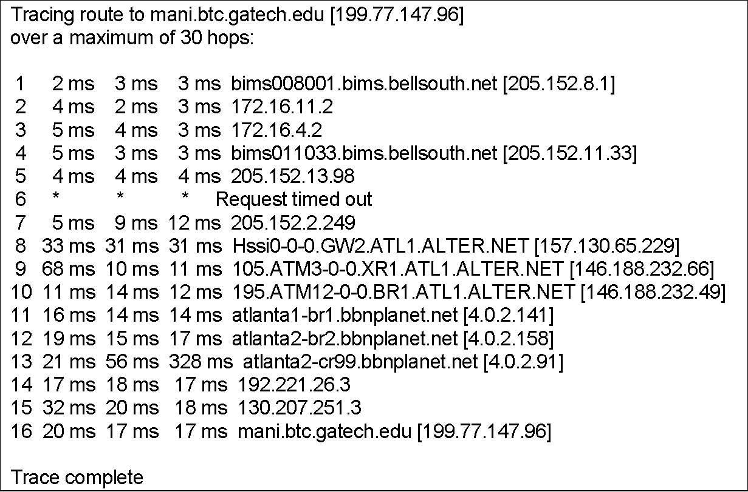
Trace Route Sample 1
Chapter 9 Network Management Tools, Systems, and Engineering
Notes
Network Management: Principles and Practice
© Mani Subramanian and T. A. Gonsalves 2010
*
Notes:
*

Slide 19
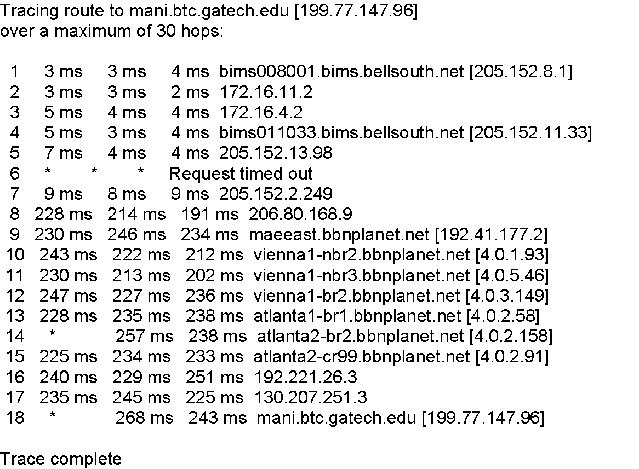
Trace Route Sample 2
Chapter 9 Network Management Tools, Systems, and Engineering
Notes
Network Management: Principles and Practice
© Mani Subramanian and T. A. Gonsalves 2010
*
Notes:
*

Slide 20
SNMP Tools
Chapter 9 Network Management Tools, Systems, and Engineering
SNMP command-line tools
SNMP MIB Browser with graphical interface
snmpsniff: Linux/Free BSD based tool. Reads PDUs
Notes
Many tools available on public domain.
Network Management: Principles and Practice
© Mani Subramanian and T. A. Gonsalves 2010
*
Notes:
*

Slide 21
SNMP Command Tools
Chapter 9 Network Management Tools, Systems, and Engineering
snmptest
snmpget
snmpgetnext
snmpset
snmptrap
snmpwalk
snmpnetstat
Notes
Test tool is an interactive tool to get values of several managed objects, one at a time.
Get, Get-next and Set are the SNMP commands that we learned under SNMP architecture / messages. Execution of these will return an SNMP Response message.
SNMPWalk uses snmpgetnext to trace the entire MIB.
Network status command is used to test the status of network connections of a host.
Network Management: Principles and Practice
© Mani Subramanian and T. A. Gonsalves 2010
*
Notes:
*

Slide 22
SNMP Get Command
Chapter 9 Network Management Tools, Systems, and Engineering
% snmpget noc5.btc.gatech.edu public system.sysDescr.0
system.sysDescr.0 = OCTET STRING: "SunOS noc5 5.6 Generic_105181-03 sun4u"
Notes
Note that the value 0 at the end of the object id indicates that it is a single-valued scalar.
Network Management: Principles and Practice
© Mani Subramanian and T. A. Gonsalves 2010
*
Notes:
*

Slide 23
SNMP Get Next Command
Chapter 9 Network Management Tools, Systems, and Engineering
% snmpgetnext noc5.btc.gatech.edu public interfaces.ifTable.ifEntry.ifIndex.1
interfaces.ifTable.ifEntry.ifIndex. 2 = INTEGER: 2
Notes
Network Management: Principles and Practice
© Mani Subramanian and T. A. Gonsalves 2010
*
Notes:
*

Slide 24
SNMP Set Command
Chapter 9 Network Management Tools, Systems, and Engineering
Command: snmpset host community
Notes
Network Management: Principles and Practice
© Mani Subramanian and T. A. Gonsalves 2010
*
Notes:
*

Slide 25
Network Status
Chapter 9 Network Management Tools, Systems, and Engineering
Command: snmpnetstat host community
Useful for finding status of network connections
% snmpnetstat noc5 public
Active Internet Connections
Proto Recv-Q Send-Q Local Address Foreign Address (state)
tcp 0 0 *.* *.* CLOSED
tcp 0 0 localhost.46626 localhost.3456 ESTABLISHED
tcp 0 0 localhost.46626 localhost.3712 ESTABLISHED
tcp 0 0 localhost.46626 localhost.3968 ESTABLISHED
tcp 0 0 localhost.46626 localhost.4224 ESTABLISHED
tcp 0 0 localhost.3456 localhost.46626 ESTABLISHED
tcp 0 0 localhost.3712 localhost.46626 ESTABLISHED
tcp 0 0 localhost.3968 localhost.46626 ESTABLISHED
tcp 0 0 localhost.4224 localhost.46626 ESTABLISHED
tcp 0 0 noc5.41472 noc5.4480 ESTABLISHED
tcp 0 0 noc5.41472 noc5.4736 ESTABLISHED
tcp 0 0 noc5.4480 noc5.41472 ESTABLISHED
tcp 0 0 noc5.4736 noc5.41472 ESTABLISHED
Notes
Network Management: Principles and Practice
© Mani Subramanian and T. A. Gonsalves 2010
*
Notes:
*

Slide 26
SNMP Browser
Chapter 9 Network Management Tools, Systems, and Engineering
Command: snmpwalk host community [variable name]
Uses Get Next Command
Presents MIB Tree
Notes
199.77.147.182:
sysDescr.0 : SunOS noc5 5.6 Generic_105181-03 sun4u
sysObjectID.0 : 1.3.6.1.4.1.11.2.3.10.1.2
sysUpTime.0 : 8d 22:21:53.74
sysContact.0 :
sysName.0 : noc5
sysLocation.0 :
sysServices.0 : 72
sysORLastChange.0 : 0d 0:00:00.00
Figure 9.8 MIB Browser Example (text based) for System Group
Network Management: Principles and Practice
© Mani Subramanian and T. A. Gonsalves 2010
*
Notes:
*

Slide 27
SNMP Sniff
Chapter 9 Network Management Tools, Systems, and Engineering
snmpsniff -I interface
A tool in Linux / FreeBSD environment
Puts the interface in promiscuous mode and captures snmp PDUs.
Similar to tcpdump
Notes
Network Management: Principles and Practice
© Mani Subramanian and T. A. Gonsalves 2010
*
Notes:
*

Slide 28
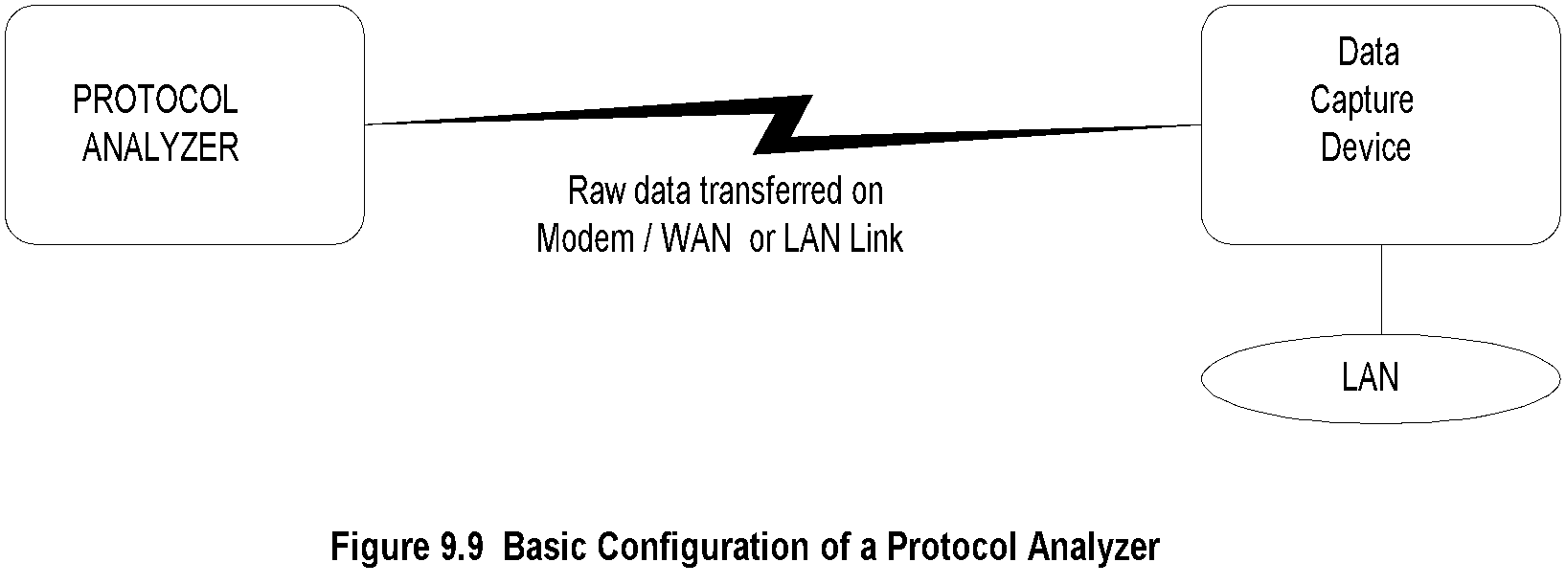
Protocol Analyzer
Chapter 9 Network Management Tools, Systems, and Engineering
Notes
Analyzes data packets on any transmission line including LAN
Measurements made locally or remotely
Probe (data capture device) captures data and transfers to the protocol analyzer (no storage)
Data link between probe and protocol analyzer either dial-up or dedicated link or LAN
Protocol analyzer analyzes data at all protocol levels
Network Management: Principles and Practice
© Mani Subramanian and T. A. Gonsalves 2010
*
Notes:
*

Slide 29
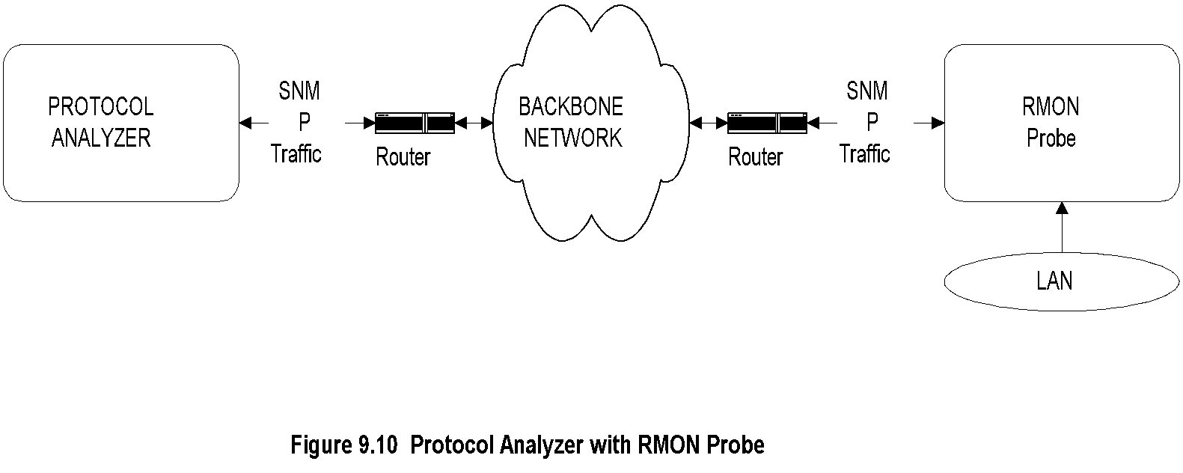
RMON Probe
Chapter 9 Network Management Tools, Systems, and Engineering
Notes
Network Associates Sniffer
Stand-alone and Networked
HP NetMetrix / HP OpenView
Communication between probe and analyzer is using SNMP
Data gathered and stored for an extended period of time and analyzed later
Used for gathering traffic statistics and used for configuration management for performance tuning
Network Management: Principles and Practice
© Mani Subramanian and T. A. Gonsalves 2010
*
Notes:
*

Slide 30
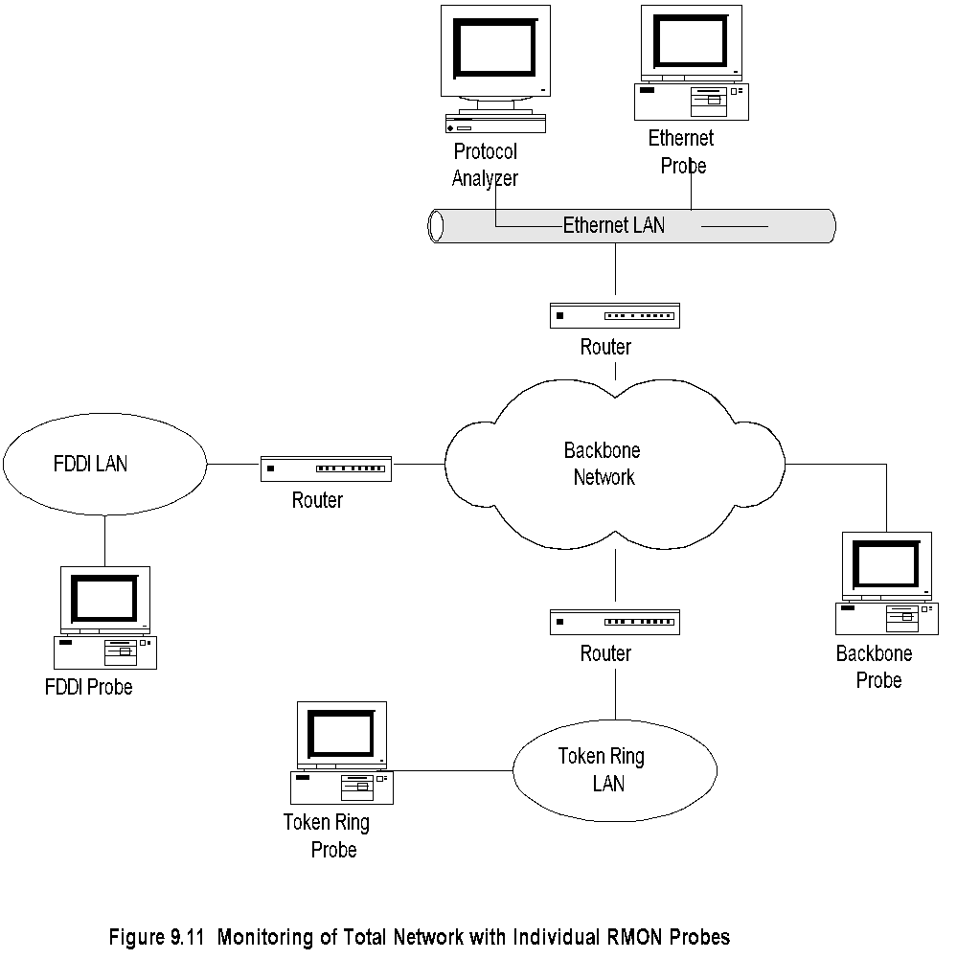
Network Monitoring with RMON Probe
Chapter 9 Network Management Tools, Systems, and Engineering
Network Management: Principles and Practice
© Mani Subramanian and T. A. Gonsalves 2010
*
Notes:
*

Slide 31
Network Statistics
Chapter 9 Network Management Tools, Systems, and Engineering
Protocol Analyzers
RMON Probe / Protocol analyzer
MRTG (Multi router traffic grouper)
Home-grown program using tcpdump
Notes
Network Management: Principles and Practice
© Mani Subramanian and T. A. Gonsalves 2010
*
Notes:
*

Slide 32
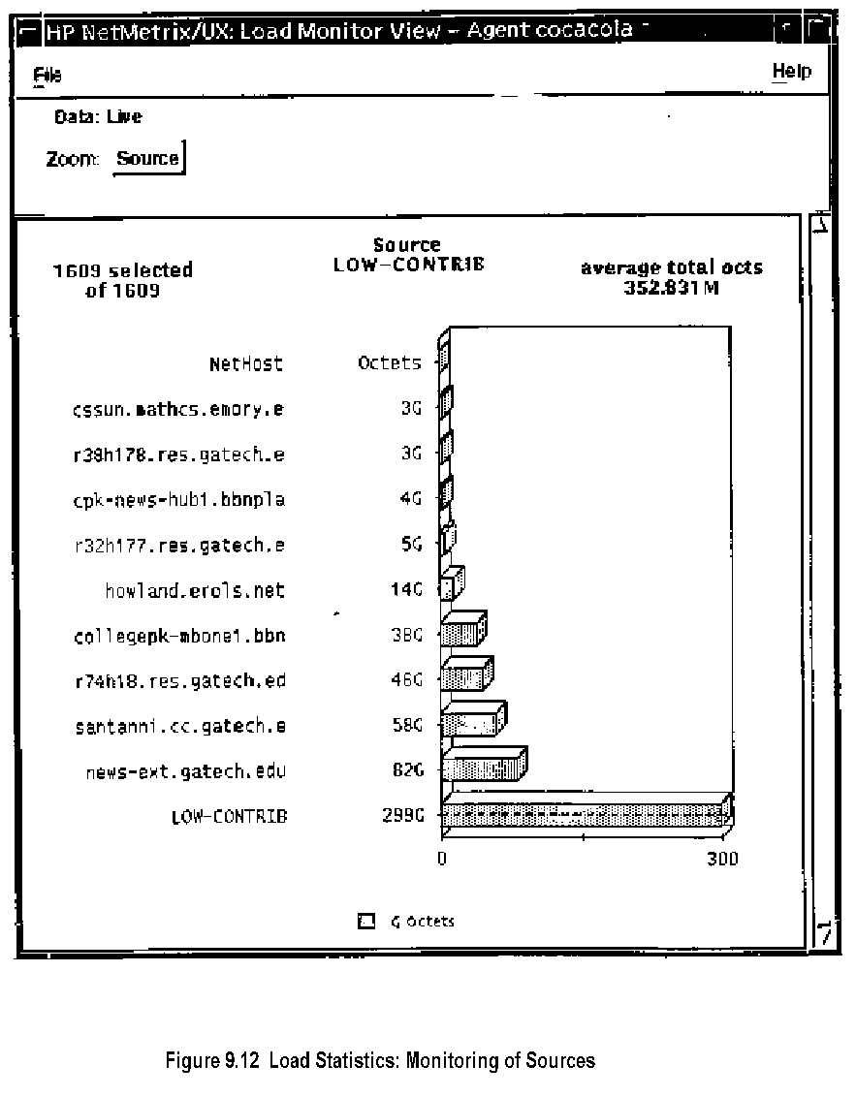
Traffic Load: Source
Chapter 9 Network Management Tools, Systems, and Engineering
Network Management: Principles and Practice
© Mani Subramanian and T. A. Gonsalves 2010
*
Notes:
*

Slide 33
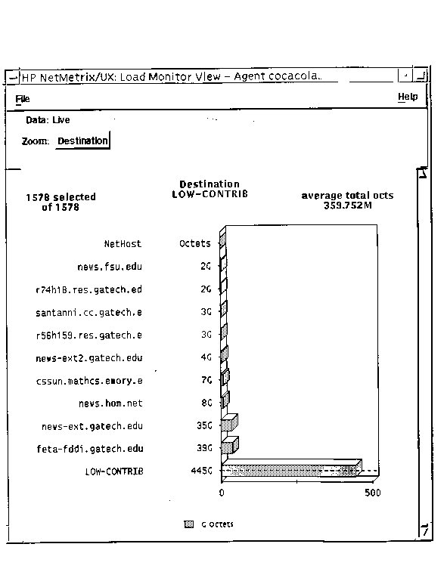
Traffic Load: Destination
Chapter 9 Network Management Tools, Systems, and Engineering
Figure 9.13 Load Statistics: Monitoring of Destinations
Network Management: Principles and Practice
© Mani Subramanian and T. A. Gonsalves 2010
*
Notes:
*

Slide 34
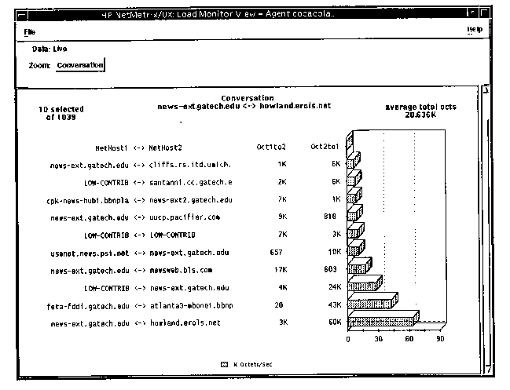
Traffic Load: Conversation
Chapter 9 Network Management Tools, Systems, and Engineering
Figure 9.14 Load Statistics: Monitoring of Conversation Pairs
Network Management: Principles and Practice
© Mani Subramanian and T. A. Gonsalves 2010
*
Notes:
*

Slide 35
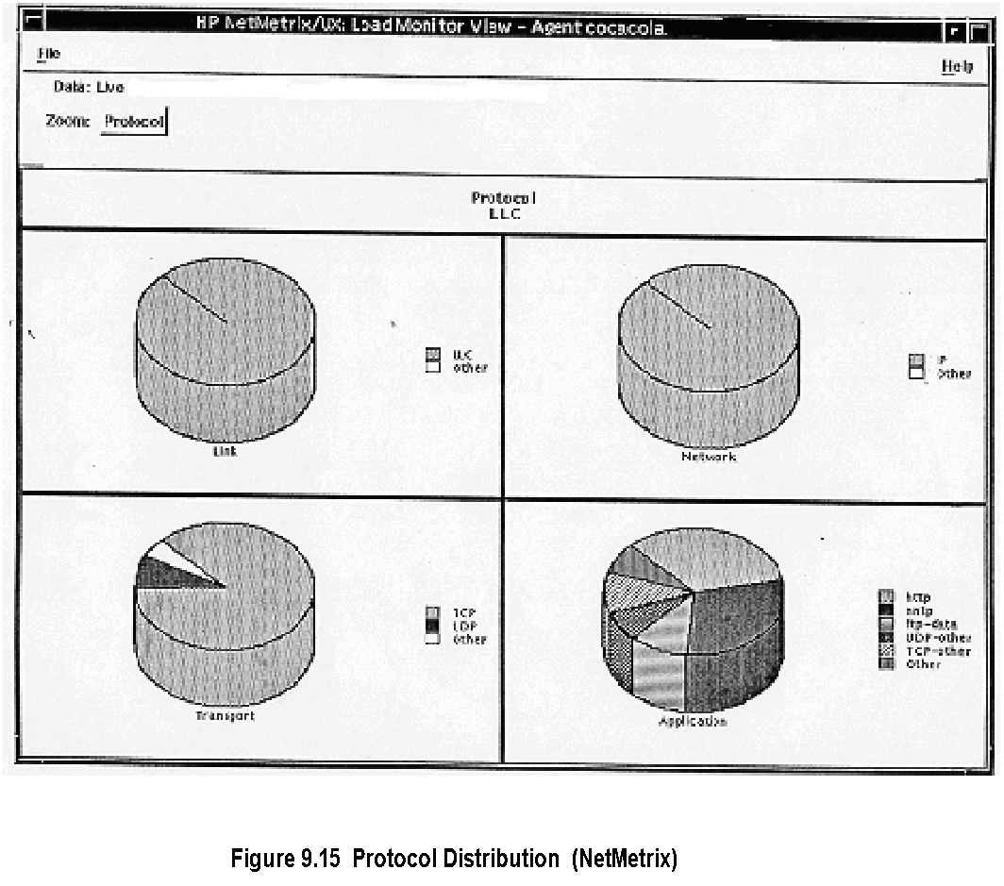
Protocol Distribution
Chapter 9 Network Management Tools, Systems, and Engineering
Network Management: Principles and Practice
© Mani Subramanian and T. A. Gonsalves 2010
*
Notes:
*

Slide 36
MRTG
Chapter 9 Network Management Tools, Systems, and Engineering
Multi Router Traffic Grouper (Oeticker and Rand)
www.ee.ethz.ch/stats/mrtg/
Generates graphic presentation of traffic on Web
Daily view
Weekly view
Monthly view
Yearly view
Notes
Network Management: Principles and Practice
© Mani Subramanian and T. A. Gonsalves 2010
*
Notes:
*

Slide 37
MIB Engineering
Chapter 9 Network Management Tools, Systems, and Engineering
Network Management: Principles and Practice
© Mani Subramanian and T. A. Gonsalves 2010
*
Notes:
*

Slide 38
MIB Engineering: What & Why
Chapter 9 Network Management Tools, Systems, and Engineering
Designing of MIB is MIB Engineering
MIB contains SNMP model info of managed object
Manager’s view is of the NE is limited to MIB view
MIB view is embedded in NE and hence permanent
Common constructs, idioms, used in MIB are defined by SMI
Notes
Network Management: Principles and Practice
© Mani Subramanian and T. A. Gonsalves 2010
*
Notes:
*

Slide 39
SMI: Principles
Chapter 9 Network Management Tools, Systems, and Engineering
Element defined by a set of variables, called objects
Objects constricted to a limited number of data types
Data types:
scalar, primitive or atomic type e.g.: Boolean, Integer, IP address, String, counter,.
Constructed types :
Array:
Ordered set of elements
All elements are of same type
Each element identified by an index
Record:
Ordered collection of elements
Elements are of different types
Each element referred to by name
Set
Unordered collection of elements
Elements of same or different types
Notes
Network Management: Principles and Practice
© Mani Subramanian and T. A. Gonsalves 2010
*
Notes:
*

Slide 40
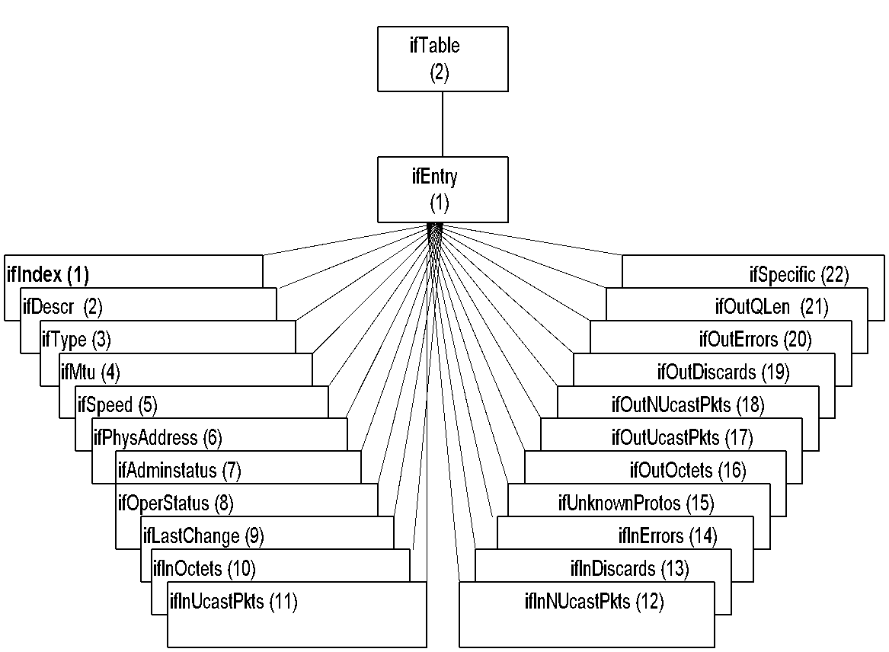
Example of Set: ifTable
Chapter 9 Network Management Tools, Systems, and Engineering
Notes
ifTable is an array of instantiation of ifEntry
One element for each interface in the node with an ifIndex
Each element in the table contains a record with several fields (variables) describing the interface
Network Management: Principles and Practice
© Mani Subramanian and T. A. Gonsalves 2010
*
Notes:
*

Slide 41
Example of Set: Trap Filter
Chapter 9 Network Management Tools, Systems, and Engineering
Definition of a trap filter in an agent TrapFilter ::= SET OF Conditions
Set of conditions are AND’ed together
Trap forwarded when all conditions are satisfied
Order of evaluation of the conditions irrelevant
Notes
Network Management: Principles and Practice
© Mani Subramanian and T. A. Gonsalves 2010
*
Notes:
*

Slide 42
SNMP / SMI Limitations
Chapter 9 Network Management Tools, Systems, and Engineering
Restrictions on the construction of types
Array can contain record and vice versa
Array can contain record that can contain other records
Array cannot contain a record that contains an array
Two records with the collection of identical records in
two parts of a MIB has to have different names
SNMP limitation
SNMP has variables and access methods, not methods to perform actions (See section 3.9)
Other restrictions include
PDU size limits the number of objects for access
SNMP transaction very limited compared to db transactions
Notes
Network Management: Principles and Practice
© Mani Subramanian and T. A. Gonsalves 2010
*
Notes:
*

Slide 43
Counters vs Rates in NMS
Chapter 9 Network Management Tools, Systems, and Engineering
Rates play key role in performance measurements
Rates impact of design of buffers in NEs
Counters are used to measure rates
Rate calculation depends on averaging time
Different applications require rates based on different averaging time
MIB does not include rates; NMS computes it
Above factors should be considered in the NMS design
Notes
Network Management: Principles and Practice
© Mani Subramanian and T. A. Gonsalves 2010
*
Notes:
*

Slide 44
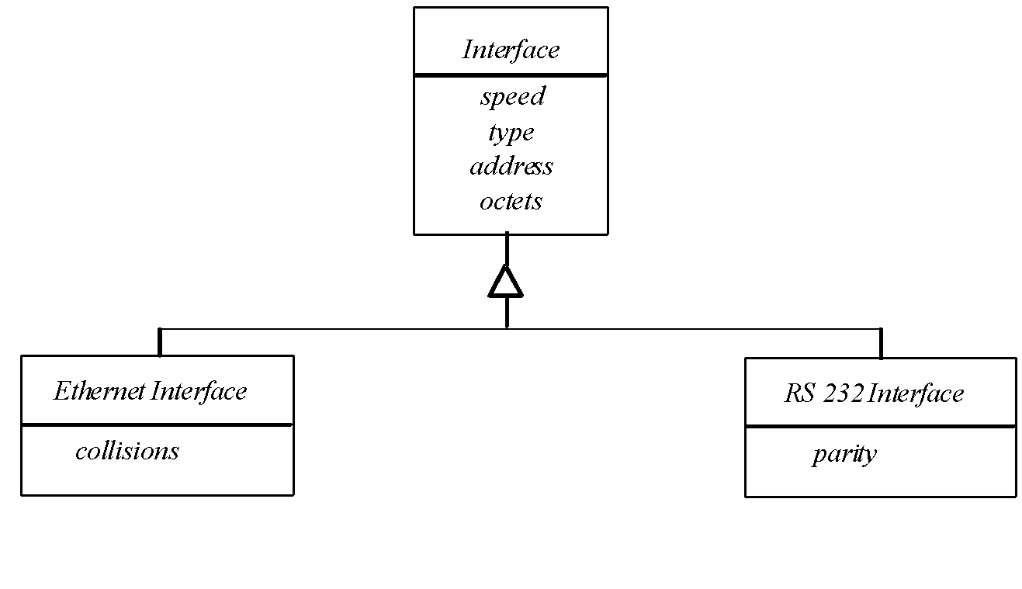
Object-Oriented Approach to MIB Engineering
Chapter 9 Network Management Tools, Systems, and Engineering
Figure 9.17 Inheritance Used to Define Various Network Interfaces
Notes
Two options
Total object-oriented network management e.g., XML network management (Chapter 16)
Conversion of SNMP scalar MIB to O-O information modeling (this Chapter)
e.g. Router with network interface with individual IF MIBs for each technology can be modeled using inheritance classes
Network Management: Principles and Practice
© Mani Subramanian and T. A. Gonsalves 2010
*
Notes:
*

Slide 45
Object-Oriented Approach to MIB Engineering (Contd.)
Chapter 9 Network Management Tools, Systems, and Engineering
Naming: Use of MIB group prefix for same name in different subtrees
e.g.: mib2.system.sysdescr mib-2.interfaces.ifTable.ifEntry.ifDescr
Instantiation
Router r1, r2; //Statically create 2 routers
Router *r3;
. . . . // Dynamic creation of a router
if (condition) r3 = new Router;
Notes
Network Management: Principles and Practice
© Mani Subramanian and T. A. Gonsalves 2010
*
Notes:
*

Slide 46
Object-Oriented Approach to MIB Engineering (Contd.)
Chapter 9 Network Management Tools, Systems, and Engineering
Recommended pracitices
Use of unique prefix: e.g., if, tcp, etc
Extensive use of tables: e.g., ifTable, tcpConnTable
Dynamic creation of rows and ifNumber
Copy-and-paste of certain blocks of MIB definition from one subtree to another
Notes
Network Management: Principles and Practice
© Mani Subramanian and T. A. Gonsalves 2010
*
Notes:
*

Slide 47
MIB ENGINEERING: SMI Tables
Chapter 9 Network Management Tools, Systems, and Engineering
Problem:
Indexing of tables to uniquely define a row is complex, especially if it is “multiple-index”
Retrieving a row in from a large table is extremely time-consuming and may even time-out
Solutions to consider in MIB engineering:
Sequence number as index; e.g. port number
Create unique name as index by adding prefix appTable.appEntry.appPath.’A’.’p’.’a’.’c’.’h’.’e’ appTable.appEntry.appPath.65.112.97.99.104.101
OID as Index based on vendor product
Multidimensional tables with multiple index; Need to select, prioritize and organize the table
Notes
Network Management: Principles and Practice
© Mani Subramanian and T. A. Gonsalves 2010
*
Notes:
*

Slide 48
MIB Engineering: SMI Actions
Chapter 9 Network Management Tools, Systems, and Engineering
ifAdminStatus OBJECT-TYPE
SYNTAX INTEGER {
up(1), -- ready to pass packets down(2),
testing(3) -- in some test mode
}
ACCESS read-write
STATUS mandatory
DESCRIPTION
"The desired state of the interface. The
testing(3) state indicates that no operational
packets can be passed."
no operational
packets can be passed ::= { ifEntry 7 }
Notes
Problem: No actions in SNMP defined (as in OSI CMIP/CMISE)
Solution: Define an action MIB that can be set to perform actions similar to ifAdminStatus up(1), down(2), and testing(3)
Network Management: Principles and Practice
© Mani Subramanian and T. A. Gonsalves 2010
*
Notes:
*

Slide 49
MIB Engineering: SMI Transactions
Chapter 9 Network Management Tools, Systems, and Engineering
aRoot
aData
(1)
. . .
aLock
(1001)
aManagerInfo (1002)
aTimeout
(1003)
aForceUnlock
(1004)
Notes
MIB for process oriented transactions
e.g. aRoot above for locking and unlocking data for troubleshooting
Network Management: Principles and Practice
© Mani Subramanian and T. A. Gonsalves 2010
*
Notes:
*

Slide 50
NMS Design
Chapter 9 Network Management Tools, Systems, and Engineering
Network Management: Principles and Practice
© Mani Subramanian and T. A. Gonsalves 2010
*
Notes:
*

Slide 51
Functional Requirements
Chapter 9 Network Management Tools, Systems, and Engineering
Scalability
Heterogeneity
Geographic spread
Bursty Load
Real-time response
Batch processing
Diverse users
Local and remote management
Ease of use
Security
Data management
Notes
Network Management: Principles and Practice
© Mani Subramanian and T. A. Gonsalves 2010
*
Notes:
*

Slide 52
NM Software Components
Chapter 9 Network Management Tools, Systems, and Engineering
NMS Server
Centralized
Distributed
Local NMS / EMS
Integrated NMS / MoM
NMS Client
Local / Console
Remote
Dedicated
Browser-based
Notes
Network Management: Principles and Practice
© Mani Subramanian and T. A. Gonsalves 2010
*
Notes:
*

Slide 53
NMS Server Architecture
Chapter 9 Network Management Tools, Systems, and Engineering
User
Interface
G U I
W e b
E m a i l
S M S
. . .
Reports
Config.
Mgr
Perf.
Mgr
Fault
Mgr
Data
Collector
MODB
Discovery
Mgmt
Protocols
S N M P
C O R B A
C M I P
Proprietary
. . .
T C P / U D P
I P
To NEs
Notes
Modular architecture
Managed object database
Configuration Manager / Discovery Module
Fault Manager
Performance Manager
Module Layers
Lower (core) layer: Performs business logic
Upper layer: Graphical User Interface (GUI)
Network Management: Principles and Practice
© Mani Subramanian and T. A. Gonsalves 2010
*
Notes:
*

Slide 54
Server Key Design Decisions
Chapter 9 Network Management Tools, Systems, and Engineering
Modular
Object-oriented
Scalable
Real-time response for handling notifications; Priority
Software structure: Threads and Processes
Relational DBMS: Oracle, DB2, SQL
GUI: Browser-based.
User-friendly interface
Notes
Network Management: Principles and Practice
© Mani Subramanian and T. A. Gonsalves 2010
*
Notes:
*

Slide 55
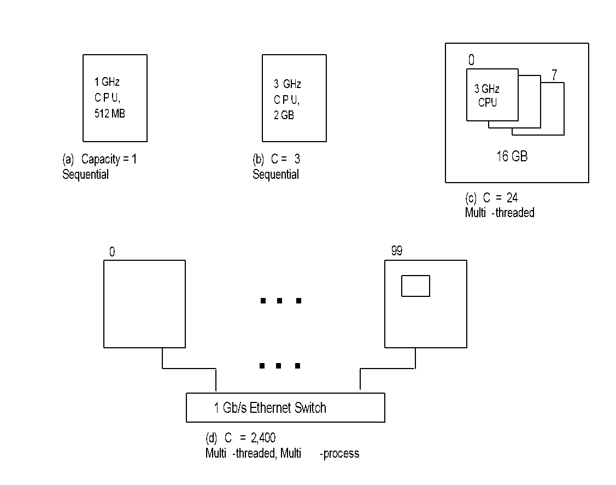
Design Decisions: Scalability
Chapter 9 Network Management Tools, Systems, and Engineering
Notes
Limited scalability achieved with more powerful hardware: Compare (a) and (b)
Scalability increased with multiple CPUs sharing memory (SMP): (c) above
As SMP gets expensive, redesign software with cluster of MSPs interconnected by high-speed LAN: (d) above
Network Management: Principles and Practice
© Mani Subramanian and T. A. Gonsalves 2010
*
Notes:
*

Slide 56
Discovery Module
Chapter 9 Network Management Tools, Systems, and Engineering
Discovers topology of network
Auto-discovery
Manual configuration
Discovery queries for NEs in specified range of IP
Found IP NEs are queried for specific details
Discovery process is configures with parameters given in the above table
Notes
Network Management: Principles and Practice
© Mani Subramanian and T. A. Gonsalves 2010
*
Notes:
*

Slide 57
Discovery Parameters
Chapter 9 Network Management Tools, Systems, and Engineering
Parameter | Value | Description
IP addresses | 10.0.0.1 – 10.0.0.254, 192.168.0.0 / 24 | A range or list of IP addresses
Wait Interval | 10 secs | Waiting time between discovery of successive IPs to minimize load on the network
SNMP version | v1 | v1, v2c, or v3
SNMP community | “public” | A commonly-used value
Discover types | Router, server, switch | Only elements of these types are added to the MODB
Ignore types | PC, UPS | Elements of these types are not added to the MODB
Notes
Discovery parameters are set in the discovery configuration file
Discovery parameters chosen to manage the scope of NEs discovered and the time for discovery run
Network Management: Principles and Practice
© Mani Subramanian and T. A. Gonsalves 2010
*
Notes:
*

Slide 58
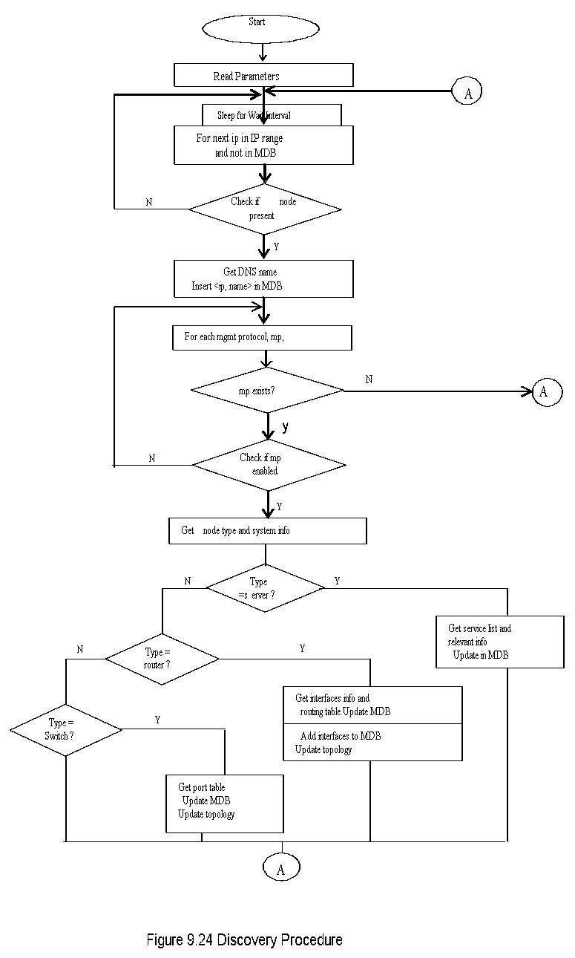
Discovery Procedure
Chapter 9 Network Management Tools, Systems, and Engineering
Network Management: Principles and Practice
© Mani Subramanian and T. A. Gonsalves 2010
*
Notes:
*

Slide 59
Rediscovery
Chapter 9 Network Management Tools, Systems, and Engineering
Periodic check by NMS NEs in the network with MDB for changes in the network
Deleted NEs are detected by scheduled polling and to be manually deleted by the operator
New NEs are discovered by simpler discovery process and added to MDB
Discovered components are compared to the ones in MDB and the difference reported for appropriate action
Notes
Network Management: Principles and Practice
© Mani Subramanian and T. A. Gonsalves 2010
*
Notes:
*

Slide 60
Topology
Chapter 9 Network Management Tools, Systems, and Engineering
R₁
192.168.0.6
192.168.1.1
59.96.172.9
100 M Ethernet
64K
PPP
2 M
HDLC
192.168.1.2
59.96.172.23
R₂
R₃
Notes
Topology shows the nodes and interconnections
Nodes are routers and switches; Hubs are non-managed
Router information collected from router MIB variables
ipAdEntAddr & ipAdEntIfIndex (ipAddressTable)
ipForwardNextHop ipForwardIfIndex (ipForwardingTable)
ifType & ifSpeed (ifTable)
Switch information (RFC 1493)
dot1dBaseNumPorts
dot1dStpPortTable
dot1dTpfDbTable
Network Management: Principles and Practice
© Mani Subramanian and T. A. Gonsalves 2010
*
Notes:
*

Slide 61
Thread Pool for Speedy Discovery
Chapter 9 Network Management Tools, Systems, and Engineering
Discovery Controller
Control
Data
Task Q
Worker 1
Worker 2
Worker 100
SNMP/ICMP/IP
Notes
Single threaded discovery is slow for large network discovery
Lower % IP address in use, larger the discovery time
Use concurrent discovery using pool of worker threads
Discovery controller creates task queue, each task with 1 or more Ips
It then creates a number of worker threads to do parallel processing
Network Management: Principles and Practice
© Mani Subramanian and T. A. Gonsalves 2010
*
Notes:
*

Slide 62
Single Thread vs Mutithread discovery
Chapter 9 Network Management Tools, Systems, and Engineering
9.7 Time to Complete Discovery Sequentially
(Note: Numbers in italics are days, normal font in hours)
% Addresses in Use | 5% | 20% | 50% | 100%
Total Assignable Addresses
1 Class C ~ 250 | 2.0 hr | 1.7 hr | 1.2hr | 0.3 hr
10 Class C ~ 2,500 | 20.0 hr | 17.4 hr | 12.2 hr | 3.5 hr
1 Class B ~ 65,000 | 21.6 dy | 18.8 dy | 13.2 dy | 3.8 dy
16 Class B ~ 1,000,000 | 332.8 dy | 289.4 dy | 202.5 dy | 57.9 dy
Table 9.8 Time to Complete Discovery with 10 Concurrent Threads
(Note: Numbers in italics are hours, normal font in secs)
% in Addresses Use | 5% | 20% | 50% | 100%
Total Assignable Addresses
1 Class C ~250 | 72 s | 63 s | 44 s | 13 s
10 Class C ~2,500 | 719 s | 625 s | 438 s | 125 s
1 Class B ~65,000 | 5.2 hr | 4.5 hr | 3.2 hr | 0.9 hr
16 Class B ~1,000,000 | 79.9 hr | 69.4 hr | 48.6 hr | 13.9 hr
Network Management: Principles and Practice
© Mani Subramanian and T. A. Gonsalves 2010
*
Notes:
*

Slide 63
Performance Manager
Chapter 9 Network Management Tools, Systems, and Engineering
Two major functions
Data Collection
Analysis and report generation
Data Collection
Offline: Use local data collector and periodic batch transmittal to NMS. Should have NE id, OID, Value and timestamp
Online: For real-time performance analysis:
Issues
Overloading of the server
Overloading the network
Overloading the agent
Poll configuration
Database schema
Notes
Network Management: Principles and Practice
© Mani Subramanian and T. A. Gonsalves 2010
*
Notes:
*

Slide 64
Poll Configuration
Chapter 9 Network Management Tools, Systems, and Engineering
Frequency of polling
Fast ( backbone traffic) - 30secs to 2 minutes
Slow (free disk space) - once an hour
Dynamic polling
Increase polling frequency during critical time (Congestion in traffic)
Keep the network load within limits
Concurrency of polling in large networks
Mitigate overrun (delay) in scheduled polling
Notes
Network Management: Principles and Practice
© Mani Subramanian and T. A. Gonsalves 2010
*
Notes:
*

Slide 65
Database Schema
Chapter 9 Network Management Tools, Systems, and Engineering
Table 9.9 Typical Growth of Collected Data (56 B / Record)
 | 1 day | 1 week | 1 month | 1 year
Number of records | 29 m | 201 m | 863 m | 10, 501m
Database size | 1.6GB | 11.3GB | 48.3 GB | 588 GB
Table 9.10 Comparison of Different DBMS Schema Designs
 | 1 table | 1 table/NE | 1 table/OID | 1 table/day
Space / record | 28 B | 20 B | 20 B | 20 B
Number of open tables | 1 | Very large | Large | Few
Insert | Slow | Fast | Fast | Fast
Reports | 1 table, conflict with insert | 1 table, less conflict | Several tables, some conflict | 1 table, Conflict for online reports, No Conflict for offline reports
Data safety | Poor | Good | Good | Very Good
Notes
Database grows rapidly
Database should be easily and rapidly accessible
Careful design needed based on size and application needs
Polled data can be stored in multiple tables
One table per NE
One table per variable
One table per day / period
Network Management: Principles and Practice
© Mani Subramanian and T. A. Gonsalves 2010
*
Notes:
*

Slide 66
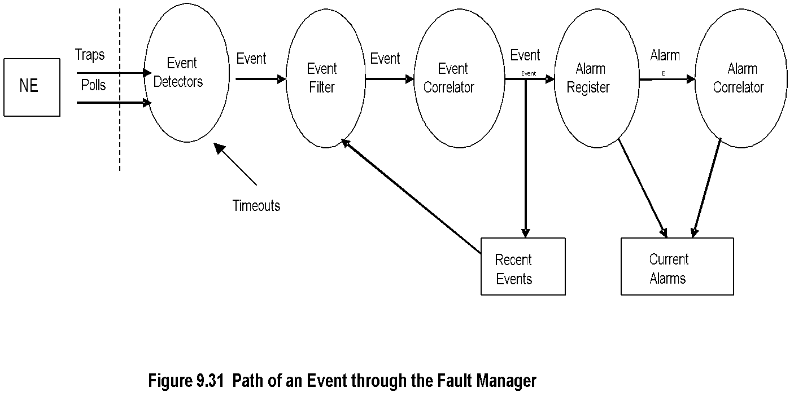
Fault Manager
Chapter 9 Network Management Tools, Systems, and Engineering
Notes
Event generation:
Notification or trap indicator of fault
Multiple consecutive status polls fail to receive response
Threshold crossing, e.g. performance limit
Internal escalation of fault resolution
Event filtering of unwanted events
Event correlation of repeated receipt of same fault event
Conversion of event to alarm by alarm register
Root cause analysis of multiple alarms done alarm correlator
Alarm indications: Visual, audio, SMS / phone call, email, log
Network Management: Principles and Practice
© Mani Subramanian and T. A. Gonsalves 2010
*
Notes:
*

Slide 67
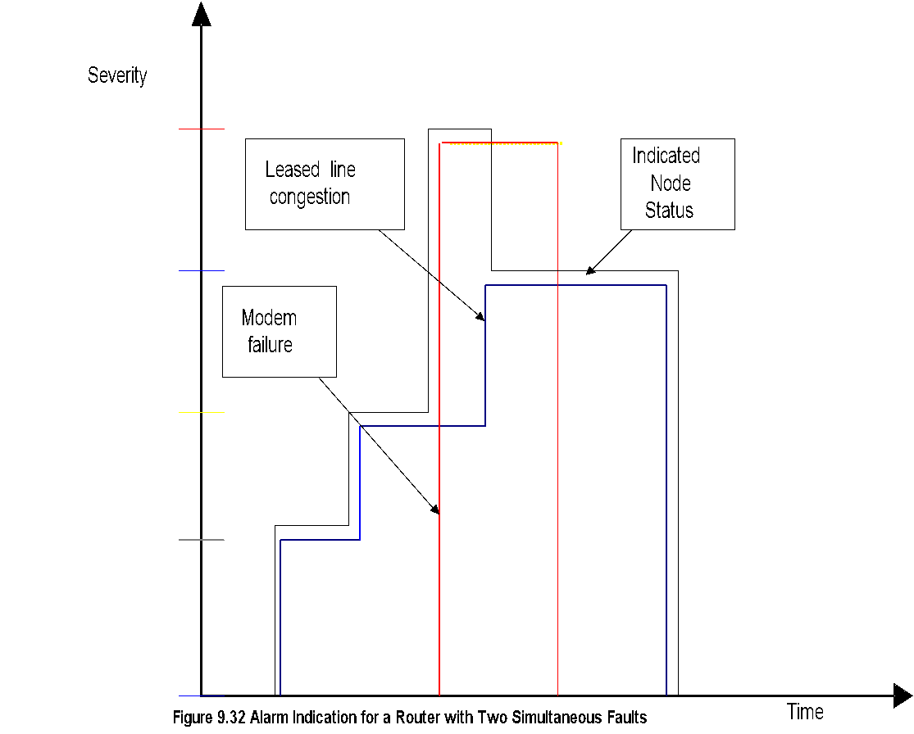
Alarm Severity and Priority
Chapter 9 Network Management Tools, Systems, and Engineering
Critical
Major
Notes
For each <NE, subsystem, event>, set the severity
For each <NE, subsystem, event>, set the priority
For each <NE, subsystem, event, severity>, set the alarm indication(s)
For each <NE, subsystem, event, priority>, set the alarm indication(s)
Network Management: Principles and Practice
© Mani Subramanian and T. A. Gonsalves 2010
*
Notes:
*

Slide 68
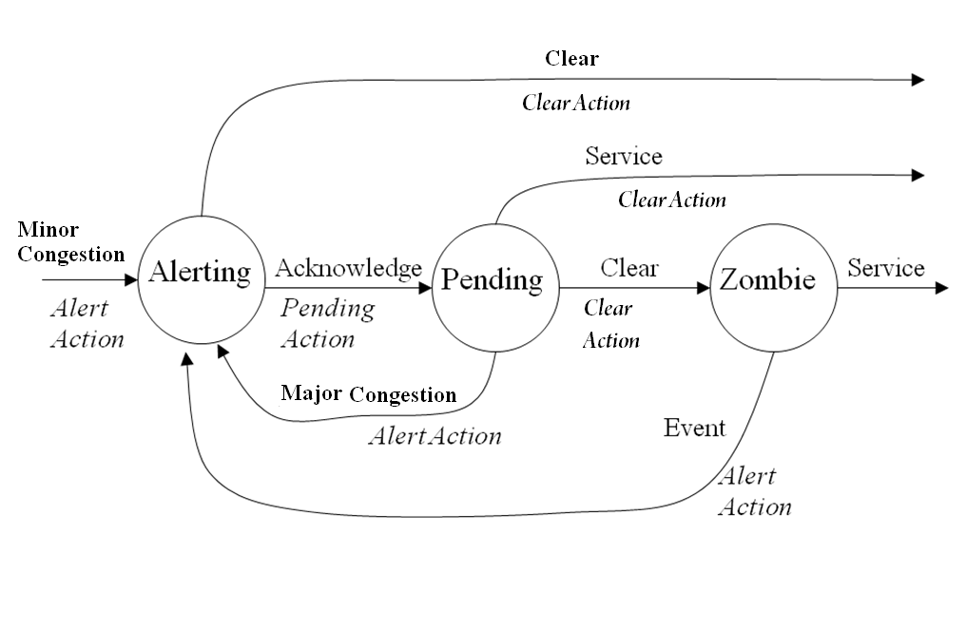
Alarm Finite State Machine
Chapter 9 Network Management Tools, Systems, and Engineering
Notes
Table 9.11 List of Alarm States
State | Description
Initial | A new, unused alarm object
Altering | The alarm is registered in the list of active alarms. The FM operator has not yet noticed the alarm. The FM uses various alarm indications to catch the attention of the operator.
Pending | The operator has noticed the alarm. The FM is awaiting the results of corrective actions.
Zombie | The FM is aware that the fault condition is clear. The icon color is normal. The operator has yet to indicate the corrective action taken.
Closed | The operator and FM are both aware that the fault is closed. The alarm object is returned to the pool of unused alarms and is effectively in the initial state.
Network Management: Principles and Practice
© Mani Subramanian and T. A. Gonsalves 2010
*
Notes:
*

Slide 69
Alarm Finite State Machine
Chapter 9 Network Management Tools, Systems, and Engineering
Notes
Table 9.12 List of FSM Events
Events | Description
Minor congestion | Utilization on a link exceeds 90%
Major congestion | Utilization or a link exceeds 95%
Clear | Utilization or a link exceeds 95%
Acknowledge | Operator invokes an FM menu or button to indicate awareness of a new alarm
Service | Operator invokes an FM menu or button to indicate corrective action taken
Network Management: Principles and Practice
© Mani Subramanian and T. A. Gonsalves 2010
*
Notes:
*

Slide 70
Alarm Finite State Machine
Chapter 9 Network Management Tools, Systems, and Engineering
Notes
Table 9.13 Transition Table for Alarm FSM in Figure 9.33
 | Initial | Alerting | Pending | Zombie
Minor Congestion | Alert action Alerting state | Null | Null | Alert action Alerting state
Major Congestion | Alert action Alerting state | If alarm severity is Minor then: Alerting action Alerting state | If alarm severity is Minor then: Alerting action Alerting state | Alert action Alerting state
Acknowledge | NA | Pending action Pending state | NA | NA
Service | NA | NA | Clear action Closed state | Clear action Closed state
Clear | Null | Clear action Closed state | Clear action Zombie state | Null
Network Management: Principles and Practice
© Mani Subramanian and T. A. Gonsalves 2010
*
Notes:
*

Slide 71
Root Cause Analysis
Chapter 9 Network Management Tools, Systems, and Engineering
Head Office
Branch Office
S₁
NMS
R₁
WAN
R₂
link
L A N
S₂
S₃
Notes
RCA shows one primaray alarm for one fault; Suppresses secondary alarms
RCA based on dependency, i.e., reachability by NMS
Status: Up, Down, Unreachable / Unknown
R₁ failure primary node (shown red); Link, R₂, S₁, S₂, and S₃ are secondary failures (shown grey)
Network Management: Principles and Practice
© Mani Subramanian and T. A. Gonsalves 2010
*
Notes:
*

Slide 72
Distributed Management
Chapter 9 Network Management Tools, Systems, and Engineering
L1
L2
F/P
L2
P
L2
P
L2
F
L2
F
Ln
Ln
Ln
Ln
Ln
Notes
Large networks managed by geographically distributed configuration
Several managers running on different servers
Classification
Weakly distributed: Hierarcical, vertical delegation
Strongly distributed: Horizantal delegation allowed
Multitier architecture: Trade-off between Flexibility vs Ease of implementation and deployment
Topology: One parent NMS for each cluster of lower level NMSs
Network Management: Principles and Practice
© Mani Subramanian and T. A. Gonsalves 2010
*
Notes:
*

Slide 73
Server Platforms
Chapter 9 Network Management Tools, Systems, and Engineering
Operating System Requirements
Support threads, processes and shared-memory multiprocessors
Large disk, RAM and peripherals
Variety of programming and scripting languages
Supports 3rd party tools, components, and libraries
Examples: UNIX (Sun Solaris, IBM AIX, HPUX MacOS X, FreeBSD) and Microsoft Windows
Notes
Database Management System (DBMS) Requirements
Support large amount of data
Support transactions
Good administrative tools
Create indices
Recover from table corruption
Backups
Performance tuning
Examples:
Open source: MySQL and PostgreSQL
Commercial: Oracle, IBM, db2, Microsoft SQL Server, Sybase
Network Management: Principles and Practice
© Mani Subramanian and T. A. Gonsalves 2010
*
Notes:
*

Slide 74
NMS Client Design
Chapter 9 Network Management Tools, Systems, and Engineering
Three approaches
Terminal client
Rich client
Browser or Web client
Notes
Network Management: Principles and Practice
© Mani Subramanian and T. A. Gonsalves 2010
*
Notes:
*

Slide 75
Terminal Client
Chapter 9 Network Management Tools, Systems, and Engineering
“dumb” character-oriented terminal
Terminal emulation software (xterm, Putty) on PC
Connection to NMS via telnet or ssh over TCP/IP
No GUI
Notes
Network Management: Principles and Practice
© Mani Subramanian and T. A. Gonsalves 2010
*
Notes:
*

Slide 76
Rich Client
Chapter 9 Network Management Tools, Systems, and Engineering
PC runs special client application that works with server
GUI interface
Runs NMS functionalities
Usually written in object-oriented languaage
Drawbacks
Lack of portability
Requires update with NMS server update
High degree of incompatibility with multiple servers
Notes
Network Management: Principles and Practice
© Mani Subramanian and T. A. Gonsalves 2010
*
Notes:
*

Slide 77
Browser or Web Client
Chapter 9 Network Management Tools, Systems, and Engineering
de-facto standard now
GUI capability
Minimal NMS-dependent software in the client
Portability between different browsers still a problem, but minimized
Popular usage: Microsoft IE and Mozilla Firefox
Notes
Network Management: Principles and Practice
© Mani Subramanian and T. A. Gonsalves 2010
*
Notes:
*

Slide 78
NMS for Enterprise & Service Providers
Chapter 9 Network Management Tools, Systems, and Engineering
Management of data transport
IBM Netview, IBM Microcuse, HP OpenView, NMSWorks CygNet
Systems management
CA Unicenter and Tivoli TME
Network and systems management
Partnerships
Telecommunications management
NMSWorks CygNet, Agilent CNMS
Service management and policy management
Notes
Network Management: Principles and Practice
© Mani Subramanian and T. A. Gonsalves 2010
*
Notes:
*

Slide 79
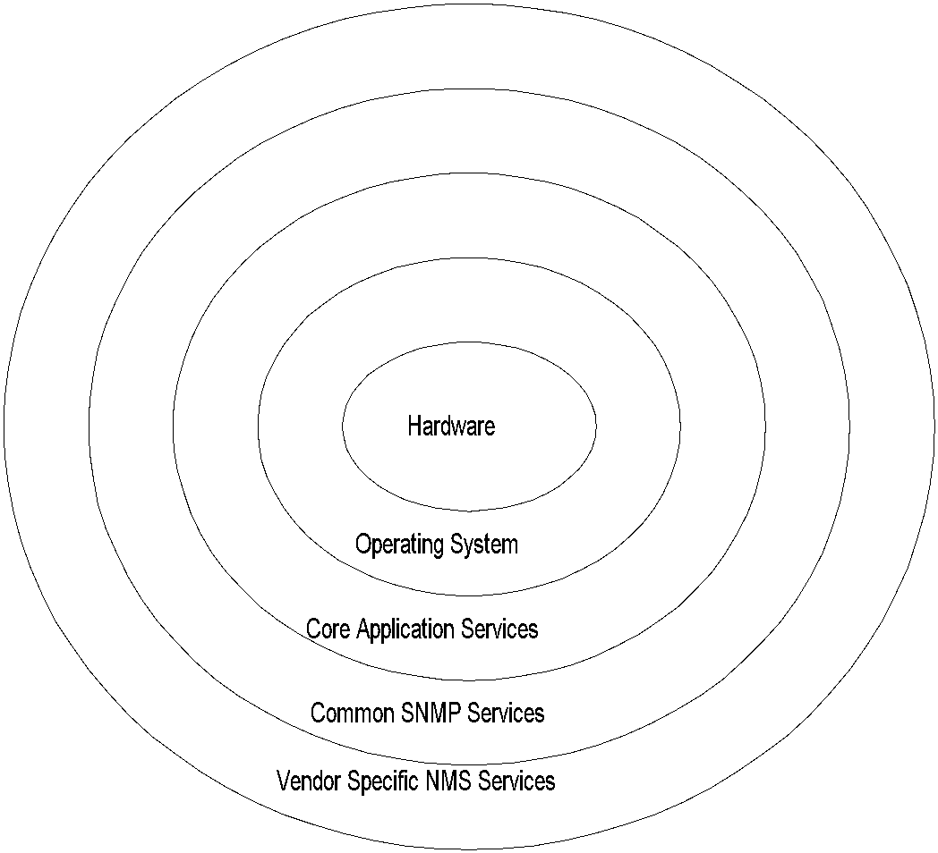
NMS Components
Chapter 9 Network Management Tools, Systems, and Engineering
Notes
Network Management: Principles and Practice
© Mani Subramanian and T. A. Gonsalves 2010
*
Notes:
*

Slide 80
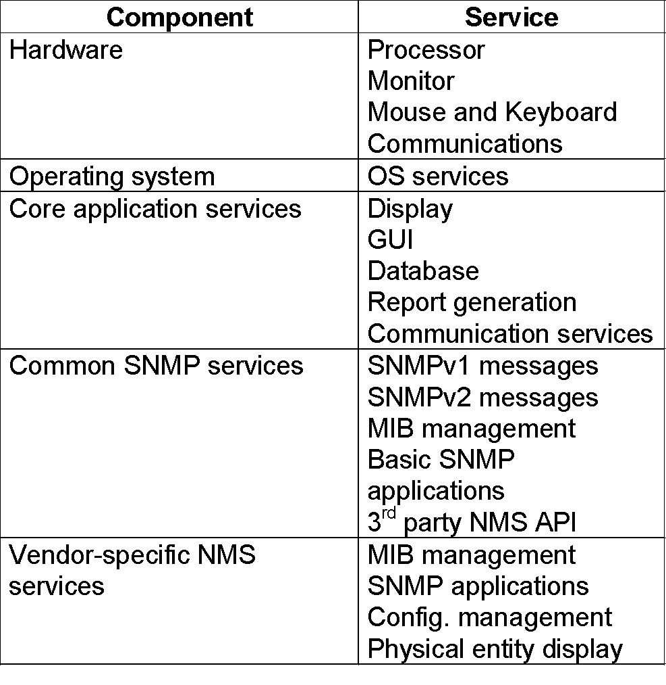
NMS Components
Chapter 9 Network Management Tools, Systems, and Engineering
Notes
Network Management: Principles and Practice
© Mani Subramanian and T. A. Gonsalves 2010
*
Notes:
*

Slide 81
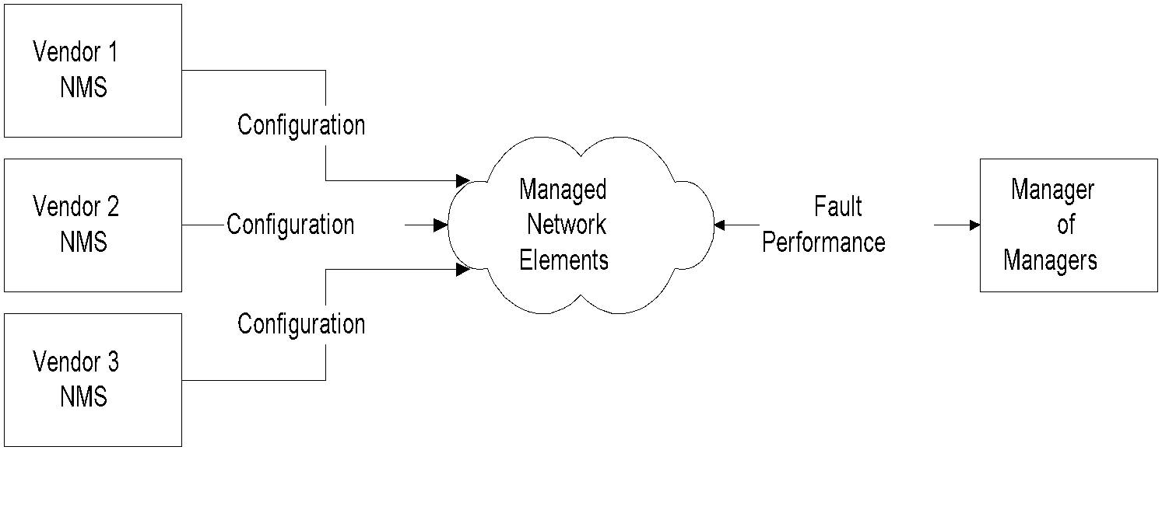
Multi-NMS Configuration
Chapter 9 Network Management Tools, Systems, and Engineering
Notes
Network Management: Principles and Practice
© Mani Subramanian and T. A. Gonsalves 2010
*
Notes:
*

Slide 82
Network Configuration
Chapter 9 Network Management Tools, Systems, and Engineering
Configure agents
Configure management systems
Community administration parameters
Community name
MIB view
Trap targets
Autodiscovery : Scope
Notes
Network Management: Principles and Practice
© Mani Subramanian and T. A. Gonsalves 2010
*
Notes:
*

Slide 83
Network Monitoring
Chapter 9 Network Management Tools, Systems, and Engineering
By polling
By traps
Failure indicated by pinging or traps
Ping frequency optimized for network load vs. quickness of detection
trap messages: linkdown, linkUp, coldStart, warmStart, etc.
Network topology discovered by auto-discovery
Monitoring done at multiple levels - “drilling”
Notes
Network Management: Principles and Practice
© Mani Subramanian and T. A. Gonsalves 2010
*
Notes:
*

Slide 84
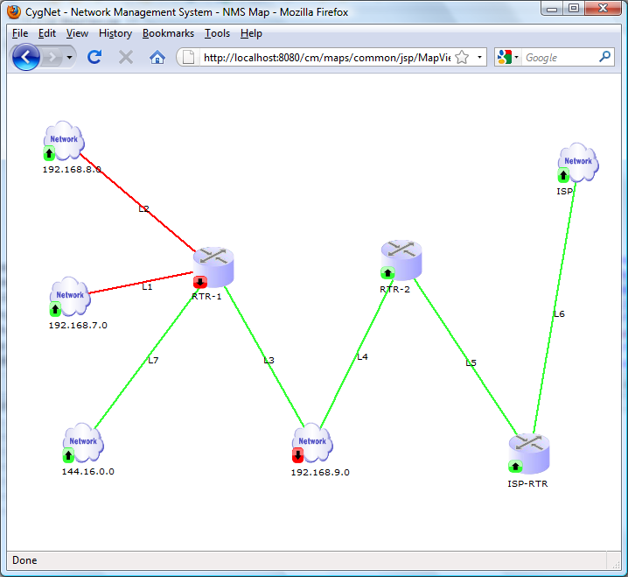
Global View
Chapter 9 Network Management Tools, Systems, and Engineering
Network Management: Principles and Practice
© Mani Subramanian and T. A. Gonsalves 2010
*
Notes:
*

Slide 85
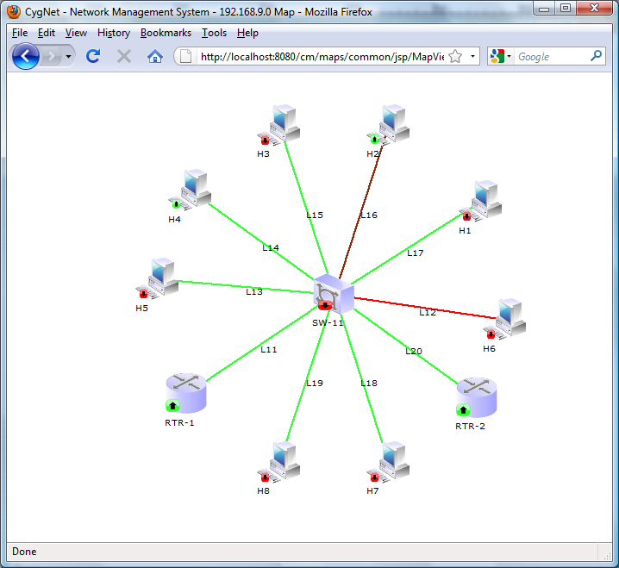
Domain View
Chapter 9 Network Management Tools, Systems, and Engineering
Network Management: Principles and Practice
© Mani Subramanian and T. A. Gonsalves 2010
*
Notes:
*

Slide 86
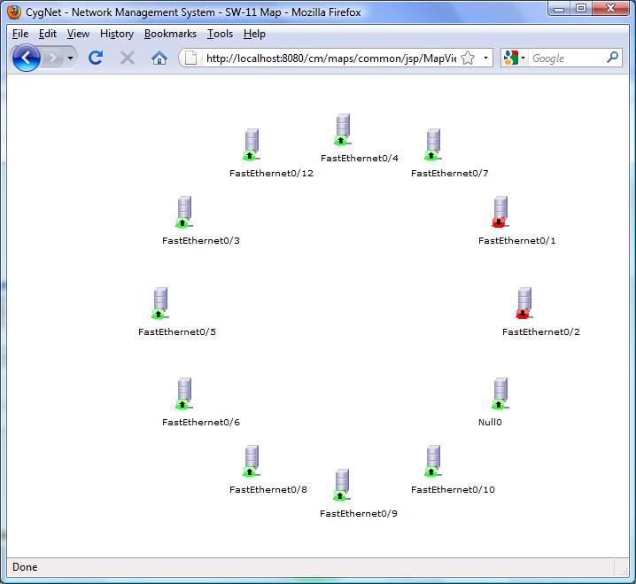
Interfaces View
Chapter 9 Network Management Tools, Systems, and Engineering
Network Management: Principles and Practice
© Mani Subramanian and T. A. Gonsalves 2010
*
Notes:
*

Slide 87
Commercial / Open Source NMS & System Solutions
Chapter 9 Network Management Tools, Systems, and Engineering
Low End NMS
Enterprise NMS
Centralized
Distributed
System and Network Management
Notes
Enterprise NMS
Hewlett-Packard OpenView
IBM Micromuse
NMSWorks CygNet
Low End NMS
SNMPc
Open NMS
Nagios
System & Network Management
Computer Associates Unicenter TNG
Tivoli TME / Netview
AdventNet Operations Manager
Big Brother
Spong
Network Management: Principles and Practice
© Mani Subramanian and T. A. Gonsalves 2010
*
Notes:
*

Slide 88
HP OpenView Network Node Manager
Chapter 9 Network Management Tools, Systems, and Engineering
Autodiscovery and mapping
Drill-down views
Fault monitoring
Event monitoring
MIB Browser
SNMP tools
Traffic monitoring
3rd party integration
Notes
OpenView is Hewlett-Packard’s platform for Network Management
Many NMSs use OpenView Platform: CiscoWorks, CA TNG, Transcend
NNM is HP NMS on OpenView
Drill-down Map Hierarchy
Network Management: Principles and Practice
© Mani Subramanian and T. A. Gonsalves 2010
*
Notes:
*

Slide 89
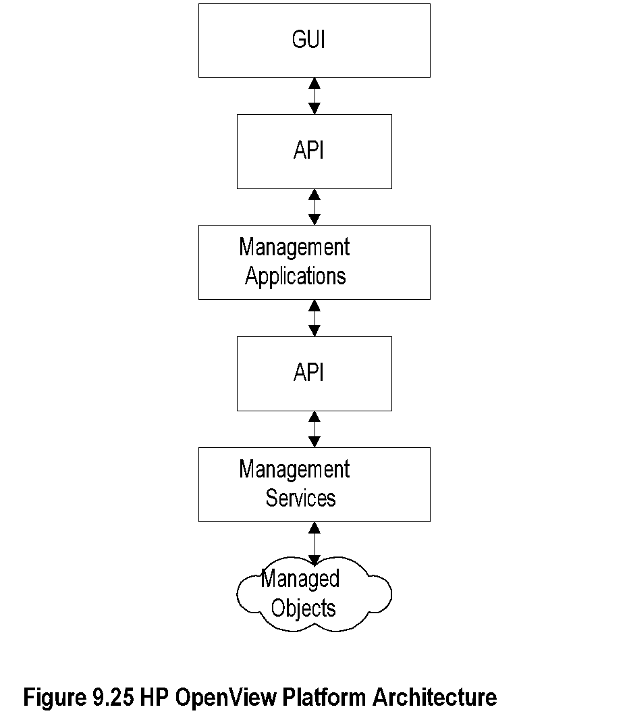
HP OpenView Platform
Chapter 9 Network Management Tools, Systems, and Engineering
Notes
Open, modular, and distributed architecture
Object-oriented design; TNM can be implemented
Open API-based architecture
Easy vendor-specific NMS integration by 3rd party
Network Management: Principles and Practice
© Mani Subramanian and T. A. Gonsalves 2010
*
Notes:
*

Slide 90
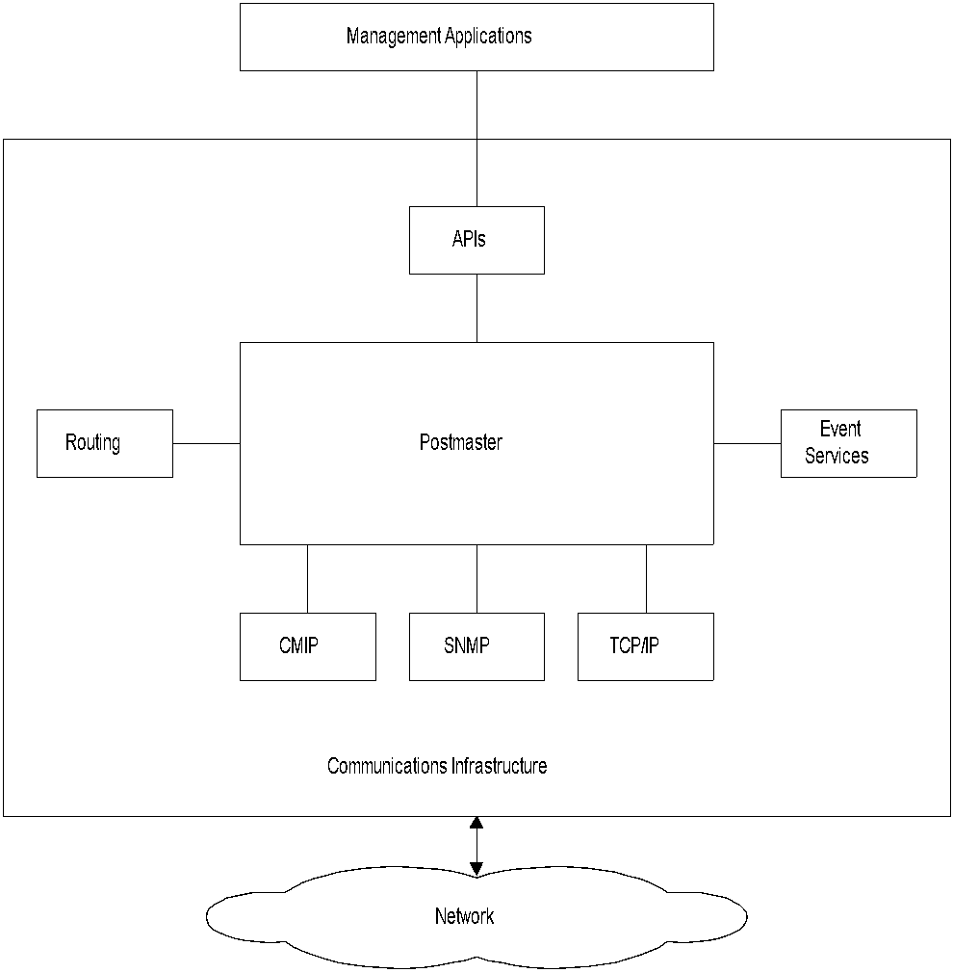
OpenView Distributed Platform
Chapter 9 Network Management Tools, Systems, and Engineering
Notes
Postmaster integrates all management services - multiple protocol stacks: SNMP, CMIP, TCP/IP
Routing enables distributed message routing
Event services control event and alarm messages
Management services interface with management applications via APIs
Network Management: Principles and Practice
© Mani Subramanian and T. A. Gonsalves 2010
*
Notes:
*

Slide 91
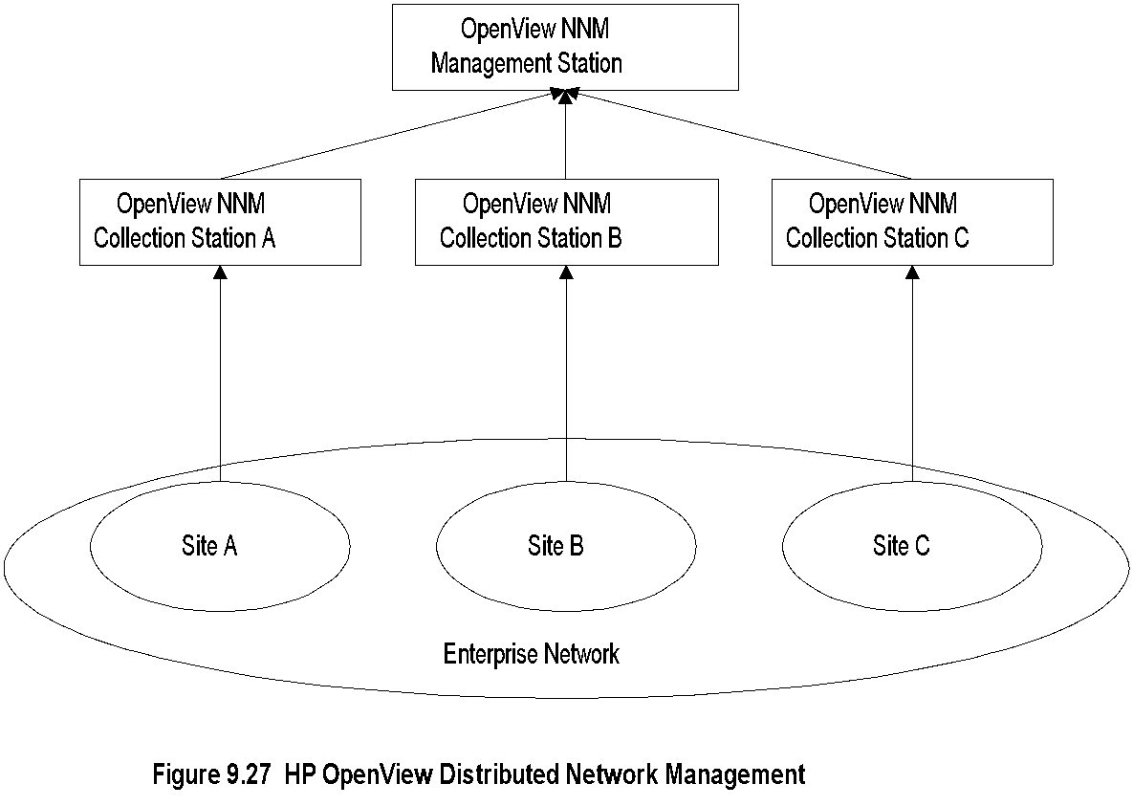
Distributed OpenView NNMs
Chapter 9 Network Management Tools, Systems, and Engineering
Notes
An enterprise network managed by multiple NMSs
Collection stations could be regular NNMs or entry-NNMs (100 nodes)
Filtered information sent to MoM (top level NNM) reduces traffic
MoM integrates and presents enterprise data
Network Management: Principles and Practice
© Mani Subramanian and T. A. Gonsalves 2010
*
Notes:
*

Slide 92
Telecommunications NMS
Chapter 9 Network Management Tools, Systems, and Engineering
Differs from Enterprise NMS – most based on IP
Features specific to Telecom:
Management of network based on legacy equipment
Based on ITU-T standard vs. IP
NMS necessitated to interface to EMS, not NE
Multivendor, multitechnology equipment using diverse protocols
Provisioning, such as SDH / SONET optical network complex
Dynamic accurate inventory management critical for bandwidth provisioning
Importance of QoS / SLA in voice call management
Real-time Service Impact Analysis on network failures necessary
Telecom networks are large and hence more difficult to manage
Notes
Network Management: Principles and Practice
© Mani Subramanian and T. A. Gonsalves 2010
*
Notes:
*

Slide 93
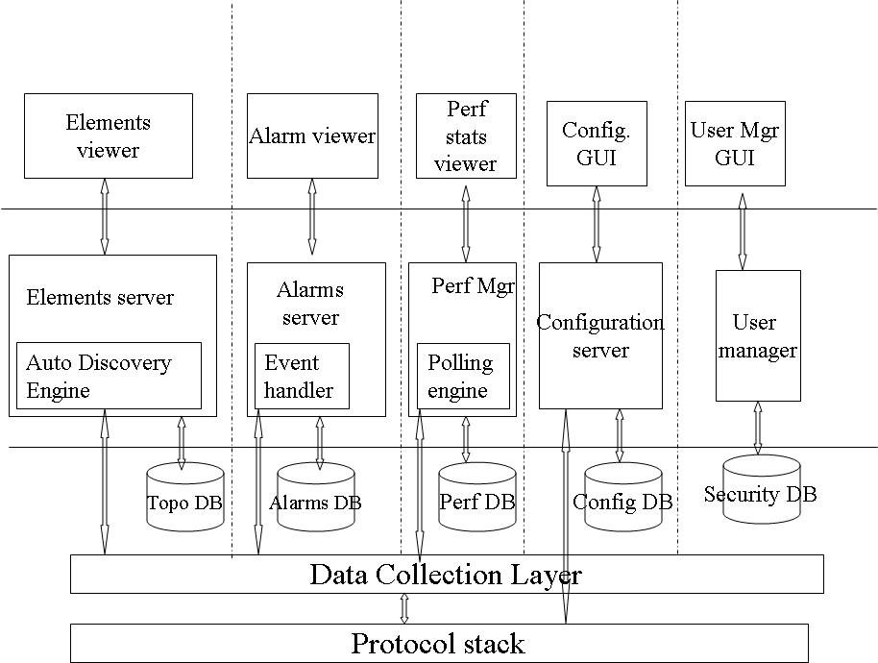
CygNet Core Architecture
Chapter 9 Network Management Tools, Systems, and Engineering
Notes
Elements server discovers NEs and links and stores them in Topo (Topology) database
Alarm server receives events, does correlation, generates alarms, stores, and sends notifications
Performance manager gathers telecommunication data such as call data, generates statistics, and stores them
Configuration manager is a tool to set the configuration of NEs
User manager system security operations
Network Management: Principles and Practice
© Mani Subramanian and T. A. Gonsalves 2010
*
Notes:
*

Slide 94

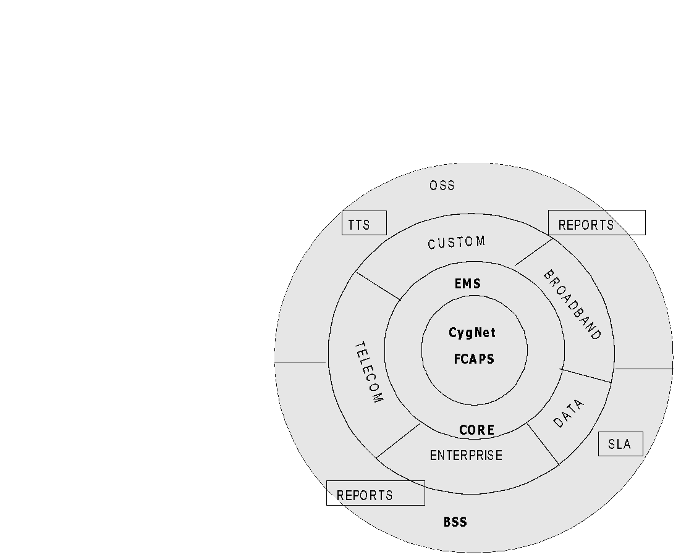
CygNet as Telecom NMS
Chapter 12
Notes
CygNet NMS for telecom management is an application on top of CygNet core module
Custom module in the architecture enables customization needed for telecom NMS
Network Management: Principles and Practice
© Mani Subramanian and T. A. Gonsalves 2010
*
Notes:
*

Slide 95
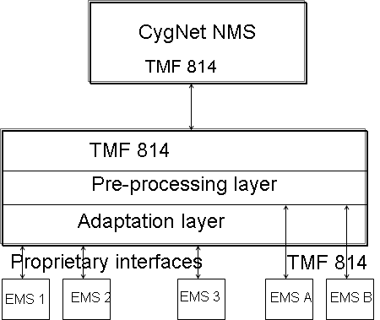
CygNet Mediation Server
Chapter 9 Network Management Tools, Systems, and Engineering
Notes
Mediation server enables handling of multivendor multitechnology NEs
Cygnet NMS with south-bound standard TMF 814 protocol is transparent to the multivendor multi- technology due to the presence of mediation server
Network Management: Principles and Practice
© Mani Subramanian and T. A. Gonsalves 2010
*
Notes:
*

Slide 96
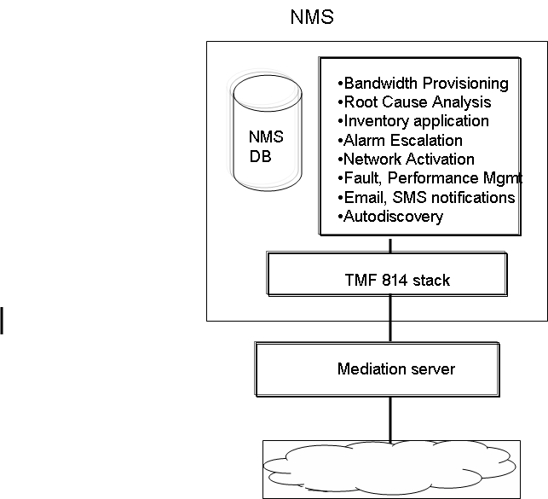
CygNet OTNMS Architecture
Chapter 9 Network Management Tools, Systems, and Engineering
Notes
OTNMS (Optical Transport NMS) manages multivendor multitechnology optical network from service and network fulfillment to service and network assurance
Network Management: Principles and Practice
© Mani Subramanian and T. A. Gonsalves 2010
*
Notes:
*

