Slide 1
Chapter 7 SNMP Management: SNMPv3
Chapter 7
SNMP Management:
SNMPv3
Network Management: Principles and Practice
© Mani Subramanian 2010
*

Slide 2
Objectives
Chapter 7 SNMP Management: SNMPv3
SNMPv3 features
  Documentation architecture
  Formalized SNMP architecture
  Security
SNMP engine ID and name for network entity
SNMPv3 applications and primitives
SNMP architecture
  Integrates the three SNMP versions
  Message processing module
  Dispatcher module
  Future enhancement capability
User security model, USM
  Derived from user ID and password
  Authentication
  Privacy
  Message timeliness
View-based access control model, VACM
  Configure set of MIB views for agent with contexts
  Family of subtrees in MIB views
  VACM process
Network Management: Principles and Practice
© Mani Subramanian 2010
*

Slide 3
Chapter 7 SNMP Management: SNMPv3
Key Features
Modularization of document
Modularization of architecture
SNMP engine
Security feature
  Secure information
  Access control
  Notes
Network Management: Principles and Practice
© Mani Subramanian 2010
*

Slide 4
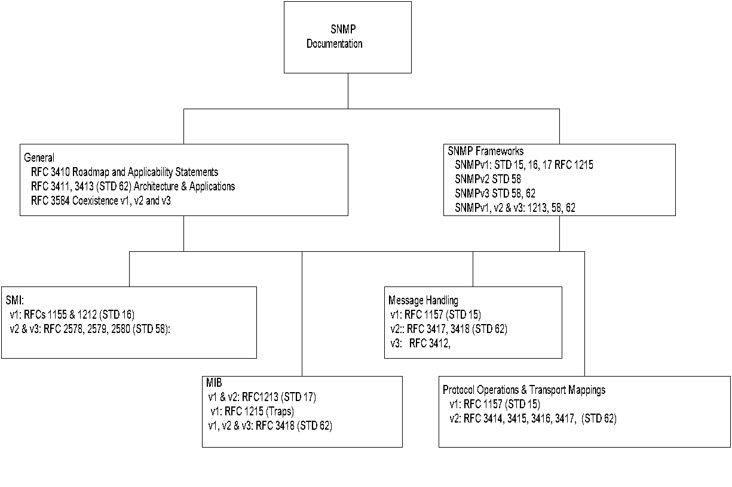
Chapter 7 SNMP Management: SNMPv3
Documentation
Compare this to the document organization in Chapter 4
Table 7.1 SNMPv3 RFCs
RFC 3410 | Introduction and Applicability Statements (not STD)
RFC 3411 | Architecture for Describing SNMP Management Frameworks
RFC 3412 | Message Processing and Dispatching for SNMP
RFC 3413 | SNMPv3 Applications
RFC 3414 | User-based Security Model (USM) for SNMPv3
RFC 3415 | View-based Access Control Model for SNMP
RFC 3416 | Version 2 of the Protocol Operations for SNMP
RFC 3417 | Transport Mappings for SNMP
RFC 3418 | MIB for SNMP
RFC 3584 | SNMPv3 Coexistence and Transition (BCP 74)
Network Management: Principles and Practice
© Mani Subramanian 2010
*

Slide 5
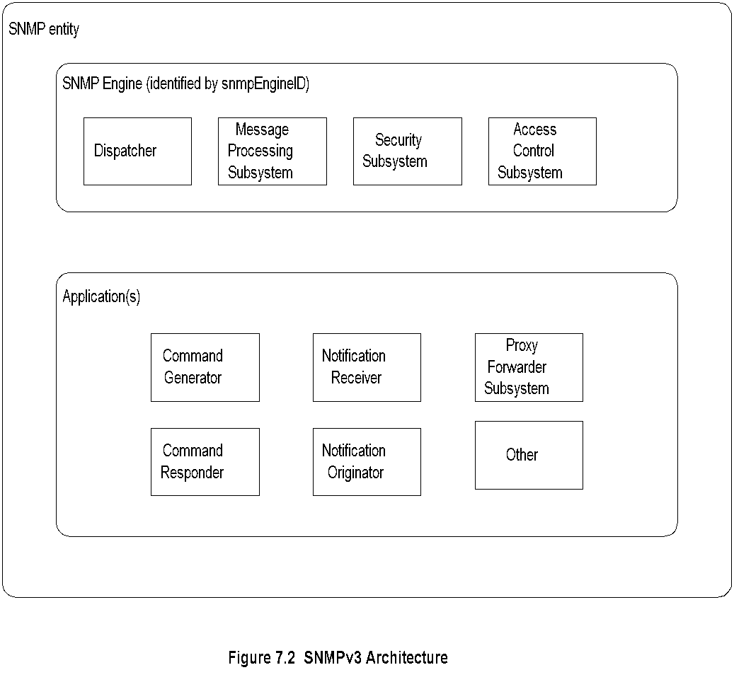
Chapter 7 SNMP Management: SNMPv3
Architecture
  Notes
SNMP entity is a node with an SNMP management
element - either an agent or manager or both
Three names associated with an entity
  Entities: SNMP engine
  Identities: Principal and security name
  Management Information: Context engine
Network Management: Principles and Practice
© Mani Subramanian 2010
*

Slide 6
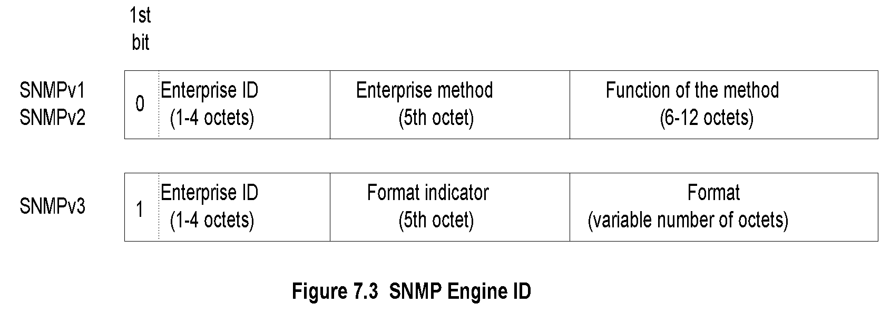
Chapter 7 SNMP Management: SNMPv3
SNMP Engine ID
  Notes
Each SNMP engine has a unique ID: snmpEngineID
Acme Networks {enterprises 696}
SNMPv1 snmpEngineID ‘000002b8’H
SNMPv3 snmpEngineID ‘800002b8’H
(the 1st octet is 1000 0000)
Network Management: Principles and Practice
© Mani Subramanian 2010
*

Slide 7
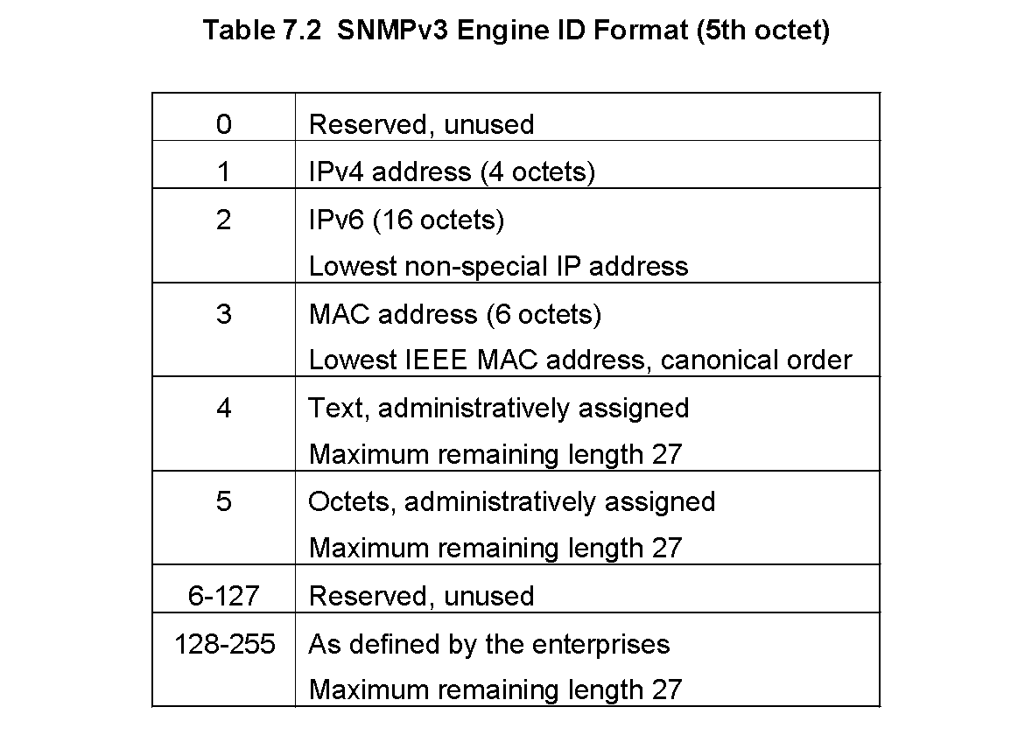
Chapter 7 SNMP Management: SNMPv3
SNMPv3 Engine ID Format
5th Octet
  Notes
For SNMPv1 and SNMPv2:
  Octet 5 is the method
  Octet 6-12 is IP address
Examples: IBM host IP address 10.10.10.10
SNMPv1: 00 00 00 02 01 0A 0A 0A 0A 00 00 00
SNMPv3: 10 00 00 02 02 00 00 ... 00 00 00 0A 0A 0A 0A
Network Management: Principles and Practice
© Mani Subramanian 2010
*

Slide 8
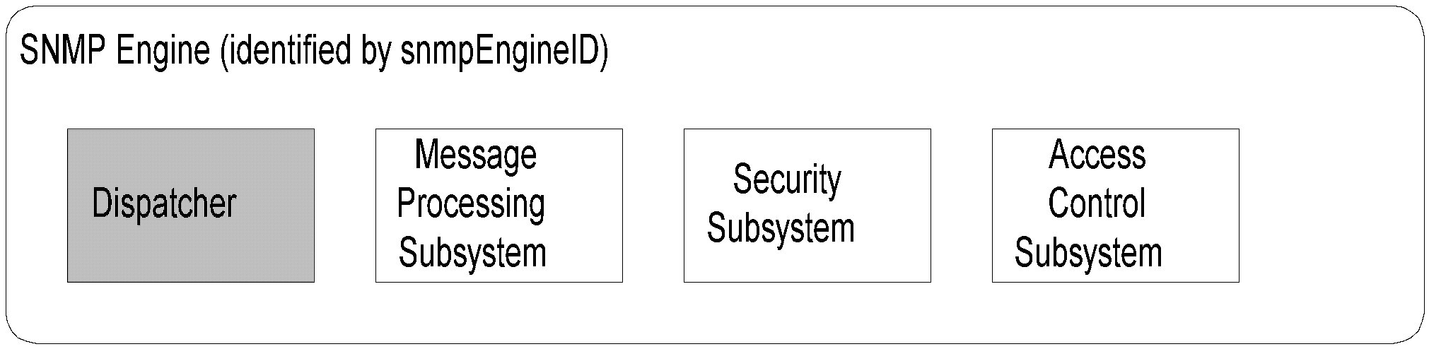
Chapter 7 SNMP Management: SNMPv3
Dispatcher
  Notes
One dispatcher in an SNMP engine
Handles multiple version messages
Interfaces with application modules, network, and
message processing models
Three components for three functions
  Transport mapper delivers messages over the
  transport protocol
  Message Dispatcher routes messages between
  network and appropriate module of MPS
  PDU dispatcher handles messages between
  application and MPS
Network Management: Principles and Practice
© Mani Subramanian 2010
*

Slide 9
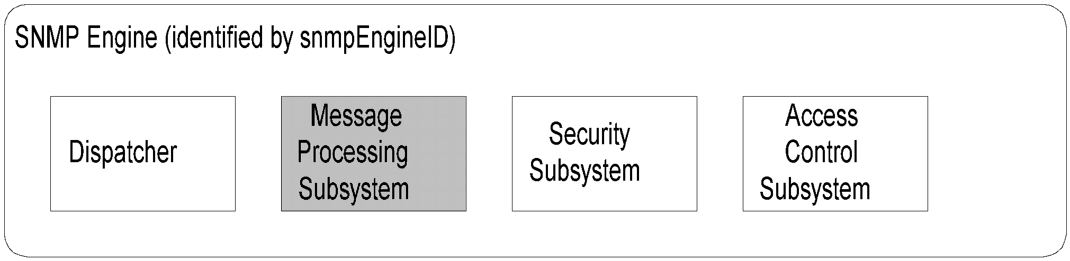
Chapter 7 SNMP Management: SNMPv3
Message Processing Subsystem
  Notes
Contains one or more Message Processing Models
One MPM for each SNMP version
SNMP version identified in the header
Network Management: Principles and Practice
© Mani Subramanian 2010
*

Slide 10
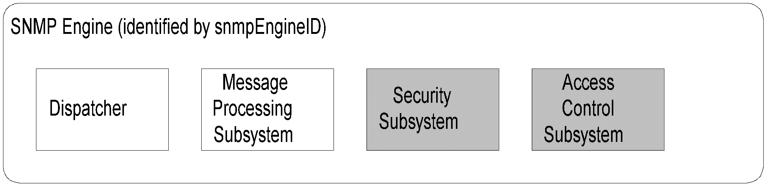
Chapter 7 SNMP Management: SNMPv3
Security and Access Control
  Notes
Security at the message level
  Authentication
  Privacy of message via secure communication
Flexible access control
  Who can access
  What can be accessed
  Flexible MIB views
Network Management: Principles and Practice
© Mani Subramanian 2010
*

Slide 11
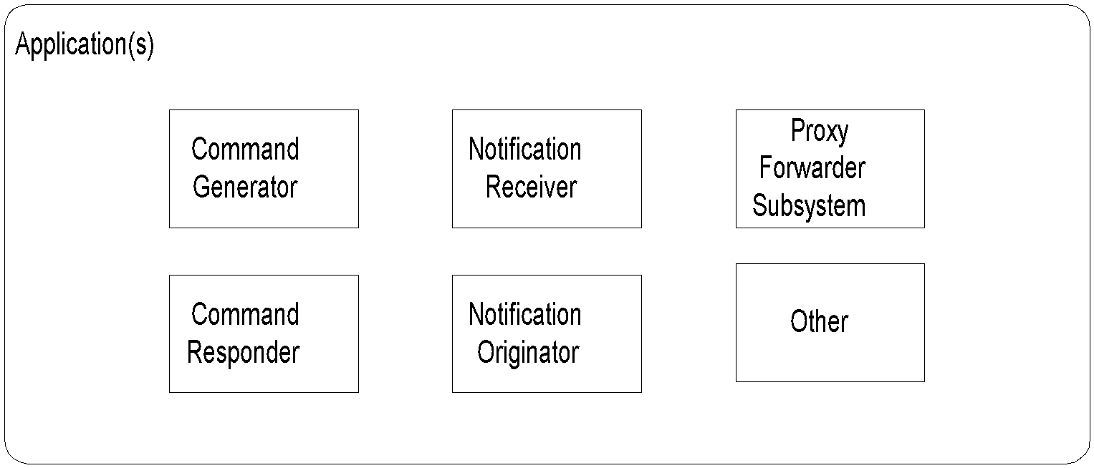
Chapter 7 SNMP Management: SNMPv3
Applications
  Notes
Application Example
Command generator get-request
Command responder get-response
Notification originator trap generation
Notification receiver trap processing
Proxy Forwarder get-bulk to get-next
(SNMP versions only)
Other Special application
Network Management: Principles and Practice
© Mani Subramanian 2010
*

Slide 12
Chapter 7 SNMP Management: SNMPv3
Names
SNMP Engine ID snmpEngineID
Principal principal
Who: person or group or application
Security Name securityName
human readable name
Context Engine ID contextEngineID
Context Name contextName
  Notes
An SNMP agent can monitor more than one
network element (context)
Examples:
SNMP Engine ID IP address
Principal John Smith
Security Name Administrator
Principal Li, David, Kristen, Rashmi,
Security Name Operator
Network Management: Principles and Practice
© Mani Subramanian 2010
*

Slide 13
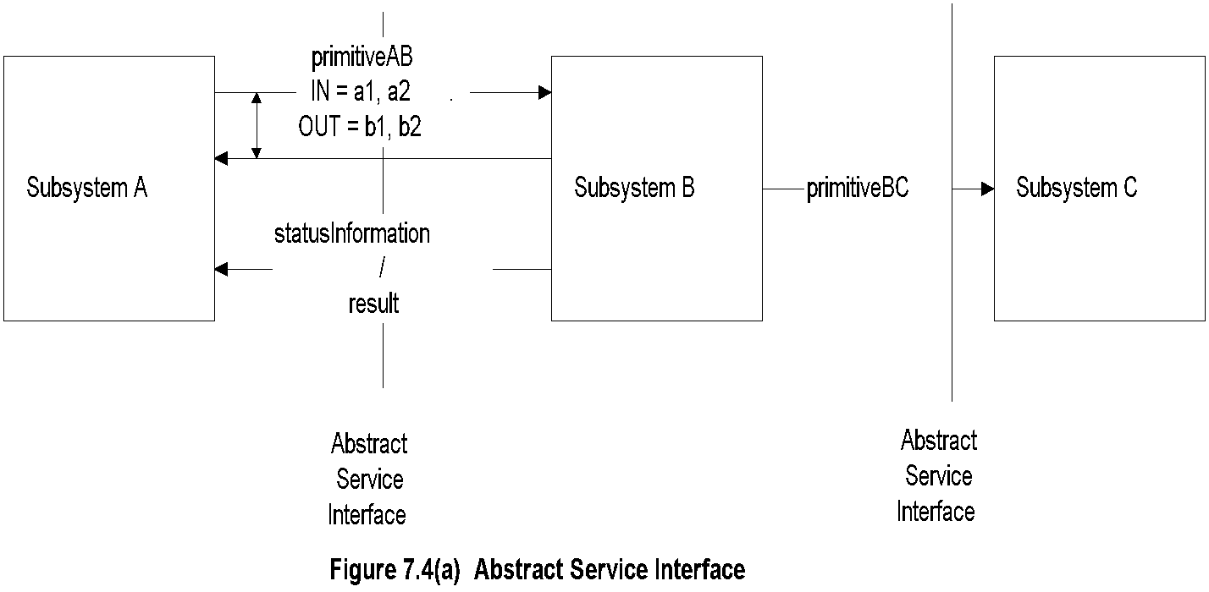
Chapter 7 SNMP Management: SNMPv3
Abstract Service Interface
  Notes
Abstract service interface is a conceptual interface
between modules, independent of implementation
Defines a set of primitives
Primitives associated with receiving entities except
for Dispatcher
Dispatcher primitives associated with
  messages to and from applications
  registering and un-registering of application
  modules
  transmitting to and receiving messages from
  network
IN and OUT parameters
Status information / result
Network Management: Principles and Practice
© Mani Subramanian 2010
*

Slide 14
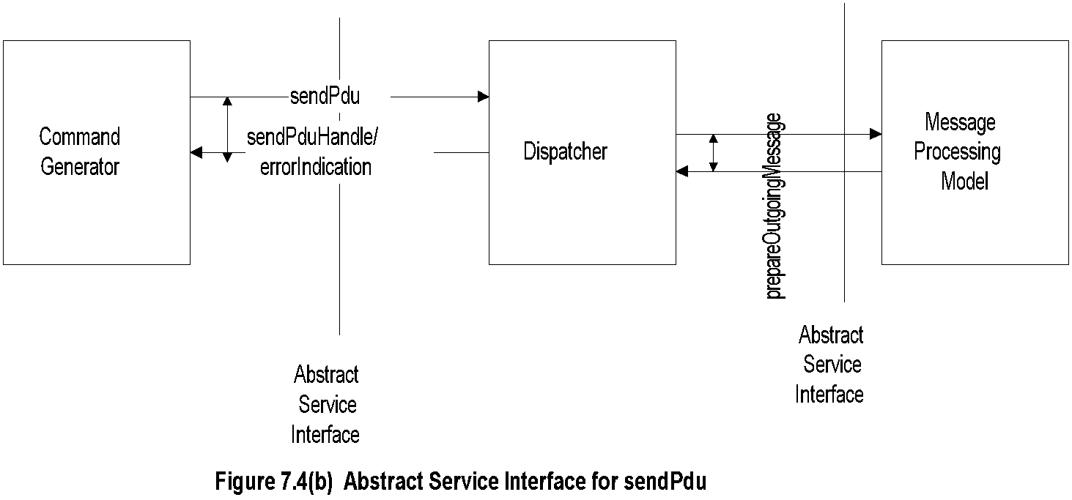
Chapter 7 SNMP Management: SNMPv3
sendPDU Primitive
  Notes
sendPdu request sent by the application module,
command generator, is associated with the
receiving module, dispatcher
After the message is transmitted over the network,
dispatcher sends a handle to the command generator
for tracking the response
sendPdu is the IN parameter
sendPduHandle is the OUT parameter, shown as
coupled to the IN parameter
Network Management: Principles and Practice
© Mani Subramanian 2010
*

Slide 15
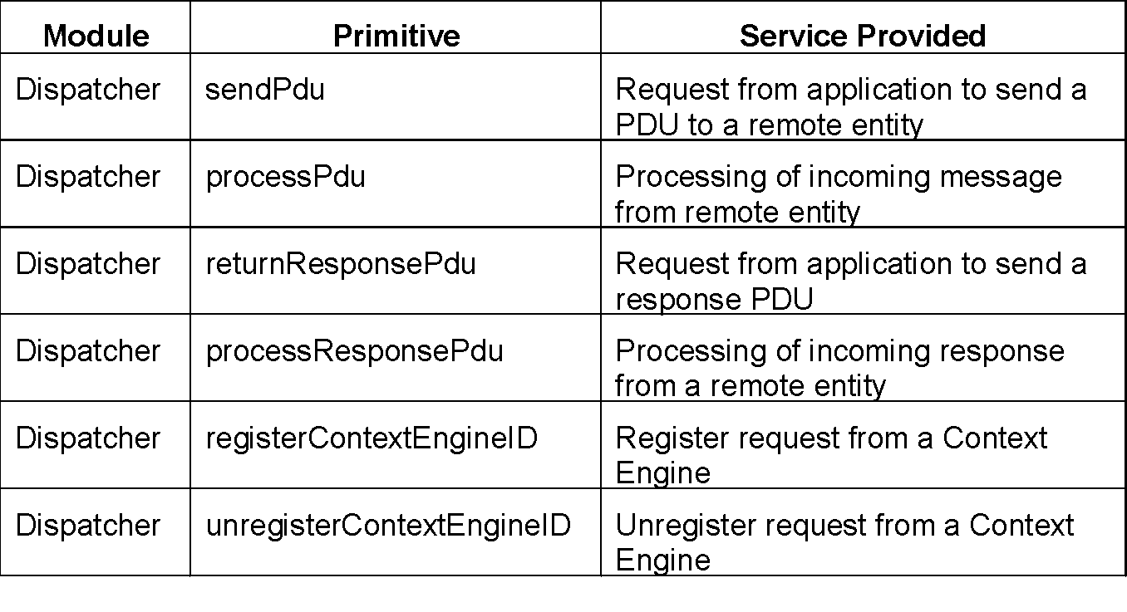
Chapter 7 SNMP Management: SNMPv3
Dispatcher Primitives
  Notes
Network Management: Principles and Practice
© Mani Subramanian 2010
*

Slide 16
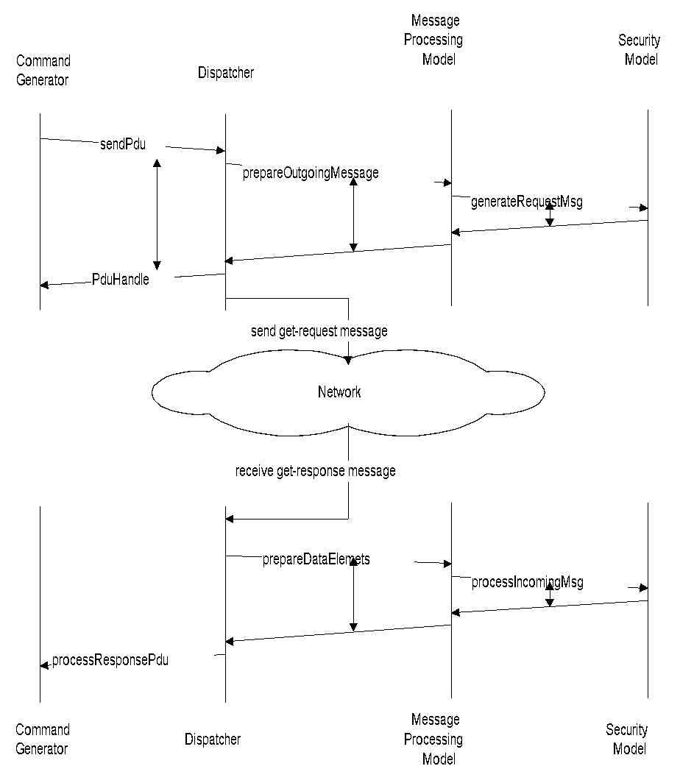
Chapter 7 SNMP Management: SNMPv3
Command Generator
Figure 7.5 Command Generator Application
Network Management: Principles and Practice
© Mani Subramanian 2010
*

Slide 17
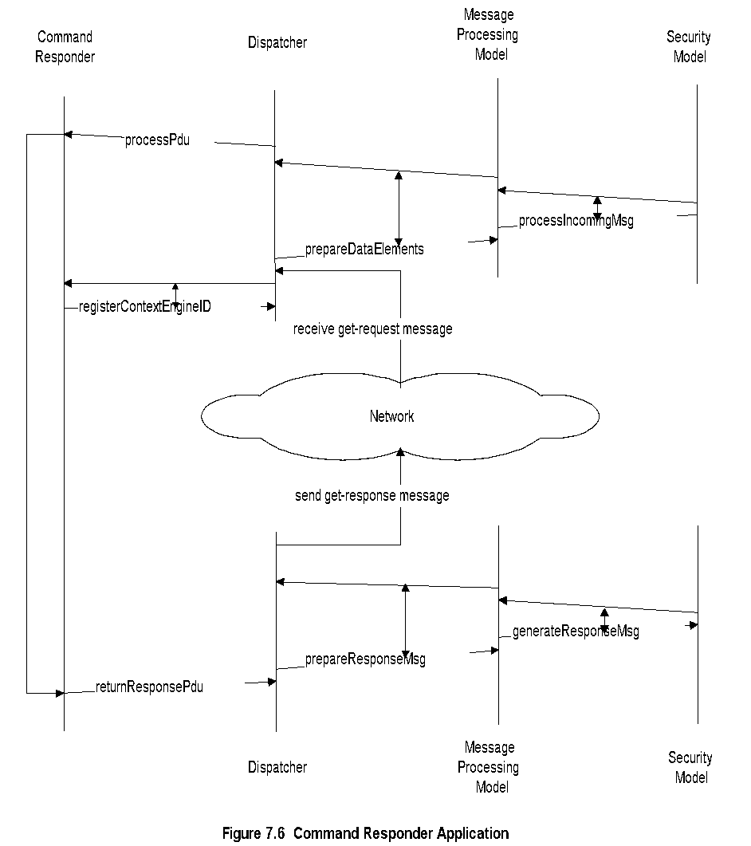
Chapter 7 SNMP Management: SNMPv3
Command Responder
Network Management: Principles and Practice
© Mani Subramanian 2010
*

Slide 18
Chapter 7 SNMP Management: SNMPv3
Notification / Proxy
Notification originator
  Generates trap and inform messages
  Determines target, SNMP version, and security
  Decides context information
Notification receiver
  Registers with SNMP engine
  Receives notification messages
Proxy forwarder
  Proxy server
  Handles only SNMP messages by
    Command generator
    Command responder
    Notification generator
    Report indicator
  Uses the translation table in the proxy group MIB
  Notes
Network Management: Principles and Practice
© Mani Subramanian 2010
*

Slide 19
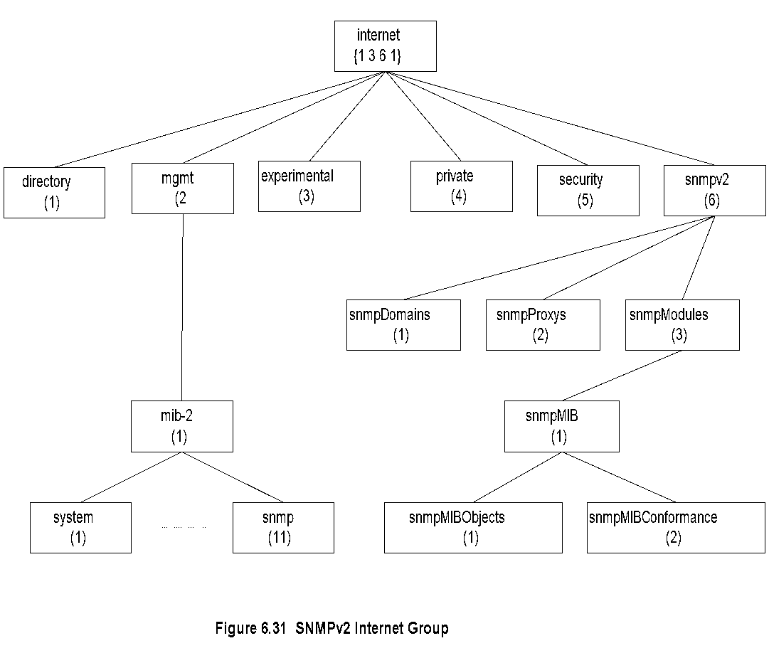
Chapter 7 SNMP Management: SNMPv3
SNMpV2 MIB
  Notes
SNMPv3 MIB developed under snmpModules
Security placeholder not used
Network Management: Principles and Practice
© Mani Subramanian 2010
*

Slide 20
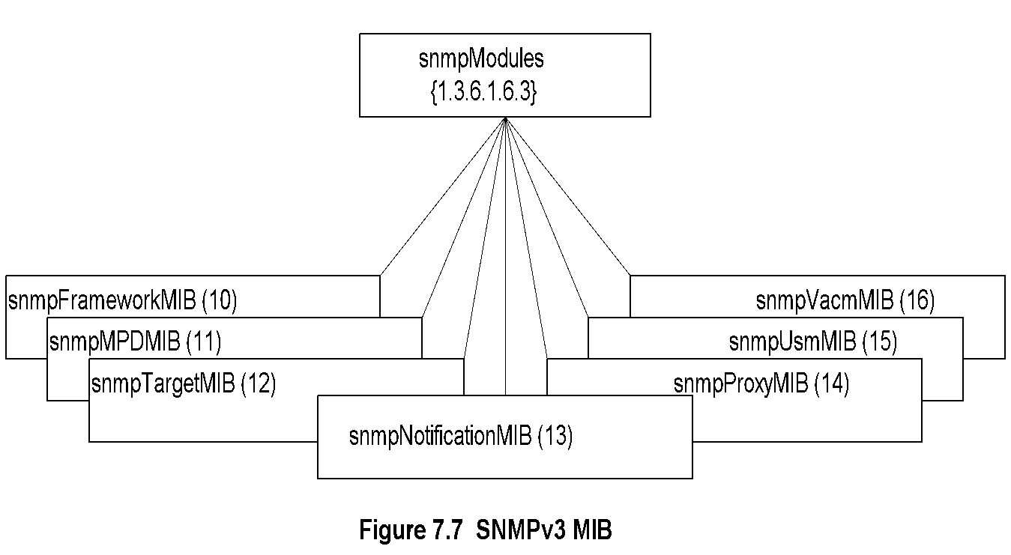
Chapter 7 SNMP Management: SNMPv3
SNMPv3 MIB
  Notes
snmpFrameworkMIB describes SNMP
management architecture
snmpMPDMIB identifies objects in the message
processing and dispatch subsystems
snmpTargetMIB and snmpNotificationMIB used
for notification generation
snmpProxyMIB defines translation table for proxy
forwarding
snmpUsm MIB defines user-based security model
objects
snmpVacmMIB defines objects for view-based
access control
Network Management: Principles and Practice
© Mani Subramanian 2010
*

Slide 21
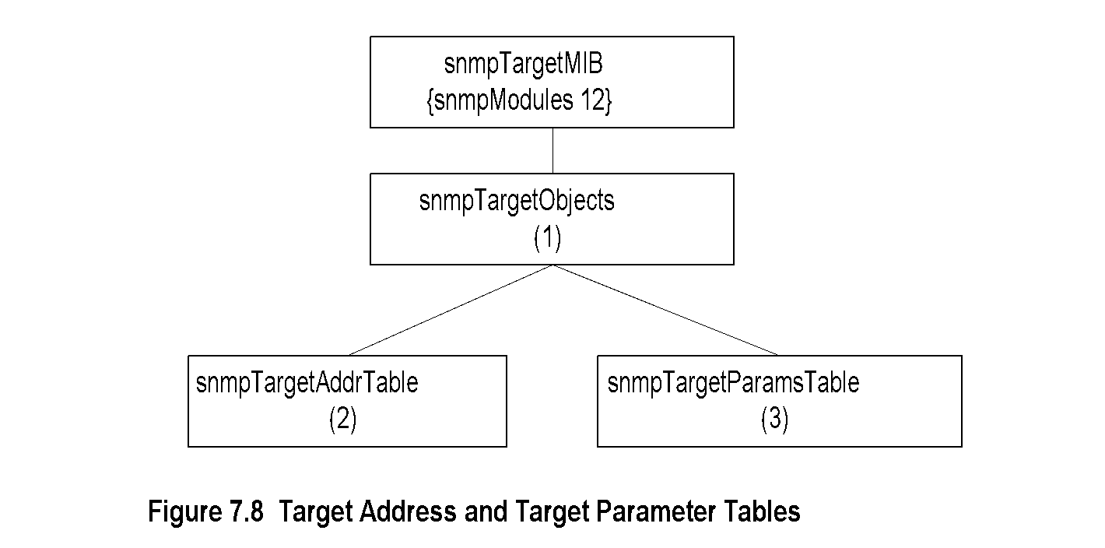
Chapter 7 SNMP Management: SNMPv3
SNMPv3 Target MIB
  Notes
Target MIB contains two tables
Target address table contains addresses of the
targets for notifications (see notification group)
Target address table also contains information for
establishing the transport parameters
Target address table contains reference to the
second table, target parameter table
Target parameter table contains security parameters
for authentication and privacy
Network Management: Principles and Practice
© Mani Subramanian 2010
*

Slide 22
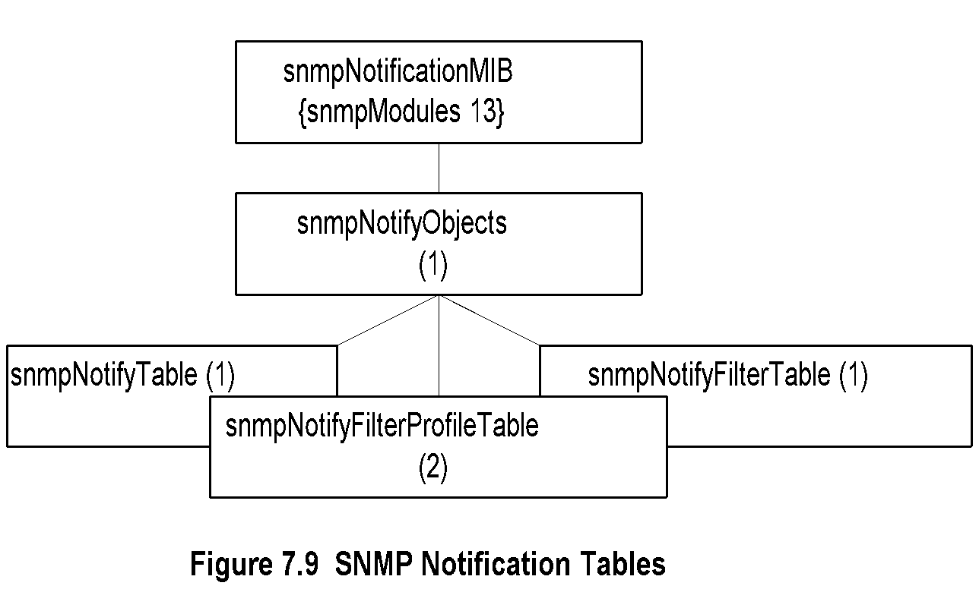
Chapter 7 SNMP Management: SNMPv3
SNMPv3 Notification MIB
  Notes
Notification group contains three tables
Notify table contains groups of management targets
to receive notifications and the type of notifications
The target addresses to receive notifications that
are listed in target address table (see target group)
are tagged here
Notification profile table defines filter profiles
associated with target parameters
Notification filter table contains table profiles of the
targets
Network Management: Principles and Practice
© Mani Subramanian 2010
*

Slide 23
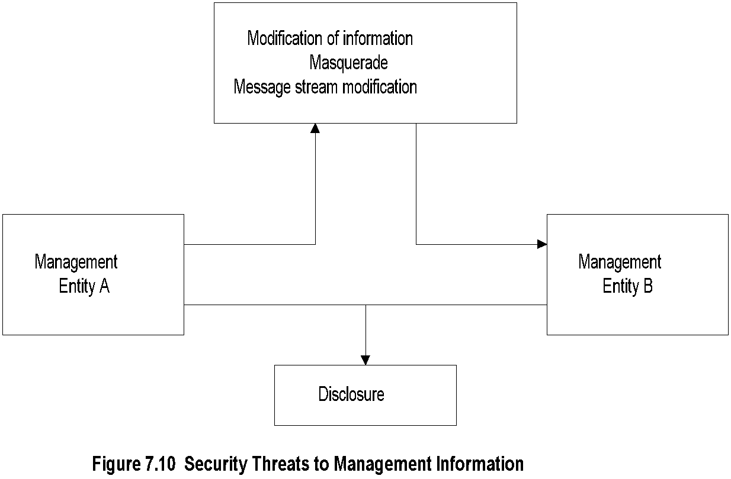
Chapter 7 SNMP Management: SNMPv3
Security Threats
  Notes
Modification of information: Contents modified by
unauthorized user, does not include address change
Masquerade: change of originating address by
unauthorized user
Fragments of message altered by an unauthorized
user to modify the meaning of the message
Disclosure is eavesdropping
Disclosure does not require interception of message
Denial of service and traffic analysis are not con-
sidered as threats
Network Management: Principles and Practice
© Mani Subramanian 2010
*

Slide 24
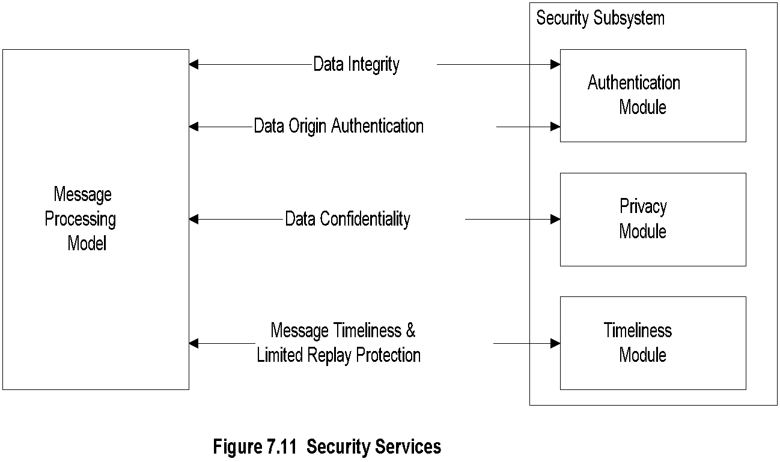
Chapter 7 SNMP Management: SNMPv3
Security Services
  Notes
Authentication
  Data integrity:
    HMAC-MD5-96 / HMAC-SHA-96
  Data origin authentication
    Append to the message a unique Identifier
    associated with authoritative SNMP engine
Privacy / confidentiality:
  Encryption
Timeliness:
  Authoritative Engine ID, no. of engine boots
  and time in seconds
Network Management: Principles and Practice
© Mani Subramanian 2010
*

Slide 25
Chapter 7 SNMP Management: SNMPv3
Role of SNMP Engines
Non-Authoritative Engine
(NMS)
Authoritative Engine
(Agent)
  Notes
Responsibility of Authoritative engine:
  Unique SNMP engine ID
  Time-stamp
Non-authoritative engine should keep a table of the
time-stamp and authoritative engine ID
Network Management: Principles and Practice
© Mani Subramanian 2010
*

Slide 26
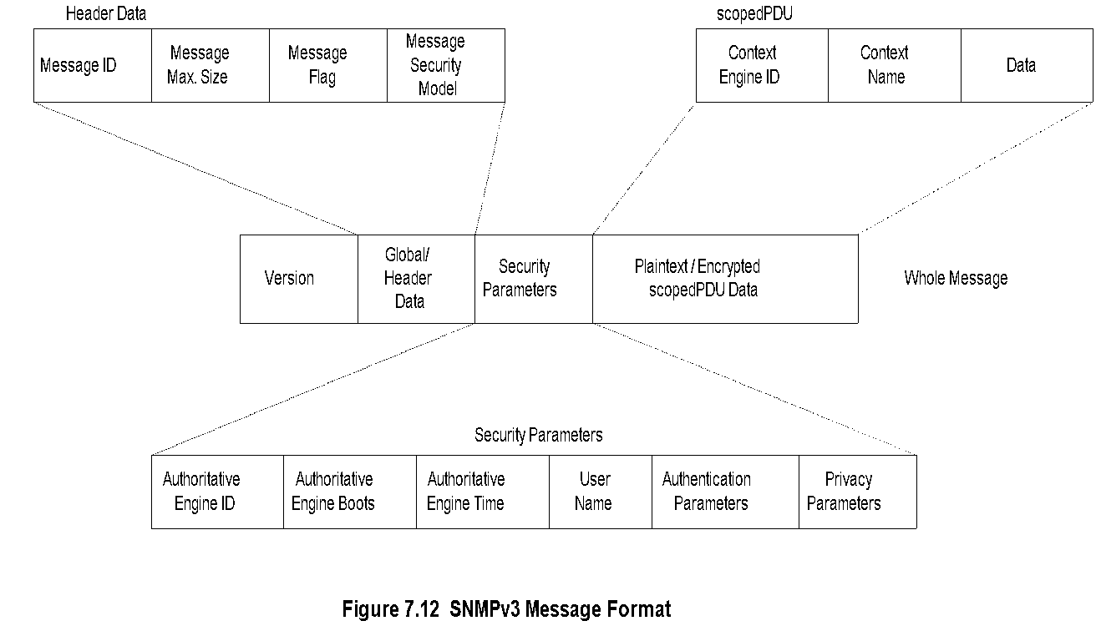
Chapter 7 SNMP Management: SNMPv3
SNMPv3 Message Format
  Notes
Network Management: Principles and Practice
© Mani Subramanian 2010
*

Slide 27
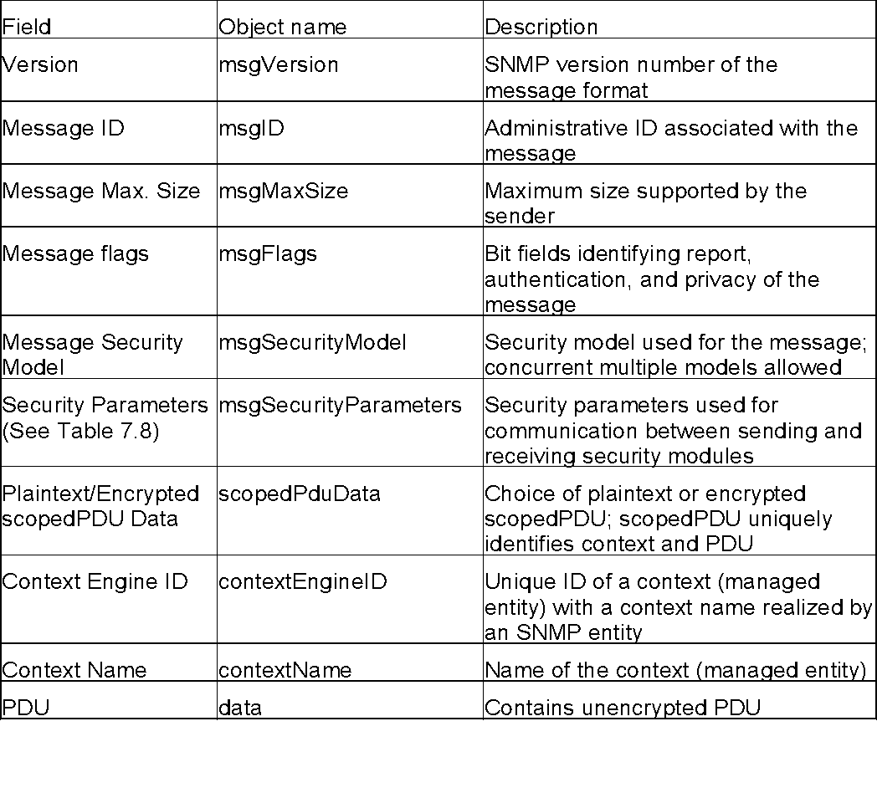
Chapter 7 SNMP Management: SNMPv3
SNMPv3 Message Format
Table 7.7 SNMPv3 Message Format
Network Management: Principles and Practice
© Mani Subramanian 2010
*

Slide 28
Chapter 7 SNMP Management: SNMPv3
User-based Security Model
Based on traditional user name concept
USM primitives across abstract service interfaces
  Authentication service primitives
    authenticateOutgoingMsg
    authenticateIncomingMsg
  Privacy Services
    encryptData
    decryptData
  Notes
Network Management: Principles and Practice
© Mani Subramanian 2010
*

Slide 29
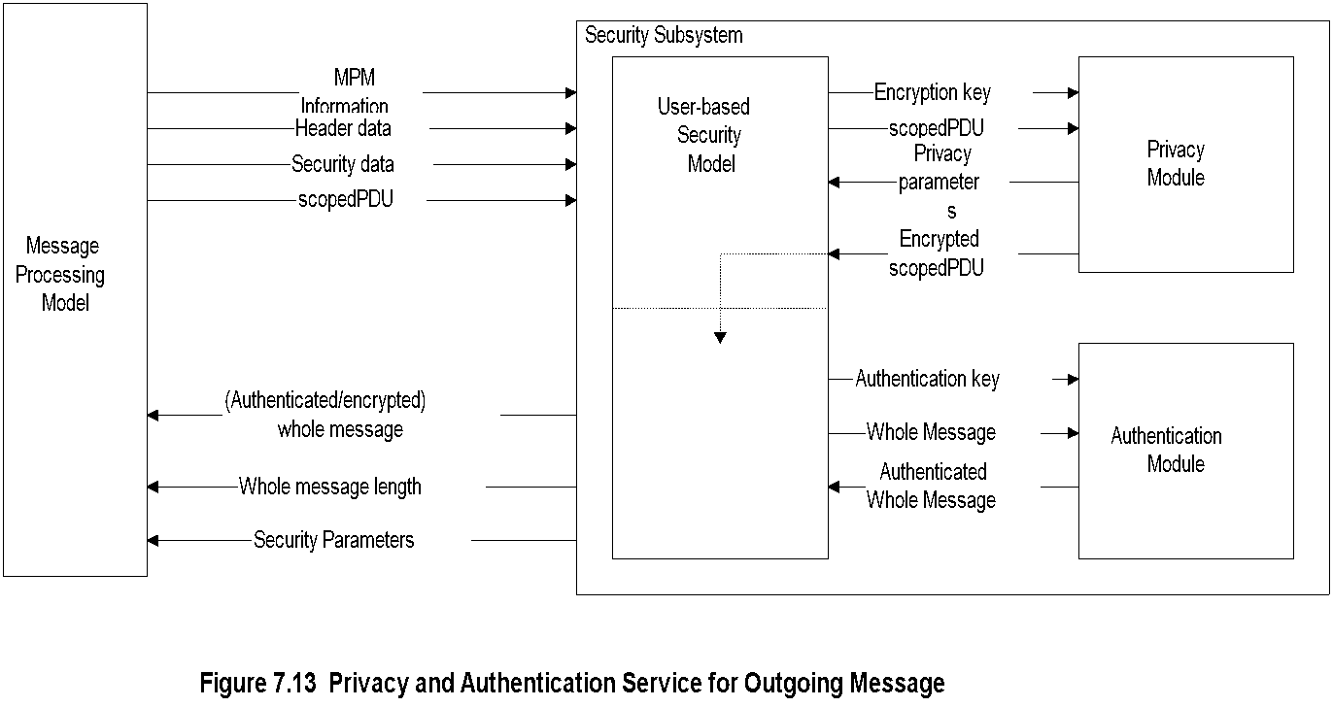
Chapter 7 SNMP Management: SNMPv3
Secure Outgoing Message
  Notes
USM invokes privacy module w/ encryption key
and scopedPDU
Privacy module returns privacy parameters and
encrypted scopedPDU
USM then invokes the authentication module
with authentication key and whole message and
receives authenticated whole message
Network Management: Principles and Practice
© Mani Subramanian 2010
*

Slide 30
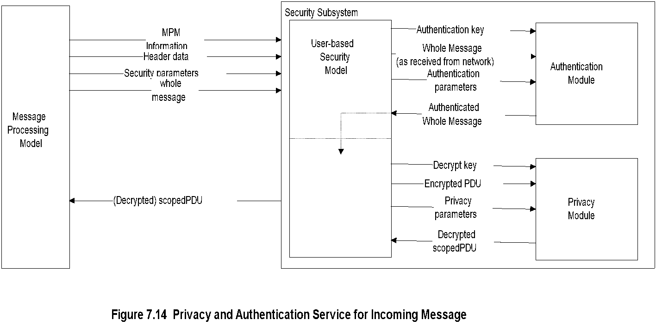
Chapter 7 SNMP Management: SNMPv3
Secure Incoming Message
  Notes
Processing secure incoming message reverse of
secure outgoing message
Authentication validation done first by the
authentication module
Decryption of the message then done by the
privacy module
Network Management: Principles and Practice
© Mani Subramanian 2010
*

Slide 31
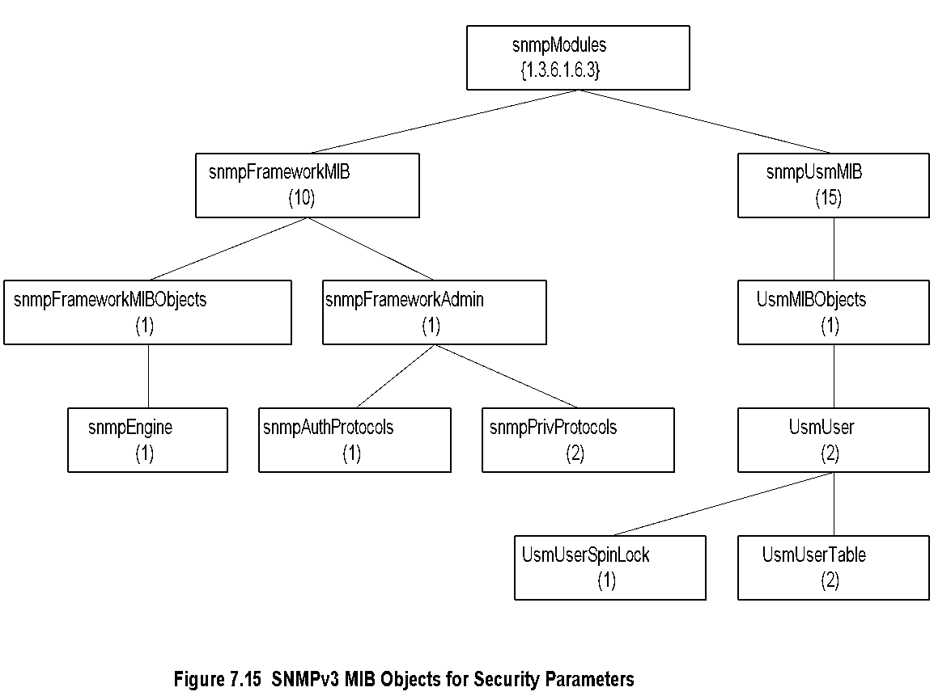
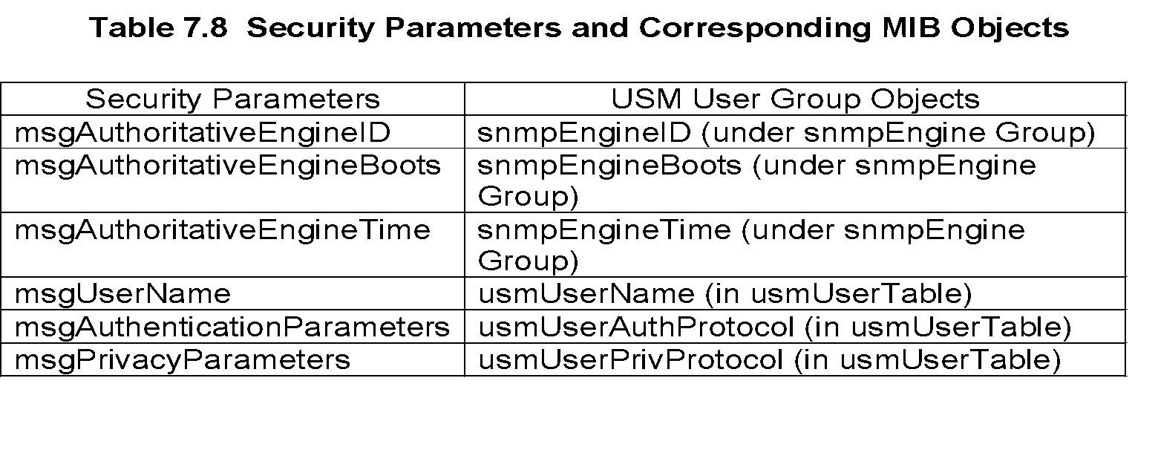
Chapter 7 SNMP Management: SNMPv3
Security Parameters
  Notes
Network Management: Principles and Practice
© Mani Subramanian 2010
*

Slide 32
Chapter 7 SNMP Management: SNMPv3
Privacy Module
Encryption and decryption of scoped PDU
(context engine ID, context name, and PDU)
CBC - DES (Cipher Block Chaining - Data
Encryption Standard) symmetric protocol
Encryption key (and initialization vector)
made up of secret key (user password), and
timeliness value
Privacy parameter is salt value (unique for
each packet) in CBC-DES
  Notes
Network Management: Principles and Practice
© Mani Subramanian 2010
*

Slide 33
Chapter 7 SNMP Management: SNMPv3
Authentication Key
Secret key for authentication
Derived from user (NMS) ID and password
MD5 or SHA-1 algorithm used
Authentication key is digest2
  Notes
Procedure:
1. Derive digest0:
Password repeated until it forms 2²⁰ octets.
2. Derive digest1:
Hash digest0 using MD5 or SHA-1.
3. Derive digest2:
Concatenate authoritative SNMP engine ID and
digest1 and hash with the same algorithm
Network Management: Principles and Practice
© Mani Subramanian 2010
*

Slide 34
Chapter 7 SNMP Management: SNMPv3
Authentication Parameters
Authentication parameter is Hashed Message
Access Code (HMAC)
HMAC is 96-bit long (12 octets)
Derived from authentication key (authKey)
  Notes
Procedure:
1. Derive extendedAuthKey:
Supplement authKey with 0s to get 64-byte string
2. Define ipad, opad, K1, and K2:
ipad = 0x36 (00110110) repeated 64 times
opad = 0x5c (01011100) repeated 64 times
K1 = extendedAuthKey XOR ipad
K2 = extendedAuthKey XOR opad
3. Derive HMAC by hashing algorithm used
HMAC = H (K2, H (K1, wholeMsg))
Network Management: Principles and Practice
© Mani Subramanian 2010
*

Slide 35
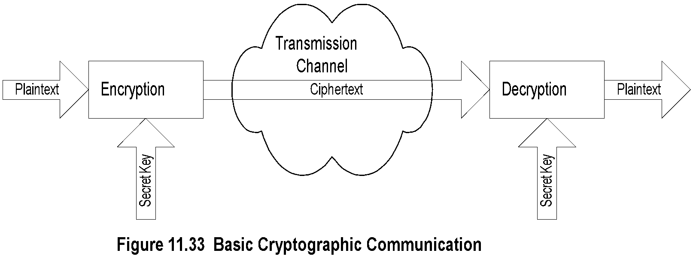
Chapter 7 SNMP Management: SNMPv3
Encryption Protocol
Cipher Block Chaining mode of
Data Encryption Standard (CBC-DES) protocol
16-octet privKey is secret key
First 8-octet of privKey used as 56-bit DES key;
(Only 7 high-order bits of each octet used)
Last 8-octet of privKey used as pre-initialization vector
  Notes
CBC Mode
  Plaintext divided into 64-bit blocks
  Each block is XOR-d with ciphertext of the
  previous block and then encrypted
  Use pre-IV (initialization vector) for prefixing
  the first message block
Network Management: Principles and Practice
© Mani Subramanian 2010
*

Slide 36
Chapter 7 SNMP Management: SNMPv3
Access Control
View-based Access Control Model
  Groups: Name of the group comprising
  security model and security name:
  In SNMPv1, is community name
  Security Level
    no authentication - no privacy
    authentication - no privacy
    authentication - privacy
  Contexts: Names of the context
  MIB Views and View Families
    MIB view is a combination of view subtrees
  Access Policy
    read-view
    write-view
    notify-view
    not-accessible
  Notes
Network Management: Principles and Practice
© Mani Subramanian 2010
*

Slide 37
Chapter 7 SNMP Management: SNMPv3
VCAM Process
Answers 6 questions:
1. Who are you (group)?
2. Where do you want to go (context)?
3. How secured are you to access the information
(security model and security level)?
4. Why do you want to access the information
(read, write, or send notification)?
5. What object (object type) do you want to
access?
6. Which object (object instance) do you want to
access?
  Notes
Network Management: Principles and Practice
© Mani Subramanian 2010
*

Slide 38
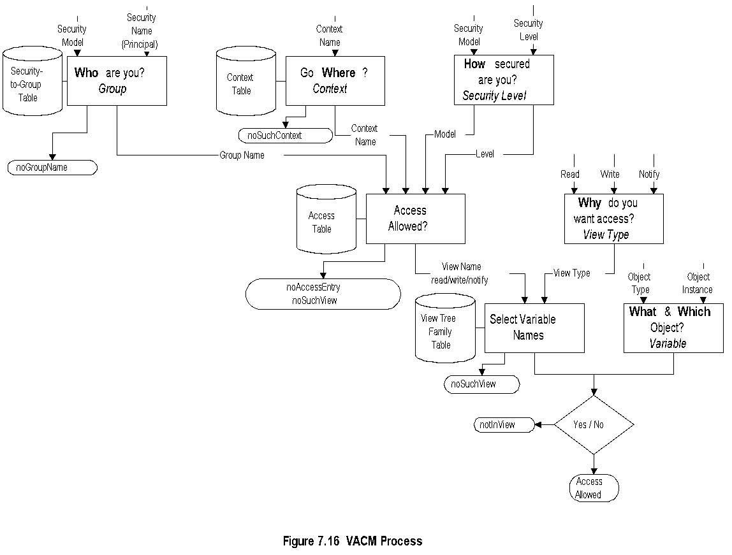
Chapter 7 SNMP Management: SNMPv3
VCAM Process
  Notes
Network Management: Principles and Practice
© Mani Subramanian 2010
*

Slide 39
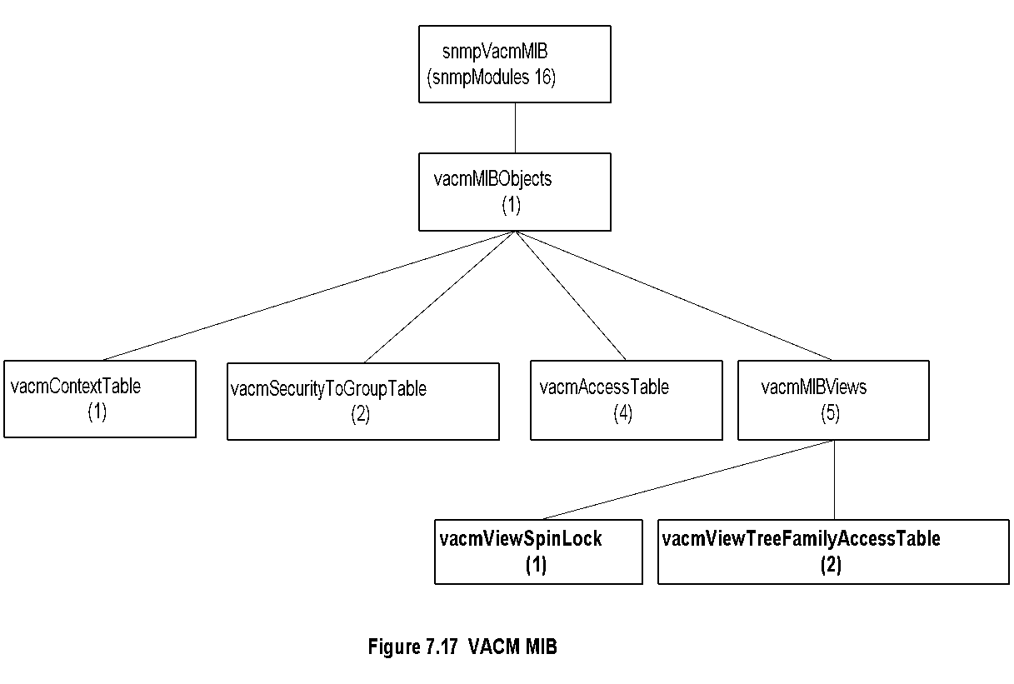
Chapter 7 SNMP Management: SNMPv3
VACM MIB
  Notes
Four tables used to achieve access control:
  Group defined by security-to-group table
  Context defined by context table
  Access determines access allowed and the
  view name
  View tree family table determines the MIB view,
  which is very flexible
Network Management: Principles and Practice
© Mani Subramanian 2010
*

Slide 40
Chapter 7 SNMP Management: SNMPv3
MIB Views
Simple view:
  system 1.3.6.1.2.1.1
Complex view:
  All information relevant to a particular interface –
  system and interfaces groups
Family view subtrees
  View with all columnar objects in a row
  appear as separate subtree.
  OBJECT IDENTIFIER (family name)
paired with bit-string value (family mask)
to select or suppress columnar objects
  Notes
Network Management: Principles and Practice
© Mani Subramanian 2010
*

Slide 41
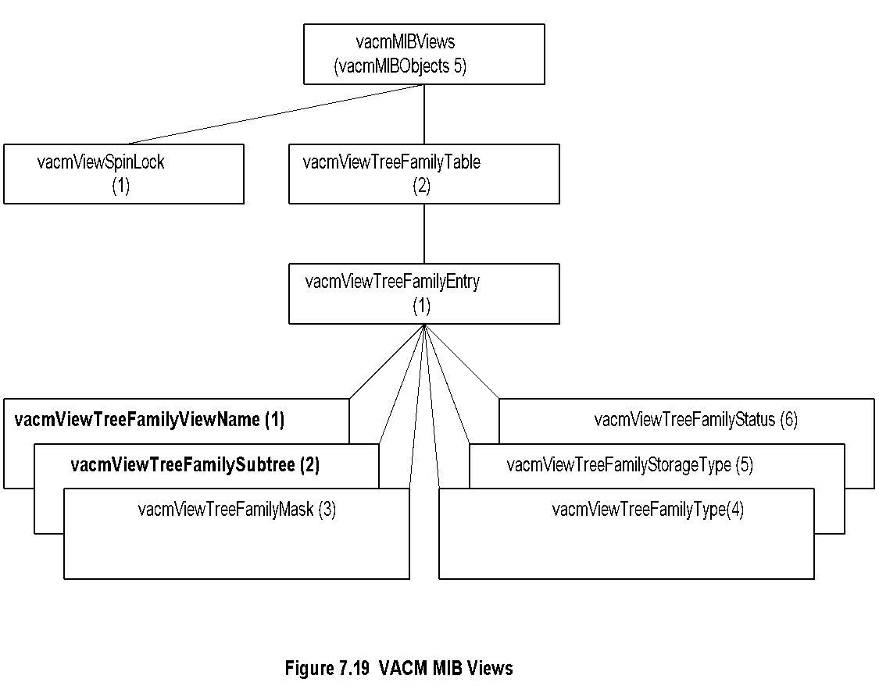
Chapter 7 SNMP Management: SNMPv3
VACM MIB View
  Notes
Example:
Family view name = “system”
Family subtree = 1.3.6.1.2.1.1
Family mask = “” (implies all 1s by convention)
Family type = 1 (implies value to be included)
Network Management: Principles and Practice
© Mani Subramanian 2010
*

