Slide 1
Chapter 6 SNMP Management: SNMPv2
Chapter 6
SNMP Management:
SNMPv2
Network Management: Principles and Practice
© Mani Subramanian 2010
*

Slide 2
Objectives
Chapter 6 SNMP Management: SNMPv2
Community-based security
SNMPv2 enhancements
Additional messages
Formalization of SMI
Get-bulk request and information-request
SNMP MIB modifications
Incompatibility with SNMPv1
Proxy server
Bilingual manager
Network Management: Principles and Practice
© Mani Subramanian 2010
*

Slide 3
Chapter 6 SNMP Management: SNMPv2
Major Changes
Bulk data transfer
Manager-to-manager message
Enhancements to SMI: SMIv2
Module definitions: MODULE-IDENTITY macro
Object definitions: OBJECT-TYPE macro
Trap definitions: NOTIFICATION-TYPE macro
Textual conventions
Conformance statements
Row creation and deletion in table
MIB enhancements
Transport mappings
Notes
Security features, originally to be in SNMPv2 moved to SNMPv3
SNMPv2, like SNMPv1, is community-based administrative framework
Network Management: Principles and Practice
© Mani Subramanian 2010
*

Slide 4
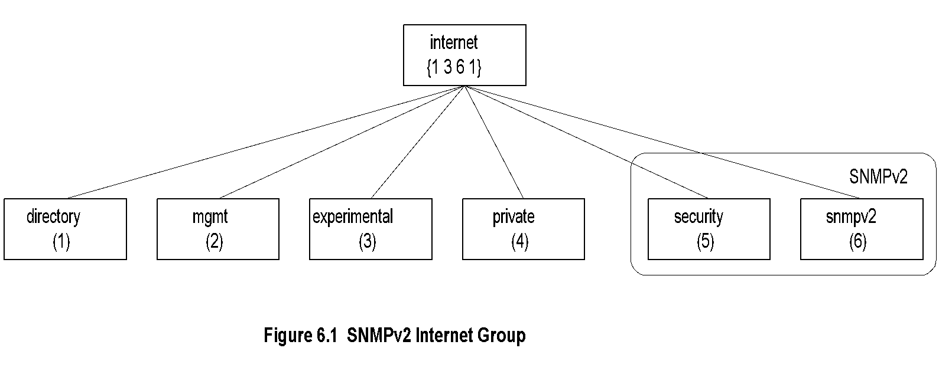
Chapter 6 SNMP Management: SNMPv2
SNMPv2 Internet Group
Notes
Objects added to System group
Extensive modification of the SNMP group
Additional SNMPv2 group added
Security group is a placeholder
Network Management: Principles and Practice
© Mani Subramanian 2010
*

Slide 5
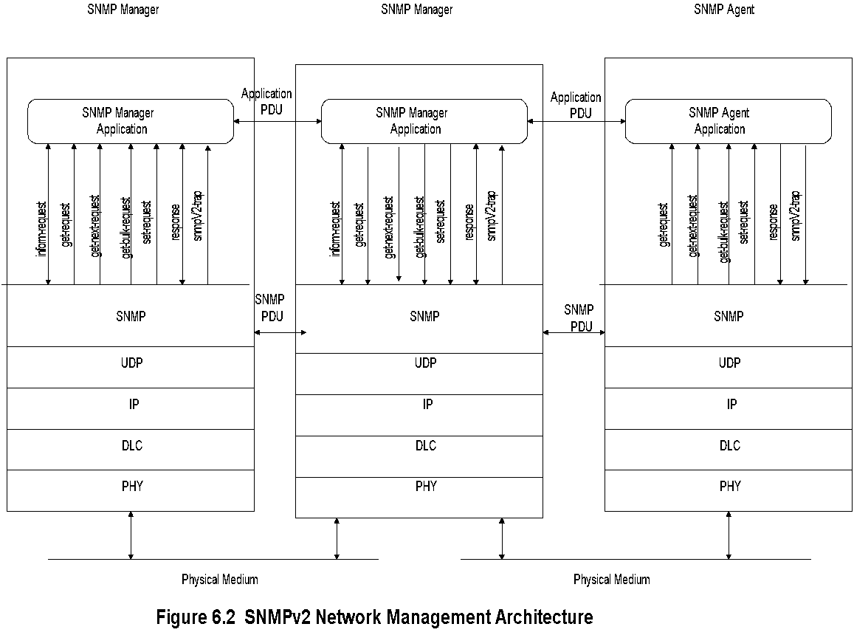
Chapter 6 SNMP Management: SNMPv2
SNMPv2 NM Architecture
Notes
Network Management: Principles and Practice
© Mani Subramanian 2010
*

Slide 6
Chapter 6 SNMP Management: SNMPv2
SNMPv2 New Messages
inform-request
manager-to-manager message
get-bulk-request
transfer of large data
report
not used
Notes
Network Management: Principles and Practice
© Mani Subramanian 2010
*

Slide 7
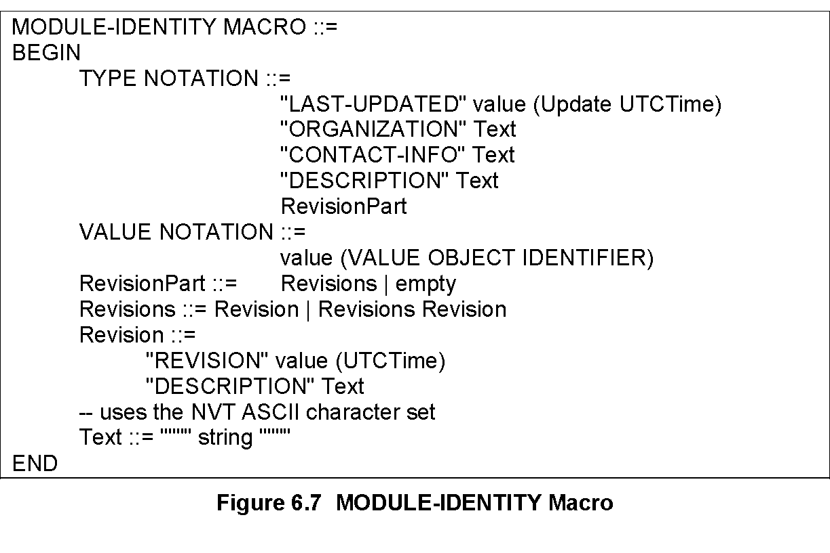
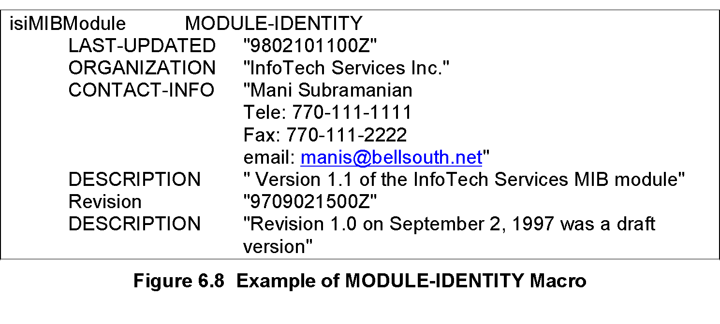
Chapter 6 SNMP Management: SNMPv2
Module Identity Macro
Notes
Module is a group of related assignments
MODULE-IDENTITY macro defines the module definitions
Network Management: Principles and Practice
© Mani Subramanian 2010
*
Notes:
*

Slide 8
Chapter 6 SNMP Management: SNMPv2
OBJECT ??
OBJECT IDENTIFIER defines the administrative identification of a node in the MIB
OBJECT-IDENTITY macro assigns an object identifier to an object identifier in the MIB
OBJECT-TYPE macro defines the type of a managed object
Notes
Network Management: Principles and Practice
© Mani Subramanian 2010
*

Slide 9
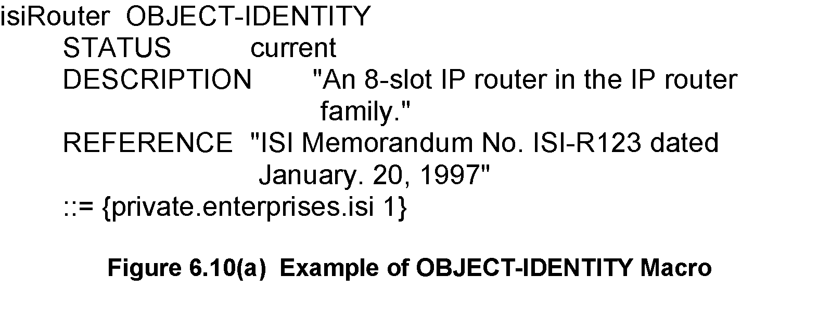
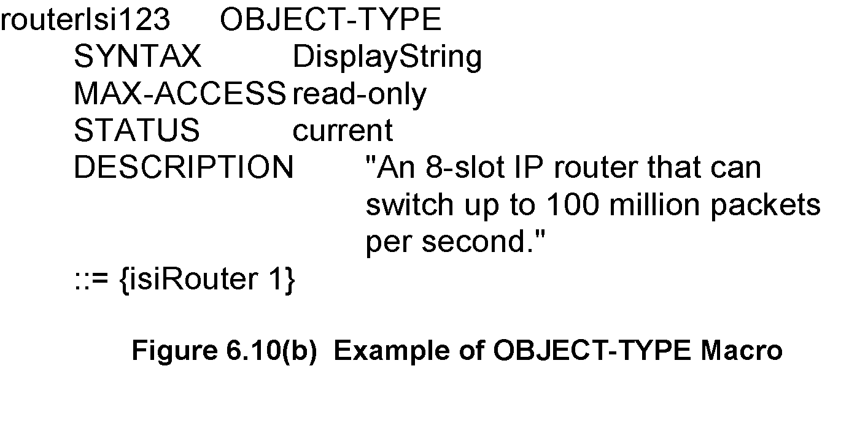
Chapter 6 SNMP Management: SNMPv2
OBJECT-IDENTITY / OBJECT-TYPE
OBJECT-IDENTITY is high level description
OBJECT-TYPE details description needed for implementation
Network Management: Principles and Practice
© Mani Subramanian 2010
*

Slide 10
Chapter 6 SNMP Management: SNMPv2
Table Expansion
Augmentation of a table (dependent table) adds additional columns to an existing table (base table)
Dense table enables addition of more rows to base table
Sparse table supplements less rows to a base table
Notes
Network Management: Principles and Practice
© Mani Subramanian 2010
*

Slide 11
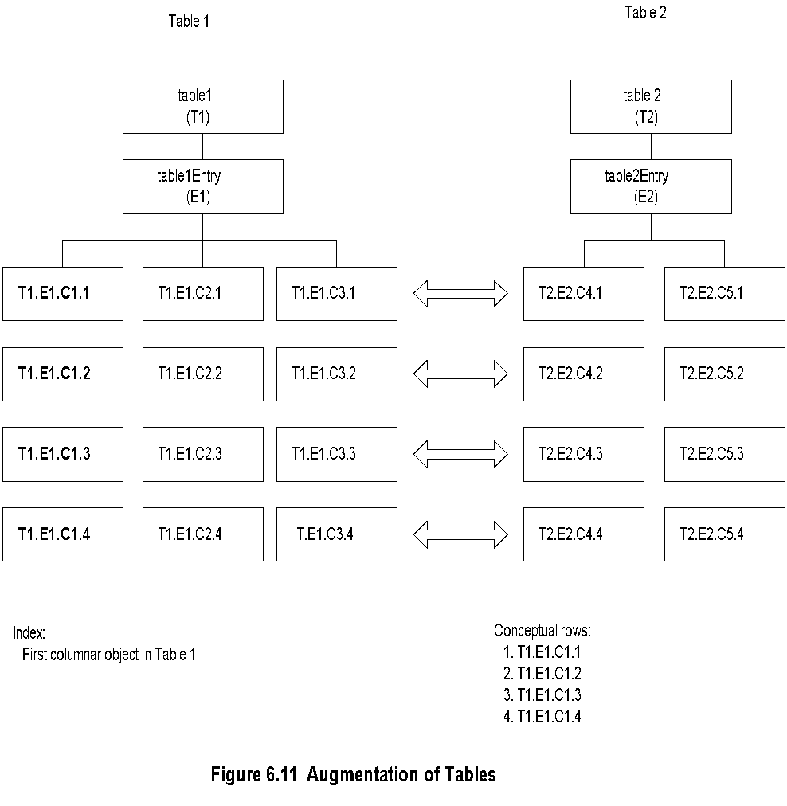
Chapter 6 SNMP Management: SNMPv2
Augmentation of Tables
Network Management: Principles and Practice
© Mani Subramanian 2010
*

Slide 12
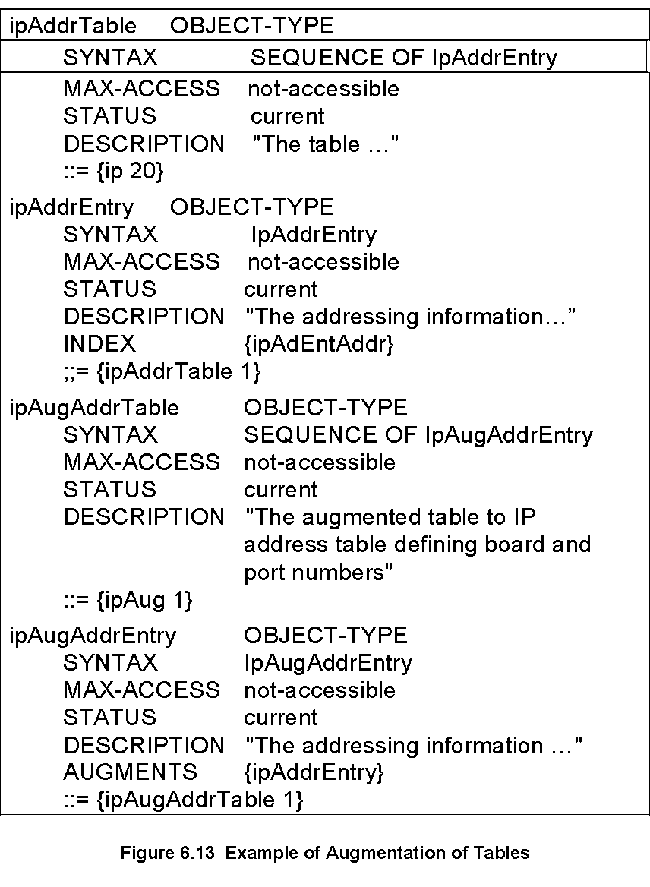
Chapter 6 SNMP Management: SNMPv2
Augmentation of Tables: Example
Network Management: Principles and Practice
© Mani Subramanian 2010
*

Slide 13
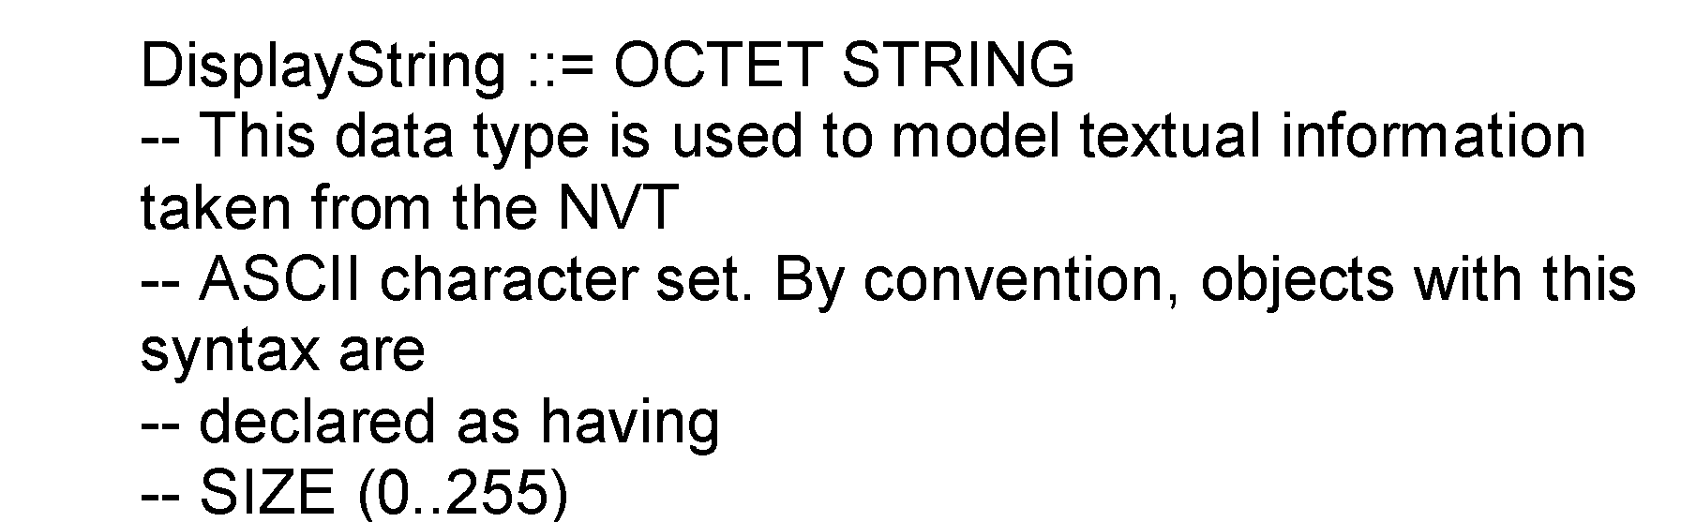
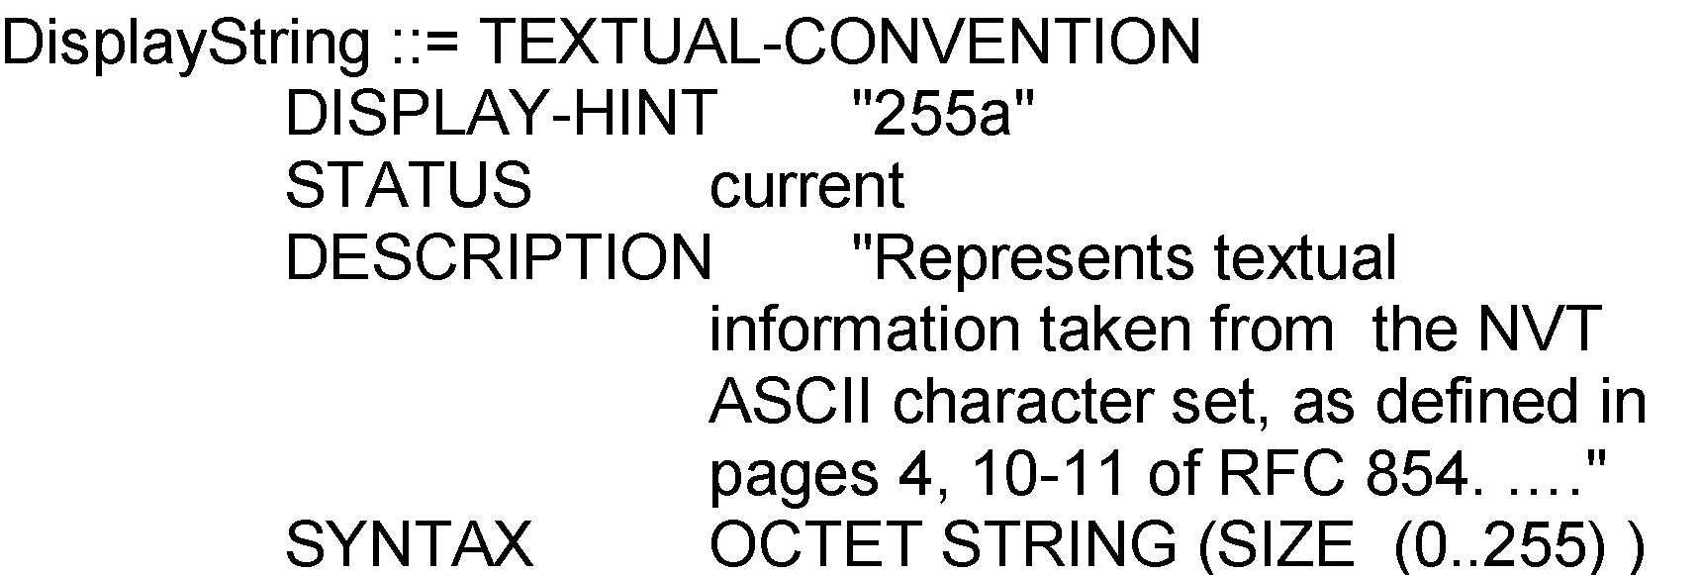
Chapter 6 SNMP Management: SNMPv2
Textual Convention
Enables defining new data types
Makes semantics of data types consistent and human readable
Creates new data types using existing ones and applies restrictions to them
An important textual convention in SNMPv2, RowStatus creates and deletes rows
Notes
SNMPV1:
SNMPv2:
Network Management: Principles and Practice
© Mani Subramanian 2010
*

Slide 14
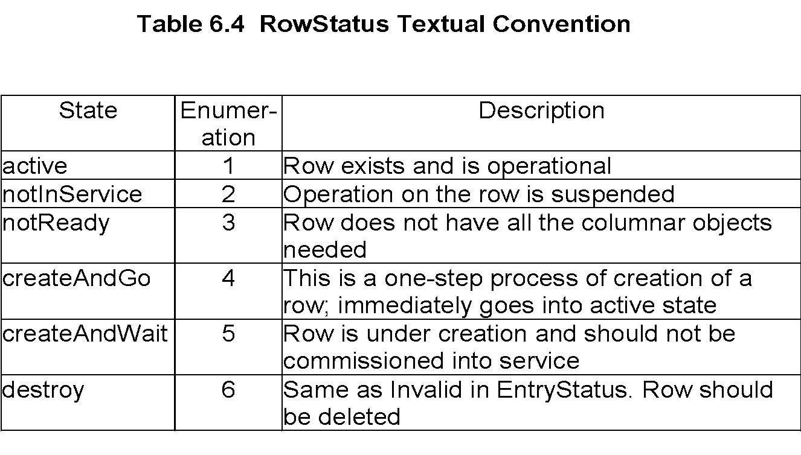
Chapter 6 SNMP Management: SNMPv2
Creation of Row: RowStatus
Notes
Status: A new column is added to the conceptual table
SYNTAX of Status is RowStatus
Value of RowStatus is Enumerated INTEGER
Network Management: Principles and Practice
© Mani Subramanian 2010
*

Slide 15
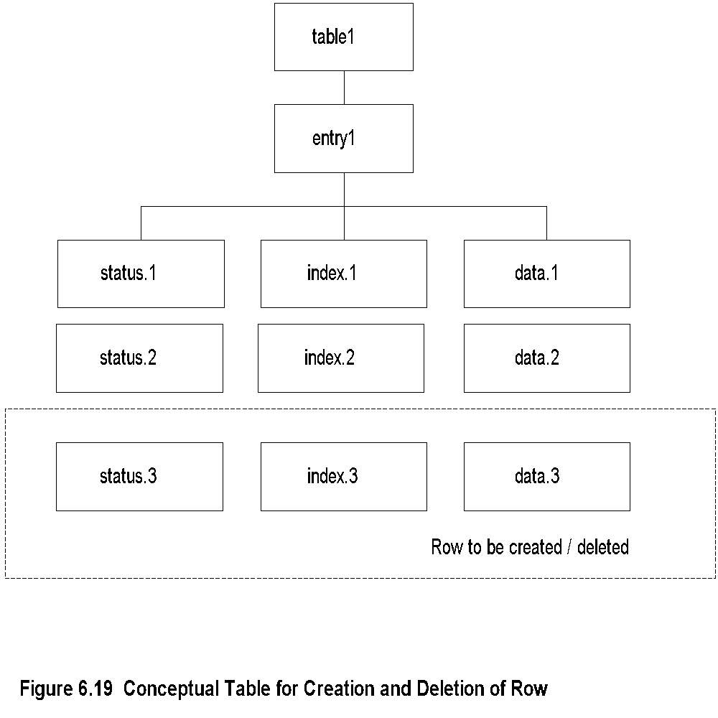
Chapter 6 SNMP Management: SNMPv2
Row Creation and Deletion
Notes
Network Management: Principles and Practice
© Mani Subramanian 2010
*

Slide 16
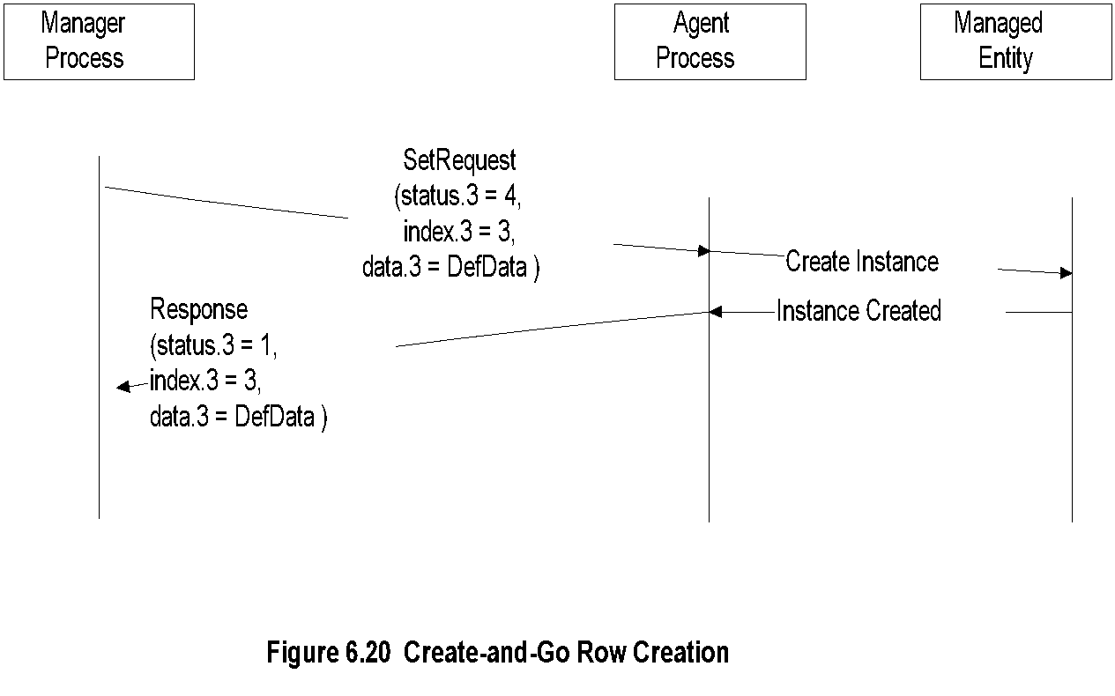
Chapter 6 SNMP Management: SNMPv2
Create-and-Go Row Creation
Network Management: Principles and Practice
© Mani Subramanian 2010
*

Slide 17
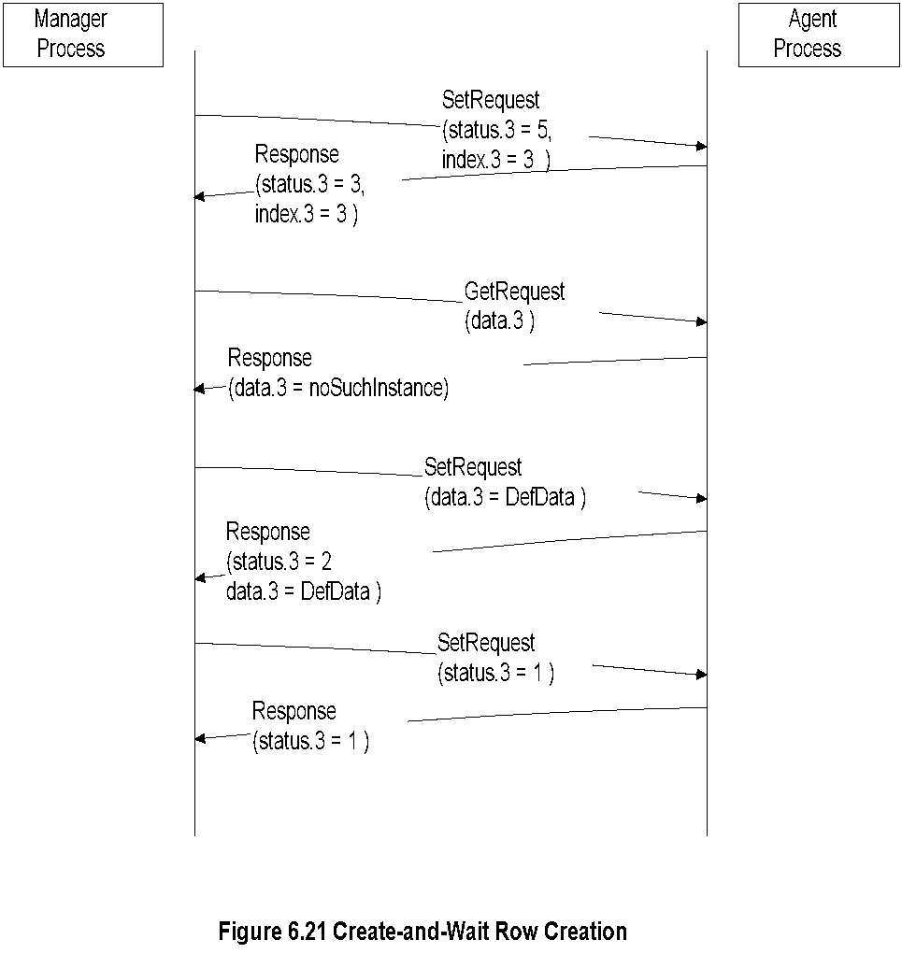
Chapter 6 SNMP Management: SNMPv2
Create-and-Wait:
Row Creation
Network Management: Principles and Practice
© Mani Subramanian 2010
*

Slide 18
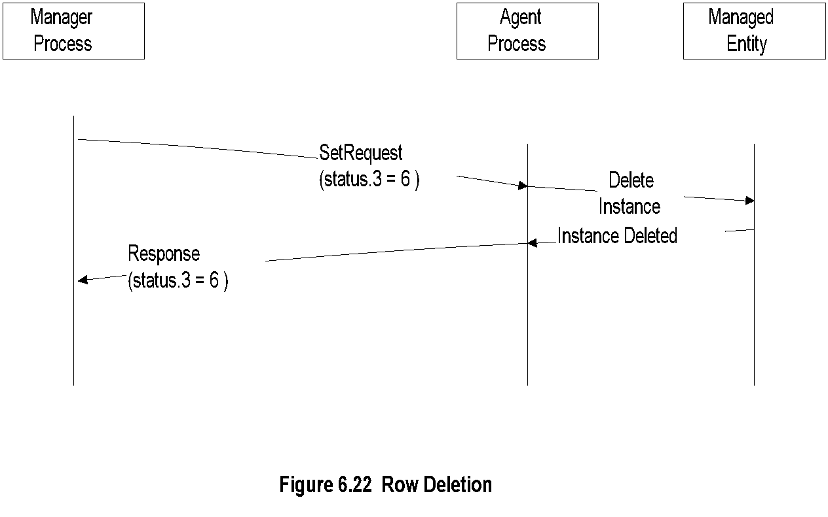
Chapter 6 SNMP Management: SNMPv2
Row Deletion
Network Management: Principles and Practice
© Mani Subramanian 2010
*

Slide 19
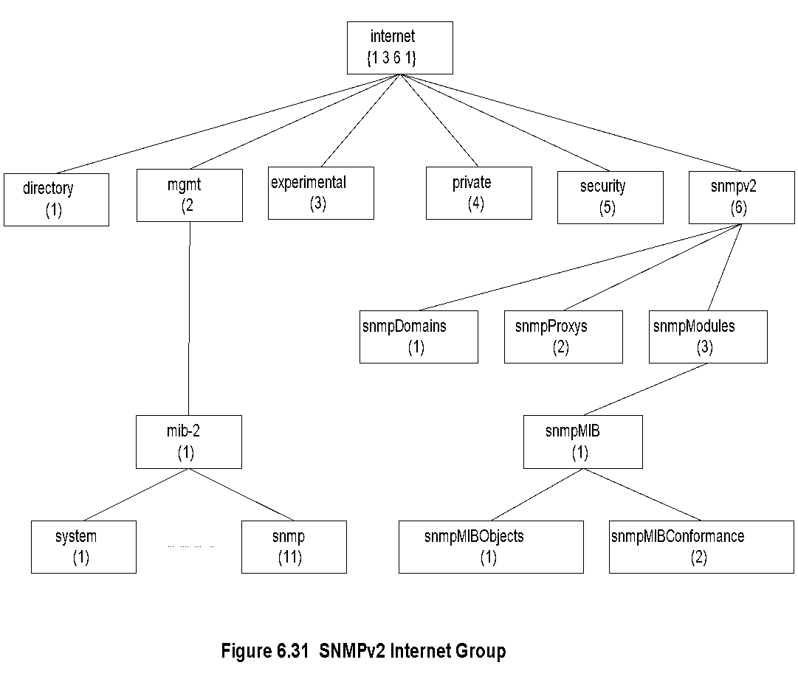
Chapter 6 SNMP Management: SNMPv2
SNMPv2 MIB
Notes
Security is a placeholder
System group: A table sysORTable added that lists resources that the agent controls; NMS configures NE through the agents.
Most of the objects in the SNMPv1 obsoleted
Object Groups and Notification Groups defined for conformance specifications.
Network Management: Principles and Practice
© Mani Subramanian 2010
*

Slide 20
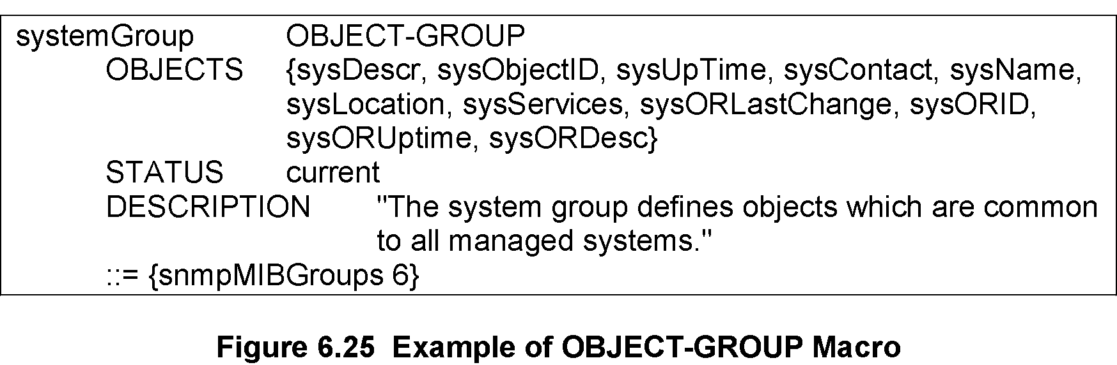
Chapter 6 SNMP Management: SNMPv2
Conformance: OBJECT-GROUP
Conformance defined by
OBJECT-GROUP macro
NOTIFICATION-GROUP macro
OBJECT-GROUP
Compiled during implementation, not at run time
OBJECTS clause names each object
Every object belongs to an OBJECT- GROUP
Access defined by MAX-ACCESS, the maximum access privilege for the object
Notes
Network Management: Principles and Practice
© Mani Subramanian 2010
*

Slide 21
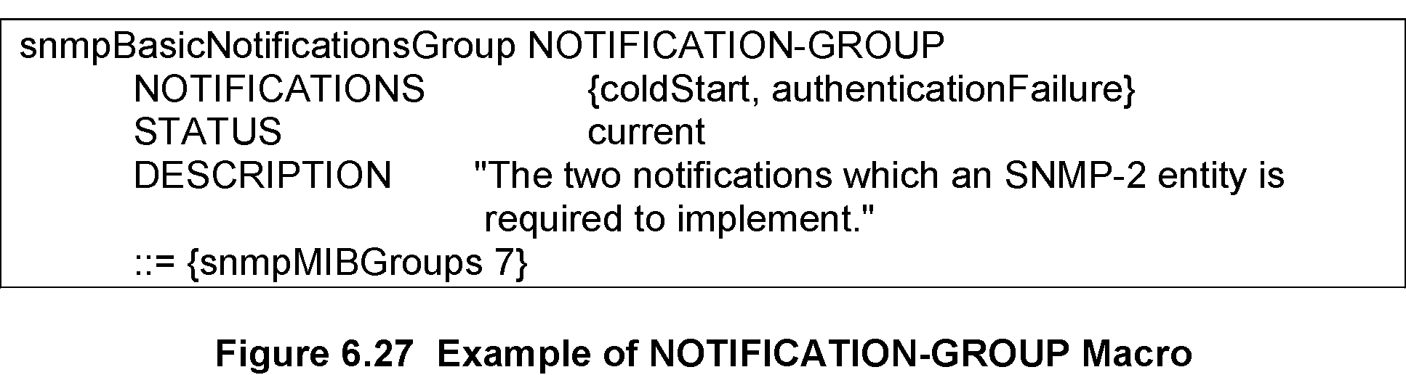
Chapter 6 SNMP Management: SNMPv2
Conformance: NOTIFICATION-GROUP
NOTIFICATION-GROUP
Contains trap entities defined in SMIv1
NOTIFICATIONS clause identifies the notifications in the group
NOTIFICATIONS-GROUP macro compiled during implementation, not at run time
Notes
Network Management: Principles and Practice
© Mani Subramanian 2010
*

Slide 22
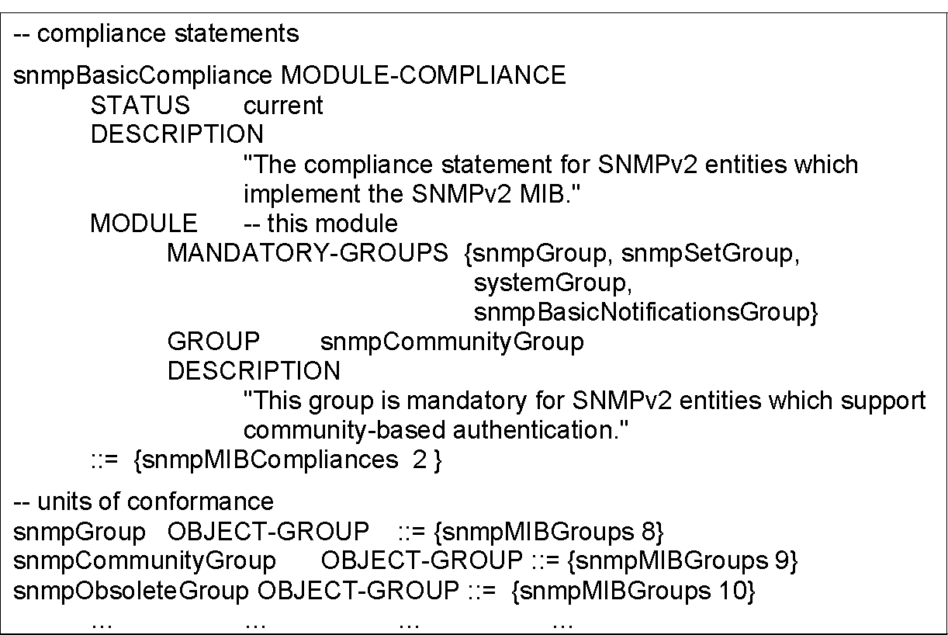
Chapter 6 SNMP Management: SNMPv2
Compliance
Compliance has two classes of groups
MANDATORY-GROUPS ... Required
GROUP …Optional
Notes
Network Management: Principles and Practice
© Mani Subramanian 2010
*

Slide 23
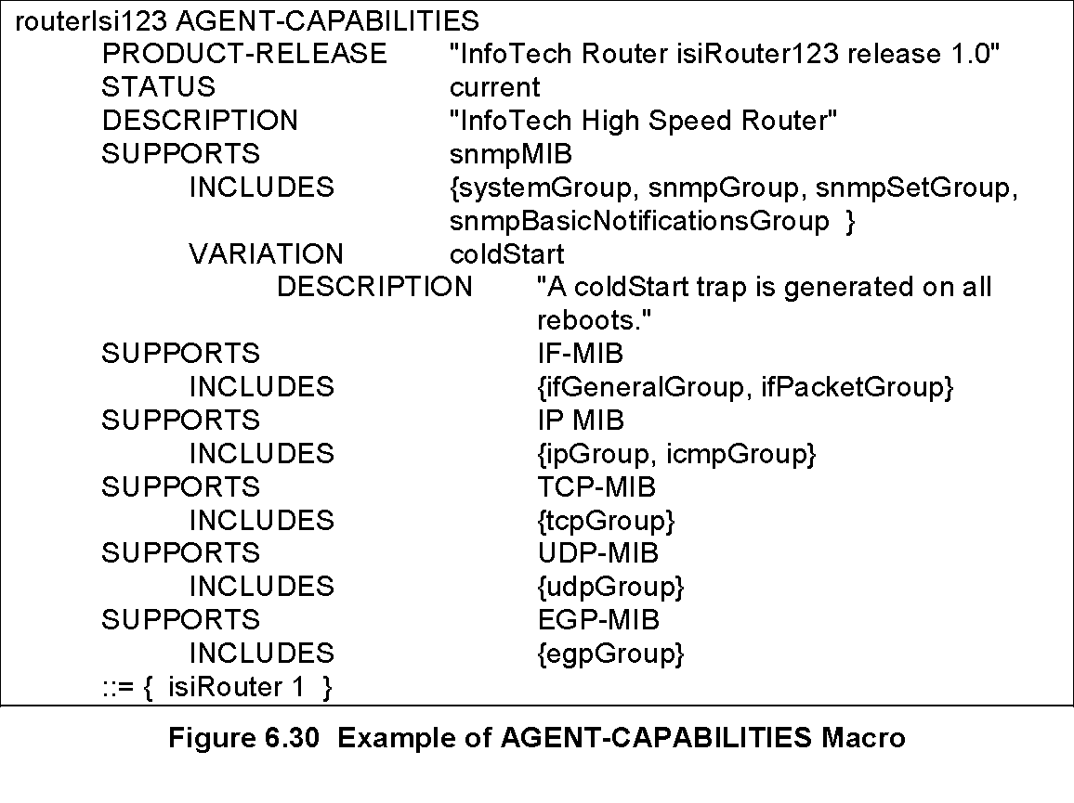
Chapter 6 SNMP Management: SNMPv2
Agent Capabilities
AGENT-CAPABILITIES macro
SUPPORTS modules and includes groups
VARIATION identifies additional features
Notes
Network Management: Principles and Practice
© Mani Subramanian 2010
*

Slide 24
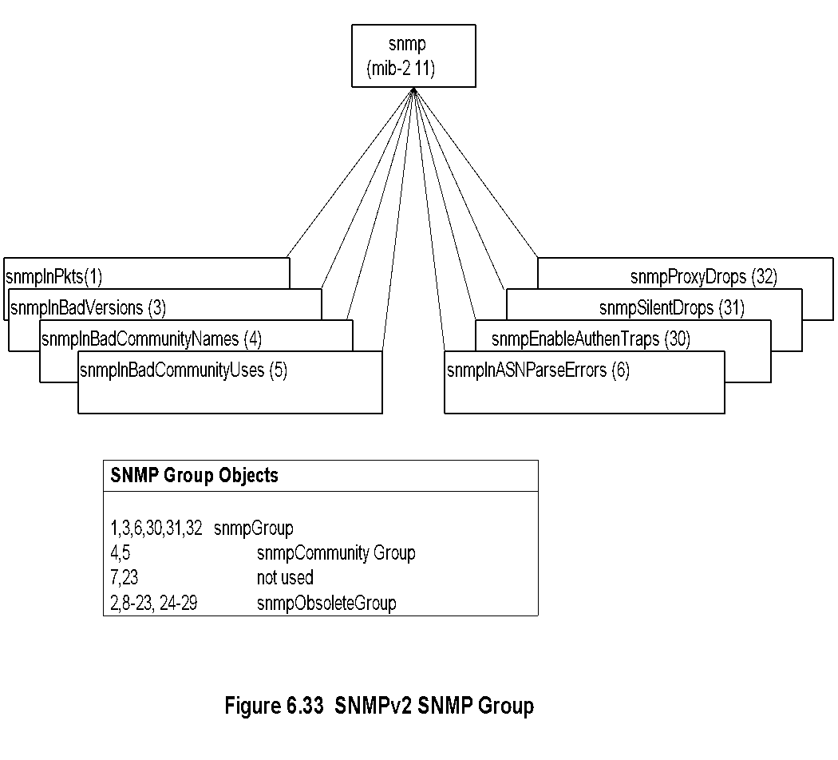
Chapter 6 SNMP Management: SNMPv2
SNMPv2 SNMP MIB
Notes
Compare this to SNMPv1 MIB!
Network Management: Principles and Practice
© Mani Subramanian 2010
*

Slide 25
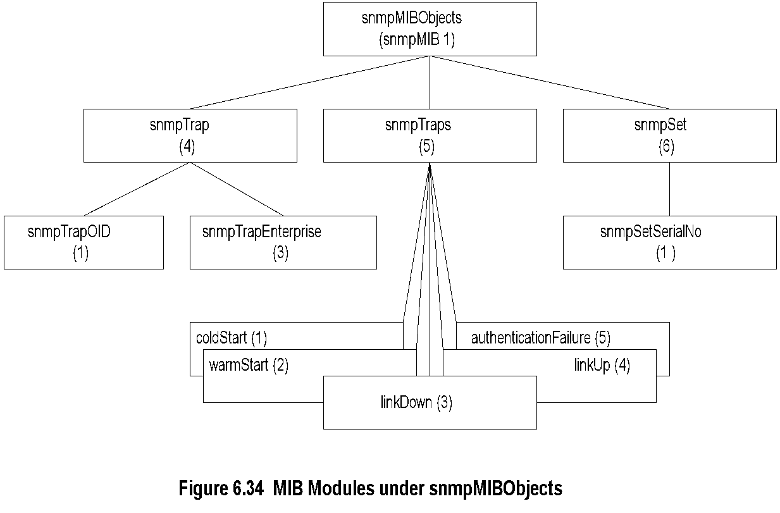
Chapter 6 SNMP Management: SNMPv2
snmpMIBObjects MIB
Notes
Network Management: Principles and Practice
© Mani Subramanian 2010
*

Slide 26
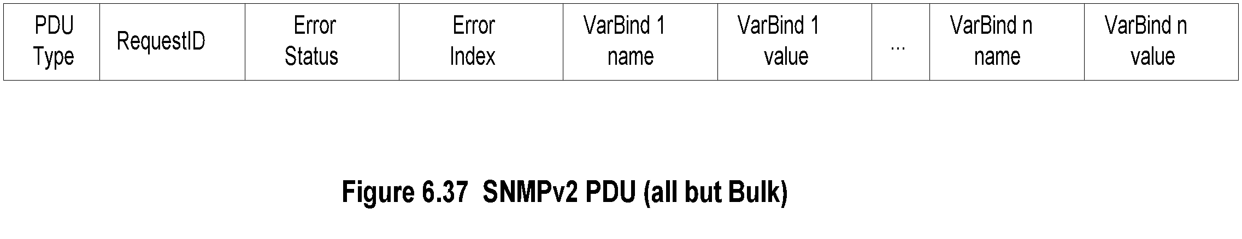
Chapter 6 SNMP Management: SNMPv2
SNMPv2 PDU
Notes
Standardized format for all messages
Interpretation of error status and error index fields; In v1, if error occurs status and index field filled, but varBindList blank
Interpretation in v2 Status Index
varBindList ignored x
varBind of index field ignored x x
Network Management: Principles and Practice
© Mani Subramanian 2010
*

Slide 27
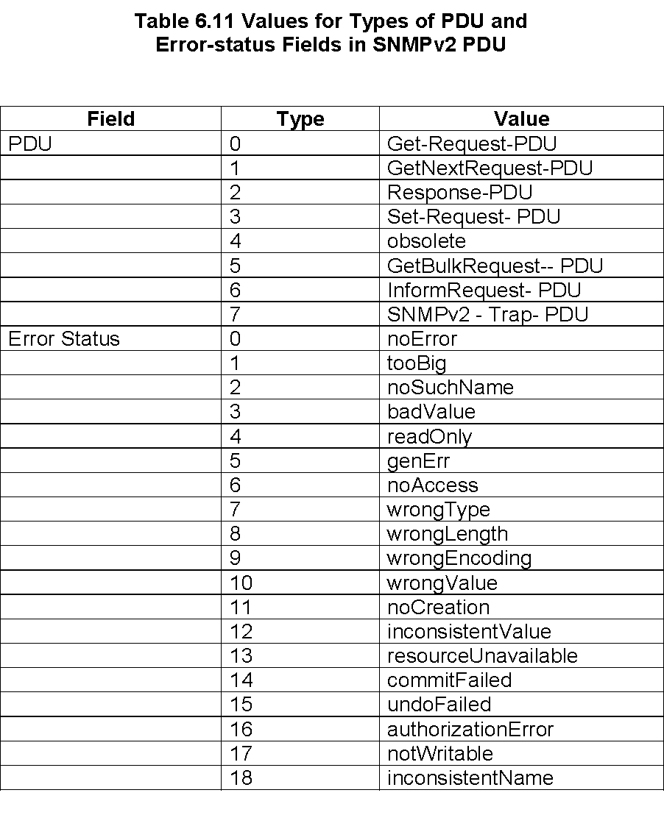
Chapter 6 SNMP Management: SNMPv2
SNMPv2 PDU and Error Status
Network Management: Principles and Practice
© Mani Subramanian 2010
*

Slide 28
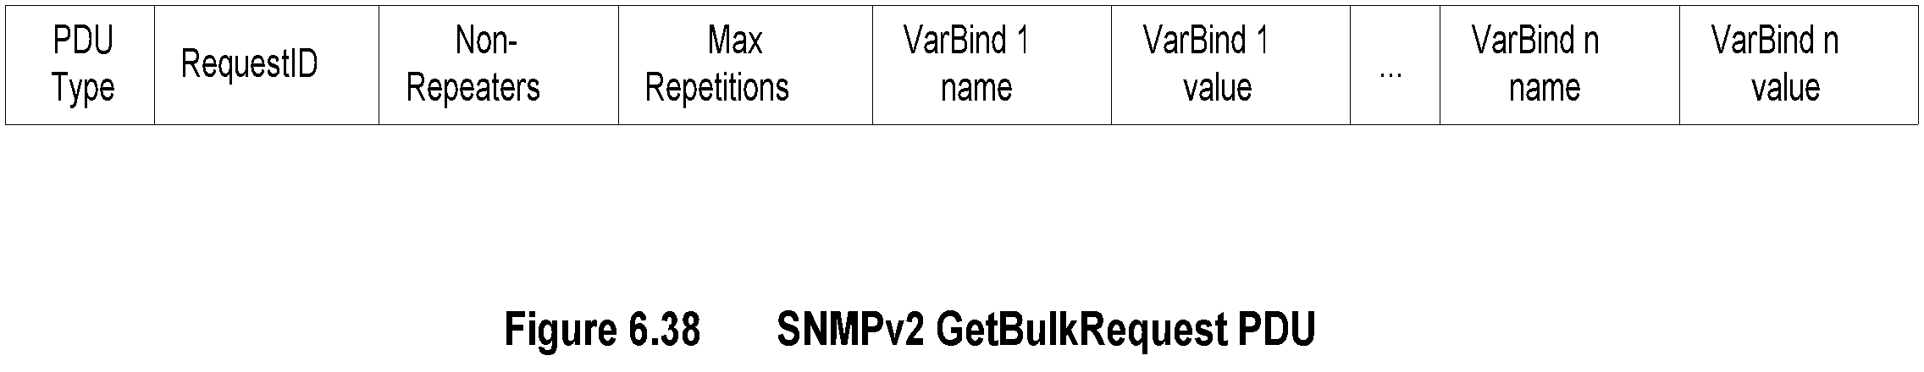
Chapter 6 SNMP Management: SNMPv2
SNMPv2 GetBulkRequest PDU
Notes
Error status field replaced by Non-repeaters
Error index field replaced by Max repetitions
No one-to-one relationship between request and response
Network Management: Principles and Practice
© Mani Subramanian 2010
*

Slide 29
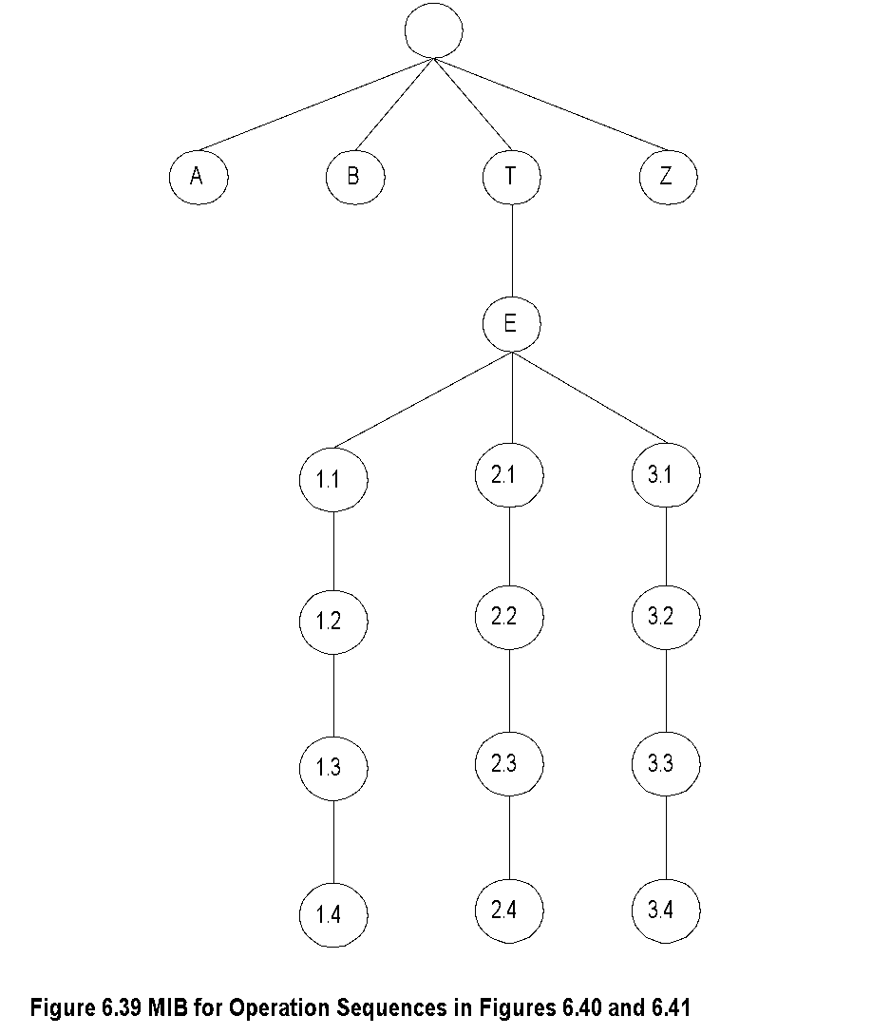
Chapter 6 SNMP Management: SNMPv2
Get-Bulk-Request: Generic MIB
Network Management: Principles and Practice
© Mani Subramanian 2010
*

Slide 30
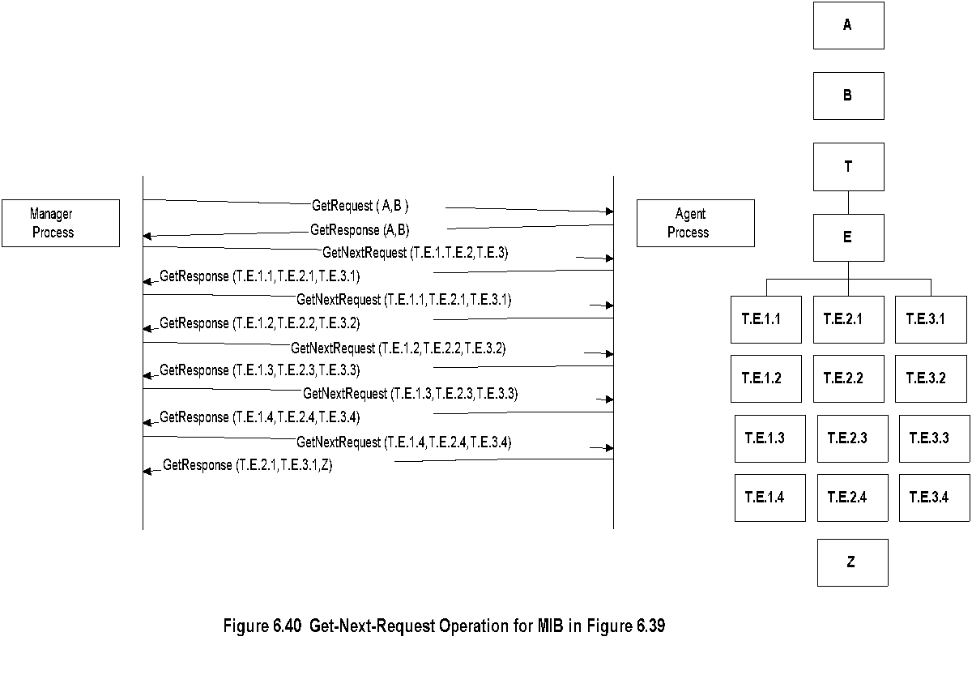
Chapter 6 SNMP Management: SNMPv2
Get-Next-Request Operation
Notes
Network Management: Principles and Practice
© Mani Subramanian 2010
*

Slide 31
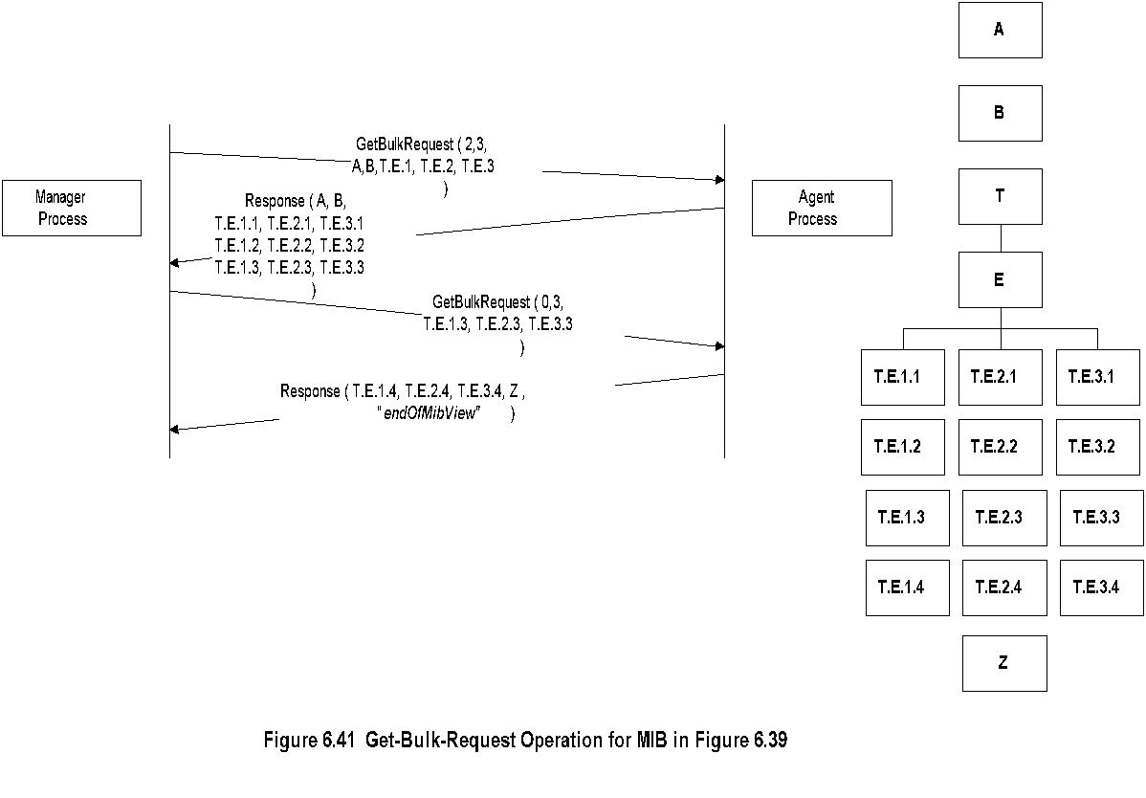
Chapter 6 SNMP Management: SNMPv2
Get-Bulk-Request Operation
Notes
Network Management: Principles and Practice
© Mani Subramanian 2010
*

Slide 32
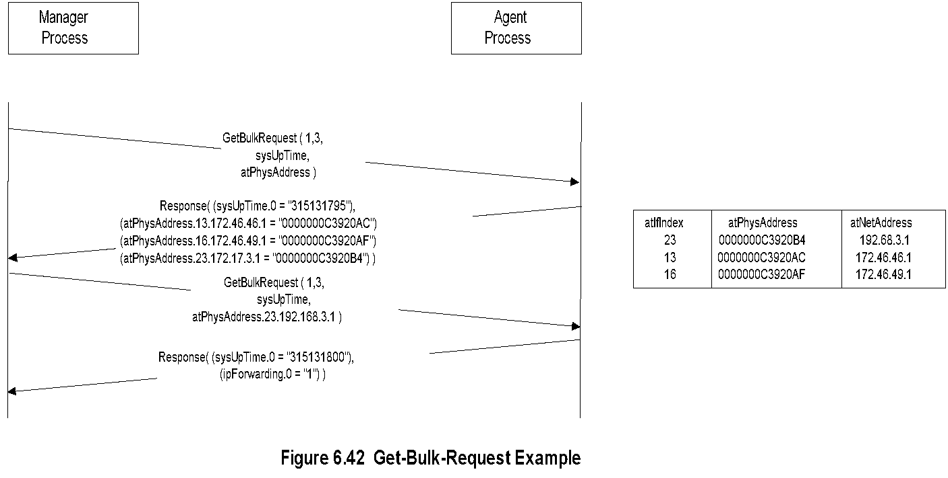
Chapter 6 SNMP Management: SNMPv2
Get-Bulk-Request Example
Notes
Network Management: Principles and Practice
© Mani Subramanian 2010
*

Slide 33
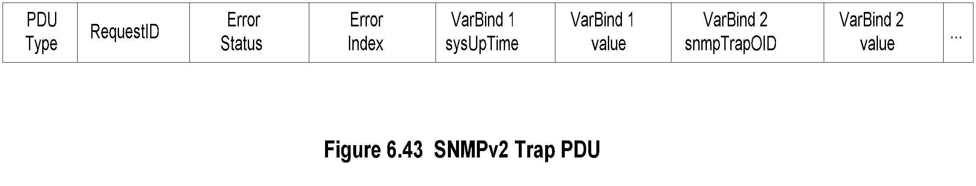
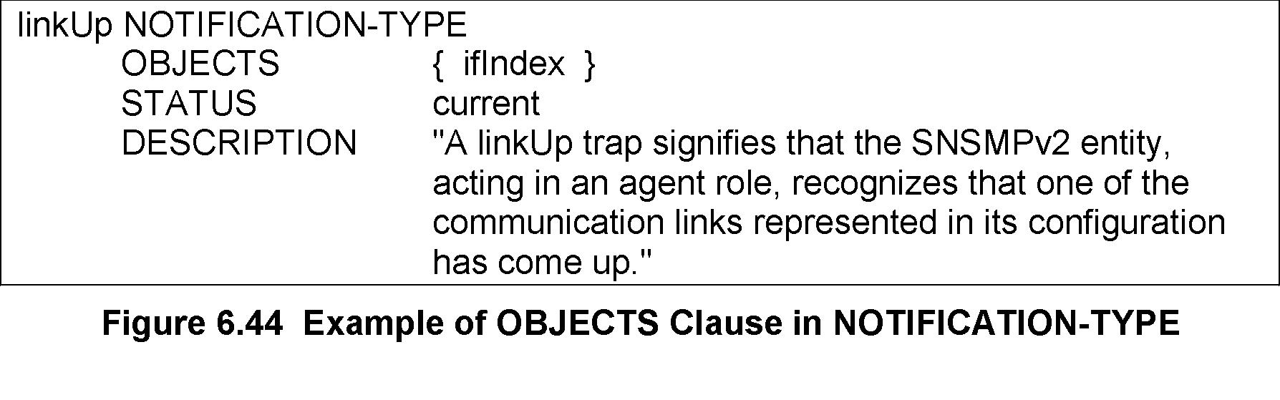
Chapter 6 SNMP Management: SNMPv2
SNMPv2 Trap
Notes
Addition of NOTIFICATION-TYPE macro
OBJECTS clause, if present, defines order of variable bindings
Positions 1 and 2 in VarBindList are sysUpTime and snmpTrapOID
Network Management: Principles and Practice
© Mani Subramanian 2010
*

Slide 34
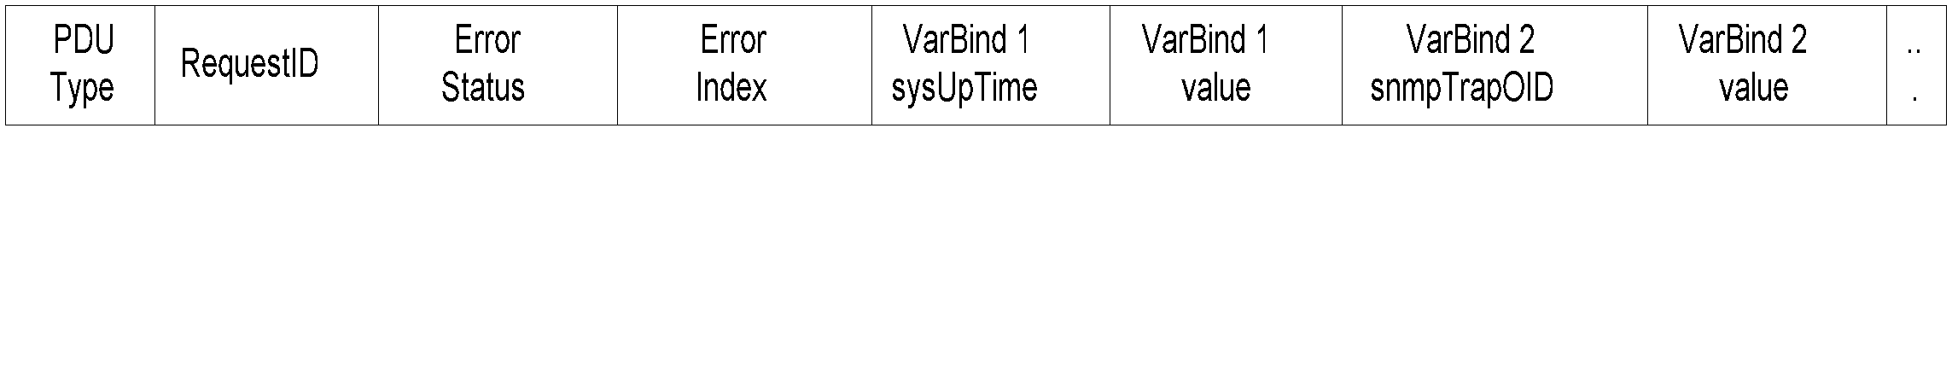
Chapter 6 SNMP Management: SNMPv2
Inform-Request
Figure 6.43 SNMPv2 Trap PDU
Notes
Inform-Request behaves as trap in that the message goes from one manager to another unsolicited
The receiving manager sends response to the sending manager
Network Management: Principles and Practice
© Mani Subramanian 2010
*

Slide 35
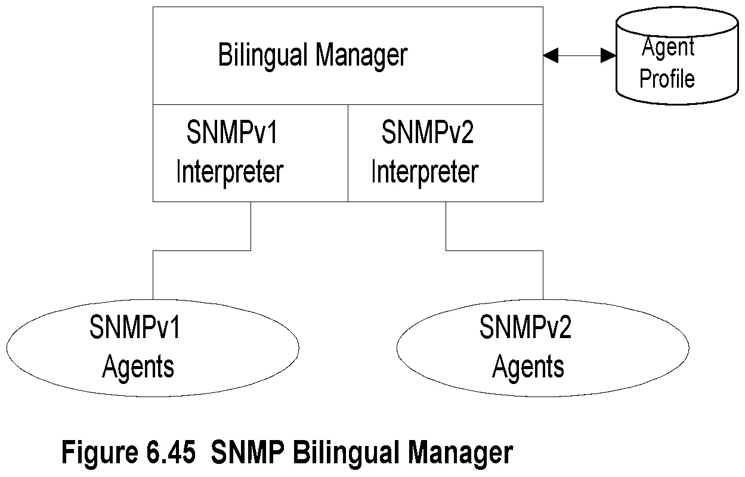
Chapter 6 SNMP Management: SNMPv2
Bilingual Manager
Notes
Compatibility with SNMPv1
Bilingual Manager
Proxy Server
Bilingual Manager expensive in resource and operation
Network Management: Principles and Practice
© Mani Subramanian 2010
*

Slide 36
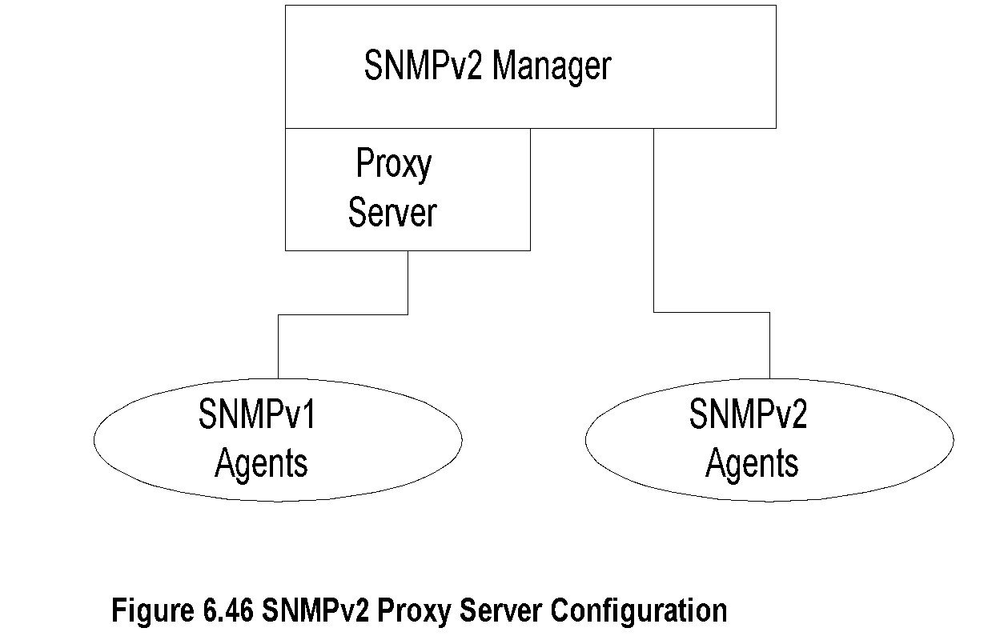
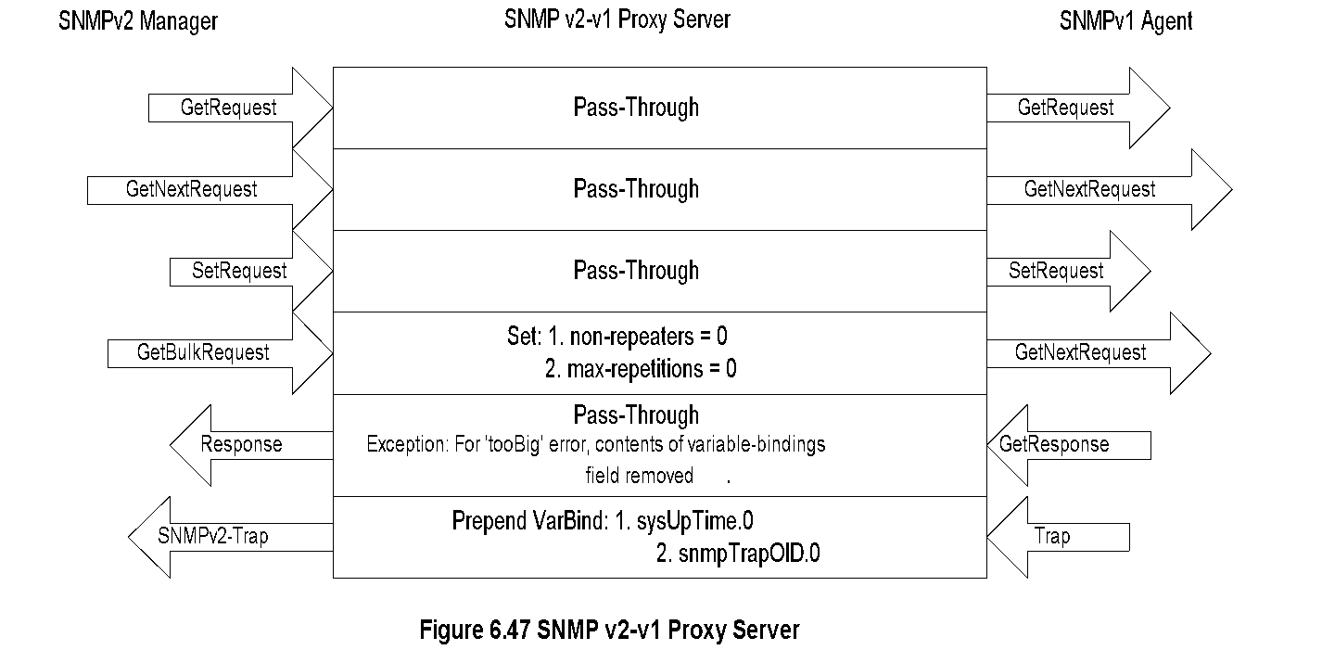
Chapter 6 SNMP Management: SNMPv2
SNMP Proxy Server
Network Management: Principles and Practice
© Mani Subramanian 2010
*

