Slide 1
Chapter 2
Review of Information Network and Technology
Chapter 2 Review of Information Network and Technology
Network Management: Principles and Practice
© Mani Subramanian 2010
*
Notes:
*

Slide 2
Objectives
Chapter 2 Review of Information Network and Technology
Network components and technologies to be managed
  Network Topologies: LAN and WAN
  Wired LAN topology: Bus, Ring, Star, and Hybrid Hub
  Wireless LAN
  WAN topology: Mesh and Tree
  Fixed and mobile wireless networks
  Fiber networks
Ethernet LAN:
  Physical media and MAC protocol
  10 and 100 Mbps; 1 and 10 Gbps Ethernet LAN
  Switched and Duplex Ethernet LANs
  Virtual LAN
Token-ring LAN
FDDI
Network components
  Bridges
  Routers
  Gateways
Circuit switching and packet switching
Transmission technology
  Transmission media: Wired and Wireless
  Transmission modes
  Multiplexing: TDM and WDM
  SONET and SDH
Multimedia networks and services
Network Management: Principles and Practice
© Mani Subramanian 2010
*
Notes:
*

Slide 3
Technology and Management
Chapter 2 Review of Information Network and Technology
What are the technologies that need to managed?
Challenges of technological progress on
network management
  Notes
Network Management: Principles and Practice
© Mani Subramanian 2010
*

Slide 4
Information Network Technology
Chapter 2 Review of Information Network and Technology
Network components
  Links
  Nodes
Topology: How they’re configured
LANs
Wireless LAN
WANs
Bridges
Routers and Gateways
Switches
Transmission Media
Transmission Modes
ISDN
Broadband networks and services
  Notes
Network Management: Principles and Practice
© Mani Subramanian 2010
*

Slide 5
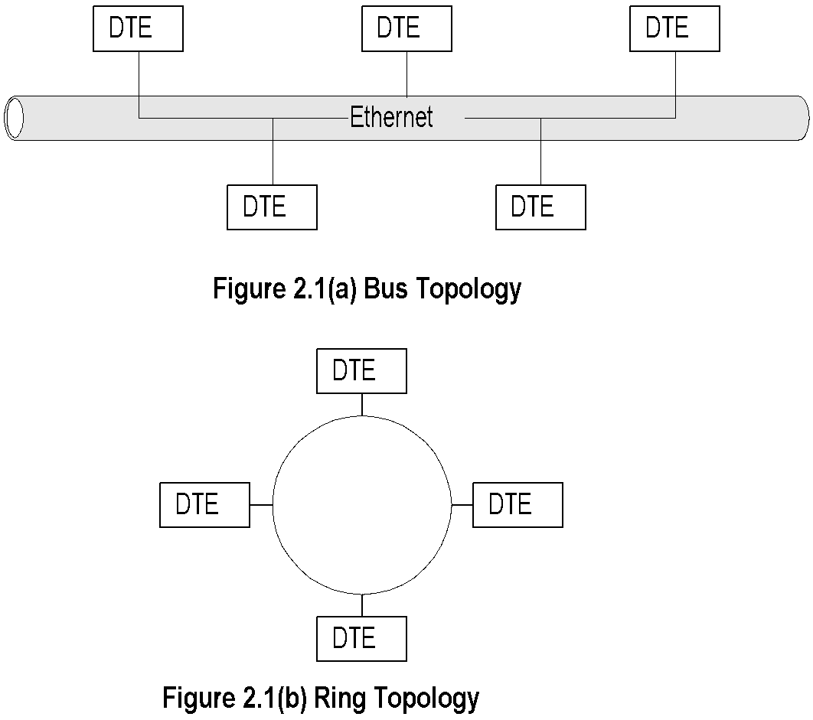
Basic LAN Topologies
Chapter 2 Review of Information Network and Technology
  Notes
Bus Topology
  Used in Ethernet LAN family
  Common shared medium
  Randomized access (CSMA/CD)
  Easy to implement
  Lower utilization under heavy traffic 30%-40%
  Single culprit could effect the entire LAN
Network Management: Principles and Practice
© Mani Subramanian 2010
*

Slide 6
Basic LAN Topologies (cont.)
Chapter 2 Review of Information Network and Technology
  Notes
Ring Topology
  Used in token ring and FDDI
  Shared medium
  Deterministic access
  Master DTE has control
  High utilization >90%
  Also used in MAN
Network Management: Principles and Practice
© Mani Subramanian 2010
*

Slide 7
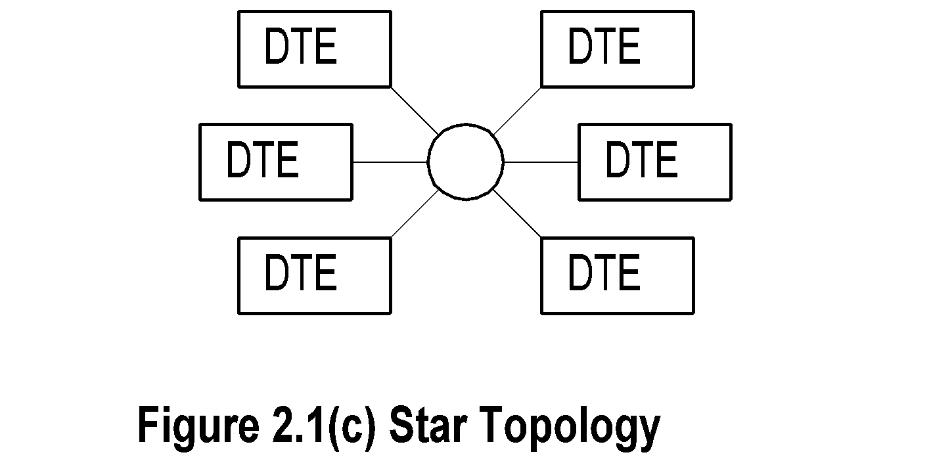
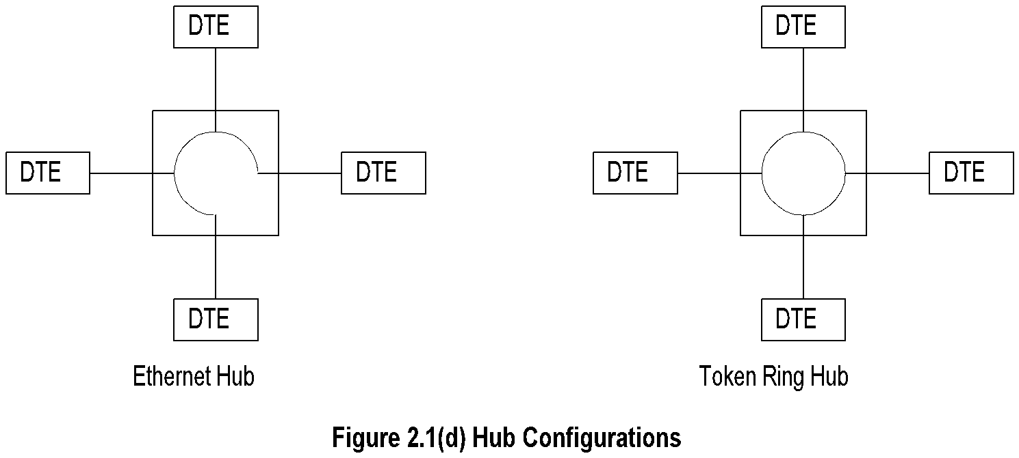
Star & Hybrid LAN Topologies
Chapter 2 Review of Information Network and Technology
  Notes
Star topology used with bus and ring topology
Hub is “LAN in a box”
What does the electronic LAN inside the box
look like?
Why has hub become so popular?
Network Management: Principles and Practice
© Mani Subramanian 2010
*

Slide 8
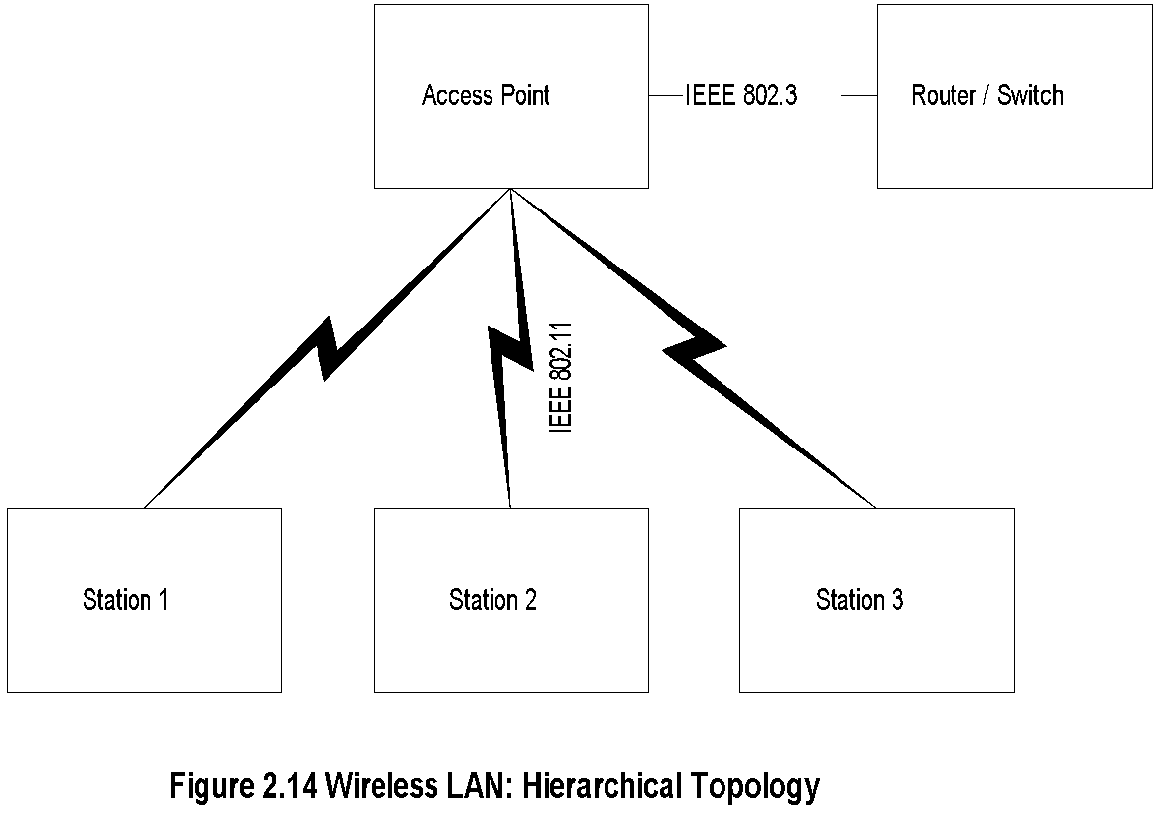
Wireless LAN
Chapter 2 Review of Information Network and Technology
  Notes
Hierarchical
Ad Hoc
Network Management: Principles and Practice
© Mani Subramanian 2010
*

Slide 9
IEEE 802.11
Standards and Amendments
Chapter 2 Review of Information Network and Technology
802.11a | 54 Mbps data rate 5.15 MHz to 5.35 and 5.4 MHz to 5.825 MHz
802.11b | 11 Mbps data rate at 2.4 GHz
802.11e | Addresses QoS issues
802.11f | Addresses multivendor AP interoperability
802.11g | Higher data rate extension to 54 Mbps in the 2.4 GHz
802.11h | Dynamic frequency selection and transmit power control for operation of 5 GHz products
802.11i | Addresses security issues
802.11j | Addresses channelization in Japan’s 4.9 GHz band
802.11k | Enables medium and network resources more efficiently
802.11n | Addition of multiple-input multiple-output (MIMO); WiFi certification
Network Management: Principles and Practice
© Mani Subramanian 2010
*

Slide 10
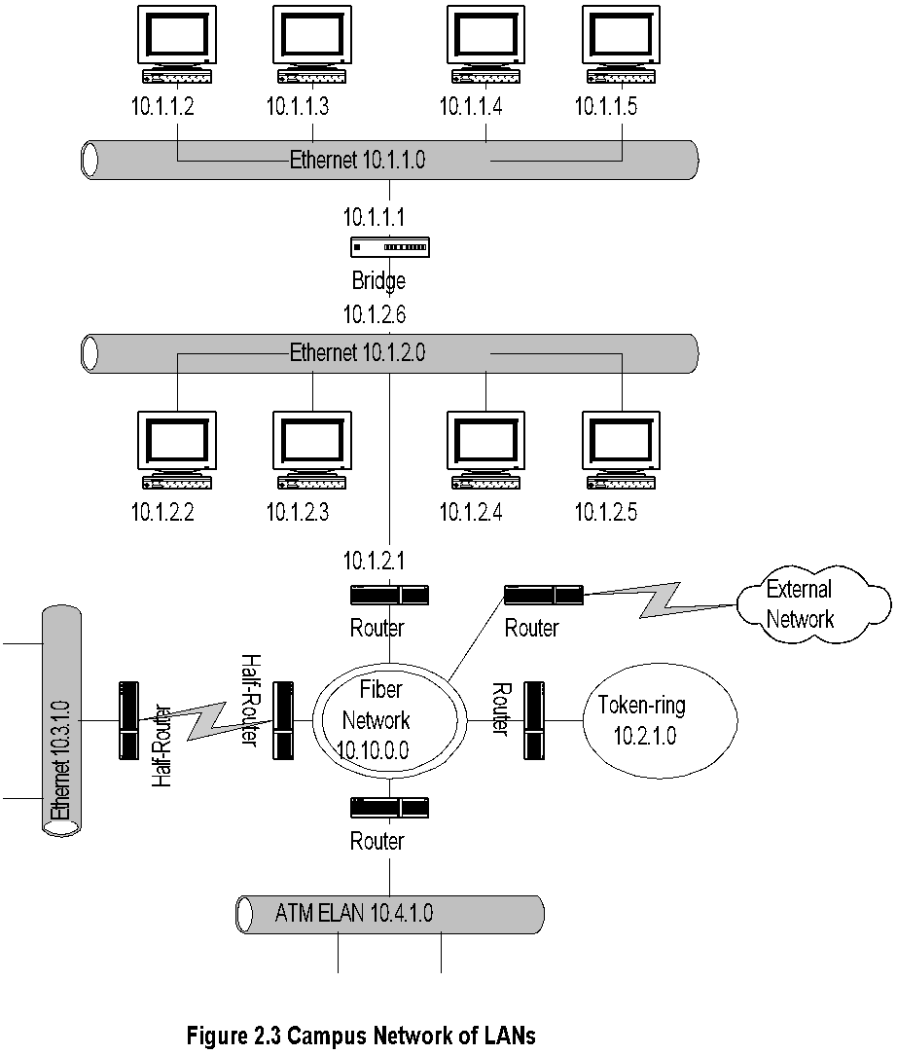
Campus Network
Chapter 2 Review of Information Network and Technology
  Notes
Fiber Network could be Gigabit LAN or MAN
Network Management: Principles and Practice
© Mani Subramanian 2010
*

Slide 11
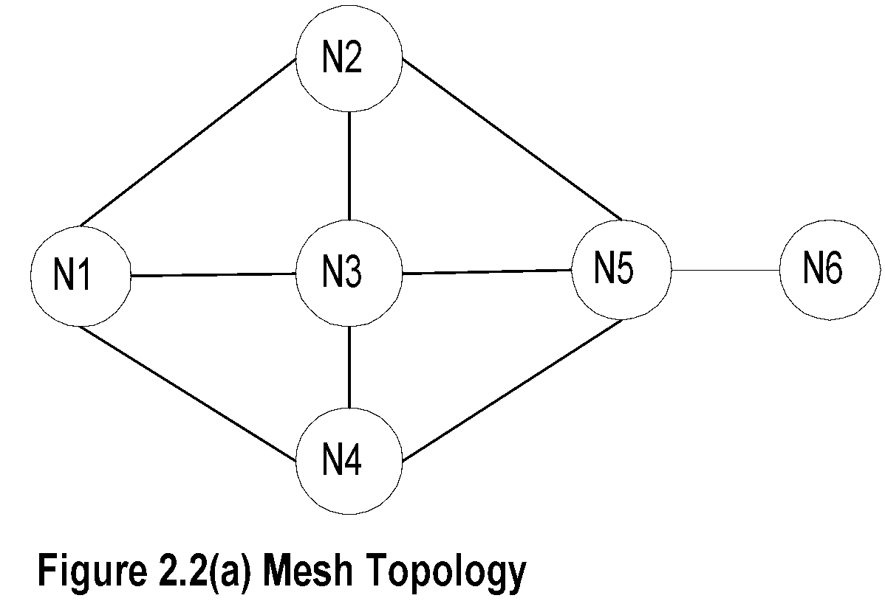
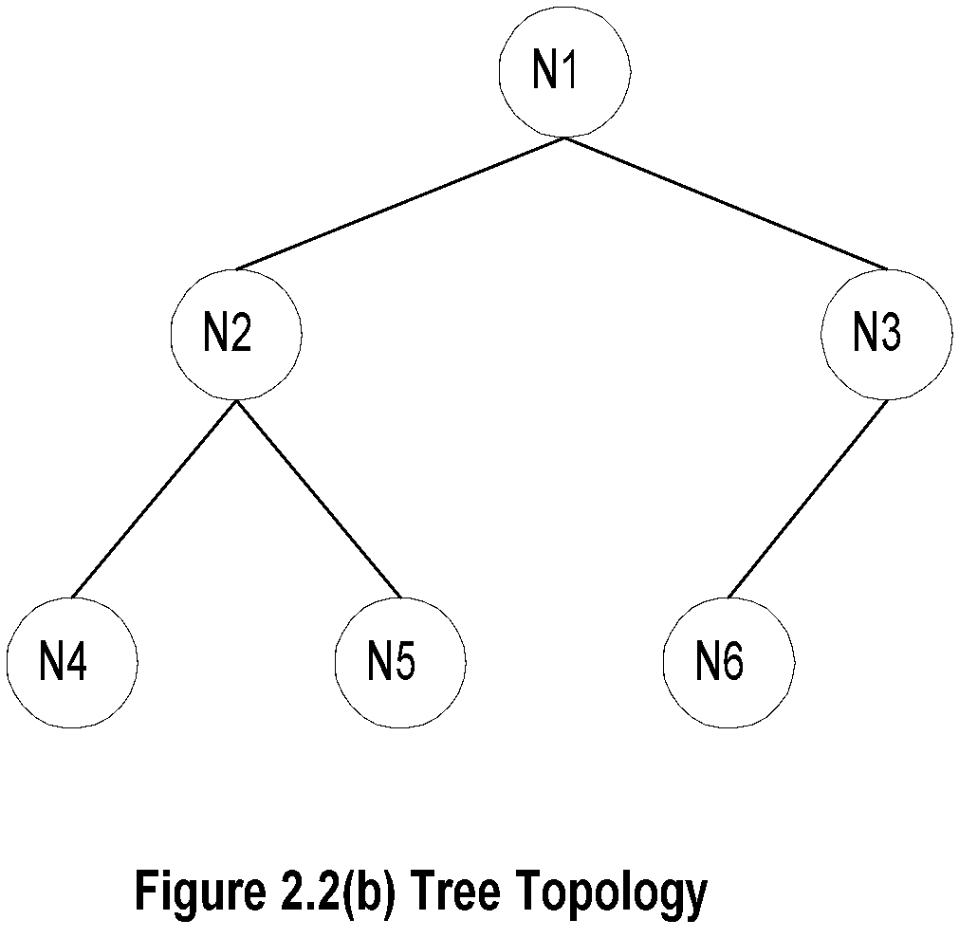
Chapter 2 Review of Information Network and Technology
WAN Topologies
  Notes
Mesh topology
  Implemented in network layer level
  Multiple paths between nodes
  Flat topology
  Redundancy
  Load balancing
  Shortest path
Tree topology
  Used with Ethernet bridges
  Hierarchical
  Efficient for small networks and special purpose
  networks
Ring Topology
  SONET / SDH
  MAN
  Broadband feeder network
Network Management: Principles and Practice
© Mani Subramanian 2010
*

Slide 12
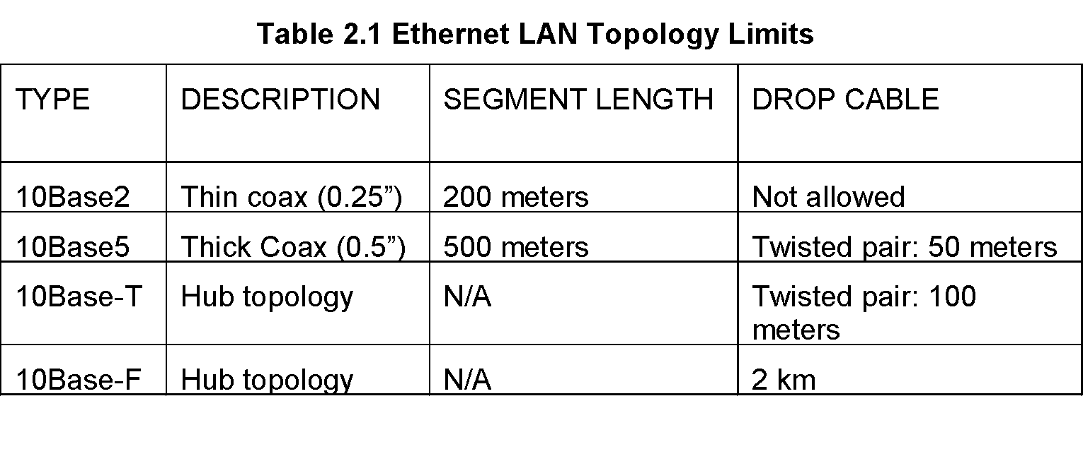
Chapter 2 Review of Information Network and Technology
Ethernet
  Notes
IEEE 802.3 standard
10 Mbps data rate
Collision - analogy of hollow pipe
Principle of operation; CSMA/CD
Segment length and drop cable length
Minimum size of packet 64 bytes
Maximum size of packet 1500 bytes
Hub configuration
Network Management: Principles and Practice
© Mani Subramanian 2010
*

Slide 13
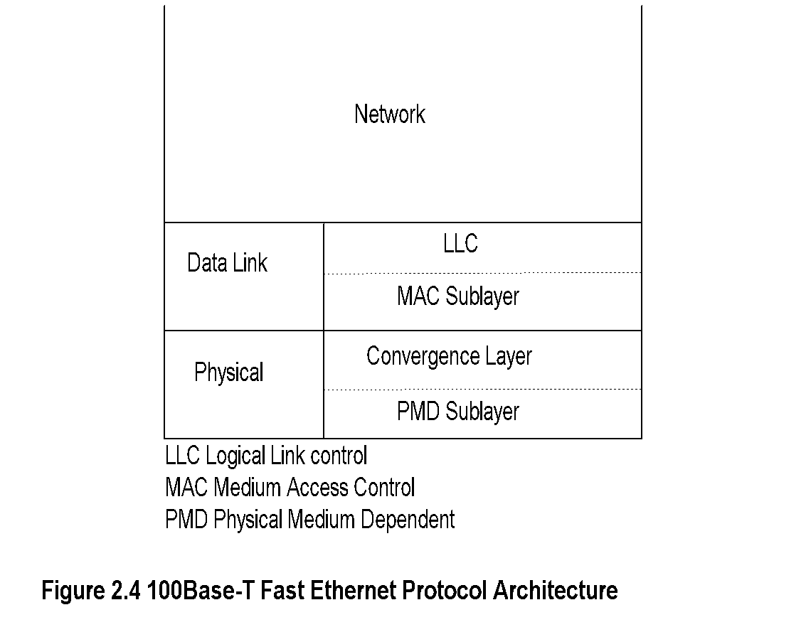
Chapter 2 Review of Information Network and Technology
Fast Ethernet
  Notes
Rationale
  Max drop length 100m => Max round-trip
  time 1/10 of Ethernet; hence 10 times data rate
Standard 100Base-T4
Compatibility with 10BaseT
Cat 5e (Max 100 m, 100 MHz)
Cat 6 (Max 100 m, 250 MHz)
100Base FX optical fiber (Max 10 km single and
400 m multimode)
Network Management: Principles and Practice
© Mani Subramanian 2010
*

Slide 14
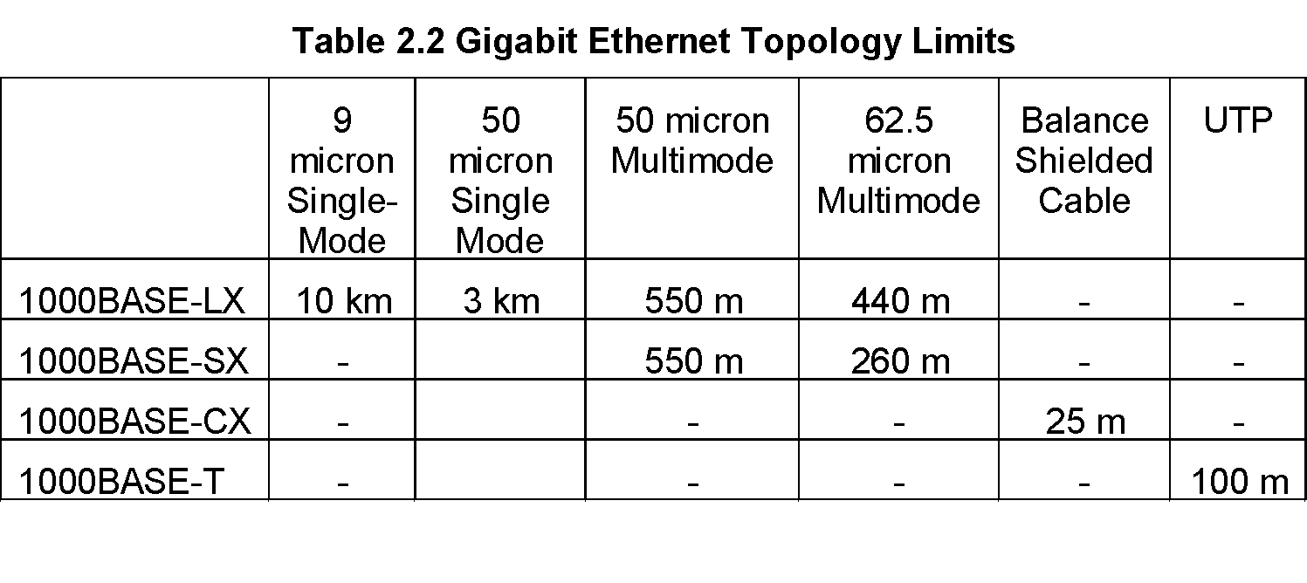
Chapter 2 Review of Information Network and Technology
Gigbit Ethernet
  Notes
Packet size 512 bytes, slot size 4.096 microseconds
Minimum frame size 64 bytes for backward
compatibility; Slot filled with carrier extension
Packet bursts with no idle time between frames
increases efficiency
Network Management: Principles and Practice
© Mani Subramanian 2010
*

Slide 15
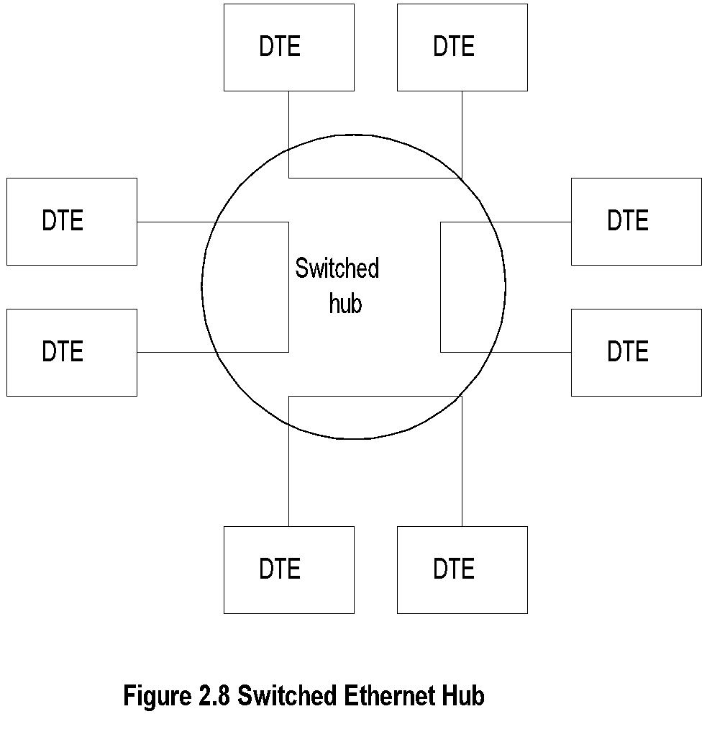
Chapter 2 Review of Information Network and Technology
Switched Ethernet
  Notes
Maximum throughput increased ~N/2 in N-port hub
Snooping capability lost for management
Network Management: Principles and Practice
© Mani Subramanian 2010
*

Slide 16
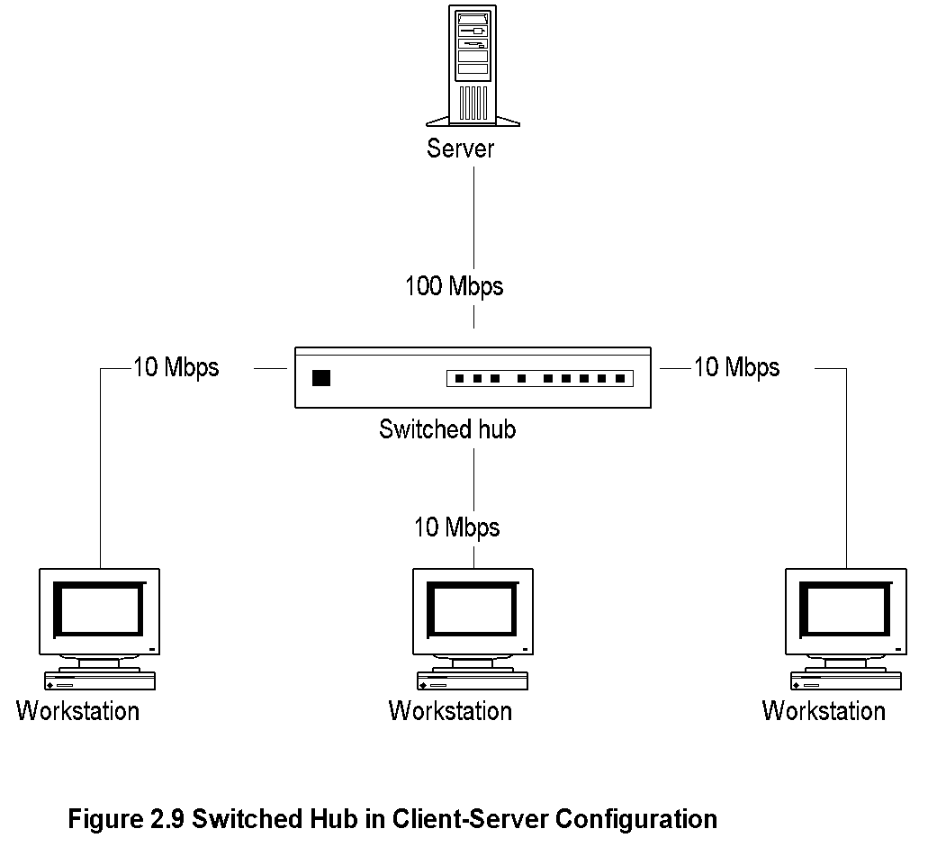
Chapter 2 Review of Information Network and Technology
Client-Server Configuration using
Switched Hub
  Notes
Network Management: Principles and Practice
© Mani Subramanian 2010
*

Slide 17
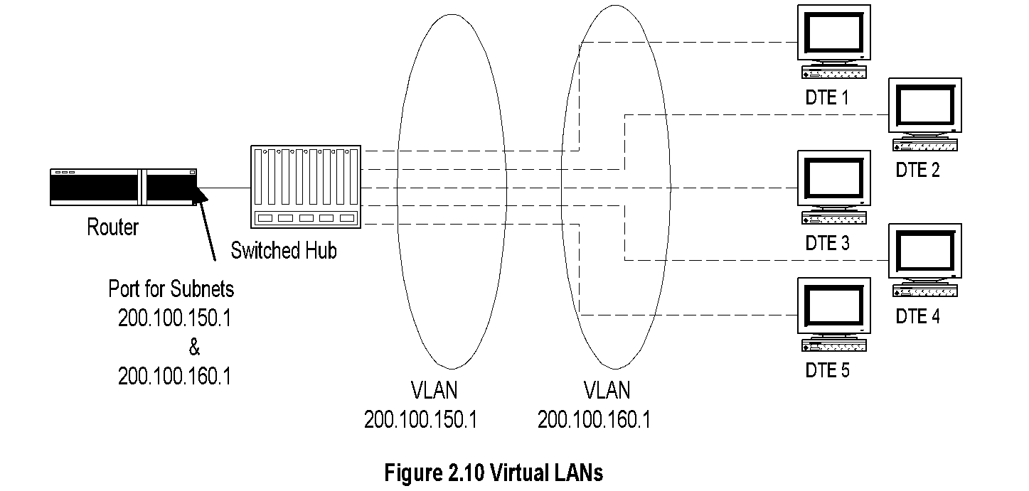
Chapter 2 Review of Information Network and Technology
Virtual LAN
  Notes
Switched hub enables establishing virtual LANs
Permits switching stations between LANs without
physical moving of equipment
Remote VLAN via switch offered by service providers
Network Management: Principles and Practice
© Mani Subramanian 2010
*

Slide 18
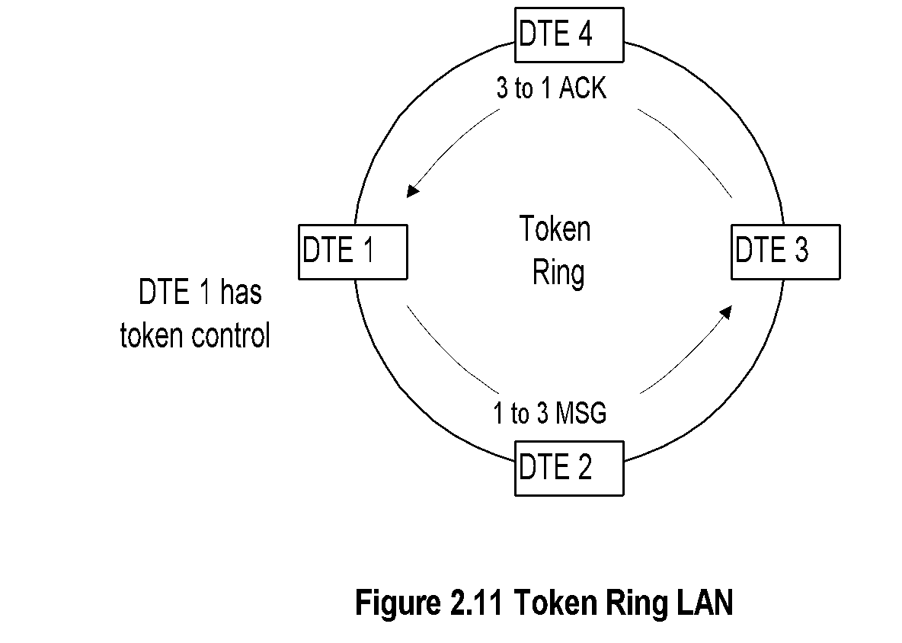
Chapter 2 Review of Information Network and Technology
Token Ring
  Notes
Adopted by IBM
IEEE 802.5 standard
Data rates of 4 Mbps and 16 Mbps
Single- and dual-ring LANs
Network Management: Principles and Practice
© Mani Subramanian 2010
*

Slide 19
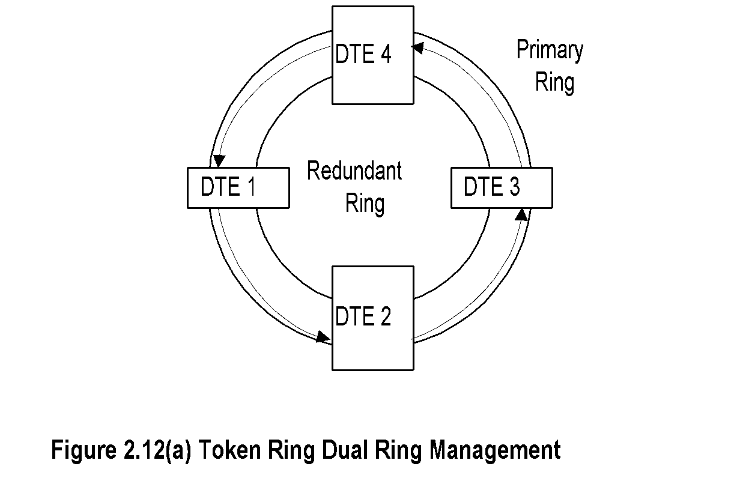
Chapter 2 Review of Information Network and Technology
Dual Ring Token Ring LAN
  Notes
Network Management: Principles and Practice
© Mani Subramanian 2010
*

Slide 20
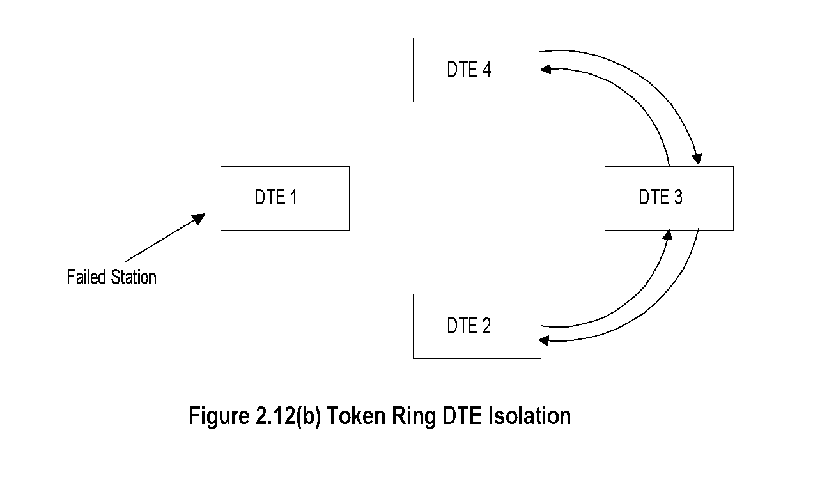
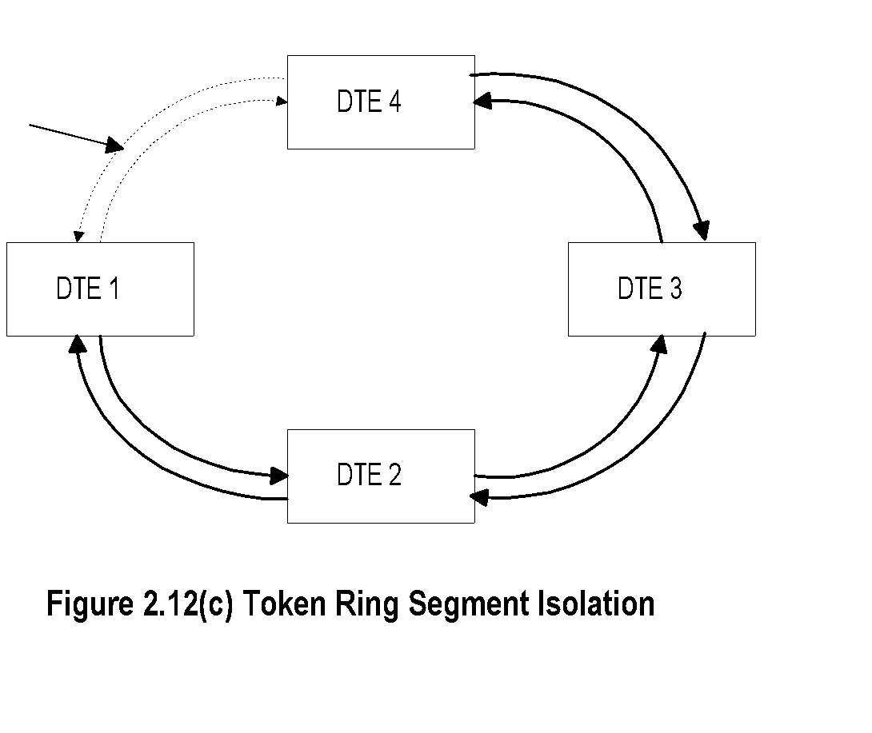
Chapter 2 Review of Information Network and Technology
Failure Recovery in TR LAN
  Notes
Station failure recovery
Link failure recovery
Network Management: Principles and Practice
© Mani Subramanian 2010
*

Slide 21
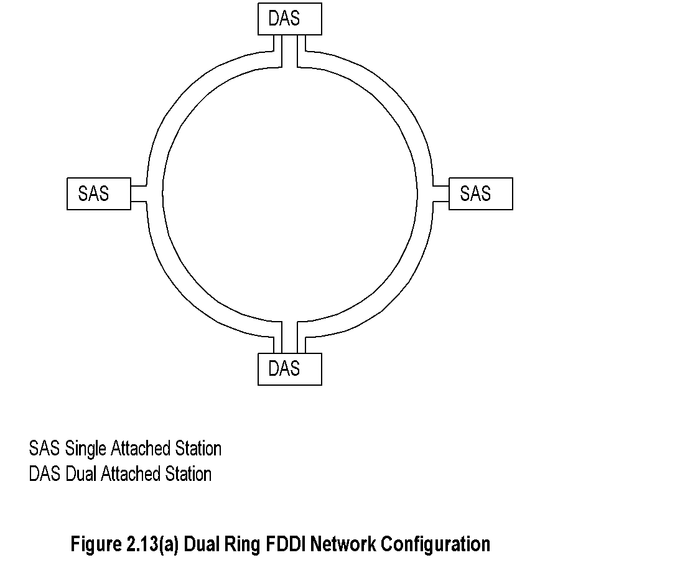
Chapter 2 Review of Information Network and Technology
FDDI
  Notes
Uses fiber optics medium
Modified token-ring protocol
Data rate 100 Mbps
Segment length 100 km
500 stations in the ring with max separation of 2 km
Single- and dual-attached stations
Dual-attached stations load share the two rings
Network Management: Principles and Practice
© Mani Subramanian 2010
*

Slide 22
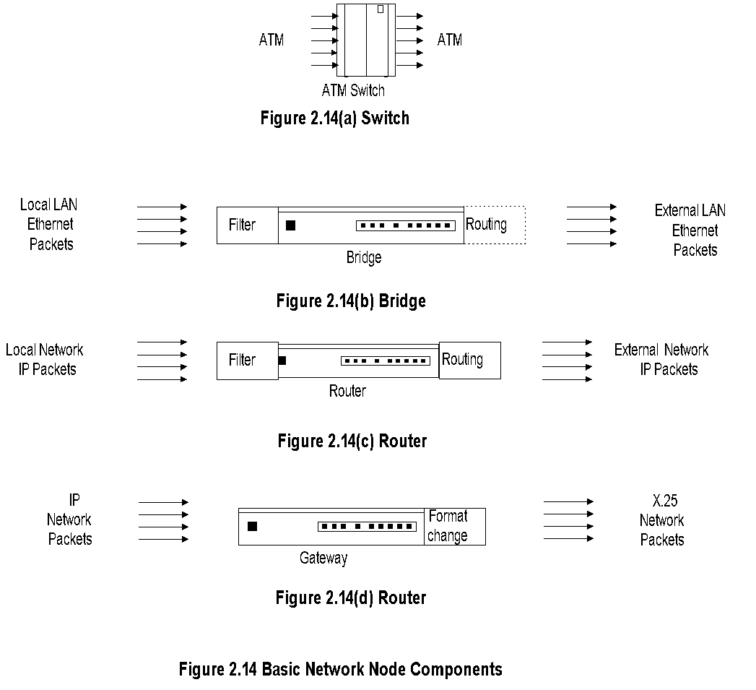
Chapter 2 Review of Information Network and Technology
Basic Network Nodes
  Notes
Network Management: Principles and Practice
© Mani Subramanian 2010
*

Slide 23
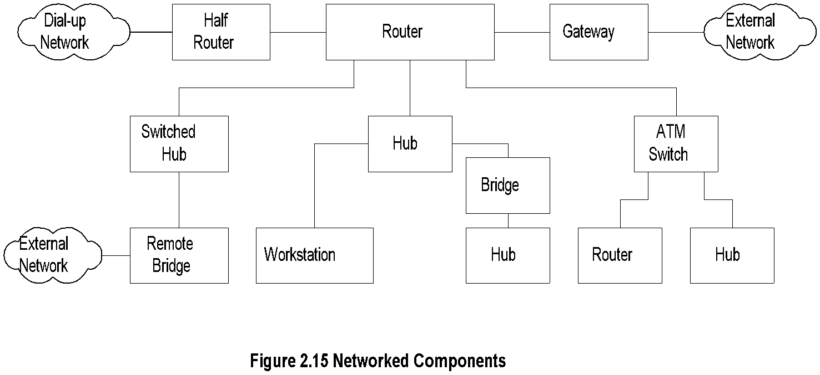
Chapter 2 Review of Information Network and Technology
Network Node Components
  Notes
Hubs
Bridges
Remote bridges
Routers
Gateways
Half bridge / half router
Switches
Transport devices (ADM, SDH)
Broadband access components
Residential distribution devices
Network Management: Principles and Practice
© Mani Subramanian 2010
*

Slide 24
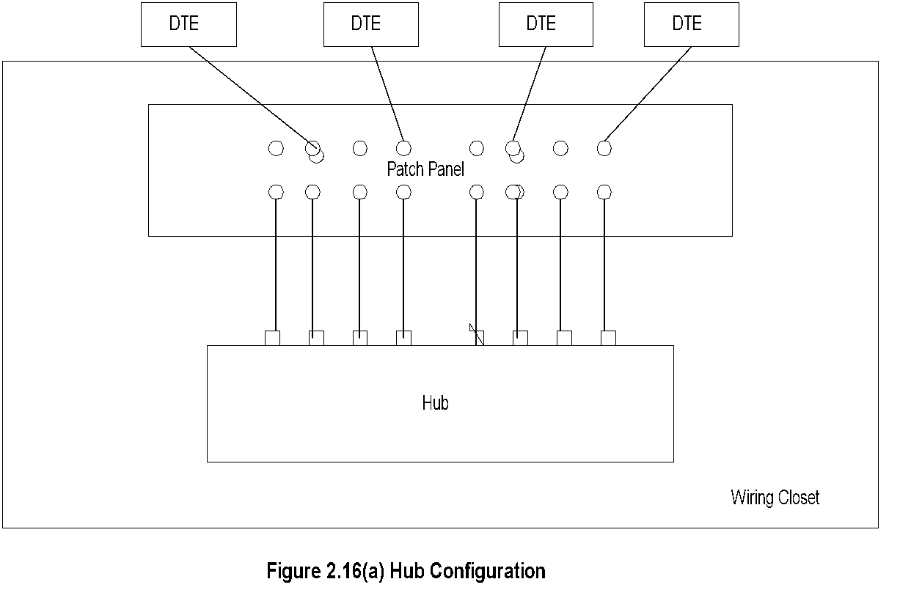
Chapter 2 Review of Information Network and Technology
Hubs
  Notes
Hub is a platform
Function dependent on what is housed
  LAN
  Switched LAN
  Bridge
Network Management: Principles and Practice
© Mani Subramanian 2010
*

Slide 25
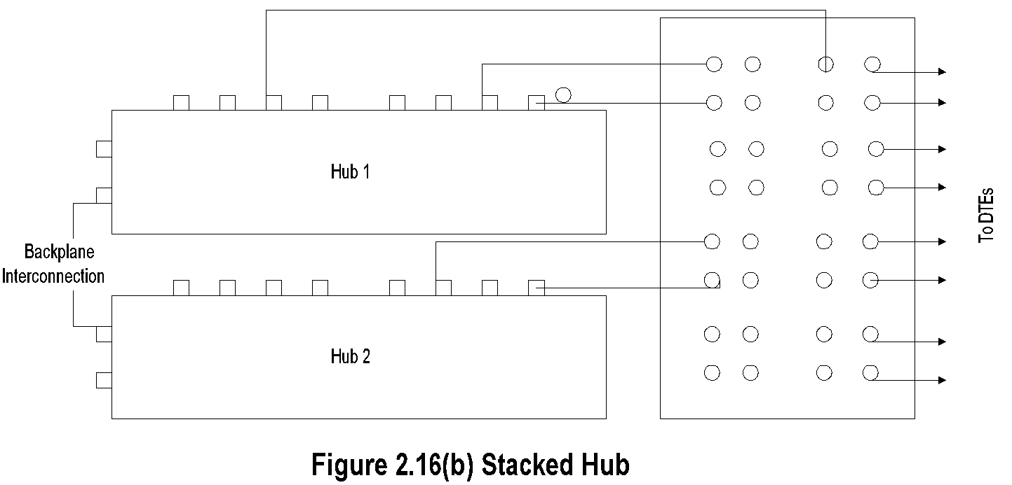
Chapter 2 Review of Information Network and Technology
Stacked Hubs
  Notes
Hub ports can be scaled up using stacked hubs
Stacked hub
  Extend back plane
  Connected as daisy chain
Network Management: Principles and Practice
© Mani Subramanian 2010
*

Slide 26
Chapter 2 Review of Information Network and Technology
Bridges
Bridge
Local Bridge
Remote Bridge
Simple
Multiport
Multiport
Multi-protocol
  Notes
Bridges two nodes at data link control layer
  Ethernet: tree topology, transparent bridge
  Token ring:mesh topology, source routing bridge
Remote bridge uses WAN interface cards;
same protocol used at both ends
Ethernet bridge is a learning bridge
Network Management: Principles and Practice
© Mani Subramanian 2010
*

Slide 27
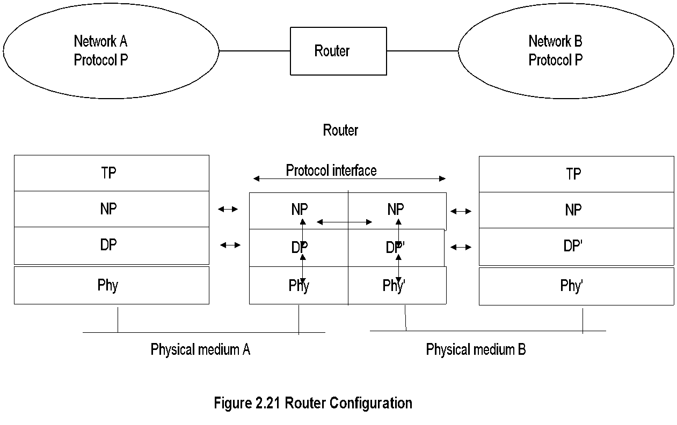
Chapter 2 Review of Information Network and Technology
Routers
  Notes
Routers operate at network layer
Routes packets between nodes of similar
network protocols
Routing table used to route packets
DLC and Physical layers could be different
under the same common network layer protocol
Network Management: Principles and Practice
© Mani Subramanian 2010
*

Slide 28

Chapter 2 Review of Information Network and Technology
Gateway
  Notes
Gateway is router connecting two networks with
dissimilar network protocols.
Gateway does the protocol conversion at the
network layer.
Protocol converter does the conversion at the
application layer.
Network Management: Principles and Practice
© Mani Subramanian 2010
*

Slide 29
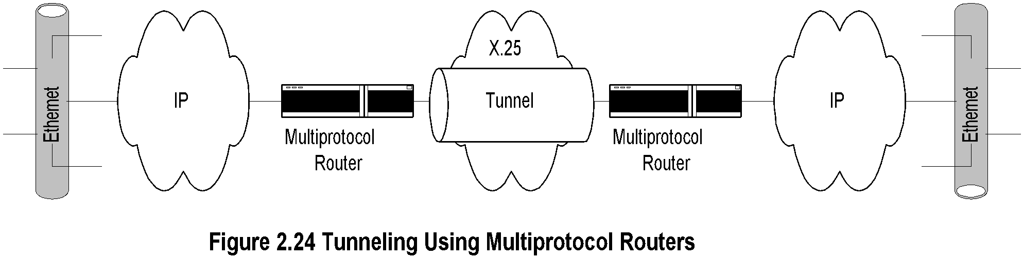
Chapter 2 Review of Information Network and Technology
Tunneling
Joe’s Mobile
Loc: Seattle
Home LAN
NY
Tunneling
Foreign
Agent
Sally
L.A
  Notes
Tunneling is transmission of packets (via
multiprotocol routers) by encapsulation.
In Figure 2.24, packets are encapsulated and
transmitted through X.25 network in a serial
mode.
In the mobile environment, Joe and his home agent
in NY communicate Joe’s Seattle location to the
foreign agent. His communication with Sally in
LA is tunneled.
Network Management: Principles and Practice
© Mani Subramanian 2010
*

Slide 30
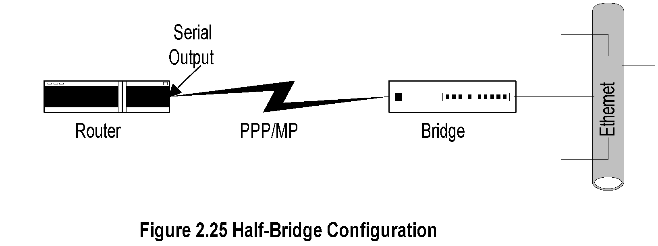
Chapter 2 Review of Information Network and Technology
Half-Bridge
  Notes
Half-bridge (also referred to as half-router) is
point-to-point communication
Uses PPP protocol
Helps low-end users to communicate with ISP
on dial-up link saving the expense of dedicated link
Router encapsulates packets in PPP frames and
puts serial outputs to the bridge, and vice-versa
Network Management: Principles and Practice
© Mani Subramanian 2010
*

Slide 31
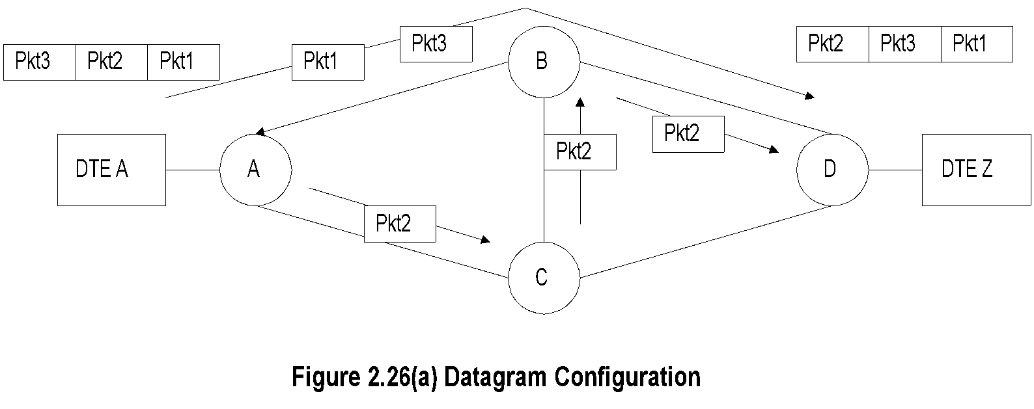
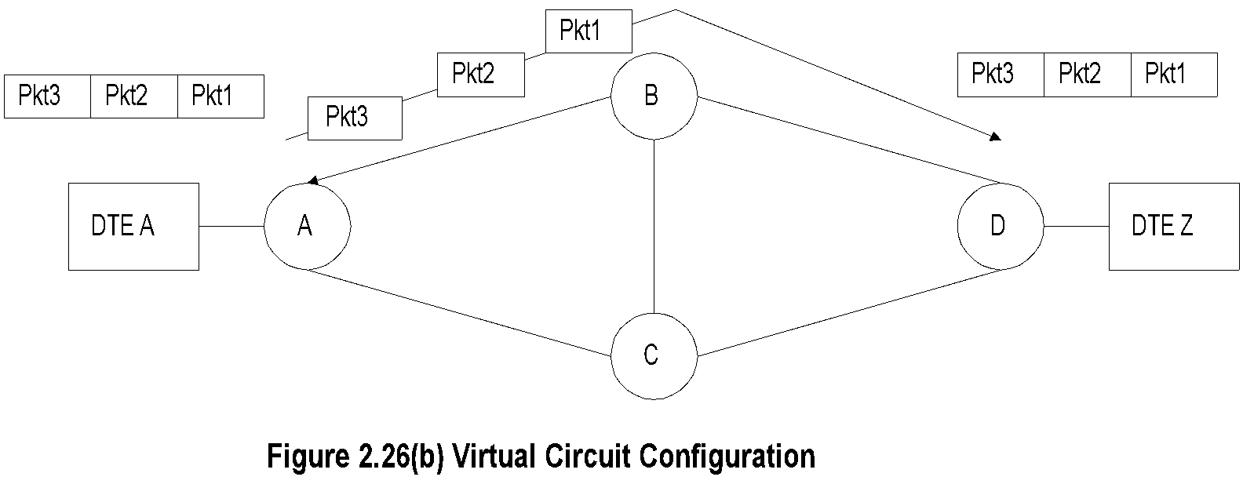
Chapter 2 Review of Information Network and Technology
Switched Networks
  Notes
Switches are embedded in bridges and routers
Switched network used in WAN
Two types of switched networks
  Circuit-switched
  Packet-switched
    Datagram service
    Virtual circuit
Network Management: Principles and Practice
© Mani Subramanian 2010
*

Slide 32
Chapter 2 Review of Information Network and Technology
Transmission Technology
Transmission Technology
Medium
Mode
Wired
Wireless
Digital
Analog
LAN
WAN
LAN Mobile Satellite
  Notes
Physical transport media
  UTP
  Coax
  Fiber
  Terrestrial wireless
  Satellite transmission
Network Management: Principles and Practice
© Mani Subramanian 2010
*

Slide 33
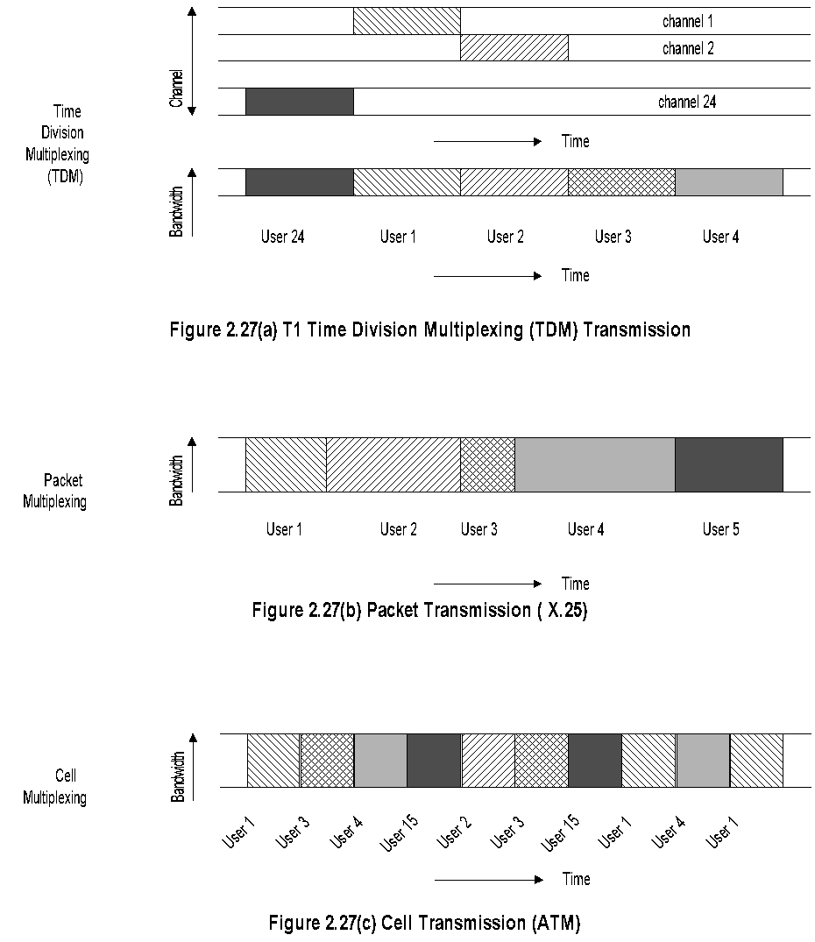
Chapter 2 Review of Information Network and Technology
Transmission Modes
  Notes
Network Management: Principles and Practice
© Mani Subramanian 2010
*

Slide 34
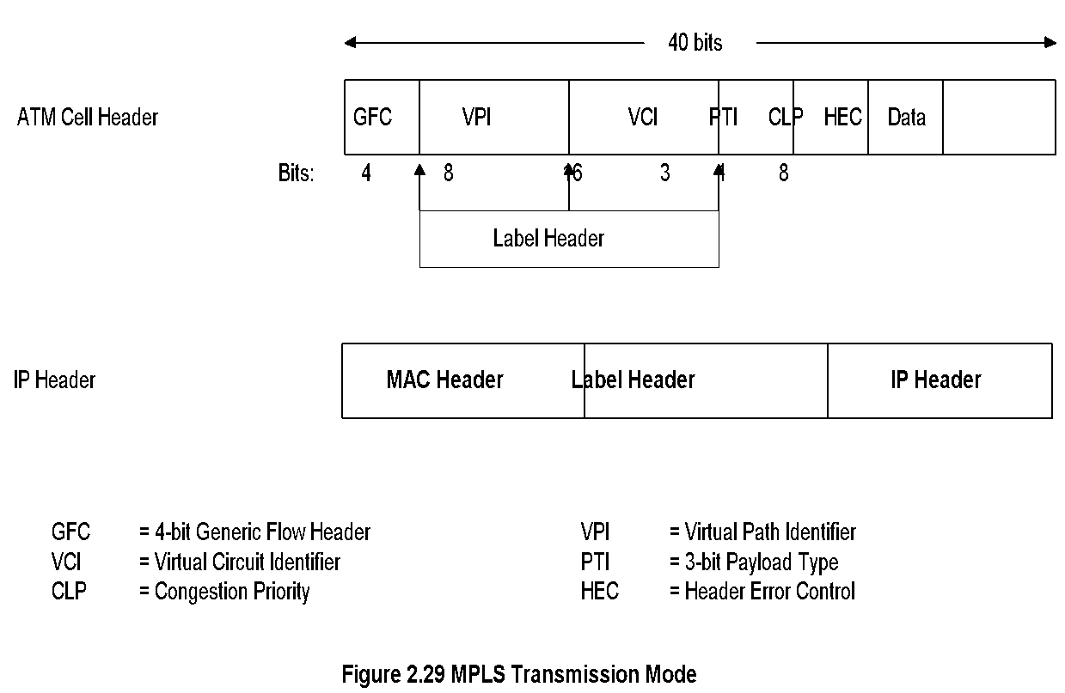
MPLS Transmission Mode
Chapter 2 Review of Information Network and Technology
  Notes
Multiprotocol Label Switching
Combines
  Richness of IP
  Performance of ATM
Label inserted between 2nd and 3rd layers
Compatible with IP and ATM
Network Management: Principles and Practice
© Mani Subramanian 2010
*

Slide 35
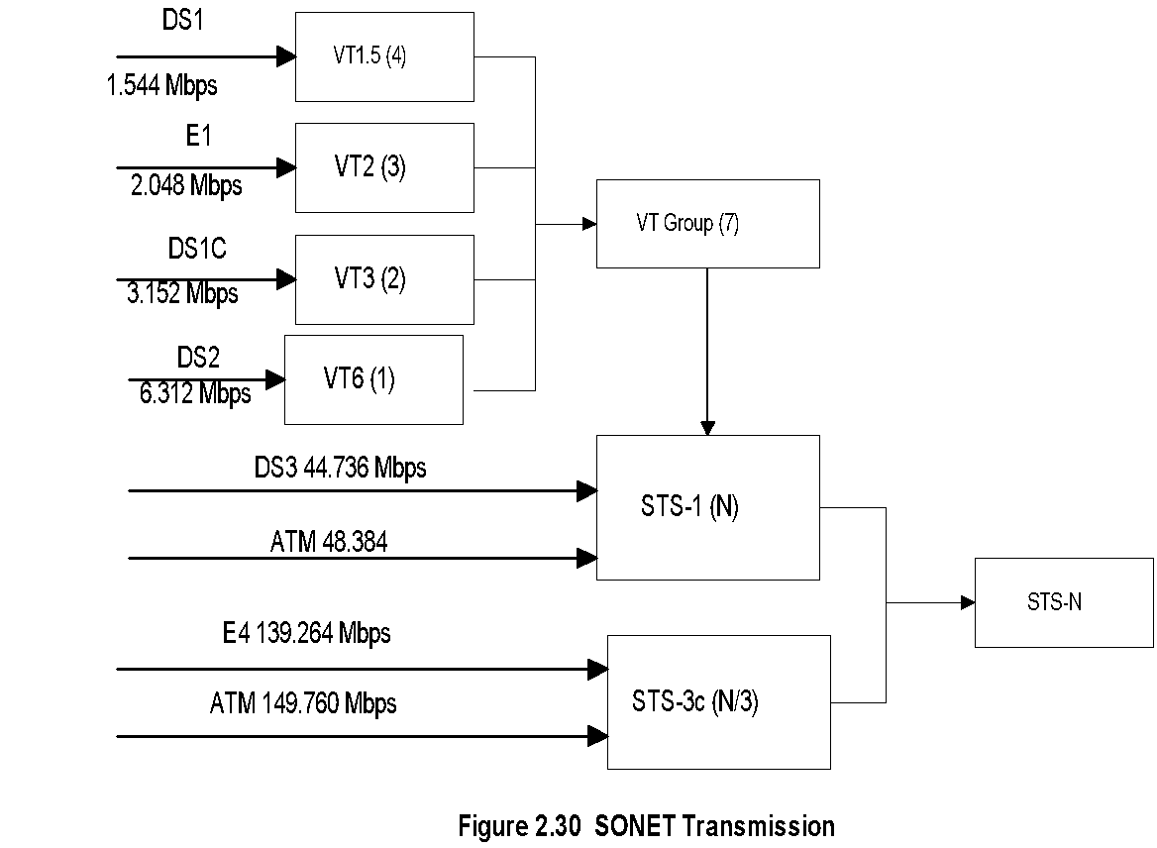
SONET Transmission
Chapter 2 Review of Information Network and Technology
  Notes
Synchronous Optical Network (SONET) based on
Synchronous Digital Hierarchy (SDH)
Incompatible T1 and E1 made into universally
compatible digital network
Uses fiber optics carrying large bandwidth
Basic digital bandwidth STS-1 of 51.84 Mbps
Hierarchy based on STM-N (Synchronous
Transmission Mode): STM-1, STM-4, etc.
Network Management: Principles and Practice
© Mani Subramanian 2010
*

Slide 36
Synchronous Digital Hierarchy
Chapter 2 Review of Information Network and Technology
SONET Signal | SDH Signal | Bit Rate (Mbps)
STS-1 |  | 51.84
STS-3 | STM-1 | 155.52
STS-12 | STM-4 | 622.08
STS-24 |  | 1244.16
STS-48 | STM-16 | 2488.32
STS-192 | STM-64 | 9953.28
STS-768 | STM-256 | 39,814.32
  Notes
Network Management: Principles and Practice
© Mani Subramanian 2010
*

Slide 37
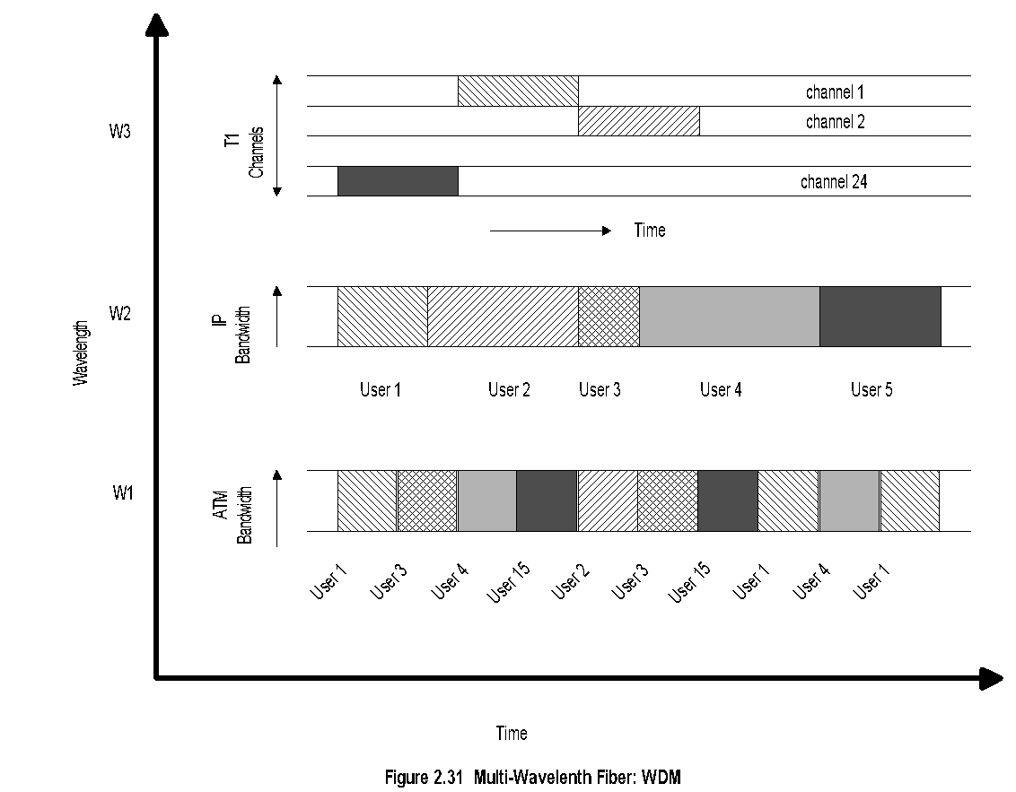
DWDM
Chapter 2 Review of Information Network and Technology
  Notes
(Dense) Wavelength Division Multiplexing
Similar to FDM at lower frequecies
Multiple wavelength carrier can be configured for
multiple protocol transmision.
Network Management: Principles and Practice
© Mani Subramanian 2010
*

Slide 38
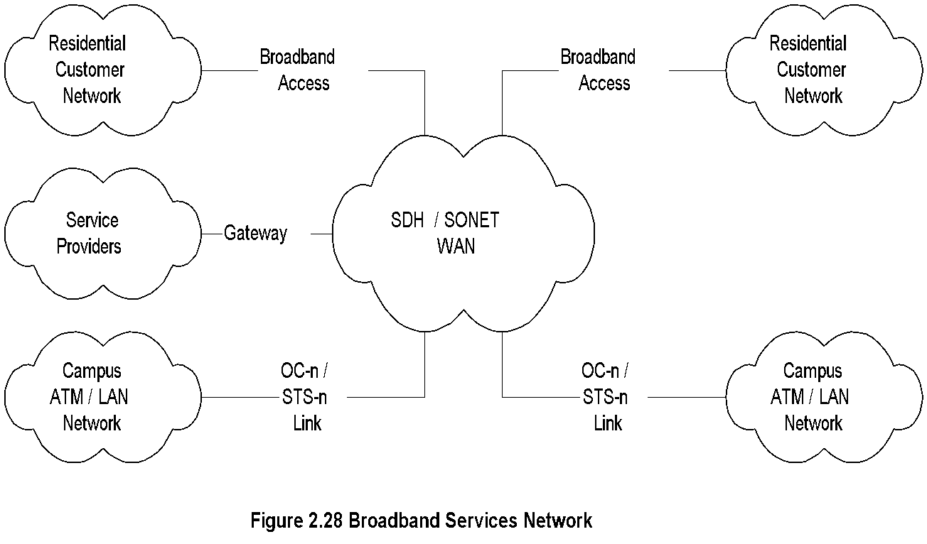
Chapter 2 Review of Information Network and Technology
Broadband Services
  Notes
Integrated services: Voice, video, and data
Narrow band ISDN (Integrated Services Digital Net.)
  Basic rate:2B + D (B channel 64 kbps and
  D channel 16 kbps
  Primary rate: 23B + D channels
Broadband (ISDN) Services uses ATM technology
  SONET (Synchronous Optical Network) or SDH
  (Synchronous Digital Hierarchy)
  Data rate OC-n
    OC-1 51.84 Mbps
    OC-3 155.52 Mbps
  Access technologies:
    Cable
    ADSL (Asymmetric Digital Subscriber Line)
    Fixed Wireless
    Mobile cellular wireless
Network Management: Principles and Practice
© Mani Subramanian 2010
*

