Slide 1
Chapter 1 Data Communications and NM Overview
Chapter 1
Data Communications and
Network Management Overview
Network Management: Principles and Practice
© Mani Subramanian 2010
*
Notes:
*

Slide 2
Chapter 1 Data Communications and NM Overview
Objectives
Telecommunications overview
Data communications overview
Evolution of converged networks
Desktop processors and LAN technology
Client-Server architecture in networking
Internet and intranet
Network communication protocols
OSI and Internet standards
Broadband networks and services
Need for network management and NMS
Operations, Administration, Maintenance, and Provisioning
Network management architecture and organization
Concept of Network Operations Center
Perspectives of network management
Network management system
Look-ahead of network management technology
  Notes
Network Management: Principles and Practice
© Mani Subramanian 2010
*
Notes:
*

Slide 3
Chapter 1 Data Communications and NM Overview
Telephone Network
Modern network evolution from Telephone /
Telecommunications Network
Characteristics of Telephone network
  Reliable - does what is expected of it
  Dependable - always there when you need
  it (remember 911?)
  Good quality (connection) - hearing each
  other well
Reasons for QoS:
  Good planning, design, and implementation
  Good operation and management of
  network
  Migration to new technologies –
    e.g., From analog to digital technology
  Notes
Network Management: Principles and Practice
© Mani Subramanian 2010
*
Notes:
*

Slide 4
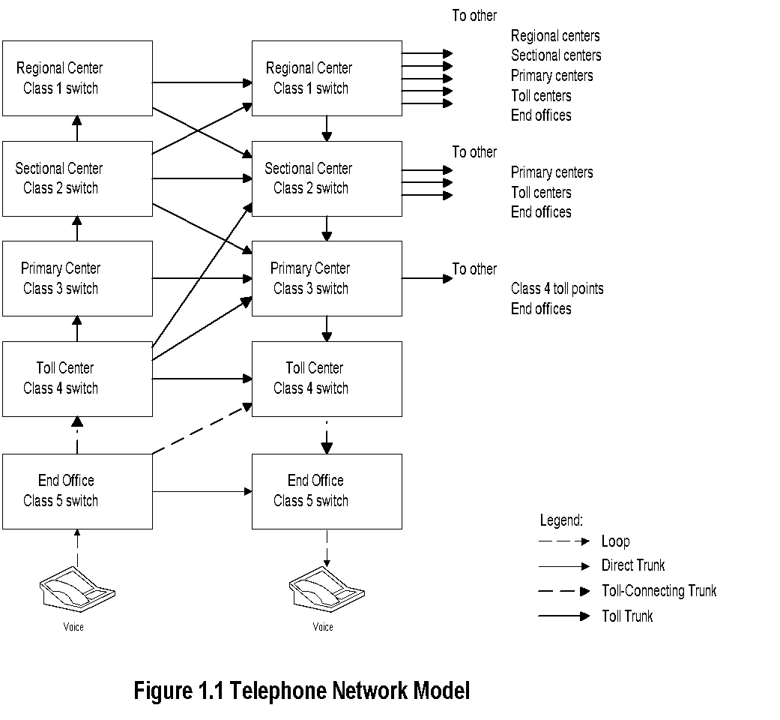
Chapter 1 Data Communications and NM Overview
Telephone Network Model
  Notes
Notice the hierarchy of switches
Primary and secondary routes programmed
Automatic routing
Where is the most likely failure?
Use of Operations Systems to ensure QoS
Network Management: Principles and Practice
© Mani Subramanian 2010
*
Notes:
*

Slide 5
Chapter 1 Data Communications and NM Overview
OSSs / NOC
Operations Support Systems (OSSs) help
manage the operation of networks
OSSs in telecommunications monitor:
  Analog network parameters:
    S/N ratio, transmission loss, call blockage,
    etc.
  Digital network parameters:
    Packet loss, Packet delay, Throughput,
    QoS, etc.
Real-time management of network
Trunk (logical entity between switches / nodes)
maintenance system measures loss and S/N
Trunks not meeting QoS removed before
customer notices poor quality
Traffic measurement systems measure call drops
and blockage. Additional switches or routers
planned to keep the call blockage or drops below
acceptable level
OSSs distributed at central offices and customer
premises
Network management done centrally from
Network Operations Center (NOC)
  Notes
Network Management: Principles and Practice
© Mani Subramanian 2010
*
Notes:
*

Slide 6
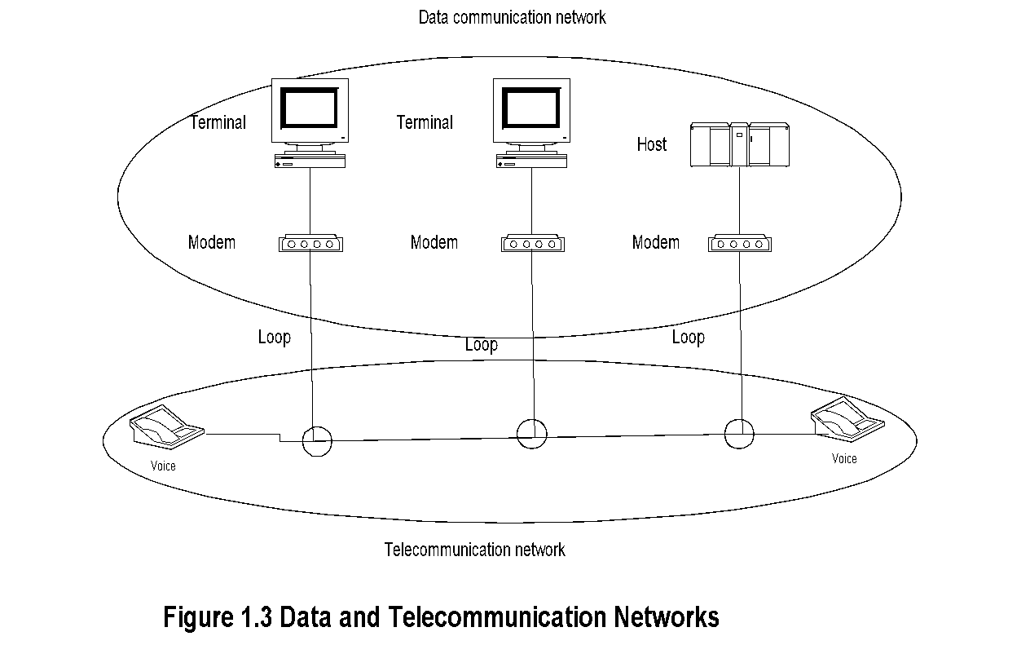
Chapter 1 Data Communications and NM Overview
Data and Telecommunication Network
  Notes
Computer data is carried over long distance by
telephone (telecommunication network)
Output of telephone is analog and output of
computers is digital
Modem is used to “modulate” and “demodulate”
computer data to analog format and back
Clear distinction between the two networks is
getting fuzzier with modern multimedia networks
Network Management: Principles and Practice
© Mani Subramanian 2010
*
Notes:
*

Slide 7
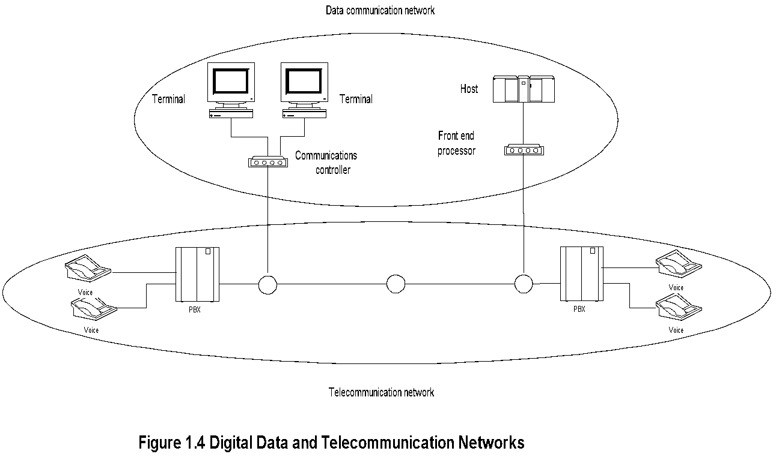
Chapter 1 Data Communications and NM Overview
Migration to Digital Technology
  Notes
Analog transmission migrated to digital
transmission
Analog sources converted to digital signals
CPE (Customer Premises equipment) included
digital PBX (Private Branch Exchanges)
Analog bandwidth hierarchy migrated to
synchronous digital hierarchy
Network Management: Principles and Practice
© Mani Subramanian 2010
*
Notes:
*

Slide 8
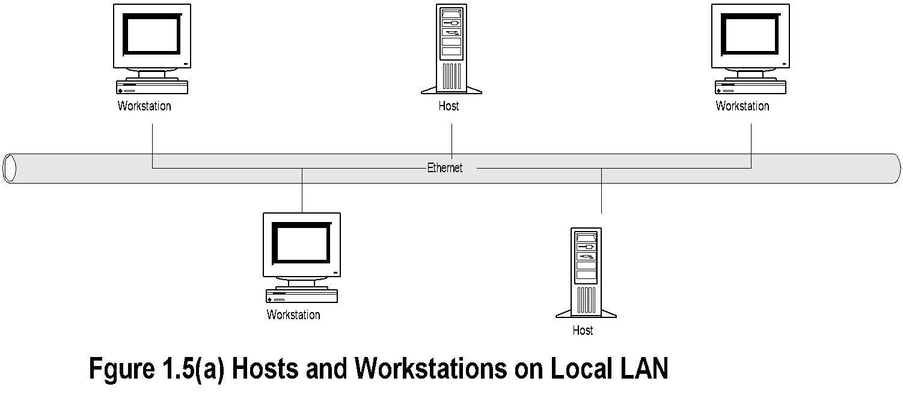
Chapter 1 Data Communications and NM Overview
DCE with LAN
DCE.. Distributed Computing Environment
  Notes
Driving technologies for DCE:
  Desktop processor
  LAN
  LAN - WAN network
Network Management: Principles and Practice
© Mani Subramanian 2010
*
Notes:
*

Slide 9
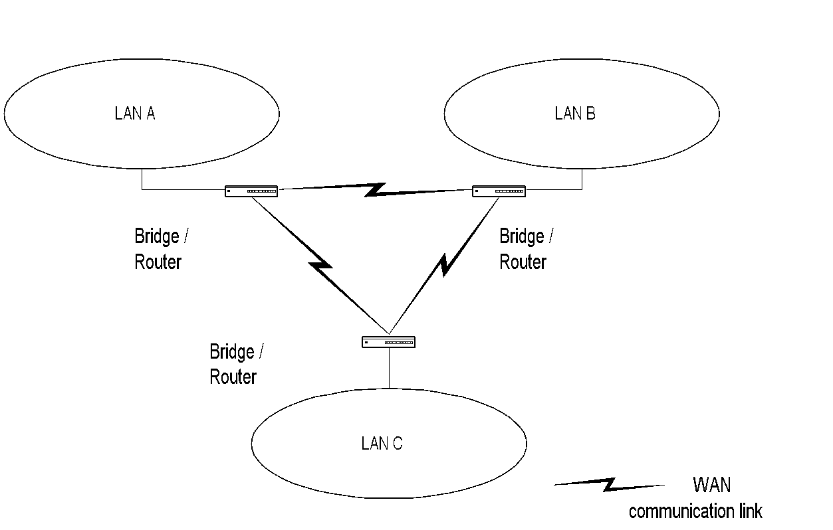
Chapter 1 Data Communications and NM Overview
LAN-WAN Network
Figure 1.5(b) Remote LANs Interconnected by WAN
  Notes
Major impacts of DCE:
  No more monopolistic service provider
  No centralized IT controller
  Hosts doing specialized function
  Client/Server architecture formed the core
  of DCE network
Network Management: Principles and Practice
© Mani Subramanian 2010
*
Notes:
*

Slide 10
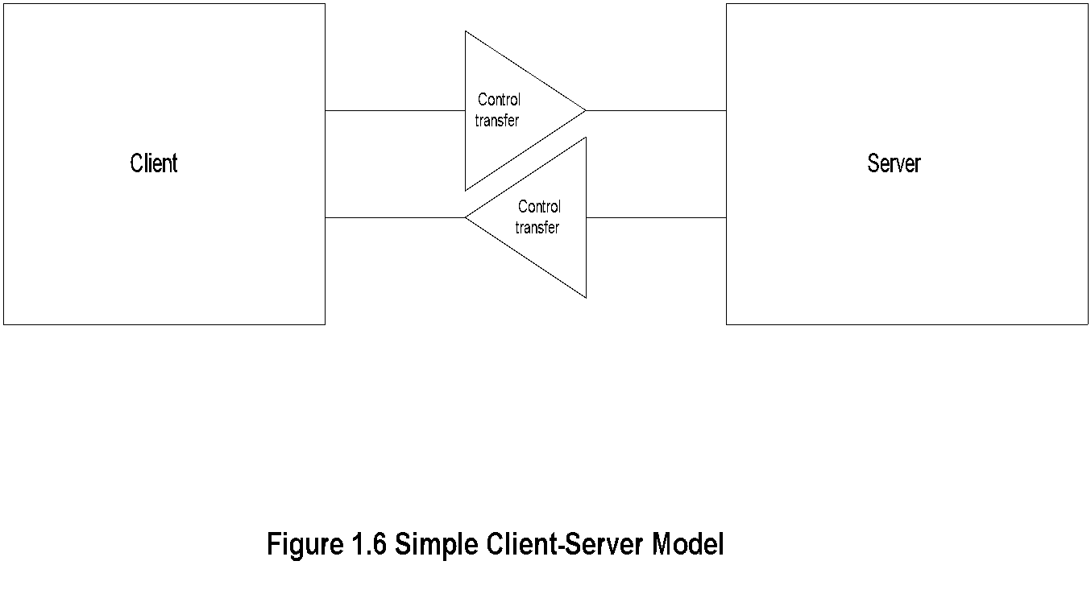
Chapter 1 Data Communications and NM Overview
Client/Server Model
Request
Response
  Notes
Post office analogy; clerk the server, and the
customer the client
Client always initiates requests
Server always responds
Notice that control is handed over to the receiving
entity.
Network Management: Principles and Practice
© Mani Subramanian 2010
*
Notes:
*

Slide 11
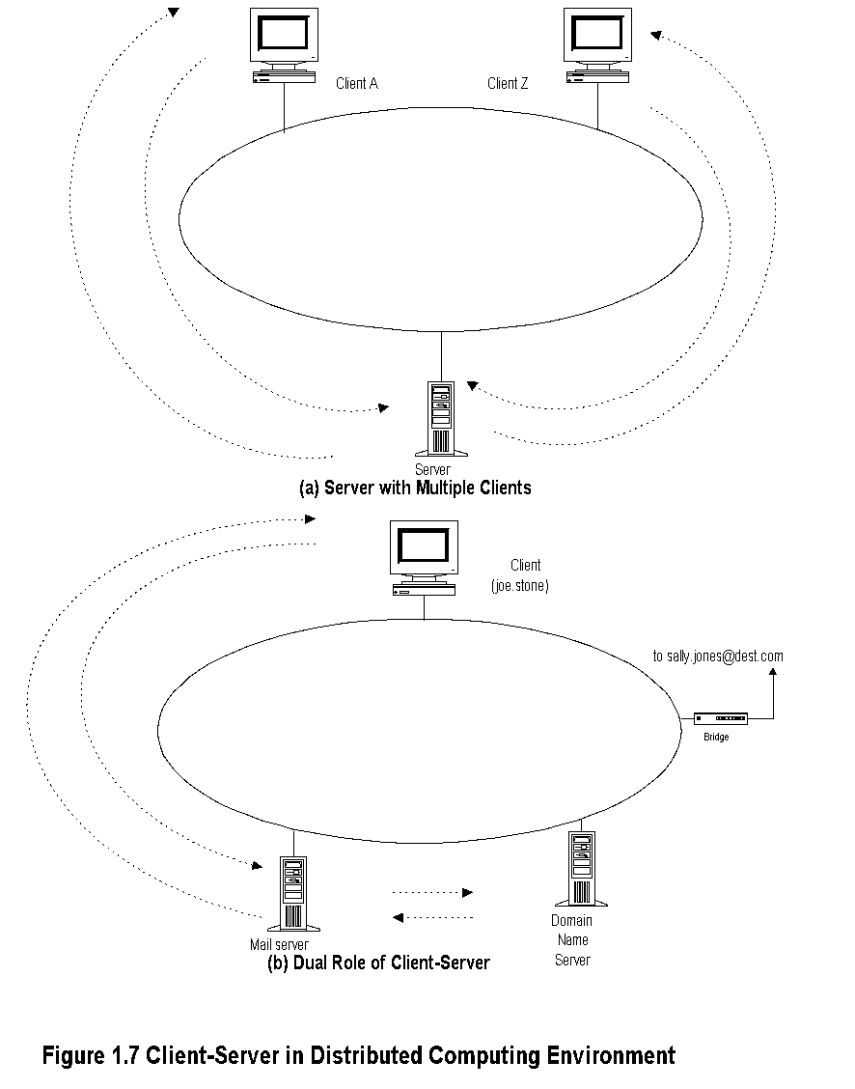
Chapter 1 Data Communications and NM Overview
Client/Server Examples
  Notes
Network Management: Principles and Practice
© Mani Subramanian 2010
*
Notes:
*

Slide 12
Chapter 1 Data Communications and NM Overview
TCP/IP Based Networks
TCP/IP is a suite of protocols
Internet is based on TCP/IP
IP is Internet protocol at the network layer level
TCP is connection-oriented transport protocol
and ensures end-to-end connection
UDP is connectionless transport protocol and
provides datagram service
Internet email and much of the network mgmt.
messages are based on UDP/IP
ICMP part of TCP/IP suite
  Notes
Network Management: Principles and Practice
© Mani Subramanian 2010
*
Notes:
*

Slide 13
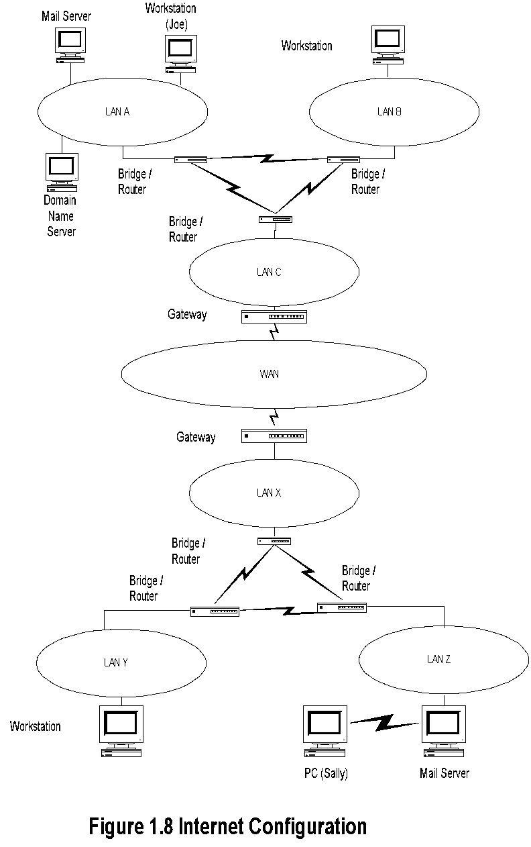
Chapter 1 Data Communications and NM Overview
Internet Configuration
  Notes
Walk through the scenario of email from Joe to Sally
Network Management: Principles and Practice
© Mani Subramanian 2010
*
Notes:
*

Slide 14
Chapter 1 Data Communications and NM Overview
Architecture, Protocols and Standards
Communication architecture
  Modeling of communication systems, comprising
    Functional components
    Operations interfaces between them
Communication protocols
  Operational procedures
    Intra- and inter-modules
Communication standards
  Agreement between manufacturers on protocols
  of communication equipment on
    Physical characteristics
    Operational procedures
  Notes
Examples: (Students to call out)
Network Management: Principles and Practice
© Mani Subramanian 2010
*
Notes:
*

Slide 15
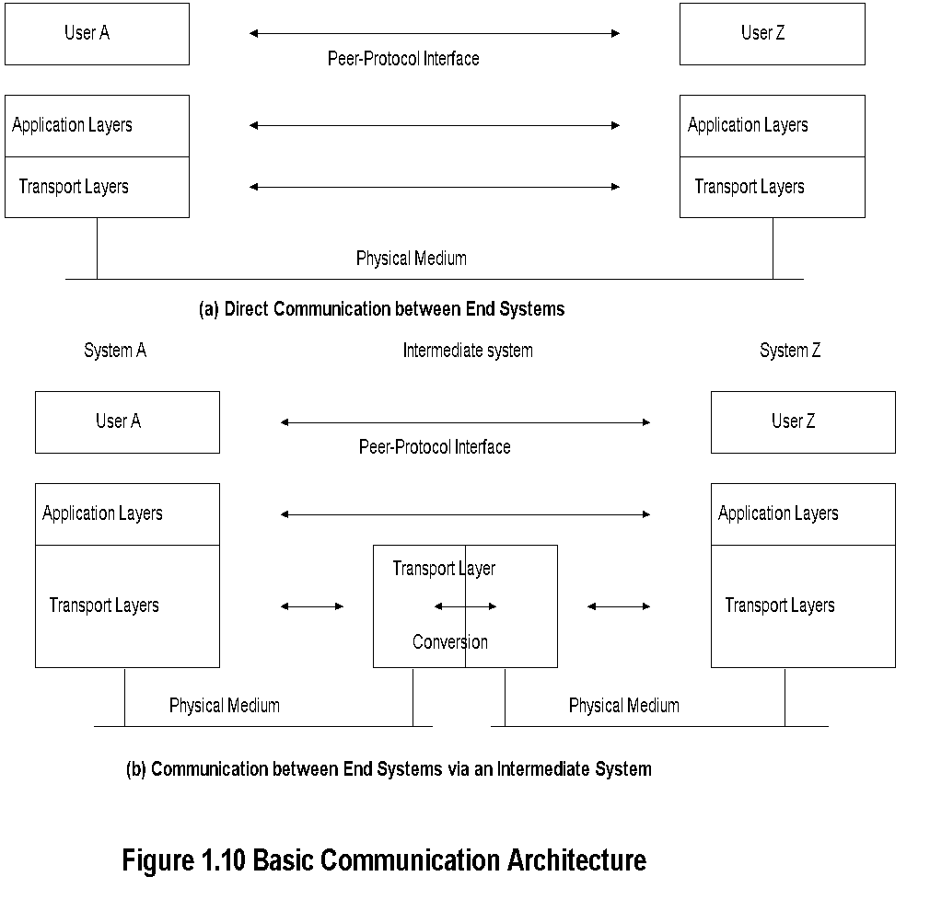
Chapter 1 Data Communications and NM Overview
Communication Architecture
  Notes
Inter-layer interface: user and service provider
Peer-layer protocol interface
Analogy of hearing-impaired student
Role of intermediate systems
Gateway: Router with protocol conversion as
gateway to an autonomous network or subnet
Network Management: Principles and Practice
© Mani Subramanian 2010
*
Notes:
*

Slide 16
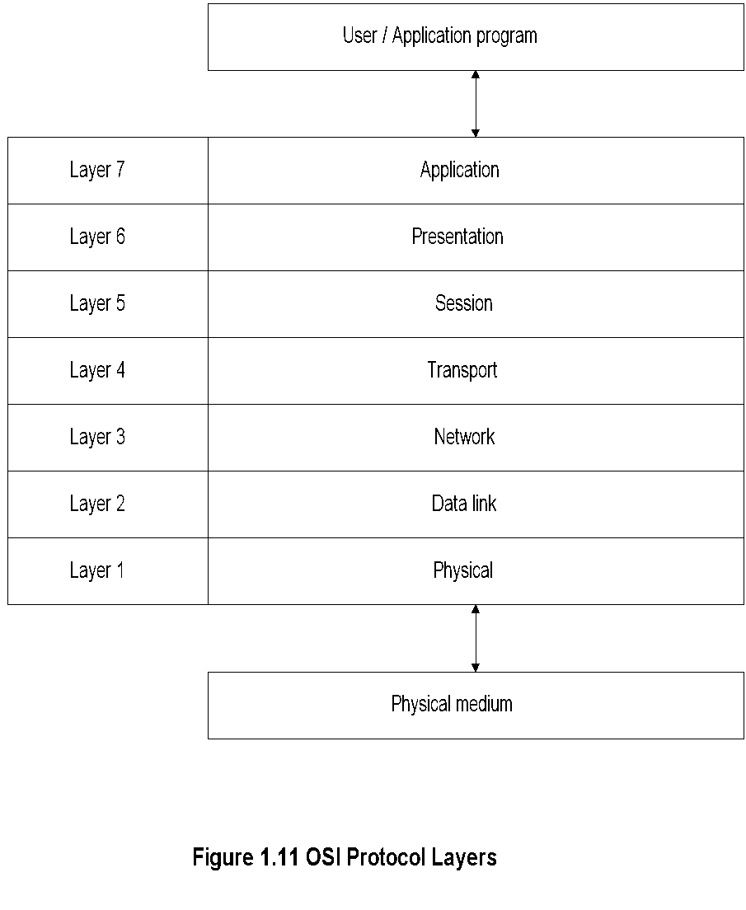
Chapter 1 Data Communications and NM Overview
OSI Reference Model
  Notes
Importance of the knowledge of layer structure
in NM
Network Management: Principles and Practice
© Mani Subramanian 2010
*
Notes:
*

Slide 17
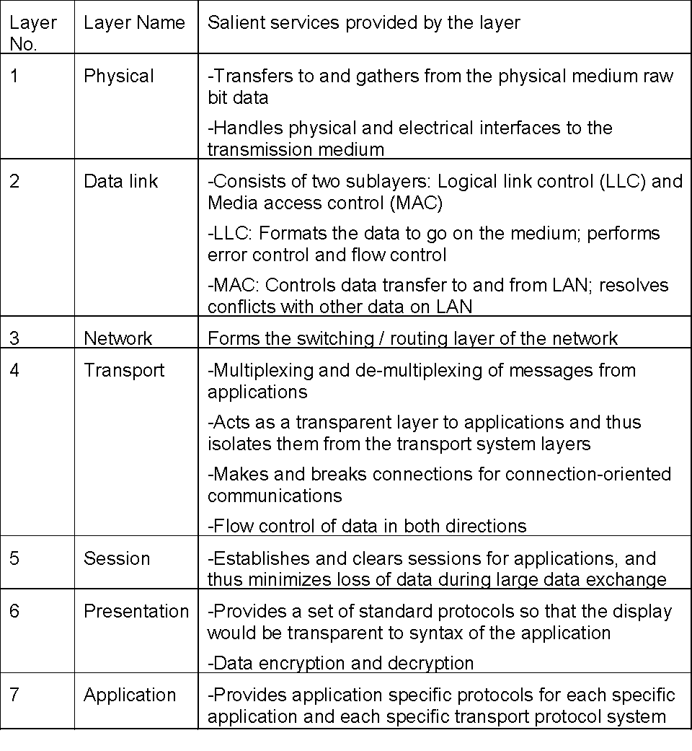
Chapter 1 Data Communications and NM Overview
OSI Layers and Services
  Notes
Importance of services offered by different layers
and the protocol conversion at different layers in NM
Network Management: Principles and Practice
© Mani Subramanian 2010
*
Notes:
*

Slide 18
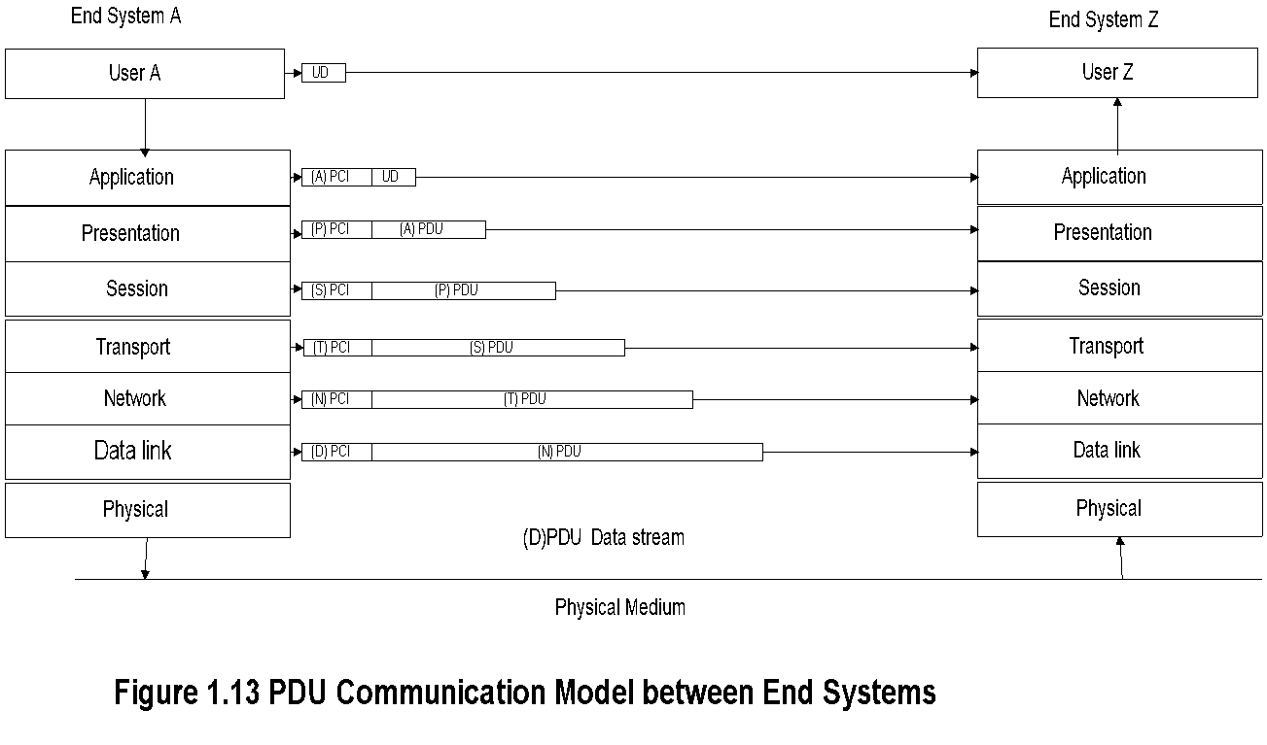
Chapter 1 Data Communications and NM Overview
PDU Communication Model
  Notes
What is the relevance of PDU model in NM?
Network Management: Principles and Practice
© Mani Subramanian 2010
*
Notes:
*

Slide 19
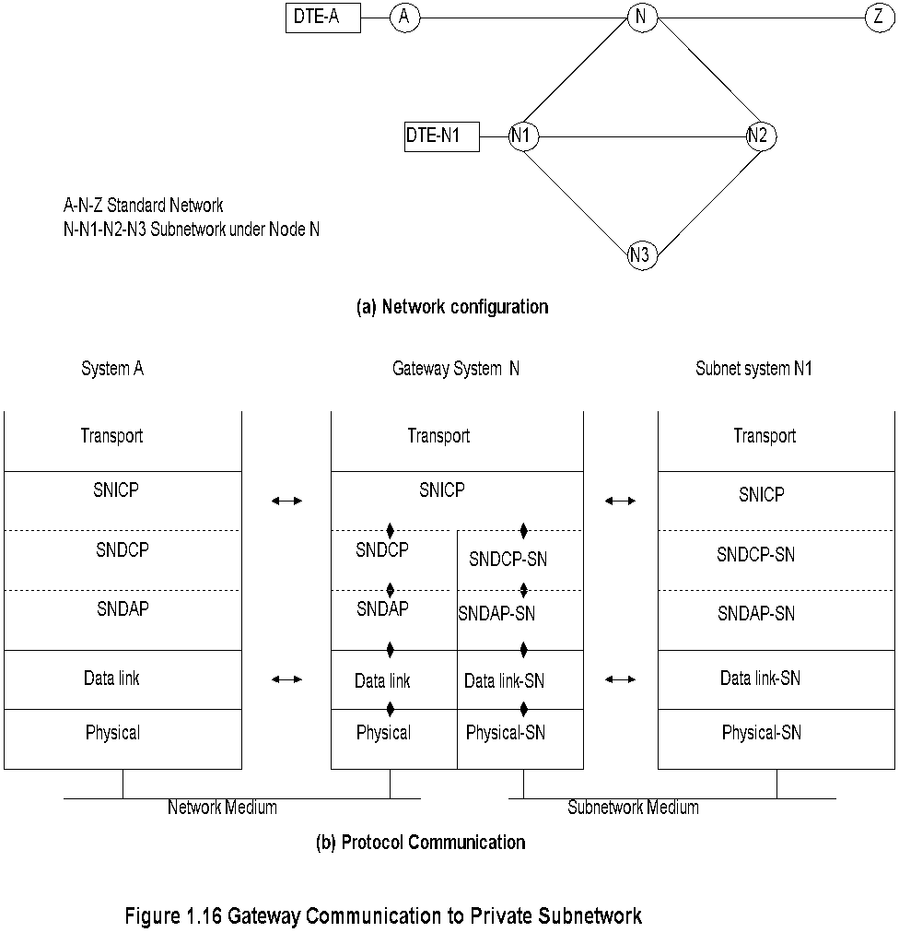
Chapter 1 Data Communications and NM Overview
Gateway
  Notes
cc:mail from a station in Novel IPX network to
an Internet station with SMTP email
Network Management: Principles and Practice
© Mani Subramanian 2010
*
Notes:
*

Slide 20
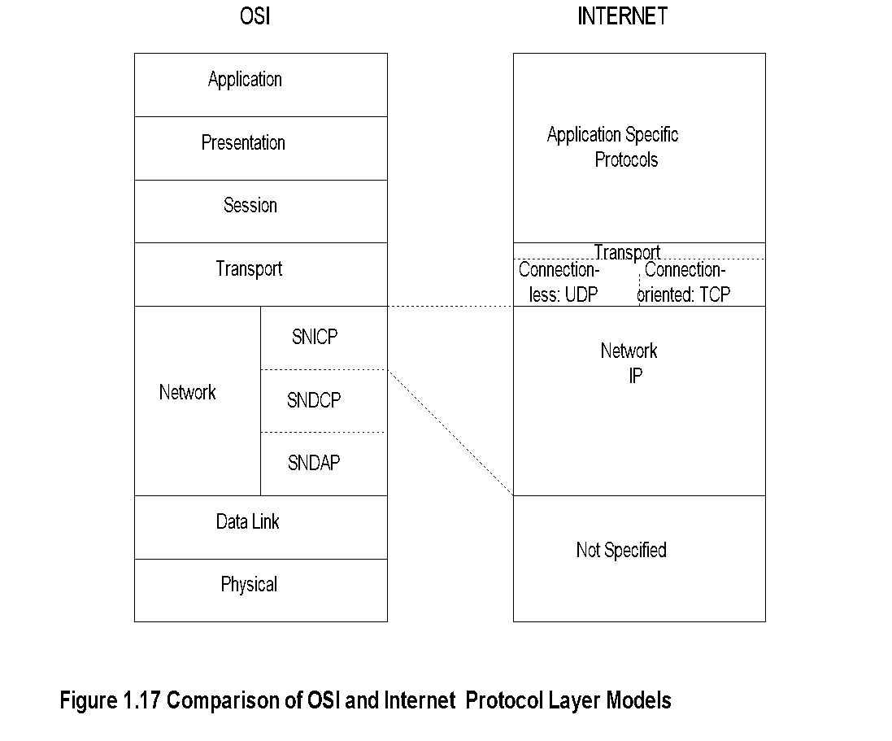
Chapter 1 Data Communications and NM Overview
OSI and Internet
  Notes
Simplicity of Internet; specifies only layers 3 and 4
Integrated application layers over Internet
Commonality of layers 1 and 2 - IEEE standard
Network Management: Principles and Practice
© Mani Subramanian 2010
*
Notes:
*

Slide 21
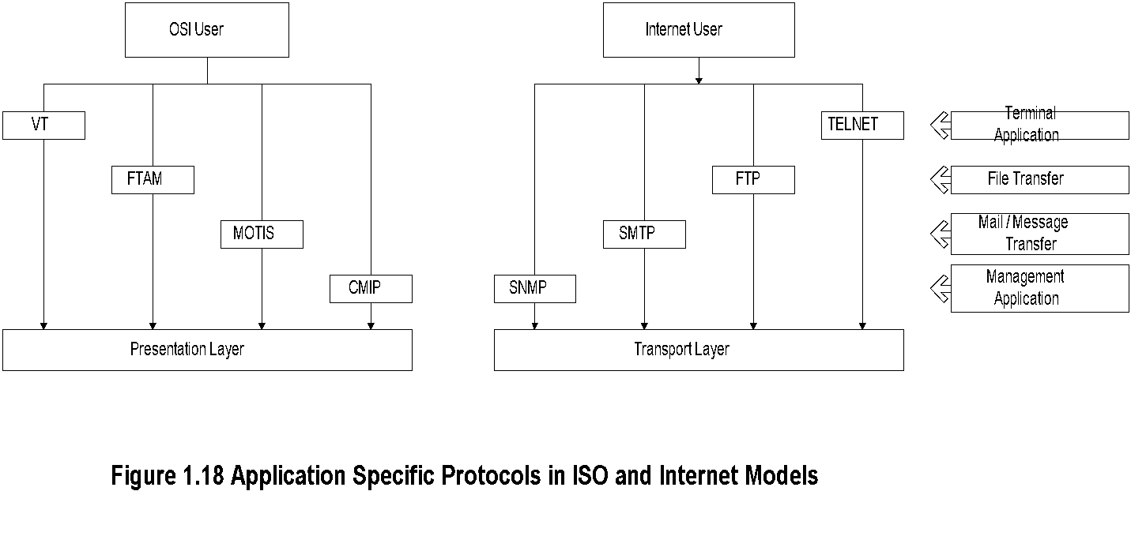
Chapter 1 Data Communications and NM Overview
Application Protocols
  Notes
Internet user OSI user
Telnet Virtual Terminal
File Transfer Protocol File Transfer Access & Mgmt
Simple Mail Transfer Message-oriented Text
Protocol Interchange Standard
Simple Network Common Management
Management Protocol Information Protocol
Network Management: Principles and Practice
© Mani Subramanian 2010
*
Notes:
*

Slide 22
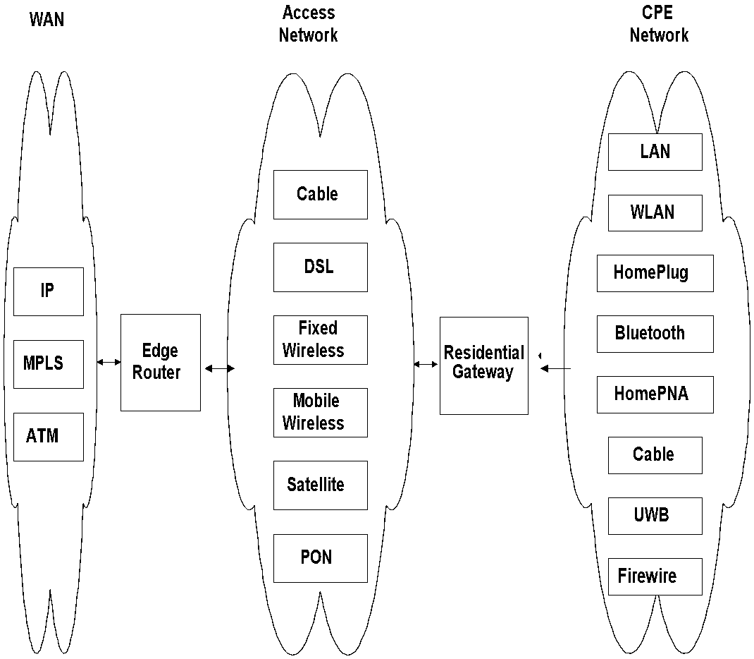
Chapter 1 Data Communications and NM Overview
Broadband Network
Figure 1.19 Broadband Network Segments and Technologies
  Notes
Network Management: Principles and Practice
© Mani Subramanian 2010
*
Notes:
*

Slide 23
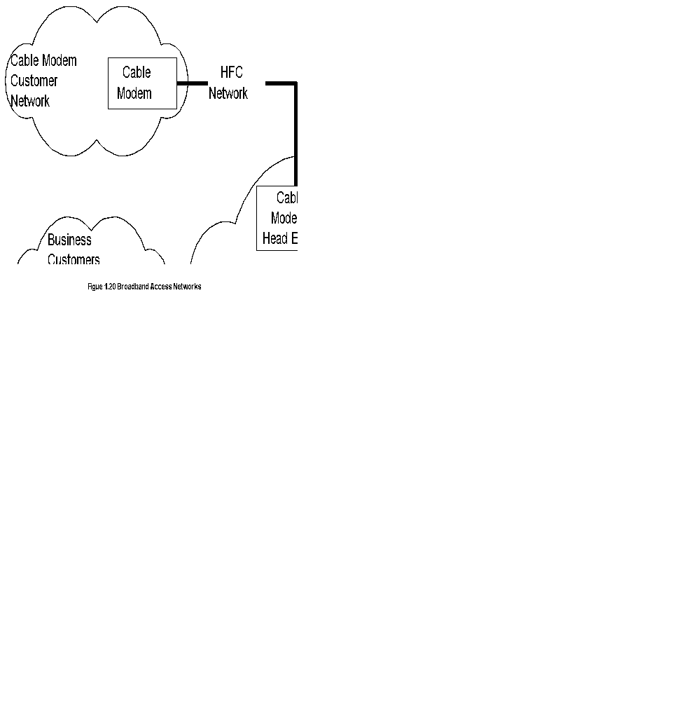
Chapter 1 Data Communications and NM Overview
Broadband Access Networks
  Notes
Network Management: Principles and Practice
© Mani Subramanian 2010
*
Notes:
*

Slide 24
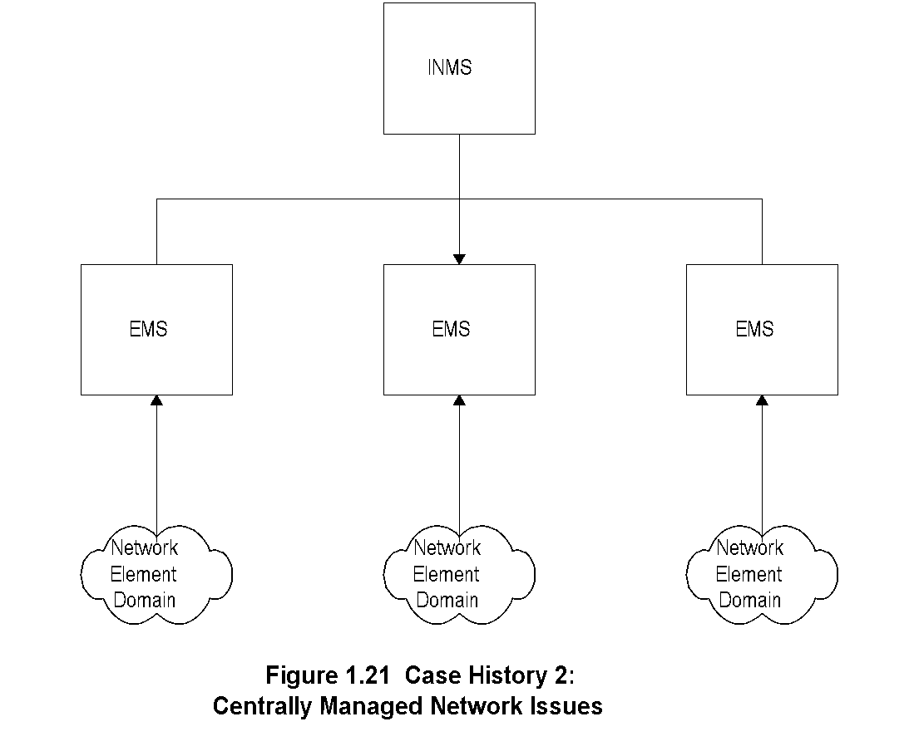
Chapter 1 Data Communications and NM Overview
Centrally Managed Network Issues
  Notes
Network Management: Principles and Practice
© Mani Subramanian 2010
*
Notes:
*

Slide 25
Chapter 1 Data Communications and NM Overview
Some Common Network Problems
Loss of connectivity
Duplicate IP address
Intermittent problems
Network configuration issues
Non-problems
Performance problems
  Notes
Network Management: Principles and Practice
© Mani Subramanian 2010
*
Notes:
*

Slide 26
Chapter 1 Data Communications and NM Overview
Challenges of IT Managers
Reliability
Non-real time problems
Rapid technological advance
Managing client/server environment
Scalability
Troubleshooting tools and systems
Trouble prediction
Standardization of operations - NMS helps
Centralized management vs. “sneaker-net”
  Notes
Network Management: Principles and Practice
© Mani Subramanian 2010
*
Notes:
*

Slide 27
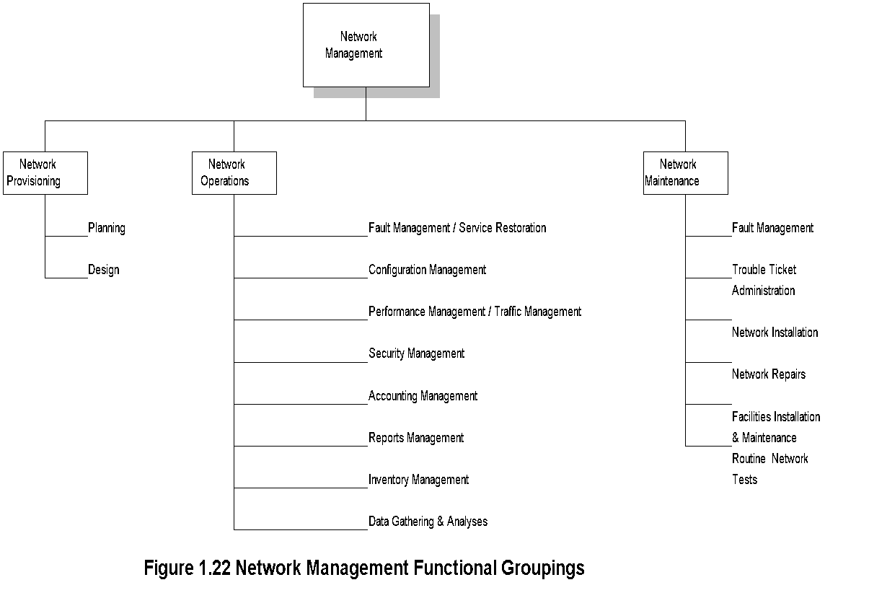
Chapter 1 Data Communications and NM Overview
Network Management
  Notes
OAMP
  Operations
  Administration
  Maintenance
  Provisioning
Network Management: Principles and Practice
© Mani Subramanian 2010
*
Notes:
*

Slide 28
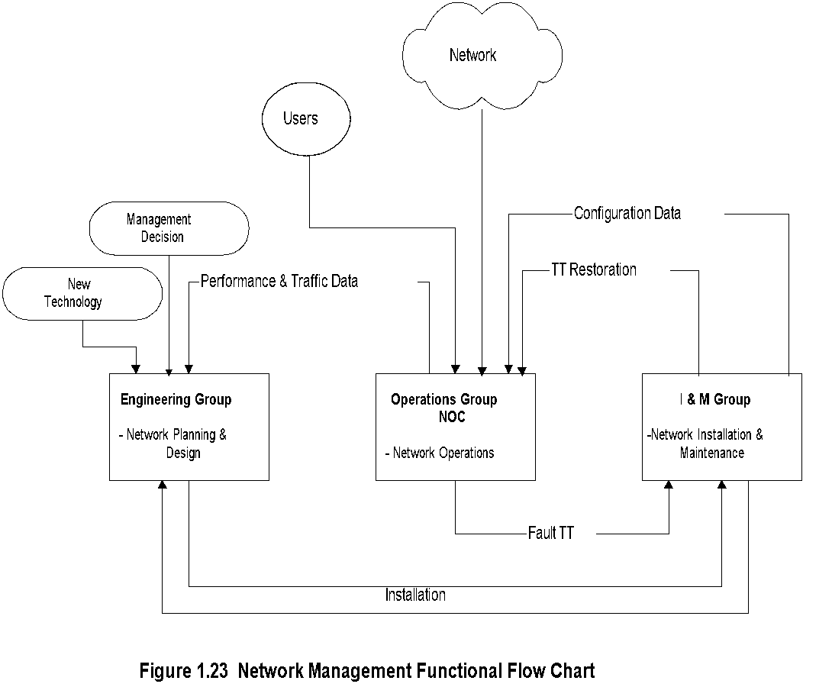
Chapter 1 Data Communications and NM Overview
NM Functional Flow Chart
  Notes
Network Management: Principles and Practice
© Mani Subramanian 2010
*
Notes:
*

Slide 29
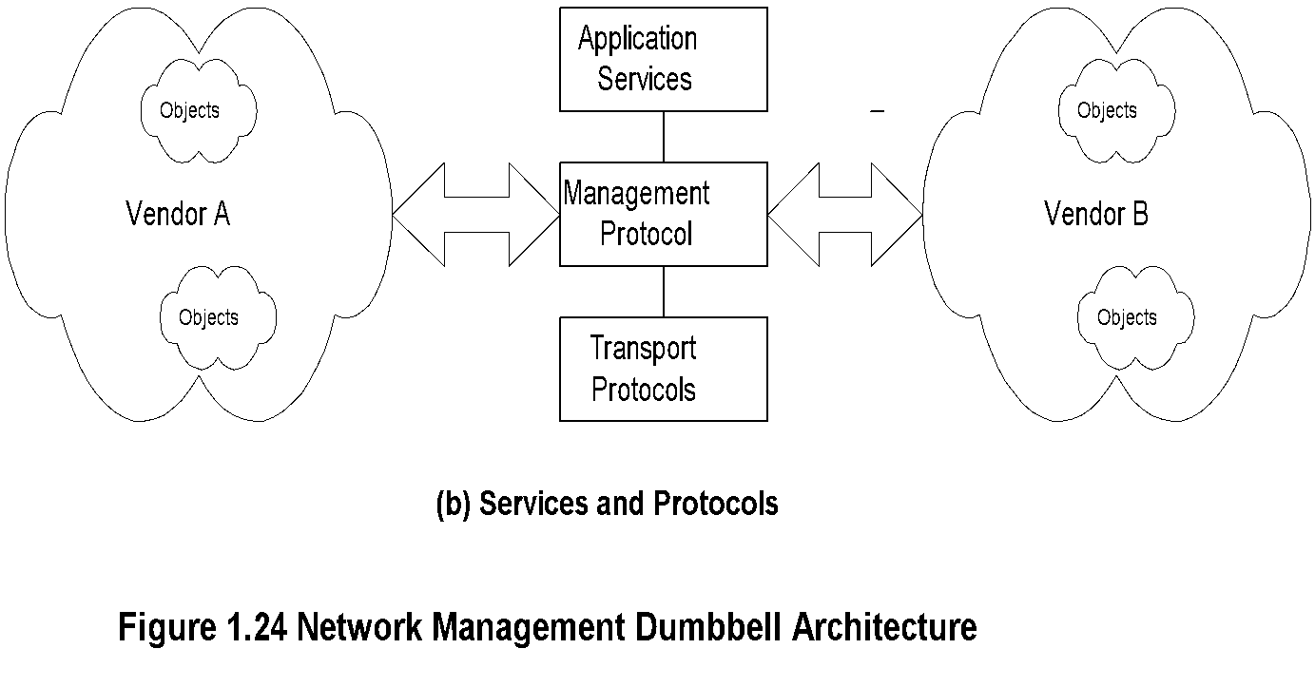
Chapter 1 Data Communications and NM Overview
Dumbbell Architecture
  Notes
Message exchange between NMSs managing
different domains
Network Management: Principles and Practice
© Mani Subramanian 2010
*
Notes:
*

Slide 30
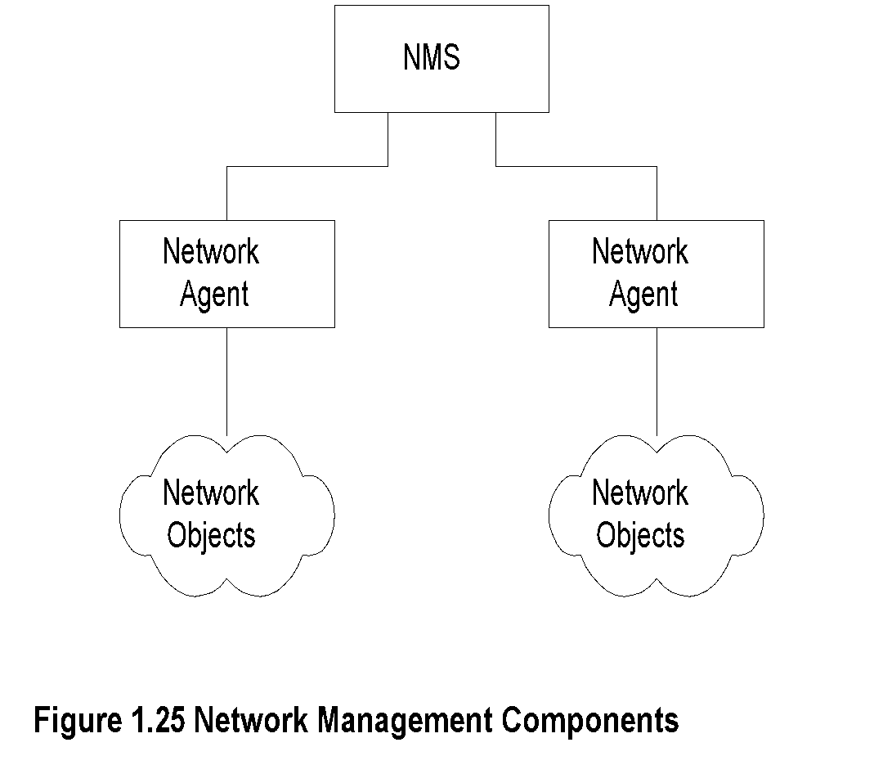
Chapter 1 Data Communications and NM Overview
NM Components
  Notes
Network Management: Principles and Practice
© Mani Subramanian 2010
*
Notes:
*

Slide 31
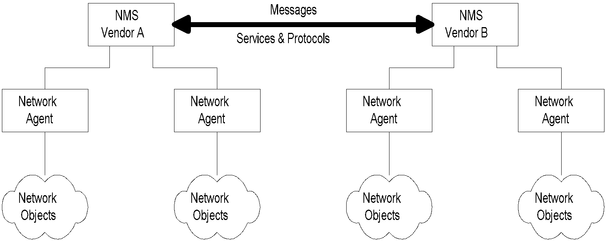
Chapter 1 Data Communications and NM Overview
Interoperability
Figure 1.26 Network Management Interoperability
  Notes
Message exchange between NMSs managing
different domains
Network Management: Principles and Practice
© Mani Subramanian 2010
*
Notes:
*

Slide 32
Chapter 1 Data Communications and NM Overview
Network Management Perspectives
Network Management
Service Management
Service and Network Provisioning
Application Management
e-Commerce Management
Inventory Management
Integrated Management
Business Management
Information Management
Management Protocols
Management Technologies
  Notes
Network Management: Principles and Practice
© Mani Subramanian 2010
*
Notes:
*

Slide 33
Chapter 1 Data Communications and NM Overview
Infrastructure Perspective
Domains
Protocols
Technologies
Transmission Media
Transmission Modes
Service Functions
  Notes
Network Management: Principles and Practice
© Mani Subramanian 2010
*
Notes:
*

Slide 34
Chapter 1 Data Communications and NM Overview
Service Perspective
Communication Services
Computing Services
Content Services
IT Services
Application Services
  Notes
Network Management: Principles and Practice
© Mani Subramanian 2010
*
Notes:
*

Slide 35
Chapter 1 Data Communications and NM Overview
Status and Future Trends
Status:
  SNMP management
  Limited CMIP management
  Operations systems
  Polled systems
Current Focus:
  Object-oriented approach
  Service and policy management
  Business management
  Web-based client management
Future Trends
  Web-based management?
  XML based management
  Notes
Network Management: Principles and Practice
© Mani Subramanian 2010
*
Notes:
*

