Slide 1
Chapter 5
SNMPv1 Network Management:
Communication and Functional Models

Slide 2
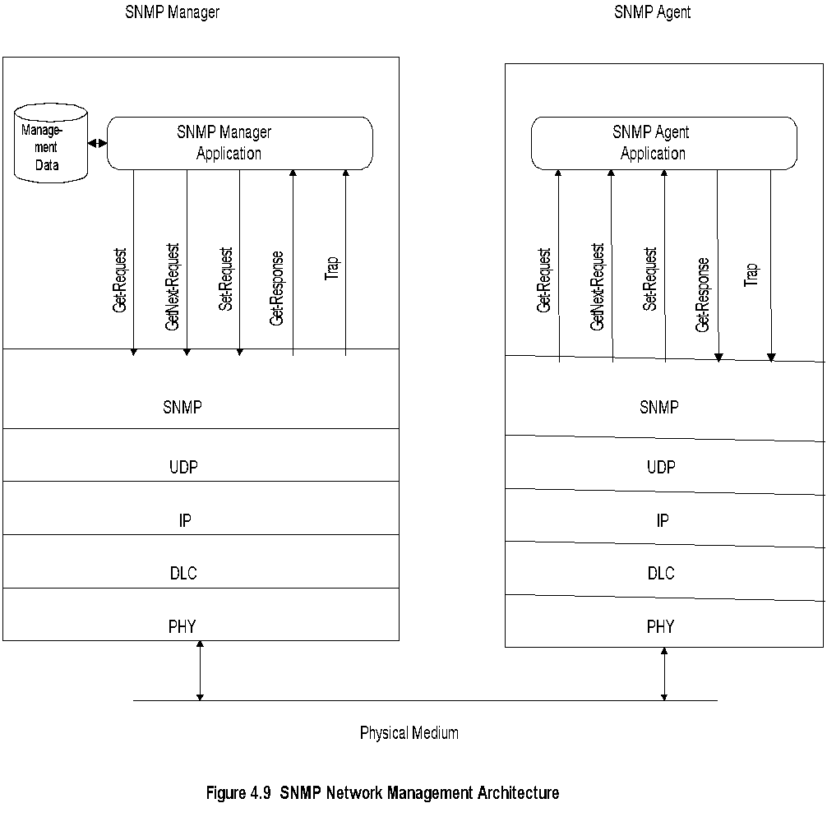
SNMP Architecture
Notes:
Truly simple network management protocol
Five messages, 3 from manager and 2 from agent

Slide 3
SNMP Messages
Notes :
Generic trap
  coldStart
  warmStart
  linkDown
  linkUp
  authenticationfailure
  egpNeighborLoss
  enterpriseSpecific
Specific trap
  For special measurements such as statistics
Time stamp: Time since last initialization
Get-Request
Get-Next-Request
Set-Request
Get-Response
Trap
  Generic trap
  Specific trap
  Time stamp

Slide 4
Administrative Model
Based on community profile and policy
SNMP Entities:
  SNMP application entities
  - Reside in management stations and network elements
  - Manager and agent
  SNMP protocol entities
  - Communication processes (PDU handlers)
  - Peer processes that support application entities

Slide 5
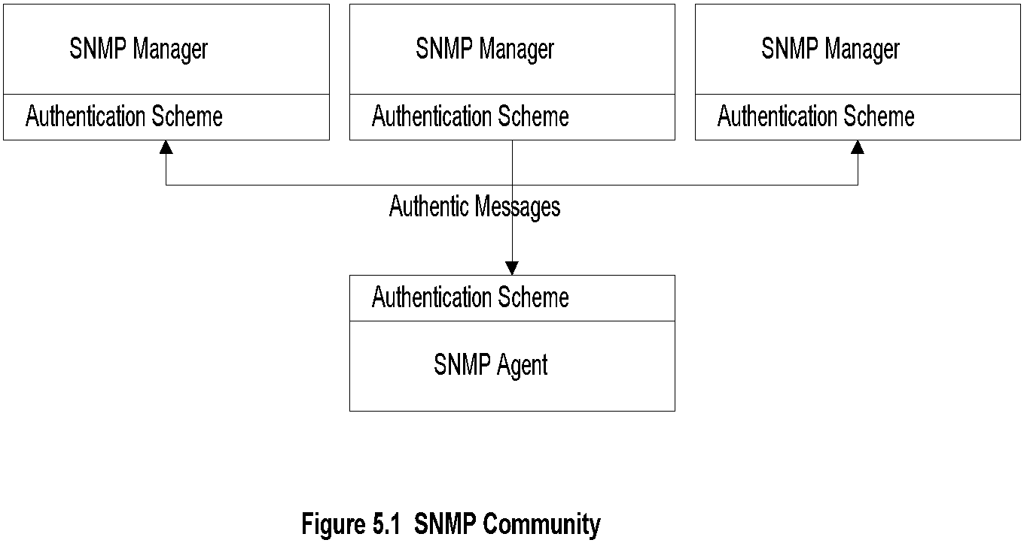
SNMP Community
Notes :
Security in SNMPv1 is community based
Authentication scheme in manager and agent
Community: Pairing of two application entities
Community name: String of octets
Two applications in the same community
communicate with each other
Application could have multiple community names
Communication is not secured in SNMPv1 - no encryption

Slide 6
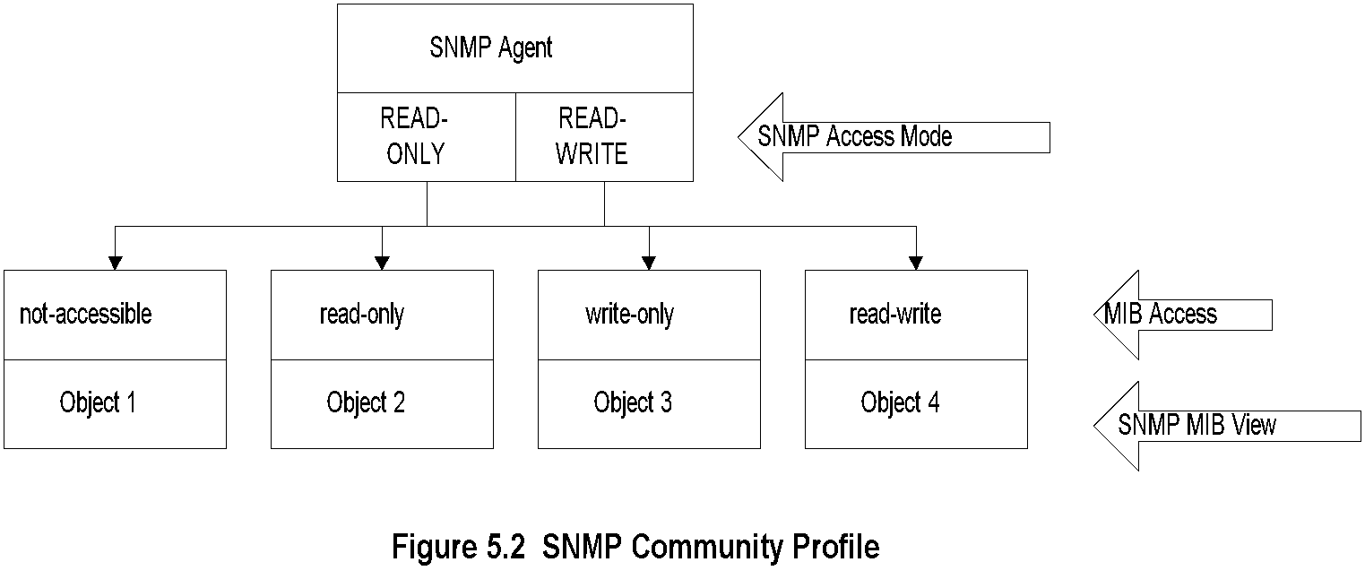
Community Profile

Slide 7
Community Profile- cont.
Notes :
MIB view
  An agent is programmed to view only a subset of managed objects of a network element
Access mode
  Each community name is assigned an access mode: read-only and read-write
Community profile: MIB view + SNMP access mode
Operations on an object determined by community profile and the access mode of the object
Total of four access privileges
Some objects, such as table and table entry are non-accessible

Slide 8
Administrative Model
Administrative model is SNMP access policy
SNMP community paired with SNMP community profile is SNMP access policy
Notes :
Parameters:
Community / communities
Agent / Agents
Manager / Managers

Slide 9
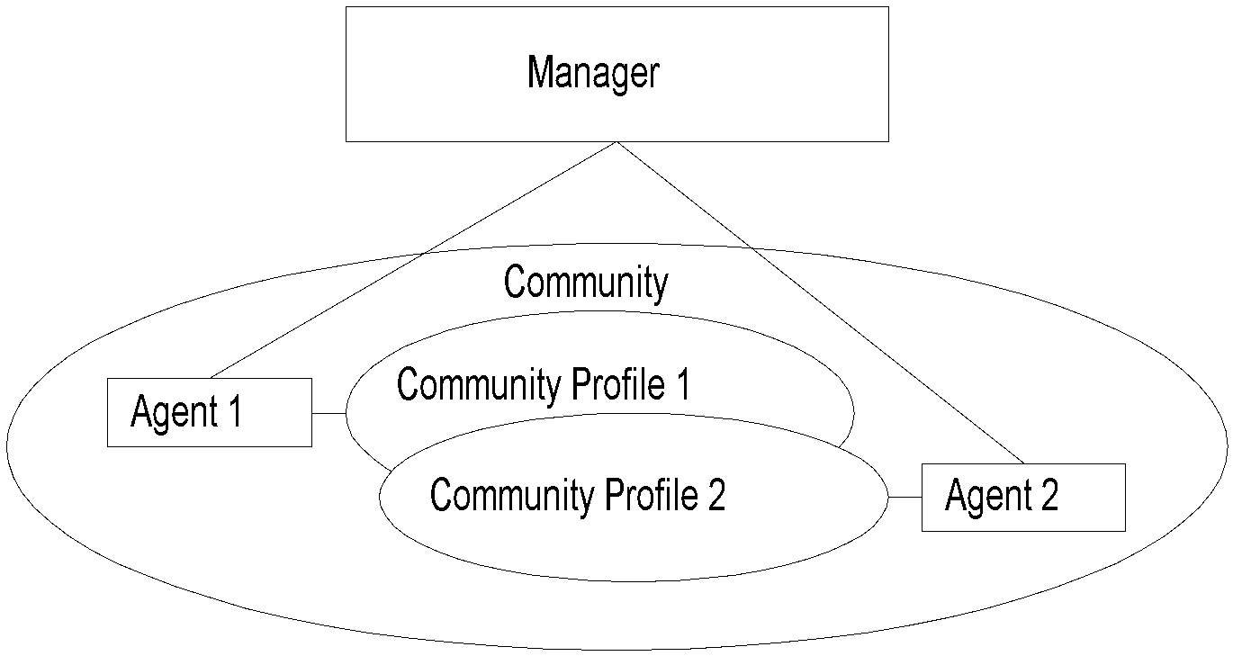
Access Policy
Notes :
Manager manages Community 1 and 2 network components via Agents 1 and 2
Agent 1 has only view of Community Profile 1,e.g., Cisco components
Agent 2 has only view of Community Profile 2,e.g., 3Com components
Manager has total view of both Cisco and 3Com components

Slide 10
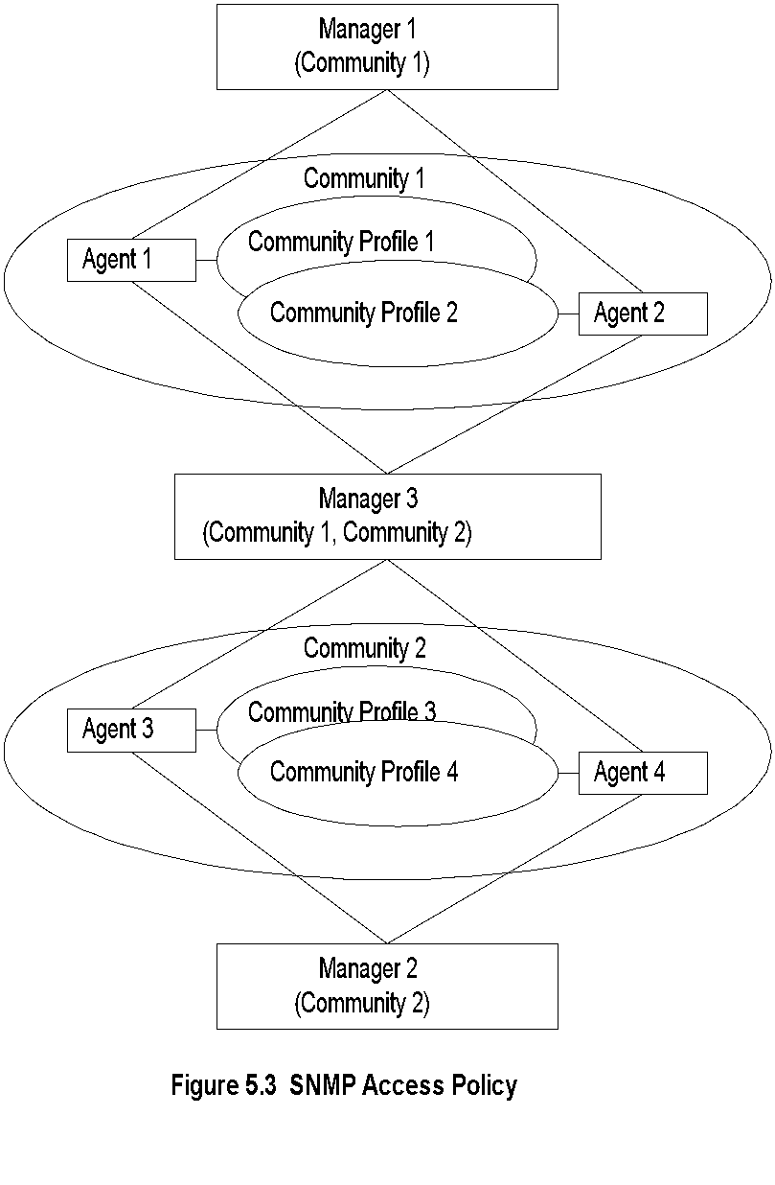
Generalized Administrative Model
Notes :
Manager 1 manages community 1, manager 2 community 2, and manager 3 (MoM) both communities 1 and 2

Slide 11
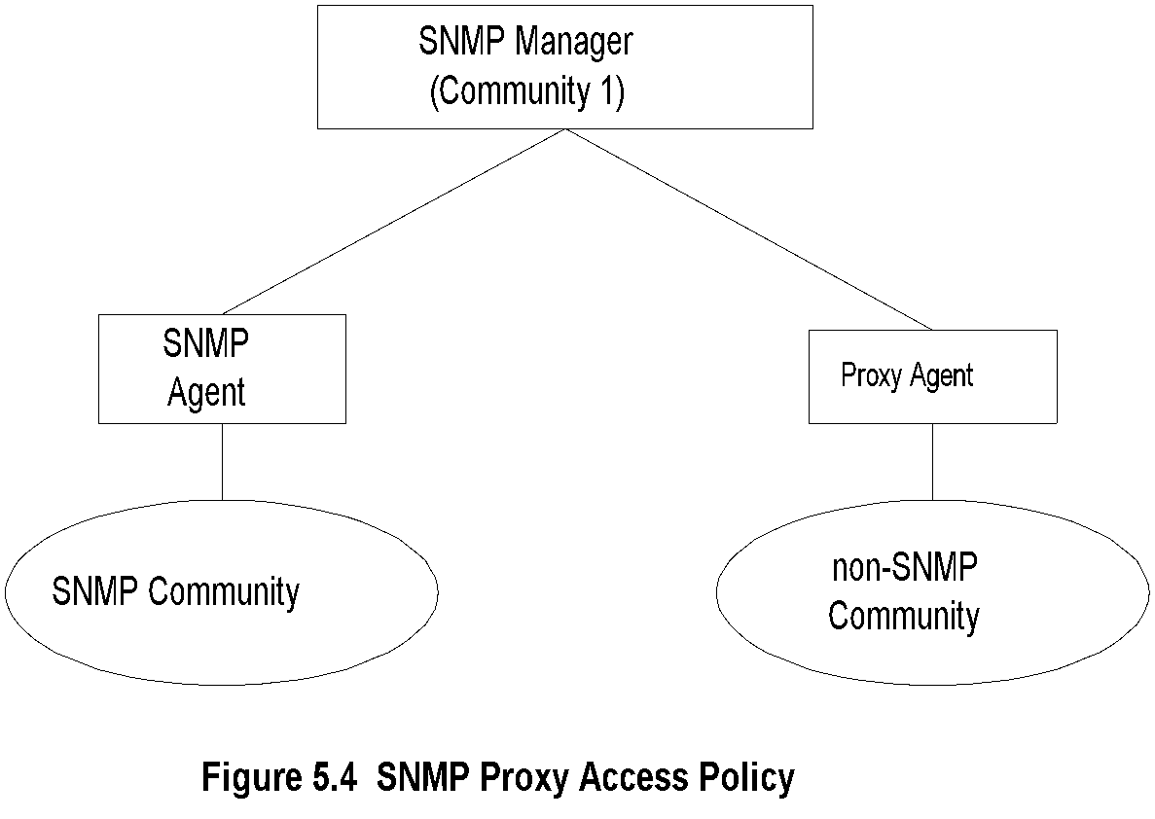
Proxy Access Policy
Notes :
Proxy agent enables non-SNMP community elements to be managed by an SNMP manager.
An SNMP MIB is created to handle the non-SNMP objects.

Slide 12
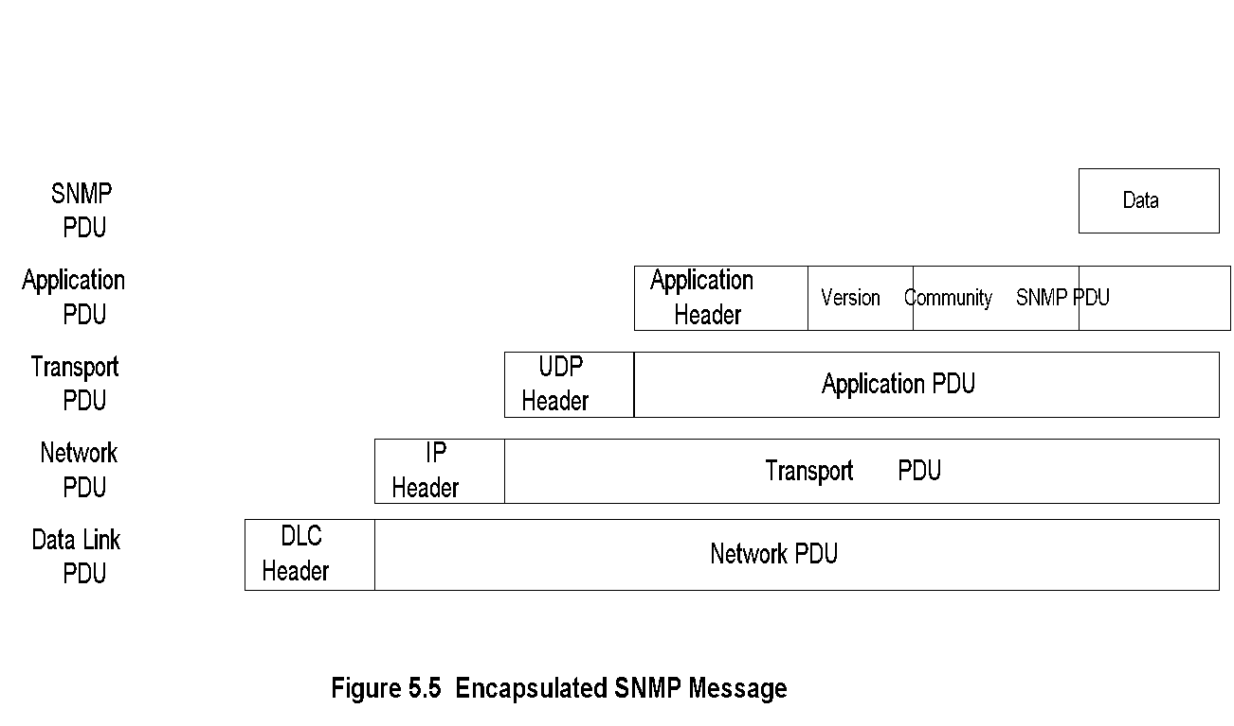
Protocol Entities
Notes :
Protocol entities support application entities
Communication between remote peer processes
Message consists of:
  Version identifier
  Community name
  Protocol Data Unit
Message encapsulated and transmitted

Slide 13
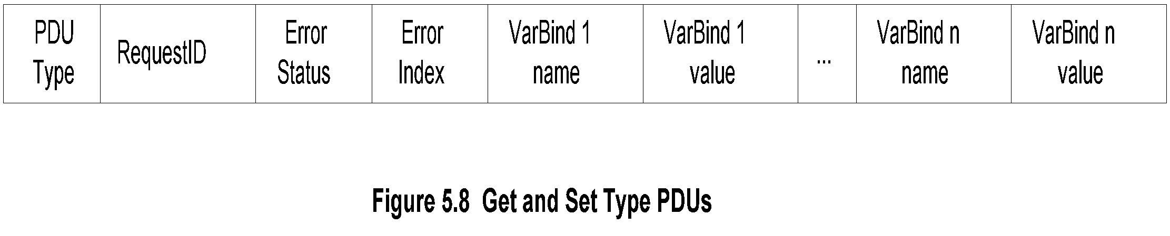
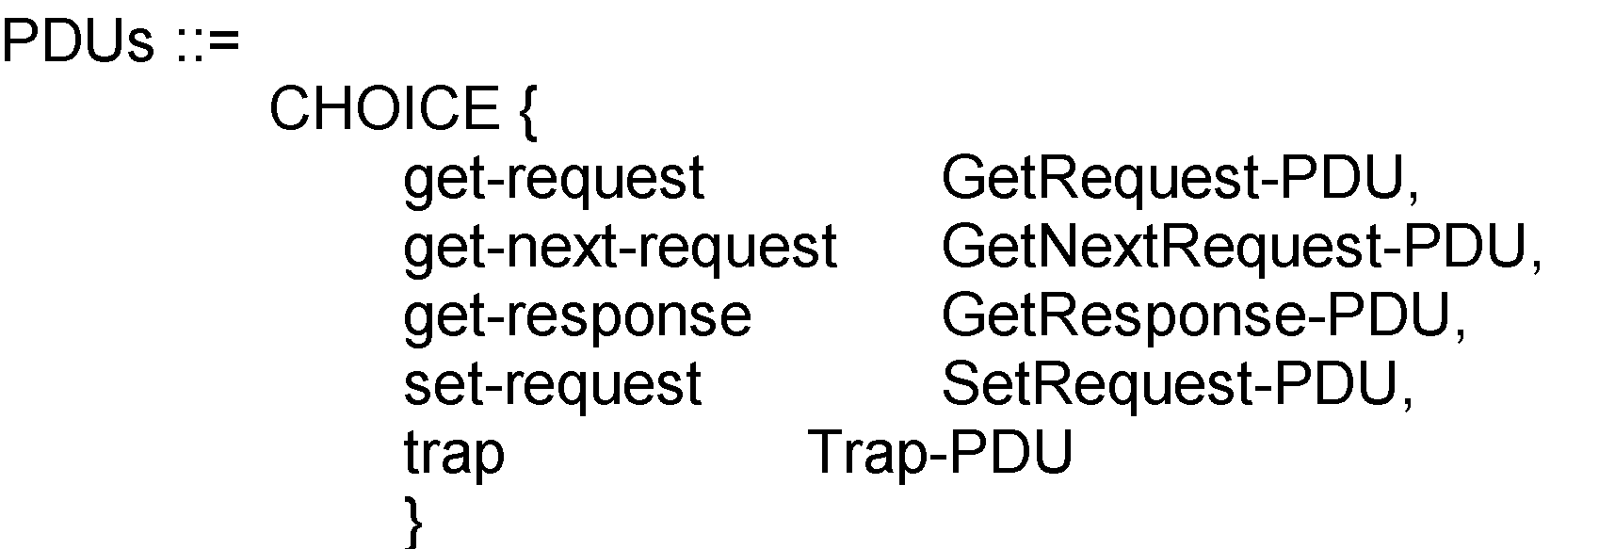
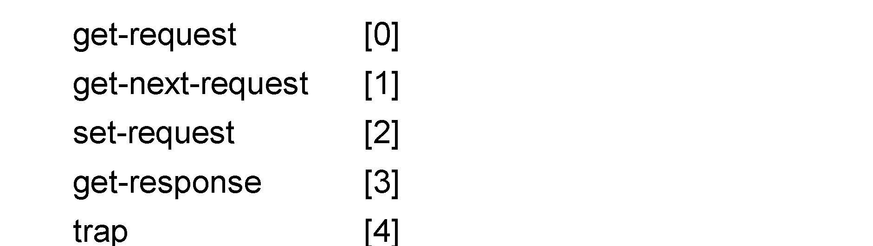
Get and Set PDU
Notes :
VarBindList: multiple instances of VarBind pairs
PDU Types: enumerated INTEGER

Slide 14
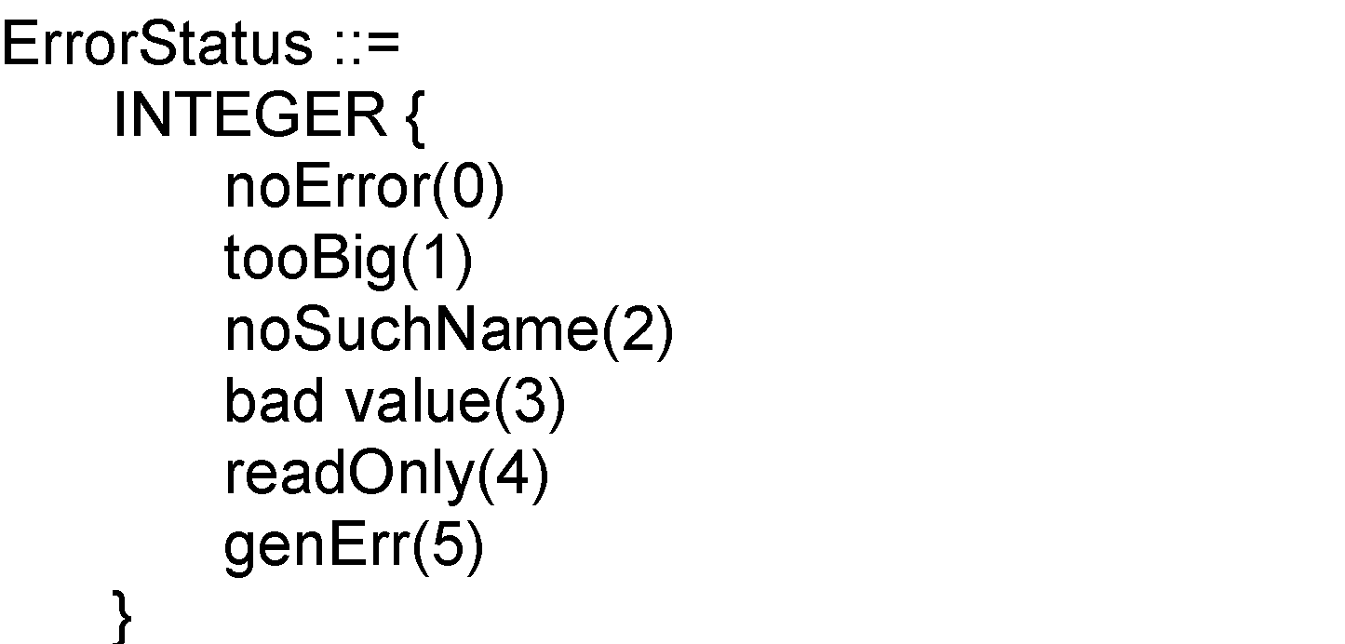
Error in Response
Error Index: No. of VarBind that the first error occurred

Slide 15
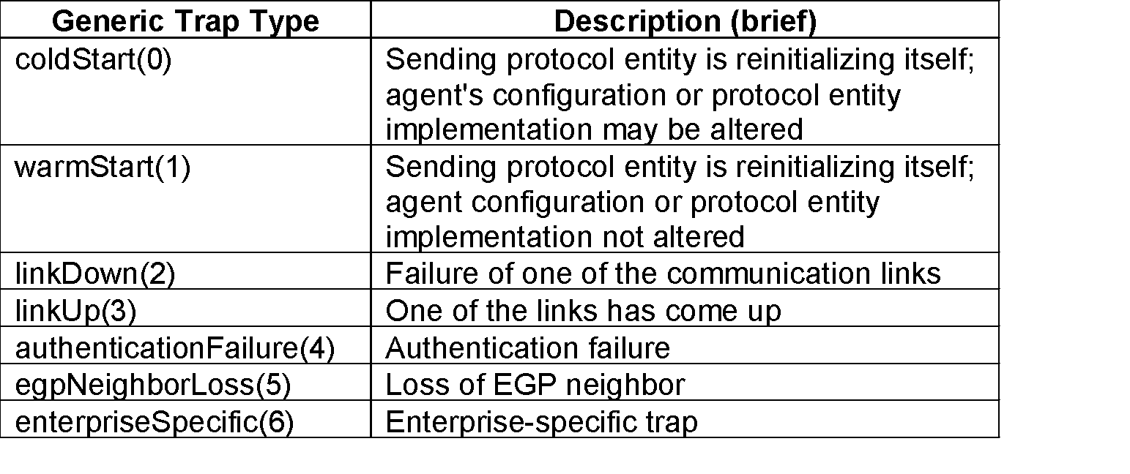
Trap PDU
Figure 5.8 Get and Set Type PDUs
Table 5.1 Generic Traps

Slide 16
Trap PDU-cont.
Notes :
Enterprise and agent address pertain to the system generating the trap
Seven generic traps specified by enumerated INTEGER
Specific trap is a trap not covered by enterprise specific trap
Timestamp indicates elapsed time since last re-initialization

Slide 17
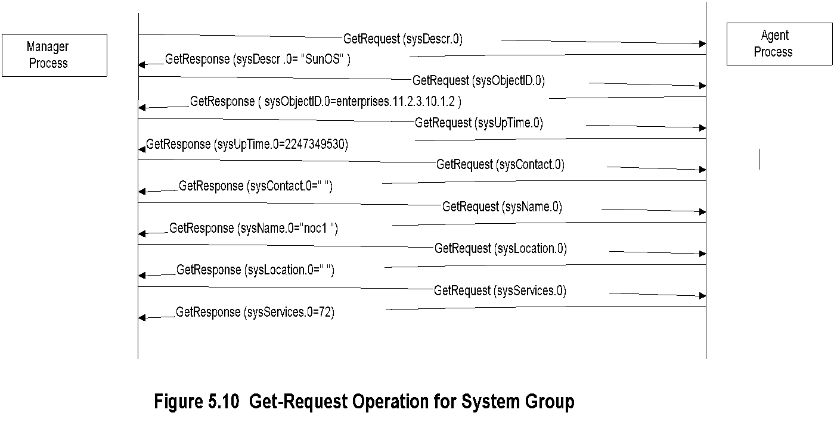
SNMP Operations

Slide 18
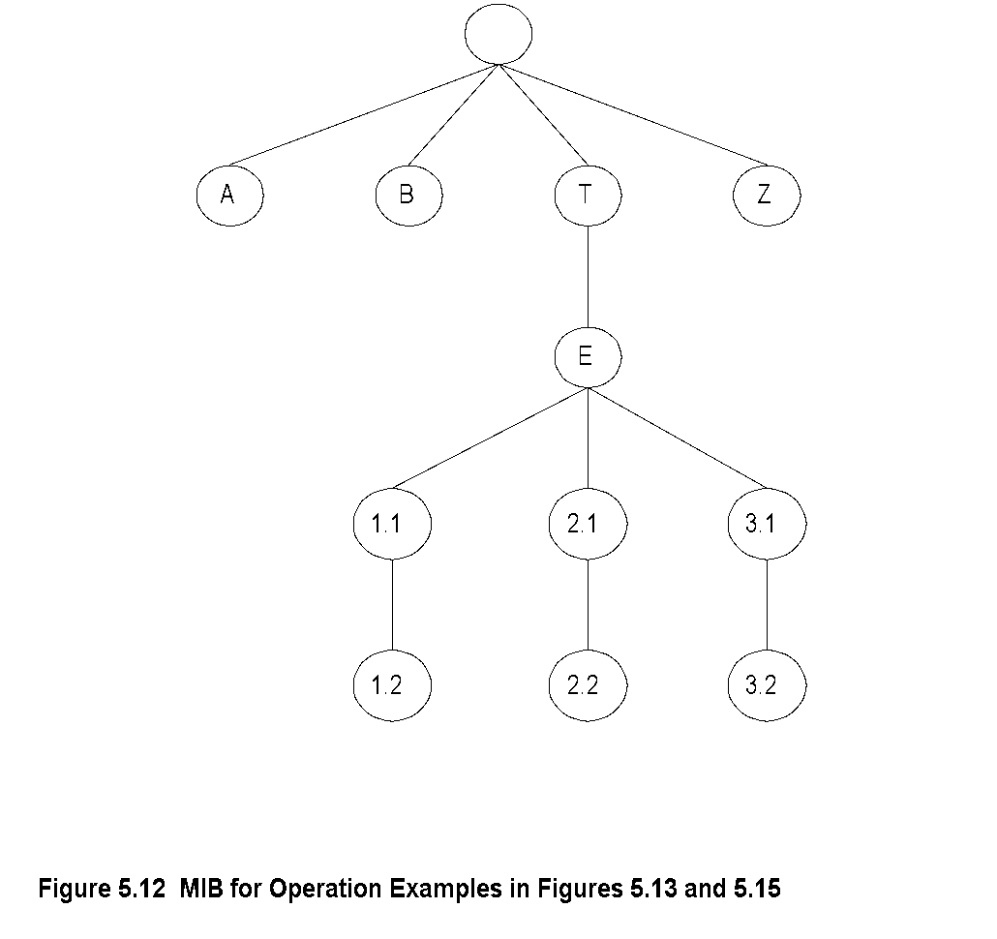
MIB for Get-Next-Request

Slide 19
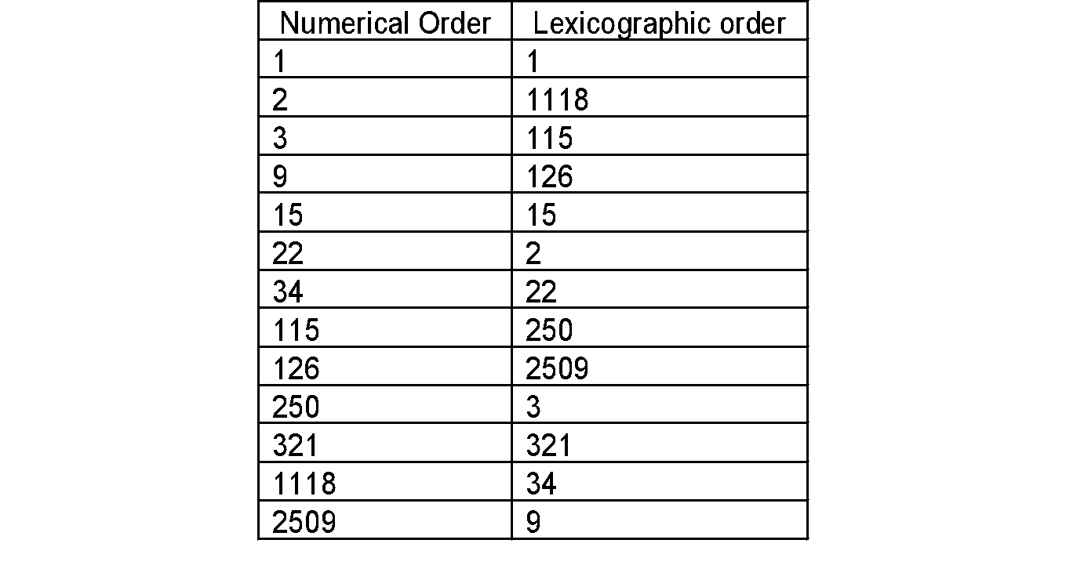
Lexicographic Order
Notes :
Procedure for ordering:
  Start with leftmost digit as first position
  Before increasing the order in the first position, select the lowest digit in the second position
  Continue the process till the lowest digit in
  the last position is captured
  Increase the order in the last position until all
  the digits in the last position are captured
  Move back to the last but one position and
  repeat the process
  Continue advancing to the first position until all
  the numbers are ordered
Tree structure for the above process
Table 5.2 Lexicographic-Order Number Example

Slide 20
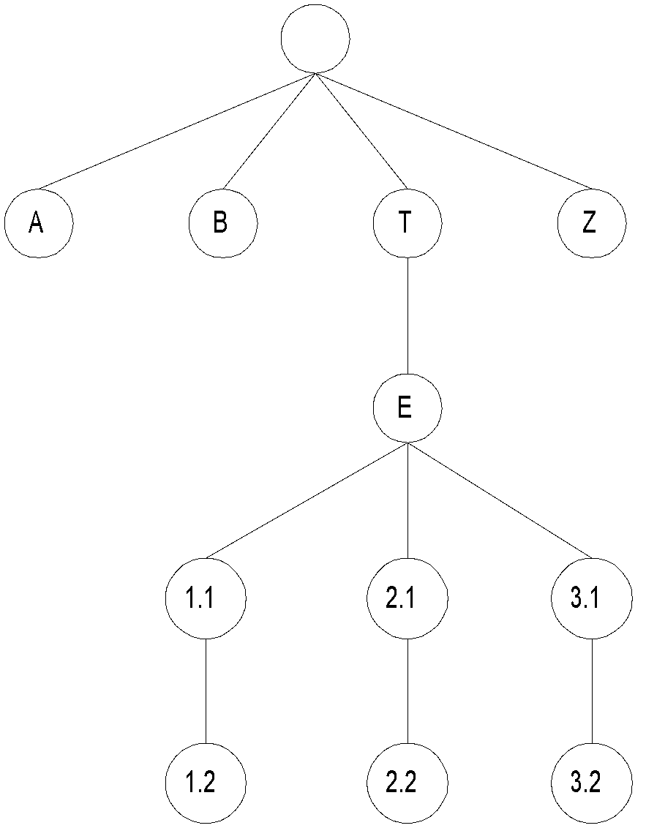
MIB Lexicographic Order
Notes :
A 3.1
B 3.2
T Z
E
1.1
1.2
2.1
2.2
Figure 5.12 MIB for Operation Examples in Figures 5.13 and 5.15

Slide 21
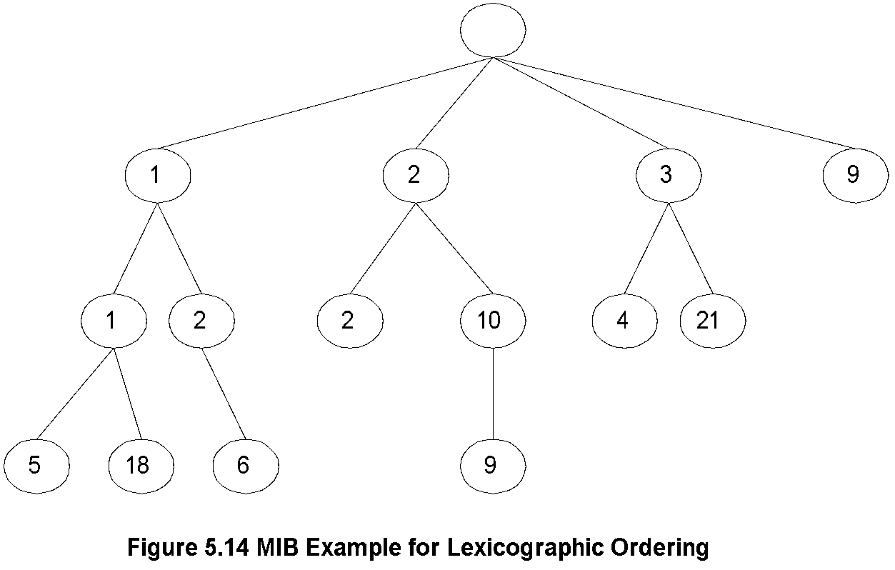
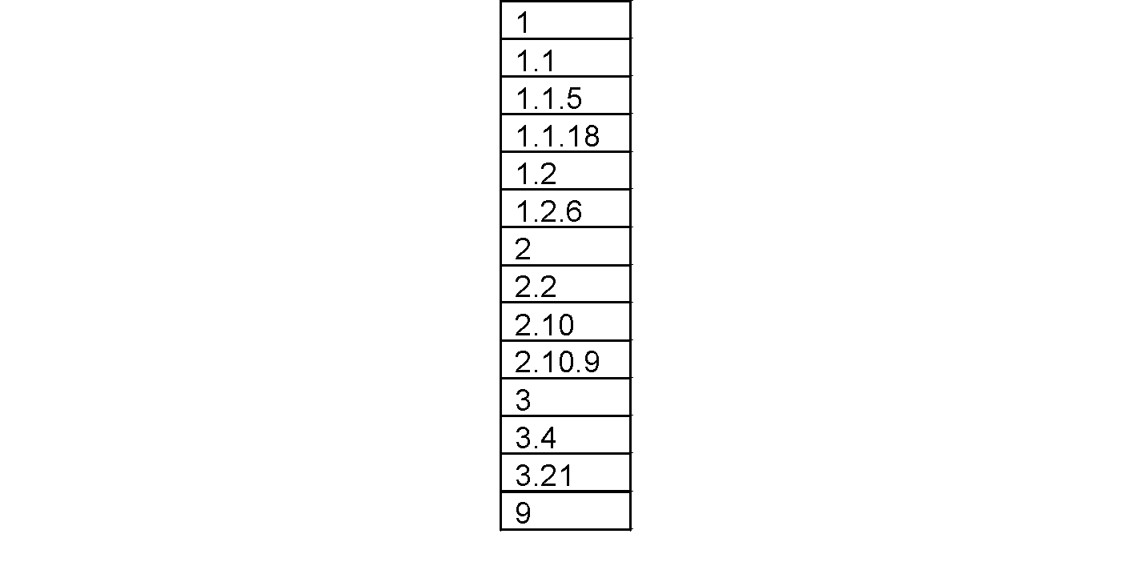
A More Complex MIB Example
Notes:

Slide 22
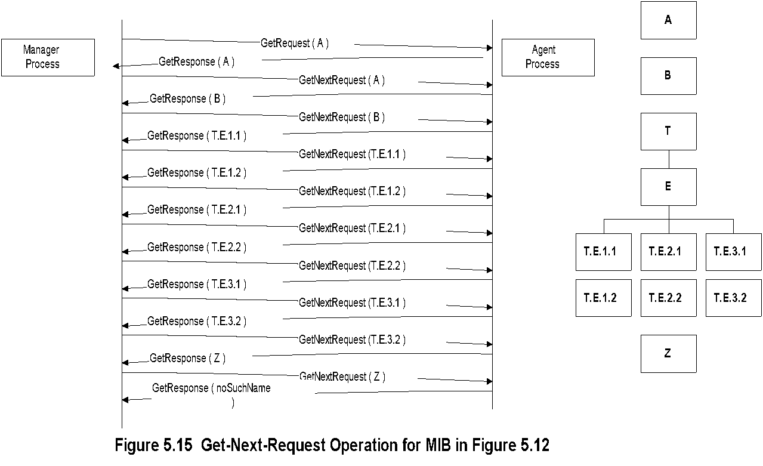
Get-Next-Request Operation

Slide 23
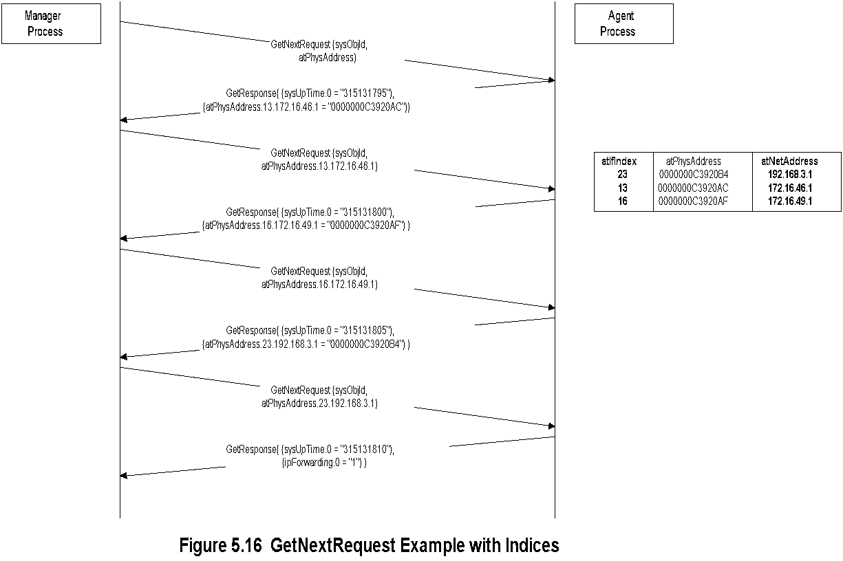
Get-Next-Request Operation

Slide 24
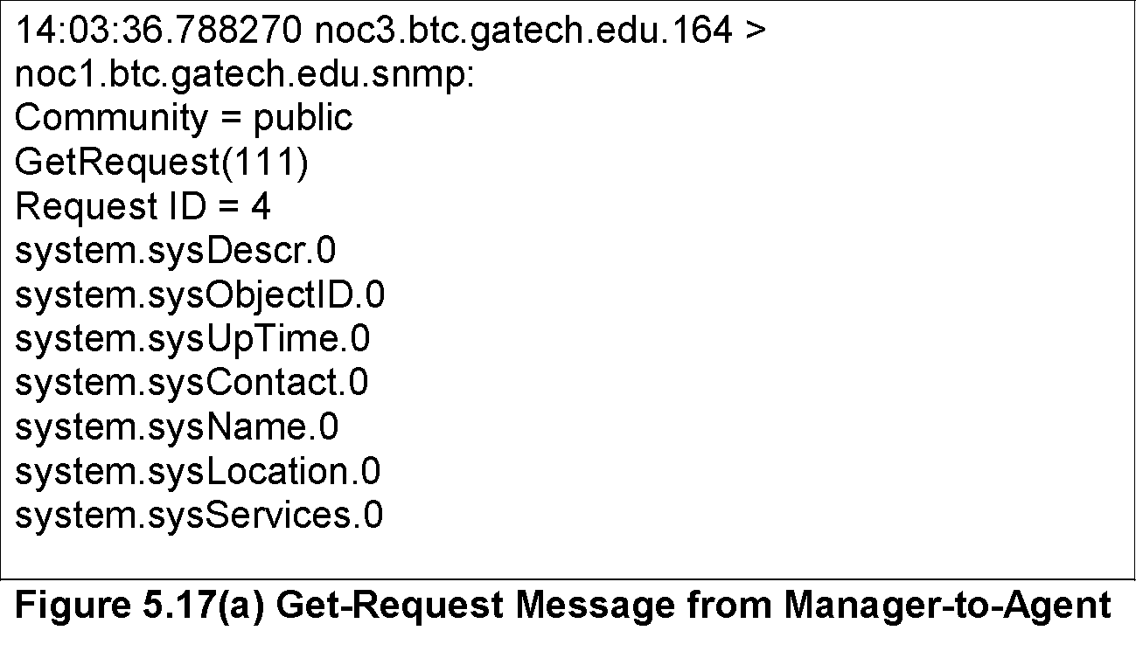
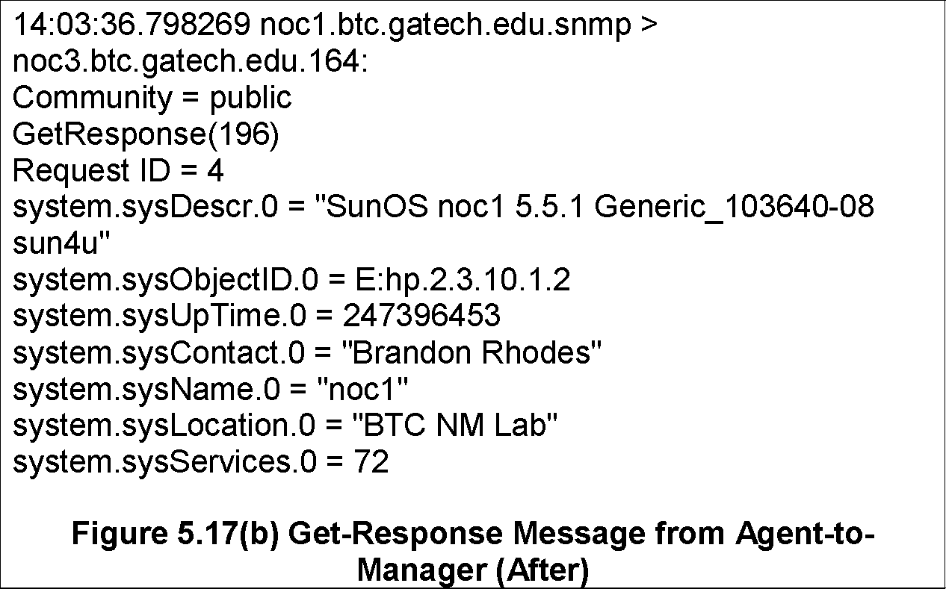
Sniffer Data

Slide 25
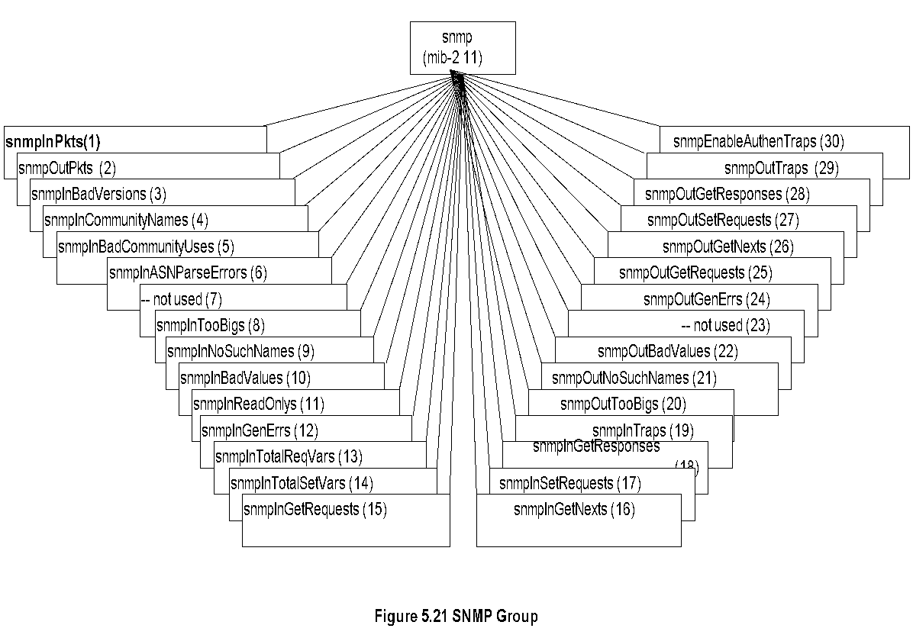
SNMP MIB
Notes :
SNMPv1 MIB has too many objects that are not used
SNMPv2 obsoleted a large number of them
Nisreen AlGhadban 120015789

