Slide 1
Chapter 4
SNMPv1 Network Management:
Organization and Information Models

Slide 2
Case Histories
AT&T Network Management Centers
  Network Control Centers
  Network Operations Center
CNN World Headquarters
Centralized troubleshooting of NIC
Performance degradation due to NMS
Bell Operating company procedure

Slide 3
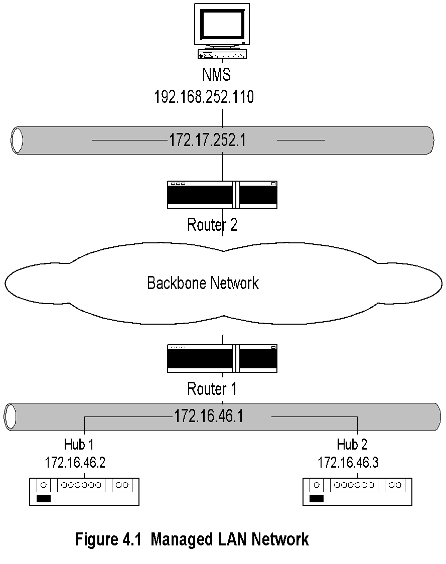
Managed LAN
Note:
NMS on subnet 192.168.252.1 manages the router and the hubs on subnet 172.16.46.1 across the backbone network

Slide 4
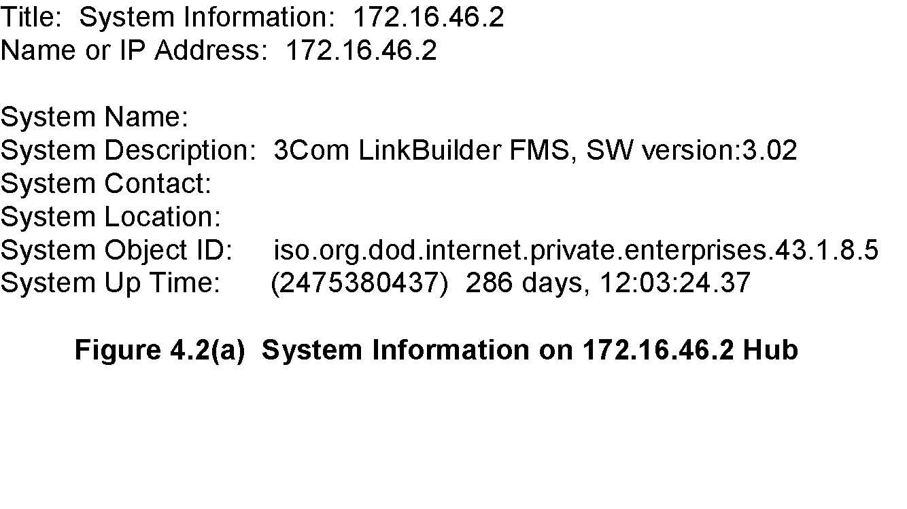
Managed Hub: System Information
Note:
Information obtained querying the hub
Data truly reflects what is stored in the hub

Slide 5
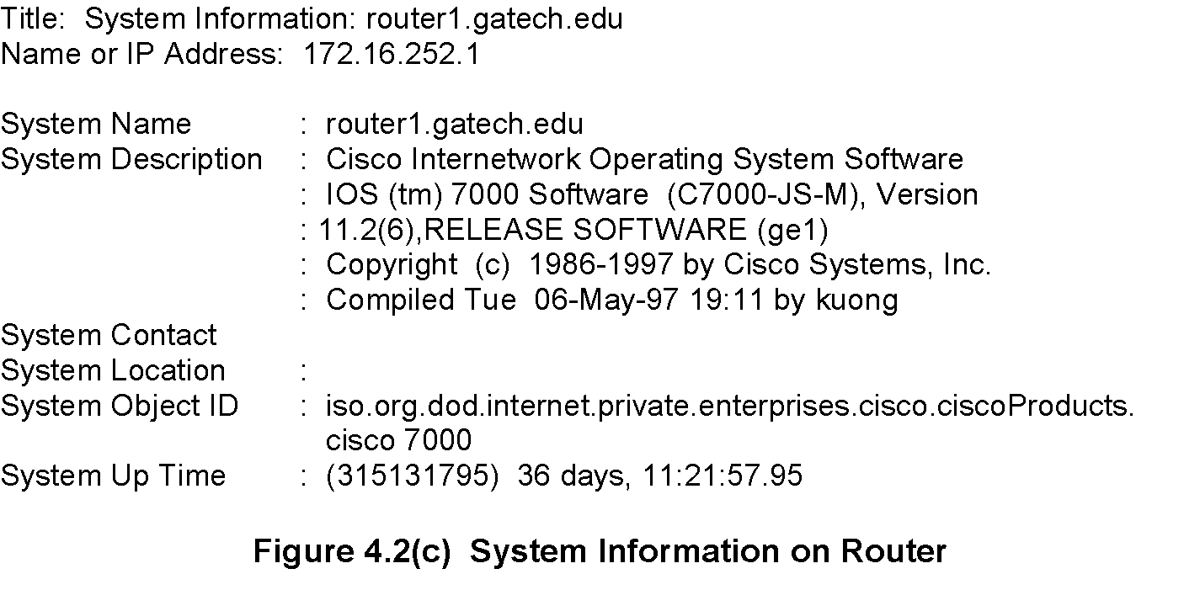
Managed Router: System Information

Slide 6
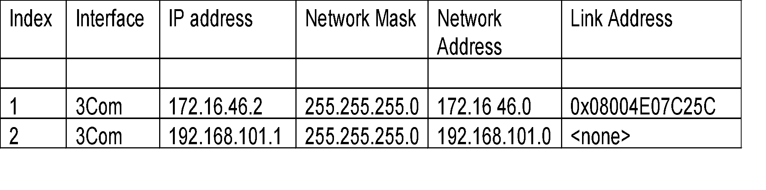
Managed Hub: Port Addresses
Note:
Information acquired by the NMS on hub interfaces
Index refers to the interface on the hub
Link address is the MAC address
The second row data is a serial link

Slide 7
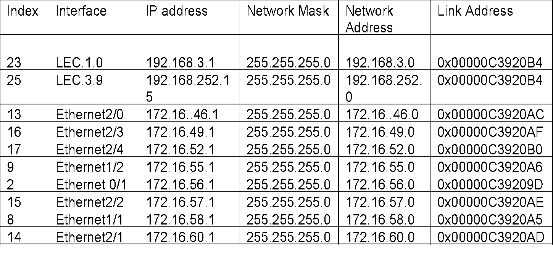
Managed Router: Port Addresses
Note:
Information acquired by NMS on the router interfaces
Index refers to the interface on the router
LEC is the LAN emulation card
Ethernet 2/0 interface refers to the interface card 2 and port 0 in that card

Slide 8
Internet SNMP Management
1970s Advanced Research Project Agency Network (ARPANET) Internet Control Message Protocol (ICMP)
Internet Engineering Task Force (IETF)
  1990 SNMPv1
  1995 SNMPv2
  1998 SNMPv3
Internet documents:
  Request for Comments (RFC)
  IETF STD Internet Standard
  FYI For Your Information
Source for RFCs
  ftp://nic.mil/rfc
  ftp://ftp.internic.net/rfc
  http://nic/internet.net/

Slide 9
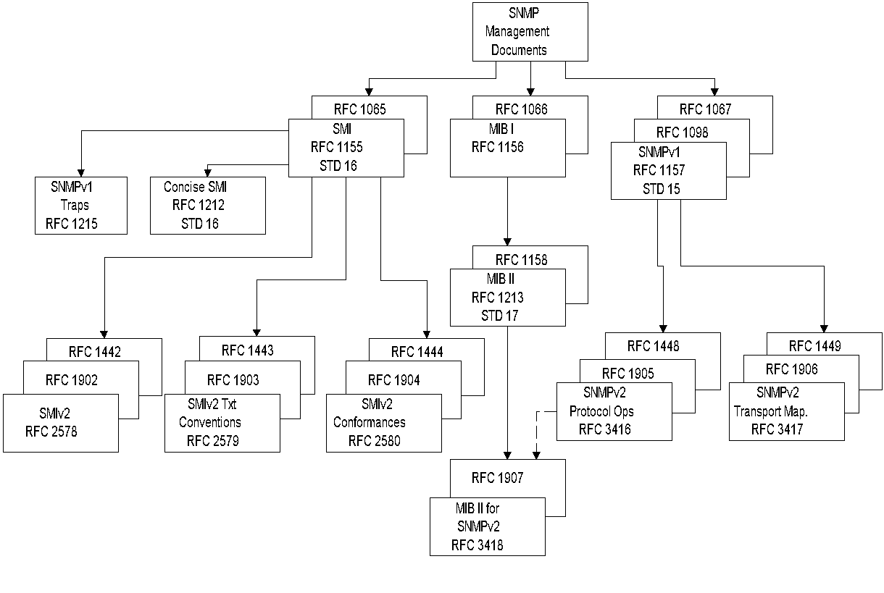
SNMPv1 & SNMPv2 Documents

Slide 10
SNMP Model
Organization Model
  Relationship between network element,
  agent, and manager
  Hierarchical architecture
Information Model
  Uses ASN.1 syntax
  SMI (Structure of Management Information)
  MIB ( Management Information Base)
Communication Model
  Transfer syntax
  SNMP over TCP/IP
  Communication services addressed by messages
  Security framework community-based model

Slide 11
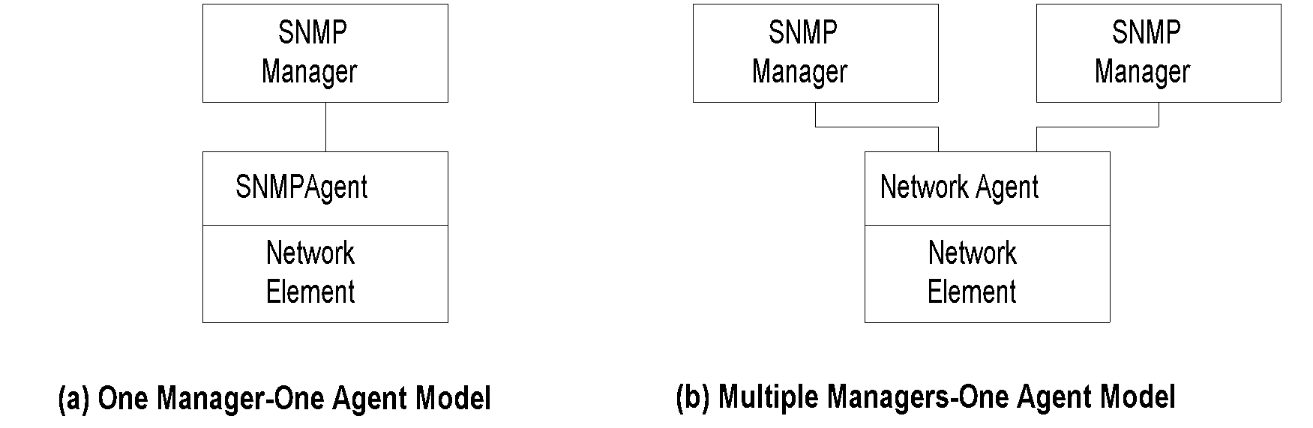
Two-Tier Organization Model
Figure 4.5 Two-Tier Organization Model
Note:
Any host that could query an agent is a manager.

Slide 12
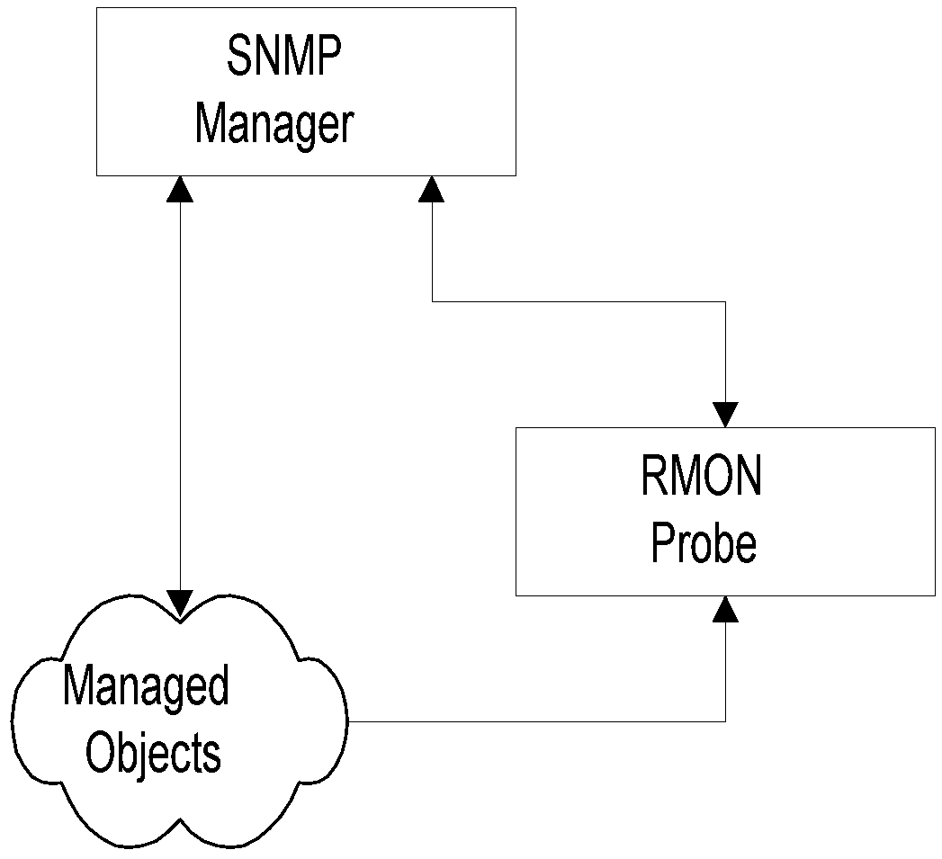
Three-Tier Organization Model: RMON
Note:
Managed object comprises network element and
management agent
RMON acts as an agent and a manager
RMON (Remote Monitoring) gathers data from MO,
analyses the data, and stores the data
Communicates the statistics to the manager
Figure 4.6 Three-Tier Organization Model

Slide 13
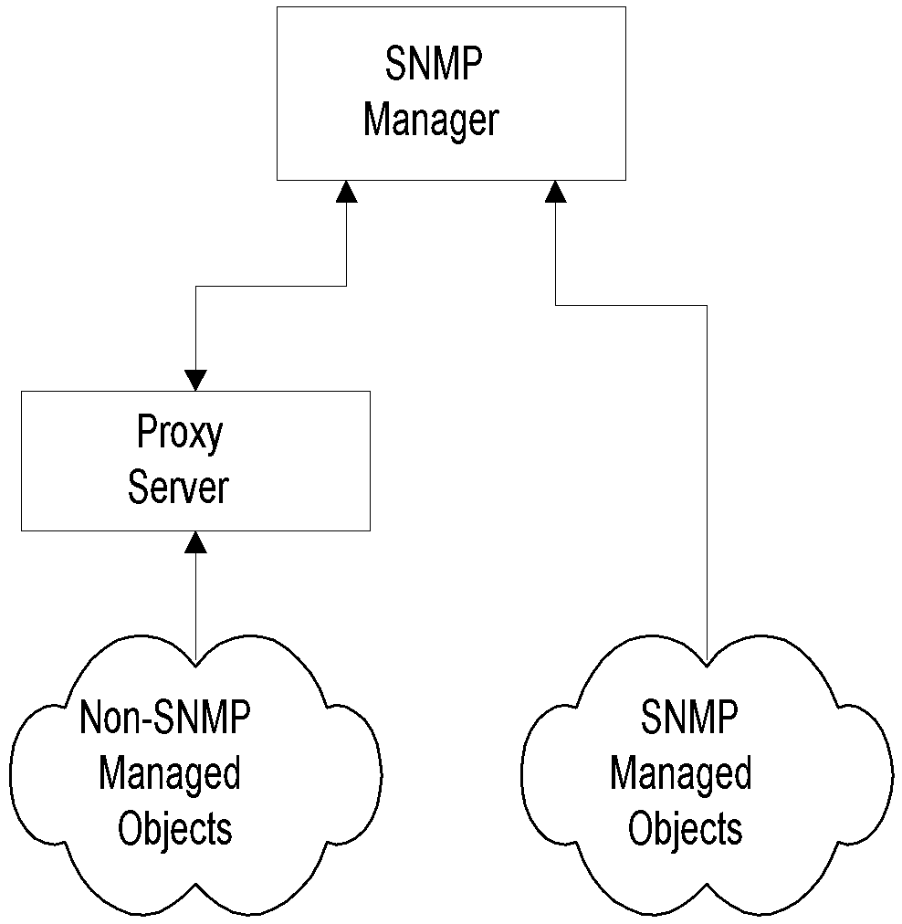
Three-Tier Organization Model: Proxy Server
Figure 4.7 Proxy Server Organization Model
Note:
Proxy server converts non-SNMP data from non-SNMP objects to SNMP compatible objects and messages

Slide 14
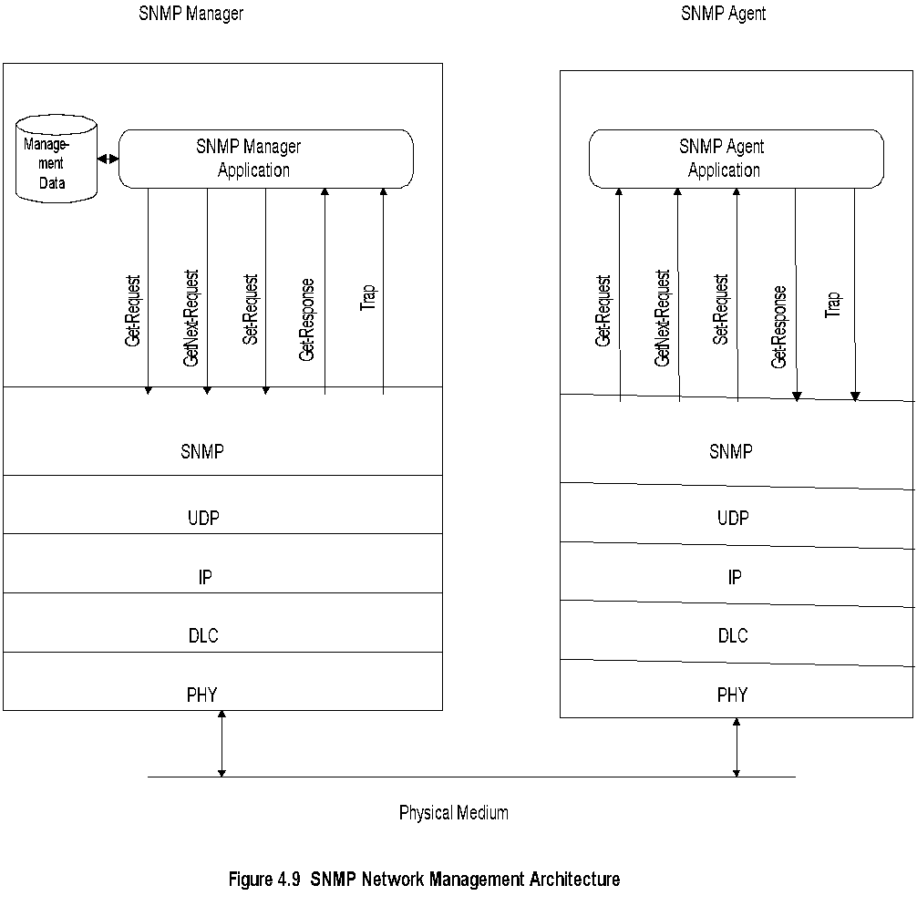
System Architecture
Note:
Messages between manager and agent
Direction of messages - 3 from manager and 2 from agent

Slide 15
SNMP Messages
Get-Request
  Sent by manager requesting data from agent
Get-Next-Request
  Sent by manager requesting data on the next
  MO to the one specified
Set-Request
  Initializes or changes the value of network
  element
Get-Response
  Agent responds with data for get and set
  requests from the manager
Trap
  Alarm generated by an agent

Slide 16
Information
Structure of Management Information (SMI)
(RFC 1155)
Managed Object
  Scalar
  Aggregate or tabular object
Management Information Base (RFC 1213)
Note:
RFCs can be downloaded from ftp.internic.net/rfc

Slide 17
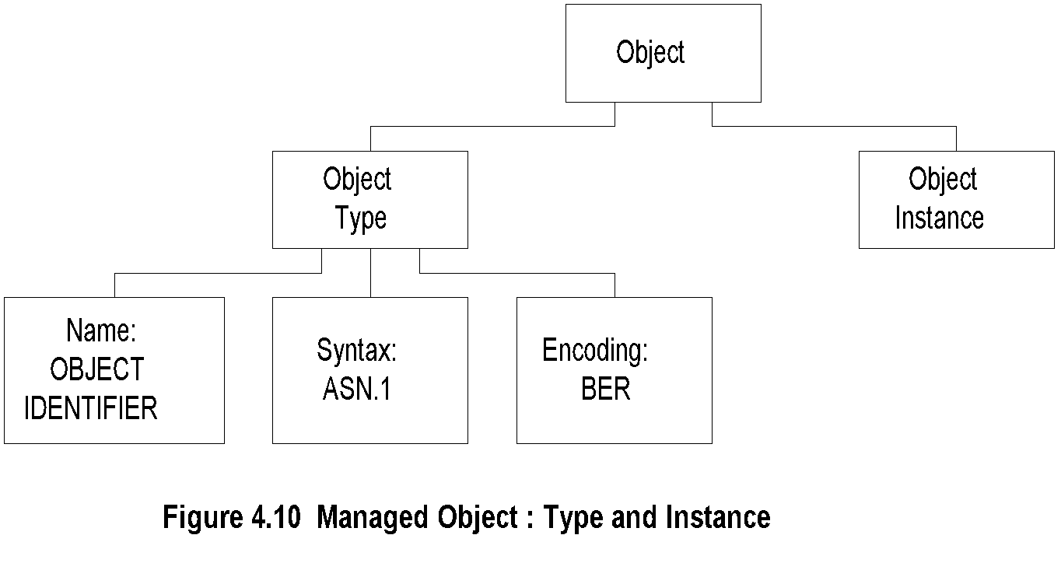
Managed Object
Note:
Object type and data type are synonymous
Object identifier is data type, not instance
Object instance IP address (See Figure 4.2)

Slide 18
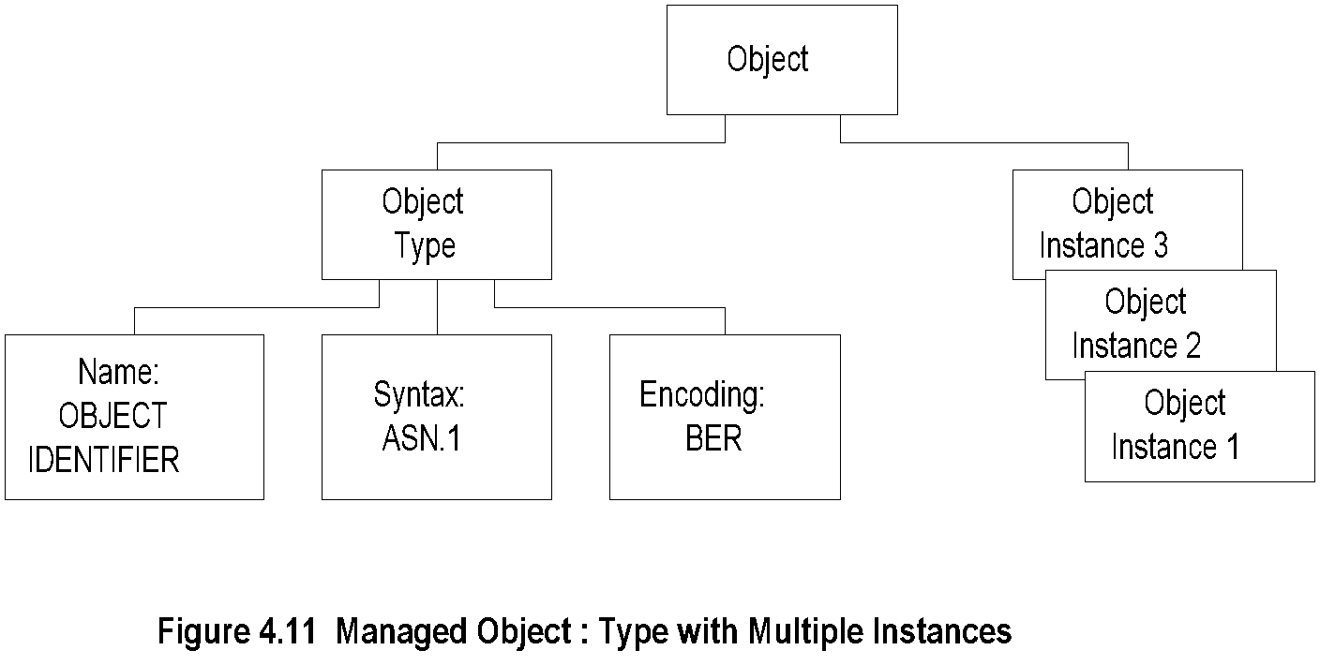
Managed Object: Multiple Instances
Note:
All 3 Com hubs of the same version have identical identifier; they are distinguished by the IP address.
Each IP address is an instance of the object.

Slide 19

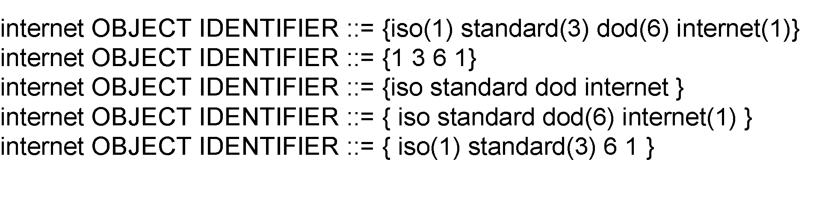
Name
Uniquely defined by
  DESCRIPTOR AND
  OBJECT IDENTIFIER
Note:
Example
ipAddrTable ip 20

Slide 20
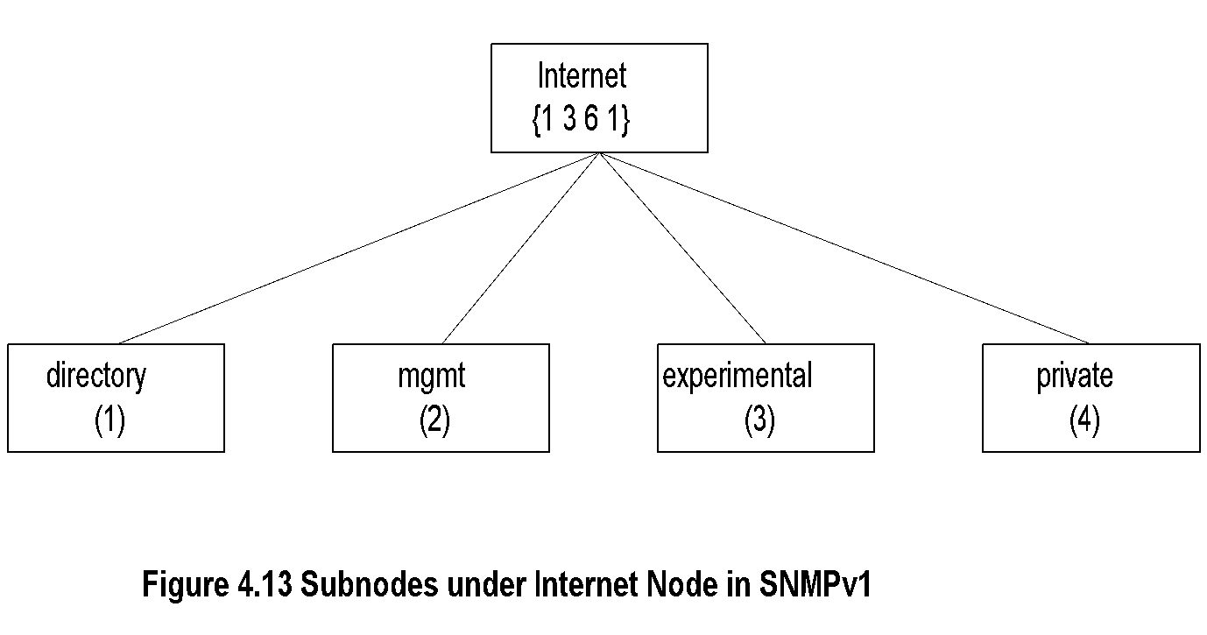
Internet Subnodes
Note:
directory OBJECT IDENTIFIER ::= {internet 1}
mgmt OBJECT IDENTIFIER ::= {internet 2}
experimental OBJECT IDENTIFIER ::= {internet 3}
private OBJECT IDENTIFIER ::= {internet 4}

Slide 21
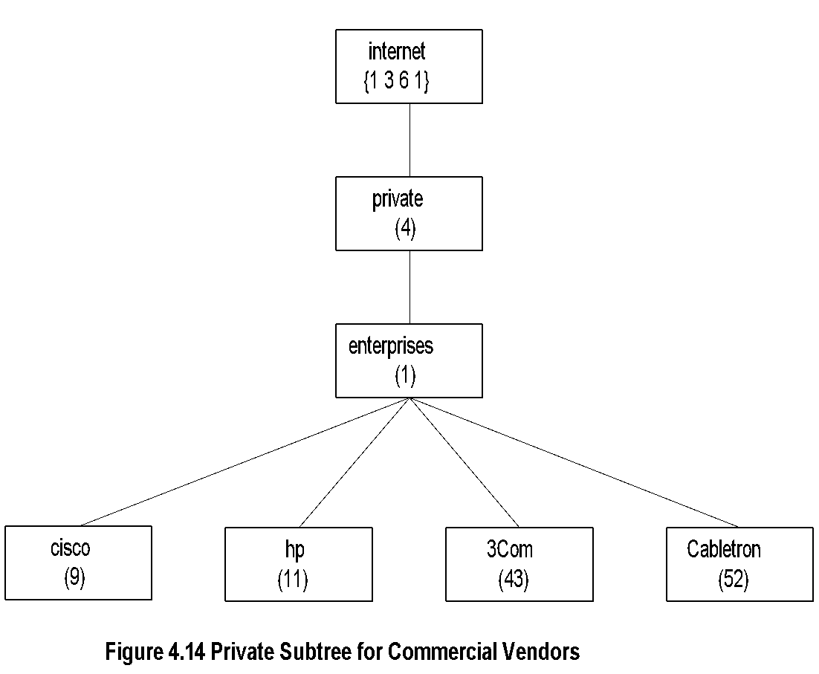
Private MIB Example
Note:
private MIB intended for vendor equipment
IANA (Internet Assigned Numbers Authority) assigns identifiers

Slide 22
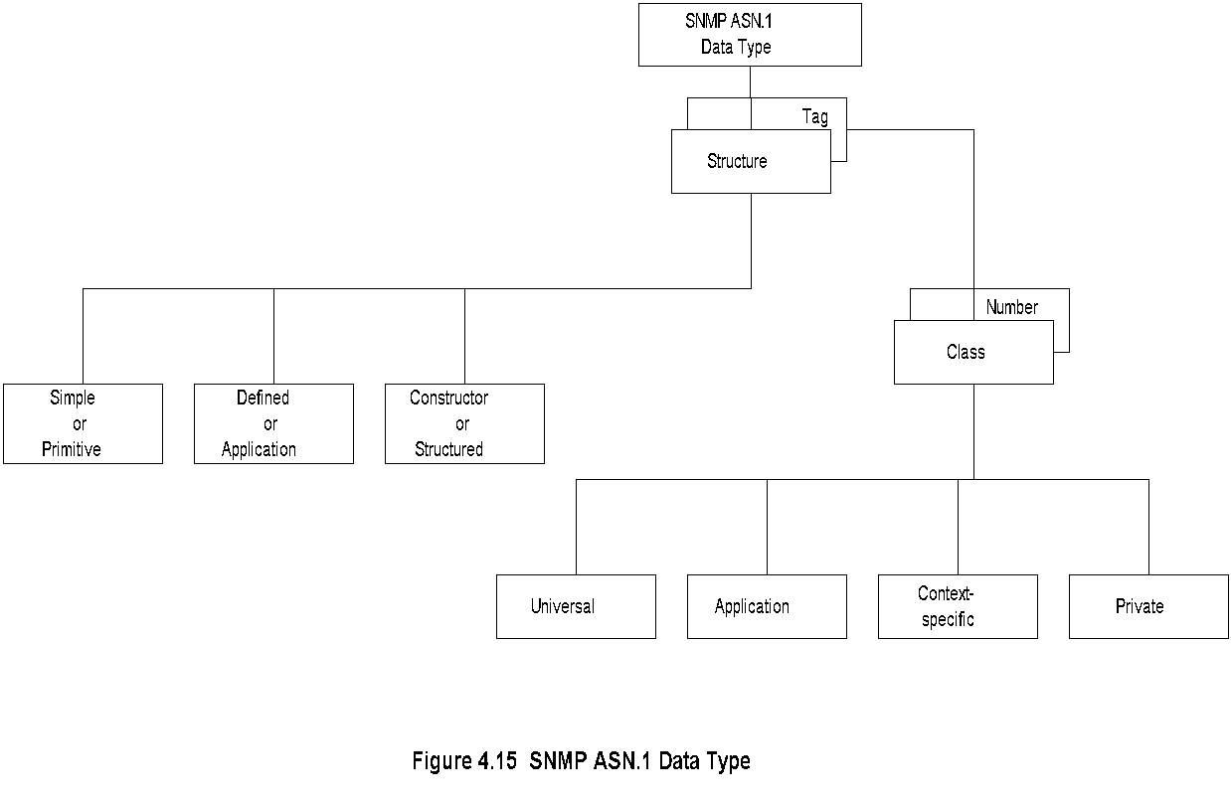
SNMP ASN.1 Data Type

Slide 23
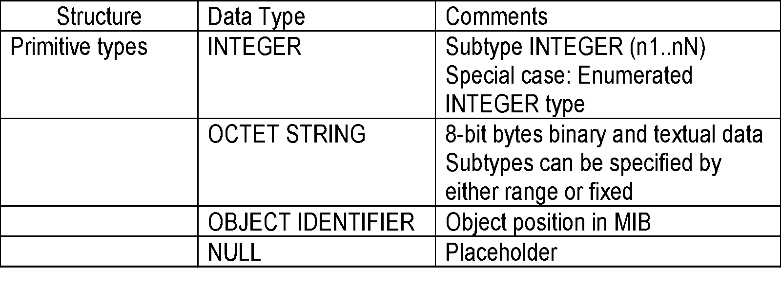
Primitive Data Types
Note:
get-request message has NULL for value fields
and get-response from agent has the values filled
in subtype:
  INTEGER (0..255)
  OCTET STRING (SIZE 0..255)
  OCTET STRING (SIZE 8)

Slide 24
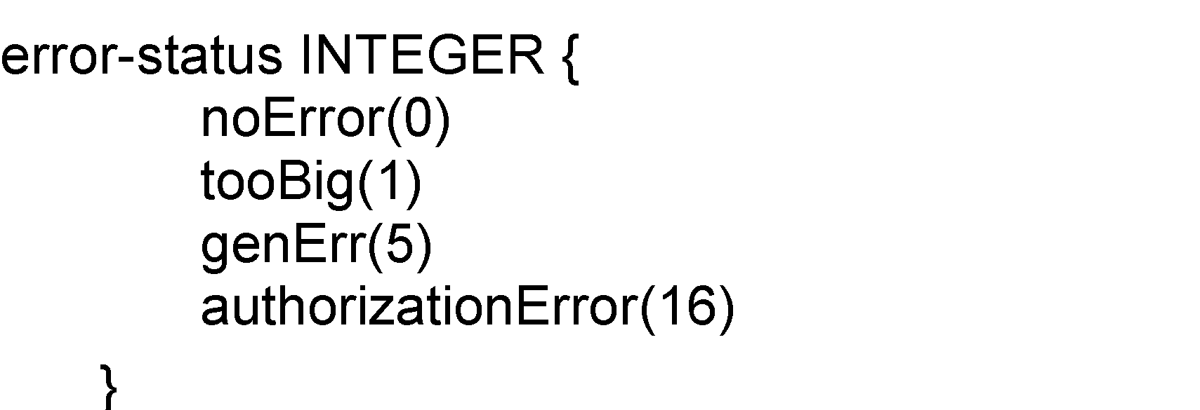
Enumerated
Special case of INTEGER data type
Note:
noError NULL by convention

Slide 25
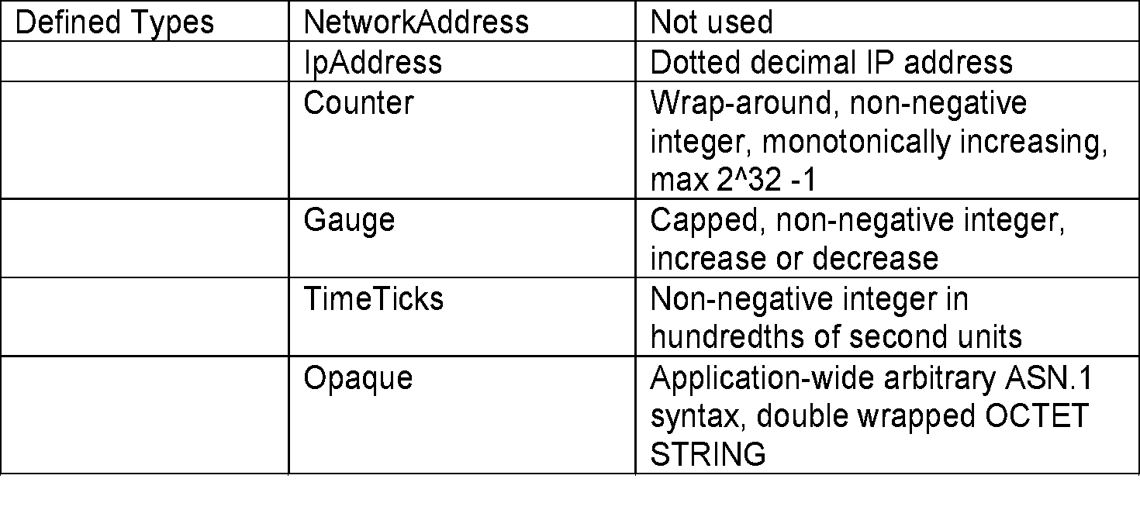
Defined or Application Data Type
Note:
Defined data types are simple or base types
Opaque is used to create data types based on previously defined data types

Slide 26
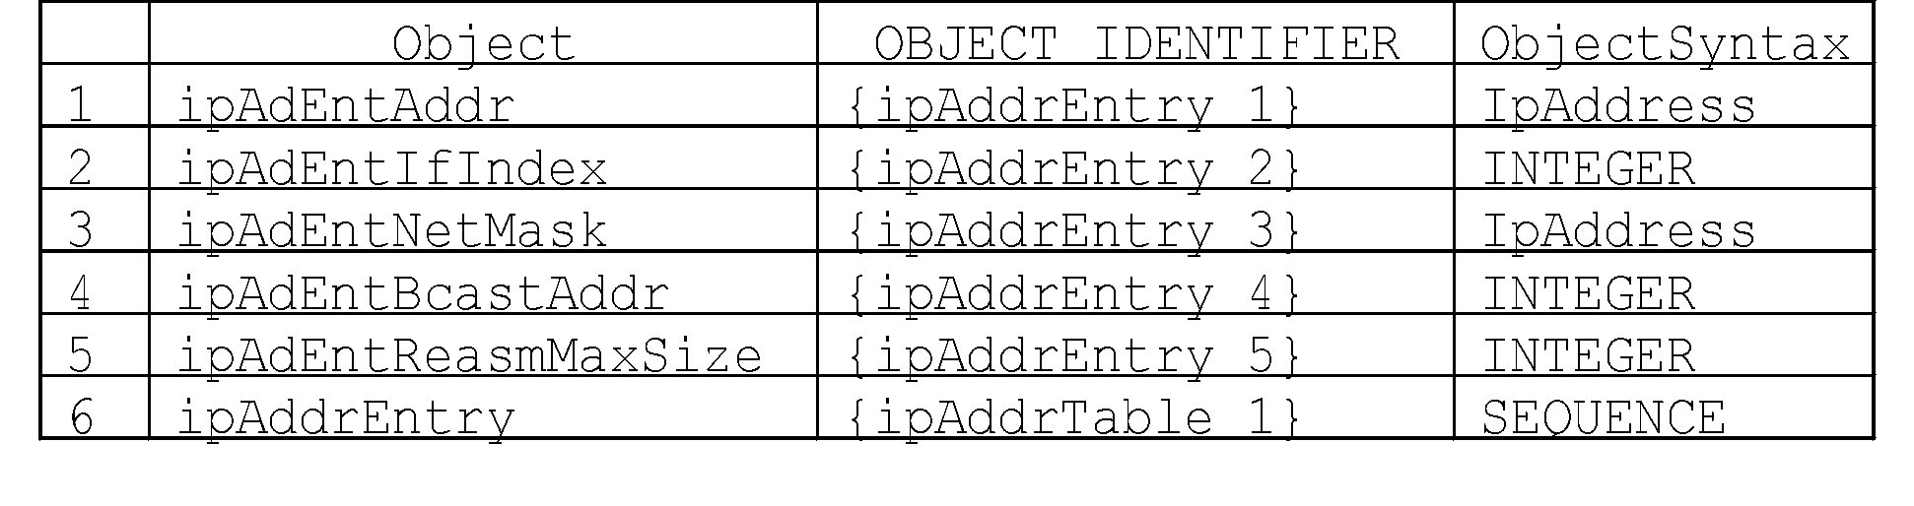
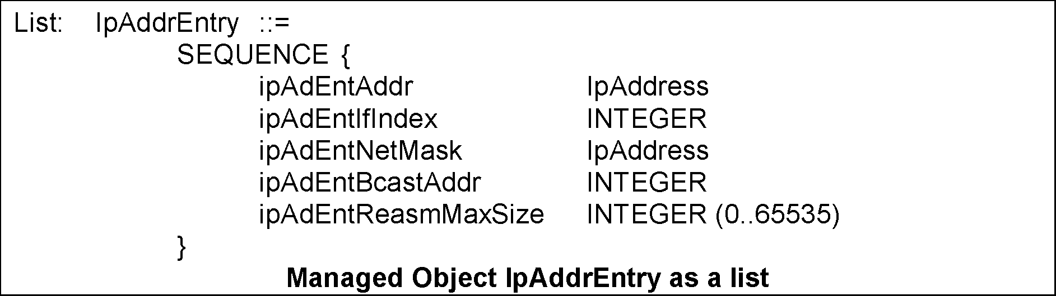
Constructor or Structured Data Type: SEQUENCE
List maker

Slide 27
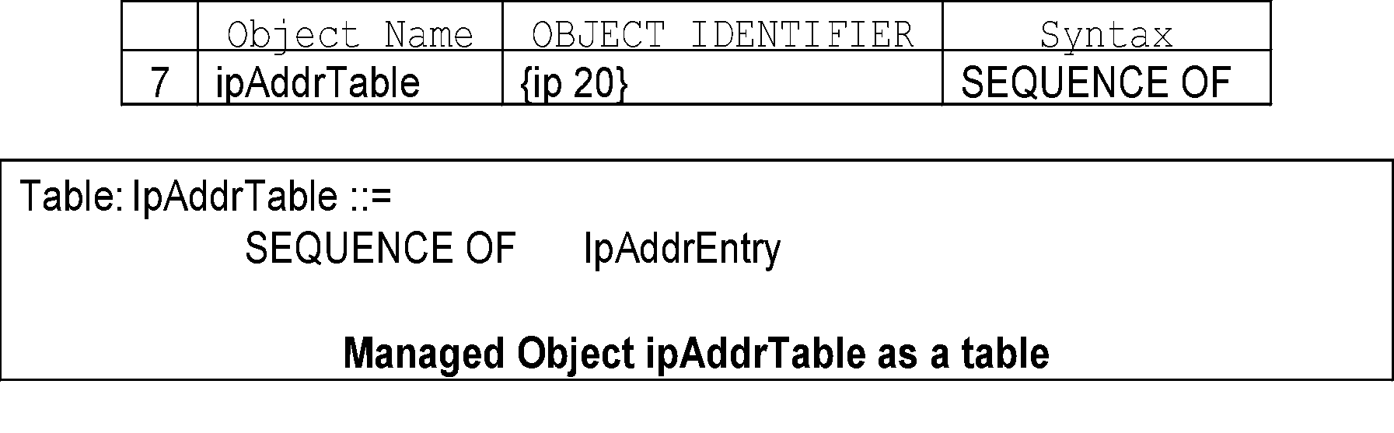
Constructor or Structured Data Type: SEQUENCE OF

Slide 28
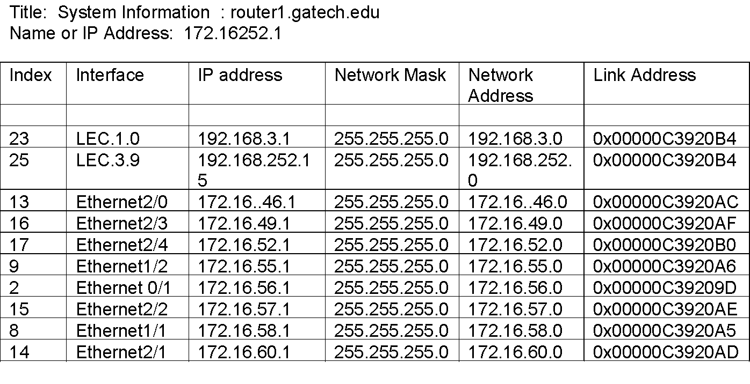
SEQUENCE OF Example
Note:
The above example (Figure 4.3) uses part of the IP MIB discussed for SEQUENCE OF construct.

Slide 29
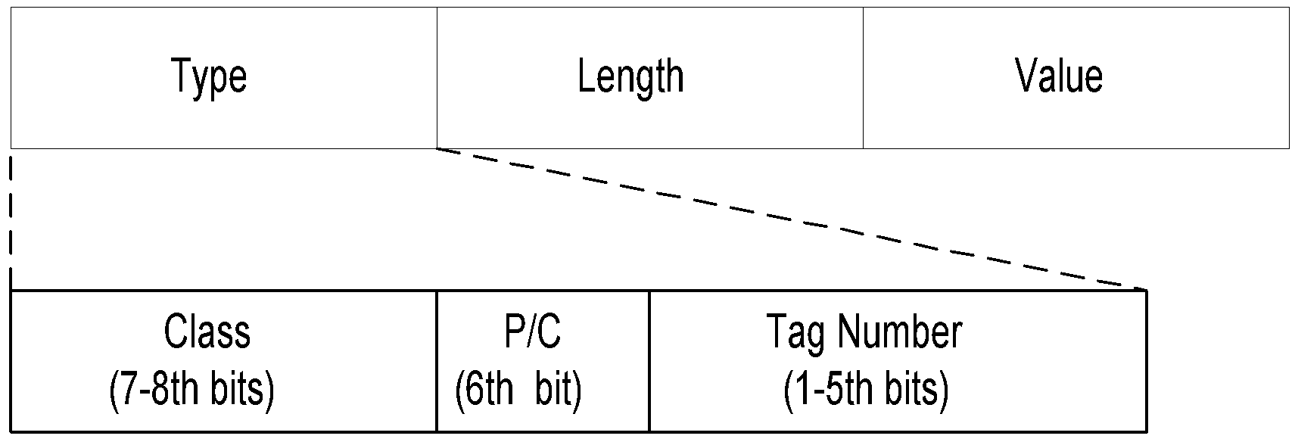
Encoding
Basic Encoding Rules (BER)
  Tag, Length, and Value (TLV)
SNMP Data Types and Tags
Type Tag
OBJECT IDENTIFIER UNIVERSAL 6
SEQUENCE UNIVERSAL 16
IpAddress APPLICATION 0
Counter APPLICATION 1
Gauge APPLICATION 2
TimeTicks APPLICATION 3
Opaque APPLICATION 4

Slide 30
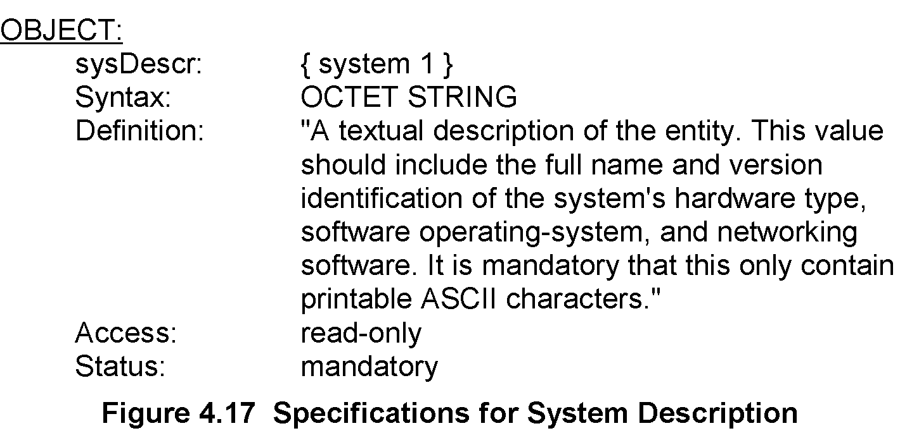
Managed Object: Structure

Slide 31
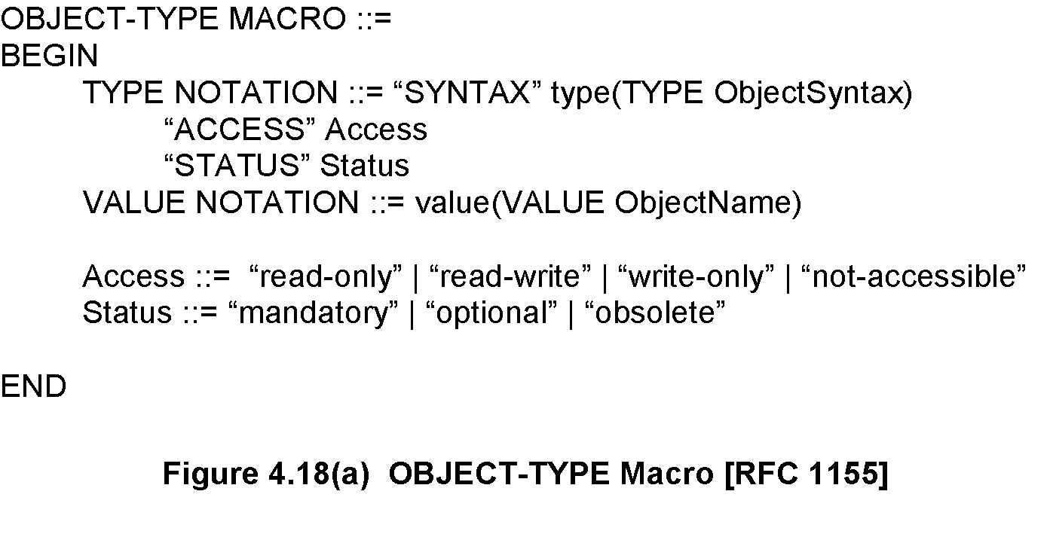
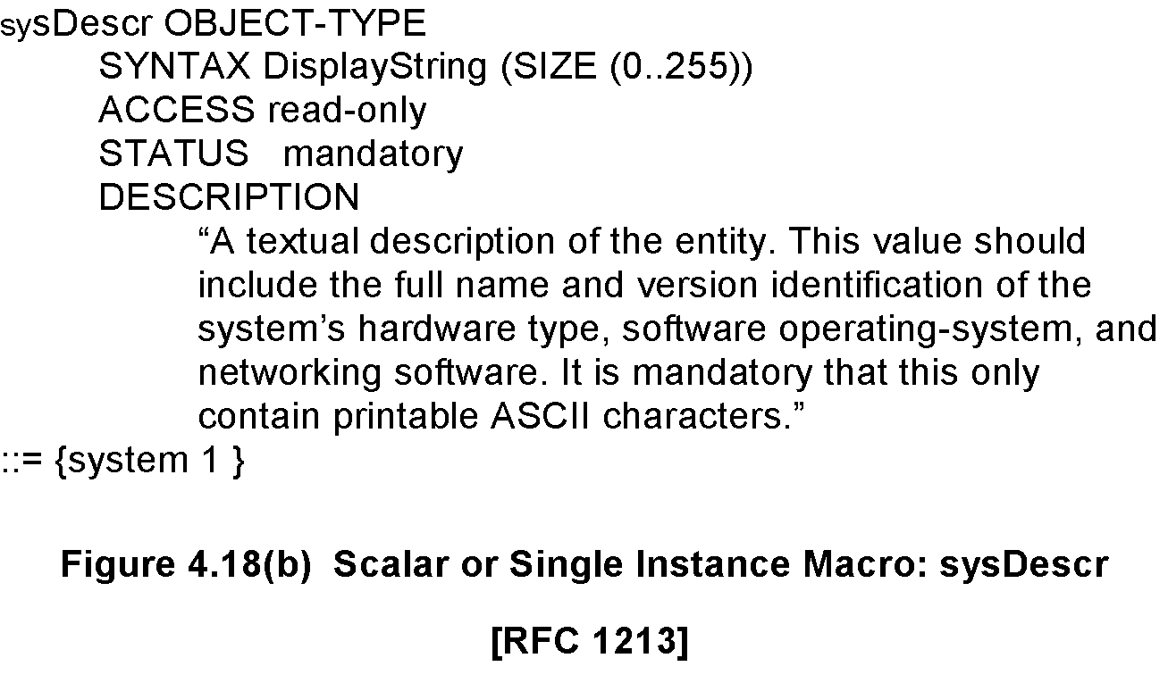
Managed Object: Macro

Slide 32
Aggregate Object
A group of objects
Also called tabular objects
Can be represented by a table with
  Columns of objects
  Rows of instances
Note:
Example: IP address table
Consists of objects:
  IP address
  Interface
  Subnet mask (which subnet this address
  belongs to)
  Broadcast address (value of l.s.b. in IP
  broadcast address)
  Largest IP datagram that can be assembled
Multiple instances of these objects associated
with the node
Table of Objects
List of Objects
Objects

Slide 33
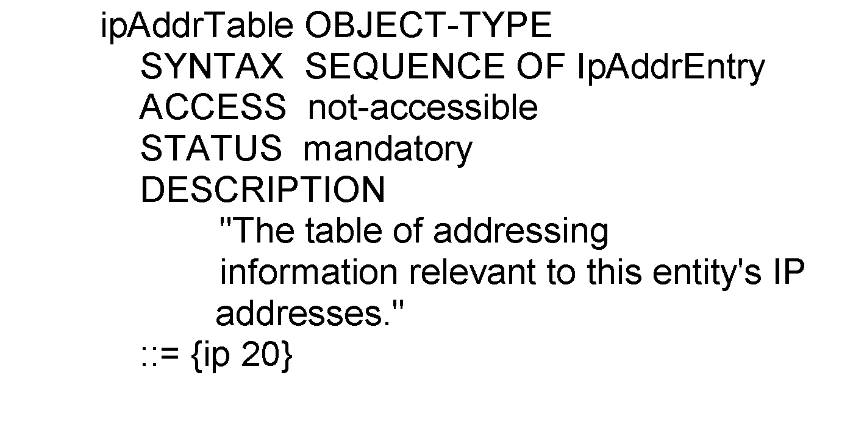
Aggregate M.O. Macro:Table Object
ipAddrTable OBJECT-TYPE
::= {ip 20}
ipAddrEntry OBJECT-TYPE
::= {ipAddrTable 1}

Slide 34
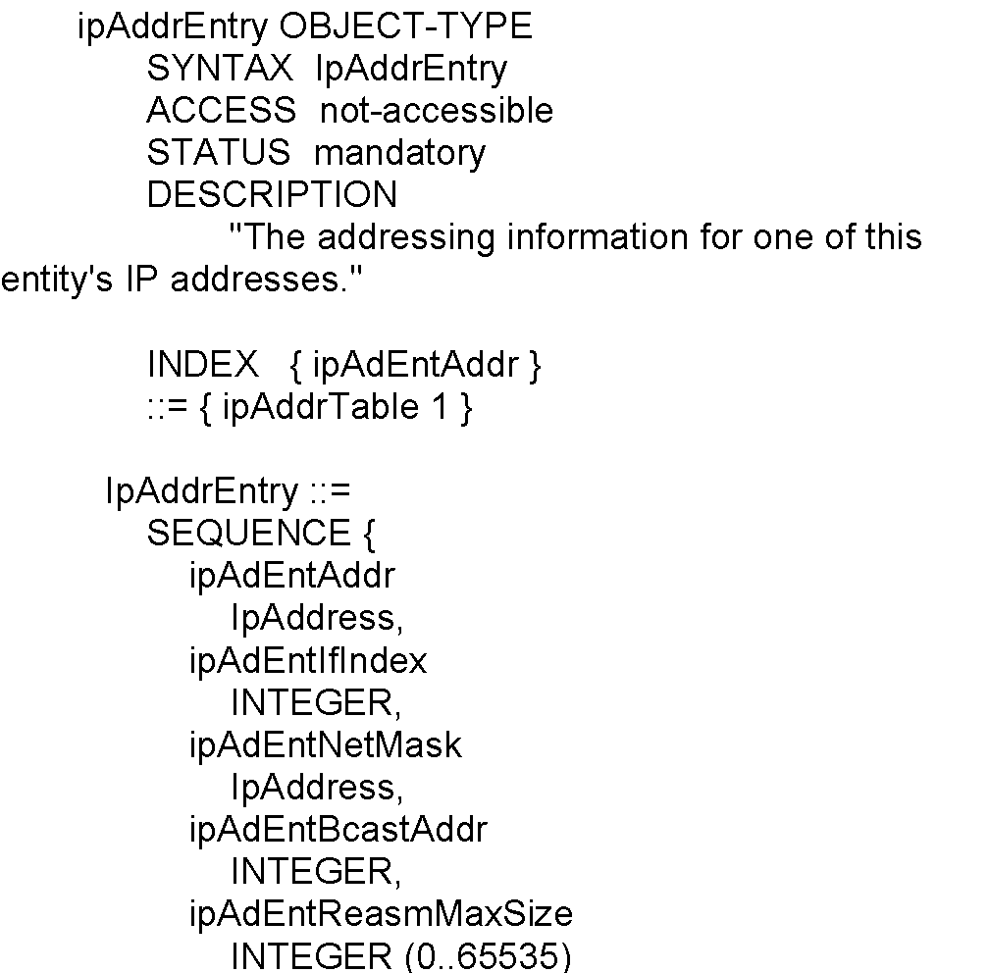
Aggregate M.O. Macro: Entry Object
Note:
Index ipAdEntAddr uniquely identifies an instance
May require more than one object in the instance to uniquely identify it

Slide 35
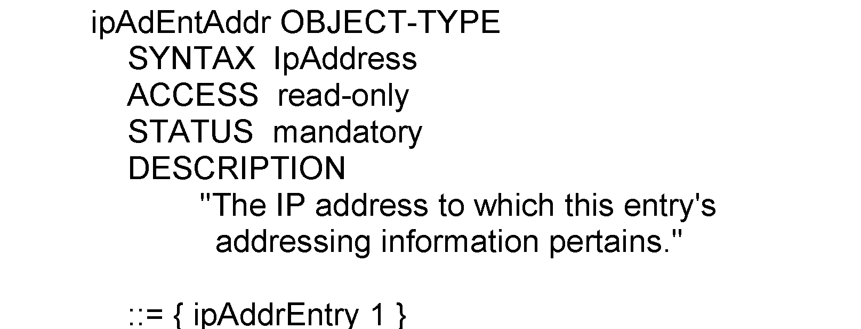
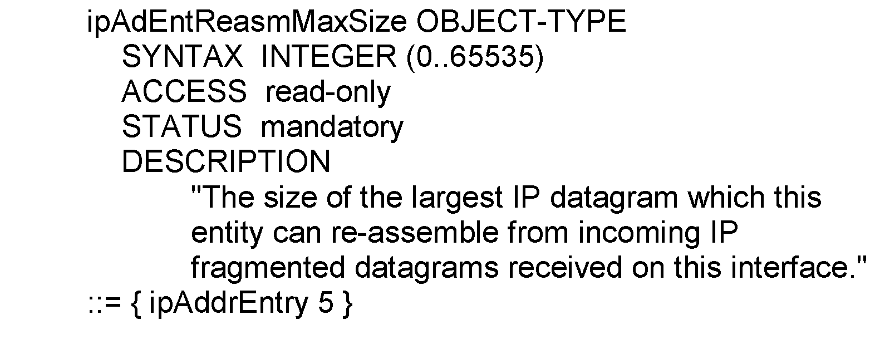
Aggregate M.O. Macro: Columnar Objects

Slide 36
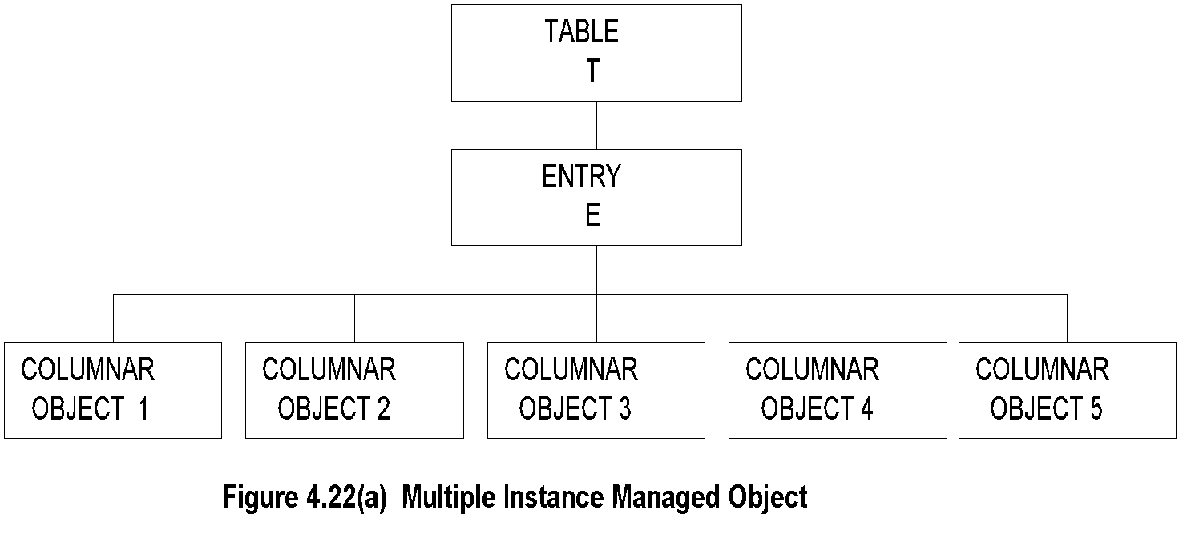
Tabular Representation of Aggregate Object
Note:
The objects TABLE T and ENTRY E are objects that are logical objects. They define the grouping and are not accessible.
Columnar objects are objects that represent the attributes and hence are accessible.
Each instance of E is a row of columnar objects1 through 5.
Multiple instances of E are represented by multiple rows.

Slide 37
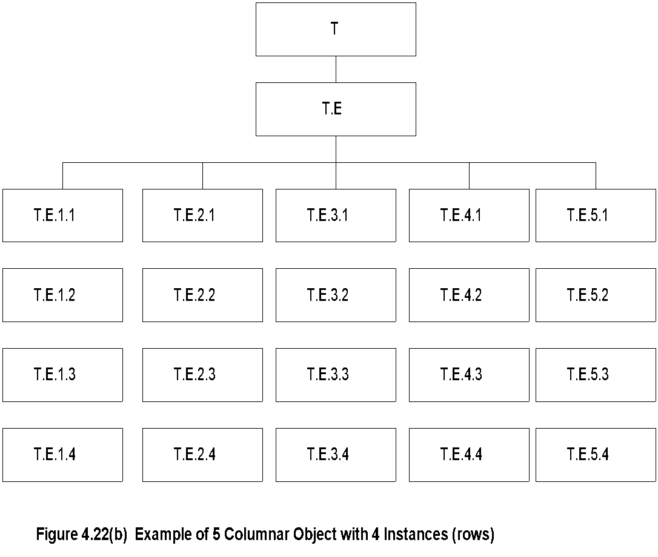
Tabular Representation of Aggregate Object (cont.)
Note:
Notice that the column-row numeric designation is reverse of what we are used to as row-column

Slide 38
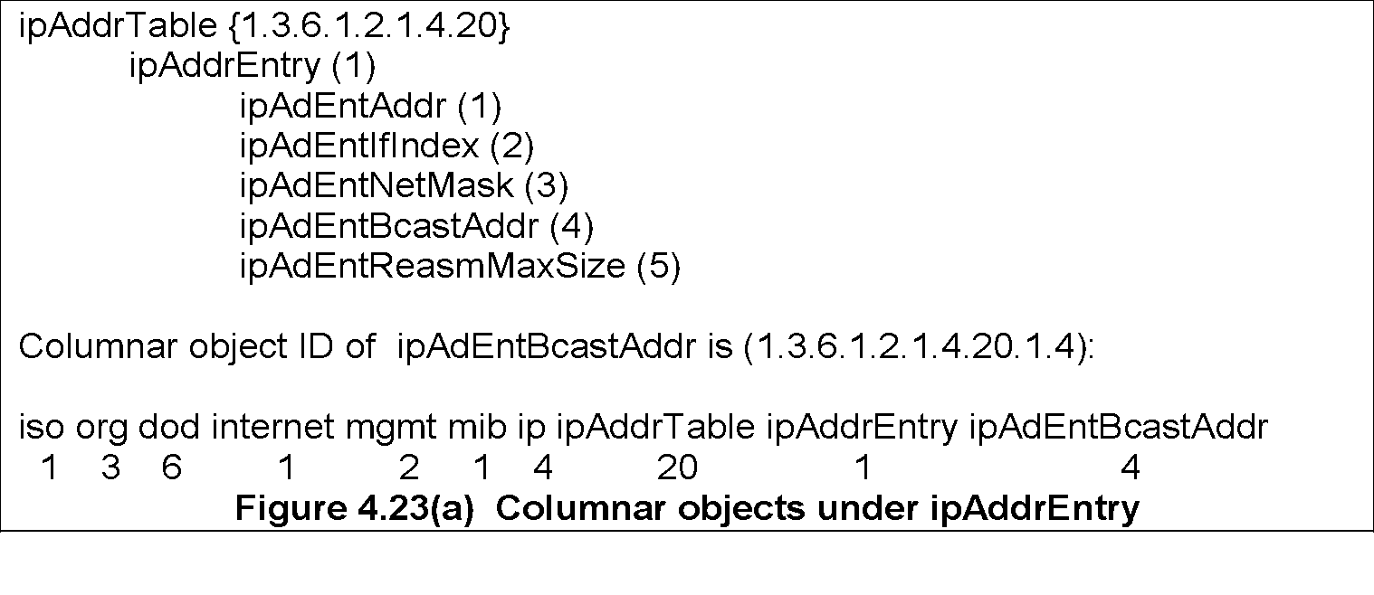
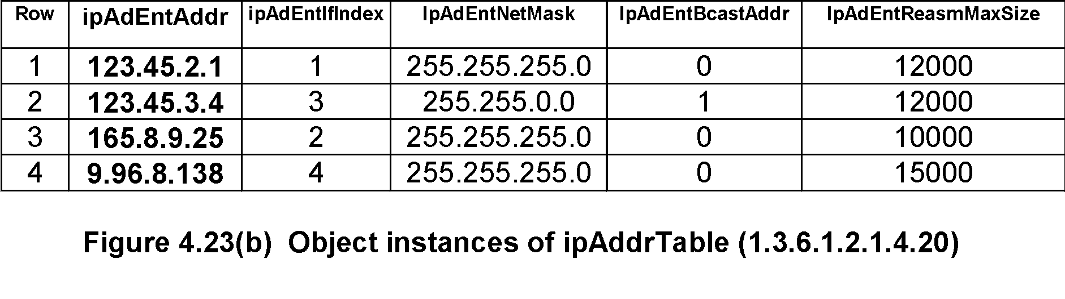
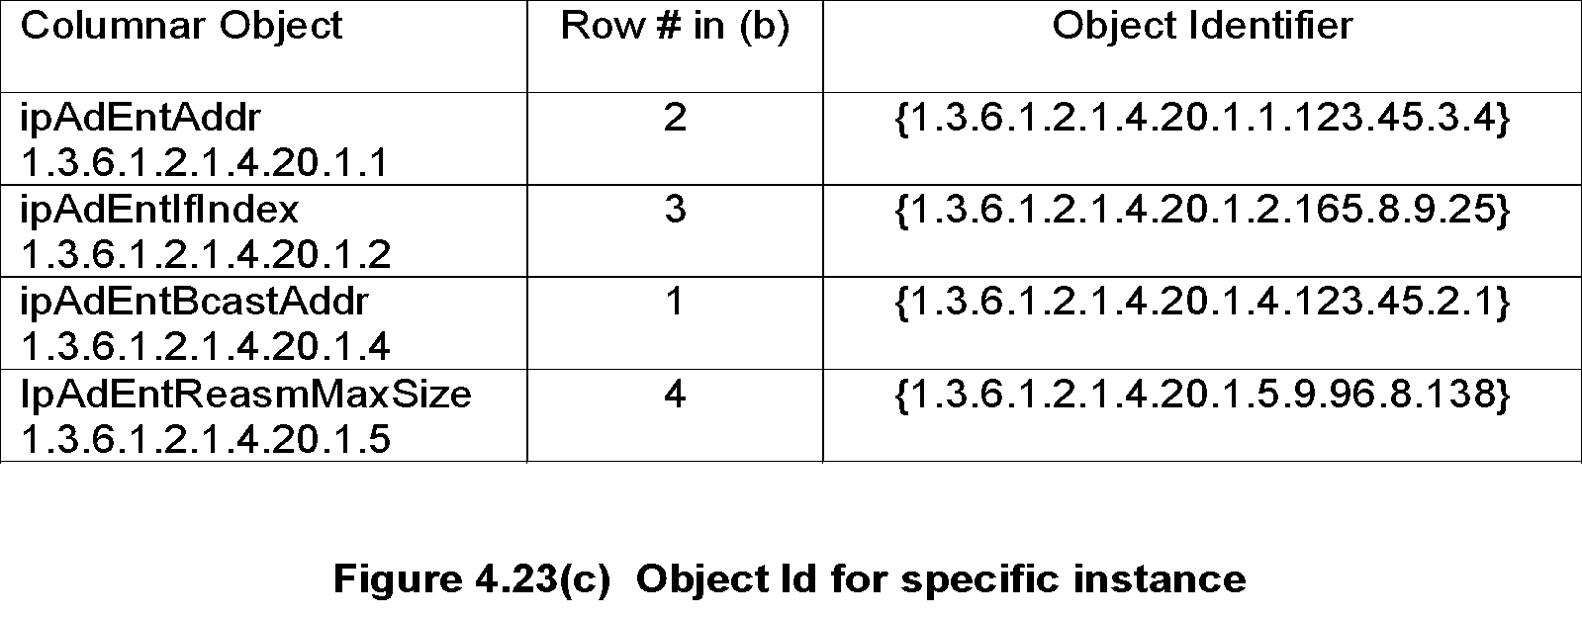
Multiple Instances of Aggregate Managed Object

Slide 39
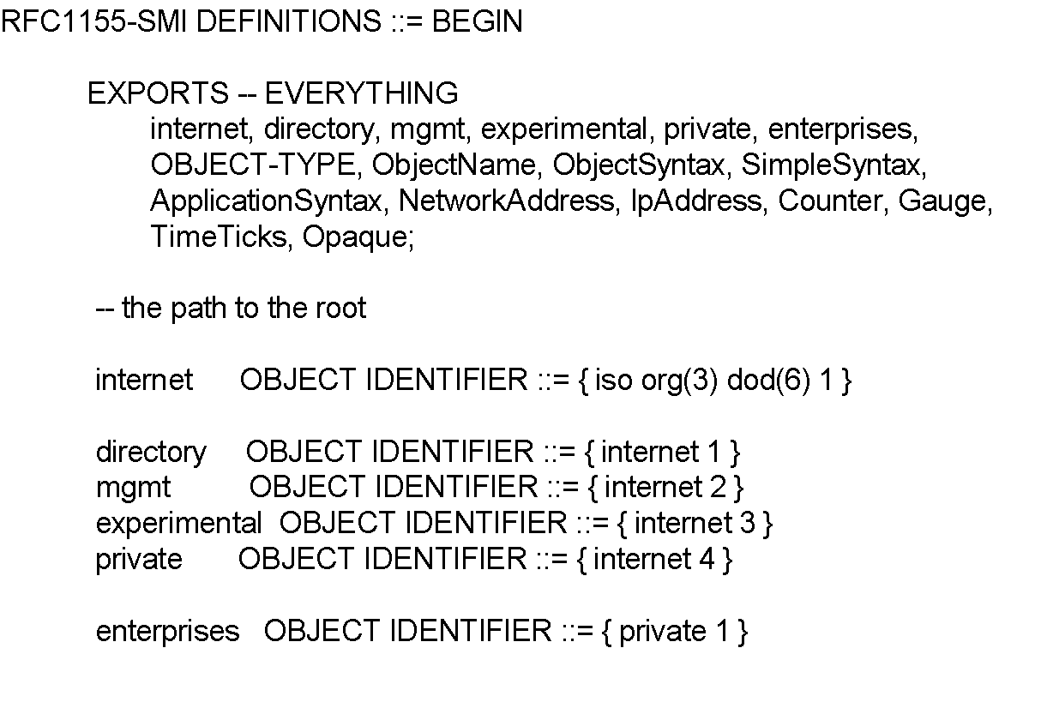
SMI Definition STD 16 / 1155 RFC
Note:
EXPORTS identifies the objects that any other module could import.

Slide 40
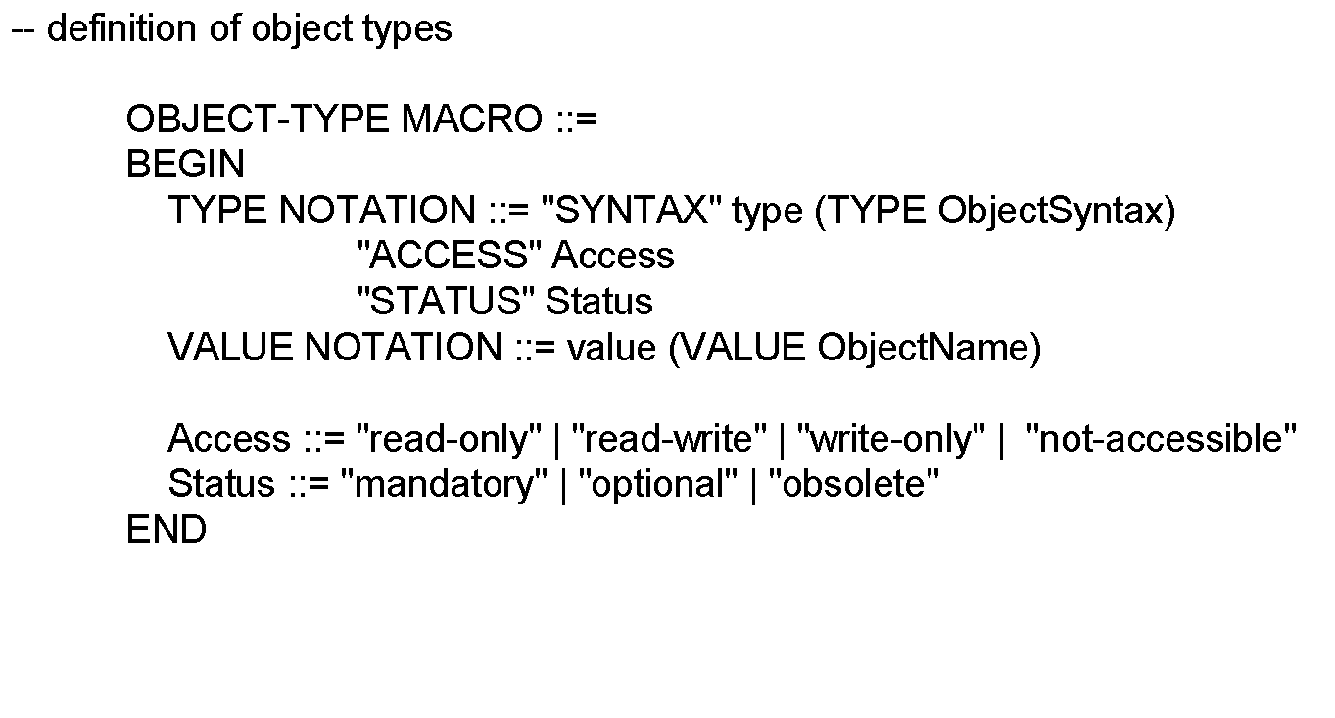
SMI Definition STD 16 / 1155 RFC (cont.)

Slide 41
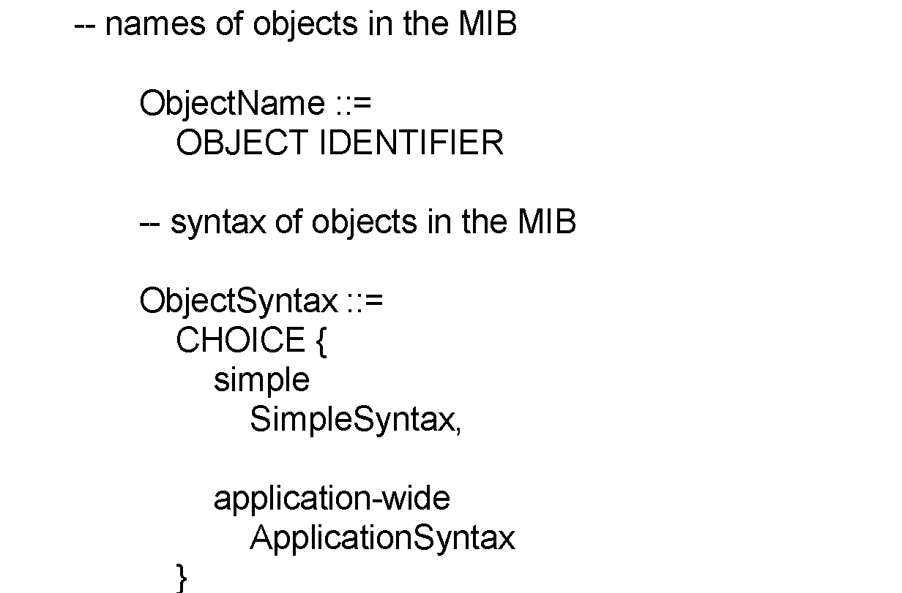
SMI Definition STD 16 / 1155 RFC (cont.)

Slide 42
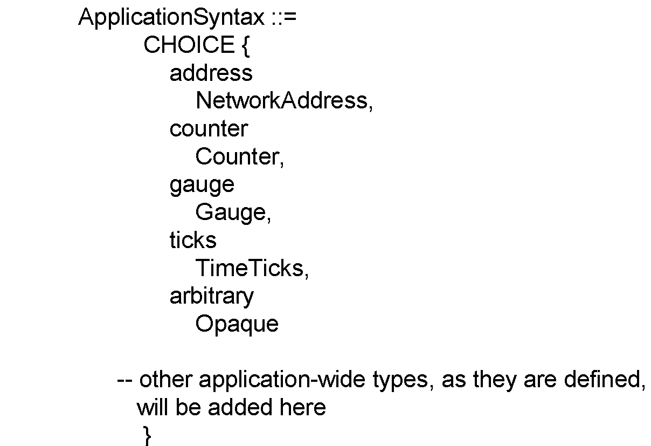
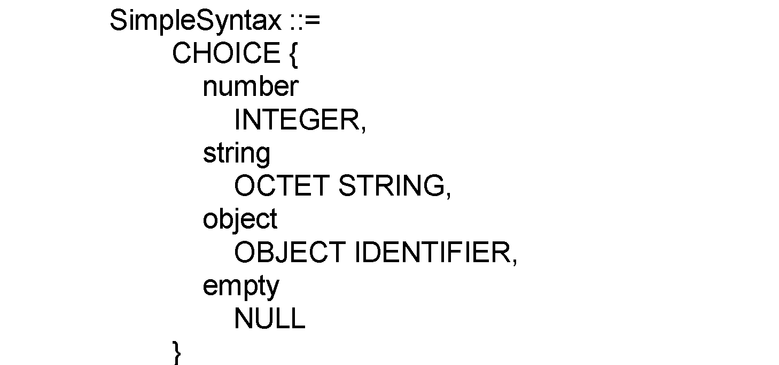
SMI Definition STD 16 / 1155 RFC (cont.)

Slide 43
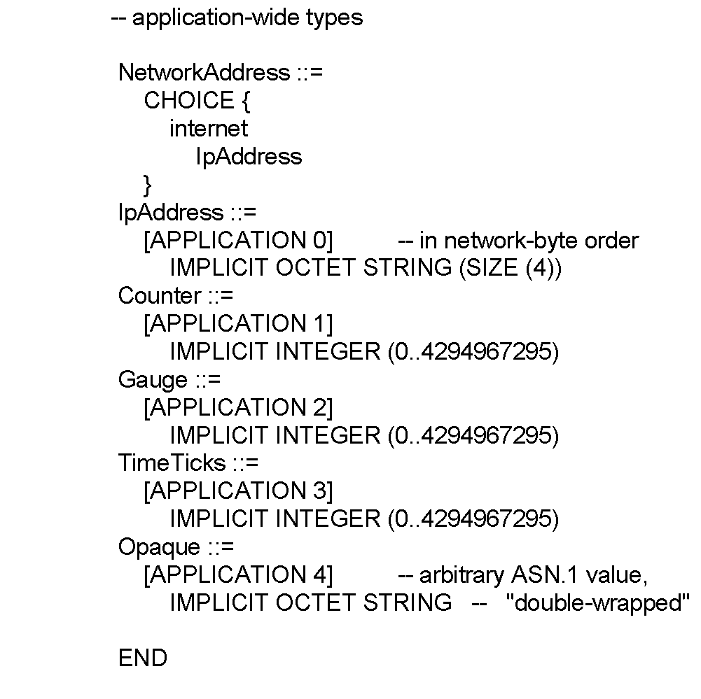
SMI Definition STD 16 / 1155 RFC (cont.)

Slide 44
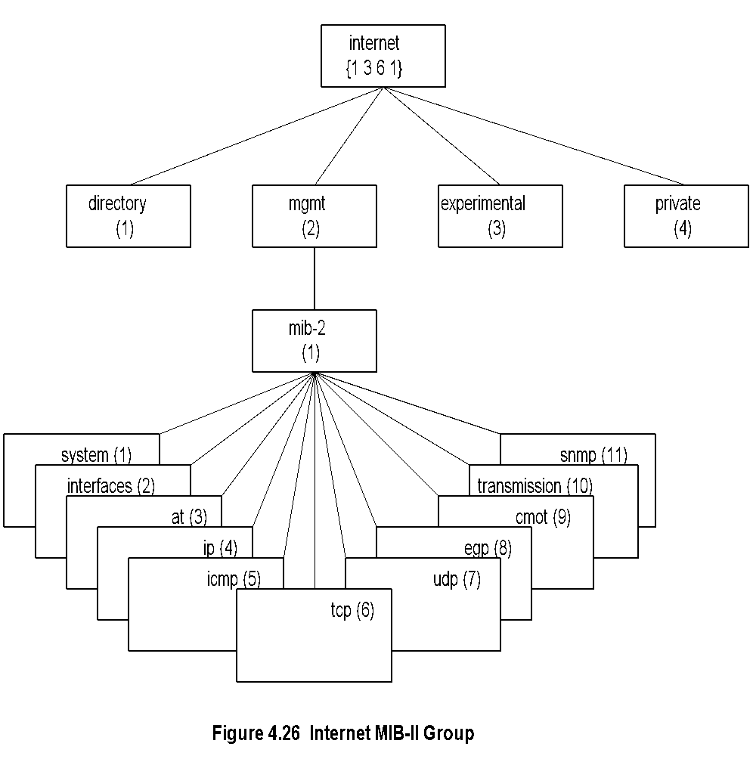
MIB
Note:
MIB-II (RFC 1213) is superset of MIB-I.
Objects that are related grouped into object groups.
MIB module comprises module name, imports from other modules, and definitions of current module.
RFC 1213 defines eleven groups; expanded later.

Slide 45
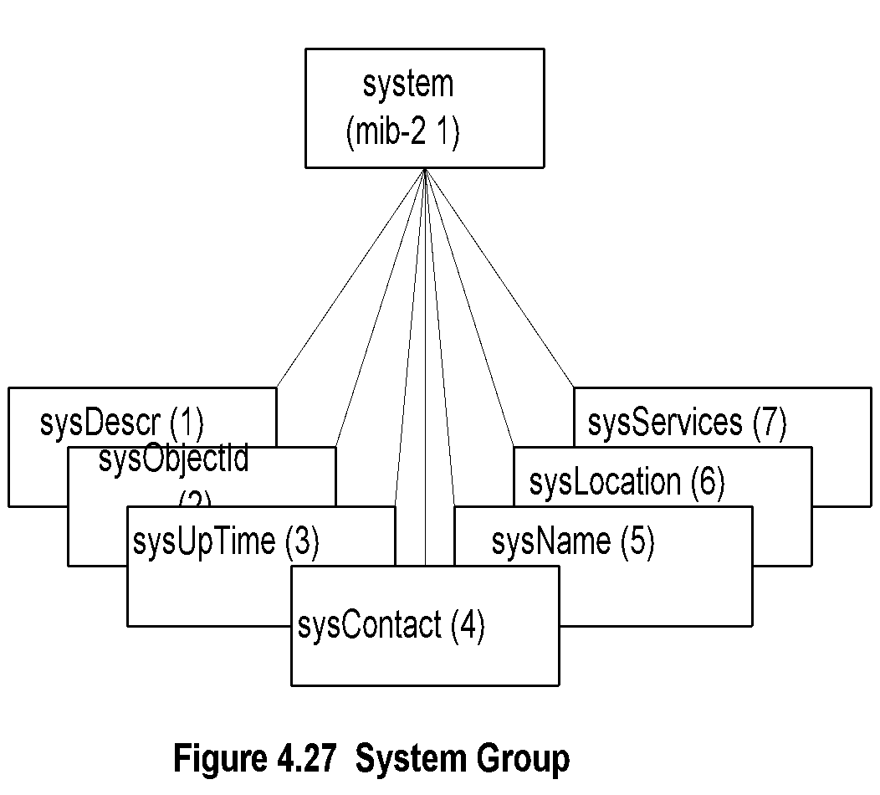
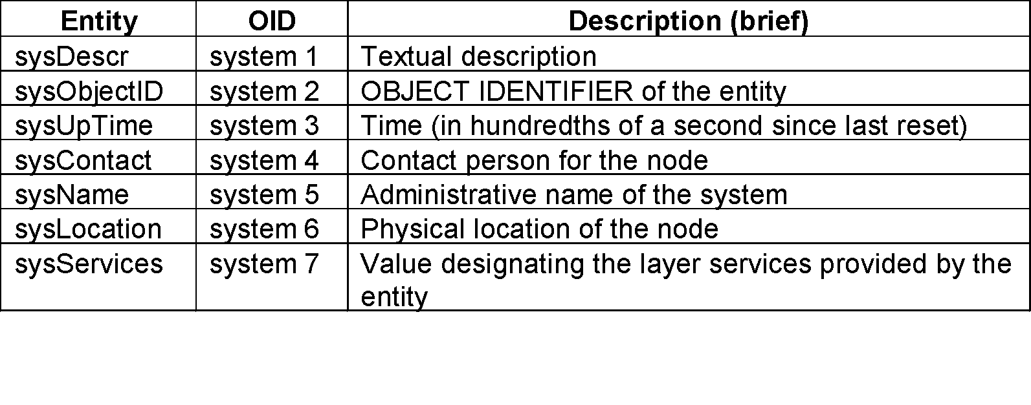
System Group
Note:

Slide 46
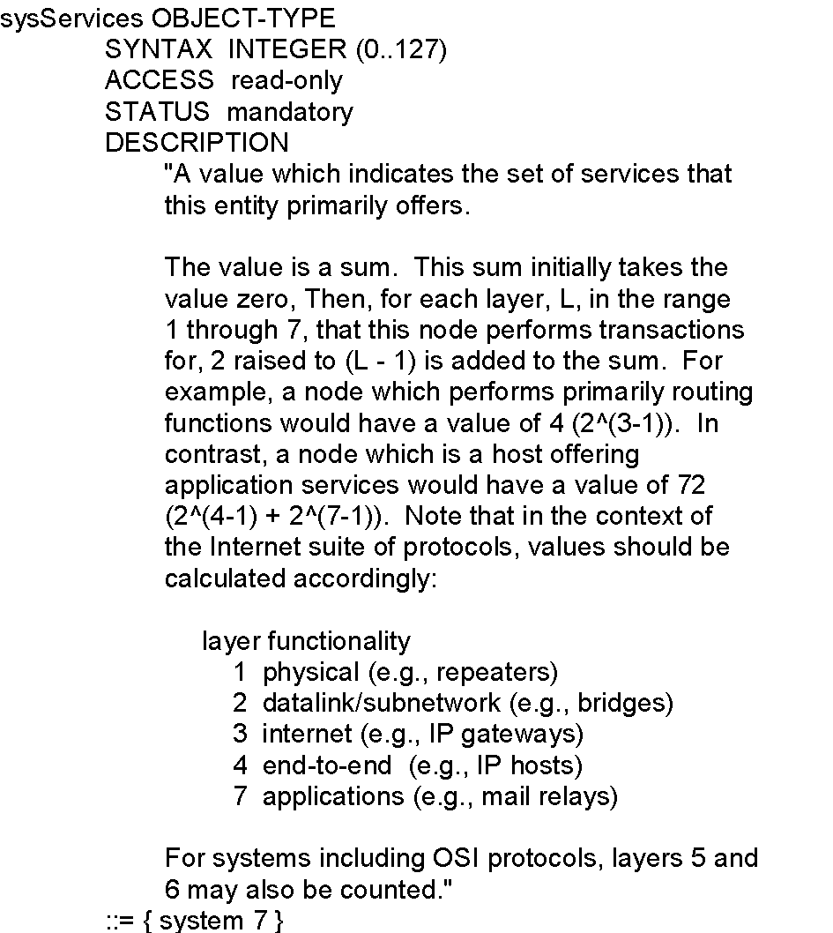
sysServices

Slide 47
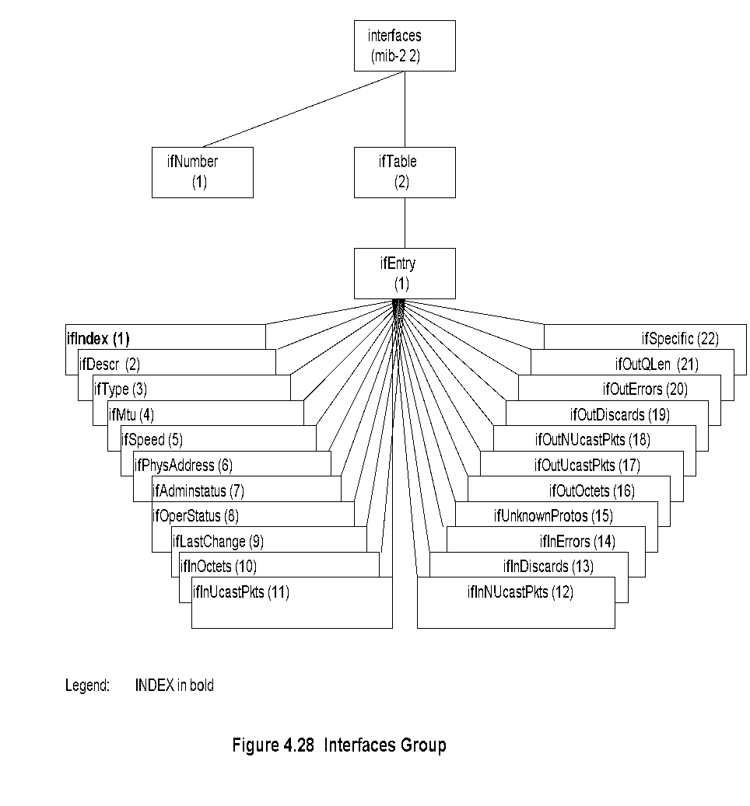
Interfaces Group

Slide 48
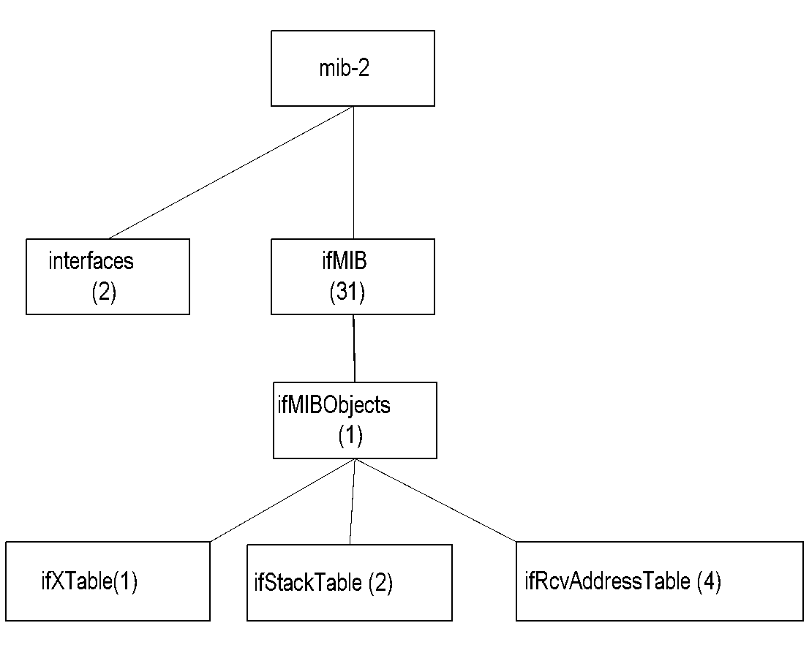
Extension to Interfaces MIB
Note:
Interfaces MIB limited by maximum number of physical ports
A physical port may have several conceptual ports
e.g., channels in cable access network
ifMIB {mib-2 31} created to extend interfaces MIB
ifMIB speicifies extension in generic manner
Specific technology related MIBs supplement details on the conceptual ports
ifIndex in interfaces MIB can exceed the maximum number of physical ports
ifStack definition accommodates interface sublayers

Slide 49
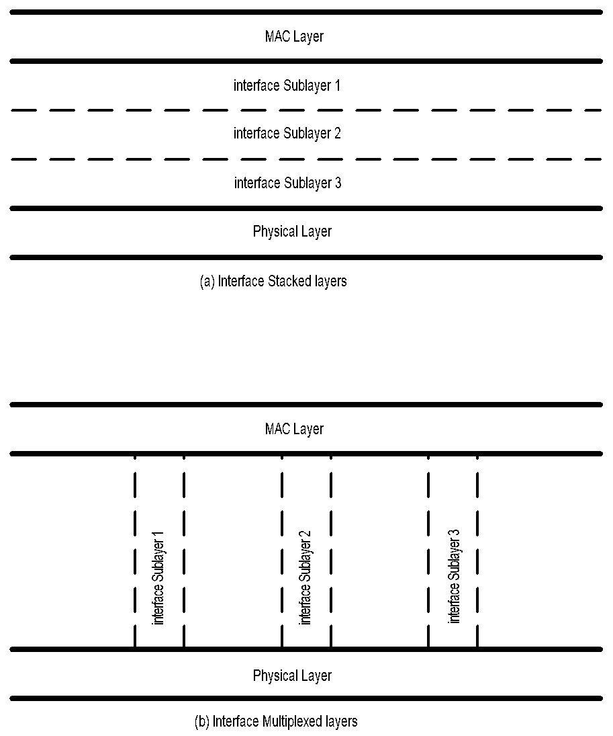
Interface Sublayers

Slide 50
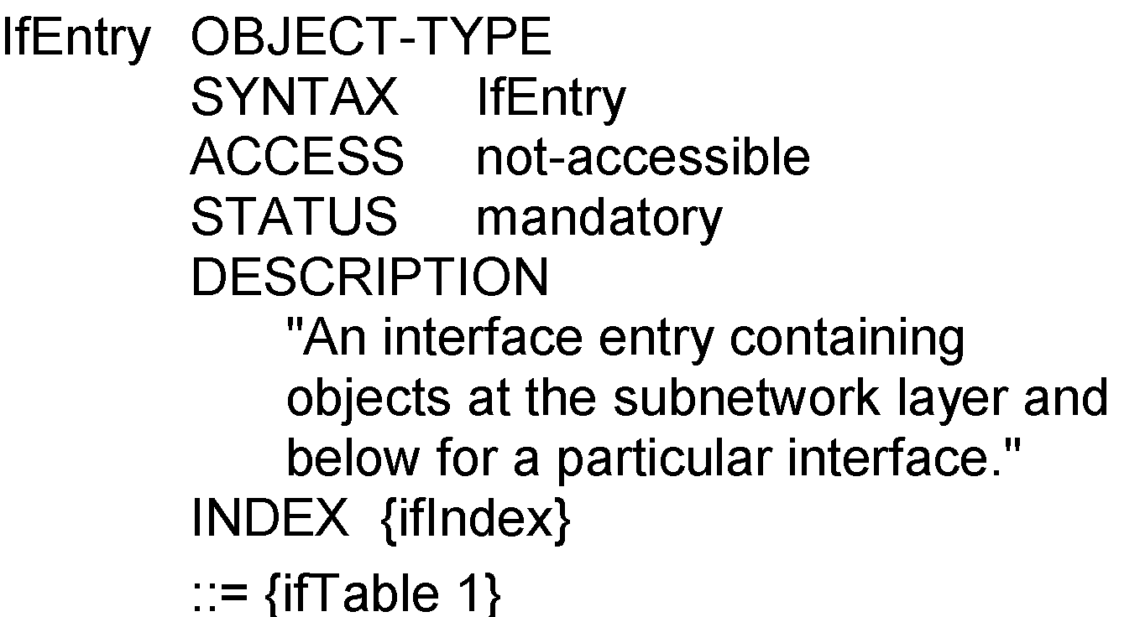
ifEntry
Note:
ifEntry specifies the objects in a row in the ifTable.
Each interface is defined as a row in the table.

Slide 51

ifType
Note:
Type of interface below the network layer defined as enumerated integer.

Slide 52

IP Group
Note:
ipForwarding: Gateway(1) and Router(2)
IP Address Table contains table of IP addresses
IP Route Table contains an entry for each route
IP Network-to-Media Table is address translation table mapping IP addresses to physical addresses

Slide 53


IP Address Table
Note:

Slide 54


IP Routing Table

Slide 55


IP Address Translation Table
Note:

Slide 56

ICMP Group
Note:
Objects associated with ping
  icmpOutEchos # ICMP echo messages sent
  icmpInEchoReps # ICMP echo reply messages received
Objects associated with traceroute/tracert
  icmpInTimeExcs # ICMP time exceeded messages received

Slide 57

TCP Group
Note:
Connection-oriented transport protocol group
Has one table

Slide 58


TCP Connection Table
Note:

Slide 59


UDP Group
Note:
Connectionless transport protocol group
Has one table, UDP table
Nisreen AlGhadban 120015789

