Slide 1
Chapter 3
Basic Foundations:
Standards, Models, and Language

Slide 2
Introduction
Standards
  Standards organizations
  Protocol standards of transport layers
  Protocol standards of management (application) layer
Management Models
Language

Slide 3
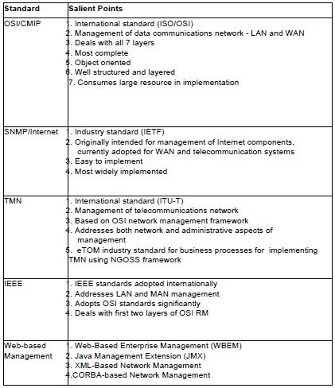
Table 3.1 Network Management Standards

Slide 4
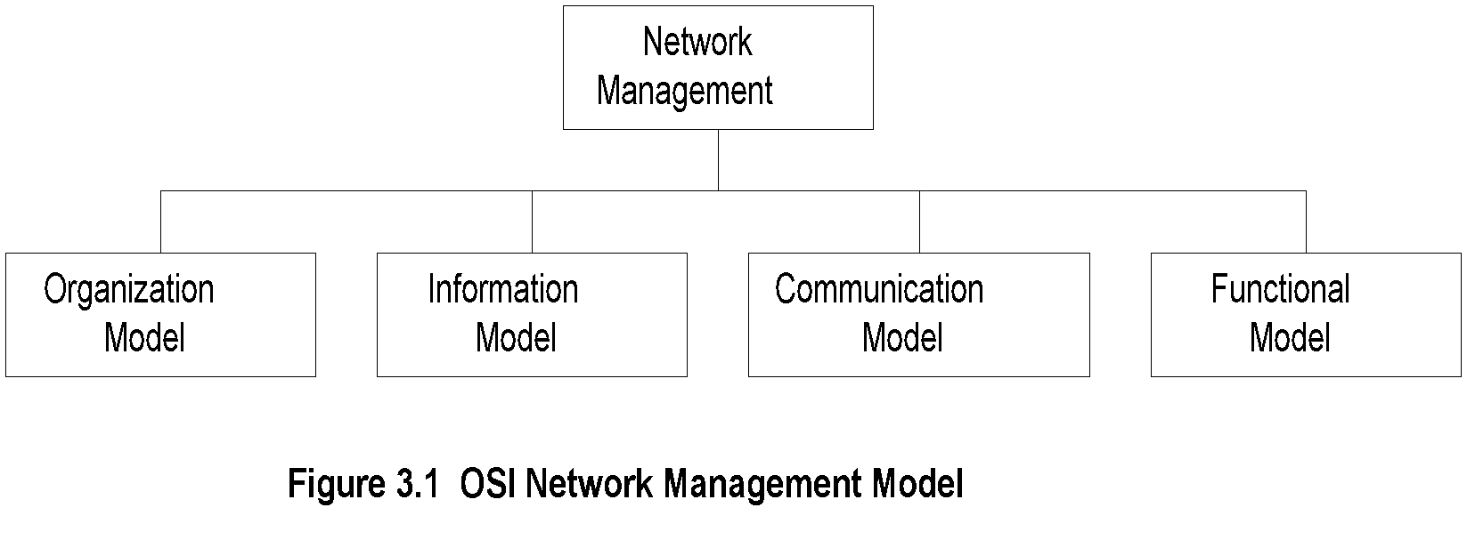
OSI Architecture and Model

Slide 5
OSI Architecture and Model (cont.)
Organization
  Network management components
  Functions of components
  Relationships
Information
  Structure of management information (SMI)
    Syntax and semantics
  Management information base (MIB)
    Organization of management information
  Object-oriented
Communication
  Transfer syntax with bidirectional messages
  Transfer structure (PDU)
Functions
  Application functions
  Configure components
  Monitor components
  Measure performance
  Secure information
  Usage accounting

Slide 6
SNMP Architecture and Model
Organization
  Same as OSI model
Information
  Same as OSI, but scalar
Communication
  Messages less complex than OSI and
  unidirectional
  Transfer structure (PDU)
Functions
  Application functions
    Fault management
    Configuration management
    Account management
    Performance management
    Security management

Slide 7
TMN (Telecommunications Management Network) Architecture
Addresses management of telecommunication networks
Based on OSI model
Superstructure on OSI network
Addresses network, service, and business
management

Slide 8
Organizational Model
Manager
  Sends requests to agents
  Monitors alarms
  Houses applications
  Provides user interface
Agent
  Gathers information from objects
  Configures parameters of objects
  Responds to managers’ requests
  Generates alarms and sends them to
  managers
Managed object
  Network element that is managed
  Houses management agent
  All objects are not managed / manageable

Slide 9
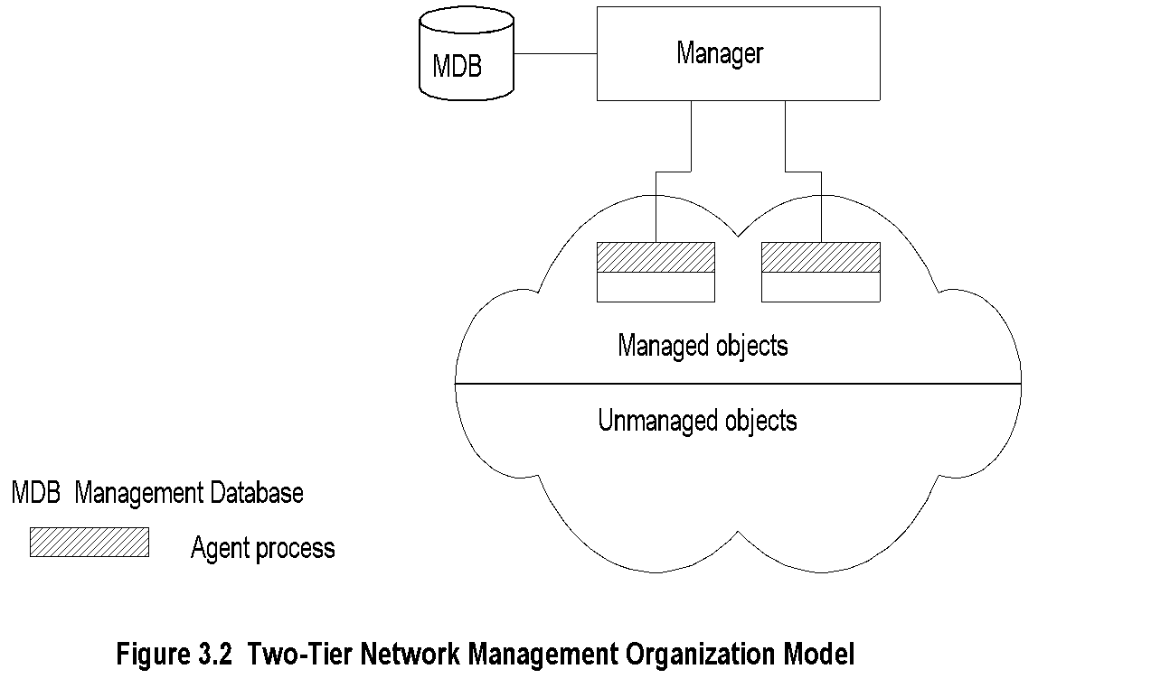
Two-Tier Model
Agent built into network element
Example: Managed hub, managed router
An agent can manage multiple elements
Example: Switched hub, ATM switch
MDB is a physical database
Unmanaged objects are network elements that are not managed - both physical (unmanaged hub) and logical (passive elements)

Slide 10
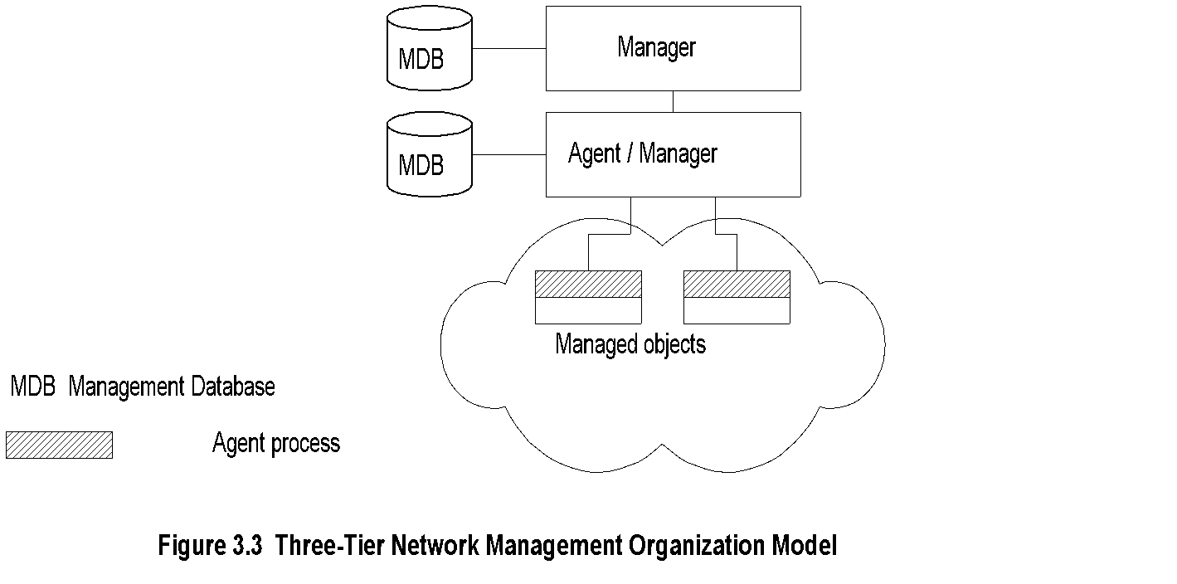
Three-Tier Model
Middle layer plays the dual role
  Agent to the top-level manager
  Manager to the managed objects
Example of middle level: Remote monitoring
agent (RMON)

Slide 11
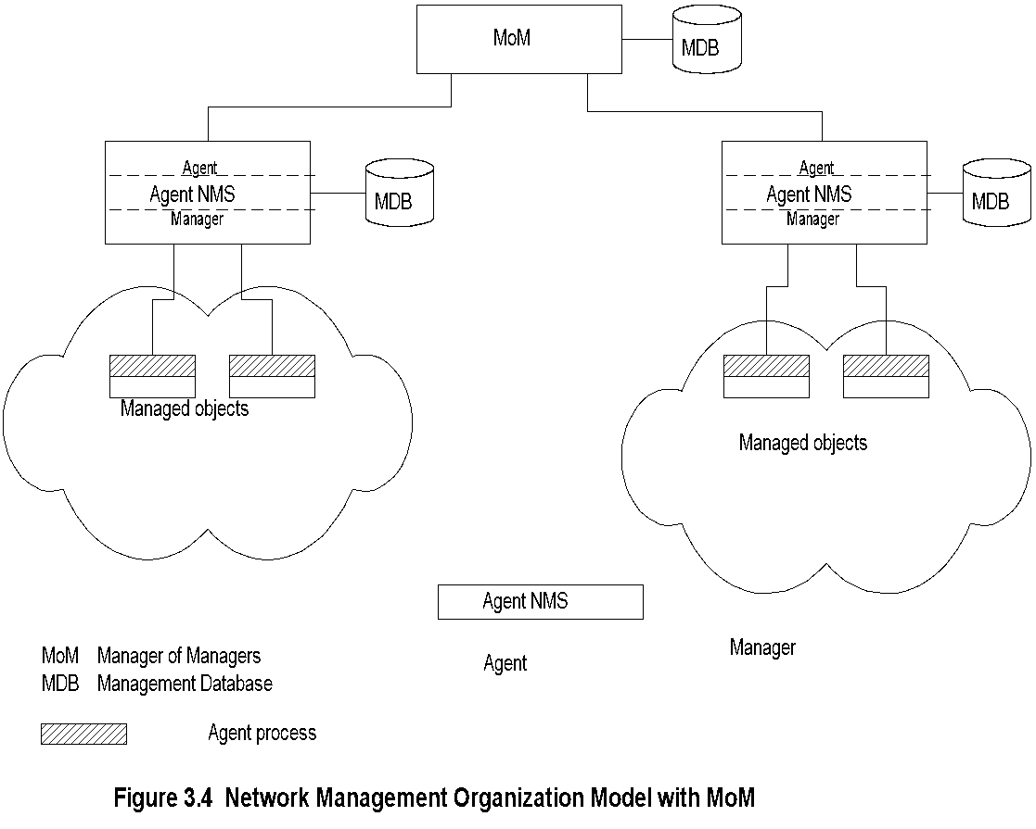
Manager of Managers
Agent NMS manages the domain
MoM presents integrated view of domains
Domain may be geographical, administrative,
vendor-specific products, etc.

Slide 12
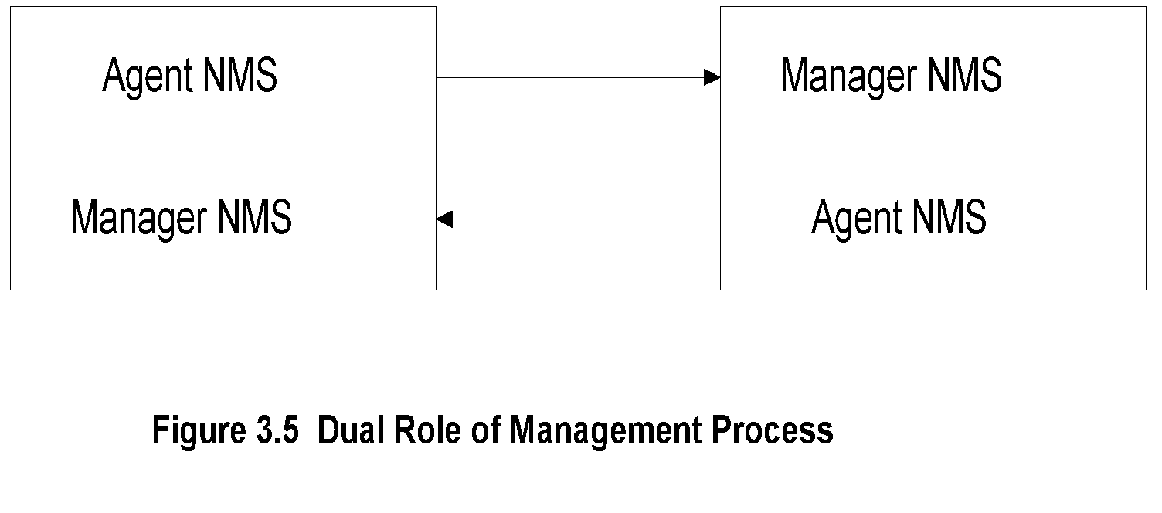
Peer NMSs
Dual role of both NMSs
Network management system acts as peers
Dumbbell architecture discussed in Chapter 1
Notice that the manager and agent functions are
processes and not systems

Slide 13
Information Model: Analogy
Figure in a book uniquely identified by
  ISBN, Chapter, and Figure number in that
  hierarchical order
ID: {ISBN, chapter, figure}
The three elements above define the syntax
Semantics is the meaning of the three
entities according to Webster’s dictionary
The information comprises syntax and semantics
about an object

Slide 14
Structure of Management Information (SMI)
SMI defines for a managed object
  Syntax
  Semantics
  Plus additional information such as status
Example
sysDescr: { system 1 }
Syntax: OCTET STRING
Definition: "A textual description of the entity. "
Access: read-only
Status: mandatory

Slide 15
Management Information Base (MIB)
Information base contains information about objects
Organized by grouping of related objects
Defines relationship between objects
It is NOT a physical database. It is a virtual
database that is compiled into management module

Slide 16
Information Base View: An Analogy
Fulton County library system has many branches
Each branch has a set of books
The books in each branch is a different set
The information base of the county has the view (catalog) of all books
The information base of each branch has the catalog of books that belong to that branch.
That is, each branch has its view (catalog) of the information base
Let us apply this to MIB view

Slide 17
MIB View and Access of an Object
A managed object has many attributes - its information base
There are several operations that can be performed on the objects
A user (manager) can view and perform only certain operations on the object by invoking the management agent
The view of the object attributes that the agent perceives is the MIB view
The operation that a user can perform is the MIB access

Slide 18
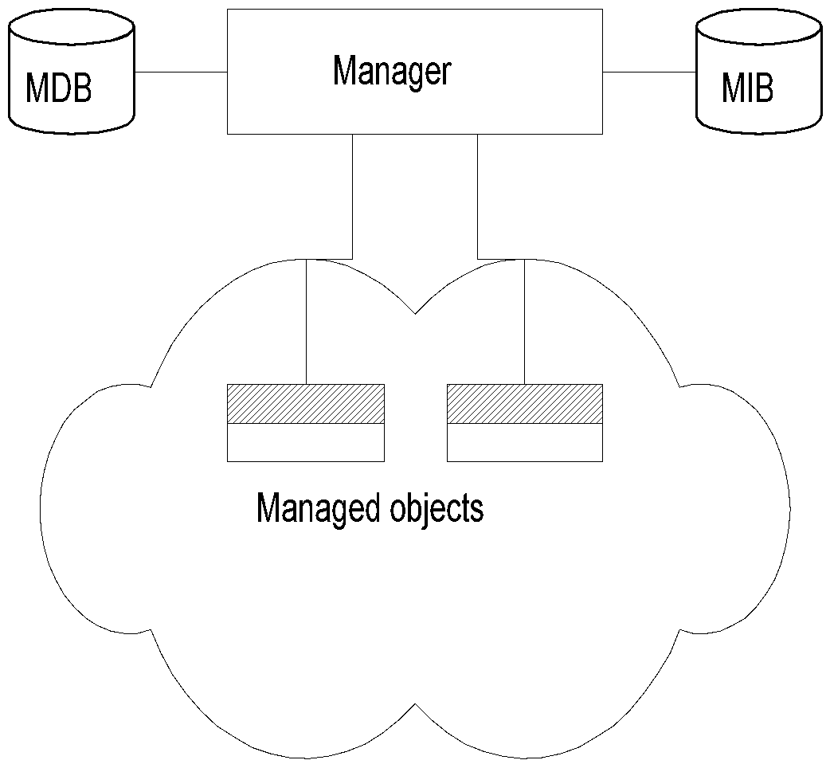
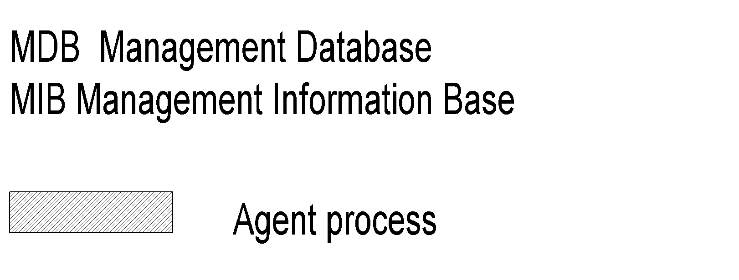
Management Data Base / Information Base
Distinction between MDB and MIB
  MDB physical database; e.g., Oracle, Sybase
  MIB virtual database; schema compiled into management software.
An NMS can automatically discover a managed object, such as a hub, when added to the network
The NMS can identify the new object as hub only after the MIB schema of the hub is compiled into NMS software.

Slide 19
Managed Object
Managed objects can be
  Network elements (hardware, system)
    Hubs, bridges, routers, transmission facilities
  Software (non-physical)
    Programs, algorithms
  Administrative information
    Contact person, name of group of objects (IP group)

Slide 20
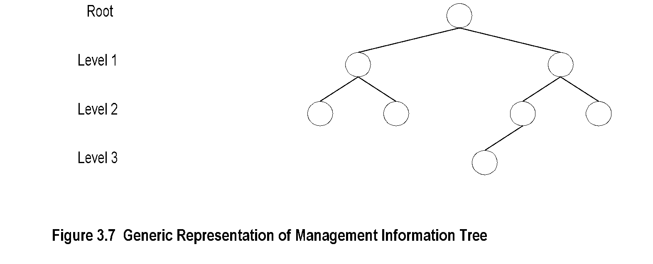
Management Information Tree

Slide 21
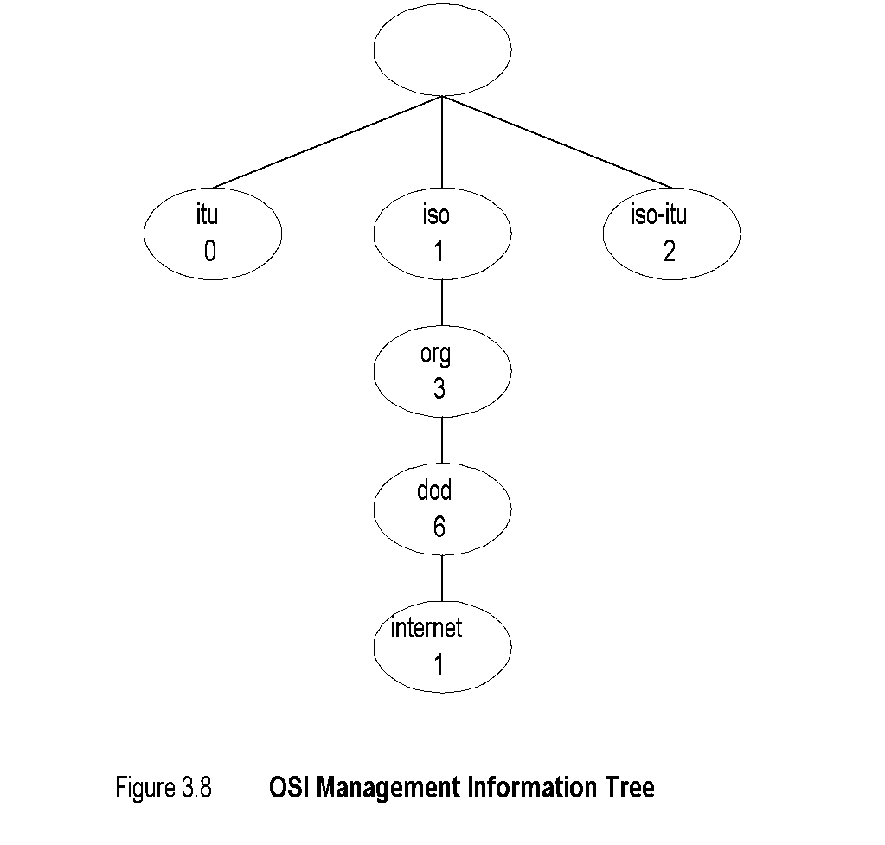
OSI Management Information Tree
iso International Standards Organization
itu International Telecommunications Union
dod Department of Defense
Designation:
  iso 1
  org 1.3
  dod 1.3.6
  internet 1.3.6.1

Slide 22
Object Type and Instance
Type
  Name
  Syntax
  Definition
  Status
  Access
Instance
Note:
Example of a circle
  “circle” is syntax
  Semantics is definition from dictionary
  “A plane figure bounded by a singl curved
  line, every point of which is of equal distance
  from the center of the figure.”
Analogy of nursery school

Slide 23
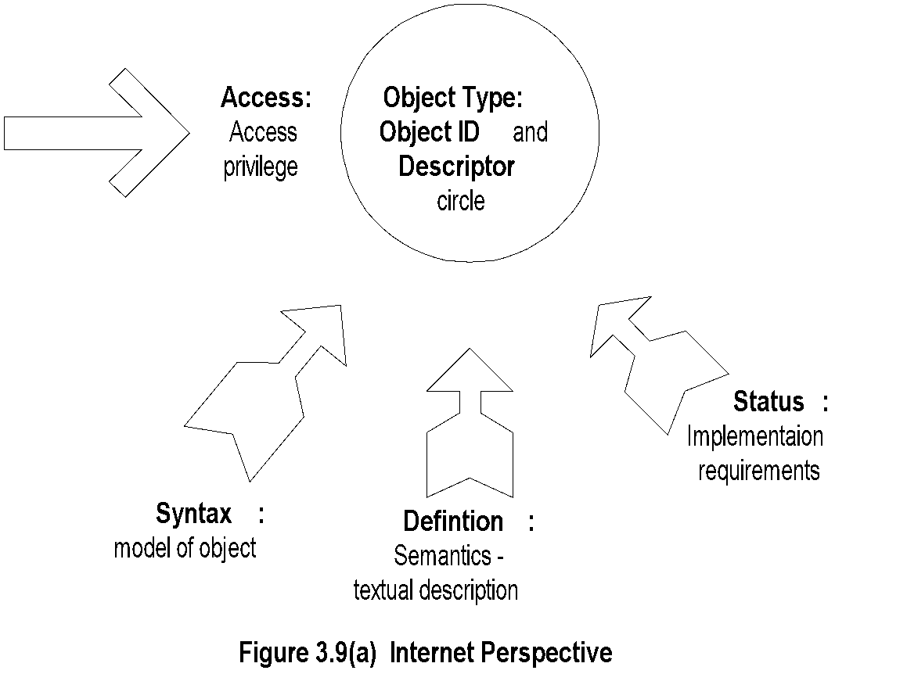
Managed Object: Internet Perspective
    object ID unique ID
    and descriptor and name for the object
    syntax used to model the object
    access access privilege to a managed object
    status implementation requirements
    definition textual description of the semantics of object type

Slide 24
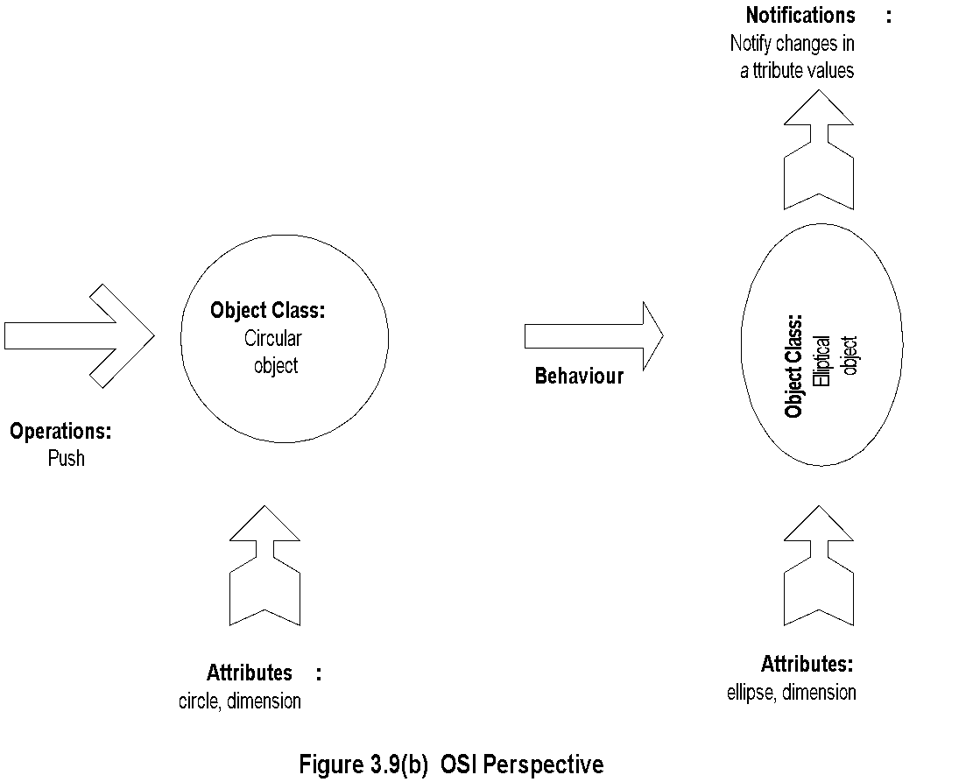
Managed Object: OSI Perspective
    object class managed object
    attributes attributes visible at its boundary
    operations operations which may be applied to it
    behavior behavior exhibited by it in response to operation
    notifications notifications emitted by the object

Slide 25
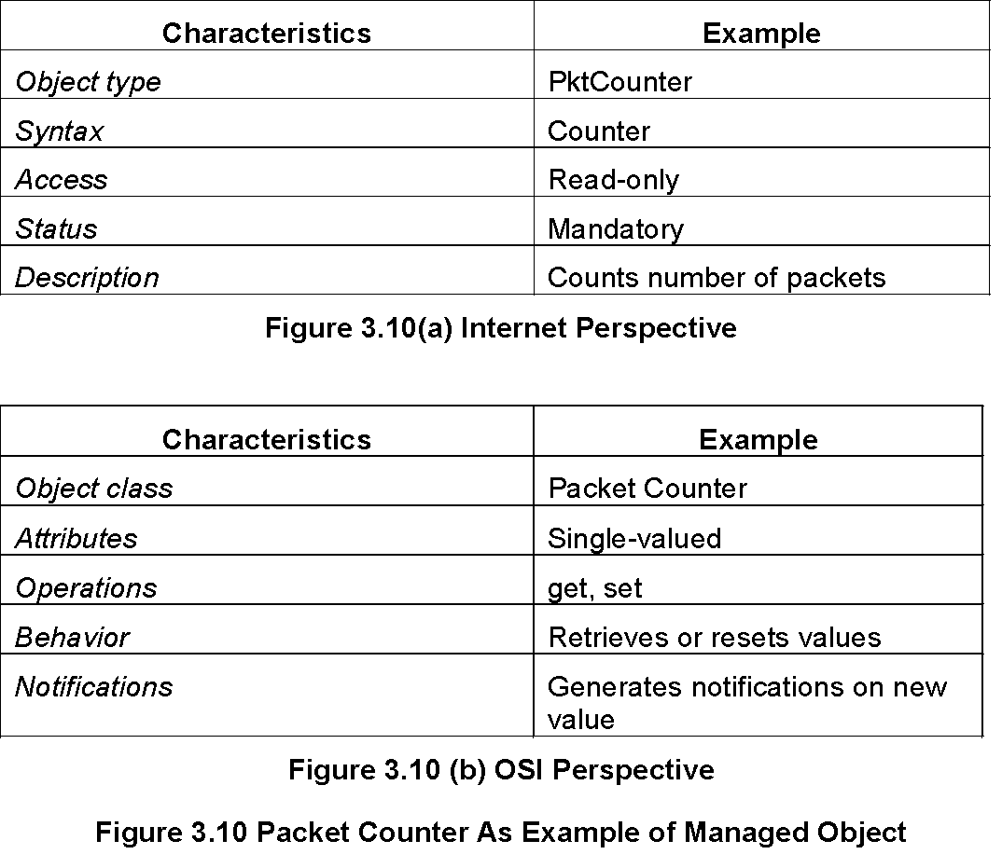
Packet Counter Example

Slide 26
Internet vs. OSI Managed Object
Scalar object in Internet vs. Object-oriented approach in OSI
OSI characteristics of operations, behavior, and notification are part of communication model in Internet: get/set and response/alarm
Internet syntax is absorbed as part of OSI attributes
Internet access is part of OSI security model
Internet status is part of OSI conformance application
OSI permits creation and deletion of objects; Internet does not: Enhancement in SNMPv2

Slide 27
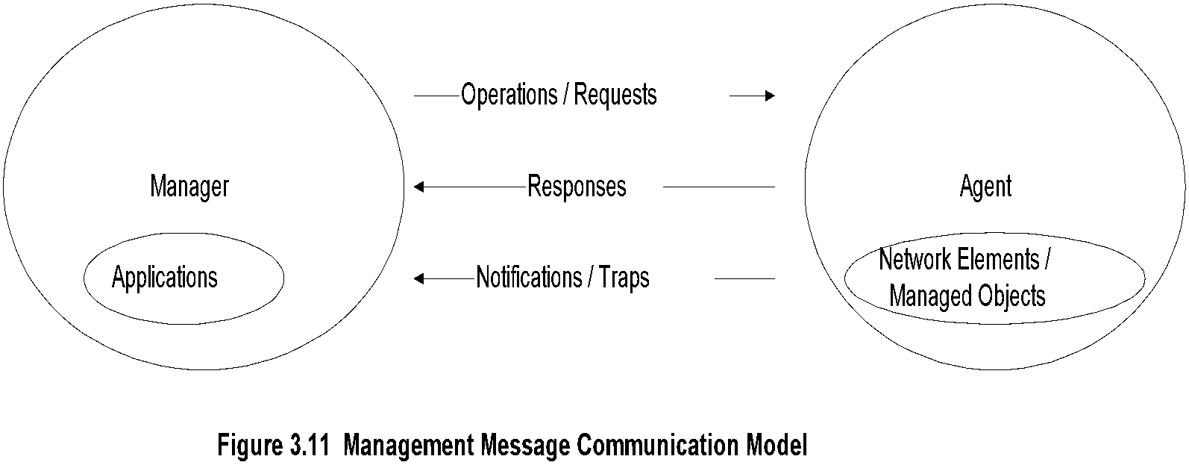
Mgmt. Communication Model
In Internet requests/responses, in OSI operations
In Internet traps and notifications (SNMPv2), in OSI notifications

Slide 28
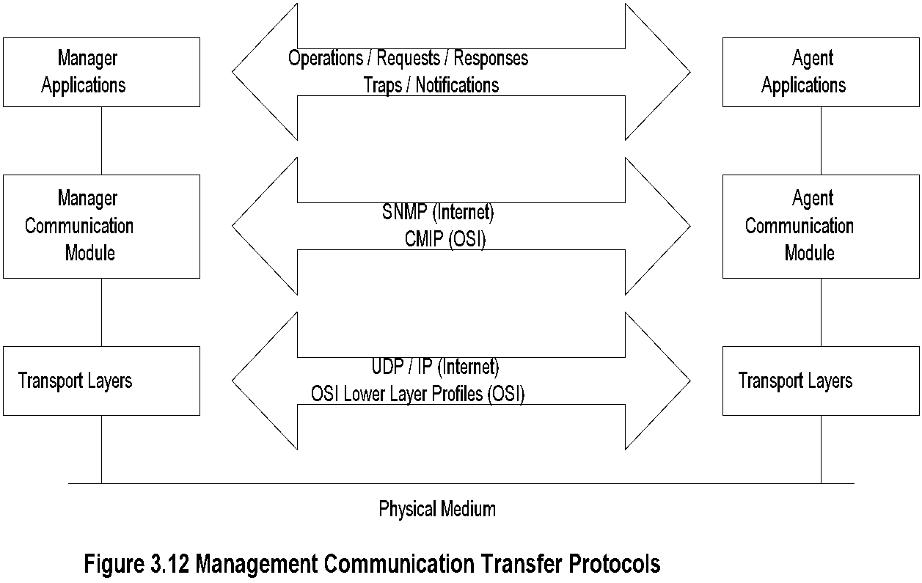
Transfer Protocols
Internet is based on SNMP; OSI is based on CMIP
OSI uses CMISE (Common Management Information Service Element) application with CMIP
OSI specifies both c-o and connectionless transport
protocol; SNMPv2 extended to c-o, but rarely used

Slide 29
Abstract Syntax Notation One
ASN.1 is more than a syntax; it’s a language
Addresses both syntax and semantics
Two types of syntax
  Abstract syntax: set of rules that specify
  data type and structure for information storage
  Transfer syntax: set of rules for communicating
  information between systems
Makes application layer protocols independent of lower layer protocols
Can generate machine-readable code: Basic Encoding Rules (BER) is used in management modules

Slide 30
Backus-Nauer Form (BNF)
Definition:
<name> ::= <definition>
Rules:
<digit> ::= 0|1|2|3|4|5|6|7|8|9
<number> ::= <number> | <digit> <number>
<op> ::= +|-|x|/
<SAE> ::= <number>|<SAE>|<SAE><op><SAE>
Example:
9 is primitive 9
19 is construct of 1 and 9
619 is construct of 6 and 19
Note:
BNF is used for ASN.1 constructs
Constructs developed from primitives
The above example illustrates how numbers are constructed from the primitive <digit>
Simple Arithmetic Expression entity (<SAE>) is constructed from the primitives <digit> and <op>

Slide 31
Simple Arithmetic Expression
<SAE> ::= <number> | <SAE><op><number>
Example: 26 = 13 x 2
Constructs and primitives

Slide 32
Type and Value
Assignments
  <BooleanType> ::= BOOLEAN
  <BooleanValue> ::= TRUE | FALSE
ASN.1 module is a group of assignments
person-name Person-Name::=
{
    first "John",
middle “T",
last "Smith"
}

Slide 33
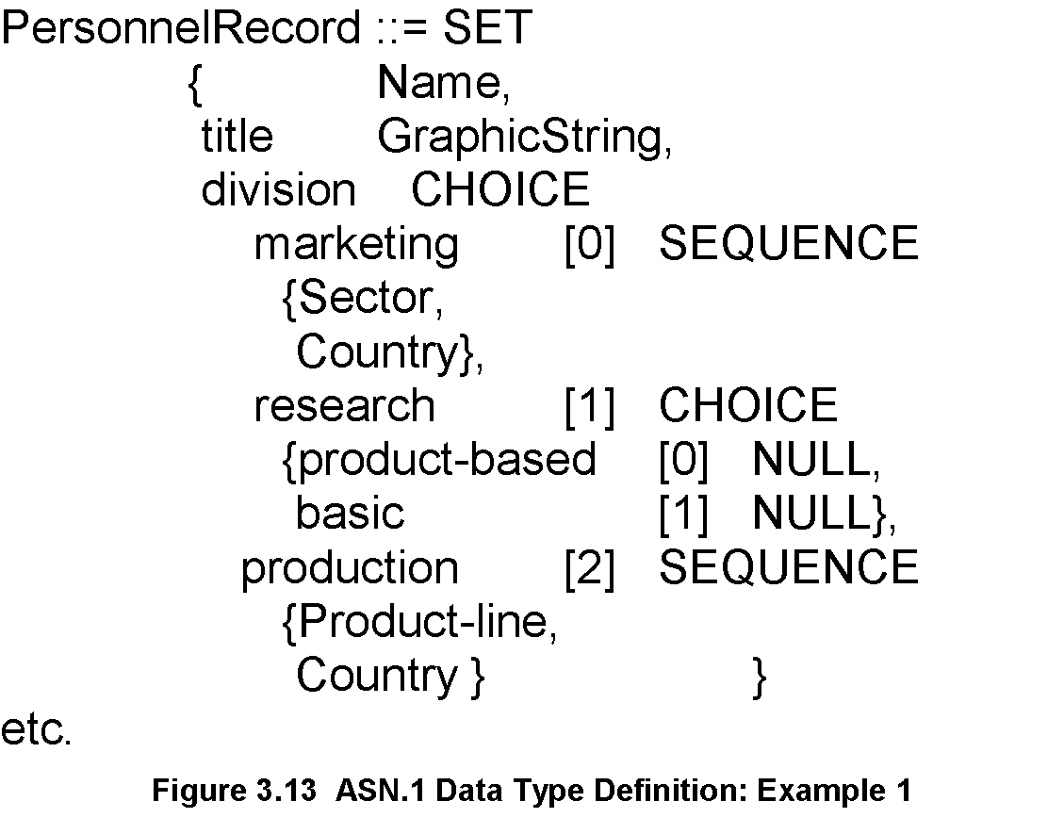
Data Type: Example 1
Note:
Module name starts with capital letters
Data types:
  Primitives: NULL, GraphicString
  Constructs
    Alternatives : CHOICE
    List maker: SET, SEQUENCE
    Repetition: SET OF, SEQUENCE OF:
Difference between SET and SEQUENCE

Slide 34
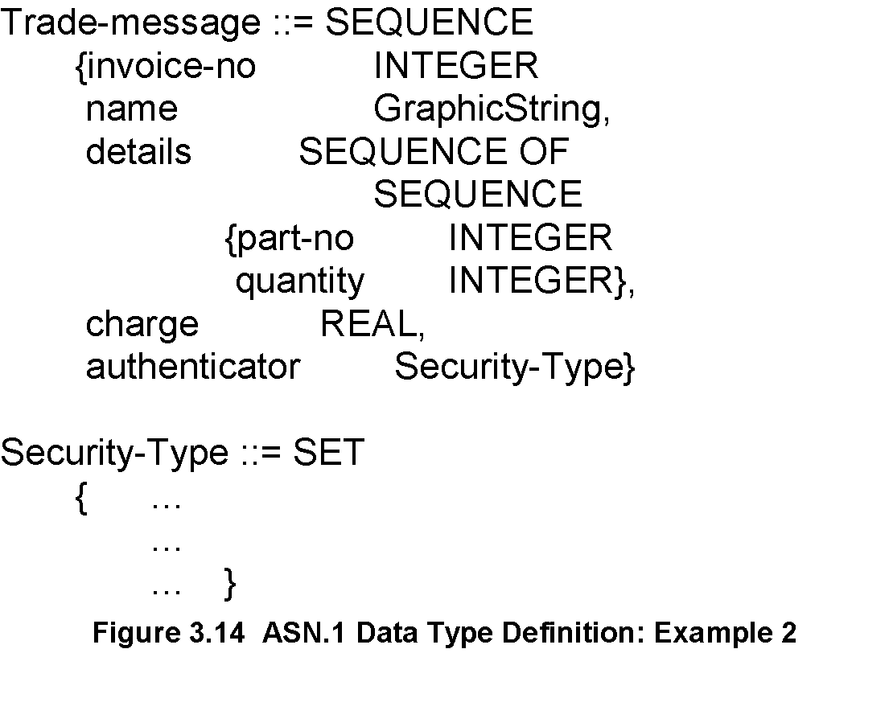
Data Type: Example 2
Note:
SEQUENCE OF SEQUENCE makes
table of rows

Slide 35
ASN.1 Symbols
Symbol Meaning
::= Defined as
| or, alternative, options of a list
- Signed number
-- Following the symbol are comments
{} Start and end of a list
[] Start and end of a tag
() Start and end of subtype
.. Range

Slide 36
Keyword Examples
CHOICE
SET
SEQUENCE
OF
NULL
Note:
Keywords are in all UPPERCASE letters

Slide 37
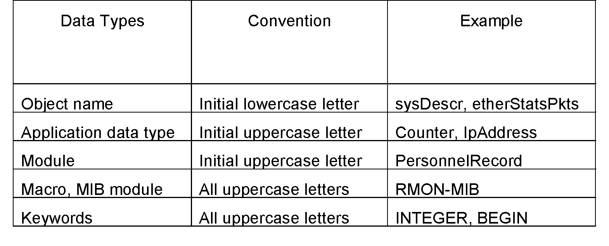
ASN.1 Data Type Conventions

Slide 38
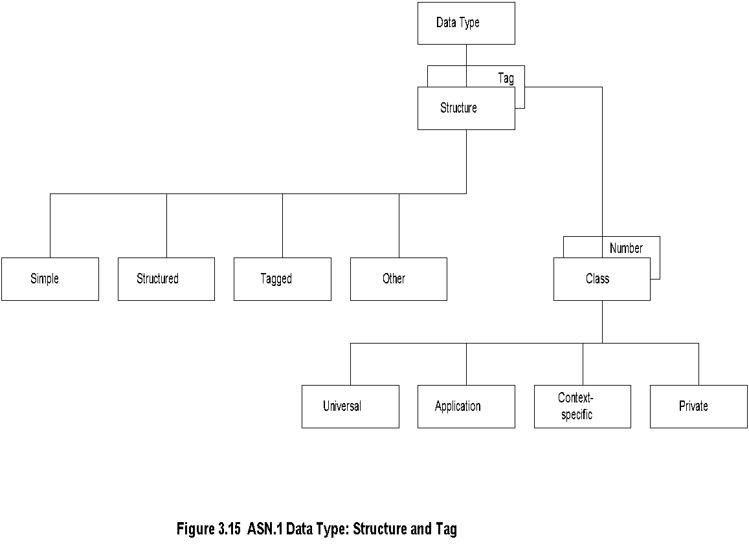
Data Type: Structure & Tag
Structure defines how data type is built
Tag uniquely identifies the data type

Slide 39
Structure
Simple
  PageNumber ::= INTEGER
  ChapterNumber ::= INTEGER
Structure / Construct
  BookPageNumber ::=
  SEQUENCE
  {ChapterNumber, Separator, PageNumber
  Example: {1-1, 2-3, 3-39}
Tagged
  Derived from another type; given a new ID
  In Fig. 3-14, INTEGER is either universal or
  application specific
Other types:
  CHOICE, ANY
Note:
BookPages ::= SEQUENCE OF { BookPageNumber}
or
BookPages ::=
SEQUENCE OF
{
SEQUENCE
    {ChapterNumber, Separator, PageNumber}
}

Slide 40
Tag
Tag uniquely identifies a data type
Comprises class and tag number
Class:
  Universal - always true
  Application - only in the application used
  Context-specific - specific context in application
  Private - used extensively by commercial
  vendors
Note:
Example:
BOOLEAN Universal 1
INTEGER Universal 2
research Application [1] (Figure 3.13)
product-based Context-specific under research [0]

Slide 41
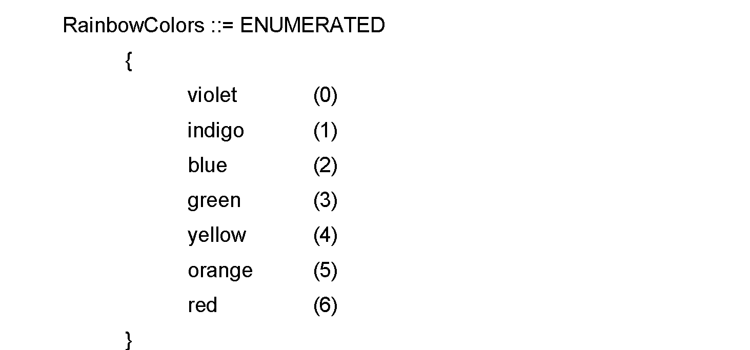
Enumerated Integer
Note:
ENUMERATED is a special case of INTEGER
Example: RainbowColors(5) is orange

Slide 42

ASN.1 Module Example

Slide 43
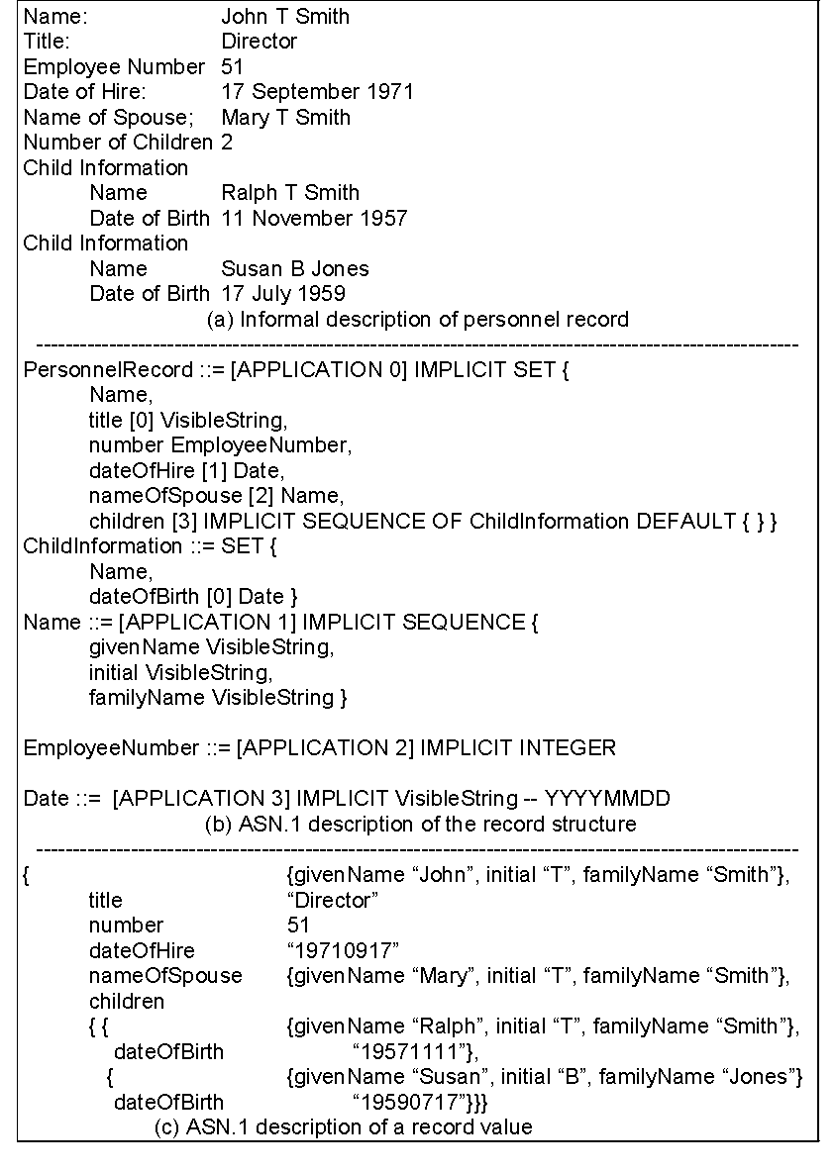

Slide 44
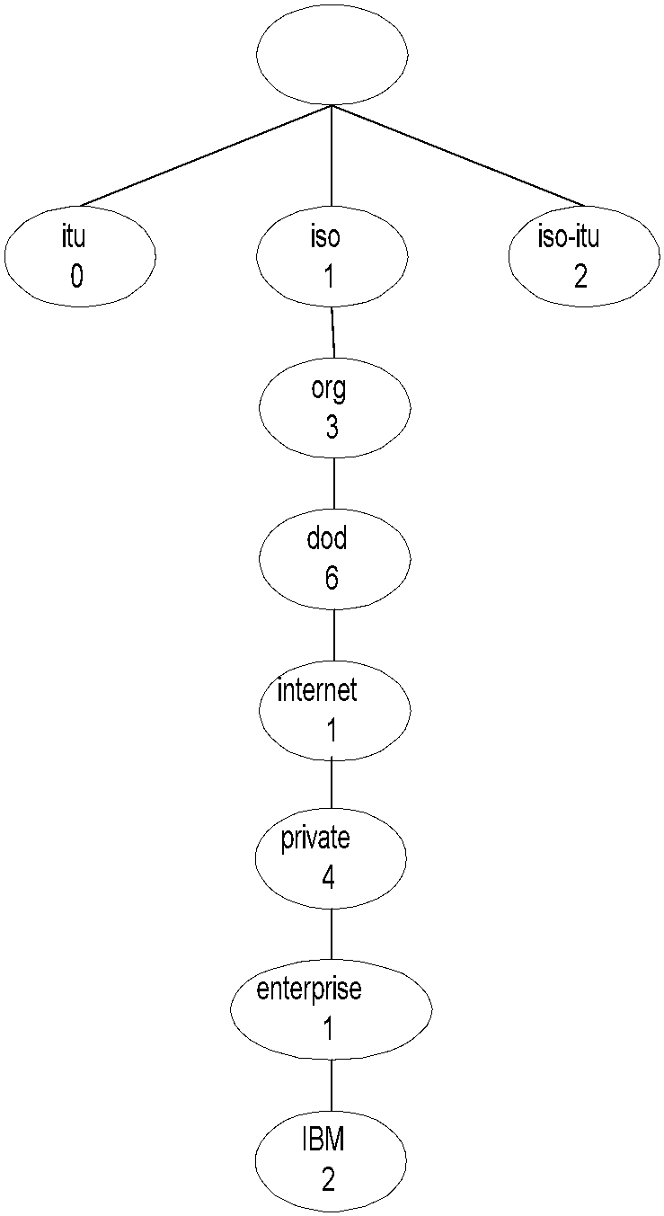
Object Name
Note:
internet OBJECT IDENTIFIER ::=
{ISO(1) ORG(3) DOD(6) INTERNET(1)}

Slide 45
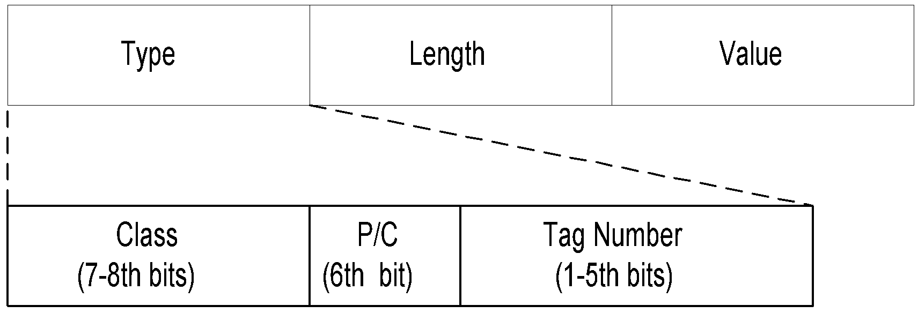

TLV Encoding
TLV Type, length, and value are components of the structure

Slide 46
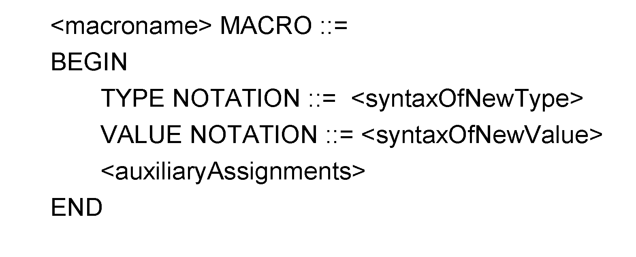
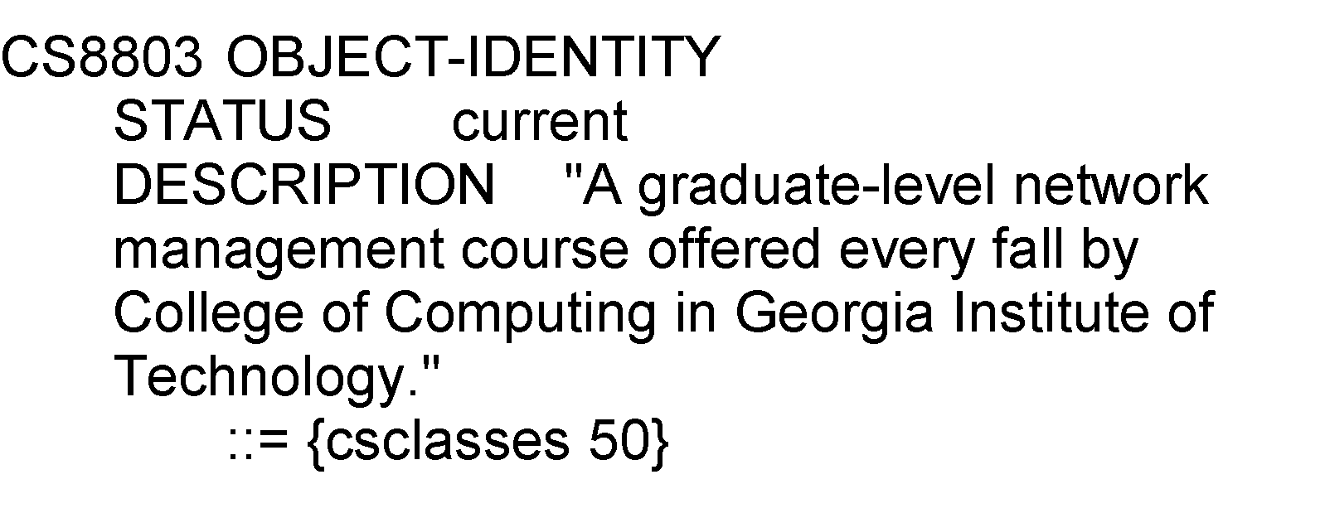
Macro
Example:
Note: Macro is used to create new data types

Slide 47
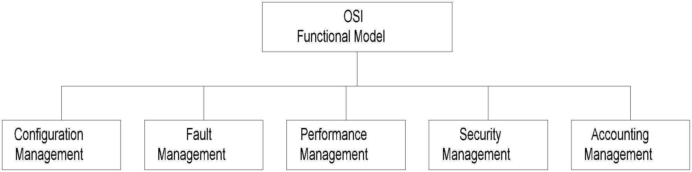
Functional Model

Slide 48
Functional Model-Cont.
Configuration management
  Set and change network configuration
  component parameters
  Set up alarm thresholds
Fault management
  Detection and isolation of failures in network
  Trouble ticket administration
Performance management
  Monitor performance of network
Security management
  Authentication
  Authorization
  Encryption
Accounting management
  Functional accounting of network usage
Nisreen AlGhadban 120015789

