Slide 1
Chapter 2
Review of Information Network and Technology

Slide 2
Technology and Management
What are the technologies that need to managed?
Challenges of technological progress on
network management

Slide 3
Information Network Technology
Network components
  Links
  Nodes
Topology: How they’re configured
LANs
Wireless LAN
WANs
Bridges
Routers and Gateways
Switches
Transmission Media
Transmission Modes
ISDN
Broadband networks and services

Slide 4
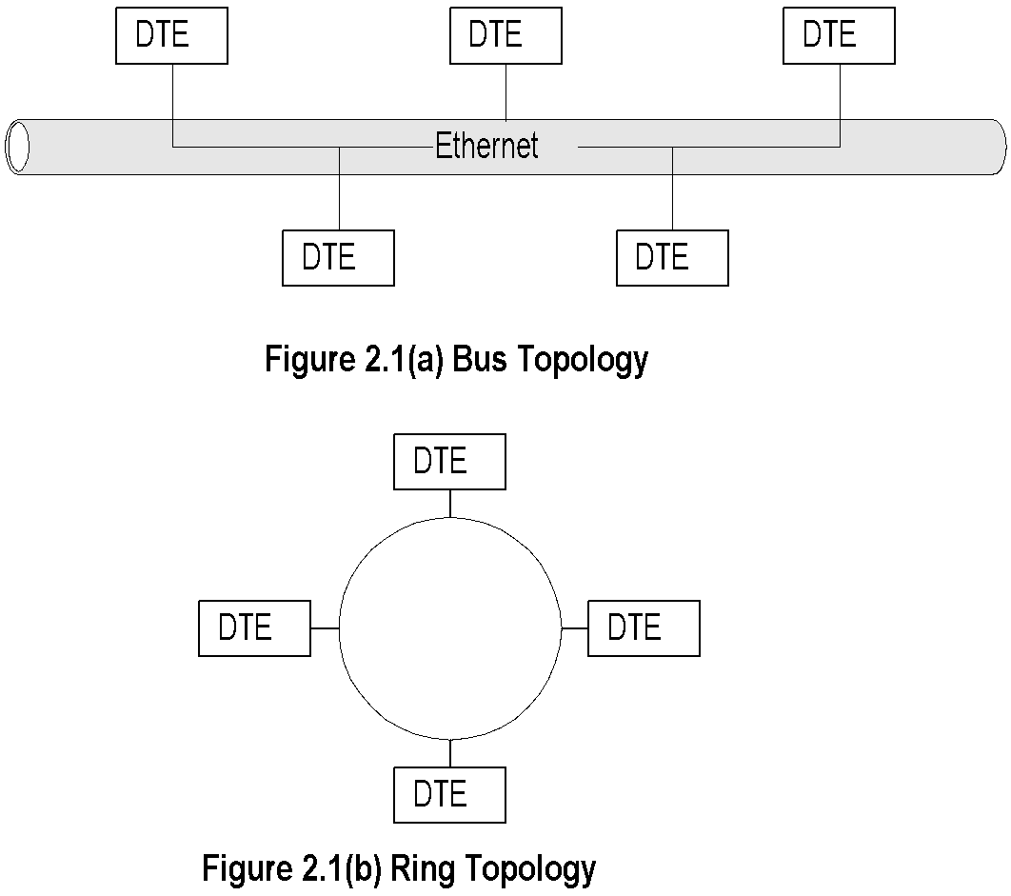
Basic LAN Topologies

Slide 5
Basic LAN Topologies
Notes:
Bus Topology:
  Used in Ethernet LAN family
  Common shared medium
  Randomized access (CSMA/CD)
  Easy to implement
  Lower utilization under heavy traffic 30%-40%
  Single culprit could effect the entire LAN
Ring Topology:
  Used in token ring and FDDI
  Shared medium
  Deterministic access
  Master DTE has control
  High utilization >90%
  Also used in MAN

Slide 6
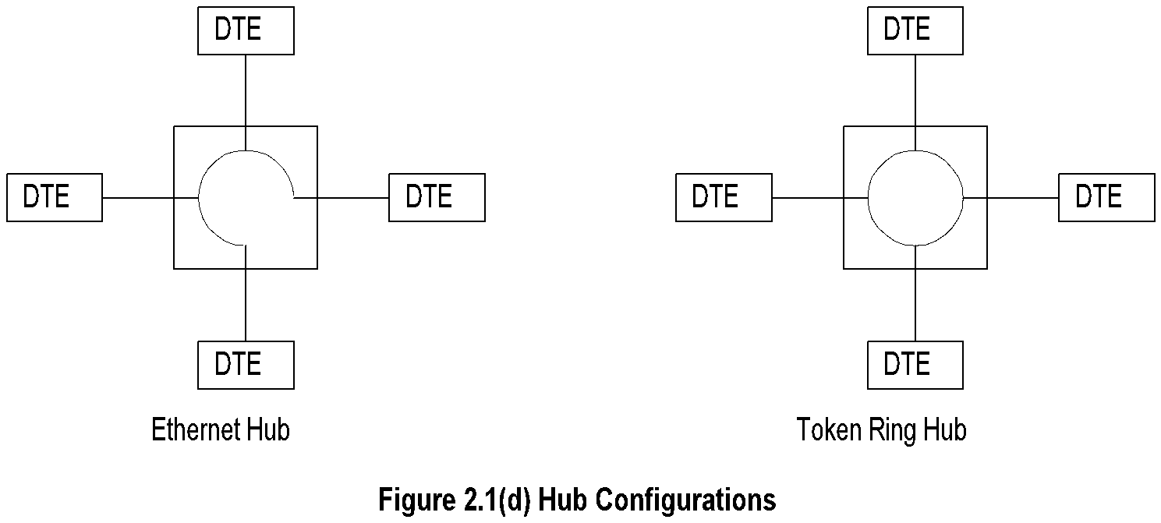
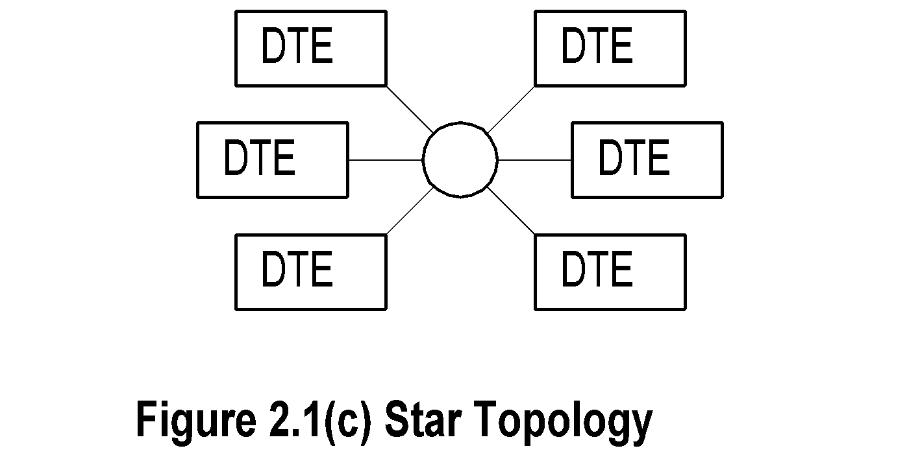
Star & Hybrid LAN Topologies
  Notes:
  Star topology used with bus and ring topology
  Hub is “LAN in a box”
  What does the electronic LAN inside the box
  look like?
  Why has hub become so popular?

Slide 7
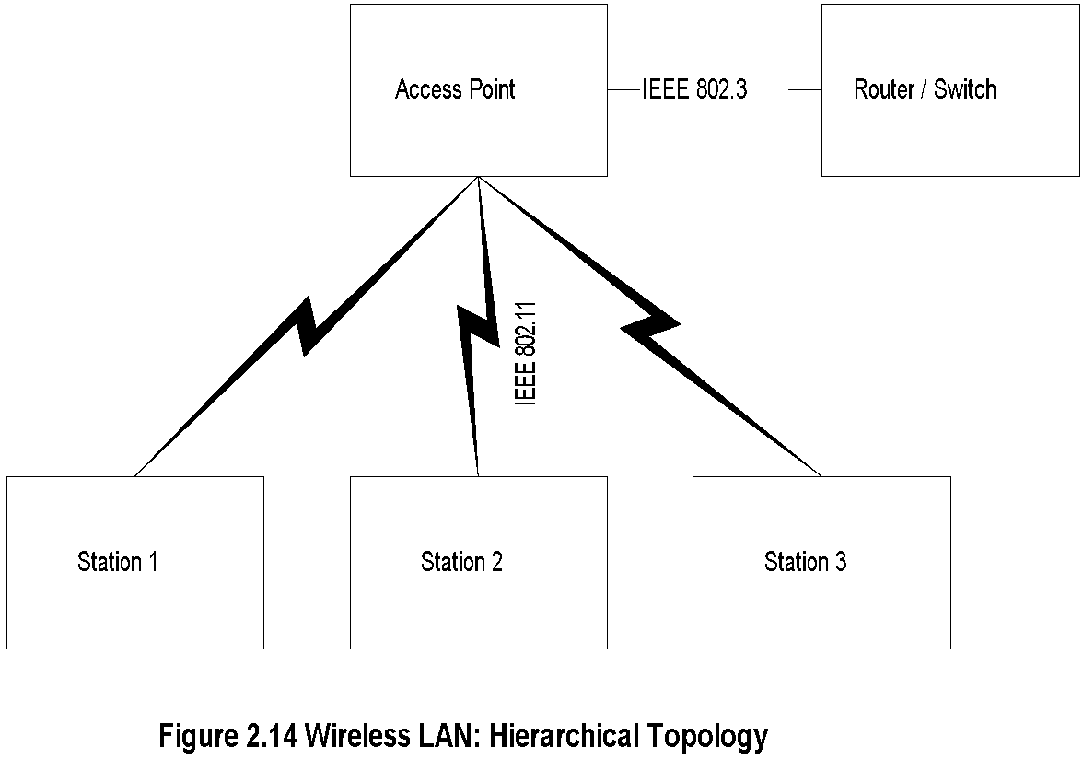
Wireless LAN
  Notes:
  Hierarchical
  Ad Hoc

Slide 8
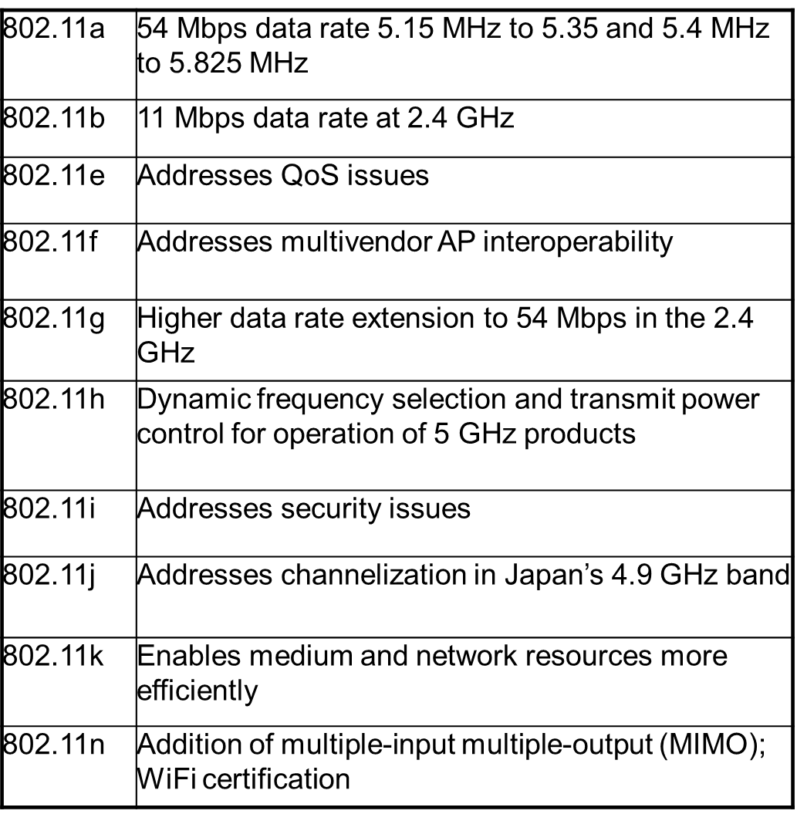
IEEE 802.11 Standards and Amendments

Slide 9
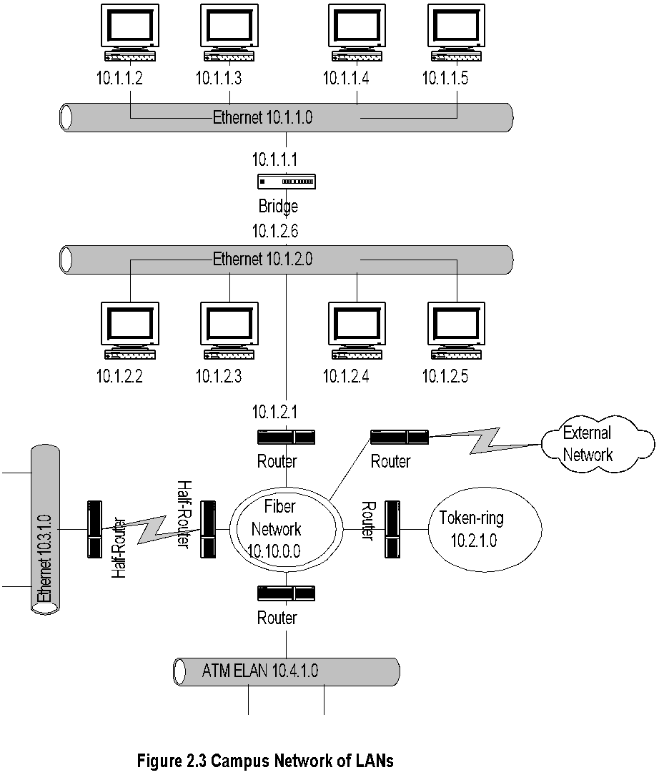
Campus Network
  Notes:
  Fiber Network could be Gigabit LAN or MAN

Slide 10
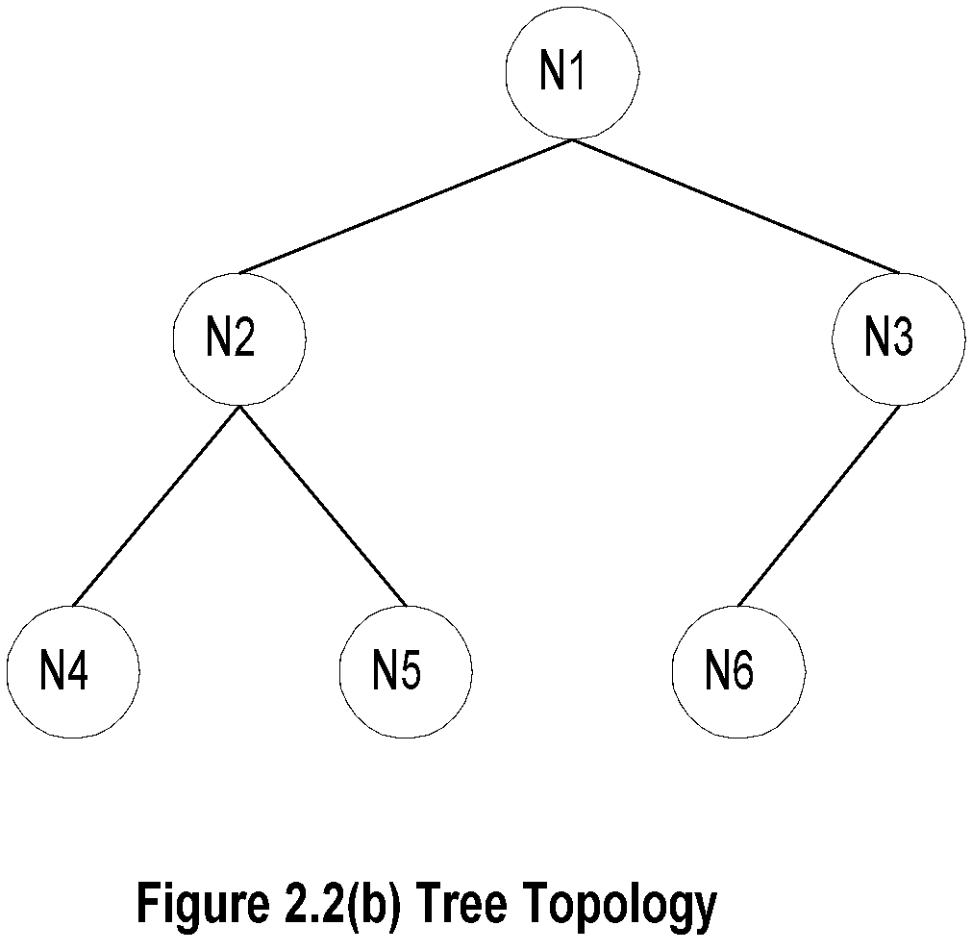
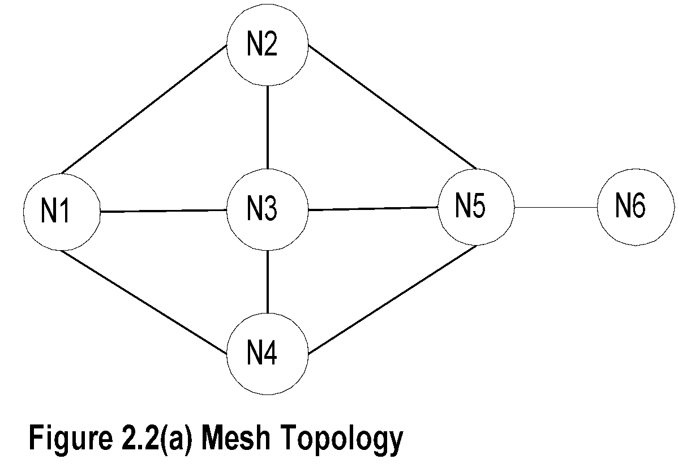
WAN Topologies

Slide 11
WAN Topologies-cont.
  Notes:
  Mesh topology
    Implemented in network layer level
    Multiple paths between nodes
    Flat topology
    Redundancy
    Load balancing
    Shortest path
  Tree topology
    Used with Ethernet bridges
    Hierarchical
    Efficient for small networks and special purpose
    networks
  Ring Topology
    SONET / SDH
    MAN
    Broadband feeder network

Slide 12
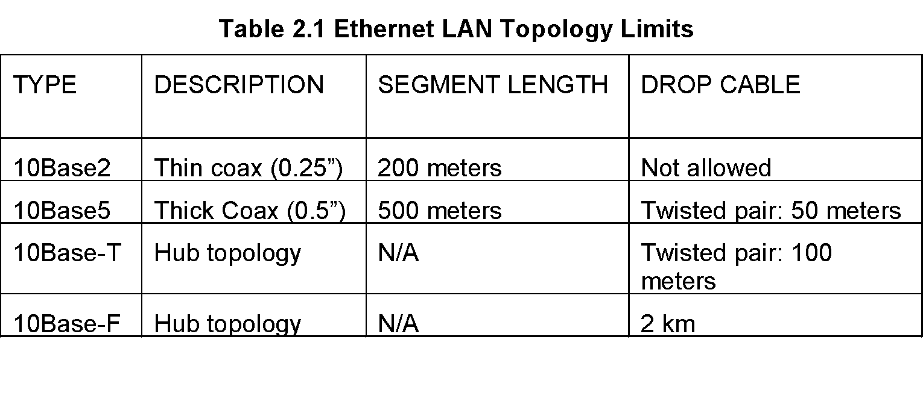
Ethernet
    Notes:
    Packet size 512 bytes, slot size 4.096 microseconds
    Minimum frame size 64 bytes for backward
    compatibility; Slot filled with carrier extension
    Packet bursts with no idle time between frames
    increases efficiency

Slide 13
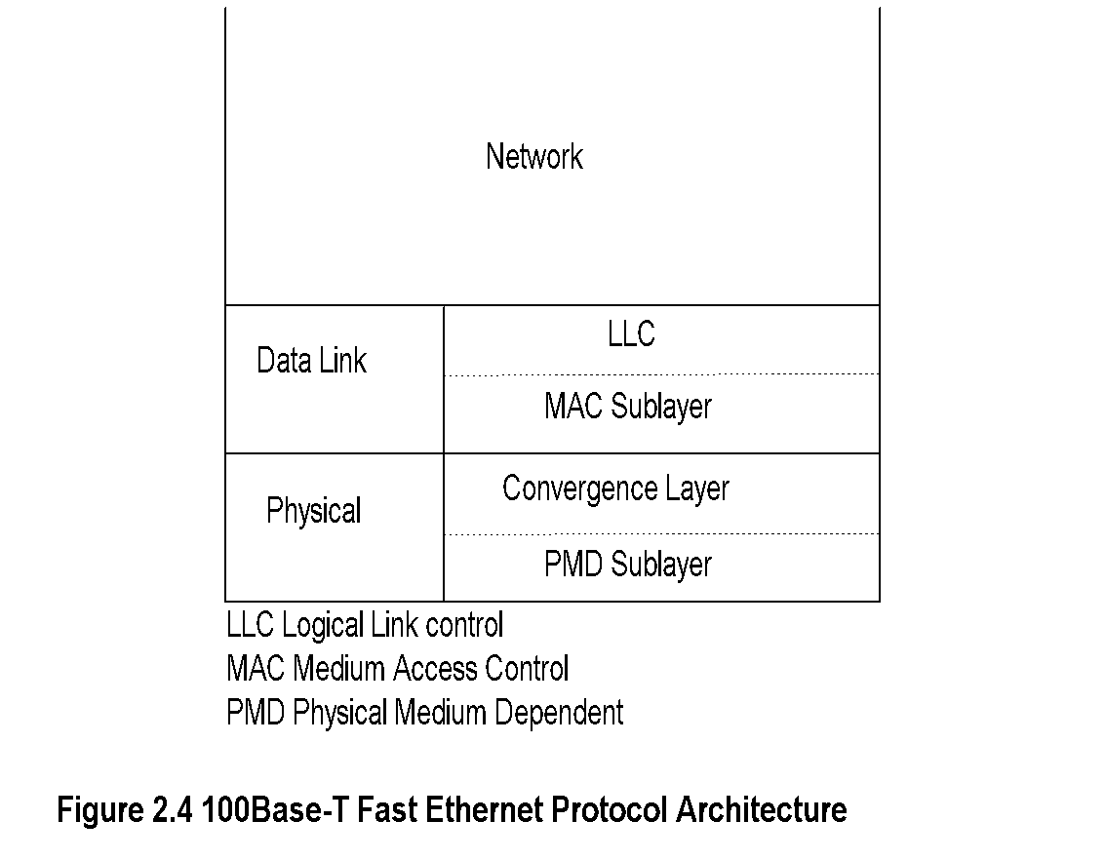
Fast Ethernet
    Notes:
    Rationale
      Max drop length 100m => Max round-trip
      time 1/10 of Ethernet; hence 10 times data rate
    Standard 100Base-T4
    Compatibility with 10BaseT
    Cat 5e (Max 100 m, 100 MHz)
    Cat 6 (Max 100 m, 250 MHz)
    100Base FX optical fiber (Max 10 km single and 400 m multimode)

Slide 14
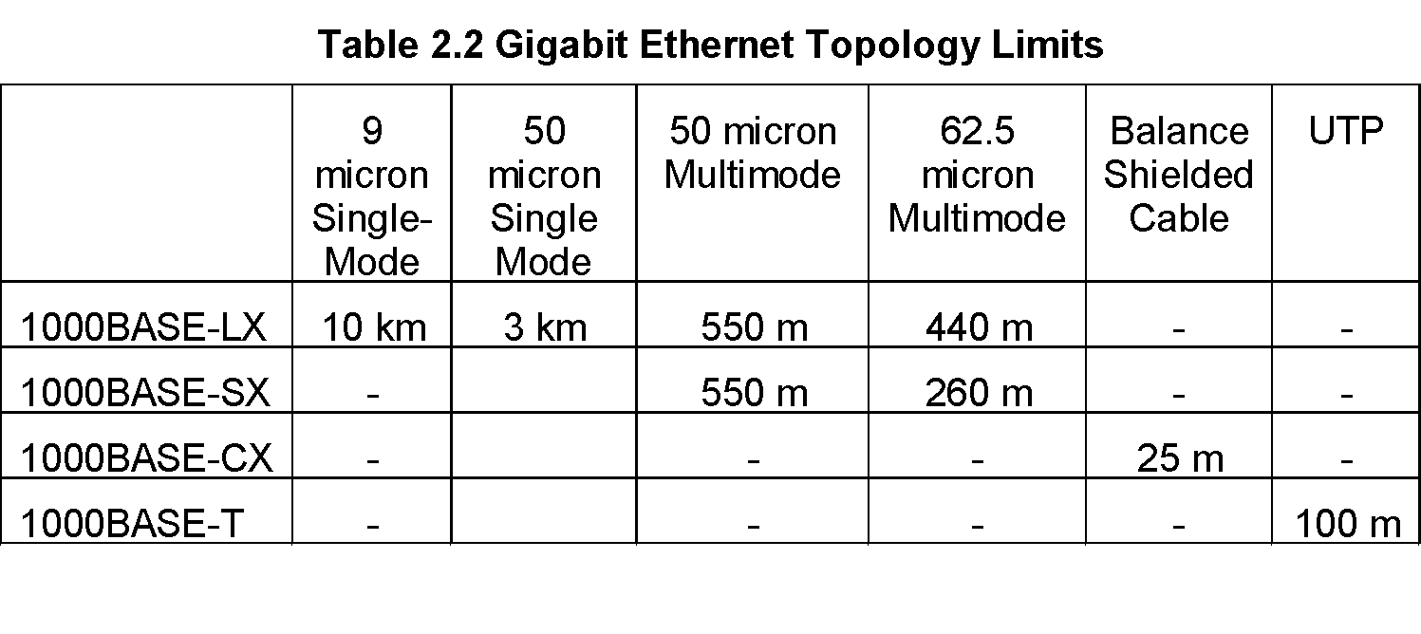
Gigabit Ethernet
    Notes:
    Packet size 512 bytes, slot size 4.096 microseconds
    Minimum frame size 64 bytes for backward
    compatibility; Slot filled with carrier extension
    Packet bursts with no idle time between frames
    increases efficiency

Slide 15
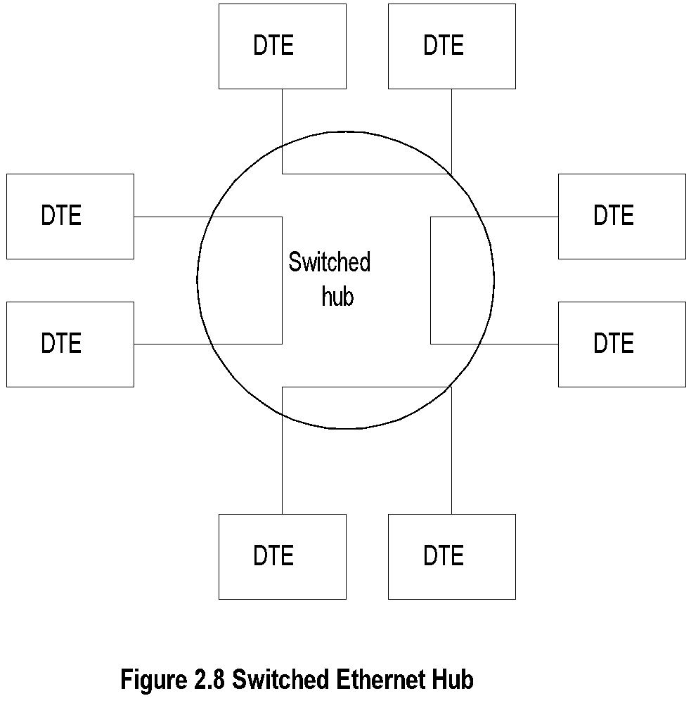
Switched Ethernet
    Notes:
    Maximum throughput increased ~N/2 in N-port hub
    Snooping capability lost for management

Slide 16
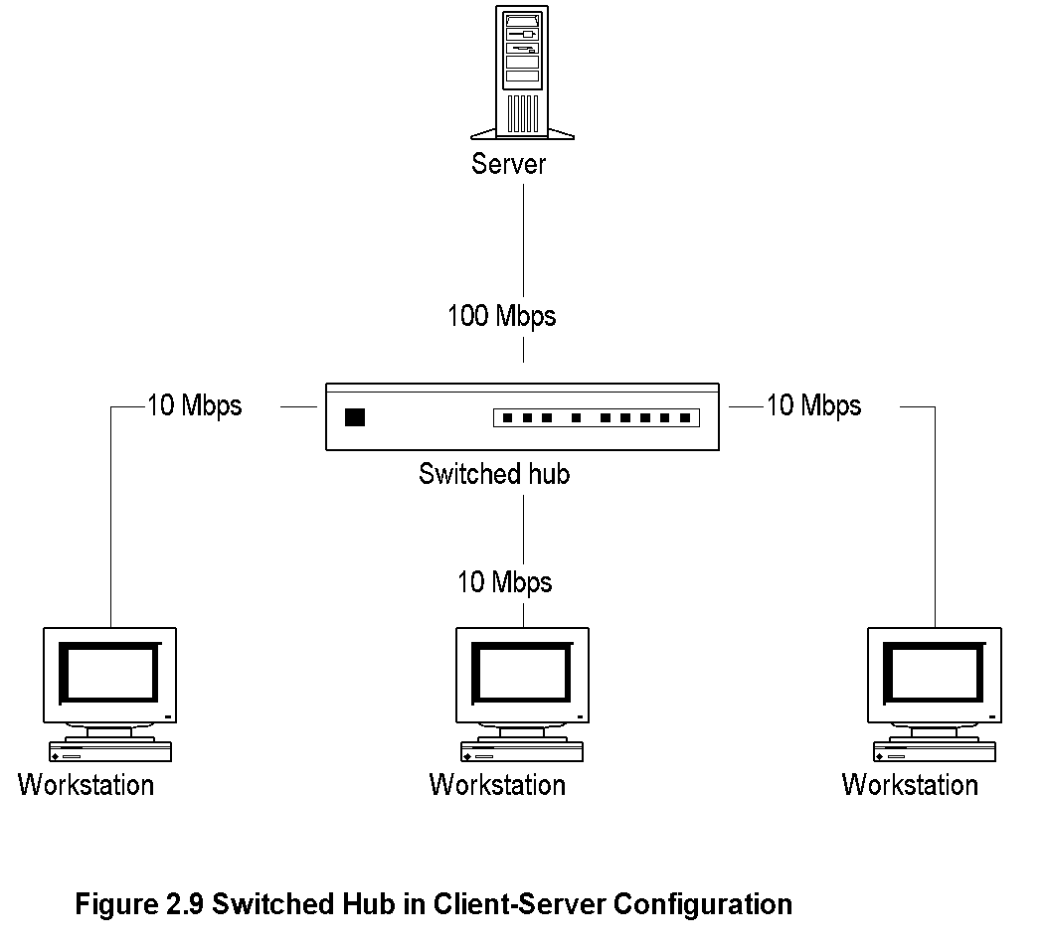
Client-Server Configuration using
Switched Hub

Slide 17
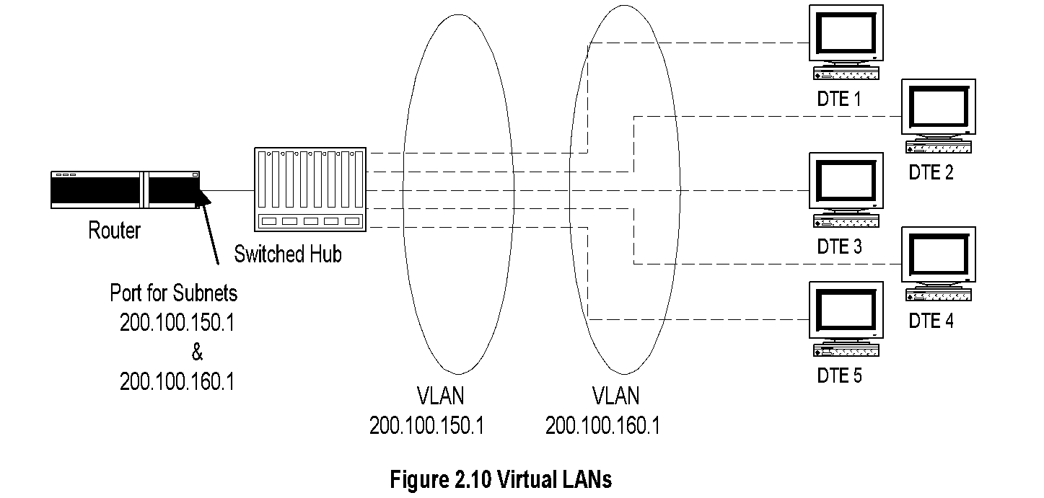
Virtual LAN
Notes:
Switched hub enables establishing virtual LANs
Permits switching stations between LANs without
physical moving of equipment
Remote VLAN via switch offered by service providers

Slide 18
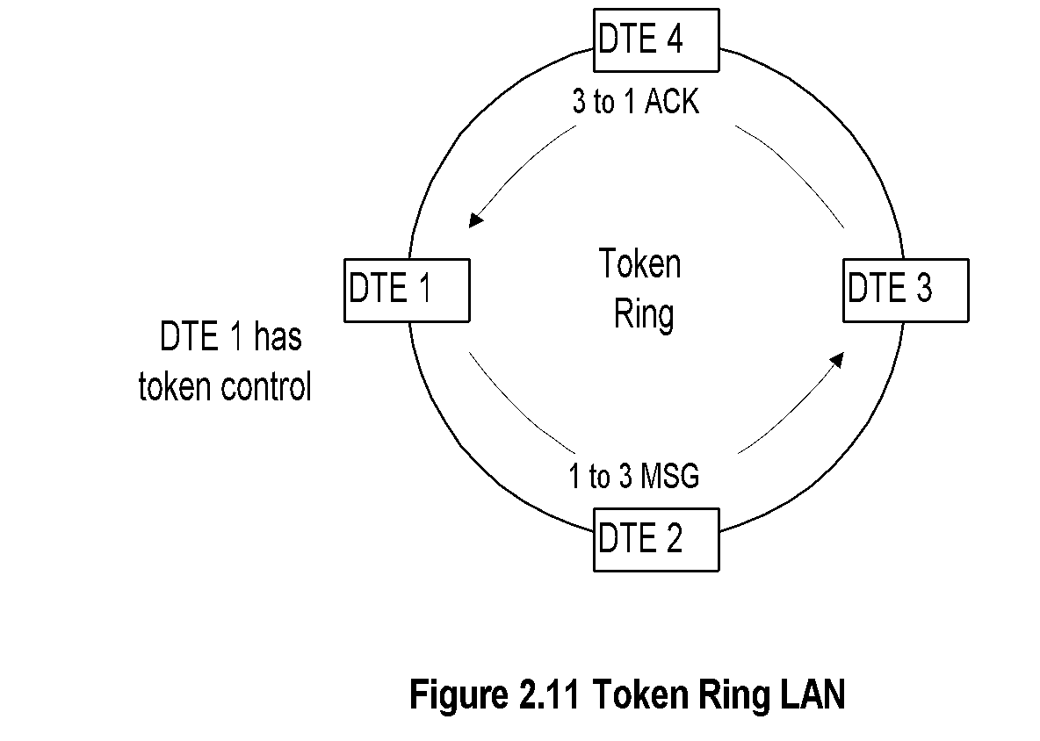
Token Ring
Notes:
Adopted by IBM
IEEE 802.5 standard
Data rates of 4 Mbps and 16 Mbps
Single- and dual-ring LANs

Slide 19
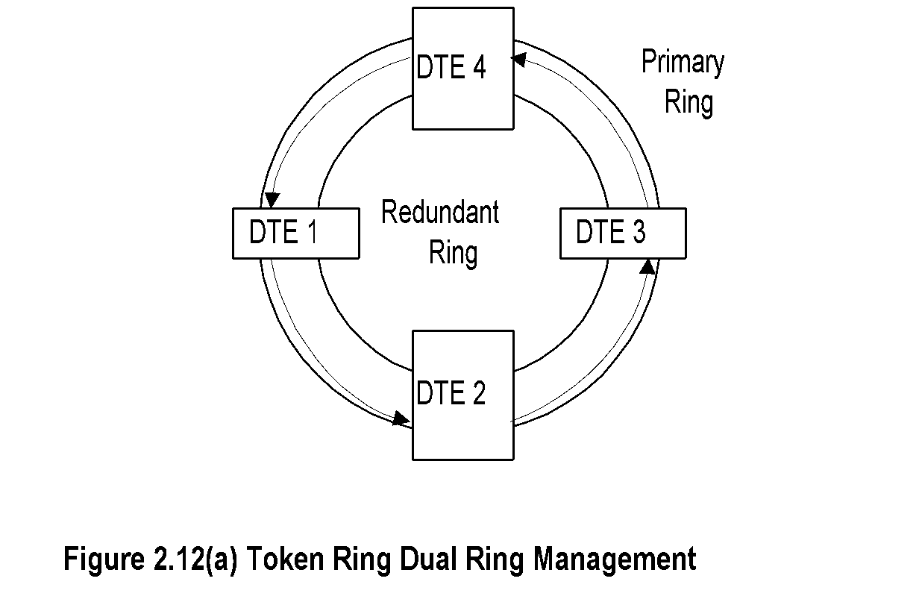
Dual Ring Token Ring LAN

Slide 20
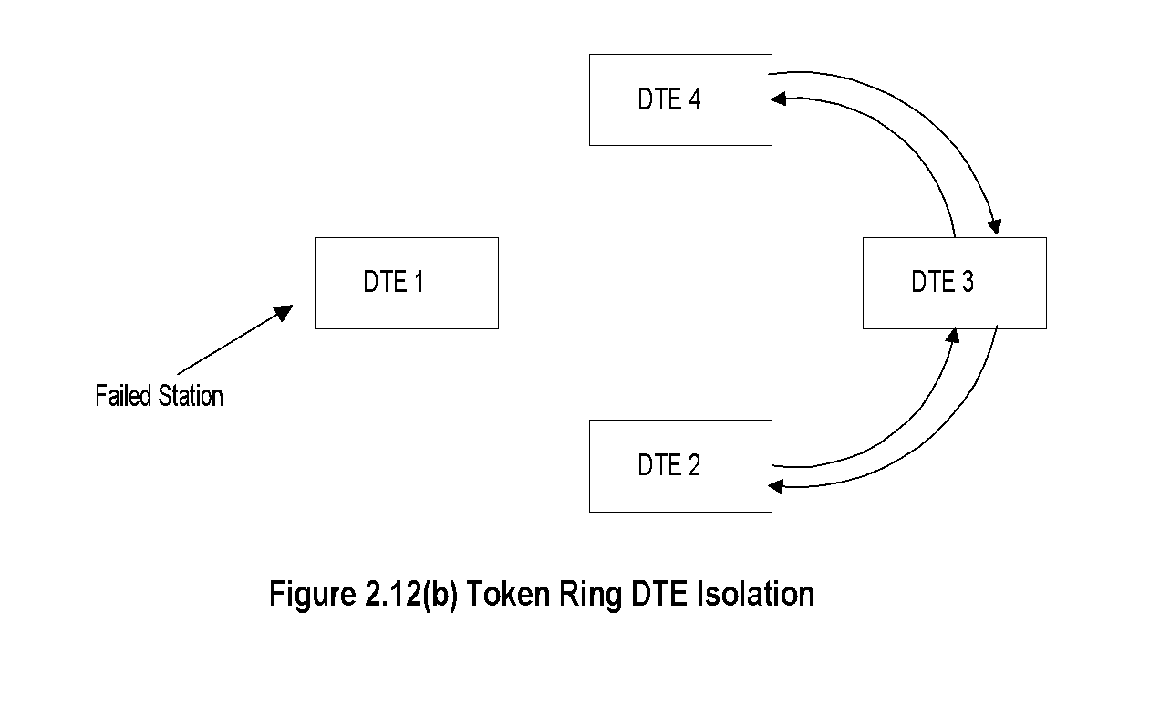
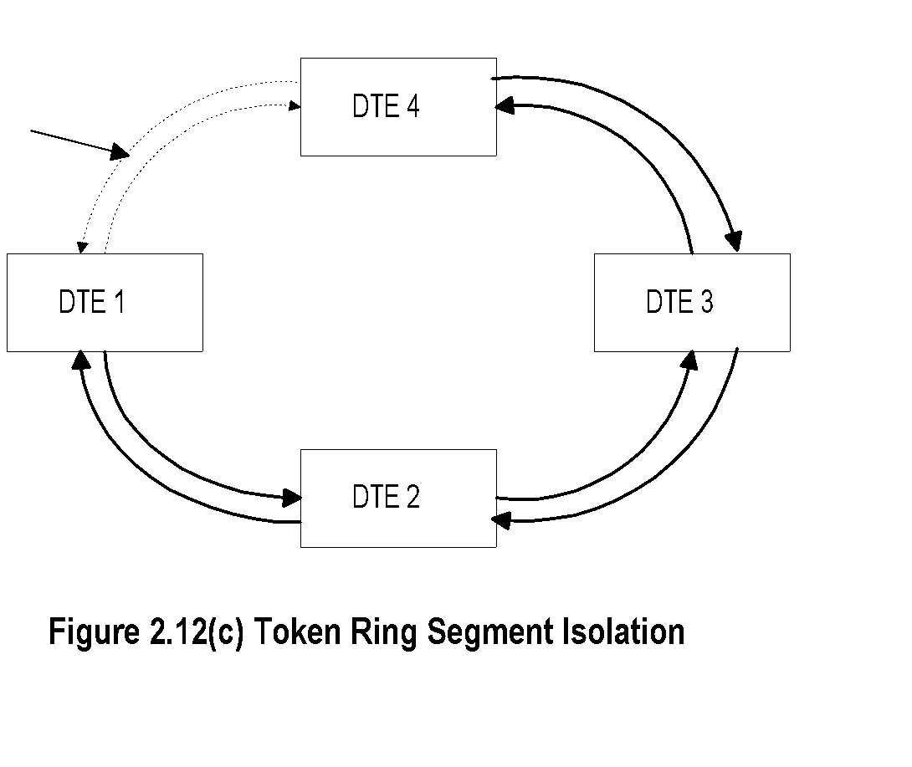
Failure Recovery in TR LAN
Notes:
Station failure recovery
Link failure recovery

Slide 21
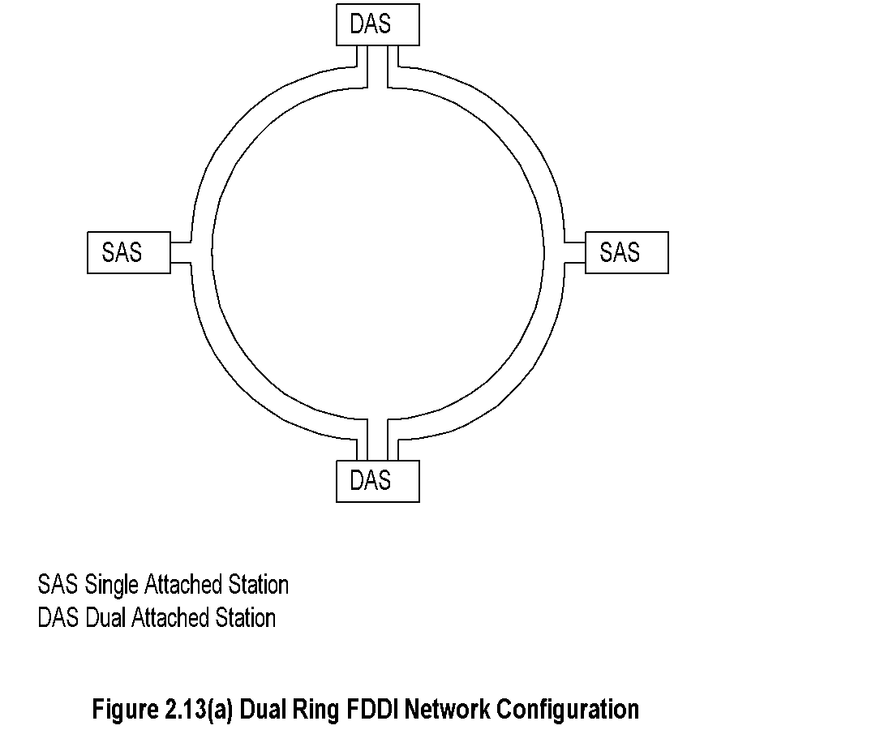
FDDI
Notes:
Uses fiber optics medium
Modified token-ring protocol
Data rate 100 Mbps
Segment length 100 km
500 stations in the ring with max separation of 2 km
Single- and dual-attached stations
Dual-attached stations load share the two rings

Slide 22
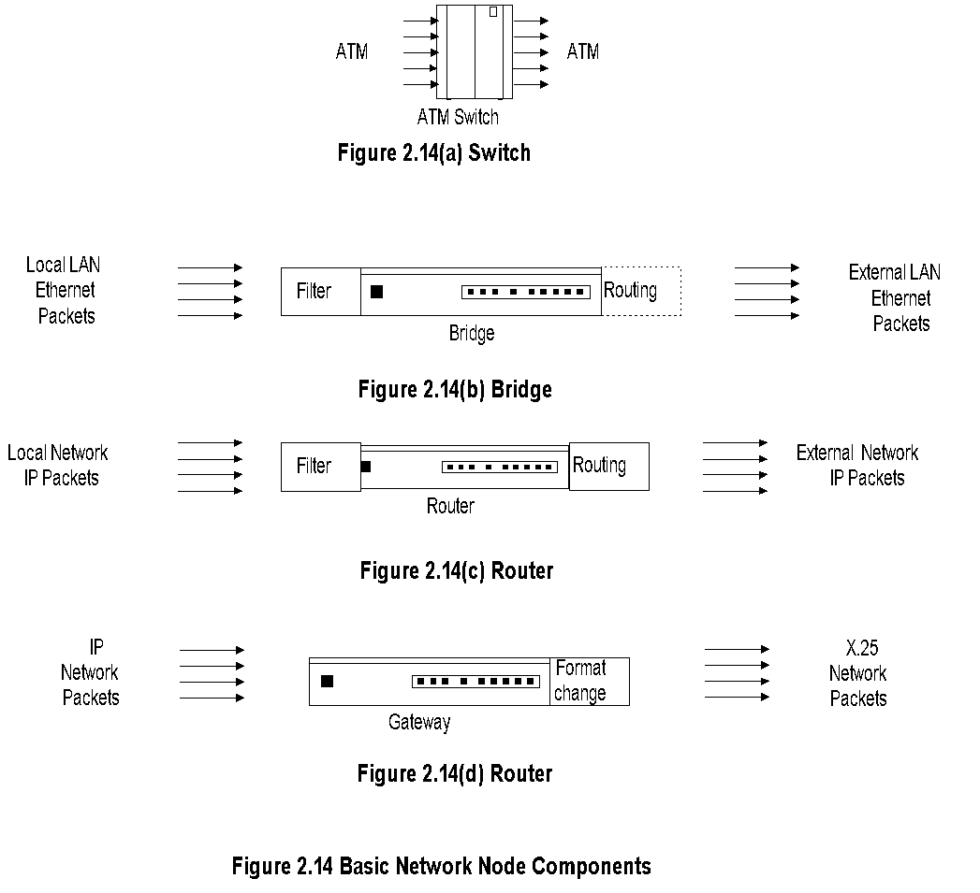
Basic Network Nodes

Slide 23
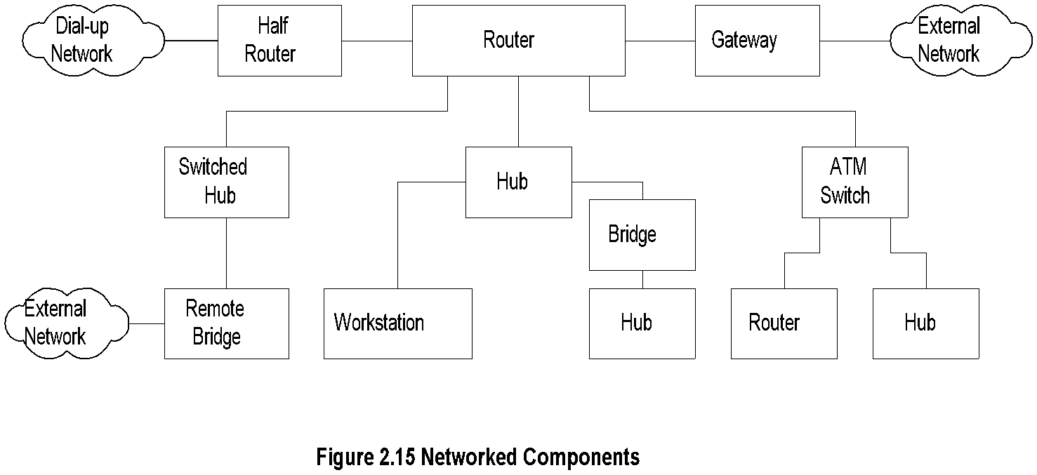
Network Node Components
Notes:
Hubs
Bridges
Remote bridges
Routers
Gateways
Half bridge / half router
Switches
Transport devices (ADM, SDH)
Broadband access components
Residential distribution devices

Slide 24
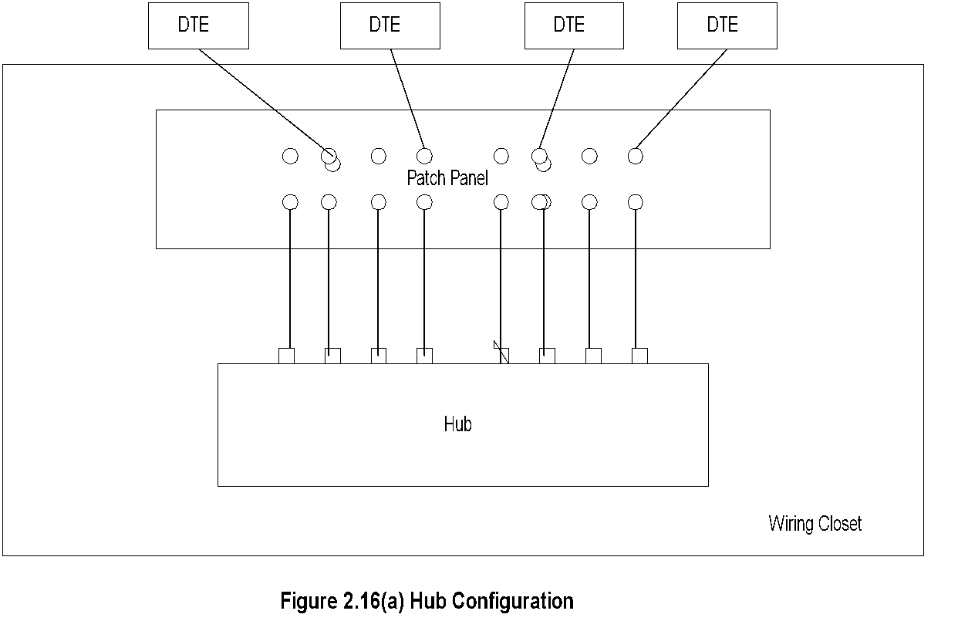
Hubs
Notes:
Hub is a platform
Function dependent on what is housed
LAN
Switched LAN
Bridge

Slide 25
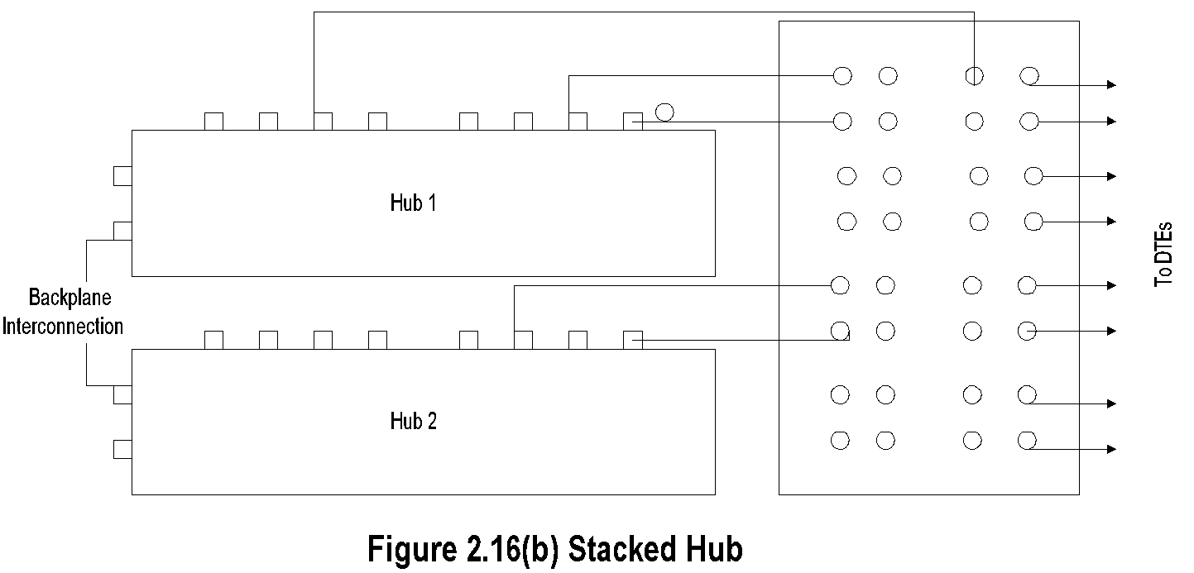
Stacked Hubs
Hub ports can be scaled up using stacked hubs
Stacked hub
Extend back plane
Connected as daisy chain

Slide 26
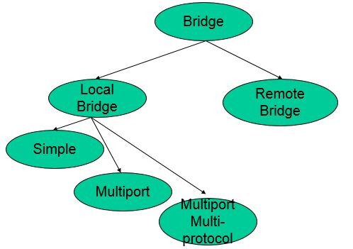
Bridges
Bridges two nodes at data link control layer
    Ethernet: tree topology, transparent bridge
    Token ring : mesh topology, source routing bridge
Remote bridge uses WAN interface cards; same protocol used at both ends
Ethernet bridge is a learning bridge

Slide 27
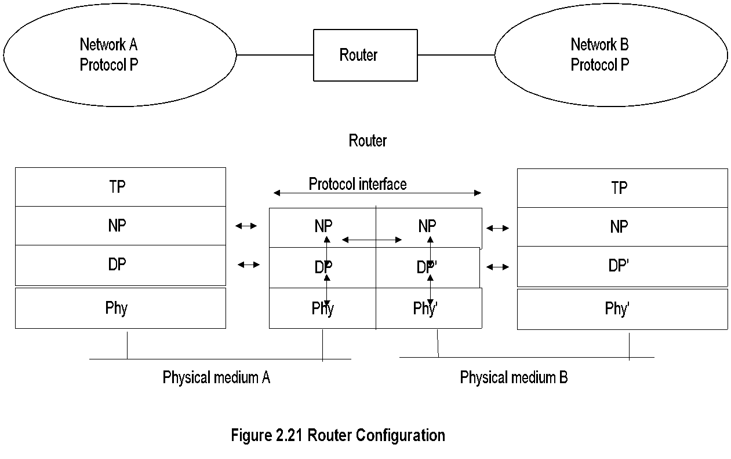
Routers
Routers operate at network layer
Routes packets between nodes of similar network protocols
Routing table used to route packets
DLC and Physical layers could be different under the same common network layer protocol

Slide 28

Gateway
Gateway is router connecting two networks with dissimilar network protocols.
Gateway does the protocol conversion at the network layer.
Protocol converter does the conversion at the application layer.

Slide 29
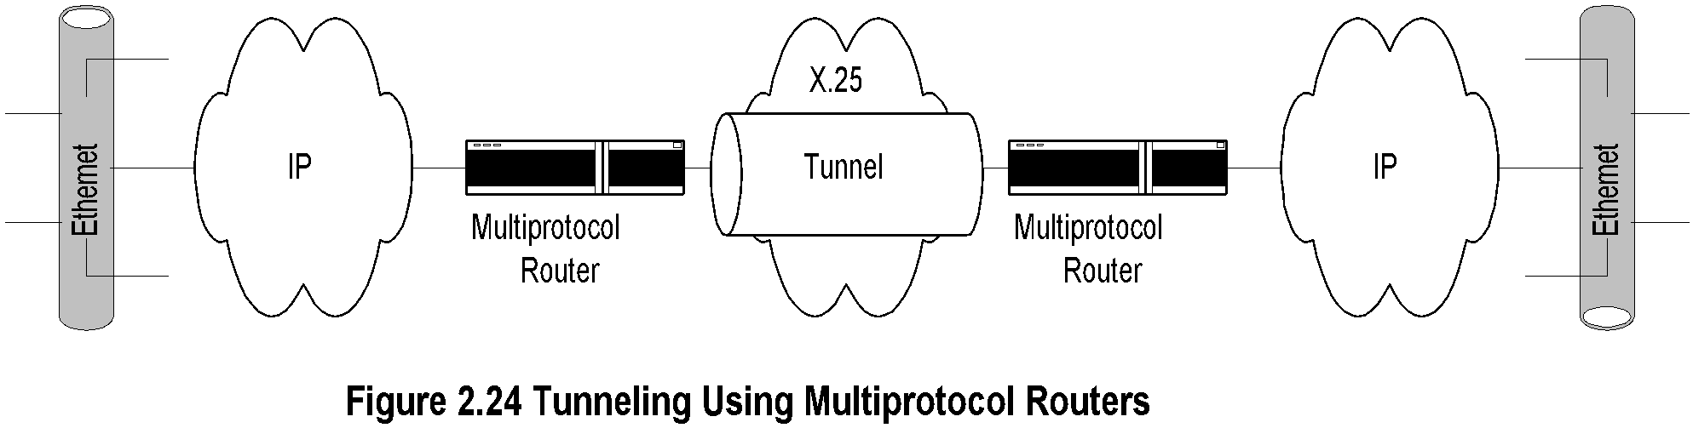
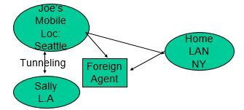
Tunneling

Slide 30
Tunneling-cont.
Tunneling is transmission of packets (via multiprotocol routers) by encapsulation.
In Figure 2.24, packets are encapsulated and transmitted through X.25 network in a serial
mode.
In the mobile environment, Joe and his home agent
in NY communicate Joe’s Seattle location to the
foreign agent.
His communication with Sally in LA is tunneled

Slide 31
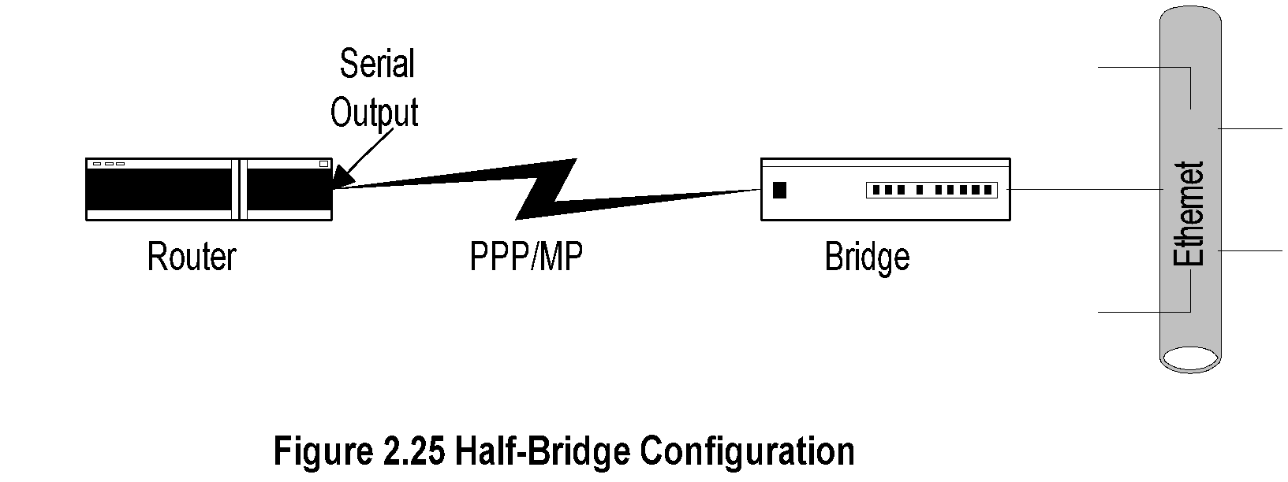
Half-Bridge
Half-bridge (also referred to as half-router) is point-to-point communication
Uses PPP protocol
Helps low-end users to communicate with ISP on dial-up link saving the expense of dedicated link
Router encapsulates packets in PPP frames and puts serial outputs to the bridge, and vice-versa

Slide 32
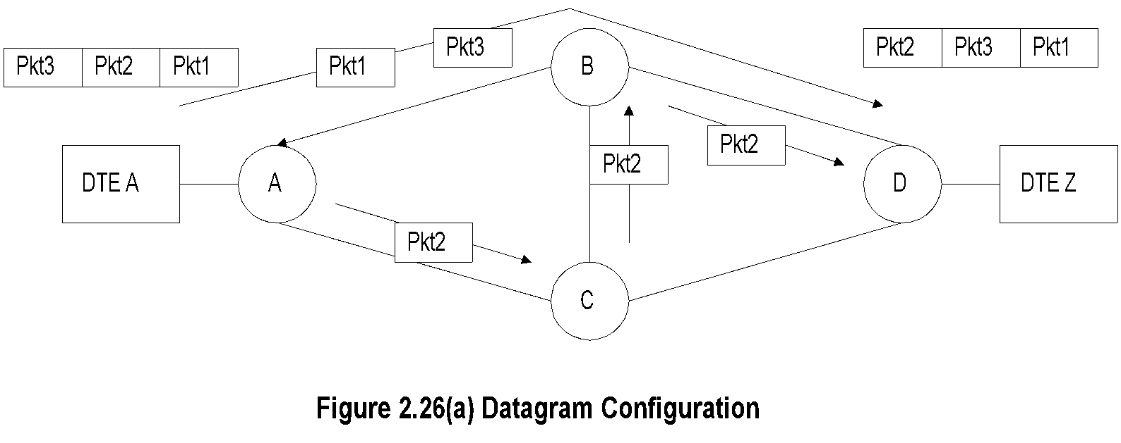
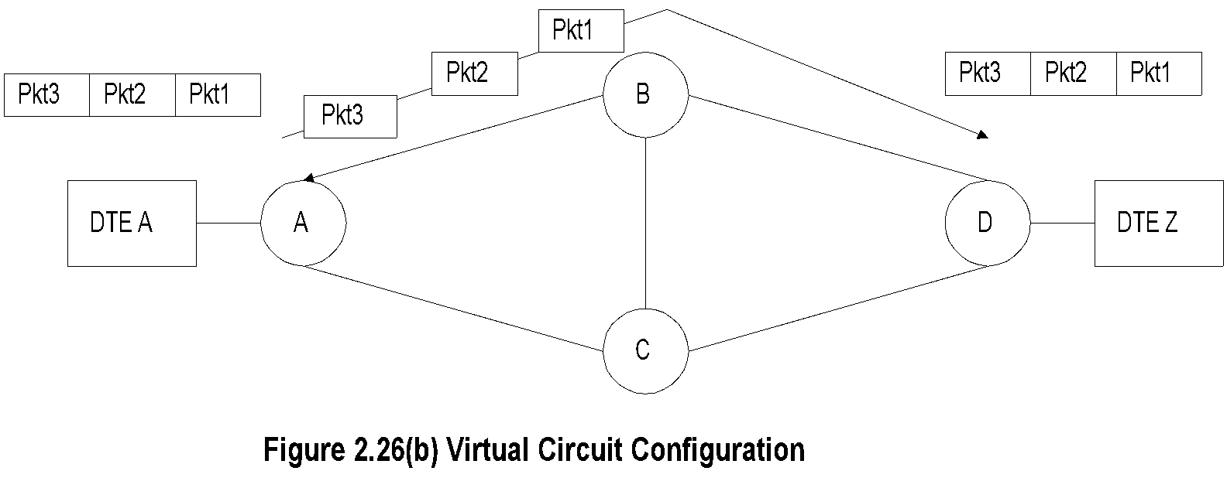
Switched Networks
Switches are embedded in bridges and routers
Switched network used in WAN
Two types of switched networks
  Circuit-switched
  Packet-switched
    Datagram service
    Virtual circuit

Slide 33
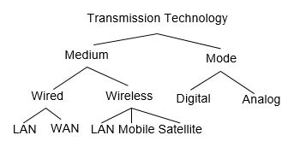
Transmission Technology
    Physical transport media
        UTP
        Coax
        Fiber
        Terrestrial wireless
        Satellite transmission

Slide 34
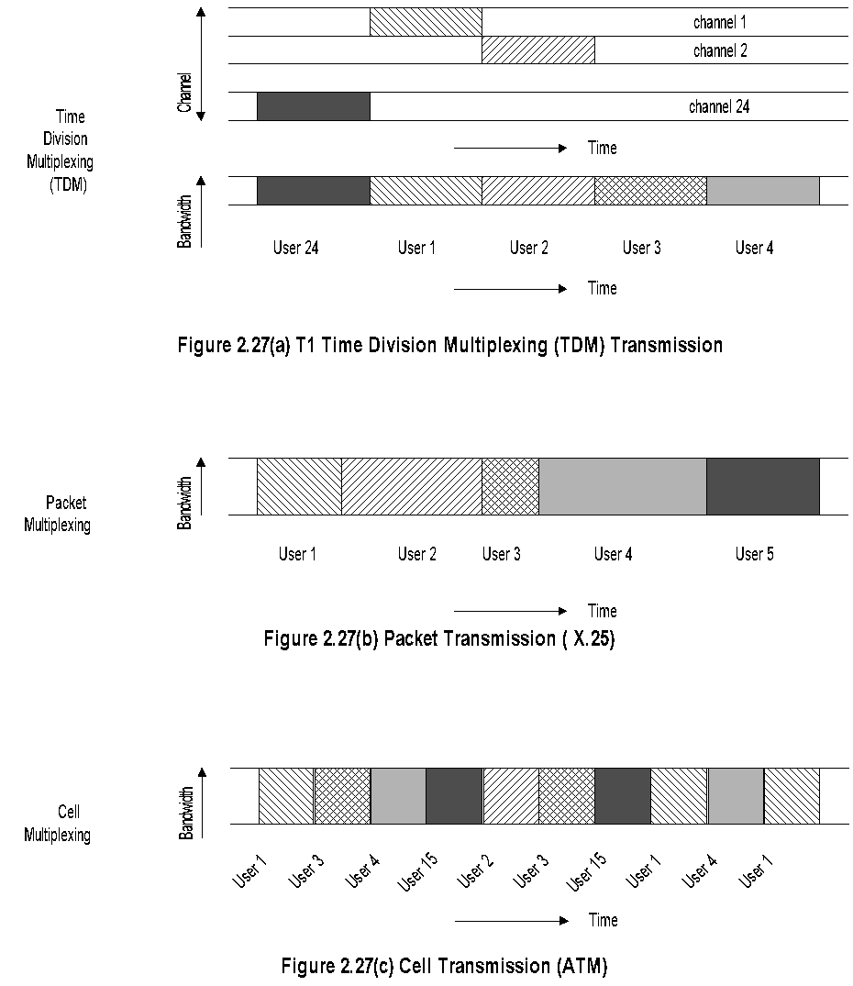
Transmission Modes

Slide 35
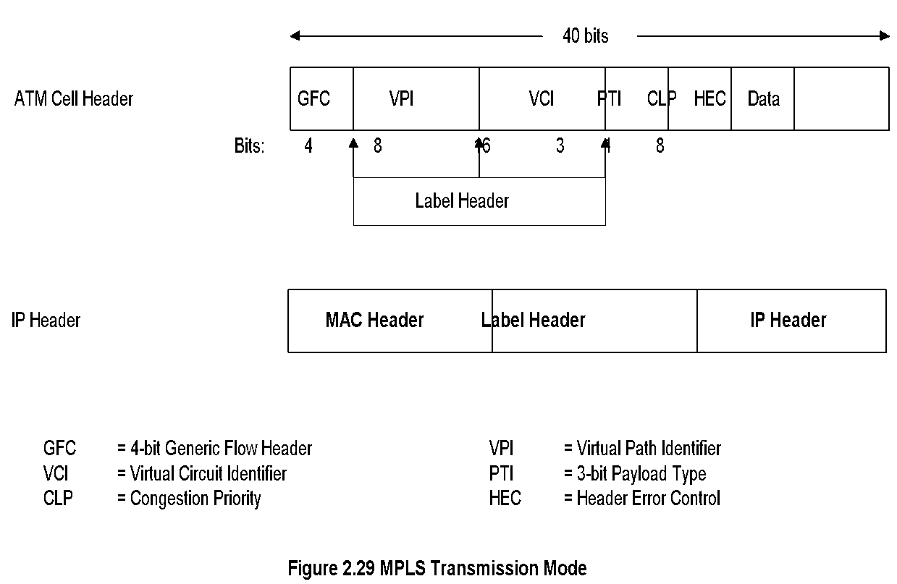
MPLS Transmission Mode
Multiprotocol Label Switching
Combines
  Richness of IP
  Performance of ATM
Label inserted between 2nd and 3rd layers
Compatible with IP and ATM

Slide 36
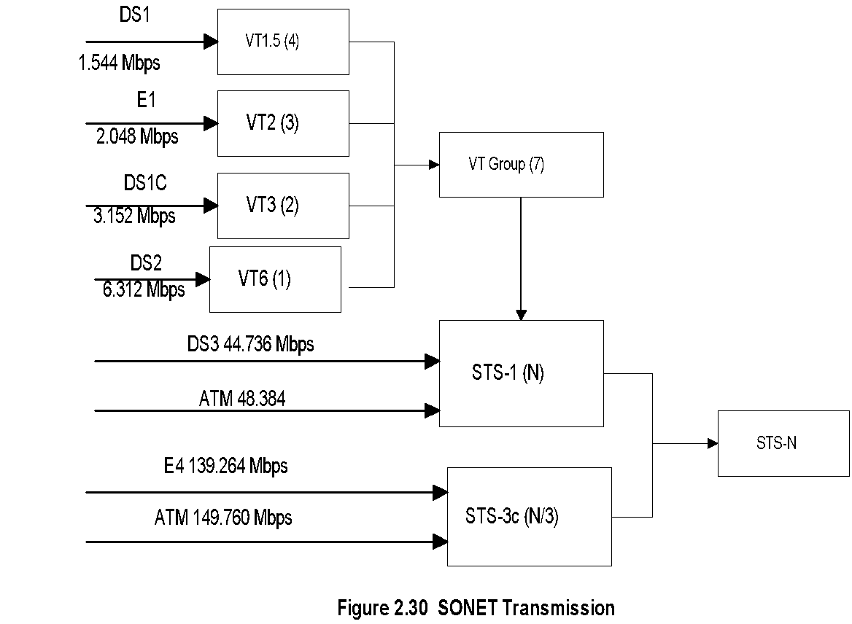
SONET Transmission
Synchronous Optical Network (SONET) based on
Synchronous Digital Hierarchy (SDH)
Incompatible T1 and E1 made into universally
compatible digital network
Uses fiber optics carrying large bandwidth
Basic digital bandwidth STS-1 of 51.84 Mbps
Hierarchy based on STM-N (Synchronous
Transmission Mode): STM-1, STM-4, etc.

Slide 37
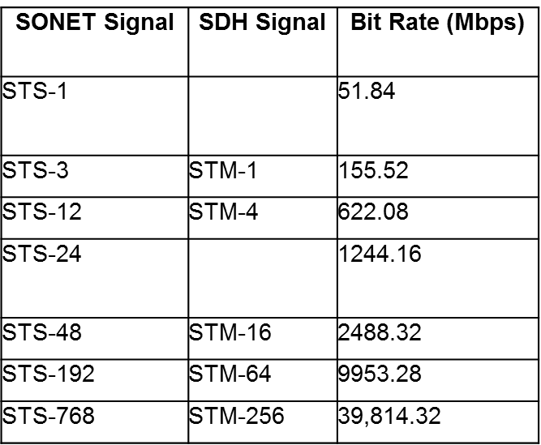
Synchronous Digital Hierarchy

Slide 38
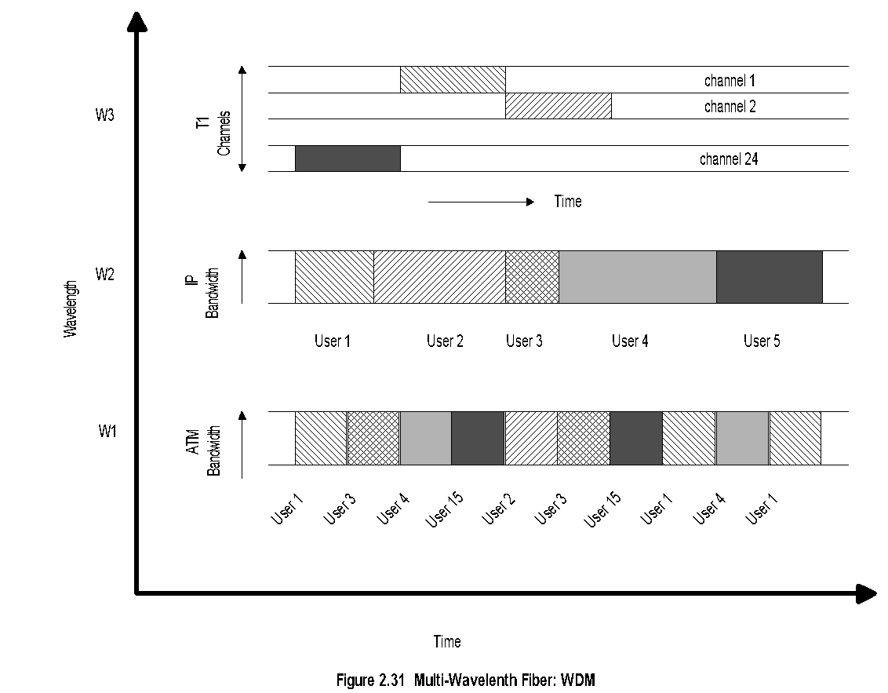
DWDM
(Dense) Wavelength Division Multiplexing
Similar to FDM at lower frequencies
Multiple wavelength carrier can be configured for
multiple protocol transmission.

Slide 39
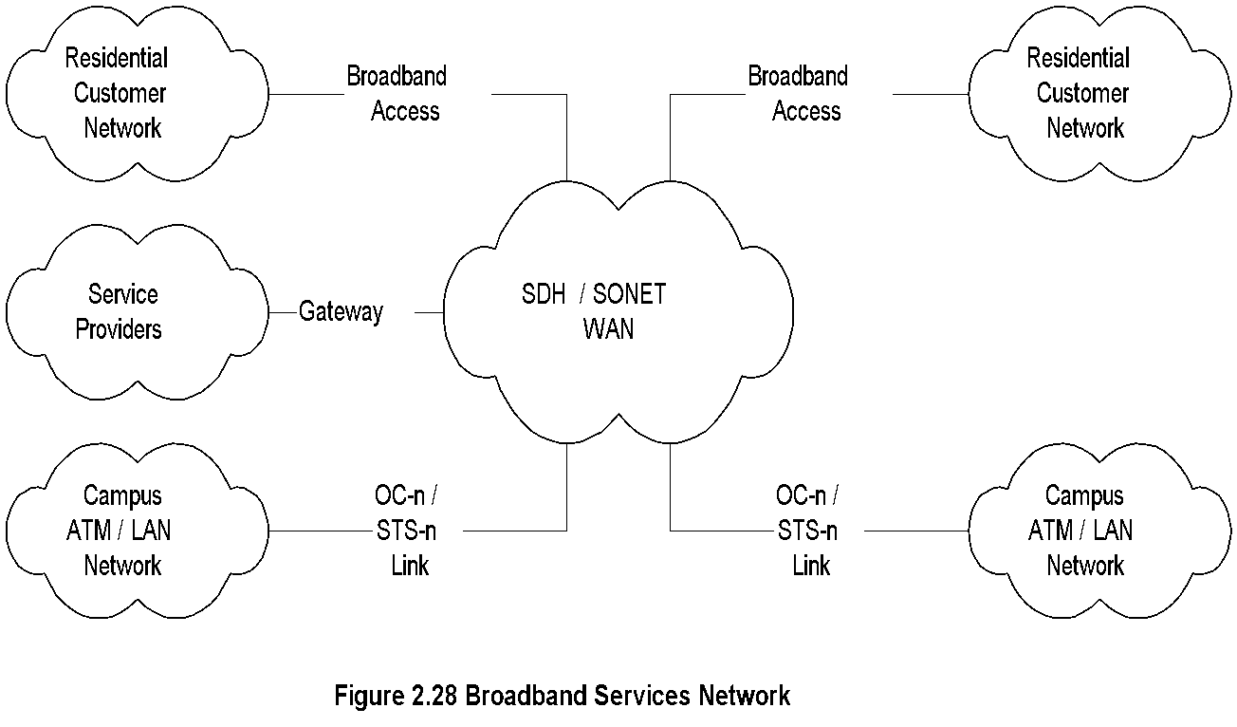
Broadband Services

Slide 40
Broadband Services-cont.
Integrated services: Voice, video, and data
Narrow band ISDN (Integrated Services Digital Net.)
  Basic rate:2B + D (B channel 64 kbps and D channel 16 kbps
  Primary rate: 23B + D channels
Broadband (ISDN) Services uses ATM technology
  SONET (Synchronous Optical Network) or SDH (Synchronous Digital Hierarchy)
  Data rate OC-n
    OC-1 51.84 Mbps
    OC-3 155.52 Mbps
  Access technologies:
    Cable
    ADSL (Asymmetric Digital Subscriber Line)
    Fixed Wireless
    Mobile cellular wireless
Nisreen AlGhadban 120015789

