Slide 1
Chapter 1
Data Communications and
Network Management Overview

Slide 2
Telephone Network
• Modern network evolution from Telephone /Telecommunications Network
• Characteristics of Telephone network
• Reliable - does what is expected of it
• Dependable - always there when you need it (remember 911?)
• Good quality (connection) - hearing each other well
• Reasons for QoS:
• Good planning, design, and implementation
• Good operation and management of network
• Migration to new technologies –
• e.g., From analog to digital technology

Slide 3
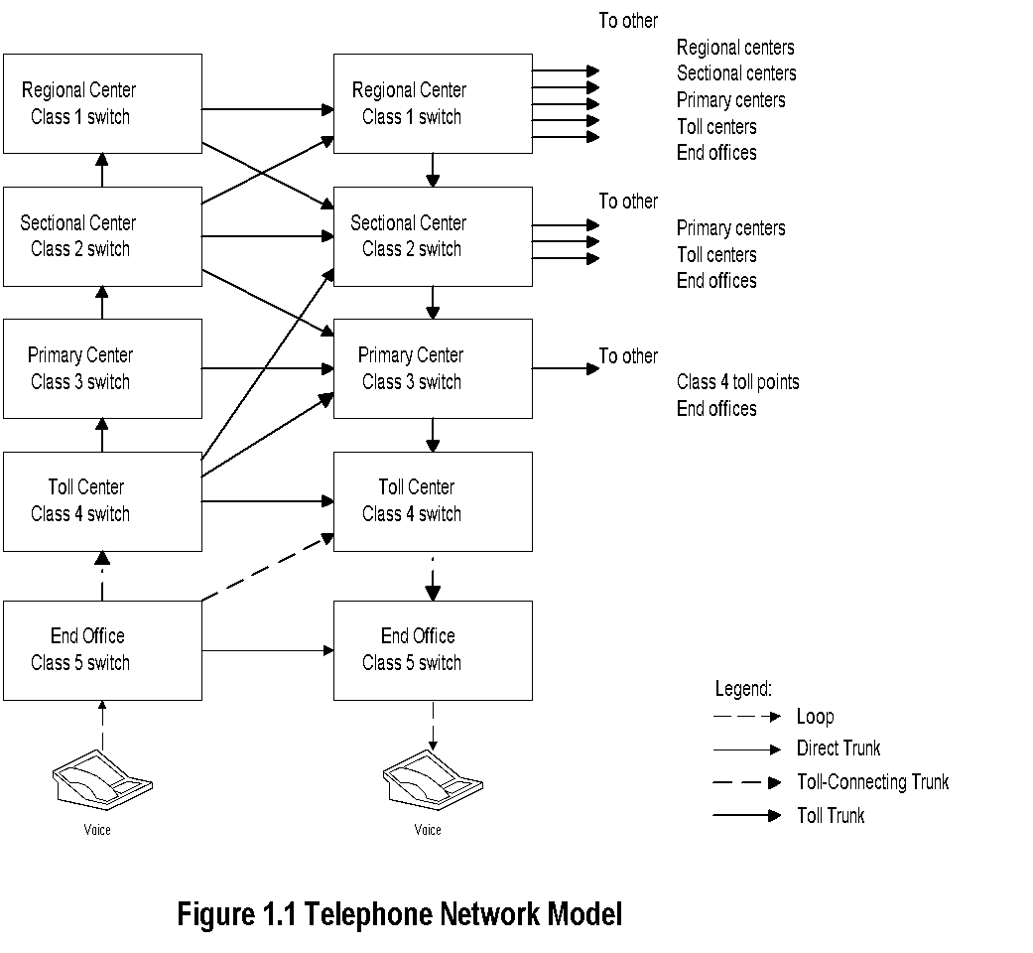
Telephone Network Model
Notes
• Notice the hierarchy of switches
• Primary and secondary routes
programmed
• Automatic routing
• Where is the most likely failure?
• Use of Operations Systems to ensure QoS

Slide 4
OSSs / NOC
• Operations Support Systems (OSSs) help
manage the operation of networks
• OSSs in telecommunications monitor:
• Analog network parameters:
•S/N ratio, transmission loss, call blockage, etc.
• Digital network parameters:
• Packet loss, Packet delay, Throughput, QoS, etc.
• Real-time management of network.
• Trunk (logical entity between switches / nodes) maintenance system measures loss and S/N Trunks not meeting QoS removed before
customer notices poor quality.
• Traffic measurement systems measure call drops and blockage. Additional switches or routers planned to keep the call blockage or drops below acceptable level.
• OSSs distributed at central offices and customer premises
• Network management done centrally from Network Operations Center (NOC).

Slide 5
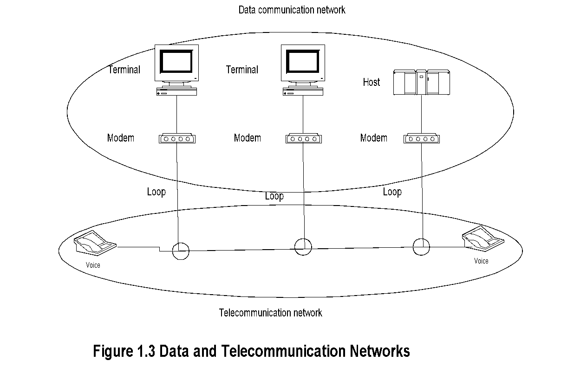
Data and Telecommunication Network

Slide 6
Notes:
• Computer data is carried over long distance by telephone (telecommunication network).
• Output of telephone is analog and output of computers is digital.
• Modem is used to “modulate” and “demodulate” computer data to analog format and back.
• Clear distinction between the two networks is getting fuzzier with modern multimedia networks
Data and Telecommunication Network- cont.

Slide 7
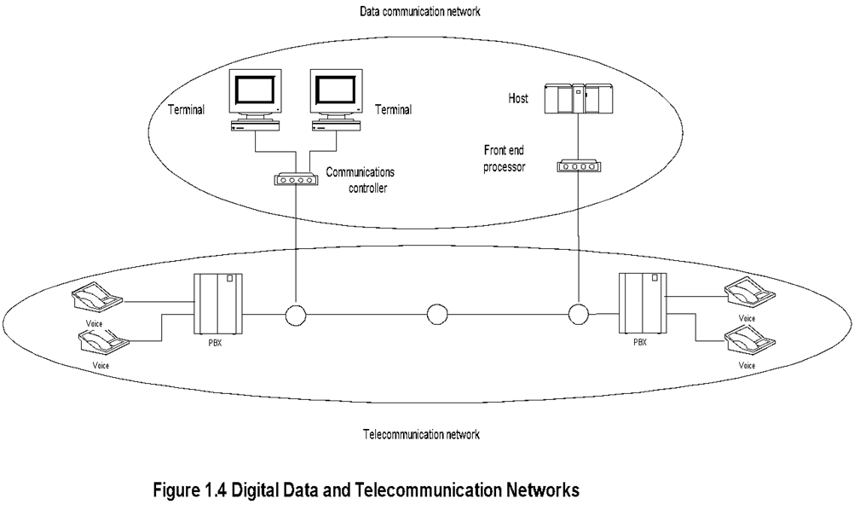
Migration to Digital Technology

Slide 8
Notes:
• Analog transmission migrated to digital transmission.
• Analog sources converted to digital signals.
• CPE (Customer Premises equipment) included digital
PBX (Private Branch Exchanges).
• Analog bandwidth hierarchy migrated to synchronous digital hierarchy.
Migration to Digital Technology- cont.

Slide 9
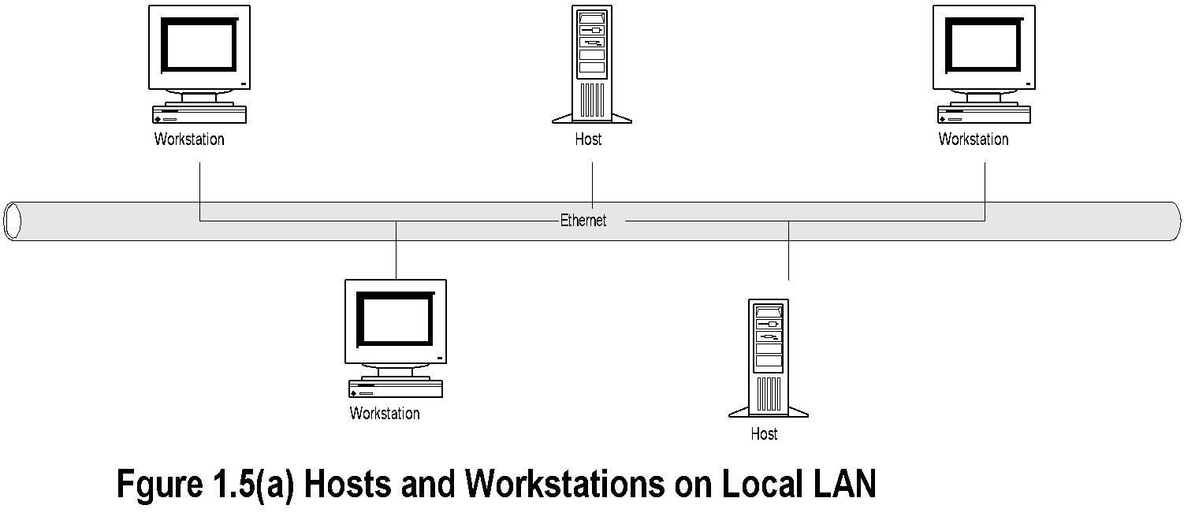
DCE with LAN DCE.. Distributed Computing Environment
Notes:
DCE.. Distributed Computing Environment
• Driving technologies for
DCE:
• Desktop processor
• LAN
• LAN - WAN network

Slide 10
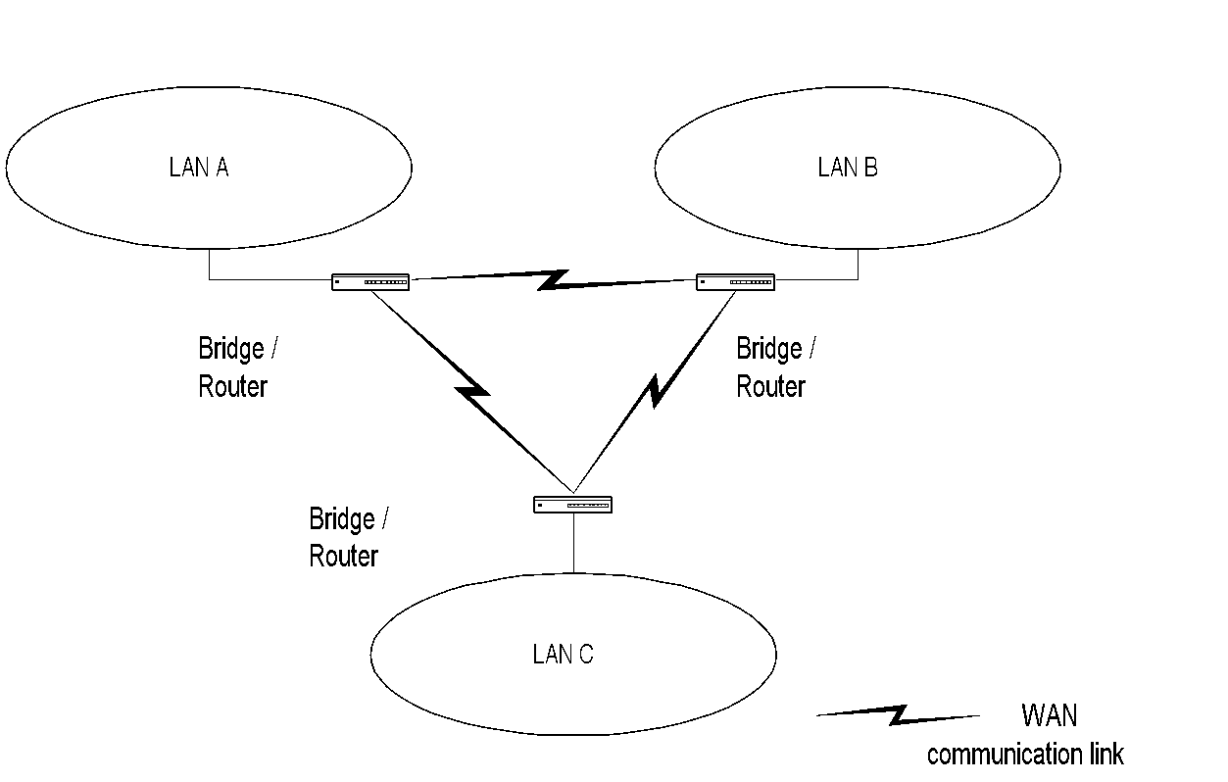
LAN-WAN Network
Notes:
• Major impacts of DCE:
• No more monopolistic service provider.
• No centralized IT controller.
• Hosts doing specialized function.
• Client/Server architecture formed the Core of DCE network.

Slide 11
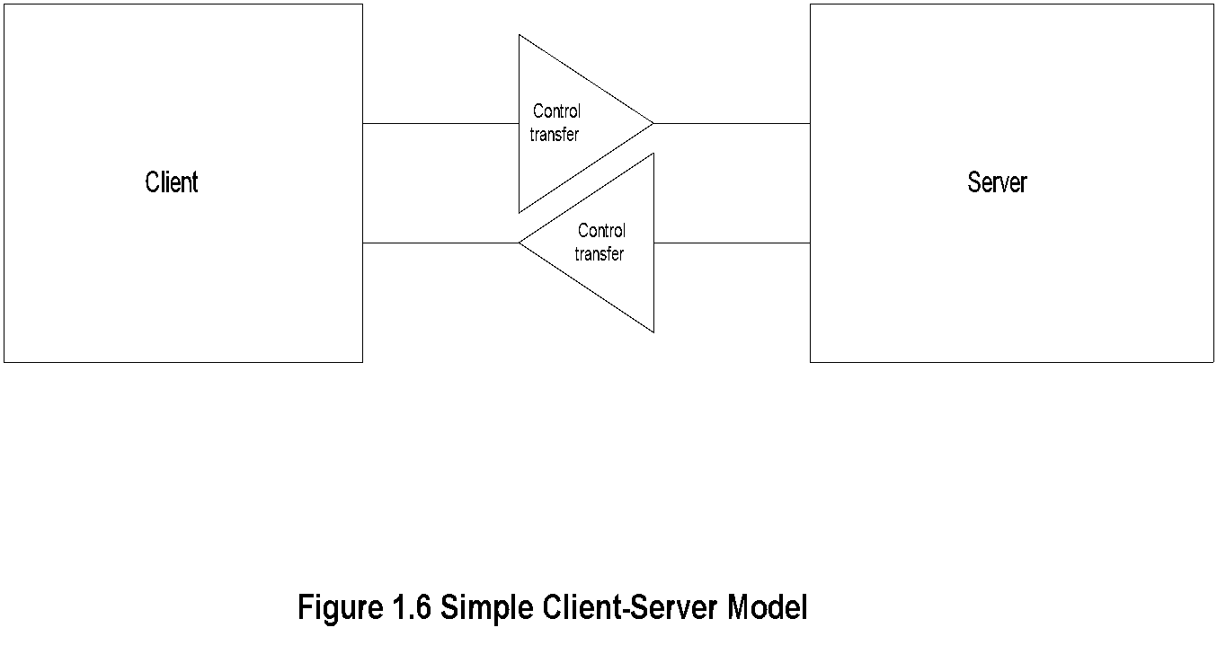
Client/Server Model
Notes:
• Post office analogy; clerk the server, and the customer the client.
• Client always initiates requests.
• Server always responds.
• Notice that control is handed over to the receiving entity.

Slide 12
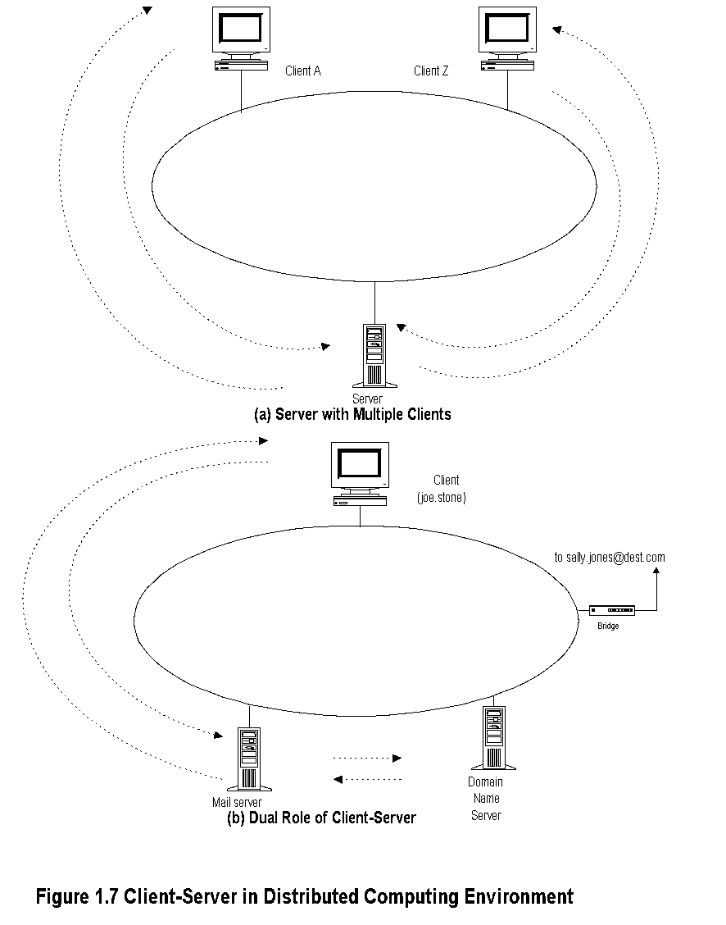
Client/Server Examples

Slide 13
• TCP/IP is a suite of protocols.
• Internet is based on TCP/IP.
• IP is Internet protocol at the network layer level.
• TCP is connection-oriented transport protocol and ensures end-to-end connection.
• UDP is connectionless transport protocol and provides datagram service.
• Internet email and much of the network mgmt. messages are based on UDP/IP.
• ICMP part of TCP/IP suite.
TCP/IP Based Networks

Slide 14
TCP/IP Based Networks
• TCP/IP is a suite of protocols
• Internet is based on TCP/IP
• IP is Internet protocol at the network layer level
• TCP is connection-oriented transport protocol and ensures end-to-end connection
• UDP is connectionless transport protocol and provides datagram service
• Internet email and much of the network mgmt. messages are based on UDP/IP
• ICMP part of TCP/IP suite

Slide 15
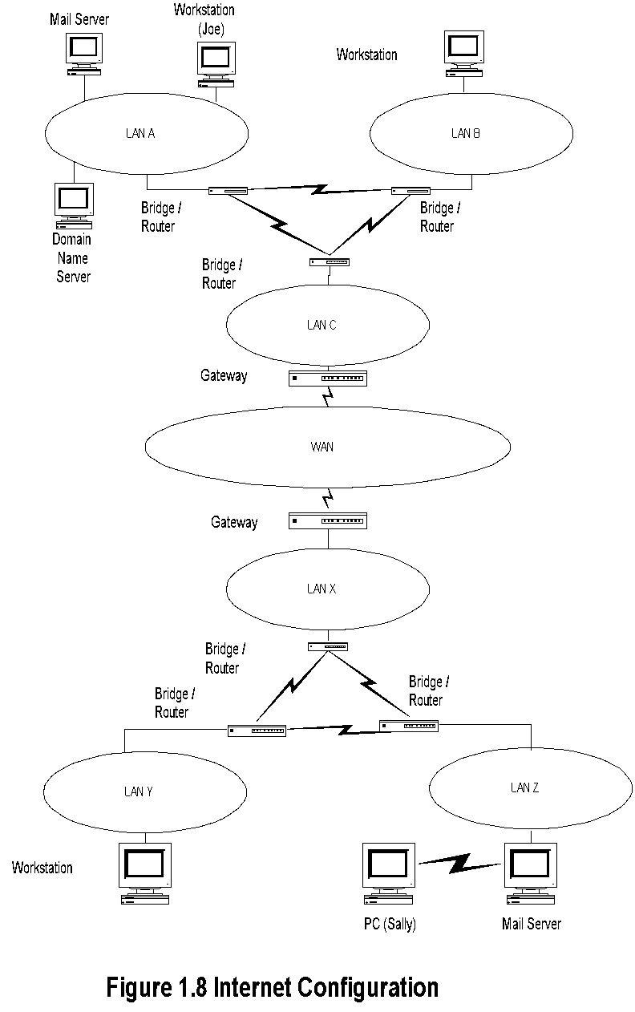
Internet Configuration
Notes:
• Walk through the scenario of email from Joe to Sally.

Slide 16
Architecture, Protocols and Standards
• Communication architecture
• Modeling of communication systems, comprising
• Functional components
• Operations interfaces between them
• Communication protocols
• Operational procedures
• Intra- and inter-modules
• Communication standards
• Agreement between manufacturers on protocols of communication equipment on
• Physical characteristics
• Operational procedures
Notes:
• Examples: (Students to call out)

Slide 17
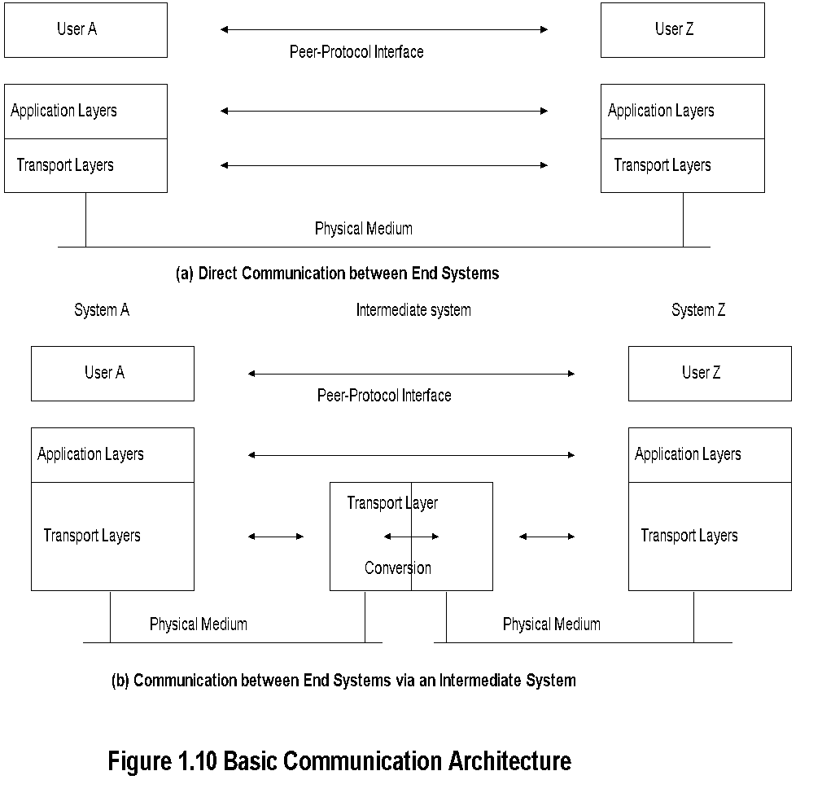
Communication Architecture
Notes:
• Inter-layer interface: user and service provider.
• Peer-layer protocol interface.
• Analogy of hearing-impaired student.
• Role of intermediate systems.
• Gateway: Router with protocol conversion as gateway to an autonomous network or subnet.

Slide 18
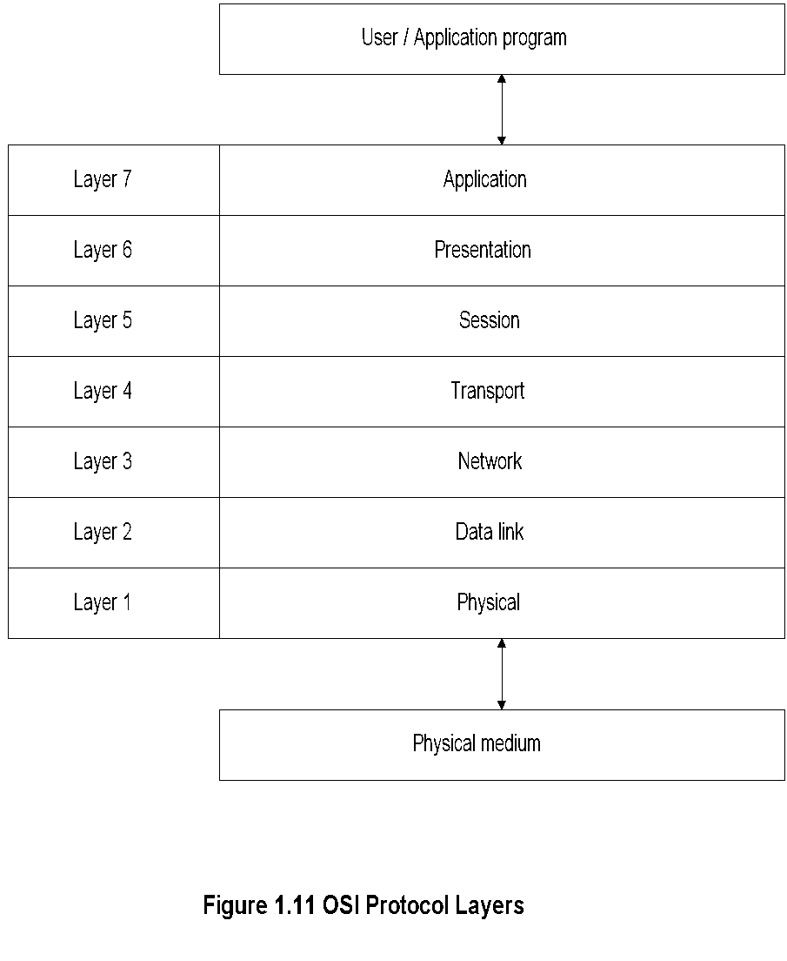
OSI Reference Model
Notes:
• Importance of the knowledge of layer
Structure in NM.

Slide 19
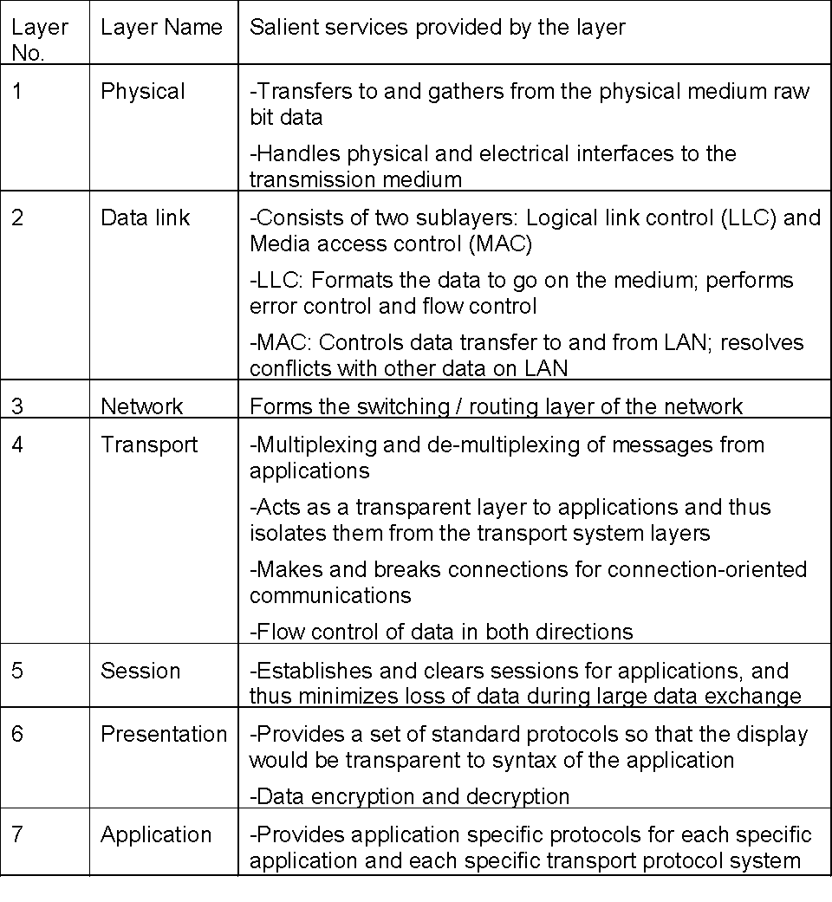
OSI Layers and Services
Notes
• Importance of services offered by different layers and the protocol conversion at different layers in NM

Slide 20
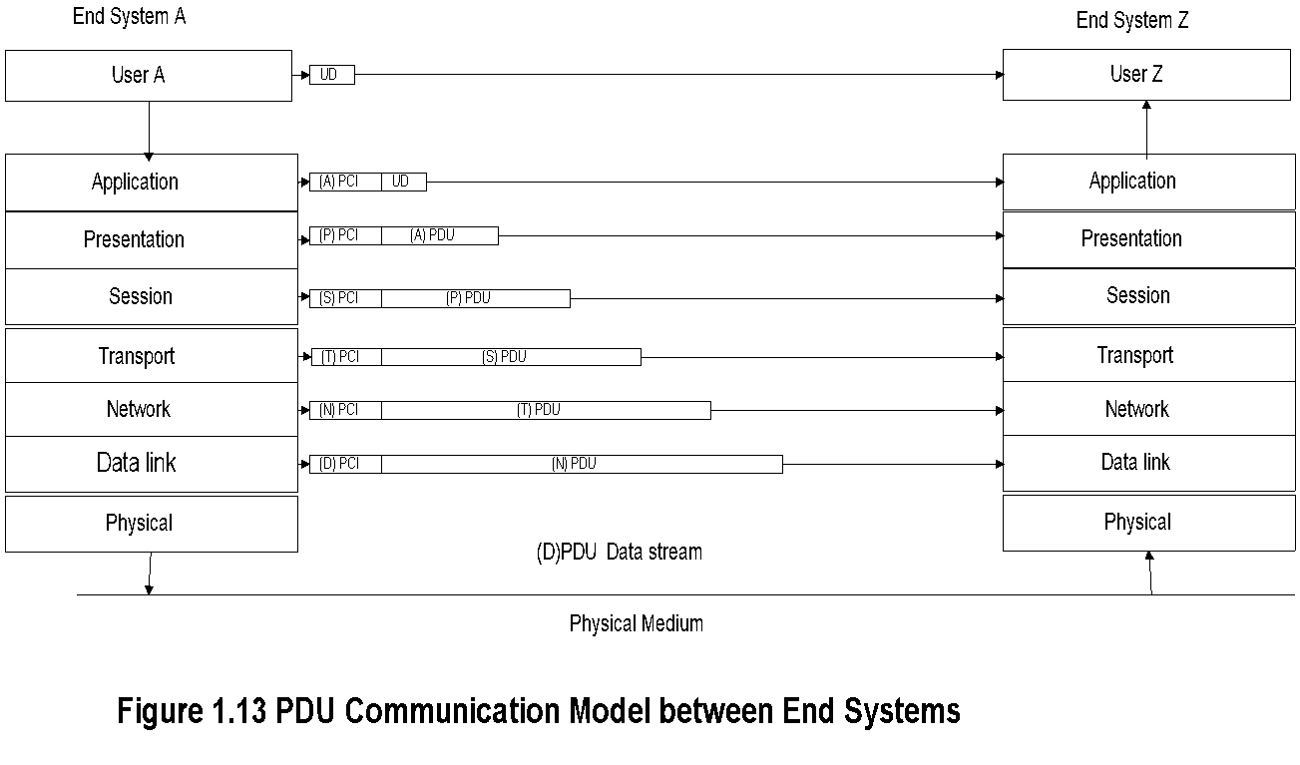
PDU Communication Model
Notes:
• What is the relevance of PDU model in NM?

Slide 21
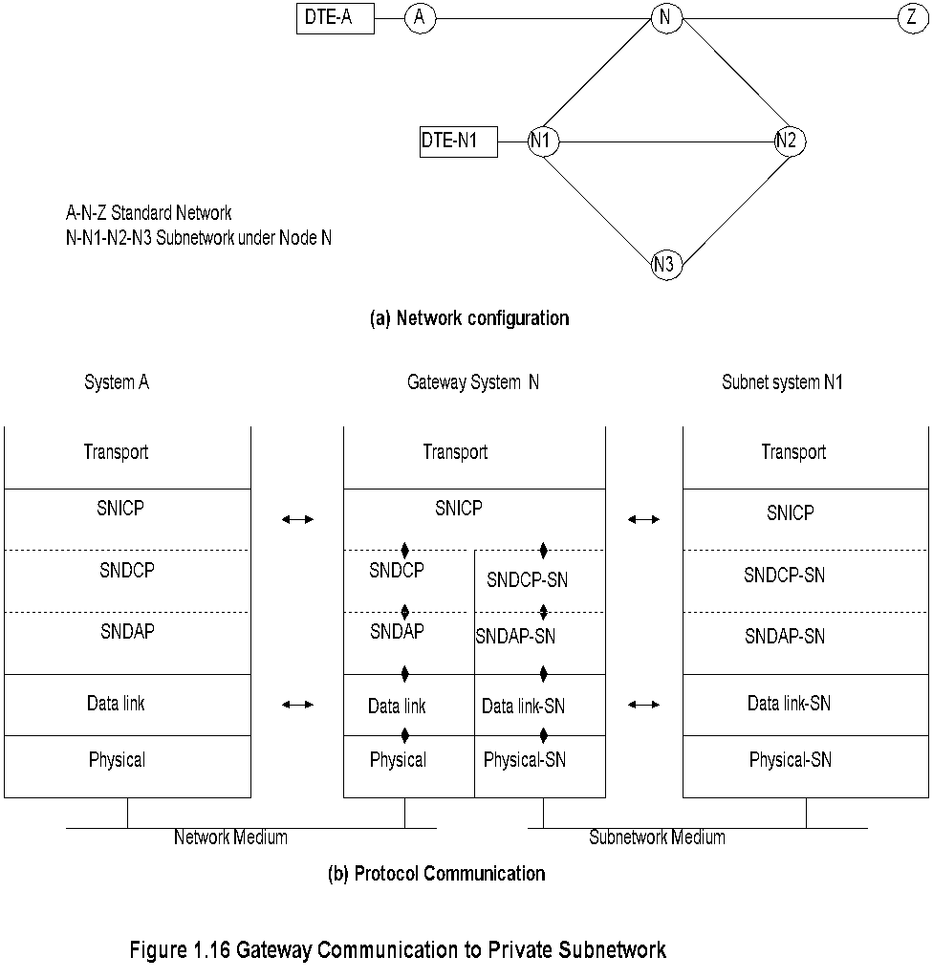
Gateway
Notes:
• cc:mail from a station in Novel IPX network to an Internet station with SMTP email

Slide 22
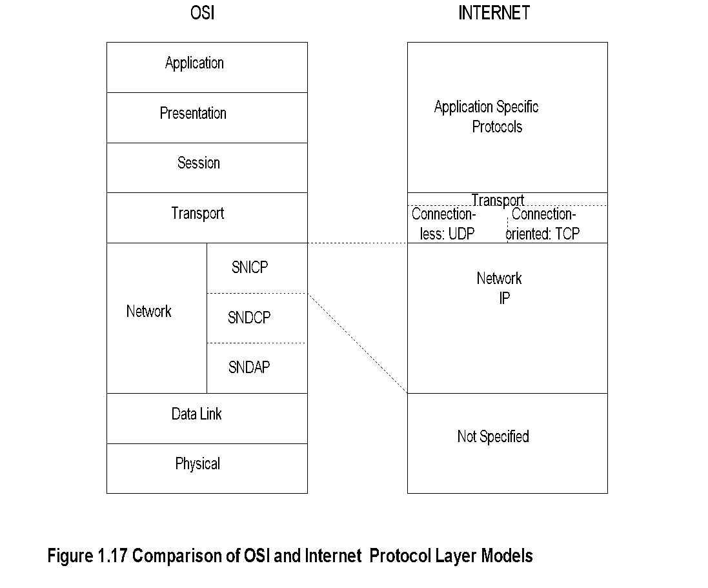
OSI and Internet
Notes:
• Simplicity of Internet; specifies only layers 3 and 4
• Integrated application layers over Internet
• Commonality of layers 1 and 2 - IEEE standard

Slide 23
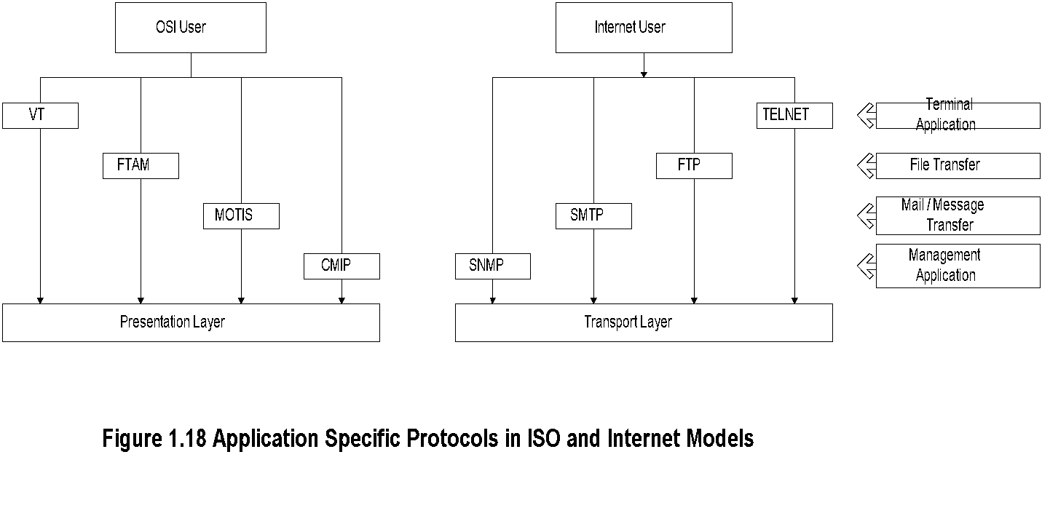
Application Protocols

Slide 24
Application Protocols-cont.
Notes:
Internet user | OSI user
Telnet | Virtual Terminal
File Transfer Protocol | File Transfer Access & Mgmt
Simple Mail Transfer Protocol | Message-oriented Text Interchange Standard
Simple Network Management Protocol | Common Management Information Protocol

Slide 25
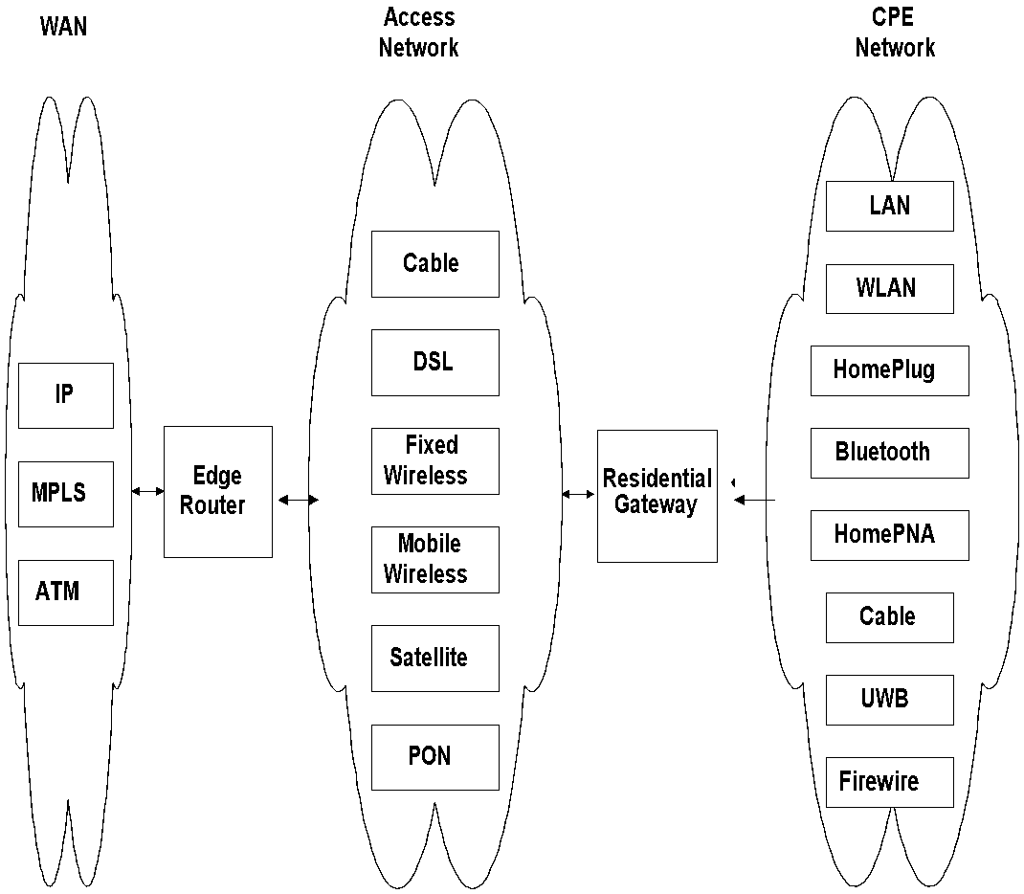
Broadband Network

Slide 26
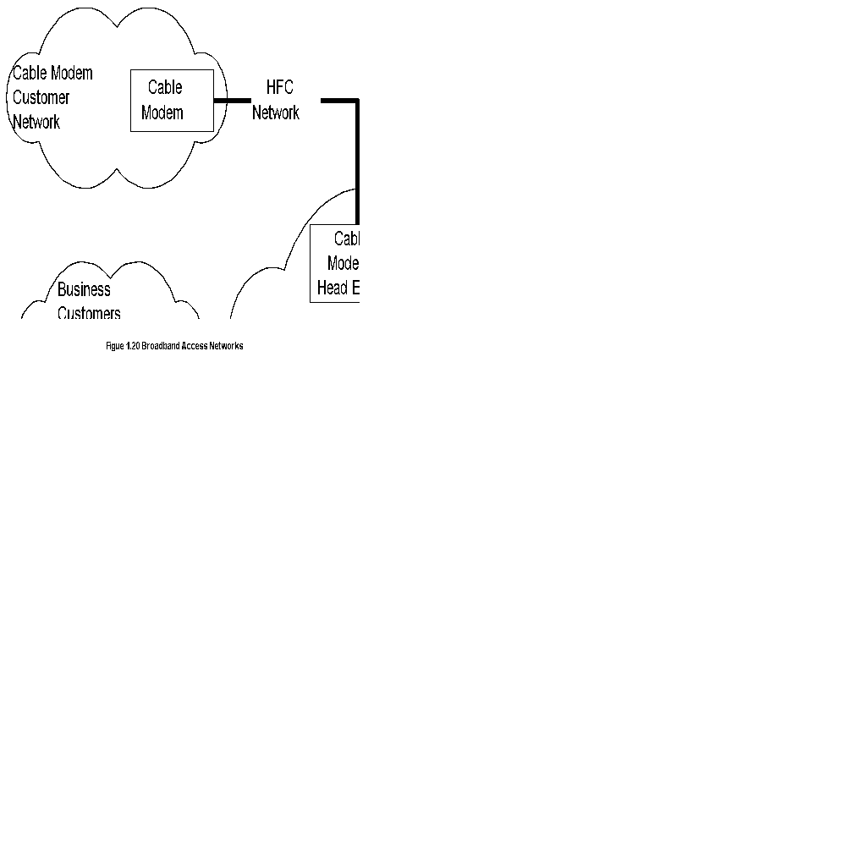
Broadband Access Networks

Slide 27
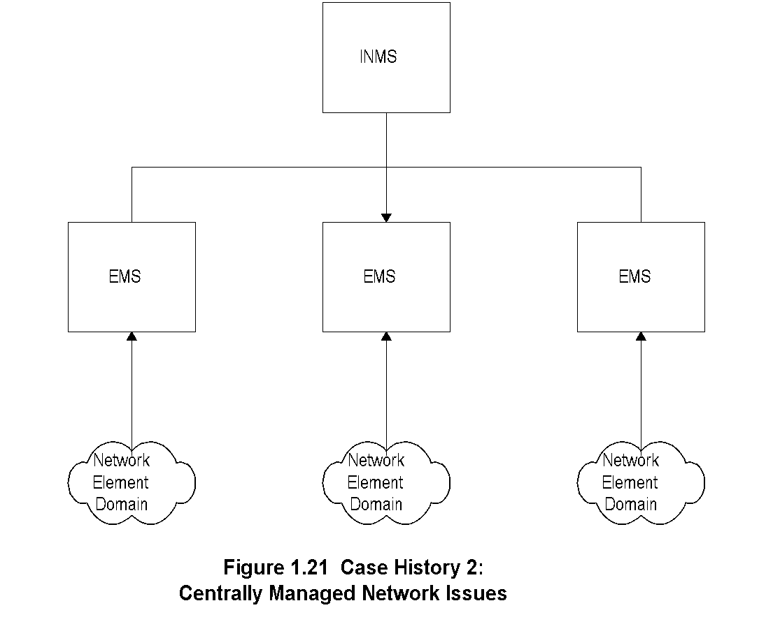
Centrally Managed Network Issues

Slide 28
• Loss of connectivity
• Duplicate IP address
• Intermittent problems
• Network configuration issues
• Non-problems
• Performance problems
Some Common Network Problems:

Slide 29
• Reliability
• Non-real time problems
• Rapid technological advance
• Managing client/server environment
• Scalability
• Troubleshooting tools and systems
• Trouble prediction
• Standardization of operations - NMS helps
• Centralized management vs. “sneaker-net”
Challenges of IT Managers:

Slide 30
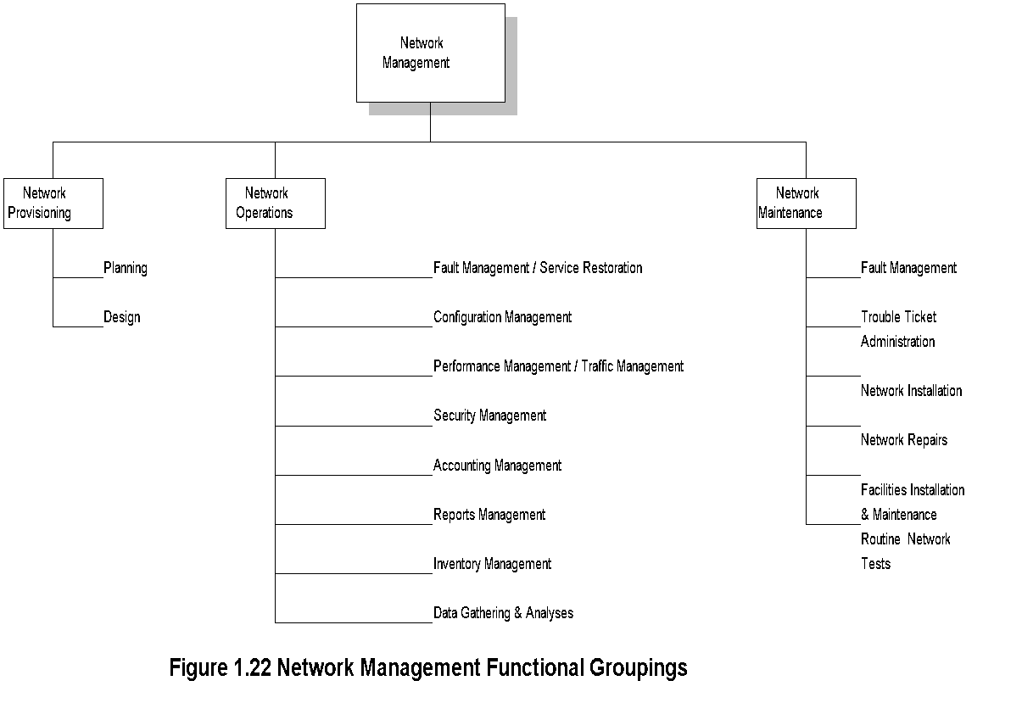
Network Management
Notes:
• OAMP
• Operations
• Administration
• Maintenance
• Provisioning

Slide 31
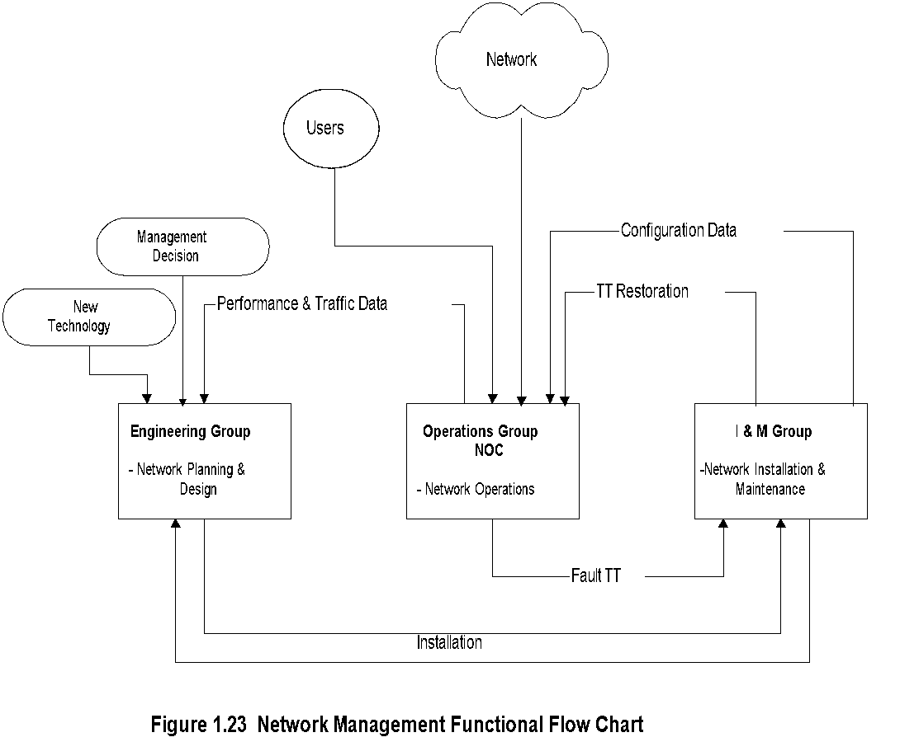
NM Functional Flow Chart

Slide 32
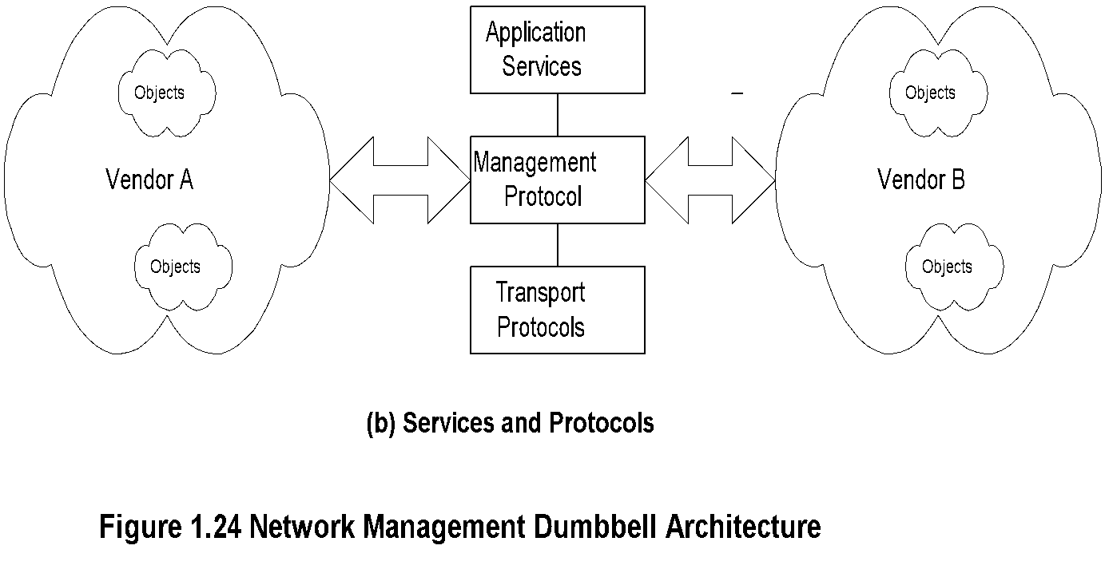
Dumbbell Architecture
Notes:
• Message exchange between NMSs managing different domains

Slide 33
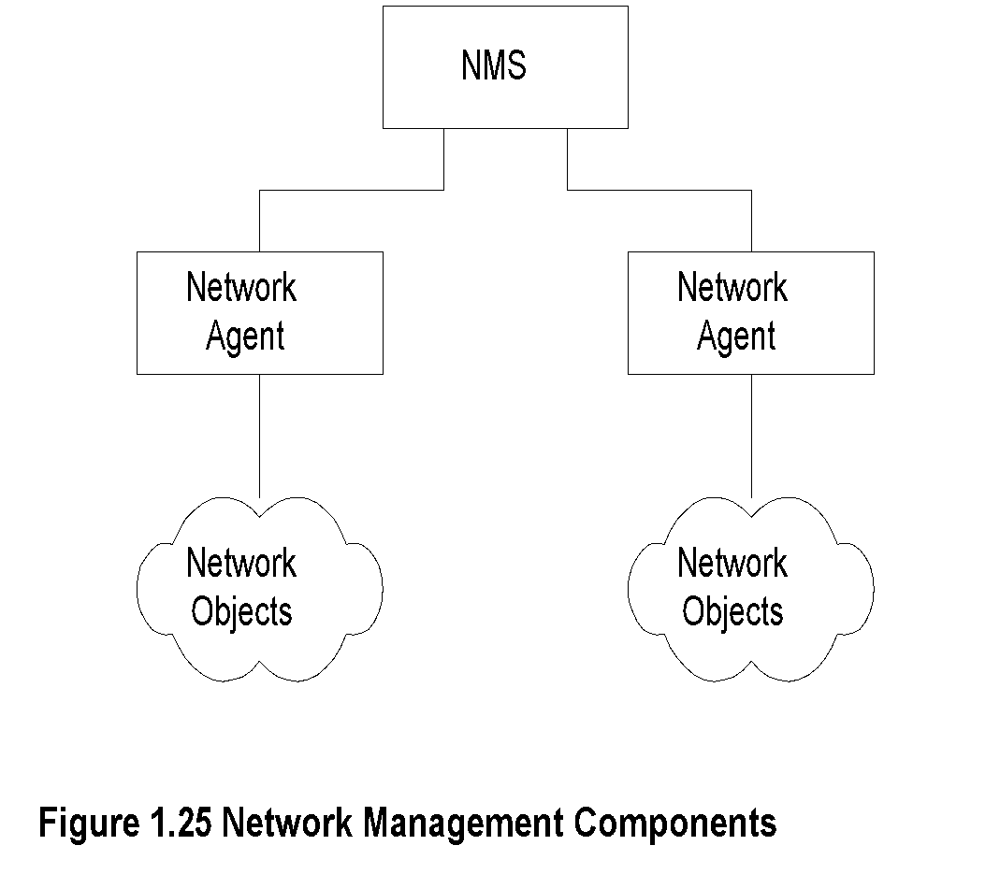
NM Components

Slide 34
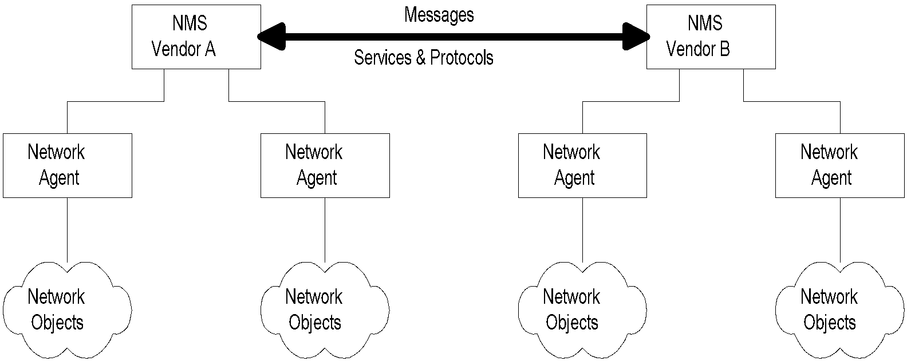
Interoperability
Notes:
• Message exchange between NMSs managing different domains.

Slide 35
• Network Management
• Service Management
• Service and Network Provisioning
• Application Management
• e-Commerce Management
• Inventory Management
• Integrated Management
• Business Management
• Information Management
• Management Protocols
• Management Technologies
Network Management Perspectives

Slide 36
• Domains
• Protocols
• Technologies
• Transmission Media
• Transmission Modes
• Service Functions
Infrastructure Perspective:
Service Perspective:
• Communication Services
• Computing Services
• Content Services
• IT Services
• Application Services

Slide 37
• Status:
• SNMP management
• Limited CMIP management
• Operations systems
• Polled systems
• Current Focus:
• Object-oriented approach
• Service and policy management
• Business management
• Web-based client management
• Future Trends
• Web-based management?
• XML based management
Status and Future Trends
Nisreen AlGhadban 120015789

