Slide 1

Chapter 9:
Project Human
Resource Management
Information Technology Project Management, Seventh Edition
Note: See the text itself for full citations.

Slide 2
Learning Objectives
Explain the importance of good human resource management on projects, including the current state of the global IT workforce and future implications for it
Define project human resource management and understand its processes
Summarize key concepts for managing people by understanding the theories of Abraham Maslow, Frederick Herzberg, David McClelland, and Douglas McGregor on motivation, H. J. Thamhain and D. L. Wilemon on influencing workers, and Stephen Covey on how people and teams can become more effective

Slide 3
Learning Objectives
Discuss human resource management planning and be able to create a human resource plan, project organizational chart, responsibility assignment matrix, and resource histogram
Understand important issues involved in project staff acquisition and explain the concepts of resource assignments, resource loading, and resource leveling
Assist in team development with training, team-building activities, and reward systems
Explain and apply several tools and techniques to help manage a project team and summarize general advice on managing teams
Describe how project management software can assist in project human resource management

Slide 4
The Importance of Human Resource Management
Many corporate executives have said, “People are our most important asset”
People determine the success and failure of organizations and projects

Slide 5
The Global IT Workforce
Although there have been ups and downs in the IT labor market, there will always be a need for good IT workers
The Digital Planet 2010 study predicts that ICT spending will have an annual growth rate of more than 6 percent each year through 2013, when it will reach almost $5 trillion
Thirty-three percent of the world’s population is online, and 45 percent of Internet users are below the age of 25

Slide 6
More Digital Planet Report Findings
With almost 6 billion mobile-cellular subscriptions, global penetration of cell phones is 87 percent, with 79 percent in the developing world
Fortune magazine lists IT as the number one “hot career for 2012 and beyond” in the United States. Openings for software application developers are projected to increase by 34 percent by 2018, while companies will hire 20 percent more computer systems analysts
The 2011 average salary for project management professionals was $105,000 per year in the United States, not including bonuses

Slide 7
Implications for the Future of IT Human Resource Management
Proactive organizations are addressing workforce needs by
  improving benefits
  redefining work hours and incentives
  finding future workers

Slide 8
Global Issues
Many people enjoy using Facebook, Twitter, and other social media sites. Some companies even encouraged workers to use these tools to get to know their colleagues better, especially for global work teams. A 2011 survey, however, shows that companies have changed their tune after realizing that worker productivity often suffers due to social media and other distraction
Psychologists have even created a term—Internet addiction disorder (IAD)—for the increasingly common addiction to Web-based activity. Many children suffer from this disorder, especially in Asian countries like China, Taiwan, and South Korea

Slide 9
What Went Wrong?
A 2011 report by CompTIA found a gap between skills that employers wanted and what they actually found in the IT workforce
Ninety-three percent of respondents reported an overall skills gap between existing and desired skill levels among their IT staff
The top priorities for IT include security, data storage, replacing old equipment, improving network infrastructure, and disaster recovery/ business continuity
Emerging areas include business process automation, mobility, collaboration, and virtualization.

Slide 10
What is Project Human Resource Management?
Making the most effective use of the people involved with a project
Processes include
  Planning human resource management: identifying and documenting project roles, responsibilities, and reporting relationships
  Acquiring the project team: getting the needed personnel assigned to and working on the project
  Developing the project team: building individual and group skills to enhance project performance
  Managing the project team: tracking team member performance, motivating team members, providing timely feedback, resolving issues and conflicts, and coordinating changes to help enhance project performance

Slide 11
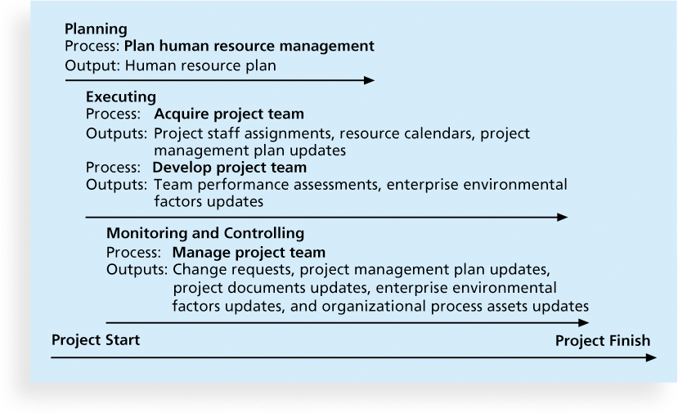
Figure 9-1. Project Human Resource Management Summary

Slide 12
Keys to Managing People
Psychologists and management theorists have devoted much research and thought to the field of managing people at work
Important areas related to project management include
  motivation theories
  influence and power
  effectiveness

Slide 13
Intrinsic and Extrinsic Motivation
Intrinsic motivation causes people to participate in an activity for their own enjoyment
Extrinsic motivation causes people to do something for a reward or to avoid a penalty
For example, some children take piano lessons for intrinsic motivation (they enjoy it) while others take them for extrinsic motivation (to get a reward or avoid punishment)

Slide 14
Maslow’s Hierarchy of Needs
Abraham Maslow argued that humans possess unique qualities that enable them to make independent choices, thus giving them control of their destiny
Maslow developed a hierarchy of needs which states that people’s behaviors are guided or motivated by a sequence of needs

Slide 15
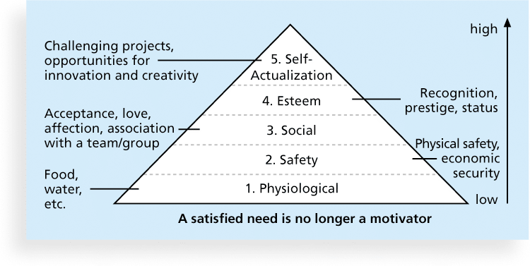
Figure 9-2. Maslow’s Hierarchy of Needs

Slide 16
Herzberg’s Motivational and Hygiene Factors
Frederick Herzberg wrote several famous books and articles about worker motivation. He distinguished between
  motivational factors: achievement, recognition, the work itself, responsibility, advancement, and growth, which produce job satisfaction
  hygiene factors: cause dissatisfaction if not present, but do not motivate workers to do more. Examples include larger salaries, more supervision, and a more attractive work environment

Slide 17
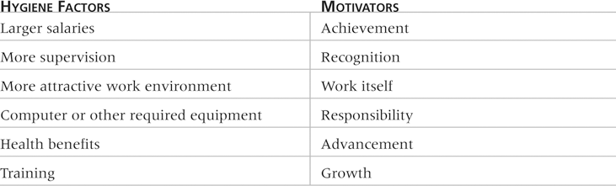
Table 9-1: Examples of Herzberg’s Hygiene Factors and Motivators

Slide 18
McClelland’s Acquired-Needs Theory
Specific needs are acquired or learned over time and shaped by life experiences, including:
  Achievement (nAch): Achievers like challenging projects with achievable goals and lots of feedback
  Affiliation (nAff): People with high nAff desire harmonious relationships and need to feel accepted by others, so managers should try to create a cooperative work environment for them
  Power: (nPow): People with a need for power desire either personal power (not good) or institutional power (good for the organization). Provide institutional power seekers with management opportunities

Slide 19
McGregor’s Theory X and Y
Douglas McGregor popularized the human relations approach to management in the 1960s
Theory X: assumes workers dislike and avoid work, so managers must use coercion, threats and various control schemes to get workers to meet objectives
Theory Y: assumes individuals consider work as natural as play or rest and enjoy the satisfaction of esteem and self-actualization needs
Theory Z: introduced in 1981 by William Ouchi and is based on the Japanese approach to motivating workers, emphasizing trust, quality, collective decision making, and cultural values

Slide 20
Thamhain and Wilemon’s Ways to Have Influence on Projects
1. Authority: the legitimate hierarchical right to issue orders
2. Assignment: the project manager's perceived ability to influence a worker's later work assignments
3. Budget: the project manager's perceived ability to authorize others' use of discretionary funds
4. Promotion: the ability to improve a worker's position
5. Money: the ability to increase a worker's pay and benefits

Slide 21
Thamhain and Wilemon’s Ways to Have Influence on Projects (cont’d)
6. Penalty: the project manager's ability to cause punishment
7. Work challenge: the ability to assign work that capitalizes on a worker's enjoyment of doing a particular task
8. Expertise: the project manager's perceived special knowledge that others deem important
9. Friendship: the ability to establish friendly personal relationships between the project manager and others

Slide 22
Ways to Influence that Help and Hurt Projects
Projects are more likely to succeed when project managers influence with
  expertise
  work challenge
Projects are more likely to fail when project managers rely too heavily on
  authority
  money
  penalty

Slide 23
Power
Power is the potential ability to influence behavior to get people to do things they would not otherwise do
Types of power include
  Coercive
  Legitimate
  Expert
  Reward
  Referent

Slide 24
Covey and Improving Effectiveness
Project managers can apply Covey’s 7 habits to improve effectiveness on projects
  Be proactive
  Begin with the end in mind
  Put first things first
  Think win/win
  Seek first to understand, then to be understood
  Synergize
  Sharpen the saw

Slide 25
Empathic Listening and Rapport
Good project managers are empathic listeners - they listen with the intent to understand
Before you can communicate with others, you have to have rapport – a relation of harmony, conformity, accord, or affinity
Mirroring is the matching of certain behaviors of the other person, a technique to help establish rapport
IT professionals need to develop empathic listening and other people skills to improve relationships with users and other stakeholders

Slide 26
Media Snapshot
RSA Animate used its popular whiteboard drawing technique to summarize key points from Pink’s book in a YouTube video called “Drive: The surprising truth about what motivates us”
Pink suggests that managers focus on the following three motivators:
  Autonomy
  Mastery
  Purpose

Slide 27
Developing the Human Resource Plan
Involves identifying and documenting project roles, responsibilities, and reporting relationships
Contents include
  project organizational charts
  staffing management plan
  responsibility assignment matrixes
  resource histograms

Slide 28
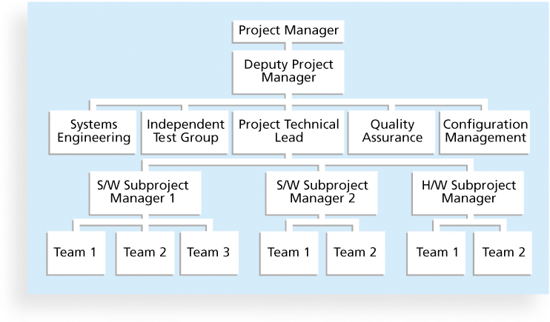
Figure 9-3. Sample Organizational Chart for a Large IT Project

Slide 29
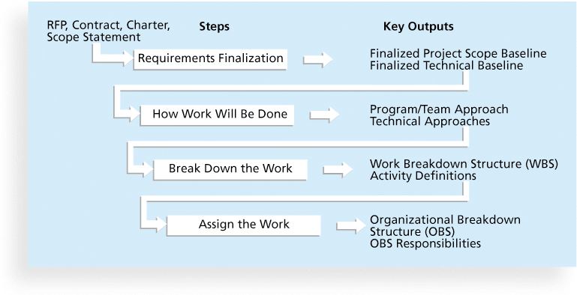
Figure 9-4. Work Definition and Assignment Process

Slide 30
Responsibility Assignment Matrices
A responsibility assignment matrix (RAM) is a matrix that maps the work of the project as described in the WBS to the people responsible for performing the work as described in the OBS
Can be created in different ways to meet unique project needs

Slide 31
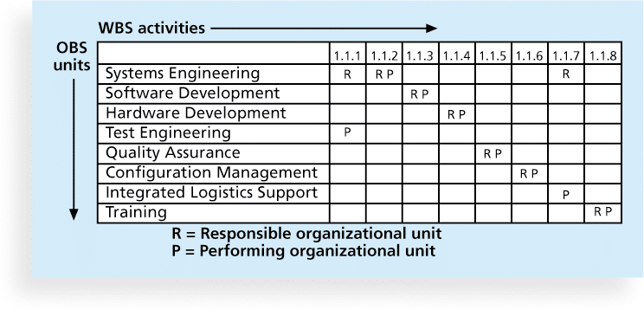
Figure 9-5. Sample Responsibility Assignment Matrix (RAM)

Slide 32
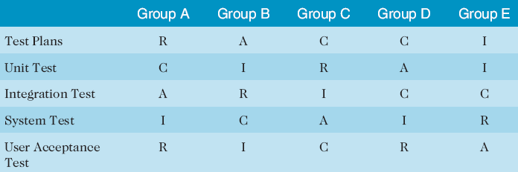
Table 9-2. Sample RACI Chart
R = responsibility
A = accountability, only one A per task
C = consultation
I = informed
Note that some people reverse the definitions of responsible and accountable.

Slide 33
Staffing Management Plans and Resource Histograms
A staffing management plan describes when and how people will be added to and taken off the project team
A resource histogram is a column chart that shows the number of resources assigned to a project over time

Slide 34
What Went Right?
In addition to providing technical training for IT personnel, several companies have made significant investments in project management training to provide career paths for project managers
  Hewlett Packard employed only six registered PMPs in 1997, but by August 2004, it employed more than 1,500 PMPs and was adding 500 more per year
  While most consulting firms offer a single path to a leadership position, IBM has four to allow their people to succeed by focusing on their strengths and interests in one or more disciplines

Slide 35
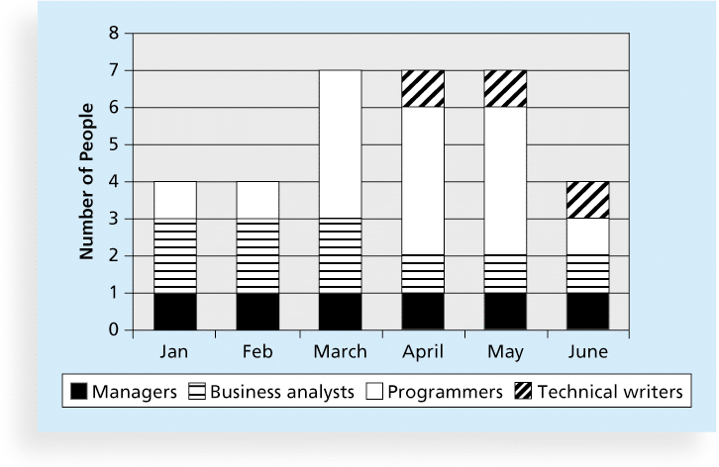
Figure 9-6. Sample Resource Histogram

Slide 36
Acquiring the Project Team
Acquiring qualified people for teams is crucial
The project manager who is the smartest person on the team has done a poor job of recruiting!
It’s important to assign the appropriate type and number of people to work on projects at the appropriate times

Slide 37
Resource Assignment
Staffing plans and good hiring procedures are important, as are incentives for recruiting and retention
  Some companies give their employees one dollar for every hour a new person they helped hire works
  Some organizations allow people to work from home as an incentive
Enrollment in U.S. computer science and engineering programs has dropped almost in half since 2000, and one-third of U.S. workers were over the age of 50 by 2010
CIO’s researchers suggest that organizations rethink hiring practices and incentives to hire and retain IT talent

Slide 38
Best Practice
Best practices can be applied to include the best places for people to work
  For example, Fortune Magazine lists the “100 Best Companies to Work For” in the United States every year, with Google taking the honors in 2007, 2008, and 2012
  Working Mothers Magazine lists the best companies in the U.S. for women based on benefits for working families
  The Timesonline (www.timesonline.co.uk) provides the Sunday Times list of the 100 Best Companies to Work For, a key benchmark against which UK companies can judge their Best Practice performance as employers

Slide 39
Resource Loading
Resource loading refers to the amount of individual resources an existing schedule requires during specific time periods
Helps project managers develop a general understanding of the demands a project will make on the organization’s resources and individual people’s schedules
Overallocation means more resources than are available are assigned to perform work at a given time

Slide 40
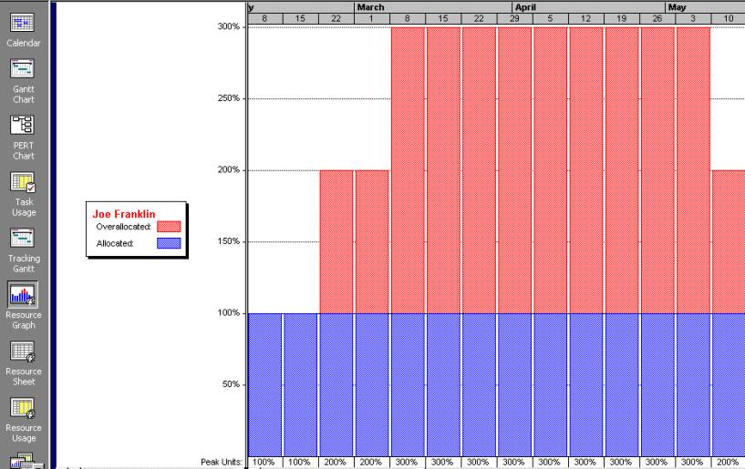
Figure 9-7. Sample Histogram Showing an Overallocated Individual

Slide 41
Resource Leveling
Resource leveling is a technique for resolving resource conflicts by delaying tasks
The main purpose of resource leveling is to create a smoother distribution of resource usage and reduce overallocation

Slide 42
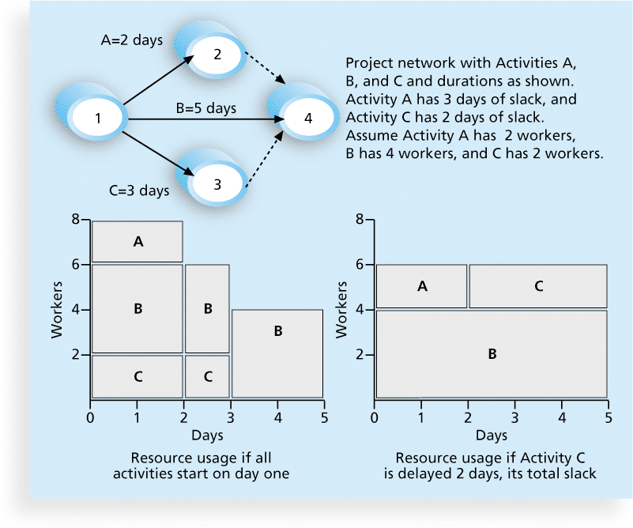
Figure 9-8. Resource Leveling Example

Slide 43
Benefits of Resource Leveling
When resources are used on a more constant basis, they require less management
It may enable project managers to use a just-in-time inventory type of policy for using subcontractors or other expensive resources
It results in fewer problems for project personnel and accounting department
It often improves morale

Slide 44
Developing the Project Team
The main goal of team development is to help people work together more effectively to improve project performance
It takes teamwork to successfully complete most projects

Slide 45
Tuckman Model of Team Development
Forming
Storming
Norming
Performing
Adjourning

Slide 46
Training
Training can help people understand themselves, each other, and how to work better in teams
Team building activities include
  physical challenges
  psychological preference indicator tools

Slide 47
Meyers-Briggs Type Indicator (MBTI)
MBTI is a popular tool for determining personality preferences and helping teammates understand each other
Four dimensions include:
  Extrovert/Introvert (E/I)
  Sensation/Intuition (S/N)
  Thinking/Feeling (T/F)
  Judgment/Perception (J/P)
NTs or rationals are attracted to technology fields
IT people vary most from the general population in not being extroverted or sensing

Slide 48
Social Styles Profile
People are perceived as behaving primarily in one of four zones, based on their assertiveness and responsiveness:
  Drivers
  Expressives
  Analyticals
  Amiables
People on opposite corners (drivers and amiables, analyticals and expressives) may have difficulties getting along

Slide 49
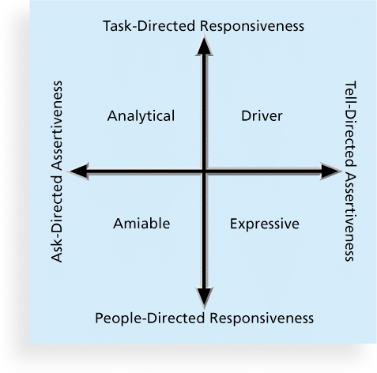
Figure 9-9. Social Styles

Slide 50
DISC Profiles
Also uses a four-dimensional model of normal behavior
  Dominance
  Influence
  Steadiness
  Compliance
People in opposite quadrants can have problems understanding each other

Slide 51
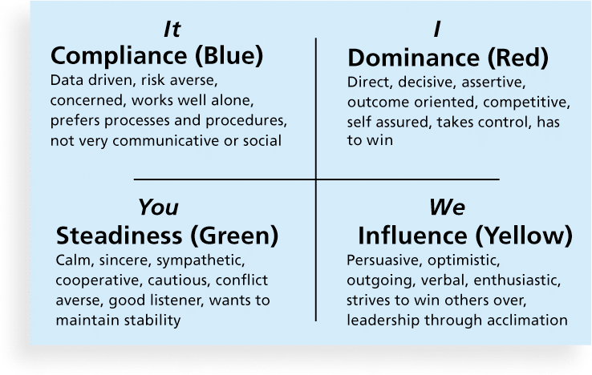
Figure 9-10. The DISC Profile

Slide 52
Reward and Recognition Systems
Team-based reward and recognition systems can promote teamwork
Focus on rewarding teams for achieving specific goals
Allow time for team members to mentor and help each other to meet project goals and develop human resources

Slide 53
Managing the Project Team
Project managers must lead their teams in performing various project activities
After assessing team performance and related information, the project manager must decide
  if changes should be requested to the project
  if corrective or preventive actions should be recommended
  if updates are needed to the project management plan or organizational process assets.

Slide 54
Tools and Techniques for Managing Project Teams
Observation and conversation
Project performance appraisals
Interpersonal skills
Conflict management

Slide 55
Conflict Handling Modes
Confrontation: Directly face a conflict using a problem-solving approach
Compromise: Use a give-and-take approach
Smoothing: De-emphasize areas of difference and emphasize areas of agreement
Forcing: The win-lose approach
Withdrawal: Retreat or withdraw from an actual or potential disagreement
Collaborating: Decision makers incorporate different viewpoints and insights to develop consensus and commitment

Slide 56
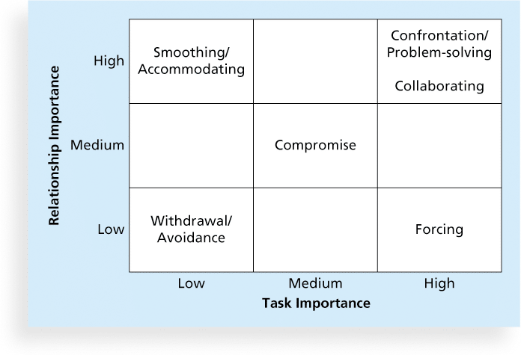
Figure 9-11. Conflict Handling Modes

Slide 57
Conflict Can Be Good
Conflict often produces important results, such as new ideas, better alternatives, and motivation to work harder and more collaboratively
Groupthink: Conformance to the values or ethical standards of a group. Groupthink can develop if there are no conflicting viewpoints
Research suggests that task-related conflict often improves team performance, but emotional conflict often depresses team performance

Slide 58
Five Dysfunctions of a Team
Patrick Lencioni, author of several books on teams, says that “Teamwork remains the one sustainable competitive advantage that has been large untapped”*
The five dysfunctions of teams are
    Absence of trust
    Fear of conflict
    Lack of commitment
    Avoidance of accountability
    Inattention to results
*Lencioni, Patrick, “Overcoming the Five Dysfunctions of a Team,” Jossey-Bass: San Francisco, CA (2005), p. 3.

Slide 59
General Advice on Teams
Be patient and kind with your team
Fix the problem instead of blaming people
Establish regular, effective meetings
Allow time for teams to go through the basic team-building stages
Limit the size of work teams to three to seven members

Slide 60
General Advice on Teams (cont’d)
Plan some social activities to help project team members and other stakeholders get to know each other better
Stress team identity
Nurture team members and encourage them to help each other
Take additional actions to work with virtual team members

Slide 61
Using Software to Assist in Human Resource Management
Software can help in producing RAMS and resource histograms
Project management software includes several features related to human resource management such as
  Assigning resources
  Identifying potential resource shortages or underutilization
  Leveling resources

Slide 62
Project Resource Management Involves Much More Than Using Software
Project managers must
  Treat people with consideration and respect
  Understand what motivates them
  Communicate carefully with them
Focus on your goal of enabling project team members to deliver their best work

Slide 63
Chapter Summary
Project human resource management includes the processes required to make the most effective use of the people involved with a project
Main processes include
  Plan human resource management
  Acquire project team
  Develop project team
  Manage project team

