Slide 1
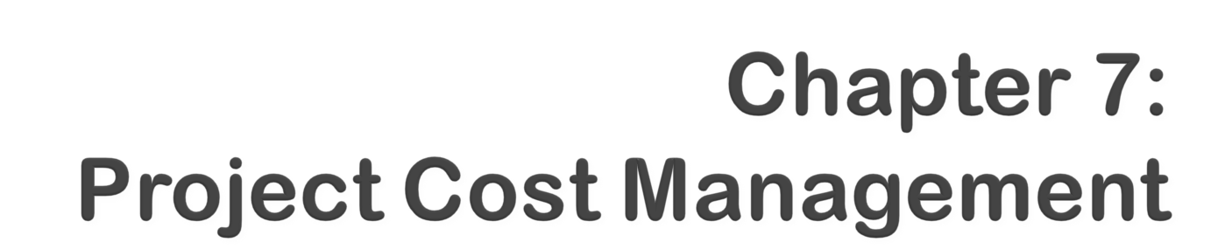

Information Technology Project Management, Sixth Edition
Note: See the text itself for full citations.
Notes:
*

Slide 2

Understand the importance of project cost management
Explain basic project cost management principles, concepts, and terms
Discuss different types of cost estimates and methods for preparing them
Information Technology Project Management, Sixth Edition
*

Slide 3

Understand the processes involved in cost budgeting and preparing a cost estimate and budget for an information technology project
Understand the benefits of earned value management and project portfolio management to assist in cost control
Describe how project management software can assist in project cost management
Information Technology Project Management, Sixth Edition
*

Slide 4

IT projects have a poor track record for meeting budget goals
The CHAOS studies found the average cost overrun (the additional percentage or dollar amount by which actual costs exceed estimates) ranged from 180 percent in 1994 to 56 percent in 2004; other studies found overruns to be 33-34 percent
Information Technology Project Management, Sixth Edition
*

Slide 5
The U.S. government, especially the Internal Revenue Service (IRS), continues to provide examples of how not to manage costs
  A series of project failures by the IRS in the 1990s cost taxpayers more than $50 billion a year
  In 2006, the IRS was in the news for a botched upgrade to its fraud-detection software, costing $318 million in fraudulent refunds that didn’t get caught
  A 2008 Government Accountability Office (GAO) report stated that more than 400 U.S. government agency IT projects, worth an estimated $25 billion, suffer from poor planning and underperformance
The United Kingdom’s National Health Service IT modernization program was called the greatest IT disaster in history with an estimated $26 billion overrun
Information Technology Project Management, Sixth Edition
*

Slide 6

Cost is a resource sacrificed or foregone to achieve a specific objective or something given up in exchange
Costs are usually measured in monetary units like dollars
Project cost management includes the processes required to ensure that the project is completed within an approved budget
Information Technology Project Management, Sixth Edition
*

Slide 7

Estimating costs: developing an approximation or estimate of the costs of the resources needed to complete a project
Determining the budget: allocating the overall cost estimate to individual work items to establish a baseline for measuring performance
Controlling costs: controlling changes to the project budget
Information Technology Project Management, Sixth Edition
*

Slide 8

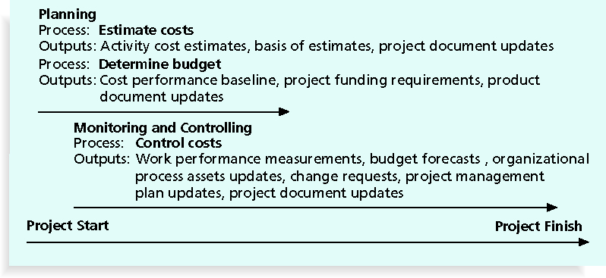
Information Technology Project Management, Sixth Edition
*

Slide 9

Most members of an executive board better understand and are more interested in financial terms than IT terms, so IT project managers must speak their language
  Profits are revenues minus expenditures
  Profit margin is the ratio of revenues to profits
  Life cycle costing considers the total cost of ownership, or development plus support costs, for a project
  Cash flow analysis determines the estimated annual costs and benefits for a project and the resulting annual cash flow
Information Technology Project Management, Sixth Edition
*

Slide 10

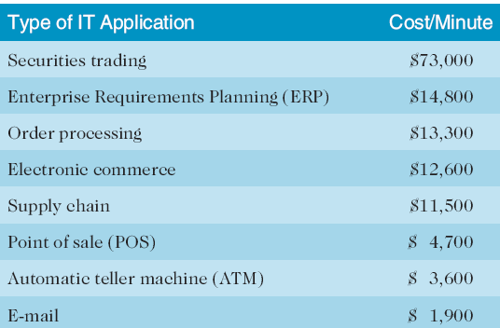
Information Technology Project Management, Sixth Edition
*

Slide 11

Many organizations use IT to reduce operational costs
Technology has decreased the costs associated with processing an ATM transaction:
  In 1968, the average cost was $5
  In 1978, the cost went down to $1.50
  In 1988, the cost was just a nickel
  In 1998, it only cost a penny
  In 2008, the cost was just half a penny!
Investing in green IT and other initiatives has helped both the environment and companies’ bottom lines; Michael Dell, CEO of Dell, reached his goal to make his company “carbon neutral” in 2008
Information Technology Project Management, Sixth Edition
*

Slide 12
Tangible costs or benefits are those costs or benefits that an organization can easily measure in dollars
Intangible costs or benefits are costs or benefits that are difficult to measure in monetary terms
Direct costs are costs that can be directly related to producing the products and services of the project
Indirect costs are costs that are not directly related to the products or services of the project, but are indirectly related to performing the project
Sunk cost is money that has been spent in the past; when deciding what projects to invest in or continue, you should not include sunk costs
Information Technology Project Management, Sixth Edition
*

Slide 13
Learning curve theory states that when many items are produced repetitively, the unit cost of those items decreases in a regular pattern as more units are produced
Reserves are dollars included in a cost estimate to mitigate cost risk by allowing for future situations that are difficult to predict
  Contingency reserves allow for future situations that may be partially planned for (sometimes called known unknowns) and are included in the project cost baseline
  Management reserves allow for future situations that are unpredictable (sometimes called unknown unknowns)
Information Technology Project Management, Sixth Edition
*

Slide 14

Project managers must take cost estimates seriously if they want to complete projects within budget constraints
It’s important to know the types of cost estimates, how to prepare cost estimates, and typical problems associated with IT cost estimates
Information Technology Project Management, Sixth Edition
*

Slide 15

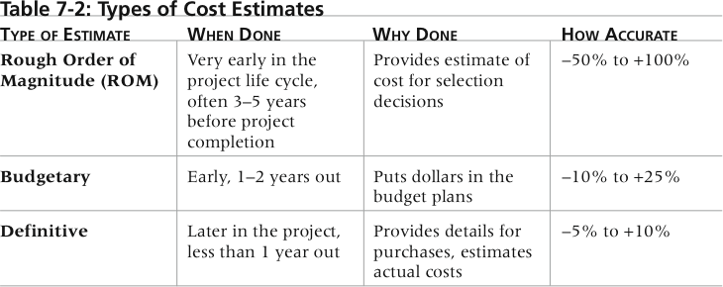
Information Technology Project Management, Sixth Edition
*

Slide 16

A cost management plan is a document that describes how the organization will manage cost variances on the project
A large percentage of total project costs are often labor costs, so project managers must develop and track estimates for labor
Information Technology Project Management, Sixth Edition
*

Slide 17

Information Technology Project Management, Sixth Edition
*

Slide 18
Basic tools and techniques for cost estimates:
  Analogous or top-down estimates: use the actual cost of a previous, similar project as the basis for estimating the cost of the current project
  Bottom-up estimates: involve estimating individual work items or activities and summing them to get a project total
  Parametric modeling uses project characteristics (parameters) in a mathematical model to estimate project costs
Information Technology Project Management, Sixth Edition
*

Slide 19

Estimates are done too quickly
Lack of estimating experience
Human beings are biased toward underestimation
Management desires accuracy
Information Technology Project Management, Sixth Edition
*

Slide 20

See pages 265-270 for a detailed example of creating a cost estimate for the Surveyor Pro project described in the opening case
Before creating an estimate, know what it will be used for, gather as much information as possible, and clarify the ground rules and assumptions for the estimate
If possible, estimate costs by major WBS categories
Create a cost model to make it easy to make changes to and document the estimate
Information Technology Project Management, Sixth Edition
*

Slide 21
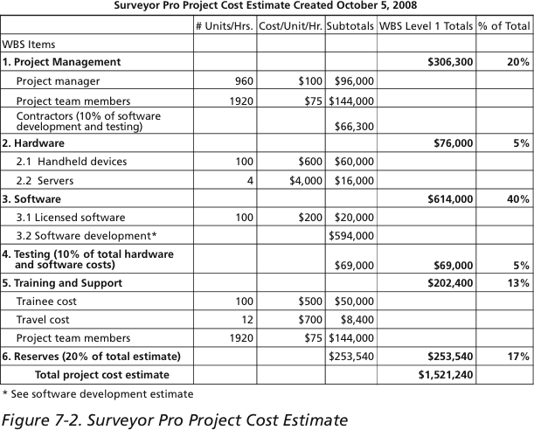
Information Technology Project Management, Sixth Edition
*

Slide 22

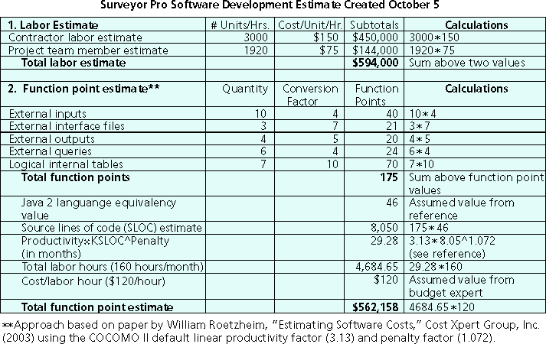
Information Technology Project Management, Sixth Edition
*

Slide 23

Cost budgeting involves allocating the project cost estimate to individual work items over time
The WBS is a required input to the cost budgeting process since it defines the work items
Important goal is to produce a cost baseline
  A time-phased budget that project managers use to measure and monitor cost performance
Information Technology Project Management, Sixth Edition
*

Slide 24

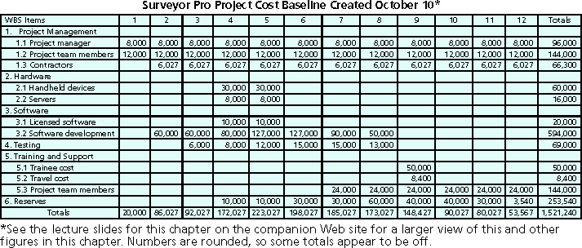
Information Technology Project Management, Sixth Edition
*

Slide 25
U.S. President Barack Obama successfully used the media and information technology in his campaign
  The Obama campaign used 16 different online social platforms to interact with people of various backgrounds; sources say 80 percent of all contributions originated from these social networks
  In a 60 Minutes episode shortly after the election, campaign leaders discussed some of the details of the campaign
  The Web site My.BarackObama was created to develop an online community with more than a million members
Information Technology Project Management, Sixth Edition
*

Slide 26
Project cost control includes:
  Monitoring cost performance
  Ensuring that only appropriate project changes are included in a revised cost baseline
  Informing project stakeholders of authorized changes to the project that will affect costs
Many organizations around the globe have problems with cost control
Information Technology Project Management, Sixth Edition
*

Slide 27

EVM is a project performance measurement technique that integrates scope, time, and cost data
Given a baseline (original plan plus approved changes), you can determine how well the project is meeting its goals
You must enter actual information periodically to use EVM
More and more organizations around the world are using EVM to help control project costs
Information Technology Project Management, Sixth Edition
*

Slide 28

The planned value (PV), formerly called the budgeted cost of work scheduled (BCWS), also called the budget, is that portion of the approved total cost estimate planned to be spent on an activity during a given period
Actual cost (AC), formerly called actual cost of work performed (ACWP), is the total of direct and indirect costs incurred in accomplishing work on an activity during a given period
The earned value (EV), formerly called the budgeted cost of work performed (BCWP), is an estimate of the value of the physical work actually completed
EV is based on the original planned costs for the project or activity and the rate at which the team is completing work on the project or activity to date
Information Technology Project Management, Sixth Edition
*

Slide 29
Rate of performance (RP) is the ratio of actual work completed to the percentage of work planned to have been completed at any given time during the life of the project or activity
Brenda Taylor, Senior Project Manager in South Africa, suggests this term and approach for estimating earned value
For example, suppose the server installation was halfway completed by the end of week 1: the rate of performance would be 50% because by the end of week 1, the planned schedule reflects that the task should be 100 percent complete and only 50 percent of that work has been completed
Information Technology Project Management, Sixth Edition
*

Slide 30

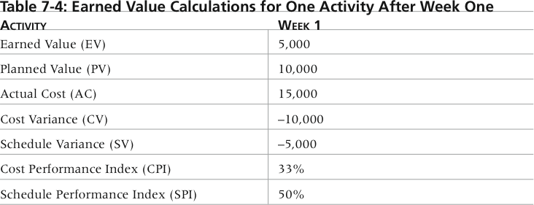
Information Technology Project Management, Sixth Edition
*

Slide 31

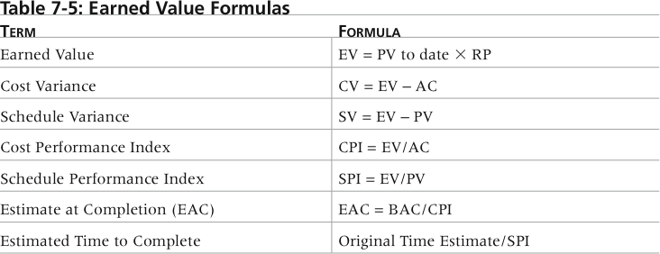
Information Technology Project Management, Sixth Edition
*

Slide 32

Negative numbers for cost and schedule variance indicate problems in those areas
CPI and SPI less than 100% indicate problems
Problems mean the project is costing more than planned (over budget) or taking longer than planned (behind schedule)
The CPI can be used to calculate the estimate at completion (EAC), an estimate of what it will cost to complete the project based on performance to date; the budget at completion (BAC) is the original total budget for the project
Information Technology Project Management, Sixth Edition
*

Slide 33
Information Technology Project Management, Sixth Edition
*

Slide 34

Many organizations collect and control an entire suite of projects or investments as one set of interrelated activities in a portfolio
Five levels for project portfolio management
  Put all your projects in one database
  Prioritize the projects in your database
  Divide your projects into two or three budgets based on type of investment
  Automate the repository
  Apply modern portfolio theory, including risk-return tools that map project risk on a curve
Information Technology Project Management, Sixth Edition
*

Slide 35

Schlumberger saved $3 million in one year by organizing 120 information technology projects into a portfolio
ROI of implementing portfolio management software by IT departments:
  Savings of 6.5 percent of the average annual IT budget by the end of year one
  Improved annual average project timeliness by 45.2 percent
  Reduced IT management time spent on project status reporting by 43 percent and IT labor capitalization reporting by 55 percent
  Decreased the time to achieve financial sign-off for new IT projects by 20.4 percent, or 8.4 days
Information Technology Project Management, Sixth Edition
*

Slide 36
A global survey released by Borland Software in 2006 suggests that many organizations are still at a low level of maturity in terms of how they define project goals, allocate resources, and measure overall success of their information technology portfolios; some of the findings include the following:
  Only 22 percent of survey respondents reported that their organization either effectively or very effectively uses a project plan for managing projects
  Only 17 percent have either rigorous or very rigorous processes for project plans, which include developing a baseline and estimating schedule, cost, and business impact of projects
  Only 20 percent agreed their organizations monitor portfolio progress and coordinate across inter-dependent projects
Information Technology Project Management, Sixth Edition
*

Slide 37
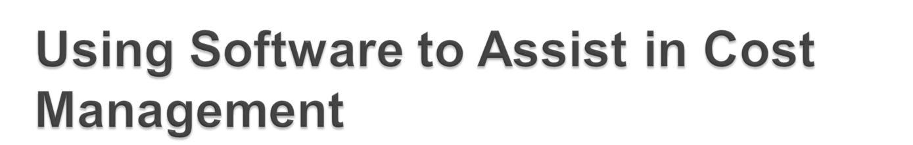
Spreadsheets are a common tool for resource planning, cost estimating, cost budgeting, and cost control
Many companies use more sophisticated and centralized financial applications software for cost information
Project management software has many cost-related features, especially enterprise PM software
Portfolio management software can help reduce costs
Information Technology Project Management, Sixth Edition
*

Slide 38

Project cost management is a traditionally weak area of IT projects, and project managers must work to improve their ability to deliver projects within approved budgets
Main processes include:
  Estimate costs
  Determine the budget
  Control costs
Information Technology Project Management, Sixth Edition
*

