Slide 1

Web Technologies
IT230
Dr Mohamed Habib

Slide 2
Objectives
Chapter 4: PHP 5 Basic Language
Chapter 5: PHP 5 OO Language

Slide 3
Advanced OOP and Design
Patterns
DESIGN PATTERNS
When designing software, certain programming patterns repeat themselves. Some of these have been addressed by the software design community and have been given accepted general solutions. These repeating problems are called design patterns.

Slide 4
Advanced OOP and Design
Patterns
Strategy Pattern
The strategy pattern is typically used when your programmer’s algorithm should be interchangeable with different variations of the algorithm. For example, if you have code that creates an image, under certain circumstances, you might want to create JPEGs and under other circumstances, you might want to create GIF files.
The strategy pattern is usually implemented by declaring an abstract base class with an algorithm method, which is then implemented by inheriting concrete classes. At some point in the code, it is decided what concrete strategy is relevant; it would then be instantiated and used wherever relevant.

Slide 5
Advanced OOP and Design
Patterns
Strategy Pattern

Slide 6
Advanced OOP and Design
Patterns
Singleton Pattern
The singleton pattern is probably one of the best-known design patterns. You have probably encountered many situations where you have an object that handles some centralized operation in your application, such as a logger object. In such cases, it is usually preferred for only one such application-wide instance to exist and for all application code to have the ability to access it.
Specifically, in a logger object, you would want every place in the application that wants to print something to the log to have access to it, and let the centralized logging mechanism handle the filtering of log messages according to log level settings. For this kind of situation, the singleton pattern exists.

Slide 7
Advanced OOP and Design
Patterns
Factory Pattern
Polymorphism and the use of base class is really the center of OOP. However, at some stage, a concrete instance of the base class’s subclasses must be created. This is usually done using the factory pattern. A Factory class has a static method that receives some input and, according to that input, it decides what class instance to create (usually a subclass).

Slide 8
Advanced OOP and Design
Patterns
Factory Pattern
Say that on your web site, different kinds of users can log in. Some are guests, some are regular customers, and others are administrators. In a common scenario, you would have a base class User and have three subclasses: GuestUser, CustomerUser, and AdminUser. Likely User and its subclasses would contain methods to retrieve information about the user (for example, permissions on what they can access on the web site and their personal preferences).
The best way for you to write your web application is to use the base class User as much as possible, so that the code would be generic and that it would be easy to add additional kinds of users when the need arises.

Slide 9
Advanced OOP and Design
Patterns
Observer Pattern
PHP applications, usually manipulate data. In many cases, changes to one piece of data can affect many different parts of your application’s code. For example, the price of each product item displayed on an e-commerce site in the customer’s local currency is affected by the current exchange rate. Now, assume that each product item is represented by a PHP object that most likely originates from a database; the exchange rate itself is most probably being taken from a different source and is not part of the item’s database entry. Let’s also assume that each such object has a display() method that outputs the HTML relevant to this product.
The observer pattern allows for objects to register on certain events
and/or data, and when such an event or change in data occurs, it is automatically
notified. In this way, you could develop the product item to be an observer
on the currency exchange rate, and before printing out the list of items, you
could trigger an event that updates all the registered objects with the correct
rate. Doing so gives the objects a chance to update themselves and take the
new data into account in their display() method

Slide 10
Advanced OOP and Design
Patterns
Observer Pattern
The observer pattern allows for objects to register on certain events and/or data, and when such an event or change in data occurs, it is automatically notified. In this way, you could develop the product item to be an observer on the currency exchange rate, and before printing out the list of items, you could trigger an event that updates all the registered objects with the correct rate. Doing so gives the objects a chance to update themselves and take the new data into account in their display() method

Slide 11
How to Write a Web Application with PHP
EMBEDDING INTO HTML

Slide 12
How to Write a Web Application with PHP
EMBEDDING INTO HTML

Slide 13
How to Write a Web Application with PHP
USER INPUT

Slide 14
How to Write a Web Application with PHP
USER INPUT

Slide 15
How to Write a Web Application with PHP
USER INPUT

Slide 16
How to Write a Web Application with PHP
SAFE-HANDLING USER INPUT
Common Mistakes
  Global Variables

Slide 17
How to Write a Web Application with PHP
SAFE-HANDLING USER INPUT
Common Mistakes
  Global Variables

Slide 18
How to Write a Web Application with PHP
SAFE-HANDLING USER INPUT
Common Mistakes
  Global Variables

Slide 19
How to Write a Web Application with PHP
SAFE-HANDLING USER INPUT
Common Mistakes
  Cross-Site Scripting

Slide 20
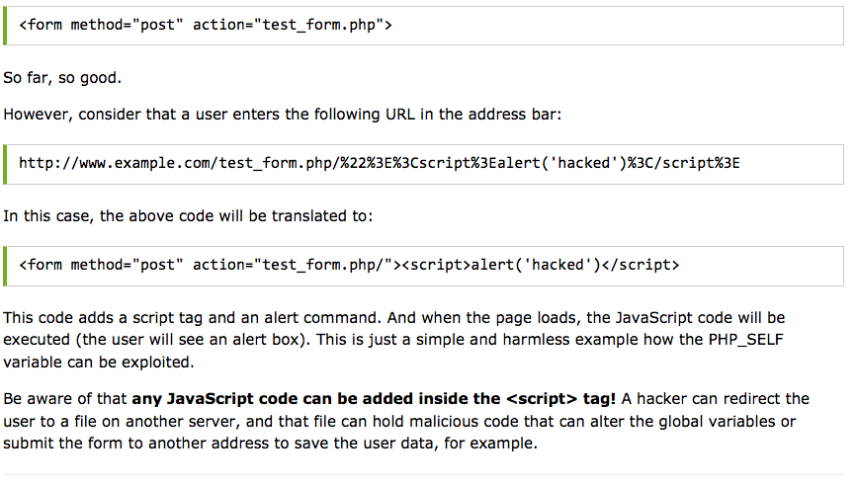
How to Write a Web Application with PHP
SAFE-HANDLING USER INPUT
Common Mistakes
  Cross-Site Scripting

Slide 21
How to Write a Web Application with PHP
SAFE-HANDLING USER INPUT
Common Mistakes
  SQL Injection

Slide 22
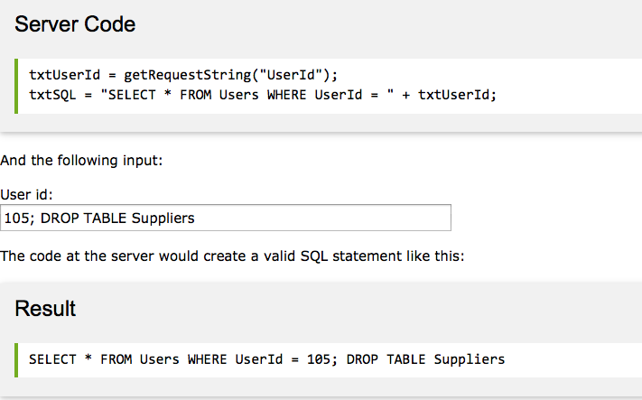
How to Write a Web Application with PHP
SAFE-HANDLING USER INPUT
Common Mistakes
  SQL Injection

Slide 23
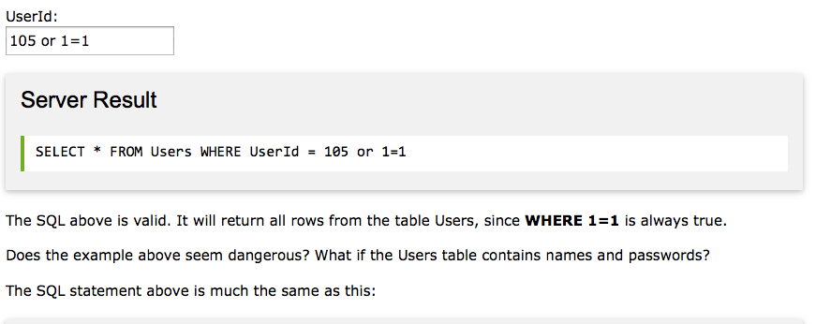
How to Write a Web Application with PHP
SAFE-HANDLING USER INPUT
Common Mistakes
  SQL Injection

Slide 24
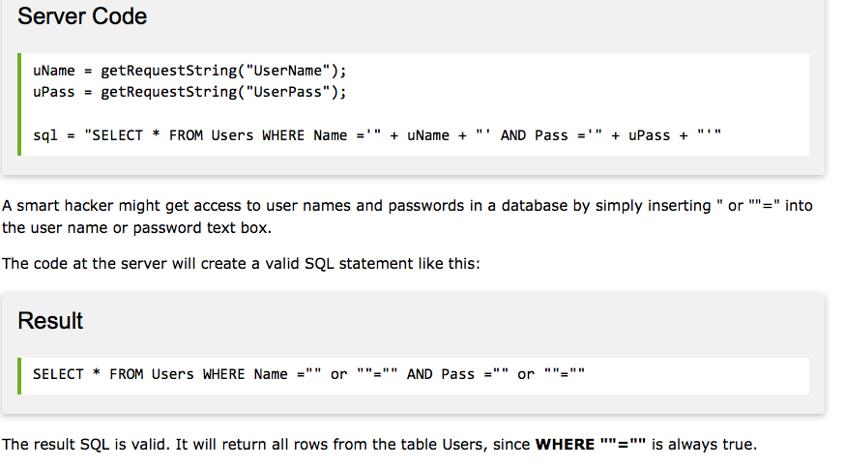
How to Write a Web Application with PHP
SAFE-HANDLING USER INPUT
Common Mistakes
  SQL Injection

Slide 25
How to Write a Web Application with PHP
TECHNIQUES TO MAKE SCRIPTS “SAFE”
Input Validation
  For different kinds of input, you can use different methods. For instance, if you expect a parameter passed with the HTTP GET method to be an integer, force it to be an integer in your script:

Slide 26
How to Write a Web Application with PHP
TECHNIQUES TO MAKE SCRIPTS “SAFE”
Input Validation
  Everything other than an integer value is converted to 0. But, what if $_GET['prod_id'] doesn’t exist? You will receive a notice because we turned the error_level setting up. A better way to validate the input would be

Slide 27
How to Write a Web Application with PHP
TECHNIQUES TO MAKE SCRIPTS “SAFE”
HMAC Verification
If you need to prevent bad guys from tampering with variables passed in the URL (such as for a redirect as shown previously, or for links that pass special parameters to the linked script), you can use a hash, as shown in the following script:

Slide 28
How to Write a Web Application with PHP
TECHNIQUES TO MAKE SCRIPTS “SAFE”
HMAC Verification

Slide 29
How to Write a Web Application with PHP
TECHNIQUES TO MAKE SCRIPTS “SAFE”
Input Filter

Slide 30
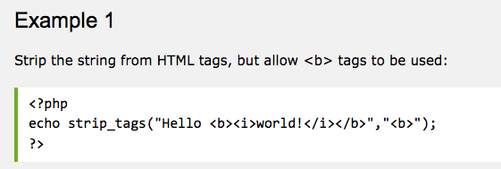
How to Write a Web Application with PHP
TECHNIQUES TO MAKE SCRIPTS “SAFE”
Input Filter
strip_tags(string,allow)

Slide 31
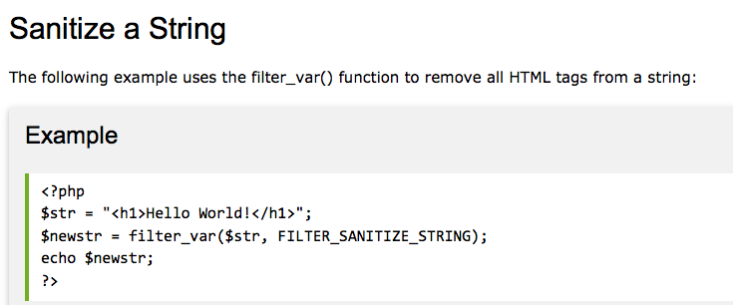
How to Write a Web Application with PHP
TECHNIQUES TO MAKE SCRIPTS “SAFE”
Input Filter

Slide 32
How to Write a Web Application with PHP
TECHNIQUES TO MAKE SCRIPTS “SAFE”
Input Filter
strip_tags(string,allow)

Slide 33
How to Write a Web Application with PHP
TECHNIQUES TO MAKE SCRIPTS “SAFE”
Working with Passwords

Slide 34
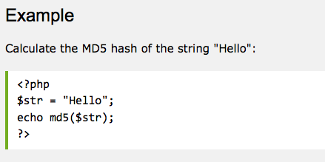
How to Write a Web Application with PHP
TECHNIQUES TO MAKE SCRIPTS “SAFE”
Working with Passwords
Result:
8b1a9953c4611296a827abf8c47804d7

Slide 35
How to Write a Web Application with PHP
COOKIES
The simple registration we used earlier in this chapter does not make data persistent across requests. If you go to the next page (such as by clicking a link or by entering a different URL in your browser’s address bar), the posted data is gone. One simple way to maintain data between the different pages in a web application is with cookies. Cookies are sent by PHP through the web server with the setcookie() function and are stored in the browser. If a time-out is set for the cookie, the browser will even remember the cookie when you reset your computer; without the time-out set, the browser forgets the cookie as soon as the browser closes. You can also set a cookie to be valid only for a specific subdomain, rather than having the cookie sent by the browser to the script whenever the domain of the script is the same as the domain where the cookie was set (the default).

Slide 36
How to Write a Web Application with PHP
COOKIES

Slide 37
How to Write a Web Application with PHP
COOKIES

Slide 38
How to Write a Web Application with PHP
COOKIES

Slide 39
How to Write a Web Application with PHP
COOKIES

Slide 40
How to Write a Web Application with PHP
COOKIES

Slide 41
How to Write a Web Application with PHP
SESSIONS

Slide 42
How to Write a Web Application with PHP
SESSIONS

Slide 43
How to Write a Web Application with PHP
SESSIONS

Slide 44
How to Write a Web Application with PHP
SESSIONS

Slide 45
IT230 – Week 13
Thanks,

