Slide 1

Web Technologies
IT230
Dr Mohamed Habib

Slide 2
Objectives
Write PHP code to perform a specific task.
Resolve problems in a PHP program.
Write PHP functions to perform specific tasks.
Chapter 2: PHP 5 Basic Language
Chapter 3: PHP 5 OO Language

Slide 3
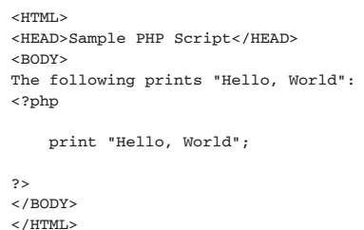
PHP 5 Basic Language
HTML EMBEDDING

Slide 4
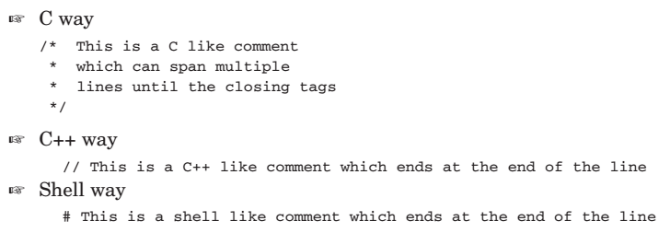
PHP 5 Basic Language
Comments

Slide 5
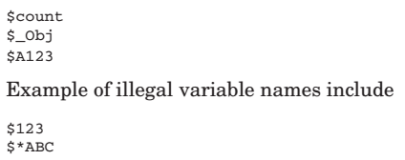

PHP 5 Basic Language
Variables

Slide 6

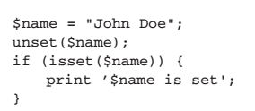
PHP 5 Basic Language
Managing Variables

Slide 7

PHP 5 Basic Language
Managing Variables

Slide 8
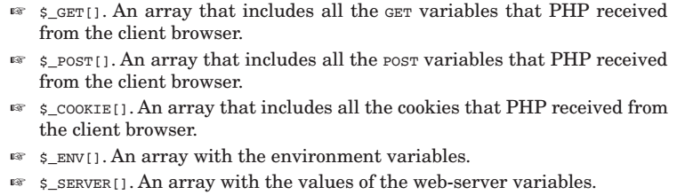
PHP 5 Basic Language
SuperGlobals

Slide 9
PHP 5 Basic Language
Basic Data Types
  Integer
  Floating Point
  Strings
  Booleans
  Null

Slide 10
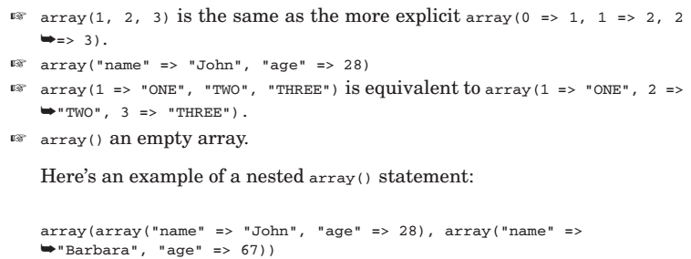
PHP 5 Basic Language
Arrays

Slide 11
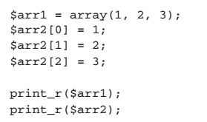
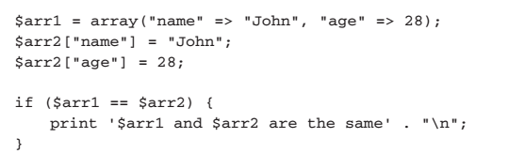
PHP 5 Basic Language

Slide 12

PHP 5 Basic Language
Reading array values

Slide 13
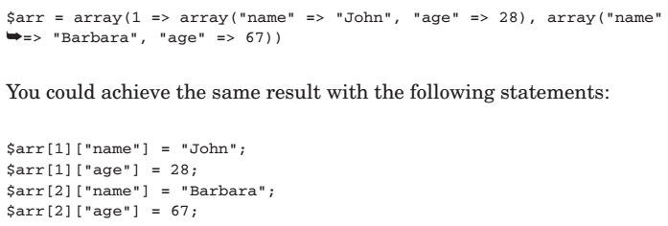
PHP 5 Basic Language
Accessing Nested Arrays

Slide 14
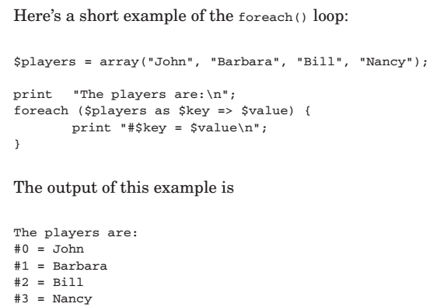
PHP 5 Basic Language
Traversing Arrays Using foreach

Slide 15
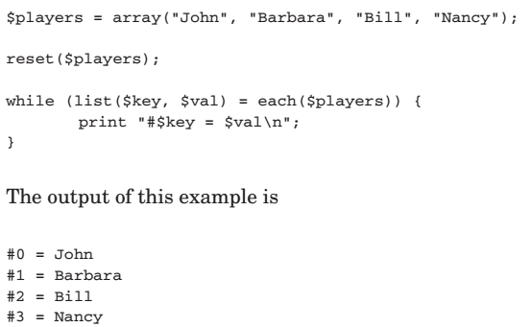
PHP 5 Basic Language
Traversing Arrays Using list() and each()

Slide 16
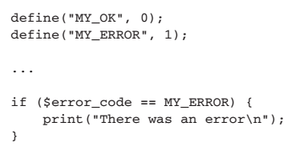
PHP 5 Basic Language
Constants

Slide 17
PHP 5 Basic Language
Operators
  Numerical Operators
  Assignment Operators
  Comparison Operators
  Logical Operators
  Bitwise Operators
  Negation Operators
  Increment/Decrement Operators
  The Cast Operators
  The Silence Operator

Slide 18
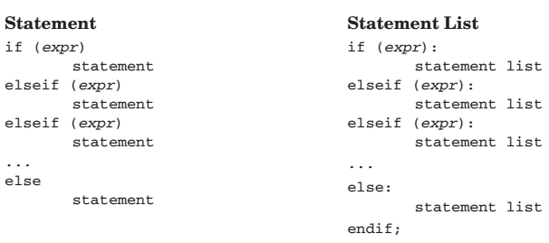
PHP 5 Basic Language
CONTROL STRUCTURES

Slide 19
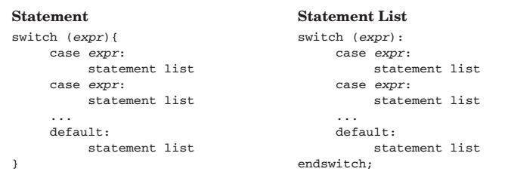
PHP 5 Basic Language
CONTROL STRUCTURES

Slide 20
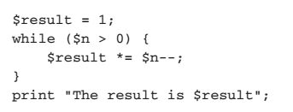

PHP 5 Basic Language
Loop Control Structures

Slide 21
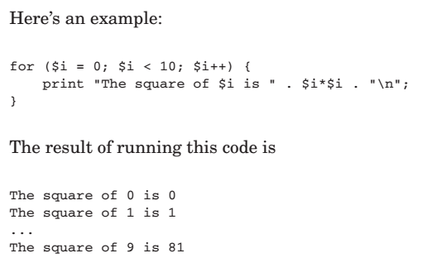
PHP 5 Basic Language
Loop Control Structures

Slide 22

PHP 5 Basic Language
Code Inclusion Control Structures

Slide 23

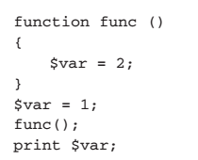
PHP 5 Basic Language
FUNCTIONS

Slide 24
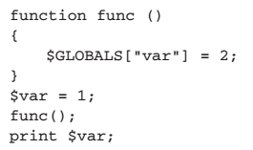
PHP 5 Basic Language
FUNCTIONS

Slide 25
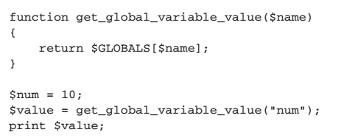
PHP 5 Basic Language

Slide 26
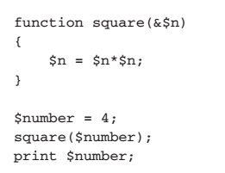
PHP 5 Basic Language
Declaring Function Parameters
  By-Value Parameters
  By-Reference Parameters

Slide 27
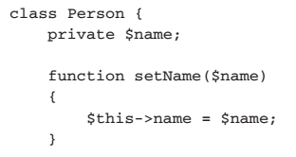
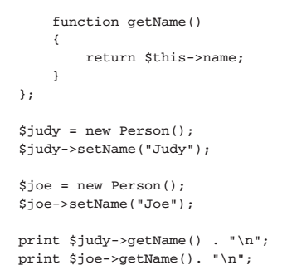
PHP 5 OO Language
Write a Class

Slide 28
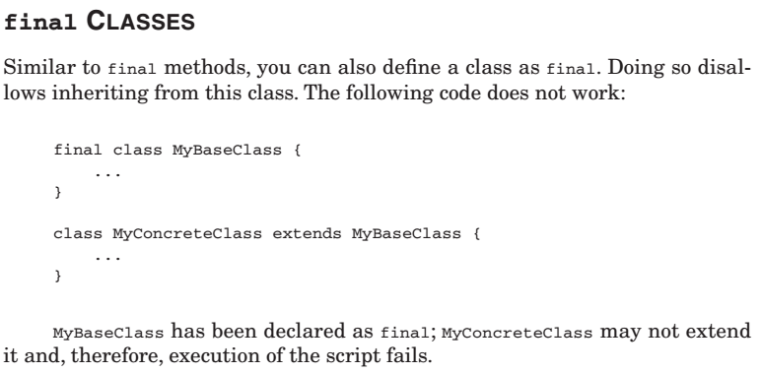
PHP 5 OO Language

Slide 29
IT230 – Week 12
Thanks,

