Slide 1

Web Technologies
PHP 5 Basic Language

Slide 2
Objectives
Write PHP code to perform a specific task.
Resolve problems in a PHP program.
Write PHP functions to perform specific tasks.
Chapter 2: PHP 5 Basic Language
Chapter 3: PHP 5 OO Language

Slide 3
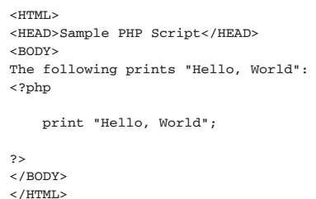
PHP 5 Basic Language
HTML EMBEDDING

Slide 4
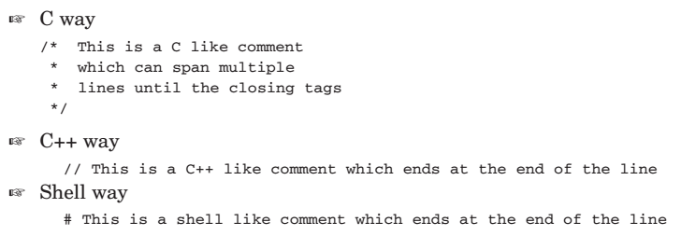
PHP 5 Basic Language
Comments

Slide 5
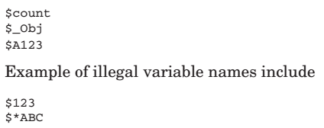

PHP 5 Basic Language
Variables
Variable names always begin with a dollar sign ($) and are case-sensitive

Slide 6

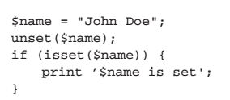
PHP 5 Basic Language
Managing Variables
Isset() — Determine if a variable is set and is not NULL
Unset() — Unset a given variable

Slide 7

PHP 5 Basic Language
empty() — Determine whether a variable is empty
isset() - returns true only when the variable is not null.
empty() - returns true if the variable is an empty string, false, array(), NULL, “0?, 0, and an unset variable.

Slide 8
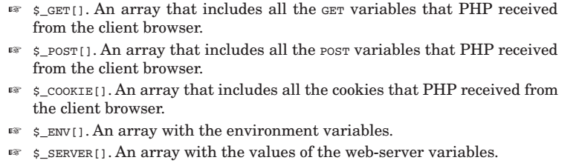
PHP 5 Basic Language
SuperGlobals

Slide 9
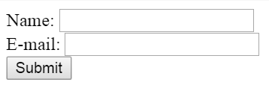
Example
<html>
<body>
<form action="welcome.php" method="post">
Name: <input type="text" name="name"><br>
E-mail: <input type="text" name="email"><br>
<input type="submit">
</form>
</body>
</html>

Slide 10
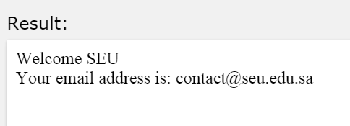
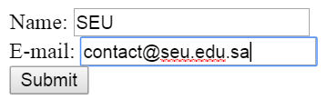
Example
<html>
<body>
Welcome <?php echo $_POST["name"]; ?><br>
Your email address is: <?php echo $_POST["email"]; ?>
</body>
</html>

Slide 11
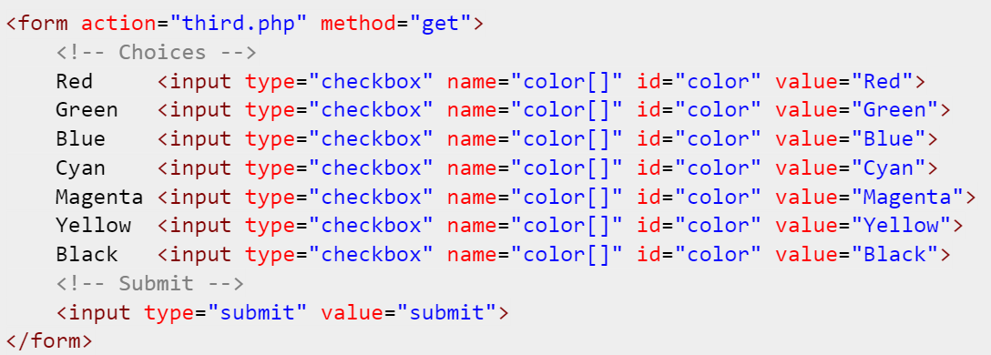
Example

Slide 12
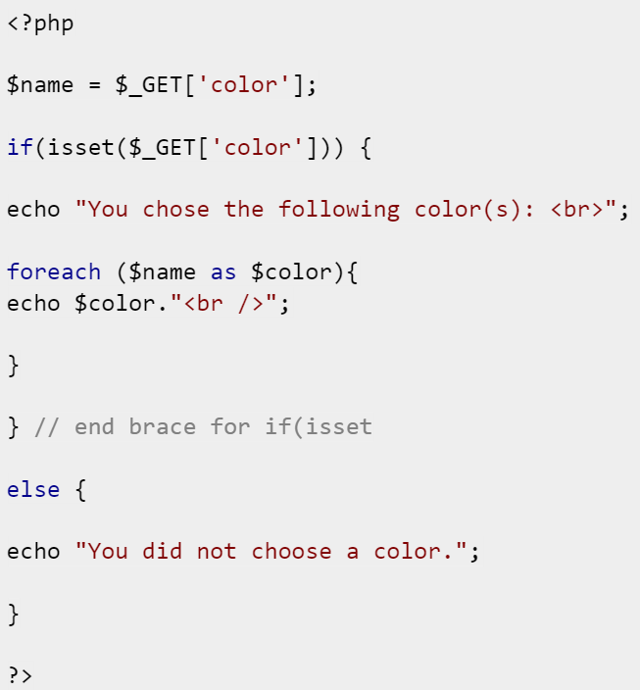

Slide 13
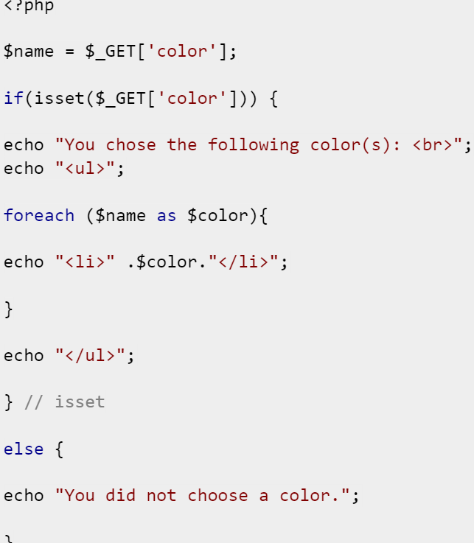

Slide 14
PHP 5 Basic Language
Basic Data Types
  Integer
  Floating Point Numbers
  Strings
  Booleans
  Null

Slide 15
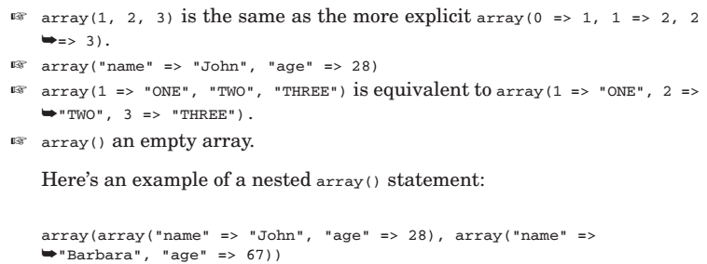
PHP 5 Basic Language
Arrays
The array() construct creates an array

Slide 16
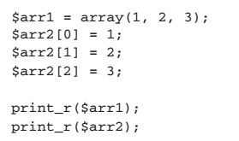
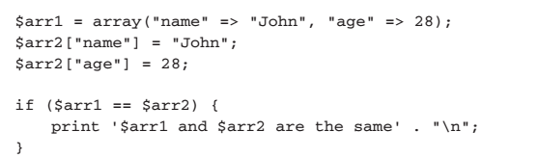
PHP 5 Basic Language
We can identify by position (a number beginning from zero) or some identify name

Slide 17

PHP 5 Basic Language
Reading array values

Slide 18
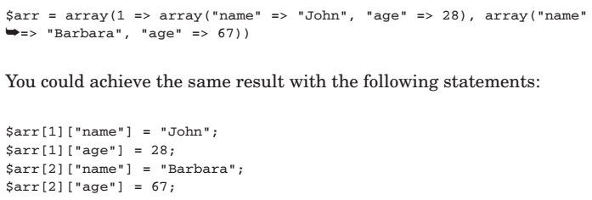
PHP 5 Basic Language
Accessing Nested Arrays

Slide 19
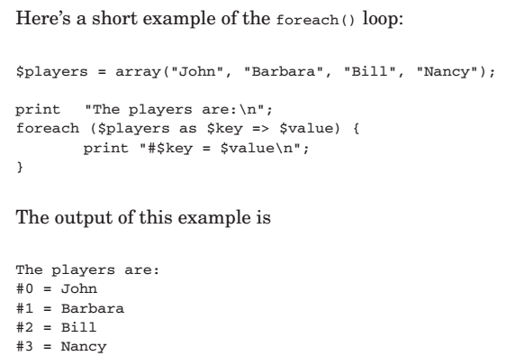
PHP 5 Basic Language
Traversing Arrays Using foreach()

Slide 20
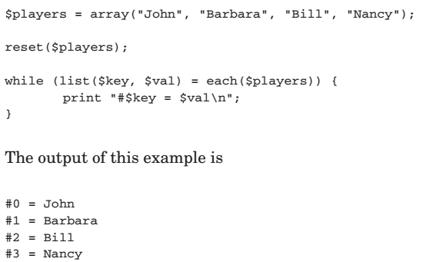
PHP 5 Basic Language
Traversing Arrays Using list() and each()

Slide 21
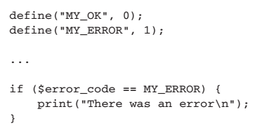
PHP 5 Basic Language
Constants
once set, the value of a constant cannot change. They are set using the define() function.

Slide 22
PHP 5 Basic Language
Operators
  Numerical Operators
  Assignment Operators
  Comparison Operators
  Logical Operators
  Bitwise Operators
  Negation Operators
  Increment/Decrement Operators
  The Cast Operators
  The Silence Operator

Slide 23
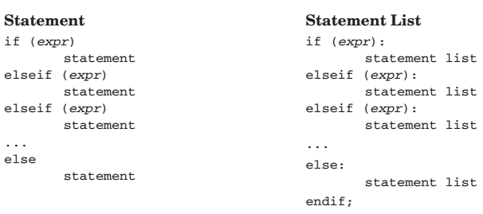
PHP 5 Basic Language
CONTROL STRUCTURES

Slide 24
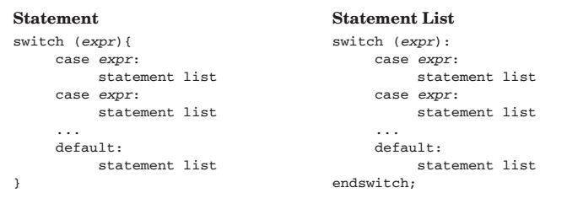
PHP 5 Basic Language
CONTROL STRUCTURES

Slide 25
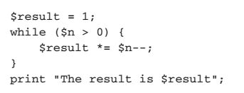

PHP 5 Basic Language
Loop Control Structures

Slide 26
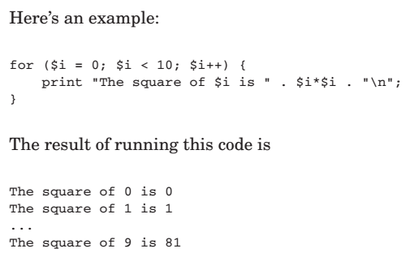
PHP 5 Basic Language
Loop Control Structures

Slide 27

PHP 5 Basic Language
Code Inclusion Control Structures

Slide 28

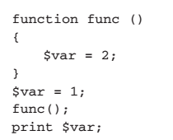
PHP 5 Basic Language
FUNCTIONS

Slide 29
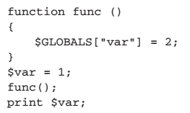
PHP 5 Basic Language
FUNCTIONS

Slide 30
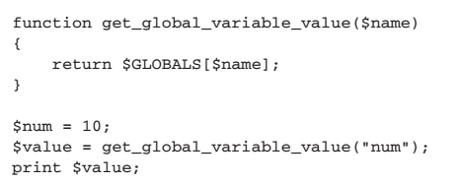
PHP 5 Basic Language
Returning Values By Reference

Slide 31
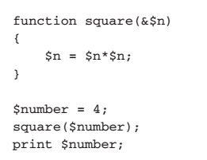
PHP 5 Basic Language
Declaring Function Parameters
  By-Value Parameters
  By-Reference Parameters

Slide 32
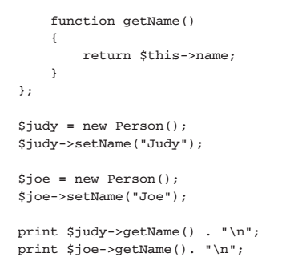
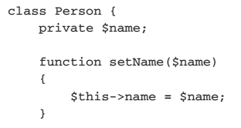
PHP 5 OO Language
Write a Class

Slide 33
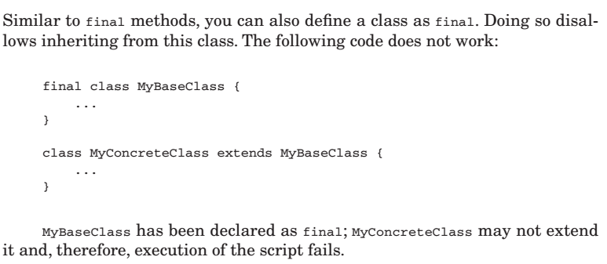
PHP 5 OO Language
final Classes

Slide 34
IT230 – Week 12
Thanks,

