Slide 1
Chapter 5 Host Objects: Browsers and the DOM
WEB TECHNOLOGIES
A COMPUTER SCIENCE PERSPECTIVE JEFFREY C. JACKSON
Allows us to manipulate the elements, attributes, and text on a page.

Slide 2
Overview
The Document Object Model (DOM) is an API that allows programs to interact with HTML (or XML) documents
In typical browsers, the JavaScript version of the API is provided via the document host object
W3C recommendations define standard DOM
Several other browser host objects are informal, de facto standards
alert, prompt are examples
Many others are covered in this chapter

Slide 3
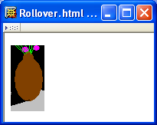
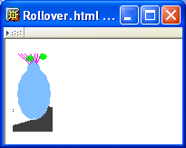
DOM Introduction
Example: “Rollover” effect
Cursor not over image
Image changes when cursor
moves over

Slide 4
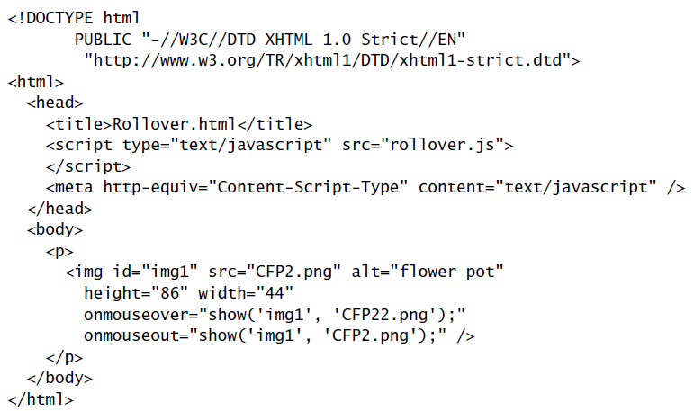
DOM Introduction
Import JavaScript
code
Default language for scripts specified as attribute values
Calls to JavaScript
show() function when
mouse moves over/away
from image
Notice that id of image is first argument to show()

Slide 5
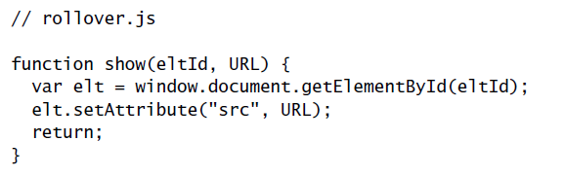
DOM Introduction
DOM method returning Object
Method inherited by Element instances
for setting value of an attribute

Slide 6
DOM Introduction
Effect: src attribute of HTML element with
specified eltId is changed to specified URL

Slide 7
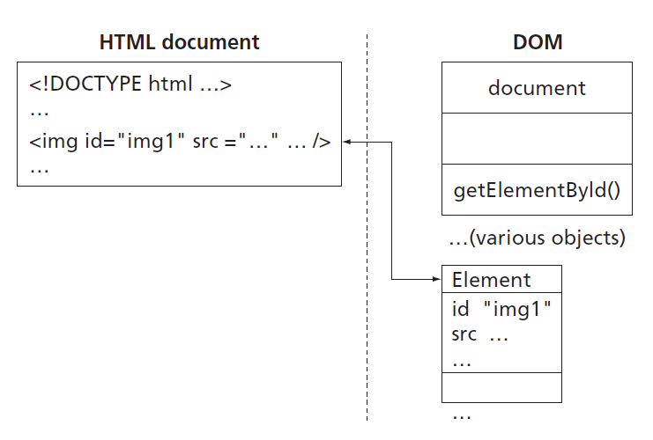
DOM Introduction
Returns instance
of Element
(DOM-defined
host object)
representing
HTML element
with given id
Some properties of
Element instance
correspond
to attributes of
HTML element

Slide 8
DOM Introduction
Image src changed to
CFP22.png when mouse
is over image,
CFP2.png when leaves

Slide 9
Intrinsic Event Handling
An event is an occurrence of something potentially interesting to a script:
Ex: mouseover and mouseout events
An HTML intrinsic event attribute is used to specify a script to be called when an event occurs
Ex: onmouseover
Name of attribute is on followed by event name

Slide 10
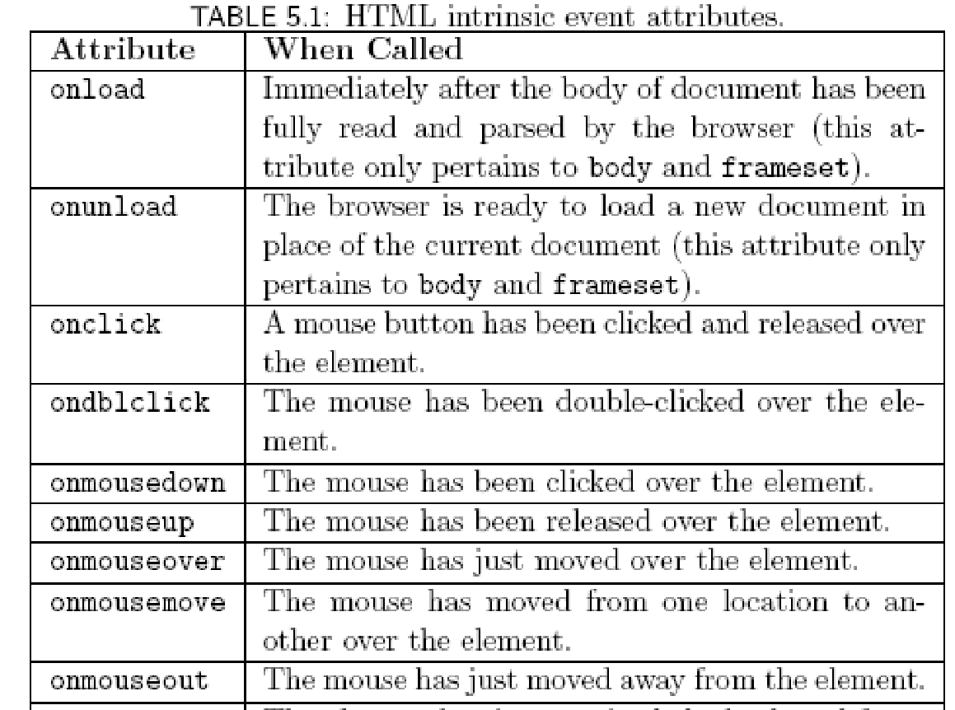
Intrinsic Event Handling

Slide 11
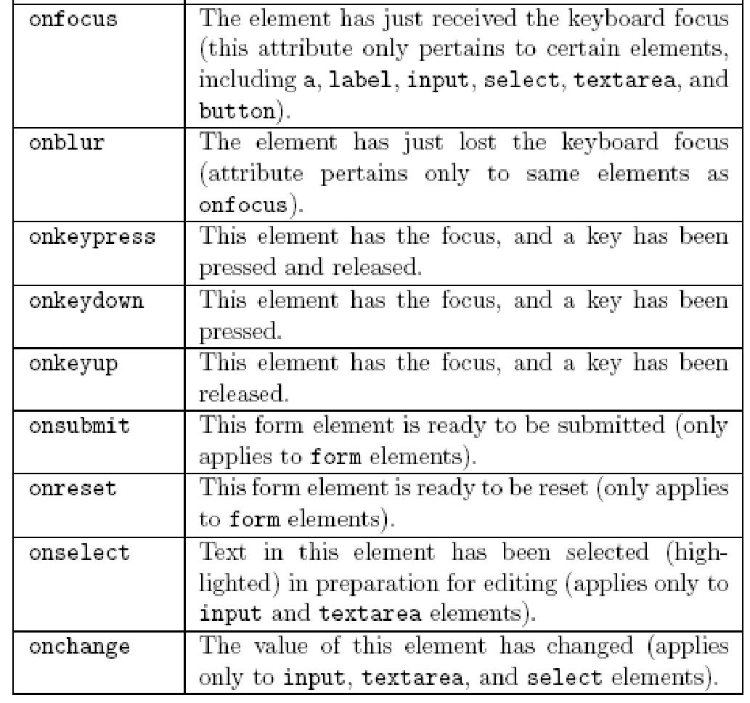
Intrinsic Event Handling

Slide 12
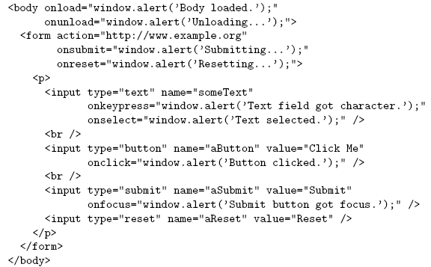
Intrinsic Event Handling

Slide 13
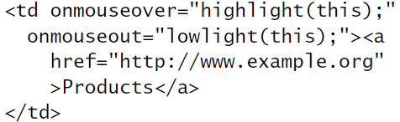
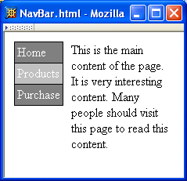
Modifying Element Style
Like rollover, style needs to be modified both when entering and exiting the element.
Change
background color
of element
containing cursor

Slide 14
Modifying Element Style
Reference to Element instance
representing the td element

Slide 15
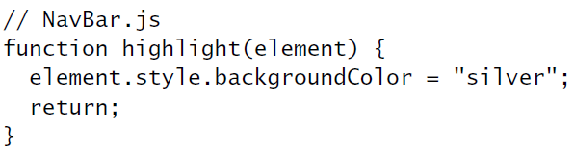
Modifying Element Style
Reference to Element instance
All Element instances have a style property
with an Object value

Slide 16
Modifying Element Style
Properties of style object correspond to CSS style properties of the corresponding HTML element.
Net effect: “silver” becomes the specified value for CSS background-color property of td element;
browser immediately modifies the window.

Slide 17
Modifying Element Style
Rules for forming style property names from names of CSS style properties:
If the CSS property name contains no hyphens, then the style object’s property name is the same
Ex: color color
Otherwise, all hyphens are removed and the letters that immediately followed hyphens are capitalized
Ex: background-color backgroundColor

Slide 18
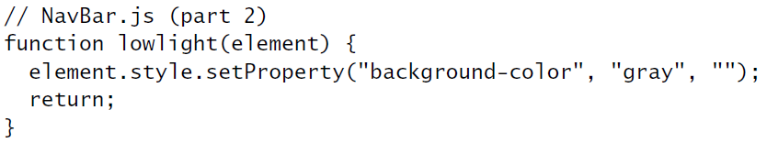
Modifying Element Style
Alternate syntax (not supported in IE6):
Every DOM2-compliant style object
has a setProperty() method

Slide 19
Modifying Element Style
Alternate syntax (not supported in IE6):
CSS property
value
CSS property
name
(unmodified)
Empty string
or
“important”

Slide 20
Modifying Element Style
Obtaining specified CSS property value:
Alternate DOM2 syntax (not supported by IE6):

Slide 21
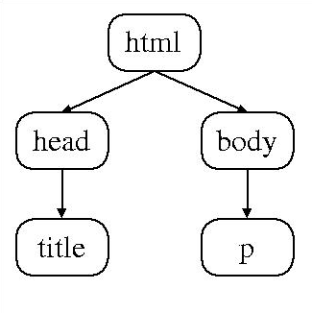
Document Tree
Recall that HTML document elements form a tree structure, e.g.,
DOM allows scripts to access and modify the document tree

Slide 22
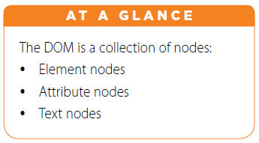
Document Tree: Node
There are many types of
nodes in the DOM document
tree, representing:
elements
text
comments
the document type declaration, etc.
Every Object in the DOM document tree has properties and methods defined by the Node host object

Slide 23
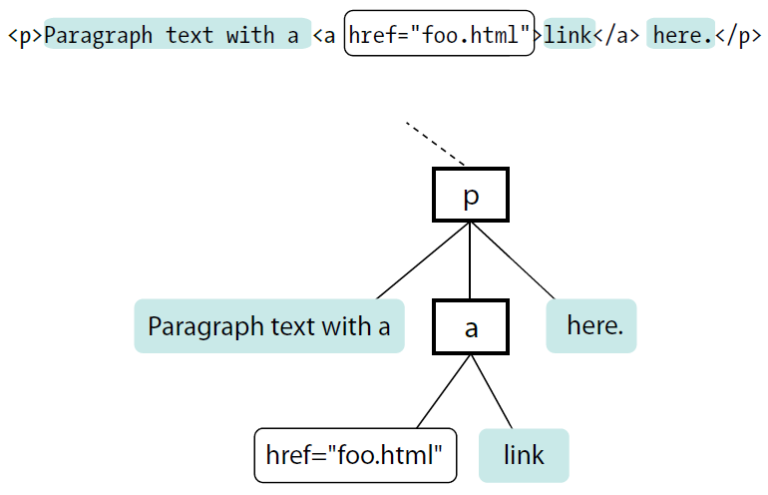
Document Tree: Node

Slide 24
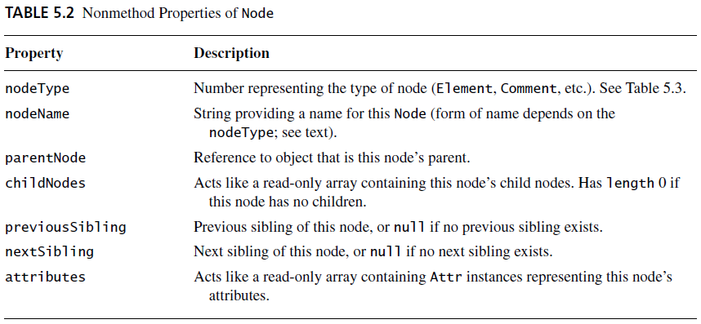
Document Tree: Node

Slide 25
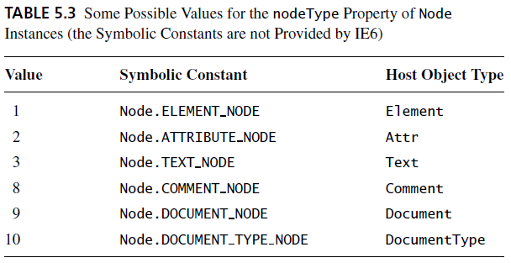
Document Tree: Node

Slide 26
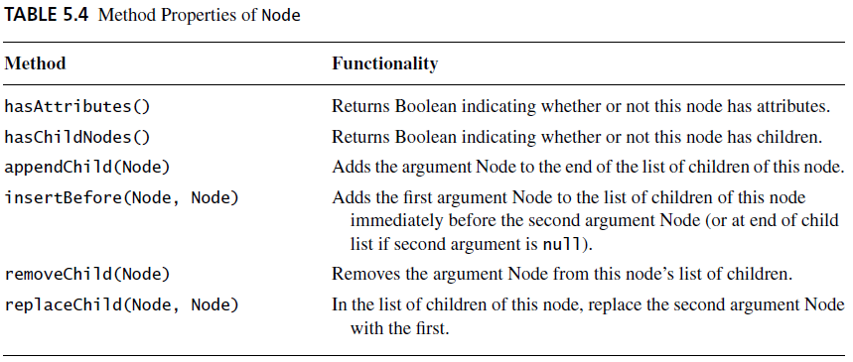
Document Tree: Node

Slide 27
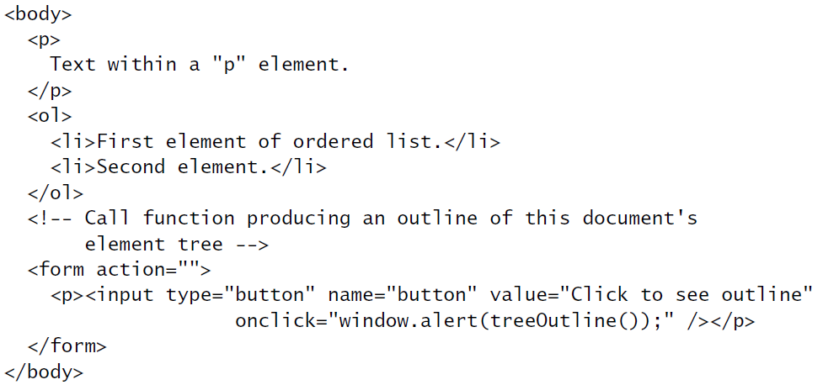
Document Tree: Node
Function we will write that will
use Node methods and properties
to produce string representing
Element tree

Slide 28
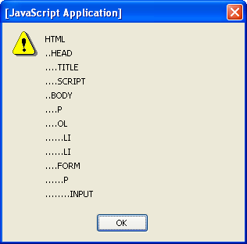
Document Tree: Node
String produced by TreeOutline():

Slide 29
Document Tree: HTML Properties
Attribute values can be set two ways:
As with CSS properties, former has some advantages:
Makes clear that setting an HTML attribute, not merely a property of an object
Avoids certain special cases, e.g. element.setAttribute(“class”, “warning”); //DOM element.className = “warning”; //req’d in IE6
element.setAttribute("id", "element3");
element.id = "element3";
class is reserved word in JavaScript

Slide 30
DOM Event Handling
Note: IE6 has a different event model
Event instance created for each event
Event instance properties:
type: name of event (click, mouseover, etc.)
target: Node corresponding to document element that generated the event (e.g., button element for click, img for mouseover). This is the event target.

Slide 31
DOM Event Handling
JavaScript event listener: function that is called with Event instance when a certain event occurs
An event listener is associated with a target element by calling addEventListener() on the element

Slide 32
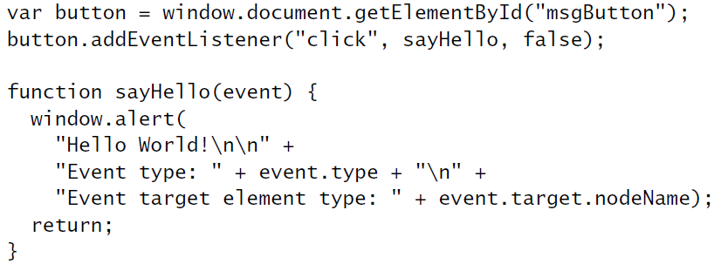
DOM Event Handling
Event
target
Event type
Event handler
Definition
of event
handler

Slide 33
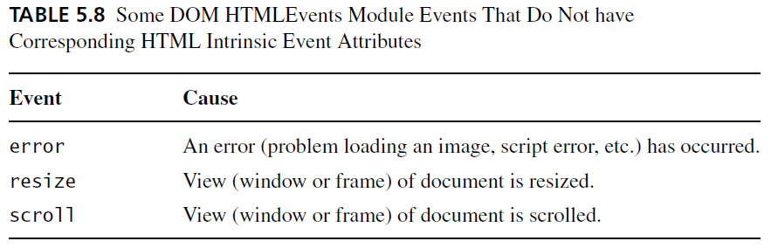
DOM Event Handling
DOM event types:
All HTML intrinsic events except keypress, keydown, keyup, and dblclick
Also has some others that are typically targeted at the window object:

Slide 34
DOM Event Handling
Normally false (more later)
Event instance
Definition
of event
handler

Slide 35
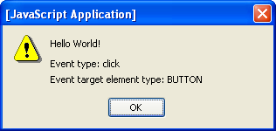
DOM Event Handling

Slide 36
DOM Event Handling: Mouse Events
DOM2 mouse events:
click
mousedown
mouseup
mousemove
mouseover
mouseout
Event instances have additional properties for mouse events

Slide 37
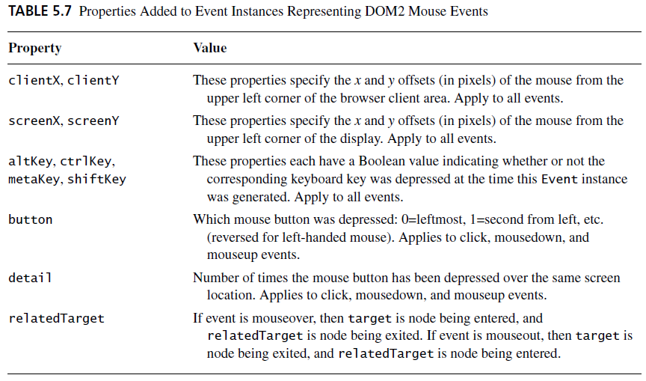
DOM Event Handling: Mouse Events

Slide 38
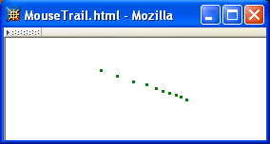
DOM Event Handling: Mouse Events
Example: mouse “trail”

Slide 39

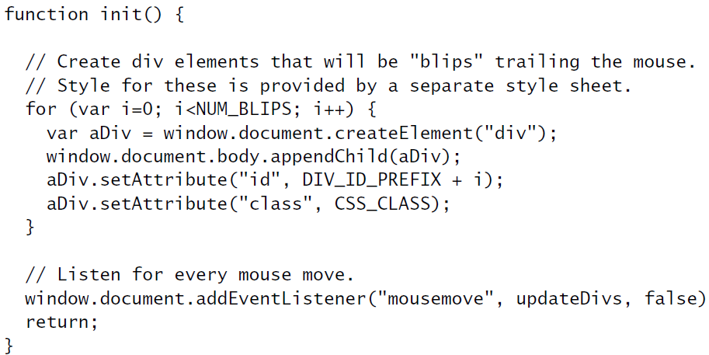
DOM Event Handling: Mouse Events
HTML document:
JavaScript init() function:
Create
“blips”
String uniquely
identifying this div
Add event listener

Slide 40
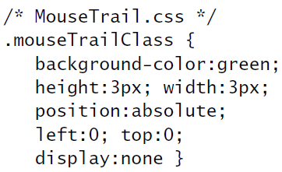
DOM Event Handling: Mouse Events
Style sheet for “blips”:
Initially, not displayed

Slide 41
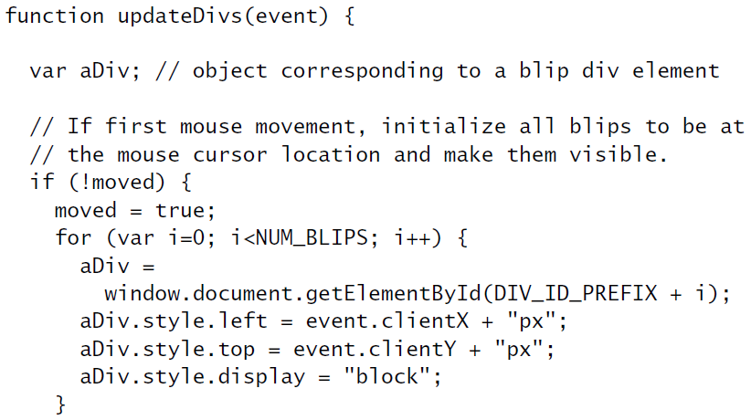
DOM Event Handling: Mouse Events
Event handler updateDivs():
Convert mouse location
from Number to String
and append units

Slide 42
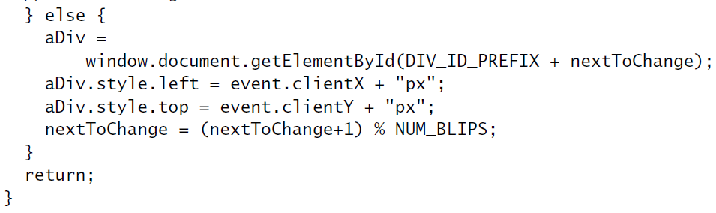
DOM Event Handling: Mouse Events
Event handler updateDivs():
Mod (remainder) operator
used to cycle through “blip” divs
(least-recently changed is the
next div moved)

Slide 43
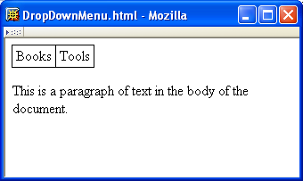
Example: Drop-down Menus
When cursor
moves over
upper menu
…

Slide 44
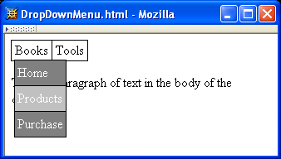
Example: Drop-down Menus
…
a drop-down
appears

Slide 45
Example: Drop-down Menus
Background color changes as cursor moves over drop-down items

Slide 46
Example: Drop-down Menus
Drop-down
disappears
when cursor
leaves both
drop-down
and menu

Slide 47
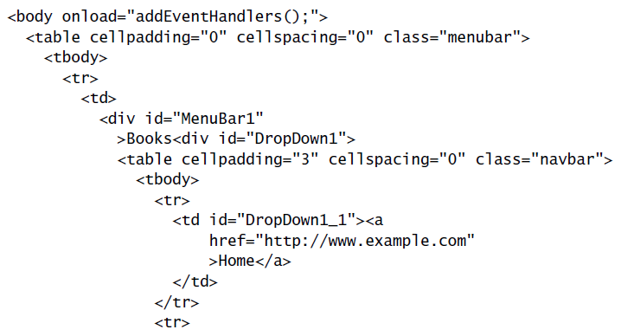
Example: Drop-down Menus
Document structure:
Event handlers will be added by
JavaScript code
Top menu
is a table
CSS:
Each top
menu item is
a (positioned)
div

Slide 48
Example: Drop-down Menus
Document structure:
CSS:
Associated
drop-down is
in a div
that is
out of the normal
flow and initially
invisible
Associated drop-down is
a table

Slide 49
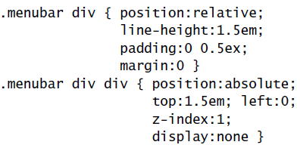
Example: Drop-down Menus
Top menu item div
is “positioned” but
not moved from normal
flow location
Full style rules:
Upper left corner of
drop-down div overlaps
bottom border of top
menu
Drop-down drawn over
lower z-index elements

Slide 50


Example: Drop-down Menus
Adding event handlers to top menu:
Document:
JavaScript addEventHandlers():
Target
event
handlers
menuBar1 will be target of events; adding reference to the drop-down
div makes it easy for event handler to access the drop-down

Slide 51
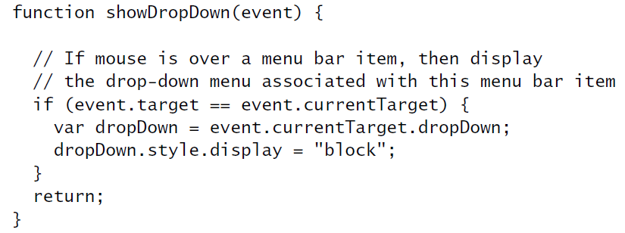
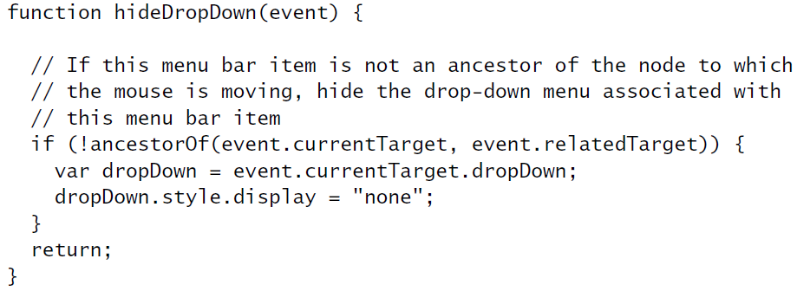
Example: Drop-down Menus
Ignore bubbling mouseover
events from drop-down
Basic
processing:
change
visibility of
drop-down
Ignore mouseout event if cursor is remaining
over menu item or drop-down (self or descendant)

Slide 52
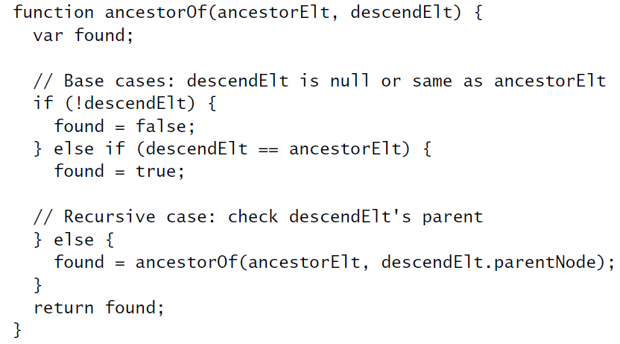
Example: Drop-down Menus

Slide 53
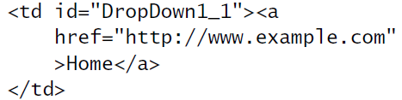

Example: Drop-down Menus
Adding event handlers to drop-down:
Document:
JavaScript addEventListener():

Slide 54
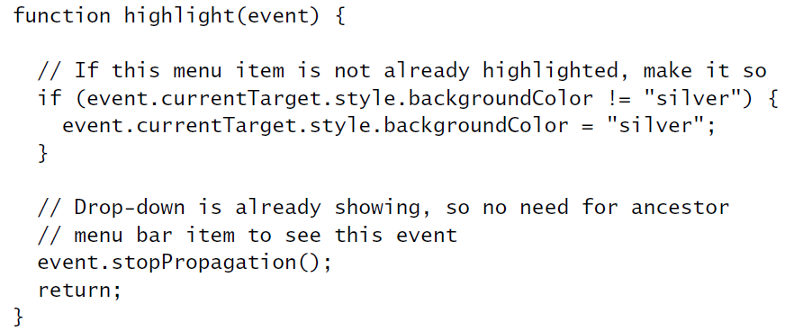
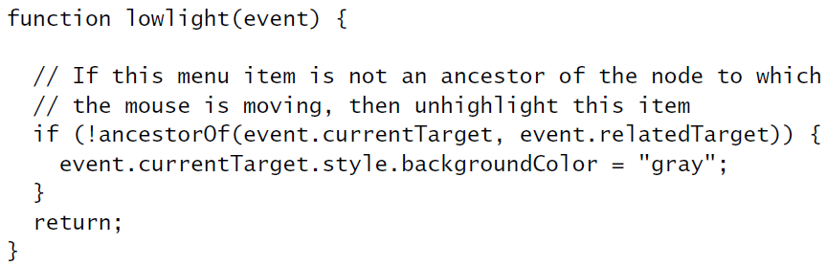
Example: Drop-down Menus
Don’t
bother
changing
style if
this event
bubbled
from a
descendant.
Don’t bubble up to showDropDown since
the drop-down must be visible
Ignore
mouseout to
a descendant

Slide 55
DOM Event Cancellation
Browser provides default event listener for certain elements and events
Ex: click on hyperlink
Ex: click on submit button
Default listeners are called after all user-specified listeners
stopPropagation() does not affect default listeners
Instead, call preventDefault() on Event instance to cancel default event handling

Slide 56
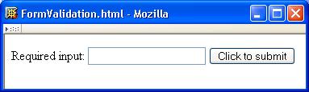
DOM Form Validation
<body onload="addListeners();">
<form id="validatedForm" action="http://www.example.com">
<p>
<label>Required input:
<input type="text" name="requiredField" id="requiredField" />
</label>
<input type="submit" name="submit" value="Click to submit" />
</p>
</form>
</body>

Slide 57
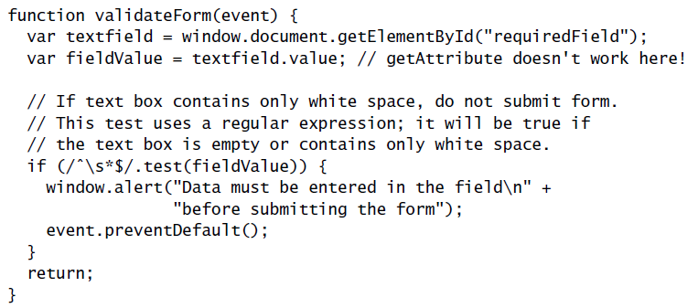
DOM Form Validation
Listen for form to be submitted
Must use value property to access
value entered in text field on form

Slide 58
DOM Form Validation
Regular expression literal representing
“set of strings consisting only of white space”
Cancel browser’s default submit event processing

Slide 59
DOM Event Generation
Several Element’s provide methods for generating events
Ex: causes text in text field to be selected and a select event to occur

Slide 60
Detecting Host Objects
How can a JavaScript program test for the existence of a certain host object?
Does the style element have a setProperty() method?
If we’re also not sure that element is defined or that style exists:

Slide 61
Detecting Host Objects
Is a browser DOM-compliant?
Ex: document.implementation(“Core”, “2.0”) returns true if browser implements all of DOM 2 Core module, false otherwise
Problem: what does false tell you?
Many scripts attempt to directly determine the browser, but…
What about new browsers?
Some browsers can “lie” about what they are

Slide 62
Other Common Host Objects
Browsers also provide many non-DOM host objects as properties of window
While no formal standard defines these objects, many host objects are very similar in IE6 and Mozilla

