Slide 1
Chapter 3 Style Sheets: CSS
WEB TECHNOLOGIES
A COMPUTER SCIENCE PERSPECTIVE JEFFREY C. JACKSON

Slide 2
Motivation
HTML markup can be used to represent
Semantics: h1 means that an element is a top-level heading
Presentation: h1 elements look a certain way
It’s advisable to separate semantics from presentation because:
It’s easier to present documents on multiple platforms (browser, cell phone, spoken, …)
It’s easier to generate documents with consistent look
Semantic and presentation changes can be made independently of one another (division of labor)
User control of presentation is facilitated

Slide 3
Style Sheet Languages
Cascading Style Sheets (CSS)
Applies to (X)HTML as well as XML documents in general
Focus of this chapter
Extensible Stylesheet Language (XSL)
Often used to transform one XML document to another form, but can also add style
XSL Transformations covered in later chapter

Slide 4
How Style Sheet Work?
Start with a document that has been marked up in HTML or XHTML.
Write style rules for how you’d like certain elements to look.
Attach the style rules to the document. When the browser displays the document, it follows your rules for rendering elements

Slide 5
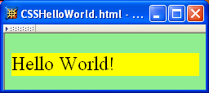
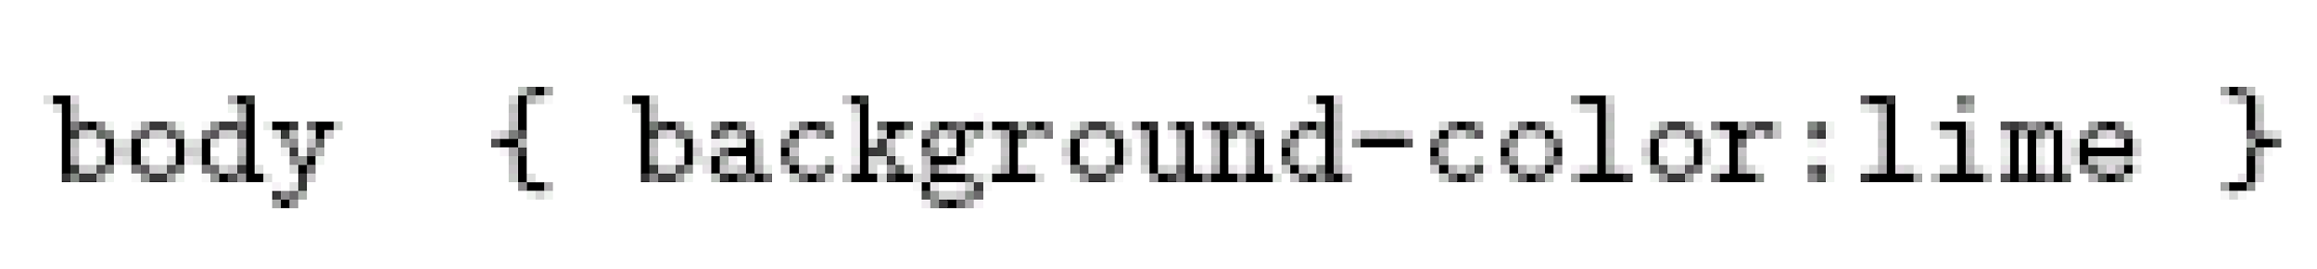
CSS Introduction
A styled HTML document produced by the style sheet style1.css:

Slide 6
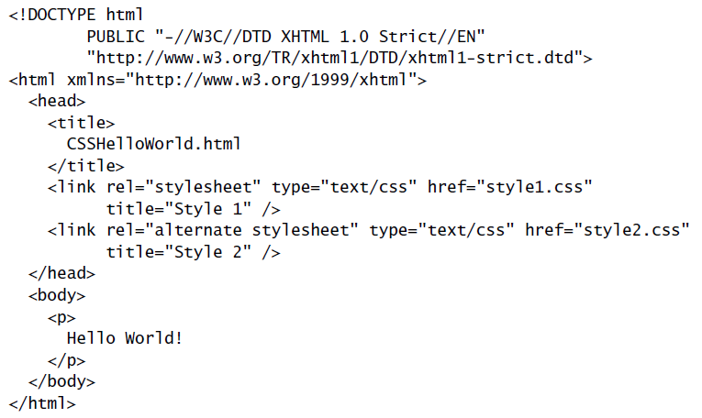
CSS Introduction
link element associates style sheet with doc.
type attribute specifies style language used
href attribute provides style sheet URL
title attribute provides style sheet name

Slide 7
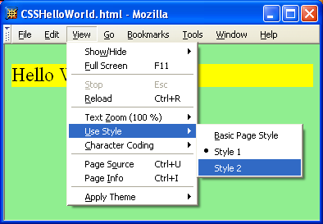
CSS Introduction

Slide 8
CSS Introduction
Alternative, user selectable style sheets
can be specified

Slide 9
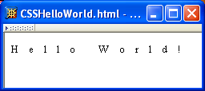
CSS Introduction
A styled HTML document produced by the style sheet style2.css:

Slide 10
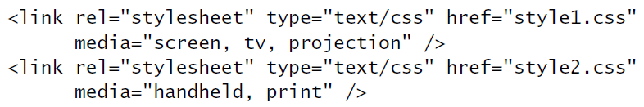
CSS Introduction
Single document can be displayed on multiple media platforms by tailoring style sheets: This document will be printed differently than it is displayed.

Slide 11
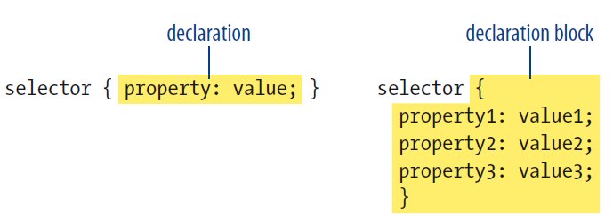
CSS Syntax

Slide 12
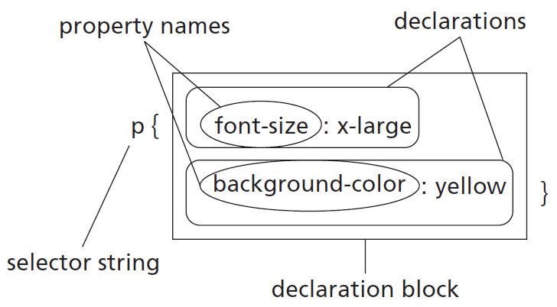
CSS Syntax
Parts of a style rule (or statement)

Slide 13

CSS Syntax: Selector Strings
Single element type:
Multiple element types:
All element types:
Specific elements by id:
type selector
universal selector
ID selector

Slide 14
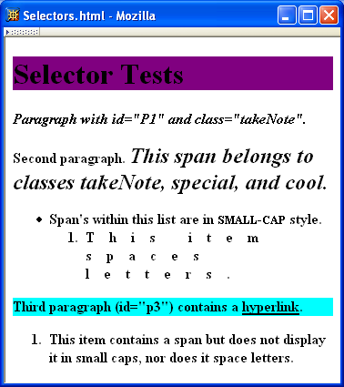

CSS Syntax: Selector Strings

Slide 15
CSS Syntax: Selector Strings
Elements belonging to a style class:
Referencing a style class in HTML:
Elements of a certain type and class:
class selector
this span belongs to three style classes
this rule applies only to span’s belonging to class special

Slide 16
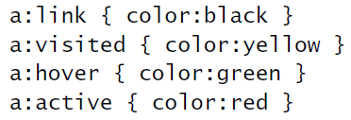
CSS Syntax: Selector Strings
Source anchor elements:
Element types that are descendents:
pseudo-classes
rule applies to li element
that is part of the content of an ol element
that is part of the content of a ul element

Slide 17
CSS Syntax
Style rules covered thus far follow ruleset syntax
At-rule is a second type of rule
Reads style rules from specified URL
Must appear at beginning of style sheet
URL relative to style sheet URL

Slide 18
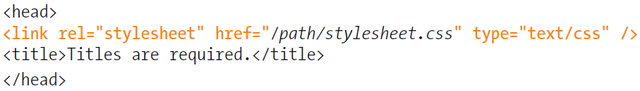
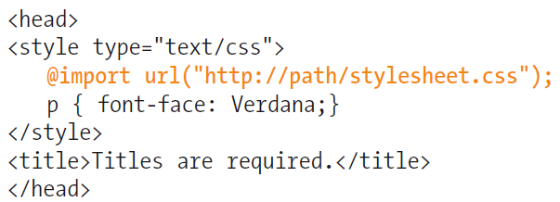
Style Sheets and HTML: Attaching the styles to the document
External style sheets: There are two ways to refer to an external style sheet from within the XHTML document:
The link element
The @import rule.

Slide 19
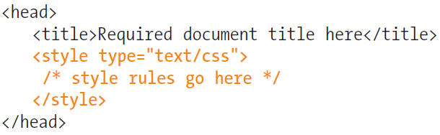
Style Sheets and HTML: Attaching the styles to the document
Embedded style sheets: It is placed in a document using the style element and its rules apply only to that document.
Inline styles: You can apply properties and values to a single element using the style attribute in the element itself

Slide 20


CSS Rule Cascade
What if more than one style declaration applies to a property of an element?
The CSS rule cascade determines which style rule’s declaration applies

Slide 21
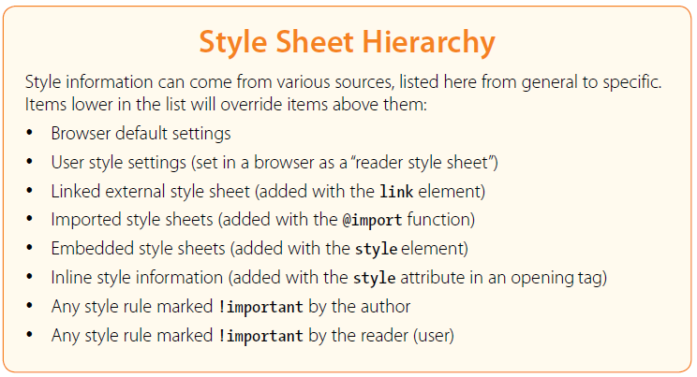
CSS Rule Cascade

Slide 22
CSS Rule Cascade
User can define a style sheet
Explicitly (easy in IE)
Implicitly (preferences)
User/important highest priority in CSS2 to accommodate users with special needs
Rules made important by adding “!important”:
p {color: blue !important;}

Slide 23
CSS Rule Cascade
Select style sheets and insert rules for HTML attributes
Prioritize declarations by origin and weight
Break ties based on specificity (style attribute or most specific selector)
Break ties based on position within style sheet (last occurring wins)
Alternative Style Sheets
Specificity:
style attribute
rule with selector:
ID
class/pseudo-class
descendant/element type
universal
HTML attribute

Slide 24
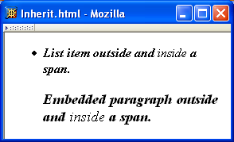
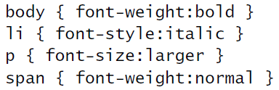
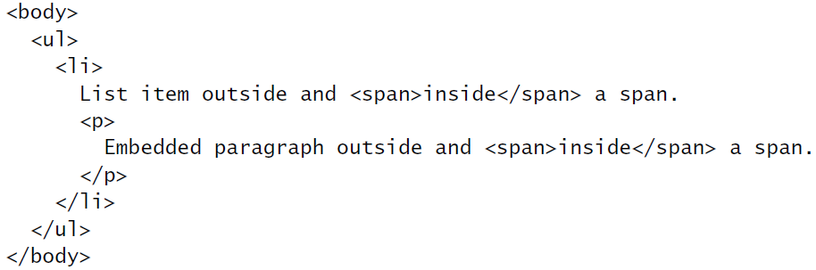
CSS Inheritance

Slide 25
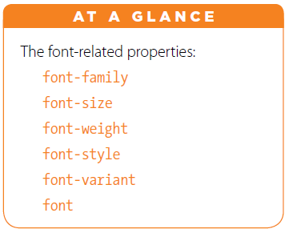
CSS Font Properties

Slide 26
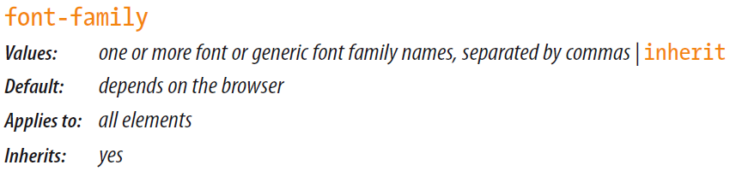

CSS Font Properties: Font Family
A font family is a collection of related fonts (typically differ in size, weight, etc.)
Example:
1st choice
2nd choice
generic

Slide 27
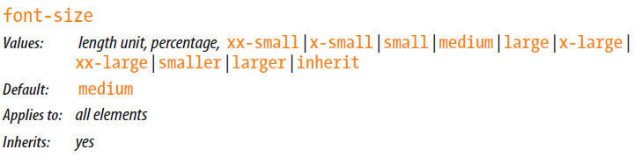
CSS Font Properties: Font size
Many properties, such as font-size, have a value that is a CSS length
All CSS length values except 0 need units

Slide 28
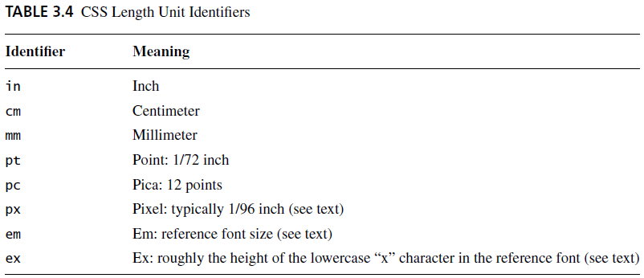
CSS Font Properties: Font size

Slide 29
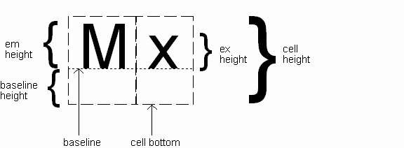
CSS Font Properties: Font size
Computed value
of font-size property

Slide 30
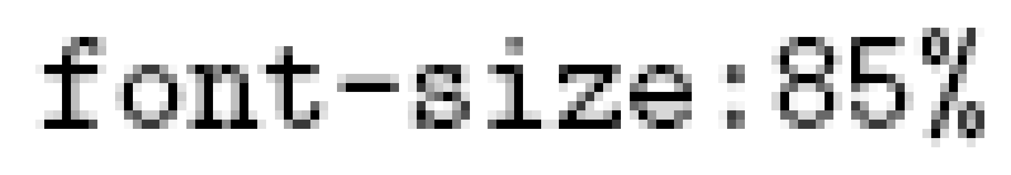
CSS Font Properties: Font size
Other ways to specify value for font-size:
Percentage (of parent font-size)
Absolute size keyword: xx-small, x-small, small, medium (initial value), large, x-large, xx-large
User agent specific; should differ by ~ 20%
Relative size keyword: smaller, larger
Relative to parent element’s font

Slide 31
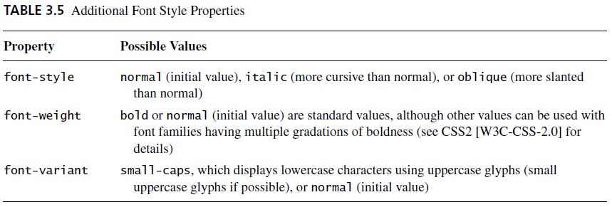
CSS Font Properties

Slide 32
CSS Font Properties: font
font shortcut property:
{ font: italic bold 12pt "Helvetica",sans-serif }
{ font-style: italic;
font-variant: normal;
font-weight: bold;
font-size: 12pt;
line-height: normal;
font-family: "Helvetica",sans-serif }
Initial values used if no value specified in font
property list
specifying line-height
{ font: bold oblique small-caps 12pt/2 "Times New Roman",serif }
any order
size and family required, order-dependent

Slide 33
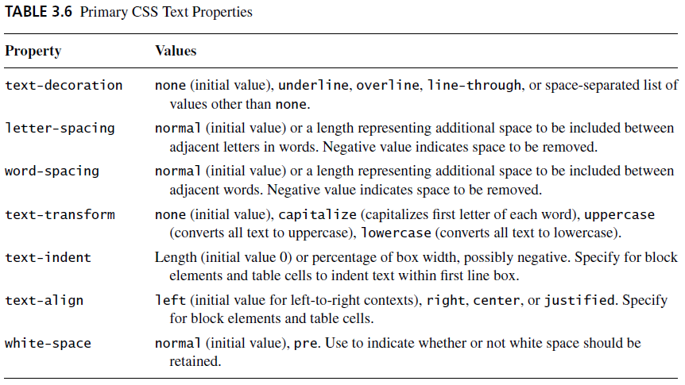
CSS Text Formatting

Slide 34
CSS Text Color: color
Font color specified by color property
Two primary ways of specifying colors:
Color name: black, gray, silver, white, red, lime, blue, yellow, aqua, fuchsia, maroon, green, navy, olive, teal, purple,
- full list at http://www.w3.org/TR/SVG11/types.html#ColorKeywords
red/green/blue (RGB) values

Slide 35
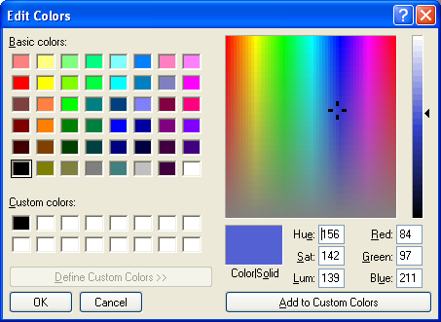
CSS Text Color: color

Slide 36
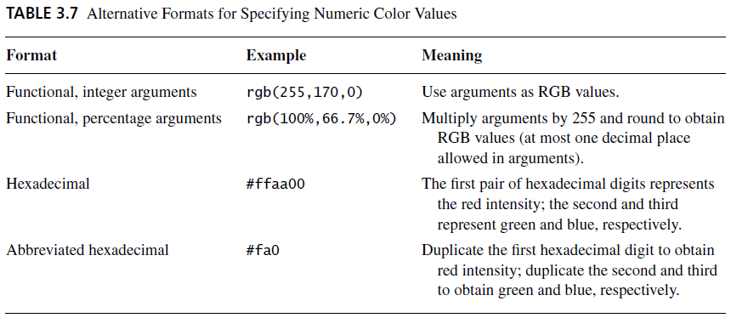
CSS Text Color: color

Slide 37
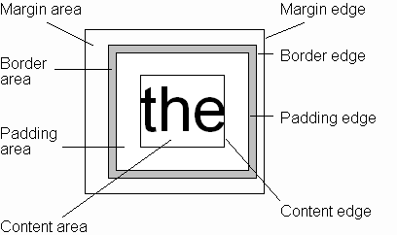
CSS Box Model
Every rendered element occupies a box:
(or outer edge)
(or inner edge)

Slide 38
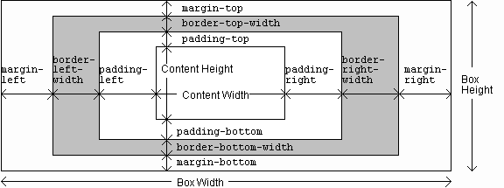
CSS Box Model

Slide 39
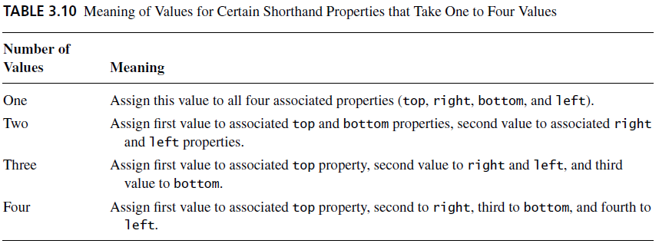
CSS Box Model

Slide 40
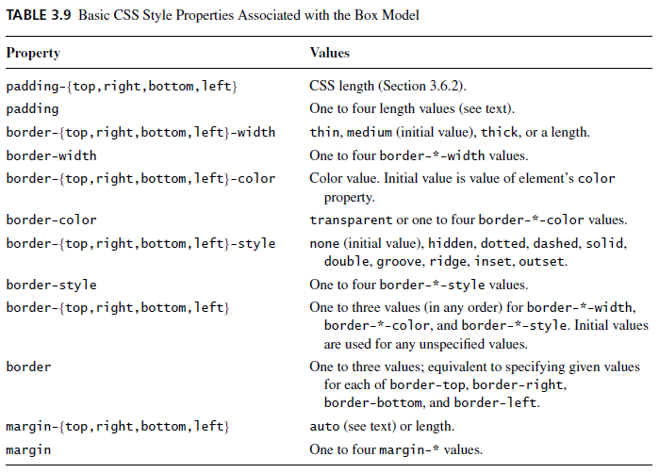
CSS Box Model

Slide 41
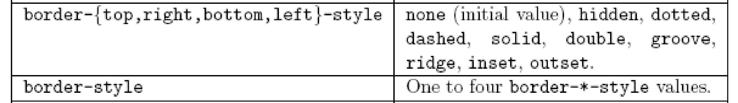
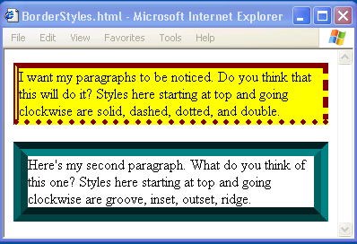
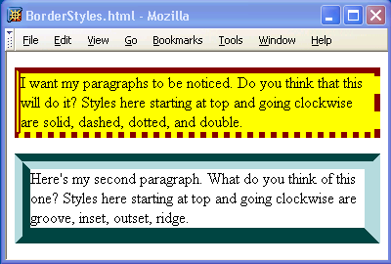
CSS Box Model

Slide 42
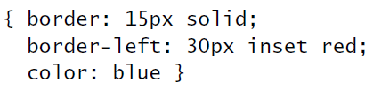
CSS Box Model
If multiple declarations apply to a property, the last declaration overrides earlier specifications
Left border is 30px wide,
inset style, and red

Slide 43
Backgrounds
background-color
Specifies background color for content, padding, and border areas
Margin area is always transparent
Not inherited; initial value transparent
background-image
Specifies (using url() function) image that will be tiled over an element

Slide 44
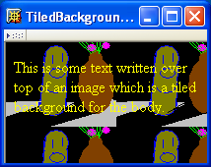
Backgrounds
<body style="background-image:url('CucumberFlowerPot.png')">

Slide 45
Normal Flow Layout
In normal flow processing, each displayed element has a corresponding box
html element box is called initial containing block and corresponds to entire document
Boxes of child elements are contained in boxes of parent
Sibling block elements are laid out one on top of the other
Sibling inline elements are one after the other

Slide 46
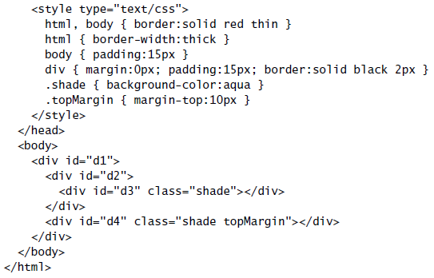
Normal Flow Layout
Block
elements
only

Slide 47
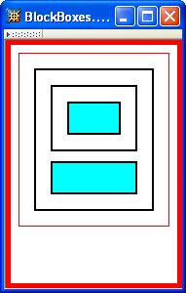
Normal Flow Layout
html
body
div d1
div d2
div d3
div d4
Top edges of
block boxes are
in document order

Slide 48

Beyond Normal Flow
CSS allows for boxes to be positioned outside the normal flow:
Relative positioning
span’s shifted backwards relative to normal flow

Slide 49
Beyond Normal Flow
CSS allows for boxes to be positioned outside the normal flow:
Relative positioning
other span’s are not affected

Slide 50
Beyond Normal Flow
CSS allows for boxes to be positioned outside the normal flow:
Relative positioning
<span style="background-color:red">&nbsp;&nbsp;&nbsp;&nbsp;
</span><span class="right">Red</span>
<span style="background-color:yellow">&nbsp;&nbsp;&nbsp;&nbsp;
</span><span class="right">Yellow</span>
<span style="background-color:lime">&nbsp;&nbsp;&nbsp;&nbsp;
</span><span class="right">Green</span>
style rules that move span’s
away from normal-flow right edge

Slide 51
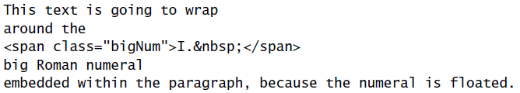
Beyond Normal Flow
CSS allows for boxes to be positioned outside the normal flow:
Float positioning
style rule that “floats” left

Slide 52
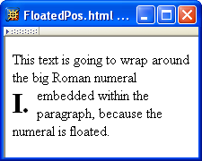
Beyond Normal Flow
CSS allows for boxes to be positioned outside the normal flow:
Float positioning
span taken out of normal
flow and “floated” to the
left of its line box

Slide 53
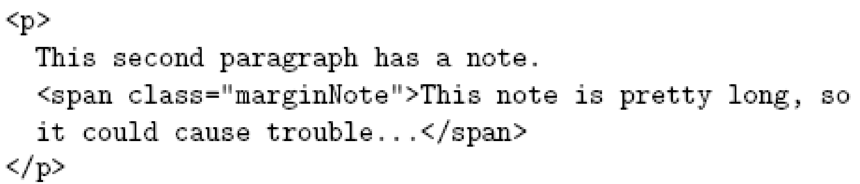
Beyond Normal Flow
CSS allows for boxes to be positioned outside the normal flow:
Absolute positioning
style rule that moves span relative to
upper left corner of containing
p element’s box

Slide 54
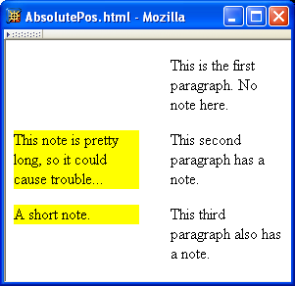
Beyond Normal Flow
CSS allows for boxes to be positioned outside the normal flow:
Absolute positioning
span’s removed from
normal flow and
positioned relative
to another box

Slide 55
Beyond Normal Flow
Properties used to specify positioning:
position: static (initial value), relative, or absolute
Element is positioned if this property not static
Properties left, right, top, bottom apply to positioned elements
Primary values are auto (initial value) or CSS length
float: none, left, or right
Applies to elements with static and relative positioning only

Slide 56
Beyond Normal Flow
Relative positioning
Specifying positive value for right property of relatively positioned box moves it to left
<span style="background-color:red">&nbsp;&nbsp;&nbsp;&nbsp;
</span><span class="right">Red</span>
span
containing
text moves
left

Slide 57
Beyond Normal Flow
Relative positioning
Specifying negative value for left property also moves box to left
<span style="background-color:red">&nbsp;&nbsp;&nbsp;&nbsp;
</span><span class="right">Red</span>
same
effect as
before

Slide 58
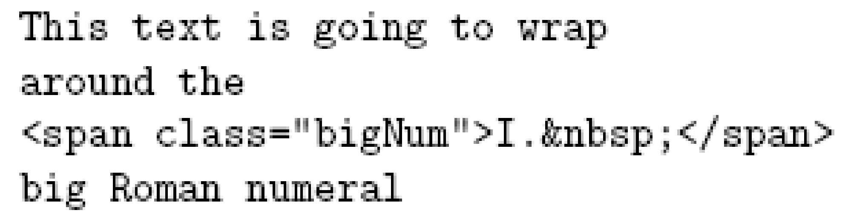
Beyond Normal Flow
Float positioning
Specify value for float property
Floated element becomes a CSS block
element (e.g., can set height and width)

Slide 59
Beyond Normal Flow
Absolute positioning
Specify location for corner of box relative to positioned containing block
p elements are positioned (but don’t move!)
margin area
padding area
containing
block
This second paragraph has a
note.

Slide 60

Beyond Normal Flow
Absolute positioning
Specify location for edges of box relative to positioned containing block

Slide 61

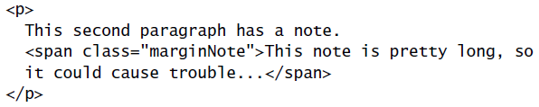
Beyond Normal Flow
Absolute positioning
10em
padding top
edge
padding left
edge
8em

Slide 62
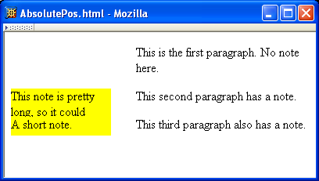
Beyond Normal Flow
Absolutely positioned box does not affect positioning of other boxes!
Second absolutely
positioned box
obscures first

Slide 63
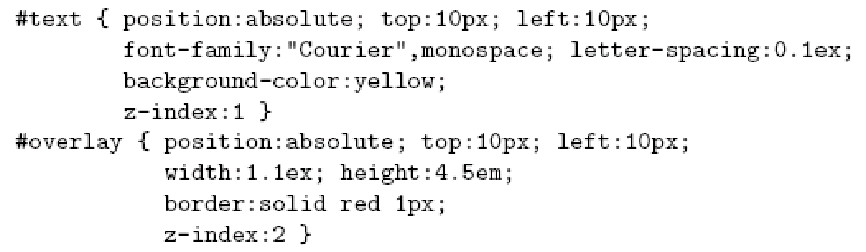
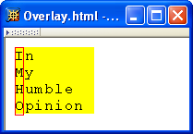
CSS Position-Related Properties
z-index: drawing order for overlaid boxes (largest number drawn last)

Slide 64
CSS Position-Related Properties
display: value none means that element and its descendants are not rendered and do not affect normal flow
visibility: value hidden (initial value is visible) means that element and its descendants are not rendered but still do affect normal flow

