Slide 1
Chapter 2 Markup Languages: XHTML 1.0
WEB TECHNOLOGIES
A COMPUTER SCIENCE PERSPECTIVE JEFFREY C. JACKSON

Slide 2
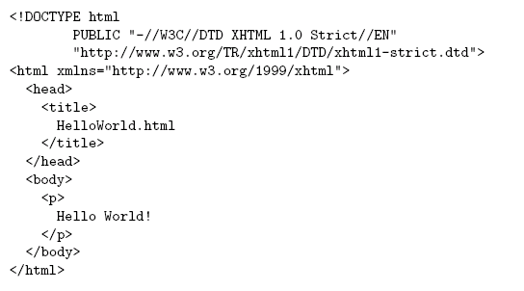
HTML: “Hello World!”
Document
Type
Declaration
Document
Instance

Slide 3

HTML: “Hello World!”

Slide 4
HTML: History
1990: HTML invented by Tim Berners-Lee
1993: Mosaic browser adds support for images, sound, video to HTML
1994-~1997: “Browser wars” between Netscape and Microsoft, HTML defined operationally by browser support
~1997-present: Increasingly, World-Wide Web Consortium (W3C) recommendations define HTML

Slide 5
HTML: Versions
HTML 4.01 (Dec 1999) syntax defined using Standard Generalized Markup Language (SGML)
XHTML 1.0 (Jan 2000) syntax defined using Extensible Markup Language (XML)
Primary differences:
HTML allows some tag omissions (e.g., end tags)
XHTML element and attribute names are lower case (HTML names are case-insensitive)
XHTML requires that attribute values be quoted

Slide 6
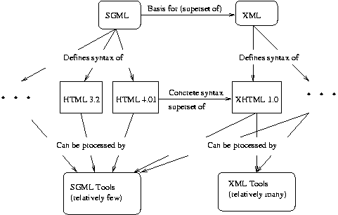
SGML and XML

Slide 7
HTML: head and body Elements
The body element contains information displayed in the browser client area
The head element contains information used for other purposes by the browser:
title (shown in title bar of browser window)
scripts (client-side programs)
style (display) information
etc.

Slide 8
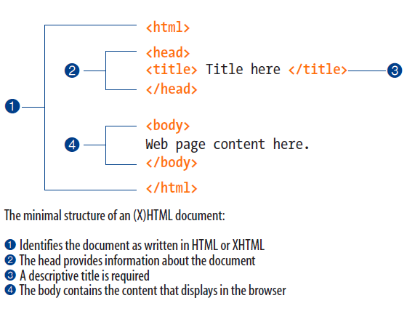
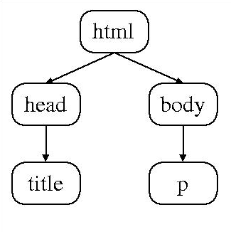
HTML: Element Tree
Root
Element

Slide 9
HTML: Root Element
Document type declaration specifies name of root element: <!DOCTYPE html
Root of HTML document must be html
XHTML 1.0 (standard we will follow) requires that this element contain xmlns attribute specification (name/value pair)

Slide 10
HTML: “Flavors”
For HTML 4.01 and XHTML 1.0, the document type declaration can be used to select one of three “flavors”:
Strict: W3C ideal
Transitional: Includes deprecated elements and attributes (W3C recommends use of style sheets instead)
Frameset: Supports frames (subwindows within the client area)

Slide 11
HTML: Document Type Declarations
XHTML 1.0 Strict: <!DOCTYPE html PUBLIC "-//W3C//DTD XHTML 1.0 Strict//EN"
"http://www.w3.org/TR/xhtml1/DTD/xhtml1-strict.dtd">
XHTML 1.0 Frameset: <!DOCTYPE html PUBLIC "-//W3C//DTD XHTML 1.0 Frameset//EN“ "http://www.w3.org/TR/xhtml1/DTD/xhtml1-frameset.dtd">
HTML 4.01 Transitional: <!DOCTYPE html PUBLIC "-//W3C//DTD HTML 4.01 Transitional//EN“ "http://www.w3.org/TR/html4/loose.dtd">
HTML5
<!DOCTYPE html>

Slide 12
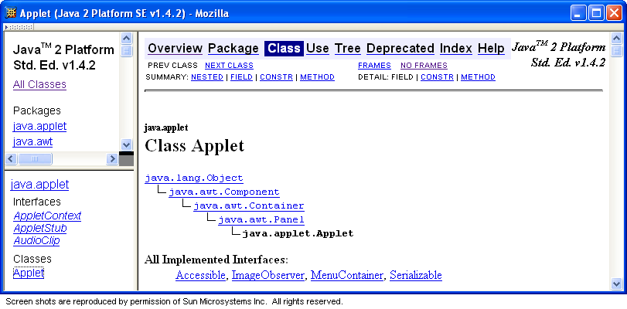
HTML: Frameset

Slide 13
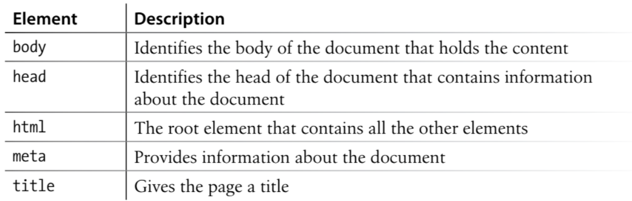
HTML: Document Structure

Slide 14
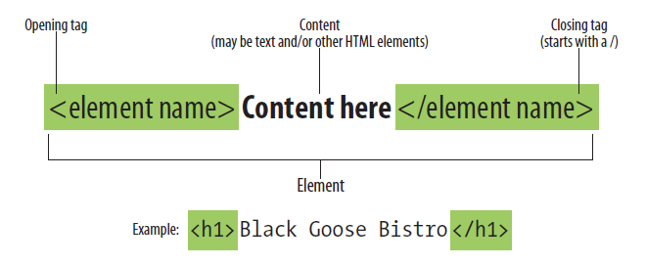
HTML: Tags and Elements
An element consists of both the content and its markup.

Slide 15
HTML: Tags and Elements
Any string of the form < … > is a tag
All tags in document instance of Hello World are either end tags (begin with </) or start tags (all others)
Tags are an example of markup, that is, text treated specially by the browser
Non-markup text is called character data and is normally displayed by the browser
String at beginning of start/end tag is an element name
Everything from start tag to matching end tag, including tags, is an element
Content of element excludes its start and end tags

Slide 16
XHTML: White Space
Four white space characters: carriage return, line feed, space, horizontal tab
Normally, character data is normalized:
All white space is converted to space characters
Leading and trailing spaces are trimmed
Multiple consecutive space characters are replaced by a single space character

Slide 17
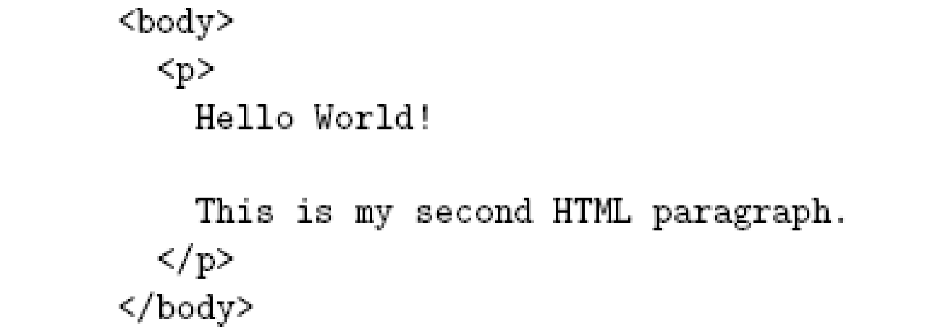
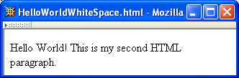
XHTML: White Space

Slide 18
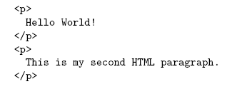
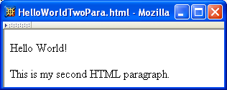
XHTML: White Space

Slide 19
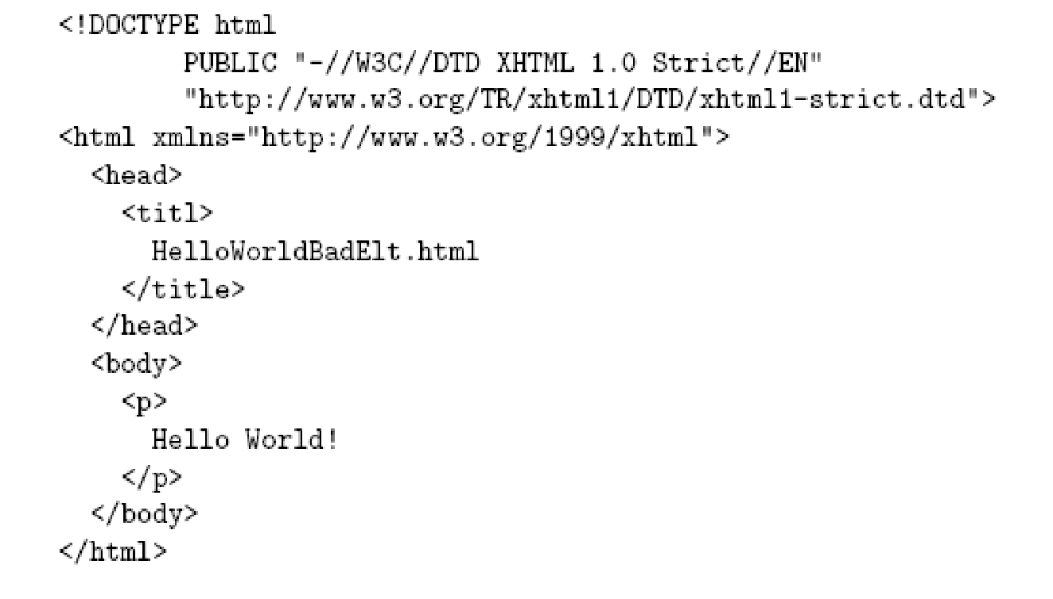
Unrecognized HTML Elements
Misspelled
element name

Slide 20
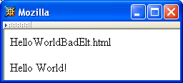
Unrecognized HTML Elements
Belongs
here
title character
data

Slide 21
Unrecognized HTML Elements
title character
data
Displayed
here

Slide 22
Unrecognized HTML Elements
Browsers ignore tags with unrecognized element names, attribute specifications with unrecognized attribute names
Allows evolution of HTML while older browsers are still in use
Implication: an HTML document may have errors even if it displays properly
Should use an HTML validator to check syntax

Slide 23
Unrecognized HTML Elements
The inclusion of a DOCTYPE declaration. Without it the validator doesn’t know which version of HTML or XHTML to validate against.
An indication of the character encoding for the document.
The inclusion of required rules and attributes.
Non-standard elements.
Mismatched tags.
Nesting errors.
Typos and other minor errors.
Validator: http://validator.w3.org/

Slide 24
HTML: References
Since < marks the beginning of a tag, how do you include a < in an HTML document?
Use markup known as a reference
Two types:
Character reference specifies a character by its Unicode code point
For <, use &#60; or &#x3C; or &#x3c;
Entity reference specifies a character by an HTML-defined name
For <, use &lt;

Slide 25
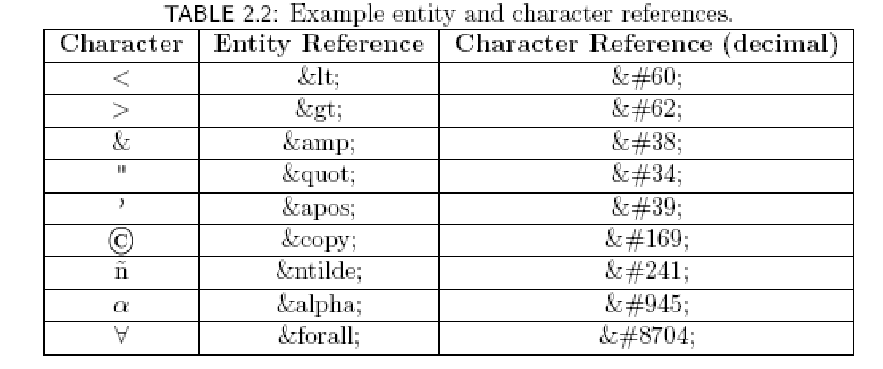
HTML: References

Slide 26
HTML: References
Since < and & begin markup, within character data or attribute values these characters must always be represented by references (normally &lt; and &amp;)
Good idea to represent > using reference (normally &gt;)
Provides consistency with treatment of <
Avoids accidental use of the reserved string ]]>

Slide 27
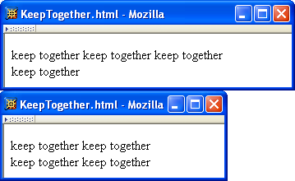
HTML: References
Non-breaking space ( &nbsp; ) produces space but counts as part of a word
Ex: keep&nbsp;together keep&nbsp;together …

Slide 28
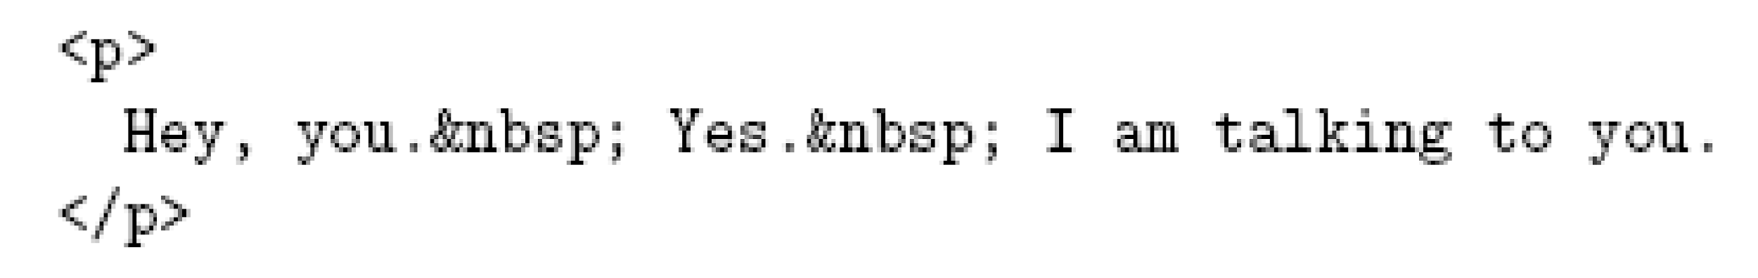
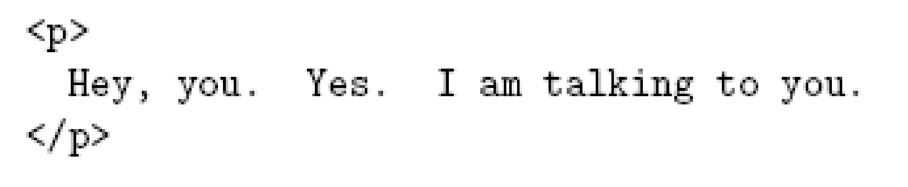
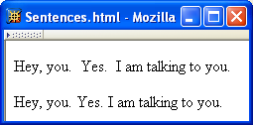
HTML: References
Non-breaking space often used to create multiple spaces (not removed by normalization)
&nbsp; + space
displays as two
spaces

Slide 29
HTML: References
Non-breaking space often used to create multiple spaces (not removed by normalization)
two spaces
display as one

Slide 30
XHTML: Attribute Specifications
Example:
Syntax:
Valid attribute names specified by HTML recommendation (or XML, as in xml:lang)
Attribute values must be quoted (matching single or double quotes)
Multiple attribute specifications are space-separated, order-independent

Slide 31
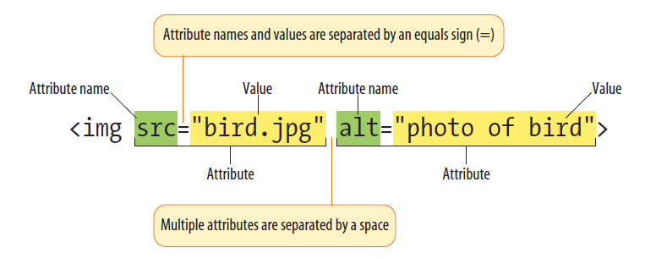
XHTML: Attribute Specifications

Slide 32

XHTML: Attribute Values
Can contain embedded quotes or references to quotes
May be normalized by browser
Best to normalize attribute values yourself for optimal browser compatibility

Slide 33
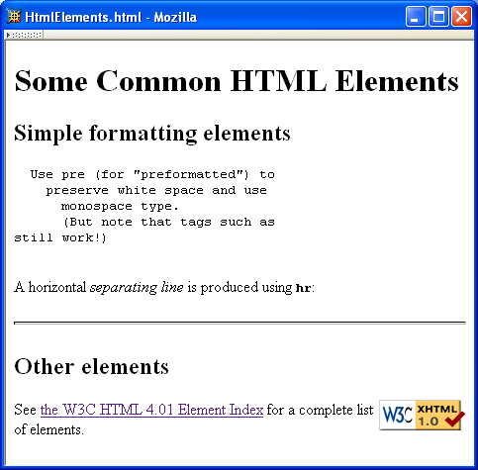
Common HTML Elements

Slide 34
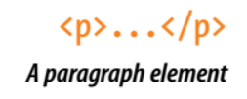
Common HTML Elements: p
Paragraph
Paragraphs may contain text, images, and other inline elements (called phrasing content in the spec), but they may not contain headings, lists, sectioning elements, or any element that typically displays as a block by default.

Slide 35
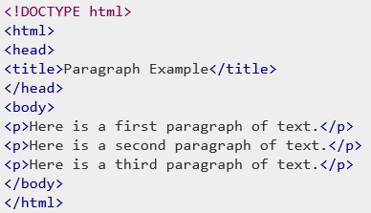
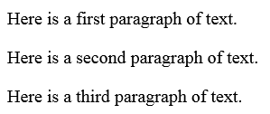
Common HTML Elements: p
Paragraph

Slide 36
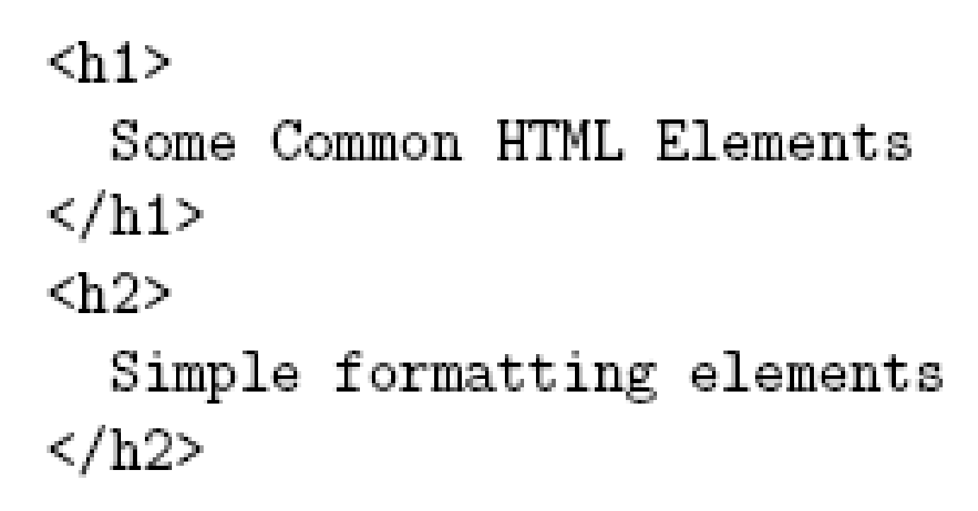
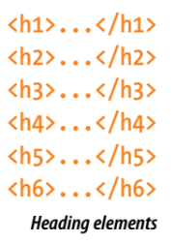
Common HTML Elements: h#
Headings
are produced using h1, h2, …, h6 elements:
Should use h1 for highest level, h2 for next highest, etc.
Change style (next chapter) if you don’t like the “look” of a heading

Slide 37
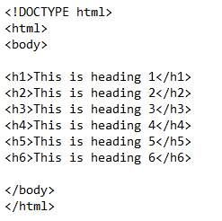
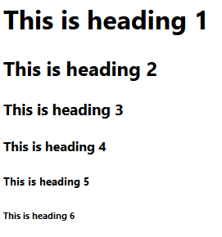
Common HTML Elements: h#
Headings

Slide 38

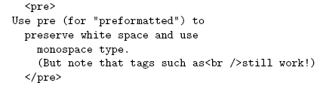
Common HTML Elements: pre
Preformatted Text
Use pre to retain format of text and display using monospace font:
Note that any embedded markup (such as <br /> ) is still treated as markup!

Slide 39
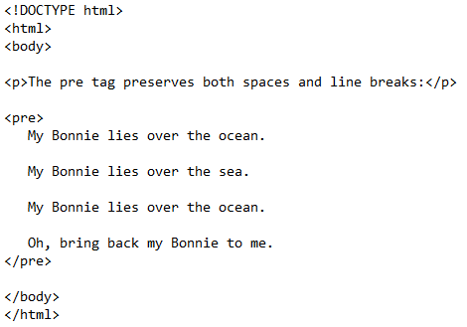
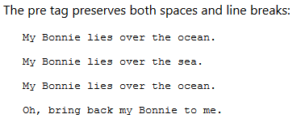
Common HTML Elements: pre
Preformatted Text

Slide 40

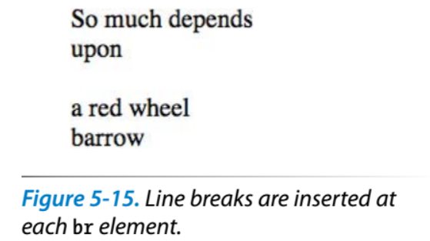
Common HTML Elements: br
Line break
br is example of an empty element, i.e., element that is not allowed to have content

Slide 41
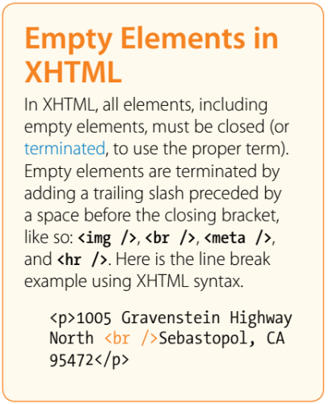
Empty Elements
XML allows two syntactic representations of empty elements
Empty tag syntax <br /> is recommended for browser compatibility
XML parsers also recognize syntax <br></br> (start tag followed immediately by end tag), but many browsers do not understand this for empty elements

Slide 42

Common HTML Elements: span
Text can be formatted in various ways:
Apply style sheet technology (next chapter) to a span element (a styleless wrapper):
Use a phrase element that specifies semantics of text (not style directly):
Use a font style element
Not recommended, but frequently used

Slide 43
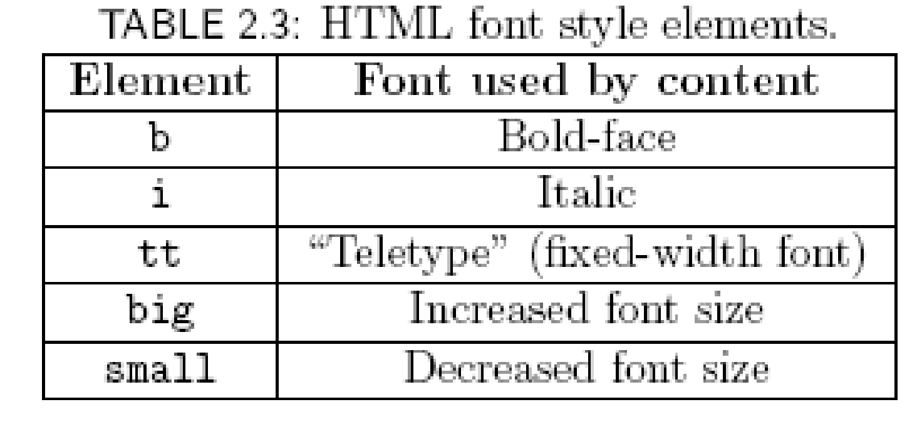
Common HTML Elements

Slide 44

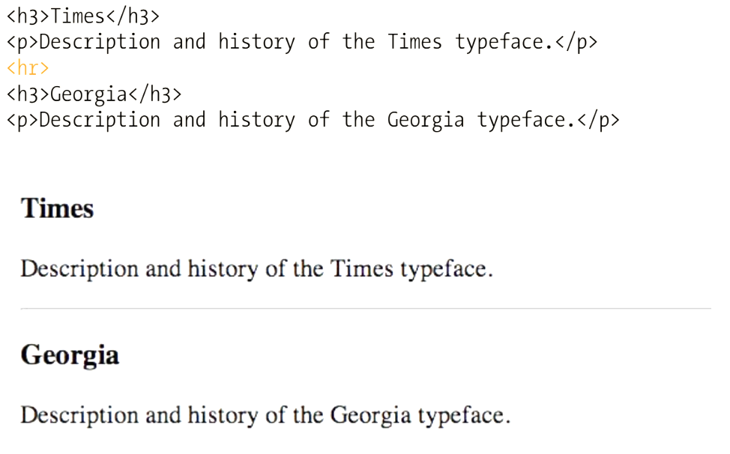
Common HTML Elements: hr
Horizontal rule
Also an empty element
Style can be modified using style sheet technology

Slide 45

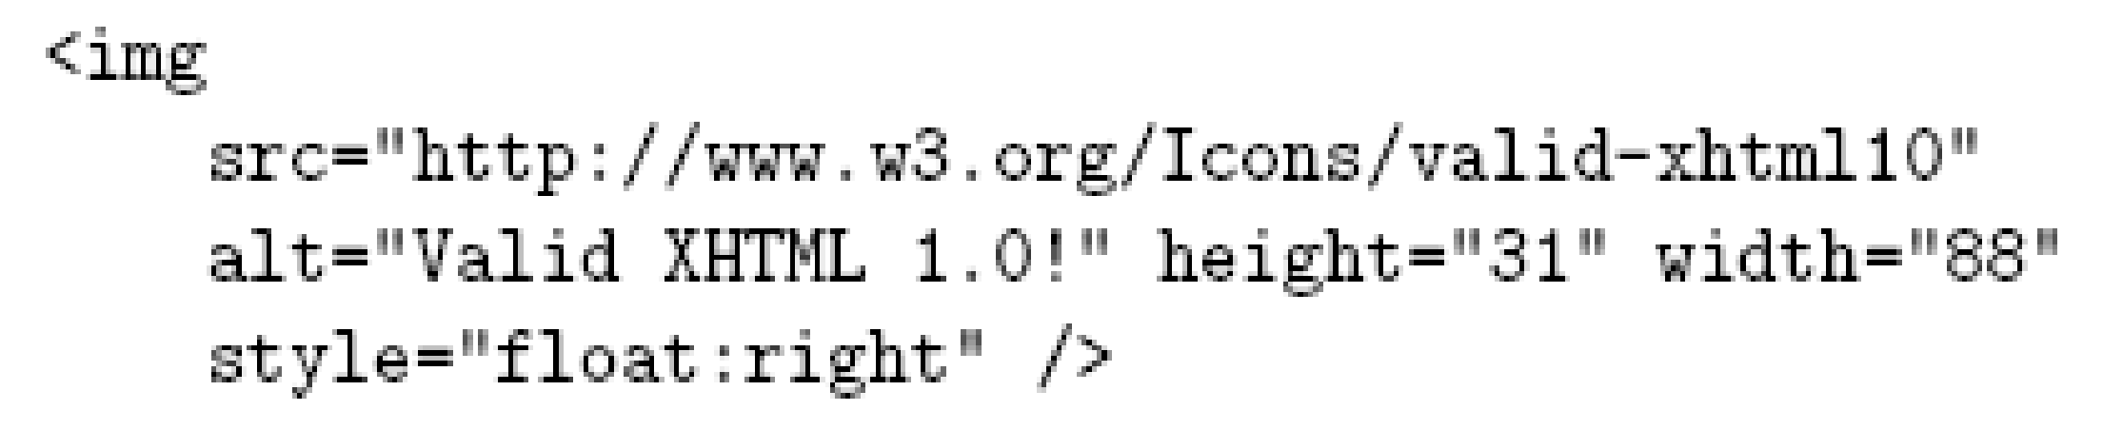
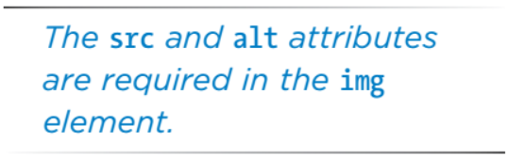
Common HTML Elements: img
Images
can be embedded using img element
Attributes:
src: URL of image file (required). Browser generates a GET request to this URL.
alt: text description of image (required)
height / width: dimensions of area that image will occupy (recommended)

Slide 46
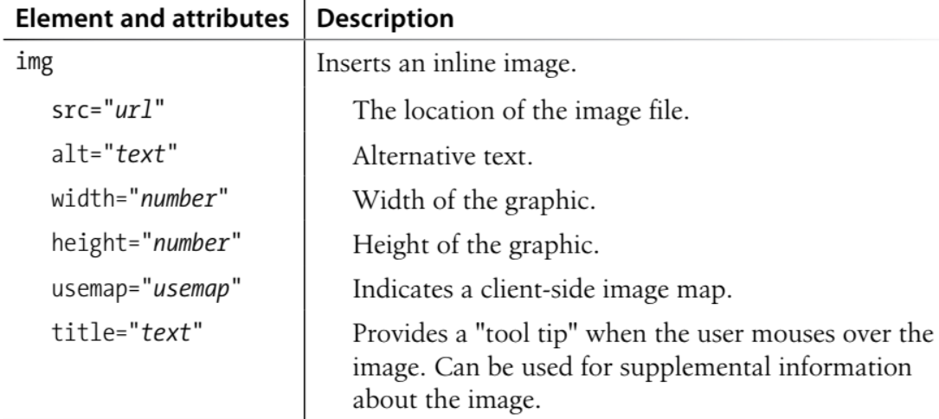
Common HTML Elements: img

Slide 47
Common HTML Elements: img
If height and width not specified for image, then browser may need to rearrange the client area after downloading the image (poor user interface for Web page)
If height and width specified are not the same as the original dimensions of image, browser will resize the image
Default units for height and width are “picture elements” (pixels)
Can specify percentage of client area using string such as “50%”

Slide 48
Common HTML Elements: img
Monitor resolution determines pixel size
1024 elements per line
500 pixel wide line is almost
half the width of monitor
768 lines

Slide 49
Common HTML Elements: img
Monitor resolution determines pixel size
1280 elements per line
500 pixel wide line is less
than half the width of monitor
1024 lines

Slide 50

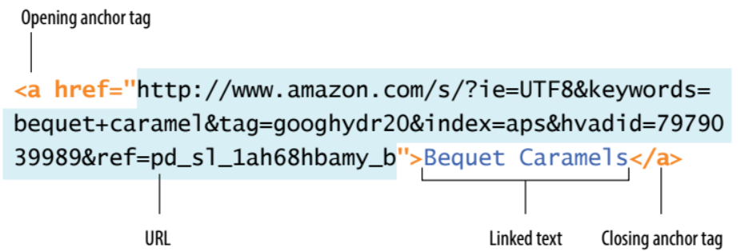
Common HTML Elements: a
Hyperlinks
are produced by the anchor element a
Clicking on a hyperlink causes browser to issue GET request to URL specified in href attribute and render response in client area
Content of anchor element is text of hyperlink (avoid leading/trailing space in content)

Slide 51
Common HTML Elements: a
Anchors can be used as source (previous example) or destination
The fragment portion of a URL is used to reference a destination anchor
Browser scrolls so destination anchor is at (or near) top of client area

Slide 52
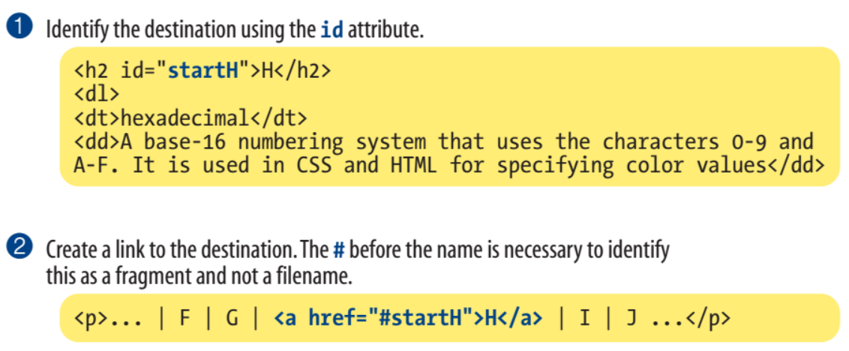

Common HTML Elements: a
Linking to a specific point in a page:

Slide 53
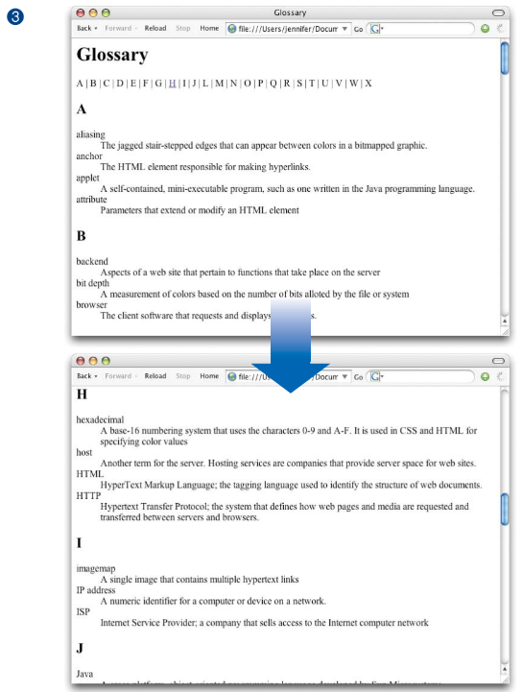
Common HTML Elements: a

Slide 54
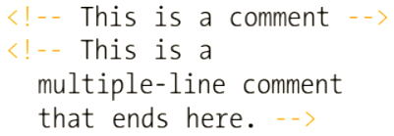

Common HTML Elements: comments
Comments are a special form of tag
Not allowed to use -- within comment

Slide 55

Nesting Elements
If one element is nested within another element, then the content of the inner element is also content of the outer element
XHTML requires that elements be properly nested

Slide 56
Nesting Elements
Most HTML elements are either block or inline
Block: browser automatically generates line breaks before and after the element content
Ex: p
Inline: element content is added to the “flow”
Ex: span, tt, strong, a

Slide 57
Nesting Elements
Syntactic rules of thumb:
Children of <body> must be blocks
Blocks can contain inline elements
Inline elements cannot contain blocks
Specific rules for each version of (X)HTML are defined using SGML or XML (covered later)

Slide 58
Relative URL’s
Relative URLs: describe the pathname to a file relative to the current document.
This is an example of a relative URL: it is interpreted relative to the URL of the document
Ex: If document URL is: http://localhost:8080/MultiFile.html then relative URL above represents absolute URL http://localhost:8080/valid-xhtml10.png

Slide 59
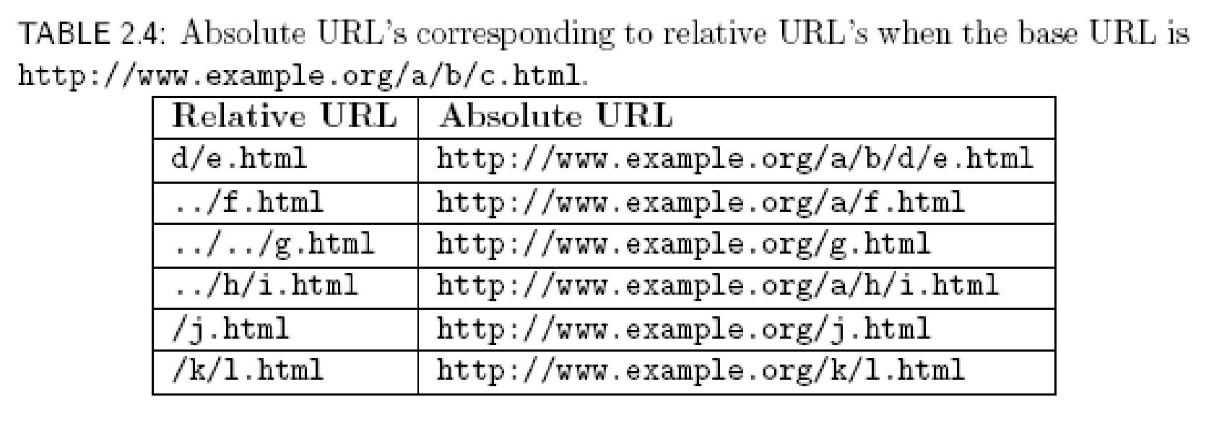
Relative URL’s

Slide 60

Relative URL’s
Query and fragment portions of a relative URL are appended to the resulting absolute URL
Example: If document URL is http://localhost:8080/PageAnch.html and it contains the anchor element then the corresponding absolute URL is http://localhost:8080/PageAnch.html#section1

Slide 61
Relative URL’s
Advantages:
Shorter than absolute URL’s
Primary: can change the URL of a document (e.g., move document to a different directory or rename the server host) without needing to change URL’s within the document
Should use relative URL’s whenever possible

Slide 62
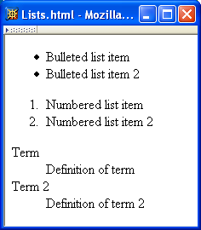
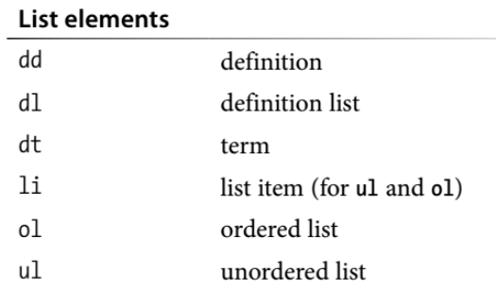
Lists

Slide 63
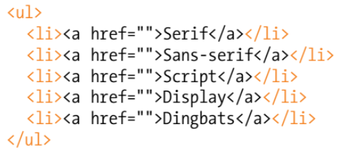
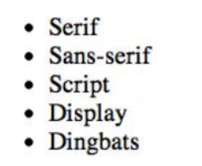
Lists: Unordered list

Slide 64
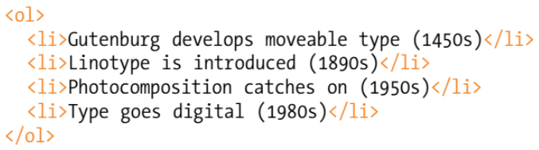
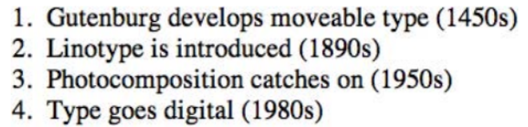
Lists: Ordered list

Slide 65
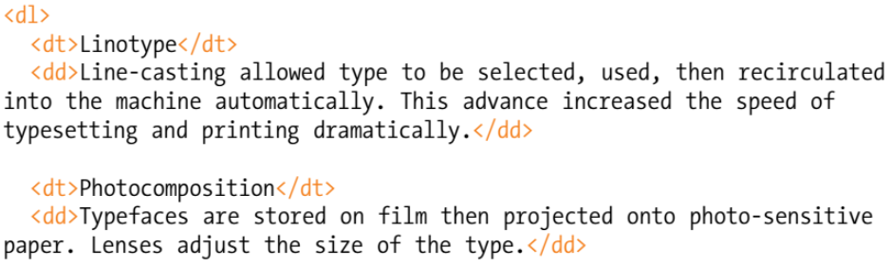
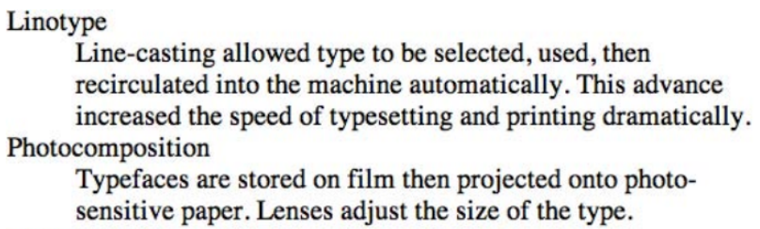
Lists: Definition list
</dl>

Slide 66

Tables

Slide 67


Tables
Rules
Borders
Rules

Slide 68


Tables
Border 5 pixels, rules 1 pixel
Table Row
Table Data

Slide 69

Tables

Slide 70


Tables
Table Header

Slide 71

Tables

Slide 72

Tables: Cell padding
Cell padding is the amount of space held between the contents of the cell and the cell border

Slide 73

Tables: Cell spacing
Cell spacing is the amount of space held between cells, specified in number of pixels

Slide 74

Tables

Slide 75
Frames

Slide 76


Frames
1/3,2/3 split

Slide 77
Frames
Hyperlink in one frame can load document in another:
Value of target attribute specification is id/name of a frame

Slide 78
Frames
User interface issues:
What happens when the page is printed?
What happens when the Back button is clicked?
How should assistive technology “read” the page?
How should the information be displayed on a small display?
Recommendation: avoid frames except for applications aimed at “power users”

Slide 79

Forms

Slide 80
Forms
Each form is content of a form element
<form action=“http://www.example.org” method=“get”>
<div>
<label>
Enter your name: <input type=“text” name=“username” size=“40”/>
</label>
<br/>
<label>
Give your life’s story in 100 words or less:
<br/>
<textarea name=“lifestory” rows=“5” cols=“60”></textarea>
</label>

Slide 81
Forms
action specifies URL where form data is sent in an HTTP request
<form action=“http://www.example.org” method=“get”>
<div>
<label>
Enter your name: <input type=“text” name=“username” size=“40”/>
</label>
<br/>
<label>
Give your life’s story in 100 words or less:
<br/>
<textarea name=“lifestory” rows=“5” cols=“60”></textarea>
</label>

Slide 82
Forms
HTTP request method (lowercase)
<form action=“http://www.example.org” method=“get”>
<div>
<label>
Enter your name: <input type=“text” name=“username” size=“40”/>
</label>
<br/>
<label>
Give your life’s story in 100 words or less:
<br/>
<textarea name=“lifestory” rows=“5” cols=“60”></textarea>
</label>

Slide 83
Forms: div
<form action=“http://www.example.org” method=“get”>
<div>
<label>
Enter your name: <input type=“text” name=“username” size=“40”/>
</label>
<br/>
<label>
Give your life’s story in 100 words or less:
<br/>
<textarea name=“lifestory” rows=“5” cols=“60”></textarea>
</label>
div is the block element analog of span (no-style block element)
Form control elements must be content of a block element

Slide 84
Forms: text line

Slide 85
Forms: text line
<form action=“http://www.example.org” method=“get”>
<div>
<label>
Enter your name: <input type=“text” name=“username” size=“40”/>
</label>
<br/>
<label>
Give your life’s story in 100 words or less:
<br/>
<textarea name=“lifestory” rows=“5” cols=“60”></textarea>
</label>
Single-line text field

Slide 86
Forms: text line
<form action=“http://www.example.org” method=“get”>
<div>
<label>
Enter your name: <input type=“text” name=“username” size=“40”/>
</label>
<br/>
<label>
Give your life’s story in 100 words or less:
<br/>
<textarea name=“lifestory” rows=“5” cols=“60”></textarea>
</label>
The name attribute provides the variable name for the control.
name associated with this control’s data in HTTP request

Slide 87
Forms: text line
<form action=“http://www.example.org” method=“get”>
<div>
<label>
Enter your name: <input type=“text” name=“username” size=“40”/>
</label>
<br/>
<label>
Give your life’s story in 100 words or less:
<br/>
<textarea name=“lifestory” rows=“5” cols=“60”></textarea>
</label>
Width (number of characters) of text field

Slide 88
Forms: text line
<form action=“http://www.example.org” method=“get”>
<div>
<label>
Enter your name: <input type=“text” name=“username” size=“40”/>
</label>
<br/>
<label>
Give your life’s story in 100 words or less:
<br/>
<textarea name=“lifestory” rows=“5” cols=“60”></textarea>
</label>
input is an empty element

Slide 89
Forms: label
<form action=“http://www.example.org” method=“get”>
<div>
<label>
Enter your name: <input type=“text” name=“username” size=“40”/>
</label>
<br/>
<label>
Give your life’s story in 100 words or less:
<br/>
<textarea name=“lifestory” rows=“5” cols=“60”></textarea>
</label>
Use label to associate text with a control

Slide 90
Forms: br
<form action=“http://www.example.org” method=“get”>
<div>
<label>
Enter your name: <input type=“text” name=“username” size=“40”/>
</label>
<br/>
<label>
Give your life’s story in 100 words or less:
<br/>
<textarea name=“lifestory” rows=“5” cols=“60”></textarea>
</label>
Form controls are inline elements

Slide 91
Forms: textarea

Slide 92
Forms: textarea
<form action=“http://www.example.org” method=“get”>
<div>
<label>
Enter your name: <input type=“text” name=“username” size=“40”/>
</label>
<br/>
<label>
Give your life’s story in 100 words or less:
<br/>
<textarea name=“lifestory” rows=“5” cols=“60”></textarea>
</label>
textarea control used for multi-line input
textarea is not an empty element; any content is displayed

Slide 93
Forms: textarea
<form action=“http://www.example.org” method=“get”>
<div>
<label>
Enter your name: <input type=“text” name=“username” size=“40”/>
</label>
<br/>
<label>
Give your life’s story in 100 words or less:
<br/>
<textarea name=“lifestory” rows=“5” cols=“60”></textarea>
</label>
Height and width in characters

Slide 94
Forms: checkbox

Slide 95
Forms: checkbox
check all that apply to you:
<label>
<input type=“checkbox” name=“boxgroup1” value=“tall”/>tall
</label>
<label>
<input type=“checkbox” name=“boxgroup1” value=“funny”/>funny
</label>
<label>
<input type=“checkbox” name=“boxgroup1” value=“smart”/>smart
</label>
<br/><br/>
<input type=“submit” name=“doit” value=“Publish my life’s story”/>
</div>
</form>
Checkbox control

Slide 96
Forms: checkbox
check all that apply to you:
<label>
<input type=“checkbox” name=“boxgroup1” value=“tall”/>tall
</label>
<label>
<input type=“checkbox” name=“boxgroup1” value=“funny”/>funny
</label>
<label>
<input type=“checkbox” name=“boxgroup1” value=“smart”/>smart
</label>
<br/><br/>
<input type=“submit” name=“doit” value=“Publish my life’s story”/>
</div>
</form>
Value sent in HTTP request if box is checked

Slide 97
Forms: checkbox
check all that apply to you:
<label>
<input type=“checkbox” name=“boxgroup1” value=“tall”/>tall
</label>
<label>
<input type=“checkbox” name=“boxgroup1” value=“funny”/>funny
</label>
<label>
<input type=“checkbox” name=“boxgroup1” value=“smart”/>smart
</label>
<br/><br/>
<input type=“submit” name=“doit” value=“Publish my life’s story”/>
</div>
</form>
Controls can share a common name

Slide 98
Forms: checkbox
check all that apply to you:
<label>
<input type=“checkbox” name=“boxgroup1” value=“tall”/>tall
</label>
<label>
<input type=“checkbox” name=“boxgroup1” value=“funny”/>funny
</label>
<label>
<input type=“checkbox” name=“boxgroup1” value=“smart”/>smart
</label>
<br/><br/>
<input type=“submit” name=“doit” value=“Publish my life’s story”/>
</div>
</form>
Submit button: form data sent to action URL if button is clicked

Slide 99
Forms: checkbox
check all that apply to you:
<label>
<input type=“checkbox” name=“boxgroup1” value=“tall”/>tall
</label>
<label>
<input type=“checkbox” name=“boxgroup1” value=“funny”/>funny
</label>
<label>
<input type=“checkbox” name=“boxgroup1” value=“smart”/>smart
</label>
<br/><br/>
<input type=“submit” name=“doit” value=“Publish my life’s story”/>
</div>
</form>
Displayed on button and sent to server if button clicked

Slide 100

Forms
Form data (in GET request)

Slide 101

Forms
Radio buttons: at most
one can be selected at
a time.

Slide 102
Forms: radio button
Your annual income is (select one): <br/>
<label>
<input type=“radio” name=“radgroup1” value=“0-10”/>
Less than $10,000
</label><br/>
<label>
<input type=“radio” name=“radgroup1” value=“10-50”
checked=“checked”/>
between $10,000 and $50,000
</label><br/>
<label>
< input type=“radio” name=“radgroup1” value=“&gt;50”/>
over $50,000
</label>
Radio button control

Slide 103
Forms: radio button
Your annual income is (select one): <br/>
<label>
<input type=“radio” name=“radgroup1” value=“0-10”/>
Less than $10,000
</label><br/>
<label>
<input type=“radio” name=“radgroup1” value=“10-50”
checked=“checked”/>
between $10,000 and $50,000
</label><br/>
<label>
< input type=“radio” name=“radgroup1” value=“&gt;50”/>
over $50,000
</label>
All radio buttons with the same name form a button set

Slide 104
Forms: radio button
Your annual income is (select one): <br/>
<label>
<input type=“radio” name=“radgroup1” value=“0-10”/>
Less than $10,000
</label><br/>
<label>
<input type=“radio” name=“radgroup1” value=“10-50”
checked=“checked”/>
between $10,000 and $50,000
</label><br/>
<label>
< input type=“radio” name=“radgroup1” value=“&gt;50”/>
over $50,000
</label>
This button is initially selected (checked attribute also applies to check boxes)

Slide 105
Forms: radio button
Your annual income is (select one): <br/>
<label>
<input type=“radio” name=“radgroup1” value=“0-10”/>
Less than $10,000
</label><br/>
<label>
<input type=“radio” name=“radgroup1” value=“10-50”
checked=“checked”/>
between $10,000 and $50,000
</label><br/>
<label>
< input type=“radio” name=“radgroup1” value=“&gt;50”/>
over $50,000
</label>
Boolean attribute: default false,
set true by specifying name as
value

Slide 106
Forms: radio button
Your annual income is (select one): <br/>
<label>
<input type=“radio” name=“radgroup1” value=“0-10”/>
Less than $10,000
</label><br/>
<label>
<input type=“radio” name=“radgroup1” value=“10-50”
checked=“checked”/>
between $10,000 and $50,000
</label><br/>
<label>
< input type=“radio” name=“radgroup1” value=“&gt;50”/>
over $50,000
</label>
Represents string: >50

Slide 107

Forms: drop-down menu
Menu

Slide 108
Forms: drop-down menu
Your annual income is (select one):
<select name=“income”>
<option value=“0-10”> Less than $10,000 </option>
<option value=“10-50” selected=“selected”>
Between $10,000 and $50,000
</option>
<option value=“&gt;50”/>over $50,000 </option>
</select>
Menu control; name given once

Slide 109
Forms: drop-down menu
Your annual income is (select one):
<select name=“income”>
<option value=“0-10”> Less than $10,000 </option>
<option value=“10-50” selected=“selected”>
Between $10,000 and $50,000
</option>
<option value=“&gt;50”/>over $50,000 </option>
</select>
Each menu item has its own value

Slide 110
Forms: drop-down menu
Your annual income is (select one):
<select name=“income”>
<option value=“0-10”> Less than $10,000 </option>
<option value=“10-50” selected=“selected”>
Between $10,000 and $50,000
</option>
<option value=“&gt;50”/>over $50,000 </option>
</select>
Item initially displayed in menu
control

Slide 111

Forms: other controls
Other form controls:
Fieldset (grouping)
Password
Clickable image
Non-submit buttons
Hidden (embed data)
File upload
Hierarchical menus

Slide 112

Forms: other controls

Slide 113
XML DTD
Recall that XML is used to define the syntax of XHTML
Set of XML files that define a language are known as the document type definition (DTD)
DTD primarily consists of declarations:
Element type: name and content of elements
Attribute list: attributes of an element
Entity: define meaning of, e.g., &gt;

Slide 114

XML: Element Type Declaration
Element type name
Element type content specification (or content model)

Slide 115

XML: Element Type Declaration
Element type content specification (or content model)

Slide 116
XML: Element Type Declaration
Element type content specification (or content model)

Slide 117
XML: Element Type Declaration
<!ELEMENT textarea (#PCDATA)>
Element type content specification (or content model)

Slide 118

XML: Element Type Declaration
Element type content specification (or content model)

Slide 119
XML: Element Type Declaration
Child elements of table are:

Slide 120
XML: Element Type Declaration
Child elements of table are:
Optional caption

Slide 121
XML: Element Type Declaration
Child elements of table are:
Optional caption followed by

Slide 122
XML: Element Type Declaration
Child elements of table are:
Optional caption followed by
Any number of col elements

Slide 123
XML: Element Type Declaration
Child elements of table are:
Optional caption followed by
Any number of col elements or

Slide 124
XML: Element Type Declaration
Child elements of table are:
Optional caption followed by
Any number of col elements or any number of colgroup elements

Slide 125
XML: Element Type Declaration
Child elements of table are:
Optional caption followed by
Any number of col elements or any number of colgroup elements then

Slide 126
XML: Element Type Declaration
Child elements of table are:
Optional caption followed by
Any number of col elements or any number of colgroup elements then
Optional header

Slide 127
XML: Element Type Declaration
Child elements of table are:
Optional caption followed by
Any number of col elements or any number of colgroup elements then
Optional header followed by

Slide 128
XML: Element Type Declaration
Child elements of table are:
Optional caption followed by
Any number of col elements or any number of colgroup elements then
Optional header followed by optional footer

Slide 129
XML: Element Type Declaration
Child elements of table are:
Optional caption followed by
Any number of col elements or any number of colgroup elements then
Optional header followed by optional footer then

Slide 130
XML: Element Type Declaration
Child elements of table are:
Optional caption followed by
Any number of col elements or any number of colgroup elements then
Optional header followed by optional footer then
One or more tbody elements

Slide 131
XML: Element Type Declaration
Child elements of table are:
Optional caption followed by
Any number of col elements or any number of colgroup elements then
Optional header followed by optional footer then
One or more tbody elements or

Slide 132
XML: Element Type Declaration
Child elements of table are:
Optional caption followed by
Any number of col elements or any number of colgroup elements then
Optional header followed by optional footer then
One or more tbody elements or one or more tr elements

Slide 133

XML: Attribute List Declaration
Element type name

Slide 134
XML: Attribute List Declaration
Recognized
attribute names

Slide 135
XML: Attribute List Declaration
Attribute types
(data types allowed as attribute values)

Slide 136
XML: Attribute List Declaration
ASCII characters: letter, digit, or . - _ :

Slide 137
XML: Attribute List Declaration
Attribute value must be ltr or rtl

Slide 138
XML: Attribute List Declaration
Like NMTOKEN but must begin with letter or _ : Attribute value must be unique

Slide 139
XML: Attribute List Declaration
Any character except XML special characters < and &
or the quote character enclosing the attribute value

Slide 140

XML: Attribute List Declaration

Slide 141
XML: Attribute List Declaration
Attribute default declarations

Slide 142

XML: Attribute List Declaration

Slide 143

XML: Entity Declaration
Entity declaration is essentially a macro
Two types of entity:
General: referenced from HTML document using &
Entity name

Slide 144
XML: Entity Declaration
Entity declaration is essentially a macro
Two types of entity:
General: referenced from HTML document using &
Replacement text;
recursively replaced if it is a reference

Slide 145

XML: Entity Declaration
Entity declaration is essentially a macro
Two types of entity:
General: referenced from HTML document using &
Parameter: reference from DTD using %

Slide 146
XML: Entity Declaration
Entity declaration is essentially a macro
Two types of entity:
General: referenced from HTML document using &
Parameter: reference from DTD using %

Slide 147
DTD Files
System Identifier: URL for primary DTD document
DTD document contains element type, attribute list, and entity declarations
May also contain declaration of external entities: identifiers for secondary DTD documents
<!DOCTYPE html
PUBLIC "-//W3C//DTD XHTML 1.0 Strict//EN"
"http://www.w3.org/TR/xhtml1/DTD/xhtml1-strict.dtd">

Slide 148

DTD Files
External entity name

Slide 149
DTD Files
System identifier (relative URL)

Slide 150
DTD Files
Entity reference; imports content (entity declarations, called entity set) of external entity at this point in the primary DTD

Slide 151

HTML Creation Tools

Slide 152

Case Study

Slide 153

Case Study
Borderless table used to lay out form

Slide 154

Case Study
Special text field for passwords

Slide 155

Case Study
Use ref. to
get <
Fix this
later with
“style”

Slide 156

Case Study

Slide 157

Case Study
Banner
Table used for side-by-side layout
Blog entries
Side
information

Slide 158

Case Study: Blog Entry

Slide 159

Case Study: Side Information
Represent & in attribute value
Keep month
and year
together

Slide 160
References
XHTML 1.0
Semantics: HTML 4.01
Index of all elements
Syntax restrictions: XHTML 1.0
Annotated DTD
Relative URL
Accessibility guidelines
XML 1.0

