Slide 1
Chapter 1
Web Essentials: Clients, Servers, and Communication
WEB TECHNOLOGIES
A COMPUTER SCIENCE PERSPECTIVE
JEFFREY C. JACKSON

Slide 2
The Internet: History
Technical origin: ARPANET (late 1960’s)
  Advanced Research Project Agency
  One of earliest attempts to network heterogeneous, geographically dispersed computers
  Email first available on ARPANET in 1972 (and quickly very popular!)
ARPANET access was limited to select DoD-funded organizations

Slide 3
The Internet: History
Open-access networks
  Regional university networks (e.g., SURAnet)
  CSNET for CS departments not on ARPANET
NSFNET (1985-1995)
  Primary purpose: connect supercomputer centers
  Secondary purpose: provide backbone to connect regional networks

Slide 4
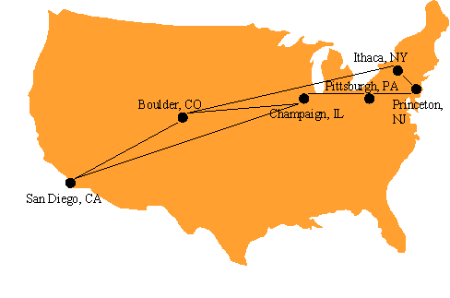
The Internet

Slide 5
The Internet: Definition
the network of networks connected via the public backbone and communicating using TCP/IP communication protocol
  Backbone initially supplied by NSFNET, privately funded (ISP fees) beginning in 1995
The collection of computers that can communicate with one another using TCP/IP over an open, global communication network.

Slide 6
Internet Protocols
Communication protocol: how computers talk
  Cf. telephone “protocol”: how you answer and end call, what language you speak, etc.
Internet protocols developed as part of ARPANET research
  ARPANET began using TCP/IP in 1982
Designed for use both within local area networks (LAN’s) and between networks

Slide 7
Internet Protocols: IP
IP is the fundamental protocol defining the Internet (as the name implies!)
IP address:
  32-bit number (in IPv4)
  Associated with at most one device at a time (although device may have more than one)
  Written as four dot-separated bytes, e.g. 192.0.34.166

Slide 8
Internet Protocols: IP
IP function: transfer data from source device to destination device
IP source software creates a packet representing the data
  Header: source and destination IP addresses, length of data, etc.
  Data itself
If destination is on another LAN, packet is sent to a gateway that connects to more than one network

Slide 9
Internet Protocols: IP
Source
Network 1
Destination
Network 3
Gateway
Network 2
Gateway
Source
LAN 1
Gateway
Destination
Internet Backbone
Gateway
LAN 2

Slide 10
Internet Protocols: TCP
Limitations of IP:
  No guarantee of packet delivery (packets can be dropped)
  Communication is one-way (source to destination)
TCP adds concept of a connection on top of IP
  Provides guarantee that packets delivered
  Provide two-way (full duplex) communication

Slide 11
Internet Protocols: TCP
{
Can I talk to you?
Source
Destination
1. Establish
connection.
OK. Can I talk to you?
OK.
{
Here’s a packet.
2. Send packet
with
acknowledgment.
Got it.
{
Here’s a packet.
3. Resend packet if no (or delayed)
acknowledgment.
Here’s a resent packet.
Got it.

Slide 12
Internet Protocols: TCP
TCP also adds concept of a port
  TCP header contains port number representing an application program on the destination computer
  Some port numbers have standard meanings
    Example: port 25 is normally used for email transmitted using the Simple Mail Transfer Protocol (SMTP)
  Other port numbers are available first-come-first served to any application

Slide 13
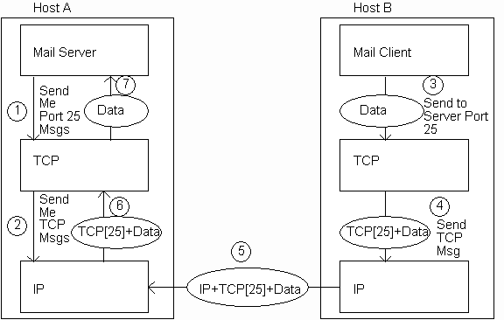
Internet Protocols: TCP

Slide 14
Internet Protocols: UDP
Like TCP in that:
  Builds on IP
  Provides port concept
Unlike TCP in that:
  No connection concept
  No transmission guarantee
Advantage of UDP vs. TCP:
  Lightweight, so faster for one-time messages

Slide 15
Domain Name Service (DNS)
Run using UDP rather than TCP
DNS is the “phone book” for the Internet
  Map between host names and IP addresses
  DNS often uses UDP for communication
Fully Qualified Domain Name (FQDN): a domain name that includes a hostname.
  www.example.com is the FQDN

Slide 16
Domain Name Service (DNS)
FQDN can have three parts:
Hostname: www, mail, ftp, store, support, etc.
Domain: apple, microsoft, ibm, facebook, etc.
Top level domain (TLD): .com, .net, .org,
    Generic: .com, .org, etc.
    Country-code: .us, .sa, etc.
Domains are divided into second-level domains, which can be further divided into subdomains, etc.
  E.g., in www.example.com, example is a second-level domain

Slide 17
Domain Name Service (DNS)
nslookup program provides command-line access to DNS (on most systems)
looking up a host name given an IP address is known as a reverse lookup
  Recall that single host may have mutliple IP addresses.
  Address returned is the canonical IP address specified in the DNS system.

Slide 18
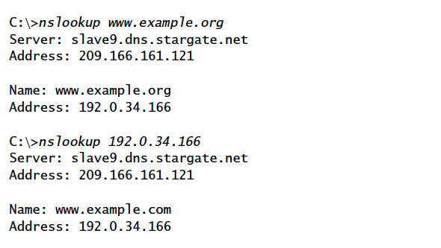
Domain Name Service (DNS)
Reverse Lookup

Slide 19
Analogy to Telephone Network
IP ~ the telephone network
TCP ~ calling someone who answers, having a conversation, and hanging up
UDP ~ calling someone and leaving a message
DNS ~ directory assistance

Slide 20
Higher-level Protocols
Many protocols build on TCP
  Telephone analogy: TCP specifies how we initiate and terminate the phone call, but some other protocol specifies how we carry on the actual conversation
Some examples:
  SMTP (email)
  FTP (file transfer)
  HTTP (transfer of Web documents)

Slide 21
World Wide Web
Originally, one of several systems for organizing Internet-based information
  Competitors: WAIS, Gopher, ARCHIE
Distinctive feature of Web: support for hypertext (text containing links)
  Communication via Hypertext Transport Protocol (HTTP)
  Document representation using Hypertext Markup Language (HTML)

Slide 22
World Wide Web
The Web is the collection of machines (Web servers) on the Internet that provide information, particularly HTML documents, via HTTP.
Machines that access information on the Web are known as Web clients. A Web browser is software used by an end user to access the Web.

Slide 23
Hypertext Transport Protocol: HTTP
HTTP is based on the request-response communication model:
  Client sends a request
  Server sends a response
HTTP is a stateless protocol:
  The protocol does not require the server to remember anything about the client between requests.

Slide 24
Hypertext Transport Protocol: HTTP
Normally implemented over a TCP connection (80 is standard port number for HTTP)
Typical browser-server interaction:
  User enters Web address in browser
  Browser uses DNS to locate IP address
  Browser opens TCP connection to server
  Browser sends HTTP request over connection
  Server sends HTTP response to browser over connection
  Browser displays body of response in the client area of the browser window

Slide 25
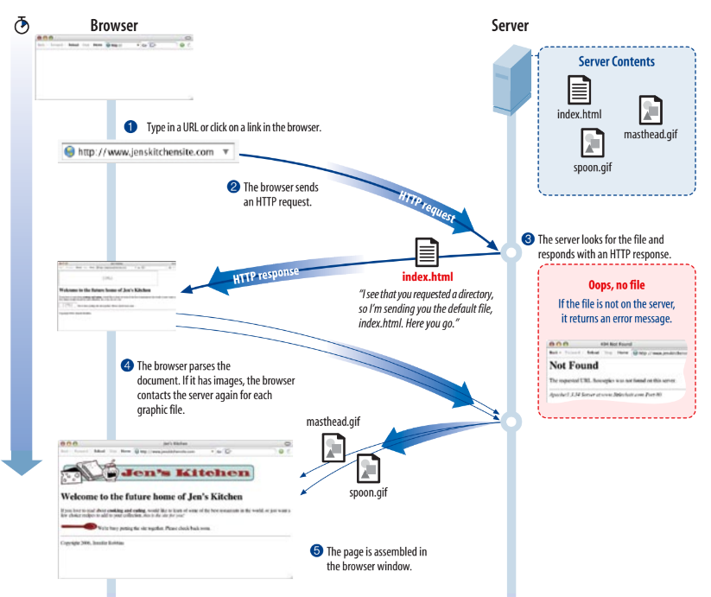
Hypertext Transport Protocol: HTTP

Slide 26
Hypertext Transport Protocol: HTTP
The information transmitted using HTTP is often entirely text
Can use the Internet’s Telnet protocol to simulate browser request and view server response

Slide 27
Hypertext Transport Protocol: HTTP
Connect
{
$ telnet www.example.org 80
Trying 192.0.34.166...
Connected to www.example.com (192.0.34.166).
Escape character is ’^]’.
GET / HTTP/1.1
Host: www.example.org
HTTP/1.1 200 OK
Date: Thu, 09 Oct 2003 20:30:49 GMT
…
Send
Request
{
{
Receive
Response

Slide 28
HTTP Request
An HTTP client sends an HTTP request to a server in the form of a request message.
Structure of the request:
  start line
  header field(s) (one or more)
  blank line
  Message body (optional)

Slide 29
HTTP Request
Structure of the request:
  start line
  header field(s)
  blank line
  optional body
$ telnet www.example.org 80
Trying 192.0.34.166...
Connected to www.example.com (192.0.34.166).
Escape character is ’^]’.
GET / HTTP/1.1
Host: www.example.org
HTTP/1.1 200 OK
Date: Thu, 09 Oct 2003 20:30:49 GMT
…

Slide 30
HTTP Request: Start line
Start line
  Example: GET / HTTP/1.1
Three space-separated parts:
  HTTP request method
  Request-URI
  HTTP version
    We will cover 1.1, in which version part of start line must be exactly as shown (all capital letters and no white spaces)

Slide 31
HTTP Request: Start line
Start line
  Example: GET / HTTP/1.1
Three space-separated parts:
  HTTP request method
  Request-URI
  HTTP version

Slide 32
HTTP Request: Start line
Common request methods:
  GET
    Used if link is clicked or address typed in browser
    No body in request with GET method
  POST
    Used when submit button is clicked on a form
    Form information contained in body of request
  HEAD
    Requests that only header fields (no body) be returned in the response

Slide 33
HTTP Request: Start line
Start line
  Example: GET / HTTP/1.1
Three space-separated parts:
  HTTP request method
  Request-URI
  HTTP version

Slide 34
HTTP Request: Start line
Uniform Resource Identifier (URI)
  It identifies a resource either by location, or a name, or both.
  Syntax: scheme : scheme-depend-part
    Ex: In http://www.example.com/
    the scheme is http
  Request-URI is the portion of the requested URI that follows the host name (which is supplied by the required Host header field)
    Ex: / is Request-URI portion of http://www.example.com/

Slide 35
URI
URI’s are of two types:
  Uniform Resource Name (URN)
    Can be used to identify resources with unique names, such as books (which have unique ISBN’s)
    Scheme is urn
  Uniform Resource Locator (URL)
    Specifies location at which a resource can be found
    In addition to http, some other URL schemes are https, ftp, mailto, and file

Slide 36
HTTP Request: header field(s)
Structure of the request:
  start line
  header field(s)
  blank line
  optional body

Slide 37
HTTP Request: header field(s)
Header field structure:
  field name : field value
Syntax
  Field name is not case sensitive
  Field value may continue on multiple lines by starting continuation lines with white space
  Field values may contain MIME types, quality values, and wildcard characters (*’s)

Slide 38
Multipurpose Internet Mail Extensions (MIME)
Convention for specifying content type of a message
  In HTTP, typically used to specify content type of the body of the response
MIME content type syntax:
  top-level type / subtype
Examples: text/html, image/jpeg

Slide 39
HTTP Quality Values and Wildcards
Example header field with quality values:
Accept:
text/xml,text/html;q=0.9,
text/plain; q=0.8,image/jpeg,
image/gif;q=0.2,*/*;q=0.1
Quality value applies to all preceding items
Higher the value, higher the preference
Note use of wildcards to specify quality 0.1 for any MIME type not specified earlier

Slide 40
HTTP Request: header field(s)
Common header fields:
  Host: host name from URL (required)
  User-Agent: type of browser sending request
  Accept: MIME types of acceptable documents
  Connection: value close tells server to close connection after single request/response
  Content-Type: MIME type of (POST) body, normally application/x-www-form-urlencoded
  Content-Length: bytes in body
  Referer: URL of document containing link that supplied URI for this HTTP request

Slide 41
HTTP Response
Structure of the response:
  status line
  header field(s)
  blank line
  optional body

Slide 42
HTTP Response: Status line
Status line
  Example: HTTP/1.1 200 OK
Three space-separated parts:
  HTTP version
  status code
  reason phrase (intended for human use)

Slide 43
HTTP Response: Status line
Status code
  Three-digit number
  First digit is class of the status code:
    1=Informational
    2=Success
    3=Redirection (alternate URL is supplied)
    4=Client Error
    5=Server Error
  Other two digits provide additional information

Slide 44
HTTP Response: header field(s)
Structure of the response:
  status line
  header field(s)
  blank line
  optional body

Slide 45
HTTP Response: header field(s)
Common header fields:
  Connection, Content-Type, Content-Length
  Date: date and time at which response was generated (required)
  Location: alternate URI if status is redirection
  Last-Modified: date and time the requested resource was last modified on the server
  Expires: date and time after which the client’s copy of the resource will be out-of-date
  ETag: a unique identifier for this version of the requested resource (changes if resource changes)

Slide 46
Client Caching
A cache is a local copy of information obtained from some other source
Most web browsers use cache to store requested resources so that subsequent requests to the same resource will not necessarily require an HTTP request/response
  Ex: icon appearing multiple times in a Web page

Slide 47
Client Caching
Client
Server
Browser
1. HTTP request for image
Web
Server
2. HTTP response containing image
3. Store image
Cache

Slide 48
Client Caching
Client
Server
Browser
Web
Server
I need that
image
again…
Cache

Slide 49
Client Caching
Client
Server
Browser
Web
Server
This…
HTTP request for image
I need that
image
again…
HTTP response containing image
Cache

Slide 50
Client Caching
Client
Server
Browser
Web
Server
I need that
image
again…
Get
image
… or this
Cache

Slide 51
Client Caching
Cache advantages
  (Much) faster than HTTP request/response
  Less network traffic
  Less load on server
Cache disadvantage
  Cached copy of resource may be invalid (inconsistent with remote version)

Slide 52
Client Caching
Validating cached resource:
  Send HTTP HEAD request and check Last-Modified or ETag header in response
  Compare current date/time with Expires header sent in response containing resource
  If no Expires header was sent, use heuristic algorithm to estimate value for Expires
    Ex: Expires = 0.01 * (Date – Last-Modified) + Date

Slide 53
Character Sets
Every document is represented by a string of integer values (code points)
The mapping from code points to characters is defined by a character set
Some header fields have character set values:
  Accept-Charset: request header listing character sets that the client can recognize
    Ex: accept-charset: ISO-8859-1,utf-8;q=0.7,*;q=0.7
  Content-Type: can include character set used to represent the body of the HTTP message
    Ex: Content-Type: text/html; charset=UTF-8

Slide 54
Character Sets
Technically, many “character sets” are actually character encodings
  An encoding represents code points using variable-length byte strings
  Most common examples are Unicode-based encodings UTF-8 and UTF-16
IANA maintains complete list of Internet-recognized character sets/encodings

Slide 55
Character Sets
Typical US PC produces ASCII documents
US-ASCII character set can be used for such documents, but is not recommended
UTF-8 and ISO-8859-1 are supersets of US-ASCII and provide international compatibility
  UTF-8 can represent all ASCII characters using a single byte each and arbitrary Unicode characters using up to 4 bytes each
  ISO-8859-1 is 1-byte code that has many characters common in Western European languages, such as é

Slide 56
Web Clients
Many possible web clients:
  Text-only “browser” (lynx)
  Mobile phones
  Robots (software-only clients, e.g., search engine “crawlers”)
  etc.
We will focus on traditional web browsers

Slide 57
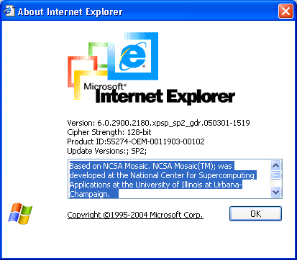
Web Browsers
First graphical browser running on general-purpose platforms: Mosaic (1993)

Slide 58
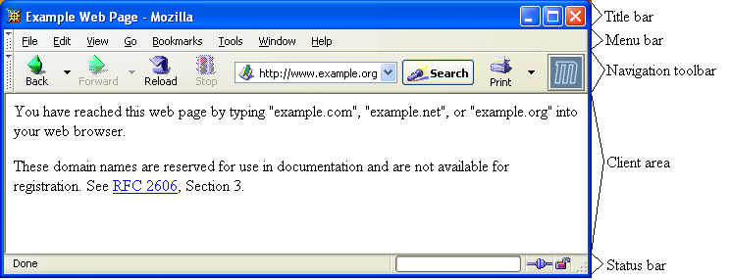
Web Browsers

Slide 59
Web Browsers
Primary tasks:
  Convert web addresses (URL’s) to HTTP requests
  Communicate with web servers via HTTP
  Render (appropriately display) documents returned by a server

Slide 60
HTTP URL’s
http://www.example.org:56789/a/b/c.txt?t=win&s=chess#para5
host (FQDN)
port
path
query
fragment
authority
Request-URI
Browser uses authority to connect via TCP
Request-URI included in start line (/ used for path if none supplied)
Fragment identifier not sent to server (used to scroll browser client area)

Slide 61
Web Browsers
Standard features
  Save web page to disk
  Find string in page
  Fill forms automatically (passwords, CC numbers, …)
  Set preferences (language, character set, cache and HTTP parameters)
  Modify display style (e.g., increase font sizes)
  Display raw HTML and HTTP header info (e.g., Last-Modified)
  Choose browser themes (skins)
  View history of web addresses visited
  Bookmark favorite pages for easy return

Slide 62
Web Browsers
Additional functionality:
  Execution of scripts (e.g., drop-down menus)
  Event handling (e.g., mouse clicks)
  GUI for controls (e.g., buttons)
  Secure communication with servers
  Display of non-HTML documents (e.g., PDF) via plug-ins

Slide 63
Web Servers
Basic functionality:
  Receive HTTP request via TCP
  Map Host header to specific virtual host (one of many host names sharing an IP address)
  Map Request-URI to specific resource associated with the virtual host
    File: Return file in HTTP response
    Program: Run program and return output in HTTP response
  Map type of resource to appropriate MIME type and use to set Content-Type header in HTTP response
  Log information about the request and response

Slide 64
Web Servers
httpd: UIUC, primary Web server c. 1995
Apache: “A patchy” version of httpd, now the most popular server (esp. on Linux platforms)
IIS: Microsoft Internet Information Server
Tomcat:
  Java-based
  Provides container (Catalina) for running Java servlets (HTML-generating programs) as back-end to Apache or IIS
  Can run stand-alone using Coyote HTTP front-end

Slide 65
Web Servers
Some Coyote communication parameters:
  Allowed/blocked IP addresses
  Max. simultaneous active TCP connections
  Max. queued TCP connection requests
  “Keep-alive” time for inactive TCP connections
Modify parameters to tune server performance

Slide 66
Web Servers
Some Catalina container parameters:
  Virtual host names and associated ports
  Logging preferences
  Mapping from Request-URI’s to server resources
  Password protection of resources
  Use of server-side caching

Slide 67
Tomcat Web Server
HTML-based server administration
Browse to
http://localhost:8080
and click on Server Administration link
  localhost is a special host name that means “this machine”

Slide 68
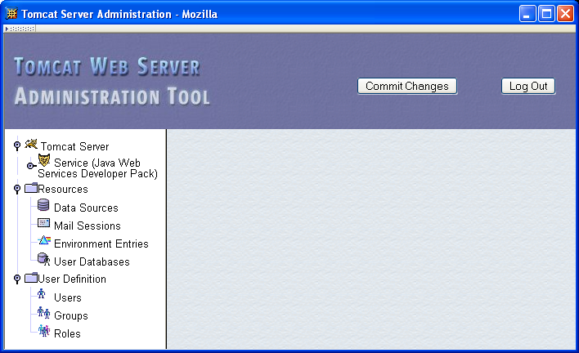
Tomcat Web Server

Slide 69
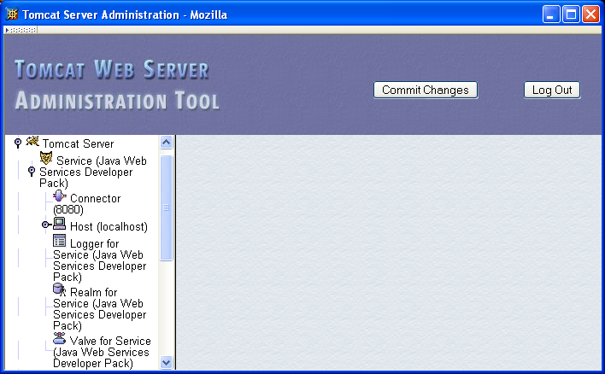
Tomcat Web Server

Slide 70
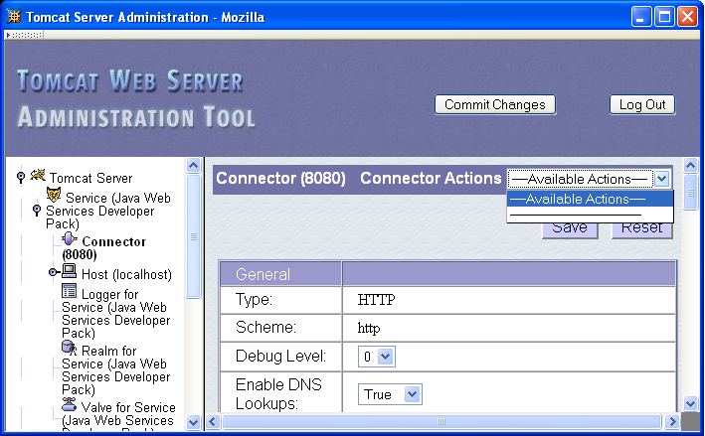
Tomcat Web Server

Slide 71
Tomcat Web Server
Some Connector fields:
  Port Number: port “owned” by this connector
  Max Threads: max connections processed simultaneously
  Connection Timeout: keep-alive time

Slide 72
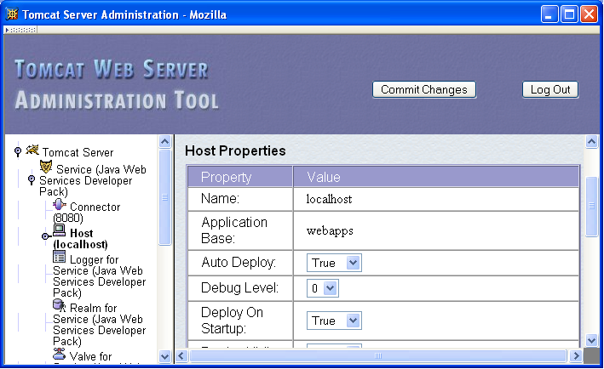
Tomcat Web Server

Slide 73
Tomcat Web Server
Each Host is a virtual host (can have multiple per Connector)
Some fields:
  Host: localhost or a fully qualified domain name
  Application Base: directory (may be path relative to JWSDP installation directory) containing resources associated with this Host

Slide 74
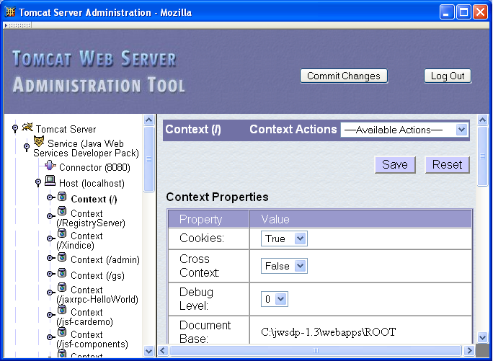
Tomcat Web Server

Slide 75
Tomcat Web Server
Context provides mapping from Request-URI path to a web application
Document Base field is directory (possibly relative to Application Base) that contains resources for this web application
For this example, browsing to
http://localhost:8080/
returns resource from
c:\jwsdp-1.3\webapps\ROOT
  Returns index.html (standard welcome file)

Slide 76
Tomcat Web Server
Access log records HTTP requests
Parameters set using AccessLogValve
Default location: logs/access_log.* under JWSDP installation directory
Example “common” log format entry (one line):
www.example.org - admin
[20/Jul/2005:08:03:22 -0500]
"GET /admin/frameset.jsp HTTP/1.1"
200 920

Slide 77
Tomcat Web Server
Other logs provided by default in JWSDP:
  Message log messages sent to log service by web applications or Tomcat itself
    logs/jwsdp_log.*: default message log
    logs/localhost_admin_log.*: message log for web apps within /admin context
  System.out and System.err output (exception traces often found here):
    logs/launcher.server.log

Slide 78
Tomcat Web Server
Access control:
  Password protection (e.g., admin pages)
    Users and roles defined in
    conf/tomcat-users.xml
  Deny access to machines
    Useful for denying access to certain users by denying access from the machines they use
    List of denied machines maintained in RemoteHostValve (deny by host name) or RemoteAddressValve (deny by IP address)

Slide 79
Secure Servers
Since HTTP messages typically travel over a public network, private information (such as credit card numbers) should be encrypted to prevent eavesdropping
https URL scheme tells browser to use encryption
Common encryption standards:
  Secure Socket Layer (SSL)
  Transport Layer Security (TLS)

Slide 80
Secure Servers
Browser
TLS/
SSL
I’d like to talk securely to you (over port 443)
TLS/
SSL
Web
Server
HTTP
Requests
Here’s my certificate and encryption data
HTTP
Requests
Here’s an encrypted HTTP request
Here’s an encrypted HTTP response
Here’s an encrypted HTTP request
HTTP
Responses
HTTP
Responses
Here’s an encrypted HTTP response

Slide 81
Secure Servers
Man-in-the-Middle Attack
Fake
DNS
Server
Fake
www.example.org
100.1.1.1
What’s IP
address for
www.example.org?
100.1.1.1
My credit card number is…
Browser
Real
www.example.org

Slide 82
Secure Servers
Preventing Man-in-the-Middle
Fake
DNS
Server
Fake
www.example.org
100.1.1.1
What’s IP
address for
www.example.org?
100.1.1.1
Send me a certificate of identity
Browser
Real
www.example.org

Slide 83
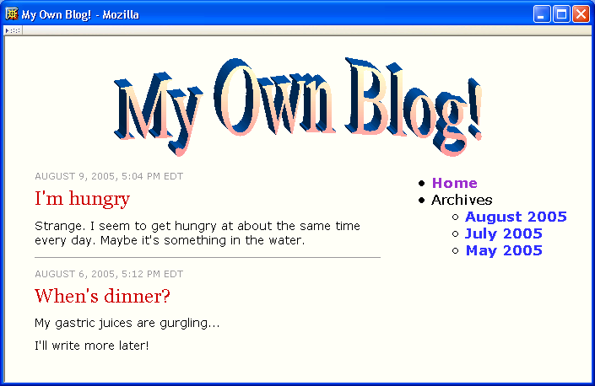
Case Study

Slide 84
Case Study
What web server will we use?
  Tomcat
What web browsers will we support?
  IE6, Mozilla
What level of security will we implement?
  Non-secure (http scheme)
  Password required to add to blog

