Slide 1
Systems Analysis and Design
Alan Dennis, Barbara Haley Wixom, and Roberta Roth
John Wiley & Sons, Inc.
Slides by Candace S. Garrod
Red Rocks Community College
PowerPoint Presentation for Dennis, Wixom, & Roth Systems Analysis and Design, 4th Edition
Copyright 2009© John Wiley & Sons, Inc. All rights reserved.
9 - *

Slide 2
User Interface Design
Chapter 9
PowerPoint Presentation for Dennis, Wixom, & Roth Systems Analysis and Design, 4th Edition
Copyright 2009© John Wiley & Sons, Inc. All rights reserved.
9 - *
Notes:
*

Slide 3
Key Definitions
The user interface defines how the system will interact with external entities
The system interfaces define how systems exchange information with other systems
PowerPoint Presentation for Dennis, Wixom, & Roth Systems Analysis and Design, 4th Edition
Copyright 2009© John Wiley & Sons, Inc. All rights reserved.
9 - *

Slide 4
Key Definitions
The navigation mechanism provides the way for users to tell the system what to do
The input mechanism defines the way the system captures information
The output mechanism defines the way the system provides information to users or other systems
PowerPoint Presentation for Dennis, Wixom, & Roth Systems Analysis and Design, 4th Edition
Copyright 2009© John Wiley & Sons, Inc. All rights reserved.
9 - *

Slide 5
Key Definitions
Graphical user interface (GUI) is the most common type of interfaces most students are likely to use personally and for developing systems.
PowerPoint Presentation for Dennis, Wixom, & Roth Systems Analysis and Design, 4th Edition
Copyright 2009© John Wiley & Sons, Inc. All rights reserved.
9 - *

Slide 6
PRINCIPLES FOR USER INTERFACE DESIGN
PowerPoint Presentation for Dennis, Wixom, & Roth Systems Analysis and Design, 4th Edition
Copyright 2009© John Wiley & Sons, Inc. All rights reserved.
9 - *
Notes:
*

Slide 7
Principles for User Interface Design
Layout
Content awareness
Aesthetics
User experience
Consistency
Minimize user effort
PowerPoint Presentation for Dennis, Wixom, & Roth Systems Analysis and Design, 4th Edition
Copyright 2009© John Wiley & Sons, Inc. All rights reserved.
9 - *

Slide 8
Layout Concepts
The screen is often divided into three boxes
  Navigation area (top)
  Status area (bottom)
  Work area (middle)
Information can be presented in multiple areas
Like areas should be grouped together
PowerPoint Presentation for Dennis, Wixom, & Roth Systems Analysis and Design, 4th Edition
Copyright 2009© John Wiley & Sons, Inc. All rights reserved.
9 - *

Slide 9
More Layout Concepts
Areas and information should minimize user movement from one to another
Ideally, areas will remain consistent in
  Size
  Shape
  Placement for entering data
  Reports presenting retrieved data
PowerPoint Presentation for Dennis, Wixom, & Roth Systems Analysis and Design, 4th Edition
Copyright 2009© John Wiley & Sons, Inc. All rights reserved.
9 - *

Slide 10
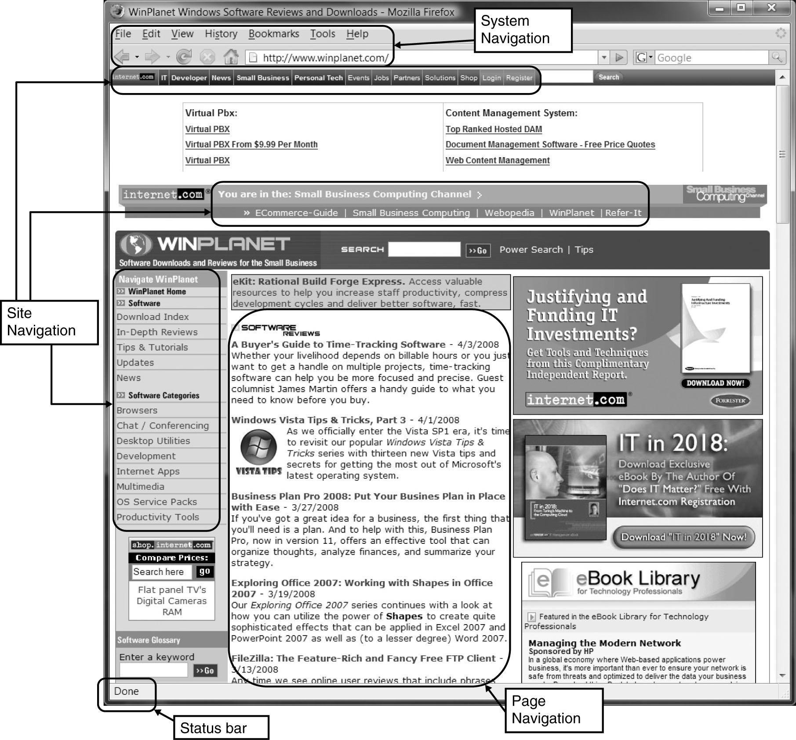
PowerPoint Presentation for Dennis, Wixom, & Roth Systems Analysis and Design, 4th Edition
Copyright 2009© John Wiley & Sons, Inc. All rights reserved.
9 - *

Slide 11
Content Awareness
All interfaces should have titles
Menus should show
  where you are
  where you came from to get there
It should be clear what information is within each area
Fields and field labels should be selected carefully
Use dates and version numbers to aid system users
PowerPoint Presentation for Dennis, Wixom, & Roth Systems Analysis and Design, 4th Edition
Copyright 2009© John Wiley & Sons, Inc. All rights reserved.
9 - *

Slide 12
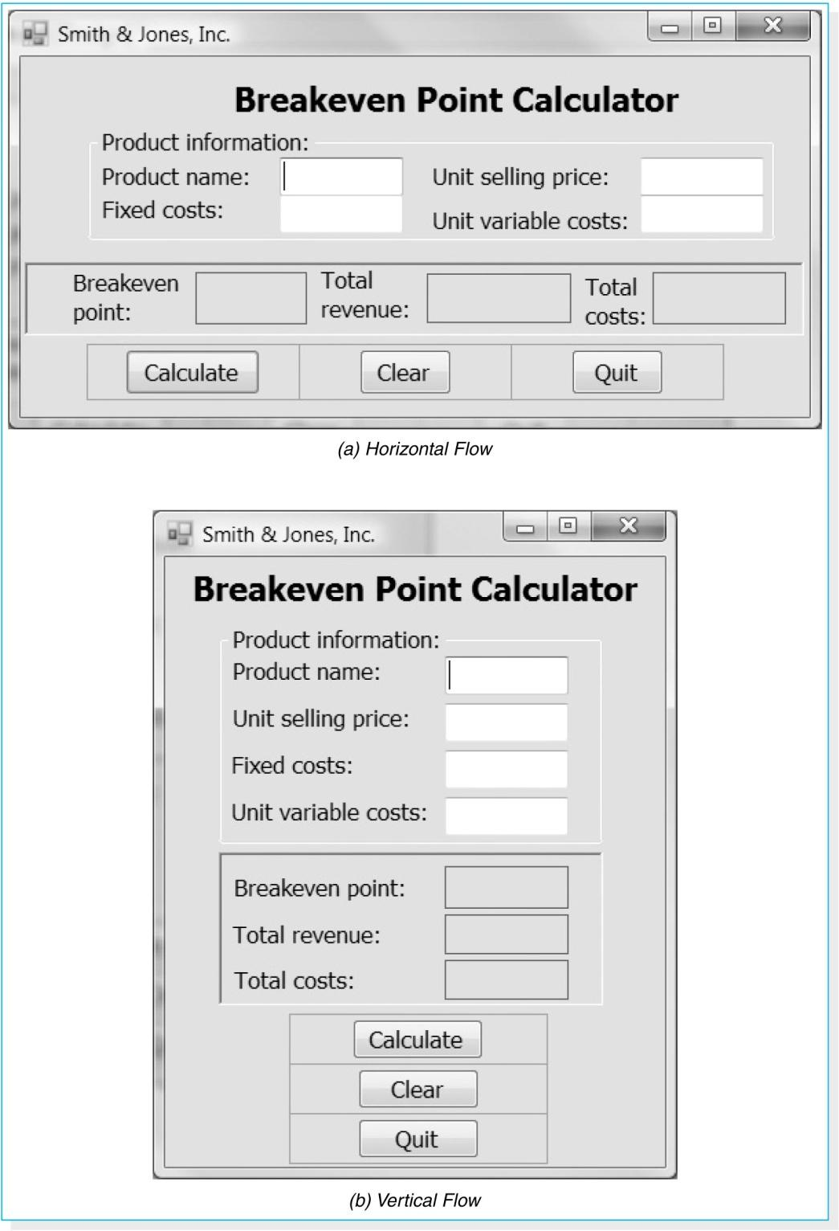
PowerPoint Presentation for Dennis, Wixom, & Roth Systems Analysis and Design, 4th Edition
Copyright 2009© John Wiley & Sons, Inc. All rights reserved.
9 - *

Slide 13
Aesthetics
Interfaces need to be functional and inviting to use
Avoid squeezing in too much, particularly for novice users
Design text carefully
  Be aware of font and size
  Avoid using all capital letters
PowerPoint Presentation for Dennis, Wixom, & Roth Systems Analysis and Design, 4th Edition
Copyright 2009© John Wiley & Sons, Inc. All rights reserved.
9 - *

Slide 14
More Aesthetics
Colors and patterns should be used carefully
  Test quality of colors by trying the interface on a black/white monitor
  Use colors to separate or categorize items
PowerPoint Presentation for Dennis, Wixom, & Roth Systems Analysis and Design, 4th Edition
Copyright 2009© John Wiley & Sons, Inc. All rights reserved.
9 - *

Slide 15
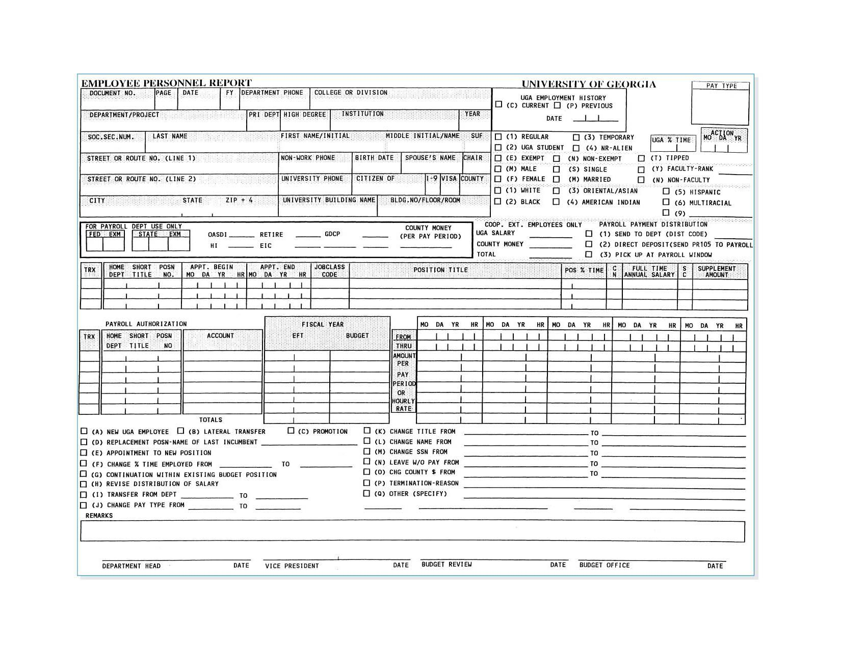
Form Example
PowerPoint Presentation for Dennis, Wixom, & Roth Systems Analysis and Design, 4th Edition
Copyright 2009© John Wiley & Sons, Inc. All rights reserved.
9 - *

Slide 16
User Experience
How easy is the program to learn?
How easy is the program to use for the expert?
Consider adding shortcuts for the expert
Where there is low employee turnover, some training can lessen the impact of less precise interfaces
PowerPoint Presentation for Dennis, Wixom, & Roth Systems Analysis and Design, 4th Edition
Copyright 2009© John Wiley & Sons, Inc. All rights reserved.
9 - *

Slide 17
Consistency
Enables users to predict what will happen
Reduces learning curve
Considers items within an application and across applications
Pertains to many different levels
  Navigation controls
  Terminology
  Report and form design
PowerPoint Presentation for Dennis, Wixom, & Roth Systems Analysis and Design, 4th Edition
Copyright 2009© John Wiley & Sons, Inc. All rights reserved.
9 - *

Slide 18
Minimize User Effort
Three clicks rule
  Users should be able to go from the start or main menu of a system to the information or action they want in no more than three mouse clicks or three keystrokes
PowerPoint Presentation for Dennis, Wixom, & Roth Systems Analysis and Design, 4th Edition
Copyright 2009© John Wiley & Sons, Inc. All rights reserved.
9 - *

Slide 19
USER INTERFACE DESIGN PROCESS
PowerPoint Presentation for Dennis, Wixom, & Roth Systems Analysis and Design, 4th Edition
Copyright 2009© John Wiley & Sons, Inc. All rights reserved.
9 - *
Notes:
*

Slide 20
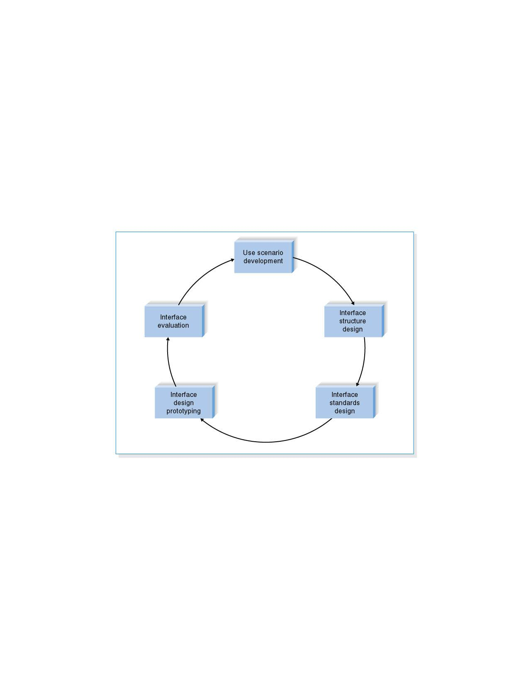
User Interface Design Process
PowerPoint Presentation for Dennis, Wixom, & Roth Systems Analysis and Design, 4th Edition
Copyright 2009© John Wiley & Sons, Inc. All rights reserved.
9 - *

Slide 21
Use Scenario Development
An outline of steps to perform work
Presented in a simple narrative tied through the related use case and DFD
Document the most common paths through the use case so interface designs will be easy to use for those situations
PowerPoint Presentation for Dennis, Wixom, & Roth Systems Analysis and Design, 4th Edition
Copyright 2009© John Wiley & Sons, Inc. All rights reserved.
9 - *

Slide 22
Interface Structure Design
A diagram showing how all screens, forms, and reports are related
Shows how user moves from one to another
Similar to DFD in using boxes and lines
Boxes denote screens
Lines show movement from one to another
Different from DFD in having no standard rules or format
PowerPoint Presentation for Dennis, Wixom, & Roth Systems Analysis and Design, 4th Edition
Copyright 2009© John Wiley & Sons, Inc. All rights reserved.
9 - *

Slide 23
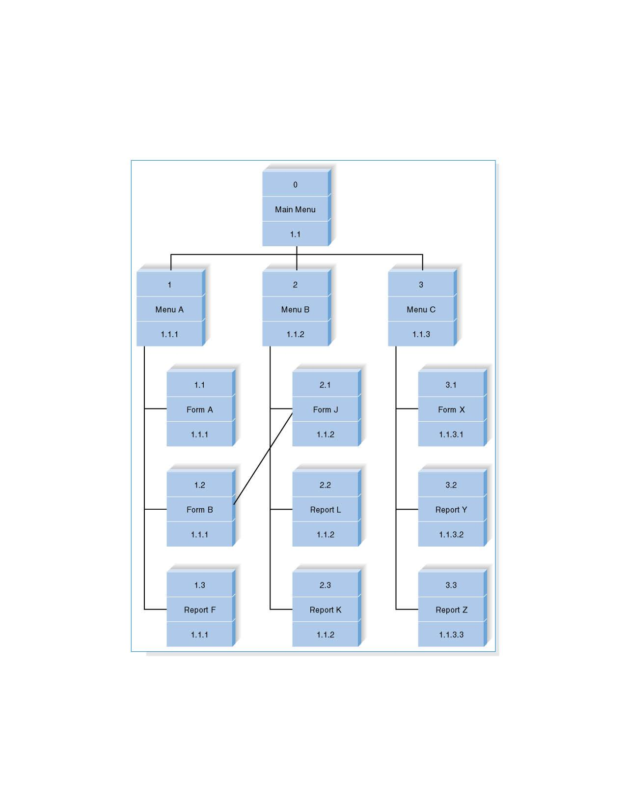
Interface Structure Diagram Example
PowerPoint Presentation for Dennis, Wixom, & Roth Systems Analysis and Design, 4th Edition
Copyright 2009© John Wiley & Sons, Inc. All rights reserved.
9 - *

Slide 24
Interface Standards Design
The basic elements that are common across individual screens, forms, and reports within the application
Interface metaphor
  Desktop, checkbook, shopping cart
Interface objects
Interface actions
Interface icons
Interface templates
PowerPoint Presentation for Dennis, Wixom, & Roth Systems Analysis and Design, 4th Edition
Copyright 2009© John Wiley & Sons, Inc. All rights reserved.
9 - *

Slide 25
Interface Design Prototyping
A mock-up or simulation of screen, form, or report
Common methods include
  Paper
  Storyboarding
  HTML prototype
  Language prototype
PowerPoint Presentation for Dennis, Wixom, & Roth Systems Analysis and Design, 4th Edition
Copyright 2009© John Wiley & Sons, Inc. All rights reserved.
9 - *

Slide 26
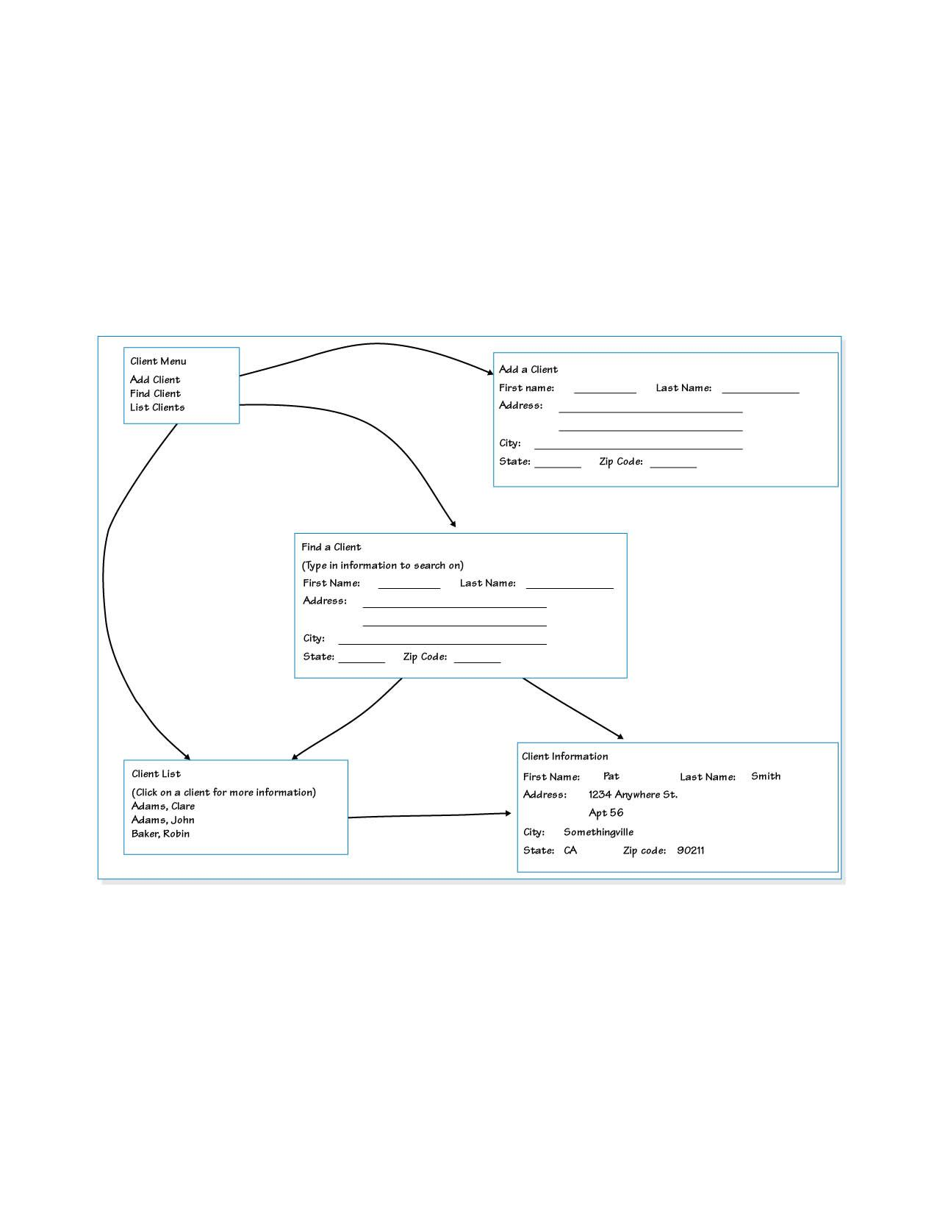
Storyboard Example
PowerPoint Presentation for Dennis, Wixom, & Roth Systems Analysis and Design, 4th Edition
Copyright 2009© John Wiley & Sons, Inc. All rights reserved.
9 - *

Slide 27
HTML Prototype
Built with the use of Web pages created in HTML
The user uses HTML to create a series of Web pages that show the fundamental parts of the system.
The users have the ability to interact with the pages by clicking on buttons and entering pretend data.
PowerPoint Presentation for Dennis, Wixom, & Roth Systems Analysis and Design, 4th Edition
Copyright 2009© John Wiley & Sons, Inc. All rights reserved.
9 - *

Slide 28
Language Prototype
An interface design prototype built in the actual language or by the actual tool that will be used to build the system.
Language prototypes are designed in the same ways as HTML prototypes
PowerPoint Presentation for Dennis, Wixom, & Roth Systems Analysis and Design, 4th Edition
Copyright 2009© John Wiley & Sons, Inc. All rights reserved.
9 - *

Slide 29
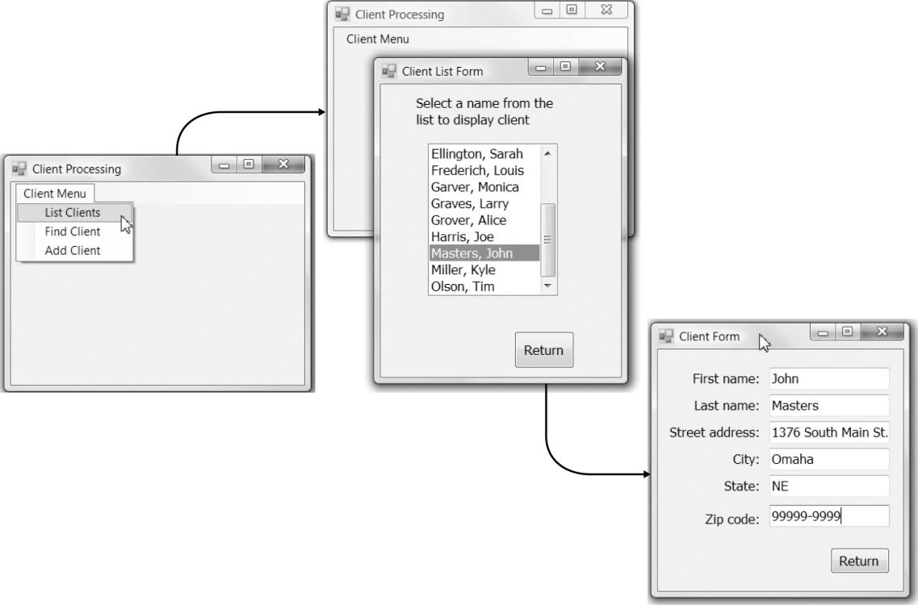
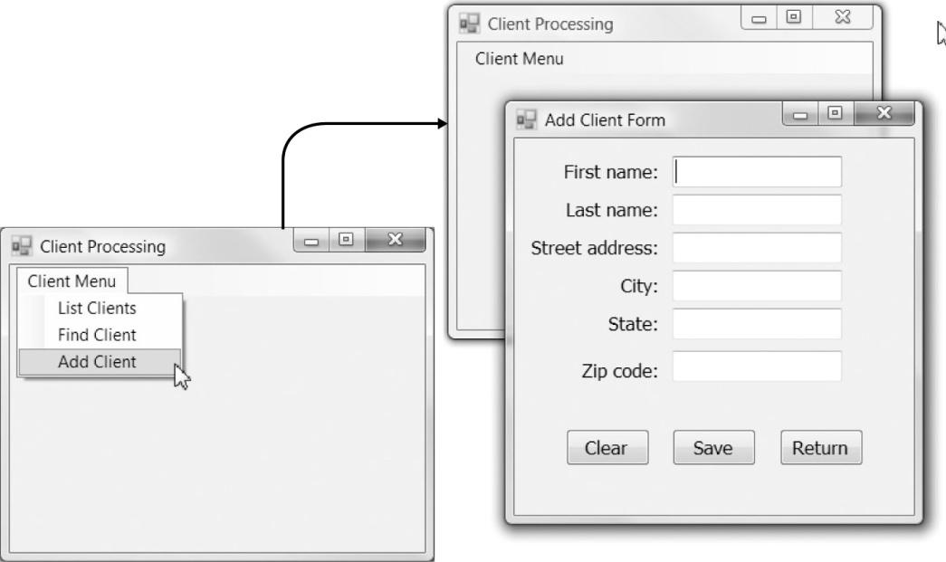
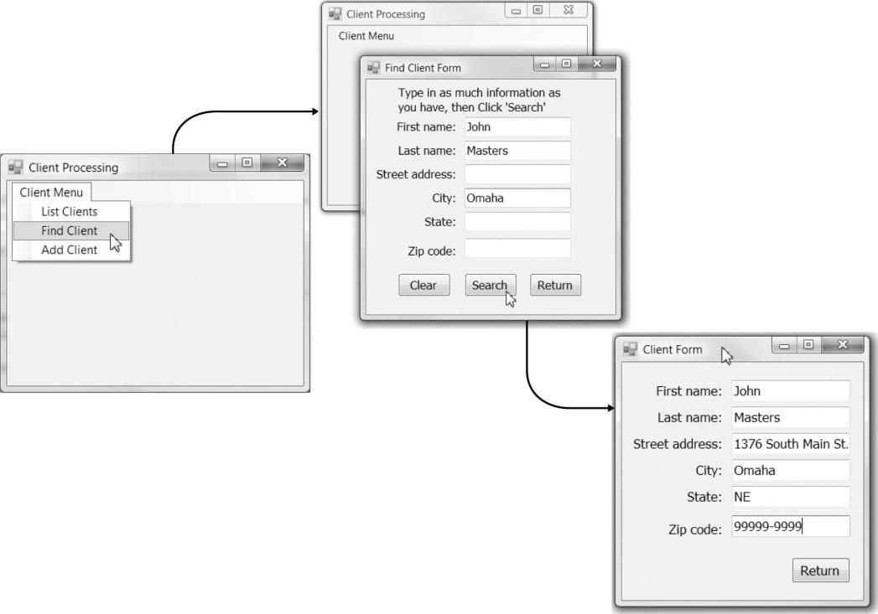
PowerPoint Presentation for Dennis, Wixom, & Roth Systems Analysis and Design, 4th Edition
Copyright 2009© John Wiley & Sons, Inc. All rights reserved.
9 - *

Slide 30
Interface Evaluation
Heuristic evaluation
  Compare design to checklist
Walkthrough evaluation
  Team simulates movement through components
Interactive evaluation
  Users try out the system
Formal usability testing
  Expensive
  Detailed use of special lab testing
PowerPoint Presentation for Dennis, Wixom, & Roth Systems Analysis and Design, 4th Edition
Copyright 2009© John Wiley & Sons, Inc. All rights reserved.
9 - *

Slide 31
NAVIGATION DESIGN
PowerPoint Presentation for Dennis, Wixom, & Roth Systems Analysis and Design, 4th Edition
Copyright 2009© John Wiley & Sons, Inc. All rights reserved.
9 - *
Notes:
*

Slide 32
Basic Principles of Navigation Design
Assume users
  Have not read the manual
  Have not attended training
  Do not have external help readily at hand
All controls should be clear and understandable and placed in an intuitive location on the screen.
PowerPoint Presentation for Dennis, Wixom, & Roth Systems Analysis and Design, 4th Edition
Copyright 2009© John Wiley & Sons, Inc. All rights reserved.
9 - *

Slide 33
Basic Principles of Navigation Design
Prevent mistakes
  Limit choices
  Never display commands that can’t be used (or “gray them out”)
  Confirm actions that are difficult or impossible to undo
Simplify recovery from mistakes
Use consistent grammar order
PowerPoint Presentation for Dennis, Wixom, & Roth Systems Analysis and Design, 4th Edition
Copyright 2009© John Wiley & Sons, Inc. All rights reserved.
9 - *

Slide 34
Types of Navigation Control
Languages
  Command language
  Natural language
Menus
  Generally aim at broad shallow menu
  Consider using “hot keys”
Direct Manipulation
  Used with icons to start programs
  Used to shape and size objects
  May not be intuitive for all commands
PowerPoint Presentation for Dennis, Wixom, & Roth Systems Analysis and Design, 4th Edition
Copyright 2009© John Wiley & Sons, Inc. All rights reserved.
9 - *

Slide 35
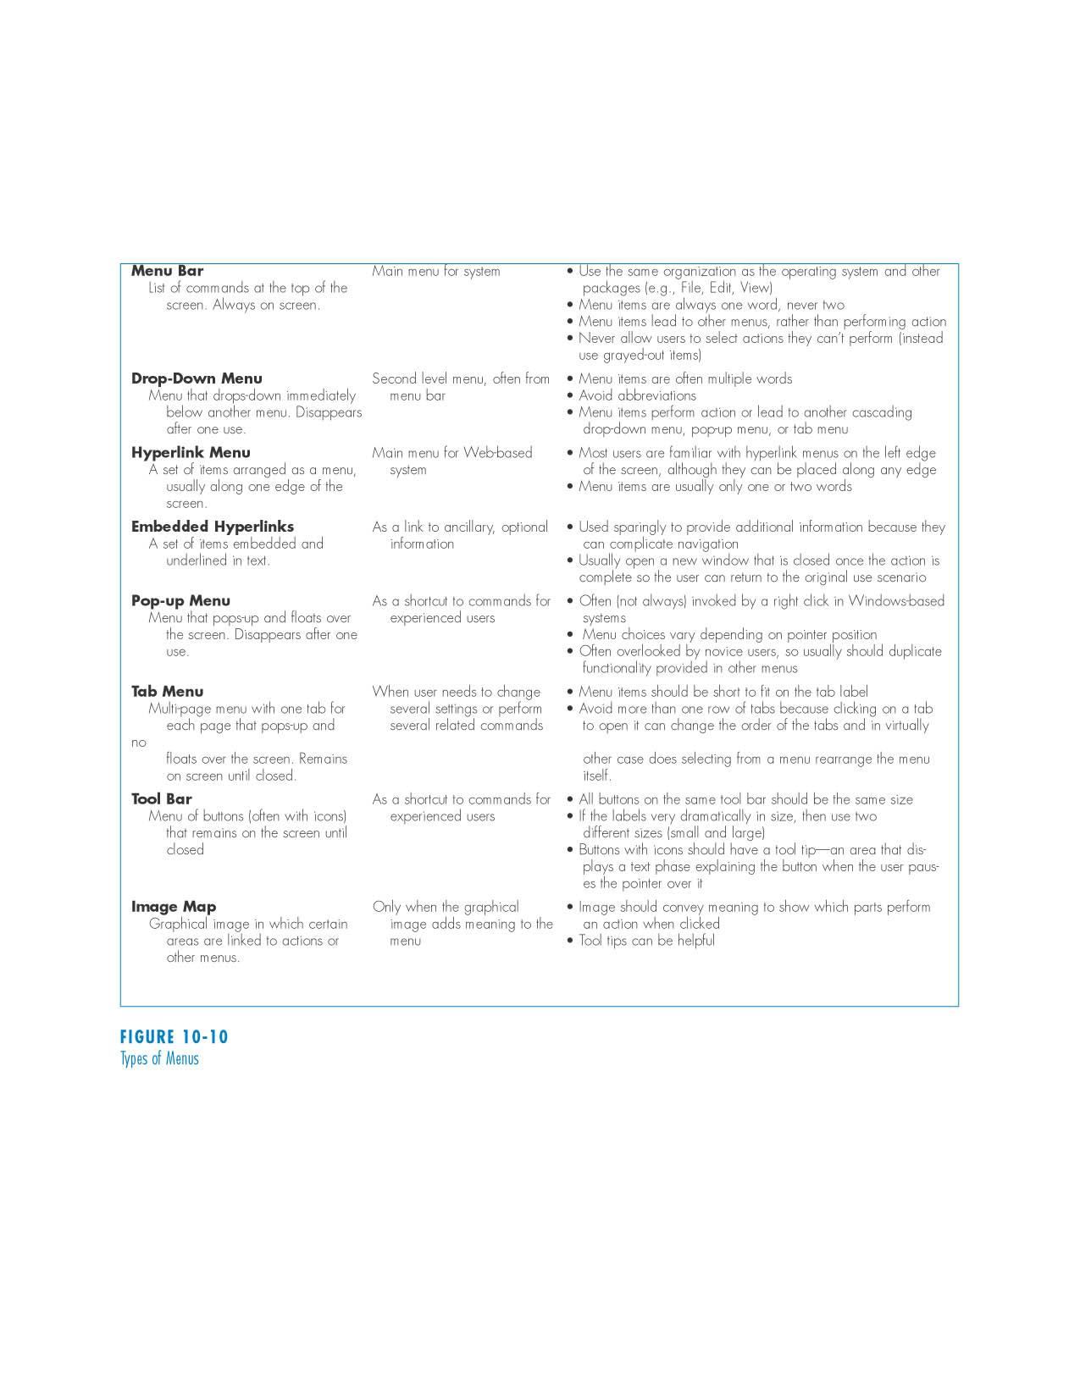
Types of Menus
PowerPoint Presentation for Dennis, Wixom, & Roth Systems Analysis and Design, 4th Edition
Copyright 2009© John Wiley & Sons, Inc. All rights reserved.
9 - *

Slide 36
Message Tips
Should be clear, concise, and complete
Should be grammatically correct and free of jargon and abbreviations (unless they are the users)
Avoid negatives and humor
PowerPoint Presentation for Dennis, Wixom, & Roth Systems Analysis and Design, 4th Edition
Copyright 2009© John Wiley & Sons, Inc. All rights reserved.
9 - *

Slide 37
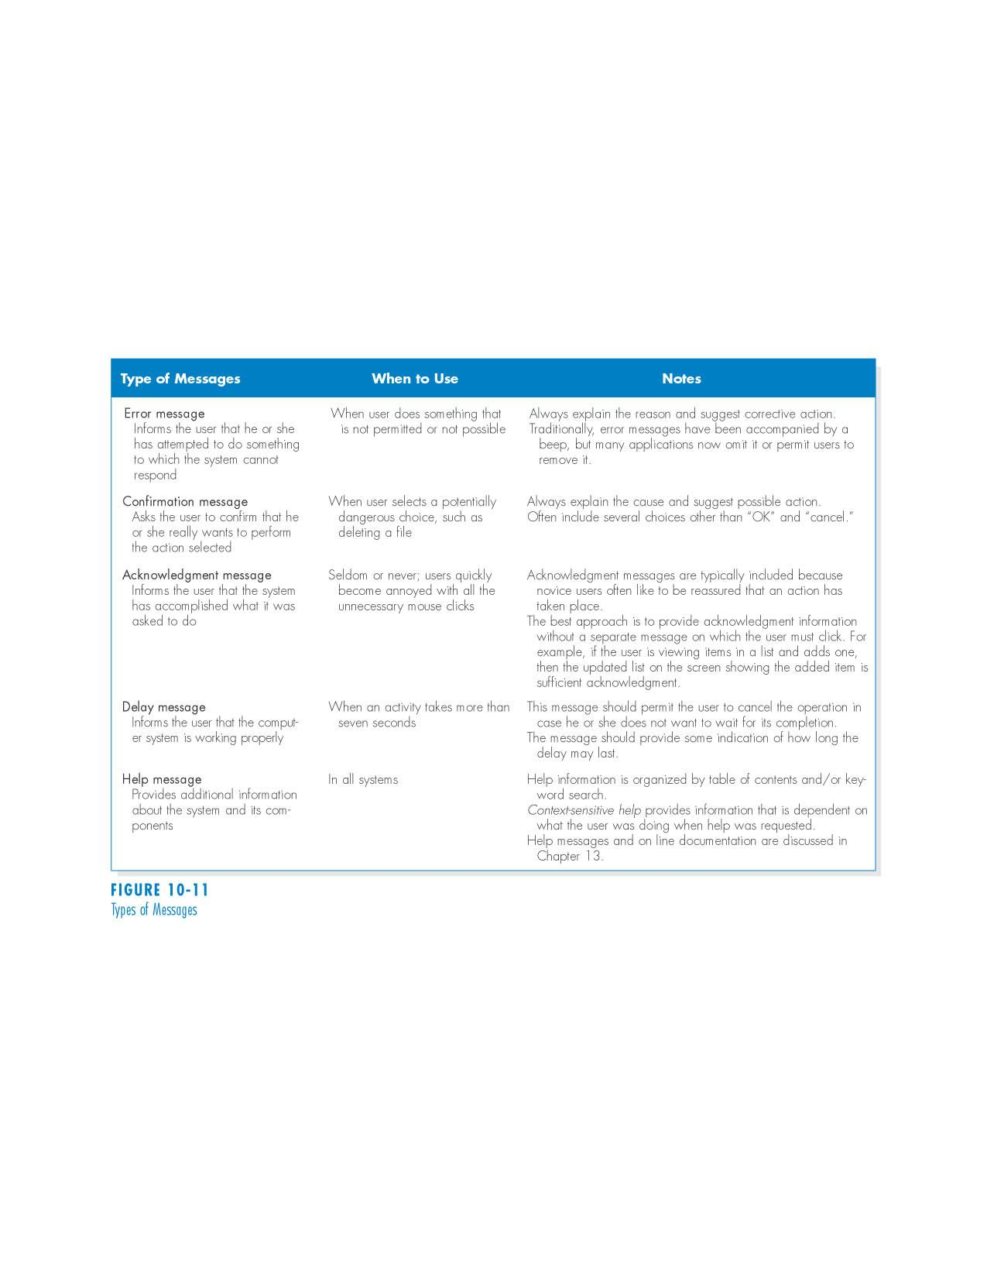
Types of Messages
PowerPoint Presentation for Dennis, Wixom, & Roth Systems Analysis and Design, 4th Edition
Copyright 2009© John Wiley & Sons, Inc. All rights reserved.
9 - *

Slide 38
INPUT DESIGN
PowerPoint Presentation for Dennis, Wixom, & Roth Systems Analysis and Design, 4th Edition
Copyright 2009© John Wiley & Sons, Inc. All rights reserved.
9 - *
Notes:
*

Slide 39
Basic Principles of Input Design
The goal is to simply and easily capture accurate information for the system
Reflect the nature of the inputs
Find ways to simplify their collection
PowerPoint Presentation for Dennis, Wixom, & Roth Systems Analysis and Design, 4th Edition
Copyright 2009© John Wiley & Sons, Inc. All rights reserved.
9 - *

Slide 40
Online versus Batch Processing
Online processing immediately records the transaction in the appropriate database
Batch processing collects inputs over time and enters them into the system at one time in a batch
Batch processing simplifies data communications and other processes, master files are not updated real time
PowerPoint Presentation for Dennis, Wixom, & Roth Systems Analysis and Design, 4th Edition
Copyright 2009© John Wiley & Sons, Inc. All rights reserved.
9 - *

Slide 41
Capture Data at the Source
Reduces duplicate work
Reduces processing time
Decreases cost
Decreases probability of error
PowerPoint Presentation for Dennis, Wixom, & Roth Systems Analysis and Design, 4th Edition
Copyright 2009© John Wiley & Sons, Inc. All rights reserved.
9 - *

Slide 42
Source Data Automation
Can be obtained by using the following technologies:
  bar code readers
  optical character recognition
  magnetic stripe readers
  smart cards
  RFID (radio frequency identification tags)
How can internet be used for source data automation?
PowerPoint Presentation for Dennis, Wixom, & Roth Systems Analysis and Design, 4th Edition
Copyright 2009© John Wiley & Sons, Inc. All rights reserved.
9 - *

Slide 43
Minimize Keystrokes
Never ask for information that can be obtained other ways
  Lookups
  Dropdown lists
  Default values
PowerPoint Presentation for Dennis, Wixom, & Roth Systems Analysis and Design, 4th Edition
Copyright 2009© John Wiley & Sons, Inc. All rights reserved.
9 - *

Slide 44
Types of Inputs
Data items linked to fields
Text
Numbers
Selection boxes
Check boxes
Radio buttons
On-screen list boxes
Drop-down list boxes
Combo boxes
Sliders
PowerPoint Presentation for Dennis, Wixom, & Roth Systems Analysis and Design, 4th Edition
Copyright 2009© John Wiley & Sons, Inc. All rights reserved.
9 - *

Slide 45
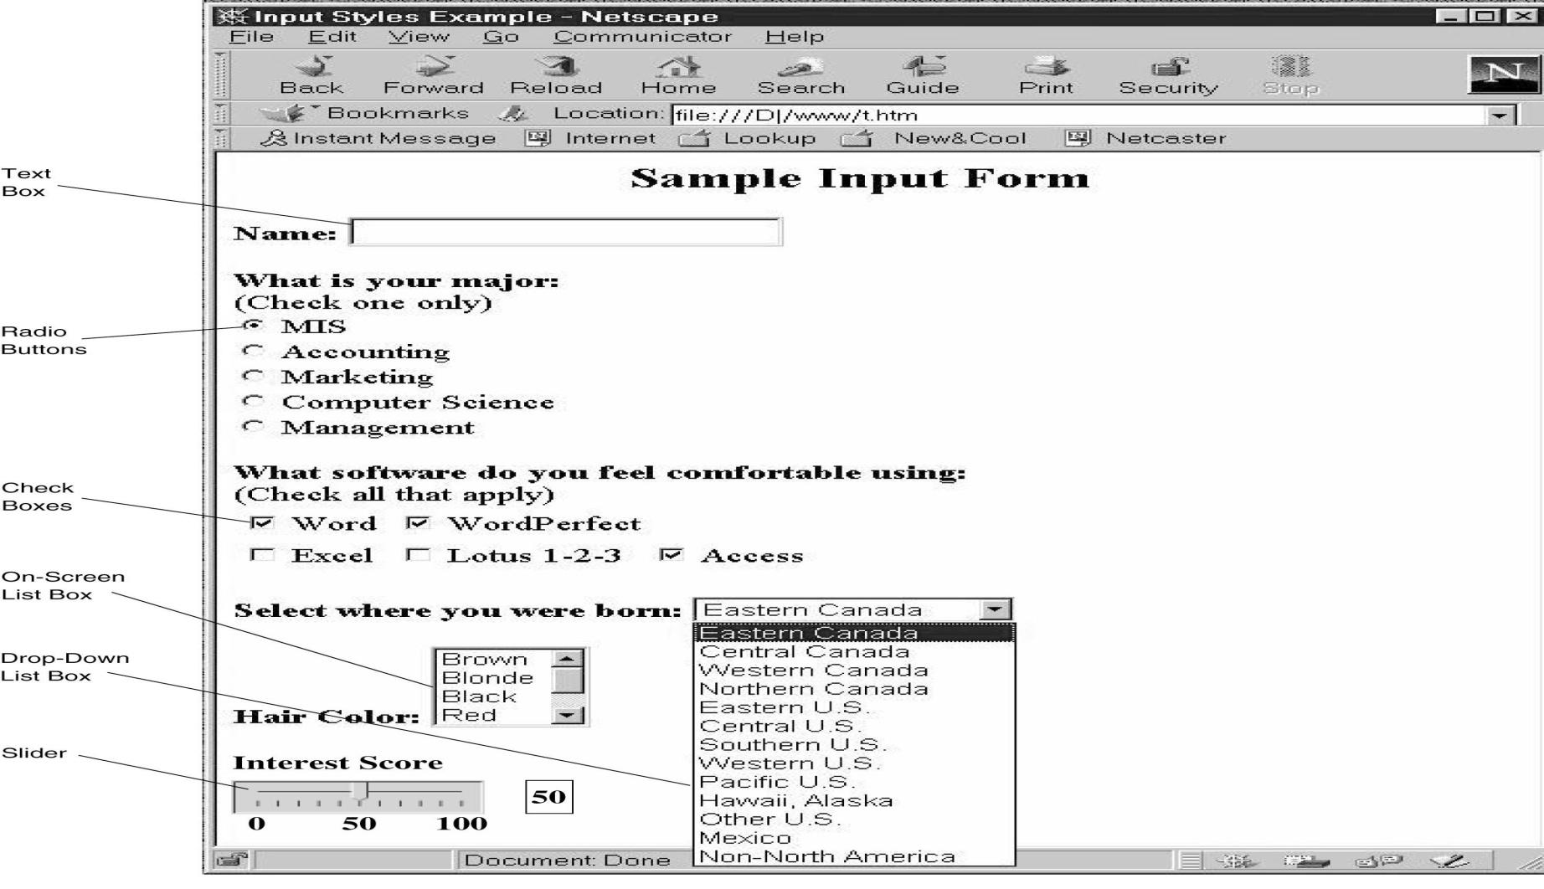
Types of Input Forms
PowerPoint Presentation for Dennis, Wixom, & Roth Systems Analysis and Design, 4th Edition
Copyright 2009© John Wiley & Sons, Inc. All rights reserved.
9 - *

Slide 46
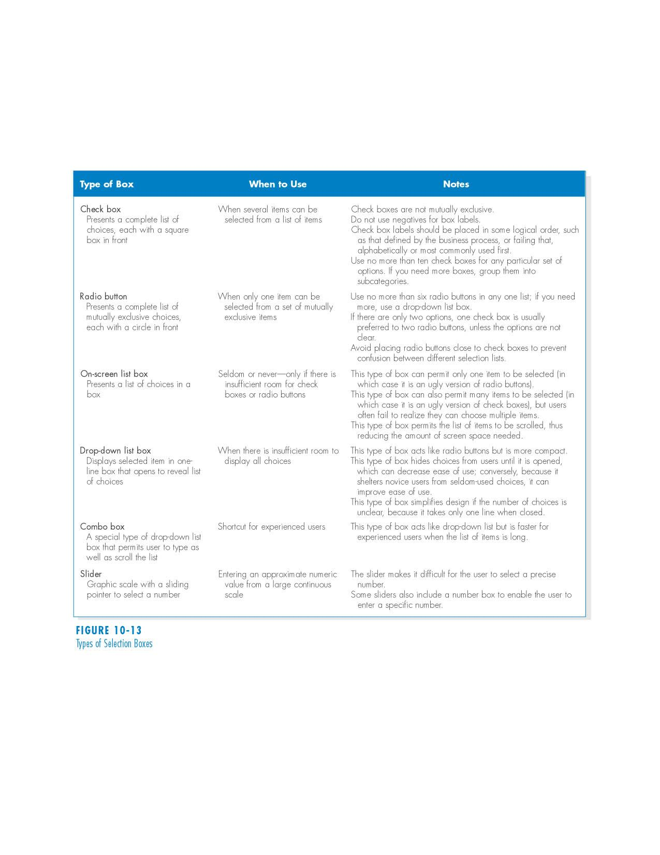
Types of Selection Boxes
PowerPoint Presentation for Dennis, Wixom, & Roth Systems Analysis and Design, 4th Edition
Copyright 2009© John Wiley & Sons, Inc. All rights reserved.
9 - *

Slide 47
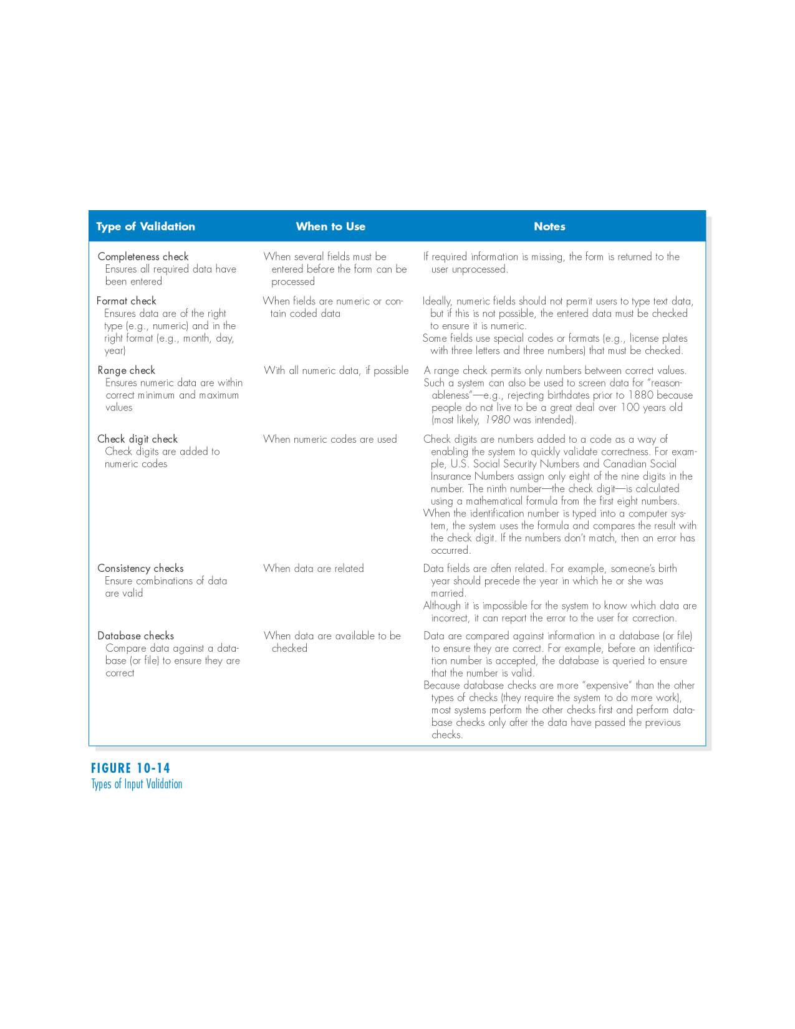
Types of Input Validation
PowerPoint Presentation for Dennis, Wixom, & Roth Systems Analysis and Design, 4th Edition
Copyright 2009© John Wiley & Sons, Inc. All rights reserved.
9 - *

Slide 48
OUTPUT DESIGN
PowerPoint Presentation for Dennis, Wixom, & Roth Systems Analysis and Design, 4th Edition
Copyright 2009© John Wiley & Sons, Inc. All rights reserved.
9 - *
Notes:
*

Slide 49
Basic Principles
Understand report usage
  Reference or cover-to-cover?
  Frequency?
  Real-time or batch reports?
Manage information load
  All needed information, no more
Minimize bias
PowerPoint Presentation for Dennis, Wixom, & Roth Systems Analysis and Design, 4th Edition
Copyright 2009© John Wiley & Sons, Inc. All rights reserved.
9 - *

Slide 50
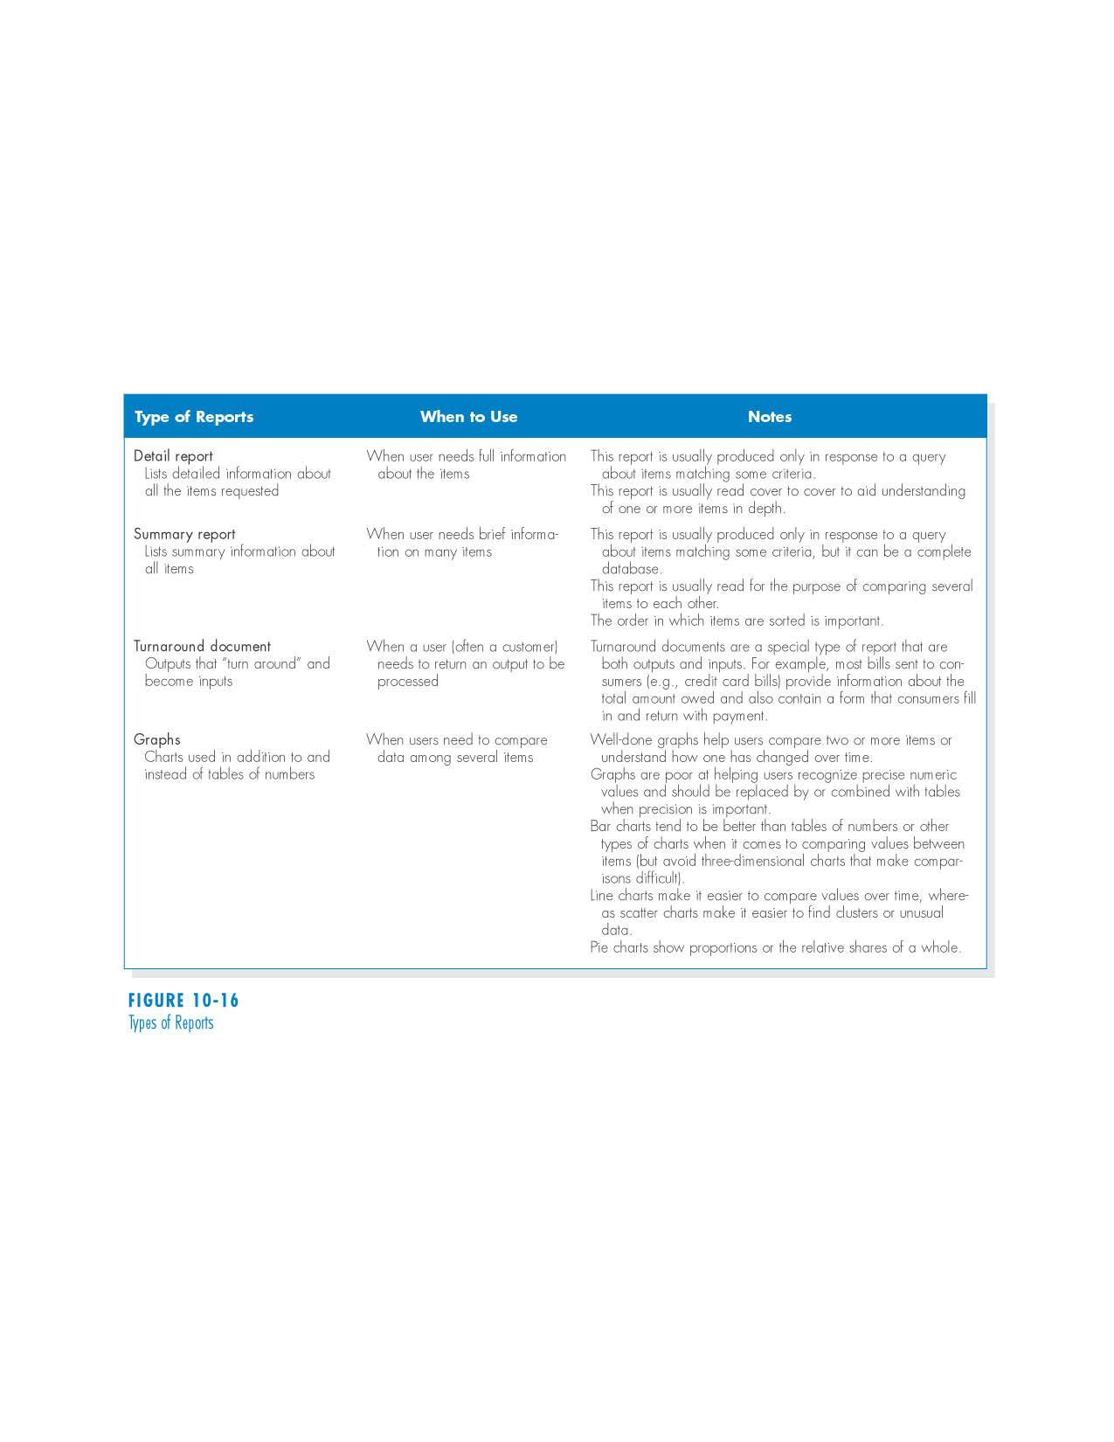
Types of Reports
PowerPoint Presentation for Dennis, Wixom, & Roth Systems Analysis and Design, 4th Edition
Copyright 2009© John Wiley & Sons, Inc. All rights reserved.
9 - *

Slide 51
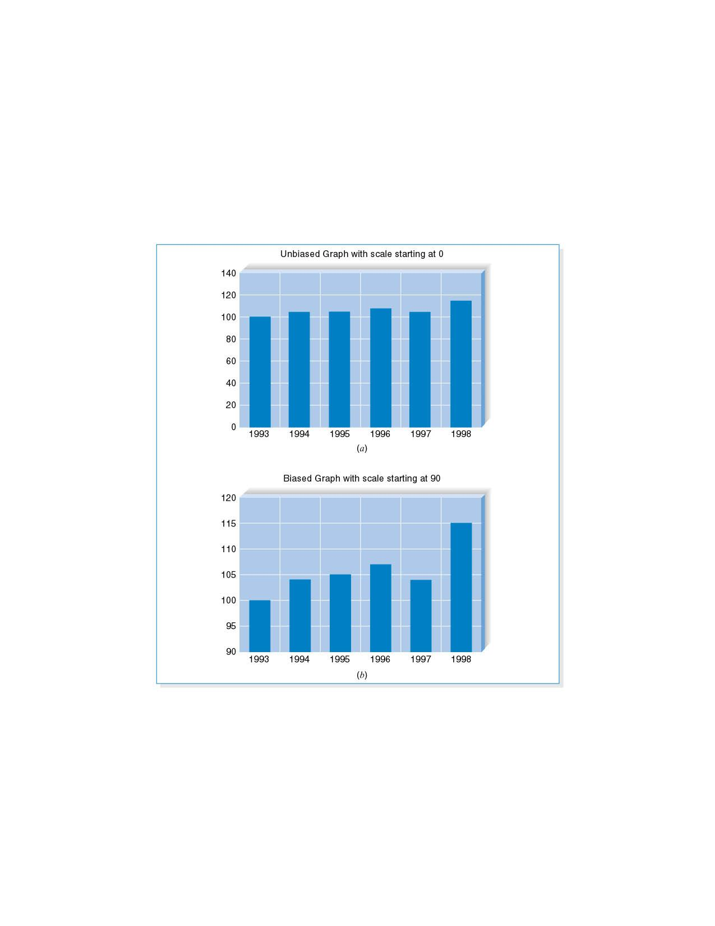
Bias in Graphs
PowerPoint Presentation for Dennis, Wixom, & Roth Systems Analysis and Design, 4th Edition
Copyright 2009© John Wiley & Sons, Inc. All rights reserved.
9 - *

Slide 52
Summary
The user interface should be designed to make the user’s work easier and more effective.
Principles for good interface design include concern for content and context for navigation through activities, aesthetic considerations, assistance for novices and experts, consistency, and minimizing user effort.
The design process focuses on user actions, diagramming the structure, setting up standards and a template, then evaluating interface designs.
PowerPoint Presentation for Dennis, Wixom, & Roth Systems Analysis and Design, 4th Edition
Copyright 2009© John Wiley & Sons, Inc. All rights reserved.
9 - *

Slide 53
Summary
The fundamental goal of navigation design is to make the system as simple to use as possible
The goal of input mechanism is to simply and easily capture accurate information
The goal of the output mechanism is to provide accurate information to users that minimize information overload and bias
PowerPoint Presentation for Dennis, Wixom, & Roth Systems Analysis and Design, 4th Edition
Copyright 2009© John Wiley & Sons, Inc. All rights reserved.
9 - *

Slide 54
Copyright © 2009
John Wiley & Sons, Inc.
All rights reserved. Reproduction or translation of this work beyond that permitted in Section 117 of the 1976 United States Copyright Act without the express written permission of the copyright owner is unlawful.
Request for further information should be addressed to the Permissions Department, John Wiley & Sons, Inc.
The purchaser may make back-up copies for his/her own use only and not for redistribution or resale.
The Publisher assumes no responsibility for errors, omissions, or damages, caused by the use of these programs or from the use of the information contained herein.
PowerPoint Presentation for Dennis, Wixom, & Roth Systems Analysis and Design, 4th Edition
Copyright 2009© John Wiley & Sons, Inc. All rights reserved.
9 - *
PowerPoint Presentation for Dennis, Wixom, & Roth Systems Analysis and Design, 4th Edition
Copyright 2009© John Wiley & Sons, Inc. All rights reserved.
9 - *
Notes:
*

