Slide 1
Systems Analysis and Design 3rd Edition
Alan Dennis, Barbara Haley Wixom, and Roberta Roth
John Wiley & Sons, Inc.
Slides by Candace S. Garrod
Red Rocks Community College

Slide 2
Requirements Determination
Chapter 3

Slide 3
Key Definitions
The As-Is system is the current system and may or may not be computerized
The To-Be system is the new system that is based on updated requirements
The System Proposal is the key deliverable from the Analysis Phase

Slide 4
Key Ideas
The goal of the analysis phase is to truly understand the requirements of the new system and develop a system that addresses them -- or decide a new system isn’t needed.
The System Proposal is presented to the approval committee via a system walk-through.
Systems analysis incorporates initial systems design.
Requirements determination is the single most critical step of the entire SDLC.

Slide 5
REQUIREMENTS DETERMINATION

Slide 6
What is a Requirement?
A statement of what the system must do
A statement of characteristics the system must have
Focus is on business user needs during analysis phase
Requirements will change over time as project moves from analysis to design to implementation

Slide 7
Requirement Types
Functional Requirements
  A process the system has to perform
  Information the system must contain
Nonfunctional Requirements
  Behavioral properties the system must have
    Operational
    Performance
    Security
    Cultural and political

Slide 8
Documenting Requirements
Requirements definition report
  Text document listing requirements in outline form
  Priorities may be included
Key purpose is to define the project scope: what is and is not to be included.

Slide 9
Determining Requirements
Participation by business users is essential
Three techniques help users discover their needs for the new system:
  Business Process Automation (BPA)
  Business Process Improvement (BPI)
  Business Process Reengineering (BPR)

Slide 10
Basic Process of Analysis (Determining Requirements)
Understand the “As-Is” system
Identify improvement opportunities
Develop the “To-Be” system concept
Techniques vary in amount of change
  BPA – small change
  BPI – moderate change
  BPR – significant change
Additional information gathering techniques are needed as well

Slide 11
REQUIREMENTS ANALYSIS TECHNIQUES

Slide 12
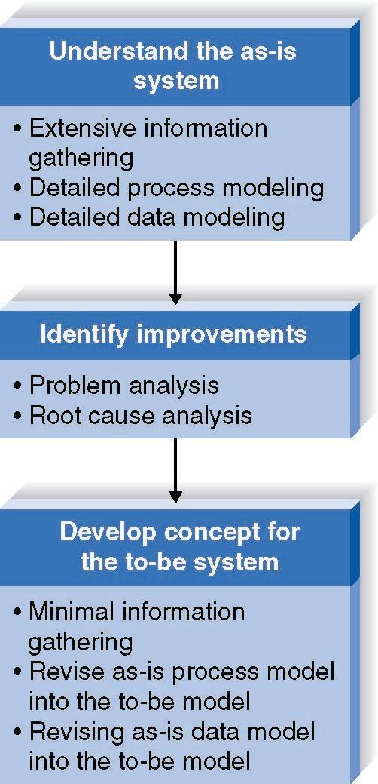
Business Process Automation
Goal:
Efficiency
for users

Slide 13
Identifying Improvements in As-Is Systems
Problem Analysis
  Ask users to identify problems and solutions
  Improvements tend to be small and incremental
  Rarely finds improvements with significant business value
Root Cause Analysis
  Challenge assumptions about why problem exists
  Trace symptoms to their causes to discover the “real” problem

Slide 14
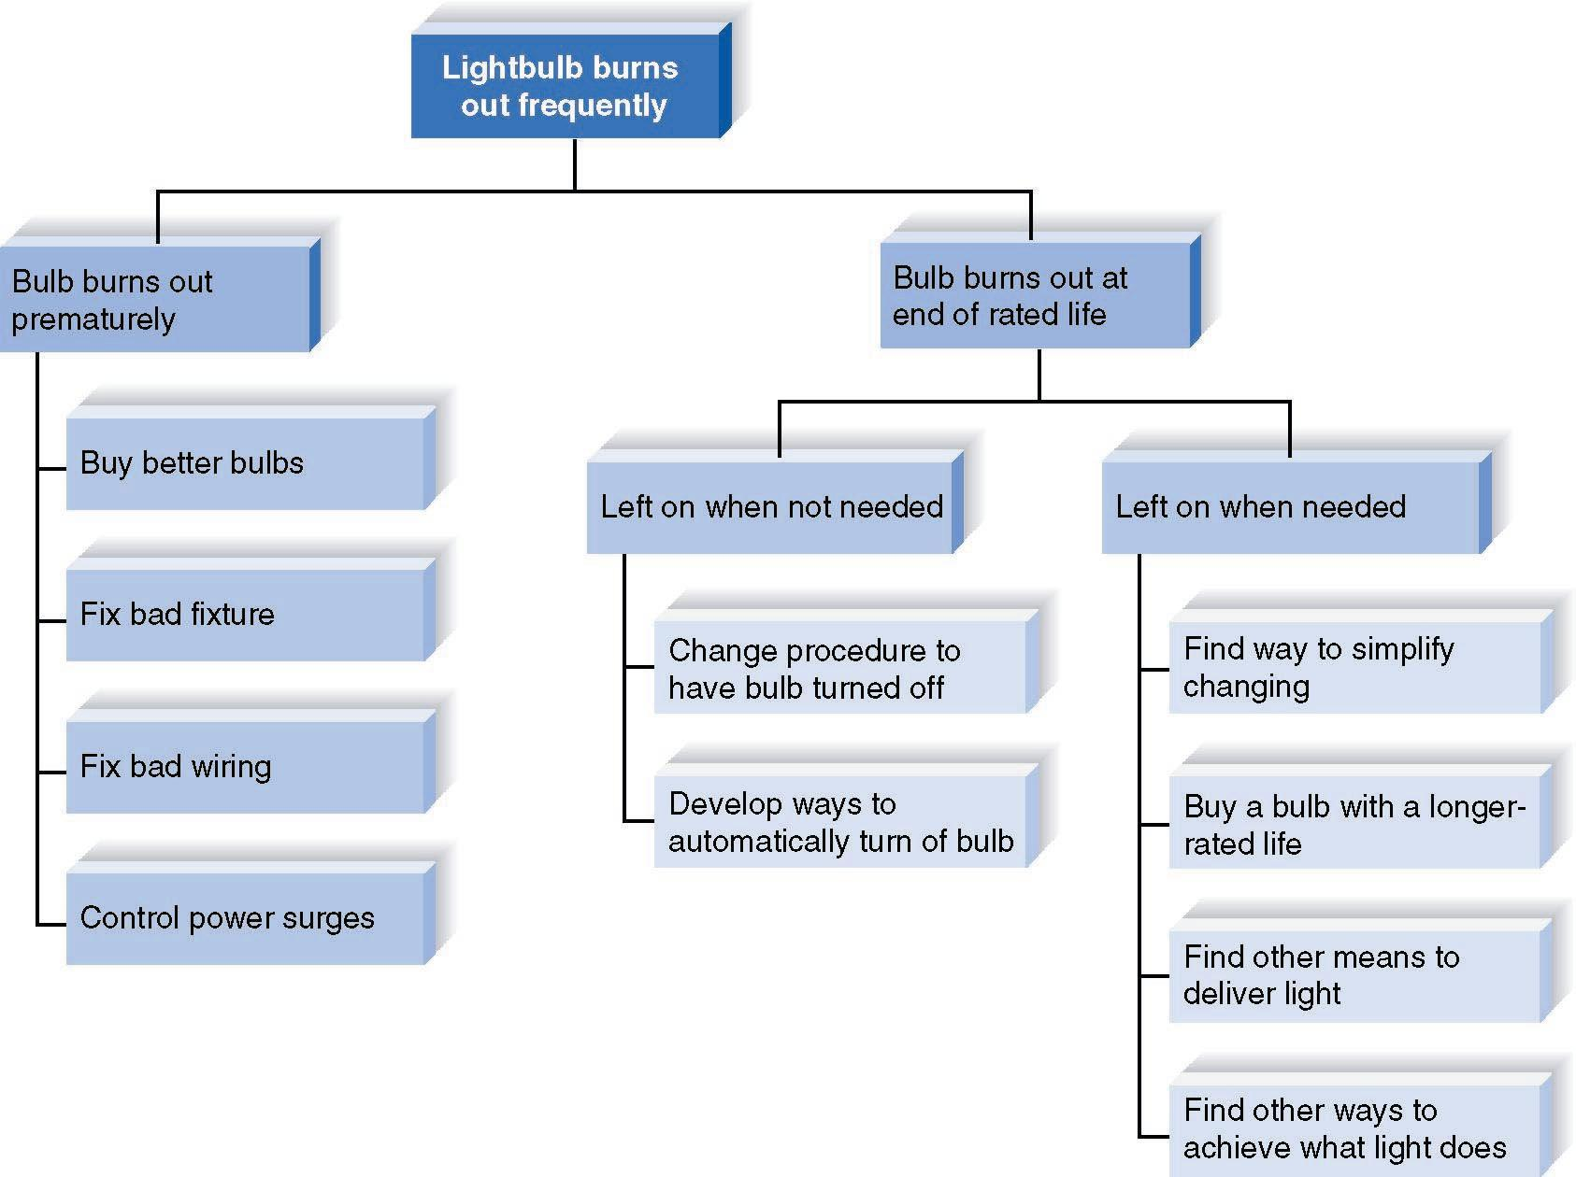
Root Cause Analysis Example

Slide 15
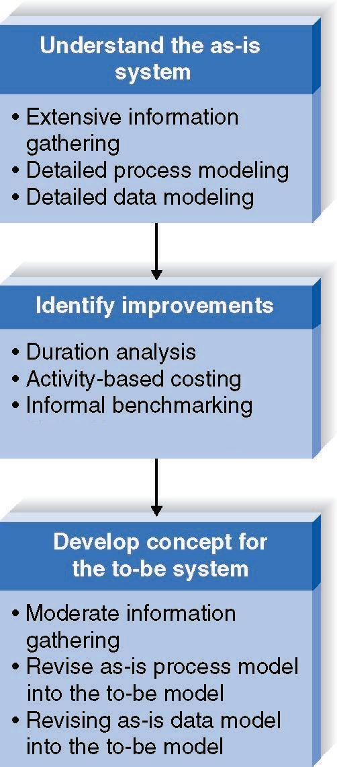
Business Process Improvement
Goal:
Efficiency
and
effectiveness
for users

Slide 16
Duration Analysis
Calculate time needed for each process step
Calculate time needed for overall process
Compare the two – a large difference indicates a badly fragmented process
Potential solutions:
  Process integration – change the process to use fewer people, each with broader responsibilities
  Parallelization – change the process so that individual step are performed simultaneously

Slide 17
Activity-Based Costing
Calculate cost of each process step
Consider both direct and indirect costs
Identify most costly steps and focus improvement efforts on them

Slide 18
Benchmarking
Studying how other organizations perform the same business process
Informal benchmarking
  Common for customer-facing processes
  Interact with other business’ processes as if you are a customer

Slide 19
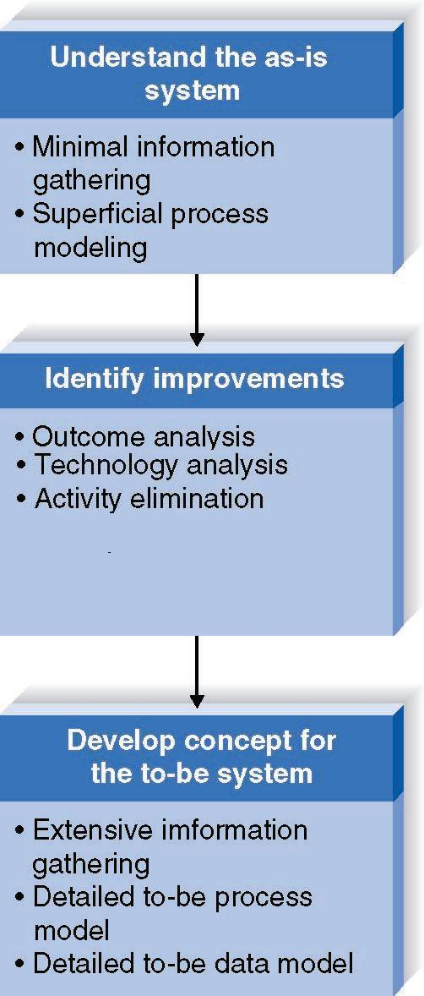
Business Process Reengineering (BRP)
Goal:
Radical redesign of business processes

Slide 20
Outcome Analysis
Consider desirable outcomes from customers’ perspective
Consider what the organization could enable the customer to do

Slide 21
Technology Analysis
Analysts list important and interesting technologies
Managers list important and interesting technologies
The group identifies how each might be applied to the business and how the business might benefit

Slide 22
Activity Elimination
Identify what would happen if each organizational activity were eliminated
Use “force-fit” to test all possibilities

Slide 23
Comparing Analysis Techniques
Potential business value
Project cost
Breadth of analysis
Risk

Slide 24

Project Characteristics

Slide 25
REQUIREMENTS-GATHERING TECHNIQUES

Slide 26
Interviews
Most commonly used technique
Basic steps:
  Selecting Interviewees
  Designing Interview Questions
  Preparing for the Interview
  Conducting the Interview
  Post-Interview Follow-up

Slide 27
Selecting Interviewees
Based on information needs
Best to get different perspectives
  Managers
  Users
  Ideally, all key stakeholders
Keep organizational politics in mind

Slide 28
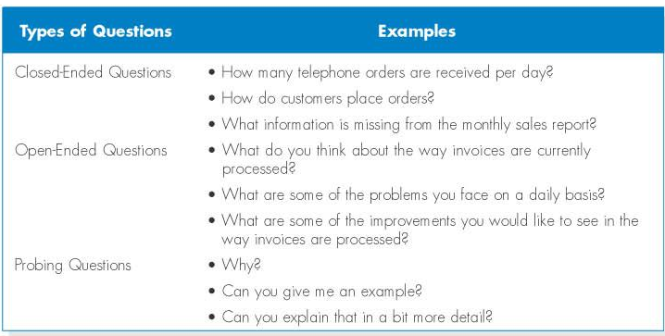
Three Types of Questions

Slide 29
Designing Interview Questions
Unstructured interview useful early in information gathering
  Goal is broad, roughly defined information
Structured interview useful later in process
  Goal is very specific information

Slide 30
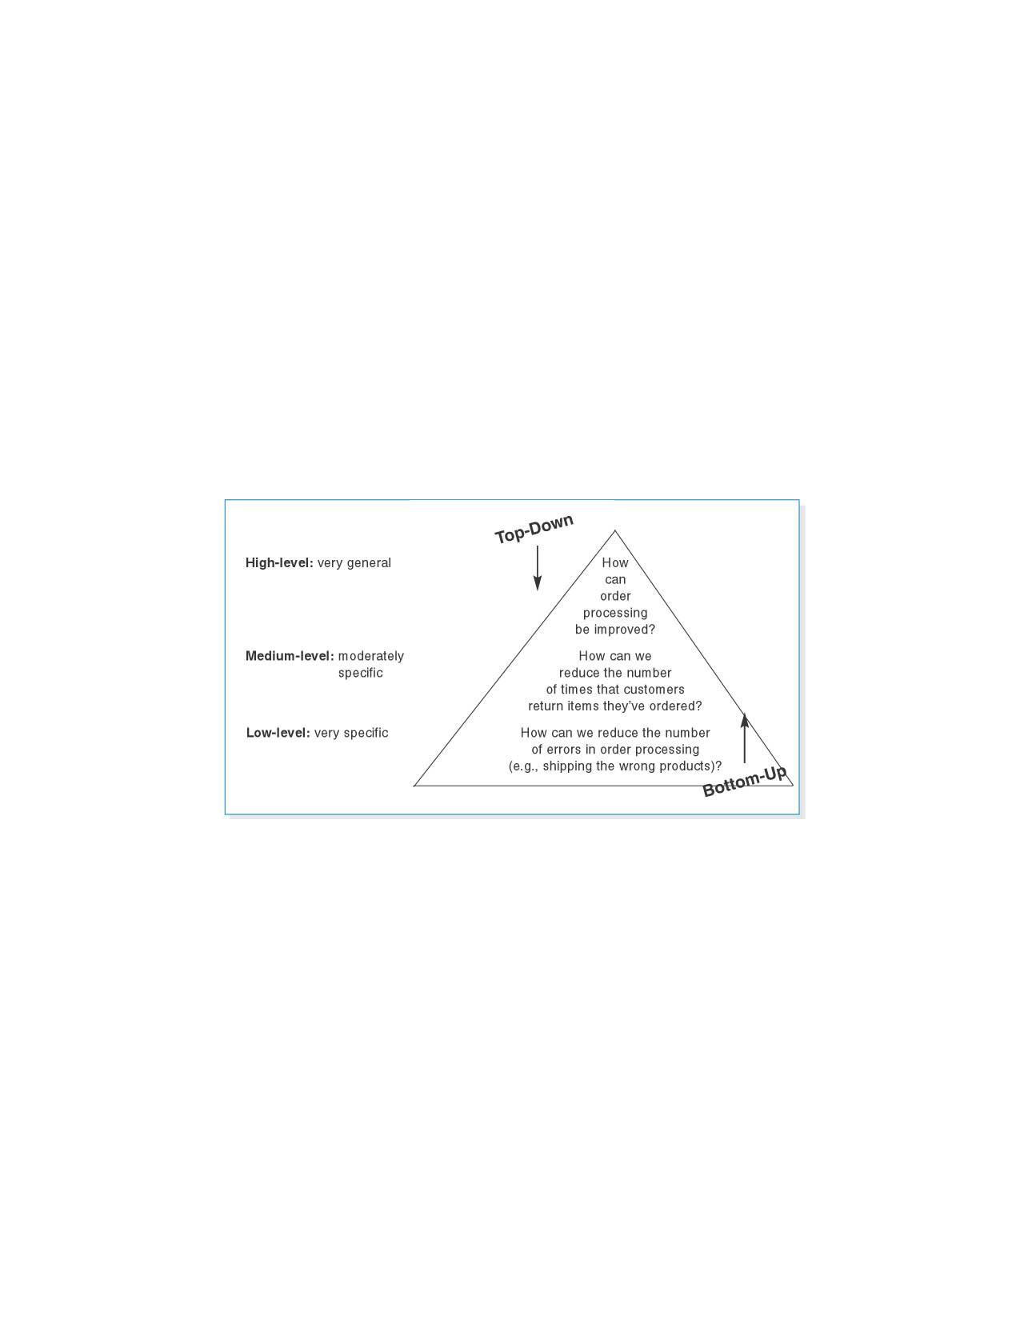
Top-Down and Bottom-up Questioning Strategies

Slide 31
Preparing for the Interview
Prepare general interview plan
  List of question
  Anticipated answers and follow-ups
Confirm areas of knowledge
Set priorities in case of time shortage
Prepare the interviewee
  Schedule
  Inform of reason for interview
  Inform of areas of discussion

Slide 32
Conducting the Interview
Appear professional and unbiased
Record all information
Check on organizational policy regarding tape recording
Be sure you understand all issues and terms
Separate facts from opinions
Give interviewee time to ask questions
Be sure to thank the interviewee
End on time

Slide 33
Post-Interview Follow-Up
Prepare interview notes
Prepare interview report
Have interviewee review and confirm interview report
Look for gaps and new questions

Slide 34
Joint Application Development (JAD)
A structured group process focused on determining requirements
Involves project team, users, and management working together
May reduce scope creep by 50%
Very useful technique

Slide 35
JAD Participants
Facilitator
  Trained in JAD techniques
  Sets agenda and guides group processes
Scribe(s)
  Record content of JAD sessions
Users and managers from business area with broad and detailed knowledge

Slide 36
Preparing for the JAD Sessions
Time commitment – ½ day to several weeks
Strong management support is needed to release key participants from their usual responsibilities
Careful planning is essential
e-JAD can help alleviate some problems inherent with groups

Slide 37
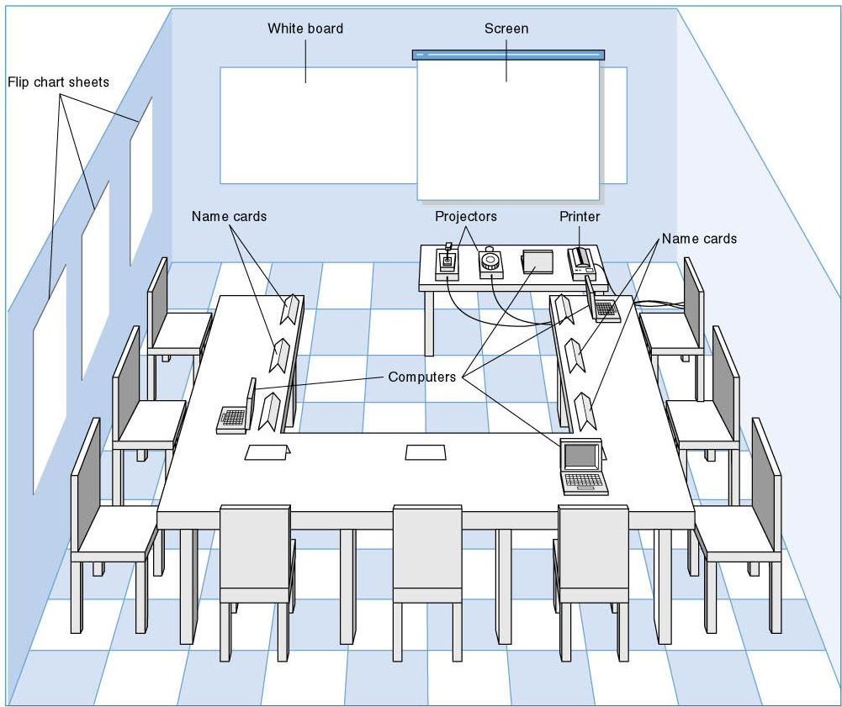
JAD Meeting Room

Slide 38
Conducting the JAD Session
Formal agenda and ground rules
Top-down structure most successful
Facilitator activities
  Keep session on track
  Help with technical terms and jargon
  Record group input
  Stay neutral, but help resolve issues
Post-session follow-up report

Slide 39
Post JAD Follow-up
Postsession report is prepared and circulated among session attendees
The report should be completed approximately a week to two after the JAD session

Slide 40
Questionnaires
A set of written questions, often sent to a large number of people
May be paper-based or electronic
Select participants using samples of the population
Design the questions for clarity and ease of analysis
Administer the questionnaire and take steps to get a good response rate
Questionnaire follow-up report

Slide 41

Good Questionnaire Design

Slide 42
Document Analysis
Study of existing material describing the current system
Forms, reports, policy manuals, organization charts describe the formal system
Look for the informal system in user additions to forms/report and unused form/report elements
User changes to existing forms/reports or non-use of existing forms/reports suggest the system needs modification

Slide 43
Observation
Watch processes being performed
Users/managers often don’t accurately recall everything they do
Checks validity of information gathered other ways
Be aware that behaviors change when people are watched
Be unobtrusive
Identify peak and lull periods

Slide 44
Selecting the Appropriate Requirements-Gathering Techniques
Type of information
Depth of information
Breadth of information
Integration of information
User involvement
Cost
Combining techniques

Slide 45
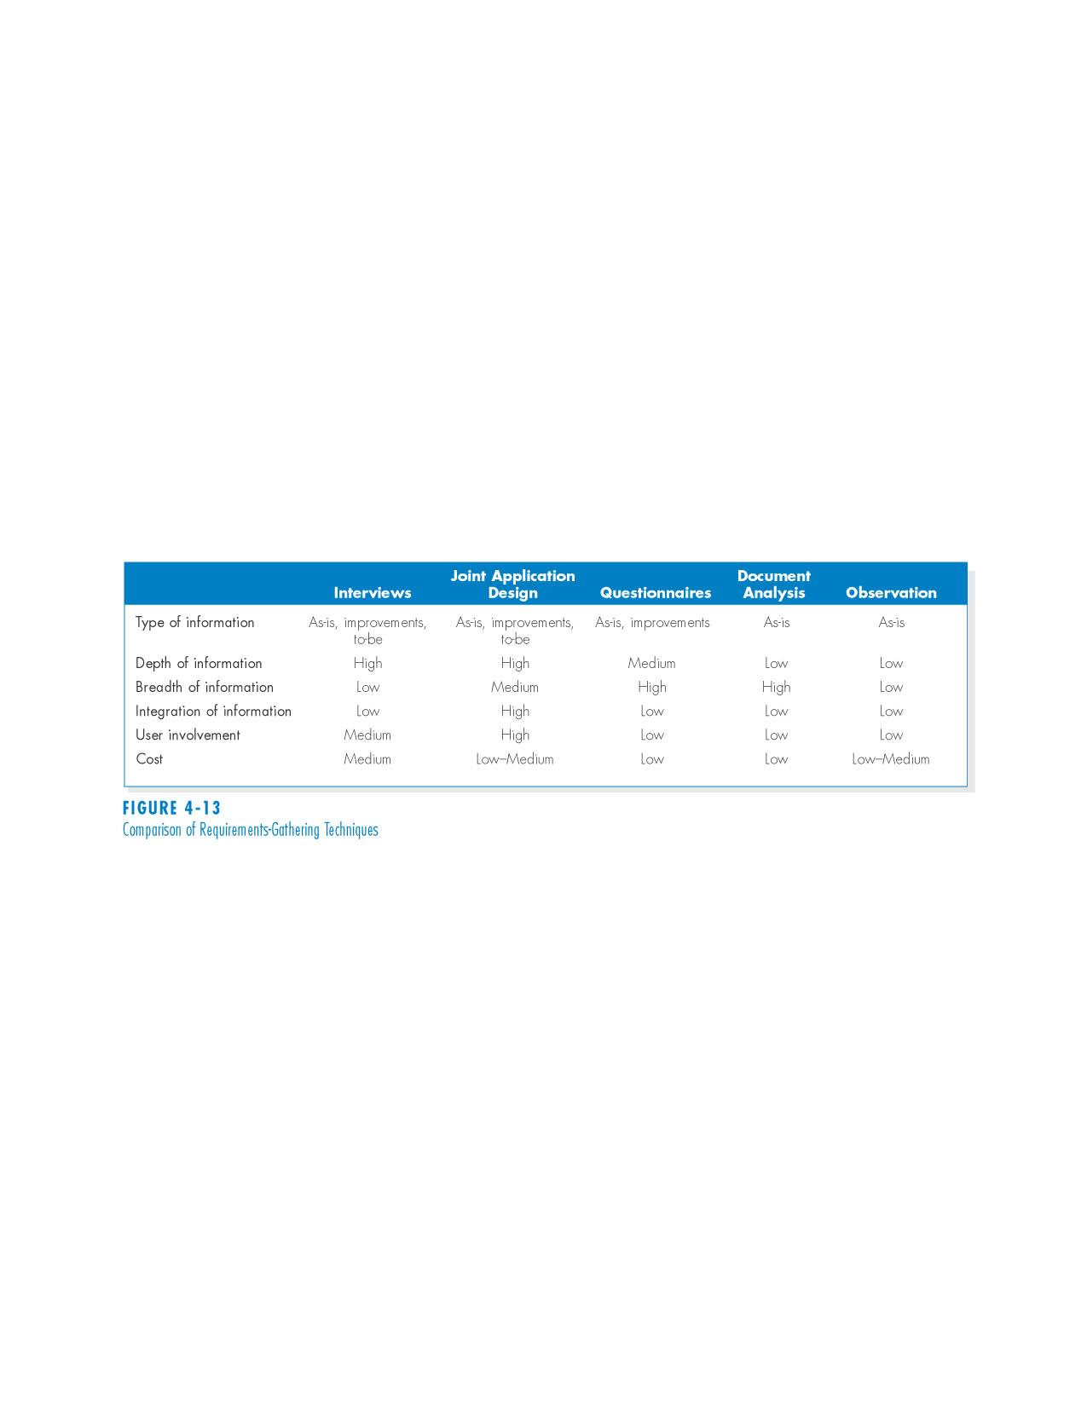
Comparison of Requirements-Gathering Techniques

Slide 46
Summary
The analysis process focuses on capturing the business requirements for the system
Functional and non-functional business requirements tell what the system must do
Three main requirements analysis techniques are BPA, BPI, and BPR
These techniques vary in potential business value, but also in potential cost and risk

Slide 47
Summary, continued
There are five major requirements-gathering techniques that all systems analysts must be able to use: Interviews, JAD, Questionnaires, Document Analysis, and Observation.
Systems analysts must also know how and when to use each as well as how to combine methods.

Slide 48
Copyright © 2009
John Wiley & Sons, Inc.
All rights reserved. Reproduction or translation of this work beyond that permitted in Section 117 of the 1976 United States Copyright Act without the express written permission of the copyright owner is unlawful.
Request for further information should be addressed to the Permissions Department, John Wiley & Sons, Inc.
The purchaser may make back-up copies for his/her own use only and not for redistribution or resale.
The Publisher assumes no responsibility for errors, omissions, or damages, caused by the use of these programs or from the use of the information contained herein.

